Slide 1
GDR Neutrino
20 juin 2012 to 21 juin 2012 at APC, Paris
Beta Beams
Elena Wildner, CERN

Slide 2
The Beta Beam studies
Design Study, 2004-2008
EUROnu Design Study, 2008-2012:
Next generation neutrino oscillation facilities in Europe
Beta Beam is one of 3 facilities in EUROnu
CERN to Frejus/Canfranc/Gran Sasso
Performance of baseline detector
Physics reach
Feeding back to the design of the Beta Beam Facility
2

Slide 3
Participating Institutes, Beta Beams
Full Partners
CEA, Saclay
CERN, Geneva
LPSC, Grenoble
LNMCI, Grenoble
UCL, Louvain la Neuve
INFN, Legnaro
Associates
IAP, Novgorod
Technical University of Aachen, Aachen
Weizmann Institute of Science, Revohot
GSI, Darmstadt
Cockcroft Institute, Daresbury
3

Slide 4
Collaborators, Beta Beams
et al.
4

Slide 5
The Beta Beam concept
Aim: production of (anti-)neutrino beams from the beta decay of radio-active ions circulating in a storage ring with long straight sections.
Beta-decay at rest
ν−spectrum well known from the electron spectrum
Reaction energy Q typically of a few MeV
Accelerate parent ion to relativistic γ_{max}
Boosted neutrino energy spectrum: E_{ν} ≤ 2γQ
Forward focusing of neutrinos: θ ≤ 1/γ
Pure electron (anti-)neutrino beam!
Depending on β⁺- or β⁻ - decay we get a neutrino or anti-neutrino
Two different parent ions for neutrino and anti-neutrino beams
Possible physics applications of a beta-beam
Primarily neutrino oscillation physics and CP-violation (high energy)
Cross-sections of neutrino-nucleus interaction, sterile neutrinos (low energy)
5

Slide 6
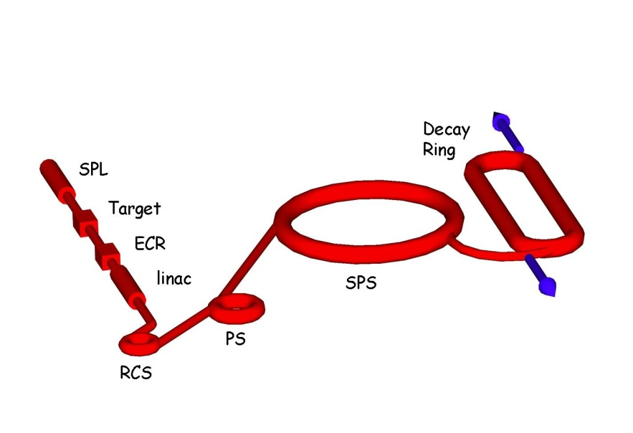
Beta beams at CERN
Use of CERN machines and infrastructures, technology
Use of existing machines: PS and SPS
Relativistic gamma=100 for both ions
SPS allows maximum of 150 (⁶He) or 250 (¹⁸Ne)
Gamma choice optimized for physics reach
Opportunity to share detectors
Frejus (baseline option), Gran Sasso, Canfranc ???
Assumed rates for estimations
2.9*10¹⁸ anti-neutrinos from ⁶He
1.1 10¹⁸ neutrinos from ¹⁸Ne
beta beams (CERN)
6
Notes:
≤≤

Slide 7
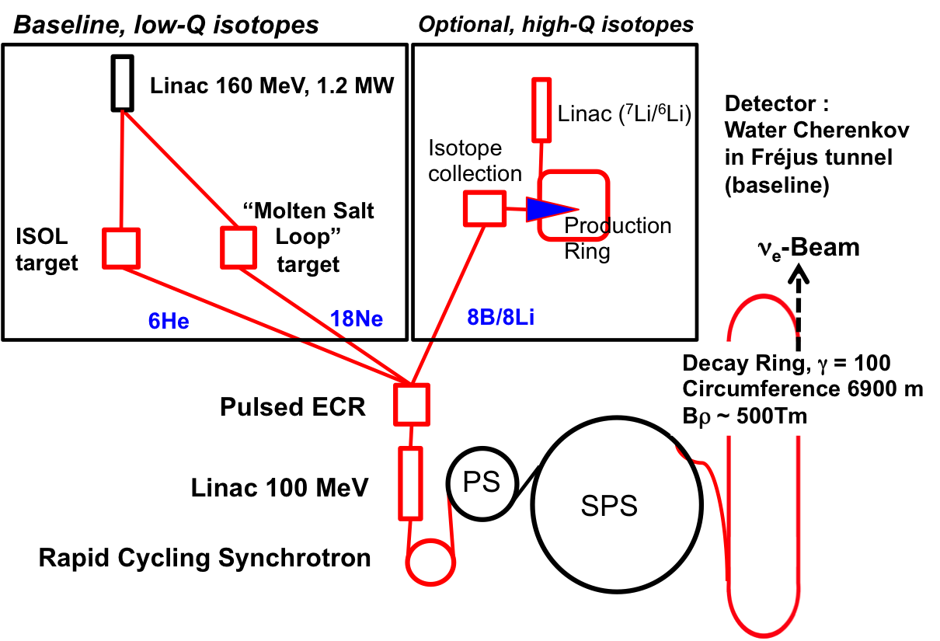
The CERN Beta Beam
CERN Specific,
Beta Beam favored by θ ₁₃ results
Decay Ring: Bρ ~ 500 Tm, B = ~7 T, C = ~6900 m, L_{ss}= ~2500 m, γ = 100, all ions
Notes:
What is changing is mainly the production

Slide 8
Research Beta Beams
Isotope Production (β – and β ⁺)
Cross section measurements
Collection of isotopes
Ionizing isotopes
Accelerate optimally a stable ion beam
Optimize the acceleration and cycling
Radioprotection

Slide 9
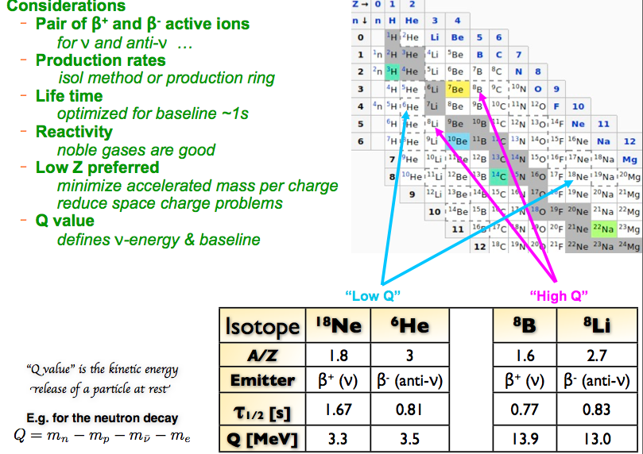
Choice of isotopes

Slide 10
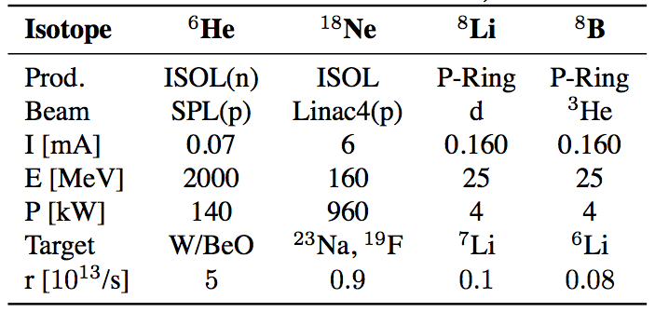
Production of β-active isotopes
Aim ⁶He and ¹⁸Ne: 2 10¹³/s
Targets below MWatt is a considerable advantage!
⁶He production exp. T. Stora, CERN-2010-003, pp. 110-117
10
Notes:
What is changing is mainly the production

Slide 11
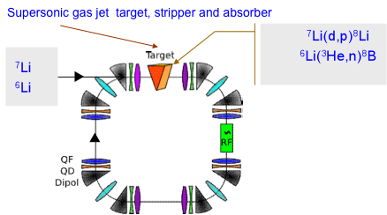
The Production Ring (⁸B and ⁸Li)
Aachen Univ., GSI, CERN, ANL
Production of 8B and 8Li
C. Rubbia, EUROnu proposal
Gas jet target:
too high density would be needed
vacuum problems
Direct production with liquid Li film targets
11

Slide 12
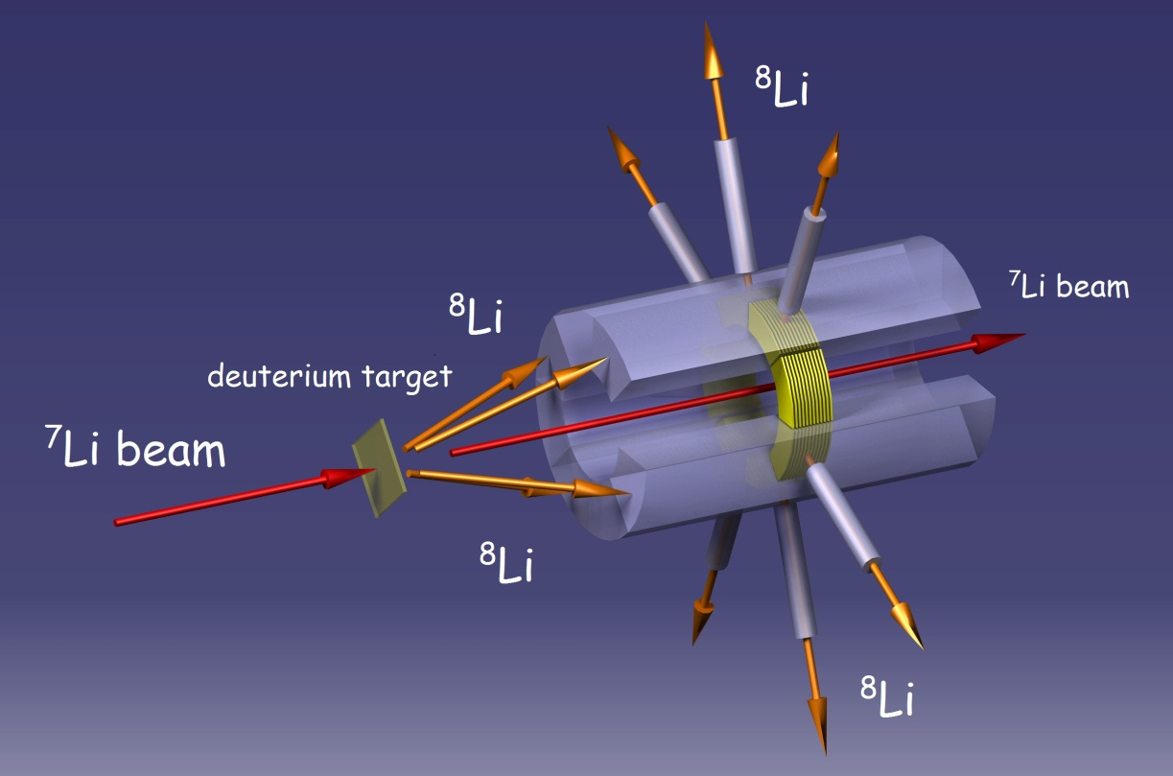
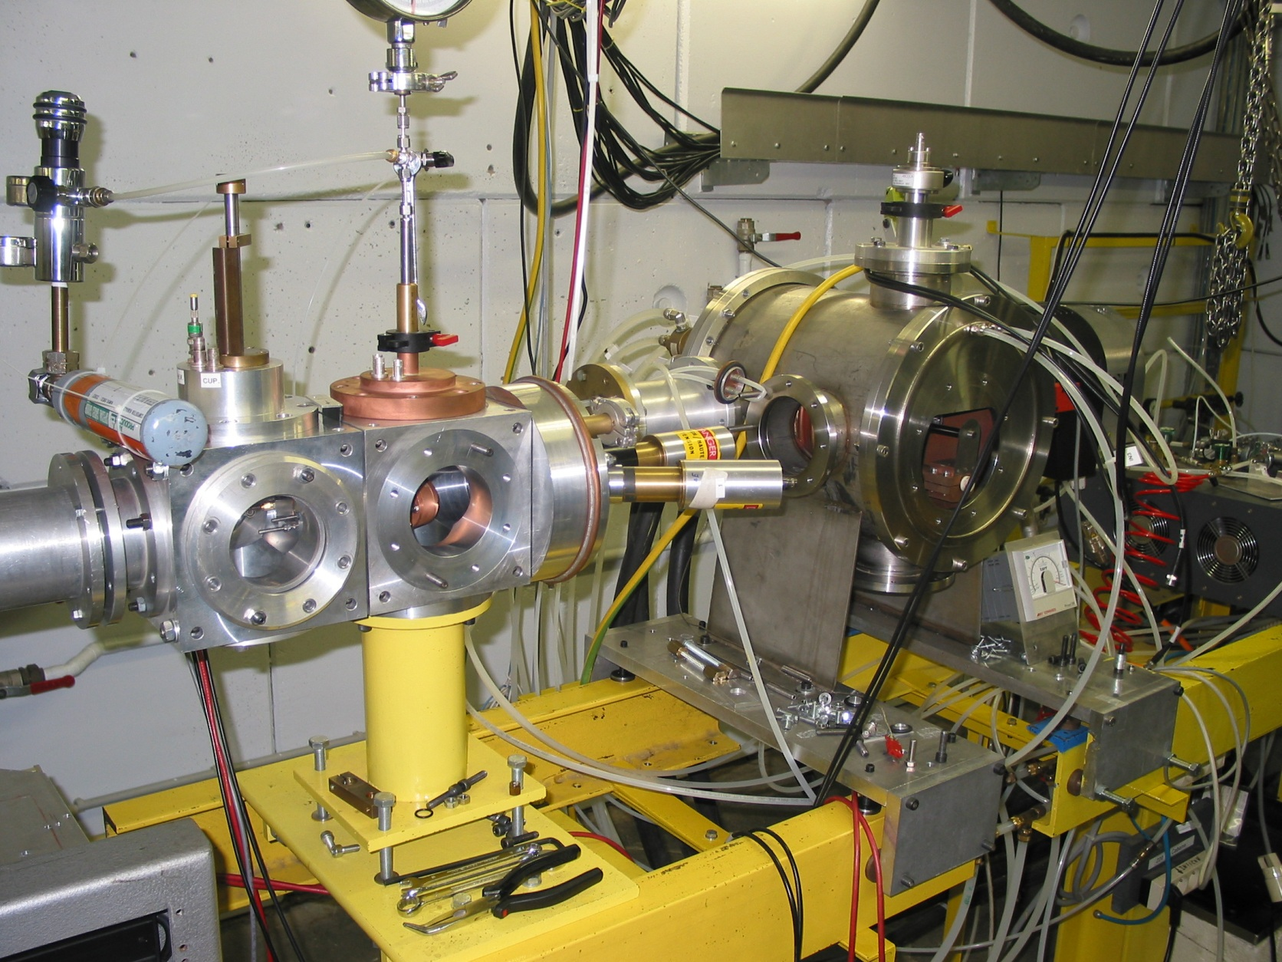
The collection device
UCL, Louvain la Neuve
Production and collection finished
Efficiencies will be reported July 2012

Slide 13
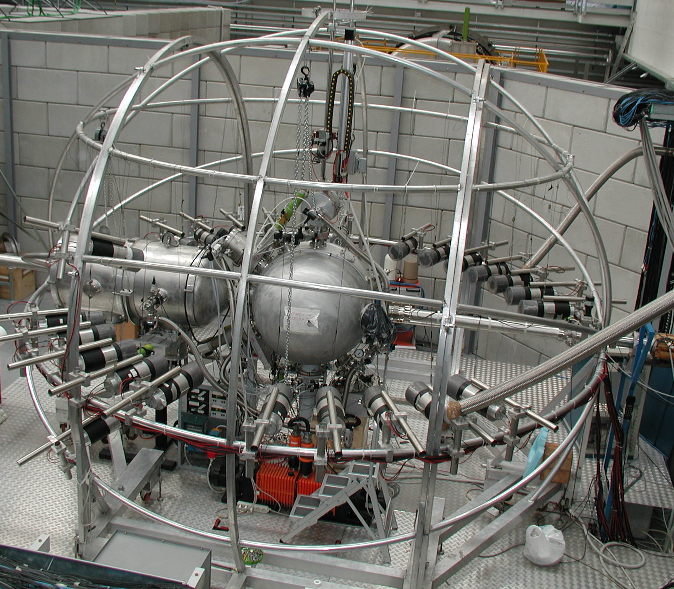
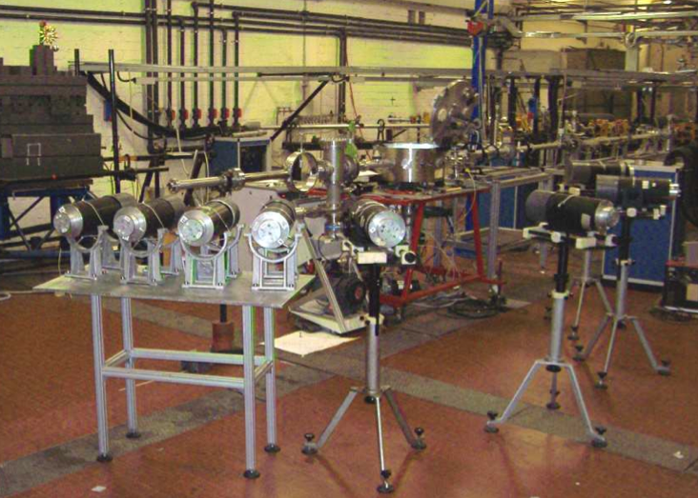
⁸B & ⁸Li production: X-sections
⁶Li (³He,n) ⁸B
⁷Li (d,p) ⁸Li
⁶Li (³He,n) ⁸B
⁸Li
90±18 mb at E_{lab}(7Li) = 25 MeV, between 6 and 10 degrees.
⁸B
Very good agreement with theory, for beam energies available for the test (need experiments at 20MeV to 25 MeV)
INFN, Legnaro

Slide 14
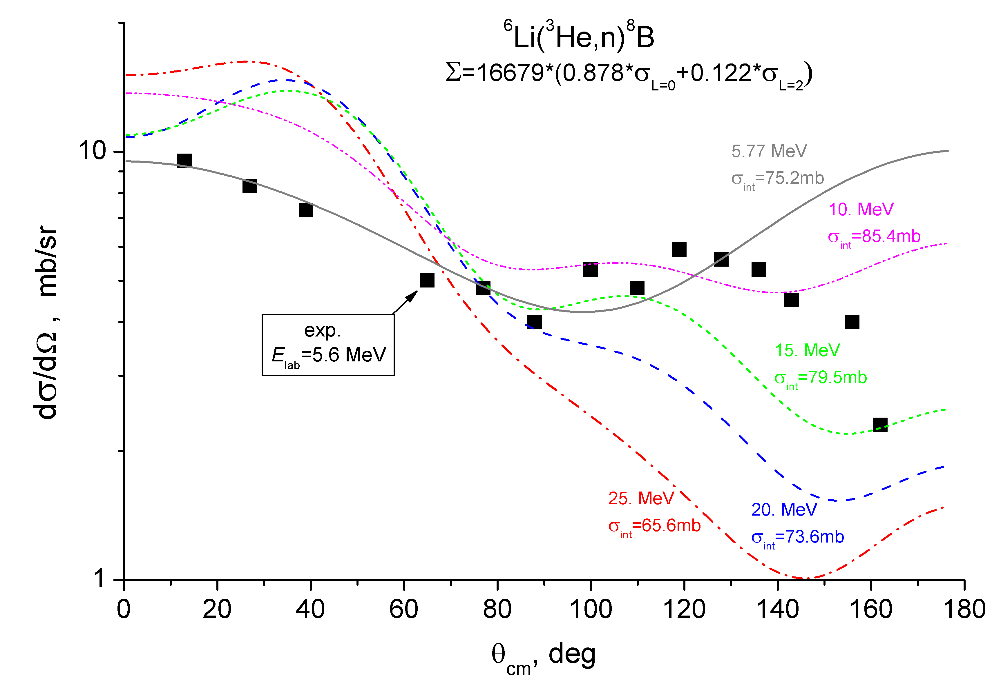
⁸B production (Preliminary)
THIS WORK -

Slide 15
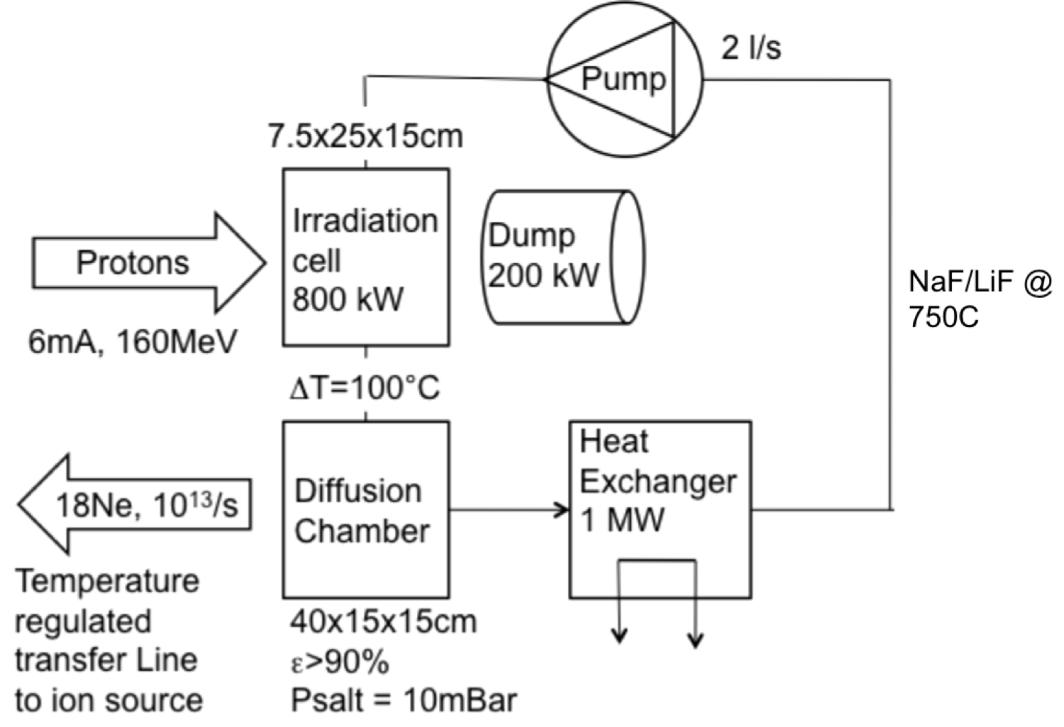
¹⁸Ne Experiments for Beta Beams 1
Molten salt loop experiment to produce 18Ne
Tests with beam at CERN & LPSC (Grenoble) in June 2012
CERN ISOLDE
¹⁸Ne production rate estimated to 0.9 x10¹³ ions/s (dc) for 960 kW on target.

Slide 16
¹⁸Ne Experiments for Beta Beams 2
NaF:ZrF4 sublimation of ZrF4 limits its use in a molten salt loop.
Eutectic binary NaF:LiF system: ongoing experiments
The effects of temperature and proton beam impact, which strongly affects the release efficiency in molten targets, are measured.
Results expected July, seem to confirm expectations (as of today)

Slide 17
Duty factor in DR small θ₁₃
10¹⁴ ions and ~0.5% duty factor (atmospheric background suppression in the detector)
RF system fulfilling requirements has recently been designed and costed
20 bunches, 5.2 ns long, distance 23*4 nanosseconds
filling 1/11 of the Decay Ring, repeated every 23
microseconds
17
17

Slide 18
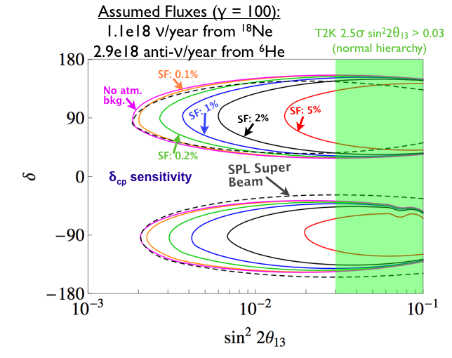
CPV dependence on SF (Fréjus option)
SF 2% seems sufficient for larger sin²2θ₁₃ (0.6% used up till now)
Permits higher fluxes and reach will increase (needs optimization)
E. Fernandez, P. Coloma, C. Hansen, E. Wildner
18

Slide 19
Duty factor in DR large θ₁₃
10¹⁴ ions and ~2% duty factor by having more bunches(atmospheric background suppression in the detector)
RF system can be relaxed
Optimize intensity distribution
Beam stability is better
Higher neutrino flux ?
19
19

Slide 20
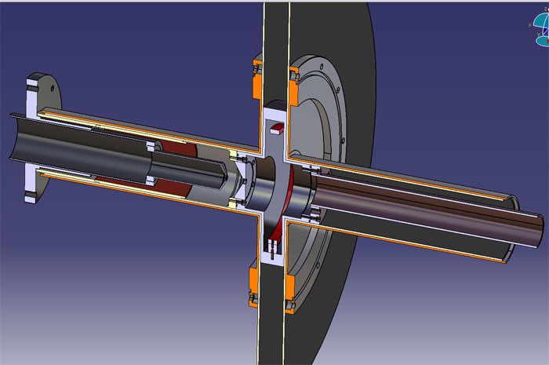
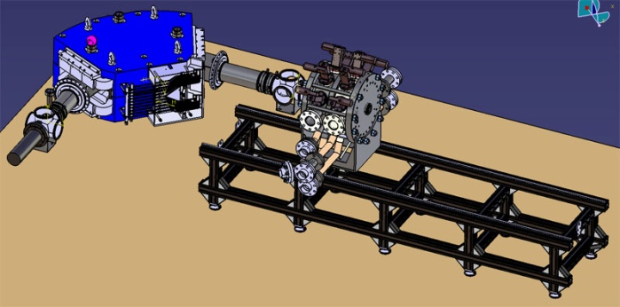
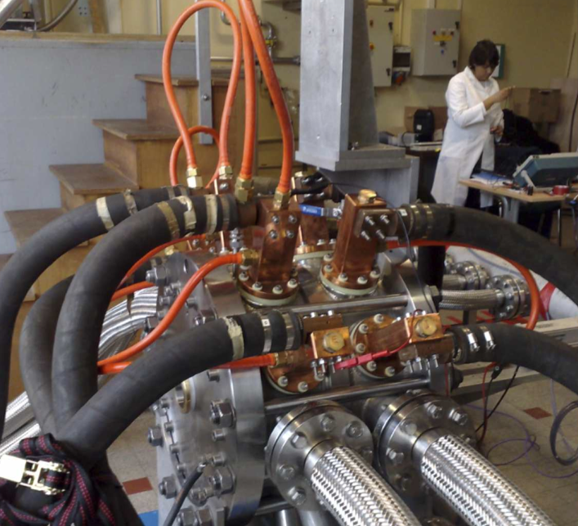
60 GHz ECR Source
Puller
electrode
High voltage
ring
Plasma
electrode
28 GHz
waveguide
Extraction
insulator
Plasma
chamber
T. Lamy
20

Slide 21
60 GHz ECR Source tests
The 60 GHz ECR source prototype assembled
The magnetic field has been measured at half intensity
Experimental data, 28 GHz operation, show good agreement with simulations.
The 60 GHz gyrotron (Russia) will be tested in June 2012.
The first beam experiments at 28 GHz in July 2012 followed by 60 GHz operation
21

Slide 22
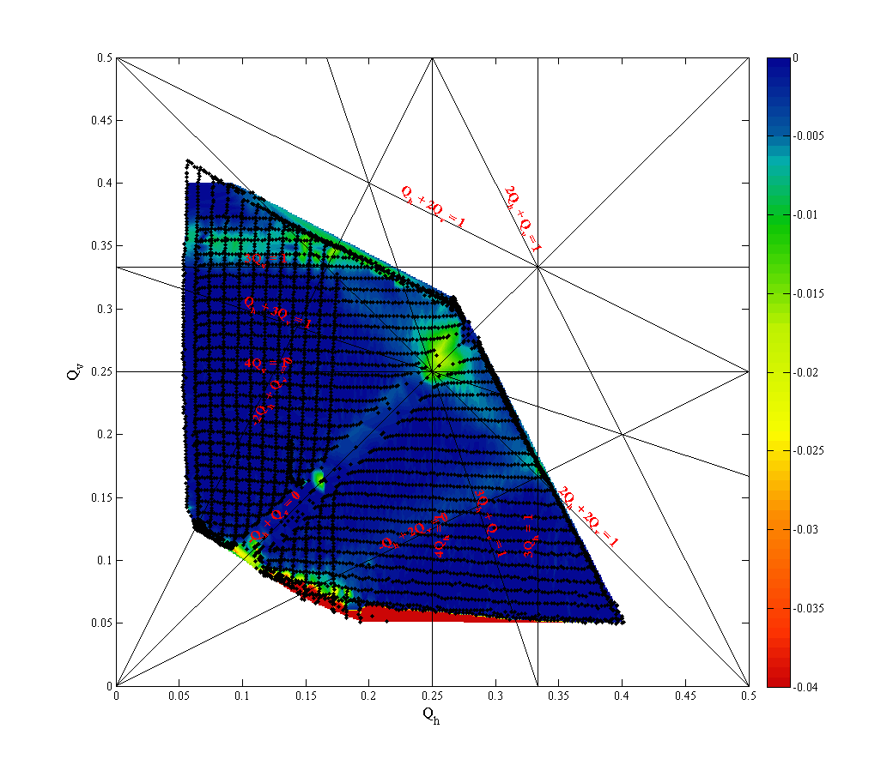
Integration: PS & SPS
Tune scans in PS
6He will survive, 18Ne needs resonance compensation (PS)
Beam stability in the PS and the SPS still needs studies
22

Slide 23
Integration: PS, radiation studies (1)
S. Damjanovic
DGS-RP, CERN
23

Slide 24
Integration: PS, radiation studies (2)
24

Slide 25
Costing and Safety Beta Beams
Work Breakdown Structure (WBS) set up
Cost of equipment will be estimated as well as possible
Some equipment need resources for design
Layout & civil engineering cost driving
Simple layout will be costed, infrastructure scaled
Extensive list of safety items for beta beams is set up
Standard CERN
Specific for Acceleration of Radiocative Ions

Slide 26
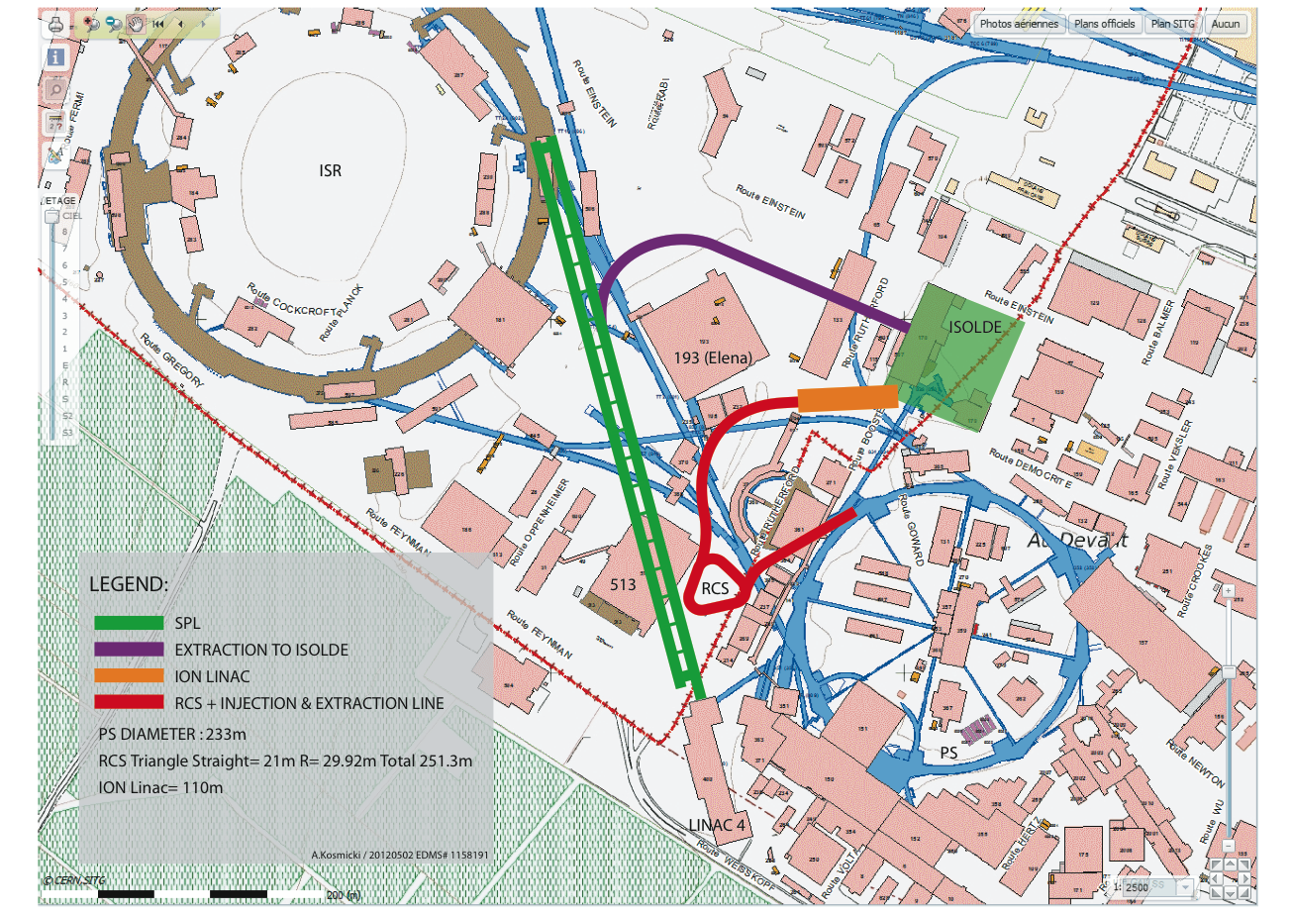
Layout BB: Low Energy part
Osborne/Kosmicki
Kosmicki
J. Osborne

Slide 27
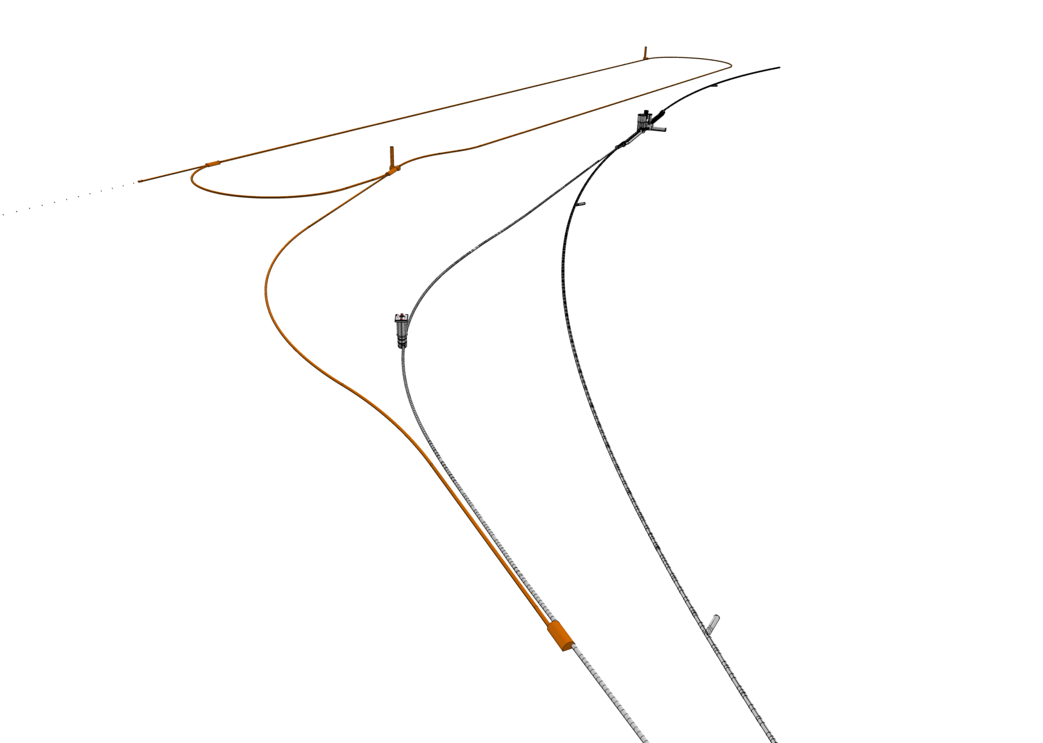
Layout BB: Decay Ring Injection
Decay Ring
PMI2
TI2 Tunnel
LHC Tunnel
Le tunnel d’injection descend de 11.12m
Ensuite le tunnel Decay Ring est plat au niveau du Point 2 Alice
Junction Cavern
Kosmicki
J. Osborne
Osborne/Kosmicki

Slide 28
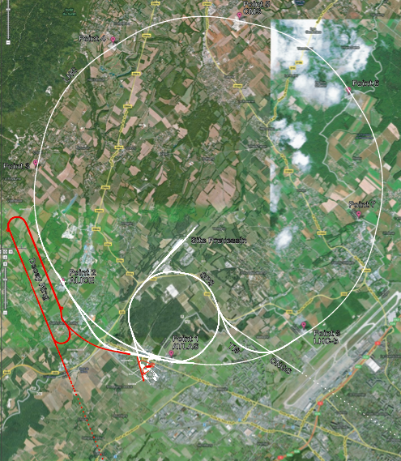
Footprint Beta Beam
Kosmicki
J. Osborne
Osborne/Kosmicki

Slide 29
Conclusion
The EUROnu Beta Beam work ending August 2012
The Low-Q option ⁶He/¹⁸Ne (CERN-Fréjus) is our baseline
Used for cost/performance evaluations
Preliminary RP studies : no show stopper
Studies remaining
Optimizations of bunching in the acceleration chain
Consolidate Beam stability (PS, SPS, DR)
Magnet protection DR
Radioprotection

Slide 30
Some physics plots (EUROnu)
Slides from Pilar Hernández
University of Valencia/IFIC, EUROnu meeting
Outcome is being prepared, final phase of EUROnu
Assumptions, systematics
Superbeams: 5% eff, 5% background
Beta-beam, Nufact: 2.5% eff, 5% background

Slide 31
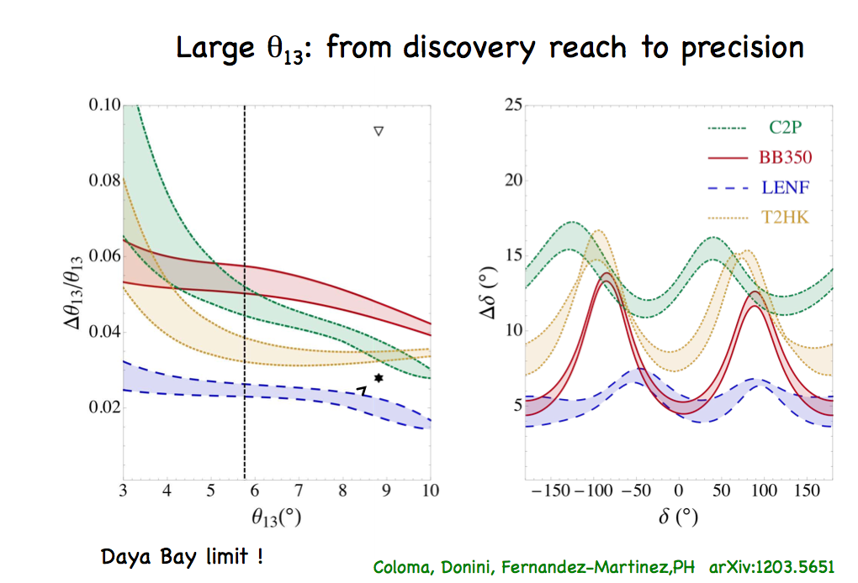

Slide 32
