Slide 1
Better support users
G. Romier
Relationship with user communities
France Grilles IAC – Paris – April 2012

Slide 2
Table of content
Introduction.
  Where we were last year.
  Where we are now.
  Where we want to be.
Where we are now and what was done this year?
  Metrics, projects & status.
Responses to the last IAC recommendations.
Next steps.

Slide 3
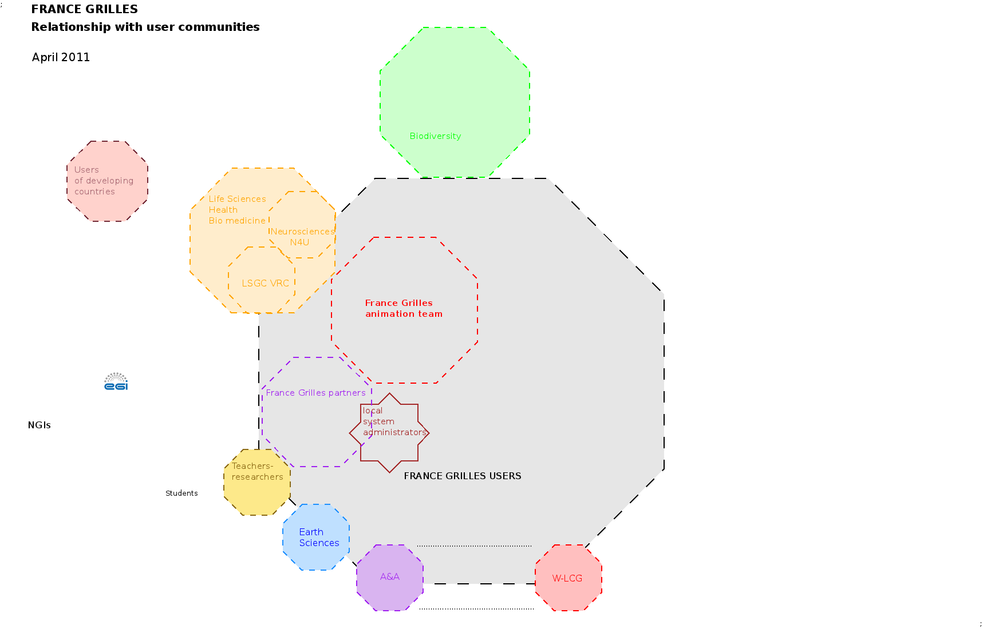
Introduction: where we were last year

Slide 4
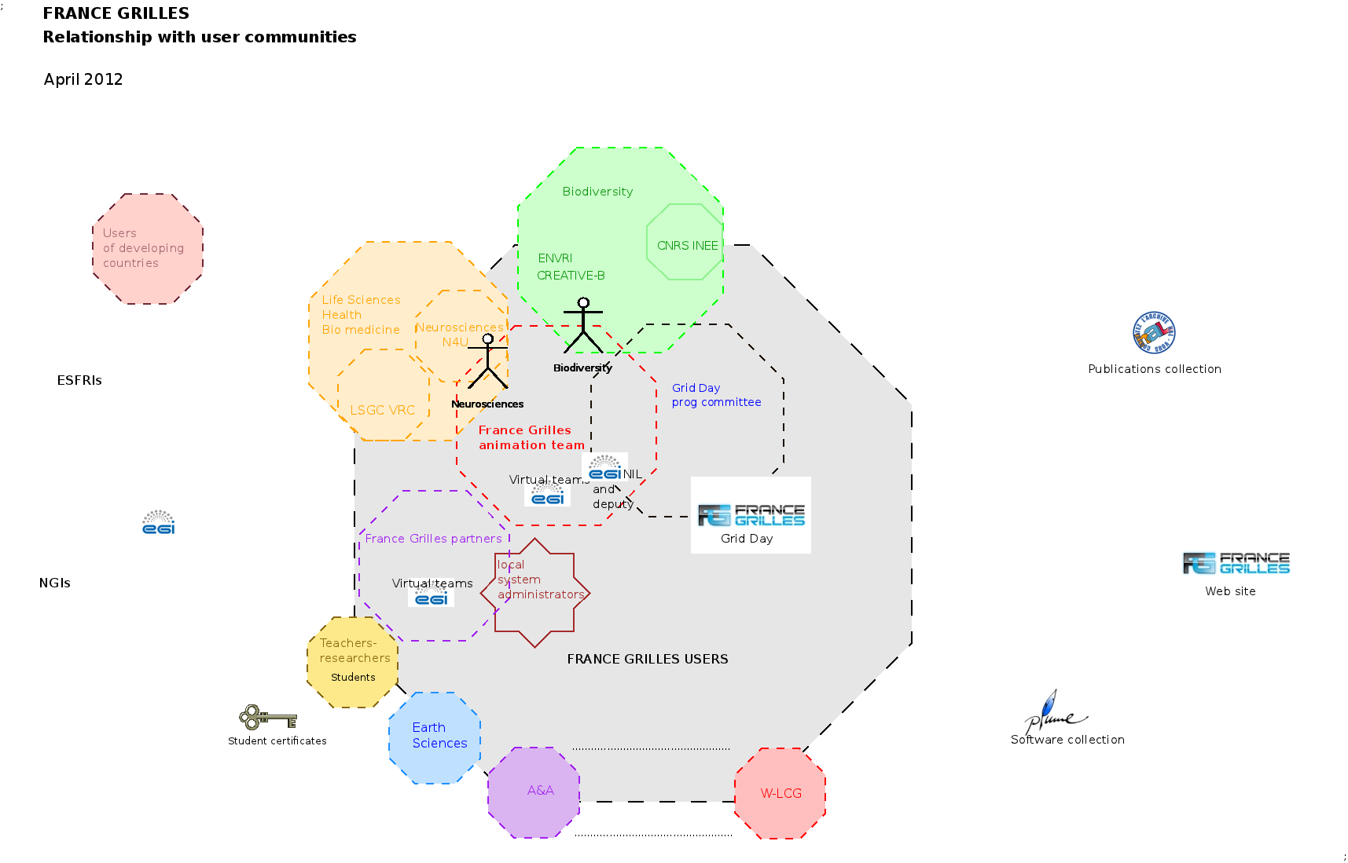
Introduction: where we are now

Slide 5
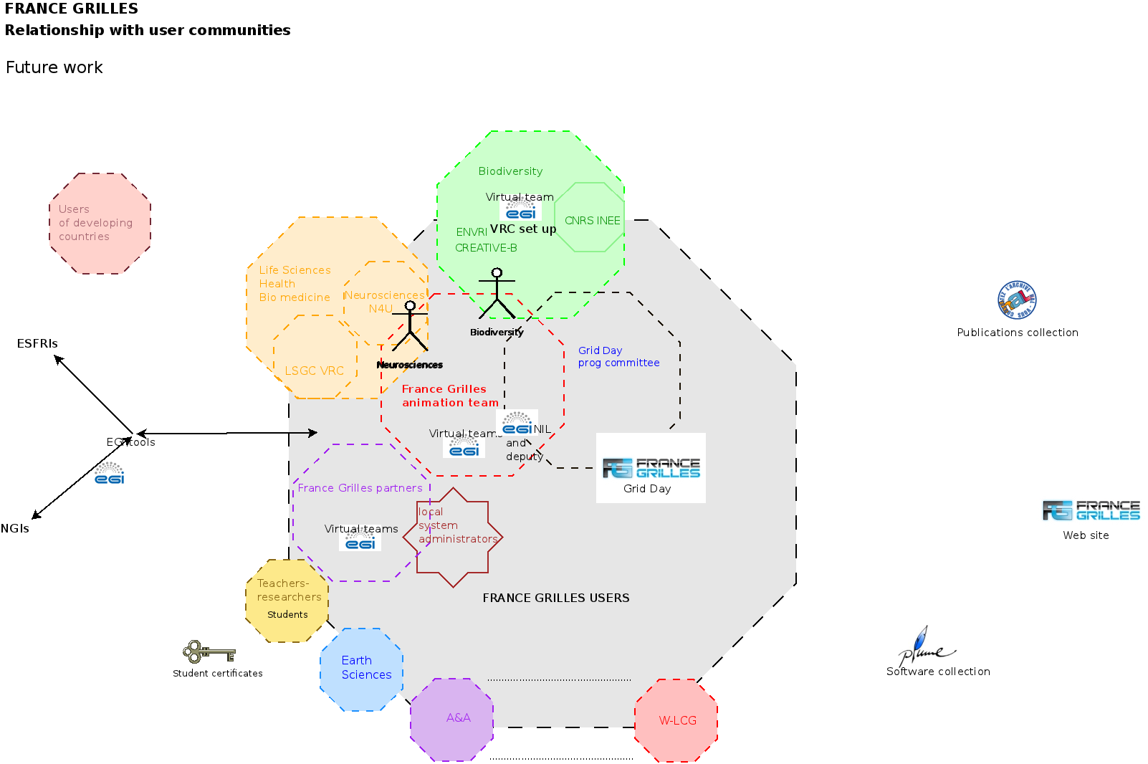
Introduction: where we want to be soon
Long term objective: a real community

Slide 6
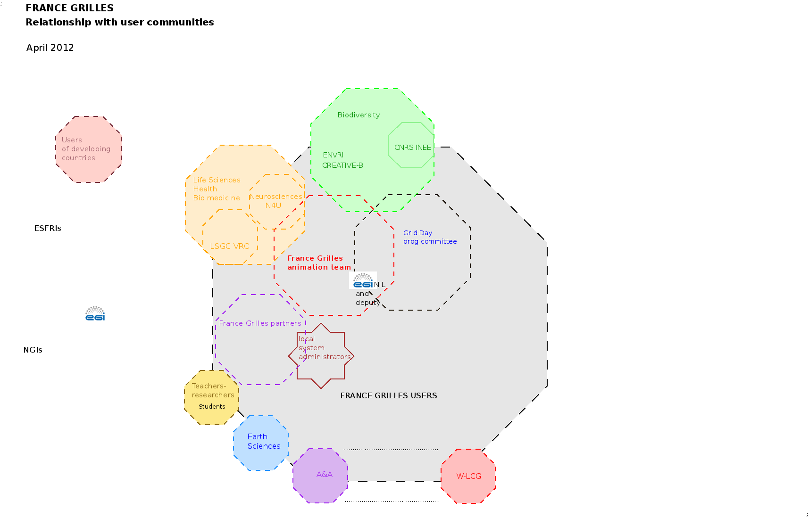
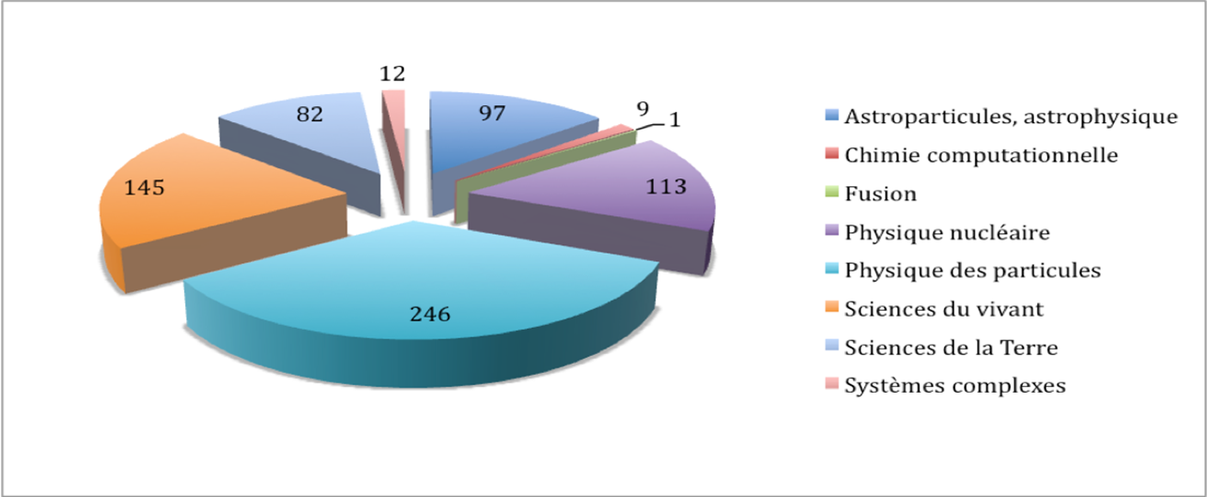
And now? Where are we? Several metrics
Who are our users?
Which communities do they belong to?
Per discipline distribution

Slide 7
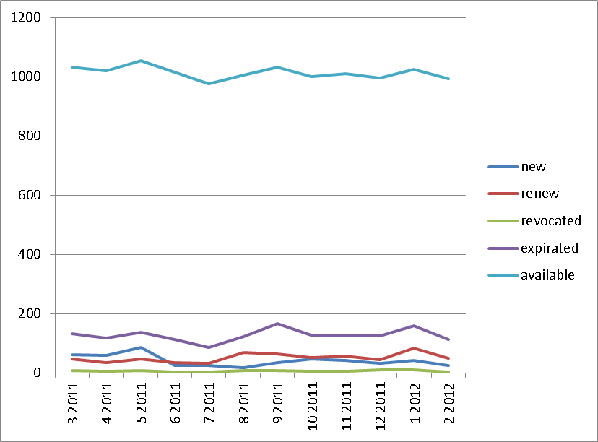
How many national users do we have?
Number of GRID2-FR credentials
NB:
some users use grid resources through a robot credential (e.g. 67 users use the Biomed robot).
people may have credential without necessarily using the grid.
Notes:
VB: Je ne peux pas modifier la légende mais il faut corriger:
- renew -> renewed
- expirated -> expired

Slide 8
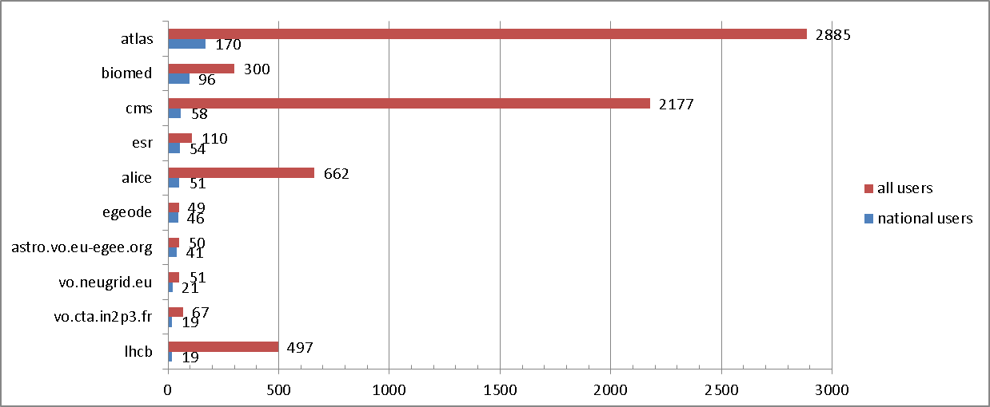
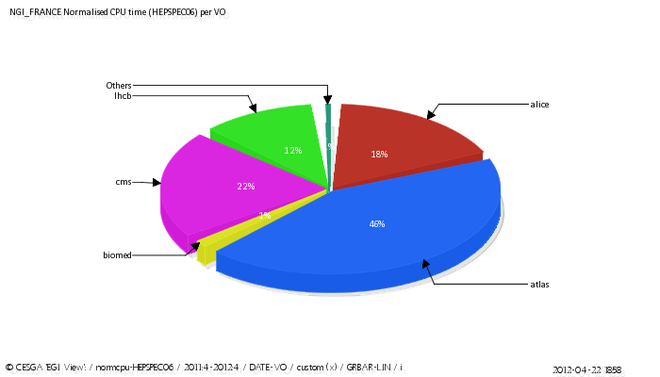
Where are most of them working?
10 global VOs with most national users April 2012
Particle Physics: atlas, cms, lhcb
Nuclear Physics: alice
Life Sciences: biomed, neugrid
Earth Sciences: esr, egeode
Astronomy Astrophysics Astro-Particle Physics: astro, cta
April2011 – April 2012 consumption

Slide 9
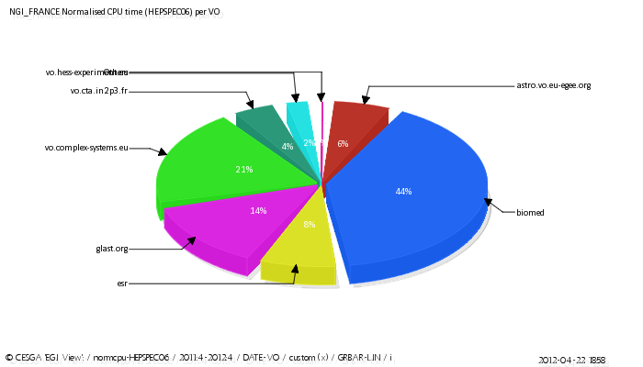
In which VOs are they proportionally most numerous?
global VOs where the ratio of national users is most important - April 2012
Life Sciences: biomed, neugrid, sim-e-child
Earth Sciences: esr, egeode
Astronomy Astrophysics Astro-Particle Physics: agata, glast, hess, astro
April2011-April2012 consumption

Slide 10
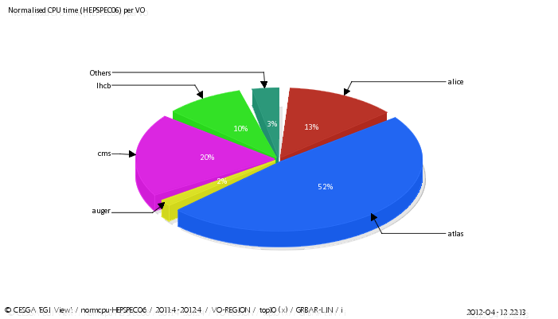
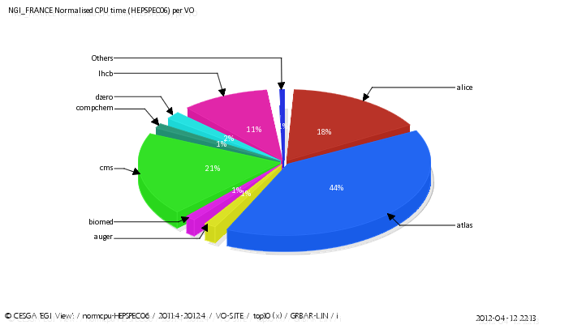
Who are the biggest consumers?
Normalised HEPSPEC06 CPU time per VO 4/2011 – 4/2012
World wide EGI VOs Top 10
NGI-France VOs top 10
Particle Physics: atlas, cms, lhcb, Dzero, Nuclear Physics: alice, Life Sciences: biomed, Earth Sciences: esr, Astronomy Astrophysics Astro-Particle Physics: auger, Chemistry: Compchem

Slide 11
Atlas and LHCb specificity
Atlas 2011, T1 and T2 sites
LHCb
Jobs user/all ~ 49.7%
CPU user/all ~ 13.5%
WT user/all ~ 16.6%
Credit: E. Lançon
Jobs user/all ~ 41%
CPU user/all ~ 10%
WT user/all ~ 13%
Credit: Andrei Tsaregorodtsev
Notes:
Je pense que ces chiffres concernent l’utilisation internationale des VOs, pas sepcifiquement LCG-France

Slide 12

What was done this year? activities targeted to the communities.
International level: EGI.eu, N4U, ENVRI and Creative-B
First French Grid Day.
Scientific publications collection set up.
First step of software dissemination.
Training.
What about students?
How to reach new communities?
Better welcome new users!
Examples of new users.

Slide 13
International level: EGI.eu, N4U, ENVRI and Creative-B
EGI.eu set up the NIL role and virtual teams: we do participate!
  France Grilles is involved in several VTs:
    Website content
    Intelligence Collection & Analysis Process
    Assessing the adoption of Federated Identity Providers within the EGI Community
    Organise a high impact presence for EGI at EGU General Assembly 2012
N4U project (NeuGrid follow up, neurosciences): an IdGC FTE is responsible for dissemination, exploitation, concertation activities, several French labs, organisms and one SME are also involved.
Creative-B and ENVRI, biodiversity projects: an IdGC FTE is responsible for dissemination activity.

Slide 14
French Grid Day: Rencontres scientifiques France Grilles
First edition September 2011, Lyon, co-located with EGI Technical Forum (that we co-organised). A success!
  http://www.france-grilles.fr/Rencontres-scientifiques-2011
Organisation set up:
  program committee: (representatives of disciplines). We will build the France Grilles community around it!
  29 articles received / 10 oral presentations webcasted, now available from France Grilles web site / 11 posters and 5 demos on the FG booth.
  60 to 80 attended and 20 on-line (webcast)
  scientific committee: awarded the price.
    http://www.france-grilles.fr/Prix-France-Grilles-2011

Slide 15
Collection of scientific publications
France Grilles needs to
  represent the scientific activity based on its infrastructure,
  measure its impact,
  justify to funding agencies the scientific use of grids for user communities,
  establish statistics to evaluate the use of grids across time.
Publications are the more visible result of research!
Building a collection of publications: constraints
  impossible to do manually,
  authors are owners of their papers. Authors, communities and their scientific managers should be part of the project,
  data should be publicly available for all in different ways adapted to all needs,
  possibility of statistics is mandatory.

Slide 16
Scientific publications: our project
The HAL platform is the tool build by CNRS CCSD and officially used by the France Grilles main partners to reference their publications.
Principle: a specific tag “France-Grilles” is stamped (manually) on the publications. All tagged publications appear immediately in the collection.
Difficulties:
  a publication has to be in HAL to be stamped,
  we need to inform and convince all researchers to put their publications in HAL,
  finding the relevant publications is not easy.
Help:
  referencing the publications in HAL is mandatory in several organisms (as INRIA e.g.).

Slide 17
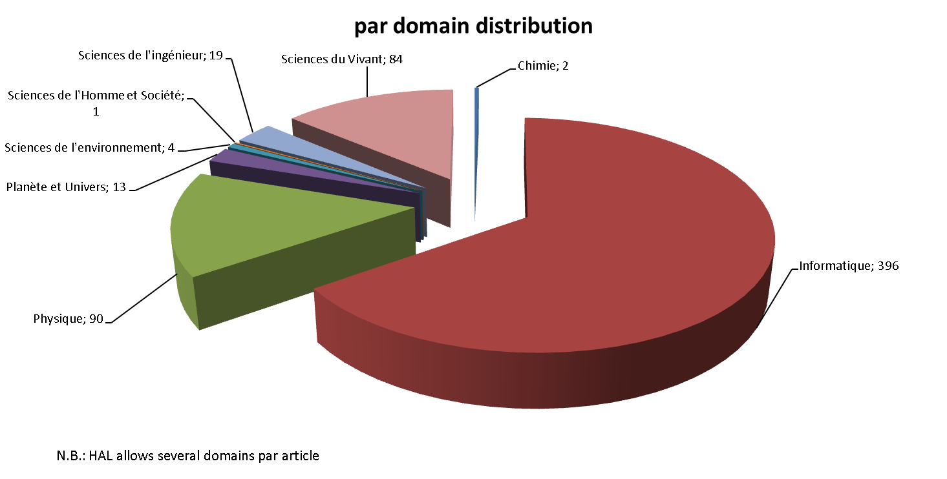
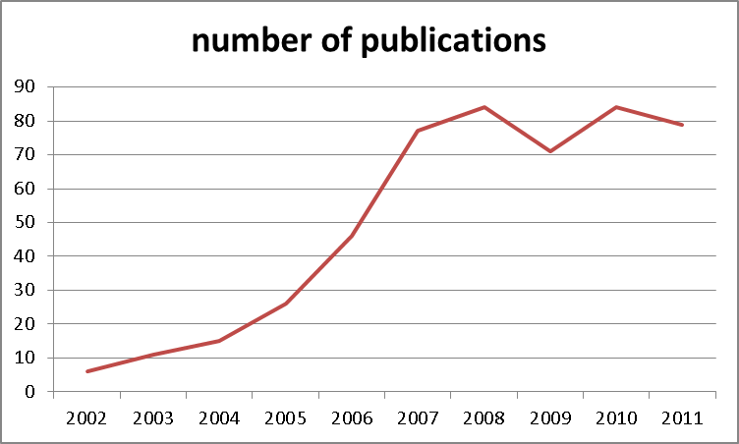
Scientific publications: current results, NOT representative
Kick-off of the collection: end of June 2011.
Evolution of the collection:
January 250 articles and references.
April 500 articles and references.

Slide 18
Scientific publications: just a beginning!

Slide 19
Software production
Software production is another direct or indirect result of research.
Software production should be of interest for other organisms, industry, potential partners...
Publishing developed software is a way to reduce double work, to conduct software to a better level of quality and to find new collaborations...

Slide 20
Software production: a dissemination platform exists
Plume platform was set up in 2007
  now > 1000 software index cards (>80 in English)
  to Promote economicaL, Useful and Maintained softwarE For the Higher Education And THE Research communities.(understand FLOSS)
Main target: all the French speaking research and higher education community
Plume is a good tool to disseminate software!

Slide 21
Software production: status of our project
Grid and Cloud theme on Plume web site:
  French “dissemination” cards published:
    XtremWeb-HEP (LAL), OAR & CiGri (LIG), APCScheduler (APC), Paraloop (LIPM), HINTS (DSI CNRS),
  English “dissemination” cards published,
    XtremWeb-HEP (LAL), CiGri (LIG), Paraloop (LIPM), HINTS (DSI CNRS),
  a few in work DIET, JSAGA, Lavoisier.
We use also Plume to set up France Grilles catalogue of production software (see operation presentation).
  iRODS, DIRAC, EGI Application Database French description cards e.g.
We need to advertise and convince people to participate!

Slide 22
Training
April 2010 - March 2011: 176 trainees / 18 days of training
  of which 3 Dirac and 1 cloud.
April 2011 – April 2012: 215 trainees / 25 days of training.
  of which 52 trainees users and administrators / 9 days in Vietnam,
  of which 2 cloud, 1 DIRAC, 1 Gatelab.
Planned: 2 other tutorials in June.
Questionnaire shows that training is important!

Slide 23
What about students?
Following a few requests, France Grilles and GRID2-FR set up a procedure and a certificate category (specific OU) for academic students in the framework of a cursus.
Almost ready!
It will be available for the next school year.
  work experiences within labs are considered as employment and still possible since long time.

Slide 24
Reaching out new users: development of our networks
Through specific pages of our web site.
Within user communities:
  top-down and bottom-up at the same time when possible!
  ESFRI and organisms with the help of EGI.eu and in collaboration with other NGIs (EGI.eu CRM will help).
Through local administrators and professional networks:
  as advisory people for computing in the labs.

Slide 25
Booths at conferences and networks contacts
We attended JRES (French administrators conference, > 1000 attendees, many contacts).
We are involved in the Plume technical team, in the RESINFO team, in the future database academic professional network.
They all give us opportunities to advertise France Grilles!

Slide 26
Welcome new users!
Most newcomers join existing communities.
  They contact directly a site/VO and enter the grid!
  We do not see them!
Other newcomers are requesting access to the infrastructure through:
  the FG web site (improved this year),
  a GRID2-FR certificate request (information exchange established with GRID2-FR),
  Word of mouth.

Slide 27
First steps to better welcome new users:
Procedure set up to welcome new users in collaboration with technical direction:
  a questionnaire to be filled in by new users
    to describe the application, the team/lab, their needs.
  a simple workflow to address the question: what is the best VO, how to give them support?
  Discussion is internally recorded.
  The procedure is regularly improved.

Slide 28
Better welcome users: our national VO.
How to welcome new users if their discipline is not currently organised to work on the grid?
Operations set up a national multidisciplinary VO vo.france-grilles.fr.
  Dirac will be soon available.
First users just welcomed
  solid state physics and biodiversity.
BUT we do not have correct user support now!

Slide 29
New users: emergent scientific communities on the grid
Biodiversity, ecology:
  CEFE laboratory (UMR 5175) - important biodiversity laboratory,
  INRA.
Solid state physics:
  LPTM.
The BEDOFIH project (European Database of High Frequency Financial Data):
  Eurofidai.

Slide 30
Biodiversity, the CEFE application example:
CEFE laboratory (UMR 5175 ) - important biodiversity lab - EEE group : Evolutionary Epidemiology application
  Evolution of pathogen virulence and host resistance
  What is the impact of the spatial (or social) structure of populations on the evolution of disease severity?
  Current project : evolution of host resistance in a bacteria-virus interaction.
    can bacteria resist viral infection by committing suicide?
    lab experiments + models + stochastic simulations
    Grid used to compute probability that the resistant strain "wins“
    Dirac was used to simplify job and data handling

Slide 31
Solid state physics
A team fromLPTM (UMR8089 CNRS - Université de Cergy-Pontoise) laboratory will port a first solid state physics application to the grid
They attended the last training session
They just enter the national VO as first “real” users
GRIF will support them

Slide 32
BEDOFIH project
Initiated by EUROFIDAI (European Institute of Financial Data), to develop a European database of high frequency data.
selected in the scope of future investments
Such a database will allow France to develop innovative research in the current field of economics affected by the financial crisis.
It collects and deals with several TeraOctets of monthly, financial information
relies on the operational structures of France-Grilles and LPSC in Grenoble for this.

Slide 33
Scientific communities in France
89 VOs of which 27 national or local VOs organized by theme or around the sites and the labs.
International well established scientific communities (W-LCG, VRCs such as LSGC, Earth Science VRC) have representatives in France.
  W-LCG: In 2011, the LHC part is 88 % of the French NGI CPU usage and the French infrastructure contribution represents 10% of the global consumption.
France Grilles manages the LSGC (both scientific & technical mgt) and provides most human resources.
  Perspectives
    Improve 200+ users to 100+ sites liaison
    Manage community data (scattered in 100s experiments)

Slide 34
Scientific communities in France
Earth Sciences in France suffers lack of human resources to support its users. The French community could be a bigger user if there were several persons close to the researchers in charge of the gridification of the applications.
User demands for using the grid in the complex-systems community are increasing, however the computational resources accessible to the VO are under-sized. Complex-systems are presently in process with France Grilles to get a support to increase the VO capacities, waiting for new investment.
RENABI/GRISBI, a bioinformatics thematic French community,
Grid Observatory and Green computing Observatory

Slide 35
Scientific communities: the local Vos around sites and labs
Often related to laboratories or regional projects or dedicated to specific needs
  2 Astronomy, Astrophysics and Astro-Particle Physics
  1 Computer Science and Mathematics
  12 High-Energy Physics
  9 regional more or less multidisciplinary (mainly collaboration of institutes)
  1 training
  Our national VO is one of them.

Slide 36
Responses to 2011 recommendations
8. Identify two non‐HEP communities to each be supported by a dedicated full‐time member of the IdG team.
9. Quantitatively analyse the current allocation of resources for user support and training.
10. Collect users’ opinions on a regular basis.

Slide 37
8. Identify two non‐HEP communities to each be supported by a dedicated full‐time member of the IdG team.
Two FTE were hired by IdGC in 2011.
One is in charge of Biodiversity and responsible for ENVRI and Creative-B dissemination.
  These projects will help to structure the biodiversity community.
  He will be the leader of an EGI.eu VT which aim is to help to structure a Grid community through a VRC in collaboration with several other NGIs such as Spain or UK.
One is in charge of neurosciences and responsible for N4U dissemination.
They both take part in France Grilles work.

Slide 38
9. Quantitatively analyse the current allocation of resources for user support and training.
User support and training organisation:
  Since May 2011 a FTE is dedicated to the relationship with user communities.
  Since 2008 a person is in charge of the organisation of training (partial time until September).
Infrastructure:
  France Grilles maintains a specific VO and grid resources for training. Two persons manage the VO, one is in charge of the credentials delivery .
There is currently in France Grilles no allocated human resources for user support or for trainers. Sites or regional grids may offer support and/or training to their users
Trainers:
  The budget allocated is sufficient to organise the training sessions but not to pay trainers at market price level.
  The administrative rules are complicated and we could not easily pay internal trainers.
  Trainers work on a volunteer basis and specific training sessions are depending on the persons concerned. It can be very difficult!

Slide 39
9. User support
Issue: France Grilles currently does not offer support to users, it is a barrier to the DCI adoption, people vanish after bad user experience.
=> We need to organise the user support!
  NB: subject is user support and not operational support that exists.
Context: Users use freely the infrastructure and the services, they are not required to participate even if they do not share resources.
Users are consumers without paying! They do not care about their tool! We think they have to be concerned. We need to empower them!

Slide 40
9. User support as a common interest network?
Question: could we set up a user support on a volunteer basis involving our users such as in FLOSS projects?
Basis of this model:
  involvement based on the common interest of the users for the success of the project, based on the share of knowledge and competences without immediate or direct counterpart
  free engagement, no constraints, no payment but clear rules of participation
  large part of contributions at best effort level - few people more active
  organisation, tools, events and roadmap provided by the project

Slide 41
9. User support: what do we need?
Short term:
  seriously prepare the project and its dissemination before to launch it (discussions with users, how to interface it with operational support, possibility of prototyping...),
  convince a volunteers' team to kick-off the project,
  identify and set up an adapted user friendly collaborative tool ,
  set up good documentation and FAQ (to be improved).
Long term:
  be attractive enough to gain and maintain a critical volume of contributions and effective support to the users.

Slide 42
10. Collect users opinions on a regular basis: questionnaire to our users
Goal: to know the opinion of our users about France Grilles
Constraints: no mean to address simply all our users, not bother researchers with a long questionnaire.
Method:
  ask a few contacts in the main communities to indicate 2 or 3 users (happy and less happy).
  send the users a simple questionnaire
The questions:
  Who are you?
  What was your interest for the grid? Did you get a tutorial?
  Did the grid fulfill your needs? Main benefit? Did you get useful support?
  Your proposal to improve the grid and the “user experience”? Do you use other infrastructure? (cloud, supercomputer...)
To do: publish results on the web site and send them to concerned users.

Slide 43
10. Results of the questionnaire: lessons learnt
Poor number of answers and difficult to obtain => limited interest
half researchers/half engineers,
all needed big resources (CPU, big data, lot of jobs),
training is important, all found close support (lab or site),
3/7 found issues (<1/2 reliability or 1/7 data transfer problems),
  know more about users experience => next survey goal
  we have to improve users experience!
2/7 are/have been also HPC users => next Grid day will give more information
1/7 think are interested by cloud computing for the future.

Slide 44
Future work: new projects
2012 French Grid Day.
New VTs proposed by user communities (biodiversity, data management by Biomed).
A survey focused on user experience.
User support organization.
Ensure resources to communities.
And of course continue all “in work” projects.

Slide 45
French Grid Day: Rencontres scientifiques France Grilles
Second edition: Paris, 1st-3rd October 2012
Co-organized with the HPC users meeting
  same dates, same location.
Reduce cost for participation! Limited travel budget this year!

Slide 46
How to ensure resources to the new communities? a policy
New users/communities enter the grid mostly without having/sharing resources
We need to set up clear rules:
  France Grilles infrastructure is a multidisciplinary shared tool
  France Grilles provides its users with a core set of services
  users may bring resources and share them, large users are required to bring and share resources
  operation people take care of the infrastructure at a high level of quality but they can not take care of all users
  all users are invited to participate to the user support effort

Slide 47
Challenges and risks
Main challenges of the last year:
  Initiate projects mainly to disseminate “what” research is done with the help of the grid & first thoughts about a community.
Main concrete challenges for next year:
  Improve the representativeness of the data, show results,
  first real steps to build a community of interest, users support kick-off.
Main real challenge:
  attract, convince, involve and keep people!
Main risks:
  Limited adherence to the projects from users, teams, labs, partners,
  lack of trainers, difficulties to organise new sessions,
  too many difficulties for new users/teams/communities (user experiences and users support).

Slide 48
Conclusion: priorities for next year
Take active part in international activities (biodiversity, neurosciences, EGI.eu VTs and NIL job).
2nd Grid Day with HPC : must be a success!
Get major progress in publications collection (number of labs or institute) => better show France Grilles scientific impact.
Maintain level of users training despite difficulties.
Better know users issues => new survey.
Study, organise and kick-off collaborative user support.
All actions to be able to better welcome new users!

Slide 49
Thanks for your attention!

Slide 50
Scientific communities: the international well established
LCG-France
Life Sciences Grid Community (LSGC)
Earth Sciences
A&A
Complex systems

Slide 51
Scientific communities: the international well established
LGC-France: French part of the LCG community
slides: Fairouz Malek and Frédérique Cholet

Slide 52
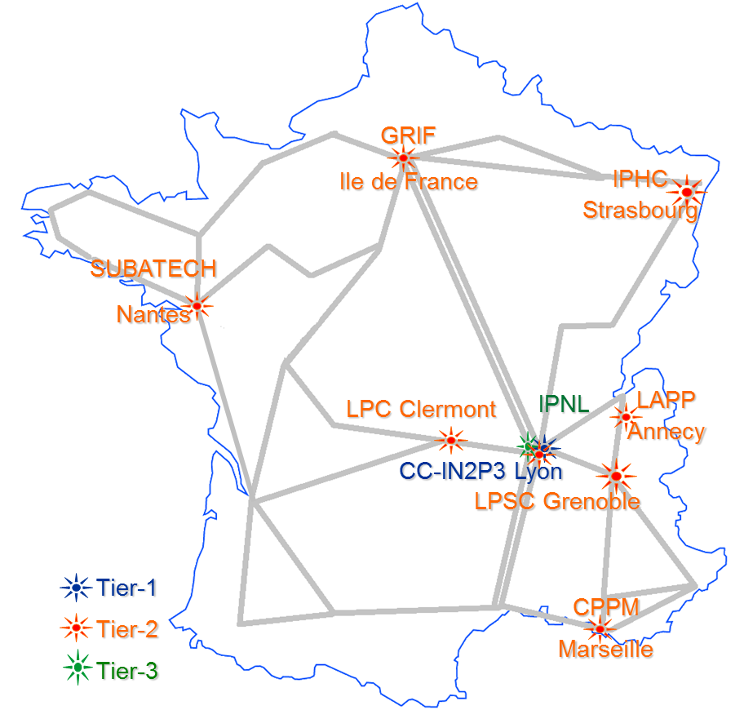
LCG-France Sites
Role | Site | ALICE | ATLAS | CMS | LHCb
Tier-1 | IN2P3-CC | ✓ | ✓ | ✓ | ✓
Tier-2 | IN2P3-CC-T2 (AF) | ✓ | ✓ | ✓ | ✓
 | IN2P3-CPPM |  | ✓ |  | ✓
 | GRIF | ✓ | ✓ | ✓ | ✓
 | IN2P3-LPC | ✓ | ✓ |  | ✓
 | IN2P3-IPHC | ✓ |  | ✓
 | IN2P3-LAPP |  | ✓ |  | ✓
 | IN2P3-LPSC | ✓ | ✓
 | IN2P3-SUBATECH | ✓
Tier-3 | IN2P3-IPNL | ✓ |  | ✓
52
Notes:
52
Les sites LCG-France comprennent tous différentes composantes :
ressources de type Tier-1, Tier-2 et Tier-3 au CC-IN2P3 avec 2 sites distincts déclarés auprès de W-LCG
ressources de type Tier-2 et Tier-3 dans les sites Tier-2 hors CC
ressources uniquement Tier-3 pour l’IPNL (non déclarées auprès de W-LCG)
Neuf sites sur les dix que compte le projet, sont déclarés auprès de W-LCG .
A l’échelle mondiale, il existe aujourd’hui 12 sites Tier-1 et 138 sites Tier-2. 1 Tier-1 et 8 Tier-2s français figurent dans le MoU W-LCG.
L’infrastructure LCG-France est constituée de un Tier-1, huit Tier-2 et neuf Tier-3 avec l’IPNL de Lyon.
L’intérêt de disposer de composante Tier-3 dans les sites Tier-2 est communément admis comme LE moyen de garantir la disponibilité d’une partie des ressources pour les besoins d’analyse des physiciens français de l’IN2P3 et de l’Irfu. Dans les faits, ceci reste à évaluer en détails par chacune des expériences et à préciser avec les sites.

Slide 53
WLCG CPU usage
CPU used (HS06-hours/month)
~ 140k CPU continuous use
from WLCG project status report , CRRB 18/10/11 (Ian Bird)
F.Malek/F.Chollet
F.Malek/F.Chollet
53
53
53

Slide 54
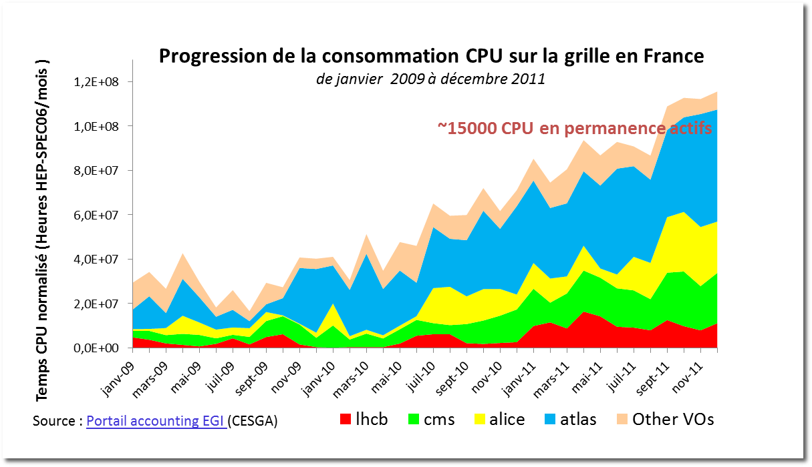
Grid CPU usage in France
2009-2011
In 2011, the LHC part is 88 % of the French NGI CPU usage
F.Malek/F.Chollet
F.Malek/F.Chollet
54
54

Slide 55
LHC CPU in France
Contribution per country
F.Malek/F.Chollet
F.Malek/F.Chollet
F.Malek/F.Chollet
F.Malek/F.Chollet
55
55
55
55

Slide 56
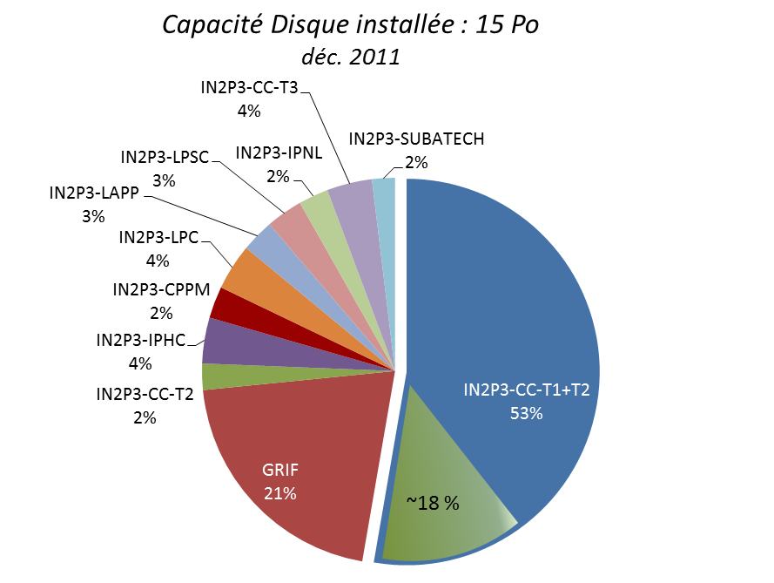
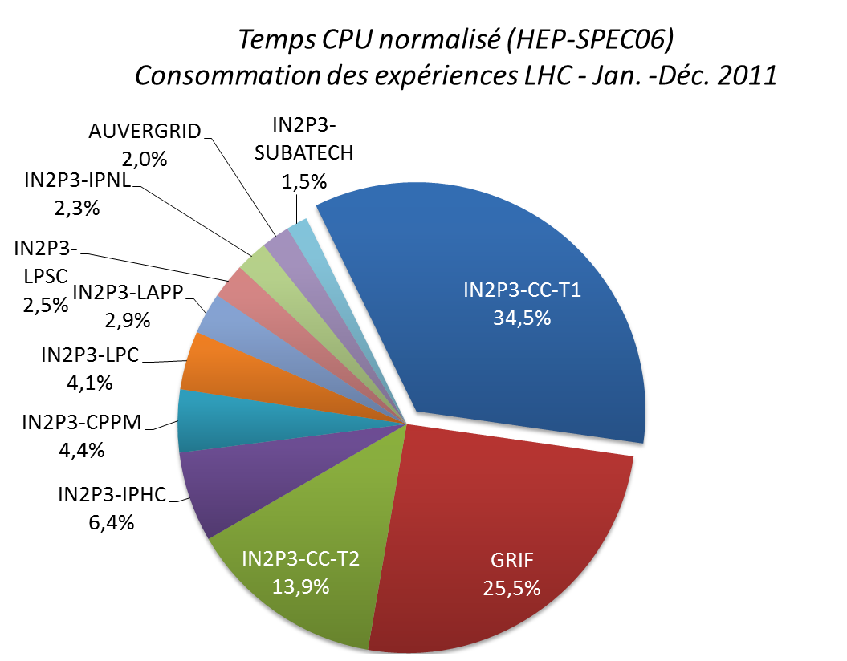
LHC resources usage in France
Contribution per site
Available Disk capacity
Used CPU
Sources : http://gstat.egi.eu/gstat/summary/EGI_NGI/NGI_FRANCE/
https://grid.in2p3.fr/LCGFrAccounting/
F.Malek/F.Chollet
F.Malek/F.Chollet
F.Malek/F.Chollet
F.Malek/F.Chollet
56
56
56
56
Notes:
56

Slide 57
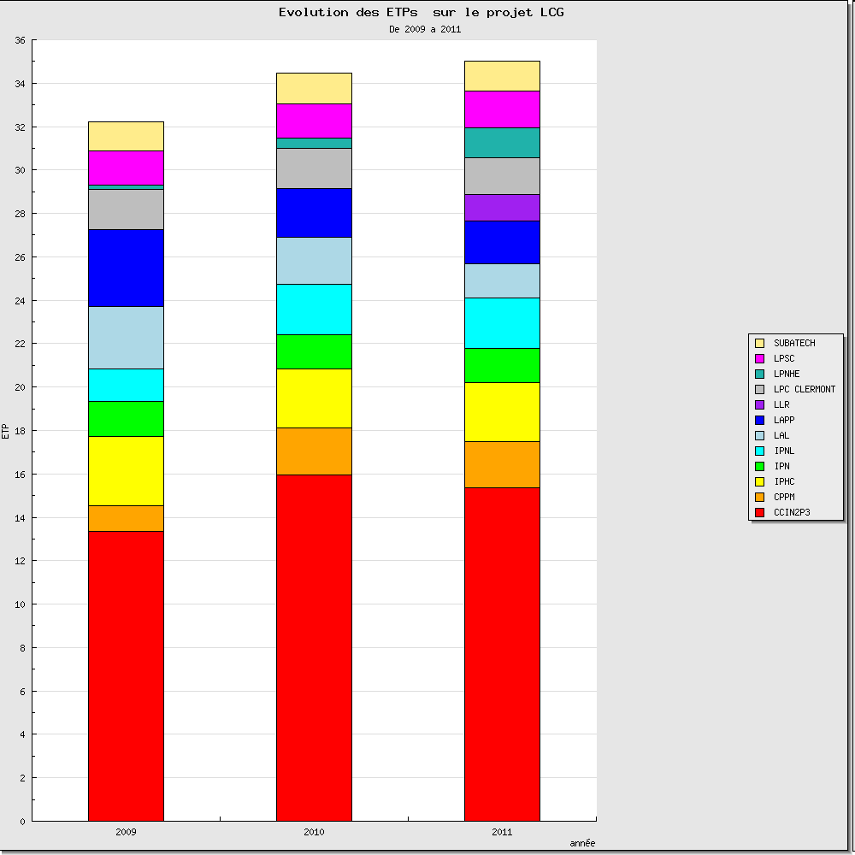
IN2P3 HR resources
RH IN2P3 HR resources extracted from ISIS DB
In 2011 : ~34 ETPs were declared by IN2P3 Labs (where 40 % is by CCin2p3).
57
Notes:
Evolution des ETPs affectés au projet LCG à partir des données renseignées par les laboratoires dans ISIS.
En 2011 : ~34 ETPs sont déclarés par les laboratoires IN2P3 dans ISIS (dont 40 % CC).
Ces données ne concernent que les ressources humaines IN2P3/CNRS (chercheurs, ingénieurs et CDDs).
En tenant compte du personnel CEA/IRFU (estimé à 3ETPs), on peut estimer le total des ressources affectées au projet autour de 37 ETPs.
57

Slide 58
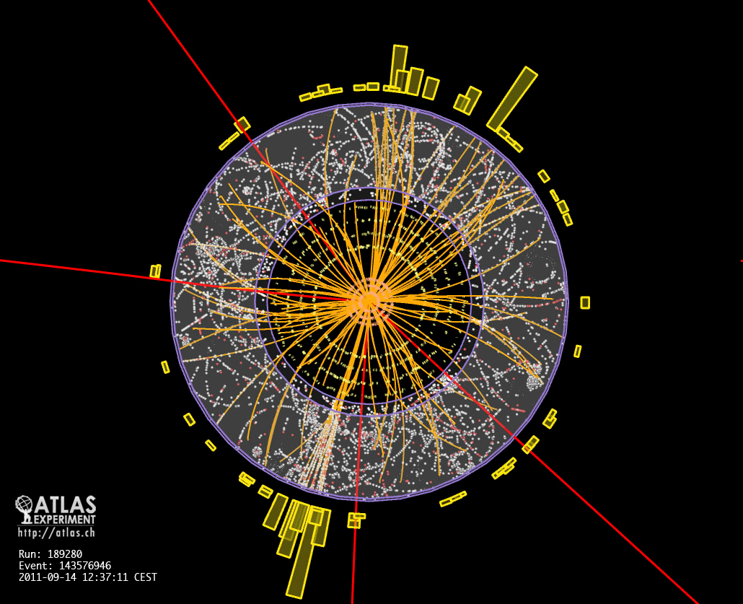
One possible Higgs → 4 μ candidate seen from 2011 data
It can be also two Z particles decaying to μ μ

Slide 59
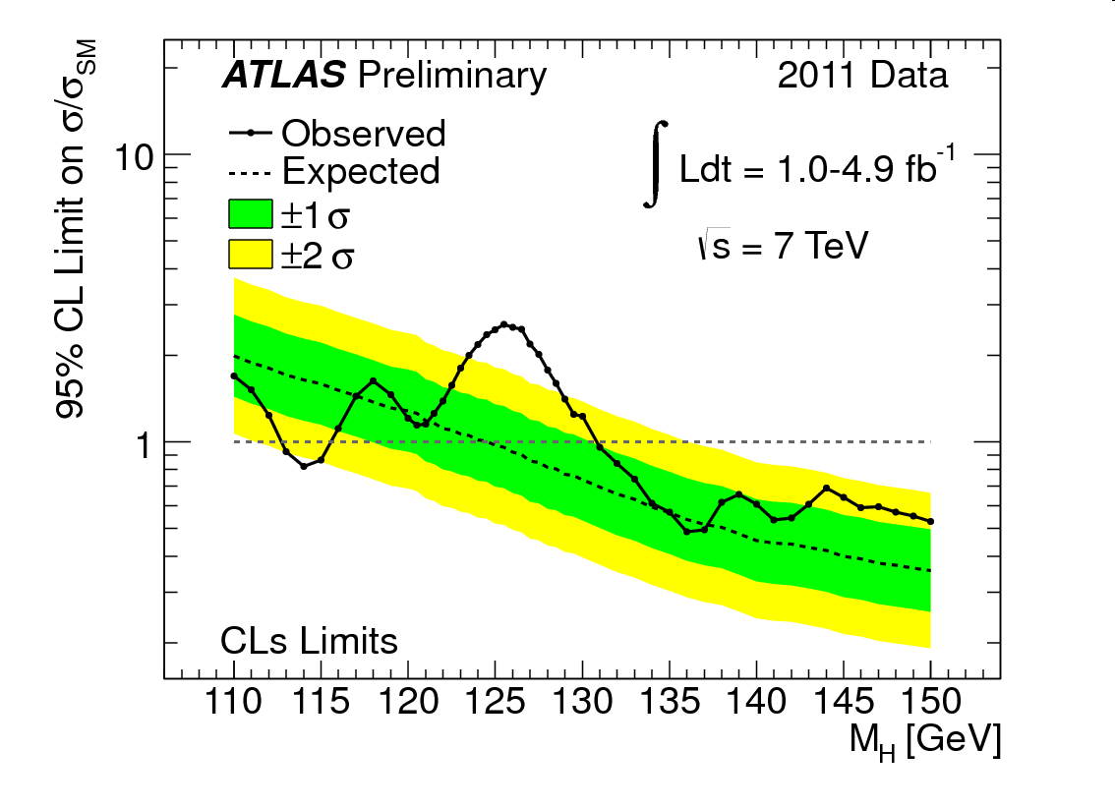
Backgroung fluctuation or Higgs signal
Around mass 125 GeV ????
The answer to that question is possible only if the measurement is done with a enough statistics and precision→ (> 3 σ) → results not before end of 2012

Slide 60
Scientific Results and Publications
Each of the 4 LHC experiments has already published more than 200 scientific articles since 2010.
Results on the existence of the Higgs at mass 125 GeV or the discovery of any other nature will not be possible until enough statistics and precise measurements are done. We believe some answers can be provided at the end of year 2012.

Slide 61
Scientific communities: the international well established
Life Sciences Grid Community (LSGC): a community where national users are particularly active
Slides: Johan Montagnat

Slide 62
Life Sciences Grid Community (LSGC)
LSGC is a broad spectrum community
  Life ScienceS deserves plural, largest community beyond LHC experiments
  Multi-grids (although a large fraction is an EGI Virtual Research Community – implemented through 5 VOs)
  France Grilles manages the LSGC (both scientific & technical mgt) and provides most human resources
Had to face HealthGrid association ending
  Proved to be a resilient, loosely coupled organization

Slide 63
LSGC achievements
LSGC Technical team
  Improve resource reliability (VO-wise monitoring)
  Liaise with resource providers and EGI (100+ resource centers)
User applications
VRC execution
LSGC
technical
team
environments
Operations
Resources consumption in 2011
  4.2 Mjobs = 1600 norm. CPU years
  2 PB of data
  200+ active users (lot of small experiments)
DCI

Slide 64
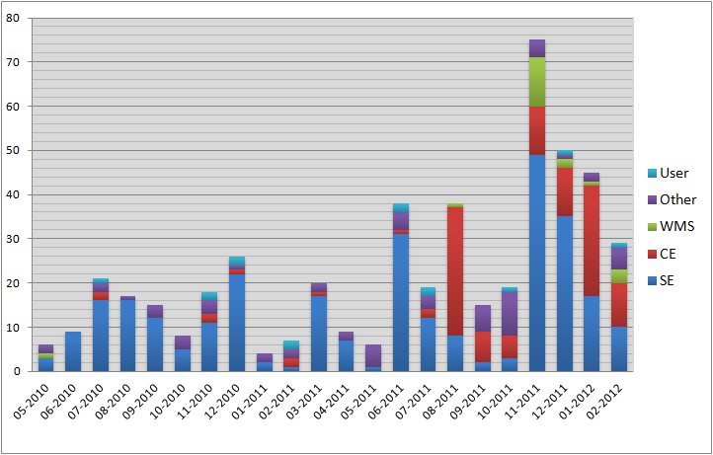
LSGC connection with operations
~500 GGUS tickets handled last year
  Currently cleaning up 8 years of activity (left users and obsolete data; site resources configuration and availability…)
Start
monitoring WMSs
Full SEs, fix
published data
Start
monitoring CEs

Slide 65
LSGC activity
Too many “small” experiments to report
  *omics, HT sequencing, structural biology, system biology, medical imaging, neurodegenerative diseases, models and simulations….
Stringent requirements and community-driven environments
  Data-driven workflows, distributed databases, knowledge repositories and inference, long-term data archival, grid pilot-jobs and clouds (virtual environments) exploitation

Slide 66






LSGC needs and perspective
Technical management
  Proved to be a key point, mandatory between end-users and operations
  Currently evaluating existing and missing tools for proper user community management
GOCDB
GStat 2.0
Perspectives
  Improve 200+ users to 100+ sites liaison
  Manage community data (scattered in 100s experiments)

Slide 67
Scientific communities: the international well established
Earth Sciences
slides Monique Petitdidier

Slide 68
Earth Science [1]
Earth Science research is intrinsically a Global undertaking that addresses both fundamental understanding of the Earth’s evolution, and augmented societal issues concerning natural hazards, energy resources, environmental changes and national security.
Monitoring networks and satellite observations are continuously transmitting a wealth of data integrated in loosely coupled international data infrastructures with standard DMS and formats
ES data intensive applications
  Data analysis of large volume and large number of distributed data sets
  Data simulation, inversion and assimilation
  Data integration and parallel data mining; Large scale synthetic data analysis;
  Scenario and stochastic analysis (parametric methods).
Challenges and Needs
  A service-oriented architecture and a platform of services and tools across Data, Grid, Cloud and HPC infrastructures

Slide 69
Earth Science [2]
Scientific domains
ESR: Atmospheric sciences (interface with satellite observations); Earthquake and Seismology (interface EGI/EPOS); Hydrology; Climate (interface EGI/ESG); EGEODE: seismic and geophysics exploration using Geocluster on the Grid provided by CGG-Veritas – update of Geocluster porting
European dimension
Earth Science Virtual Research Community (EGI VRC, EGI-Inspire): Earth Science (M. Petitdidier, IPSL & H. Schwichtenberg, SCAI/Fraunhofer)
ESFRI-PP projects: EPOS, EMSO …
FP7 Initiatives: Infrastructure:VERCE (CNRS-INSU), DRIHM; ENVRI capacity call; EnviroGrid
International dimension
Collaboration with other ES Grid activities: in Europe, in Asia (Taiwan, Vietnam), Latin America (GISELA through IPGP)

Slide 70
Earth Science – National dimension
2 Sites : IPGP&IPSL at IPGP, BRGM & access to most of the French sites and many European sites
VO:
  ESR VO: IPSL, IPGP, LOA, LGEI, BRGM ….
  EGEODE:stand-by for the users of Geocluster - GeoAzur, IPGS-EOST, ISTEP, UPMC-Sysiphe, ENS-Paris, IPGP
Partners
  Few persons in each laboratory and Institute
  Need more Grid people in ES laboratories or Institutes to support new teams and applications
  Need an engineer devoted to dissemination, contact with European Grid activities, technical support and survey in replacement of Dr Monique Petitdidier (IPSL)

Slide 71
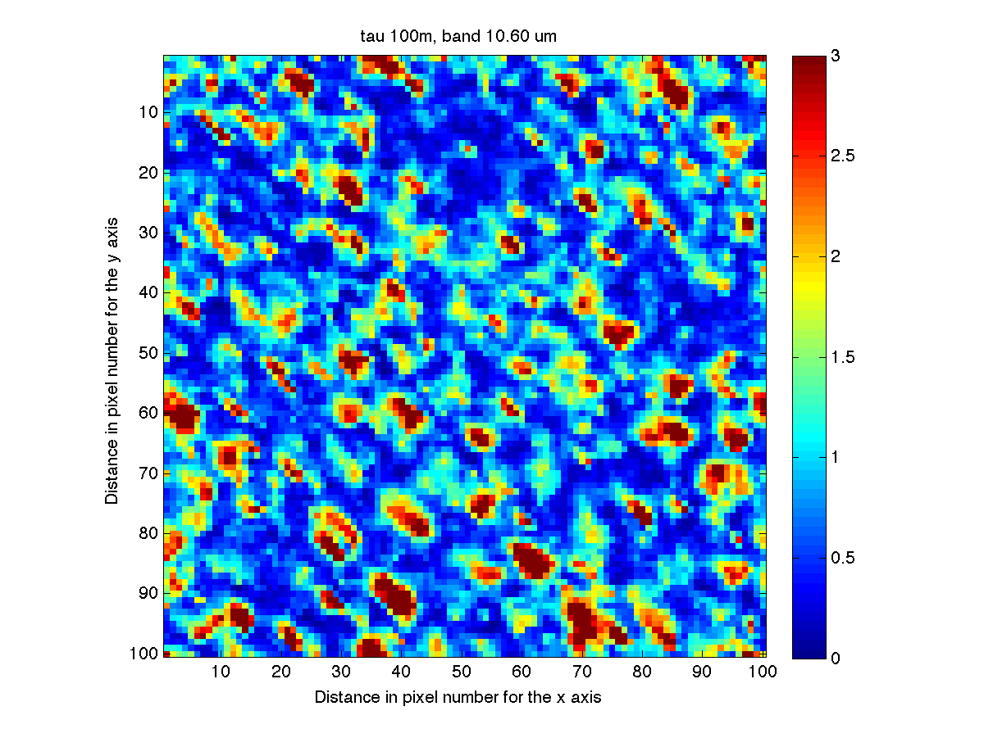
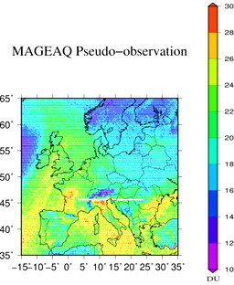
EARTH SCIENCE NEW APPLICATIONS
Radiative Transfer Model for Cloud (LOA, Lille)
Interpretation of POLDER/Parasol satellite observations
Monte Carlo Method (12days% 3years with a 8 processors computer)
A paper to be finalized and a PhD in preparation
GeoQAIR (IPSL/LISA, Paris)
Development of a OSSE (Observing system simulation Experiment): Design and validation of a new satellite instrument concept for air pollution observations
Pseudo-observation database from 4 previous satellite instruments: 45.000.000pixels from 4 instruments i.e. around 50O.000CPUs –quite done
1 paper published
Brightness Temperature simulated with a 100m-resolution (T. Fauchez)
0-6km ozone partial column simulated for one of the two future geostationnary instruments : MAGEAQ – to air quality.

Slide 72
EARTH SCIENCE APPLICATION - new issues
Interface ESG (Earth System Grid) & EGI (IPSL, Paris)
  ESGF: database of CMIP5 climate model outputs provided by worlwide teams for the next IPCC (International Panel on Climate Change)
  Goal: Use EGI for parametric, regional climate and impact studies,Extreme event statistics…
  Testbed: Climate simulation: MPI application, Data retrieved from ESGF
New issues
    Synchro-data: CMIP5 Access tool – due to its performance largely used by Climate teams
    Credential_translation_service: to overcome the difference of security protocols between ESGF & EGI
    A&A problem addressed to EGI & ESGF in collaboration with P. Kershaw (STFC, UK)
      Participation & contribution to the workshops on federated identity systems for scientific collaborations
    Impact on new climate projects

Slide 73
Earth Science
To face the data intensive challenges Grid seems to be a good candidate but not effectively adopted in Earth Science:
  In France Few teams (scientists + Grid engineers) then few permanent involvement
  Lack of local expertise & information, difficult to use, non-unified security protocols
  European and International collaboration in ES GRID mainly based only on best efforts => difficult for common works & developments, even information
ES Scientists used HPC, Cloud or Grid according to the stage of their work
  Need: architecture hiding complexity of the underlying infrastructures through mechanisms to manage automatic mapping of credentials, data access adapters and to call heterogeneous security protocols
  Cf. : Climate application, EU Projects: VERCE, DRIHM, EnviroGrids
DISSEMINATION
  European Geosciences Union: Grid, Cloud & HPC sessions, Booth
  Seminar organized by CNES, several Grid centres and projects
  Intensive computation and Grid days organized in Egypt and RDC during a school on
  Space weather

Slide 74
Scientific communities: the international well established
Astrophysics & Astroparticles:
slides Giovanni Lamanna
slides Franck Lepetit

Slide 75
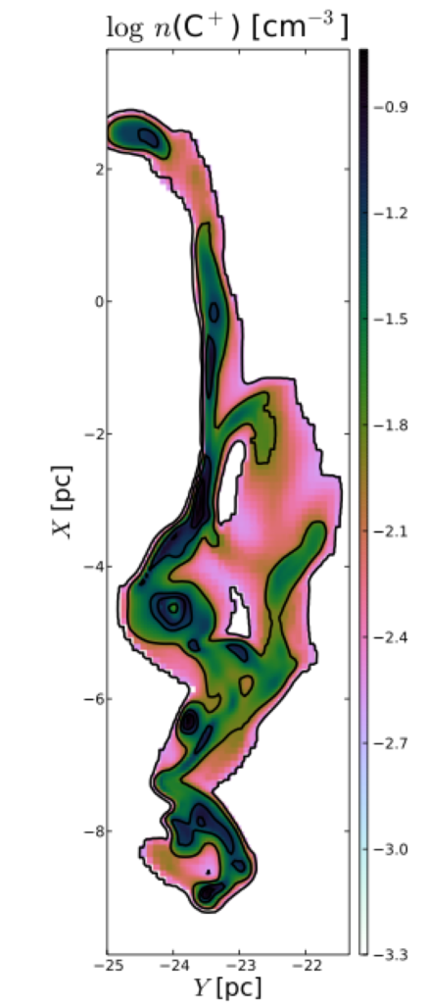
A&A Community
Specificities of A&A applications on Grid
Embarassingly parallel applications
Heterogeneous applications
Example of applications in 2011 - 2012
Simulations of atmospheric cascades for CTA project
Modeling of chemical structure in the interstellar Medium
  post-treatment of large simulations
Study of orbits stability in the Earth neighborhood for spatial missions

Slide 76
A&A Community
Grid is potentially useful for several astrophysical applications
Exploration of parameter space
Online simulation services (Virtual Observatory)
Some massive data analysis
Up to now few users because of
historical reasons :
use of national computing infrastructure (IDRIS, CINES, CCRT)
difficulties to link Grid and Virtual Observatory
no strong user community

Slide 77
Scientific communities: the international well established
Complex Systems
Slides: Romain Reuillon

Slide 78
Requirements
Grid is used to solve inverse problems:
  Model calibration
  Sensitivity analysis
  Systems optimisation
  Study of dynamic properties
  Reconstruction of dynamic from 3D + times images
Applications in divers scientific domains: geography, social-sciences, biology, food, neurosciences...

Slide 79
Example
Calibration of an agent based model of inter-cities geography.
Which values of the input parameters of the models leads to physically realistic situations.
Resolution using evolutionary algorithms:
  Evaluation of a set of parameters for the model => 30 replications of the model or 30 minutes CPU
  Solving the problem requires at least 100 000 evaluations
  2000 evaluations are executed at the same time on the grid when a result comes back a new job is submitted.

Slide 80
Means
Usage of vo.complex-systems.eu and of the workflow management system to experiment on models: OpenMOLE.
User demands for using the grid in the complex-systems community are increasing, however the computational resources accessible to the VO are under-sized.
The LAL cluster which should provide computational power for the VO doesn't accepts jobs anymore (0 jobs running)
We are presently in process with France Grilles to get a support to increase the VO capacities, waiting for new investments.

Slide 81
RENABI/GRISBI
A thematic French community
Slides Christophe Blanchet

Slide 82

French RENABI GRISBI
Federate Life Science community and provide with IT answers to challenging bioinformatics applications
Working group on technological aspects:
e.g. gLite, DIET, GridWay, BioMaj, ActiveCircle, Caringo, HDFS, XtreemFS, dCache, …
Build a distributed infrastructure
  Above the regional centres of RENABI (5)
  Based on the bioinformatics platforms (9)
    approved as national RIO / IBISA
    ~90 registered members
  Computing resources
    in PFs 2600 cores, 310 TB storage
    in grid 860 cores, 26TB storage
Financial support by RENABI , IBISA 2008-2011, IDG 2009-2010
In collaboration with the national IT infrastructures: IDG, GENCI, Grid5000, regional computing centres
www.grisbio.fr
Courtesy of GRISBI project

Slide 83
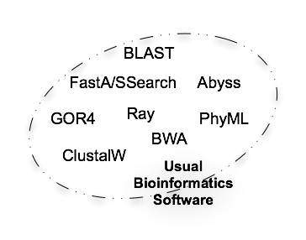
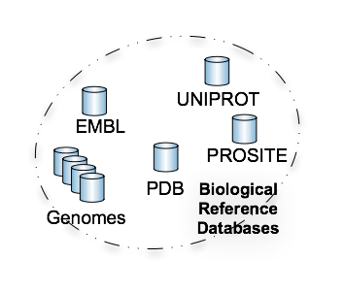
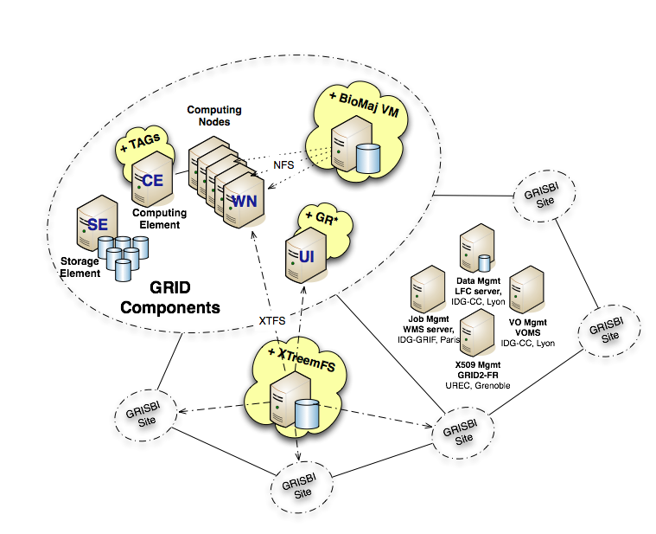
Bioinformatics Infrastructure
Courtesy of GRISBI project

Slide 84
Grid Observatory, Green Observatory
Slides Cécile Germain

Slide 85
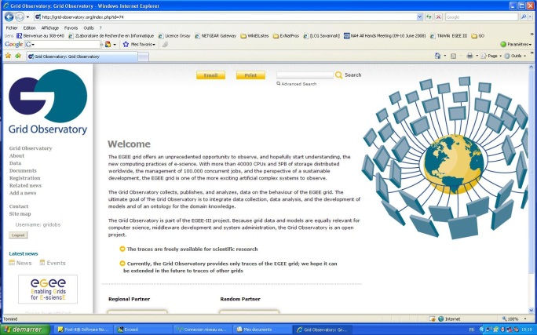
The Grid Observatory
Grid traces collection portal
  Started in EGEE-III, online since October 2008
  Digital curation of the behavioural data of the EGI grid: job traffic, file access, middleware, energy usage
Recent supports
  EGI-inspire, INRIA (ADT), CNRS (PEPS), COST Action IC0804
Research-production link
  Complex systems description
  Models, optimization, Autonomics
www.grid-observatory.org
Notes:
ADT: action développement technologique
PEPS: Programme exploratoire

Slide 86
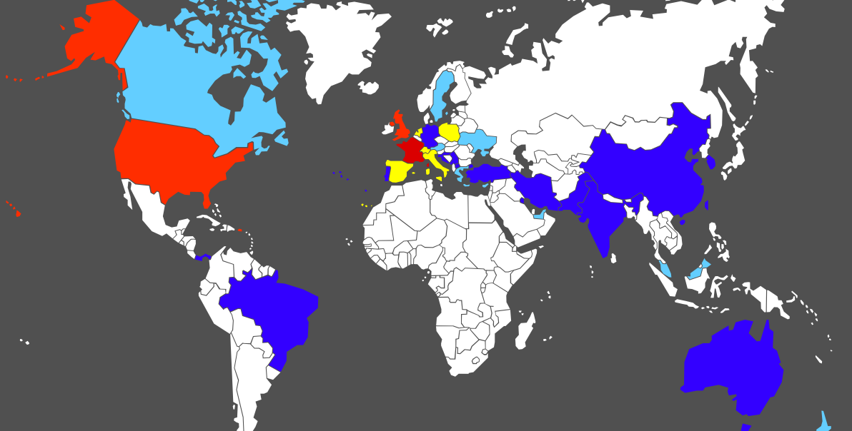
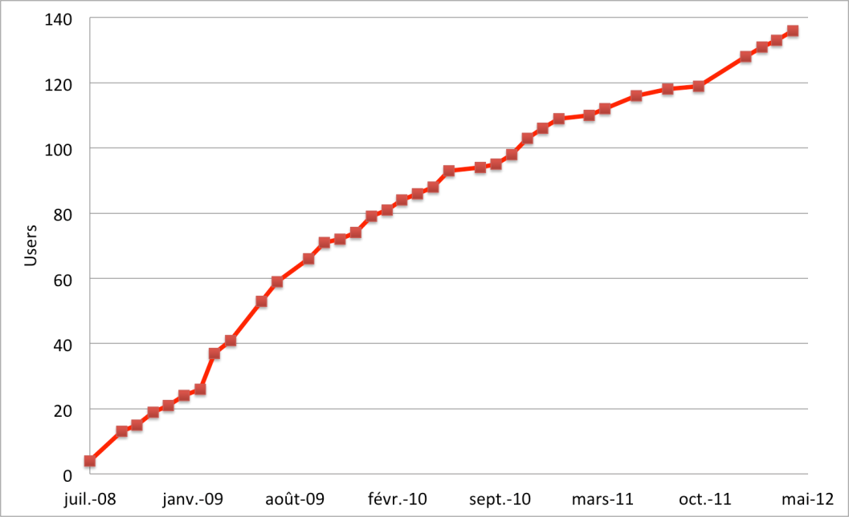
Usage statistics
30+ international peer-reviewed computer science publications

Slide 87
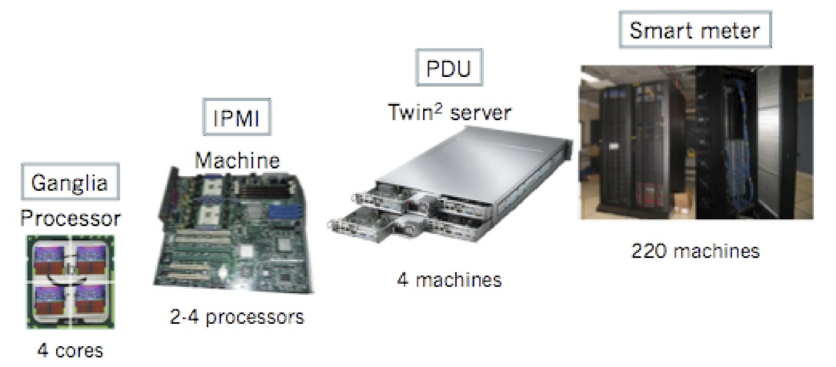
The Green Computing Observatory
Extensive traces of energy consumption from LAL site
  2200+ cores, 500TB storage
  Acquisition based on standards: IPMI and Ganglia
Notes:
integrate motherboard-level monitoring with information on computing, networking, storage, and cooling.

Slide 88
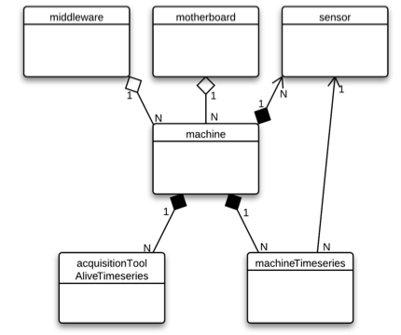
The Green Computing Observatory
Extensive traces of energy consumption from LAL site
  2200+ cores, 500TB storage
  Acquisition based on standards: IPMI and Ganglia
  Integration based on a new ontology of IT systems measurements, including virtual machines
  The XML-formatted traces are published by the GO portal
Notes:
A bird’s eye view of the xml schema as a UML diagram

Slide 89
Additional slides
additional metrics
details

Slide 90
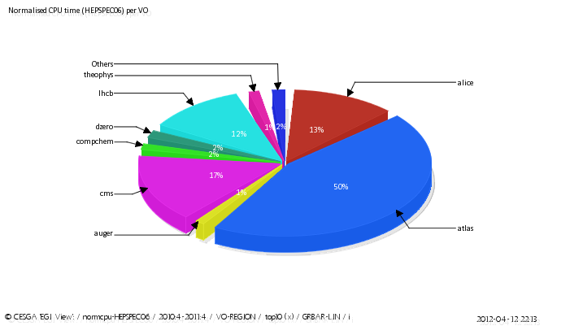
World wide EGI CPU resources consumed per-VO
April 2010- April 2011
April 2011- April 2012
Pie Charts showing the share in Normalised CPU time (HEPSPEC06) per VO
(only information about TOP 10 -ordered by CPU time- VOs is returned).

Slide 91
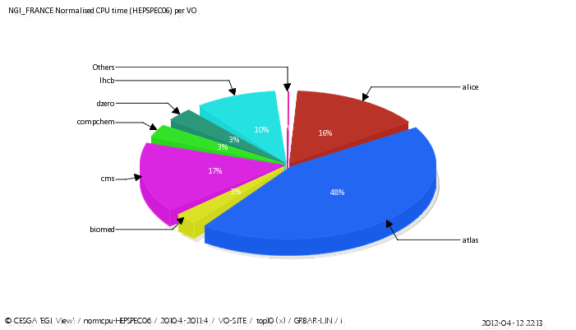
Normalised HEPSPEC06 CPU time per VO 4/2010 – 4/2011
World wide EGI Top 10
NGI-France top 10

Slide 92
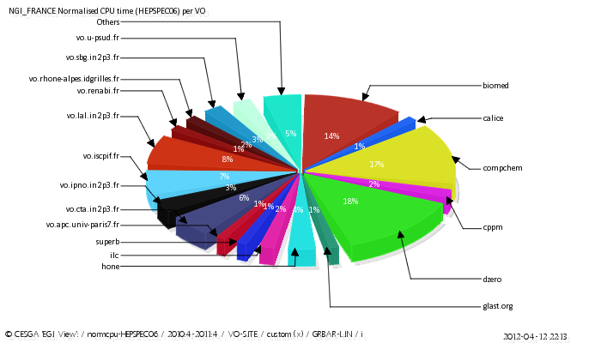
Normalised CPU time (HEPSPEC06) per VO without LHC
April 2010 – April 2011

Slide 93
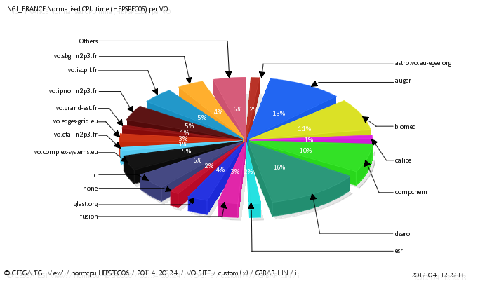
Normalised CPU time (HEPSPEC06) per VO without LHC
April 2011 – April 2012

Slide 94
Training details
 |  | nb days | nb trainees
Tutorial utilisateur grille | 02/06/2010 | 1 | 15
Journée Outils pour le calcul Scientifique en Rhône-Alpes | 29/06/2010 | 1 | 23
GRISBI - Calcul Scientifique sur Grille pour la Bioinformatique | 27/09/2010 | 5 | 27
Formation utilisateurs - Présentation et initiation aux grilles de calcul | 18/10/2010 | 2 | 16
Formation utilisateurs ligne de commande du middleware de grille de calcul Glite | 22/10/2010 | 1 | 23
Formation sur l\’utilisation de OGC (service web) dans le contexte de la Grille EGI | 26/10/2010 | 1 | 14
Formation sur l\’utilisation de DIRAC dans le contexte de la Grille de Calcul EGI | 27/10/2010 | 1 | 20
Formation utilisateurs DIRAC | 09/12/2010 | 1 | 11
Formation utilisateurs - Présentation et initiation aux grilles de calcul & Apprentissage de l\’outil DIRAC | 01/02/2011 | 3 | 19
Open Nebula - Stratulab | 30/03/2011 | 2 | 8
Open Nebula - Stratulab | 04/04/2011 | 2 | 5
GateLab | 08/04/2011 | 1 | 20
Formation utilisateurs - Présentation et initiation aux grilles de calcul & Apprentissage de l\’outil DIRAC | 19/04/2011 | 3 | 19
Formation utilisateurs d\’EGI | 18/05/2011 | 3 | 18
Journées GRISBI 2011 | 26/05/2011 | 2 | 30
ACGRID3 school | 24/10/2011 | 9 | 52
Tutoriel sur l\’infrastructure de grille de calcul GRISBI | 04/11/2011 | 1 | 30
StratusLab Cloud Training | 17/11/2011 | 2 | 25
Formation utilisateurs - Présentation et initiation aux grilles de calcul | 04/04/2012 | 2 | 16

Slide 95
Why not the EGI.eu AppsDB?
Users’ proposal in a previous operation workshop
French is important for our target
Plume is a multidisciplinary tool used by many scientific fields -> good mean to disseminate DCI!
People are used to Plume and Plume federates people.
Several cards are not directly related to EGI.eu
Plume is a link to the computing research

Slide 96
questionnaire
  ask twice 10 people for 2-3 contacts -> 4 answers
  6 final responses
  3 researchers/3engineers
  5 men/1woman
  High energy astrophysics
  2 biology
  complex systems
  Earth Sciences Océanographie physique, domaine littoral
  astroparticules
motivation:
  number of CPUs, high number of jobs, jobs durations, big data
training: 4 yes/2no (1 with specialist)
all found close support
all found benefit
4 found issues
  3 reliability
  1 big data transfer
2 HPC users
1 think to cloud

