Slide 1
Grid Operations : Status and perspectives Gilles Mathieu, Hélène Cordier
France Grilles International Advisory Committee – April 2012

Slide 2
Outline
Where are we ?
Some enlightening metrics
Last year’s highlights
Events and workshops
Catalogue of services
Internal tools and organization
Starting cloud initiatives
Perspectives for the year to come
When Grid Operations meet Grid Users…
Getting more metrics: Methodology
Cloud perspectives
Towards sustainability
Evaluating the cost and benefits of Grid Operations
Running national and global services beyond EGI-InSPIRE
What issues are we facing? How can we solve them?

Slide 3
Outline
Where are we ?
Some enlightening metrics
Last year’s highlights
Events and workshops
Catalogue of services
Internal tools and organization
Starting cloud initiatives
Perspectives for the year to come
When Grid Operations meet Grid Users…
Getting more metrics: Methodology
Cloud perspectives
Towards sustainability
Evaluating the cost and benefits of Grid Operations
Running national and global services beyond EGI-InSPIRE
What issues are we facing? How can we solve them?
YOU ARE HERE

Slide 4
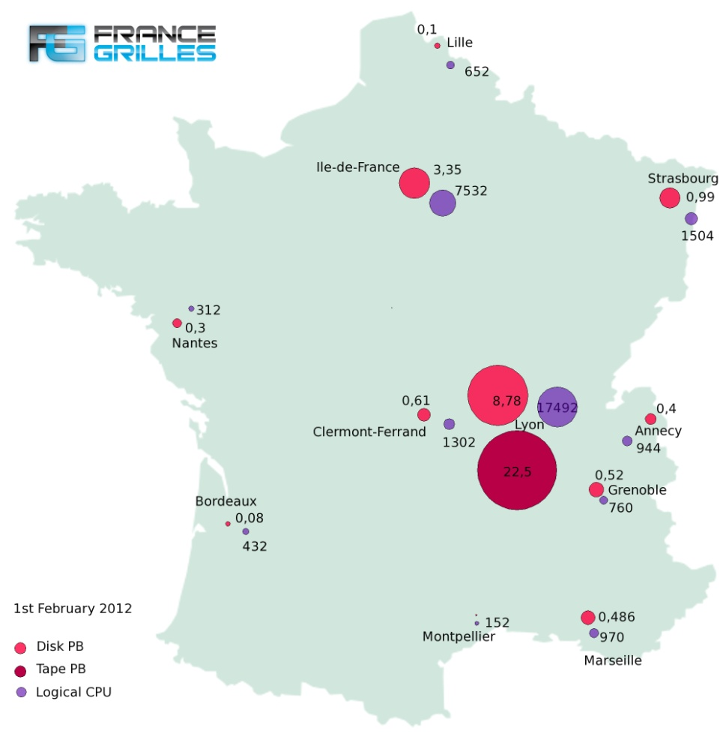
Some enlightening metrics (1) – Available resources
Available resources and their distribution
18 production sites
31,860 logical CPUs
280,316 HEPSPEC06
15.7 PB disk storage
22.5 PB tape storage

Slide 5
Some enlightening metrics (2) – Available resources
Logical CPUs over the last year
Disk storage (PB) over the last year

Slide 6
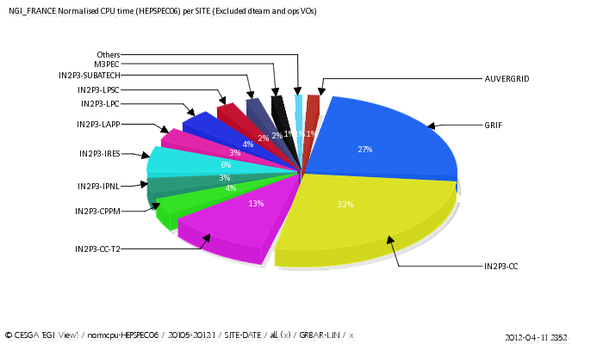
Some enlightening metrics (3) – Used resources
Used resources
Normalized CPU time per site from Q1 to Q7
Last IAC, march 2011

Slide 7
Some enlightening metrics (4) – French contribution to EGI
Computing resources
11.1% of available capacity
14.4% of used capacity
3rd contributor to EGI behind:
UK (16.6%)
Germany (15.4%)
Storage resources
11.8% of available disk space
5th contributor to EGI behind
Germany (14.8%)
CERN (14.4%)
UK (12.4%)
Italy (12.0%)
Available and used capacity
provided by France
in % of EGI values

Slide 8
Some enlightening metrics (5) – Quality
Quality of our infrastructures
98.4% availability
99.0% reliability
100.0% availability/reliability of our central core services (Top-BDII) since September 2011
Definitions of Availability and Reliability:
A = (Up period)/(known period)
R = (Up period)/(known period – scheduled downtime)
More on https://wiki.egi.eu/wiki/Availability_and_reliability_monthly_statistics
Production infrastructure
(average 04/2011 - 03/2012)
Notes:
Definir A/R – ou lien vers la définition précise

Slide 9
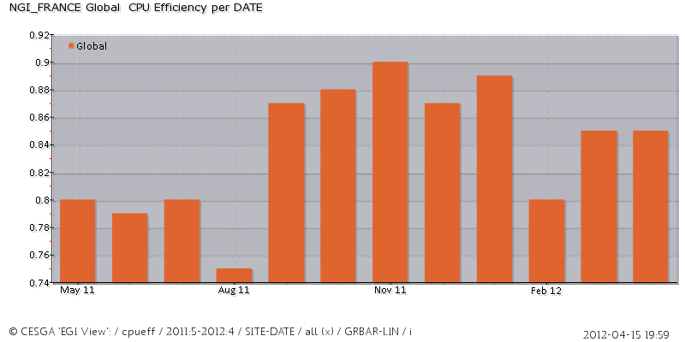
Some enlightening metrics (6) – Load and efficiency
CPU efficiency
Sum (CPUtime)/Sum (Walltime)
84% average on last year
Load on grid machines
Simplistic evaluation: (Used/Available)
Does that make sense? Still many questions to address
Ongoing work to determine more precisely how loaded is our infrastructure
Metric under definition

Slide 10
Some enlightening metrics (7) – Security
Number of detected Critical Vulnerabilities (CVE)
EGI
As of 13/04: 378 CVE
Average: 270/day
France
As of 13/04: no CVE
Average: 0.6/day
Source : Operations Portal/Security Dahsboard

Slide 11
Some enlightening metrics (8) – Operational support
Tickets over the last year (Apr 2011 - March 2012)
691 tickets assigned to NGI_FRANCE, 558 solved
Solution time: 12.5 days average, 1.7 day median
Source : GGUS / Global Grid User Support

Slide 12
Some enlightening metrics (9) – Effort and time
Effort needed and spent on "central" tasks
Tasks at national/NGI level
 | NEEDED EFFORT |  |  |  |  |  | CURRENT EFFORT
 | Crit. |  | Crit. + Import. |  | All
 | h/week | FTE | h/week | FTE | h/week | FTE | h/week | FTE
Technical coordination | 45 | 1,18 | 71 | 1,87 | 88 | 2,32 | 41 | 1,08
Executive Technical committee | 11 | 0,29 | 22 | 0,58 | 23 | 0,61 | 13 | 0,34
Accounting | 19 | 0,5 | 23 | 0,61 | 27 | 0,71 | 18 | 0,47
Monitoring | 23 | 0,61 | 35 | 0,92 | 36 | 0,95 | 17,5 | 0,46
Network | 3 | 0,08 | 41,5 | 1,09 | 42,5 | 1,12 | 23 | 0,61
Certification Authority | 36,5 | 0,96 | 52 | 1,37 | 53,5 | 1,41 | 37 | 0,97
Security | 17 | 0,45 | 25 | 0,66 | 31 | 0,82 | 16 | 0,42
Deployment | 2 | 0,05 | 11 | 0,29 | 41 | 1,08 | 38 | 1
Others | 30 | 0,79 | 36 | 0,95 | 48 | 1,26 | 36 | 0,95
TOTAL | 186,5 | 4,91 | 316,5 | 8,34 | 390 | 10,28 | 239,5 | 6,3

Slide 13
Outline
Where are we ?
Some enlightening metrics
Last year’s highlights
Events and workshops
Catalogue of services
Internal tools and organization
Starting cloud initiatives
Perspectives for the year to come
When Grid Operations meet Grid Users…
Getting more metrics: Methodology
Cloud perspectives
Towards sustainability
Evaluating the cost and benefits of Grid Operations
Running national and global services beyond EGI-InSPIRE
What issues are we facing? How can we solve them?
YOU ARE HERE

Slide 14
Events and workshops (1)
2nd Grid Operations Workshop – Oct. 20th 2011
Addressed topics
Placing operations within overall strategy
Internal organization of Grid Operations
France Grilles’ service offer
A good occasion to get a different perspective
Presentations and discussions with UK and Polish NGIs
Broadening the scope by linking operations with the rest
Building a roadmap for the following 6 months

Slide 15
Events and workshops (2)
France Grilles 2nd Cloud Day – Oct. 21st 2011
Addressed topics
Sharing and disseminating knowledge on cloud technologies
Assessing state-of-the-art in the area
Discussing issues and opportunities
Reached goals
Raising cloud awareness and knowledge
Paving the way for French cloud initiatives and wider implications

Slide 16
Events and workshops (3)
Trainings for site administrators
ACGRID3 school, Vietnam, oct.2011 (53 participants)
Quattor administration, dec.2011 (16 participants)
DIRAC administration, jan.2012 (15 participants)
EGI Technical Forum 2011
High implication from operational actors because the EGI-TF was in Lyon

Slide 17
Catalogue of services – Catch-all VO vo.france-grilles.fr
Deployement and status
Deployment Launched April 2011
Going through questionnaires, feasibility study, interactions with regional VOs, AUP definition etc.
Technically in place since July 2011
4 VO managers
Resources and services
Now supported on 12 sites
Central services (LFC, VOMS) hosted at CC-IN2P3
Available through DIRAC framework (see next slide)

Slide 18
Catalogue of services – Providing new services (1) : DIRAC
The DIRAC project
Distributed Infrastructure with Remote Agent Control
Initially developed for LHCb experiment
http://www.diracgrid.org
A good opportunity for France Grilles
IN2P3 highly involved in development (CPPM, Marseille)
Seen as a great added value for our users

Slide 19
Catalogue of services – Providing new services (2) : DIRAC
FG-DIRAC: France Grilles’ national instance
A 3 phases project
Initialization (September 2011 – January 2012)
Preparation (January 2012 – April 2012)
Production (May 2012 onwards)
A multi-tier collaboration
CC-IN2P3
Hosting
IN2P3-CPPM
France Grilles
M3PEC
CC-IN2P3
Project coordination
DIRAC project
CREATIS
LUPM
Service administration
Development

Slide 20
Catalogue of services – Providing new services (3) : DIRAC
FG-DIRAC: current status
Ready to start production as scheduled
Platform installed and operational
MoUs underway (for hosting and administration)
Preliminary tests successful
Pilot communities ready to use the service
Ready to have it used and to communicate about it
Advanced dissemination at next operations workshop
Admin training in June

Slide 21
Catalogue of services – Providing new services (4)
iRODS storage system
Plans to open the service to FG community
Discussions planed at next operations workshop
Admin training scheduled in June
Tools Catalogue
Software used and/or developed within a Grid context
https://www.projet-plume.org/grille

Slide 22
Internal tools and organization (1)
Operational Model : formalizing missions and tasks
Time-bound work
Regular and continuous work
Definition
Strategic coordination
Planning
Technical supervision
Execution
Service admin
Hosting
Implementation
Support & follow-up

Slide 23
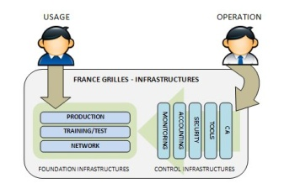
Internal tools and organization (2)
Formalizing the definition of our infrastructures

Slide 24
Internal tools and organization (3)
Setup of an Executive Technical Committee
Experts + representatives from site and user communities
Discussing and validating strategic orientations
Expert groups
Accounting, Monitoring, Security, Deployment, Network, Certification Authority
Collaborative tools
Wiki, task tracker, RPM repository

Slide 25
Cloud initiatives (1) – Academic Cloud at CC-IN2P3
Who/what
Initiated in Nov. 2011 by Mattieu Puel
France-Grilles directly sponsored : 384 cores (16*24 cores)+ 1,5 TB (16*96 GB) +32 TB
State of the art
Currently evaluating Openstack/Opennebula/Vmware
Evaluation criteria:
General considerations (wide adoption, compliance with standards, scalability, price)
functionalities (cloud management, monitoring, accounting, local storage)

Slide 26
Cloud initiatives (2) – Academic Cloud at CC-IN2P3
Steps
Offer IAAS resources through generic interfaces (EC2/OCCI)
Integrate national/international academic federations
Use-case to be opened to :
EGI Cloud Federation Task Force testbed
DIRAC usage of cloud resources
Individual early users (biomed)
Webimatics (neurobiology)
Later: eTRIKS project (drug discovery)
Participation to EGI Cloud Federation TF
WP4 (development of the Openstack driver for federated accounting)
WP5 (VM monitoring)

Slide 27
Cloud initiatives (3) – Hybrid Cloud at cloudmip.univ-tlse3.fr
Who/what
Managed by F. Thiebolt & J.M. Pierson
France-Grilles directly sponsored : 32 blades (8 cores, 32Go RAM, 2 x SAS 15ktpm) – March 2012
State of the art :
Scientific Linux 6.2 + KVM + OpenNebula, or
OpenStack (IaaS) + GlusterFS (RedHat DFS) + CompatibleOne (SaaS)
Alternative : RHEV3.0 + GlusterFS

Slide 28
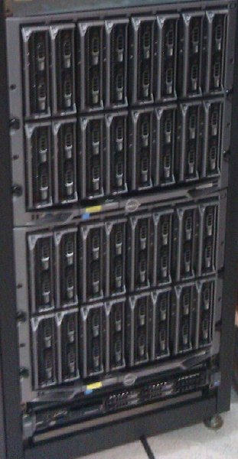
Cloud initiatives (4) – Hybrid Cloud at cloudmip.univ-tlse3.fr
Interests /issues
Green IT in datacenter
Cloud & inter-cloud distributed storage
Use-case to be opened to :
Local academics
Users of grid5K
Some private companies

Slide 29
Outline
Where are we ?
Some enlightening metrics
Last year’s highlights
Events and workshops
Catalogue of services
Internal tools and organization
Starting cloud initiatives
Perspectives for the year to come
When Grid Operations meet Grid Users…
Getting more metrics: Methodology
Cloud perspectives
Towards sustainability
Evaluating the cost and benefits of Grid Operations
Running national and global services beyond EGI-InSPIRE
What issues are we facing? How can we solve them?
YOU ARE HERE

Slide 30
Does that make sense to have plans ?
2012
Well… let’s try anyway

Slide 31
What next? (1)
Keep on going…
Maintain the Quality of Service we already deliver
Bring FG-DIRAC to a full production service
Continue towards adding iRODS to our catalogue
3rd FG Operations workshop – Spring 2012
May 10th in Lille
Advanced dissemination on DIRAC and iRODS
Engaging operations with user communities

Slide 32
What next? (2)
Strengthen relations between operations and:
User communities
Encourage collaborative support
Provide user training on new services
Federate help on application porting
Grid sites
Formalize relationships, establish MoUs
Start thinking in an "SLA" way

Slide 33
Thou shalt produce metrics (1)
Metrics definition methodology
Work bottom-up
from "what do we want to know"…
… to "what metric do we need for that"
Define areas by origin : who produces the metric?
Operations, user communities, training, communication, budget/finances, collaborations/projects
Standardize description for each metric
Metric definition model

Slide 34
Thou shalt produce metrics (2)
Metrics definition model
Category | (e.g. Infrastructure, users, training, etc.)
Parent indicator group | (e.g. "available resources", "Operational support activities", etc.)
Indicator ID and name | (e.g. "INFRA-1.1 - Number of available logical CPU"...)
Scope | (e.g. national, EGI, ...)
Goal | Why do we want to measure that
Description | Detailed description of what is measured
Calculation method | How are number obtained, especially if they derive from other metrics
collection/publication frequency | (e.g. "Monthly retrieval, published when retrieved")
Sources and tools | Where do data come from, how they are collected
Responsible person | Person that is responsible for collecting data
target value | Could be a minimum value, an ideal value, a general tendency…
Report model | (e.g. results table, graph, raw numbers, …)
Status | (not started, in progress, defined, implemented...)
Collection Starting date | (e.g. 01/01/2010, PM1, Q3, etc.)

Slide 35
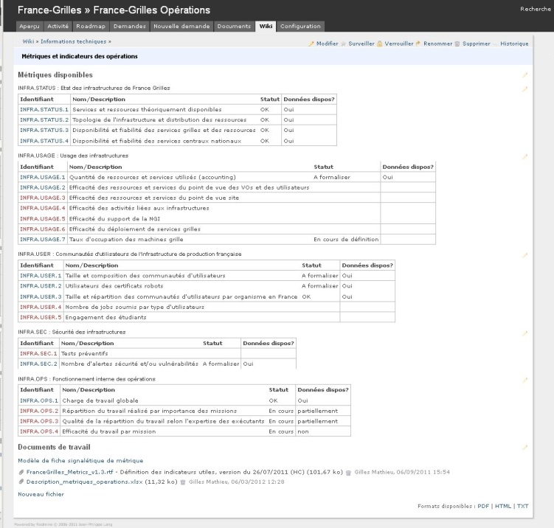
Thou shalt produce metrics (3)
Status
Work in progress on operations metrics
"dashboard" on operations wiki
Most of the data already there

Slide 36
Next activities on clouds
Collaboration with CSIC (Spain)
One person from CSIC to come to France for a year to work on cloud activities
Federating French initiatives
Paris/GRIF and Stratuslab efforts
Cloud initiative and interests in Strasbourg/IPHC
Next cloud day in Lille - 11th May
Contribute resources to EGI Cloud Federation TF

Slide 37
Conclusion on 2011 highlights and 2012 perspectives
Addressed recommendations from last IAC
Realization of plans for a national VO
Initial description of our catalogue of services
Ongoing work on “easily understandable metrics to measure the performance and impact of IdG”
Laying foundation stones for a cloud infrastructure
And now…
Time to think about longer term plans

Slide 38
Outline
Where are we ?
Some enlightening metrics
Last year’s highlights
Events and workshops
Catalogue of services
Internal tools and organization
Starting cloud initiatives
Perspectives for the year to come
When Grid Operations meet Grid Users…
Getting more metrics: Methodology
Cloud perspectives
Towards sustainability
Evaluating the cost and benefits of Grid Operations
Running national and global services beyond EGI-InSPIRE
What issues are we facing? How can we solve them?
YOU ARE HERE

Slide 39
The magic formula to successful operations
Grid
Non Grid
On all sites, Grid operations are tightly intricated
with non grid operations

Slide 40
Cooperation and interdependencies
YESTERDAY
TODAY
TOMORROW ?

Slide 41
Cost of FG Operations (1) : Effort and manpower
What is needed to play the "Grid Symphony"?
The orchestra: effort at site level
Estimation 30 FTE for site operations (incl. WLCG operations) over the current 18 production sites
Section leaders and conductor(s): effort at NGI level
5 FTE for the minimum, 10FTE for the best (see slide 12)
NEEDED EFFORT
Critical missions |  | Criticial and important missions |  | All missions
h/week | FTE | h/week | FTE | h/week | FTE
186,5 | 4,91 | 316,5 | 8,34 | 390 | 10,28

Slide 42
Cost of FG Operations (2) : Other costs
Infrastructure costs
Hardware renewal and/or extension
Running grid resources and services (electricity, air conditioning, maintenance costs)
Operating costs
Internal events (logistics and travel costs)
International involvement (travel costs , conference registration fees…)

Slide 43
Benefits of FG Operations
Direct benefits
Mutualization and sharing
Effort, investment and expertise : the "human Grid"
Coordination activities
m/w and service deployement, links to and between different projects
Central Grid services and functions
Monitoring, accounting, Certification Authority, Support
Grid security coordination
Indirect benefits
Strategic collaborations (e.g. joint answers to project calls)
Visibility

Slide 44
FG Operations : Current funding
Who cover those costs today?
France Grilles - annual TGIR budget
120k€ in 2012 for Operations
Hardware investments (e.g. 375k€ in 2012 on cloud infra.)
EGI-InSPIRE contribution for SA1 tasks
1034 k€ for SA1 tasks over 4 years
Other projects funding source
WLCG, local grid projects, collaborations…
Sites/partners contributions to:
Effort
Travel and administrative costs for staff
Grid resources and services running costs

Slide 45
Beyond costs and benefits…
How much of what we do would have to be done anyway, even if France Grilles didn’t exist?
Probably most of site operations
Administration, operational support…
Most of high level expertise activities
Monitoring, accounting, Certification Authority, Security…

Slide 46
Sustainability questions
Maintain living infrastructures
What happens if we don’t have funding for :
The 35 needed FTEs?
Hardware & services maintenance costs?
External dependencies
What if the tools we use stop being developed or maintained (e.g. EMI m/w, GOCDB, SAM-Nagios)?
What if we have to stop providing one of them to the Grid community (e.g. EGI Operations Portal)?

Slide 47
Some mitigation ideas (1)
Consolidate our estimation of what we do
Go deeper in the costs/benefits analysis
Replace operations in the global picture
Assess and clarify our “place in the landscape”
Formalize relations between France Grilles and
Its production sites
Its national partners
Its international partners

Slide 48
Some mitigation ideas (2)
Build sustainability scenarios
Start from the hypotheses we can make on future funding, manpower, service availability etc.
Try and get ideas to turn each scenario into a form of success
Get inspiration from elsewhere
What can Service Level Management teach us?
We are not alone… how are other NGIs doing?
Can we learn from the free software world?

Slide 49
Anyway…
Whatever happens…

Slide 50
THANK YOU
Direction-technique@france-grilles.fr

