Slide 1
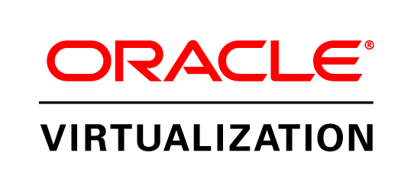
Oracle Virtualization Overview
March 2012

Slide 2
Safe Harbor Statement
The following is intended to outline our general product direction. It is intended for information purposes only, and may not be incorporated into any contract. It is not a commitment to deliver any material, code, or functionality, and should not be relied upon in making purchasing decisions.
The development, release, and timing of any features or functionality described for Oracle’s products remains at the sole discretion of Oracle.
Notes:
2

Slide 3

Agenda
Server Virtualization
Engineered for Oracle
Succeed with Oracle Virtualization

Slide 4
Evolving IT Needs
“Datacenters” are becoming “Service Centers”
Cloud computing is driving the need to deliver complete integrated stacks, not “just” OS provisionning
On-going need for greater optimization & efficiency
Virtualization must enable the entire stack to be..
  Easier to DEPLOY
  Easier to MANAGE
  Easier to SUPPORT
IT Needs to Deliver Ready to Run Services
Notes:
Information technology needs are rapidly evolving as data centers have now become service centers that have to deliver instantly, on demand, 24x7, responding to changing customer requirements with speed. Service level requirements have become more stringent. Cloud computing, as we all know, is becoming more pervasive in data centers, reflecting their end-users’ desire to get IT services “on-demand”.
So, the need for delivery of IT services are evolving as users are becoming less accepting of “build it yourself” philosophy and more demanding of resources “just in time, right when they need it”. There is an ongoing need for greater optimization and efficiency in how we deploy, manage and support software and solutions powering the data centers.
Virtualization is one of the key technologies used in data centers for optimization of resources. However, with the evolving needs of IT, you can no longer just consider “virtualization” as an isolated technology to solve a single problem.

Slide 5
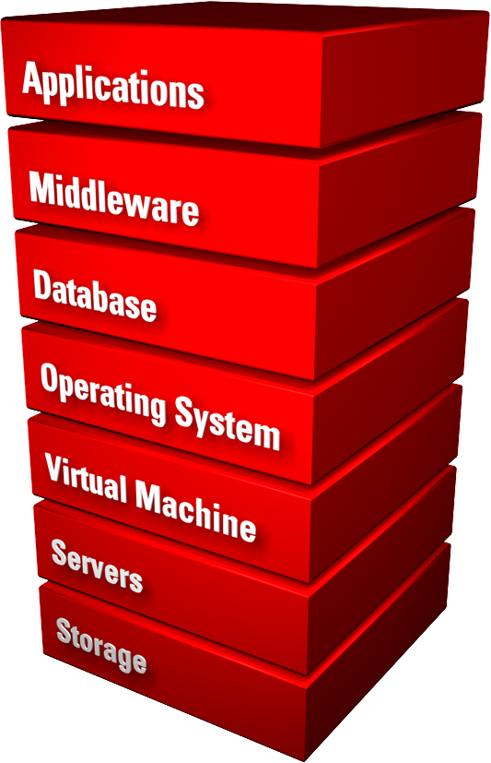
Oracle Virtualization
Most comprehensive
Fully tested with applications
Designed for full stack deployments
Integrated, full stack management
Integrated support
Notes:
This is where Oracle comes in. Only Oracle offers the industry's most complete and integrated virtualization solutions portfolio that can virtualize and manage the full hardware and software stack. With a focus on testing from applications to disk, integrated management and support, Oracle’s unique approach to virtualization enables IT to deliver on-demand services rapidly to their end-users.
I’d now like to invite Adam Hawley to give us more details on Oracle’s server virtualization solutions, and show how they deliver more value to users than VMware and the other virtualization technology providers.

Slide 6
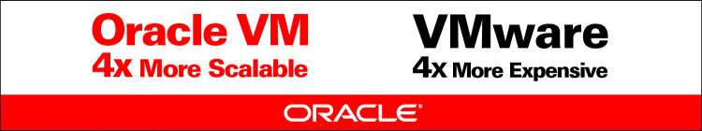
Oracle VM Server Virtualization
Transform the way you deploy and manage apps
Suitable for all datacenter workloads
Engineered for Oracle
The only x86 server virtualization software supported and certified for all Oracle software
Lower cost
Free to download
Enterprise-quality support
Real-world deployment testing
Risk-free virtualization

Slide 7
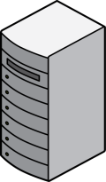
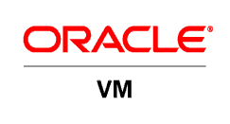

Oracle VM Server 3.0
Server Performance & Scalability
Support for Linux, Solaris, and Microsoft Windows on x86 servers
Support for PV- and hardware virtualized (HVM) virtual machines
Up to 128 vCPUs per guest
  4X VMware vSphere5
  Up to 160 physical CPUs per server tested
Up to 1TB memory per guest tested
  Up to 2TB physical per server tested
Notes:
Speaker Notes:
“Oracle VM” includes both the Server and management components in one solution that is freely available, with no license cost.
Oracle VM Manager is the virtualization element manager included with Oracle VM
Oracle Enterprise Manager Grid Control is the system management product from Oracle for providing an integrated management environment for the full software stack together, whether on physical or virtual machines.

Slide 8
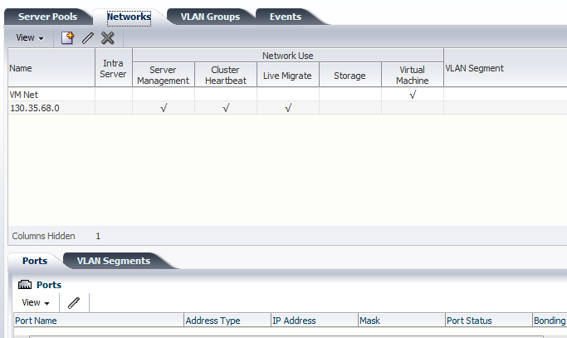
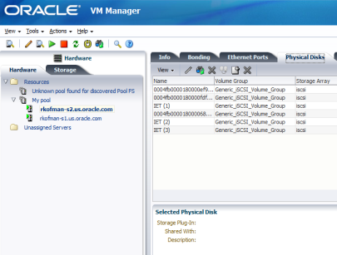
Oracle VM Manager 3.0
Scalability to Support Your Entire Datacenter
Manage hundreds or thousands of VMs centrally
Centralized management server
  Web browser-based: No client required
  Enterprise-grade scalability included
    WebLogic Server application server
    Oracle Database
Comprehensive
  Advanced virtualization management included
Notes:
Speaker Notes:
“Oracle VM” includes both the Server and management components in one solution that is freely available, with no license cost.
Oracle VM Manager is the virtualization element manager included with Oracle VM
Oracle Enterprise Manager Grid Control is the system management product from Oracle for providing an integrated management environment for the full software stack together, whether on physical or virtual machines.

Slide 9
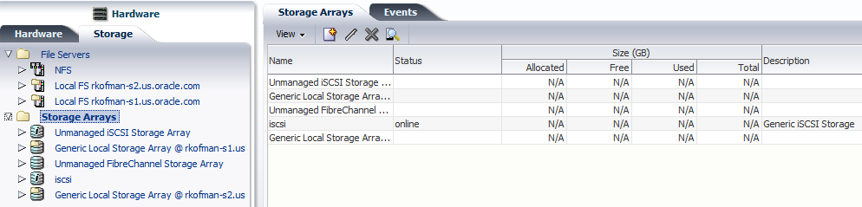

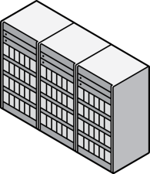


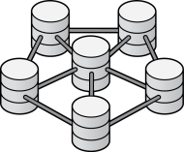
Oracle VM Storage Connect
Advanced Storage Operations
Storage Connect Plug-In Framework & API
Create LUN
Oracle Plug-In
Partner Plug-In
vendor_specific_command_CREATE_LUN
Sun Storage
Partner Storage
3.0
Storage Repositories
CLONE VM
OCFS2 Plug-In
_INSTANT_CLONE
More than just provisioning…
Create LUNs or Volumes
Expand LUNs or Volumes
Associate, share with VMs
OCFS2 Filesystem
Storage Connect Plug-Ins for Management…
Oracle and 3rd party storage…from the Manager UI
JBOD

Slide 10
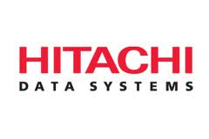

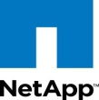
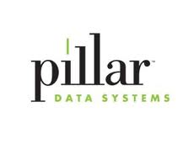


Oracle VM Storage Connect
Notes:
New Updates in RED…
We are working with the top vendors to deliver a number of plug-ins
Fujitsu will have their plug-in available at Oracle OpenWorld.
Pillar will release in Oct so they should be fine to mention
ZFS…YES! Available 2HOct
NetApp: ships Dec
EMC: NO…specifically requested NOT to mention/include
Hitachi: maybe

Slide 11

Oracle VM: Available Via Amazon EC2
AWS offers Amazon EC2 using Oracle VM for Oracle Software AMIs
  AMIs automatically and transparently run on OVM
  Derivative AMIs will also run on OVM
  AMIs ranging from OS to fully installed Oracle Enterprise Applications
  Alternative to AWS Xen
  Official support for production licensing of Oracle software
No additional charge
Hybrid Cloud: Manage the Oracle “stack” running in your private data center and the public cloud from a single Oracle Enterprise Manager instance

Slide 12
Agenda
Server Virtualization
Engineered for Oracle
Succeed with Oracle Virtualization

Slide 13
Oracle VM 3.0
Engineered for Oracle
At the core of Oracle’s middleware
and cloud strategy
Virtual platform for Oracle applications
Integrated management of the virtual stack with Oracle Enterprise Manager 12c
Rapid application deployment and management

Slide 14

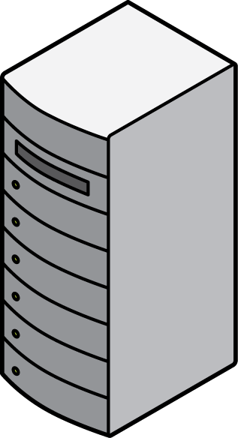
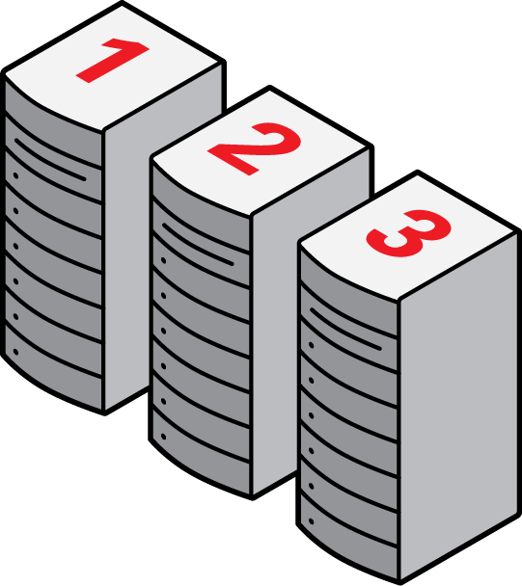
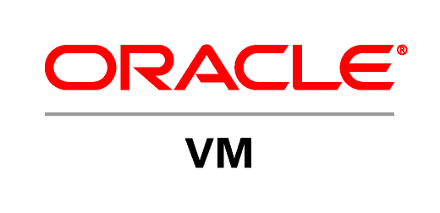
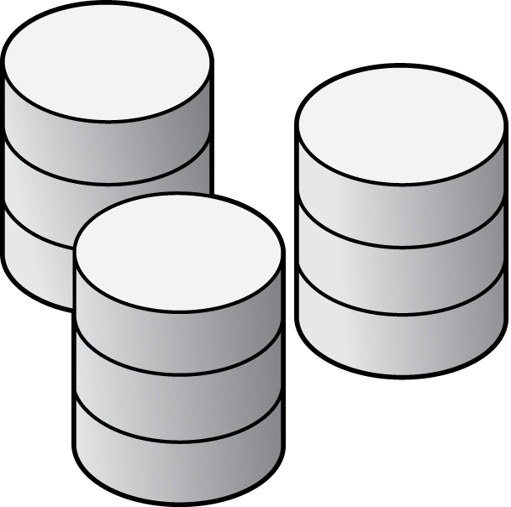
Oracle VM Templates
Rapid Deployment; 90+ Templates Available
Download from Oracle
Pre-built, pre-configured, production-ready VM
Apps, Databases, Middleware, OS
Siebel CRM, Database 11g, Enterprise Manager, More…
Oracle VM
Servers
Siebel
CRM
Siebel
CRM
File
File
Siebel
CRM
VM 1
Software Delivery Cloud
Import to
Oracle VM
Manager
Server
Pool 2
Download
Start-up in
Oracle VM Pool
Customize & Save
as Golden Image
Notes:
Speaker Notes:
Faster Application Deployment with VM Templates – Download and import pre-configured virtual machines containing pre-installed Oracle enterprise applications or other software to get up and running in hours not weeks
Full-production licensed software

Slide 15
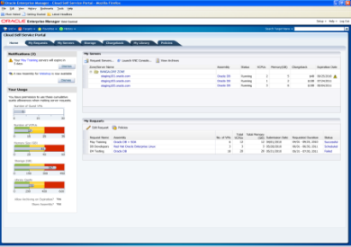
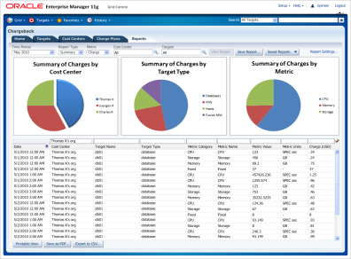
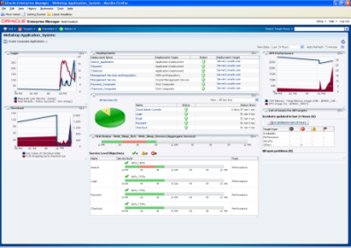
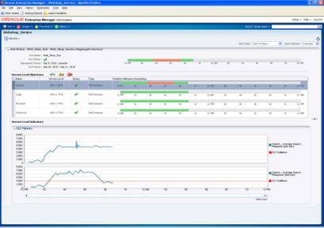
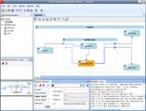
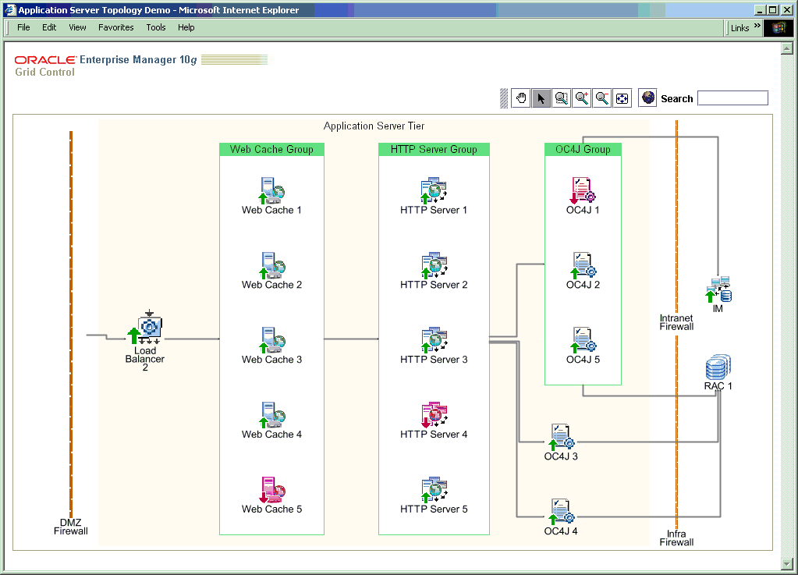
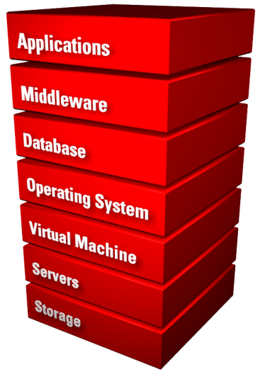
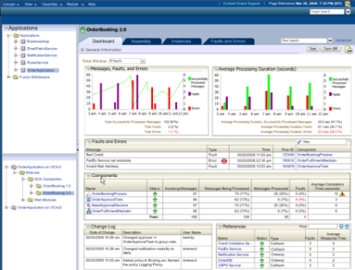
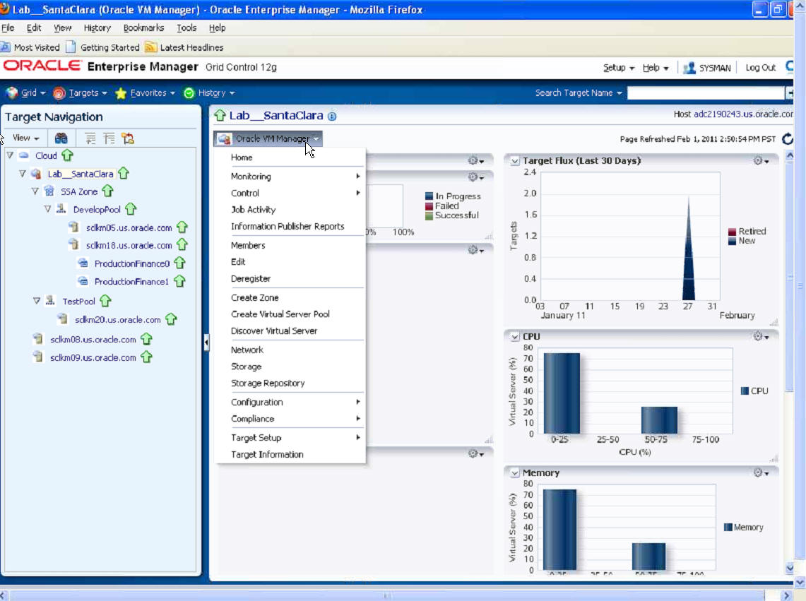
Oracle Enterprise Manager 12c
Cloud Lifecycle Management built on Oracle VM 3
Self-Service
Provisioning
Metering and
Chargeback
Policy-Driven Resource Mgmt
Capacity
Planning
Assembly
Packaging
Foundation Capabilities for Managing Datacenters
Configuration
and
Compliance
Lifecycle
Management
Application
Performance
& Quality
Management
Oracle VM Enables Cloud Management Capabilities
Oracle VM 3.0 Virtualization Management
Full Apps to Disk Management

Slide 16

Oracle Enterprise Manager 12c
Cloud Lifecycle Management built on Oracle VM 3
Optimize
Plan
Plan & Setup the Cloud Environment
Identify all IT assets (cloud building blocks)
Decide apps, cost models, policies, roles…
Consolidation planning
  (P2V, P2E, DBs, Apps..)
Create shared resource pools
Setup shared components
Setup cloud services
  (IaaS, DBaaS, PaaS, Apps)
Setup self service portal
Setup
Meter &
Charge
Applications and
Business Services
Build
Manage
Platform as a Service
Database-as-a-Service
Infrastructure-as-a-Service
Test
Monitor
Deploy
Notes:
- j

Slide 17
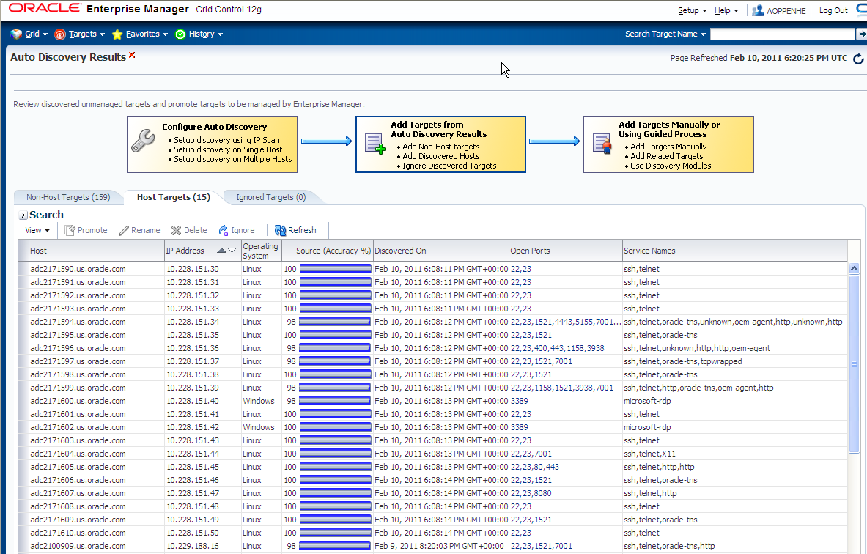
Automated Discovery and Resource Baselining
Automatic asset discovery using network scanning techniques
Integrated workflow for agent deployment for active management
Promote the targets from “Unmanaged” to “Managed”
Integrate with Consolidation Planner to identify underutilized assets

Slide 18
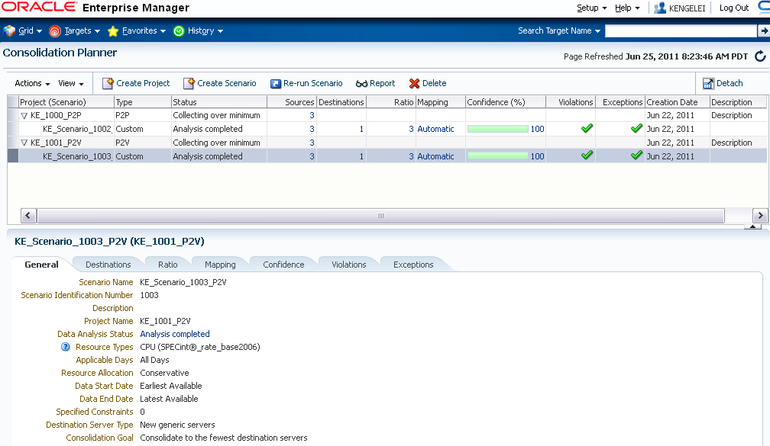
Consolidation Planning
Guided migration path to Cloud
Consolidation advice based on technical as well as business constraints
  Processor architecture
  LOB ownership, location, lifecycle
Wide variety of consolidation choices
  Physical-to-Physical (P2P)
  Physical-to-Virtual (P2V)
  Database Consolidation on Exadata
  Application Consolidation on Exalogic

Slide 19
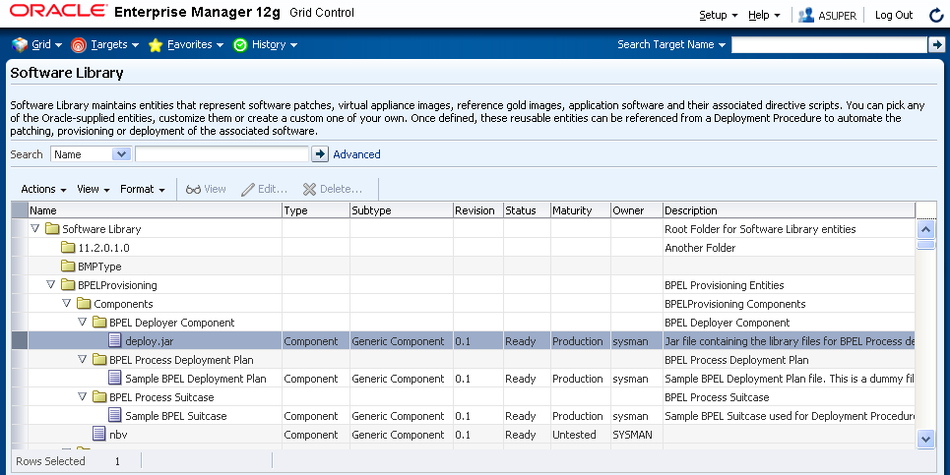
Centralized Software Library
Single repository for storing and retrieving images, scripts and assemblies
Can be co-located with Self-Service Application or with cloud targets
Choice of Storage types and Protocols (NFS, HTTP(S)), ideally suited for remote data centers
Integrated with Packaging tools like Assembly Builder
Supports Access rights for each image/assembly
Notes:
Topic Name

Slide 20
Oracle Enterprise Manager 12c
Cloud Lifecycle Management built on Oracle VM 3
Optimize
Plan
Setup
Build, Test & Deploy Cloud Services
Package complex multi-tier applications
Test all tiers of services – easily, securely, comprehensively
Identify performance and availability bottlenecks and fix them
Self-service deploy the service – database, middleware, application or any underlying infrastructure
Meter &
Charge
Applications and
Business Services
Build
Manage
Platform as a Service
Database-as-a-Service
Infrastructure-as-a-Service
Test
Monitor
Deploy
Notes:
- j

Slide 21
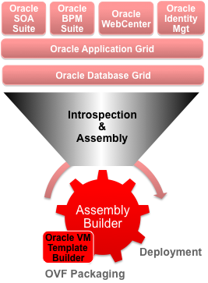

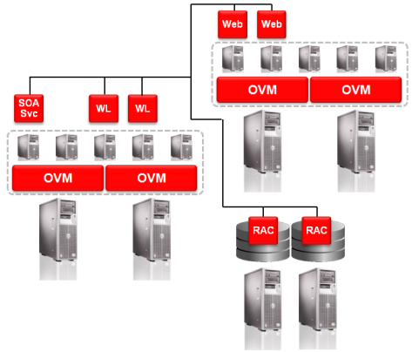
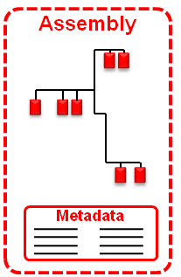
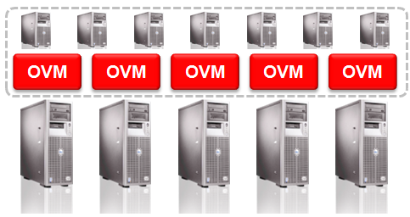
Oracle Virtual Assembly Builder
Package Complex, Multi-Tier Applications
config1
Oracle Enterprise Manager
(Software Library)
config2
Assembly = Appliances (VM Templates + configuration Metadata) + relationships & start order Metadata
Dev/Test Environment
Production Environments
Define late binding configuration using OVF Metadata
Easily replicate topology in production with minor variations
Each production instance has well-contained configuration parameters for flexibility

Slide 22
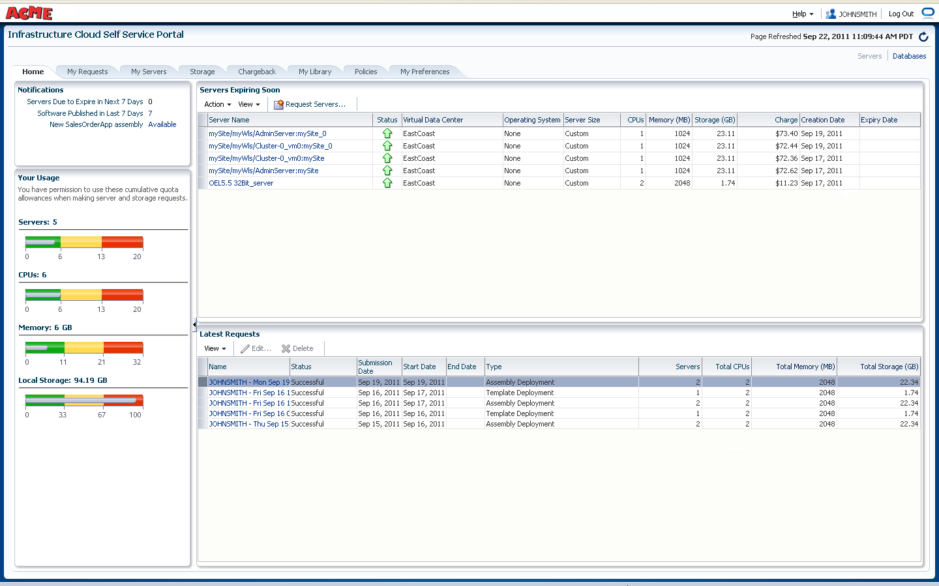
Self-service Provisioning
Out-of-Box, Self-Service Portal
  Part of the base product, no additional setup required
Rich service catalog:
    VM Templates, Assemblies
    Database service
    Java applications
Full Operational Control
  Start/Stop Services, Request additional resources, Backup/Restore
  Basic resource monitoring
  Chargeback information
  Quota monitoring
Programmatic Access using APIs
  RESTFul APIs and CLI (Submitted to DMTF)
Notes:
22

Slide 23
Oracle Enterprise Manager 12c
Cloud Lifecycle Management built on Oracle VM 3
Optimize
Plan
Monitor & Manage Cloud Operations
End-user and business-level monitoring (user experience, business transactions, business services, business KPIs…)
Application monitoring (app uptime, health, performance, app service level monitoring..)
Infrastructure monitoring (A2D, compliance..)
Start/stop services
Policy driven scale up/down
Backup/recovery
Manage downtime: patch, upgrade…
Setup
Meter &
Charge
Applications and
Business Services
Build
Manage
Platform as a Service
Database-as-a-Service
Infrastructure-as-a-Service
Test
Monitor
Deploy
Notes:
- j

Slide 24
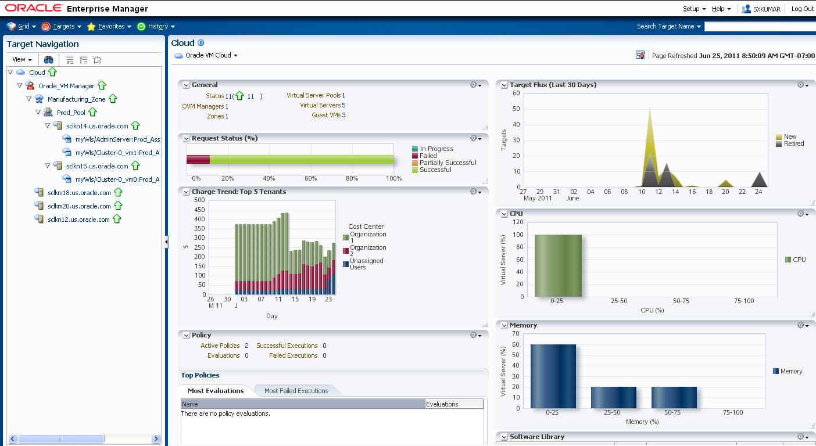
Cloud Resource and Request Monitoring
Manage Cloud Zones and underlying resources
  Server Pools, VMs, databases, Middleware)
Track resource flux, tenants, policy violations, etc
Drill down into individual resources for deeper monitoring
Monitor requests and failure rates and identify potential bottlenecks to remediate

Slide 25
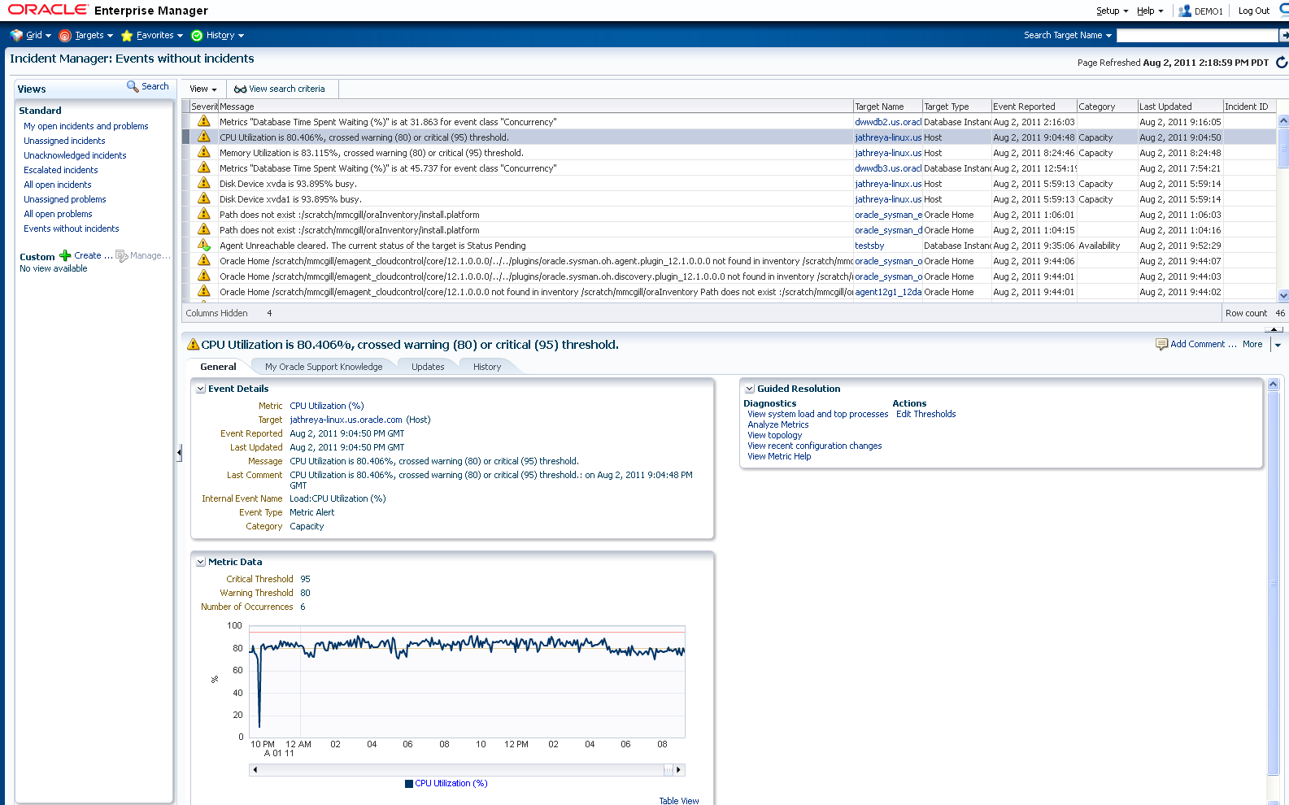
Centralized Incident and Problem Management
Centralized incident management for the Cloud
  View, manage, diagnose and resolve incidents from one console
Support for incident lifecycle operations
  Assign, acknowledge, prioritize, track status, escalate, suppress
Accelerated resolution with “My Oracle Support” integration
Integrated with Helpdesk Systems
  Out of box connectors for Remedy, HP Service Center

Slide 26
Oracle Enterprise Manager 12c
Cloud Lifecycle Management built on Oracle VM 3
Optimize
Plan
Setup
Meter, Charge & Optimize Services
Meter resource utilization and cloud usage
Optionally chargeback to application owners, end-users, and/or business departments
Optimize cloud performance, capacity, QOS, agility, geography, people, costs…
Meter &
Charge
Applications and
Business Services
Build
Manage
Platform as a Service
Database-as-a-Service
Infrastructure-as-a-Service
Test
Monitor
Deploy
Notes:
- j

Slide 27
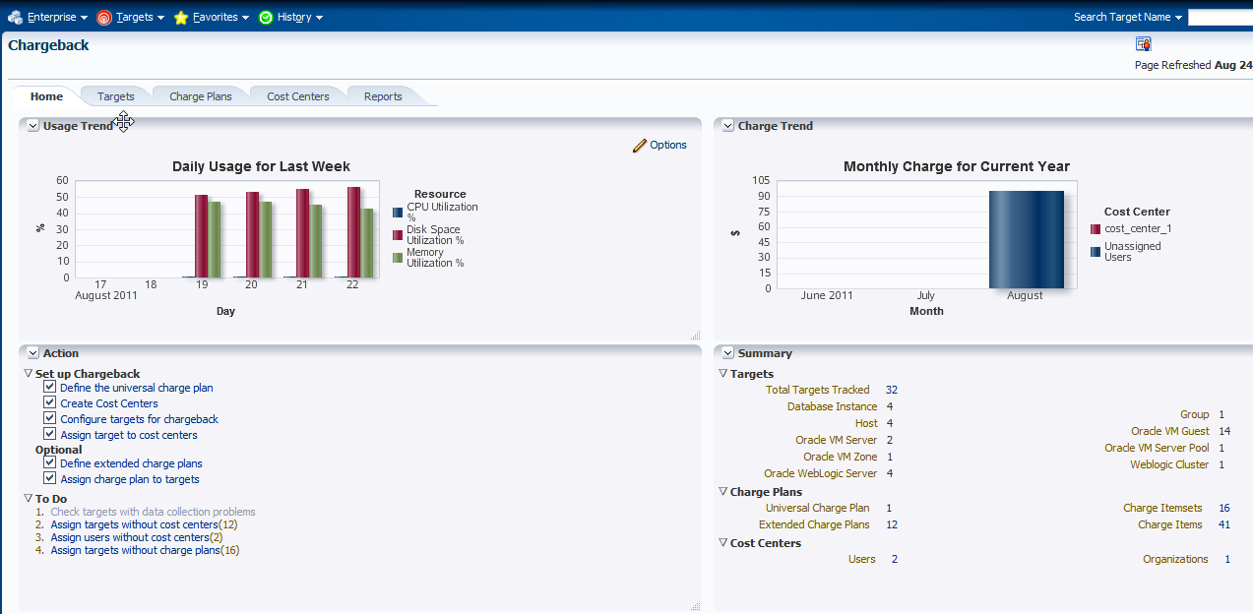
Metering and Chargeback
App-to-Disk Resource Metering
  VM Guests, Database, Web Logic Server, Host
  Composite Target: aggregation over supported target types
  CPU, Memory, Storage, Network Bandwidth
  Database transactions, SQL Executions, etc.
  Mid Tier resource usage
  Application/Activity metering (planned)
User Defined Chargeback Plan
  Usage-based items (Resource and Activity)
  Configuration-based items
  Fixed-cost items

Slide 28
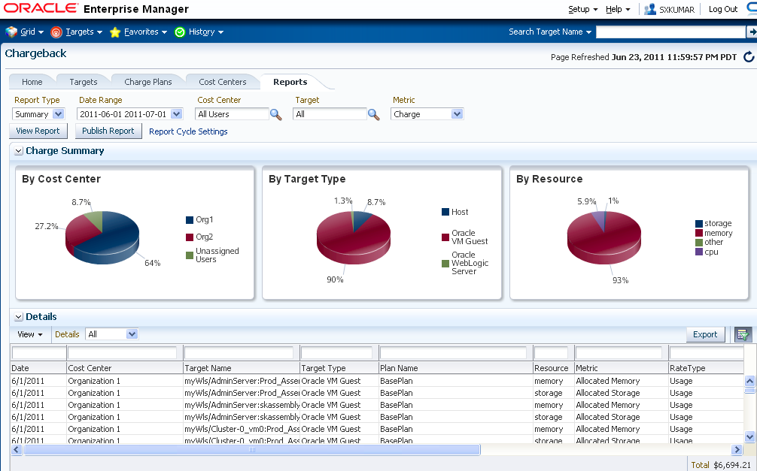
Chargeback Reporting
Rollup based on LDAP hierarchy
Generate Reports in variety of formats (Excel, Work, PowerPoint, HTML, PDF)
Accessible from Self-Service Portal
Integrated with BI Publisher
  Generate and Email reports to recipients on defined schedule (e.g.Monthly)
Notes:
Finally, chargeback has integration with BI Publisher.
This enables the chargeback administrator to generate charge and usage reports in a variety of formats such as excel, pdf, and html.
The reports can run on a scheduled basis and be distributed to users who don’t have access to the Enterprise Manager environment.

Slide 29
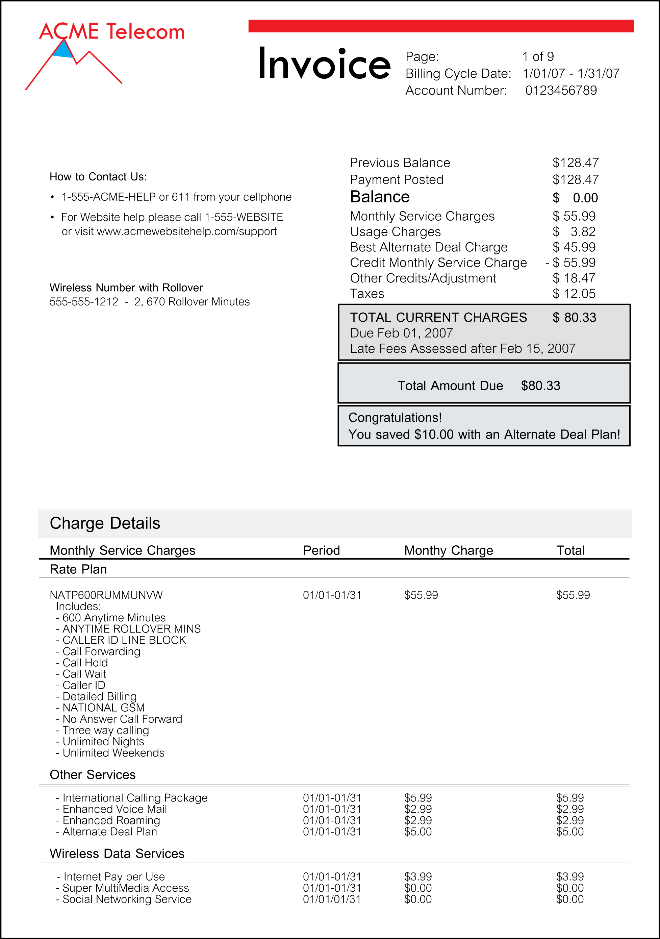


Chargeback and Billing
Oracle Enterprise Manager + Oracle Billing and Revenue Management
Cloud
Services
Cloud Management
Cloud Monetization
Oracle Enterprise Manager
Oracle Billing and Revenue Management
Applications
Configuration Mgmt
Provisioning
Metered Usage
Pricing/Charging Flexibility
Middleware
Lifecycle Management
Database
Customer Management
Bill/Invoice generation and delivery
Application Performance
Management
OS
Complete Billing Operations
Virtualization
Application Quality
Management
Balance Control
Usage data collection
Value Chain Management
Ops Center
Physical & Virtual
Systems Management
Business Intelligence
Notes:
29
29
29

Slide 30
Agenda
Server Virtualization
Engineered for Oracle
Succeed with Oracle Virtualization

Slide 31
Oracle VM 3.0 vs. VMware vSphere5
100 2-Socket Servers, each with 6 VMs and 48 GB vRAM per Server
 | Oracle | VMware vSphere5
Virtualization: | Oracle VM (2-socket system, Premier Support, unlimited VMs, unlimited vRAM) License - $0 Support - $599 / server / yr | VMware vSphere5 Enterprise Plus Edition (per socket, 96GB vRAM) License - $3495 x 2 sockets = $6990 Support (Production) - $874 x 2 = $1748/yr
Management | Oracle VM Manager License - $0 Support - $0 | VMware vCenter Server Standard License - $4995 Support - $1249 (1yr Production SnS/ instance)
Total Cost (Annual) | License: $0 Oracle VM (annual): $599 | VMware Lic (perpetual): $703,995 VMware Support (annual): $176,049
Total Cost (3 Years) | $179,700 | $1,232,142 (6.9X Oracle)
Source: http://www.vmware.com/files/pdf/vsphere_pricing.pdf

Slide 32
Oracle VM 3.0 with Oracle x86 Hardware
100 2 Socket Servers, each with 6 VMs and 48 GB vRAM per Server
Oracle VM Support is included in Oracle Hardware Support
 | Oracle VM included in Oracle Hardware | VMware vSphere5 *
Virtualization: | Oracle VM (Unlimited VMs, Premier Support, Unlimited vRAM) License - $0 Support - $0 | VMware vSphere5 Enterprise Plus Edition (per socket, 96GB vRAM) License - $3495 x 2 sockets = $6990 Support (Production) - $874 x 2 = $1748/yr
Management | License & Support: Oracle VM Manager - $0 Oracle Ops Center - $0 Oracle Enterprise Manager - $0 | VMware vCenter Server Standard License - $4995 Support - $1249 (1yr Production SnS/ instance)
Total Cost (Annual) | Oracle VM License: $0 Oracle VM Support: $0 | VMware Lic (perpetual): $703,995 VMware Support (annual): $176,049
Total Virtualization Cost (3 Years) Excluding Hardware | $0 | $1,232,142
Source: http://www.vmware.com/files/pdf/vsphere_pricing.pdf

Slide 33
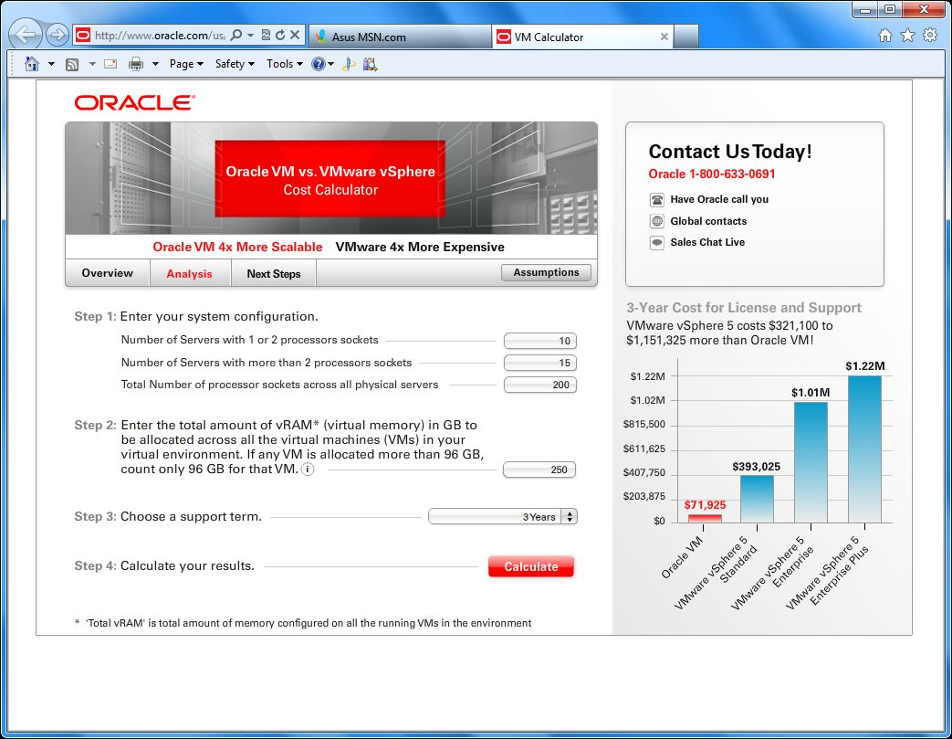
Oracle VM TCO calculator
http://www.oracle.com/us/media/calculator/vm/index.html
Source: http://www.vmware.com/files/pdf/vsphere_pricing.pdf

Slide 34
Oracle Delivers More Value Than VMware
Reason | Details
Application-Driven | Complete apps to disk stack with virtualization fully integrated into each layer of the stack. Oracle virtualization has full awareness of what’s running inside the VM and can provision and manage apps, middleware and database VMware offers hypervisor only, without integration with apps
Lower cost | Unlike VMware, Oracle VM is free to use, download and distribute Affordable support fees; simple licensing Oracle VM support included with Oracle’s Sun x86 systems support at no additional fees
Integrated Management | Single tool manages hypervisor, operating system, database and apps Single point of support from Apps to Disk VMware management can only manage the hypervisor
Faster App Deployment | Oracle VM Templates and Oracle Virtual Assembly Builder enable deployment of enterprise software in minutes as opposed to days, and help create multi-tier software assemblies quickly – eg. PSFT, Siebel, EBS, more VMware offers third party software appliances for testing and dev purposes
Scalability | With support for 128 vCPUs in each virtual machine, Oracle VM is 4 times more scalable than VMware which only supports 32 vCPUs per virtual machine. Useful for virtualizing heavy duty database and applications workloads

Slide 35
Oracle Delivers More Value Than VMware
Reason | Details
Architected for Efficiency | Oracle VM architected for low performance overhead when moving DB and Apps from physical to virtual servers Same engineering team for Xen and Linux; better integration Aggressive testing with real DB and Apps workloads VMware’s architecture is prone to high performance overhead
Better High Availability (HA) | Unlike VMware, Oracle offers HA for the entire stack, not just the hypervisor Oracle VM customers can use Oracle Clusterware for additional HA Clustering and virtualization complementary; RAC works with Oracle VM
Virtualization Built into the System | Included with Sun x86 systems Besides Oracle VM, Oracle also offers Solaris Containers, virtualization built into Oracle Solaris,. And Dynamic Domains built into the M-series hardware
Comprehensive Platform Support | While VMware only supports x86 architecture, Oracle VM supports both x86 and SPARC architectures.
Integrated Support | One call to Oracle for the complete stack; no finger pointing Faster time to resolution Better performance for virtual database and apps

Slide 36

UMASS Cuts IT Overhead by 60% with Oracle VM
“About 80 percent of our applications are from Oracle, so if Oracle can provide support from top to bottom, it makes sense for us to take advantage of that.”
Michael Poole
Chief Technology Officer, University of Massachusetts

Slide 37

“In the past, it used to take 6 to 10 weeks to provision a physical server. With Oracle VM, we can have a virtual machine up and running in 35 minutes.”
Christine Varga
Business Systems Analyst, Parks Victoria

Slide 38

“We can use existing Oracle VM Templates to build fully-blown, fully-installed, fully-configured environments to support specific new technologies or development requirements. We can simply grab a template and have a fully deployable system very quickly.”
Raymond Payne
Principal Systems Architect, Johns Hopkins Applied Physics Lab

Slide 39



Oracle Eco-Enterprise Innovation Awards
Prestigious award, recognizing customers using Oracle products to support sustainability initiatives and reduce environmental impact
Two desktop virtualization customers selected as 2011 award winners:
Denver Health Hospital
Gunsan City Hall

Slide 40
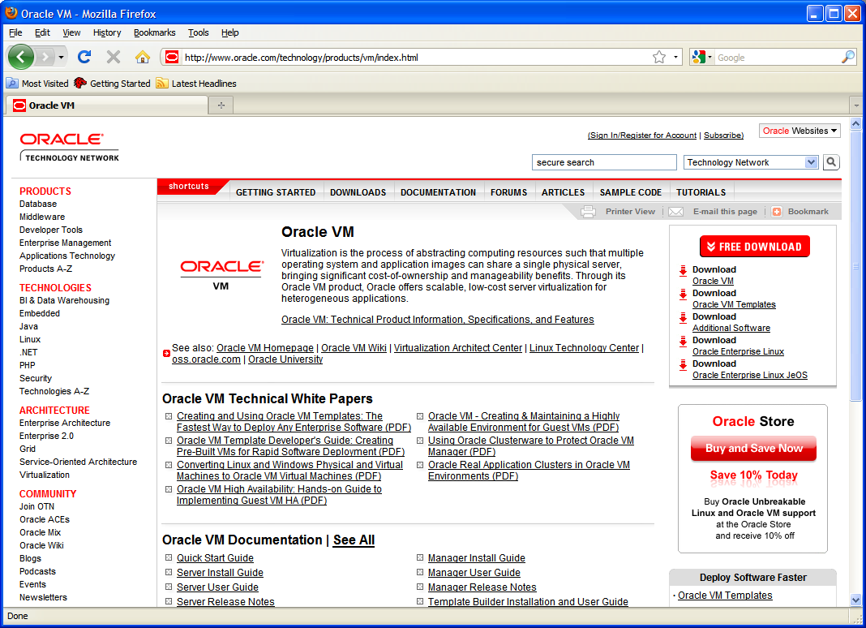
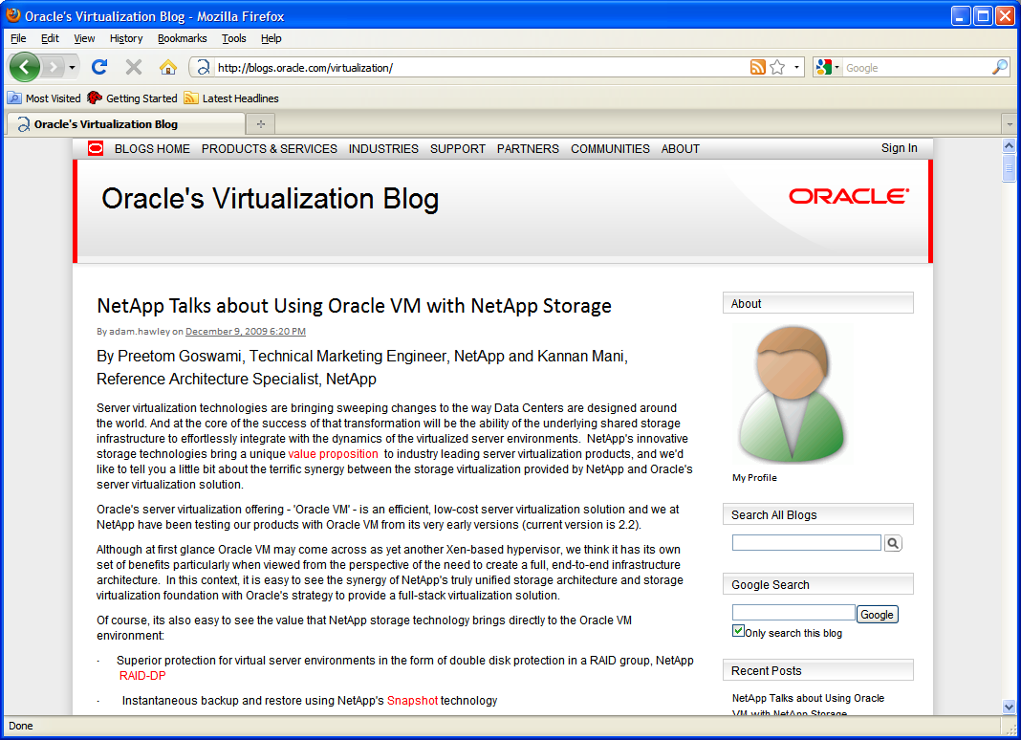
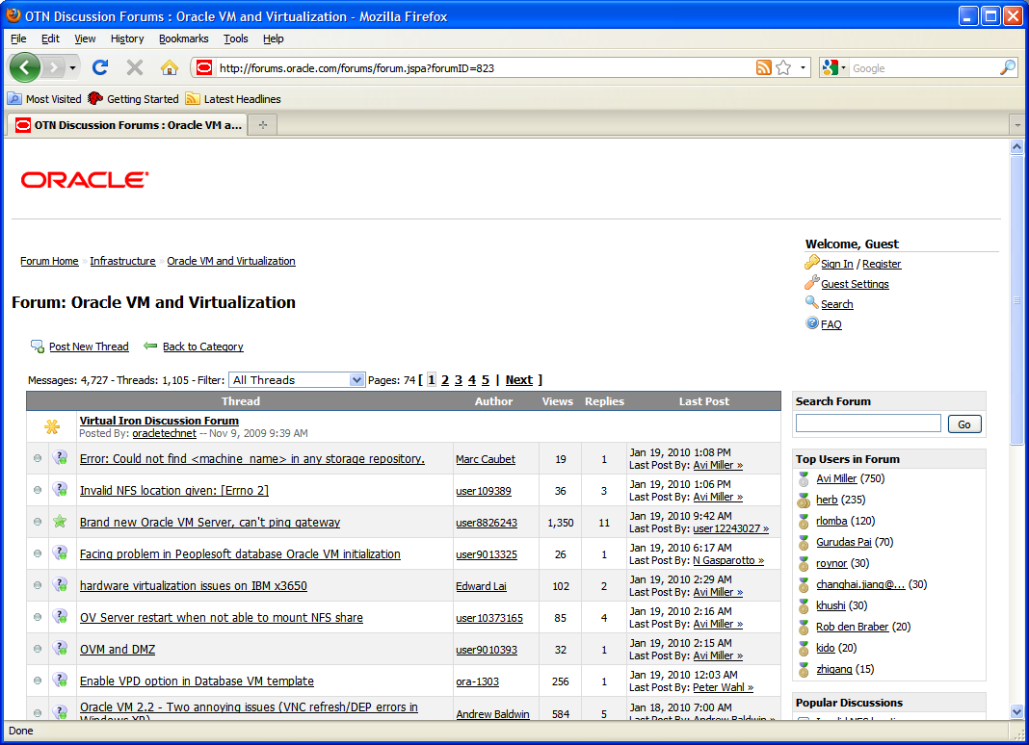
Oracle Virtualization
Home Page oracle.com/virtualization
Twitter twitter.com/orcl_virtualize
Facebook facebook.com/oraclevirtualization
Blog blogs.oracle.com/virtualization
Download edelivery.oracle.com/oraclevm

Slide 41

