Slide 1
Nimbus:
Introduction & Architecture
Pierre Riteau
Nimbus Project
University of Chicago

Slide 2
Introduction

Slide 3
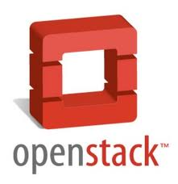


Introducing Nimbus
High-quality, extensible, customizable,
open source implementation
Nimbus Platform
Enable users to use IaaS clouds
Context Broker
Cloudinit.d
Elastic Scaling Tools
Today’s presentation
Enable providers to build IaaS clouds
Nimbus Infrastructure
Workspace Service
Cumulus
Enable developers to extend,
experiment and customize

Slide 4
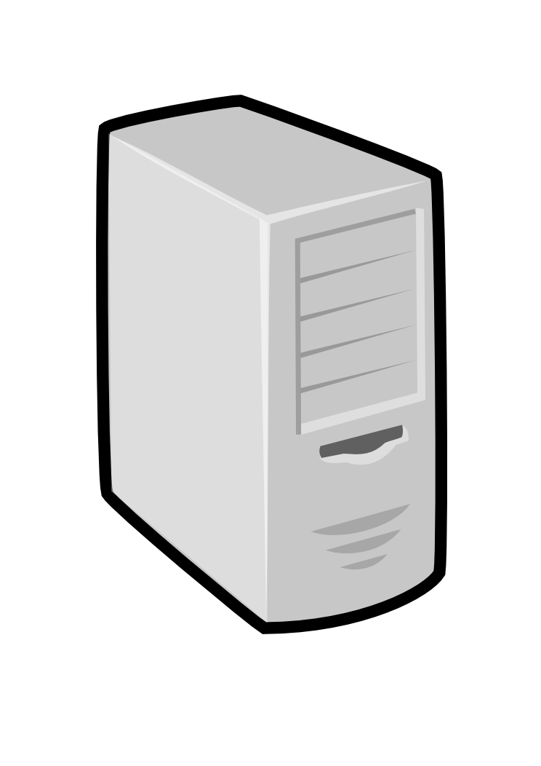
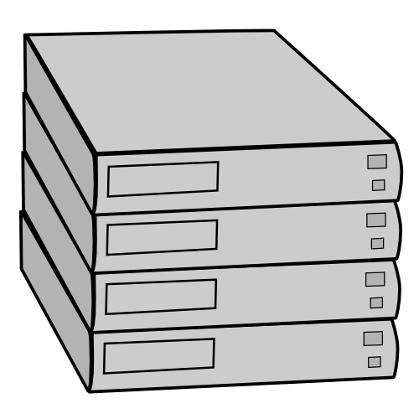
Nimbus IaaS: How it Works
Pool
node
Pool
node
Pool
node
Nimbus
Pool
node
Pool
node
Pool
node
Pool
node
Pool
node
Pool
node
Pool
node
Pool
node
Pool
node

Slide 5
Nimbus IaaS: How it Works
Nimbus publishes
information about each VM
Pool
node
Pool
node
Pool
node
Nimbus
Pool
node
Pool
node
Pool
node
Users can find out
information about their
VM (e.g. what IP
the VM was bound to)
Pool
node
Pool
node
Pool
node
Pool
node
Pool
node
Pool
node
Users can interact directly with their VM in the same way the would with a physical machine.

Slide 6
Using Nimbus Clouds
AWS Interfaces
  Protocol compliant with EC2 and S3
  Many libraries and clients can be used
Cloud-client
  Easy to user command line client for Nimbus
  Remote access to any nimbus cloud
  X509 security

Slide 7
Nimbus One-Click Clusters
Virtual Clusters In Nimbus Clouds
Turnkey, tightly-coupled cluster
  Shared trust/security context
  Shared configuration/context information
Sample images
  NFS file systems, torque queues, GridFTP servers, etc…
Easily repeatable and distributable
  An xml file and a VM image

Slide 8
Nimbus One-Click Clusters Context
Personalize a VM instance
  seed them with secrets, access policies, and just-in-time configurations
  Populate /etc/hosts with cluster member addresses
  Set up SSH host-based authentication across all accounts
Must run a light weight script (context agent) on boot.
  Context broker/agent discussed in detail later
AWS compute cluster does not have this

Slide 9

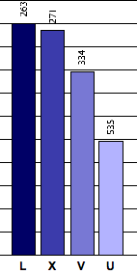
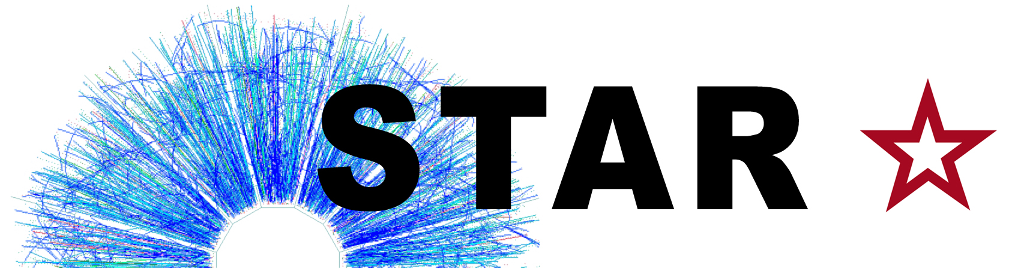



A Brief History of Nimbus
OOI
starts
First STAR
production
run on EC2
Experimental
Clouds for
Science
Xen released
Science Clouds
available
EC2 released
2004
2006
2008
2010
“A Case for Grid Computing on VMs”
In-Vigo, VIOLIN, DVEs,
Dynamic accounts
Policy-driven negotiation
First Nimbus
release
Nimbus
Context Broker
release

Slide 10
Recent Release History
Nimbus 2.9: January 2012
Nimbus 2.8: August 2011
Nimbus 2.7: February 2011
Nimbus 2.6: November 2010
Nimbus 2.5: July 2010
Nimbus 2.4: May 2010
Nimbus 2.3: February 2010

Slide 11
Nimbus Team

Slide 12
Nimbus Collaboration

Slide 13
The Nimbus Team
Project lead: Kate Keahey, ANL&UC
Committers:
  Tim Freeman - Weather Central
  Ian Gable - University of Victoria
  David LaBissoniere - University of Chicago
  John Bresnahan - Argonne National Laboratory
  Patrick Armstrong - University of Victoria
  Pierre Riteau - University of Chicago
GitHub Contributors:
  Tim Freeman, David LaBissoniere, John Bresnahan, Pierre Riteau, Alex Clemesha, Paulo Gomez, Patrick Armstrong, Matt Vliet, Ian Gable, Paul Marshall, Adam Bishop
And many others
  See http://www.nimbusproject.org/about/people/

Slide 14
Open Source Project
Open source license
Open code
Design for extensibility
Acceptance test framework
Social coding mechanisms
Inclusive team dynamic

Slide 15
Architecture

Slide 16
Running Your Own Private Cloud
Infrastructure
  Workspace service (VMs)
  Cumulus (Storage)
Platform
  Context Broker (Contextualization)

Slide 17
Infrastructure
The Workspace Service
and Cumulus

Slide 18
The IaaS Back Story
Cumulus and Workspace Service
allow clients to upload and
deploy VM images
Nimbus
Pool
node
Pool
node
Pool
node
Pool
node
Pool
node
Pool
node
Workspace back-end:
Resource manager for
a pool of physical nodes
Deploys and manages
workspaces on the nodes
Pool
node
Pool
node
Pool
node
Each node must have a
VMM (Xen or KVM) installed, as
well as the workspace control
program that manages
individual nodes
Pool
node
Pool
node
Pool
node

Slide 19
Nimbus: A Highly-Configurable IaaS Architecture
Workspace Interfaces
Cumulus interfaces
EC2: SOAP and Query
WSRF
S3
Workspace API
Cumulus API
Workspace Service Implementation
Cumulus Service Implementation
Workspace RM options
Default
Default+backfill/spot
Workspace pilot
Workspace Control Protocol
Cumulus Storage API
Workspace Control
Cumulus Implementation options
Virtualization
(libvirt)
Image Mngm
Network
Ctx
scp
…
POSIX
Xen
KVM
LANtorrent
BlobSeer

Slide 20
Workspace Service
Workspace Interfaces
Workspace Interfaces
Cumulus interfaces
EC2: SOAP and Query
EC2: SOAP and Query
WSRF
WSRF
S3
Workspace API
Workspace API
Cumulus API
Workspace Service Implementation
Cumulus Service Implementation
Workspace RM options
Default
Default+backfill/spot
Workspace pilot
Workspace Control Protocol
Cumulus Storage API
Workspace Control
Cumulus Implementation options
Virtualization
(libvirt)
Image Mngm
Network
Ctx
scp
…
POSIX
Xen
KVM
LANtorrent
BlobSeer

Slide 21
Workspace Service Interfaces
EC2 Interfaces
  Support for EC2 SOAP and EC2 Query
  All base features except security groups and elastic IPs
WSRF Interfaces
Clients
  Any standard EC2 client
    Any standard EC2 client (Java-based, boto, libcloud)
  WSRF clients
    Reference client
    Nimbus cloud client

Slide 22
Workspace Service Security
Workspace Service Authentication
  X509 certificates for EC2 SOAP and WSRF
  Token authentication for EC2 Query
Workspace Service Authorization
  Id-based authorization
  Privilege levels specified by administrator
    E.g., total allocation, number of VMs per request, etc.
    An Id can be assigned a privilege level

Slide 23
Workspace Service Security
Secure access to VMs
  SSH public key upload through the EC2 API
  Injection of SSH public keys in VMs
  Clients can access VMs using their SSH private keys

Slide 24
Workspace Service
Workspace Interfaces
Workspace Interfaces
Cumulus interfaces
EC2: SOAP and Query
EC2: SOAP and Query
WSRF
WSRF
S3
Workspace API
Workspace API
Cumulus API
Workspace Service Implementation
Workspace Service Implementation
Cumulus Service Implementation
Workspace RM options
Default
Default+backfill/spot
Workspace pilot
Workspace Control Protocol
Cumulus Storage API
Workspace Control
Cumulus Implementation options
Virtualization
(libvirt)
Image Mngm
Network
Ctx
scp
…
POSIX
Xen
KVM
LANtorrent
BlobSeer

Slide 25
Workspace Service Implementation
Workspace Service Implementation
Accounting
User Management
Configuration Management
Logging
Persistence
Network Leasing
State Machine
Task Management

Slide 26
Workspace Service
Workspace Interfaces
Workspace Interfaces
Cumulus interfaces
EC2: SOAP and Query
EC2: SOAP and Query
WSRF
WSRF
S3
Workspace API
Workspace API
Cumulus API
Workspace Service Implementation
Workspace Service Implementation
Cumulus Service Implementation
Workspace RM options
Workspace RM options
Default
Default
Default+backfill/spot
Default+backfill/spot
Workspace pilot
Workspace pilot
Workspace Control Protocol
Cumulus Storage API
Workspace Control
Cumulus Implementation options
Virtualization
(libvirt)
Image Mngm
Network
Ctx
scp
…
POSIX
Xen
KVM
LANtorrent
BlobSeer

Slide 27
Workspace Default RM
Implements on-demand leases
Datacenter technology equivalent
Basic slot fitting
  Algorithms: load-balanced (default), greedy
Deployed on most current Nimbus installations

Slide 28
Challenge of On-demand Leases
Batch Cluster
Underprovisioned Cloud
Utilization on the Fusion cluster @ ANL
courtesy of Ray Bair, LCRC
Utilization Cost

Slide 29
Backfill / Spot Leases
Nimbus 2.7: open source community contributions
  Spot instances: contributed by Paulo Ricardo Motta Gomes as part of Google Summer of Code 2010
Generic VMs deployed on idle cloud VMM nodes
VMs can be configured to perform any action
Preempted by on-demand requests
  Can be provided to users at a lower cost
  Variable number of backfill / spot VMs may be running at any given time

Slide 30
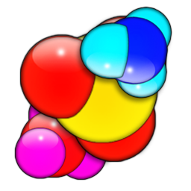


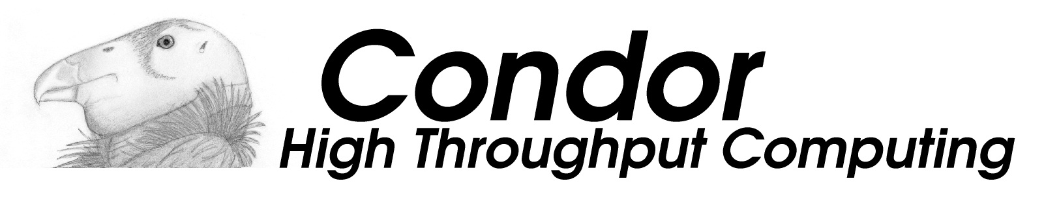
Workloads
Volunteer computing
Condor
Many others!

Slide 31
Example Backfill Deployment

Slide 32
What does this mean for you?
Cloud providers
  Increase resource utilization, decrease costs
Cloud users
  Another type of resource lease, cheaper than on-demand leases
Backfill / spot users (volunteer computing users)
  Inexpensive option for moving workloads to the cloud

Slide 33
Utilization with Backfill VMs
Average utilization: 83.82% Maximum utilization: 100%
Marshall, et al. “Improving Utilization of Infrastructure Clouds.” CCGrid, 2011.

Slide 34
Workspace Service
Workspace Interfaces
Workspace Interfaces
Cumulus interfaces
EC2: SOAP and Query
EC2: SOAP and Query
WSRF
WSRF
S3
Workspace API
Workspace API
Cumulus API
Workspace Service Implementation
Workspace Service Implementation
Cumulus Service Implementation
Workspace RM options
Workspace RM options
Default
Default
Default+backfill/spot
Default+backfill/spot
Workspace pilot
Workspace pilot
Workspace Control Protocol
Cumulus Storage API
Workspace Control
Cumulus Implementation options
Virtualization
(libvirt)
Image Mngm
Network
Ctx
scp
…
POSIX
Xen
KVM
LANtorrent
BlobSeer

Slide 35
The Workspace Pilot
Can I use my cluster as a cloud?

Slide 36

Workspace Pilot
Challenge: configure a cloud without significantly changing the current operation model of your cluster
Glidein approach: “pilot” program submitted to queue that claims a resource slot
Integrates with popular LRMs (e.g. Torque)
Implements “best effort” leases
Bottom Line: a minimally invasive cloud
Significant open source community contributions and testing
  Including administrator tools
Freeman et al., “Simple Leases with Workspace Pilot”, EuroPar08

Slide 37
The Workspace Pilot
Level 2:
provision VMs
Level 1:
provision raw
resources
Nimbus
User requests VMs
VM
VM
Xen dom0
VM
VM
LRM/PBS
Xen dom0
Xen dom0

Slide 38
Workspace Service
Workspace Interfaces
Workspace Interfaces
Cumulus interfaces
EC2: SOAP and Query
EC2: SOAP and Query
WSRF
WSRF
S3
Workspace API
Workspace API
Cumulus API
Workspace Service Implementation
Workspace Service Implementation
Cumulus Service Implementation
Workspace RM options
Workspace RM options
Default
Default
Default+backfill/spot
Default+backfill/spot
Workspace pilot
Workspace pilot
Workspace Control Protocol
Workspace Control Protocol
Cumulus Storage API
Workspace Control
Workspace Control
Cumulus Implementation options
Virtualization
(libvirt)
Virtualization
(libvirt)
Image Mngm
Image Mngm
Network
Network
Ctx
Ctx
…
scp
…
scp
POSIX
Xen
Xen
KVM
KVM
LANtorrent
LANtorrent
BlobSeer

Slide 39
Workspace Control
Runs on backend VMM nodes
Functions
  Virtualization and VM control
  Pluggable VM image propagation and management
  Networking Management
  Basic Contextualization
Interacts with Workspace Service and RM via a well-abstracted protocol

Slide 40
Workspace Service
Workspace Interfaces
Workspace Interfaces
Cumulus interfaces
EC2: SOAP and Query
EC2: SOAP and Query
WSRF
WSRF
S3
Workspace API
Workspace API
Cumulus API
Workspace Service Implementation
Workspace Service Implementation
Cumulus Service Implementation
Workspace RM options
Workspace RM options
Default
Default
Default+backfill/spot
Default+backfill/spot
Workspace pilot
Workspace pilot
Workspace Control Protocol
Workspace Control Protocol
Cumulus Storage API
Workspace Control
Workspace Control
Cumulus Implementation options
Virtualization
(libvirt)
Virtualization
(libvirt)
Image Mngm
Image Mngm
Network
Network
Ctx
Ctx
…
scp
…
scp
POSIX
Xen
Xen
KVM
KVM
LANtorrent
LANtorrent
BlobSeer

Slide 41
Virtualization
Fundamental virtualization abstraction provided by libvirt
Implementations:
  Xen
  KVM
Most current deployments use Xen

Slide 42
Image Management
Image Propagation
  scp
  LANTorrent
  Also available HTTP, HDFS
Compression
Partition management
  Creating blank partitions

Slide 43
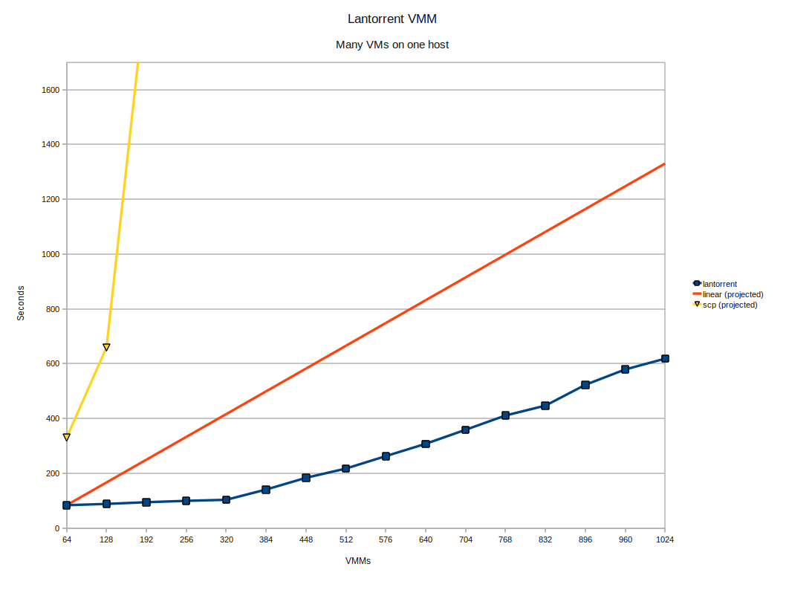
LANTorrent
Challenge: make image deployment faster
Moving images is the main component of VM deployment
LANTorrent: the BitTorrent principle on a LAN
  Streaming
  Minimizes congestion at the switch
Detecting and eliminating duplicate transfers
Bottom line: a thousand VMs in 10 minutes
Nimbus 2.6+
Preliminary data using the Magellan resource
At Argonne National Laboratory
Alternative approaches:
  Nicolae et al., BlobSeer
  Riteau et al., QCOW

Slide 44
Workspace Service
Workspace Interfaces
Workspace Interfaces
Cumulus interfaces
EC2: SOAP and Query
EC2: SOAP and Query
WSRF
WSRF
S3
Workspace API
Workspace API
Cumulus API
Workspace Service Implementation
Workspace Service Implementation
Cumulus Service Implementation
Workspace RM options
Workspace RM options
Default
Default
Default+backfill/spot
Default+backfill/spot
Workspace pilot
Workspace pilot
Workspace Control Protocol
Workspace Control Protocol
Cumulus Storage API
Workspace Control
Workspace Control
Cumulus Implementation options
Virtualization
(libvirt)
Virtualization
(libvirt)
Image Mngm
Image Mngm
Network
Network
Ctx
Ctx
…
scp
…
scp
POSIX
Xen
Xen
KVM
KVM
LANtorrent
LANtorrent
BlobSeer

Slide 45
Networking
Network Solutions
  External: public or private IPs (via VPN)
  Internal: private network via a local cluster
  Mixed: multiple NICs
Network mechanisms
  Configures trusted (non-spoofable) networking layer for the VMs
  Adapts to multiple site configurations
    E.g., centralized versus decentralized DHCP
  Creates private networks via a local cluster

Slide 46
Basic Contextualization
Image patching for basic contextualization
Meta-data server
  EC2 meta-data interfaces (internal)
  IP address authorization
  Patching the server address as part of basic contextualization

Slide 47
The Cumulus Storage Cloud

Slide 48
Cumulus Architecture
Workspace Interfaces
Cumulus interfaces
Cumulus interfaces
EC2: SOAP and Query
WSRF
S3
S3
Workspace API
Cumulus API
Cumulus API
Workspace Service Implementation
Cumulus Service Implementation
Workspace RM options
Default
Default+backfill/spot
Workspace pilot
Workspace Control Protocol
Cumulus Storage API
Workspace Control
Cumulus Implementation options
Virtualization
(libvirt)
Image Mngm
Network
Ctx
scp
…
POSIX
Xen
KVM
LANtorrent
BlobSeer

Slide 49
Cumulus Highlights
S3 compatible
Quota management
Easy to manage, easy to operate
  Install and run with a single command
  Easy-to-use set of user management tools
Customizable back-end systems
  Default installation with POSIX
Can be configured as a multi-node replicated server
With cumulus small providers can still be S3 protocol compliant
while making an independent choice on cost/reliability.

Slide 50
Cumulus Interfaces
Supports Amazon's S3 REST protocol
  All common commands implemented
  Can leverage S3’s redirect feature
Compatible with well known 3rd party S3 clients: boto, JetS3t, s3cmd, etc.
Cumulus
S3 REST

Slide 51
Cumulus Security
Authentication
  Access key (login id) / secret key (password)
    Example id: 5xecKocxGi2DoCppttrnU
    Example pw : XXm4jIim2rw16QiiqyvB8rHt409pFUBxHm3oMXGDz6
  The secret is used to sign requests
Authorization
  Users may set ACL access permissions on their objects
    Add, remove users
    Objects and Buckets
    Read, write, ACL
  Administrator sets a quota for specific user
    Before a file is uploaded Cumulus checks the user quota.
    If the quota will be exceeded the S3 error 'Account Problem' is sent

Slide 52
Cumulus Architecture
Workspace Interfaces
Cumulus interfaces
Cumulus interfaces
EC2: SOAP and Query
WSRF
S3
S3
Workspace API
Cumulus API
Cumulus API
Workspace Service Implementation
Cumulus Service Implementation
Cumulus Service Implementation
Workspace RM options
Default
Default+backfill/spot
Workspace pilot
Workspace Control Protocol
Cumulus Storage API
Workspace Control
Cumulus Implementation options
Virtualization
(libvirt)
Image Mngm
Network
Ctx
scp
…
POSIX
Xen
KVM
LANtorrent
BlobSeer

Slide 53
Cumulus Service Implementation
User management tools
  Easy to use tools that: create, remove, edit, and list users
  CLI options that make scripting easy
Logging and accounting
Configuration management
Service persistence
  State represented in a database stored on site
    Object meta data
    User authentication and access information

Slide 54
Cumulus Architecture
Workspace Interfaces
Cumulus interfaces
Cumulus interfaces
EC2: SOAP and Query
WSRF
S3
S3
Workspace API
Cumulus API
Cumulus API
Workspace Service Implementation
Cumulus Service Implementation
Cumulus Service Implementation
Workspace RM options
Default
Default+backfill/spot
Workspace pilot
Workspace Control Protocol
Cumulus Storage API
Cumulus Storage API
Workspace Control
Cumulus Implementation options
Cumulus Implementation options
Virtualization
(libvirt)
Image Mngm
Network
Ctx
scp
…
POSIX
POSIX
Xen
KVM
LANtorrent
BlobSeer
BlobSeer

Slide 55
Cumulus Backends
Cumulus Storage API is extensible to support many back-ends
POSIX API included with Cumulus
  This support for many filesystems (HDFS, GPFS, Sector, etc) via kernel VFS or FUSE
Can be configured as a set of replicated hosts
Support for BlobSeer being contributed
Cumulus
Cassandra
POSIX
Sector
HDFS
BlobSeer

Slide 56
Cumulus Transfer
Transfer Reliability
  md5sum checksums (part of the s3 protocol)
  Client side retry logic (supported by most s3 clients)
Performance
  On par with other popular, and fast data transfer protocols
  Approaches bottleneck speeds (disk) as file size increases
Bresnahan, et al. “Cumulus: An Open Source Storage Cloud for Science.” ScienceCloud, 2011.

Slide 57
Platform
The Context Broker

Slide 58
Context Broker Goals
Can work with every appliance
  Appliance schema, can be implemented in terms of many configuration systems
Can work with every cloud provider
  Simple and minimal conditions on generic context delivery
Can work across multiple cloud providers, in a widely distributed environment

Slide 59
Turnkey Virtual Clusters
IP1
HK1
IP2
HK2
IP3
HK3
IP1
HK1
IP1
HK1
IP1
HK1
MPI
IP2
HK2
IP2
HK2
IP2
HK2
IP3
HK3
IP3
HK3
IP3
HK3
Context Broker
Turnkey, tightly-coupled cluster
  Shared trust/security context
  Shared configuration/context information

Slide 60
Context Broker
Context Broker
provides
Appliance
Context Object
requires
create
context
address of Ctx Broker
context id
secret
address of Ctx Broker
context id
secret
Client
VMM/datacenter/IaaS
Resource Provider

Slide 61
Context Broker Status
Release history:
  In alpha since 08/07
  Initially released as a service in 2008
  Source code released in Nimbus 2.3 02/10
  Many updates since then
Both SOAP and REST interfaces
Integrates with Chef
Used for contextualizing hundreds of images for production runs
Contextualizable images on Science Clouds marketplace
Used and extended by OOI
Paper: Keahey&Freeman, “Contextualization: Providing One-Click Virtual Clusters”,
eScience 2008

Slide 62
Summary
Not just an IaaS implementation
  Infrastructure: Workspace service and Cumulus
  Platform: Making IaaS easy to use
Not just an open source project – an open source community
  Implementation, release policy and social practice designed to reach out
  Many examples of successful contributions
Come and join the team!

Slide 63
Demonstration

Slide 64
Nimbus Demonstration
Cloud client usage
Scripting using the EC2 interface
One-click clusters with contextualization

Slide 65
www.nimbusproject.com
Let’s make cloud computing for science happen.

