Slide 1
L.A.P.P Status Report (T. Le Flour, J.L Panazol)

Slide 2
Overview
From OPC (OLE for Process Control) to OPC-UA (OPen Connectivity-Unified Architecture)
WORK AT LAPP WITH OPC UA AND ACS
SHORT TERM DEVELOPMENTS

Slide 3
Slow Control/ Monitoring Schematic View
Remote
Control Command /Monitoring
Scheduling
Slow Control/ Monitoring
On site and remotely:
Checking specific devices
Knowing the current status of :
An array
A telescope
Access information in a standard way independently of the context
standalone mode
DAQ components
Local
Control Command
Monitoring
Control
Command
Standard Control System ( OPC UA )
CAN Bus
Specific
Hardware
PLC
Hardware
…
Annecy July 2010

Slide 4
Different possible configurations
Dev ice
PLC, Hardware
Monitoring
Control
Home made protocol
Difficult to develop
Difficult to maintain
Difficult to upgrade
Server
Client
1
HESS 2 Camera Security & Camera Loading/Unloading Systems
Siemens
PLC
Siemens
OPC
Server
LINUX Platform
Window platform is needed
All LINUX Platform should install the OPC communication software
The way of connecting OPC software is de-facto imposed
Difficult to connect other component implementing a different standard
DCOM
OPC Proxy
(OPC DataHub)
Cascade
Data
HUB
C/C++ Client
HESSDAQ Ctrl
C++ Camera Security
HESSDAQ Ctrl
JAVA
Client
JAVA
Client
Windows Platform
2
PLC
OPC
UA
Server
Binary
WebService (SOAP)
OPC
UA
Client
Communication standard (WEB Services on binary transfer)
Platform independence & Interoperability
All languages possible for Client and Server side
Scalability
Evolution
Hardware
Device
OPC
UA
Server
Binary
WebService (SOAP)
OPC
UA
Client
3

Slide 5
OPC UA
Fully specified by the OPC Foundation
To have a standard way of accessing the devices information (independently of the device type : PLCs, Hardware devices)
To be platform independent :
communication connections between OPC UA Clients and Server : Cross-Platforms interoperability
To implement OPC/UA servers on embedded systems
OPC Com could be also used with a UA architecture :
Via wrappers and proxies
RELIABILITY : clients and servers can be monitored.
Might help to implement Service Oriented Architecture (SOA) in CTA monitoring and slow control
reliability, performance, robustness, and security

Slide 6
OPC UA
COM/DCOM no longer maintained by Microsoft (WEB Services)
From a DCOM to SOA(Services Oriented Architecture)
More efficient
Migration is easier from different platforms
Migration from a representation data model to action model on objects
Based on 4 basic services :
Emitting a request, Reading a value, Writing a value, Subscribe to a variable(to follow its evolution)

Slide 7
OPC UA Services
Request/response Services
Publisher Services
Server to Server interactions
Discovery Service Set
SecureChannel Service Set
Session Service Set
NodeManagement Service Set
View Service Set
Query Service Set
Attribute Service Set
Method Service Set
MonitoredItem Service Set
Subscription Service Set

Slide 8
OPC/UA Messaging
XML Web Services
HTTP/HTTPS
With UA binary
Native binary
UA XML
UA BINARY
Encoding/
Decoding
WS SECURE CONVERSATION
UA SECURE CONVERSATION
Security
SOAP 1.2
UA TCP
HTTP / HTTPS
TCP/IP

Slide 9
OPC/UA : information model
All vendors of OPC UA servers should implement the “unified” information model
Object Model :
OPC-UA is designed for exchanging information in an object-oriented manner
OPC/UA Address Space provide a standard way for servers to represent objects to client.
Data change
notifications
Object
Variables
-
-
Read/Write
The elements of this model are represented
in the Address Space as Nodes.
Each Node is assigned to a NodeClass and
each NodeClass represents a different element
of the Object Model
References to
Other Objects
Invoke
Methods
()
()
Event
Notifications

Slide 10
OPC/UA : information model
Node
Attributes describe a node
Reference Model
Source Node
TargetNode
Attributes
Reference Name
References define relationsships
to other nodes.
References
Node
AddressSpace node model
Atrributes describes Nodes. Clients can access values using Read,Write,Query and Subscription/MonitoredItem Services
References are :
used to relate Nodes to each other
Instance of ReferenceType Nodes(visible in the Address Space)
TargetNode may be in the same address space or in the address space of another OPC UA Server

Slide 11
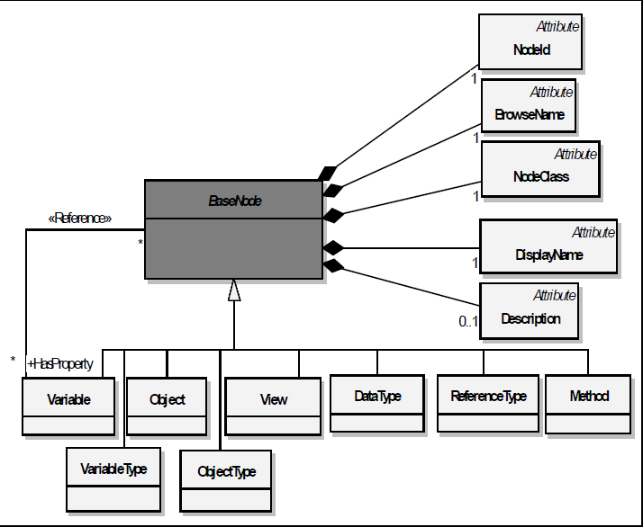
OPC UA Information MetaModel

Slide 12
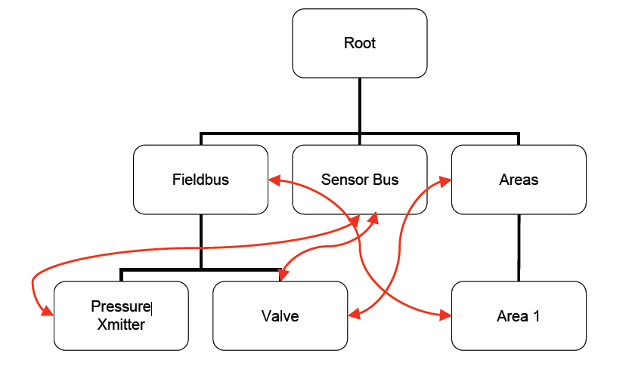
Information Model
Network Model
Unlimited Named/Typed Relationships
“Views” are used to present hierarchies
References between Nodes permits Servers to organize the AddressSpace into hierarchies, a full mesh network of Nodes, or any possible mix.
Real objects are physical or software objects
Accessible by the OPC UA Server application
A View is a subset of the AddressSpace.
Views are used to restrict the Nodes that the Server makes visible to the Client

Slide 13
UA Server Chaining
UA Client
UA Client
Enterprise Semantics
Enterprise Network
“Aggregating” UA Servers extract and process data from lower level “Device” UA Servers. Data is recast using different information models appropriate for the clients at the higher level.
UA Server
UA Client
UA Client
Operations Network
Process Semantics
UA Server
UA Server
UA Client
UA Client
Plant Floor Network
Device Semantics
UA Server
UA Server
Figure from OSISoft

Slide 14
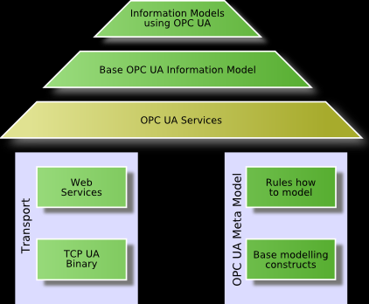
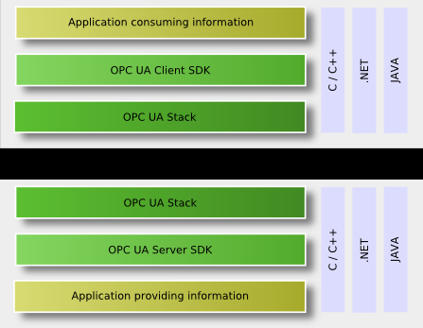
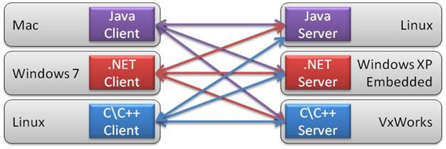
OPC/UA

Slide 15
HARDWARE
CPU
OPC/UA Computer
OPC
UA
Server
SDK
OPC
UA
Stack
OPC /UA Server
OPC /DA Server
Devices
Devices
OPC UA server SDK
OPC /UA Wrapper
OPC UA Stack
HARDWARE
CPU
OPC
UA
Server
SDK
OPC
UA
Stack
P
L
C
P
L
C
P
L
C
Server
OPC/UA Server part
OPC/UA Client part
ACS
Container
Container
DEVIO
OPC UA Stack
DEVIO
OPC UA Stack
OPC UA Client SDK
OPC UA Client SDK
Monitoring/Control Client
Monitoring/Control Client
OPC UA Stack
OPC /UA Proxy
OPC /DA Client
OPC UA Client SDK
OPC UA server embedded in the PLC CPUs
Accessing the hardware ➔
Providing API and Libraries for client and server parts

Slide 16
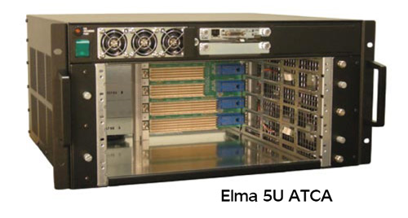
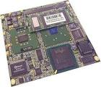
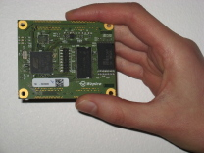
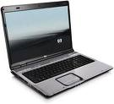
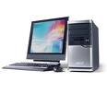
ALMA Common Software
OPCUA
Server
DevIO
OPCUA
Client
OPCUA
Server
OPCUA
Server
OPCUA
Server
OPCUA
Server

Slide 17
Summary
Most of devices can be drive with OPC/UA Standard
All software languages can be used :
.NET for Windows platform
C/C++ for embedded systems
JAVA for portable devices
OPC/DA and OPC/UA can co-exists (Wrappers and Proxies)
Homogeneous Environment
For portability :
CPU, Systems (Embedded or not)

Slide 18
Development@ LAPP
Unified Automation GmbH (German company)
Kit Evaluation Version : C++ and ANSI C Server Software Development
precompiled libraries
OPC UA SDK for UA Client Development
Environment
OPC-UA SDK Installed on Fedora 14.
openssl-0.9.8c - xml2.7.7 – gcc 4.5 required
ACS already installed on Red hat 5.3 distribution at LAPP and ported (easily) on Fedora 14
All software installed on a VMWare Fedora 14 image

Slide 19
Development@ LAPP
OPCUA (client-Server C++)
Use a simple example of client/server program.
Compilation and link with OPC-UA framework
ACS prototype :
CDB (simple configuration DB)
A OPCUA_devio for the connection with the OPCUA Server
A “container library” with some functions
Init() -> connect to OPCUA server
Read() -> describe all the structure of OPCUA server
Close() -> Disconnect to OPCUA server
All components have been successfully compiled and run via the “ACS” Command Center.

Slide 20
Next@ LAPP
Setting up a hardware platform including :
PLC, PLC Server, Security PLC
Some hardware (Motors,…)
Understanding deeper the OPC UA Data model and Address Space.
Monitoring (HESS2 Security Crate) via OPC/UA interfaces
UA Clients
UA Server (Siemens, …)

Slide 21
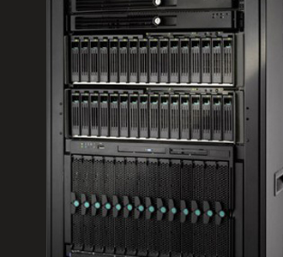
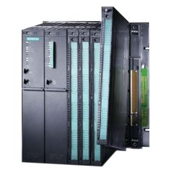
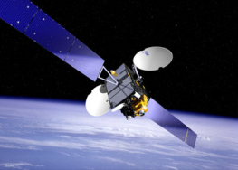
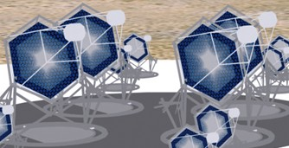
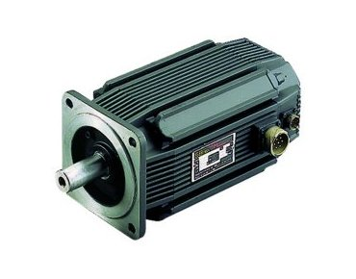
LAPP activities for LST Telescopes
Event
Alerts network
DAQ
X
PLC
Communications with PLC
ie: T. Le Flour Annecy 2010
Telescope Automation
Critical Cycle in 20 s
Displacement of the telescopes
Pointing of the target and data acquisition
Stabilization of the camera
ie: G. Deleglise Oxford 2010
Active dumping
System
Motors
21

Slide 22
LAPP STATUS REPORT OPC UA / ACS T. Le flour/ J.L Panazol

Slide 23
reminders
Objectives foreseen from 14/02/11 (last ACTL meeting)
OPC/UA study
Deeper understanding of this environment
Development and integration of an OPCUA environment in the HESS2 Camera Security Crate
Server parts
Development of OPCUA Clients (C++ and Java)

Slide 24
Current Status
Current Hardware Configuration
PC or CPU Crate
B
US cPCI
Driver
Electronic Boards
OPC UA Server
SERVER PART:
PCI Driver has been ported on the Fedora14 Platform
OPC UA Server implemented in C++ and currently runs on a Fedora14 platform
All the possible actions on the OPCUA Nodes have been implemented
Standard calls on objects(Node) methods
Events
Callbacks
CLIENT PART :
Server has been tested by using the generic client included in the Unified Automation distribution
Server has accessed via a specific client written in C++
An ACS DevIO encapsulating the OPC UA Server connection has been written, configured via Container description and tested successfully via the ACS Command Center
A basic JAVA client also tested

Slide 25
Some other test platforms @LAPP
PC or CPU Crate
RS
232
RS
232
OPC UA Server (C++)
weather station
XY Table
PC or CPU Crate
OPC UA Server (C++)
Ethernet
Ethernet
Crio
(Labview)
(serveur STM)
National Instrument CRIO Hardware used by the LST stabilization system driven by a LabView environment
client STM

Slide 26
Some news around OPC UA
SIEMENS currently provide today an OPCUA environment (independently of the platform)
BOSCH announces a OPCUA Environment before the end of this year
National Instrument will probably go toward this OPC UA Environment (Questions on that topics on user forum has been asked)

Slide 27
Some feedbacks on an OPC UA Server Implementation
For people in charge of implementing specific hardware access (without software development background) :
Coding could be complicated enough :
No description, many code lines to configure the server, the nodes, the node’s properties, …
This implies to put a layer on top of the existing software API.
Tool boxes and expertise will be absolutely needed to make the implementation easier
The client part is simpler to implement.

Slide 28
Some feedbacks on an OPC UA Server Implementation
Some new features recently appears on the development kit of Unified Automation company.
UAModeler : Graphical environment for the server description is proposed :
Full graphical node description :
Properties, specific node methods, …
Automatic code generation with code skeleton, xml server description , …

Slide 29
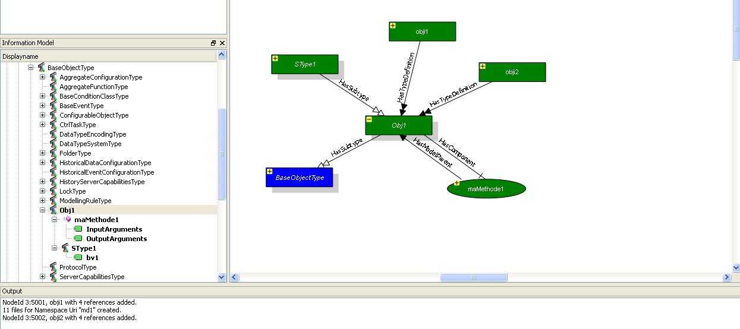
UA Modeler Graphical User Interface
UA Modeler Graphical user Interface
Nodes classes and instances views

Slide 30
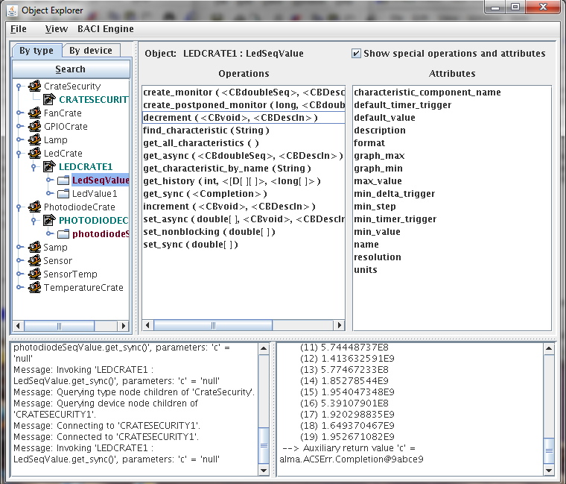
ACS Graphical User Interface

Slide 31
UaThread
BaCommunicationInterface
Init() : Create Objects
Run() : Call read/write procedure
BaControler
BaGpioControler
BaLEDControler
Open/Close
Read/Write
Read/Write
Driver

