Slide 1
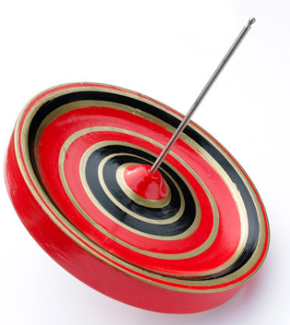
Development of Silicon-strip tracker for muon g-2 and EDM measurements at J-PARC
LPNHE, Paris
February 22, 2012
Tsutomu Mibe (KEK)
for the J-PARC muon g-2/EDM collaboration

Slide 2
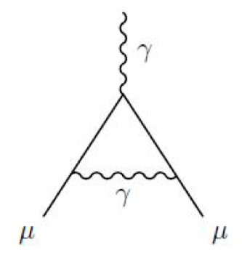
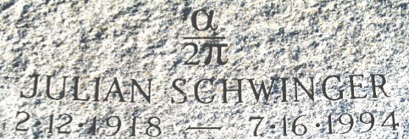
Quantum loop
The Schwinger term
From Lepton Moments (World Scientific, 2010)

Slide 3
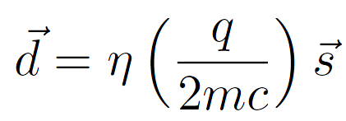
Particle dipole moments
Hamiltonian of spin 1/2 particle includes
Magnetic dipole moment
Electric dipole moment
Magnetic dipole moment
g = 2 from Dirac equation, in general g≠2 due to quantum-loop effects
＝
μ
＋
μ
＋
μ
＋ …
μ
μ
μ
a “anomalous magnetic moment”

Slide 4
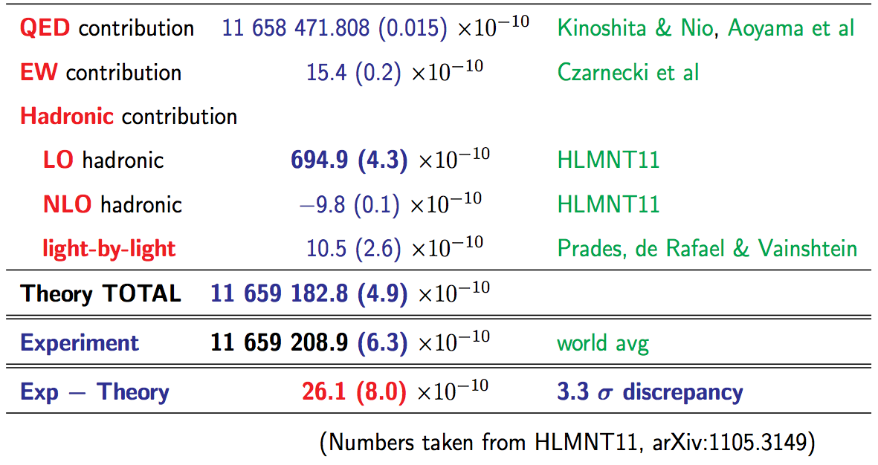
More loops
D. Nomura (PhiPsi11)

Slide 5
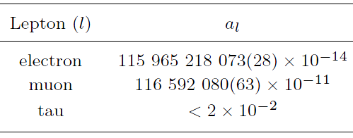
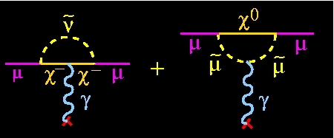
Anomalous magnetic moment : g-2
Standard model can predict g-2 with ultra high precision
Useful in searching for new particles and/or interactions
Experiment has reached the sensitivity to see such effects...
Δa_{l}(exp)/a_{l}
Δa_{l}(SM)/a_{l}
0.24ppb
0.54ppm
4.5 ppb
0.41ppm
a_{μ} ^{exp} – a_{μ} SM | = | (261 ± 80) × 10 ^{–11} (259 ± 81) × 10 ^{–11}
 3.3 ”standard deviations“
HLMNT11
DHMZ, Tau 2010 workshop

Slide 6
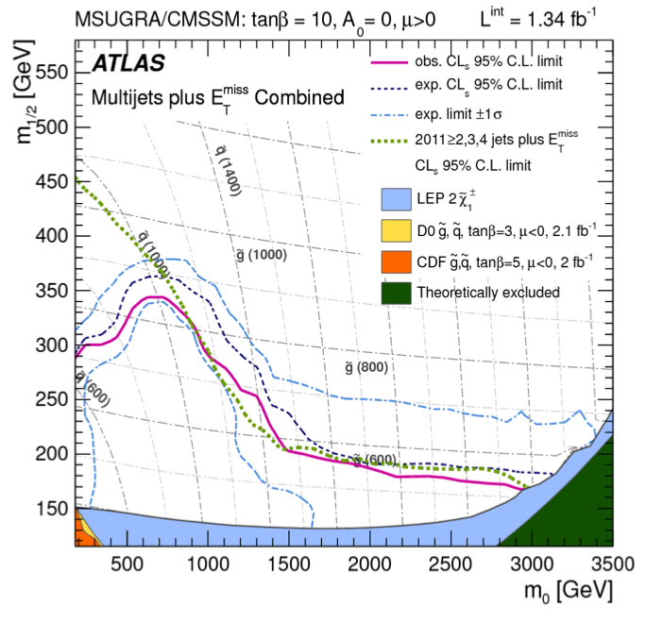
Hunting for SUSY (or other BSM) signature
FNAL g-2 proposal
~J-PARC
g-2 measurement is complementary to LHC and cLFV
More on physics discussions at Naohito’s seminar at LAL/Orsay tomorrow.

Slide 7
Muon anomalous spin precession in B and E-field
Muon spin rotates “ahead” of momentum due to g-2 >0.
Precession frequency
BNL E821
Focusing electric field to confine muons.
At the magic momentum
γ = 29.3, p = 3.094 GeV/c → (a_{μ} -1/(γ²-1) ) = 0
Safely be neglected with current upper limit on EDM
Continuation of the experiment at FNAL is planned.

Slide 8
BNL E821 Experimental Technique
25ns bunch of ≥ 1 X 10¹² protons
x_{c} ≈ 77 mm
β ≈ 10 mrad
B·dl ≈ 0.1 Tm
Pions
Inflector
p=3.1GeV/c
Target
(1.45T)
Muon polarization
Injection orbit
Central orbit
Muon storage ring
injection & kicking
Storage
ring
Kicker
Modules
focus with Electric Quadrupoles
24 electron calorimeters
R=711.2cm
d=9cm
R
R
β
Electric Quadrupoles
x_{c}
Slide from Lee Roberts
- p. 8/68
B. L. Roberts, Fermilab , 3 September 2008
Notes:
8

Slide 9
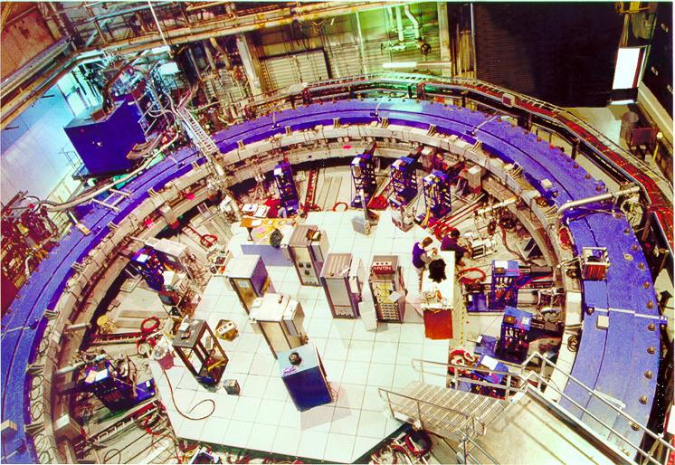
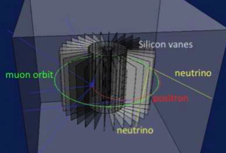
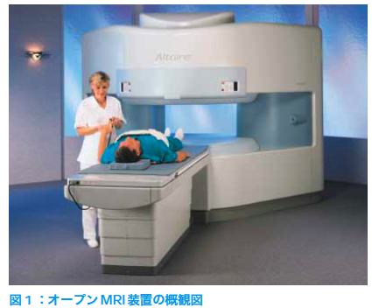
Our approach
Compact storage ring
Suited for precision control of B-field
Example : MRI magnet , 1ppm local uniformity
Completely different systematics than the BNL E821 or FNAL
BNL E821 / FNAL g-2
J-PARC g-2
70 cm
14m
P= 3.1 GeV/c , B=1.45 T
P= 0.3 GeV/c , B=3.0 T
Hitachi co.

Slide 10
Our approach (cont’)
Zero Focusing Electric field (E = 0 )
Equations of spin motion is as simple as at the magic momentum
Ultra-cold muon beam (p_{T}/p < 10⁻⁵) by utilizing the laser resonant ionization of muonium makes it possible to realize such experimental condition.

Slide 11
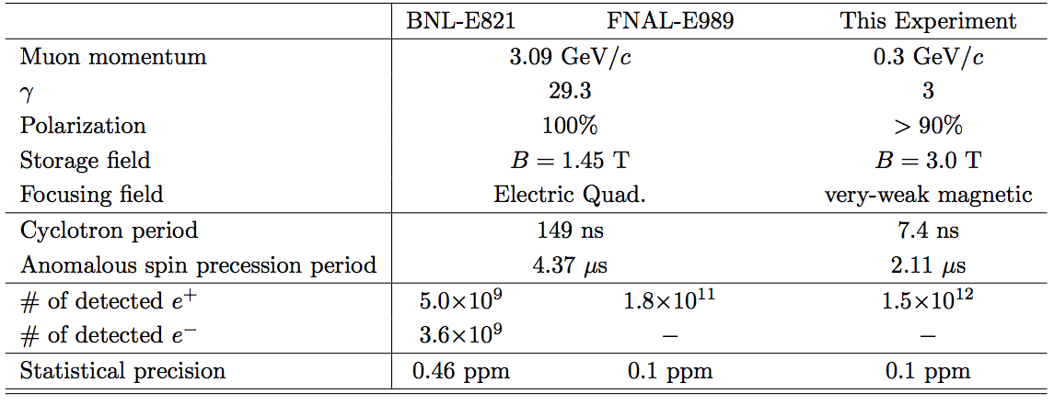
BNL, FNAL, and J-PARC

Slide 12
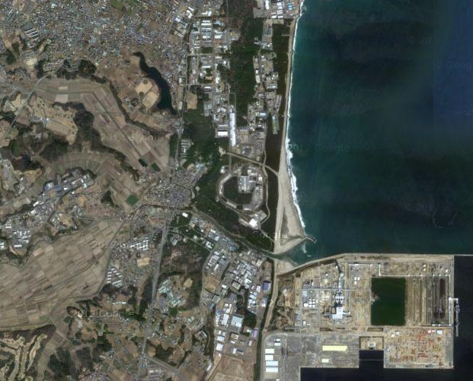
J-PARC (Japan Particle Accelerator Complex)
J-PARC
KEK
Tokyo
Mt. Fuji

Slide 13
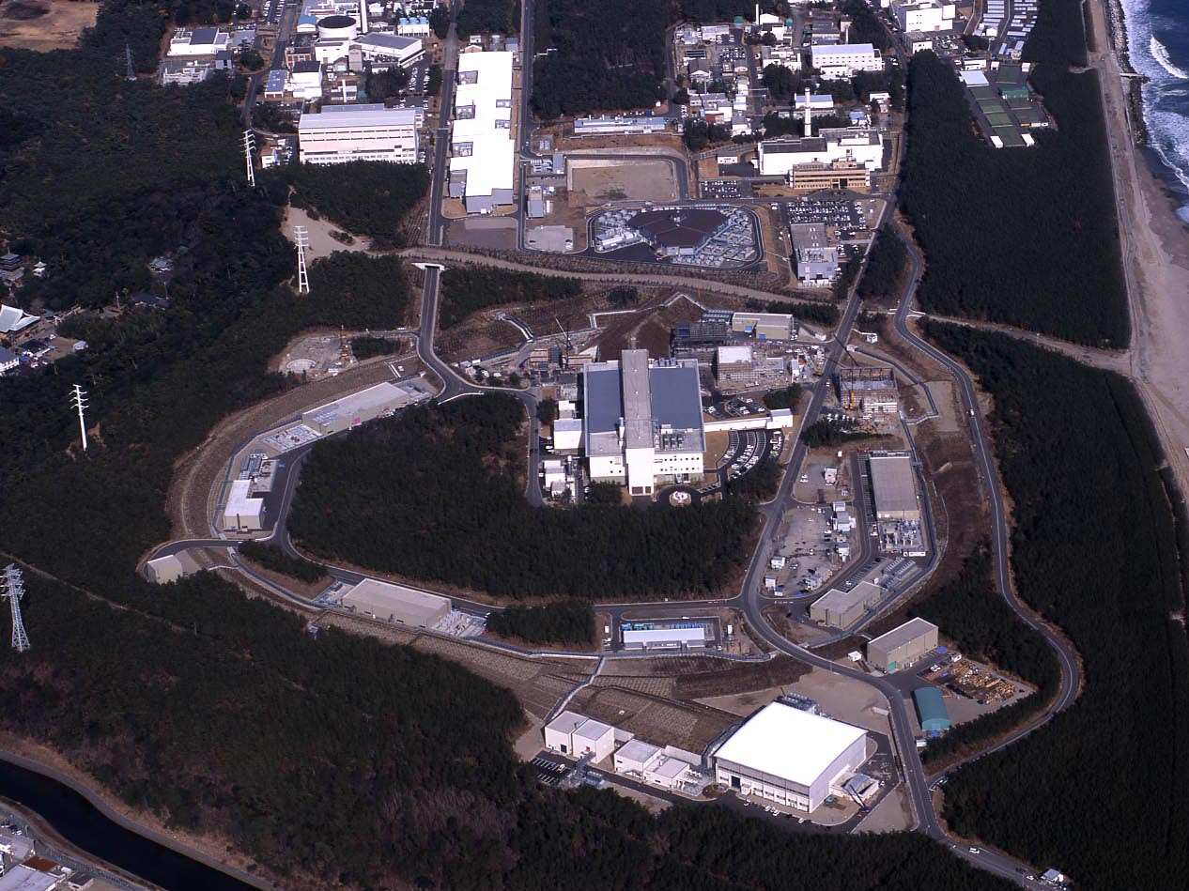
J-PARC Facility
(KEK/JAEA)
LINAC
3 GeV
Synchrotron
Neutrino Beam
To Kamioka
Material and Life Science
Facility
Main Ring
(30 GeV → 50 GeV)
Hadron Hall
Bird’s eye photo in Feb. 2008

Slide 14
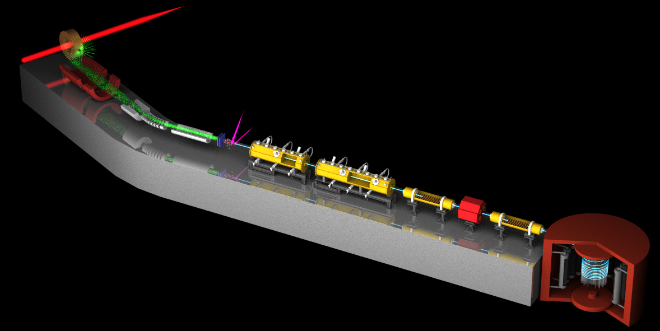
Surface muon
Ultra Cold μ+ Source
Muon
storage
Muon LINAC (300 MeV/c)
New Muon g-2/EDM Experiment at
J-PARC with Ultra-Cold Muon Beam

Slide 15
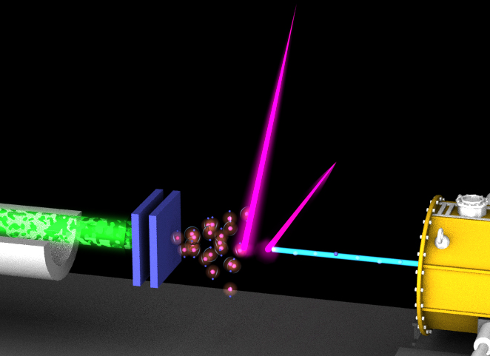
3 GeV proton beam
( 333 uA)
Graphite target
(20 mm)
Surface muon beam
(28 MeV/c, 4x10⁸/s)
Muonium Production
(300 K ~ 25 meV⇒2.3 keV/c)
Surface muon
Ultra Cold μ+ Source
Muon
storage
Resonant Laser Ionization of Muonium (~10⁶ μ⁺/s)
Muon LINAC (300 MeV/c)
New Muon g-2/EDM Experiment at
J-PARC with Ultra-Cold Muon Beam

Slide 16
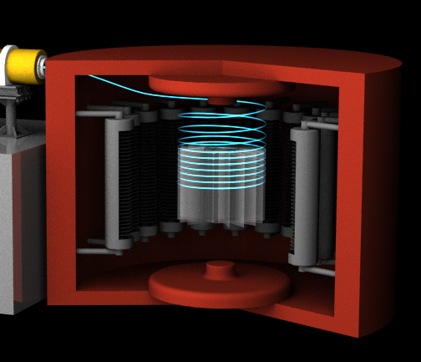
3 GeV proton beam
( 333 uA)
Graphite target
(20 mm)
Silicon Tracker
Surface muon beam
(28 MeV/c, 4x10⁸/s)
66 cm diameter
Muonium Production
(300 K ~ 25 meV⇒2.3 keV/c)
Surface muon
Super Precision Magnetic Field
(3T, ~1ppm local precision)
Ultra Cold μ+ Source
Muon
storage
Resonant Laser Ionization of Muonium (~10⁶ μ⁺/s)
Muon LINAC (300 MeV/c)
New Muon g-2/EDM Experiment at
J-PARC with Ultra-Cold Muon Beam

Slide 17
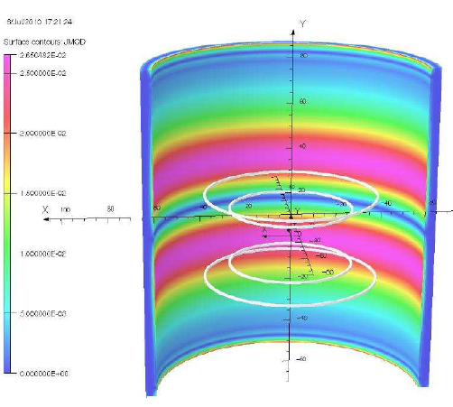
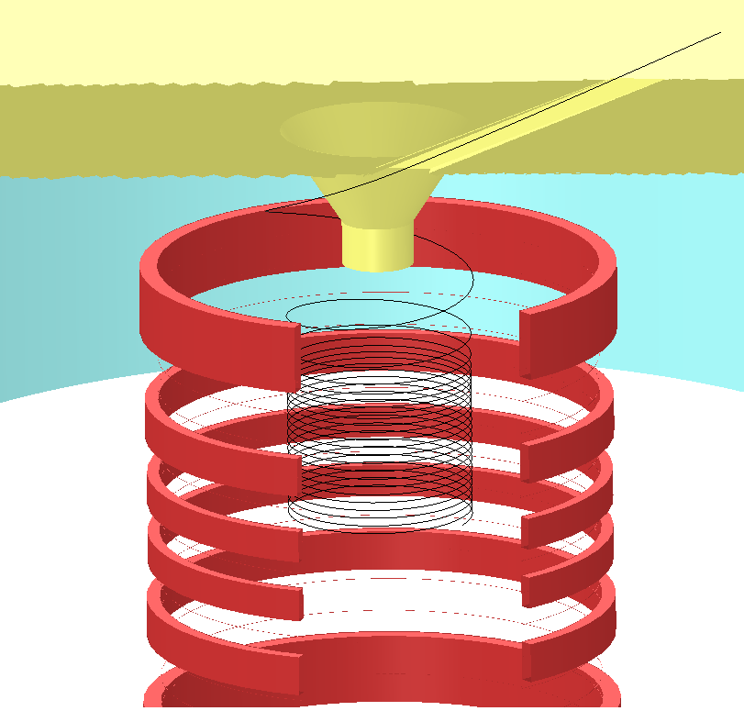
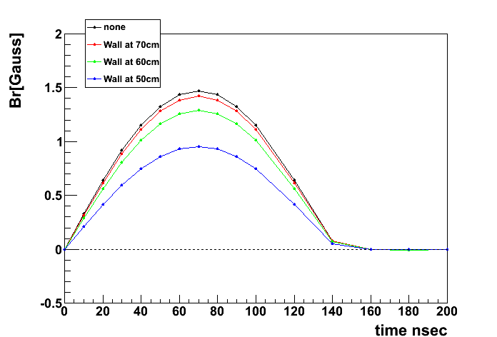
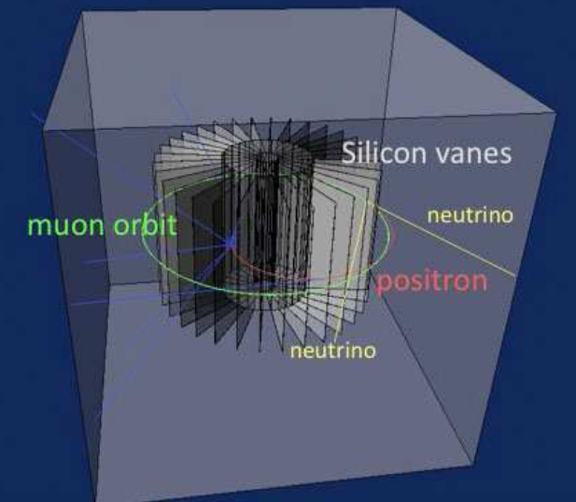
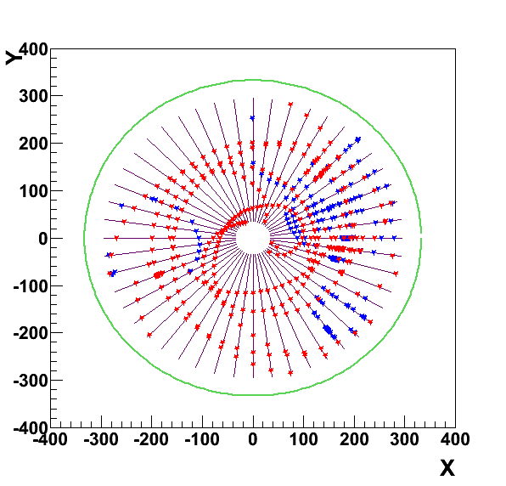
Injection, storage, and positron detection
Muon storage magnet
Muon beam is injected here
Anti-Helmholtz-type kicker
(Pulse kick to stop spiral)
Spiral injection
Magnet coil (3T)
ν
kicker
detector
e⁺
Positron tracker
ν
mm

Slide 18
The muon storage magnet
In collaboration with a Japanese private company
Magnet iron yoke
Cryogenics
Super-conducting coils
3600 mm
e+ tracker
• Storage region
– B_{z} =3T
– Local Uniformity < 1 ppm in storage
Region
• Injection field
– B_{r} × B_{z} > 0
• Very-weak magnetic focusing field
– B_{r} = −n B_{0z}/R_{z}

Slide 19
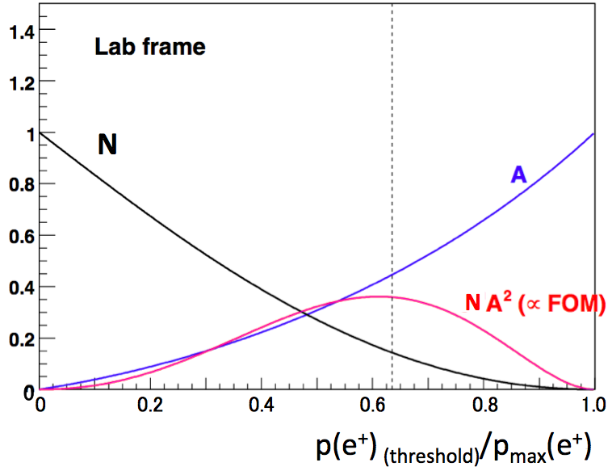
μ→e⁺νν decay kinematics
μ⁺
−
ν_{R}
e⁺_{R}
ν_{L}
Laboratory frame
W⁺_{L}
→ →
N(p>p_{(threshold)}) = N (1 + A s・p /(|s||p|)
Positron emission in muon rest frame
μ⁺
200 MeV/c
spin
−
e⁺
νν
V-A favored
V-A suppressed
p spin
e⁺
−
νν
The e+ angular distribution is subject to the V-A structure of weak interaction.
High energy positron tends to be emitted into the direction of muon spin.
The optimum e⁺ momentum threshold is around 200 MeV/c.

Slide 20
Expected time spectrum of μ→e⁺νν decay
Muon spin precesses with time.
→ number of high energy e⁺ changes with time by the frequency :
p>200 MeV/c
ω
e⁺ decay time (sec)

Slide 21
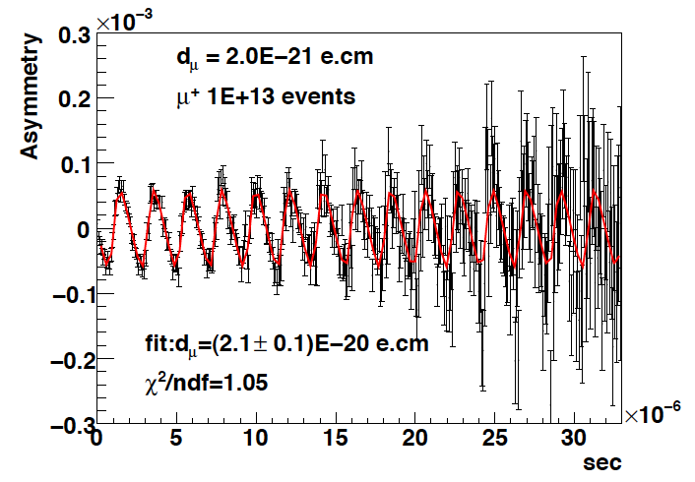
Expected time spectrum of μ→e⁺νν decay
EDM tilts the precession axis.
This yields an up-down decay asymmetry in number of e+
(oscillates with the same frequency ω)
p>200 MeV/c
d_{μ}=2E-20 e・cm
Up-down asymmetry
ω
∝EDM
e+ decay time (sec)

Slide 22
Requirements to the e+ tracker
Detector should be efficient for
Positron track with p = 200 - 300 MeV/c in 3T solenoidal B-field
with a radial vertex resolution of σ=1 mm.
Immune to early-to-late effect
The decay positron rate changes by two orders of magnitude.
1.6 MHz/strip → 10kHz/strip for 200 um pich Silicon strip.
The positron detector must be stable over the measurements.
Zero E-field (<<10⁻² V/cm) at muon storage area
Not spoil the precision B-field ( <10ppm) at muon storage area
Efficient readout in compatible with the J-PARC beam pulse structure

Slide 23
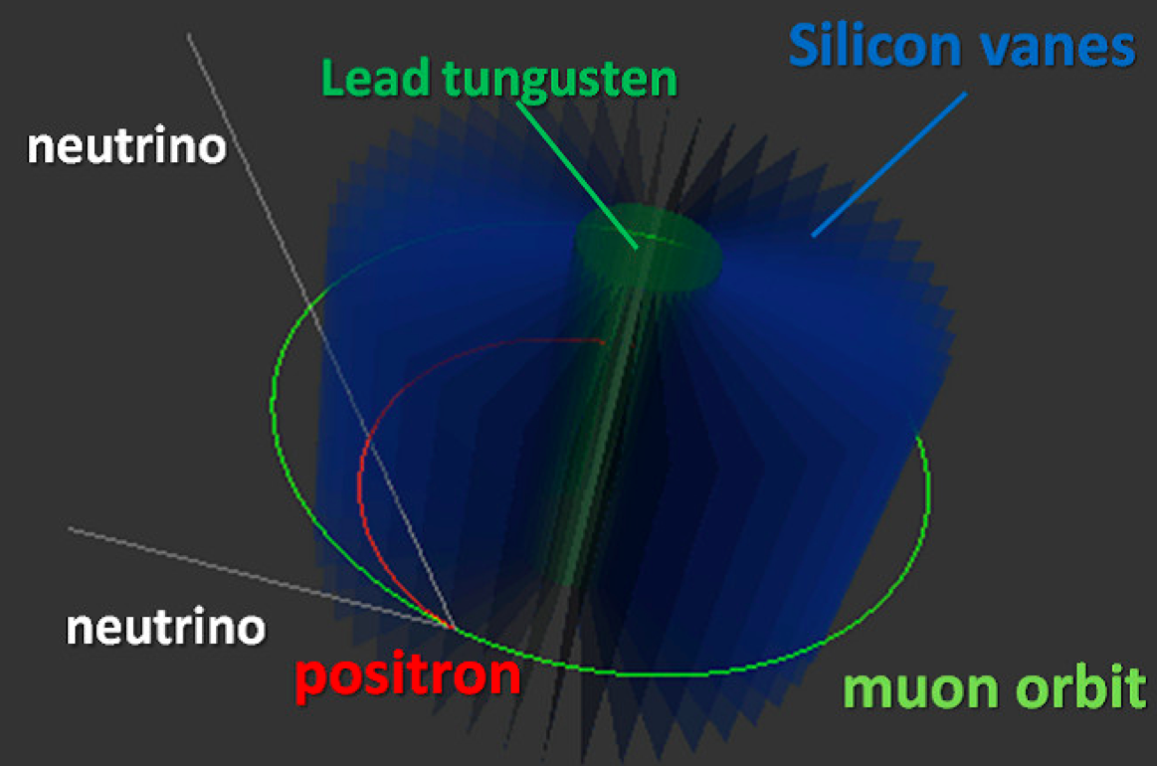
Detector design concept
Tracking planes consists of silicon-strip vanes.
Silicon sensors :
high granularity
reasonably fast signal
good stability expected

Slide 24
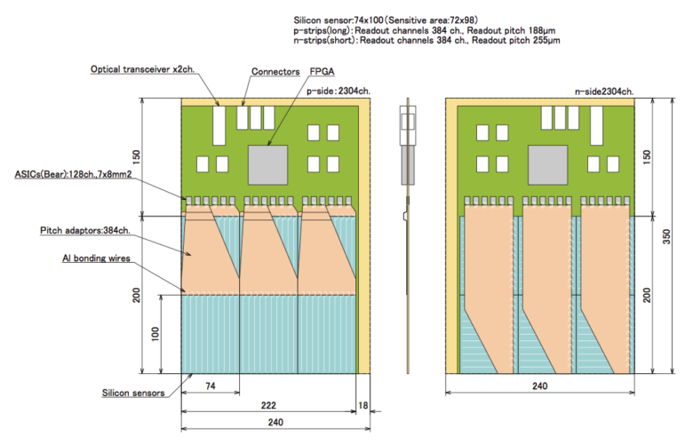
The Silicon vane
T. Kohriki
Detector modules will be placed in vacuum environment (P<0.1Pa)

Slide 25
Design parameters
Item | Specifications
Fiducial volume | 240mm (radial) x 400 mm (axial)
Number of vane | 48 (still subject for optimization)
Sensor technology | Double- or single-sided Silicon strip sensor
Strip | axial-strip : 188μm pitch, 72mm long , 384 ch radial-strip: 255μm pitch, 98mm long, 384 ch
Sensor dimension | 74 mm x 98 mm x 0.32mm
Number of sensor | 576 ( 12 sensors per vane)
Number of channel | 442,368 ch
Time measurement | Period : 33μs, Sampling time : 5ns

Slide 26
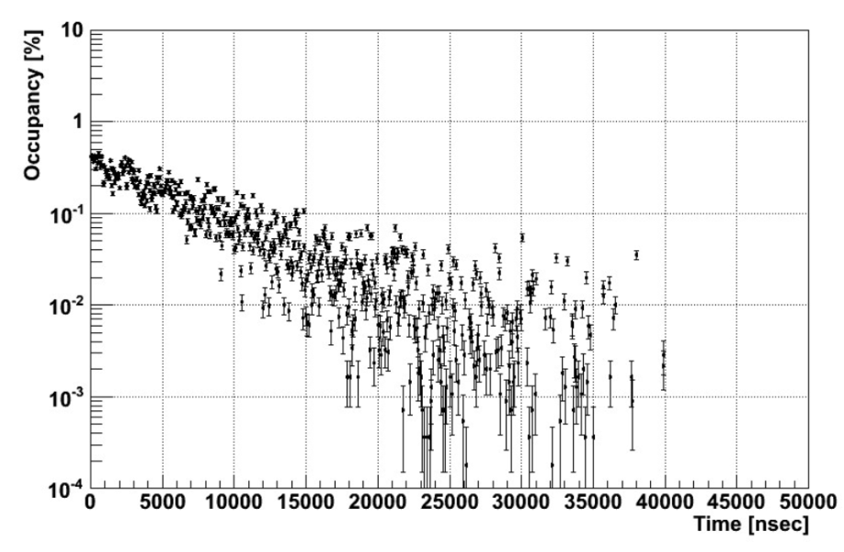
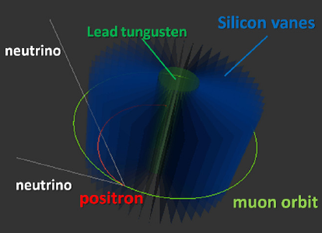
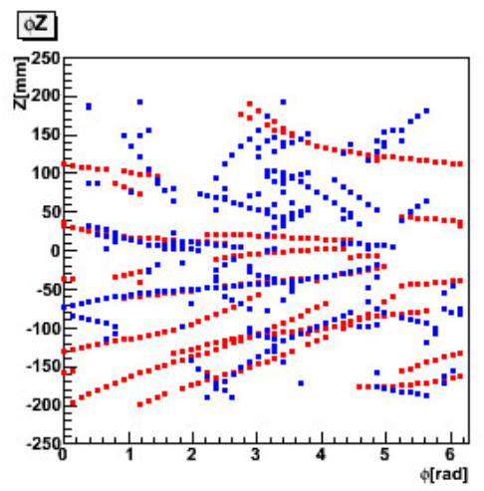
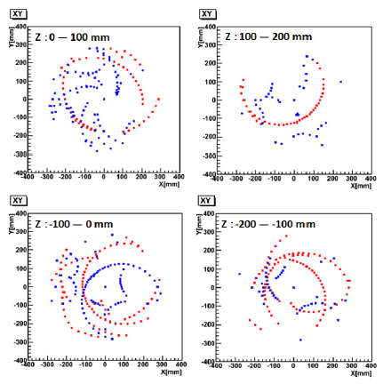
Raw occupancy and hit distributions
K. Ueno
A GEANT4 simulation has been carried out to evaluate positrons hits as well as background hits.
BG consists of EM processes: such as bremsstrahlung, annihilation, pair creation etc...
Occupancy is less than 0.5% per 5ns time stamp (5 hits/strip/spill).
Positron tracks at the beginning:
15 signal e+ tracks with p>200 MeV at first 5ns
30 BG e+ tracks with p<200 MeV at first 5ns
Strong hit correlations in φZ plane and XY plane.
G4 simulation
1 spill (40000 muon decays)
G4 simulation
first 5ns time stamp
z
x
y
φ
・ signal e+ (p>200MeV/c)
・ BG e+ (p<200MeV/c)

Slide 27
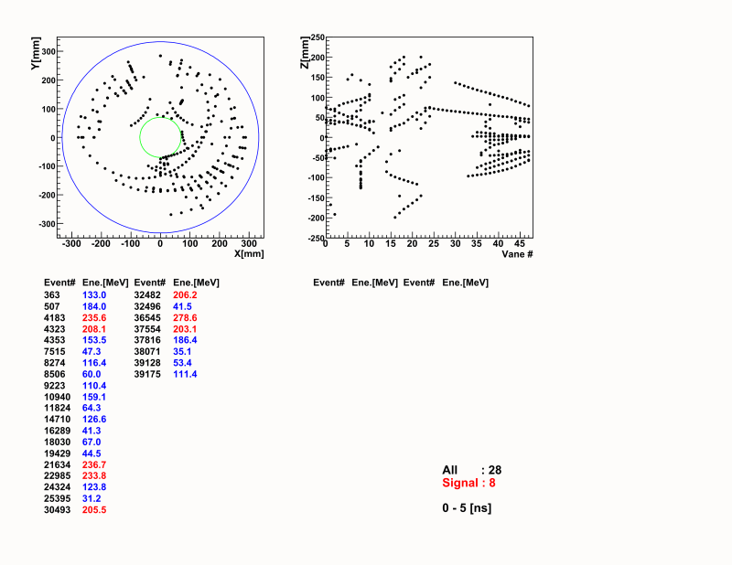
Time evolution of track hits
By Kazuki Ueno

Slide 28
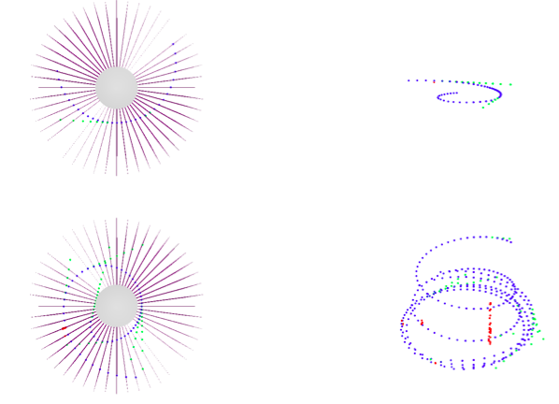
Event gallery
A 3D MC event display has been developed with ROOT/EVE framework by Wilfrid Da Silva and Frederic Kapusta.
Typical e+ track
A typical event in 5ns time stamp
Positron
Electron
Photon

Slide 29
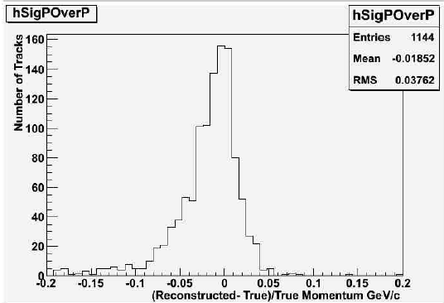
Track reconstruction
K. Ueno
W. Da Silva
F. Kapusta
Track finding
Initial search with Hough transformation algorithm in φz plane
Track finding efficiency for a single-track is >90%.
Track fitting
Fitter with GENFIT (track fitting tool kit with Karman filter) is being developed by W. Da Silva and F. Kapusta.
Evaluation of multi-track reconstruction is the next step.
single track finding efficiency
G4 simulation
Track finder (Hough)
track momentum reconstruction
G4 simulation
GENFIT

Slide 30
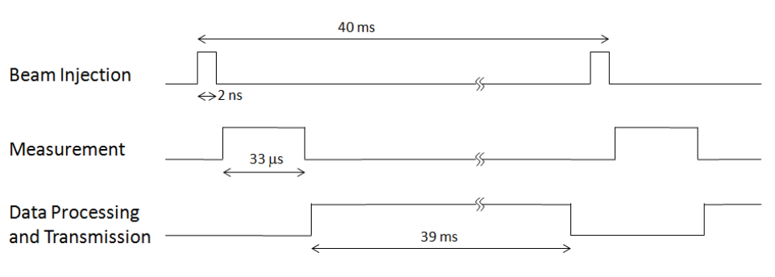
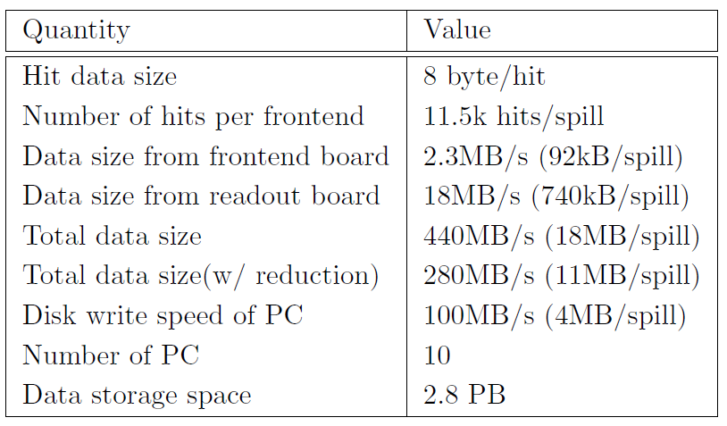
Readout electronics and DAQ
O. Sasaki
M. Tanaka
T. Uchida
J.F. Genat
Readout electronics and DAQ are designed to match the time structure of the J-PARC beam.
Signals in Silicon sensors are amplified and digitized at Front end, then transmitted to the backend readout boards.

Slide 31
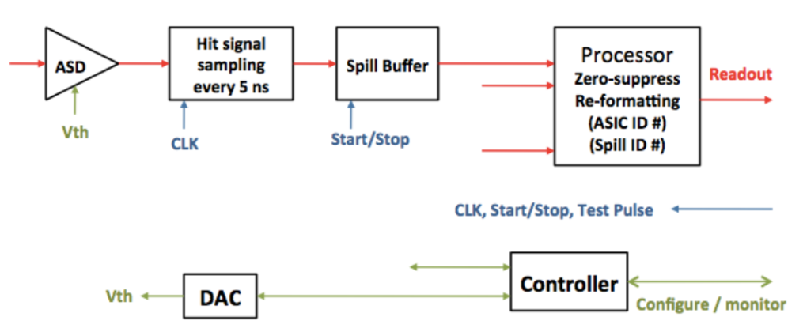
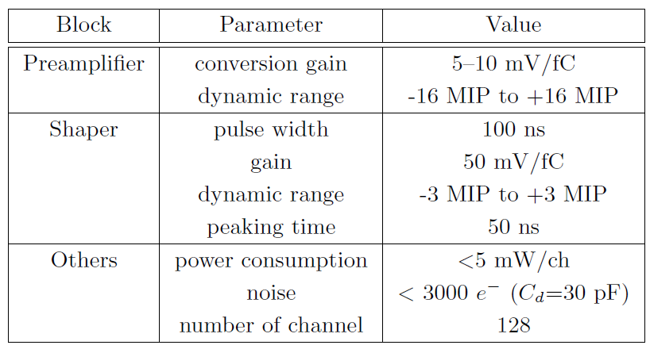
Front-end ASIC
M. Tanaka,T. Uchida
M. Ikeno,O. Sasaki
Analog and digital part of the ASIC has been designed in JFY2011.
Simulated pulse shape in ASD
Preamplifier output
Shaper output
Comparator output

Slide 32
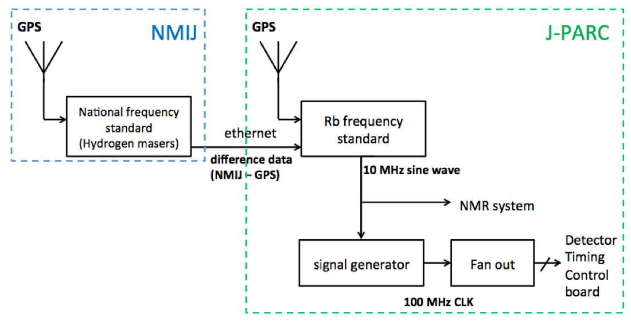
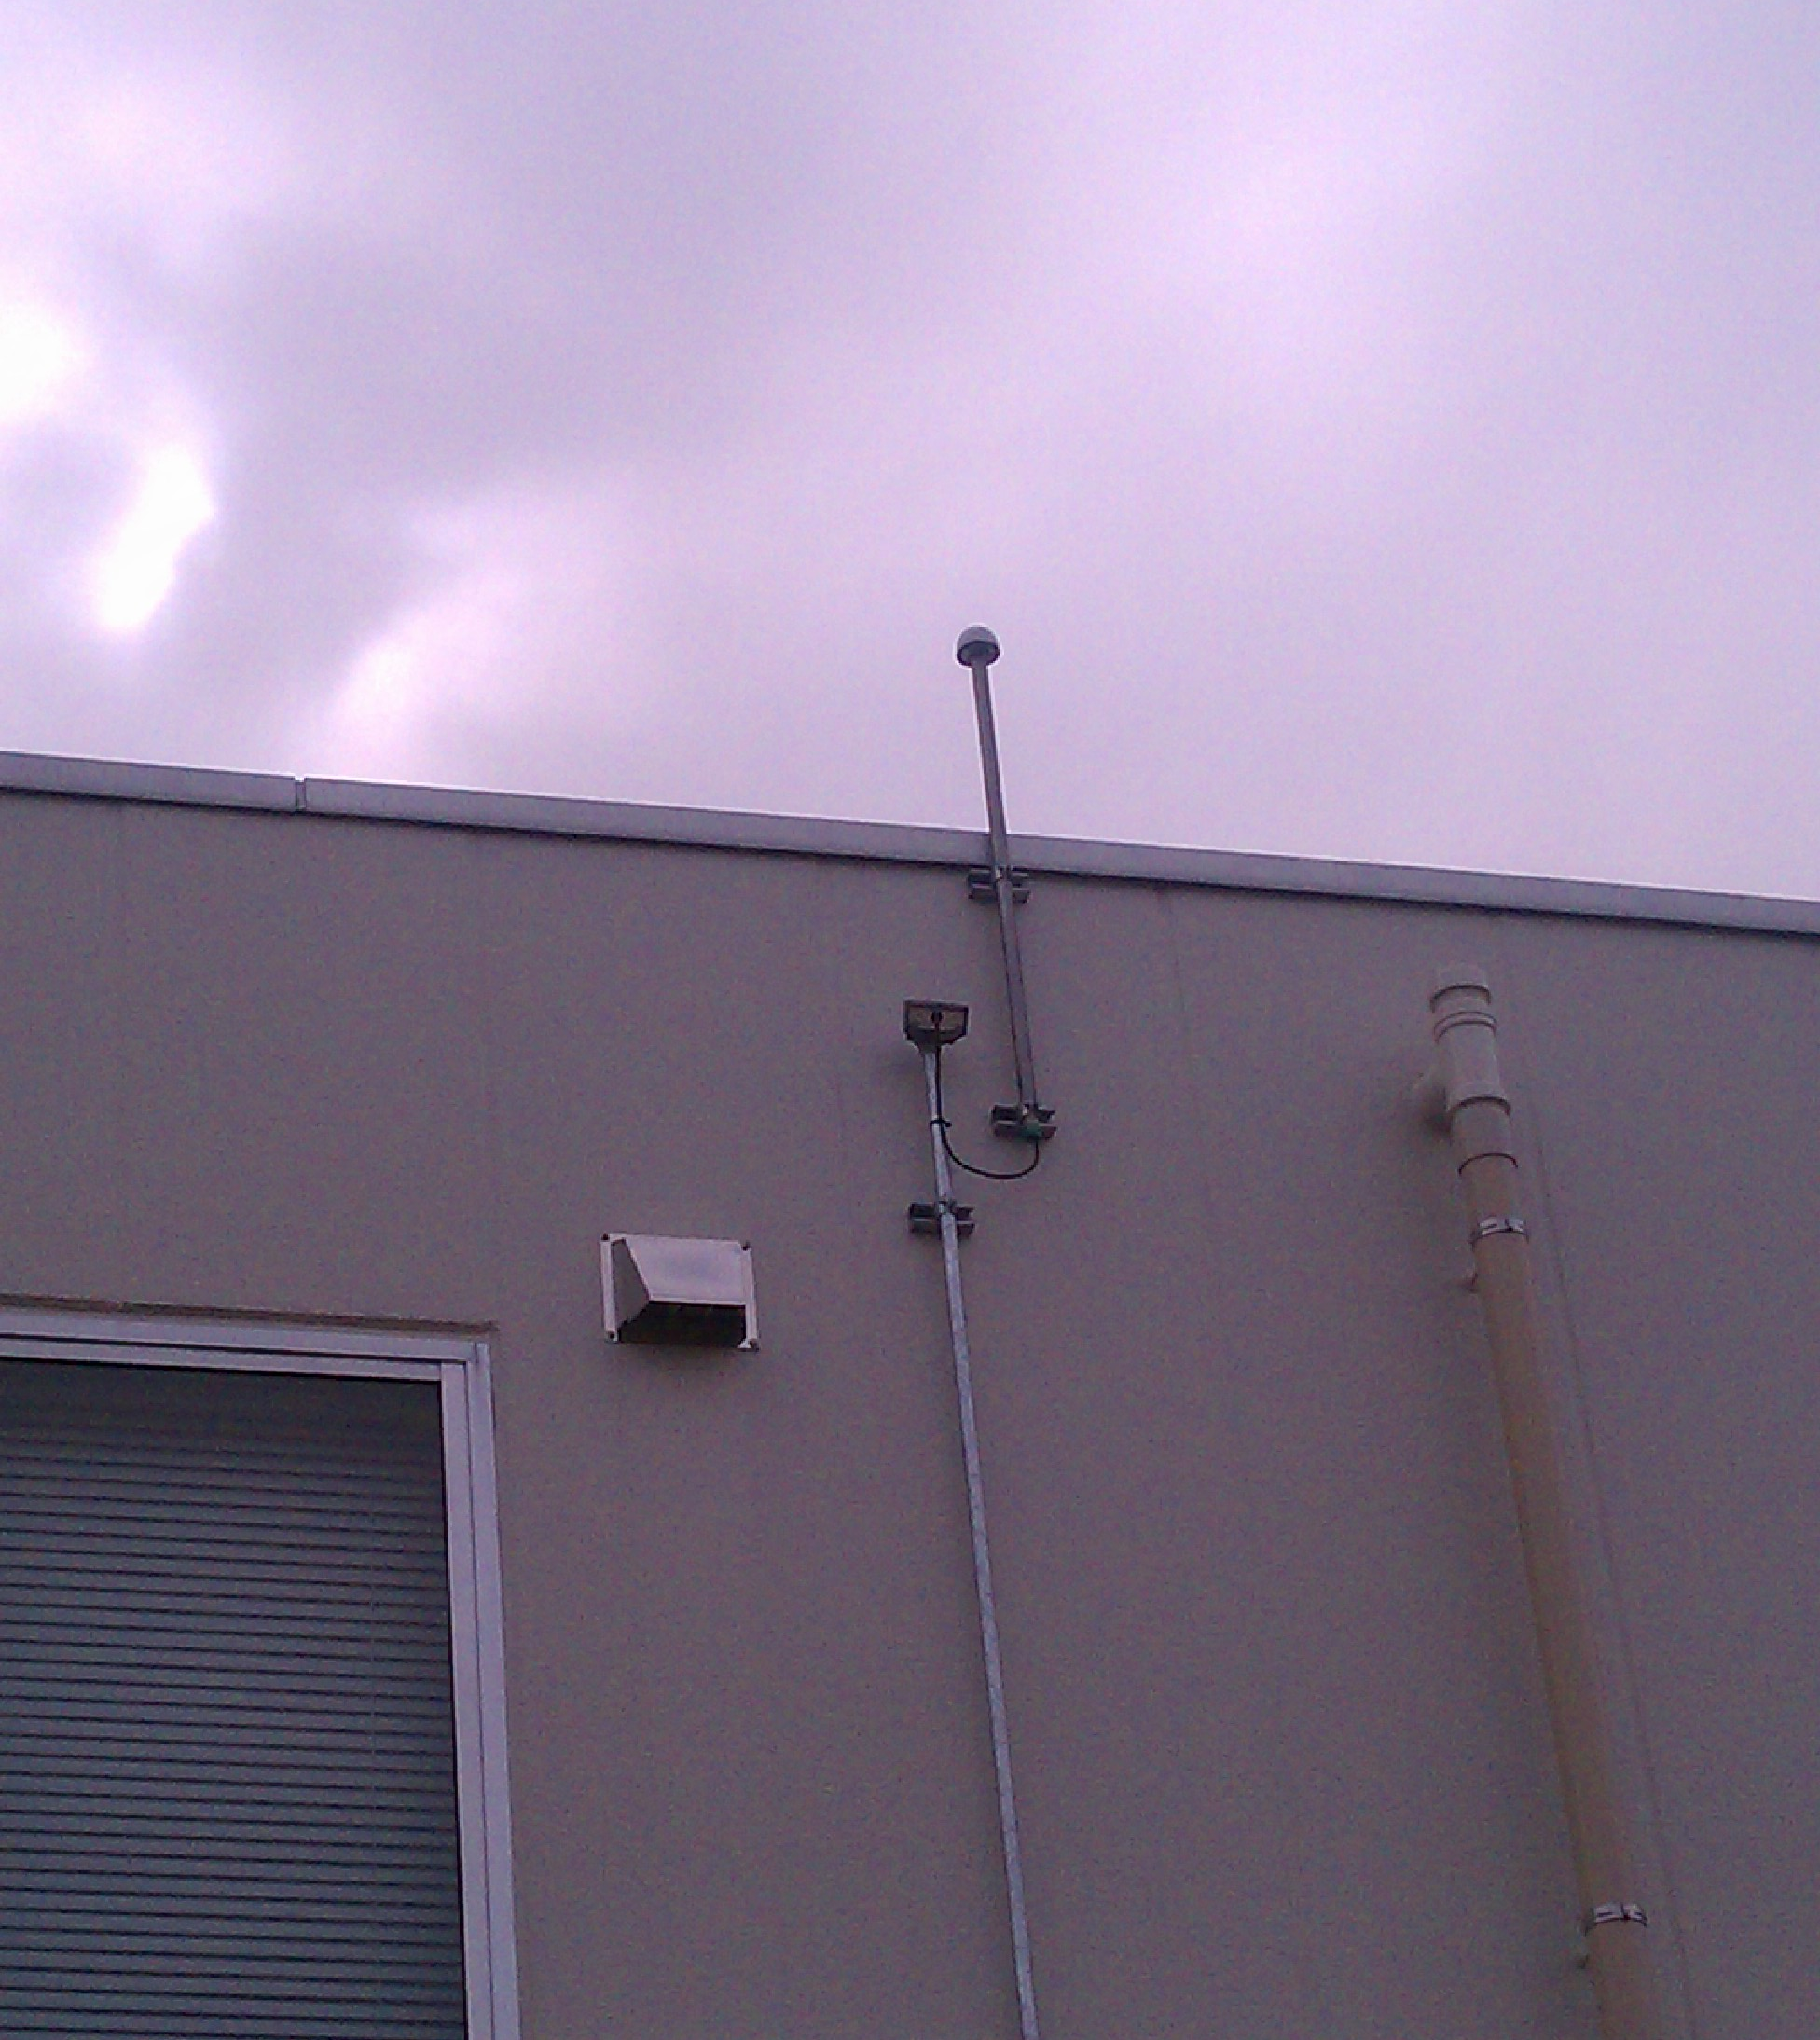
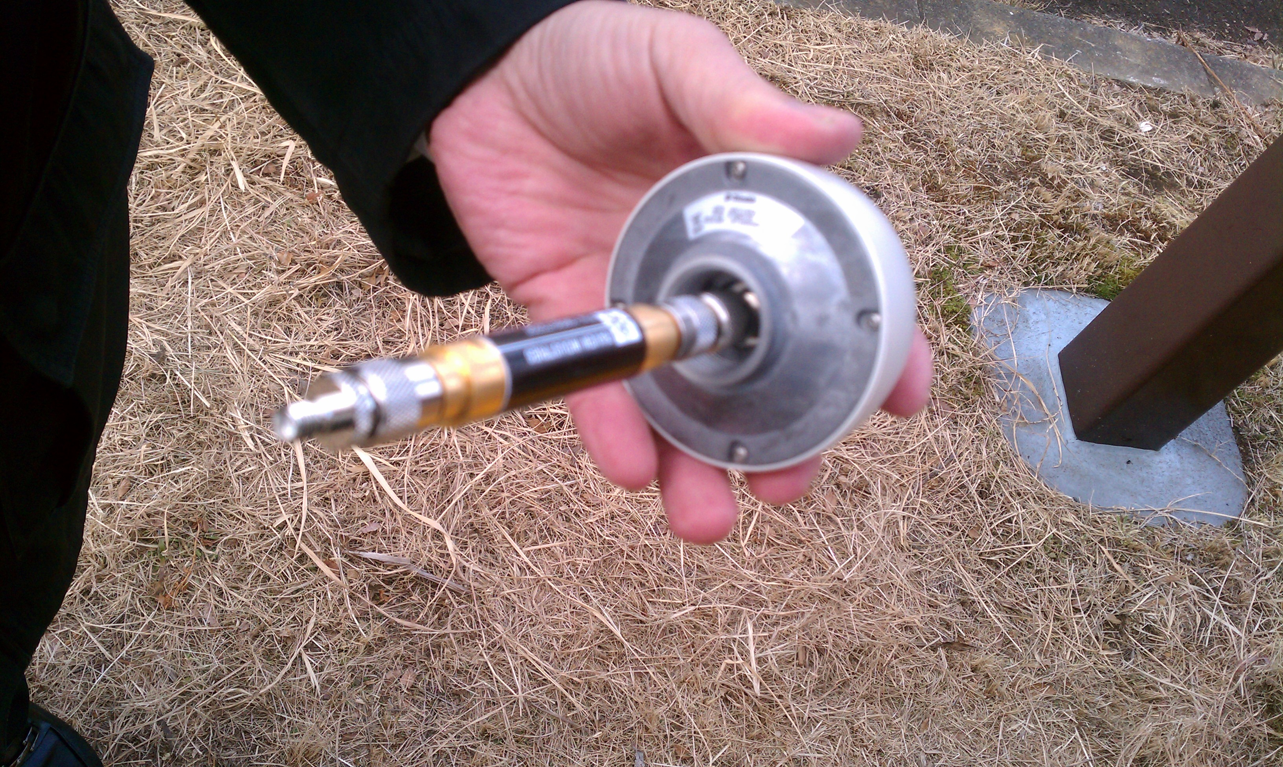
High precision clock
The system clock utilizes the high precision Rb frequency standard with remote calibration from the national frequency standard NMIJ as well as GPS to realize frequency stability of Δf/f <5 x 10⁻⁹/s.
GPS antenna at KEK

Slide 33
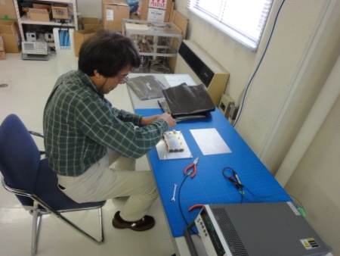
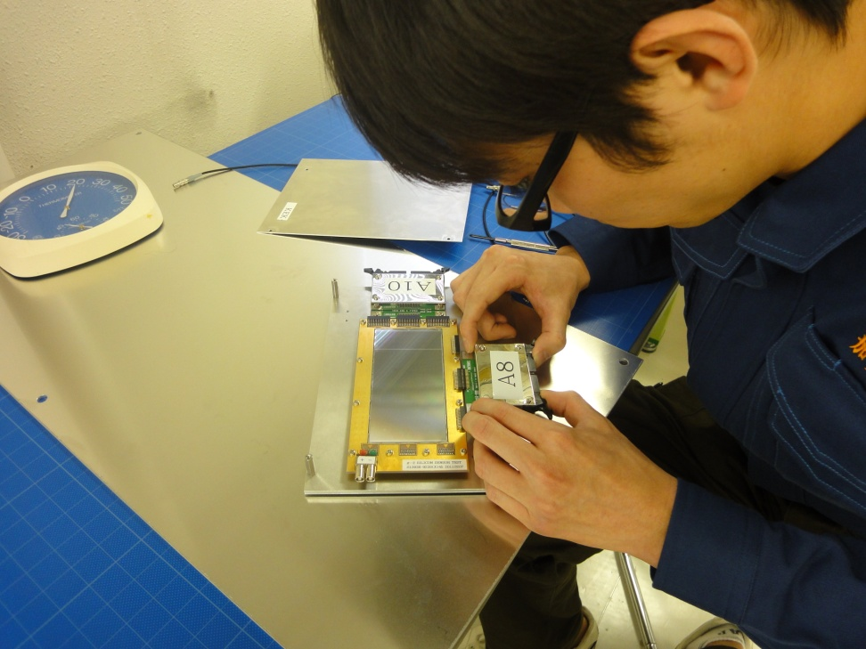
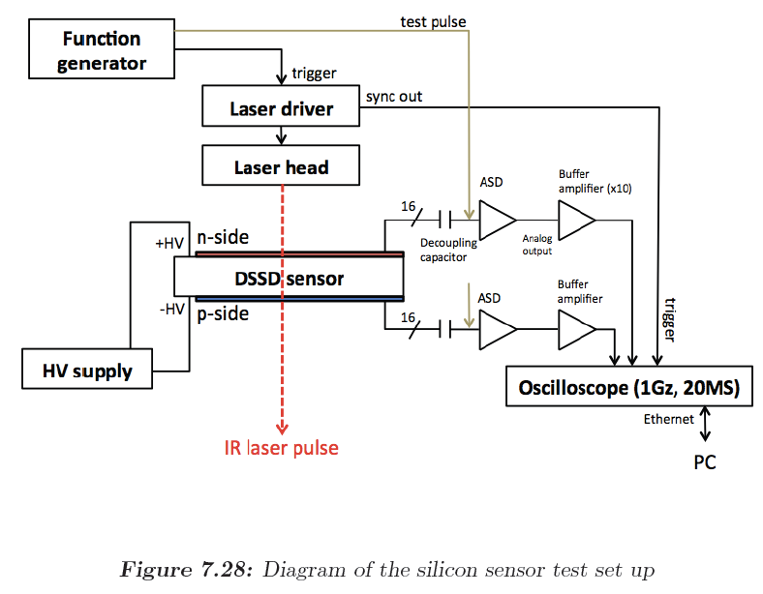
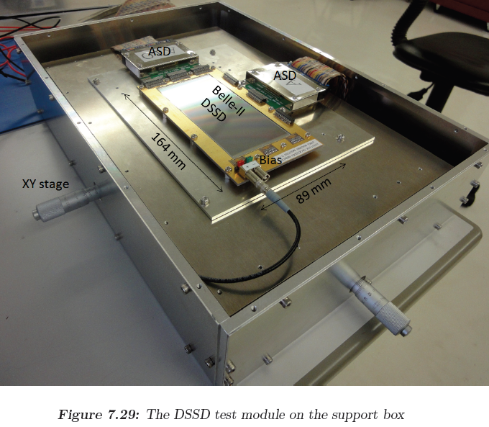
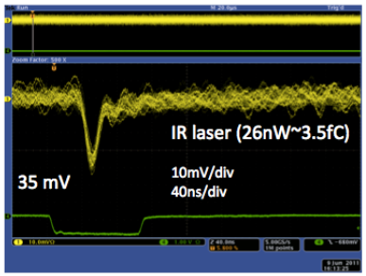
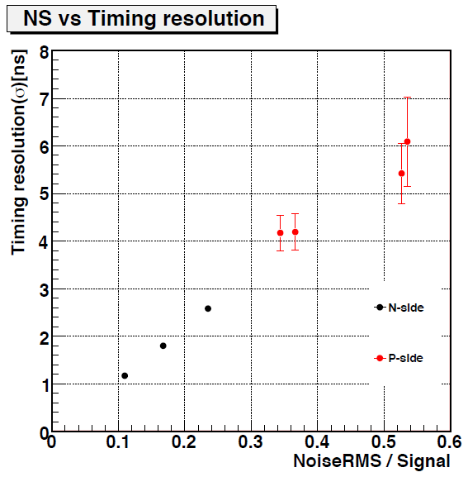
R&Ds for early-to-late effects
T. Kakurai, T. Mibe,
O. Sasaki, T. Kohriki
A silicon-sensor test system with IR laser was built.
The IR laser could be pulsed at repetition rate as high as 80MHz with an asynchronous external trigger.
Systematic studies on early-to-late effects are in progress.
f_{max}=80MHz

Slide 34
Timing resolution and rate dependence
T. Kakurai
Requirement (<10%)

Slide 35
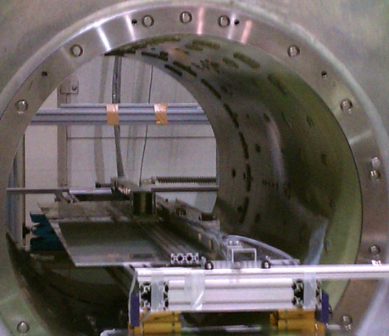
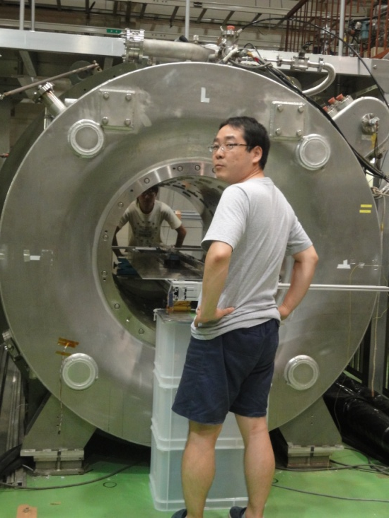
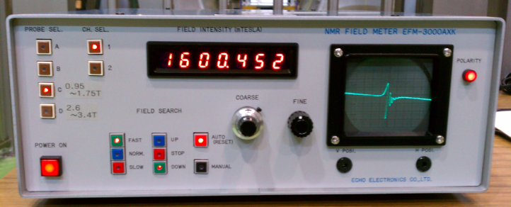
Effect of detector components in the precision B-field
K. Sasaki, T. Kakurai
T. Mibe, O. Sasaki
1.6T super-conducting
solenoid
Test material
NMR probe
NMR controller
B-field in the vicinity of material and detector components were measured by NMR probe.

Slide 36
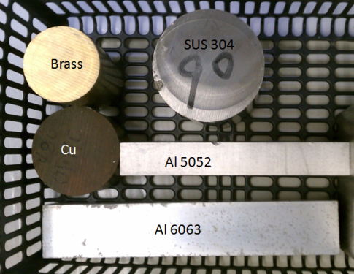
Materials and components
K. Sasaki, T. Kakurai
T. Mibe, O. Sasaki
metals
PCB board (G10+Cu, 10 layer)
Optical transceiver
Voltage regulator
10 x 1Gbps optical link
Belle-II data transmission test board
PHENIX trigger board
Registers, capacitors
FPGA/PROM
Solder (with Pb, Pb-free)

Slide 37
Comparison with calculation (Ti)
← CRC value
x (mm)
Calculated curve (ー) with expected μ/μ₀ value agrees with data.

Slide 38
Comparison with calculation (optical module)
Calculated curve (ー) with μ/μ₀ =1.009 best describes the data.
Not very good agreement with data, maybe due to ambiguity of source volume
Best estimate μ/μ₀ -1 = (9,000 +/- 750 ) E-6.

Slide 39
ΔB/B contour
+0.1ppm
+ 1ppm
+0ppm
-0.1ppm
+10ppm
+100ppm
-10ppm
-1ppm
-100ppm

Slide 40
Core R&D tasks
Detector should be efficient for
Positron track with p = 200 - 300 MeV/c in 3T solenoidal B-field
with a radial vertex resolution of σ=1 mm (if very-weak focusing is applied).
Immune to early-to-late effect
The decay positron rate changes by two orders of magnitude.
1.6 MHz/strip → 10kHz/strip for 200 um pich Silicon strip.
The positron detector must be stable over the measurements.
Zero E-field (<<10⁻² V/cm) at muon storage area
Not spoil the precision B-field ( <<0.1ppm) at muon storage area
Efficient readout in compatible with the J-PARC beam pulse structure
GEANT4 simulation, toy MC
Track finding studies
feedback
DSSD sensor evaluation
E-field calculation model
B-field measurements by NMR
Front-end electronics

Slide 41
Projected schedule
Now
CDR submitted
Stage-1 approved
TDR submmision
Stage-2 request?

Slide 42
Summary
A new muon g-2/EDM experiment at J-PARC:
Off magic momentum + compact g-2 ring
Complementary to FNAL g-2
Start in 2016
Silicon tracker for g-2
A tracker for incoming low energy positrons
Stringent requirements on early-to-late effect, E-field and B-field
Conceptual design has been developed.
LPNHE group has made significant contribution in the detector design.
Looking forward to continuous (possibly larger) contribution from LPNHE and other French group in the future.

