Slide 1
The optimisation of ALICE code
Federico Carminati
January 19, 2012

Slide 2
Rationale
The HEP code
An embarrassing parallelism
An inextricable mix of branches / integer / float / double
A “flat” timing distribution – no “hot spots”
We always got away with clock rate, now it is not possible any more
Parallelism is there to stay
We cannot claim that we are resource-hungry and then exploit ~10%-50% of the hardware
Just think what it means in terms of money

Slide 3
parallelism
From a recent talk by Intel

Slide 4
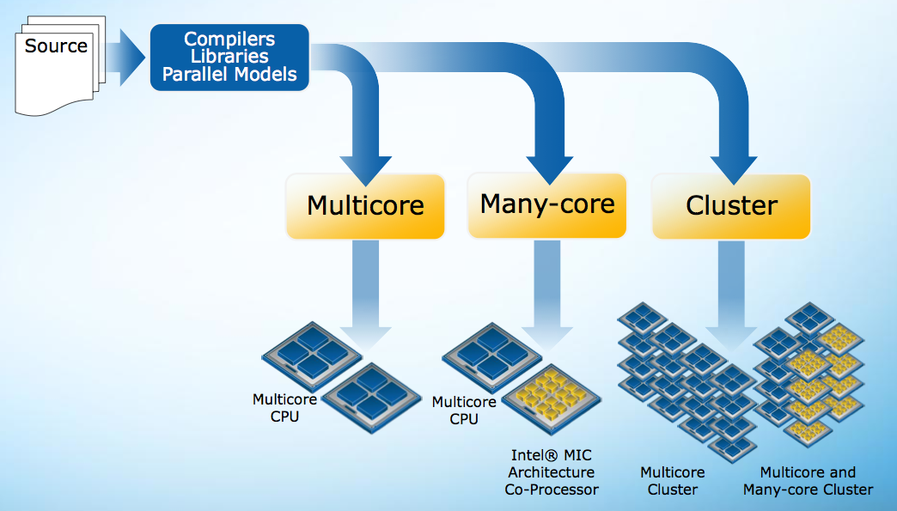
If you trust Intel

Slide 5
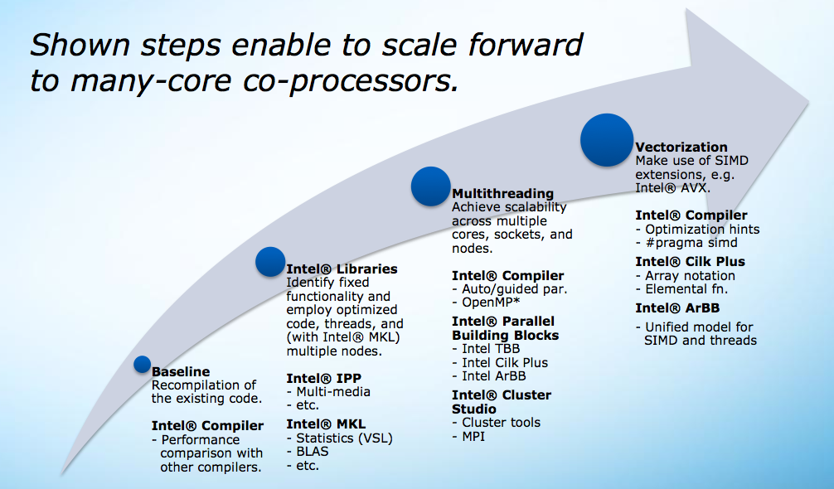
If you trust Intel 2

Slide 6
Why it is so difficult?
No clear kernel
C++ code generation / optimisation not well understood
Most of the technology is coming out now
Lack of standards
Technological risk
Non professional coders
Fast evolving code
No control on hardware acquisition

Slide 7
Why it is so difficult (cont)?
Amdhal law sets stringent limits to the results that can be achieved
No “low level” optimisation alone will yield results
Heterogeneous parallelism forces multi-level parallelisation
Essentially the code (all of it!) will have to be re-written

Slide 8
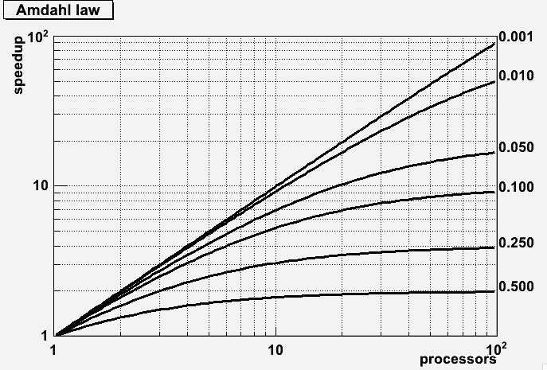

Slide 9
ALICE strategy (unauthorised)
Use the LSD-1 to essentially re-write AliRoot
Use the LSD-2 to expand the parallelism to the Grid
Hopefully the major thrust will be on MiddleWare
Refactor the code in order to expose the maximum of parallelism present at each level
Keep the code in C++ (no CUDA, OpenCL etc.)
Explore the possible use of #pragma’s (OpenMP, OpenACC)
Experiment on all hardware at hand (OpenLab, but not only)

Slide 10
Timeline
}
}
}
R&D
Phase I
Phase II
2012
2013
2014
May 2012
Kick-off
June 2013
Mid term review phase I
June 2014
Mid term review
Phase II
Jan2013
Work starts
Dec 2013 End phase I
Dec 2014 End phase II

Slide 11
One example – Simulation
The LHC experiments use extensively G4 as main simulation engine. They have invested in validation procedures. Any new project must be coherent with their framework.
One of the reasons why the experiments develop their own fast MC solution is the fact that a full simulation is too slow for several physics analysis. These fast MCs are not in the G4 framework (different control, different geometries, etc), but becoming coherent with the experiments frameworks.
Giving the amount of good work with the G4 physics, it is unthinkable to not capitalize on this work.

Slide 12
Event loop and stacking
Loop over particles
Stack
Stack manager
Virtual transporter
Field
Push primaries
Current transporter
Geometry navigator
Current transporter
Push secondaries
Step manager
Physics processes
User application
Step actions for selected process
User step actions
Notes:
The idea is that the design should better be done in a way that would ensure compatibility to the existing code, but much more flexible than the existing approaches with respect to future possibilities for parallel processing. What is today the “single stack” approach can easily be designed based on the fact that processing a primary should be independent of another. That is, if we want to split the initial stack in chunks processed by different machines (in a PROOF-like environment) this would work. At the limit, the framework should be thread safe with respect to splitting the stack and spawning several stack/step managers to take advantage of future architectures.

Slide 13
Fast and Full MonteCarlo
We would like an architecture (via the abstract transporters) where fast and full MC can be run together.
To make it possible one must have a separate particle stack.
However, it was clear from the very beginning in January that the particle stack depends strongly on the constraints of parrallelism. Multiple threads cannot update efficiently a tree data structure.

Slide 14
Conventional Transport
At each step, the navigator *nav has the state of the particle x,y,z,px,py,pz, the volume instance volume*, etc.
We compute the distance to the next boundary with something like
Dist = nav->DistoOut(volume,x,y,z,px,py,pz)
Or the distance to one physics process with, eg
Distp = nav->DistPhotoEffect(volume,x,y,z,px,py,pz)

Slide 15
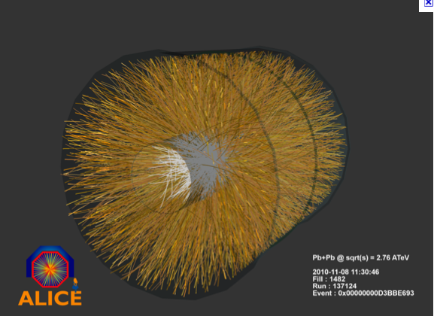

Slide 16
Current Situation
We run jobs in parallel, one per core.
Nothing wrong with that except that it does not scale in case of many cores because it requires too much memory.
A multithreaded version may reduce (say by a factor 2 or 3) the amount of required memory, but also at the expense of performance.
A multithreaded version does not fit well with a hierarchy of processors.
So, we have a problem, in particular with the way we have designed some data structures, eg HepMC.

Slide 17
Can we make progress?
We need data structures with internal relations only. This can be implemented by using pools and indices.
When looping on collections, one must avoid the navigation in large memory areas killing the cache.
We must generate vectors of reasonable size well matched to the degree of parallelism of the hardware and the amount of memory.
We must find a system to avoid the tail effects

Slide 18
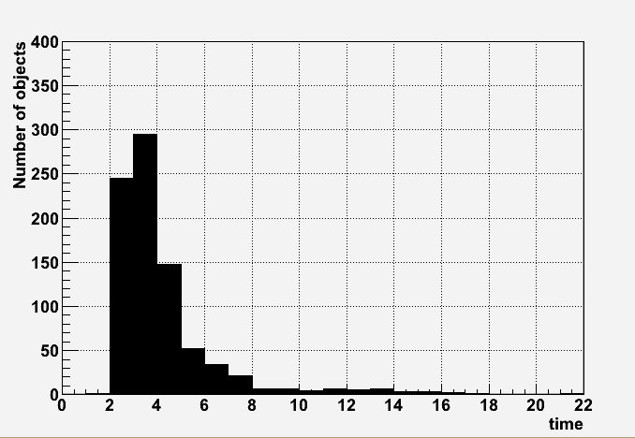
tails, tails, tails

Slide 19
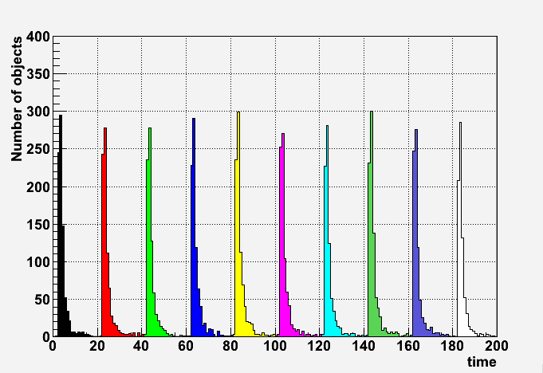
Tails again
A killer if one has to wait the end of col(i) before processing col(i+1)
Average number of objects in memory

Slide 20
New Transport Scheme
T2
o
All particles in the same volume type are transported in parallel.
Particles entering new volumes or generated are accumulated in the volume basket.
o
o
o
o
o
o
o
o
o
o
o
T4
o
o
o
o
o
o
o
o
T1
o
o
o
o
o
o
o
o
o
o
o
o
o
o
o
o
Events for which all hits are available are digitized in parallel
o
o
o
o
o
o
T3

Slide 21
Generations of baskets
When a particle enters a volume or is generated, it is added to the basket of particles for the volume type.
The navigator selects the basket with the highest score (with a high and low water mark algorithm).
The user has the control on the water marks, but the idea that this should be automatic in function of the number of processors and the total amount of memory available. (see interactive demo)

Slide 22
New Transport
At each step, the navigator *nav has the state of the particles *x,*y,*z,*px,*py,*pz, the volume instances volume**, etc.
We compute the distances (array *Dist) to the next boundaries with something like
nav->DistoOut(volume,x,y,z,px,py,pz,Dist)
Or the distances to one physics process with, eg
nav->DistPhotoEffect(volume,x,y,z,px,py,pz,DispP)

Slide 23
New Transport
The new transport system implies many changes in the geometry and physics classes. These classes must be vectorized (a lot of work!).
Meanwhile we can survive and test the principle by implementing a bridge function like
MyNavigator::DisttoOut(int n, TGeoVolume **vol, double *x,..)
{
for int i=0;i<n;i++) {
Dist[i] = DisttoOutOld(vol[i],x[i],…);
}
}

Slide 24
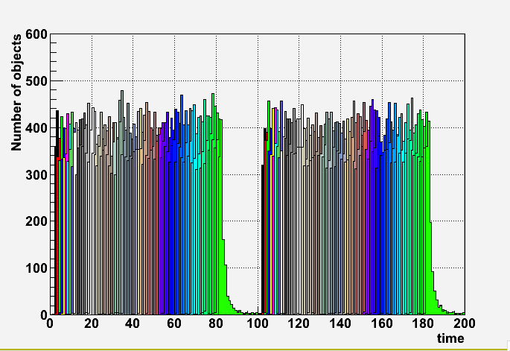
A better solution
Checkpoint
Synchronization.
Only 1 « gap » every N events
Pipeline of objects
This type of solution required anyhow for pile-up studies

Slide 25
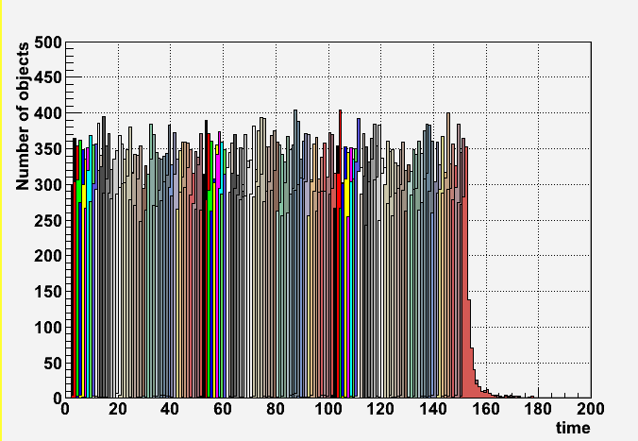
A better better solution
checkpoints
At each checkpoint we have to keep the non finished objects/events.
We can now digitize with parallelism on events, clear and reuse the slots.

Slide 26
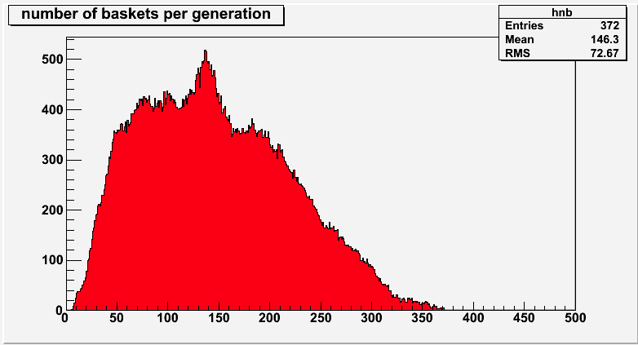

Slide 27
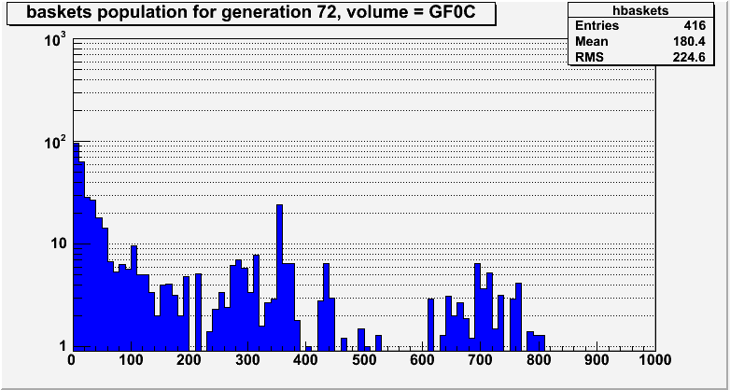

Slide 28
Vectorizing the geometry (ex1)
Double_t TGeoPara::Safety(Double_t *point, Bool_t in) const
{
// computes the closest distance from given point to this shape.
Double_t saf[3];
// distance from point to higher Z face
saf[0] = fZ-TMath::Abs(point[2]); // Z
Double_t yt = point[1]-fTyz*point[2];
saf[1] = fY-TMath::Abs(yt); // Y
// cos of angle YZ
Double_t cty = 1.0/TMath::Sqrt(1.0+fTyz*fTyz);
Double_t xt = point[0]-fTxz*point[2]-fTxy*yt;
saf[2] = fX-TMath::Abs(xt); // X
// cos of angle XZ
Double_t ctx = 1.0/TMath::Sqrt(1.0+fTxy*fTxy+fTxz*fTxz);
saf[2] *= ctx;
saf[1] *= cty;
if (in) return saf[TMath::LocMin(3,saf)];
for (Int_t i=0; i<3; i++) saf[i]=-saf[i];
return saf[TMath::LocMax(3,saf)];
}
Huge performance gain expected in this type of code where shape constants can be computed outside the loop

Slide 29
Vectorizing the geometry (ex2)
G4double G4Cons::DistanceToIn( const G4ThreeVector& p,
const G4ThreeVector& v ) const
{
G4double snxt = kInfinity ; // snxt = default return value
const G4double dRmax = 100*std::min(fRmax1,fRmax2);
static const G4double halfCarTolerance=kCarTolerance*0.5;
static const G4double halfRadTolerance=kRadTolerance*0.5;
G4double tanRMax,secRMax,rMaxAv,rMaxOAv ; // Data for cones
G4double tanRMin,secRMin,rMinAv,rMinOAv ;
G4double rout,rin ;
G4double tolORMin,tolORMin2,tolIRMin,tolIRMin2 ; // `generous' radii squared
G4double tolORMax2,tolIRMax,tolIRMax2 ;
G4double tolODz,tolIDz ;
G4double Dist,s,xi,yi,zi,ri=0.,risec,rhoi2,cosPsi ; // Intersection point vars
G4double t1,t2,t3,b,c,d ; // Quadratic solver variables
G4double nt1,nt2,nt3 ;
G4double Comp ;
G4ThreeVector Normal;
// Cone Precalcs
tanRMin = (fRmin2 - fRmin1)*0.5/fDz ;
secRMin = std::sqrt(1.0 + tanRMin*tanRMin) ;
rMinAv = (fRmin1 + fRmin2)*0.5 ;
if (rMinAv > halfRadTolerance)
{
rMinOAv = rMinAv - halfRadTolerance ;
}
else
{
rMinOAv = 0.0 ;
}
tanRMax = (fRmax2 - fRmax1)*0.5/fDz ;
secRMax = std::sqrt(1.0 + tanRMax*tanRMax) ;
rMaxAv = (fRmax1 + fRmax2)*0.5 ;
rMaxOAv = rMaxAv + halfRadTolerance ;
// Intersection with z-surfaces
tolIDz = fDz - halfCarTolerance ;
tolODz = fDz + halfCarTolerance ;
…… //here starts the real algorithm
All these statements are independent of the particle !!!
Huge performance gain expected in this type of code where shape constants can be computed outside the loop

Slide 30
Vectorizing the Physics
This is going to be more difficult when extracting the physics classes from G4. However important gains are expected in the functions computing the distance to the next interaction point for each process.
There is a diversity of interfaces and we have now sub-branches per particle type.

Slide 31
Plan ahead (no timing yet)
Continue exploring all concurrency opportunities
Develop “virtual transporter” to include a full and fast option
Introduce embryonic physics processes (em) to simulate shower development
Evaluate the prototype on parallel architectures
Evaluate different “parallel” languages (OpenMP, CUDA, OpenCL…)
Cooperate with experiments
For instance with ATLAS ISF (Integrated Simulation Framework) to put together the fast and full MC.

