Slide 1
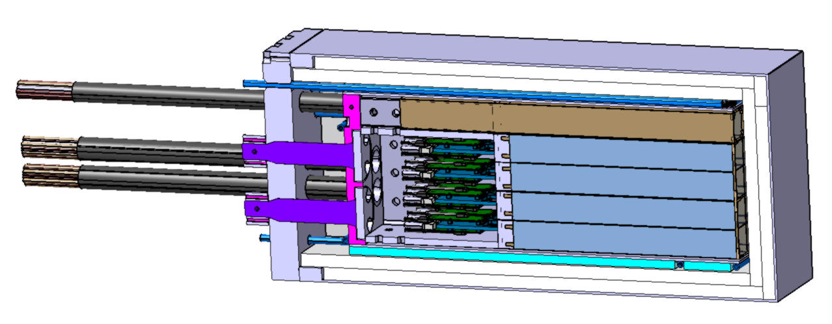
PANDA EMC BWE Proto18
Mikel Catania Goikoetxea, Javier Navarro Medrano, David Rodríguez Piñeiro, Yue Ma, Frank Maas

Slide 2
Proto18 Summary
Proto18:
Motivation
Configuration
Sections
Detector:
Crystal Group
Preamplifiers Location
Assembly
Mechanical Structure:
MP1
Feet
MP2
Cooling System:
Circuits
Chiller
Insulation System:
Elements
Backside
N2 flow
Wire Evacuation
Sensors
Support System
Proto18 Tests
Proto18: Future Tasks

Slide 3
Proto18 Motivation
First Prototype for PANDA EMC BWE
Obtain information for the EMC BWE final design
18 PbWO₄ Crystals
Closest working conditions to PANDA BWE EMC
Temperature of -25°C in Crystals
All devices held from the backside
All system circuits get out from the backside
Minimize insulators
Avoid cooling in the front due to budget material
Test different cooling configurations
Cooling & Wires: over back side
Cantilever: overhanging structure

Slide 4
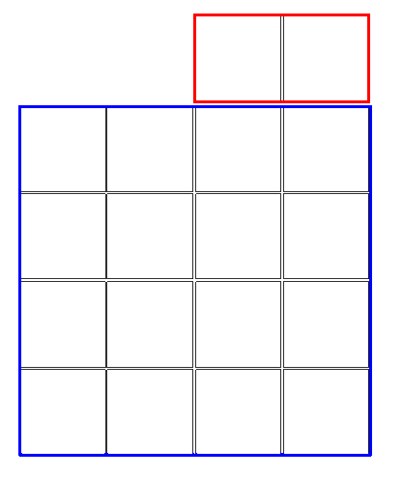
PROTO18 Configuration
18 PbWO₄ Crystals divided in two groups: 16 and 2 crystals in each one
20 Crystals available

Slide 5
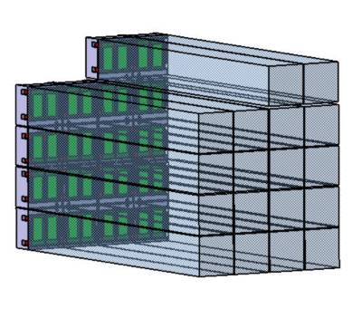
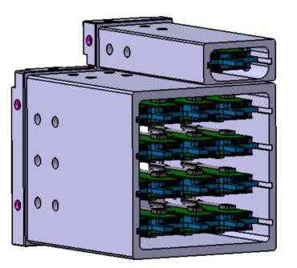
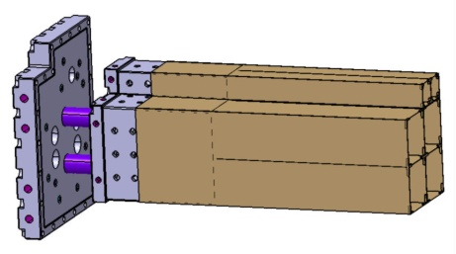
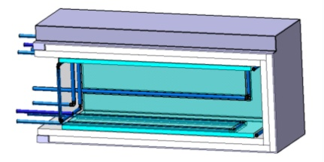
Proto18: Sections
Detectors
Crystals
Electronics
Mechanical Structure
Cooling & Insulation

Slide 6
Detector: Crystal Group

Slide 7
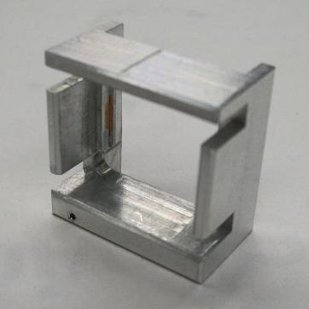
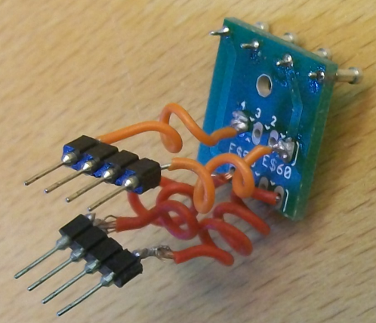
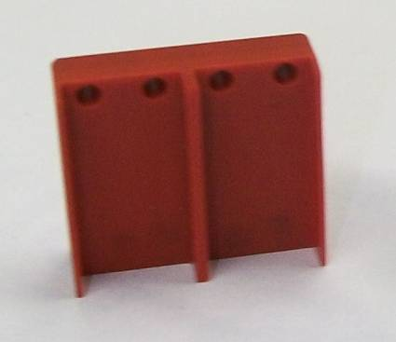
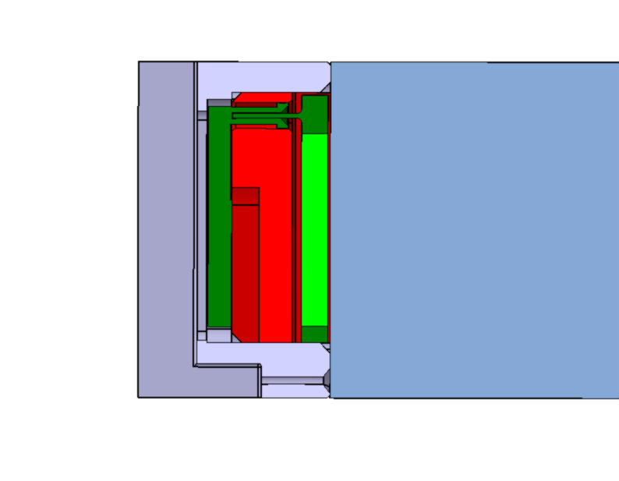
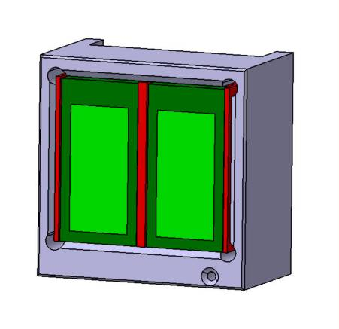
Detector: Crystal Group
Al Frame
Patch Panel
PVC Capsule
Hole for optic fiber
Dimensions adjusted to crystal (24,4x24,4mm)
Space to apply optical glue
Patch Panel wires to connect with Preamplifiers
Active part of the APDs centered in the crystal section

Slide 8
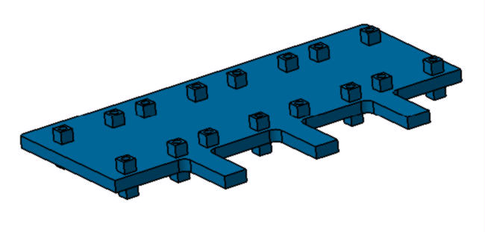
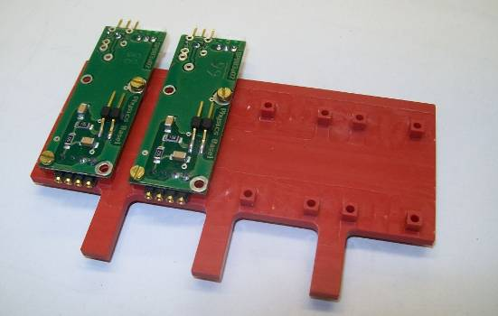
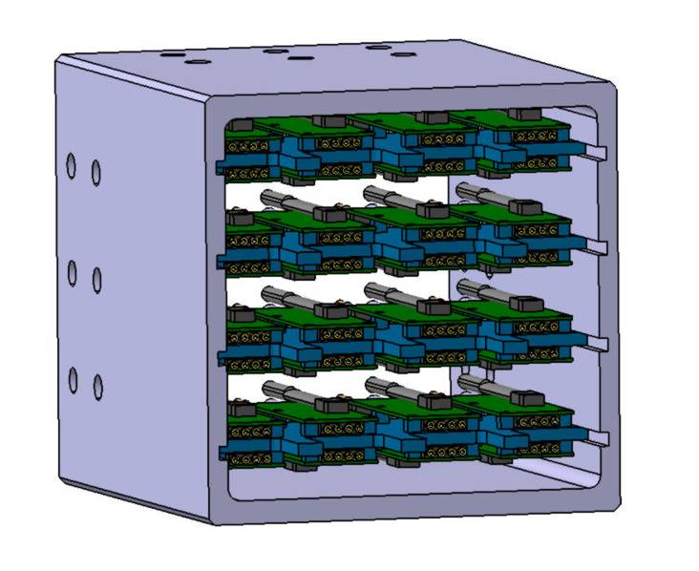
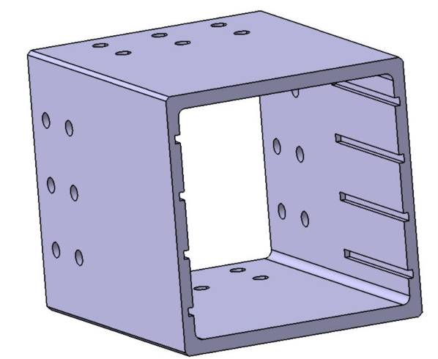
Detector: Electronics
4 x PVC Tray
8 Preamplifiers per tray
Al Insert
Grooves for trays
Holes for N₂ circulation

Slide 9
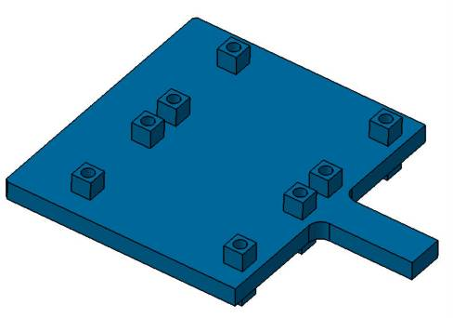
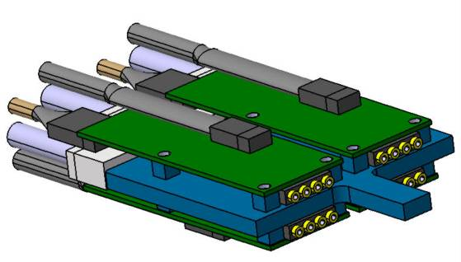
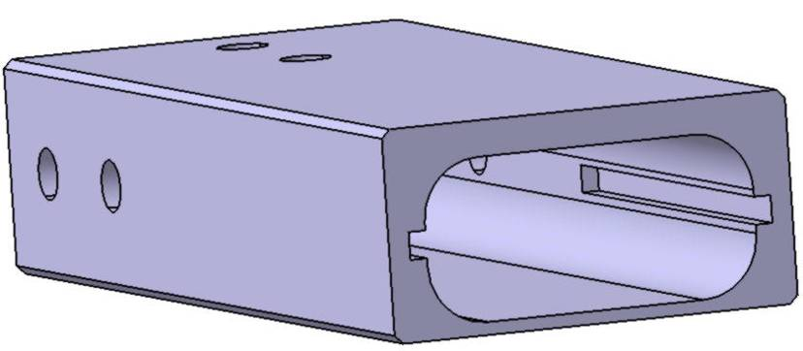
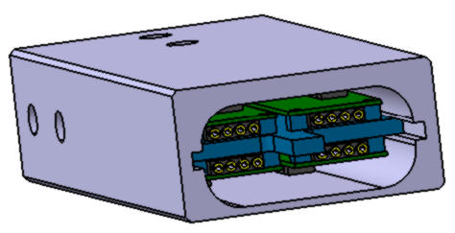
Detector: Electronics
PVC Tray
4 Preamplifiers in a tray
Al Insert

Slide 10
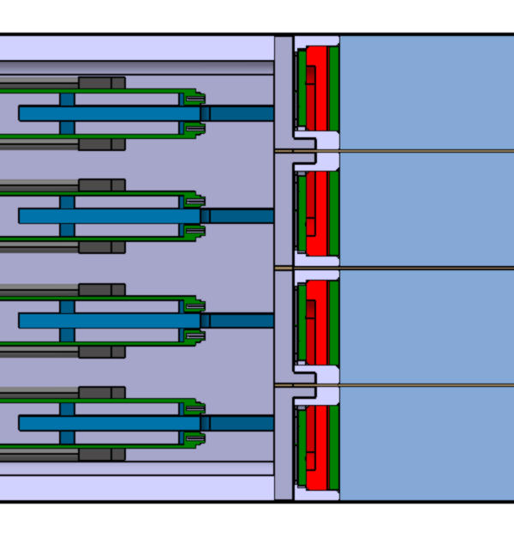
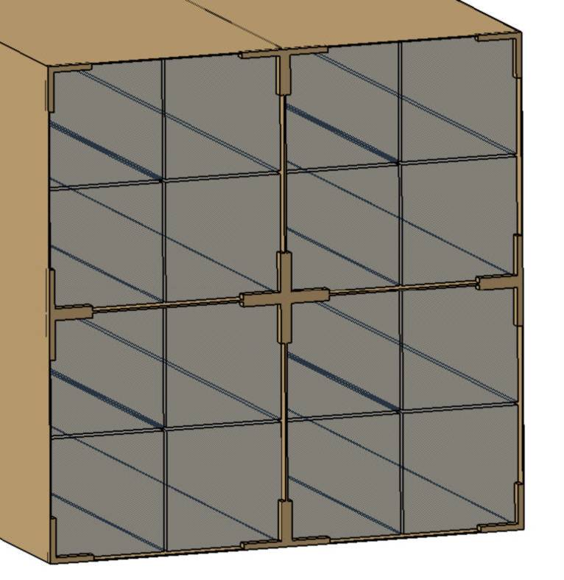
Detector: Assembly
Crystal located into the alveoli and patch-panels connected to the preamplifiers with small flexible wires
Alveoli glued to the aluminum Insert
Connection wires located into these spaces
CF Stoppers for crystals

Slide 11
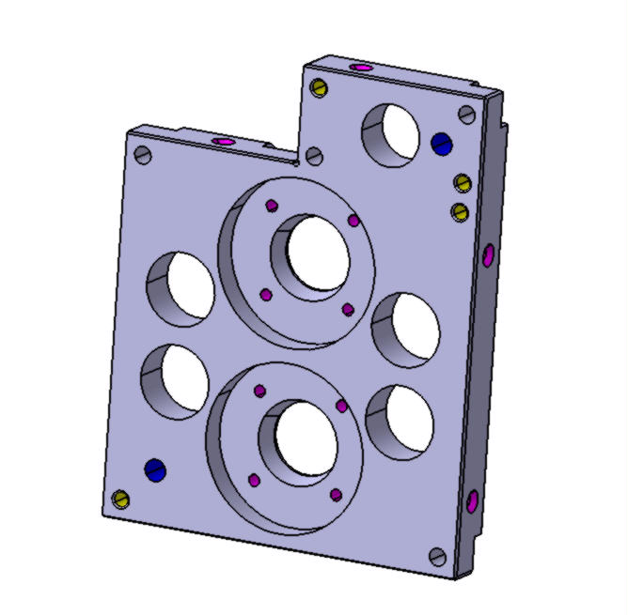
Mechanical Structure: MP1
Mounting Plate 1
Aluminum
15 mm thick
“Cold Plate”
5x Holes for wires
2x Holes for the supporting feet
2 x Holes N2

Slide 12
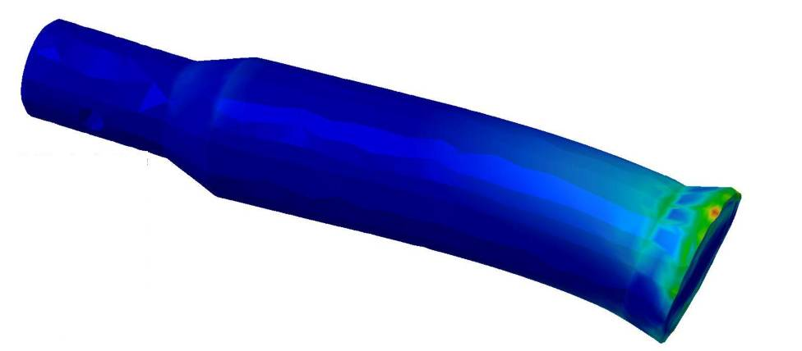
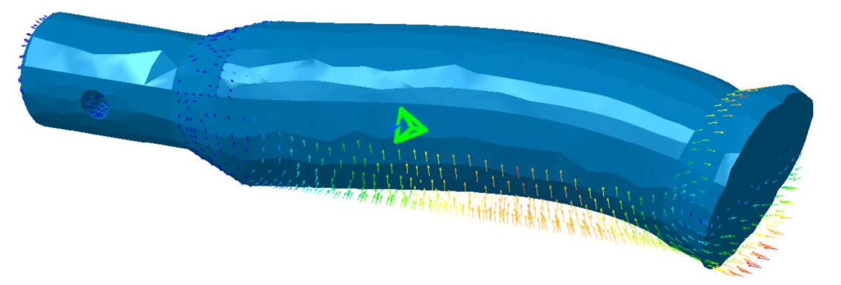
Mechanical Structure: Supporting Feet
Glass Fiber
From 14 to 23 mm diameter
100 mm long
Conical surfaces to support MP1 and hold in MP2
Tensile Yield Point, σ_{radial} = 250 MPa
Young´s modulus, E_{radial} = 25 GPa
Thermal conductivity, λ = 0, 3 W/mK
Thermal linear expansion, 1,2 x 10⁻⁵ 1/T
Max. Stress: 114 MPa
Security Coefficient > 4
Max. Displacement: 0,07 mm

Slide 13
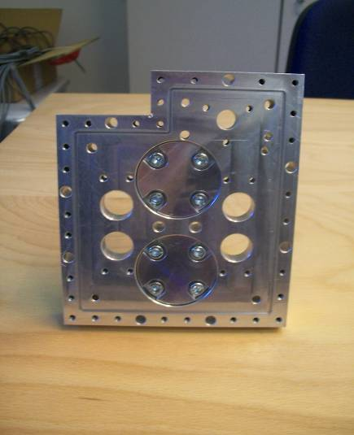
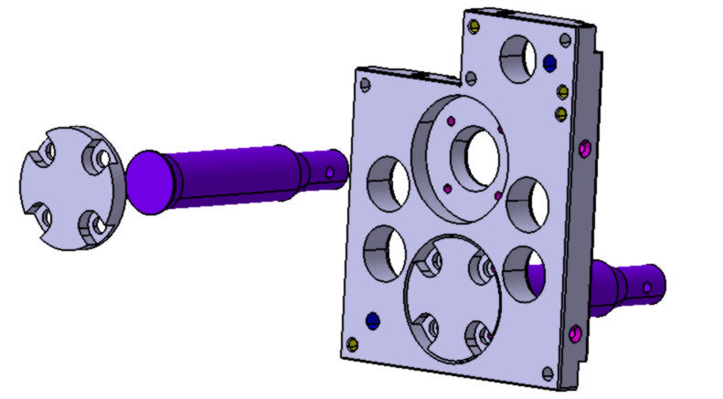
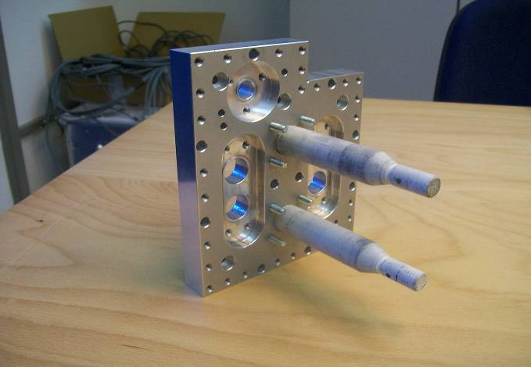
Mechanical Structure: Feet
Aluminum caps bolted with 4 screws

Slide 14
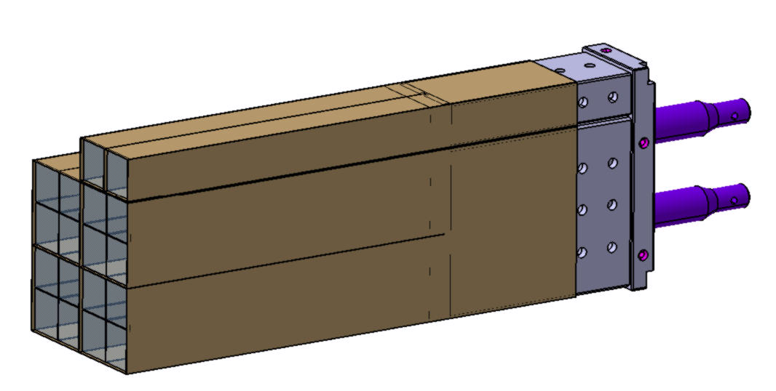
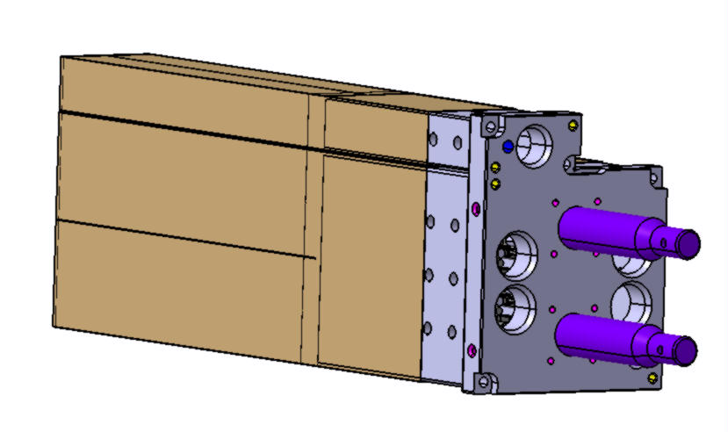
Mechanical Structure
The aluminum Inserts are bolted with 2 screws and positioned by 2 pins each one

Slide 15
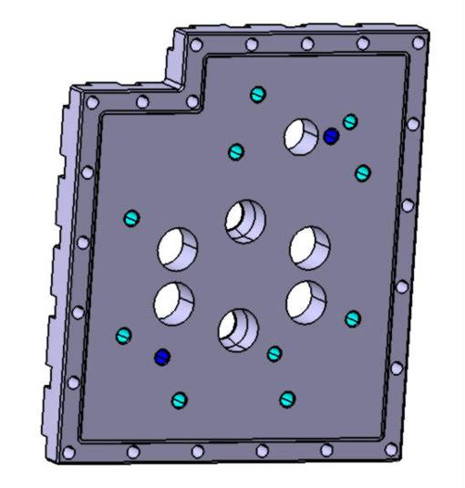
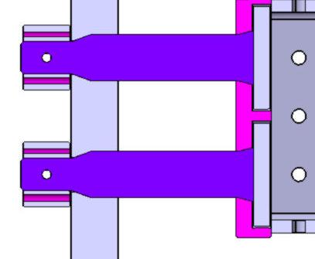
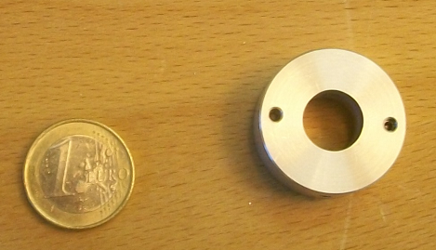
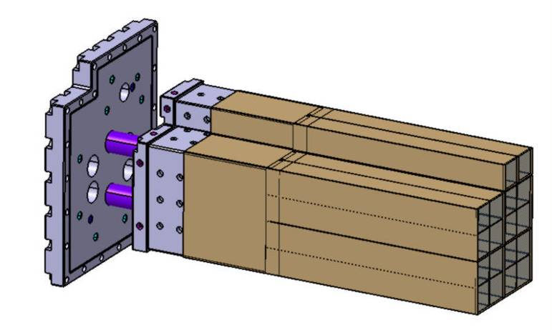
Mechanical Structure: MP2
Mounting Plate 2
Aluminum
25 mm thick
Same drilled holes as in MP2 (N₂, feet, wires)
Groove for o-ring sealing
“Warm Plate”
10 x Cooling holes
o-ring groove
2 x Aluminum Lockers

Slide 16
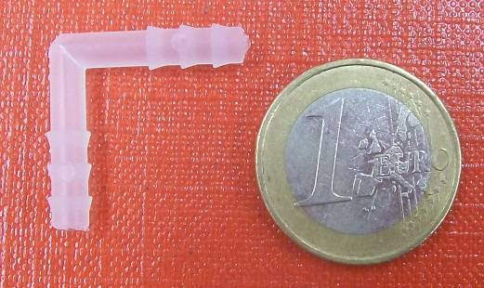
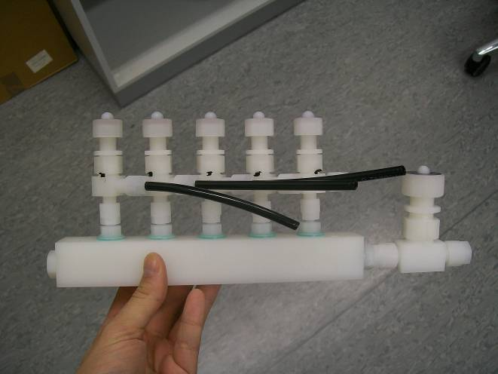
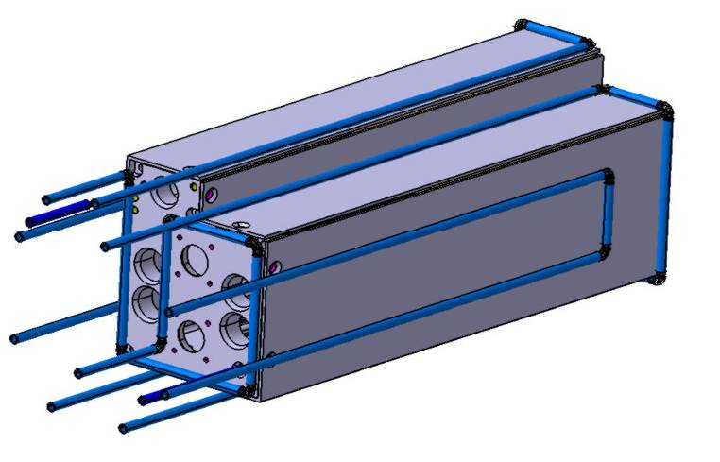
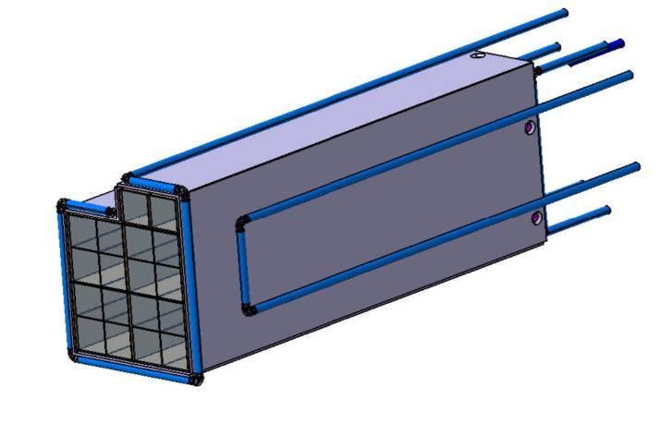
Cooling System: Circuits
Aluminum Shell (divided in 3 parts because of the shrinkage) bolted to the MP1 to distribute cooling power
PU Cooling pipe (internal diameter: 4mm, external diameter: 6mm)
PVDF 90º elbows
5 different circuits commanded by an external manifold: ability to study different cooling configurations
3
2
1
4
5

Slide 17
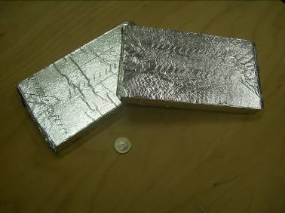
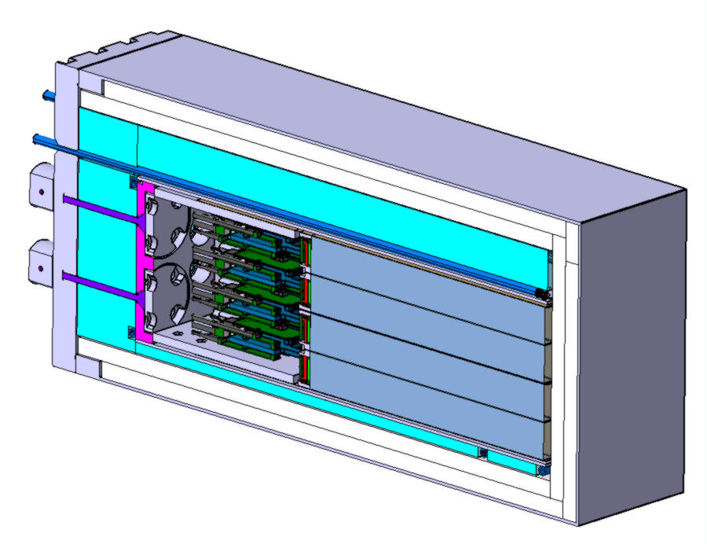
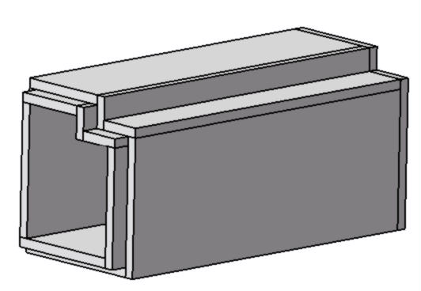
Insulation System: Elements
Vacuum Insulation Panel (λ: 0,008 W/mK)
Styrofoam (λ: 0,03 W/mK)
Insulation tubes around the cooling pipes
Styrofoam blocks (6-7 mm thick)
Al Cover
(2 mm thick)
VIP double box
(16 panels 10mm thick )
O-ring

Slide 18
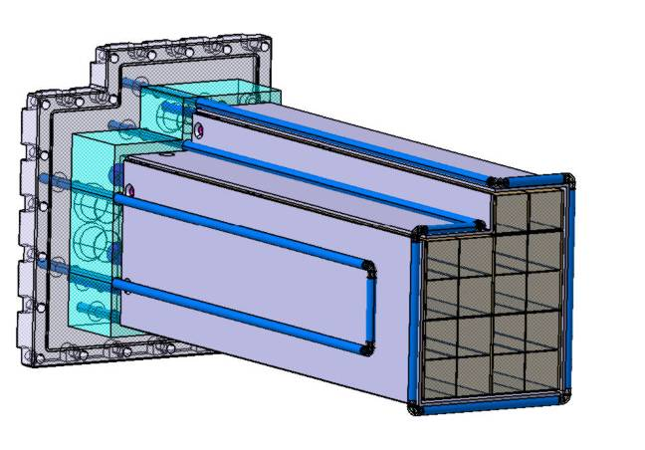
Insulation System: Backside
Back Insulation
Styrofoam 50 mm thick block. Drilled for wire evacuation, Feet, back cooling pipes and N₂ pipes (coincident holes with MPs)
Channels for back cooling pipes

Slide 19
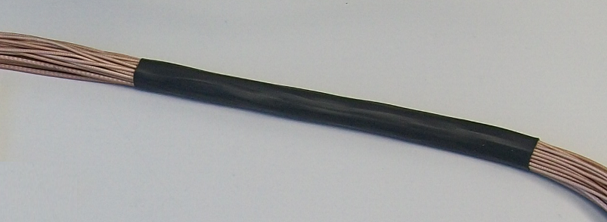
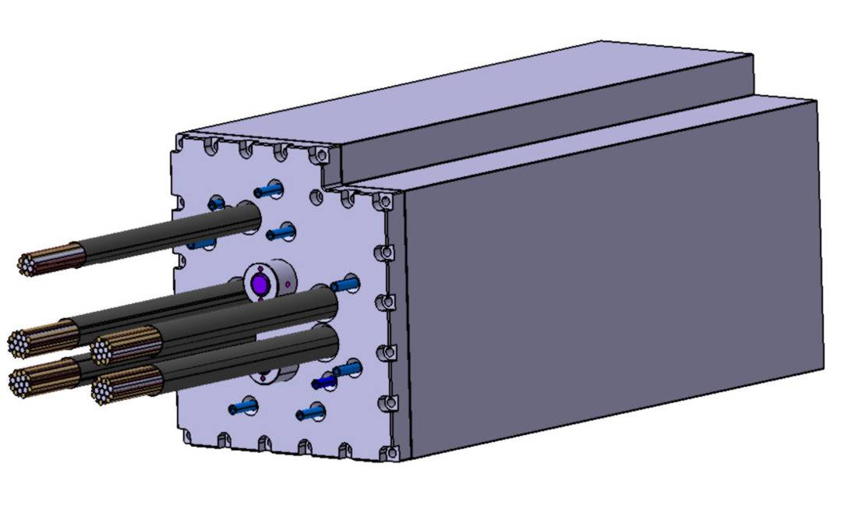
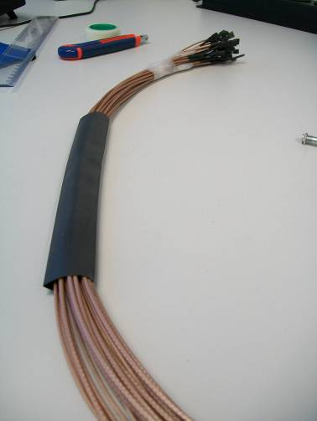
Wire Evacuation
Current status:
3 wires going out per preamplifier (signal, high voltage, power supply)
Working in reducing the quantity of wires
Study sealing, checking the possible entrance of water-air
Shrinking tubes for wire evacuation. Using black silicone for the sealing
Tight tubes after heat application

Slide 20
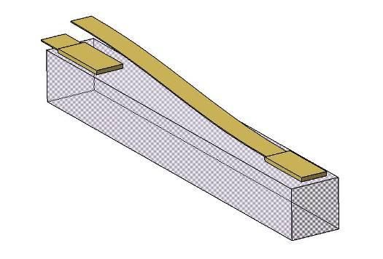
Sensors
Thermal sensors
Design from Bochum
Built by our group at GSI
Sensors in several positions to monitor temperatures
Covering most possible number of crystals
Some also around the prototype, inside
2 measurement positions in order to check the crystal gradient
Humidity sensors
To monitor the relative humidity inside
4 sensors: 2 in the front, 2 inside Inserts

Slide 21
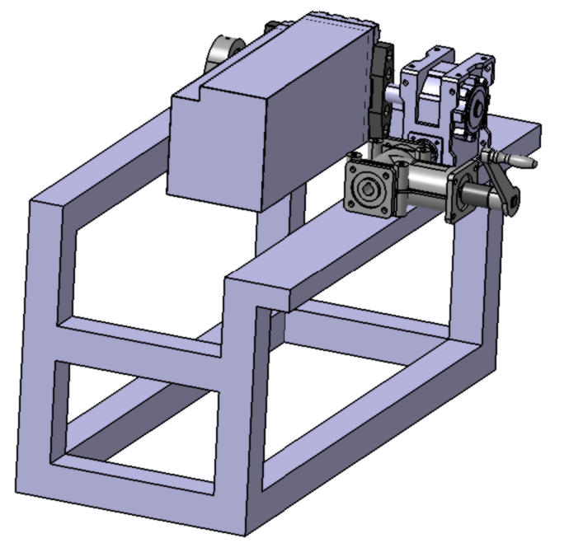
Support System
Ball Bearing
Worm Drive
Vertical position for cosmic rays testing
Hand Crank
Aluminum Profiles Structure
Bevel Gearbox

Slide 22
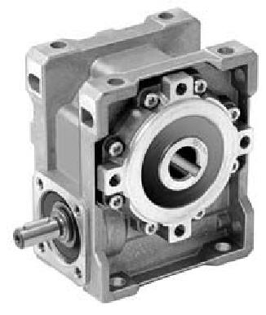
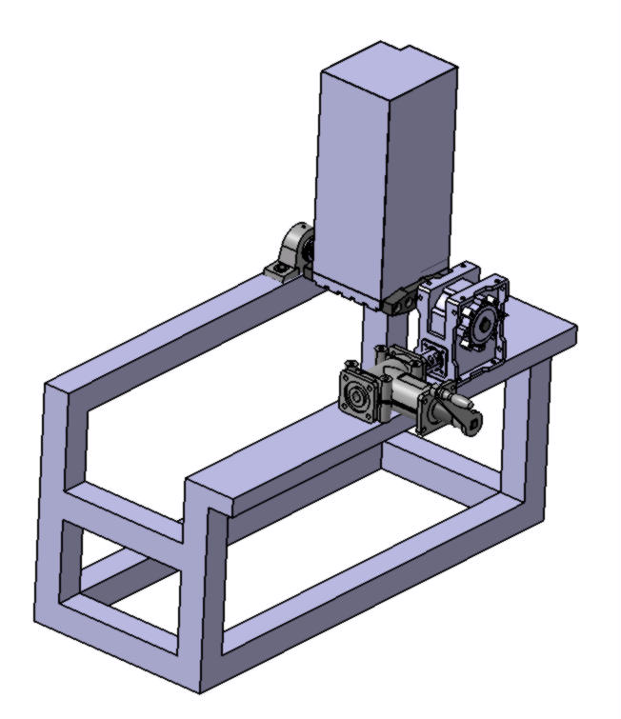
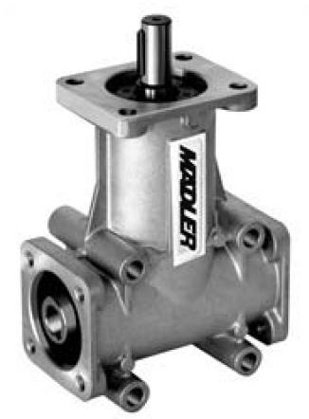
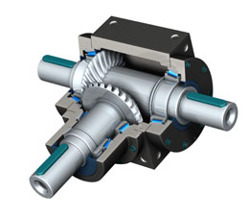
Support System
Worm Drive
Bevel Gearbox

Slide 23
Proto18 Tests
VIP Test
Load Test
Mounting Test

Slide 24
PROTO18: Future Tasks
Mechanical design
Insert design in two parts due to machining restraints
Arrange Cover, Mounting Plate designs and o-ring size with Vacuum and Mechanical Workshops
Check spaces in the front, to test front cooling too
Cooling & Insulation
Define N₂ circuit system
Chiller Selection
Define additional cooling circuits
Electronics
Patch Panels wire selection
Reduction of preamplifier number
Support & Alignment System
Design the Support Profile Structure
Define alignment system
Load Test
Check crystals deflection using Dial Indicators
VIP Test
Check VIP efficiency
Check VIP joints
Mounting test
Continue the improvement (tools design…)

