Slide 1



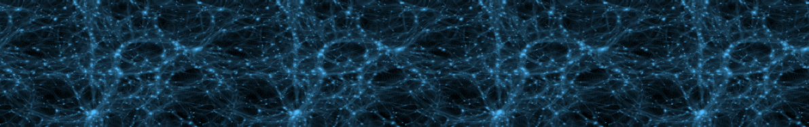
Kazuya Koyama
University of Portsmouth
Non-linear structure formation in modified gravity models
with Gong-bo Zhao (Portsmouth), Baojiu Li (Durham)

Slide 2
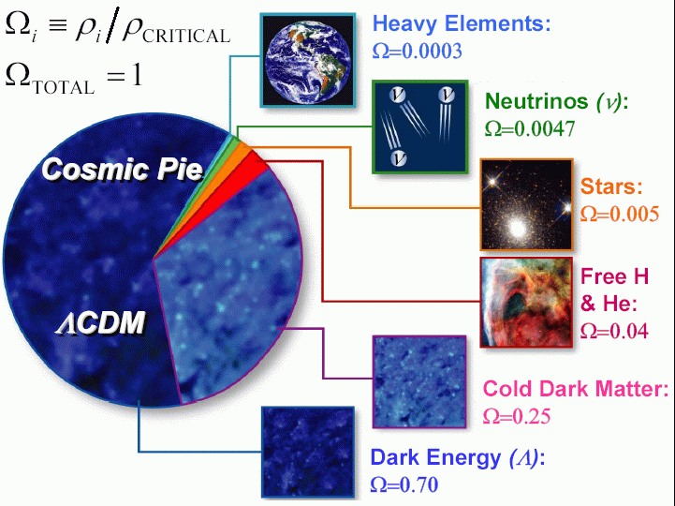
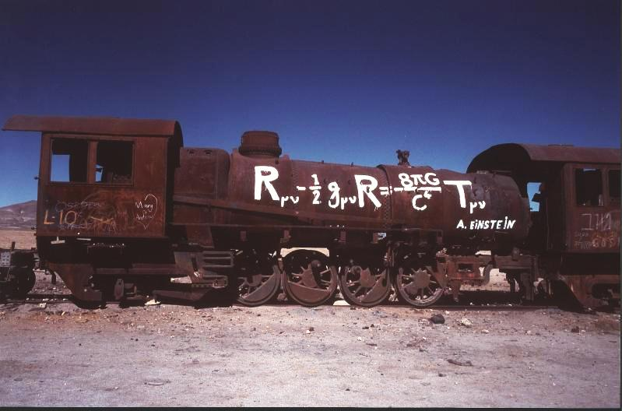
Dark energy v modified gravity
Is cosmology probing the breakdown of general relativity at large distance?

Slide 3

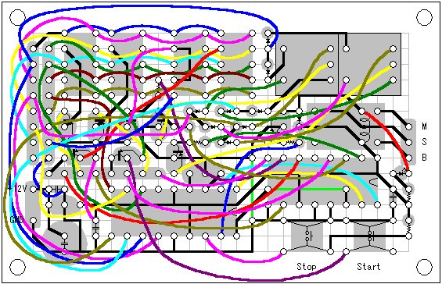
Examples
Dvali-Gabadadze-Porrati braneworld model
gravity leaks into 5D on larges scales and the Universe
self-accelerates without cosmological constant
f(R) gravity
there is no cosmological constant at low energies yet
the expansion of the universe can accelerate
It is extremely difficult to construct a consistent theory

Slide 4
General picture
Largest scales
gravity is modified so that the universe
accelerates without dark energy
Large scale structure scales
gravity is still modified by a
fifth force from scalar graviton
Small scales (solar system)
GR is recovered
Modified gravity
Scalar tensor
GR

Slide 5
From linear to non-linear scales
Linear scales
Model independent parametrisation of modified Einstein equations is possible (two functions of time and space)
  many ways to parametrise these functions directly or indirectly
  (i.e. parametrisation of the growth rate)
  Principal component analysis provides model independent tests
Non-linear scales
Mechanisms to recover GR on small scales are model dependent
Pogosian, Silverstri, KK, Zhao 1002.2383
Zhao et.al. 0908.1568, 1003.001, Hojjati et.al. 1111.3960

Slide 6
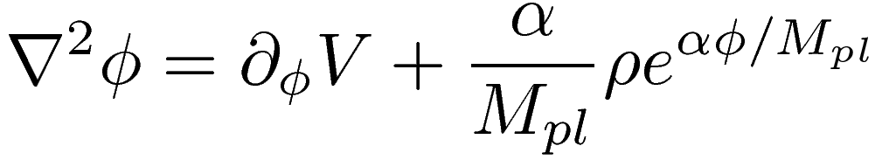
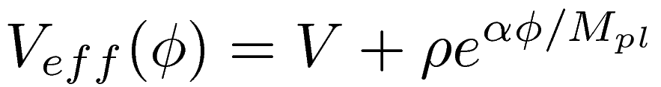

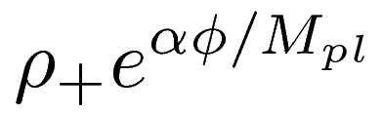

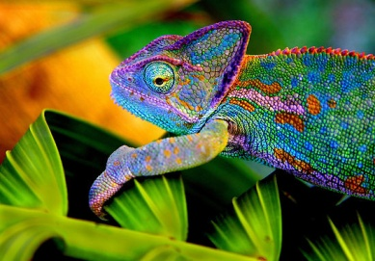
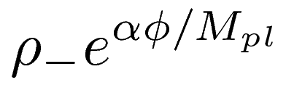

How we recover GR on small scales
Chameleon mechanism (Khoury & Weltman)

Slide 7
Example – f(R) gravity
Two limits
  GR
  Scalar-Tensor(ST)
  the fifth force has a similar strength as gravity

Slide 8
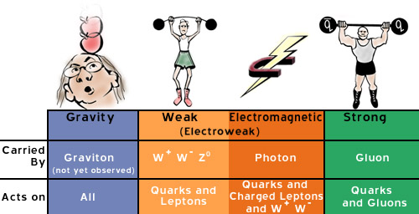

Linear regime
Linearise the equation
The fifth force does not propagate beyond
the Compton wavelength (GR limit)
Below the Compton wavelength, gravity is enhanced (ST limit)
G
GR
4G/3
ST

Slide 9


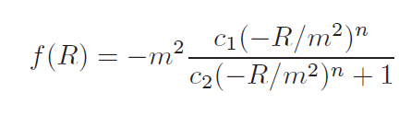
Chameleon mechanism
Khoury and Weltman
Fifth force is strongly constrained at solar system
the post-Newtonian parameter is not
Chameleon mechanism
the mass of the scalar mode becomes heavy
in a dense environment
Engineering f(R) gravity model
Brax et.al.
Hu & Sawicki

Slide 10
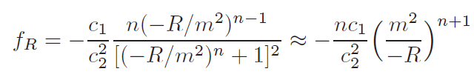


Non-linear regime
Chameleon mechanism
In a dense region, linearisation fails and GR is recovered
Present day Ricci curvature of the Universe today
It is required to solve a non-linear Klein-Gordon equation of the scalar field self-consistently

Slide 11
Behaviour of gravity
There regimes of gravity
Understandings of non-linear clustering require N-body simulations
GR
Scalar tensor
GR
G
4G/3

Slide 12

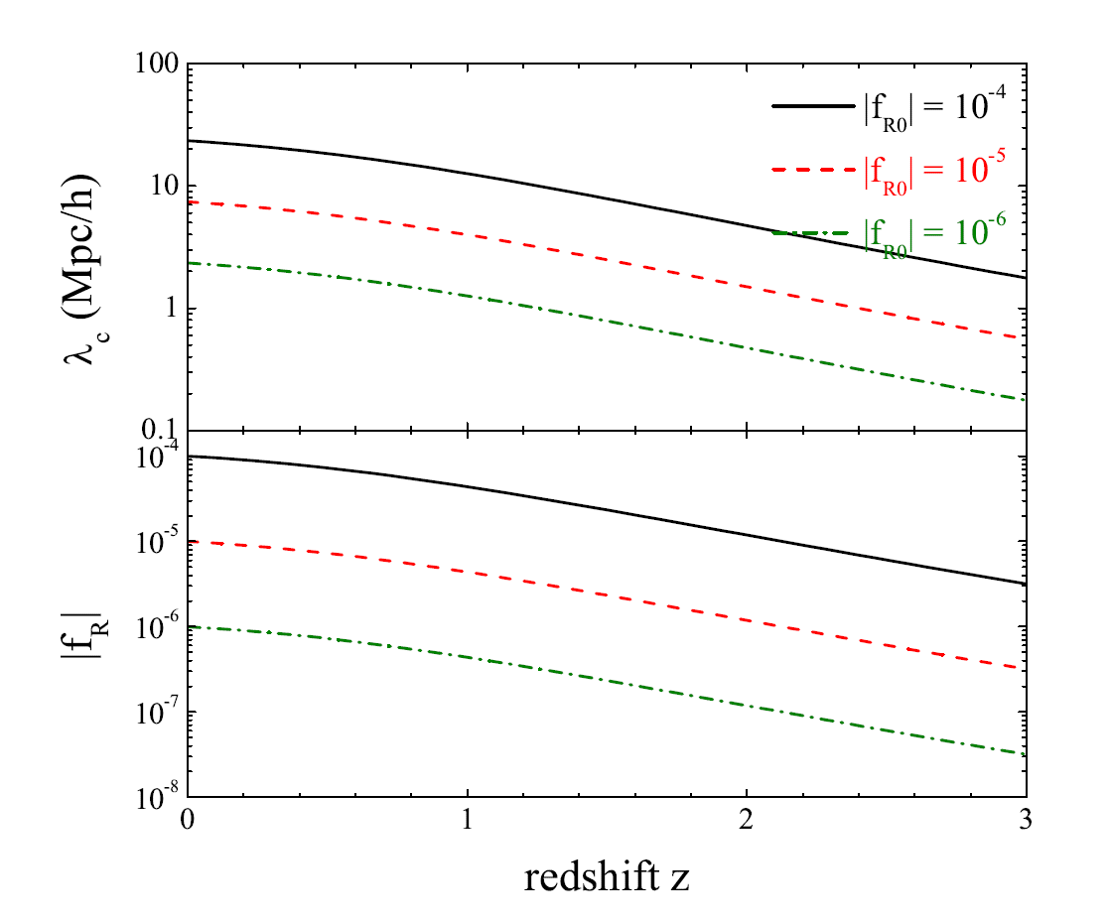
Parameter
Compton wavelength
For a larger ,
the Compton wavelength
is longer
Chameleon mechanism
The Chameleon works
when and the
linearisation fails
It works better for smaller
and earlier times

Slide 13
Models
Full f(R) simulations
solve the non-linear scalar equation
Non-Chameleon simulations
artificially suppress the Chameleon by linearising the
scalar equation to remove the Chameleon effect
LCDM
Oyaizu et.al. PRD78 123524 2008, Schmidt et.al. PRD79 083518 2009

Slide 14
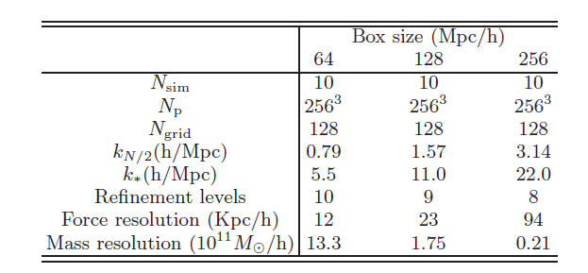
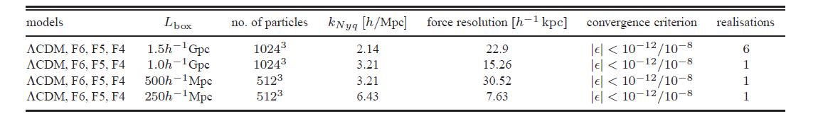
N-body Simulations
MLAPM code
ECOSMOG code (based on RAMSES)
Li, Zhao 0906.3880, Li, Barrow 1005.4231
Zhao, Li, Koyama 1011.1257
Li, Zhao, Teyssier, Koyama 1110.1379
Braxet.al. 1206.3568

Slide 15

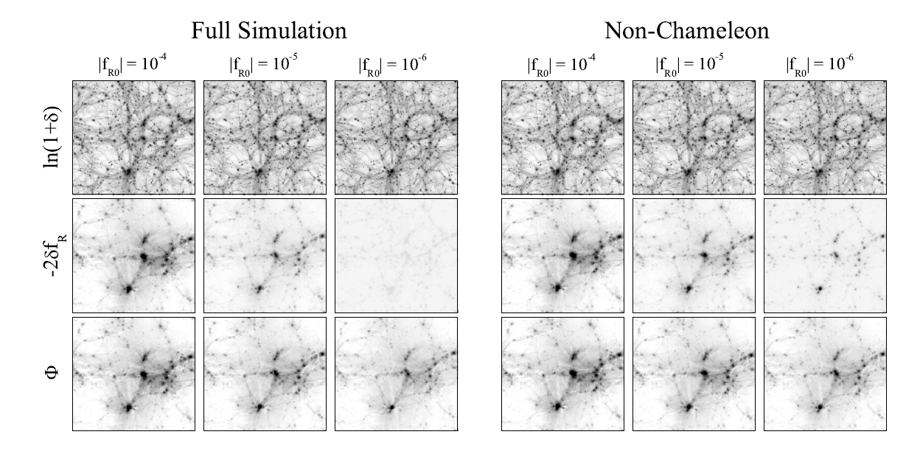
Snapshots at z=0
If the fifth force is not suppressed, we have
Fifth force is not suppressed
Chameleon is working
Compton wavelength is short

Slide 16
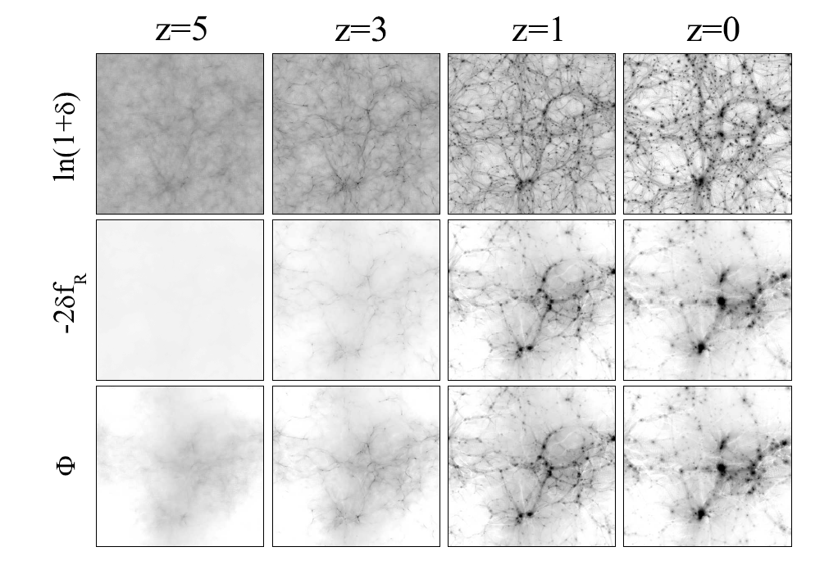
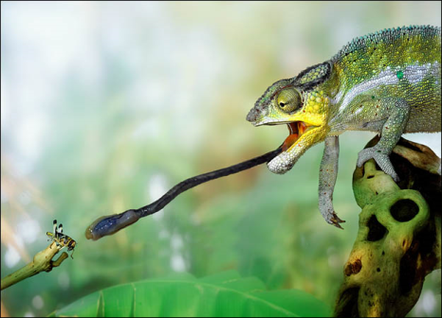
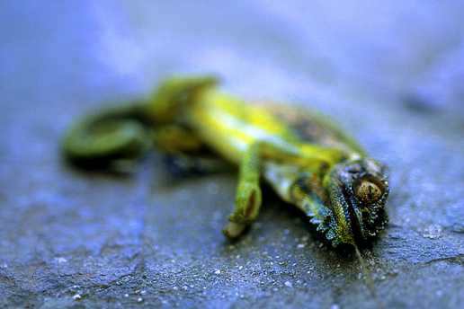

Snapshots
Chameleon is working
Chameleon
stops working
Chameleon starts to hibernate

Slide 17

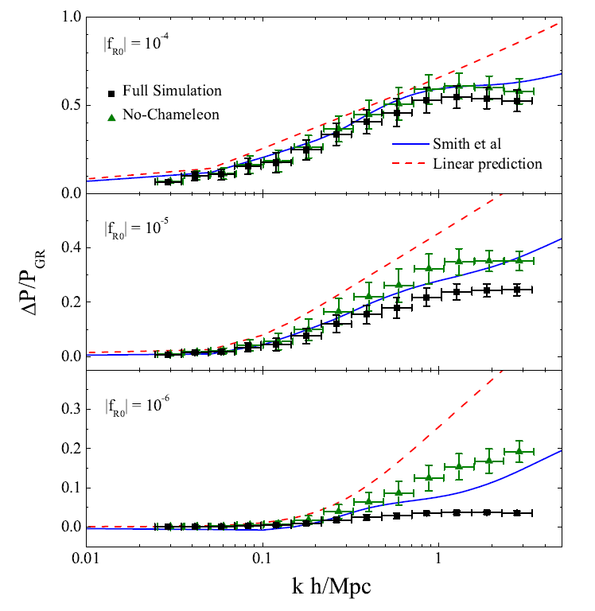
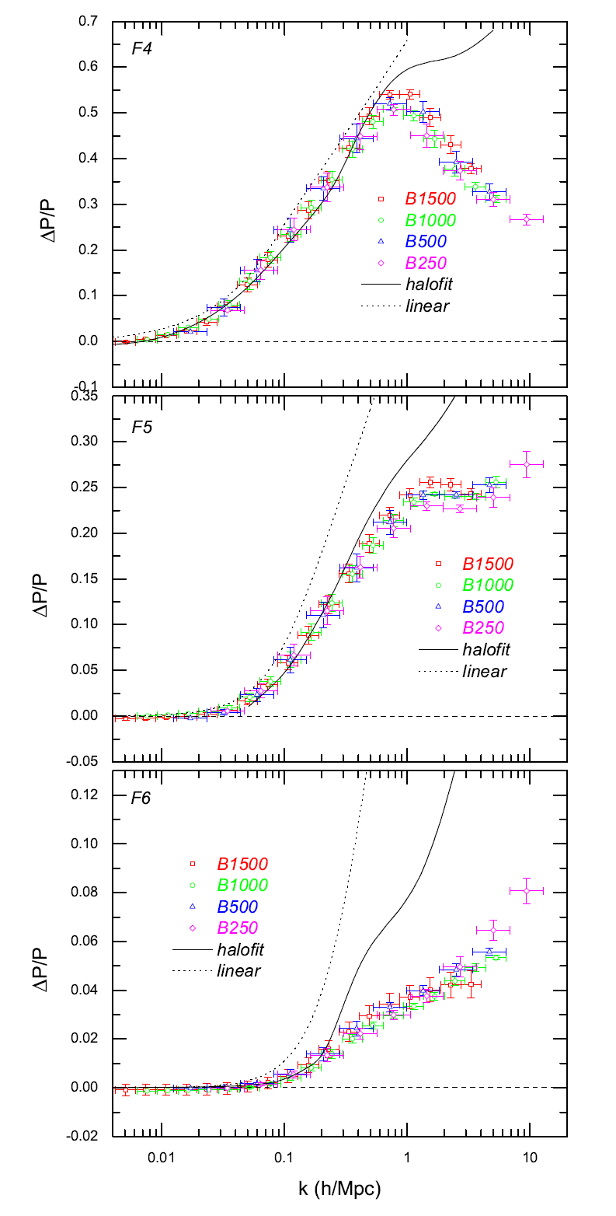
Power spectrum (z=0)
full
Non-Chameleon
Zhao, Li, KK 1011.1257
Li, Hellwing, KK, Zhao, Jennings, Baugh 1206.xxxx

Slide 18
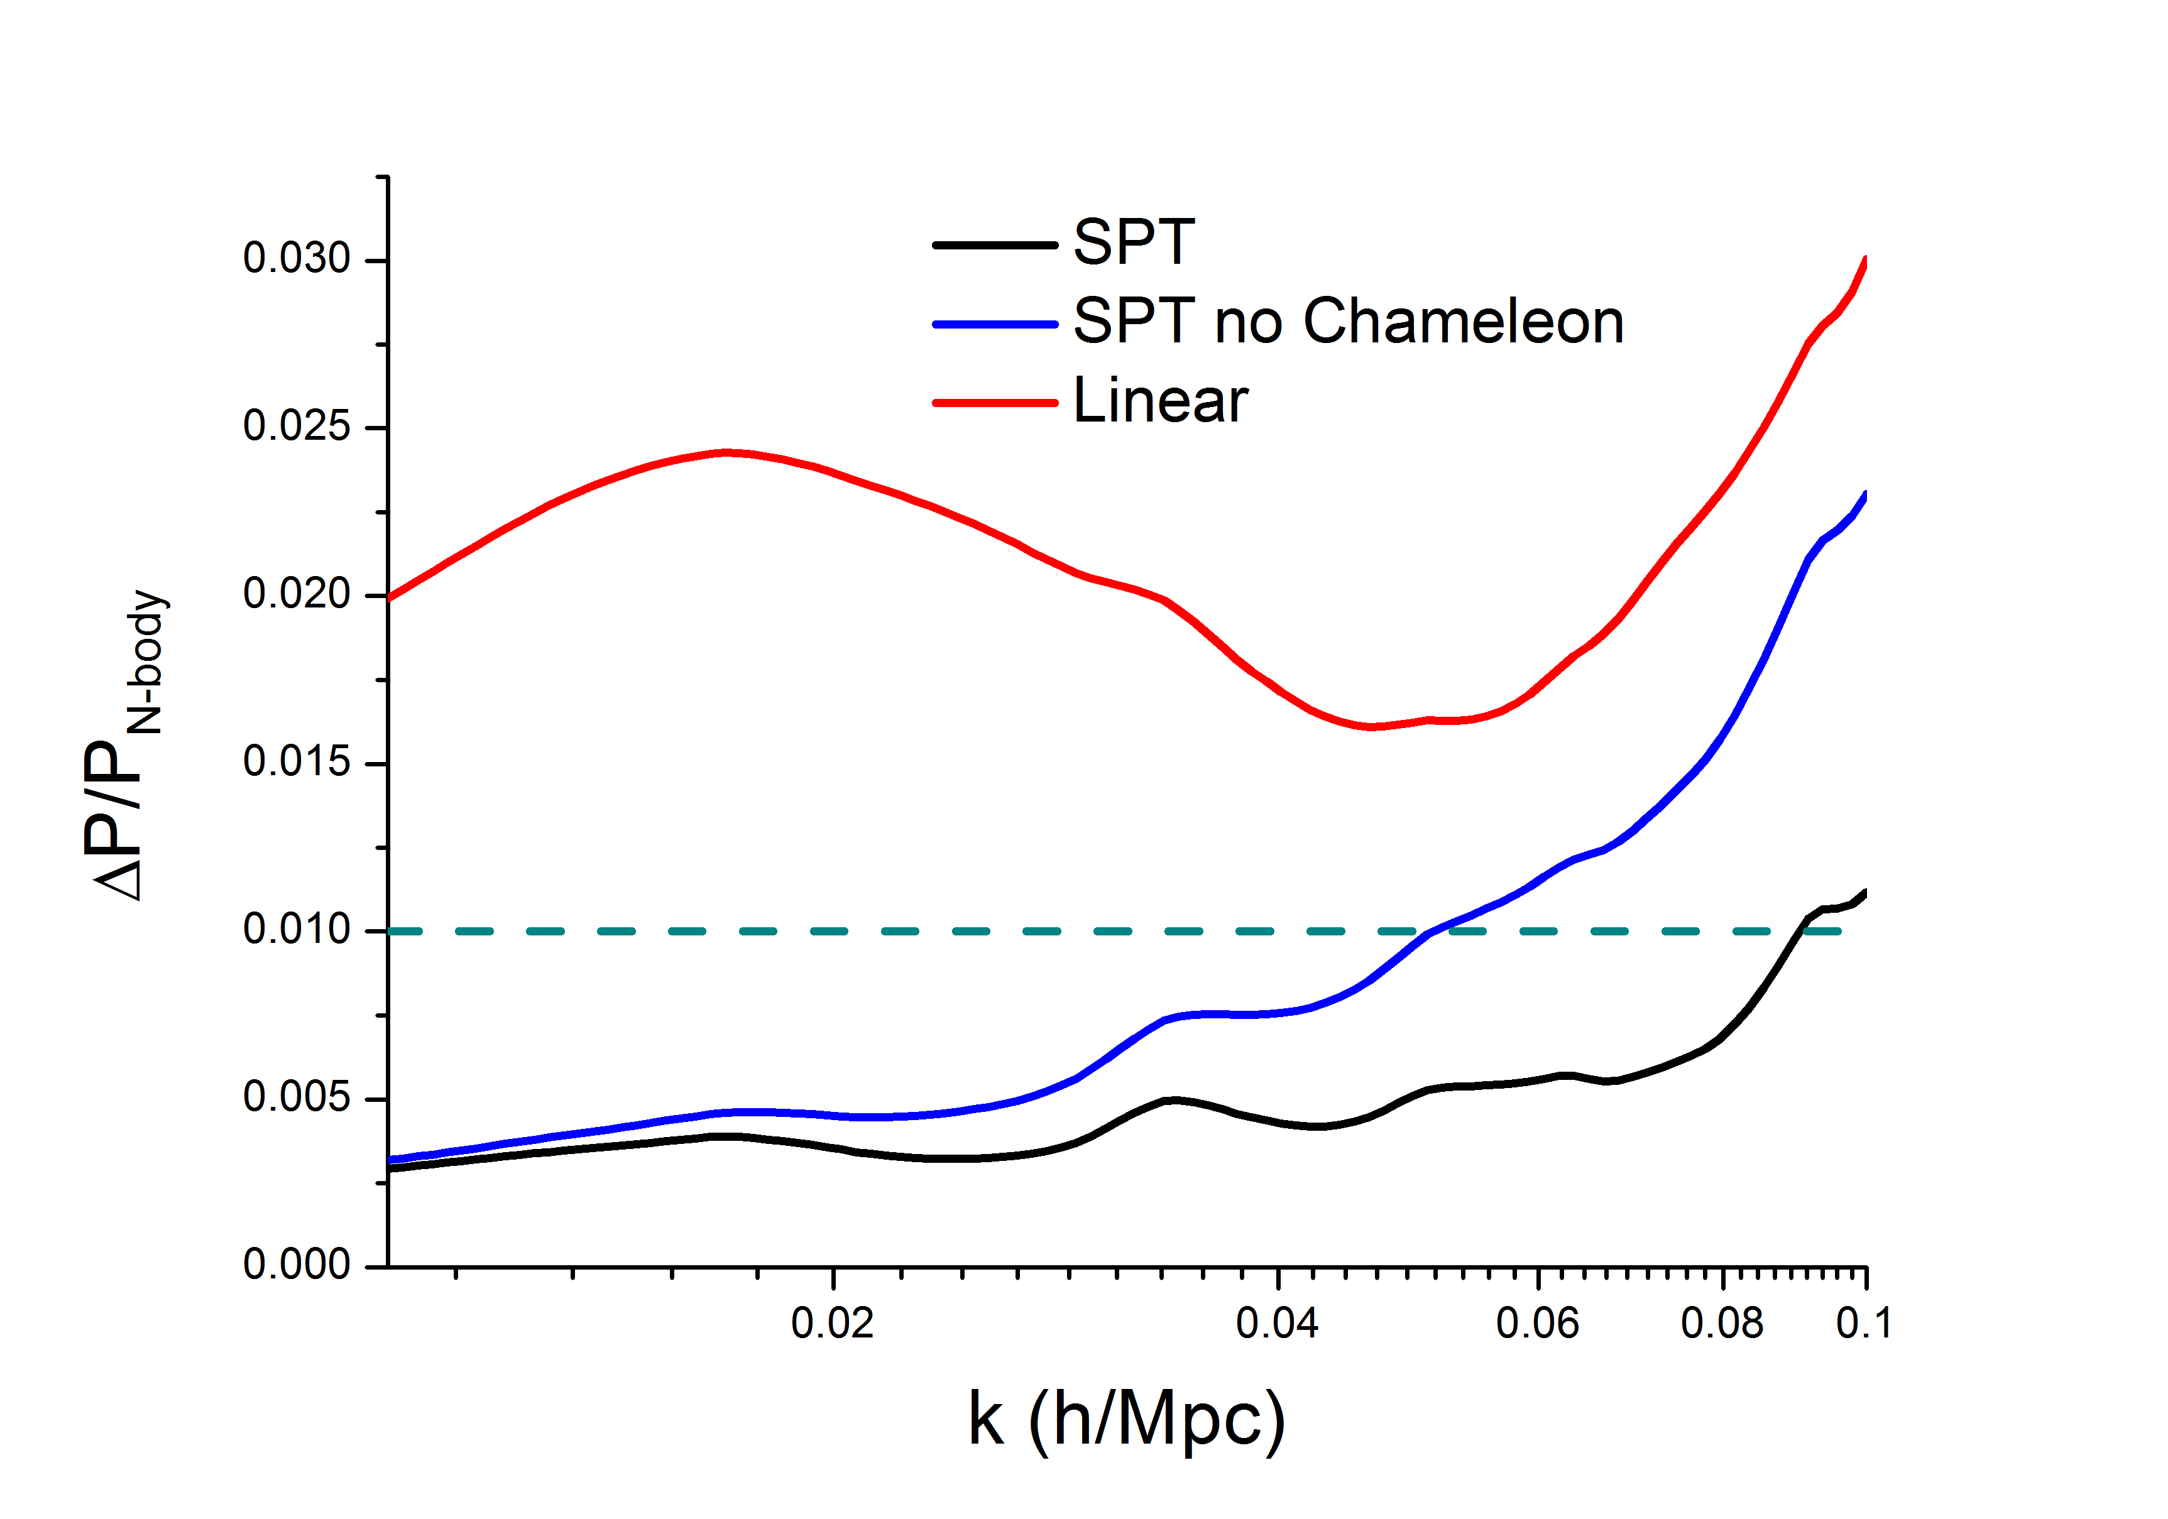
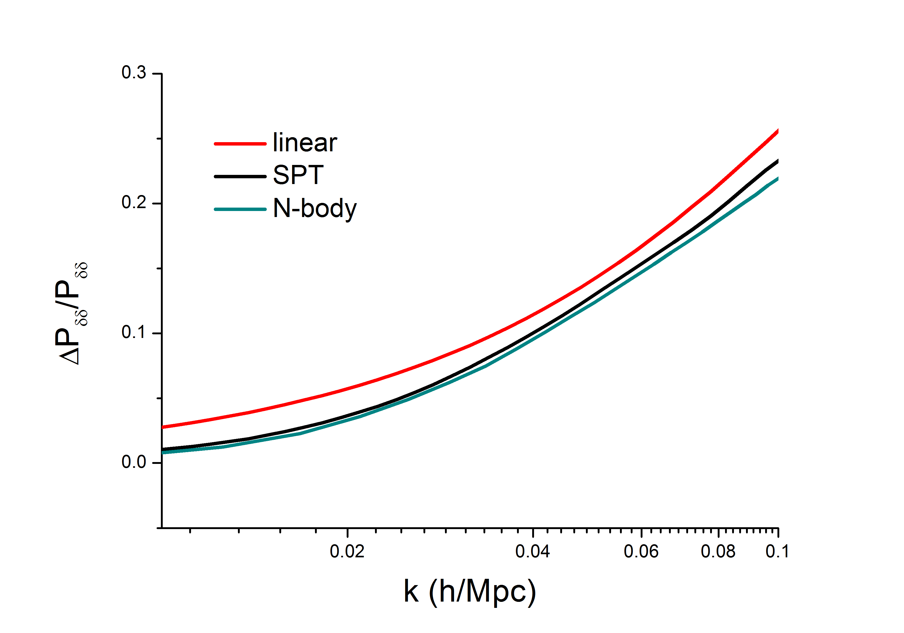
Quasi non-linear scales
Standard perturbation theory predictions
Even in F4, inclusion of Chameleon effects is important below k<0.1 h/Mpc
SPT agrees with N-body results at 1% level at k<0.09 h/Mpc (z=0)
(KK, Taruya, Hiramatsu 0902.0618)
Bernardeau, Brax 1102.1907, Brax, Valageas 1205.6583

Slide 19
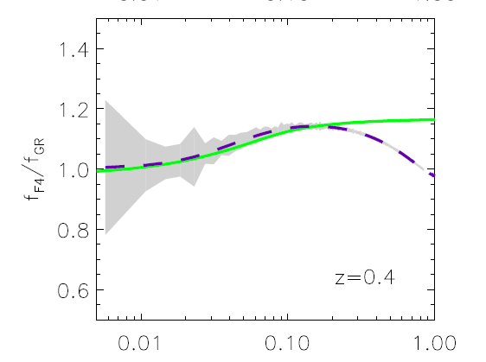
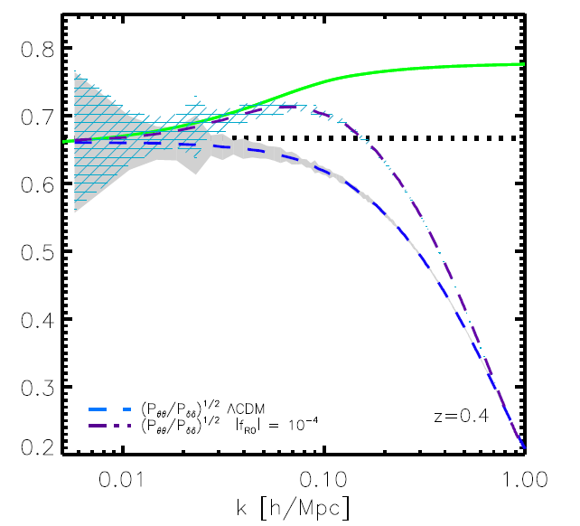
Growth rate
Jennings, Baugh, Li, Zhao, Koyama, 1205.2698
Growth rate
on linear scales it is defined as
F4 linear
GR linear
F4
G
4G/3
GR
Stronger gravity enhances linear growth rate as well as non-linear damping
F4:

Slide 20
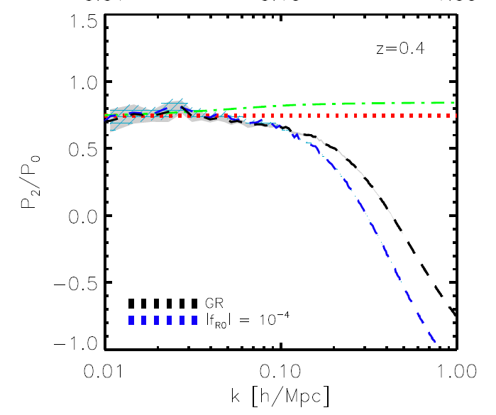
Redshift space distortions
Jennings, Baugh, Li, Zhao, Koyama, 1205.2698
Power spectrum in redshift
space become anisotropic
Multipole decomposition
F4 linear
GR linear
GR
F4
Modelling of non-linear effects is crucial to extract the differences in the linear growth rate between GR and f(R) gravity models
Taruya, Nishimichi, Saito 1006.0699, Nishimichi, Taruya 1106.4562

Slide 21
Halos
MHF (default halo identifier of MLAPM)
Use TSC interpolation to assign particles to grids and identify
halos using the spherical over density method
Spherical over-density
We use the virial over-density in LCDM
at z=0 and at z=1
Minimum number of particles in halos is 800

Slide 22
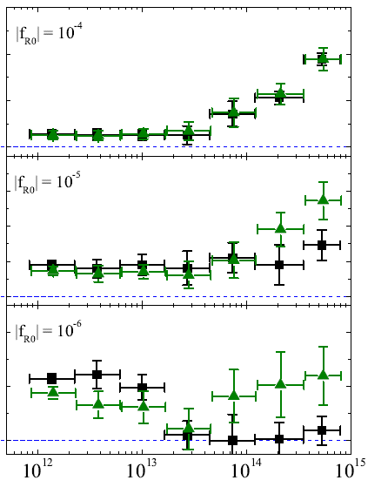


Mass function
full
Non-Chameleon
  If Chameleon is not working, strong gravity creates more and more heavy halos and the abundance of massive halos is enhanced
  Cluster abundance gives the tightest constraint so far
  Chameleon works better for heavier halos and it suppresses the abundance of large halos

Slide 23
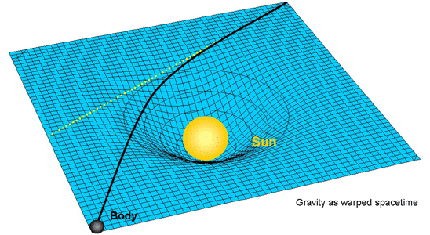
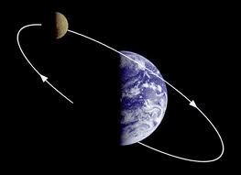


Screening of dark matter halos
Zhao, Li, Koyama 1011.1257
In modified gravity models, dynamical mass inferred from
velocity dispersions and lensing mass can be different
f(R)
Difference between dynamical and lensing masses
The fifth force does not change geodesics of photon
The fifth force enhances Newtonian gravity below the Compton wavelength
Schmidt 1003.0409

Slide 24
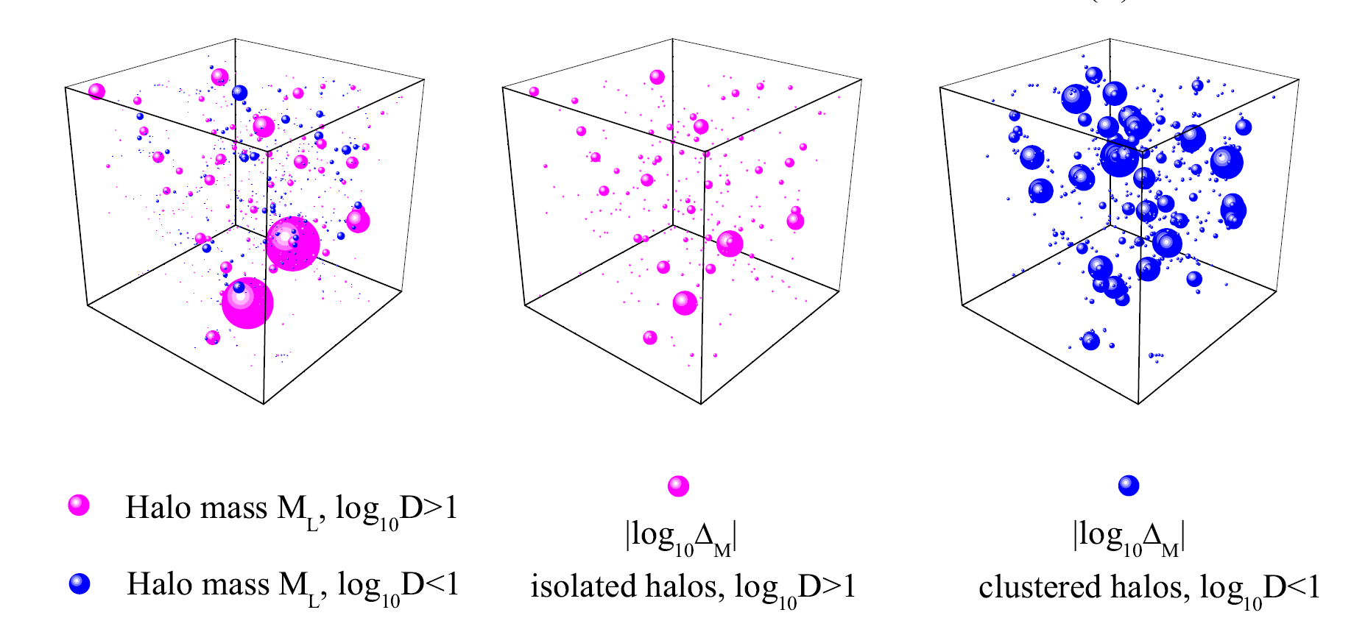
Environmental effects
Zhao, Li, Koyama 1011.1257
GR is recovered even in
small halos nearby big halos
Large bubbles =better screened (GR is recovered)

Slide 25
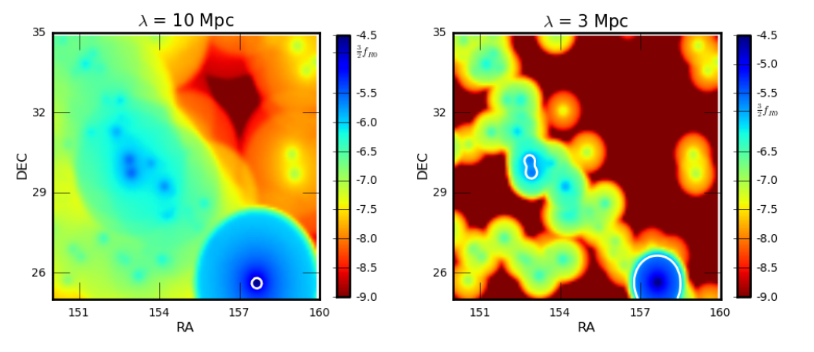
Creating a screening map
It is essential to find places where GR is not recovered
  Small galaxies in underdense regions
  SDSS galaxies within 200 Mpc
Cabre, Vikram, Zhao, Jain, KK
1204.6046
GR is recovered

Slide 26
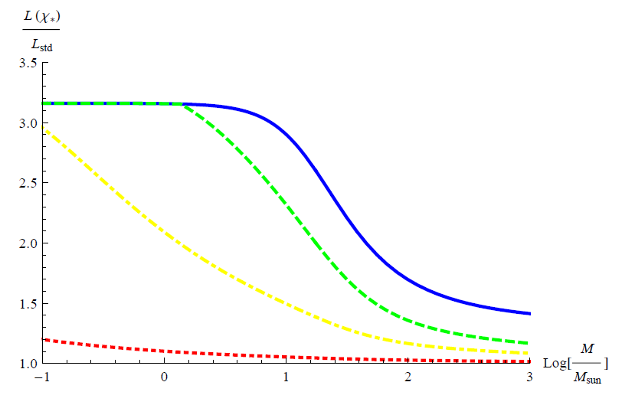
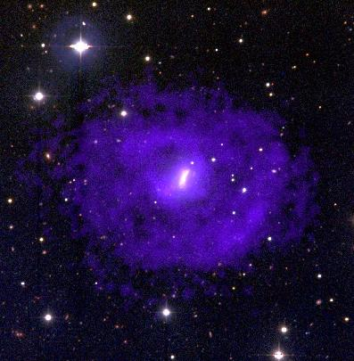
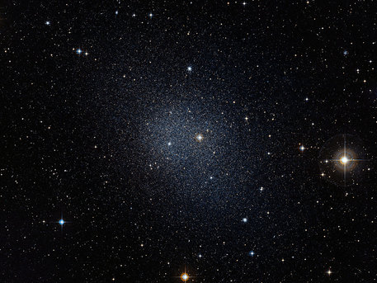
Tests of gravity using unscreened galaxies
dwarf galaxies in voids
  shallow potentials
  unscreened
  Galaxies are brighter
  A displacement of the stellar
  disks from HI gases
Davis et.al. 1102.5278
HI gas:
unscreened
Stellar disk:
screened
Jain & VanderPlas 1106.0065

Slide 27
Summary
Non-linear clustering
mechanisms to recover GR play a crucial role
  The power spectrum tends to go back to the one in GR with the same expansion history
  GR is better recovered in massive halos
  Details of the recovery of GR depend on screening mechanisms
A challenge for theoretical predictions
need to solve non-linear Poisson equation for the scalar
  Perturbation theory approach
  N-body simulations
Need to find the best places to detect deviations from GR
  Fifth force can significantly changes stellar evolution in unscreened galaxies (Chang & Hui, Davis et.al.)
  Stellar discs can be self-screened in unscreened dwarf galaxies (Jain & VanderPlas)
(KK, Taruya, Hiramatsu 0902.0618)
(Zhao, Li, KK 1011.1257, Li, Zhao, Teyssier, KK 1110.1379)

