Slide 1
France Grilles Structuration du cloud Hélène Cordier
direction-technique@france-grilles.fr

Slide 2
Les canaux de communication
EGI CLOUD Task Force
https://wiki.egi.eu/wiki/Fedcloud-tf:FederatedCloudsTaskForce
Points hebdomadaires
https://wiki.egi.eu/wiki/Fedcloud-tf:Resources
CLOUD@France-grilles
FG@CC, FG@Toulouse
https://forge.in2p3.fr/projects/francegrilles-ops/wiki/CLOUD
cloud-discuss@france-grilles.fr
CAPRI
LAL, IRFU, IPGP, CC
capri-discuss@france-grilles.fr
Cloud@CC
ccloud-discuss-l@in2p3.fr ; ccloud-tech-l@in2p3.fr

Slide 3
Participants - EGI Cloud Task-Force
France participation
Tech experts :
GRIF → RP(240) (StratusLab)
CC → RP (40) ( Openstack)
IPHC
Infrastructure Providers
StratusLab

Slide 4
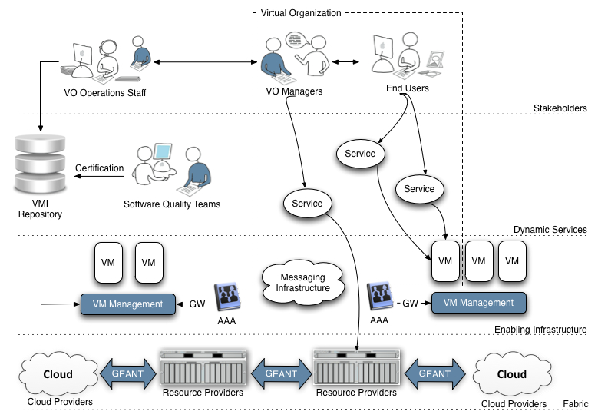
A Virtualised Future?
Experts
(Communicating between users & providers)
VO Specific Operations Staff
End-Users
(National, European & Global Collaborations)
End-User Technology Experts
(National, European & Global Collaborations)
Virtual Research Community
Infrastructure
Providers
Infrastructure Providers
(Research & Commerical – National, European & Global)

Slide 5
The EGI Cloud
Individual communities get the environments they require
Community Services
Community Services
Virtual Machines
EGI.eu Coordination
Globus
Core Software & Support
gLite
ARC
Globus
UNICORE
Community Platform
dCache
Federated Virtual Machine Managers
NGI
NGI
NGI
EIRO
Amazon
Microsoft

Slide 6
A Federated EGI Cloud
No ‘big-bang’ migration
Gradual change transparent to the end-user
Clearly identifies the role of the expert
Allows experts to deploy & configure services
Experts already residing in the NGIs and VRCs
Increases the flexibility of the infrastructure
Meet the different needs of current users
Increases accessibility for other communities

Slide 7
The long term goal
An integrated service for all researchers
Any resources: commercial, academic, …
Transparent access: environment portability
Data Oriented: shift computation to the data
Federation through grid technologies
Grid crosses administrative & trust boundaries
Federated Cloud → Grid of virtualised resources

Slide 8
Next Steps
Identification of 6 simple use cases
Issues around federation
Issues around integration into EGI
Build a prototype federated cloud
Define a blueprint to help others
Provide feedback to technology providers
Attract new users to EGI
Report back through EGI blog
Managed by the TCB

Slide 9
Scenario 1
Running a pre-defined VM Image
VM Image known and accessible
VM Instance start, stop, dispose
Federated AAI restricts access to instance
Services
VMM, AAI, Remote access
Notes:
Guidelines
========
Add as many references for further reading as required
This should at least include references to scenarios that either match, or extend existing EGI use cases.

Slide 10
Scenario 2
Running my data and VM in the Infrastructure
VM Image is generated by the user
VM Image upload, snapshot download
Data resident with provider
Runtime link to data by configuration
Services
Data staging, VM Image configuration
Notes:
Guidelines
========
Add as many references for further reading as required
This should at least include references to scenarios that either match, or extend existing EGI use cases.

Slide 11
Scenario 3
Integrating multiple resource providers
Many resource providers
Comparable service descriptions
Integration at user level
Services
Service description (Information)
Notes:
Guidelines
========
Add as many references for further reading as required
This should at least include references to scenarios that either match, or extend existing EGI use cases.

Slide 12
Scenario 4
Accounting across Resource Providers
Unique user identification across resource providers
Resource usage is accounted
Shared resource accounting profile
Services
Accounting
Notes:
Guidelines
========
Add as many references for further reading as required
This should at least include references to scenarios that either match, or extend existing EGI use cases.

Slide 13
Scenario 5
Reliability/Availability of Resource Providers
Provider reliability and availability statistics
Historic accounts, and current figures
Regular publication of statistics
Services
Monitoring, Reporting (Information?)
Notes:
Guidelines
========
Add as many references for further reading as required
This should at least include references to scenarios that either match, or extend existing EGI use cases.

Slide 14
Scenario 6
VM/Resource state change notification
Reactive/proactive management
VM Instance state change management
Real-time notification constraints
Services
Notification (infrastructure, endpoints)
Notes:
Guidelines
========
Add as many references for further reading as required
This should at least include references to scenarios that either match, or extend existing EGI use cases.

Slide 15
Meetings EGI
24 Nov 2011 → F2F on Cloud technologies
01/12/2011 → F2F Amsterdam EMI5R/ERIS
26-31 March 2011 → EGI Community meeting , MUNICH
Validate use cases
Identify working technologies
Integrate into EGI

