Slide 1

Introduction on ATLAS FCPPL Project
ACC/CEA/IN2P3
Emmanuel MONNIER (CPPM)
FCPPL 5th workshop
21 March 2012

Slide 2
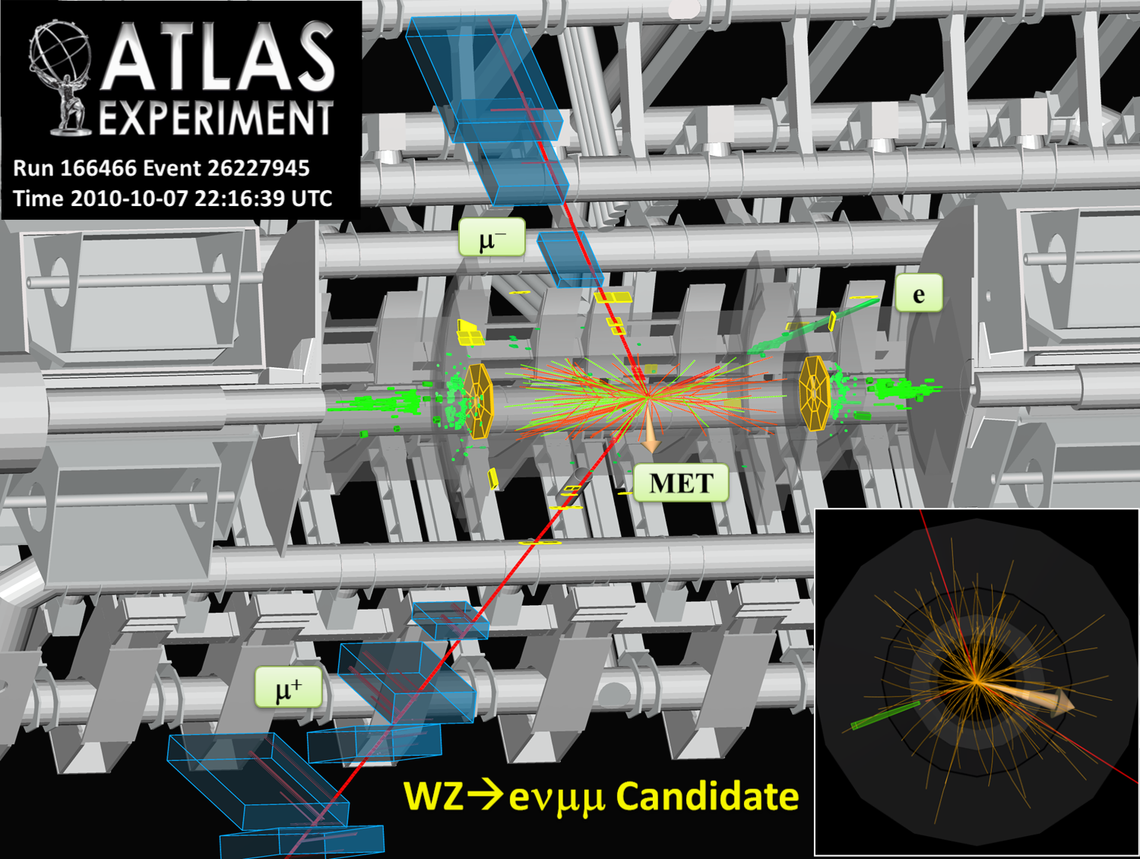
p_{T}(e) = 64 GeV, E_{T}^{Miss} = 21 GeV
p_{T}(μ⁺) = 65 GeV, p_{T}(μ⁻) = 40 GeV
M_{T} = 57 GeV, M_{μ+μ-} = 96 GeV

Slide 3
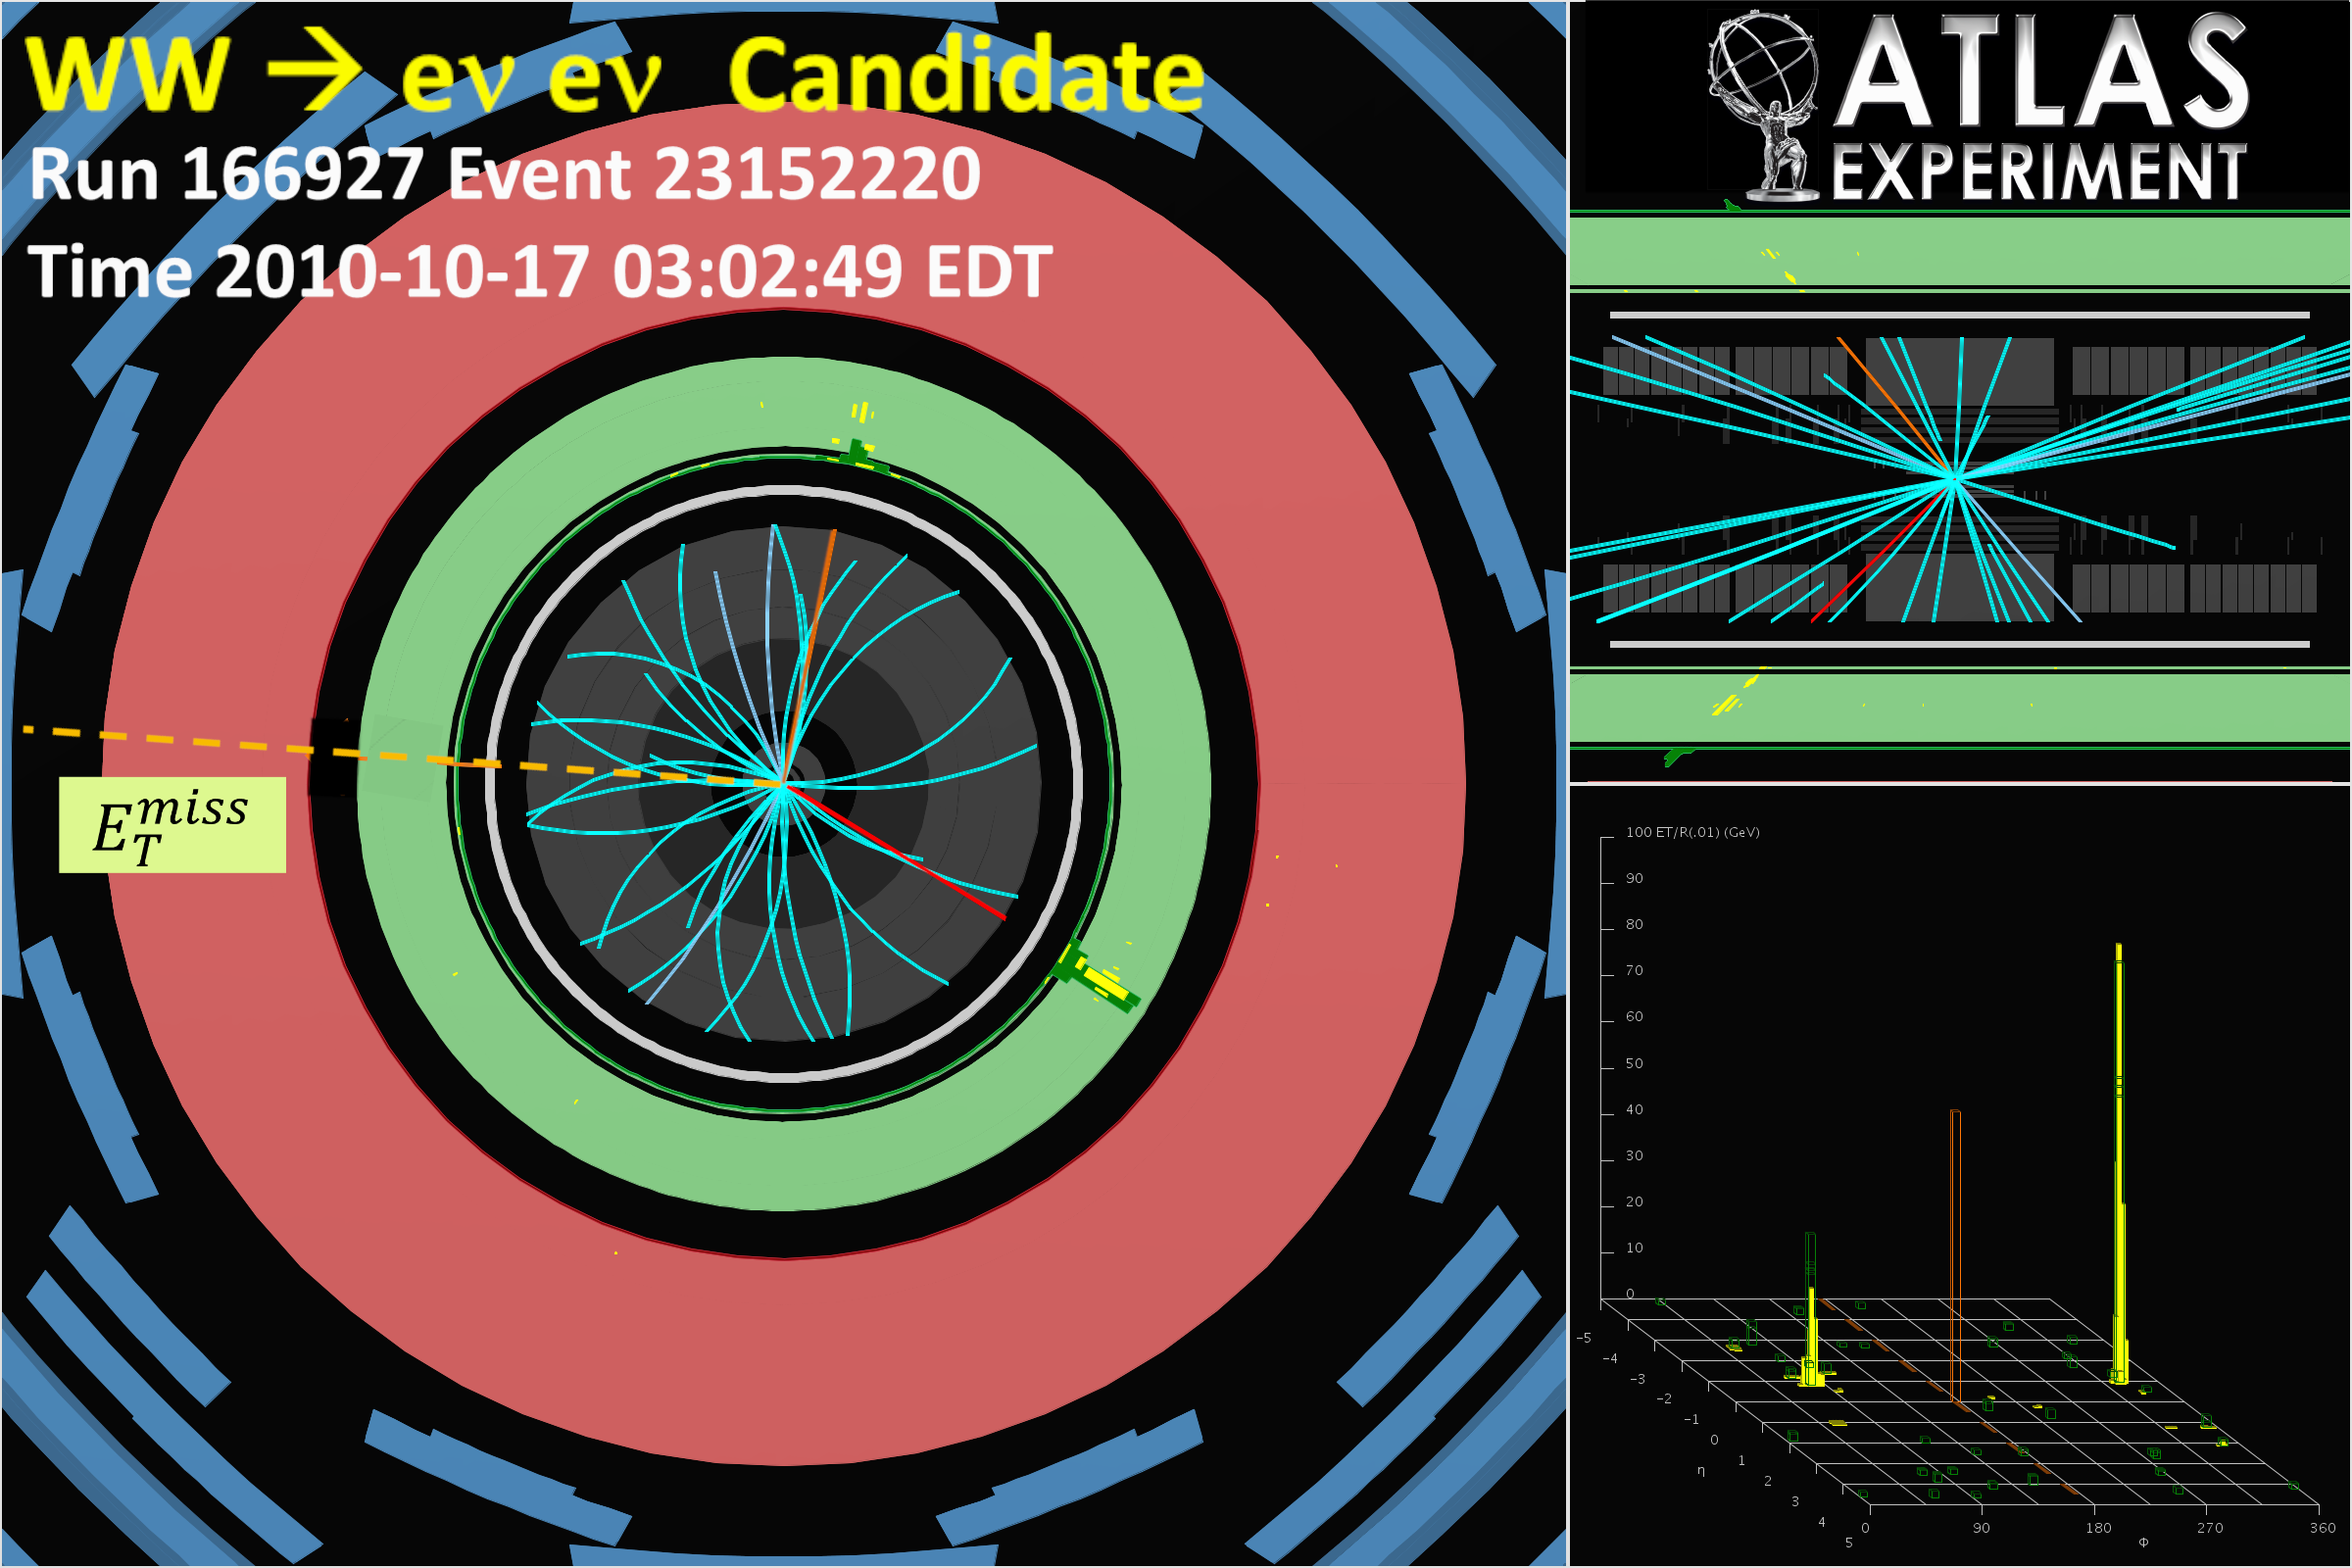

Slide 4
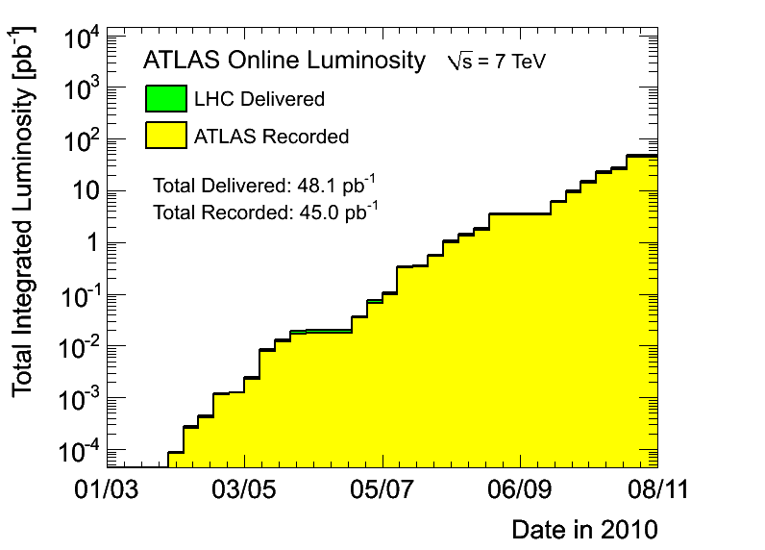
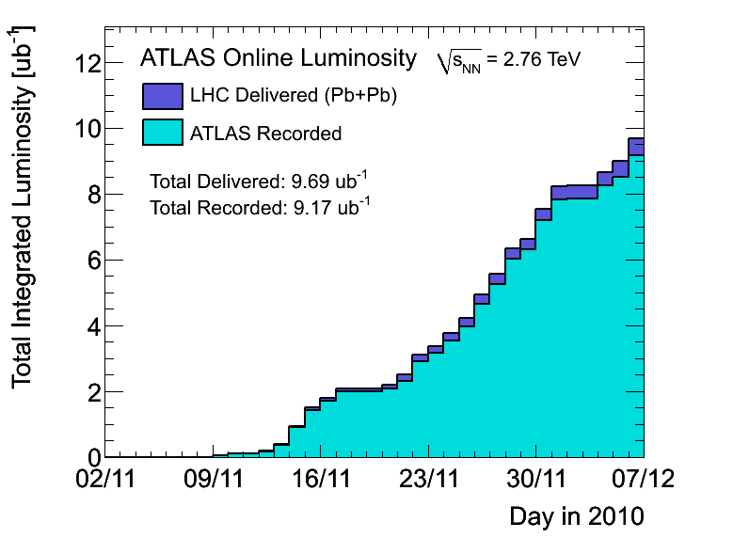
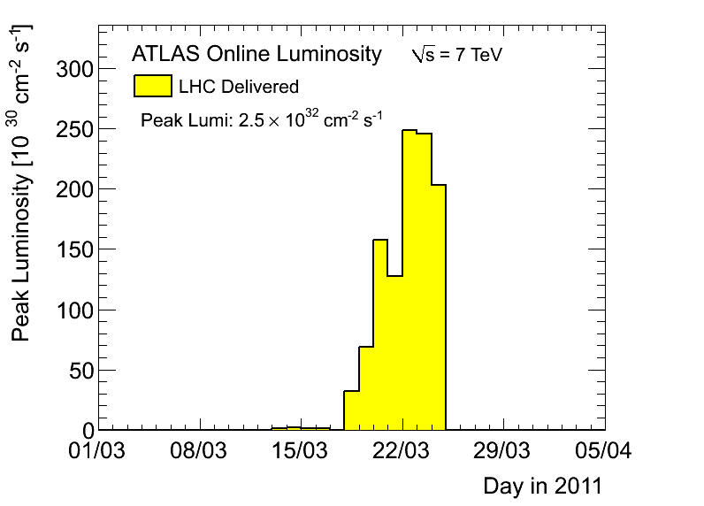
In 2010 at 7TeV, ~45pb⁻¹ pp, ~9μb⁻¹ HI, more than 35 physics publications in the pipeline, Very Successful Year !
Lots of work on Combined Perf and on Data quality, for example on LAr Calorimeter noise then on background studies using T/P technics…
FCPPL2011
pp
hi
In 2011, improved detector (>97% efficient), > 20pb⁻¹ already !
@7TeV until end of 2012, up to 2fb⁻¹ in 2011 (depend LHC perf)
  Shift in physics expectation and focus on data analysis
  top, di bosons, SUSY, Higgs studies …
  and C. Perf. studies: E/gamma, Jet/Etmiss, B tag, μ, Trigger…
  and continue Data quality work, Shifts, …

Slide 5
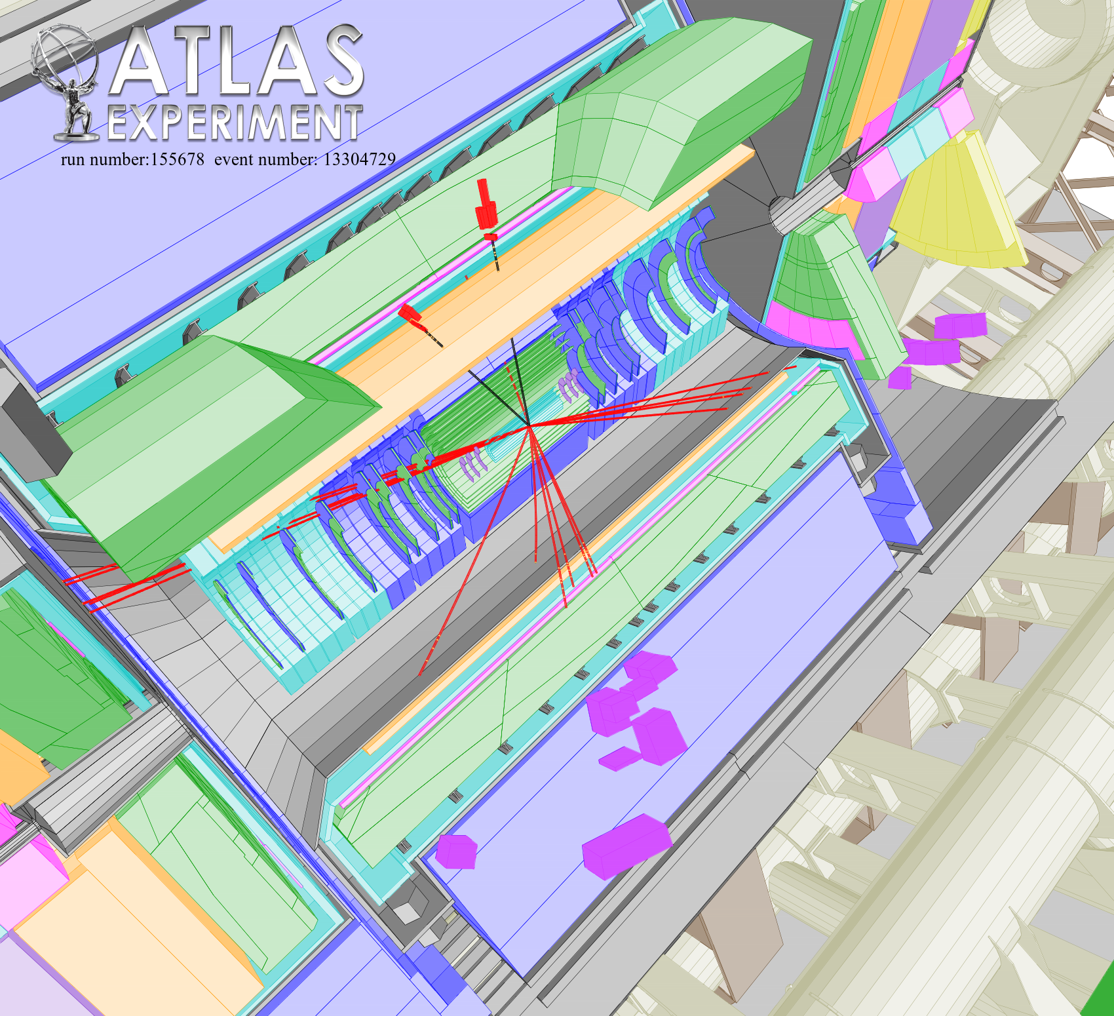
Top candidate

Slide 6
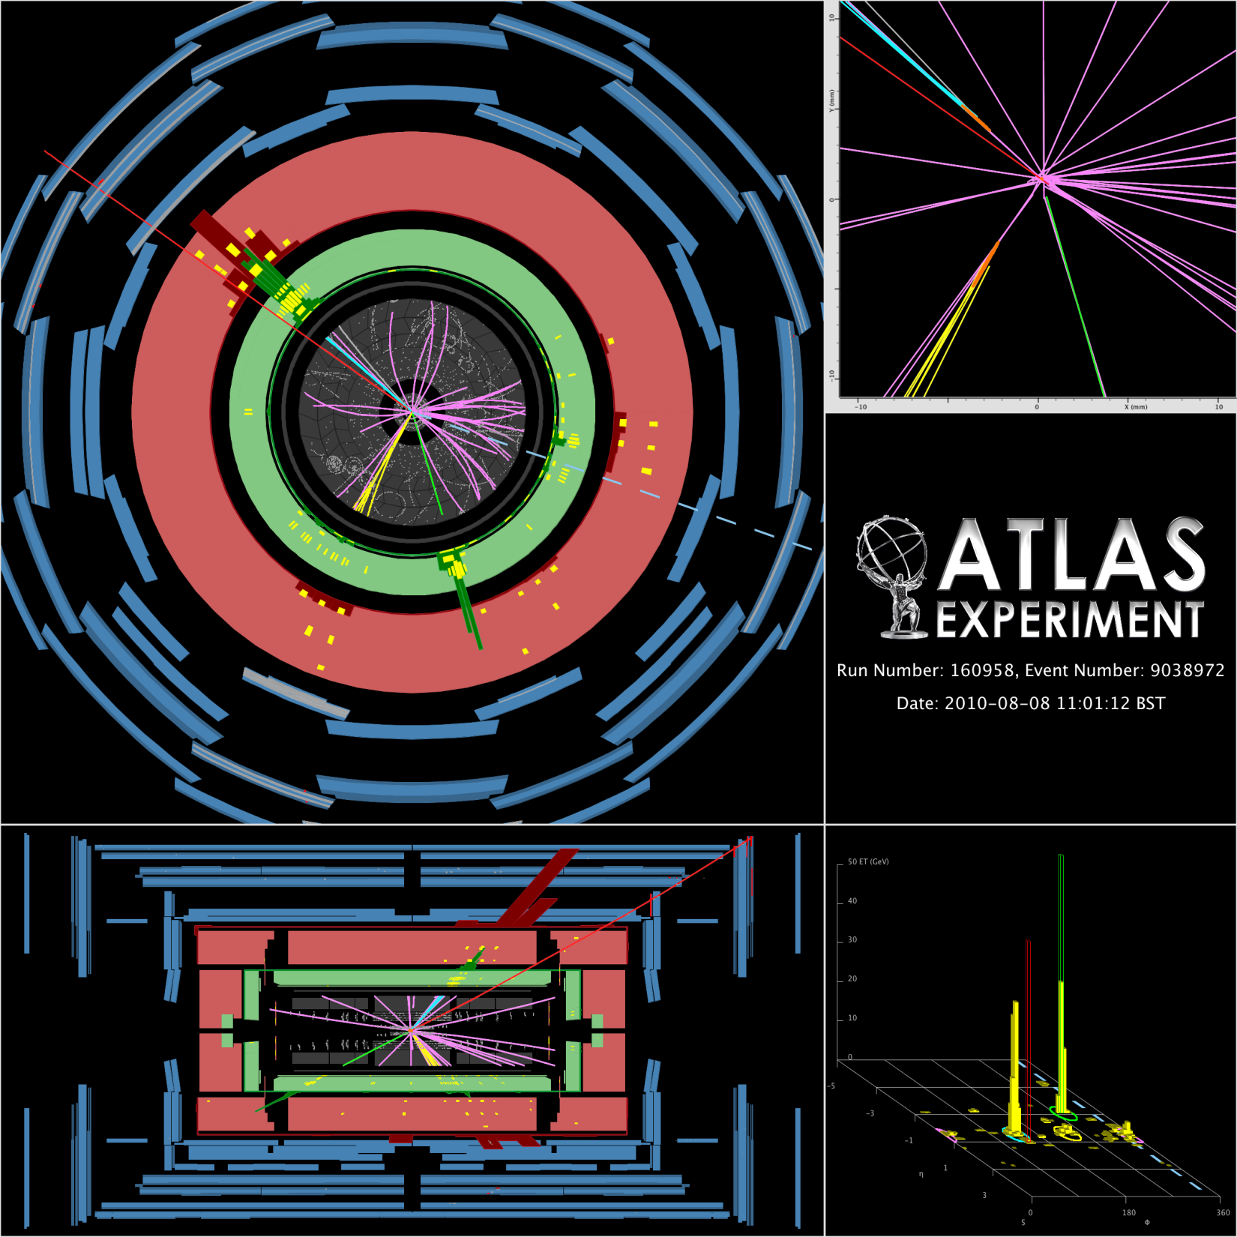
Top->emu2b:
e id, b tag, jets
Missing E

Slide 7
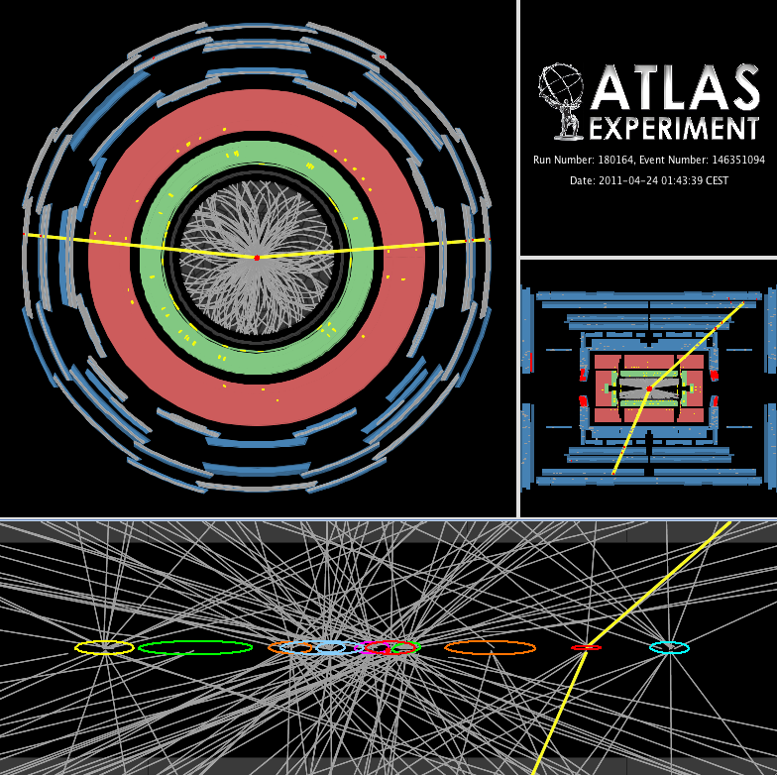
Z with pileup

Slide 8
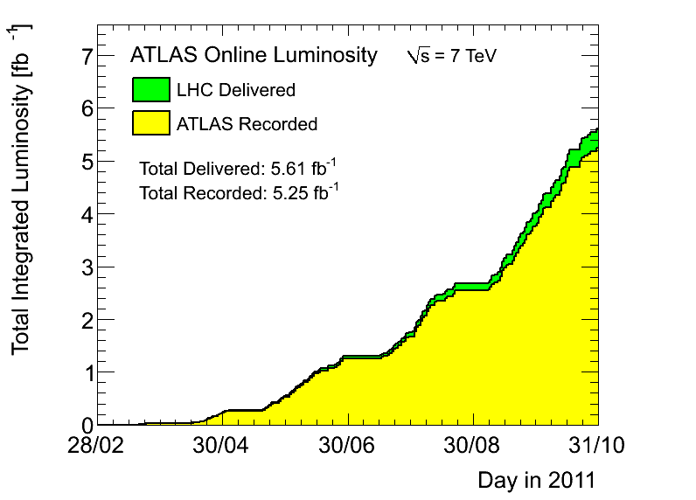
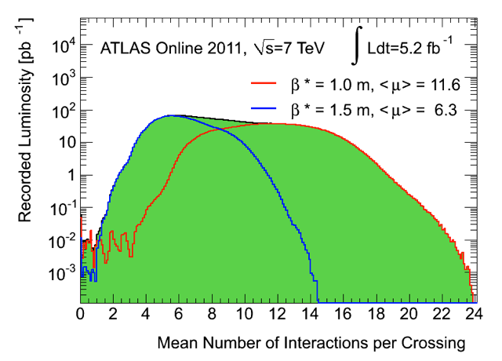
Subdetector | Number of Channels | Approximate Operational Fraction
Pixels | 80 M | 95.9%
SCT Silicon Strips | 6.3 M | 99.3%
TRT Transition Radiation Tracker | 350 k | 97.5%
LAr EM Calorimeter | 170 k | 99.9%
Tile calorimeter | 9800 | 99.5%
Hadronic endcap LAr calorimeter | 5600 | 99.6%
Forward LAr calorimeter | 3500 | 99.8%
LVL1 Calo trigger | 7160 | 100%
LVL1 Muon RPC trigger | 370 k | 98.4%
LVL1 Muon TGC trigger | 320 k | 100%
MDT Muon Drift Tubes | 350 k | 99.7%
CSC Cathode Strip Chambers | 31 k | 97.7%
RPC Barrel Muon Chambers | 370 k | 93.8%
TGC Endcap Muon Chambers | 320 k | 99.7%
5 fb⁻¹ in 2011
130 papers submitted
300 Conf notes…
Thousands supporting notes

Slide 9
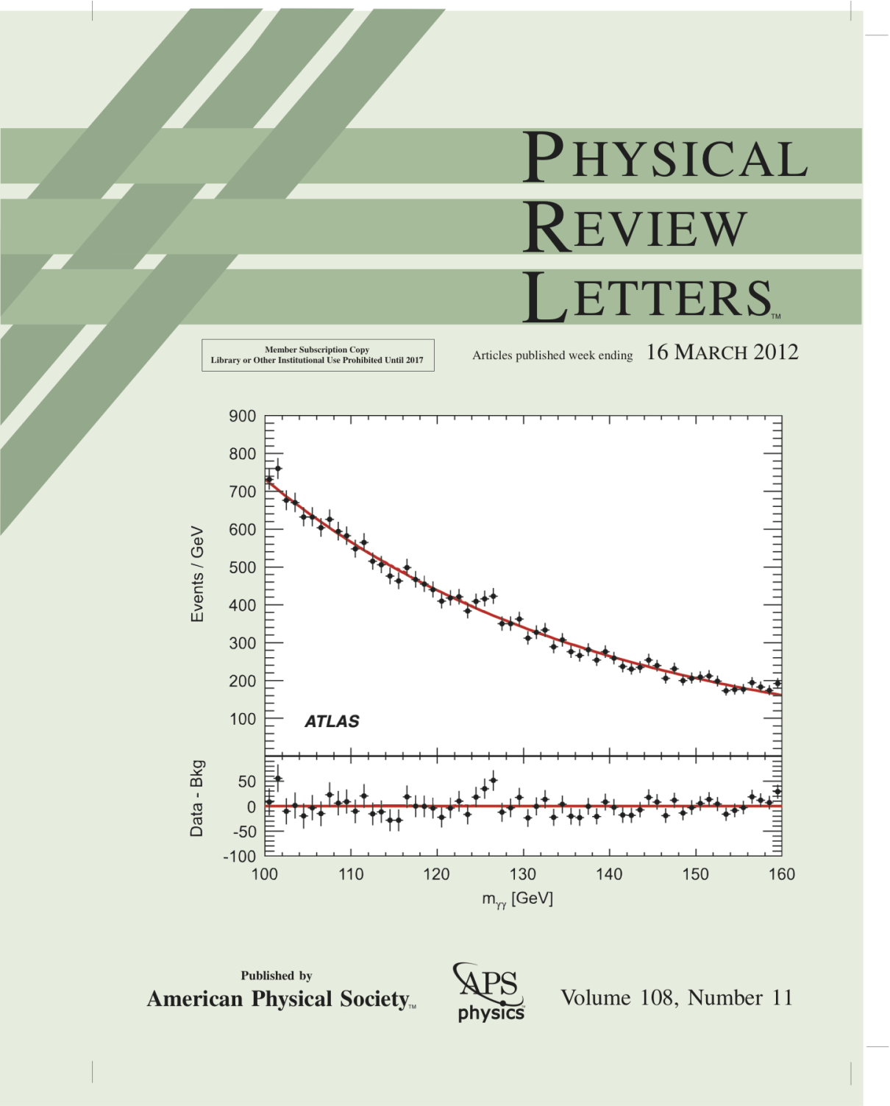
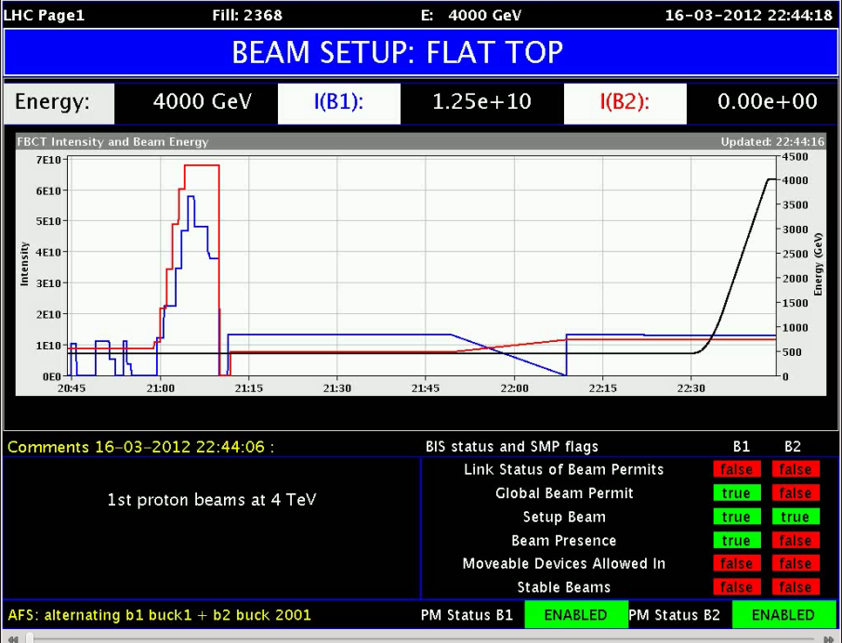
Subdetector | Number of Channels | Approximate Operational Fraction
Pixels | 80 M | 95.9%
SCT Silicon Strips | 6.3 M | 99.3%
TRT Transition Radiation Tracker | 350 k | 97.5%
LAr EM Calorimeter | 170 k | 99.9%
Tile calorimeter | 9800 | 99.5%
Hadronic endcap LAr calorimeter | 5600 | 99.6%
Forward LAr calorimeter | 3500 | 99.8%
LVL1 Calo trigger | 7160 | 100%
LVL1 Muon RPC trigger | 370 k | 98.4%
LVL1 Muon TGC trigger | 320 k | 100%
MDT Muon Drift Tubes | 350 k | 99.7%
CSC Cathode Strip Chambers | 31 k | 97.7%
RPC Barrel Muon Chambers | 370 k | 93.8%
TGC Endcap Muon Chambers | 320 k | 99.7%
In 2012:
8TeV, 0.6m β*,
>15 fb-1 exepected
Strong pileup
130 papers submitted
300 Conf notes…
Thousands support notes

Slide 10
ACC(IHEP/NJU/SDU/USTC)-CEA-IN2P3(CPPM/LAL/LPNHE/LPSC)
Very strong cooperation program between the Atlas Chinese Cluster (IHEP, NJU, SDU, USTC) and CPPM, IRFU, LAL, LPNHE, LPSC since several years:
  Higgs, Susy studies (through γ γ or WW final states and also lepton/jet/top final states)
    (see X. Ruan, G. Marchiori, L. Yao, M Xiao … talks)
  Di-boson studies (see S. Li talk)
  Top studies (see L. Shan, A. Lleres, E. Lancon talks)
  Performance studies (E/gamma - Jet/Missing Et – B tag – Trigger, Calorimeter…) (see G. Marchiori, L. Yao talks)
  Data quality, operation, shifts…
  Silicon detector R&D (see P. Pangaud talk)

Slide 11
ATLAS ACC-IN2P3 heavily involved in data analyses in 2011-2012
Co-PhD :
  B. Yu CAS funded/FCPPL (CPPM/IHEP) (05/12 defense)
  L. Yuan (French Embassy funded) (LPNHE/IHEP) (2011 defense)
  X. Ruan CAS funded (started 09/09) (LAL/IHEP)
  S. Li CSC/Eiffel funded (started 09/09) (CPPM/USTC)
  L. Yao CSC funded (started 09/10) (LPNHE/IHEP)
  B. Li CSC funded (started 09/10) (CPPM/SDU)
  L. Chen CSC Cai Yuanpei (started 01/11) (CPPM/SDU)
  J. Wang CSC funded (started 09/09) (LPSC/SDU) (06/12)
  X. Sun CSC funded (started 09/10) (LPSC/SDU)
  K. Liu CSC funded (started 09/11)(LPNHE/USTC) ….
Many senior Physicists (C. Feng, Y. Liu, F. Lu, L. Shan, C. Zhu, W. Wei…) visits with continuous cooperation work between ACC physicist and IN2P3 physicists.
Many presentations at ATLAS meetings by students and senior physicists (Chinese and French) and active contribution to Internal, Pub and Conf notes and physics paper on data analysis.
Strong SLHC Silicon detector R&D cooperation program ongoing

Slide 12
Prospect in 2012
Continue strong involvement in data analysis: physics analyses and performance. Need to sustain the effort to convert the fruit of our cooperation into more scientific results
On going Co-PhD will continue their work in this framework in both institutes involved but need to involve new PhD students since some have alread defended (or about to)
Several Senior Physicists visit already planned
Several Students visits already planned
Strengthen SLHC Silicon Detector R&D cooperation
Senior Physicist visits planned with possible students accompanying.
Senior + Student together very important for strong cooperation
Increase continuity of design and test on both sides

Slide 13
Summary
Strong and mature France China cooperation on the ATLAS scientific program with recognize visibility within ATLAS.
Sustain and strengthen the effort on Students as well as Senior physicists exchanges now that we have lots of data to analyze.
Scientific results are now flowing from these collision data analysis, and much more expected.
SLHC Silicon detector R&D program is growing up within the ATLAS community
Strengthen SLHC Silicon Detector R&D cooperation program

Slide 14
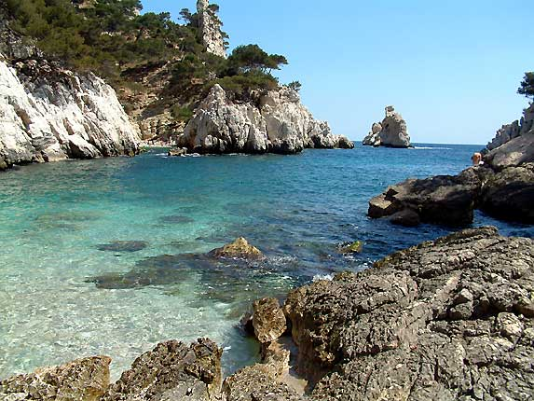
谢谢！
Merci !
Thank You !

Slide 15
Backup Slides

Slide 16
Calorimeter system
Hadronic Tile Calorimeter
|η| < 1.7, 3 layers
σ_{E}/E (jet) ~50%/√E⊕3%
Hadronic Tile Calorimeter
Flat iron absorbers
Scintillator tiles
9800 Ch. ; 98.0% Op.
EM LAr Calorimeter
Accordion lead absorbers
Liquid Argon (LAr)
170k Ch. ; 98.6% Op.
EM LAr Calorimeter
|η| < 3.2
Presampler (|η| < 1.8)
+ 3 layers, (2 for 2.5<|η|<3.2)
σ_{E}/E (e/γ) ~(10-15)%/√E⊕0.7%
Hadronic LAr Calorimeter
Flat copper absorbers + LAr
5600 ch. ; 99,9% Op.
1.5< |η| < 3.2, 4 layers
σ_{E}/E (jet) ~50%/√E⊕3%
Forward LAr Calorimeter
LAr/Cu + LAr/W
3500 Ch. ; 100% Op.
3.1 < |η| < 4.9
1 EM + 2 HAD layers
σ_{E}/E (jet) ~100%/√E⊕10%
Calorimeter L1 trigger
1GeV bit steps, tight noise suppression
L1 EM resolution < 5% at high energy
The ATLAS Experiment at the CERN Large Hadron Collider, The ATLAS Collaboration, G. Aad et al., JINST 3 (2008) S08003

Slide 17

η=-ln(tan(Θ/2))

