Slide 1
5th FCPPL Workshop
21-24 March 2011, Paris, France
Status of the TREND experiment
Thomas Saugrin (NAOC)

Slide 2
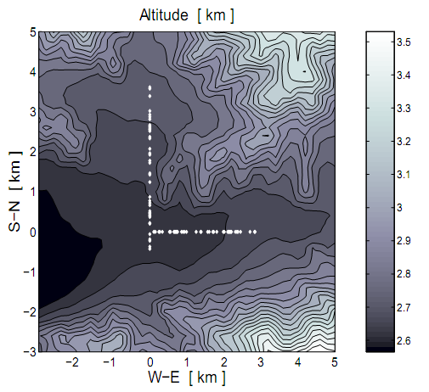
THE TREND PROJECT
TREND (Tianshan Radio Experiment for Neutrino Detection)
is a sino-french collaboration (~10 researchers) involving:
NAOC, IHEP (China)
IN2P3/CNRS (France): Subatech, LPC Clermont, LPNHE
21CMA / TREND
Driving concept :
Use the existing infrastructure of the 21CMA radio telescope site (electronics, acquisition,…) to quickly deploy a large antenna array dedicated to EAS autonomous radiodetection.
Objectives :
- Participate in the development of the autonomous radiodetection technique
- In a long-term perspective, use the topology of the Ulastai valley (surrounded by high mountains) to investigate the radiodetection of high-energy neutrinos with earth-skimming trajectory

Slide 3
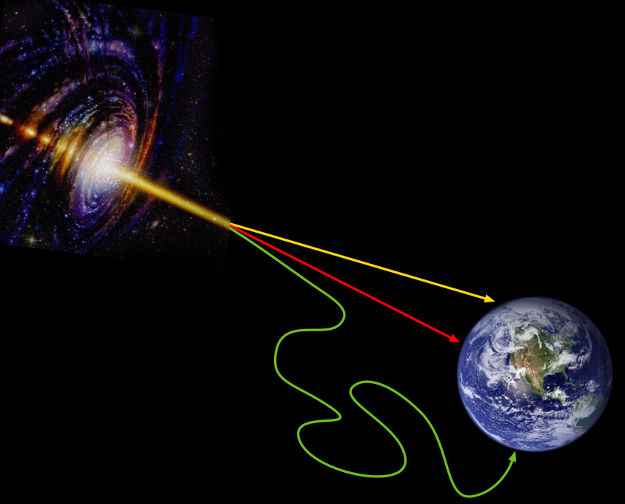
WHY A NEUTRINO DETECTOR ?
Neutrinos: last window on the Universe (after visible light, radio, Xrays, γ rays
& cosmic rays)
photons
Elusive but «clean» messengers:
no deflection
no energy loss
signature for hadronic processes
neutrinos
Cosmic rays
Huge experimental effort worldwide:
IceCube , AMANDA (use ice as target)
ANTARES, Km3Net (use water as target)
Atmosphere as a target: RADIODETECTION !

Slide 4
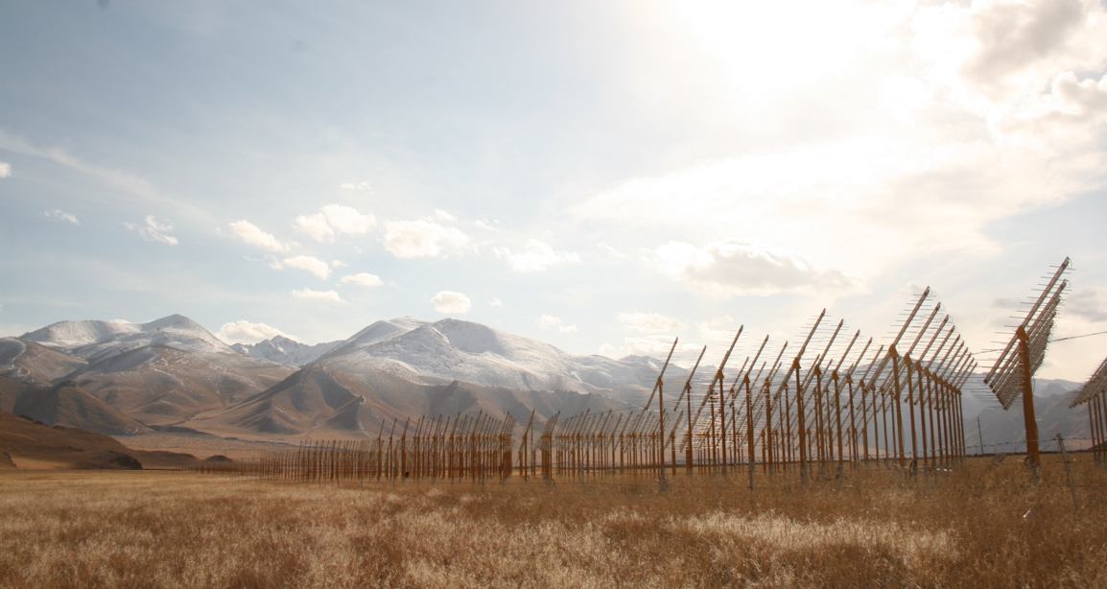
NEUTRINO RADIODETECTION
~horizontal shower
τ
ν_{τ}
Neutrino charged-current interaction in matter (mountains)
Tau lepton emerges in air & decays in atmosphere
Initiates a particle shower who generates an electric field
Creates a tau lepton
Neutrino radiodetection is theoretically possible !

Slide 5
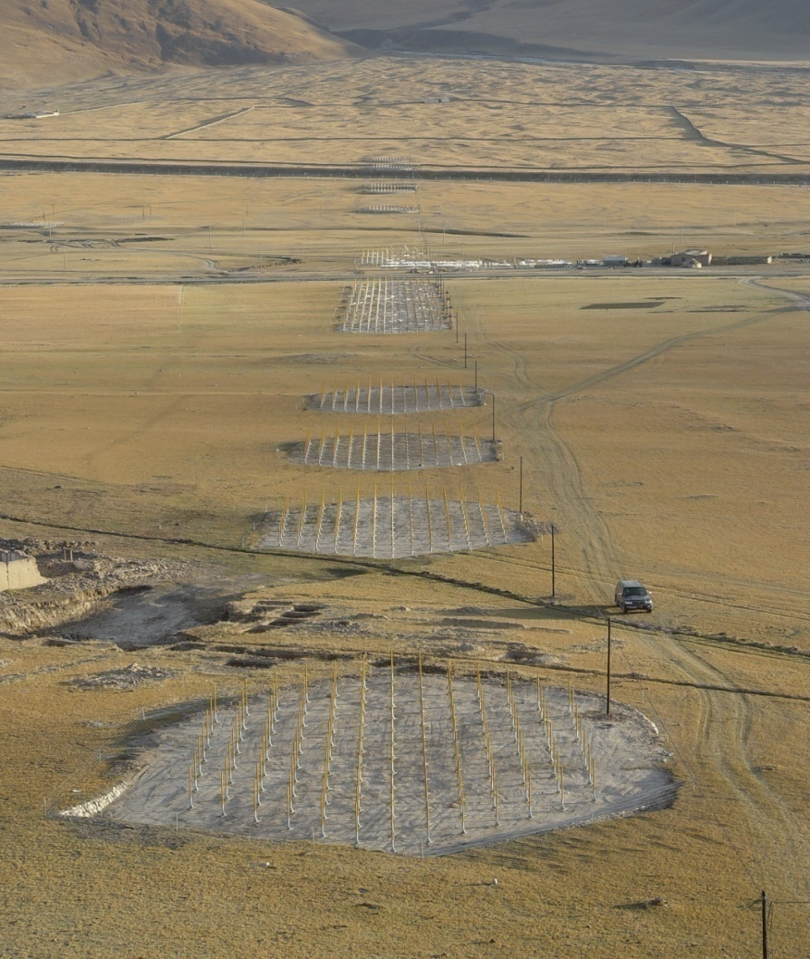
THE 21CMA RADIO TELESCOPE
21CMA is a giant radiotelescope located in the Tianshan Mountains (Xinjiang)
North
Built in 2007 by NAOC (WU X.-P.) to study the epoch of re-ionization
10160 log-periodic antennas (signal phased by pod of 127)
4 km
Each pod is linked to the acquistion room by optical fiber
Signal acquisition performed by
200 MHz ADC
South
West
DAQ
3 km
East

Slide 6
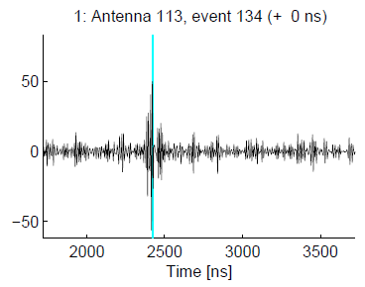
FROM 21CMA TO TREND SETUP
Continuous recording in frequency domain
21CMA acquisition
84dB
pod
DAQ room
200MSamples/s ADC+CPU+disk
optical fiber
50-200MHz filter
optical fiber
TREND acquisition
Trigger mode in time domain
N.σ
64dB
50-100MHz filter
σ
Antenna signals recorded indepently on dedicated channel:
Offline coincidence reconstruction

Slide 7
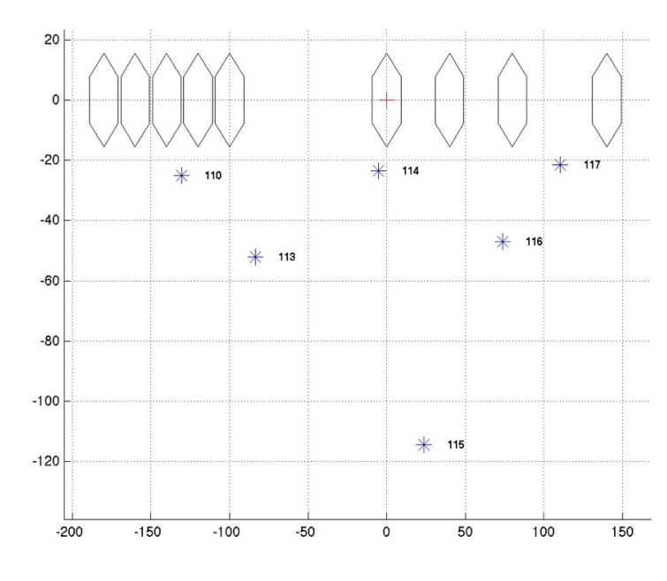
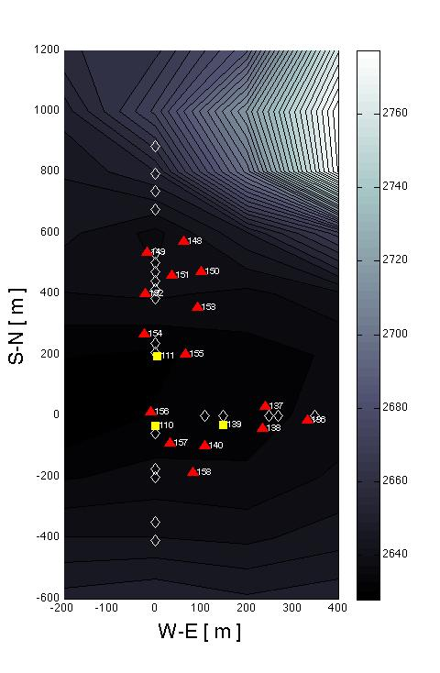
TREND LAYOUT
2009 :
250 m
Prototype of 6 log-periodic antennas
Test of antenna coincidence identification
Test of EM signal arrival direction reconstruction
100 m
TREND concept proof-of-feasability
N
2010 :
Antenna array of 15 log-periodic antennas
3 particle detectors (scintillators)
Test of EAS radio candidate identification
Offline cross-check between radio candidates and particle events (recorded indepently)
Hybrid antenna/scintillator coincidences found
800 m
Validation of
EAS autonomous radiodetection
400 m
(see Astropart Phys paper: arXiv:1007.4359)

Slide 8
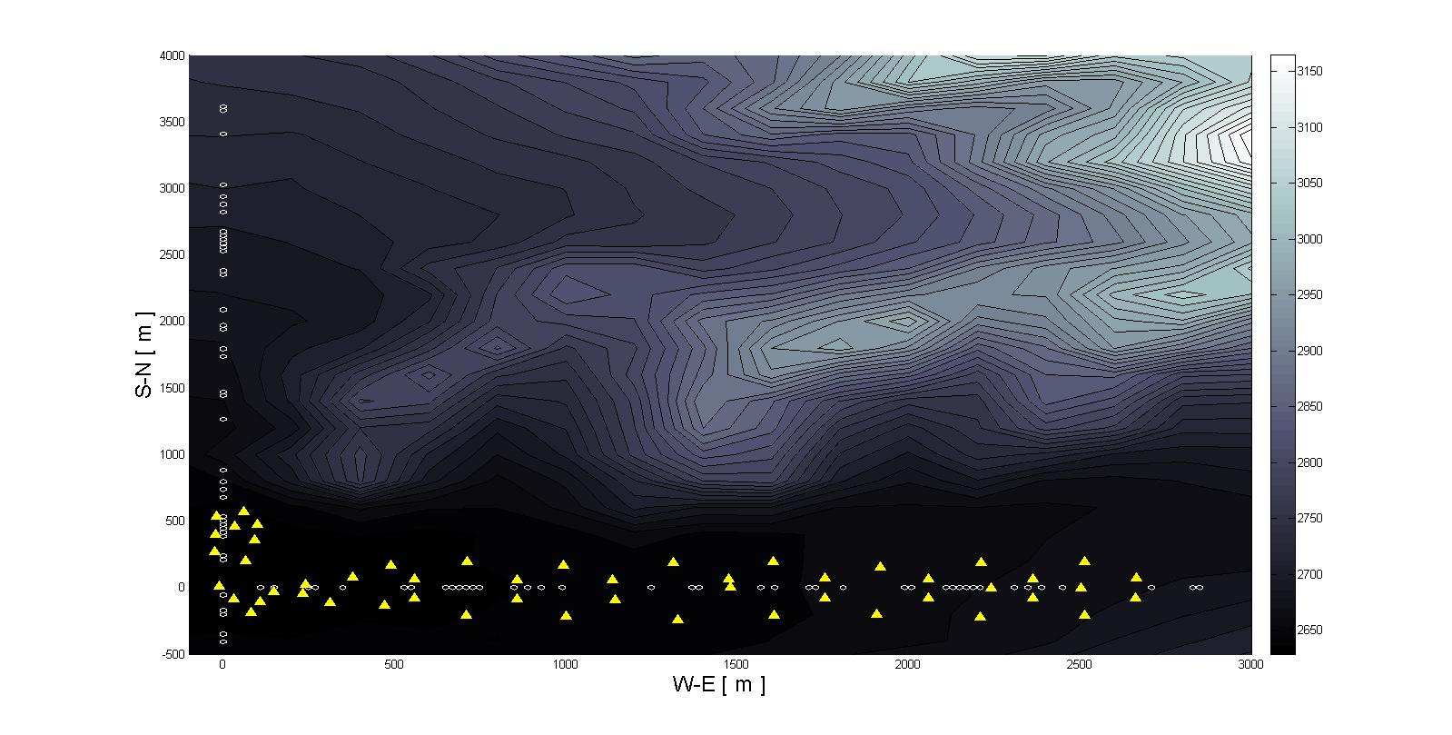
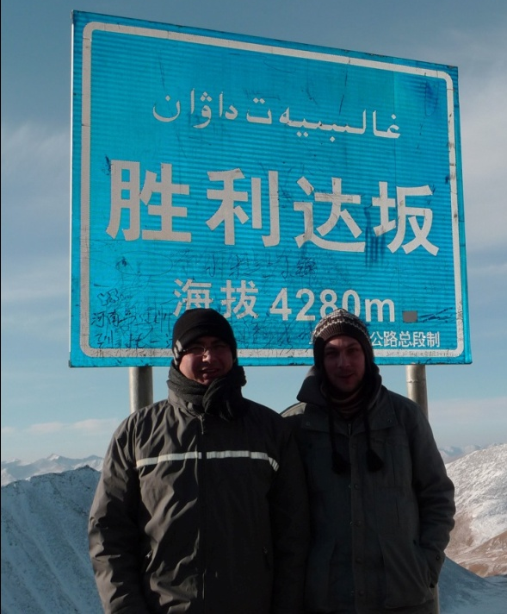
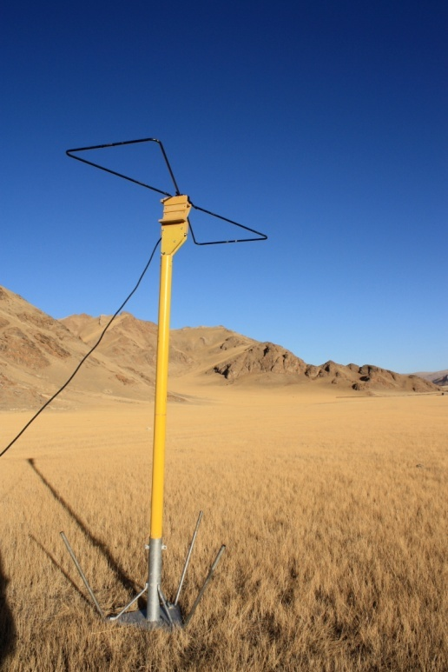
TREND LAYOUT
2011 :
- Extension to 50 antennas along the 21CMA East-West arm
New antenna design:
«butterfly-shape» passive antenna (based on the CODALEMA design)
- Redesign of the data preprocessing software
~3 km
- Constant upgrades:
Optical transmission
DAQ (Fabio Hernandez, IHEP)
Antenna support
In acquistion since March 2011

Slide 9
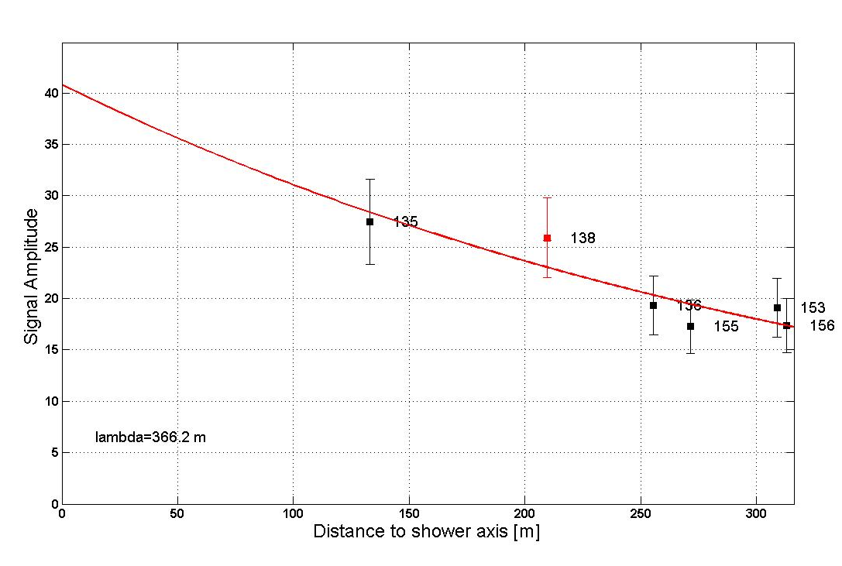
TREND STATUS
Data storage and preprocessing on the France-Asia computing grid… OK
8 TB of data currently in analysis…
Hybrid detection of EAS…
13 hybrid events (29 days of hybrid data):
5 with consistent independent source reconstruction
8 with 2 particle detectors: no direction reconstruction, but consistent trigger time
(3 random coincidences: radio source at ground or/and bad trigger pattern)
See Ardouin et al., Astropart Phys 34 (2011) for more details
Date | N_{ants} | θ_{radio} | θ_{scints} | ϕ_{radio} | ϕ_{scints}
03/04/2010 | 4 | 61±3 | 67±5 | 359±2 | 3±4
19/04/2010 | 4 | 52±1 | 49±3 | 195±2 | 191±4
27/08/2010 | 5 | 42±1 | 36±3 | 55±4 | 56±5
01/03/2011 | 4 | 45±1 | 49±3 | 12±1 | 10±5
09/03/2011 | 7 | 56±2 | 53±4 | 323±2 | 331±5

Slide 10
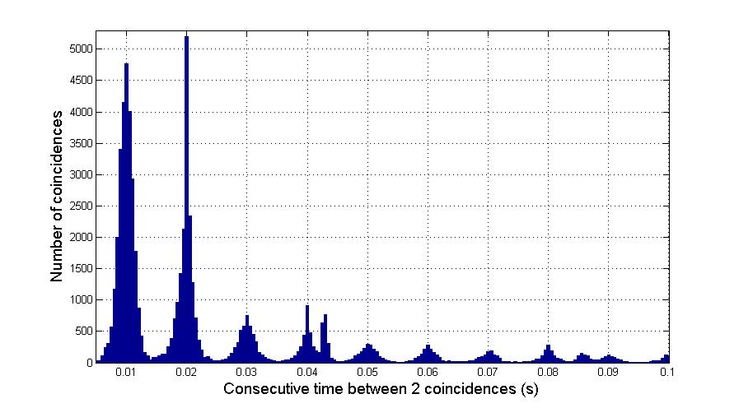
TREND STATUS
Data storage and preprocessing on the France-Asia computing grid… OK
Hybrid detection of EAS… OK
Autonomous radiodetection of EAS…
Background rejection…
- Static sources…
10 ms
Main pollution source: power line
Typical signature:
Δt between 2 events = n.10 ms
Rejection induced a ~10% dead-time for an efficiency of ~95%

Slide 11
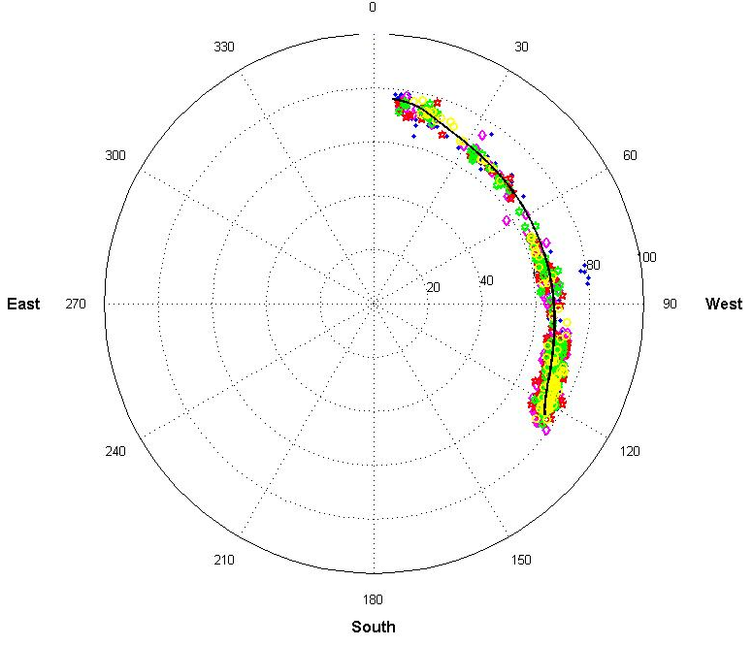
TREND STATUS
Data storage and preprocessing on the France-Asia computing grid… OK
Hybrid detection of EAS… OK
Autonomous radiodetection of EAS…
Background rejection…
- Static sources… OK
- Moving sources: track identification…
North
High multiplicity events
Angular resolution ~1°
Constant signal intensity event by event
(15% of amplitude variation along the track)

Slide 12
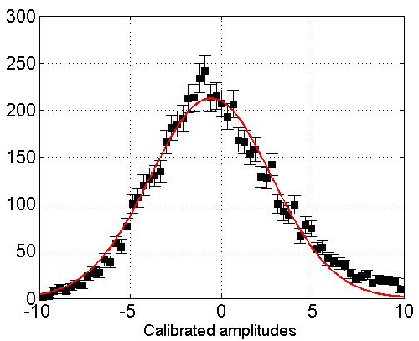
TREND STATUS
Data storage and preprocessing on the France-Asia computing grid… OK
Hybrid detection of EAS… OK
Autonomous radiodetection of EAS…
Background rejection…
- Static sources… OK
- Moving sources: track identification…
High multiplicity events
Angular resolution ~1°
Constant signal intensity event by event
(15% of amplitude variation along the track)

Slide 13
TREND STATUS
Data storage and preprocessing on the France-Asia computing grid… OK
Hybrid detection of EAS… OK
Autonomous radiodetection of EAS…
Background rejection… OK
- Static sources… OK
- Moving sources: track identification… OK
EAS candidate identification…
- Waveform analysis… In progress (cut optimization)
- Signal calibration… In progress (calibrator in development)
Preliminary analysis (on a limited sample) already shows some EAS candidates!
More candidates are needed to build a skymap (this summer?)

Slide 14
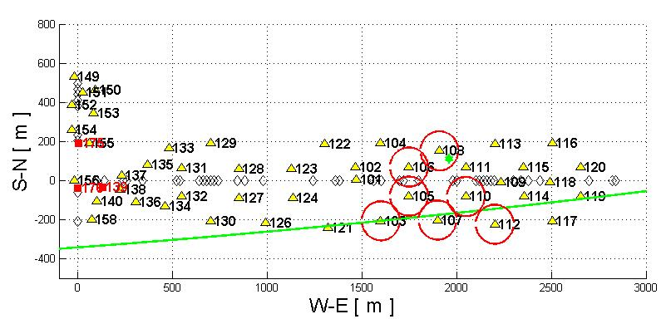
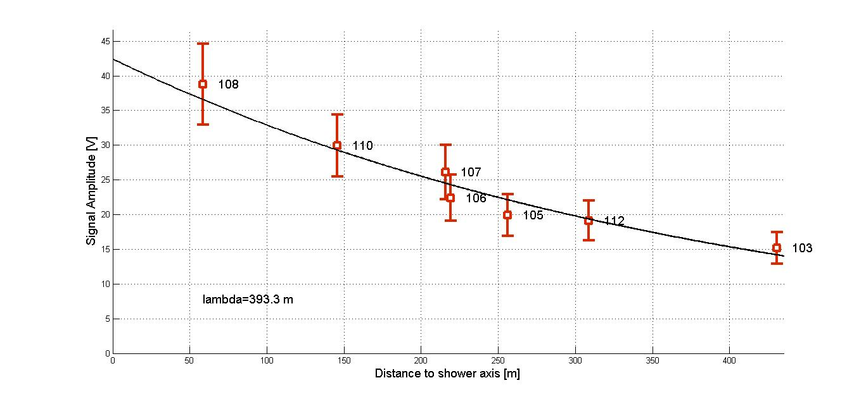
TREND STATUS
Preliminary analysis (on a limited sample) already shows some EAS candidates!
More candidates are needed to build a skymap (this summer?)

Slide 15
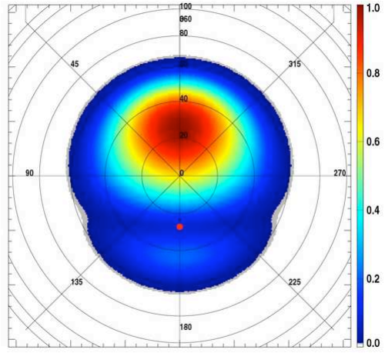
TREND STATUS
CODALEMA simulated skymap:
Strong North-South assymetry
(geomagnetic origin of the signal)
Isotropy in arrival direction
Isotropy in detection time
Preliminary analysis (on a limited sample) already shows some EAS candidates!
More candidates are needed to build a skymap (this summer?)

Slide 16
TREND STATUS
Data storage and preprocessing on the France-Asia computing grid… OK
Hybrid detection of EAS… OK
Autonomous radiodetection of EAS…
Background rejection… OK
- Static sources… OK
- Moving sources: track identification… OK
EAS candidate identification… In progress
- Waveform analysis… In progress (cut optimization)
- Signal calibration… In progress (calibrator in development)
TREND, as cosmic rays radiodetector, is close to be fully operationnal
STATISTICALLY SIGNIFANT RESULTS ARE COMING SOON !!
And what about neutrinos ?

Slide 17
NEUTRINO CANDIDATE IDENTIFICATION
Some characteristics similar to cosmic rays EAS candidate:
isolated pulses, duration <300 ns
~plane wavefront
Other characteristics can be confused with background noise:
ground pattern
slower amplitude decrease
Moreover, extremely low event rate is expected
<1 event /year/km² in the 10¹⁷-10²⁰eV range
for a Waxman-Bahcall input flux
For an estimated background radio event of ~0.1 Hz /km²,
a rejection factor of >10⁶ has to be reached !!
Hardly possible with TREND present set-up …

Slide 18
POLARIZATION MEASUREMENT
At first order, EAS polarization is perpendicular to:
- the propagation direction of the shower
- the geomagnetic field
End-to-end simulation : from neutrino CC interaction to radio signal on antennas
Shower signal simulated by our own semi-analytic model
based on the MGMR model
Simulation will give us a more accurate information on polarization
Comparison between expected polarization pattern & measured one should be a powerful tool to discriminate background & candidate

Slide 19
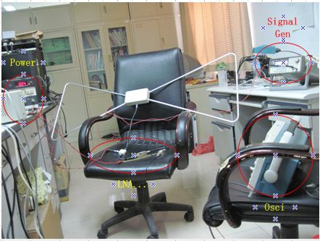
POLARIZATION MEASUREMENT
Rejection potential to be tested on present TREND array with upgraded array
(2 polarization (EW+ Vert.) measurement)
Project being developped with the trig lab of IHEP (Liu Zhen’An)
40 prototypes with:
- 2 inputs (2 polars)
- 500MHz sampling & FPGA
- GPS timing

Slide 20
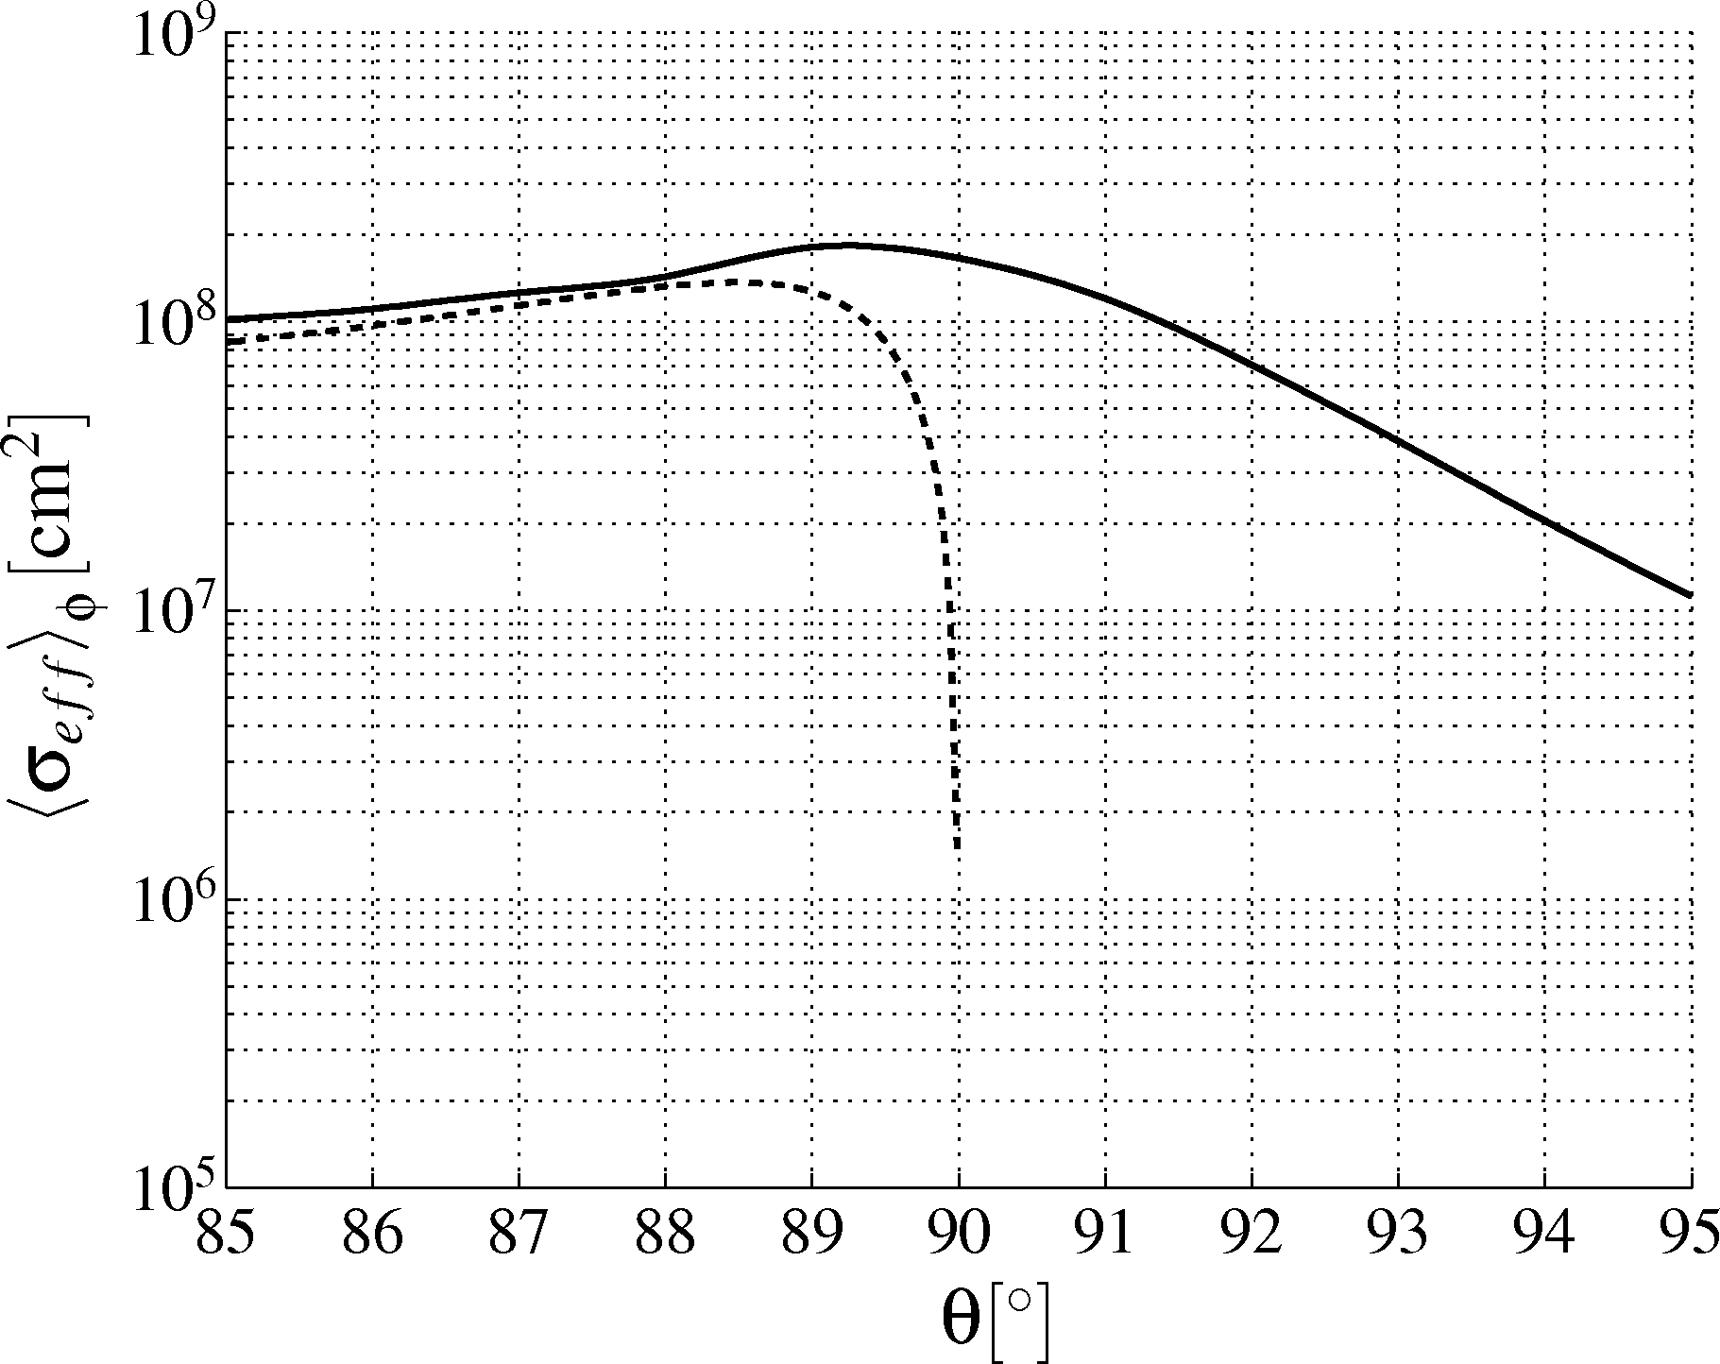
ADVANTAGES OF THE TIANSHAN SITE
E_{ν} = 10¹⁸ eV
Averaged over φ
Significantly increase event flux (x2)
Screen for « standard » CRs
Very attractive site for detection
Increased efficency
Better geometry
TREND site topology
Flat site
Upward going
Downward going
x
x
x
x
x
x
x
x
x
x
x
x
x
x
x
x

Slide 21
ADVANTAGES OF THE TIANSHAN SITE
Ulastai
25 000 km² of lowly populated mountains are within reach…

Slide 22
CONCLUSION
As cosmic rays autonomous detector :
All systems operationnal
First candidates already identified
Needs a bit more of statistics to definitely conclude
As neutrino detector :
Convince ourselves: compute expected event rate (MC simulation)
& rejection ratio (prototype array)
- Convince our labs & funding agencies to step in for a major international project.

Slide 23
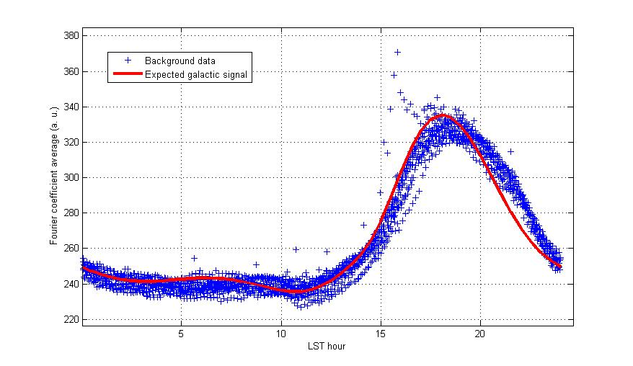
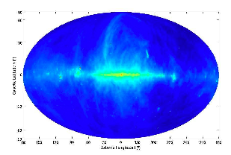
TREND RADIO ENVIRONNEMENT
General radio environnement very clear:
No major emettor after 20 MHz
TREND
@ Ulastai
Main noise: Thermal emission from galactic center
Minimum possible noise for a radio detector
TREND sensitivity is well suited for EAS radiodetection !
Signal noise level
Galactic plane @ 408 MHz
Local sidereal time

Slide 24
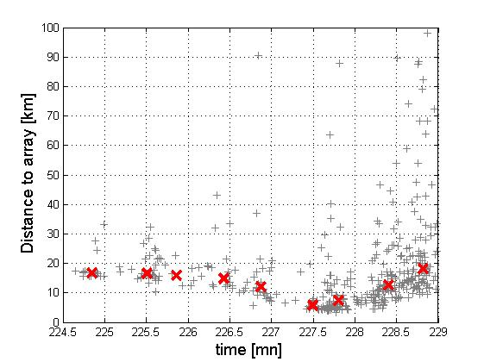

Slide 25
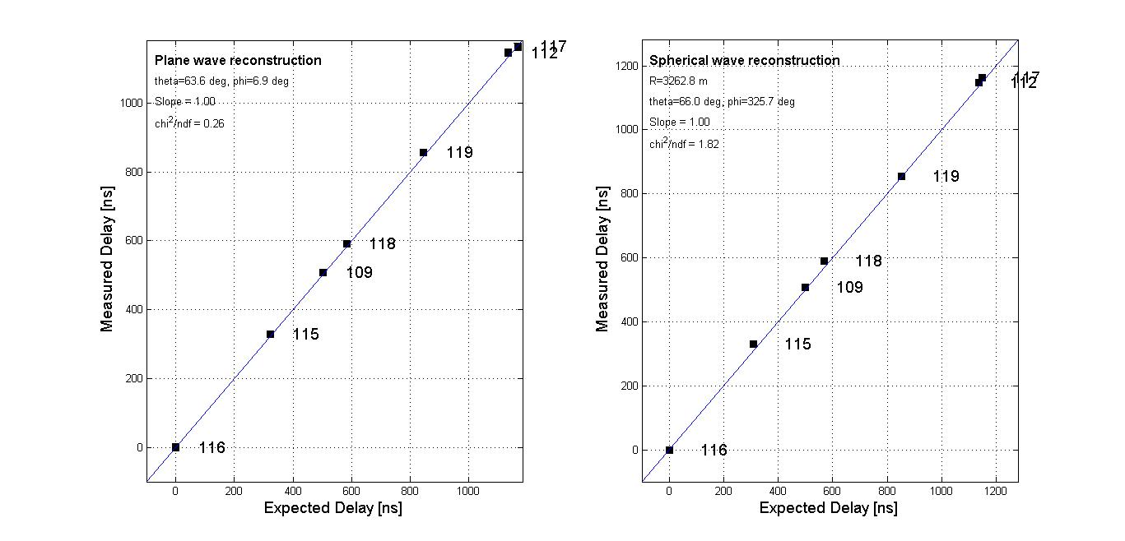

Slide 26
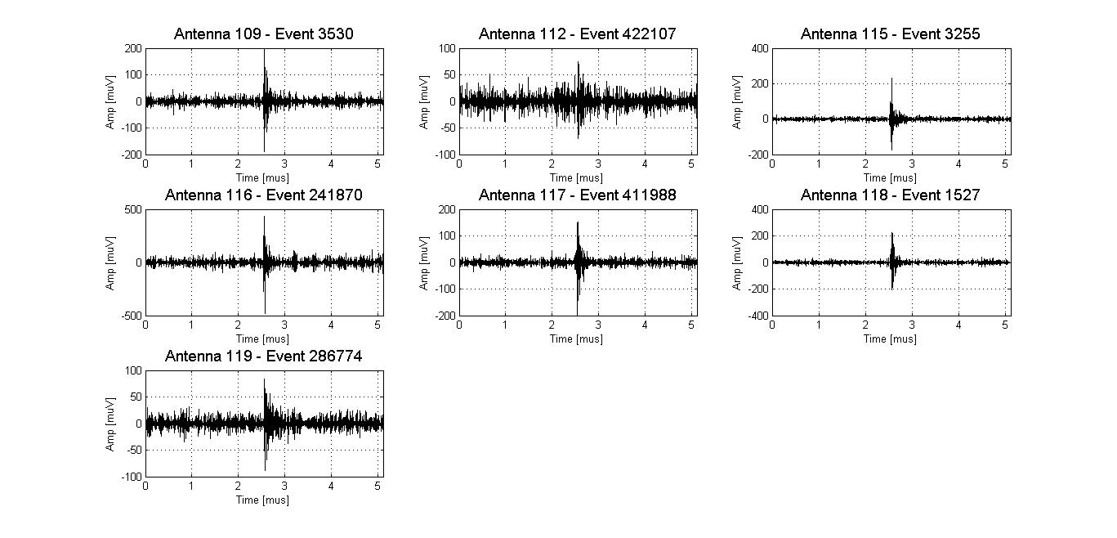

Slide 27
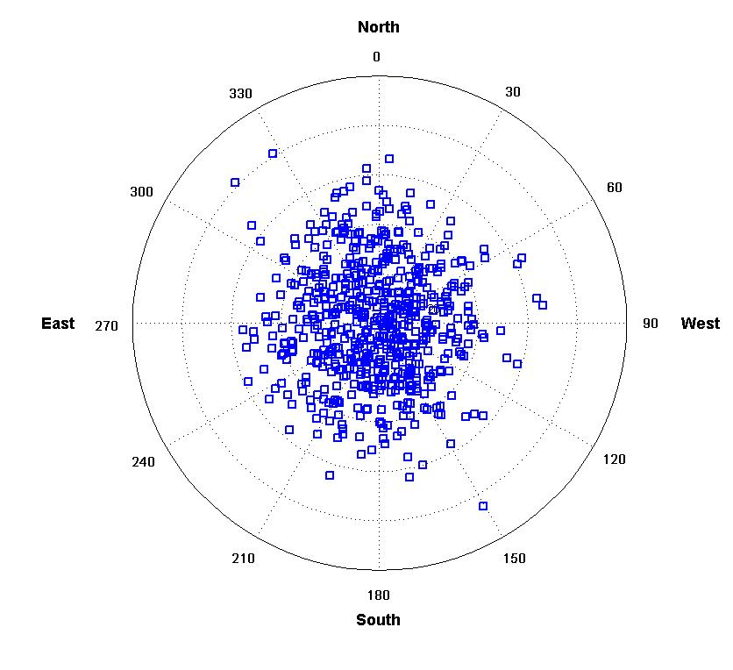
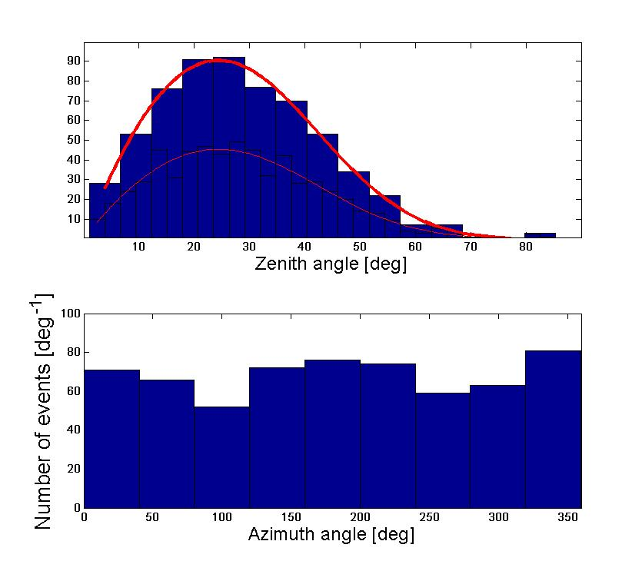
The 3-scintillators array is a valid EAS detector

