Slide 1


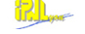



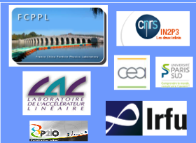
IPNL/IHEP collaboration project
Photon studies at CMS
Junquan Tao
On behalf of the IPN Lyon and IHEP CMS groups
5th FCPPL Workshop
March 21, 2012

Slide 2

Outline
A brief history about the collaboration
Motivation: The H→γγ search
Activities on the photon-related studies
Summary and Conclusion
Acknowledgements
Note/Apology: In many cases, despite significant progress, results can not yet be shown since not yet formally approved (CMS Rules)

Slide 3
The CMS groups of IHEP and of IPN Lyon: A brief history of our collaboration
January 2006: Agreement to explore possible collaboration on CMS physics analysis after the visit of F. LE DIBERDER to IHEP
July 2006: First visit of IPNL physicists and Director Bernard ILLE to IHEP
IHEP Beijing ➔ IPN Lyon: (4persons)
TAO Junquan (Doctoral Student)—January-May 2007 (IN2P3)
ZHANG Zhen (Doctoral Student)— November 2007-May 2008 (FCPPL)
TAO Junquan (Postdoc)—March-August 2009 (PICS 4162)
XIAO Hong (Doctoral Student)—January-July 2010 (PICS 4162)
FAN Jiawei (Doctoral Student)---April-October 2011 (PICS 4162)
XIAO Hong (Doctoral Student)---June-July 2011 (FCPPL)
IPN Lyon ➔ IHEP Beijing:
Nicolas CHANON (Doctoral Student)—March-May 2009 (FCPPL)
Hugues BRUN (Doctoral Student)—October-December 2010 (FCPPL)
Olivier BONDU (Doctoral Student)– April-May 2011 (FCPPL)
Louis SGANDURRA (Doctoral Student)-Oct-Nov. 2012) (FCPPL 2012 proposal)
+ participation to the
Organising committees of the
prototype workshop at IHEP and to the 1st, 2nd, 3rd , 4th and 5th FCPPL workshops
FAN Jiawei (Doctoral Student)—May-Nov. 2012) (FCPPL 2012 proposal) + applied for co-phD student (FCPPL/CSC scholarship 2012)

Slide 4
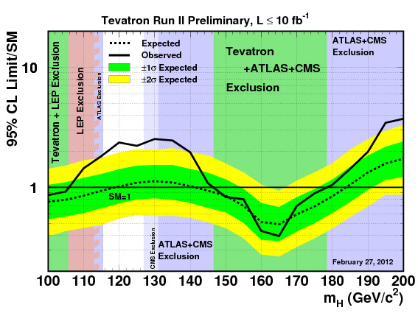
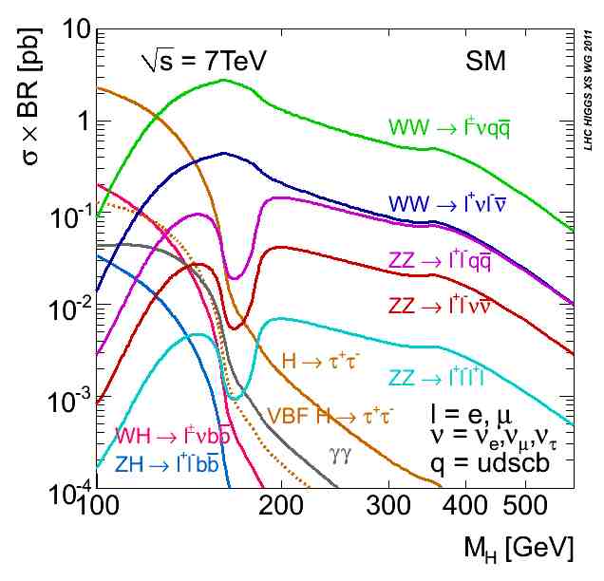

Motivation: The SM H→γγ Search
Moriond 2012
Observed exclusion at 95% CL (Moriond2012):
Tevatron: 100<M_{H}<106GeV 147<M_{H}<179GeV
CMS: 127.5<M_{H}<600GeV
ATLAS: 110<M_{H}<117.5GeV 118.5<M_{H}<122.5GeV 129<M_{H}<539GeV
Survive at 95% CL: 117.5<M_{H}<127.5GeV excluding 118.5<M_{H}<122.5GeV

Slide 5
Activities: photon-related studies
Photon reconstruction: Clusterisation, Photon Commissioning , Photon Energy Scale and Energy Corrections using Z→μμγ
Technique development: Prompt photon and non-prompt photon (γ/π⁰) discrimination
γγ+X Differential Cross-section Measurement
Impact of higher-order calculations on kinematical observables in γγ processes , contributed to H→γγ analysis

Slide 6
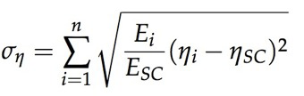
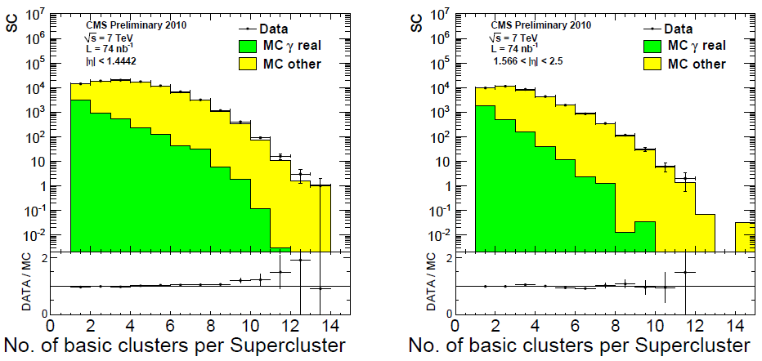
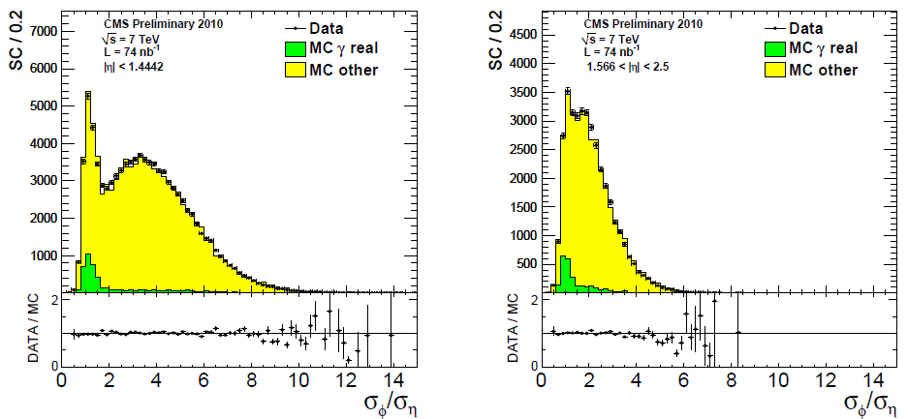
Supercluster and Photon Commissioning
(2008-..): (O. BONDU, H. BRUN, M. LETHUILLIER, S. GASCON, J. TAO, H. XIAO, Z. ZHANG)
- Check understanding of key observables for photon reconstruction (~80nb-1) :
- Cluster constituent multiplicites
- Cluster shapes used to assign energy determination method, to derive energy corrections and photon identification
- Isolation energies used for photon identification
- Results made public for ICHEP2010 (EGM-10-001 and EGM-10-005)
Loose Photon Id

Slide 7
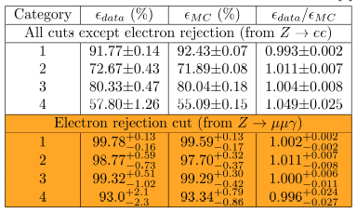
Photon Energy Scale & Photon ID efficiency
« Certified » photons from Z→μμγ FSR (2007-..): (C. BATY, O. BONDU, H. BRUN, M. LETHUILLIER, S. GASCON, L. SGANDURRA, J. TAO, Z. ZHANG)
- Isotropic source of relatively high-pT γ enabling extraction of
- Photon energy scale
- Photon id efficiency: electron veto efficiency
- Photon energy correction (2011 data)
- Photon trigger efficiency
photon energy scale was used to estimate systematic error for :
first Measurement of the Wγ and Zγ inclusive cross-sections with 2010 dataset (EWK-10-008, Phys. Lett. B 701 (2011) 535555)
Vgamma analysis with 2011 data (EWK-11-009, Preapproved in CMS)
Electron veto efficiency was used in the H→γγ analysis (HIG-11-010, HIG-11-021, HIG-11-033 and submitted to Physics Letters B arXiv:1202.1487, HIG-12-001, HIG-12-002)

Slide 8
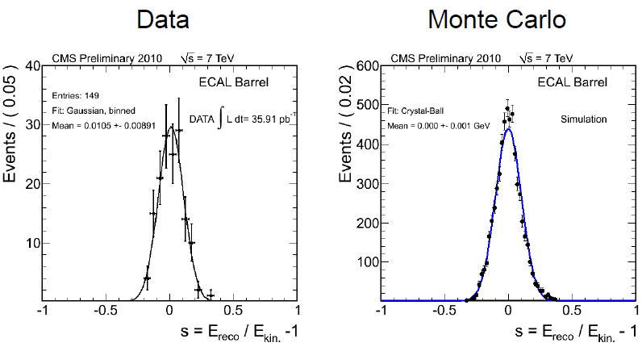


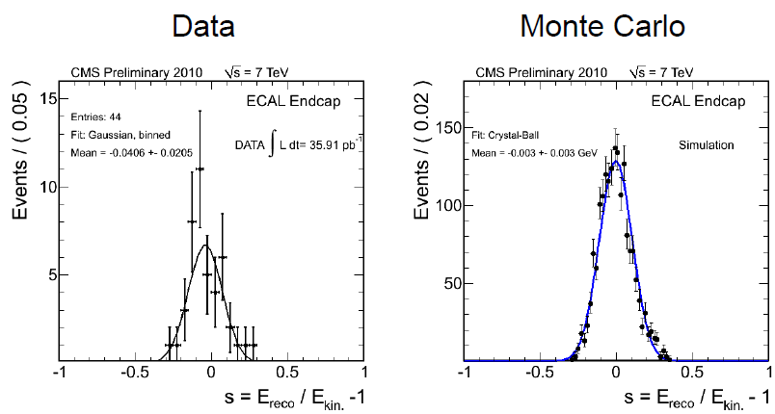
Photon Energy Scale with Z→μμγ FSR
public document CMS DPS -2011/008
Photon scale agrees with expectations at the 1% level in EB, ~3% in EE with 2010 data
See more details from Olivier Bondu’s presentation tomorrow

Slide 9
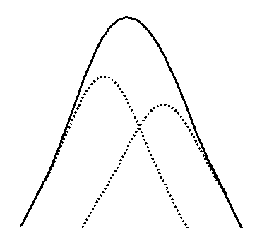
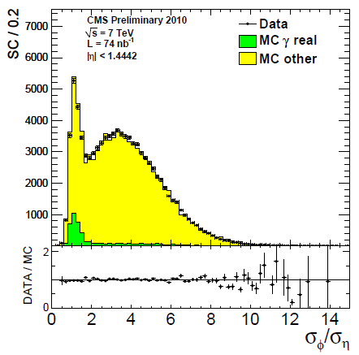
γ/π⁰ discrimination
γ/π⁰ discrmination (2008-…): (H. BRUN, N. CHANON, G. CHEN, M. LETHUILLIER, S. GASCON, J. TAO, M. YANG, Z. ZHANG, H. Xiao) for both converted and non-converted photons
Exploit particular cluster and shower shape observables proper to our crystal calorimeter, in a MLP NN
For a ‘tighter’ photon Id than current cutbased Id based on isolation
-For the measurement of the SM backgrounds to H→γγ : γγ + X and γ + X (see next)
For direct application to MVA analysis for the H→γγ search still a major challenge to this analysis for us.
Nominal shower shape of π⁰
( in fact 2γ)
Shape of 2 γ EM showers
ICHEP2010

Slide 10
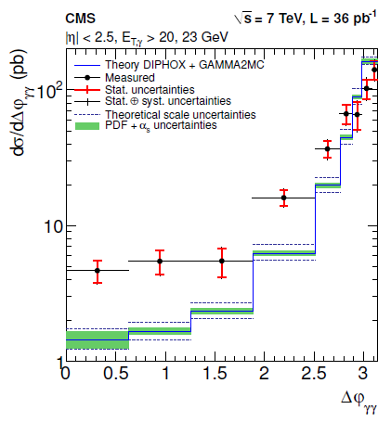
γγ+ X Differential σ Measurement
γγ + X differential cross-section measurement (2010-…): (H. BRUN, N. CHANON, G. CHEN, M. LETHUILLIER, S. GASCON, J. TAO, H. XIAO, J. FAN)
Use a data-driven ‘template’ method along the lines of the CMS γ + X cross-section measurement
- Compare to pQCD predictions
2010 data
Big difference to NLO prediction
2010 data analysis , work together with the CEA saclay group “the modified ECAL isolation method”: Observables binning, trigger efficiency , reconstruction efficiency and so on.
Trying again with NN template (from γ/π⁰ discrmination )method (and other templates) for 2011 data analysis (Hong Xiao)
NNLO: 2gammaNNLO
Accepted by JHEP
D. de Florian, L. Cieri et al
arXiv:1110.2375
(JHEP 01 (2012) 133)
LHC-Higgs
XS WG
YR2
arXiv
1201.3084v1
10

Slide 11
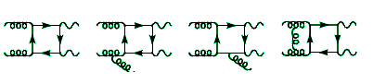
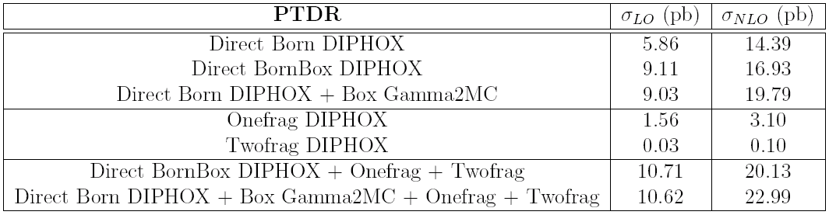
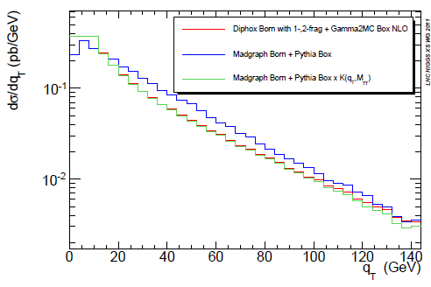
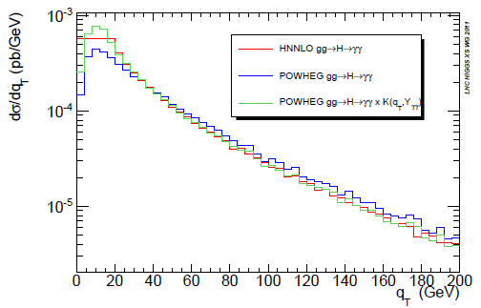
H→γγ analysis: Impact of higher-order calculations on kinematical observables in 2γ processes
(2007-…): (O. BONDU, N. CHANON, M. LETHUILLIER, S. GASCON, J. Tao, Y. Shen)
- Implemented doubly-differential reweighting scheme with dynamical k-factors (NLO/LO) for H→γγ signal and diphoton background
- Contributing to LHC-Higgs-XS working group (cut-dependent k-factors)
qT
qT
LHC-Higgs XS WG YR2 arXiv 1201.3084v1

Slide 12
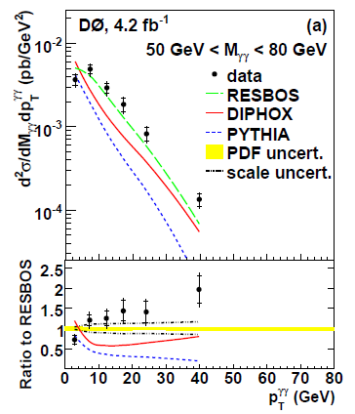
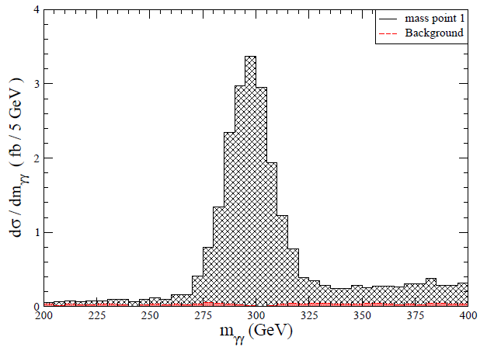
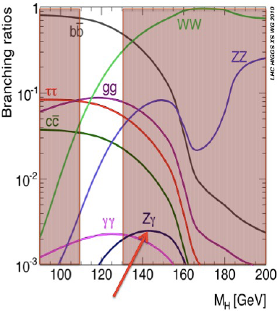
Photon-related analysis
2012
2012 LHC running will be at 8TeV, L~15 fb⁻¹
γγ final status physics analyses
Zγ final status physics analyses
σ(γγ+X) measurement
- Differential cross section: more observables
- Ratio of cross section 8TeV/7TeV
- Doubly differential measurement
H->γγ improvements
- Any benefits of PF Photons ?
- Isolation improvements in PhotonID
- Shower shapes NN in PhotonID
- continue work with theorists on improved SM direct photon spectrum predictions and their use in the Hgg search …
Any new resonance? (Wˊ±->πˊ±πˊ⁰, πˊ⁰ ->γγ)
- Need higher PT/E photon studies
“The LHC Phenomenology of Vectorlike Confinement”
JHEP 1004 (2010) 128
Z->μμγ More statistics of purity high pT photon source for photonID …
H->Zγ (MC study by Zhen Zhang (2008), now Yuqiao Shen):
- Similar production method to H->γγ
- Not included in 2011 Higgs Search
New resonance? (Wˊ±->πˊ±πˊ⁰, πˊ⁰ ->Zγ)

Slide 13
Summary and Conclusions
We continue to make good progress in direct photon measurements, photon “infrastructure” (photon commissioning and reconstruction, calibration and identification) and in the H→γγ search through our cooperation efforts, which have continued to expand
We look forward to continue our efforts, which make good use of our groups’ complementarities
Almost all this photon-related work is now contributed by both of our groups ➔ more and more common activities

Slide 14


Acknowledgements
Many thanks to:
F. Le Diberder and Chen Hesheng for their initiatives in helping us get our collaboration efforts started
To the IN2P3/CNRS and IHEP-CAS for helping us to continue, and in particular to the FCPPL directorate and steering committee
To the local organizing committee of this workshop for the wonderful hospitality and working environment

Slide 15
Backup

Slide 16
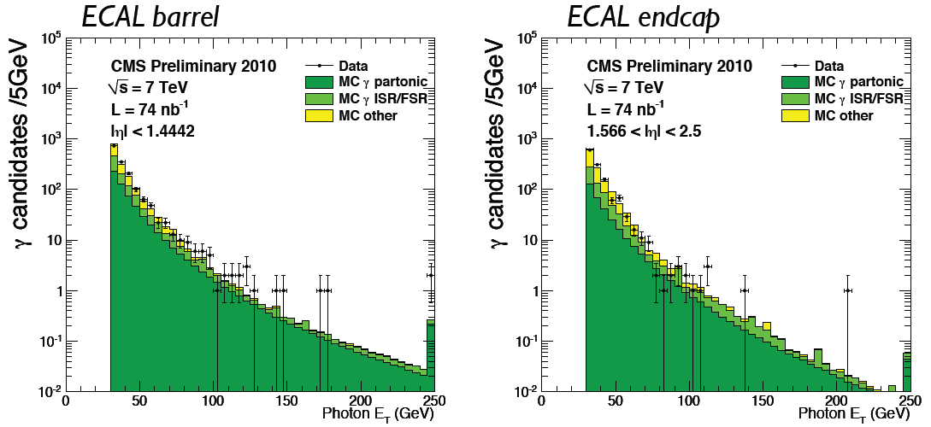
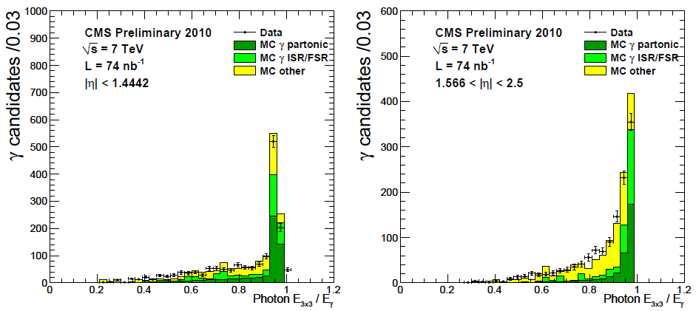
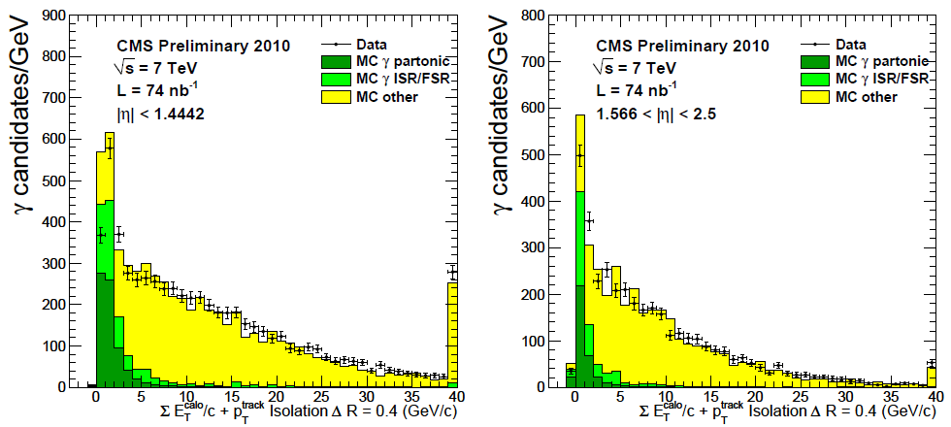
Photon Commissioning
Loose Photon Id
Notes:
2 slides from EGM-10-005 (mention 001 also)
Idea for picking categories: fit the 3 physical parts
Z=➔mumugamma:
Resultats recents (photon workshop)
Appariement PS/ME (Clement/auteurs ALPGEN, plots Bruxelles)
H-→4l: Brem recuperation (Pres N. Chanon groupe Higgs)
H-→2gamma:
CSA07 Skim testing/size estimates
Skim 3 monitoring e/gamma
Travail LH analyse NLO et de nouvelles observables
(plots LH Grazzini, DIPHOX cones saturation, boite Schmidt..) these en co-tutelle
ANR Theorique corrections Klasen/Aldo
ANR SUSY-HIGGS PF
Higgs non-standard H-→AA→4photons

Slide 17
Photon Energy Scale Measurement
input to Wγ, Zγ cross-section Measurements
See more details from Olivier Bondu’s presentation tomorrow
Notes:
Add formes automatiques
Idea for picking categories: fit the 3 physical parts
Z=➔mumugamma:
Resultats recents (photon workshop)
Appariement PS/ME (Clement/auteurs ALPGEN, plots Bruxelles)
H-→4l: Brem recuperation (Pres N. Chanon groupe Higgs)
H-→2gamma:
CSA07 Skim testing/size estimates
Skim 3 monitoring e/gamma
Travail LH analyse NLO et de nouvelles observables
(plots LH Grazzini, DIPHOX cones saturation, boite Schmidt..) these en co-tutelle
ANR Theorique corrections Klasen/Aldo
ANR SUSY-HIGGS PF
Higgs non-standard H-→AA→4photons

Slide 18
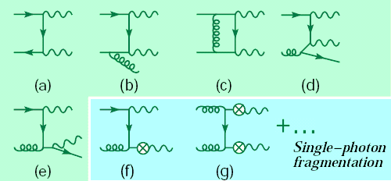
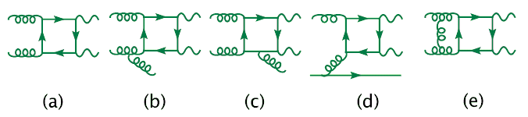
Theoretical Predictions
DIPHOX V1.3 LHAPDF-compatible
Binoth, Guillet, Pilon, Werlen, hep-ph/9911340, 2000
RESBOS LHAPDF-compatible
Balazs, Berger, Mrenna, Yuan, hep-ph/9712471, 1997
gamma2MC, NLO
Now LHAPDF-compatible!
Bern, Dixon, Schmidt, hep-ph/0211216, 2002
FIXED ORDER : NLO
NLO with NNLL Resummation
BORN + FRAG (and NLO corrections)‏
FIXED ORDER : NLO
BOX (and NLO corrections)‏
Resbos only
1-frag :
- LO, effectively in Resbos
- NLO in Diphox
2-frag :
DIPHOX only (NLO)‏
DIPHOX+gamma2MC contains the most complete NLO treatment -> 2010 analysis
ResBos for 2011 data analysis, 2gammaNNLO?
Any news will be from Workshop on Photon Physics and Simulation at Hadron Colliders”, Paris, 30 March 2012

