Slide 1
SMART PIXELS and 3D APPROACH
P.Pangaud
CPPM

Slide 2
Tezzaron-Chartered technology
Main characteristics :
2 wafers (tier 1 and tier 2) are stacked face to face with Cu-Cu thermo-compression bonding
Via Middle technology : Super-Contacts (Through Silicon contacts) are formed before the BEOL of Chartered technology.
Wafer is thinned to access Super-Contacts
Chartered technology limited to 5 metal levels
Back-side metal for bonding (after thinning)
Wafer to wafer bonding
Bond interface layout
One tier

Slide 3
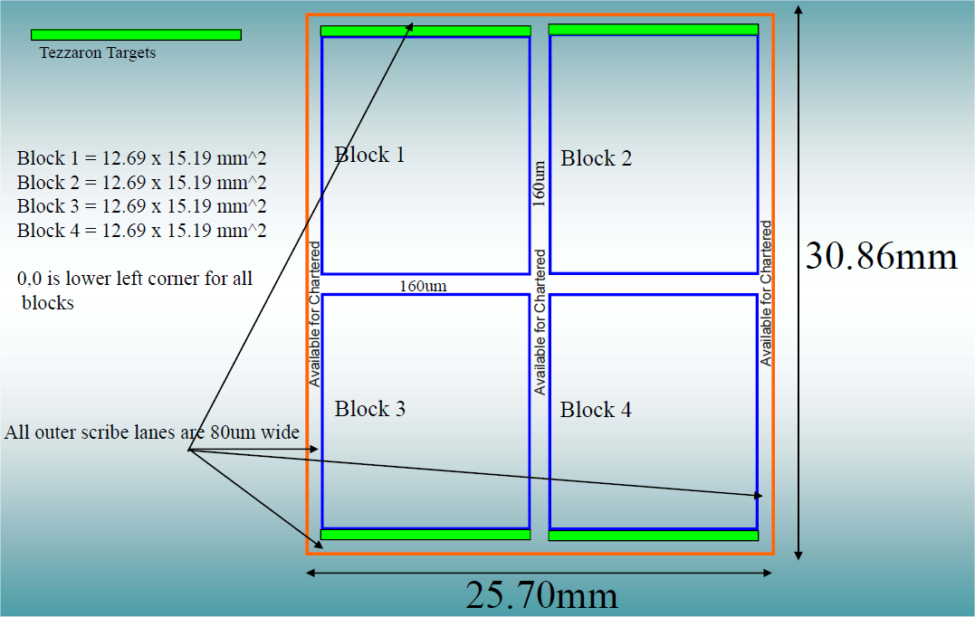
Access to the TC technology
Global Foundries (Chartered) 0.13µm LP and Tezzaron technologies
Semi-annual MPW runs via CMP-CMC- MOSIS: 2,000 $ /mm²
Example 2.5 mm x 2.5 mm = 12,500 $
Dedicated run with TEZZARON : ~350,000 $ for 1 masks set
The CMP-CMC- MOSIS price is acceptable for a chip smaller than a block size
The maximum block/prototype size is
12.69mm x 15.19mm.
Can we reach a custom 12.69mm x 20 mm prototype size?

Slide 4
TSV and Bond Interface
The TSV are realized after the FEOL stage and before the BEOL stage (diam of 1,2µm)
The bond Interface are mechanical and electrical interfaces to connect 2 tiers together by face to face Cu-Cu thermo-compression.
Tezzaron uses the 1µm thick Cu TopMetal to create the “leopard skin”.

Slide 5
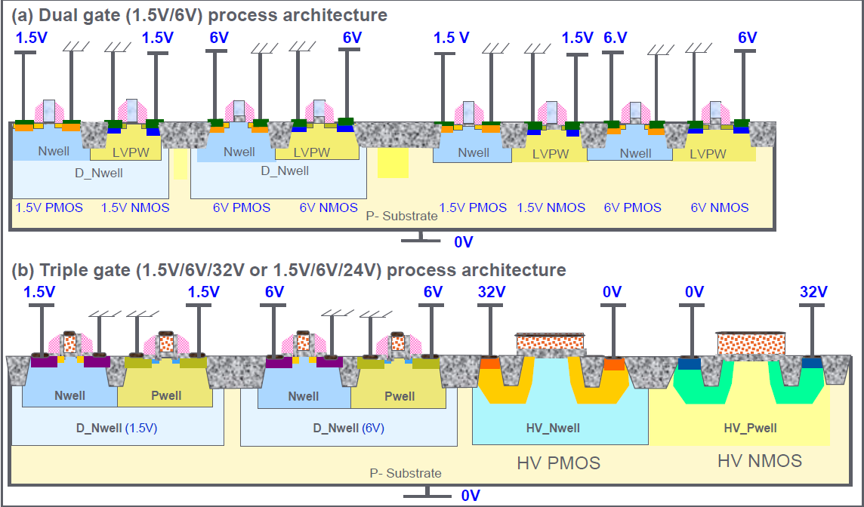
HV technologies
Substrate Resistivity = 20 ohm.cm
If -32V, depleted depth = 7,3µm
Can we design LV Tr into HV_NWELL?
Can we use DNWELL with substrate at -32V?
We are waiting more information
Best Case
0,13µm HV Global Foundries is an option of 0,13µm LP technology
0,13µm LP -> Tezzaron
1µm thick Cu TopMetal
0,13µm HV -> Tezzaron ???

Slide 6
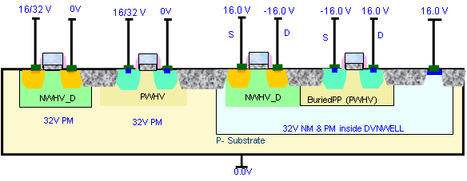
HV technologies
Substrate Resistivity = 20 ohm.cm
If -32V, depleted depth = 7,3µm
Can we design LV Tr into DVNWELL?
Can we use DVNWELL with substrate at -32V?
We are waiting more news
Other solution
0,18µm HV Global Foundries
1µm thick Cu TopMetal
0,18µm HV -> Tezzaron ???
The BuriedPP and DVNWELL layers also exist for the 0,13µmHV GF technology, but they are optional.
Awaiting more news

Slide 7
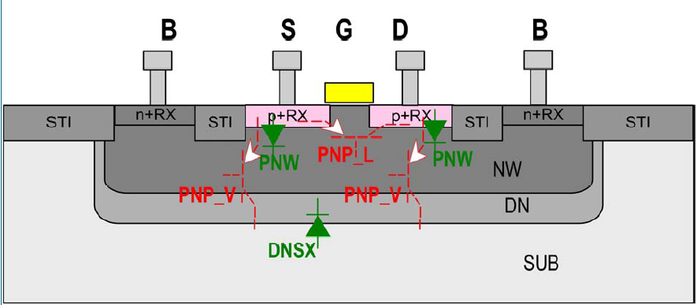
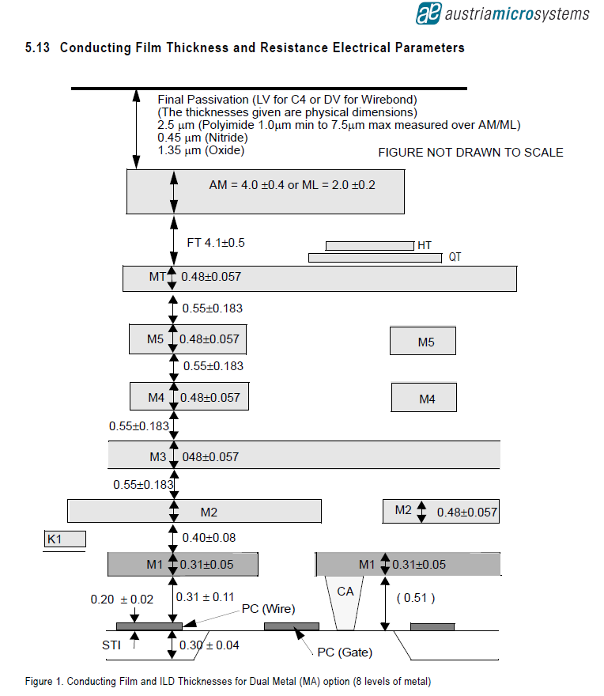
HV technologies
Substrate Resistivity = 10 ohm.cm
If -50V, depleted depth = 6,7µm
Other solution
0,18µm HV AMS
4µm thick Cu TopMetal
0,18µm HV -> Tezzaron ???

Slide 8
Depleted parameters from models

Slide 9
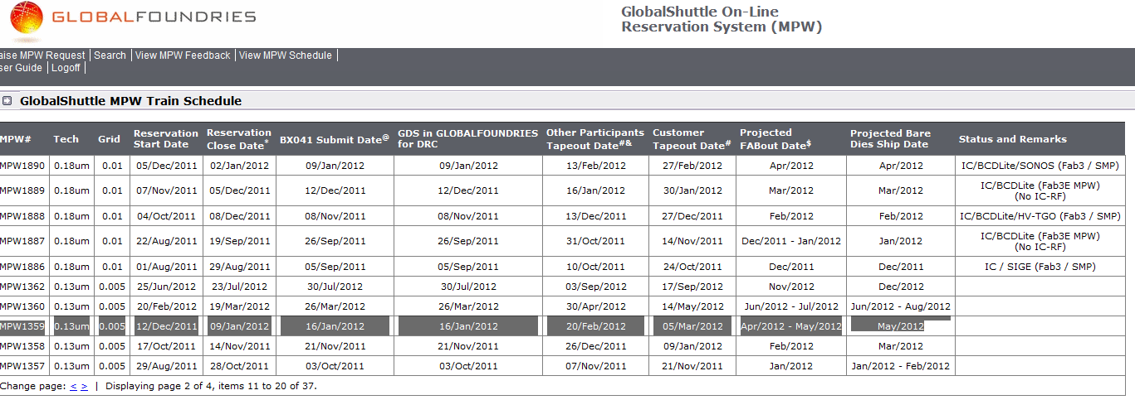
smart pixels schedule – prototypes for 3DIT
Can we design a smart pixel by using the Tezzaron-Chartered 0,13 LP technology?
We need more news from the GlobalFoundries
A loooooooooooong way….
What about the GF 0,18µm HV technology?
canceled

Slide 10
3D smart pixels schedule
Tezzaron-Chartered 0.13µm LP technology schedule
Semi-annual run (March and October)
If the GF 0.13µm HV is relevant, can we use the 0,13µmLP technology and adding HV masks? How many masks? Price?
Awaiting answers
If the 0,18µm HV (GF or AMS) are more relevant, can we 3D-connect them with an other tier (GF 0,13µm LP ; GF 65nm ; TSMC…)? Tezzaron be able to realize it? The High thickness of AMS TopMetal is a problem? Price? Etc ….
This is being discussed with Tezzaron….

