Slide 1
HV2FEI4 and 3D
A.Rozanov 9.12.2011

Slide 2
3D approach: ATLAS Pixel Front End size
50 μm
FE-I3 CMOS 250 nm
400 μm
50 μm
FE-I4 CMOS 130 nm
250 μm
50 μm
FE-TC4 CMOS 130 nm 2 layers
125 μm
< 50 μm
FE-X5-3D CMOS xx nm 3 layers
< 100 μm

Slide 3
              Tezzaron/Chartered 0.13 um Process
    Large reticule – 25.76 mm x 30.26 mm
    12 inch wafers
    Features
        Deep N-well,MiM capacitors – 1 fF/um² Single poly, 6 (8) levels of metal available, Zero Vt (Native NMOS) available, variety of transistor options (Nominal,Low voltage,High performance,Low power)
        Vias 1.6x1.6 x10um, pitch 3.2 um
        Bond points Cu 1.7x1.7 um, pitch 2.4 um
        Wafer bonding at 375 deg C
        Alignment 3 sigma ~ 1 um
        Missing bonds ~ 0.1 ppm
        1500 Temp cycling -65deg/+150deg on 100 devices without failures
sensor
Back Side Metal
Super Contact
Tier 1
(thinned wafer)
M1
M2
M3
M4
M5
M6
Bond Interface
M6
M5
M4
M3
M2
M1
Tier 2
Super Contact

Slide 4
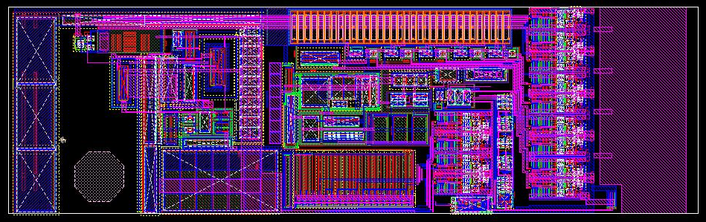
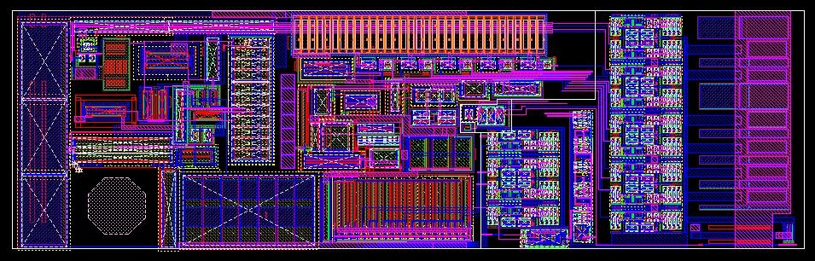
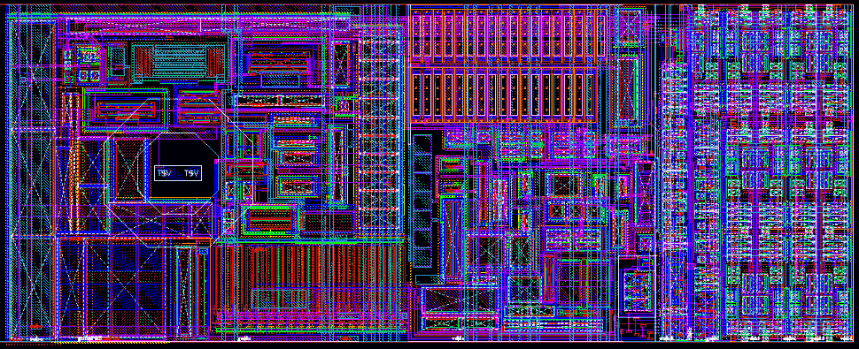
FE-C4-PX : pixels size reduction
FE-C4_P1
From the FE-I4_P1
50µm x 166µm
Tested
Bump Pad
FE-C4_P2
Electrical optimization
From the FE-C4_P1
50µm x 166µm
Tested
FE-C4_P3
Size optimization
From the FE-C4_P2
50µm x 125µm
Under tests November 2011
TSV and
Backplane Pad

Slide 5
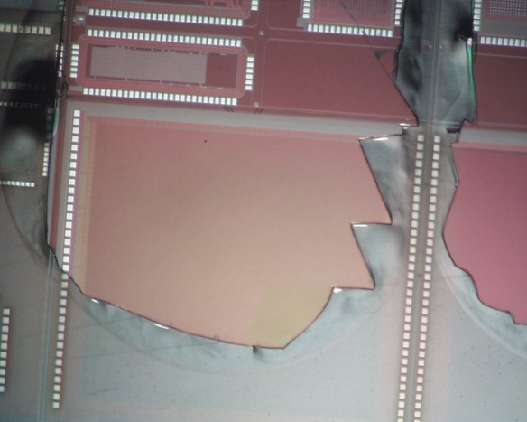
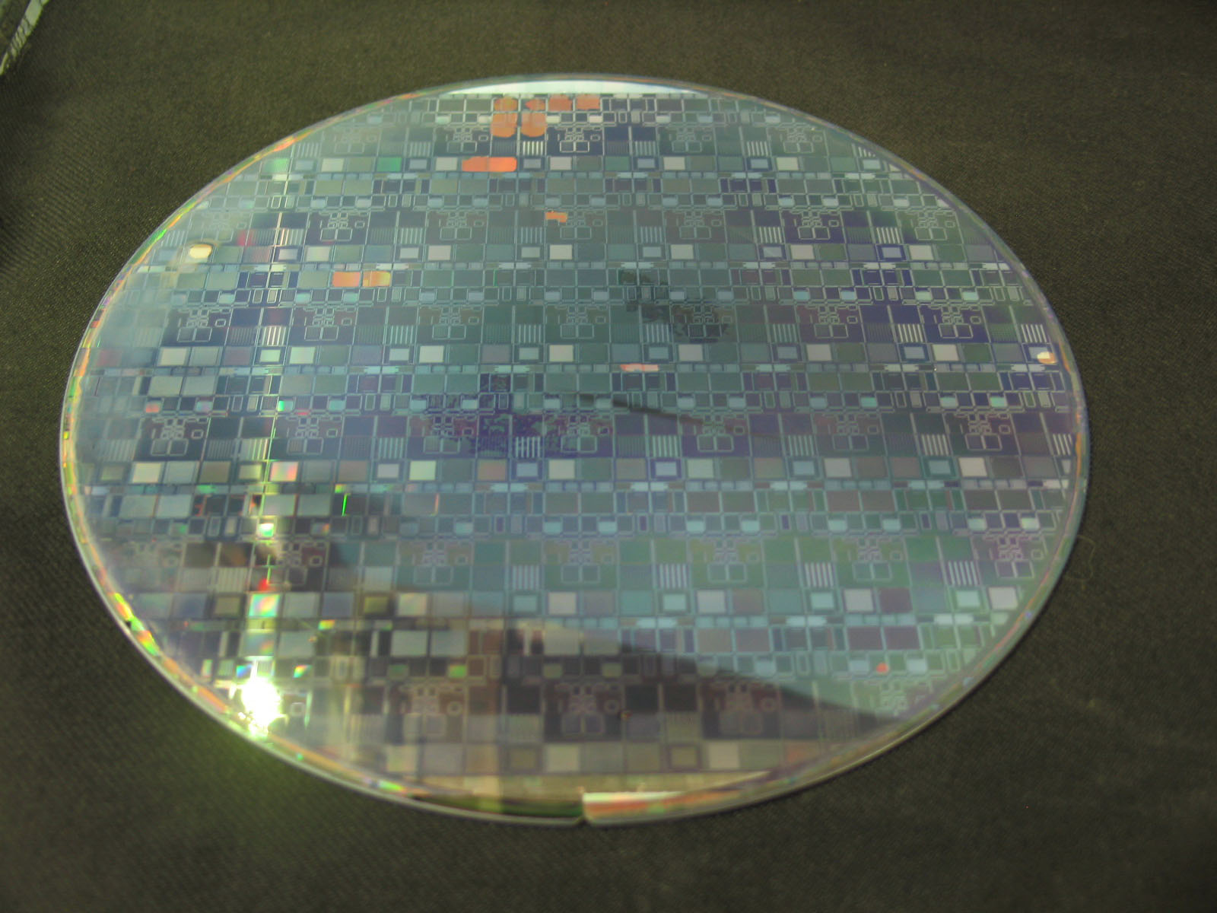
Test of first 3D wafers
Two wafers de 3D assemblies arrived CPPM September 2011. Third wafer was diced into chips. Problems with uniformity of the thinning of the upper tier: 15-20% of the wafer surface is defective. Measurements of the resistance of daisy chains and power pads have shown the short circuits between copper surface contacts between two tiers. Few chips without shorts selected. They works, but no communication between tiers established. Problem identified by Tezzaron to be bad wafer alignment at new production facility at Tempe(AZ). The same alignment problem probably creates weak adhesion and non-uniformities during thinning. Next batch of wafers will bonds at facility at Austria in November 2011 with final delivery in February 2012.

Slide 6
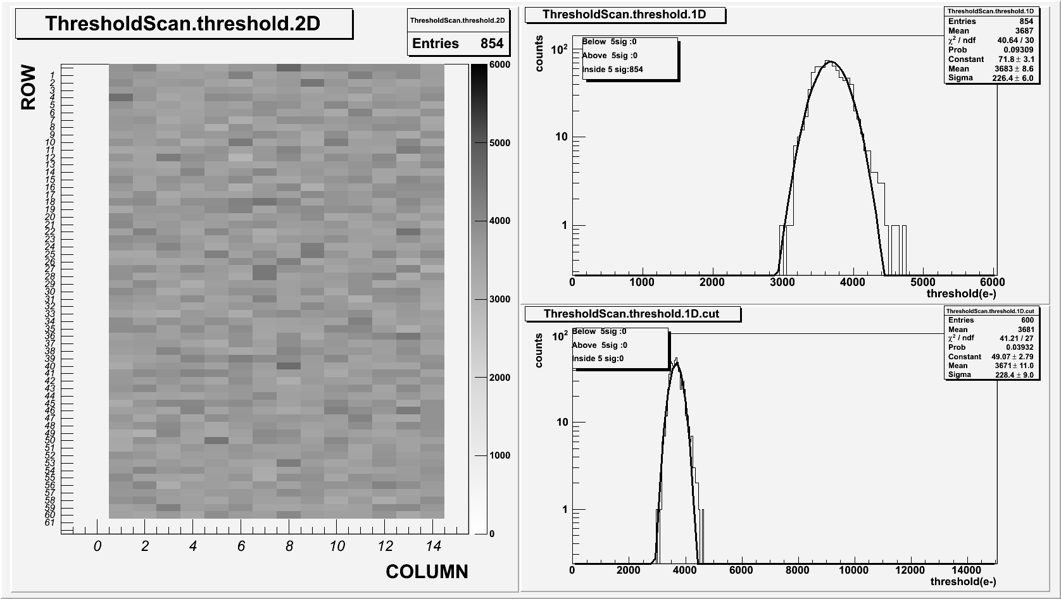
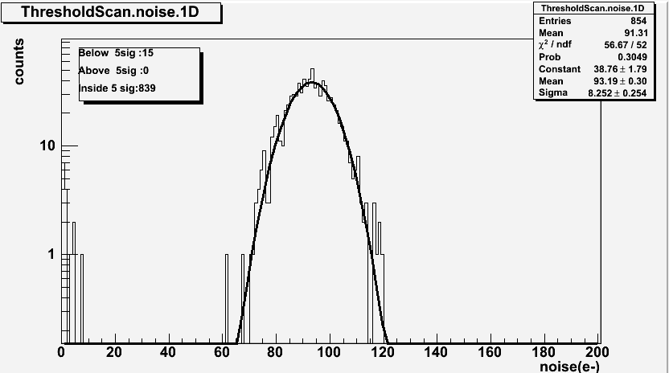
Performance of analog tier from 3D wafer with 10 µm thickness
Excellent performance of the analog tier with 10 µm thickness.

Slide 7
HV CMOS
Idea: Include in the analog tier HV CMOS sensors (Ivan Perric ).
First step: 2D demonstrator close to HV2FEI4 in GF CMOS 130 nm or 180 nm HV technology .
Longer term potential benefits are:
no need for sensor bump-bonding or capacitive gluing step, ready modules
small HV CMOS sub-pixel pitch
DC transmission of signals from analog tier to digital tier by surface contacts (signals smaller than in AC connection)
flexibility to put DACs and other service blocks on digital tier and using surface connection to analog tier
use of TSVs for one side wire bond connection for both signals and powering

Slide 8
Spares

Slide 9
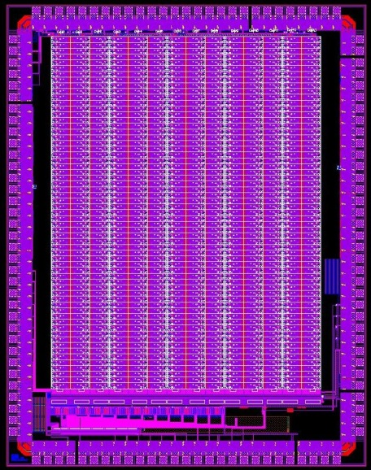
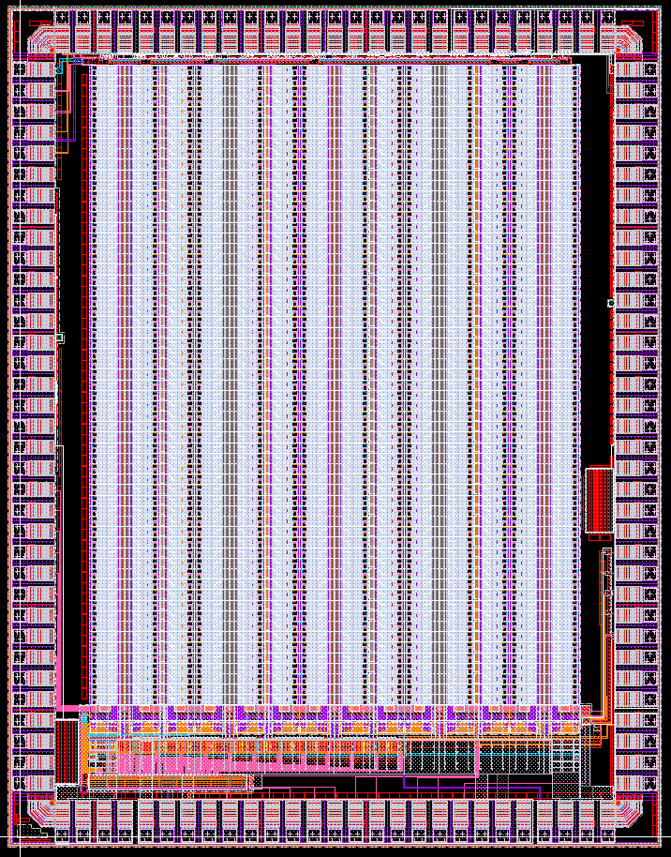
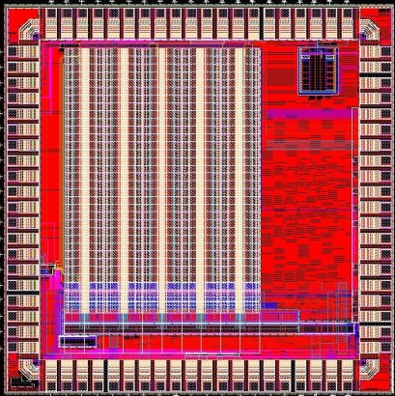
FE-X4-Pn gallery
61x14 array
61x14 array
30x10 array
FE-I4-P1
4x3mm size
IBM 0.13µm LVT
8LM
FE-C4-P1
4x3mm size
CHRT 0.13µm LP
8LM
FE-C4-P2
4x3mm size
CHRT 0.13µm LP
8LM
FE-C4-P3
2.5x2.5mm size
CHRT 0.13µm LP
8LM

Slide 10
A Closer Look at Wafer-Level Stacking
Oxide
Silicon
Dielectric(SiO2/SiN)
Gate Poly
STI (Shallow Trench Isolation)
“Super-Contact”
W (Tungsten contact & via)
Al (M1 – M5)
Cu (M6, Top Metal)

Slide 11
Next, Stack a Second Wafer Thin:

