Slide 1
HV2FEI4 simulations
CPPM
P.Pangaud

Slide 2
The HV2FEI4 simulation -1
8 Nov 2011 : Simulation of FEI4_B analog part with CCPD’s output signals from Ivan’s presentation
  Add a 2.5fF coupling capacitor ( estimation)
  Input Signal Variations from Ivan’s presentation.
Results
  The equivalent injection charge from the CCPD chip is 5ke-
  The FEI4_B output has the same variation than the CCPD ToT.
Next steps
  Simulation with different CCPD bias coding, and different coupling capacitor values
  Evaluation of the ToT accuracy (worst case models and Monte-Carlo)
  Simulation with the real CCPD spice model including parasitic elements.
  Simulation of the feedback injection effect to the CCPD chip

Slide 3
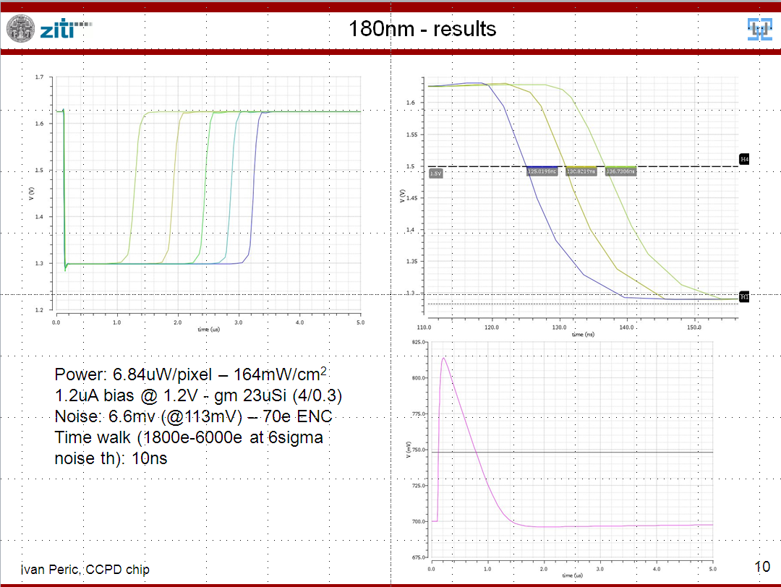
CCPD chip : specifications
8 nov 2011

Slide 4
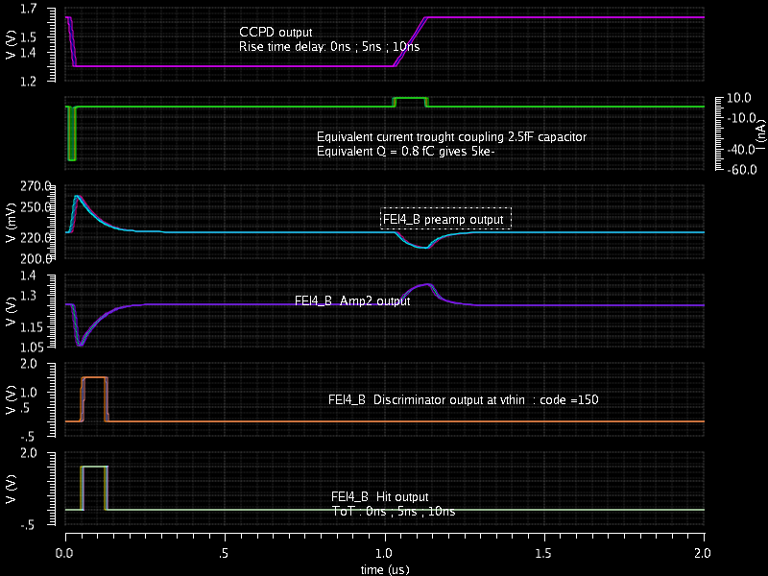
HV2FEI4 outputs
8 nov 2011
P.Pangaud - CPPM
4

Slide 5
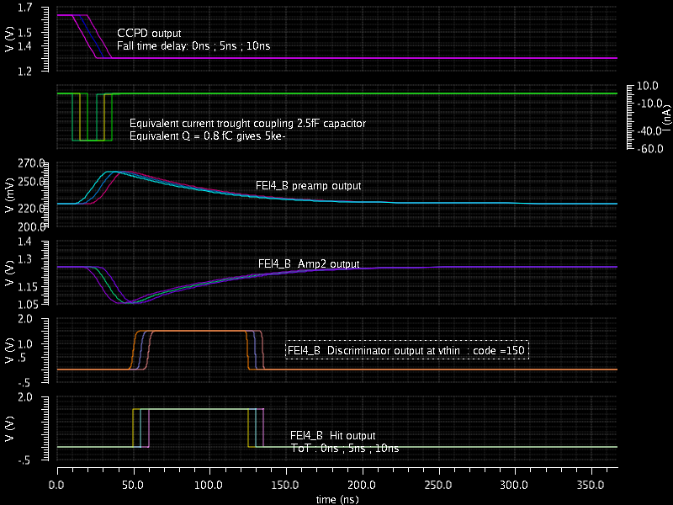
HV2FEI4 outputs : falling edge
8 nov 2011
P.Pangaud - CPPM
5

Slide 6
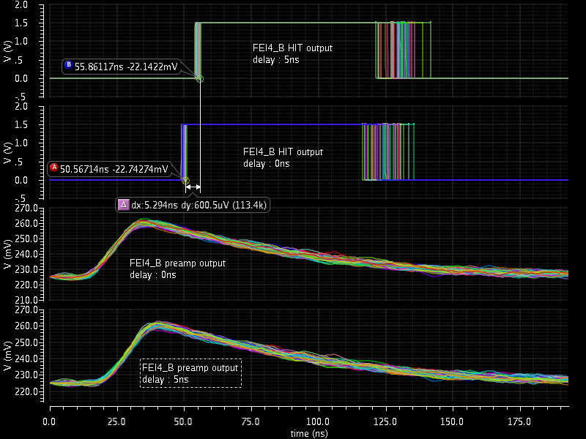
HV2FEI4 outputs : noise state
8 nov 2011
P.Pangaud - CPPM
6

Slide 7
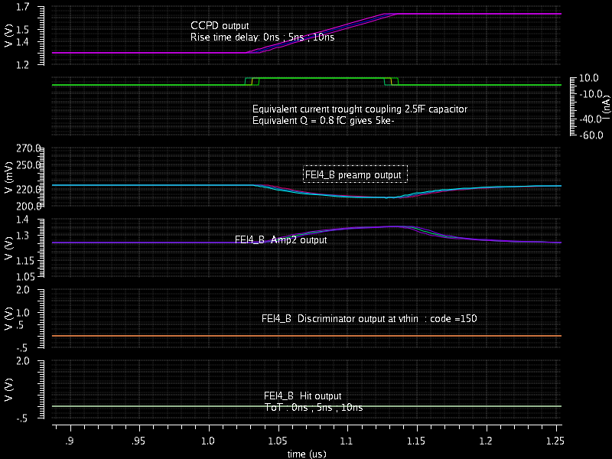
HV2FEI4 outputs : rising edge
8 nov 2011
P.Pangaud - CPPM
7

Slide 8
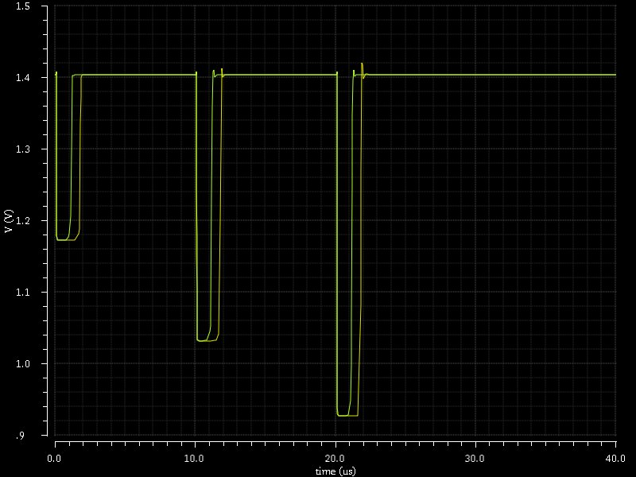
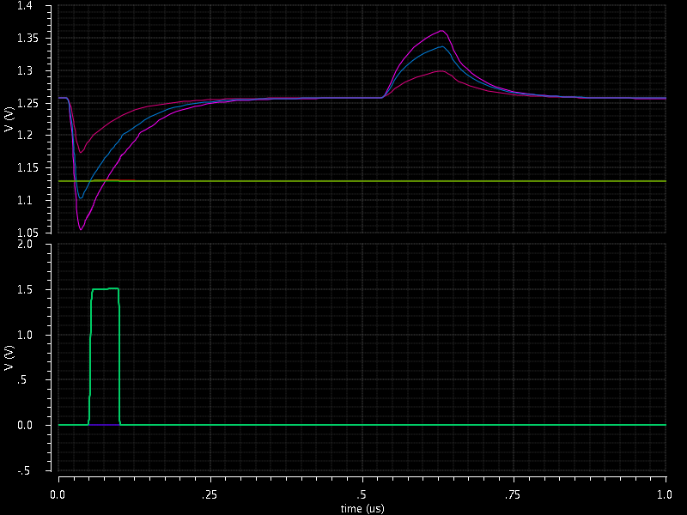
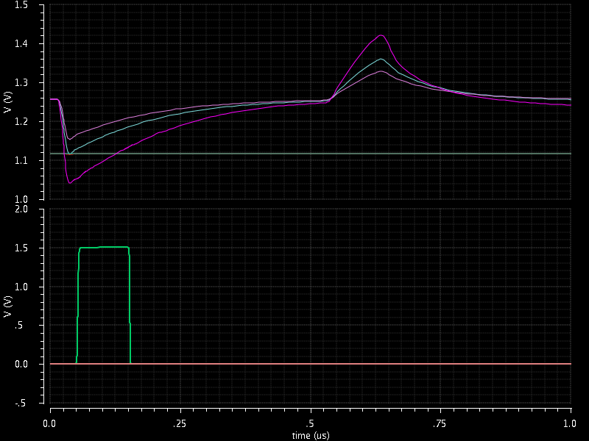
New CCPD pixel output signal
8 nov 2011
The output of the CCPD pixel is narrow now (from 3µs to 1µs).
  The FEI4 preampli output stay operational
The estimated coupling capacitor between the both chip is 1fF now .
  FDAC could improve the results (TOT)

Slide 9
The HV2FEI4 simulation -2
9 Dec 2011 : Simulation of FEI4_B analog part with CCPD’s output signals
  Add a 1fF glue-coupled capacitor + 50fF coupling capacitor
  Input Signal Variations from CCPD spice file
Results
  The equivalent injection charge from the CCPD output is 2,5ke- now (x2)
  The FEI4_B output has the same variation than the CCPD ToT.
Next steps
  Evaluation of the ToT accuracy (worst case models and Monte-Carlo).
    Need to fix Monte-Carlo mixed mode definition
  Simulation with the real CCPD spice model including parasitic elements.
    The spice file should be lower-case type including the parasitic models file (PixelAll_125.pex.netlist.PIXELALL_125.pxi)
  Simulation of the feedback injection effect to the CCPD chip

Slide 10
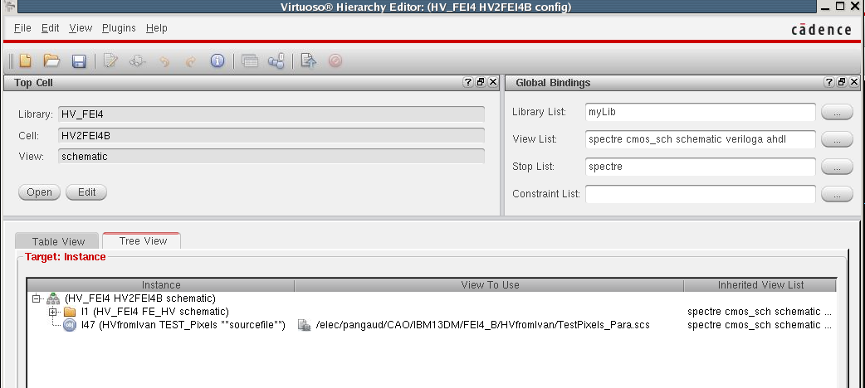
Simulation tools
9 dec 2011
Cadence ADE XL version with Multi-Technology Mode
  Need to create an instance for each technology
  Config view with spice source link to the CCPD cell
CCPD spice netlist
FEI4_B Schematic

Slide 11
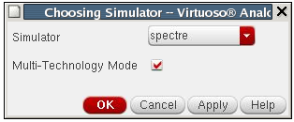
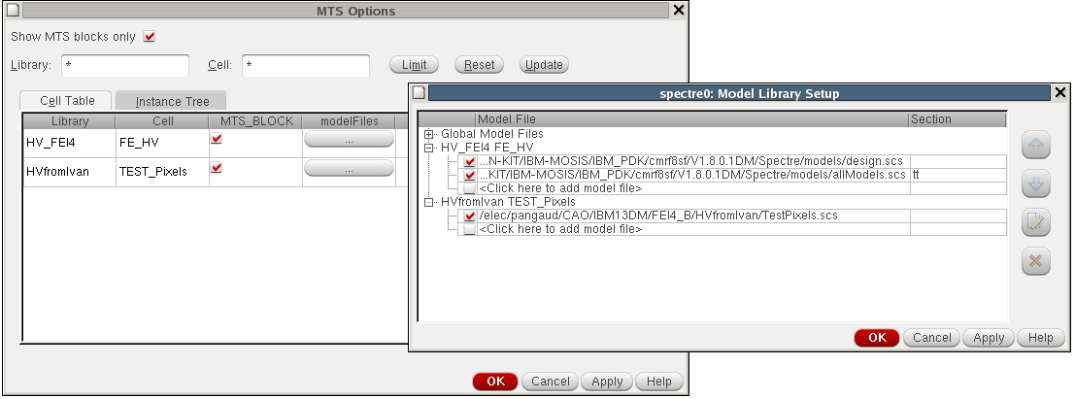
Simulation tools
9 dec 2011
Cadence ADE XL version with Multi-Technology Mode
  Activation of the Multi-Technology Mode
  Selection of the Multi-Technology Simulation blocks

Slide 12
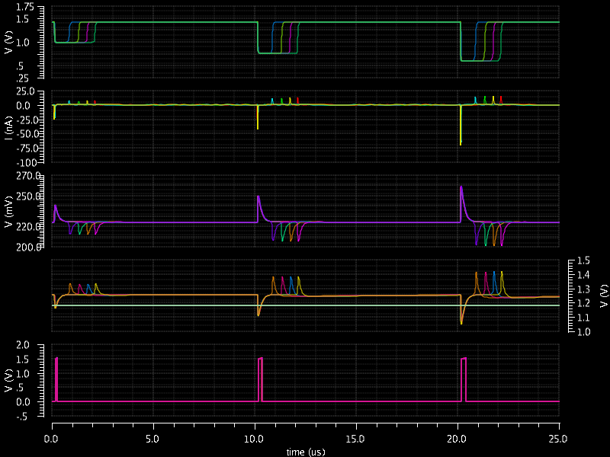
Simulation results
9 dec 2011
3 pixelCCPD Output “source = 20ns ; 30ns ; 40ns ; 50ns”
2,5ke-
3,75ke-
5ke-
Equivalent injection charge through 50fF capacitor
Preampli outputs
amp2 outputs + Threshold signal
Hit ouputs

Slide 13
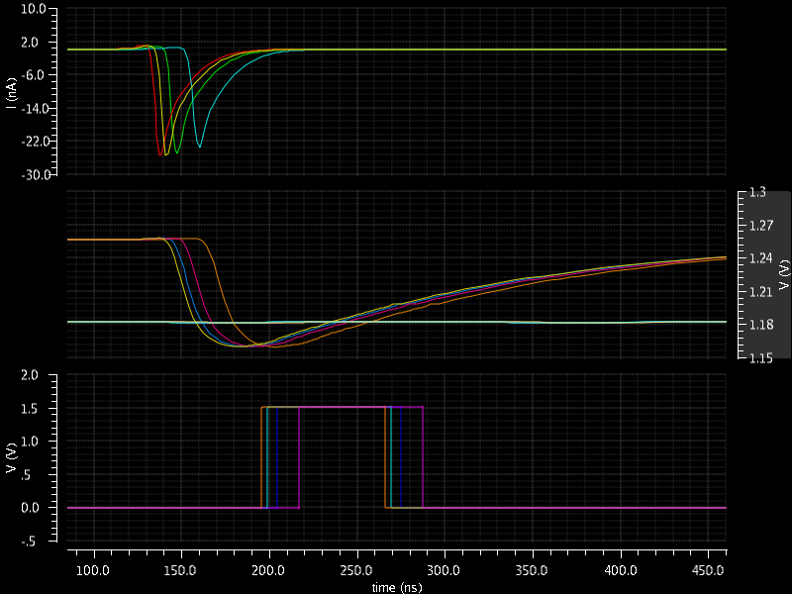
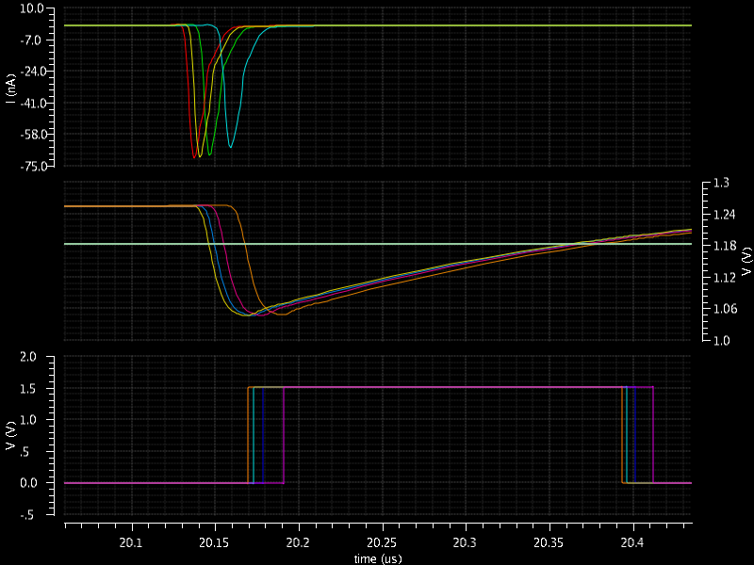
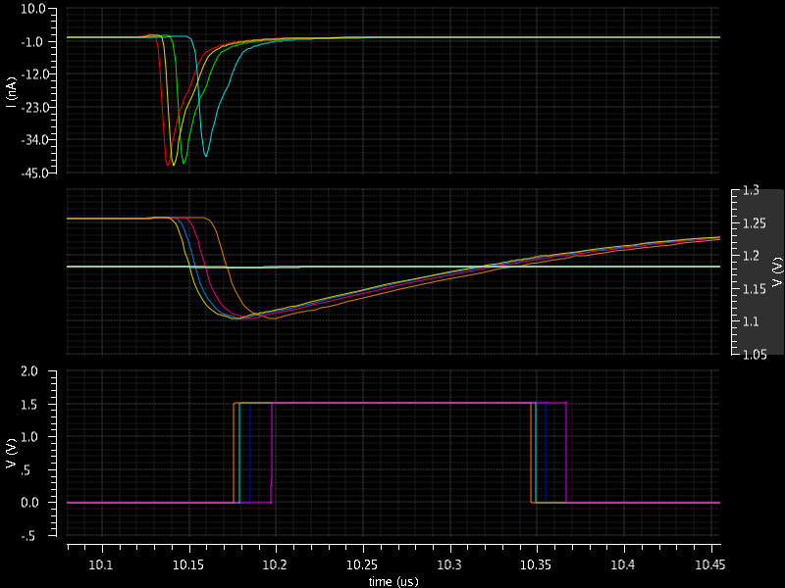
Simulation results
9 dec 2011
2,5ke-
= 1,25ke- CCPD equivalent input injection
5ke-
= 10ke- CCPD equivalent input injection
3,75ke-
= 7,5ke- CCPD equivalent input injection

