Slide 1
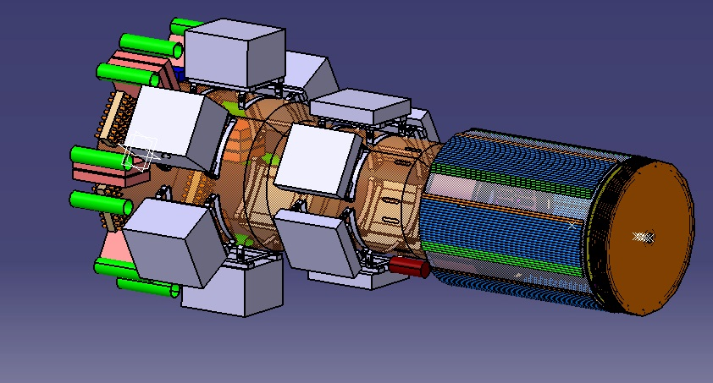
CLAS12
Micromegas Central Tracker
Project
Project launched on November 18 2011
CEBAF the Jlab’s accelerator is upgraded from 6 to 12 GeV
Our Tracker should be ready for October 2014 when Beam is delivered to CLAS12 in Jlab’s Hall B.

Slide 2
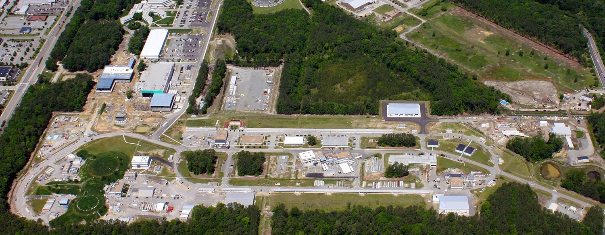
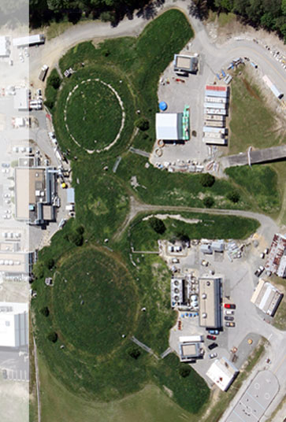
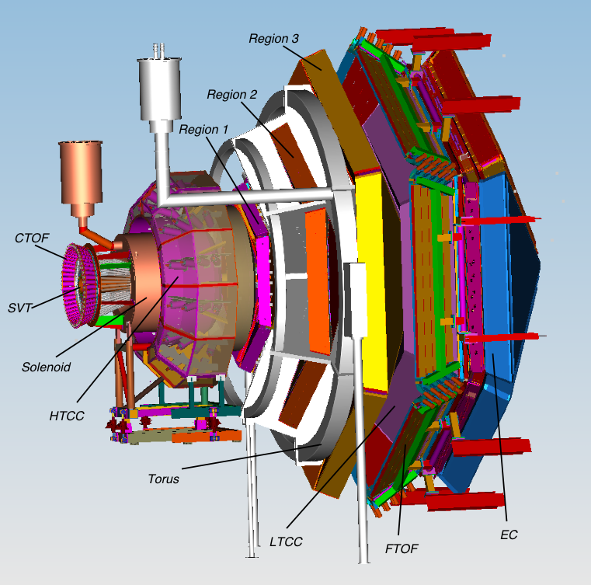
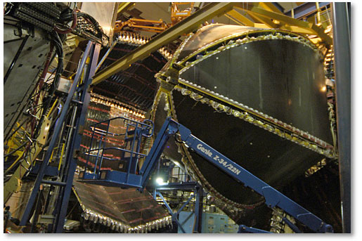
CLAS12
B
CLAS12 (Large acceptance and high luminosity - L=10³⁵ cm⁻²s⁻¹ ) to provide a new reach in Hadron Physics

Slide 3
Physics with CLAS12
3D Structure of the Nucleon –
High precision measurements of exclusive et semi-inclusive processes - Generalized Parton Distributions (GPDs) and Transverse Momentum Dependencies (TMDs).
Precise Measurements of structure functions
Elastic and Transition Form Factors at high moment transfer
Hadronization and Colour Transparency.
Spectroscopy – heavy baryons, hybrid mesons.
5 years of beam already scheduled for JLab PAC approved experiments.

Slide 4
CLAS12
Forward spectrometer:
- TORUS
HT Čerenkov
Drift chambers
LT Čerenkov
Forward ToF
Preshower Calorimeter
(6 sectors)
E.M Calorimeter. (EC)
Central Detector:
SOLENOID
Tracker Barrel Micromegas/Silicon
Forward Tracker
Central ToF
Central
Detector
Forward
Detector

Slide 5
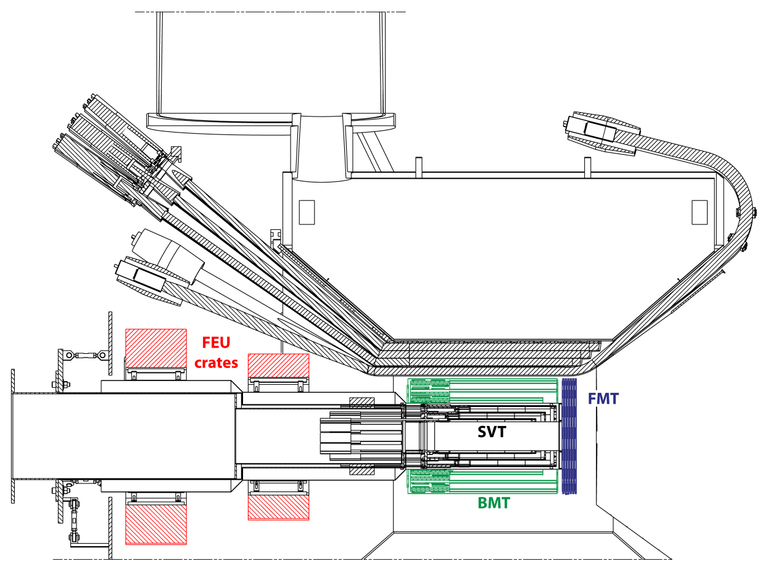
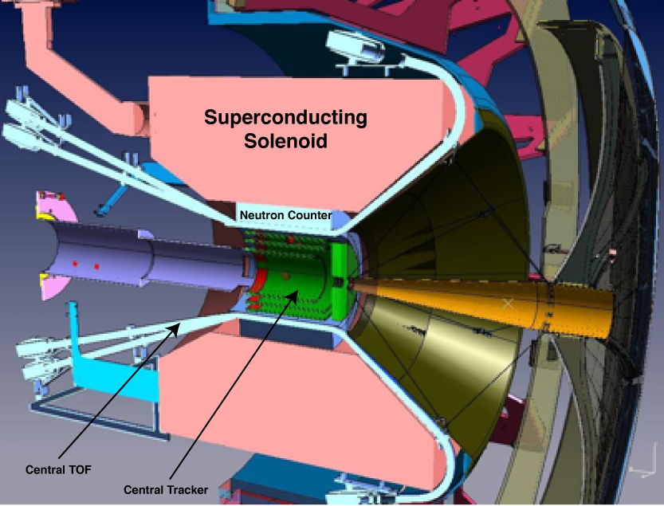
Micromegas Tracker
Central Detector
SVT – MVT :
Charged particles Tracking
from 35 to 125° and 5 to 35°( FVT)
Vertexing
CTOF, ΔT < 60psec for particle id
Neutron counter
5T Solénoid,
Active shielding vs Moller electrons
ΔB/B < 10⁻⁴ in a 2.5x4 cm² cylinder
for target polarisation
Barrel: 3 cylindrical double layers (Z,C) bulk Micromegas around 3 SVT double layers
Forward: 3 double disc shaped bulk Micromegas

Slide 6
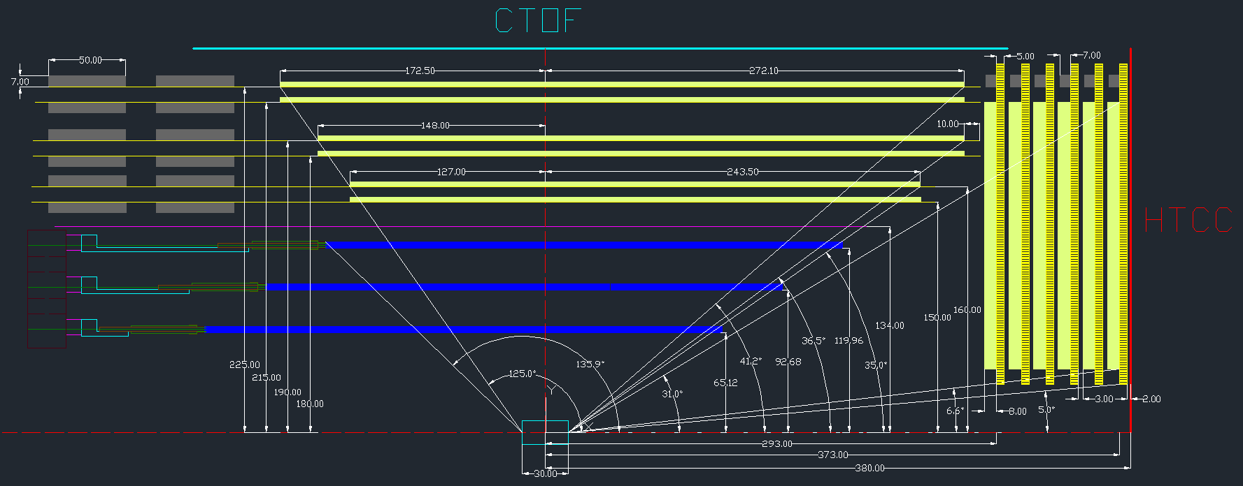
Micromegas Tracker
450
225

Slide 7
CLAS12 Tracking specs
Specification | Forward | Central
Angular Acceptance | 5-35° | 35-125°
σ_{p}/p | < 1% | < 5%
σ_{ϴ} | < 1 mrad | < 5-10 mrad
σ_{φ} | < 3 mrad | < 5 mrad

Slide 8
Resolutions comparison
(for π @ 0.6 GeV/c , θ = 90°)
 | 4 x 2MM | 4 x 2SI | 2 x 2SI + 3 x 2MM | Specs.
σ_{pT}/p_{T} (%) | 2.9 | 2.1 | 1.6 | 5
σ_{θ} (mrad) | 1.3 | 15.1 | 1.4 | 10
σ_{ϕ} (mrad) | 10.9 | 2.9 | 2.6 | 5
σ_{z} (μm) | 212 | 1522 | 267 | tbd.
→ Mixed solution benefits from advantages of both MM and Si
→ The full Si solution is never the best

Slide 9
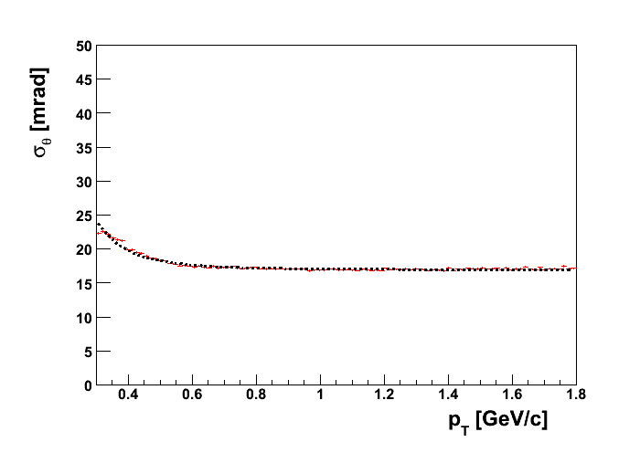
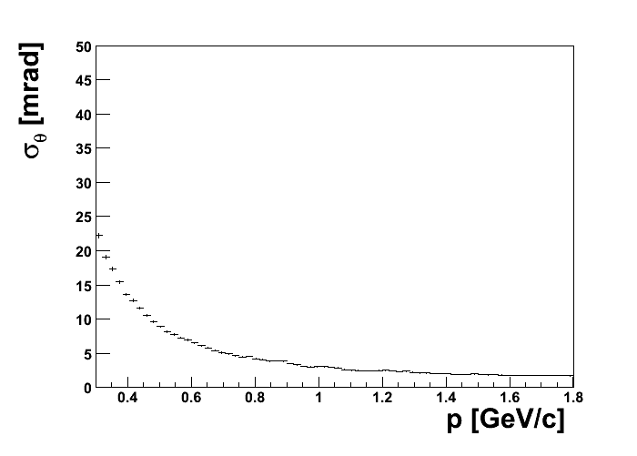
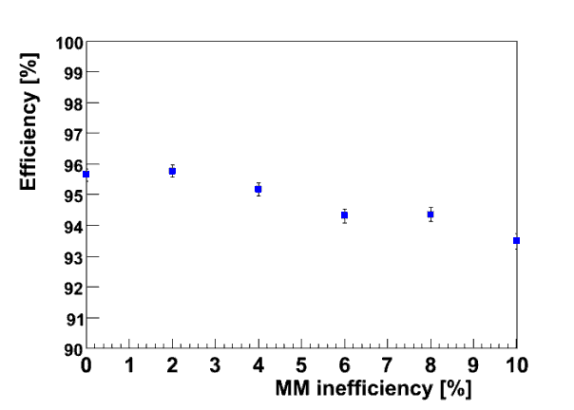
CLAS12 tracking with Barrel MM + Si
SVT
SVT+BMT
⇒ SVT + BMT best solution to reach spec on θ
Very good tracking efficiency thanks to redundancy:

Slide 10
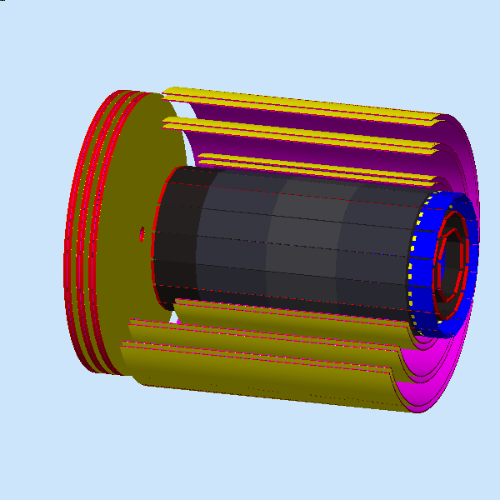
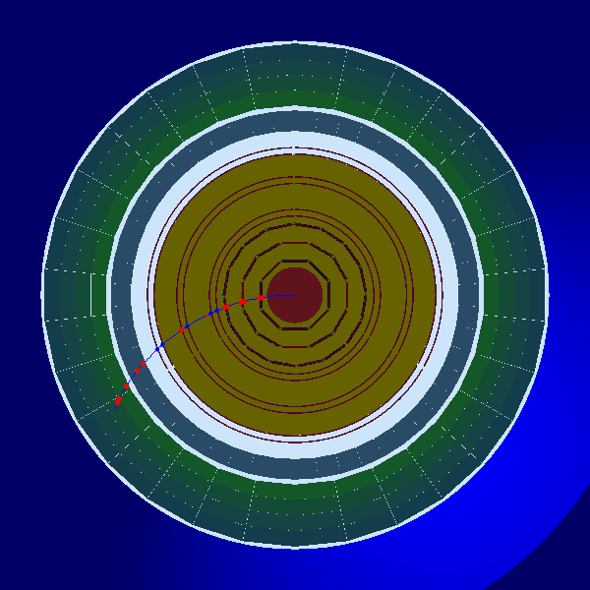
Geant4 Simulations - Barrel
Background noise (MHz)
Si | Layer 1 | Layer 2 | Layer 3 | Layer 4
e-/e+ | 3.9 | 3.7 | 4.3 | 4.3
photon | 30.5 | 22.0 | 25.7 | 20.0
hadron | 1.6 | 1.3 | 1.7 | 1.5
total | 36.2 | 27.0 | 31.9 | 26.0
MM | Layer 1 | Layer 2 | Layer 3 | Layer 4 | Layer 5 | Layer 6
e-/e+ | 1.27 | 2.73 | 1.14 | 2.92 | 1.70 | 3.68
photon | 0.08 | 0.03 | 0.07 | 0.06 | 0.09 | 0.08
hadron | 0.96 | 0.95 | 1.13 | 1.11 | 0.91 | 0.84
total | 2.40 | 3.80 | 2.40 | 4.15 | 2.77 | 4.66
© S. Procureur

Slide 11
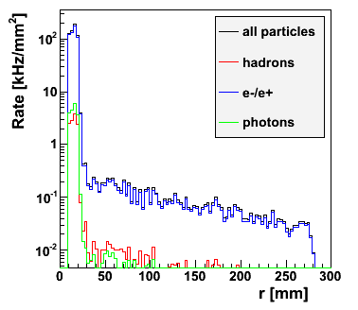
Simulations Geant4 - Forward
Rates in MHz
 | Layer 1 | Layer 2 | Layer 3 | Layer 4 | Layer 5 | Layer 6
e-/e+ | 7.6 (7.5) | 4.7 (6.4) | 4.7 (6.6) | 4.0 (7.3) | 4.0 (7.2) | 3.6 (7.5)
photon | 2.0 (13.9) | 0.2 (11.3) | 0.2 (9.5) | 0.1 (8.3) | 0.1 (7.1) | 0.1 (5.7)
hadron | 2.2 (1.6) | 2.1 (1.5) | 2.0 (1.4) | 2.0 (1.4) | 1.9 (1.4) | 1.8 (1.3)
total | 12.0 (23.1) | 7.2 (19.3) | 7.0 (17.7) | 6.2 (17.1) | 6.1 (15.8) | 5.5 (14.6)
Very high rates in the central area
© S. Procureur

Slide 12
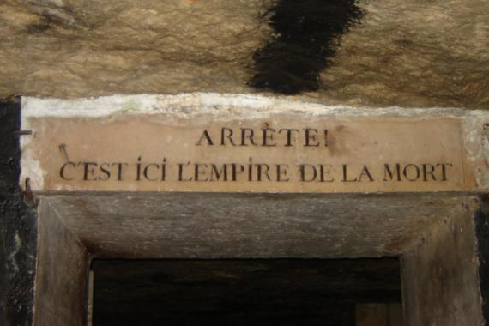
The Challenges
Large Cylindrical detectors
5T Magnetic field environment
High flux of particles
Crowded location: deported electronics

Slide 13
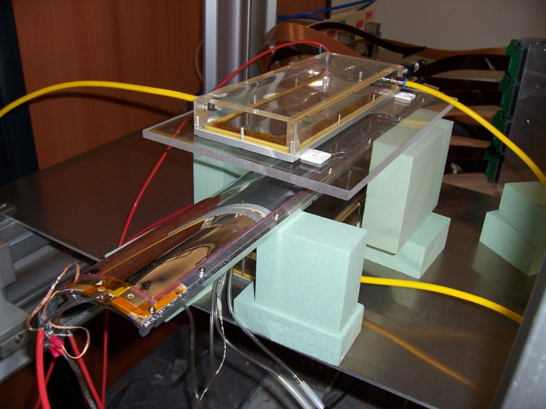
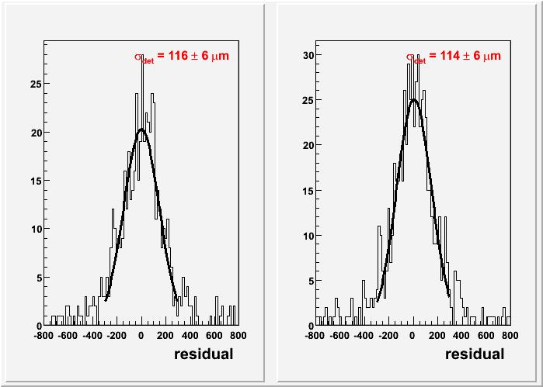
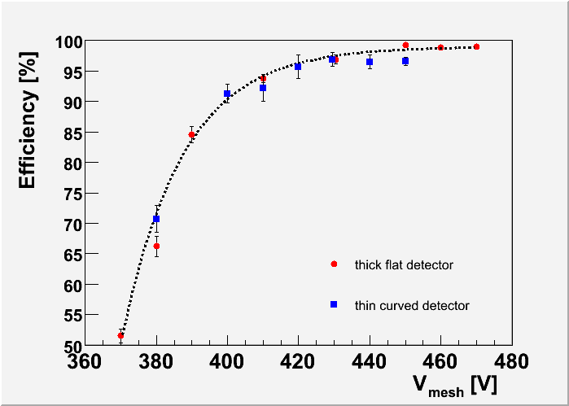
Cylindrical Micromegas
Performance compared to thick flat MM using cosmics
Thick detector
Thin detector
→ similar performance as thick
detectors

Slide 14
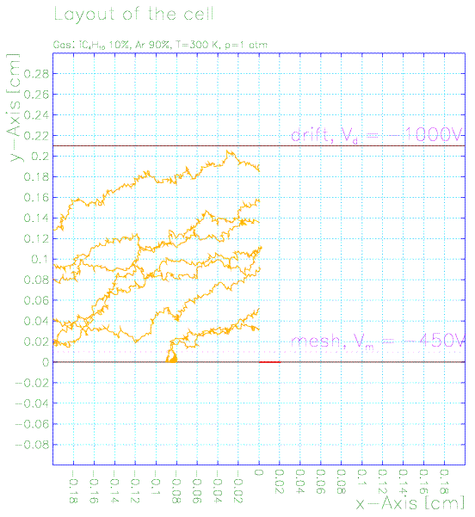
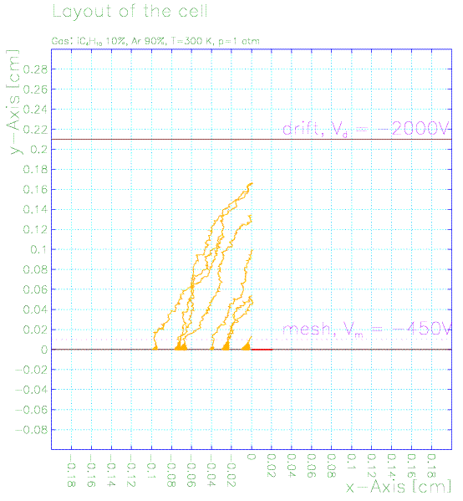
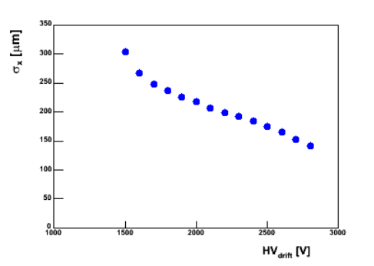
5 Tesla magnetic field
Z tiles of Barrel Micromegas are sensitive to
the Lorentz angle of drifting electrons
Δx = h tanθ = h v B / E
h
→ minimize h (but less signal)
→ use heavier gas (but more sparks)
Δx
→ increase E field (but lower
transparency)
→ σ_{z} ~ 220 µm if θ can be lowered
down to 20°
Garfield simulation

Slide 15
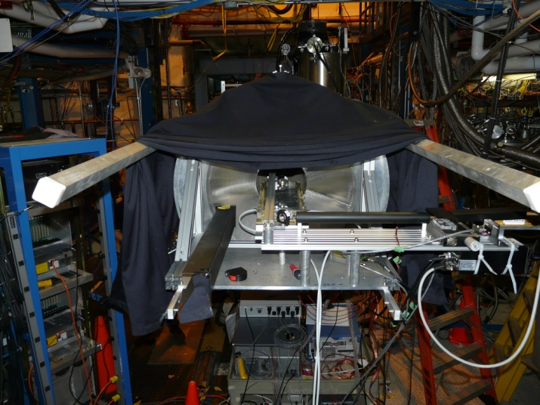
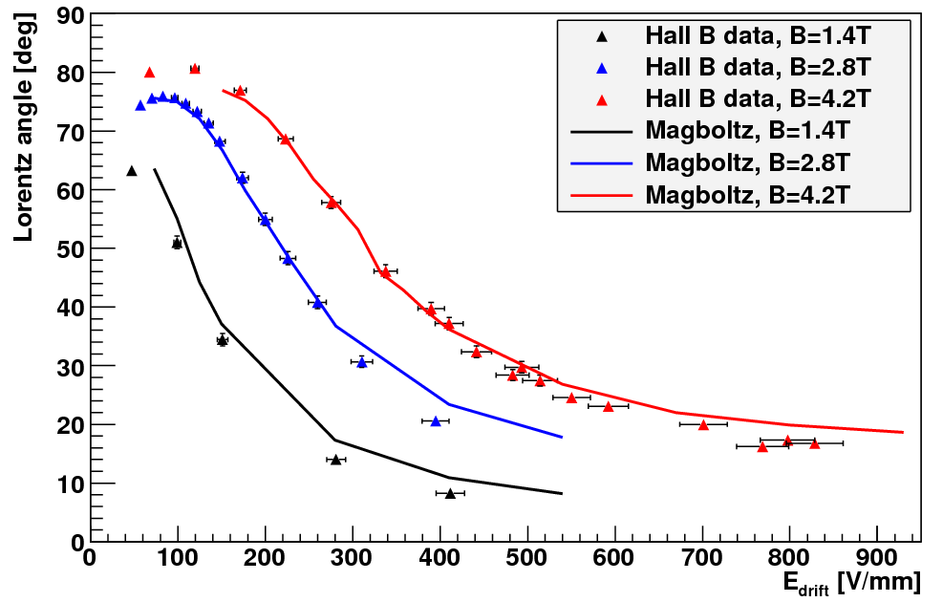
Spatial resolution in 5 T
Test to validate Garfield simulation with a Micromegas in dvcs magnet (Hall B)
→ use of a focused UV laser to extract electrons
from the drift electrode
Garfield validated, θ can be as low as 20°
P. Konczykowski et al., NIM A612 (2010), 274

Slide 16
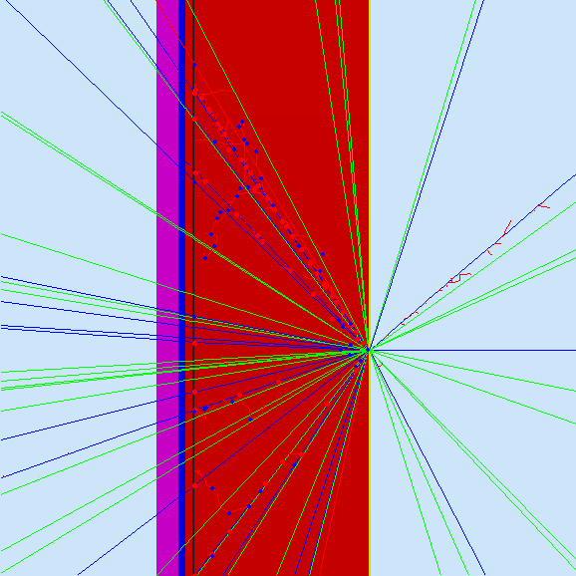
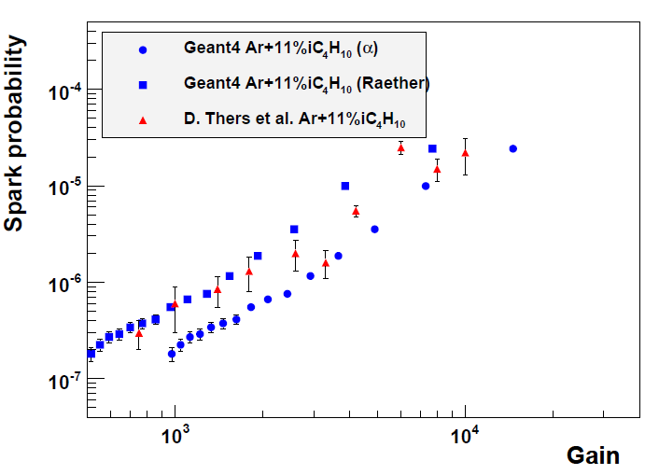
Spark Rate studies
→ simulation: try to relate sparks with large
energy deposits with Geant4 (Gemc)
→ spark condition: N_{el} ~ 10⁷ (Raether)
- Quantitatively reproduces (few) existing data
Explains gas effect & give
predictions (bulk)
S. Procureur et al., NIM A621 (2010), 177

Slide 17
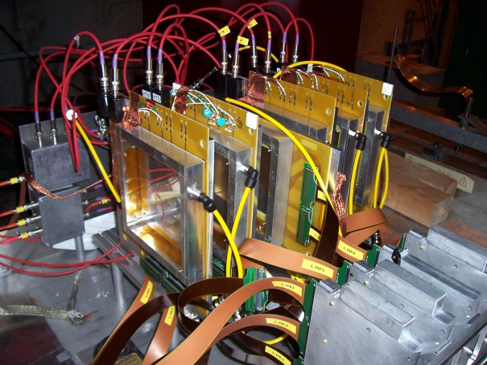
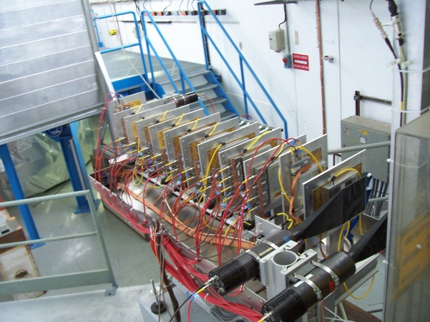
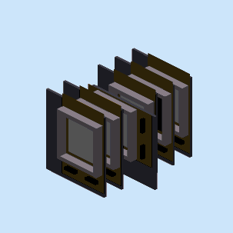
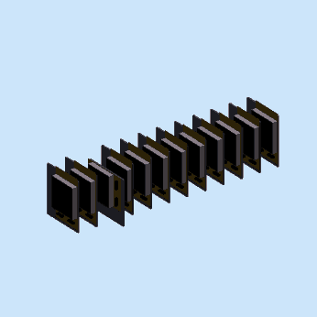
Tests @ CERN/SPS and PS
Location | CERN/SPS | CERN/PS
Date | 10/2009 | 08/2010
Goals | Spark rate in high E beam Effect of B┴ | Spark rate in low E beam Effect of a GEM foil
P_{beam} | 150 GeV/c | 0.2 - 3 GeV/c
Particles | π | π⁺, π⁻, p
Beam intensity | ≤ 10⁶ / spill | ≤ 5.10⁵ / spill
Spill | 10 s every 50 s | 0.4 s every 50 s
Gas | Ar+5%iC₄H₁₀ | Ar+5%iC₄H₁₀

Slide 18
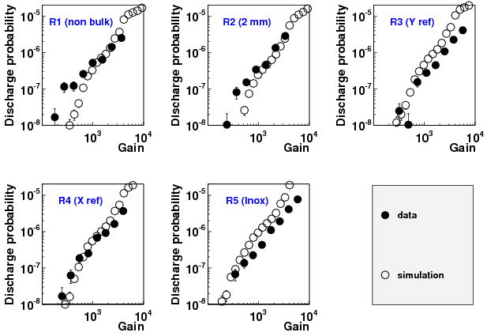
SPS: results & simulation
- No significant difference between thin and thick mesh
- Reasonable agreement with simulation using N_{el} = 2.5 10⁷
S. Procureur et al., NIM A659 (2011), 91

Slide 19
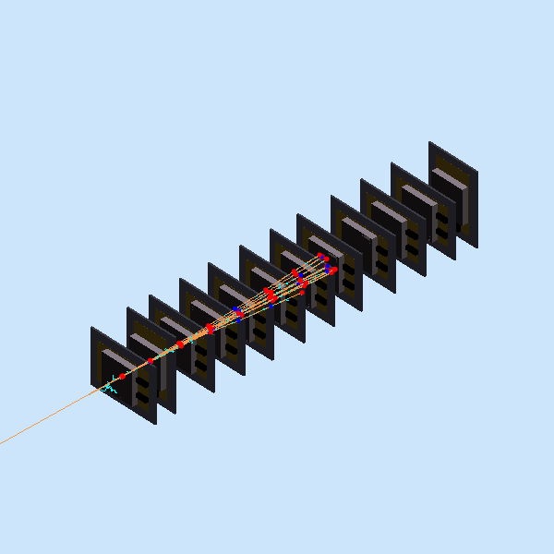
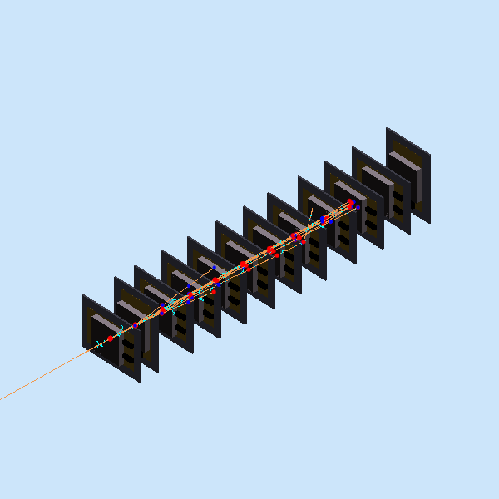
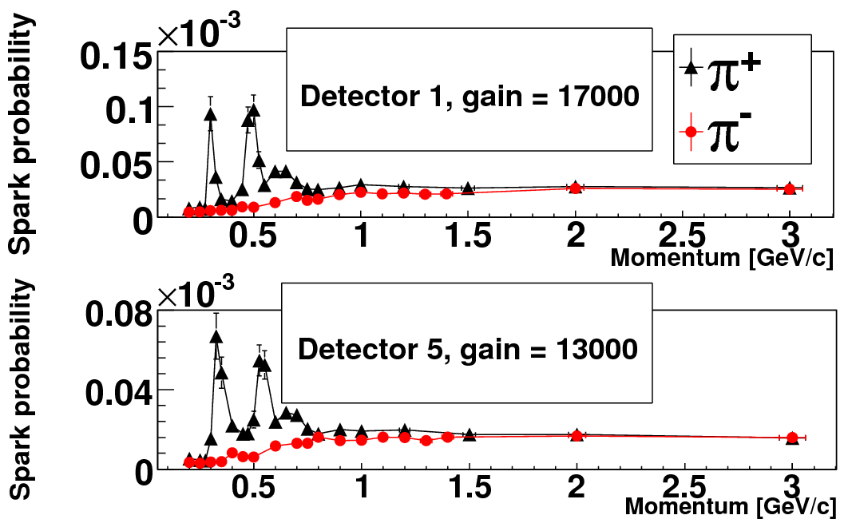
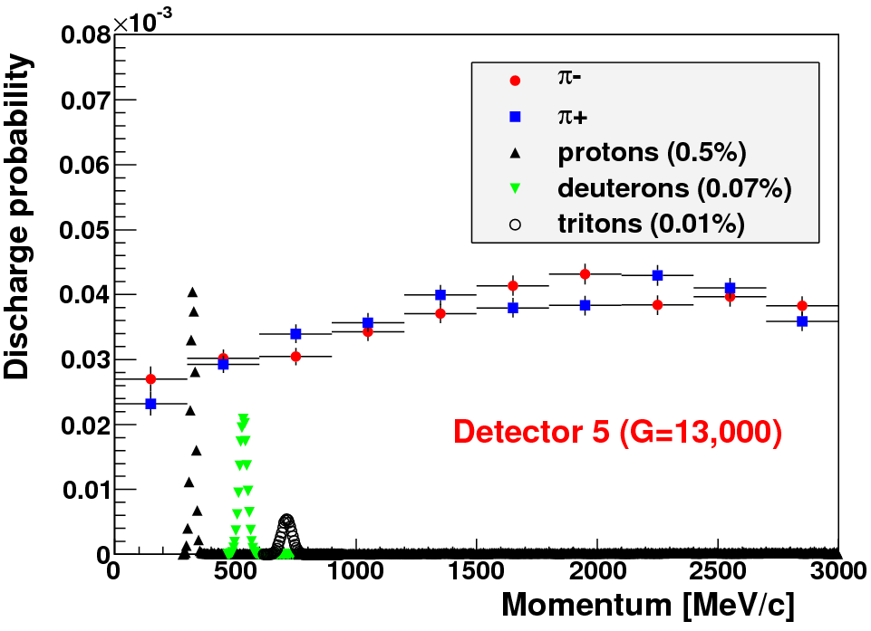
PS: results and simulation
protons @ 280 MeV/c
protons @ 300 MeV/c
→ Understanding of the signals with π⁺ beam
→ Reasonable agreement with simulation using N_{el} = 4.10⁷
G. Charles et al., NIM A648 (2011), 174

Slide 20
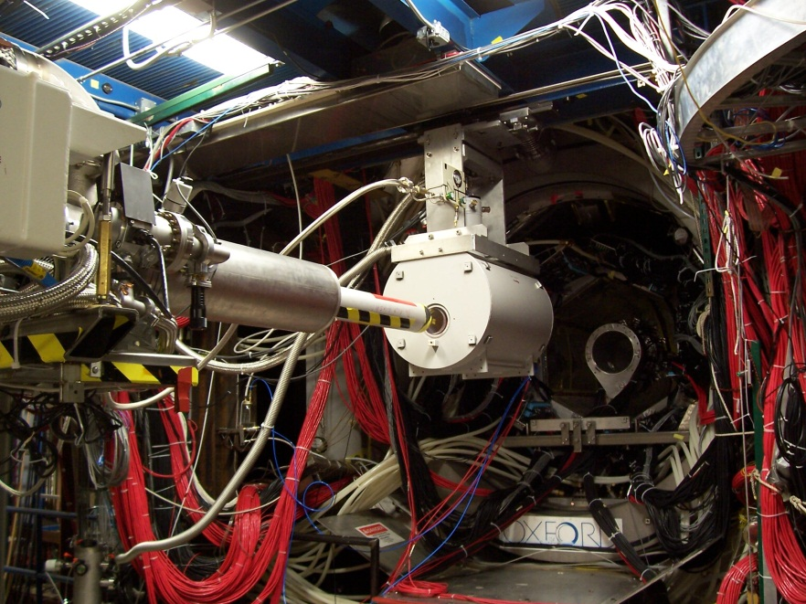
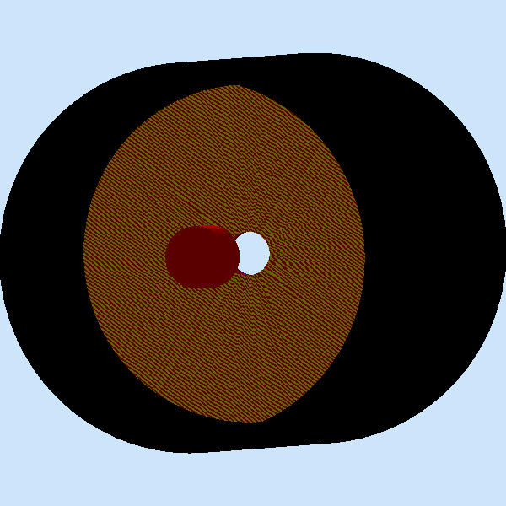
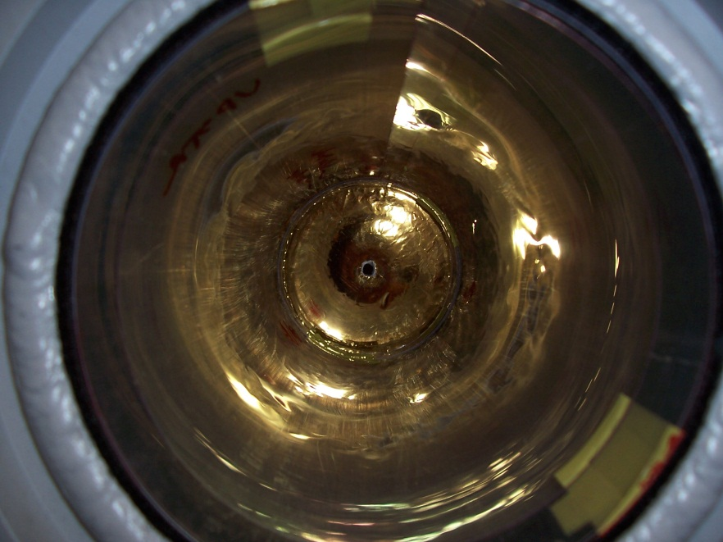
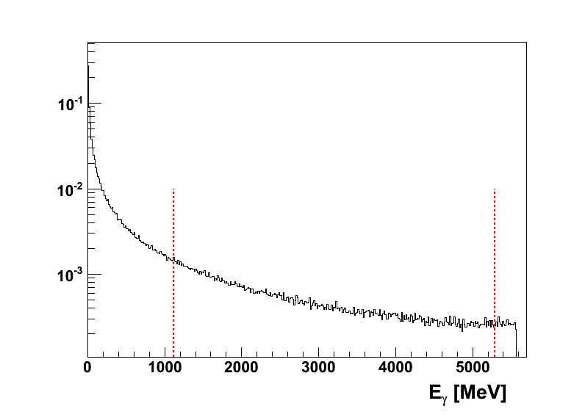
Tests @ Jlab/Hall B
Location | JLab/Hall B
Date | 08/2010
Goals | effect of B// effect of a GEM foil
P_{beam} | 0 – 5.5 GeV/c
Particles | photons on CH₂ target
Beam intensity | ≤ 2.5 10⁹ / s
Spill | continuous beam
Gas | Ar+10%iC₄H₁₀

Slide 21
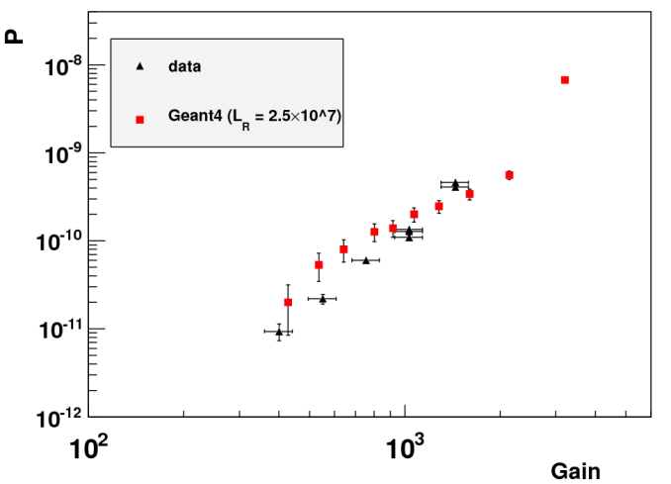
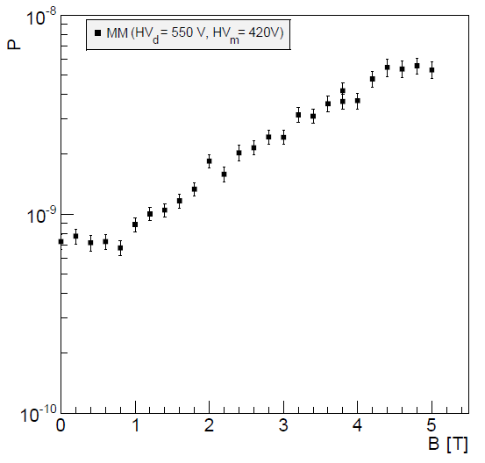
Tests à Jlab: B//E
Sparks at 0 T
Spark rate vs B(T)
→ reasonable agreement with
the simulation using
N_{el} = 2.5 10⁷
→ spark rate increased
by a factor of 10
between 0 and 5 T
⇒ Enhancement of charge density in amplification gap
B. Moreno et al., NIM A654 (2011), 135

Slide 22
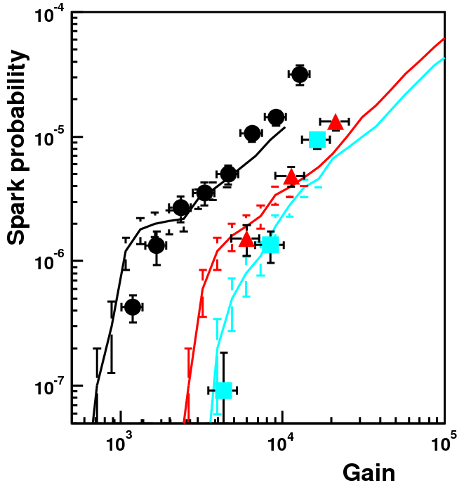
MM-GEM: Results and simulation
→ Comparison at ΔV_{GEM}=280 V (intermediate regime):
dots: data
lines: simulation
(d_{s}^{lim} = 2.10⁹ el / mm²)
MM
MM-GEM 1mm
MM-GEM 2mm

Slide 23
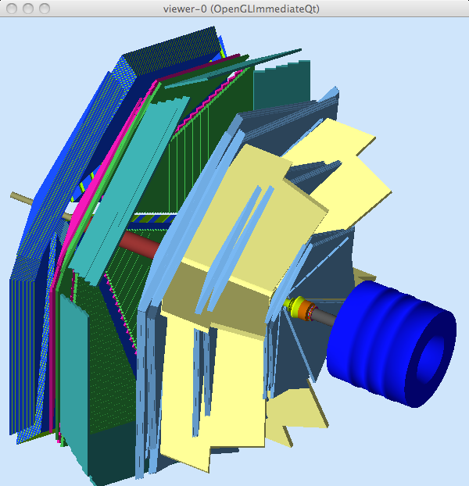
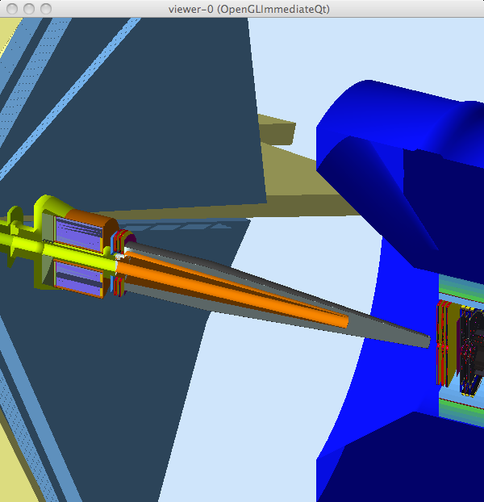
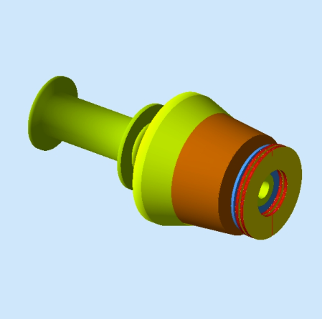
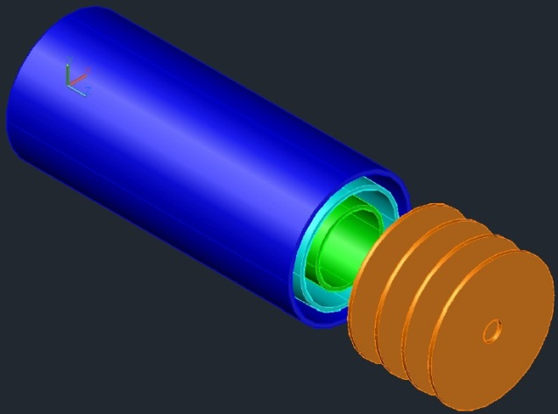
Future followed up Projects
Forward Photon Tagger (2.5 to 5°) for CLAS12
MM type Fwd
EIC MM type Barrel

Slide 24
Summary
The main issues concerning the future working environment CLAS12 Tracker project have been adressed.
Simulation tools have been developed and have enabled to understand more quantitavely the Micromegas detector
To be followed in next talk…

Slide 26
Working conditions
Parameter | Barrel MVT | Forward MVT
Gain effectif | 5000 | 3000
Mélange gazeux | Ar + 10% iC₄H₁₀ | Ne + 10% C₂H₆
Hauteur de dérive | 3 mm | 5 mm
Feuille de GEM | N/A | 1 GEM à 3 mm
Champ de dérive | 8 kV/cm (Z) et 4 kV/cm (C) | 1 kV/cm
Angle de Lorentz | 20° (Z) et 40° (C) | 0°
Rapport des champs | 5,5 (Z) et 9 (C) | ~ 50
Transparence | 40% (Z) et 50% (C) | 100%
X₀ | 0,3% | 0,3%
Segmentation | Longitudinale en 3 parties | Annulaire en 3 parties
Taille maximale PCB (et capa) | 45x43 cm² (16 nF / 3) | Φ 43 cm (12 nF / 3)
Flux de particules / couche | 4 MHz (dont 1 MHz hadrons) | 12 MHz (dont 2 MHz hadrons)
Taux de claquages / mesh | 1 Hz | 1 Hz
Temps mort | < 2 % | < 2%
Efficacité de détection | > 90% | > 95%
Pitch | 540 μm (Z) et 270 μm (C) | 500 μm
Résolution spatiale | 250 μm (Z) et 100 μm (C) | 145 μm
Résolution temporelle | 10 ns | 10 ns

