Slide 1

Mendeleev's Dream:
The Ever Expanding Periodic Table
Heino Nitsche
University of California at Berkeley
and
Lawrence Berkeley National Laboratory
hnitsche@berkeley.edu
XIIIe Journées Nationales de Radiochimie et de Chimie Nucléaire , Université de Nantes, Ecole de Mines Nantes, CNRS, SUBATECH Laboratoire, France, October 5, 2012

Slide 2
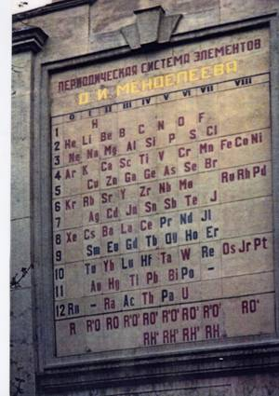

Dimitri Ivanovich Mendeleev
Professor of Chemistry
St. Petersburg University
Founder of the Modern Periodic Table (1869)

Slide 3
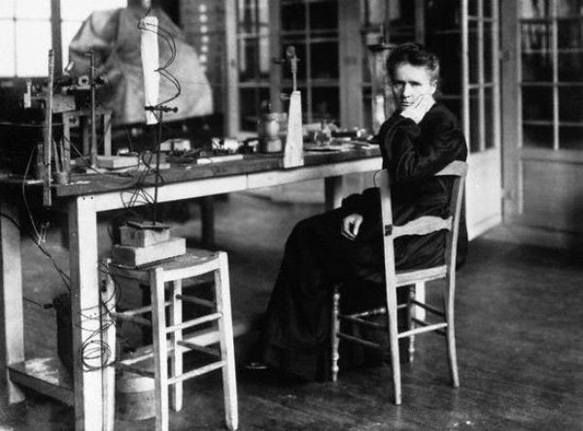
Periodic Table Around the Beginning of the 20th Century
Polonium
Po
84
Discovery of Polonium
and Radium
Radium
Ra
88
H
1
He
2
Li
3
Be
4
B
5
C
6
N
7
O
8
F
9
Ne
10
Na
11
Mg
12
Al
13
Si
14
P
15
S
16
Cl
17
Ar
18
K
19
Ca
20
Sc
21
Ti
22
V
23
Cr
24
Mn
25
Fe
26
Co
27
Ni
28
Cu
29
Zn
30
Ga
31
Ge
32
As
33
Se
34
Br
35
Kr
36
Marie Curie, joined by Pierre, refined (several tons) of pitchblende (uraninite) to isolate a new element
Rb
37
Sr
38
Y
39
Zr
40
Nb
41
Mo
42
Tc
Ru
44
Rh
45
Pd
46
Ag
47
Cd
48
In
49
Sn
50
Sb
51
Te
52
I
53
Xe
54
“We thus believe that the substance that we have extracted from pitchblende contains a metal never known be before, akin to bismuth in its analytic properties. If the existence of this new metal is confirmed, we suggest that it should be called polonium after the name of the country of origin of one of us.”
Cs
55
Ba
56
La
57 71
Ta
73
W
74
Os
76
Ir
77
Pt
78
Au
79
Hg
80
Tl
81
Pb
82
Bi
83
Po
84
Ra
88
Th
90
U
92
Ce
58
Pr
59
Nd
60
Sm
62
Eu
63
Gd
64
Tb
65
Dy
66
Ho
67
Er
68
Tm
69
Yb
70
Notes:
Polonium was discovered by Marie Sklodowska Curie, a Polish chemist, in 1898. She obtained polonium from pitchblende, a material that contains uranium, after noticing that unrefined pitchblende was more radioactive than the uranium that was separated from it. She reasoned that pitchblende must contain at least one other radioactive element. Curie needed to refine several tons of pitchblende in order to obtain tiny amounts of polonium and radium, another radioactive element discovered by Curie. One ton of uranium ore contains only about 100 micrograms (0.0001 grams) of polonium.
Due to its scarcity, polonium is usually produced by bombarding bismuth-209 with neutrons in a nuclear reactor. This forms bismuth-210, which has a half-life of 5 days. Bismuth-210 decays into polonium-210 through beta decay. Milligram amounts of polonium-210 have been produced by this method.
Polonium-210 is a very strong emitter of alpha particles. A single gram of polonium-210 creates 140 Watts of heat energy and is being considered as a lightweight heat source for thermoelectric power for spacecraft. Polonium-210 has a half-life of 138.39 days.
Polonium ( /pɵˈloʊniəm/ po-loh-nee-əm) is a chemical element with the symbol Po and atomic number 84, discovered in 1898 by Marie Skłodowska-Curie and Pierre Curie. A rare and highly radioactive element, polonium is chemically similar to bismuth^{[1]} and tellurium, and it occurs in uranium ores. Polonium has been studied for possible use in heating spacecraft. As it is unstable, all isotopes of polonium are radioactive. There is disagreement as to whether polonium is a post-transition metal or metalloid.^{[2][3]}
Also tentatively called "Radium F", polonium was discovered by Marie Skłodowska-Curie and her husband Pierre Curie in 1898^{[18]} and was later named after Marie Curie's native land of Poland (Latin: Polonia)^{[19][20]} Poland at the time was under Russian, Prussian, and Austrian partition, and did not exist as an independent country. It was Curie's hope that naming the element after her native land would publicize its lack of independence. Polonium may be the first element named to highlight a political controversy.^{[21]}
This element was the first one discovered by the Curies while they were investigating the cause of pitchblende radioactivity. The pitchblende, after removal of the radioactive elements uranium and thorium, was more radioactive than both the uranium and thorium put together. This spurred the Curies on to find additional radioactive elements. The Curies first separated out polonium from the pitchblende, and then within a few years, also isolated radium.
Because of the small quantities present in nature, isolation of polonium from natural sources is complicated. The largest ever isolated batch from 37 tonnes of residues from radium production yielded only 40 Ci of polonium-210.^{[22]}
In 1910 Marie Curie (1867–1934), who
shared the 1903 physics prize with Pierre Curie (1859–1906)
and (Antoine) Henri Becquerel (1852–1908), was the first
female candidate at the Académie des Sciences. Her husband,
Pierre Curie, had been elected on July 3, 1905, nine months
before his tragic death. He was replaced by Désiré Jean
Baptiste Gernez (1834–1910), a former student of Louis
Pasteur’s. When Gernez died, Marie Curie and Edouard Branly
(1844–1940), a physicist and professor at the Catholic
Institute, renowned for his work on the wireless telegraph,
competed for the seat. Madame Curie lost by only two votes
[6]. She never again put herself forward as a candidate even
after receiving an unprecedented second Nobel Prize, this time
in chemistry (1911). On the other hand, in 1922 she was
elected to the Académie de Médecine, which is not a part of
the Institut de France. Furthermore, Madame Curie's daughter,
Irène Joliot-Curie (1897–1956), despite sharing the 1935
Nobel Prize in Chemistry with her husband, Frédéric Joliot
(1900–1958), never became an academician. Incidentally, her
husband was elected to the seat occupied for 29 years by
Branly, the competitor of his mother-in-law, Marie Curie

Slide 4
Periodic Table Around the Beginning of the 20th Century
Actinium
Ac
89
1899 - André-Louis Debierne discovered actinium in while experimenting with pitchblende residues from radium extractions
Coworker of Madame Curie after the death of her husband Pierre
H
1
He
2
Li
3
Be
4
B
5
C
6
N
7
O
8
F
9
Ne
10
Na
11
Mg
12
Al
13
Si
14
P
15
S
16
Cl
17
Ar
18
K
19
Ca
20
Sc
21
Ti
22
V
23
Cr
24
Mn
25
Fe
26
Co
27
Ni
28
Cu
29
Zn
30
Ga
31
Ge
32
As
33
Se
34
Br
35
Kr
36
1900 - Friedrich Ernst Dorn noticed in that radium compounds emanate a radioactive gas, which he named Radium Emanation (Ra Em)
Fifth radioactive element to be discovered after uranium, thorium, radium, and polonium
Radon
Rn
86
Rb
37
Sr
38
Y
39
Zr
40
Nb
41
Mo
42
Tc
Ru
44
Rh
45
Pd
46
Ag
47
Cd
48
In
49
Sn
50
Sb
51
Te
52
I
53
Xe
54
Cs
55
Ba
56
La
57 71
Ta
73
W
74
Os
76
Ir
77
Pt
78
Au
79
Hg
80
Tl
81
Pb
82
Bi
83
Po
84
Rn
86
Ra
88
Ac
89
Th
90
U
92
1907- Georges Urbain separated the then known element ytterbium, discovered by Marignac, into two elements, and named one of them neoytterbium and the other lutetium
Named after the Roman name of his hometown, Paris
Lutetium
Lu
71
Ce
58
Pr
59
Nd
60
Sm
62
Eu
63
Gd
64
Tb
65
Dy
66
Ho
67
Er
68
Tm
69
Yb
70
Lu
71

Slide 5
Periodic Table Around the Beginning of the 20th Century
Protactinium
Pa
91
1913 - First identified by Kasimir Fajans and O.H. Göhring in while studying uranium's decay chain (named brevium)
Independently confirmed in 1918 by Otto Hahn and Lise Meitner and Frederick Soddy and John Cranston
H
1
He
2
Li
3
Be
4
B
5
C
6
N
7
O
8
F
9
Ne
10
Na
11
Mg
12
Al
13
Si
14
P
15
S
16
Cl
17
Ar
18
K
19
Ca
20
Sc
21
Ti
22
V
23
Cr
24
Mn
25
Fe
26
Co
27
Ni
28
Cu
29
Zn
30
Ga
31
Ge
32
As
33
Se
34
Br
35
Kr
36
1923 - Dirk Coster and George Charles de Hevesy found element 72 by X-ray analysis of a piece of Norwegian zircon
Zircon also contains the mineral zirconium. Zr and Hf have nearly identical chemical and physical properties
Hafnium
Hf
72
Rb
37
Sr
38
Y
39
Zr
40
Nb
41
Mo
42
Tc
Ru
44
Rh
45
Pd
46
Ag
47
Cd
48
In
49
Sn
50
Sb
51
Te
52
I
53
Xe
54
Cs
55
Ba
56
La
57 71
Hf
72
Ta
73
W
74
Re
75
Os
76
Ir
77
Pt
78
Au
79
Hg
80
Tl
81
Pb
82
Bi
83
Po
84
Rn
86
Ra
88
Ac
89
Th
90
Pa
91
U
92
Rhenium
Re
75
1925 - Discovered by Ida Tacke-Noddack, Walter Noddack, and Otto Carl Berg
In 1928, extracted one gram of rhenium from 660 kg of molybdenite
Ce
58
Pr
59
Nd
60
Sm
62
Eu
63
Gd
64
Tb
65
Dy
66
Ho
67
Er
68
Tm
69
Yb
70
Lu
71

Slide 6
Periodic Table Before WWII
Technetium
Tc
43
1935- Carlo Perrier and Emilio Segrè at the University of Palermo. First artificial element
E. O. Lawrence provided a molybdenum foil that was part of the deflector in the cyclotron at Berkeley’s Radiation Laboratory
H
1
He
2
Li
3
Be
4
B
5
C
6
N
7
O
8
F
9
Ne
10
Na
11
Mg
12
Al
13
Si
14
P
15
S
16
Cl
17
Ar
18
K
19
Ca
20
Sc
21
Ti
22
V
23
Cr
24
Mn
25
Fe
26
Co
27
Ni
28
Cu
29
Zn
30
Ga
31
Ge
32
As
33
Se
34
Br
35
Kr
36
1939 - Marguerite Catherine Perey while analyzing actinium's decay sequence
Mme. Perey was the first woman to have been elected to the French Académie des Sciences in 1962
Francium
Fr
87
Rb
37
Sr
38
Y
39
Zr
40
Nb
41
Mo
42
Tc
43
Ru
44
Rh
45
Pd
46
Ag
47
Cd
48
In
49
Sn
50
Sb
51
Te
52
I
53
Xe
54
Tc
Cs
55
Ba
56
La
57 71
Hf
72
Ta
73
W
74
Re
75
Os
76
Ir
77
Pt
78
Au
79
Hg
80
Tl
81
Pb
82
Bi
83
Po
84
At
85
Rn
86
Fr
87
Ra
88
Ac
89
Th
90
Pa
91
U
92
Astatine
At
85
1940 - Dale R. Corson, Kenneth Ross MacKenzie, and Emilio Segrè at the University of California
Least abundant element in the Earth’s crust with less than one ounce
Ce
58
Pr
59
Nd
60
Sm
62
Eu
63
Gd
64
Tb
65
Dy
66
Ho
67
Er
68
Tm
69
Yb
70
Lu
71

Slide 7
Periodic Table Before WWII
Promethium
Pm
61
1944- Jacob A. Marinsky, Lawrence E. Glendenin, and Charles D. Coryell in 1944 by extracting it from uranium fission products at Clinton Works in Tennessee
Did not claim their discovery until 1947 at an ACS meeting
H
1
He
2
Li
3
Be
4
B
5
C
6
N
7
O
8
F
9
Ne
10
Na
11
Mg
12
Al
13
Si
14
P
15
S
16
Cl
17
Ar
18
K
19
Ca
20
Sc
21
Ti
22
V
23
Cr
24
Mn
25
Fe
26
Co
27
Ni
28
Cu
29
Zn
30
Ga
31
Ge
32
As
33
Se
34
Br
35
Kr
36
Neptunium
Np
93
Rb
37
Sr
38
Y
39
Zr
40
Nb
41
Mo
42
Tc
43
Ru
44
Rh
45
Pd
46
Ag
47
Cd
48
In
49
Sn
50
Sb
51
Te
52
I
53
Xe
54
Tc
1940- Edwin McMillan and Philip M. Abelson by bombarding uranium-238 with neutrons
Cs
55
Ba
56
La
57 71
Hf
72
Ta
73
W
74
Re
75
Os
76
Ir
77
Pt
78
Au
79
Hg
80
Tl
81
Pb
82
Bi
83
Po
84
At
85
Rn
86
Fr
87
Ra
88
Ac
89
Th
90
Pa
91
U
92
Np
93
Pu
94
Plutonium
Pu
94
1940 – 1941 G. T. Seaborg, J. W. Kennedy, E. McMillan, and Art Wahl by bombarding uranium-238 with deuterons
Ce
58
Pr
59
Nd
60
Pm
61
Sm
62
Eu
63
Gd
64
Tb
65
Dy
66
Ho
67
Er
68
Tm
69
Yb
70
Lu
71

Slide 8
H
1
He
2
Li
3
Be
4
B
5
C
6
N
7
O
8
F
9
Ne
10
Na
11
Mg
12
Al
13
Si
14
P
15
S
16
Cl
17
Ar
18
K
19
Ca
20
Sc
21
Ti
22
V
23
Cr
24
Mn
25
Fe
26
Co
27
Ni
28
Cu
29
Zn
30
Ga
31
Ge
32
As
33
Se
34
Br
35
Kr
36
Rb
37
Sr
38
Y
39
Zr
40
Nb
41
Mo
42
Tc
43
Ru
44
Rh
45
Pd
46
Ag
47
Cd
48
In
49
Sn
50
Sb
51
Te
52
I
53
Xe
54
Tc
Cs
55
Ba
56
La
57 71
Hf
72
Ta
73
W
74
Re
75
Os
76
Ir
77
Pt
78
Au
79
Hg
80
Tl
81
Pb
82
Bi
83
Po
84
At
85
Rn
86
Fr
87
Ra
88
Ac
89
Th
90
Pa
91
U
92
Np
93
Pu
94
?
95
?
96
Ce
58
Pr
59
Nd
60
Pm
61
Sm
62
Eu
63
Gd
64
Tb
65
Dy
66
Ho
67
Er
68
Tm
69
Yb
70
Lu
71

Slide 9
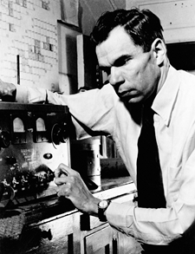
Americium
Am
95
Curium
Cm
96
H
1
He
2
Li
3
Be
4
B
5
C
6
N
7
O
8
F
9
Ne
10
Na
11
Mg
12
Al
13
Si
14
P
15
S
16
Cl
17
Ar
18
1944: Discovery of Curium
K
19
Ca
20
Sc
21
Ti
22
V
23
Cr
24
Mn
25
Fe
26
Co
27
Ni
28
Cu
29
Zn
30
Ga
31
Ge
32
As
33
Se
34
Br
35
Kr
36
James, Morgan, Ghiorso, and Seaborg
Y
39
60-Inch Cyclotron, Berkeley, Processing Met Lab, Chicago
Rb
37
Sr
38
Zr
40
Nb
41
Mo
42
Tc
43
Ru
44
Rh
45
Pd
46
Ag
47
Cd
48
In
49
Sn
50
Sb
51
Te
52
I
53
Xe
54
Tc
La
57 71
239
242
α
, 163 d
Cs
55
Ba
56
Hf
72
Ta
73
W
74
Re
75
Os
76
Ir
77
Pt
78
Au
79
Hg
80
Tl
81
Pb
82
Bi
83
Po
84
At
85
Rn
86
Pu(α, 2n) 96(Cm)
Fr
87
Ra
88
Ac
89
Th
90
Pa
91
U
92
Np
93
Pu
94
Am
95
Cm
96
1945: Discovery of Americium
Ghiorso, James, Morgan, and Seaborg
Reactor Irradiation, Processing Met Lab, Chicago
Ce
58
Pr
59
Nd
60
Pm
61
Sm
62
Eu
63
Gd
64
Tb
65
Dy
66
Ho
67
Er
68
Tm
69
Yb
70
Lu
71
, 14 y
α
239
241
β⁻
241
, ~433 y
Pu(2n,γ) Pu
95 (Am)

Slide 10
H
1
The Actinide Series
He
2
Li
3
Be
4
B
5
C
6
N
7
O
8
F
9
Ne
10
Na
11
Mg
12
Al
13
Si
14
P
15
S
16
Cl
17
Ar
18
K
19
Ca
20
Sc
21
Ti
22
V
23
Cr
24
Mn
25
Fe
26
Co
27
Ni
28
Cu
29
Zn
30
Ga
31
Ge
32
As
33
Se
34
Br
35
Kr
36
Rb
37
Sr
38
Y
39
Zr
40
Nb
41
Mo
42
Te
43
Ru
44
Rh
45
Pd
46
Ag
47
Cd
48
In
49
Sn
50
Sb
51
Te
52
I
53
Xe
54
Tc
Cs
55
Ba
56
La
57 71
Hf
72
Ta
73
W
74
Re
75
Os
76
Ir
77
Pt
78
Au
79
Hg
80
Tl
81
Pb
82
Bi
83
Po
84
At
85
Rn
86
Fr
87
Ra
88
Ac
89
Th
90
Pa
91
U
92
Np
93
Pu
94
Am
95
Cm
96
G.T. Seaborg, 1945
Ce
58
Pr
59
Nd
60
Pm
61
Sm
62
Eu
63
Gd
64
Tb
65
Dy
66
Ho
67
Er
68
Tm
69
Yb
70
Lu
71
Th
90
Pa
91
U
92
Np
93
Pu
94
Am
95
Cm
96
Bk
97
Cf
98
Es
99
Fm
100
Md
101
No
102
Lr
103
Berkeley, 1950-1965

Slide 11
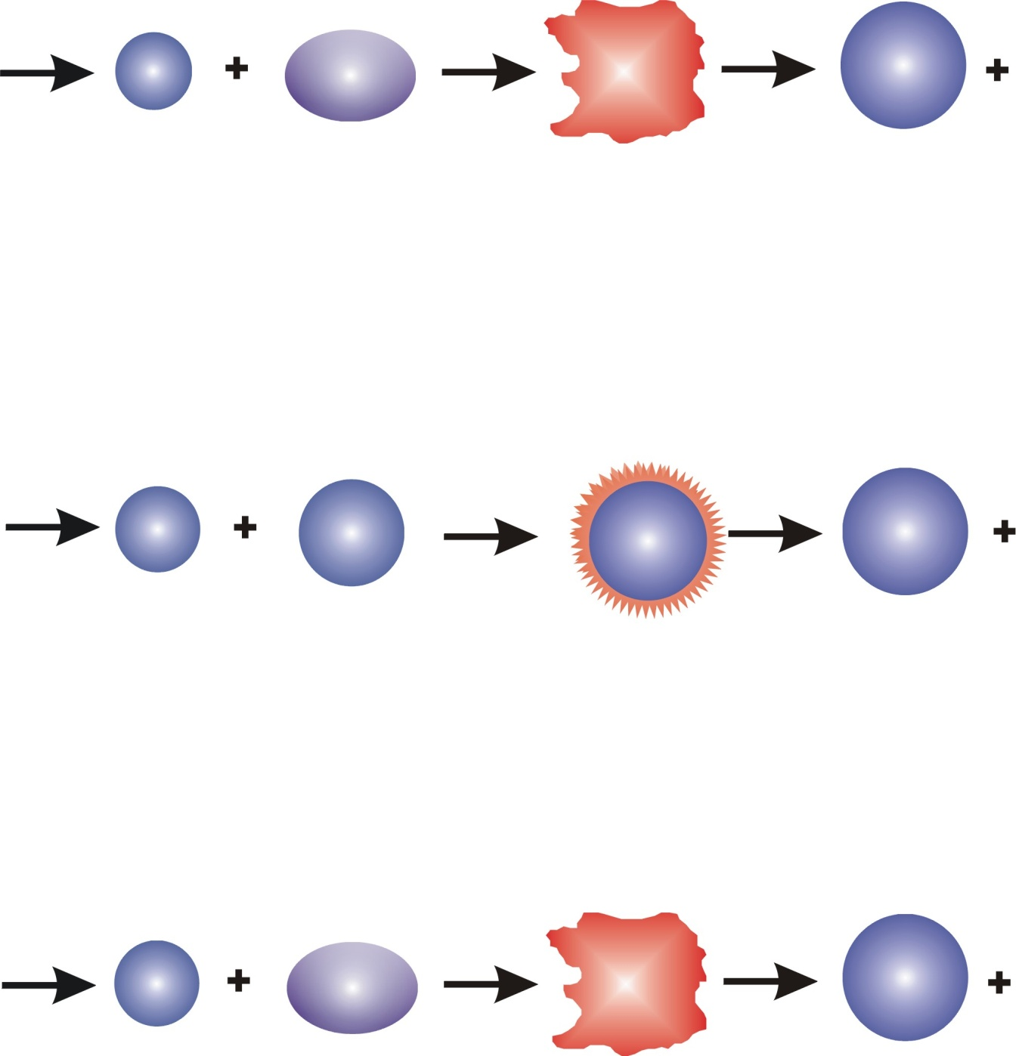

Heavy Element Production Reactions
Hot Fusion—Elements 101 through 108
4,5 n
¹⁸O
²⁴⁹Cf
²⁶³Sg
Fission Products
Cold Fusion—Elements 107 through 112
1 n
⁵⁴Cr
²⁰⁹Bi
²⁶²Bh
Fission Products
Hot Fusion-Reported Elements 112, 114, 115, 116, 117, 118
3,4,5 n
⁴⁸Ca
²⁴⁴Pu
^{289,288, 287}114
Fission Products

Slide 12

            1968 - A. Ghiorso, et al.
          1970 - A. Ghiorso, et al.
          1970 - G. N. Flerov, Y. T. Oganessian, et al.
          1974 – A. Ghiorso, G. T. Seaborg, et al.
The Modern Periodic Table
H
1
He
2
Rutherfordium
Rf
104
Li
3
Be
4
B
5
C
6
N
7
O
8
F
9
Ne
10
Na
11
Mg
12
Al
13
Si
14
P
15
S
16
Cl
17
Ar
18
K
19
Ca
20
Sc
21
Ti
22
V
23
Cr
24
Mn
25
Fe
26
Co
27
Ni
28
Cu
29
Zn
30
Ga
31
Ge
32
As
33
Se
34
Br
35
Kr
36
Dubnium
Db
105
Rb
37
Sr
38
Y
39
Zr
40
Nb
41
Mo
42
Te
43
Ru
44
Rh
45
Pd
46
Ag
47
Cd
48
In
49
Sn
50
Sb
51
Te
52
I
53
Xe
54
Tc
Cs
55
Ba
56
La
57 71
Hf
72
Ta
73
W
74
Re
75
Os
76
Ir
77
Pt
78
Au
79
Hg
80
Tl
81
Pb
82
Bi
83
Po
84
At
85
Rn
86
Fr
87
Ra
88
Ac
89
Rf
104
Db
105
Sg
106
Seaborgium
Sg
106
Ce
58
Pr
59
Nd
60
Pm
61
Sm
62
Eu
63
Gd
64
Tb
65
Dy
66
Ho
67
Er
68
Tm
69
Yb
70
Lu
71
Th
90
Pa
91
U
92
Np
93
Pu
94
Am
95
Cm
96
Bk
97
Cf
98
Es
99
Fm
100
Md
101
No
102
Lr
103

Slide 13

            1981-1984
            P. Armbruster, G. Mϋnzenberg, et al.
            1994-1996
            S. Hofmann, et al.
The Modern Periodic Table
Bohrium
Bh
107
H
1
He
2
Li
3
Be
4
B
5
C
6
N
7
O
8
F
9
Ne
10
Hassium
Hs
108
Na
11
Mg
12
Al
13
Si
14
P
15
S
16
Cl
17
Ar
18
K
19
Ca
20
Sc
21
Ti
22
V
23
Cr
24
Mn
25
Fe
26
Co
27
Ni
28
Cu
29
Zn
30
Ga
31
Ge
32
As
33
Se
34
Br
35
Kr
36
Meitnerium
Mt
109
Rb
37
Sr
38
Y
39
Zr
40
Nb
41
Mo
42
Te
43
Ru
44
Rh
45
Pd
46
Ag
47
Cd
48
In
49
Sn
50
Sb
51
Te
52
I
53
Xe
54
Tc
Cs
55
Ba
56
La
57 71
Hf
72
Ta
73
W
74
Re
75
Os
76
Ir
77
Pt
78
Au
79
Hg
80
Tl
81
Pb
82
Bi
83
Po
84
At
85
Rn
86
Darmstadtium
Ds
110
Fr
87
Ra
88
Ac
89
Rf
104
Db
105
Sg
106
Bh
107
Hs
108
Mt
109
Ds
110
Rg
111
Cn
112
Roentgenium
Rg
111
Ce
58
Pr
59
Nd
60
Pm
61
Sm
62
Eu
63
Gd
64
Tb
65
Dy
66
Ho
67
Er
68
Tm
69
Yb
70
Lu
71
Copernicium
Cn
112
Th
90
Pa
91
U
92
Np
93
Pu
94
Am
95
Cm
96
Bk
97
Cf
98
Es
99
Fm
100
Md
101
No
102
Lr
103

Slide 14
Upper End of Chart of Nuclides
Since 1999, reports of new SHEs made with ⁴⁸Ca + actinide reactions have been made from FLNR in Dubna, Russia
  Reactions first confirmed in 2007
118
²⁹⁴118
1 ms
117
²⁹³117
14 ms
²⁹⁴117
78 ms
Total of 6 new elements and 52 new isotopes from Dubna, GSI, and Berkeley from using these reactions
116
²⁹⁰116
14 ms
²⁹¹116
18 ms
²⁹²116
18 ms
²⁹³116
53 ms
115
²⁸⁷115
32 ms
²⁸⁸115
88 ms
²⁸⁹115
0.22 s
²⁹⁰115
16 ms
However, ⁴⁸Ca + actinide reactions remain disconnected from rest of chart of nuclides!
114
²⁸⁵114
0.12 s
²⁸⁶114
0.12 s
²⁸⁷114
0.45 s
²⁸⁸114
0.80 s
²⁸⁹114
2.70 s
113
²⁷⁸113
2 ms
²⁸²113
61 ms
²⁸³113
0.10 s
²⁸⁴113
0.48 s
²⁸⁵113
5.5 s
²⁸⁶113
20 s
Nuclides produced through
cold and hot fusion reactions
112
²⁷⁷Cn
0.7 μs
²⁸¹Cn
97 ms
²⁸²Cn
1 ms
²⁸³Cn
3.83 s
²⁸⁴Cn
0.10 s
²⁸⁵Cn
33.5 s
111
²⁷²Rg
3 ms
²⁷⁴Rg
15 ms
²⁷⁸Rg
4 ms
²⁷⁹Rg
0.17 s
²⁸⁰Rg
3.59 s
²⁸¹Rg
26 s
²⁸²Rg
0.51 s
110
²⁶⁹Ds
130 μs
²⁷⁰Ds
3 ms
²⁷¹Ds
12 ms
²⁷³Ds
170 μs
²⁷⁷Ds
5.7 ms
²⁷⁹Ds
0.20 s
²⁸¹Ds
9.6 s
109
²⁶⁶Mt
2 ms
²⁶⁸Mt
25 ms
²⁷⁰Mt
3 ms
²⁷⁴Mt
2.91 s
²⁷⁵Mt
10 ms
²⁷⁶Mt
0.72 s
²⁷⁸Mt
7.7 s
108
²⁶²Hs
260 μs
²⁶³Hs
23 ms
²⁶⁵Hs
2 ms
²⁶⁶Hs
4 ms
²⁶⁷Hs
68 ms
²⁶⁸Hs
0.37 s
²⁶⁹Hs
14 s
²⁷⁰Hs
23 s
²⁷¹Hs
4 s
²⁷³Hs
0.25 s
²⁷⁵Hs
0.19 s
²⁷⁷Hs
3 ms
107
²⁶⁰Bh
32 ms
²⁶¹Bh
12 ms
²⁶²Bh
0.10 s
²⁶⁴Bh
0.11 s
²⁶⁵Bh
0.94 s
²⁶⁶Bh
1 s
²⁶⁷Bh
17 s
²⁷⁰Bh
61 s
²⁷²Bh
9.79 s
²⁷⁴Bh
0.9 m
106
²⁵⁹Sg
0.48 s
²⁶⁰Sg
3.6 ms
²⁶¹Sg
0.23 s
²⁶²Sg
21 ms
²⁶³Sg
0.9 s
²⁶⁴Sg
37 ms
²⁶⁵Sg
21 s
²⁶⁶Sg
0.32 s
²⁶⁷Sg
84 s
²⁶⁹Sg
130 s
²⁷¹Sg
114 s
Nuclides produced through ⁴⁸Ca + actinide nuclear reactions
105
²⁵⁸Db
4.4 s
²⁵⁹Db
0.5 s
²⁶⁰Db
1.5 s
²⁶¹Db
1.8 s
²⁶²Db
34 s
²⁶³Db
27 s
²⁶⁶Db
22 m
²⁶⁷Db
73.4 h
²⁶⁸Db
15.9 h
²⁷⁰Db
23 h
104
²⁵⁷Rf
4.0 s
²⁵⁸Rf
12 ms
²⁵⁹Rf
3.0 s
²⁶⁰Rf
21 ms
²⁶¹Rf
2 s, 78 s
²⁶³Rf
8 s
²⁶⁵Rf
105 s
²⁶⁷Rf
77 m
103
²⁵⁶Lr
28 s
²⁵⁷Lr
0.65 s
²⁵⁸Lr
3.9 s
²⁵⁹Lr
6.3 s
²⁶⁰Lr
180 s
²⁶¹Lr
39 m
²⁶²Lr
216 m

Slide 15
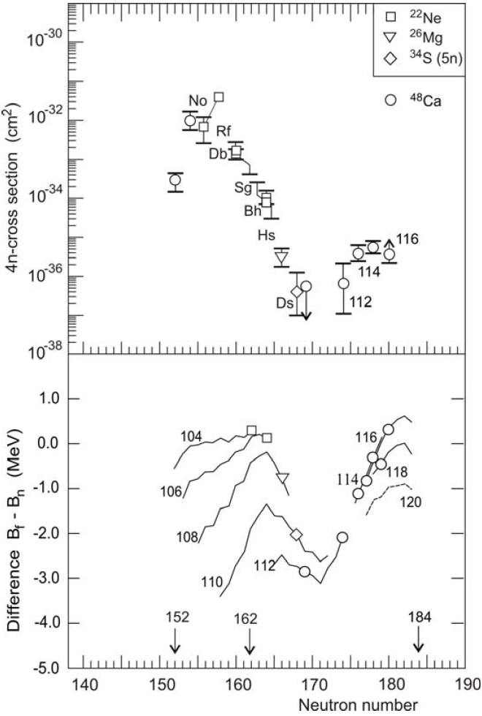
A Break in Cross Section Systematics?
Beginning with 112, the reactions cross sections are “large and constant.”
This indicates that “large” SHE cross sections are due to shell effects near Z = 114 and N = 184.
Y. Oganessian, Heaviest nuclei from ⁴⁸Ca-induced reactions. J. Phys. G: Nucl. Part. Phys., 34(4): R165, (2007).

Slide 16
The Berkeley Gas-filled Separator (BGS)
Quadrupole Triplet
Beam Trajectory
Trajectory of
Separated Nuclides
Target
Recoil Transfer
Chamber
Q1
Q1
Quadrupole
Magnet
Gradient-
Field
Magnet
Flat-Field
Dipole
Magnet
M1
M1
M2
M2

Slide 17
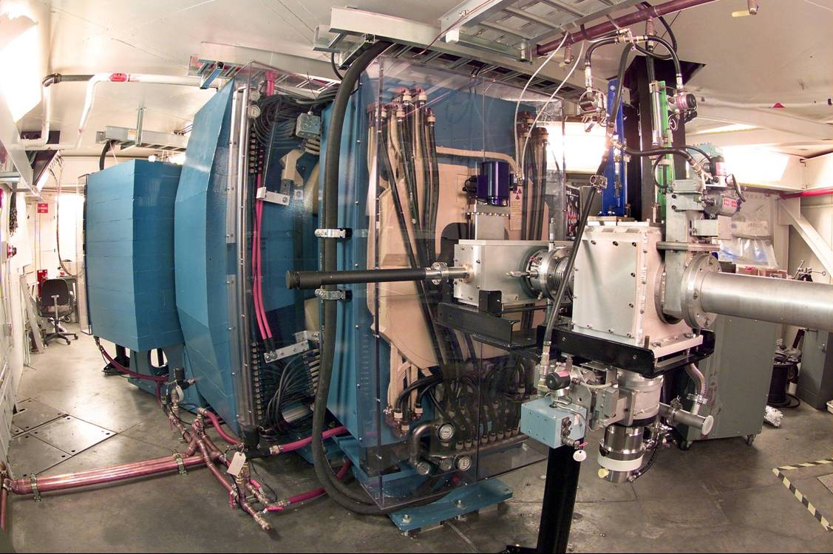
Pre-separation Using the BGS
BGS is a superior TAN separator
large angular acceptance (W=45msr) gives higher efficiency
large bend angle (70º) gives superior separation; best rejection of beam and transfer products
Beam intensity, target thickness, and efficiency give one event/(picobarn· 7 day week)

Slide 18
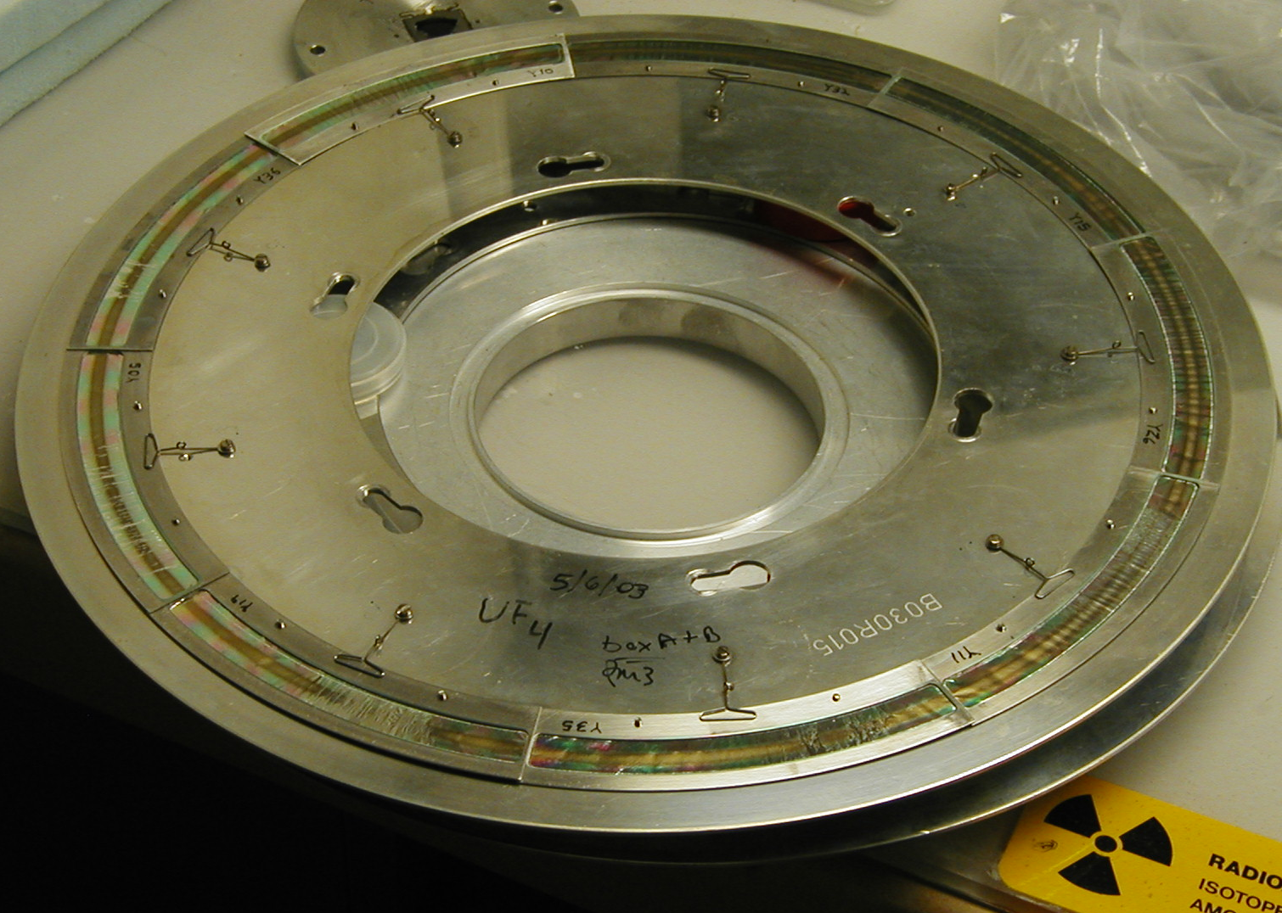
BGS Target Wheel

Slide 19
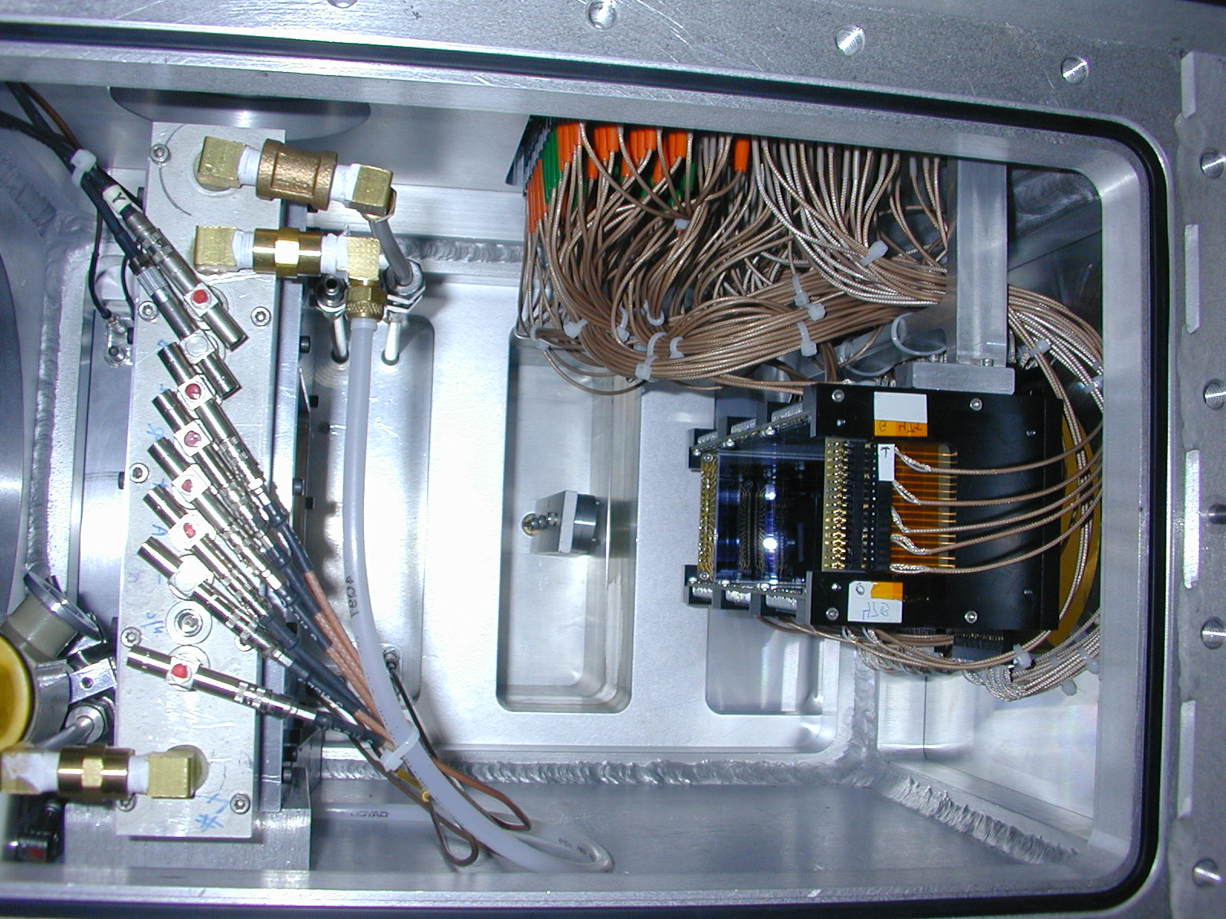
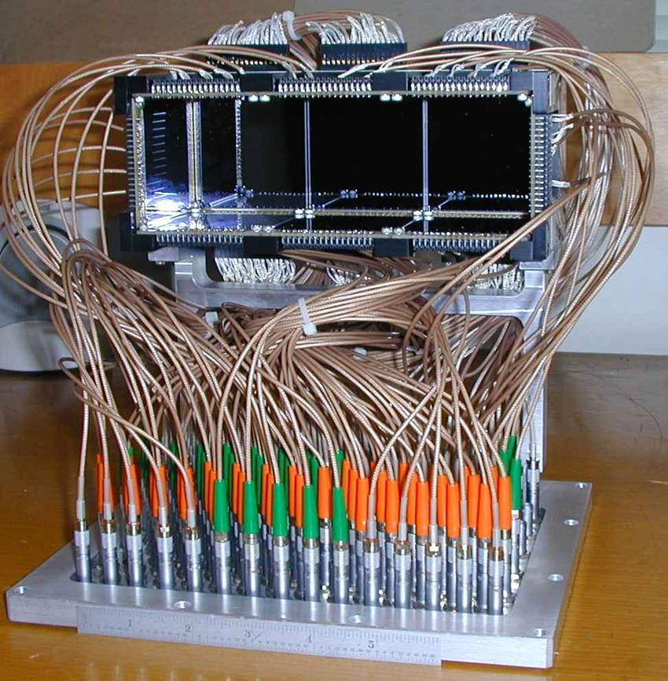
BGS Detector Array
Nuclear Reaction
Products
Multiwire
Proportional
Counter
(MWPC)
Focal
Plane
Detector

Slide 20
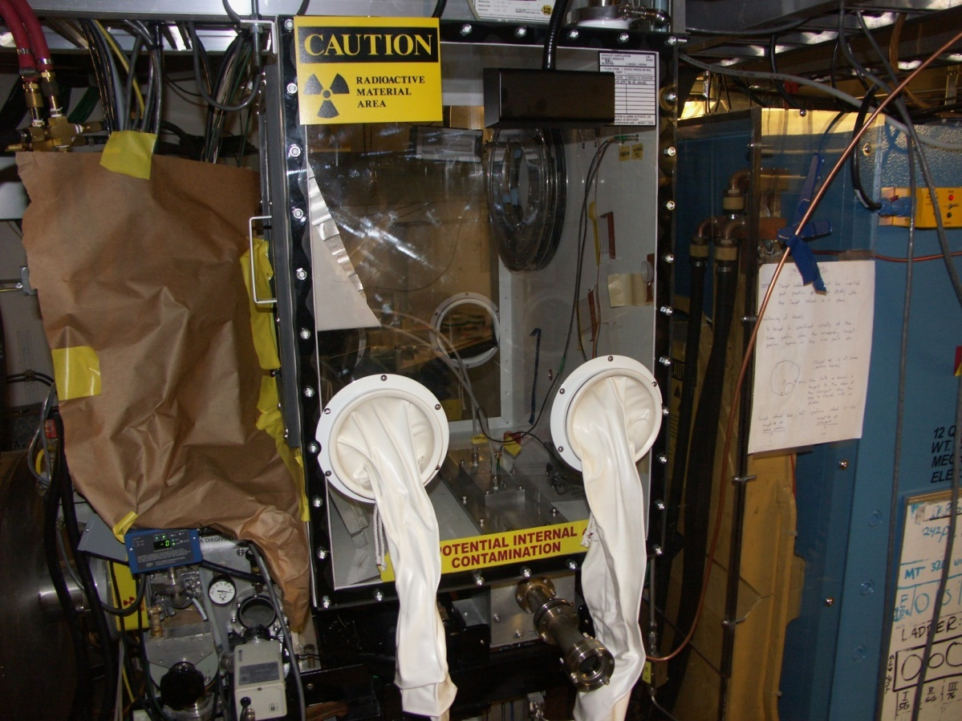
²⁴²Pu Experiments at the BGS
BGS upgrade: Radioactivity Containment Facility

Slide 21
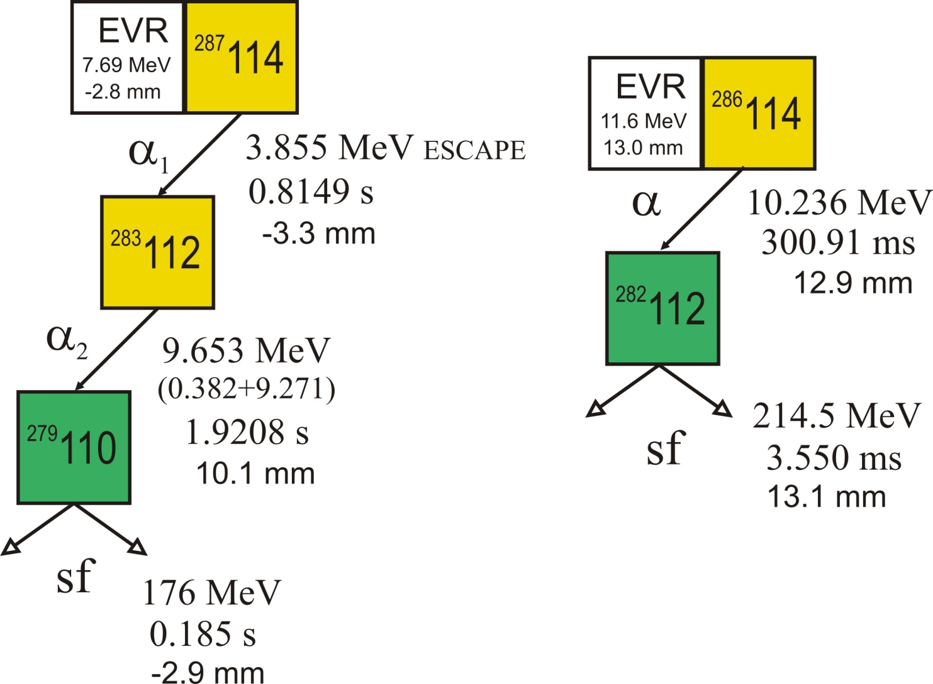
Independent Verification of
Element 114 Production
²⁴²Pu(⁴⁸Ca,3,4n)^{287, 286}114, (244 MeV cot)
+3.2
s(3n) = s(4n) = 1.4 pb
-1.2
2 decay chains + 2 SF events
L. Stavsetra, K. E. Gregorich, J. Dvorak, P.A. Ellison, I. Dragojević, M.A. Garcia, H. Nitsche, Independent verification of element 114 production in the ⁴⁸Ca + ²⁴²Pu reaction. Phys. Rev. Lett., 103, 132502, 2009

Slide 23
Element 114 Studies
Further investigations of element 114 with ⁴⁸Ca(²⁴⁴Pu,3-4n)²⁸⁸⁻²⁸⁹114 at GSI using new separator TASCA
114
²⁸⁸114
0.80 s
²⁸⁹114
2.70 s
112
²⁸⁴Cn
0.10 s
²⁸⁵Cn
33.5 s
110
²⁸¹Ds
9.6 s
108
²⁷⁷Hs
3 ms
13 element E114 chains observed (9 for ²⁸⁸114 and 4 for ²⁸⁹114)
Discovered new isotope ²⁷⁷Hs
Berkeley was a major contributor :
Gas-filled separator design and modeling
Data analysis
Presence at experiment
106
104

Slide 24
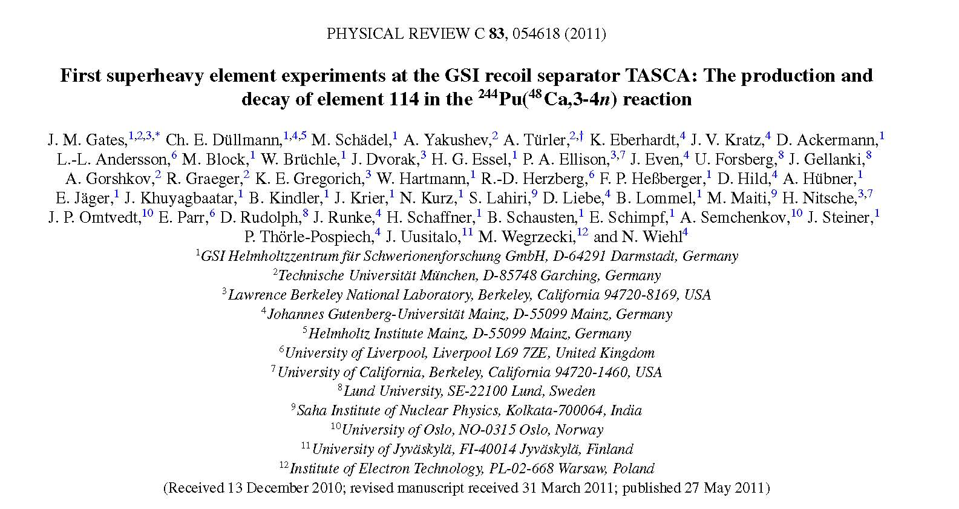
Element 114 Studies (4)

Slide 25
Element 114 Studies
Production of six new isotopes using ⁴⁸Ca(²⁴²Pu,5-4n)^{285, 286}114 reaction at BGS
114
²⁸⁵114
0.12 s
²⁸⁶114
0.12 s
EVR
16.0 MeV
-1.0 mm
²⁸⁵114
α₁
1.62 MeV
ESCAPE
0.181 s
1.2 mm
112
²⁸¹Cn
97 ms
²⁸²Cn
1 ms
²⁸¹Cn
α₂
10.31 MeV
0.140 s
-0.8 mm
110
²⁷⁷Ds
5.7 ms
²⁷⁷Ds
α₃
10.57 MeV
8 ms
-0.9 mm
EVR
14.3 MeV
-24.8 mm
²⁸⁶114
108
²⁷³Hs
0.25 s
²⁷³Hs
α
10.3 MeV
(0.60+9.70)
76 ms
-20.4 mm
α₄
9.59 MeV
0.35 s
-0.9 mm
²⁸²Cn
106
²⁶⁹Sg
130 s
²⁶⁹Sg
α₅
sf
205 MeV
0.52 s
-22.5 mm
8.56 MeV
(0.79+7.82)
185 s
1.2 mm
²⁶⁵Rf
+1.4
104
²⁶⁵Rf
105 s
σ(4n) = σ(5n) = 0.6 pb
-0.5
sf
208 MeV
152 s
-1.1 mm

Slide 26
Element 114 Studies

Slide 27
Element 114 Studies Summary
1 2 1 11 4
5n 4n 3n 4n 3n
114
²⁸⁵114
0.12 s
²⁸⁶114
0.12 s
²⁸⁷114
0.45 s
²⁸⁸114
0.80 s
²⁸⁹114
2.70 s
First independent verification of element 114 using ⁴⁸Ca(²⁴²Pu,3-4n)²⁸⁶⁻²⁸⁷114 at BGS
Further iverification of element 114 using ⁴⁸Ca(²⁴⁴Pu,3-4n)²⁸⁸⁻²⁸⁹114 at GSI using new separator TASCA
112
²⁸¹Cn
97 ms
²⁸²Cn
1 ms
²⁸³Cn
3.83 s
²⁸⁴Cn
0.10 s
²⁸⁵Cn
33.5 s
110
²⁷⁷Ds
5.7 ms
²⁷⁹Ds
0.20 s
²⁸¹Ds
9.6 s
Production of six new isotopes using ⁴⁸Ca(²⁴²Pu,5n)²⁸⁵114 reaction at BGS
108
²⁷³Hs
0.25 s
²⁷⁵Hs
0.19 s
²⁷⁷Hs
3 ms
106
²⁶⁹Sg
130 s
²⁷¹Sg
114 s
19 total element-114 chains observed from Berkeley/GSI
43 total element-114 chains observed from DUBNA
104
²⁶⁵Rf
105 s
²⁶⁷Rf
77 m

Slide 28



113
            ²⁰⁹Bi(⁷⁰Zn, n)²⁷⁸113, RIKEN
H
1
Periodic Table 2012
He
2
            ²³⁷Np(⁴⁸Ca,3-4n)^{283,282}113
Li
3
Be
4
B
5
C
6
N
7
O
8
F
9
Ne
10
Flerovium
Fl
114
Na
11
Mg
12
Al
13
Si
14
P
15
S
16
Cl
17
Ar
18
            ^{244, 242}Pu(⁴⁸Ca,3-4n)²⁸⁹⁻²⁸⁶Fl
K
19
Ca
20
Sc
21
Ti
22
V
23
Cr
24
Mn
25
Fe
26
Co
27
Ni
28
Cu
29
Zn
30
Ga
31
Ge
32
As
33
Se
34
Br
35
Kr
36
115
            ²⁴³Am(⁴⁸Ca,3-4n)^{288,287}115
Rb
37
Sr
38
Y
39
Zr
40
Nb
41
Mo
42
Te
43
Ru
44
Rh
45
Pd
46
Ag
47
Cd
48
In
49
Sn
50
Sb
51
Te
52
I
53
Xe
54
Tc
Cs
55
Ba
56
La
57 71
Hf
72
Ta
73
W
74
Re
75
Os
76
Ir
77
Pt
78
Au
79
Hg
80
Tl
81
Pb
82
Bi
83
Po
84
At
85
Rn
86
Livermorium
Lv
116
            ²⁴⁵Cm(⁴⁸Ca,3-4n)^{290,289}Lv
            ²⁴⁸Cm(⁴⁸Ca,3-4n)^{293,292}Lv
Fr
87
Ra
88
Ac
89
Rf
104
Db
105
Sg
106
Bh
107
Hs
108
Mt
109
Ds
110
Rg
111
Cn
112
113
Fl
114
115
Lv
116
117
118
117
            ²⁴⁹Bk(⁴⁸Ca,3-4n)^{294,293}117
Ce
58
Pr
59
Nd
60
Pm
61
Sm
62
Eu
63
Gd
64
Tb
65
Dy
66
Ho
67
Er
68
Tm
69
Yb
70
Lu
71
118
Th
90
Pa
91
U
92
Np
93
Pu
94
Am
95
Cm
96
Bk
97
Cf
98
Es
99
Fm
100
Md
101
No
102
Lr
103
            ²⁴⁹Cf(⁴⁸Ca,3n)²⁹⁴118

Slide 29
Chemistry Experiments using the BGS
New opportunities with preseparation
  coupling of chemistry to the BGS
Aqueous chemistry
  SISAK extraction system

Slide 30
Advantages of Pre-separation:
Freedom for Chemistry
No BGS
With BGS

Slide 31
H
1
Periodic Table 2012
He
2
Li
3
Be
4
B
5
C
6
N
7
O
8
F
9
Ne
10
Na
11
Mg
12
Al
13
Si
14
P
15
S
16
Cl
17
Ar
18
K
19
Ca
20
Sc
21
Ti
22
V
23
Cr
24
Mn
25
Fe
26
Co
27
Ni
28
Cu
29
Zn
30
Ga
31
Ge
32
As
33
Se
34
Br
35
Kr
36
Rb
37
Sr
38
Y
39
Zr
40
Nb
41
Mo
42
Te
43
Ru
44
Rh
45
Pd
46
Ag
47
Cd
48
In
49
Sn
50
Sb
51
Te
52
I
53
Xe
54
Tc
Cs
55
Ba
56
La
57 71
Hf
72
Ta
73
W
74
Re
75
Os
76
Ir
77
Pt
78
Au
79
Hg
80
Tl
81
Pb
82
Bi
83
Po
84
At
85
Rn
86
Fr
87
Ra
88
Ac
89
Rf
104
Db
105
Sg
106
Bh
107
Hs
108
Mt
109
Ds
110
Rg
111
Cn
112
113
Fl
114
115
Lv
116
116
118
Ce
58
Pr
59
Nd
60
Pm
61
Sm
62
Eu
63
Gd
64
Tb
65
Dy
66
Ho
67
Er
68
Tm
69
Yb
70
Lu
71
Th
90
Pa
91
U
92
Np
93
Pu
94
Am
95
Cm
96
Bk
97
Cf
98
Es
99
Fm
100
Md
101
No
102
Lr
103

Slide 32
SISAK (LBNL/U Oslo/U Mainz)
Production
Chemical experiment
Data acquisition
Separation
Detection
²⁰⁸Pb(⁵⁰Ti,n)²⁵⁷Rf (T_{1/2}= 4.3 s)

Slide 33

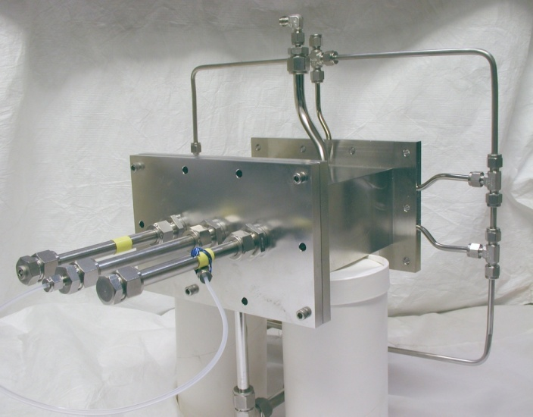
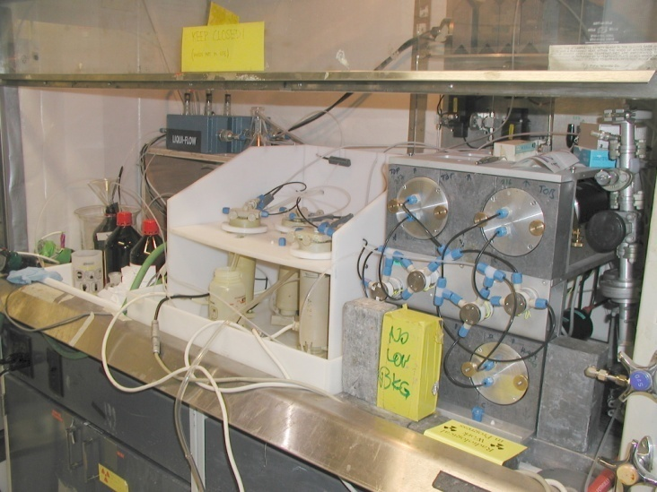
Transactinide Element Liquid-Liquid Extractions
BGS RTC SISAK
Berkeley Gas-filled Separator
Rf and Db (Z=104,105) isotopes are produced at the LBNL 88-Inch Cyclotron by bombardment of Pb and Bi targets with ⁵⁰Ti. Rf and Db are separated from other nuclear reaction products with the BGS.
Recoil Transfer Chamber
At the end of the BGS, Rf or Db atoms pass through a Mylar foil into the RTC and stop in He gas. These products become attached to aerosols are then transported through a 20-m long capillary to SISAK.
Short-lived Isotopes Studied by the AKufve technique
Continuous liquid-liquid extractions are performed with SISAK. The alpha-decay of the separated transactinide atoms is assayed by performing liquid scintillation pulse-height analysis on the flowing solution.
Notes:
Proof of principle experiments have been carried out:
²⁰⁸Pb(⁵⁰Ti,n) produces 4-sec ²⁵⁷Rf.
Preseparation with BGS
Gas-jet transport to SISAK
Fast liquid-liquid extractions
Liquid-scintillation pulse-height analysis for alpha decay
Beta background is extremely low. All alpha particles above 7.0 MeV can be attributed to the dacay of ²⁵⁷Rf or its decay daughters
Robert Eichler will do his Habilitation work here . . . vacuum thremochromatography of transactinides.

Slide 34
SISAK Summary
Four successful ²⁵⁷Rf extraction campaigns:
    TIOA/H₂SO₄, and Oxalic Acid
DBP/ HNO₃
  unambiguously detected via α-α correlations
Pre-separation (with the BGS) reduces the background to practically zero
LBNL BGS/SISAK experiment establishes SISAK as the fastest available method for transactinide liquid-chemistry experiments
  half-lives down to about 4 seconds can be used for experiments.
  these experiments are the basis of more detailed, systematic studies of the extraction behavior of Rf

Slide 35
H
1
Periodic Table 2012
He
2
Li
3
Be
4
B
5
C
6
N
7
O
8
F
9
Ne
10
Na
11
Mg
12
Al
13
Si
14
P
15
S
16
Cl
17
Ar
18
K
19
Ca
20
Sc
21
Ti
22
V
23
Cr
24
Mn
25
Fe
26
Co
27
Ni
28
Cu
29
Zn
30
Ga
31
Ge
32
As
33
Se
34
Br
35
Kr
36
Rb
37
Sr
38
Y
39
Zr
40
Nb
41
Mo
42
Te
43
Ru
44
Rh
45
Pd
46
Ag
47
Cd
48
In
49
Sn
50
Sb
51
Te
52
I
53
Xe
54
Tc
Cs
55
Ba
56
La
57 71
Hf
72
Ta
73
W
74
Re
75
Os
76
Ir
77
Pt
78
Au
79
Hg
80
Tl
81
Pb
82
Bi
83
Po
84
At
85
Rn
86
Fr
87
Ra
88
Ac
89
Rf
104
Db
105
Sg
106
Bh
107
Hs
108
Mt
109
Ds
110
Rg
111
Cn
112
113
Fl
114
115
Lv
116
116
118
Ce
58
Pr
59
Nd
60
Pm
61
Sm
62
Eu
63
Gd
64
Tb
65
Dy
66
Ho
67
Er
68
Tm
69
Yb
70
Lu
71
Th
90
Pa
91
U
92
Np
93
Pu
94
Am
95
Cm
96
Bk
97
Cf
98
Es
99
Fm
100
Md
101
No
102
Lr
103

Slide 36
Heavy Element Gas Phase Chemistry: 114, Fl
Kenneth S. Pitzer, Are elements 112, 114, and 118 relatively inert gases?
J. Chem Phys. 63, 1032-1033, 1975.
1
2
H
He
3
4
5
6
7
8
9
10
Li
Be
B
C
N
O
F
Ne
11
12
13
14
15
16
17
18
Na
Mg
Al
Si
P
S
Cl
Ar
19
20
21
22
23
24
25
26
27
28
29
30
31
32
33
34
35
36
K
Ca
Sc
Ti
V
Cr
Mn
Fe
Co
Ni
Cu
Zn
Ga
Ge
As
Se
Br
Kr
37
38
39
40
41
42
43
44
45
46
47
48
49
50
51
52
53
54
Rb
Sr
Y
Zr
Nb
Mo
Tc
Ru
Rh
Pd
Ag
Cd
In
Sn
Sb
Te
I
Xe
55
56
57
72
73
74
75
76
77
78
79
80
81
82
83
84
85
86
Cs
Ba
La
Hf
Ta
W
Re
Os
Ir
Pt
Au
Hg
Tl
Pb
Bi
Po
At
Rn
87
88
89
104
105
106
107
108
109
110
111
112
113‏
114‏
115‏
116‏
117‏
118 ‏
Fr
Ra
Ac
Rf
Db
Sg
Bh
Hs
Mt
Ds
Rg
Cn
Fl
Lv
Lanthanides
58
59
60
61
62
63
64
65
66
67
68
69
70
71
Ce
Pr
Nd
Pm
Sm
Eu
Gd
Tb
Dy
Ho
Er
Tm
Yb
Lu
Actinides
90
91
92
93
94
95
96
97
98
99
100
101
102
103
Th
Pa
U
Np
Pu
Am
Cm
Bk
Cf
Es
Fm
Md
No
Lr

Slide 37
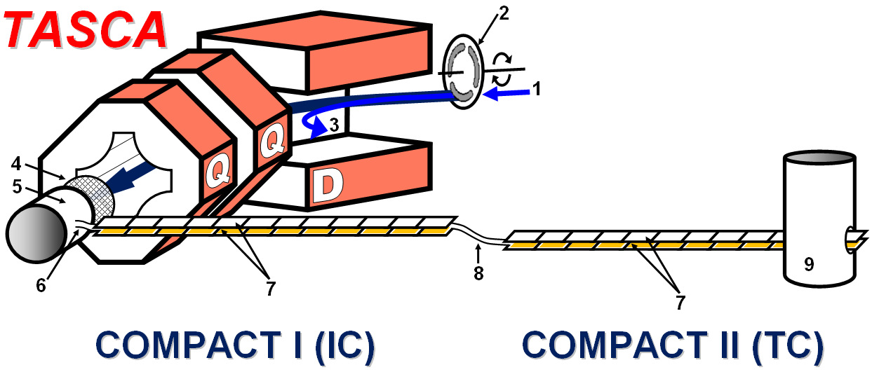
Production and Volatile Metal Behavior of Element 114, Fl (GSI colaboration)
Adsorption of Element 114 on Au using thermal chromatography
Production Reaction: ²⁴⁴Pu(⁴⁸Ca,3-4n)²⁸⁹⁻²⁸⁸114
Pb: -ΔH : >285 kJ/mol
^{Au}
ª
Hg: -ΔH : 98 kJ/mol
^{Au}
ª
Two events of Element 114 observed to adsorb on Au at room temperature:
-ΔH^{Au} = >48 kJ mol⁻¹
Rn: -ΔH : 98 kJ/mol
^{Ice}
ª
Element 114: -ΔH : >48 kJ/mol
^{Au}
ª
Cn: -ΔH : 52 kJ/mol
^{Au}
ª
Notes:
The volatility of element 114 and Cn was studied at the GSI using the COMPACT system and thermochromatography. For the experiment, Element 114 was produced in the ²⁴⁴Pu(⁴⁸Ca,3-4n)²⁸⁹⁻²⁸⁸114 reaction. It was separated from the beam and unwanted reaction products in the gas-filled TransActinide Separator and Chemistry Apparatus (TASCA). At the back of TASCA, the 114 recoils passed through a thin mylar foil and were stopped in a mixture of He and Ar and flushed into the COMPACT detectors. COMPACT consists of two rows of 32-pin diode detectors covered with a thin Au layer. The two rows of detectors are facing each other and separated by a 0.5 mm through which the He/Ar gas-mixture flows. For this experiment, 2 compact detectors were used. The first COMPACT was left at room temperature, while a temperature gradient from +30C to -150C was applied to the second detector. Volatile metals like Hg would flow into the first COMPACT and adsorb at the first interaction with the Au surface while noble gasses like Rn would pass through the first COMPACT and deposit at -150C in the second COMPACT. Two events of element 114 were observed in the warm (30C) portion of COMPACT, indicating that element 114 is a volatile metal. One decay of element 112 was observed in the cold section of the second COMPACT (~-80C), confirming earlier reports of noble gas-like behavior. (Eichler’s nature paper)

Slide 38
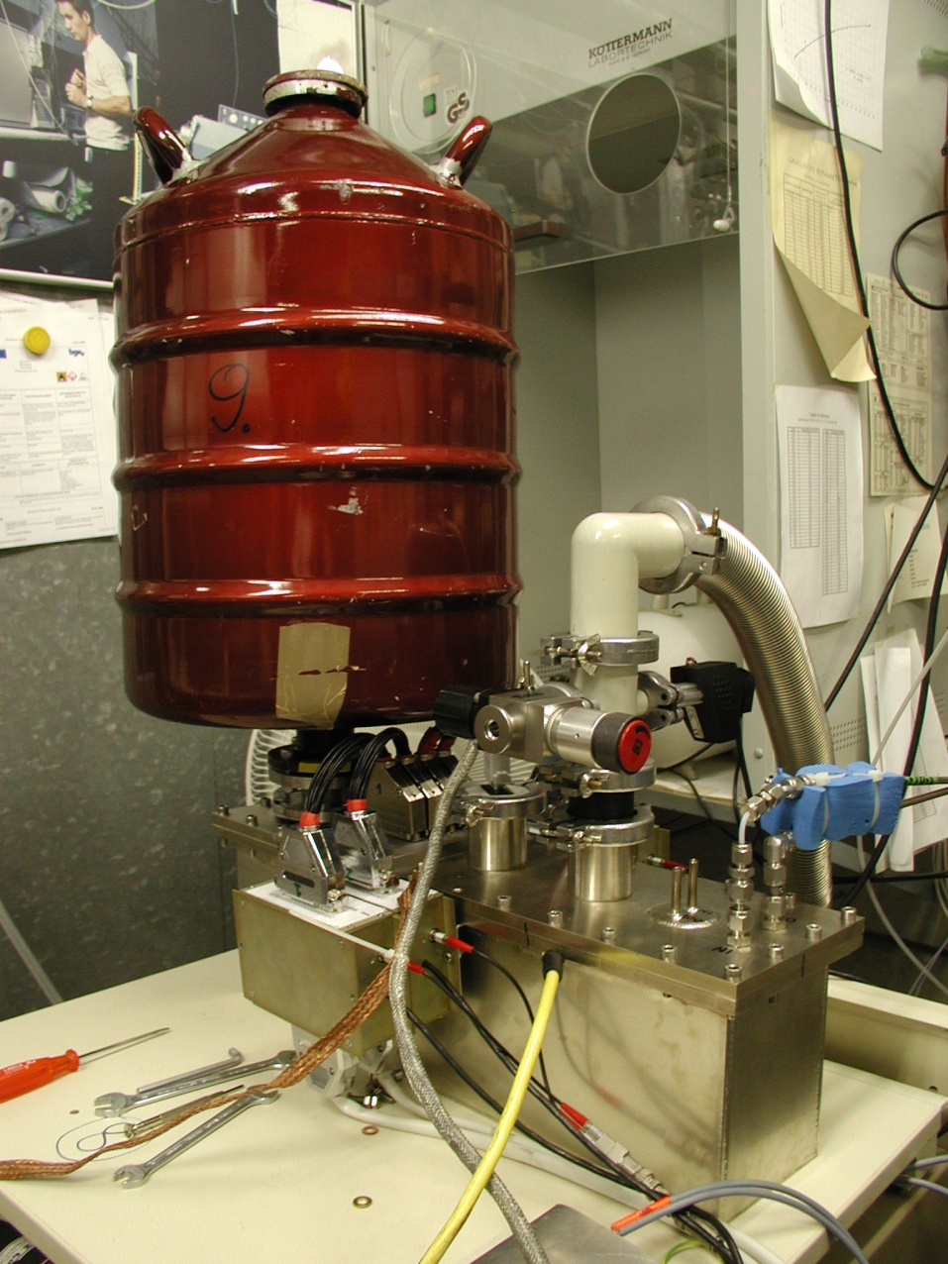
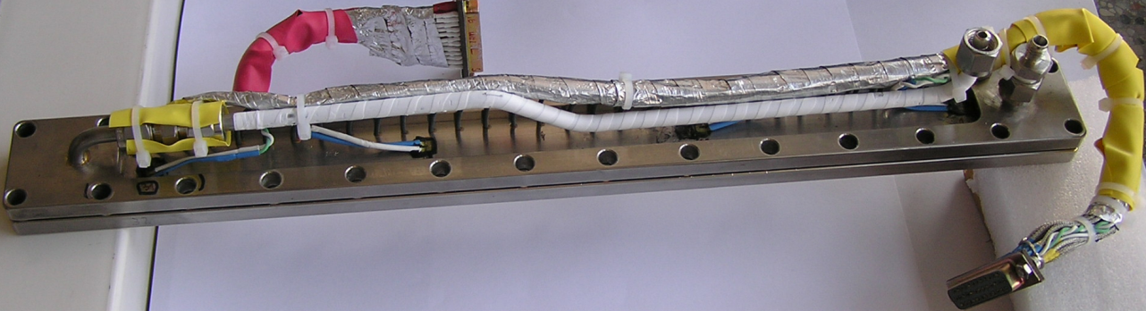
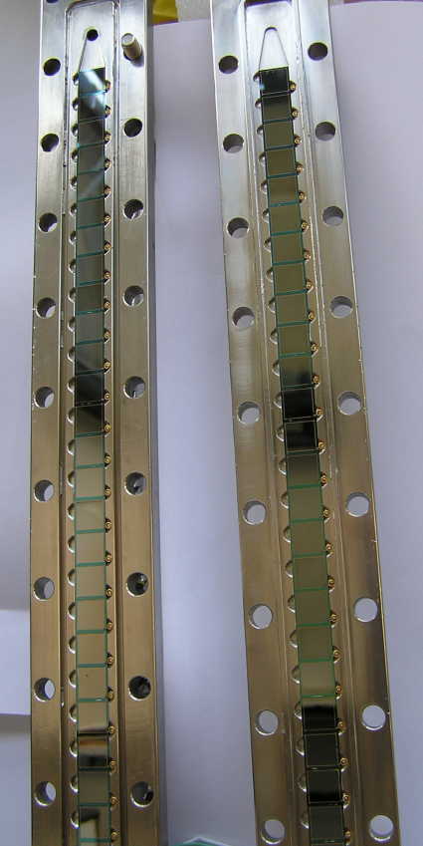
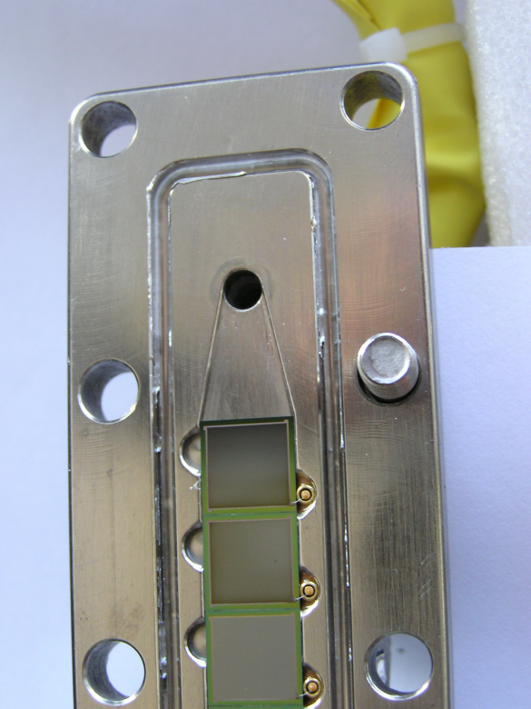
COMPACT (GSI)
Cryo Online Multidetector for Physics and Chemistry of Transactinides

Slide 39
Production and Volatile Metal Behavior of Element 114, Fl (GSI colaboration)
Adsorption of Element 114 on Au using thermal chromatography
Production Reaction: ²⁴⁴Pu(⁴⁸Ca,3-4n)²⁸⁹⁻²⁸⁸114
Pb: -ΔH : >285 kJ/mol
^{Au}
ª
Hg: -ΔH : 98 kJ/mol
^{Au}
ª
Flerovium is a Volatile Metal!
Two events of Element 114 observed to adsorb on Au at room temperature:
-ΔH^{Au} = >48 kJ mol⁻¹
Rn: -ΔH : 98 kJ/mol
^{Ice}
ª
Element 114: -ΔH : >48 kJ/mol
^{Au}
ª
Cn: -ΔH : 52 kJ/mol
^{Au}
ª
Notes:
The volatility of element 114 and Cn was studied at the GSI using the COMPACT system and thermochromatography. For the experiment, Element 114 was produced in the ²⁴⁴Pu(⁴⁸Ca,3-4n)²⁸⁹⁻²⁸⁸114 reaction. It was separated from the beam and unwanted reaction products in the gas-filled TransActinide Separator and Chemistry Apparatus (TASCA). At the back of TASCA, the 114 recoils passed through a thin mylar foil and were stopped in a mixture of He and Ar and flushed into the COMPACT detectors. COMPACT consists of two rows of 32-pin diode detectors covered with a thin Au layer. The two rows of detectors are facing each other and separated by a 0.5 mm through which the He/Ar gas-mixture flows. For this experiment, 2 compact detectors were used. The first COMPACT was left at room temperature, while a temperature gradient from +30C to -150C was applied to the second detector. Volatile metals like Hg would flow into the first COMPACT and adsorb at the first interaction with the Au surface while noble gasses like Rn would pass through the first COMPACT and deposit at -150C in the second COMPACT. Two events of element 114 were observed in the warm (30C) portion of COMPACT, indicating that element 114 is a volatile metal. One decay of element 112 was observed in the cold section of the second COMPACT (~-80C), confirming earlier reports of noble gas-like behavior. (Eichler’s nature paper)

Slide 40
How About Mendeleev’s Dream?
Where will the Periodic Table End?

Slide 41
Electronic Configurations of the Superactinides at Different Levels of Theory
119
8s
120
8s²
with correlation
n + l rule
no correlation
From: V. Pershina, GSI, Glenn T. Seaborg and the modern Periodic Table of the Elements,
244th ACS National Meeting, Philadelphia, August 20, 2012

Slide 42
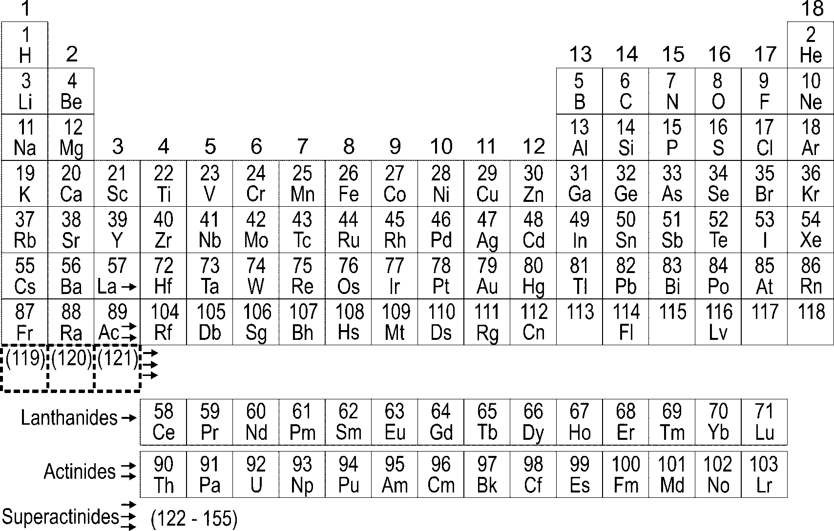
Future Periodic Table of the Elements
?
Z=173
From: V. Pershina, GSI, Glenn T. Seaborg and the Modern Periodic Table of the Elements,
244th ACS National Meeting, Philadelphia, August 20, 2006

Slide 43
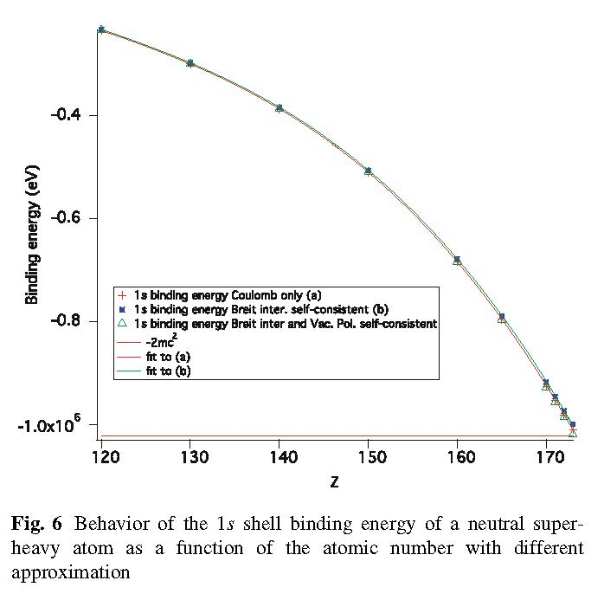
The End of the Periodic Table
MCDF + Breit + QED calculations confirmed the end of the PT with Z = 173
Z = 173.17
P. Indelicato, et al., Theor. Chem Acc. (2011) 129:495–505

Slide 44

Thank You for Your Attention

