Slide 1
Molecular Modeling of the swelling properties and interlayer structure of Cs- and K- Montmorillonites: Effects of charge distribution in the clay layers
Brice NGOUANA, Ph.D Student
Prof. Andrey KALINICHEV, Supervisor
Radiochemistry Group, Subatech

Slide 2
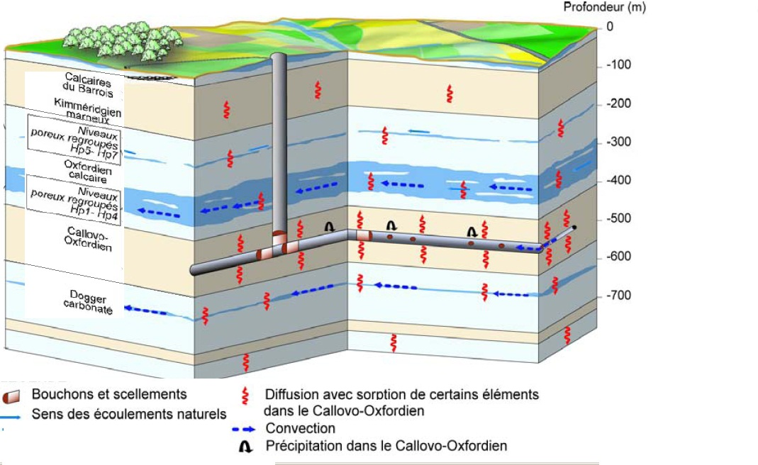
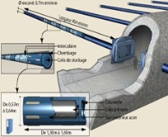
Introduction
Cs 135, Cs 137 isotopes belong to the family of long-lived ( > 30 ans) radioactive waste.
Deep geological storage is considered by many countries as the appropriate long term solution for management and storage of this type of radioactive waste.
Composition minéralogique moyenne de la formation du Callovo-Oxfordien
41% clay minerals (interstratified illite-smectite and illite)
31% calcite
25% quartz and feldspar
3% other minerals
Organic matter <1%
Clays swell, have low permeability, and good ion sorption/exchange capacity
They can play an important role in nuclear waste confinement

Slide 3
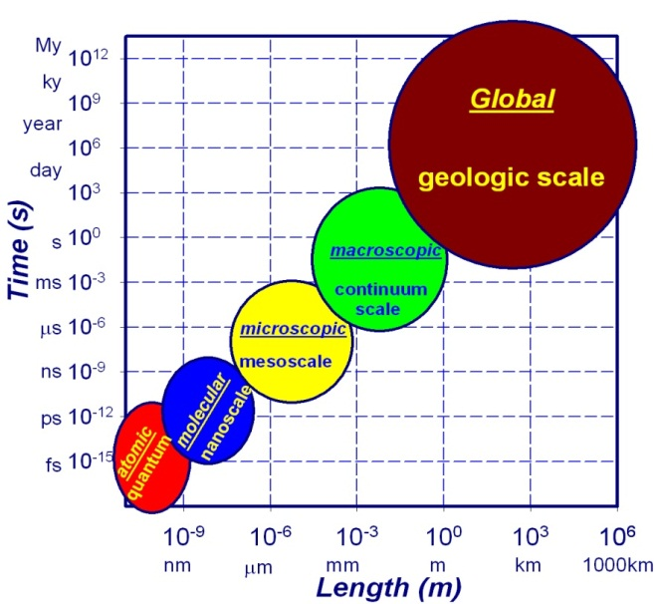
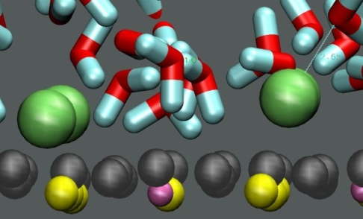
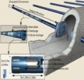
Introduction
Because of the very tiny nature of clay particles (< 2µm), some important phenomena taking place at the aqueous phase – clay interface are difficult to study by experimental methods. And even when available, some experimental data are difficult to interpret.
Nuclear waste repository
Computational molecular modeling then appear as complementary powerful tool to facilitate the atomic-scale interpretation of the observed interfacial phenomena, the effects of substrate structure and composition on the structure, dynamics, and composition of the interfacial aqueous solution.
Optimize our models by building larger, more diverse and realistic clay models.

Slide 4
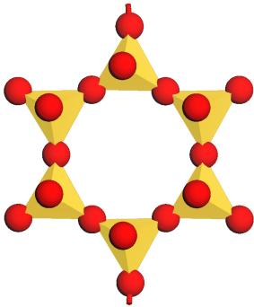
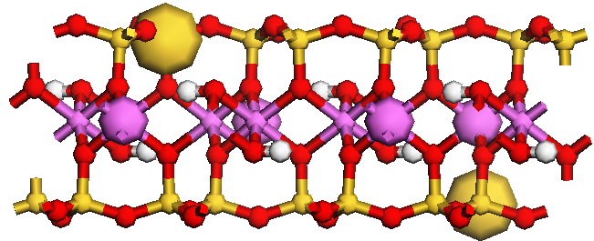
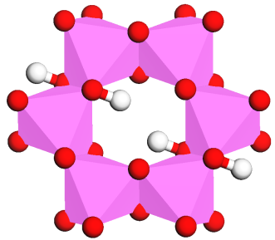
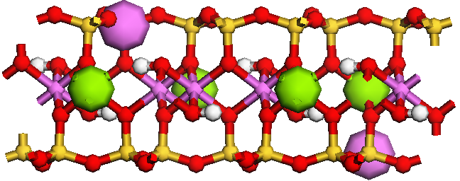
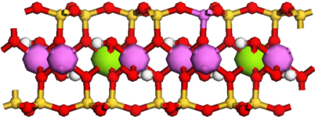
clay minerals (smectites)
Clays are mainly layered phyllosilicates minerals of SiO₄ tetrahedral sheets and AlO₆ octahedral sheets having various stacking arrangements.
Oxygen
2:1 clays
Silicon
Aluminum
Tetrahedral sheet
Octahedral sheet
Pyrophillite (smectite group)
Mg/Al and Al/Si substitutions respectively the in octahedral and/or tetrahedral layers of pyrophillite (Si₈)(Al₄)O₂₀(OH)₄ give rise to montmorillonite. This clay now has a negative layer charge that is compensated by sorption of cations. E_{x+y}(Si_{8-x}Al_{x})(Al_{4-y}Mg_{y})O₂₀(OH)_{4.} With y>x and E a compensating cation.
Wyoming montmorillonite: E_{0.75}(Si_{7.75}Al_{0.25})(Al_{3.5}Mg_{0.5})O₂₀(OH)₄ E = Cs, K
Layer charge ~0.75: montmorillonite is a swelling clay
Montmorillonite

Slide 5
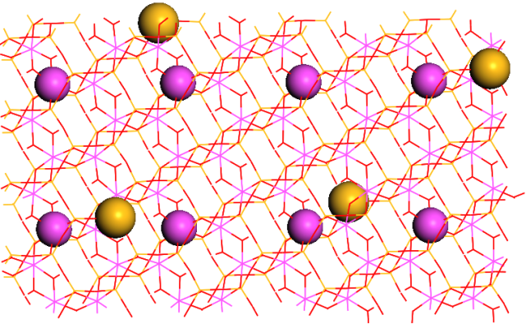
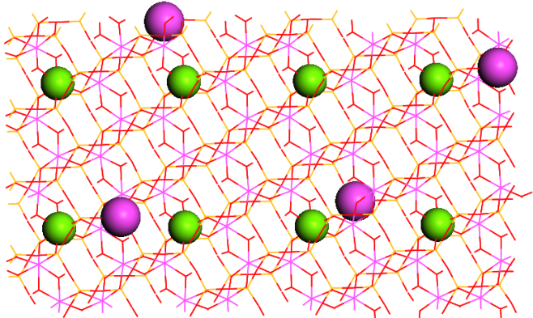
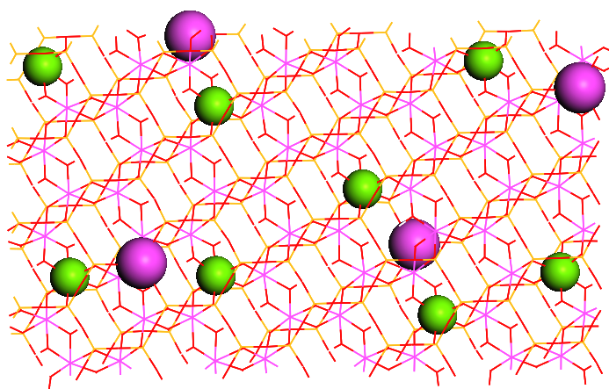
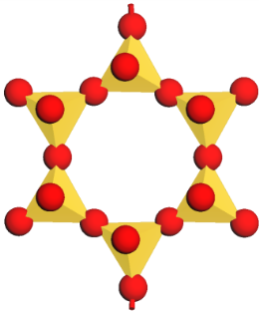
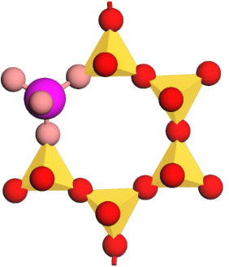
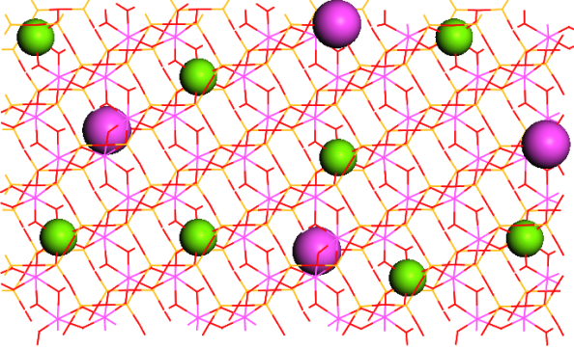
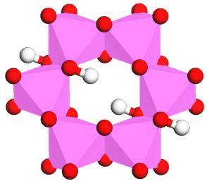
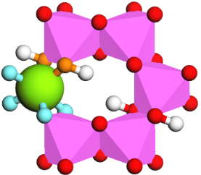
clay minerals (smectites)
Pyrophillite atomic structure from X-ray data
Uniform distribution in T and O layers (Uni)
Random distribution in O layers (RanO)
Basal oxygen (Ob) : - 1.05 e
Basal oxygen with tetrahedral substitution (Obts) : -1.1688 e
Basal oxygen with octahedral substitution (Obos)
Hydroxyl oxygen with octahedral substitution (Ohs)
Random distribution in O and T layers (RanTO)

Slide 6
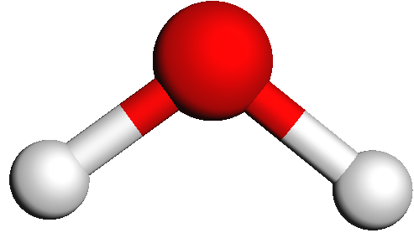
Molecular dynamics in few words
Molecular modeling is a combination of theoretical methods and computational techniques used to mimic the behavior of atoms and molecules in real natural systems in order to predict their properties.
Molecular Dynamics: Numerically Solves Newtown’s equation of motion for N interacting particles.
At time t we know r_{i}(t), v_{i}(t) for all the particles
U_{ij} = ∑(A_{ij}/r_{ij}¹² - B_{ij}/r_{ij}⁶ + q_{i}q_{j} /ε₀r_{ij}) + ∑½k_{b} (r_{αβ} - r₀)² + ∑½k_{θ} (θ - θ₀)²
V-d-Waals Coulombic bond stretching angle bending
O
r_{αβ}
Δt ~ 1 fs = 10⁻¹⁵ s
H
θ
H
CLAYFF – specialized semi-empirical fully flexible force field model allowing for realistic exchange of momentum and energy among all atoms – solid substrate and aqueous solution (Cygan et al, 2004).

Slide 7
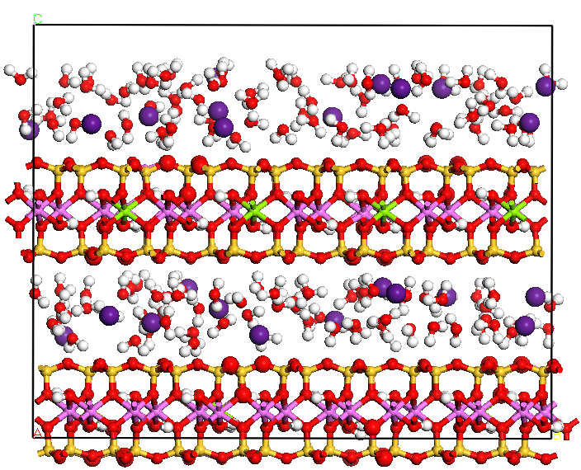
Simulated systems - 1
Classical Newtonian dynamics
Clay: Wyoming Montmorillonite
E₂₄(Si₂₄₈Al₈)(Al₁₁₂Mg₁₆)O₆₄₀(OH)₁₂₈ E = Cs, K
N_{tot} ~ 5,000 atoms
N_{H2O} ~ 0-1018 molecules (SPC model)
CLAYFF force field
a × b × c ~ 2 × 4 × 2 nm³
Periodic boundary conditions
NPT ensemble T = 298K; P = 1 bar
t = 2 ns (equilibration + equilibrium)
Δt = 1.0 fs = 10⁻¹⁵ s
Basal spacing
Isosteric heat of adsorption
Hydration Energy
Immersion Energy

Slide 8
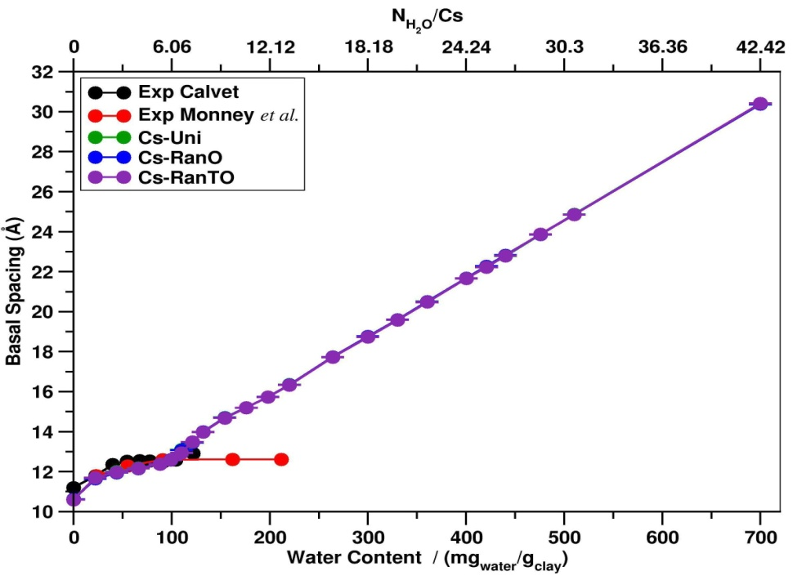
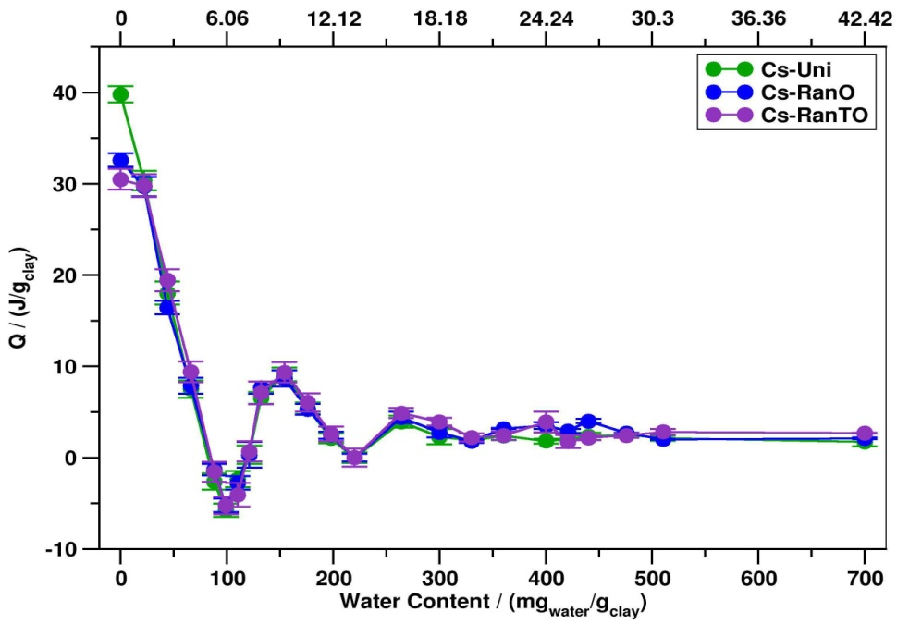
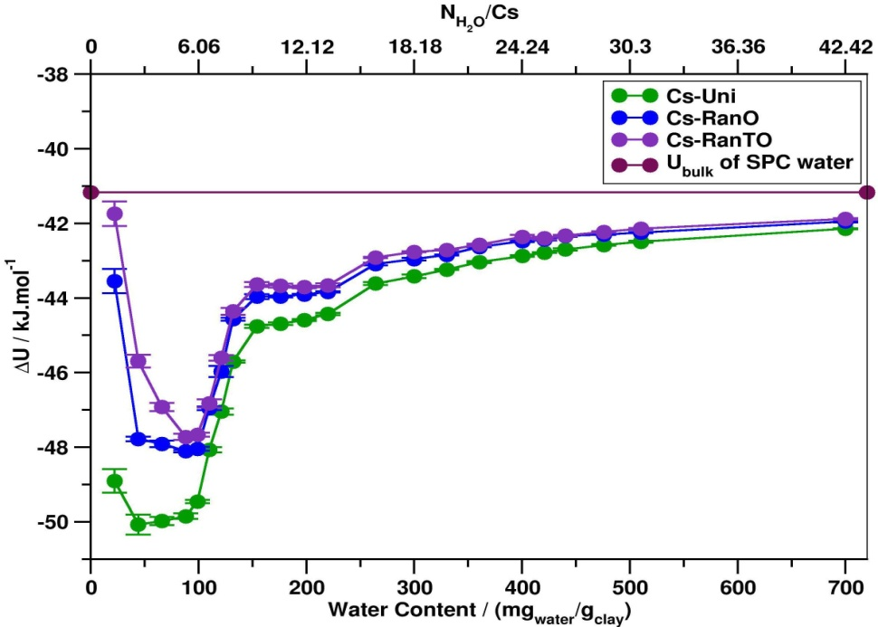
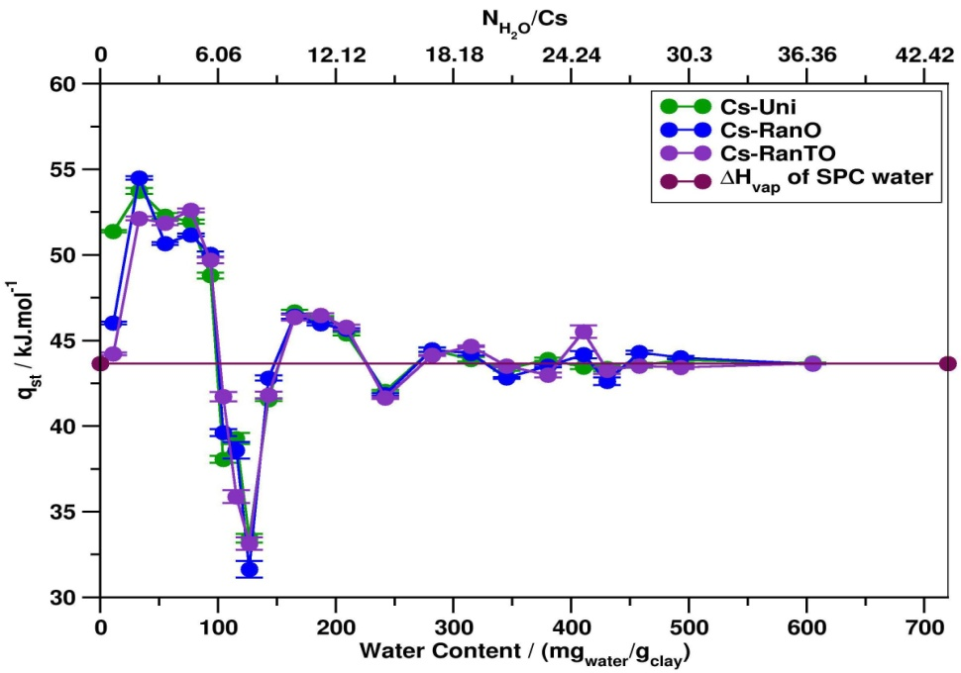
Results and discussions

Slide 9
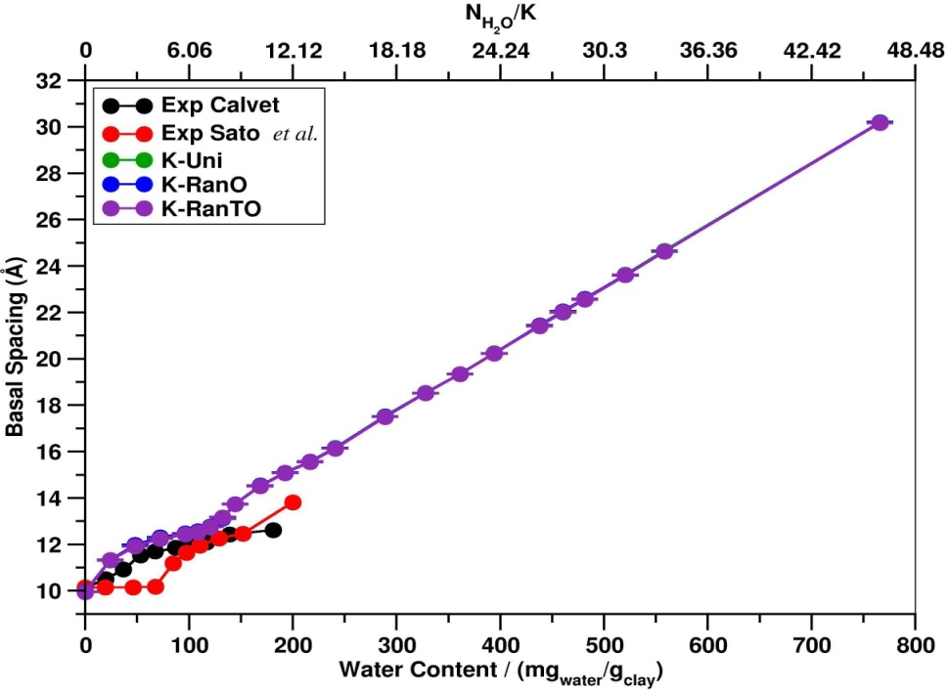
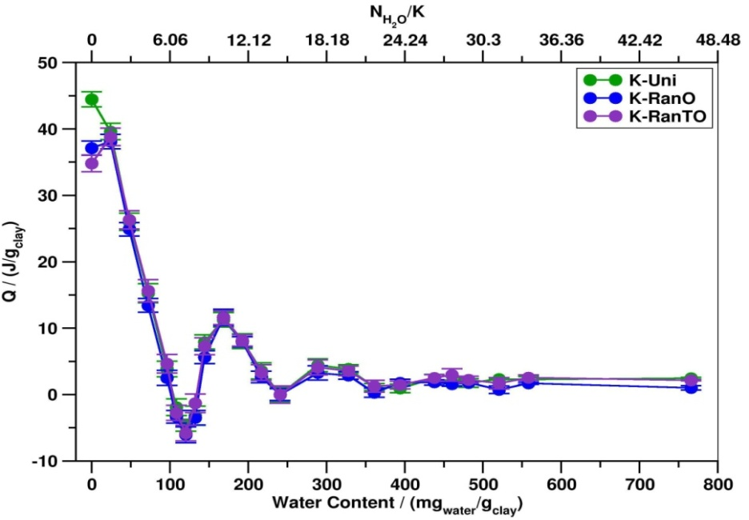
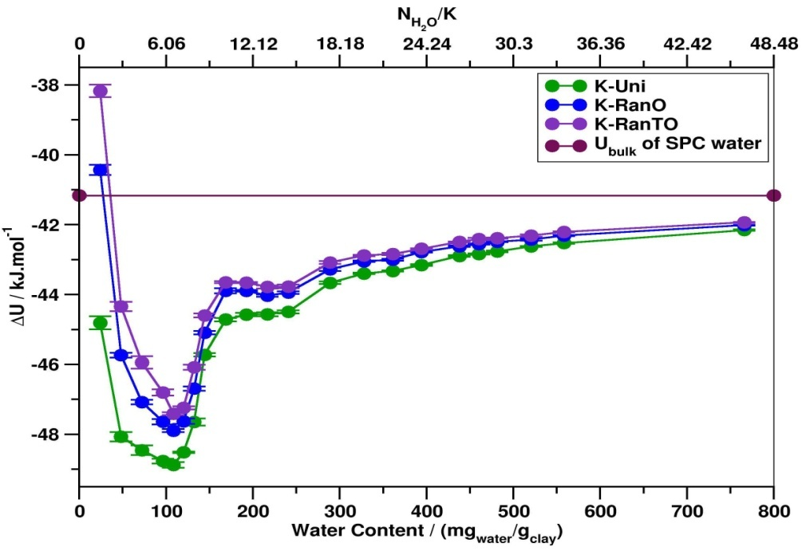
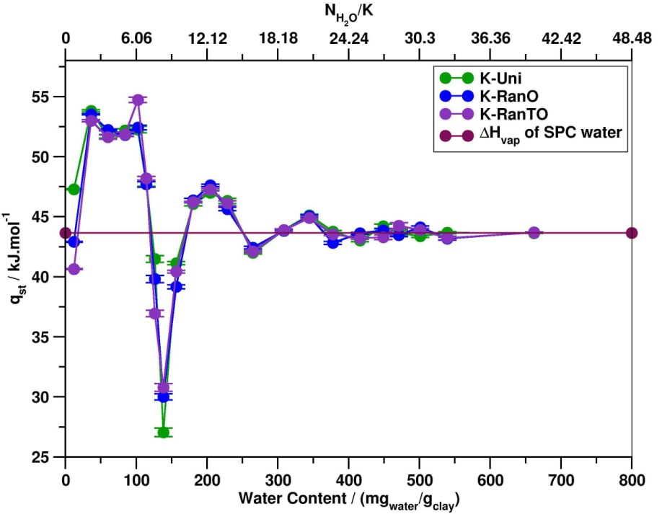
Results and discussions

Slide 10
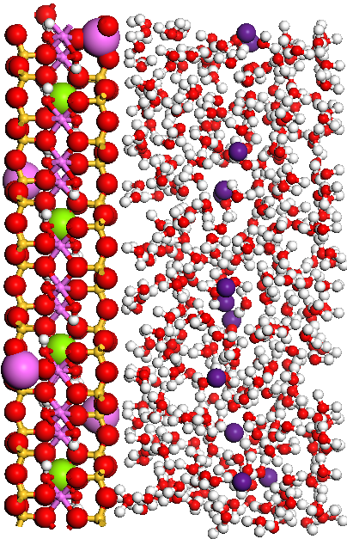
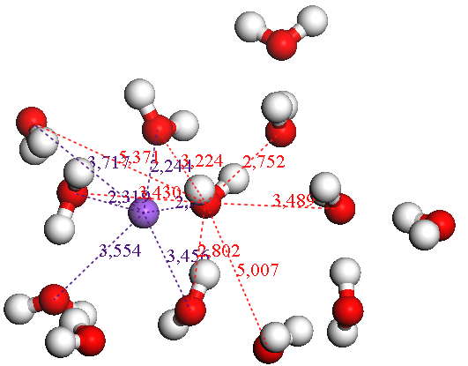
Simulated systems - 2
Classical Newtonian dynamics
E₂₄(Si₂₄₈Al₈)(Al₁₁₂Mg₁₆)O₆₄₀(OH)₁₂₈ E = Cs, K
N_{tot} < 5,000 atoms
Three first stable hydration states
CLAYFF force field
a × b × c ~ 2 × 4 × 2 nm³
Periodic boundary conditions
NVT ensemble T = 298K
t = 1.5 ns (equilibration + equilibrium)
Δt = 1.0 fs = 10⁻¹⁵ s
Radial distribution function
Atomic density profile

Slide 11
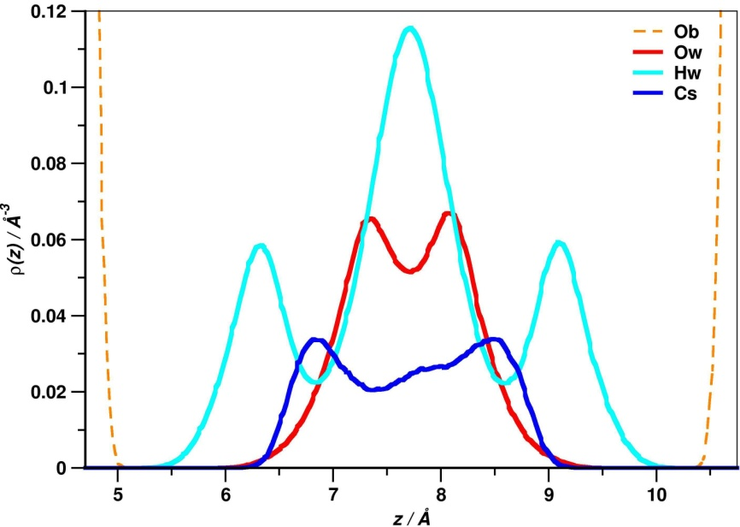
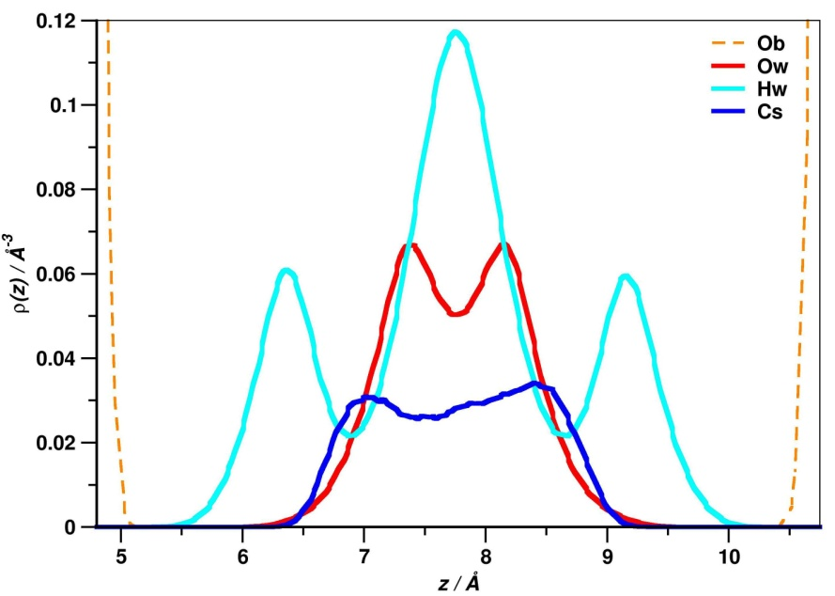
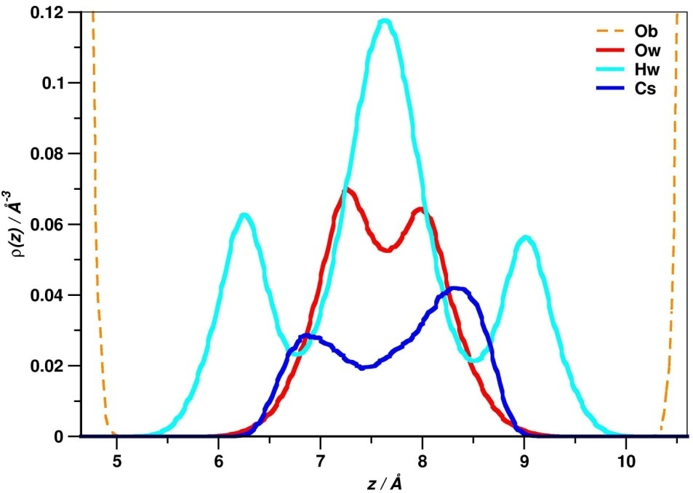
Results and discussions
Atomic density profiles
RanO
Water content = 6 H₂O / Cs
RanTO
Uniform

Slide 12
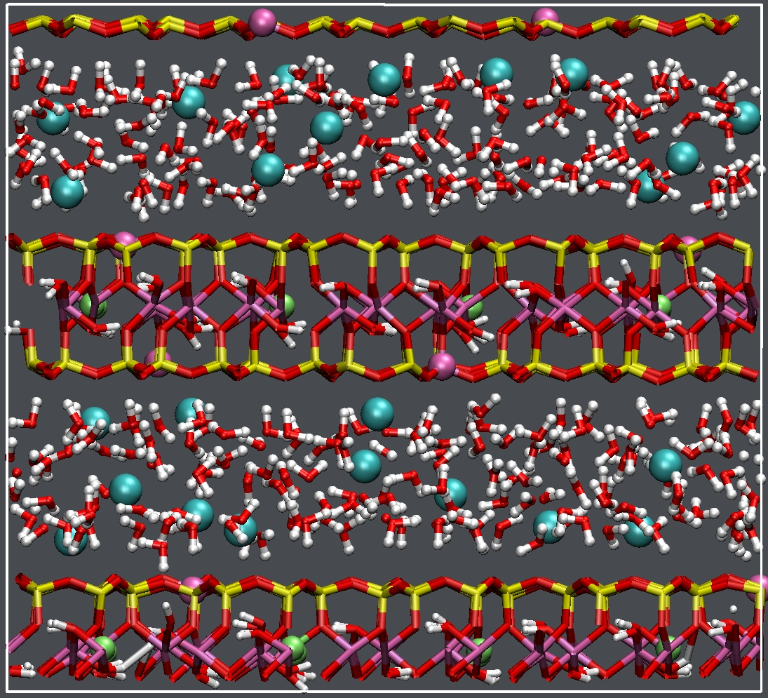
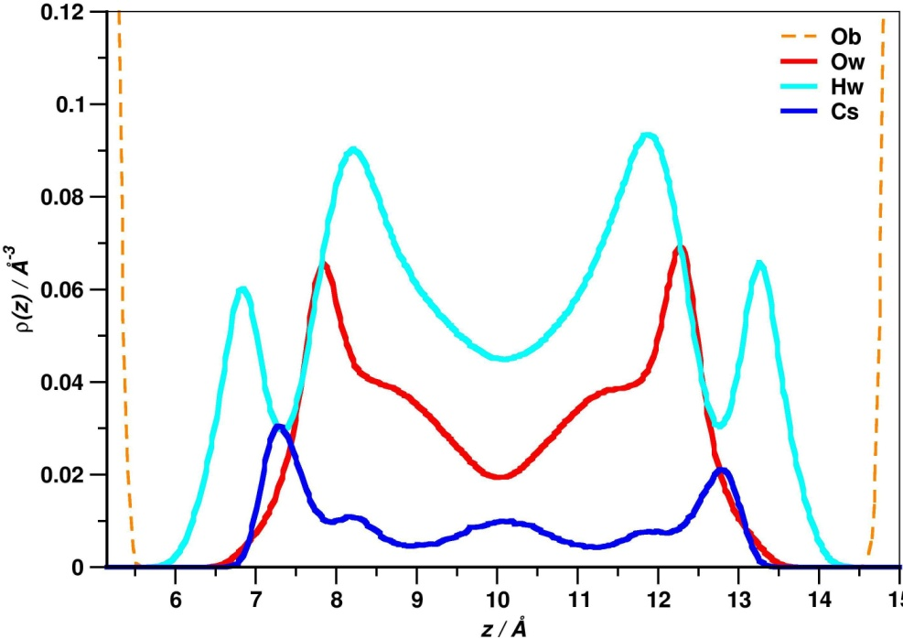
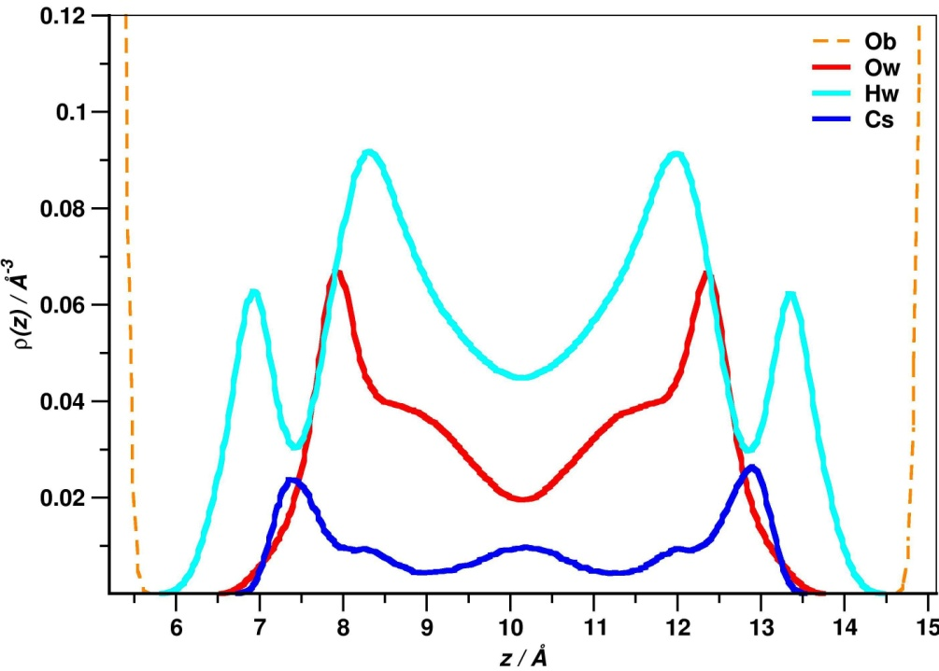
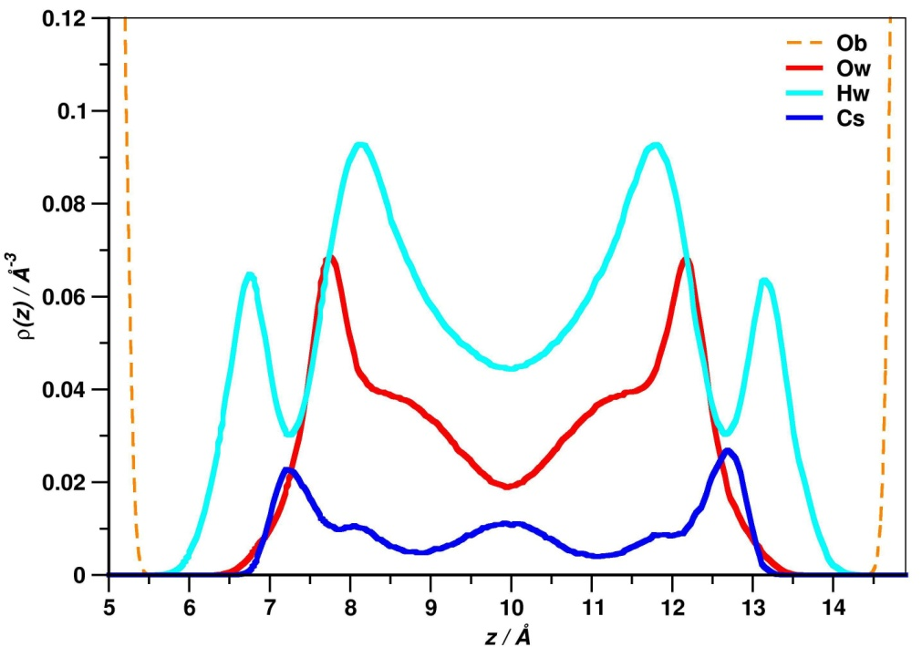
Results and discussions
Atomic density profiles
RanO
Water content = 13,33 H₂O / Cs
Uniform
RanTO

Slide 13
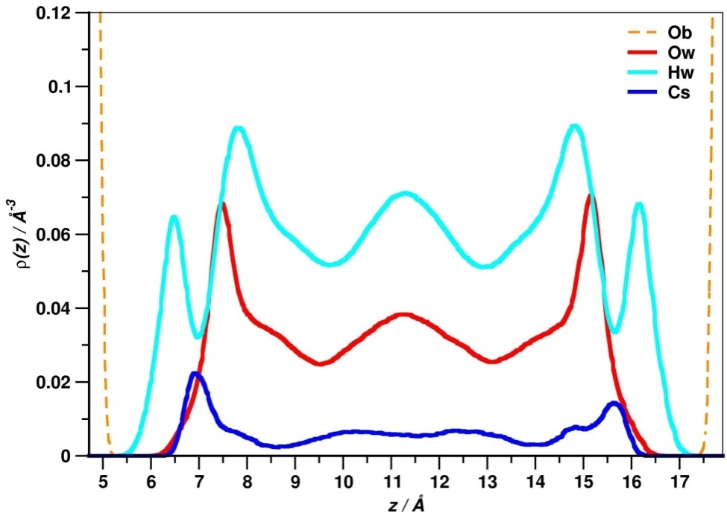
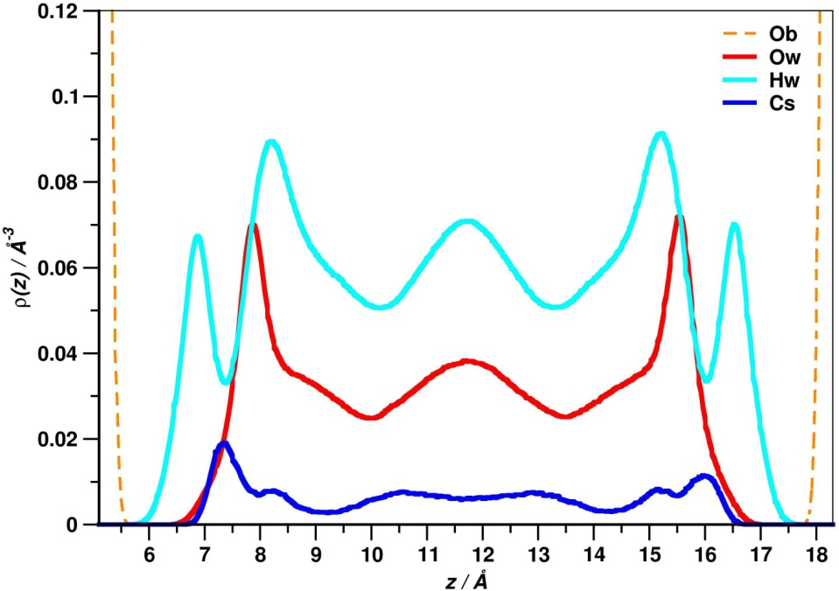
Results and discussions
Atomic density profiles
RanO
Water content = 20 H₂O / Cs
Uniform
RanTO

Slide 14
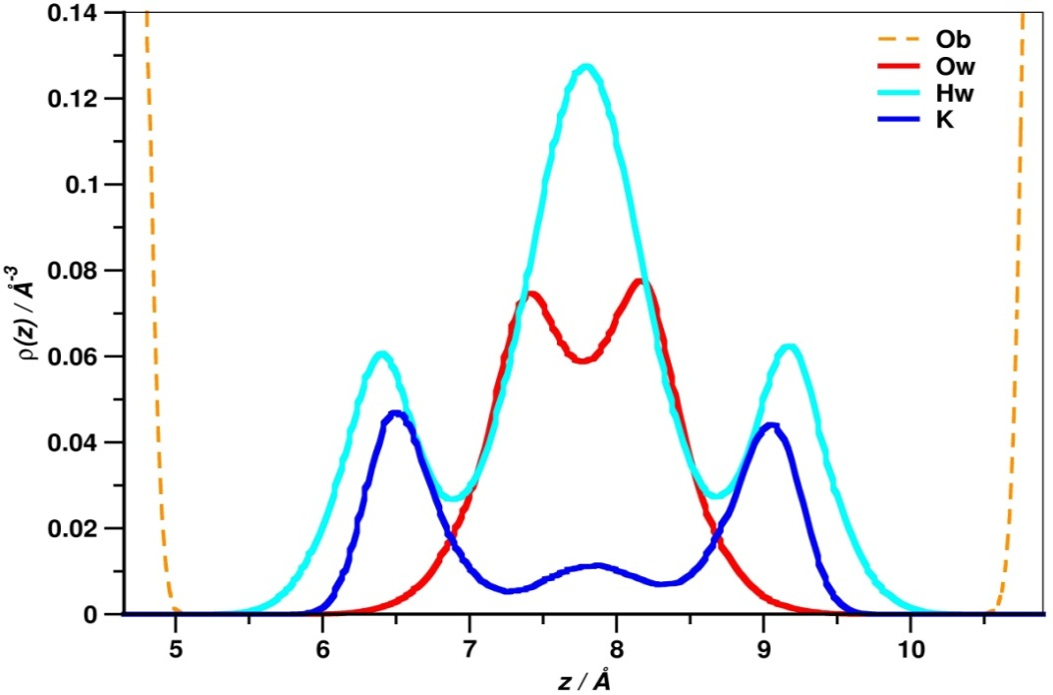
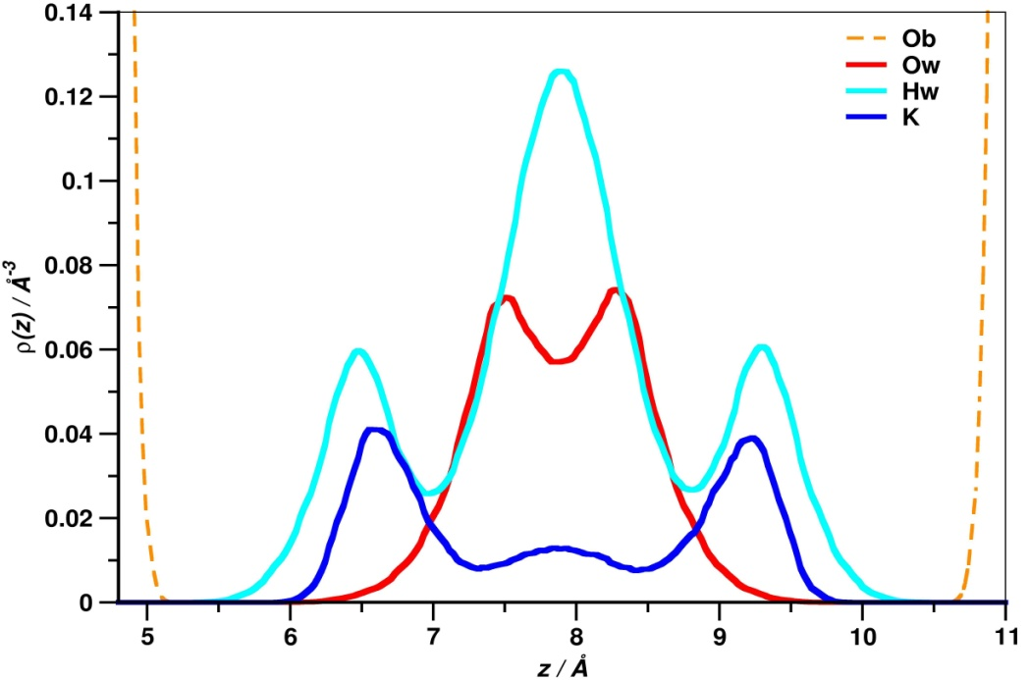
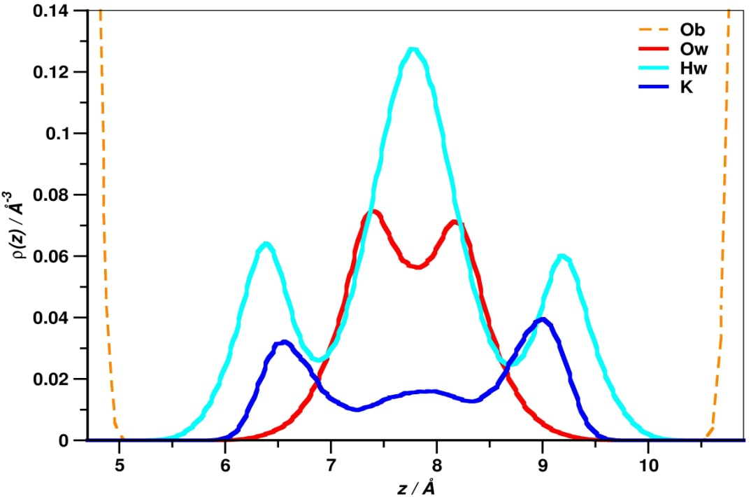
Results and discussions
Atomic density profiles
RanO
Water content = 6,67 H₂O / K
Uni
RanTO

Slide 15
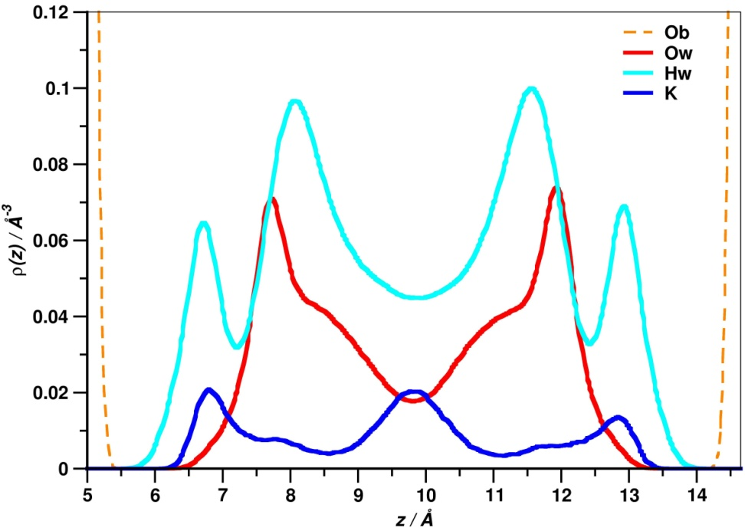
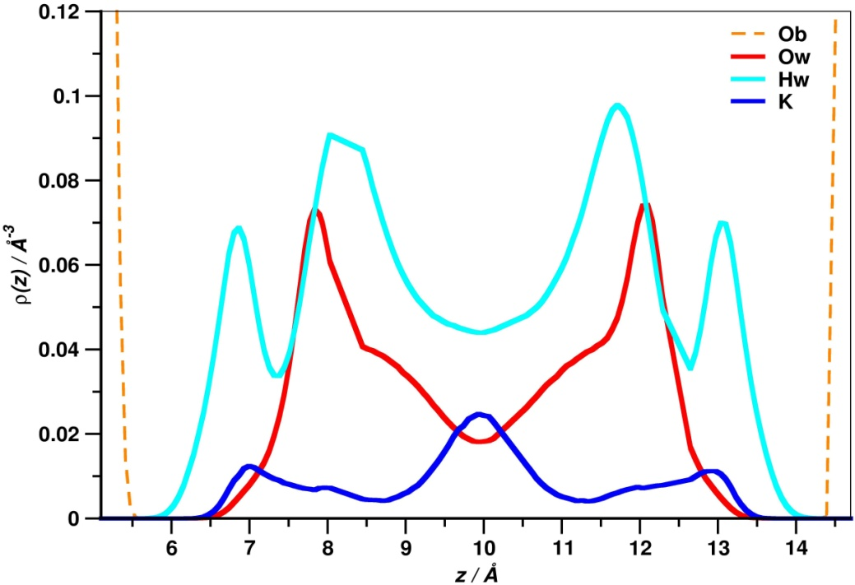
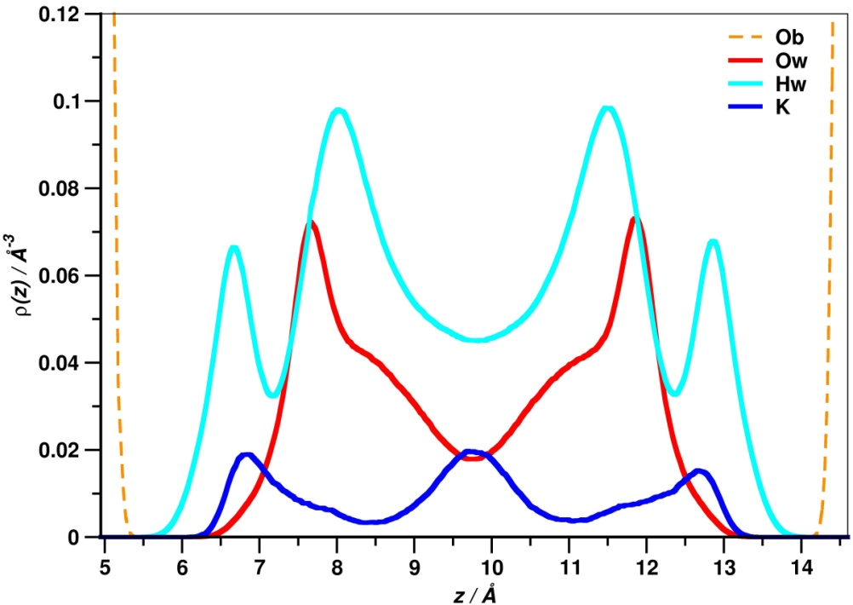
Results and discussions
Atomic density profiles
RanO
Water content = 13,33 H₂O / K
Uni
RanTO

Slide 16
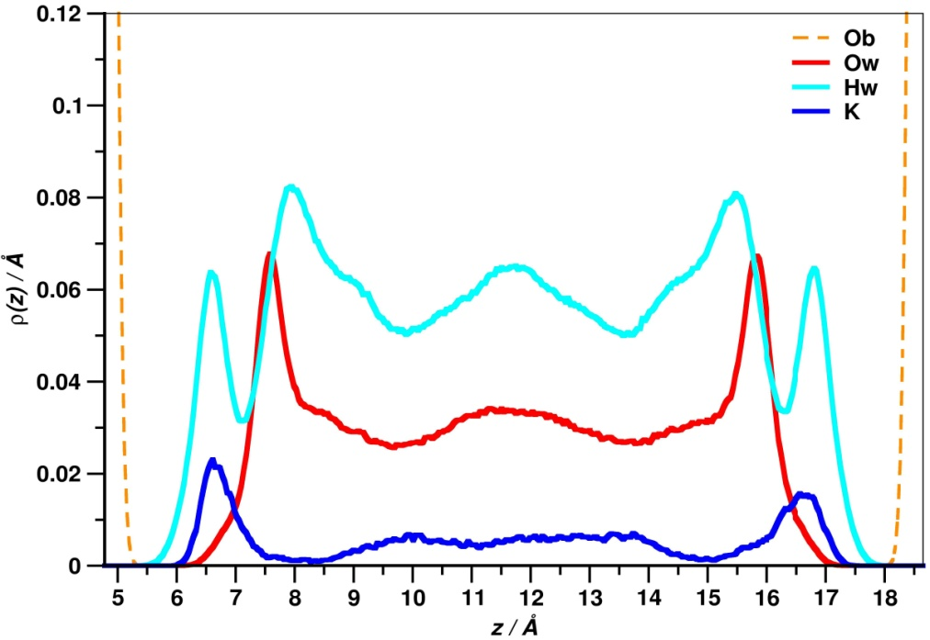
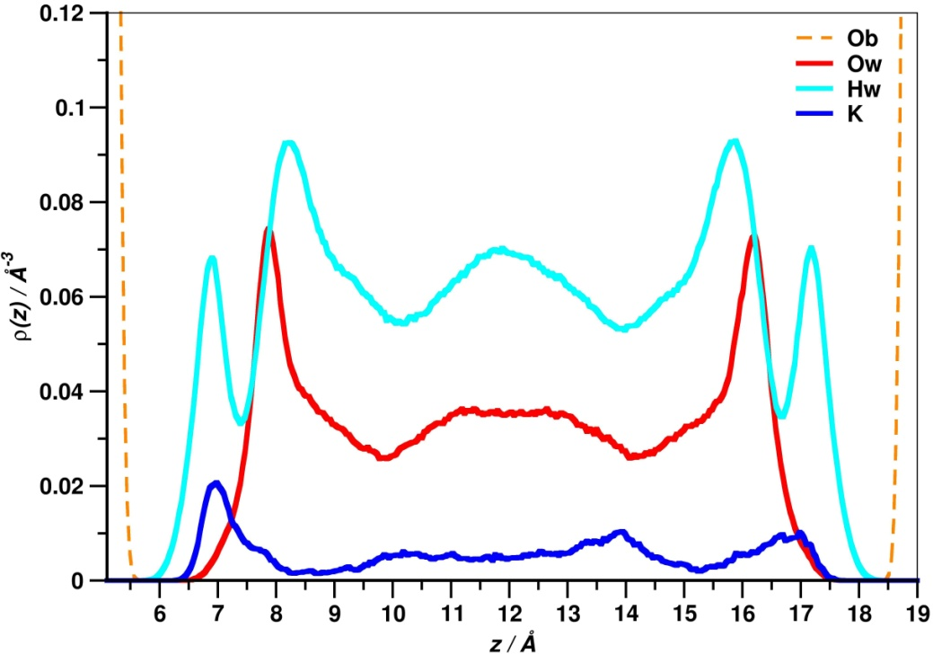
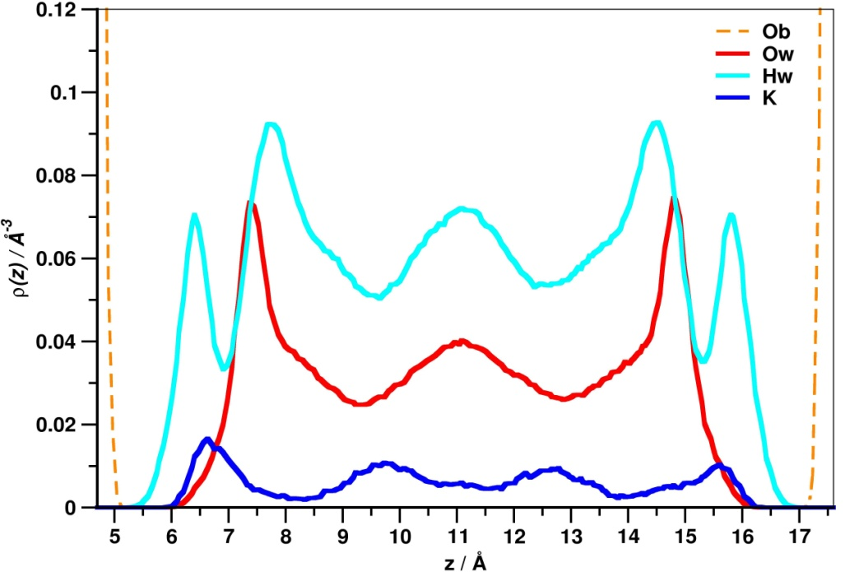
Results and discussions
Atomic density profiles
RanO
Water content = 20 H₂O / K for RanO and RanTO
= 21,83 H₂O / K for Uni
RanTO

Slide 17
Results and discussions
a
a
b
b
c
ion – Ob
ion – Obts
ion – Ow
Ow – Ob
Ow – Obts
Ow – Ow
a
Radial distribution function
Basal oxygen (Ob)
Basal oxygen with tetrahedral substitution (Obts)

Slide 18
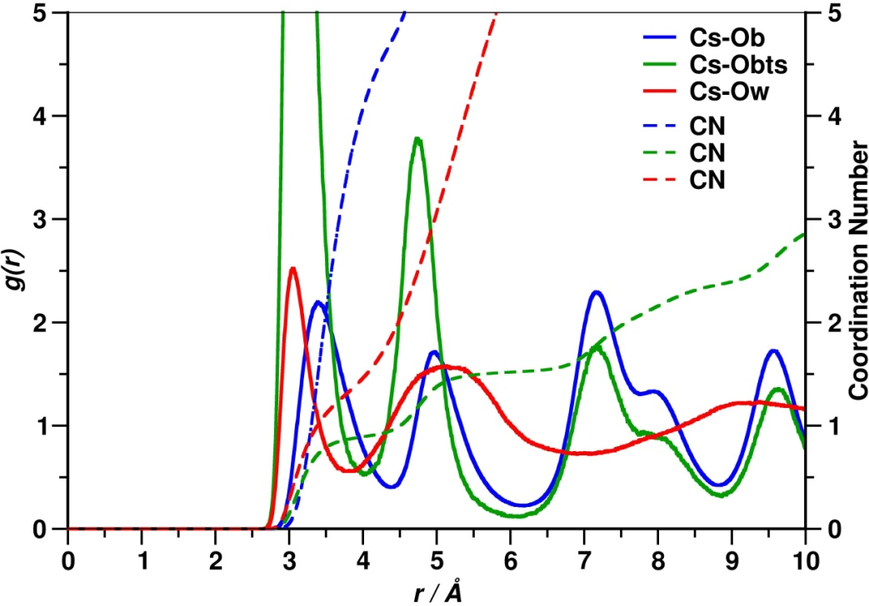
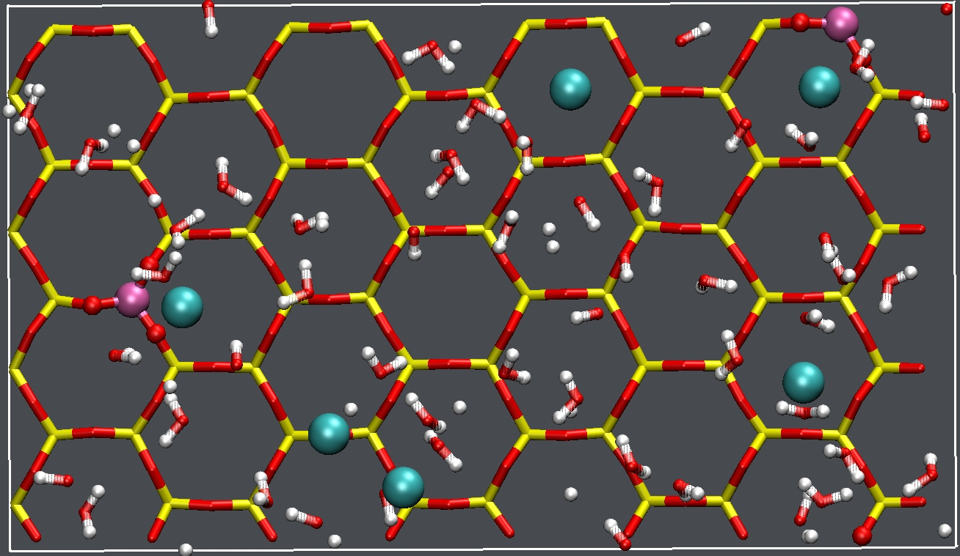
Results and discussions
Radial Distribution functions
RanO
Water content = 6,67 H₂O / Cs
Basal oxygen (Ob)
Basal oxygen with tetrahedral substitution (Obts)
Uni
RanTO

Slide 19
Results and discussions
Radial Distribution functions
Water content = 6,67 H₂O / Cs
RanO
Basal oxygen (Ob)
Basal oxygen with tetrahedral substitution (Obts)
Uni
RanTO

Slide 20
Results and discussions
Radial Distribution functions
Water content = 6,67 H₂O / K
RanO
Basal oxygen (Ob)
Basal oxygen with tetrahedral substitution (Obts)
Uni
RanTO

Slide 21
Results and discussions
Radial Distribution functions
Water content = 6,67 H₂O / K
RanO
Basal oxygen (Ob)
Basal oxygen with tetrahedral substitution (Obts)
Uni
RanTO

Slide 22
Conclusions and perspectives
The hydration energetics indicate that in addition to the commonly observed 1-layer and 2-layer hydrates, stable hydration states corresponding to 3-layer and 4-layer hydrates can also be distinguished.
The " Uniform " clay model shows a lower hydration energy compared to the two other models for both Cs and K.
There is no significant difference between the three clay models concerning the studied structural properties.
The same studies are being carried out for a series of other cations ( Sr²⁺, Ni²⁺)
The next step is to look at the dynamics of the system:
Hydrogen bonding network
Diffusion coefficient of aqueous species

Slide 23
Acknowledgments
These work is being carried out in the context of the industrial chair «Storage and Disposal of Radioactive Waste» at the Ecole des Mines and thanks to
We are also grateful for computer time allocations :
CURIE,TITANE, Partnership for Advanced Computing in Europe (PRACE), at CEA, Bruyères-Le-Châtel, France
CINECA computing center (Italy)
JADE, Centre Informatique National de l’Enseignement Supérieur(CINES), Montpellier, France
Many thanks to :
Prof. Andrey Kalinichev
Dr. Narashimhan Loganathan
Dr. Julie Champion
Thank you for your kind attention

