Slide 1
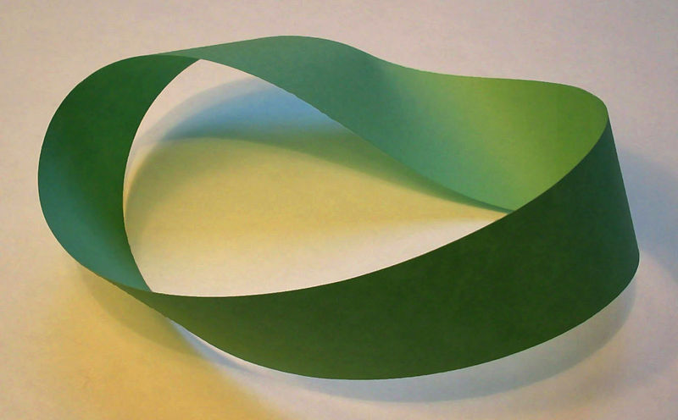
Dark Universe or twisted Universe? Einstein-Cartan theory.
Thomas Schucker : CPT Marseille France
Andre Tilquin : CPPM Marseille France
THCA Tsinghua China
\
CPPM: 6 Fevrier 2012

Slide 2
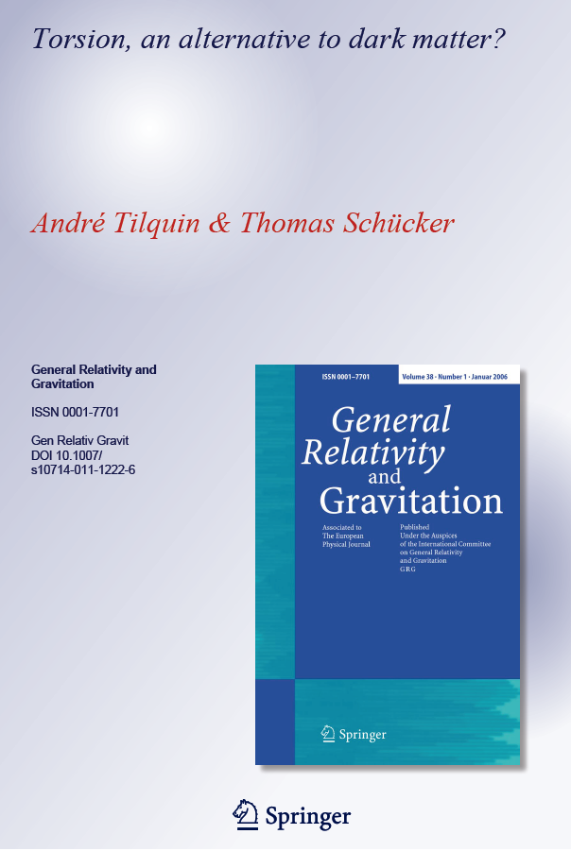
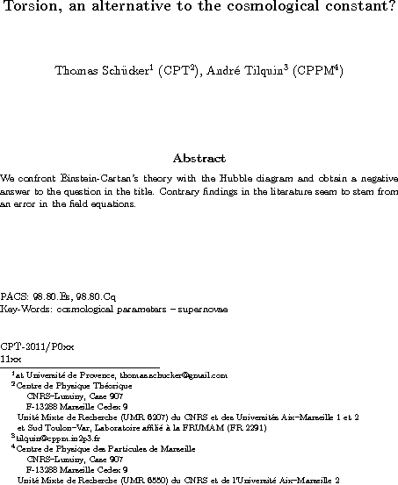
References
arXiv:1104.0160
arXiv:1109.4568
Preliminary

Slide 3
Outlook
Prelude
Status on dark Universe
Einstein general relativity: quick reminder
Parallel transport and curvature
Limitation in GR
Einstein-Cartan general relativity
Torsion: what is that?
Parallel transport and torsion
Properties and advantages
Results on supernovae with a twisted Universe
Effect of torsion on Hubble diagram
Summary and further work

Slide 4
Parallel transport in field theory
$$ℒ$$
Nother theorem
Local invariance
Parallel transport
Covariante derivative
Field definition and interaction

Slide 5
Parallel transport and interaction
$$ℒ=∂_{μ}φ∂^{μ}φ^{∗}{−m}^{2}φφ^{∗}$$
$ℒ$invariant under global rotation $θ$ in complex plane. Noether theorem->${Σe}^{−}={Σe}^{−}$
$$ℒ=\left(∂_{μ}−ieA_{μ}\right)φ{(∂}^{μ}+ieA^{μ})φ^{∗}{−m}^{2}φφ^{∗}$$
$\left.\begin{matrix}φ\underset{→}{θ}φe^{−iθ} \\ φ^{∗}\underset{→}{θ}φ^{∗}e^{iθ}\end{matrix}\right\}→φφ^{∗}$ is invariant
$\left.\begin{matrix}∂_{μ}φ\underset{→}{θ}∂_{μ}φe^{−iθ} \\ ∂^{μ}φ^{∗}\underset{→}{θ}{∂^{μ}φ}^{∗}e^{iθ}\end{matrix}\right\}→∂_{μ}φ{∂^{μ}φ}^{∗}$ is invariant
$$φ$$
$$e$$
$$A^{μ}⟺γ$$
$${ie∂}_{μ}φ A^{μ}φ^{∗}$$
But is not invariant under local rotation $θ\left(x_{μ}\right)$ in complex plane: $Σe^{−}≠Σe^{−}$
$∂_{μ}φ\underset{→}{θ}∂_{μ}φ.e^{−iθ}−i∂_{μ}θ\left(x_{μ}\right).φ$. $e^{−iθ}$
$$φ^{∗}$$
5
=
+
$$δx^{μ}$$
$$x^{μ}$$
$$∂_{μ}\left(φ\right) =$$
$$\frac{Δφ}{δx^{μ}}$$
$$+{ D}_{μ}φ$$
Variation of the field is assumed to be linear in $φ and δx_{μ}$:
$$Δφ=ieA_{μ}δx^{μ}φ$$
$$D_{μ}=∂_{μ}−ieA_{μ}$$

Slide 6
Status of dark Universe: The ΛCDM model

Slide 7
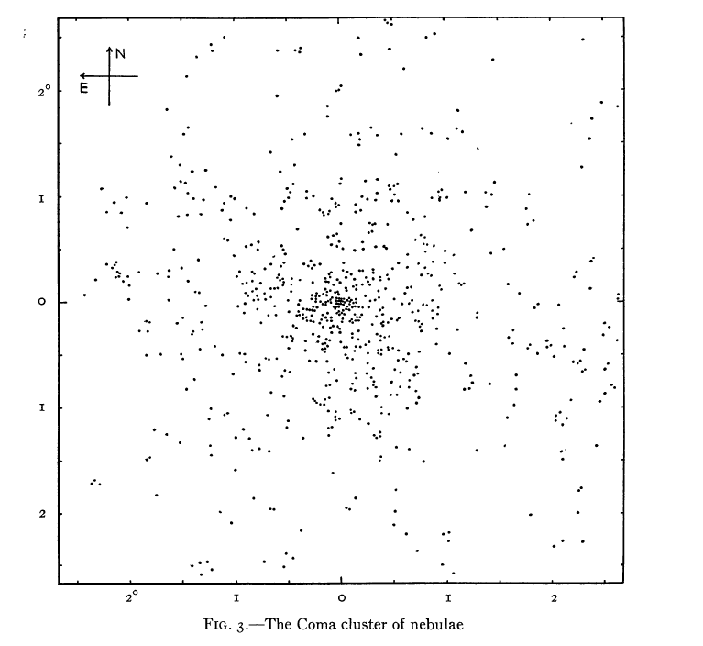
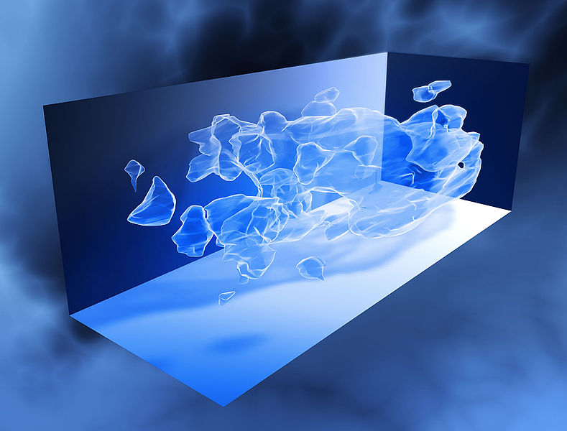
Status of cosmology: dark matter
-Dark matter: First evidence in 1933 by Fritz Zwicky
Applying virial theorem to the Coma cluster of galaxies , he estimated 400 times more mass than the one estimated by visible galaxies
The Coma cluster as seen in 1933
HST dark matter reconstruction (WL)

Slide 8
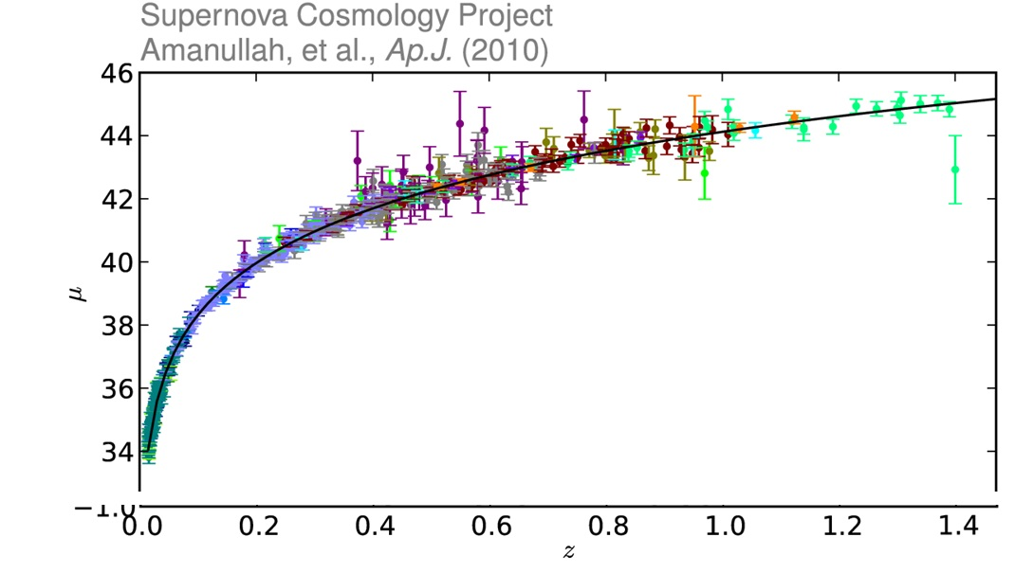
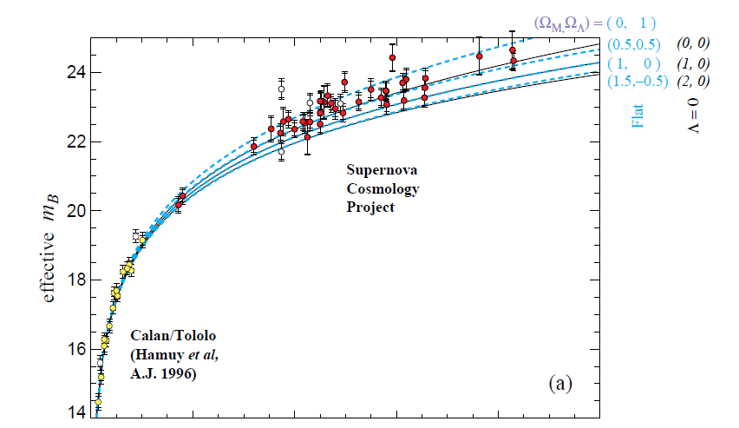
Dark energy
1938 : Fritz Zwicky proposed SN as distance indicator.
1998 : First hint of dark energy (S. Perlmutter & al., A. Riess & al.) using 60 SNIa
In 2010, 10 time more SN confirm dark energy (SCP union 2 sample)
$$Ω_{Λ}≠0 at 2σ$$
$$Ω_{Λ}≠0 at 5.4 σ (no sys)$$

Slide 9
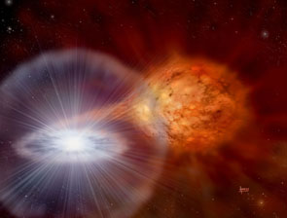
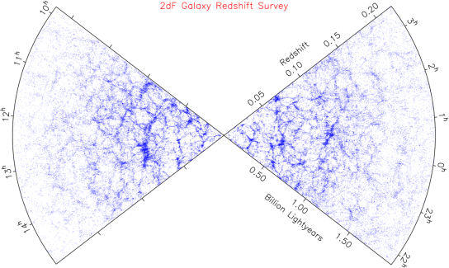
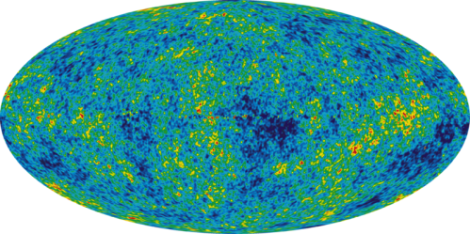
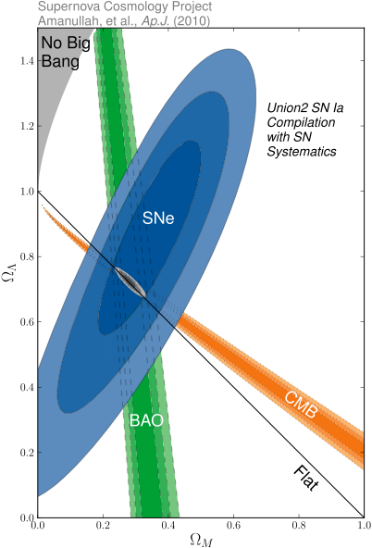
Today status
Three principal probes
Standard candles (SNe Ia)
Large scale structures
(BAO, Weak lensing, Clusters)
CMB
(COBE, WMAP, PLANCK)
Three independent measurements
Cosmological parameters
$Ω_{b}$ baryonic matter density
$Ω_{DM }$dark matter density
ΩΛ dark energy density
$$Ω_{DM}=0.22±0.03$$
$$Ω_{b}=0.046±0.003$$
$$Ω_{Λ}=0.73±0.03$$
9

Slide 10
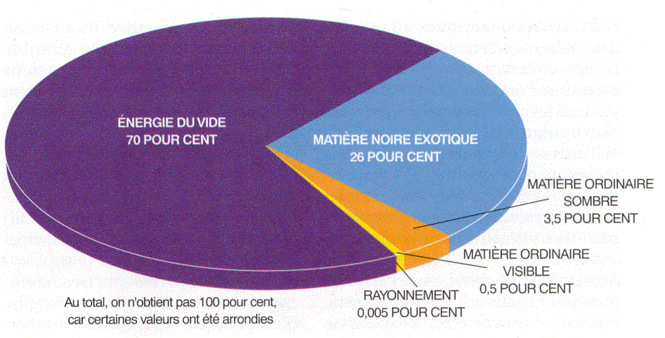
Universe is 95% dark!
Theoretical framework is
Einstein General Relativity

Slide 11
Parallel transport and differential geometry
α
Related to curvature
B
How to transport a vector or a frame in a curve space?
A₁
A₂
A
-Using this procedure on a reference frame and in the limit of a null surface defines the Einstein tensor: which is symmetric in $μν$
-Geometry generates rotation
$$G_{μν}=R_{μν}−1/2{Rg}_{μν}$$

Slide 12
General relativity
Einstein equation relates curvature with energy momentum tensor
$$G_{μν}=8πGT_{μν}$$
As a consequence of symmetric Riemann geometry, the energy momentum tensor is symmetric:
Spin: General relativity can accommodate particle with spin including spin-1/2 using vierbein formalism (all tensors are represented in terms of a chosen basis of 4 independent orthogonal vectors field)
However it can not describe spin-orbite coupling. According to the general equation of conservation of angular momentum the divergence of the spin current is non zero:
$∂_{α}S_{}^{μνα}= T^{μν}−T^{νμ}≠0$
Where $T^{μν}−T^{νμ}$is the torque density = rate of conversion between orbital momentum and spin.
$$T_{μν}={ T}_{νμ}$$
Cartan => Torsion = spin 1/2

Slide 13
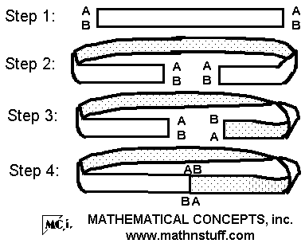
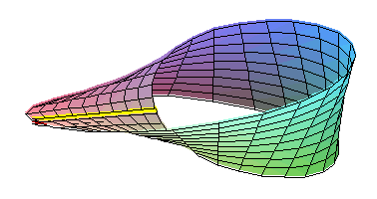
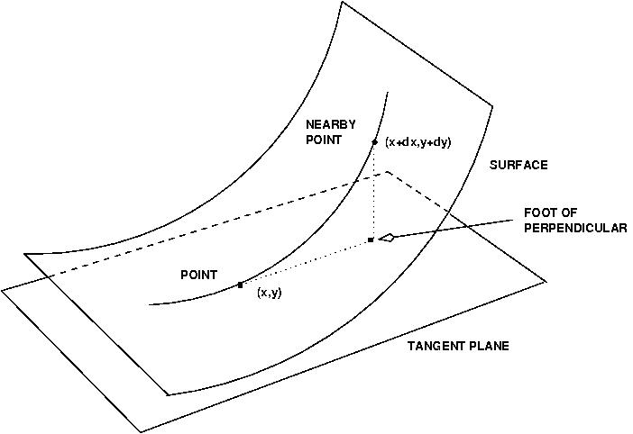
What is torsion? A kind of local Mobius strip
curvature
torsion
$$\overset{⃑}{a′}$$
$$ℵ=\overset{⃑}{\acute{a}.}\overset{⃑}{b}$$
$$\overset{⃑}{b}$$
$$t=−\overset{⃑}{\acute{c}.}\overset{⃑}{b}$$
t
$$\overset{⃑}{c′}$$
$$\overset{⃑}{c}$$
Cartan assumed that local torsion is related to spin ½ particles
$$ℵ$$

Slide 14
Parallel transport with torsion and spin
α
translation
B
A₃
A₁
A₂
A
-In presence of torsion the infinitesimal parallelogram does not close
-Geometry generates translation

Slide 15
Some properties/advantages of torsion
Energy momentum is still the only source of space-time curvature with the Newton’s constant being the coupling constant
The source of torsion is half integer spin with the same coupling constant
Spin 1 particle is not source of torsion: photon not affected
Photon and spin ½ particle (neutrino) geodesics are different
Torsion doesn’t propagate=>torsion vanishes in vacuum!
Theories of unification between gravity and standard model of particle physics need a torsion field (loop quantum gravity)
Supergravity is an Eistein-Cartan theory. Without torsion this theory loses its supersymmetry.
Torsion provides a consistency description of general relativity and particle properties

Slide 16
Einstein-Cartan consistency
${8πGT}_{ab}$
$$=$$
$$G_{ab}$$
Energy-momentum
curvature
Noether theorem
geometry
$$G_{ab}+ ∧g_{ab}=8πGT_{ab}$$
$Σ^{c}e^{d}ε_{abcd}=−8πGS_{ab}$
Translations
rotations
geometry
Noether theorem
Torsion
spin
$$Σ^{c}e^{d}ε_{abcd} =$$
$$−8πGS_{ab}$$
Cartan equation

Slide 17
New Einstein equations
In space time with torsion there are 2 Einstein equations ( in vierbien frame):
Equation for curvature:
Equation for torsion (Σ):
$$G_{ab}={R^{∗}}_{ab}−1/2R^{∗}g_{ab}$$
$G_{ab}+∧g_{ab}=8πGT_{ab}$
R* is the modify Ricci tensor no more symmetric
$$Σ^{c}e^{d}ε_{abcd}=−8πGS_{ab}$$
$S_{ab}$ = spin tensor
In a maximally symmetric Universe the most general energy momentum tensor has two functions of time:
The density : $ρ\left(t\right)$
The pressure : $p\left(t\right)$
The most general spin density
Even parity : $S_{0jk}=−s(t)δ_{jk}$
Odd parity : $S_{ijk}=−\tilde{s}(t)ε_{ijk}$
With equation of state:$p\left(t\right)≔w ρ(t)$
$$s\left(t\right)≔w_{s}ρ\left(t\right)$$
$$\tilde{s}\left(t\right)≔w_{\tilde{s}}ρ(t)$$
With “equations of state”:

Slide 18
Generalized Friedmann equations
In maximally symmetric and flat Universe Friedmann equations have 4 unknown functions of time: a,b,f and ρ.
$$3\frac{b^{2}\left(t\right)−f^{2}(t)}{a^{2}(t)}= Λ+8πGρ\left(t\right)$$
$$2\frac{b^{′}(t)}{a(t)}+\frac{b^{2}\left(t\right)−f^{2}(t)}{a^{2}(t)}= Λ−8πGp\left(t\right)$$
$$3\frac{a^{′}\left(t\right)−b(t)}{a(t)}=8πGw_{s}ρ\left(t\right)$$
$$2\frac{f(t)}{a(t)}=8πGw_{\tilde{s}}ρ(t)$$
Using these expressions today and the dimensionless density $Ω={ρ(t_{0})}/{ρ_{c}}$:
$Ω_{m}=\frac{8πGρ_{0}}{3{H_{0}}^{2}} ;Ω_{Λ}=\frac{Λ}{3{H_{0}}^{2}}$ ; $Ω_{s}=w_{s}H_{0}\frac{8πGρ_{0}}{3{H_{0}}^{2}}$ ; $Ω_{\tilde{s}}=w_{\tilde{s}}H_{0}\frac{8πGρ_{0}}{3{H_{0}}^{2}}$
The Friedmann like closure relation reads:
$$Ω_{m}+Ω_{Λ}+2Ω_{s}−{Ω_{s}}^{2}+\frac{9}{4}{Ω_{\tilde{s}}}^{2}=1$$

Slide 19
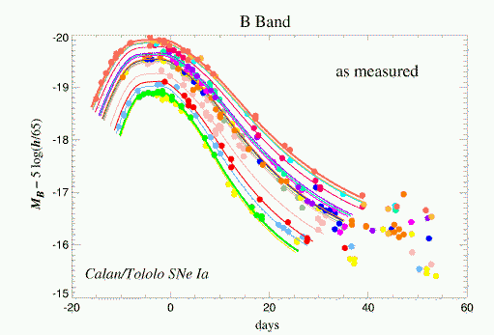
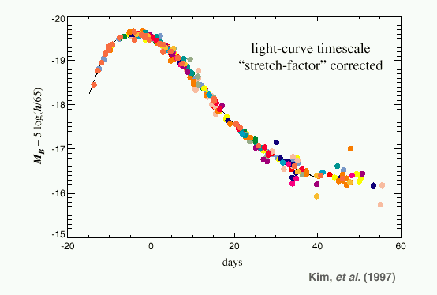
From theory to Supernovae data
Supernovae of type Ia are almost standard candle:
There intrinsic luminosity (L) can be standardized at a level of about 15%
Thus the apparent luminosity can be used as a distance indicator:
$l\left(t\right)= \frac{L}{4π{a_{0}}^{2}{x(t)}^{2}}\frac{{a(t)}^{2}}{a_{0}}$ with $x\left(t\right)= \int_{t}^{t_{0}}{\frac{dt^{′}}{a(t^{′})}}$
And the redshift as a scale factor measurement:
$z=\frac{a_{0}}{a(t)}−1$ = $\frac{λ−λ_{0}}{λ_{0}}$
Because the geodesic equations for photons decouple to torsion, redshift and luminosity have the same expression
->We just need to compute the scale factor

Slide 20
Supernovae and Hubble diagram
We used the so called Union 2 sample containing 557 supernovae up to a redshift of 1.5
$$μ\left(z\right)= m_{s}+2.5log⁡l\left(z\right)$$
Standard cosmology fit gives (flatness):
m_{s} | Ω_{m} | Ω_{Λ}
marginalized | $${{0.27}^{+0.04}}_{−0.04}$$ | $${{0.73}^{+0.04}}_{−0.04}$$

Slide 21
Fitting procedure for SN
We use the full covariance matrix, taking into account systematic errors and correlations to compute $χ^{2}={ΔM}^{T}V^{−1}ΔM$
$V=\left(\begin{matrix}{σ_{1}}^{2} & ⋯ & ρ_{1n}σ_{1}σ_{n} \\ ⋮ & ⋱ & ⋮ \\ ρ_{n1}σ_{n}σ_{1} & ⋯ & {σ_{n}}^{2}\end{matrix}\right)$ and $ΔM= \left[\begin{aligned}μ_{th}\left(z_{1},Ω\right)−μ_{1} \\ ⋮ \\ μ_{th}\left(z_{n},Ω\right)−μ_{n}\end{aligned}\right]$
The best cosmological parameters are computed by minimizing the $χ^{2}$:
Errors and contours are computed by using the frequentist prescription:
$$\frac{∂χ^{2}}{∂Ω_{k}}=0$$
$$χ^{2}\left(Ω_{m}\right)= \min_{Ω_{s},m_{s}⋯}{χ^{2}(Ω_{m},Ω_{s}},m_{s}⋯)+s^{2}$$
Free cosmological parameters are:
$m_{s},Ω_{m},Ω_{s},Ω_{\tilde{s}}$where $Ω_{Λ}$is deduced from Friedman like relation
$$Ω_{m}+Ω_{Λ}+2Ω_{s}−{Ω_{s}}^{2}+\frac{9}{4}{Ω_{\tilde{s}}}^{2}=1$$

Slide 22
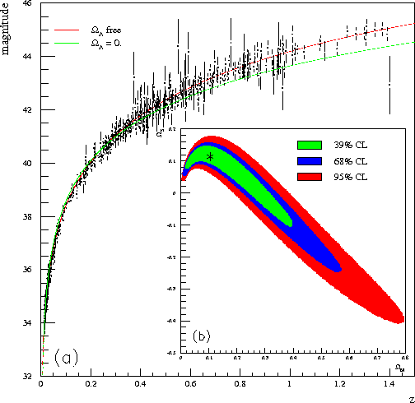
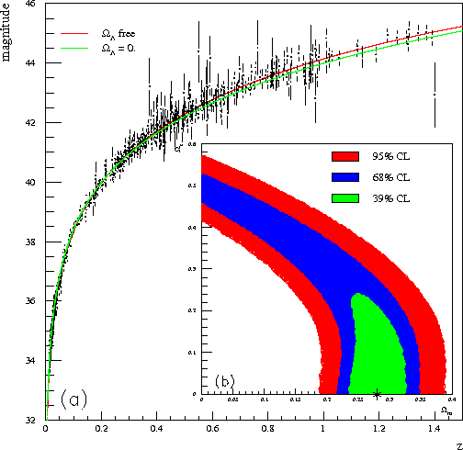
Results on torsion (flat Universe).
Even parity torsion: $Ω_{\tilde{s}}=0$
Odd parity torsion: $Ω_{s}=0$
Ω_{m} | Ω_{Λ} | $$Ω_{s}$$
$${{0.09}^{+0.30}}_{−0.07}$$ | $${{0.83}^{+0.10}}_{−0.16}$$ | $${{0.04}^{+0.01}}_{−0.07}$$
Ω_{m} | Ω_{Λ} | $$Ω_{\tilde{s}}$$
$${{0.27}^{+0.03}}_{−0.02}$$ | $${{0.73}^{+0.04}}_{−0.11}$$ | $${{0.0}^{+0.22}}_{−0.22}$$
Ω_{m} | Ω_{Λ} | $$Ω_{s}$$ | $$Ω_{\tilde{s}}$$
$${{0.08}^{+0.27}}_{−0.08}$$ | $${{0.85}^{+0.10}}_{−0.15}$$ | $${{0.04}^{+0.02}}_{−0.06}$$ | $${{0.0}^{+0.1}}_{−0.1}$$

Slide 23
Could torsion replace dark matter?
Even parity torsion gives a prefer value for matter density equal to 0.09
$$Ω_{m}={{0.09}^{+0.30}}_{−0.07}$$
The WMAP last results are:
$Ω_{b}=0.046±0.003$ and $Ω_{m}=0.27±$ 0.03
Supernovae results analyzed with torsion give a result statistically compatible with both dark matter and baryonic matter.
However, torsion can contribute to a certain amount of dark matter.
Or better to say that torsion without dark matter is not incompatible with Supernovae data.
More data or probes should be used to definitely conclude

Slide 24
Could torsion replace dark energy?
We test the hypothesis of a null cosmological constant by using the log likelihood ratio technic: Assume we want to test 2 different models:
${\left\{m_{s},Ω_{s},Ω_{Λ}=0\right\}→\left\{m_{s},Ω_{s},Ω_{Λ}\right\}}_{}$
We can define the log likelihood ratio as:
$$R=−2Ln\frac{Max\left(ℒ\left(m_{s},Ω_{s},Ω_{Λ}=0\right)\right)}{Max\left(ℒ\left(m_{s},Ω_{s},Ω_{Λ}\right)\right)} where ℒ=\frac{1}{{\left(2π\right)}^{\left(n/2\right)}{\left|V\right|}^{1/2}}e^{−χ^{2}/2}$$
$$R={χ^{2}}_{min,1}−{χ^{2}}_{min,2}$$
The probability distribution of this variable is approximately a $χ^{2}$ distribution with a number of degree of freedom equal to the difference of ndof’s = 1
For even parity : $Δχ^{2}=44.6→p_{value} ≅0. →rulled out$
For odd parity : $Δχ^{2}=30.3→p_{value}=6 {10}^{−8}→rulled out at 5.4 sigma$
This is not surprising because equation of state: $s\left(t\right)≔w_{s}ρ\left(t\right)$
If acceleration today, then acceleration in the past: s$\left(t\right)↗$ with $ρ(t)$
In contradiction with previous publication (S. Capozziello et al. 2003)

Slide 25
Summary and further work
Standard general relativity should be extended to account for spin-orbital momentum coupling: Einstein-Cartan theory.
If we apply torsion to cosmology we find:
Torsion can contribute to dark matter at a certain amount
Torsion as a source of dark energy is ruled out at more than 5 sigma
However these results are encouraging enough to go further
Look at galaxies rotation curves: Need to generalize the Schwarzschild’s equation. Work in progress.
Use other probes:
CMB/BAO/WL/Clusters: photons are not sensitive to torsion, but dynamic is different(perturbation), so everything should be recomputed. ☹
But we found a spin energy density $Ω_{s}$ of about 4% , corresponding to a state parameter $w_{s}\sim 1/H_{0}\sim {10}^{17}s$ which is 42 orders of magnitude away from the naïve value $w_{s}\sim \frac{ℏ}{m_{p}c^{2}}\sim {10}^{−25}s !$
Usual problem in cosmology i.e : Λ and vacuum energy!

Slide 26
Questions?
1) Torsion and curvature ?
2) Torsion and large scale structures
3) Torsion and galaxies rotation curves:

Slide 27
Torsion and Galaxies rotation curves
Y. Yang1 and W.B. Yeung : arXiv:111.7062v1:
Using a quadratic gravitational Lagrangian with torsion:

Slide 28
Torsion and curvature
In the general case, assuming no special equation of state: $s\left(t\right) and \tilde{s}\left(t\right)$ are free functions of time:
$$\frac{\ddot{a}}{a}=−\frac{4πG}{3}\left(ρ+3p\right)+\frac{8πG}{3}\left(\dot{s}\left(t\right)+\frac{\dot{a}\left(t\right)}{a\left(t\right)}s(t)\right)$$
Torsion is not source of gravity:
Odd parity torsion doesn’t couple to dynamic (i.e curvature)
Even parity torsion couple to curvature through kinematic not dynamic
(1)

Slide 29
Experimental possible measurements
Because geodesics are different for photons and spin ½ particles (neutrino)
Timing difference between photons and neutrinos in supernovae explosion
1987A Supernovae
Neutrino oscillation experiment OPERA. Time delay and supra luminal neutrino
Rotation curve of galaxies or the modify Schwartsfield solution
What is the effect of torsion on rotation curve of galaxy
Galaxies and cluster formation
The cosmological probes:
Supernovae 1a
CMB: effect of torsion in initial plasma (very high matter density)
Weak lensing should not be affected
Lensing is gravitational coupling between curvature and photon
Baryonic acoustic oscillation
Depends on the initial power spectrum

Slide 30
Parallel transport and Riemann tensor
As is in FT the change of vector $V^{σ}$ during parallel transport is proportional to the vector $V^{σ}$and the displacement $dx_{μ}$:
$$ΔV^{σ}= {{−Γ}_{μν}}^{σ}V^{ν}dx^{μ}$$
Where ${Γ_{μν}}^{σ}$ is the affine connection (Christoffel symbols).
The covariant derivative reads:
$∇_{μ}V^{σ}=∂_{μ}V^{σ}+{Γ_{μν}}^{σ}V^{ν}$
And can be compare to QED:
$D_{μ}φ= ∂_{μ}φ$+$ieA_{μ}φ$
And the curvature tensor (Riemann) is defined as the change of vector $V^{ν}$ parallel transported around a closed path $ξ^{μ} :$
$$ΔV^{σ}=\frac{1}{2}V^{ν}{R_{βμν}}^{σ}\oint{ξ^{μ}dx^{β}}$$

Slide 31
Torsion definition
$$ζ^{α}−{Γ_{μν}}^{α}χ^{μ}ζ^{ν}$$
$B^{α}=χ^{α}+(ζ^{α}−{Γ_{μν}}^{α}χ^{μ}ζ^{ν}$)
$$χ^{α}−{Γ_{μν}}^{α}ζ^{μ}χ^{ν}$$
$$χ^{α}$$
${{A^{α}=ζ}^{α}+(χ}^{α}−{Γ_{μν}}^{α}ζ^{μ}χ^{ν}$)
$$ζ^{α}$$
Then the difference $C^{α}=A^{α}−B^{α}$ is:
$C^{α}=2{S_{μν}}^{α}ζ^{μ}χ^{ν}$ with ${ S_{μν}}^{α}={Γ_{[μν]}}^{α}=\frac{1}{2}\left({Γ_{μν}}^{α}−{Γ_{νμ}}^{α}\right)$
Where ${ S_{μν}}^{α}$ is defined as the torsion tensor

Slide 32
What’s the meaning of these new equations of state?
$$s\left(t\right)≔w_{s}ρ\left(t\right)$$
$$\tilde{s}\left(t\right)≔w_{\tilde{s}}ρ(t)$$
$ρ\left(t\right)$ = any spin ½ matter density with null pressure
$s\left(t\right)$ = spin density considered as a perfect fluid!
$w_{s}$ has a dimension of time and is assumed to be constant
All physics are inside w_{s}:
Source of torsion is spin ½ particle
Orbital momentum or spin 1 are not source of torsion.
No spin orbital momentum coupling. Spin generates local torsion.
It contains the Planck constant and GR and QM coupling. Expected to be small.
We assume it is not zero even though we don’t know how spins average?
………

Slide 33
Solving the Friedmann equation
$$3\frac{b^{2}\left(t\right)−f^{2}(t)}{a^{2}(t)}= Λ+8πGρ\left(t\right)$$
$$2\frac{b^{′}(t)}{a(t)}+\frac{b^{2}\left(t\right)−f^{2}(t)}{a^{2}(t)}= Λ$$
$$3\frac{a^{′}\left(t\right)−b(t)}{a(t)}=8πGw_{s}ρ\left(t\right)$$
$$2\frac{f(t)}{a(t)}=8πGw_{\tilde{s}}ρ(t)$$
We eliminate f(t) and ρ(t)
We are left with 2 first order differential equations and 2 unknown functions a(t) and b(t)
a(t)
We solve it numerically with the Runge-Kutta algorithm.
This is an iterative numerical algorithm
Example:
a’(t) = 2 a(t)
Start from an initial value a(t₀)=a₀
Compute the derivative a’(t₀)=2 a₀
Predict the new point at t₀+δt using Tailor expansion : a(t₁ = t₀+δt) = a₀+2a₀ δt +…..= a₁
5. Start from this new value a(t₁)=a₁ and iterate
a₁
a₀
t₀
t
t₁=t₀+δt
We used a forth order Runge-Kutta algorithm with an adaptive step in time such that the corresponding step in redshift is much smaller than the experimental redshift error (10⁻⁵)

Slide 34
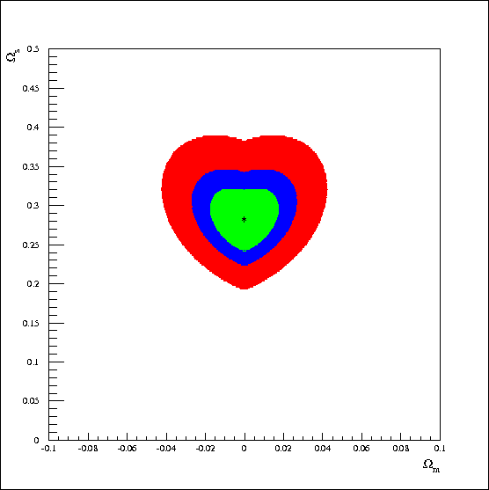
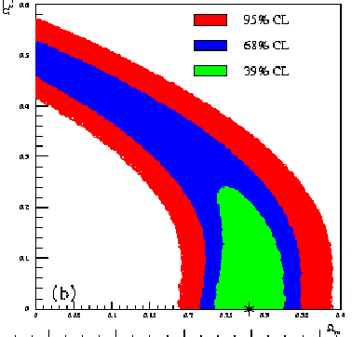
Capozziello et al(2003): Matching torsion lamba-term with observations.
In this paper they assume the same Friedmann equations for the torsion fluid
$$\frac{\ddot{a}}{a}=−\frac{4πG}{3}\left(\tilde{ρ}+3\tilde{p}\right)$$
$${\left(\frac{\dot{a}}{a}\right)}^{2}=\frac{8πG}{3}\tilde{ρ}$$
with
$$\tilde{ρ}=ρ+f^{2} and \tilde{p}=p−f^{2}$$
3
The missing factor 3 implies torsion is source of curvature and a constant “f” function with time which can be interpreted as a cosmological constant.
At beginning I made the same kind of mistake and I got ☺
Unfortunately it’s wrong!

Slide 35
Torsion and large scale structures
Torsion is not source of curvature. Is standard gravity modify?
In the most general case:
Even parity : $S_{0jk}=−s(t)δ_{jk}$
Odd parity : $S_{ijk}=−\tilde{s}(t)ε_{ijk}$
$$3\frac{b^{2}−f^{2}}{a^{2}}= Λ+8πGρ$$
$$2\frac{b^{′}}{a}+\frac{b^{2}−f^{2}}{a^{2}}= Λ−8πGp$$
$$3\frac{a^{′}−b}{a}=8πGs\left(t\right)$$
$$2\frac{f}{a}=8πG\tilde{s}(t)$$
$$\frac{\dot{b}}{a}=\frac{1}{3}\left(Λ−4πG\left(ρ+3p\right)\right)$$
$$\frac{\dot{b}}{a}=\frac{\ddot{a}}{a}−\frac{8πG}{3}\left(\dot{s(t)}+\frac{\dot{a}}{a}s(t)\right)$$
$$\frac{\ddot{a}}{a}=\frac{1}{3}\left(Λ−4πG\left(ρ+3p\right)\right)+\frac{8πG}{3}\left(\dot{s}\left(t\right)+\frac{\dot{a}}{a}s(t)\right)$$
Assuming $s\left(t\right)=w_{s}a^{−α}$
$$\left(1−α\right)w_{s}\frac{\dot{a}}{a^{α+1}}$$
Acceleration if $α<1$
Deceleration if $α>1$
(3)

Slide 36
Dynamic equation
In general case where s(t) and $\tilde{s}\left(t\right)$ are functions of time we have:
$$\frac{\ddot{a}}{a}=\frac{1}{3}\left(Λ−4πG\left(ρ+3p\right)\right)+\frac{8πG}{3}\left(\dot{s}\left(t\right)+\frac{\dot{a}}{a}s(t)\right)$$
Odd parity torsion $\tilde{s}(t)$ doesn’t modify dynamic (Einstein curvature)
If $Λ=0$and s(t):=0 , ${\ddot{a}}/a<0$ always
Even parity torsion s(t) couple to gravity
In case of constant torsion with time s(t) = $w_{s}$
$$\frac{\ddot{a}}{a}=\frac{1}{3}\left(Λ−4πG\left(ρ+3p\right)\right)+\frac{8πG}{3}\left(\frac{\dot{a}}{a}w_{s}\right)$$
In that case $ρ(t)\sim 1/{a^{2.75}}$ for odd parity, $ρ\left(t\right)\sim 1/{a^{2.25}}$ for even parity
In an empty universe:
$$\frac{\ddot{a}}{a}=\frac{8πG}{3}\left(\frac{\dot{a}}{a}w_{s}\right)$$
Torsion generate inflation !

Slide 37
Einstein-Hilbert action
The Hilbert action yields the Einstein equation through the principle of least action:
$$S=−\frac{1}{2κ}\int{R\sqrt{−g}d^{4}x}$$
R the Ricci scalar
$$g=det\left(g_{μν}\right)$$
$$κ=8πGc^{−4}$$
with
In presence of matter the action becomes:
$$S=\int{\left[\frac{1}{2κ}R+ℒ_{M}\right]\sqrt{−g}d^{4}x}$$
The action principle $δS=0$leads to:
$$δS=\int{\left[\frac{1}{2κ}\frac{δ\left(\sqrt{−g}R\right)}{δg_{μν}}+\frac{δ\left(\sqrt{−g}ℒ_{M}\right)}{δg^{μν}}\right]δg^{μν}d^{4}x}$$
$$δS=\int{\left[\frac{1}{2κ}\left(\frac{δR}{δg_{μν}}+\frac{R}{\sqrt{−g}}\frac{δ\left(\sqrt{−g}\right)}{δg^{μν}}\right)+\frac{1}{\sqrt{−g}}\frac{δ\left(\sqrt{−g}ℒ_{M}\right)}{δg^{μν}}\right]δg^{μν}\sqrt{−g}d^{4}x}$$

Slide 38
Einstein Equation
Since the previous equation should hold for any $δg^{μν}$
$$\frac{δR}{δg^{μν}}+\frac{R}{\sqrt{−g}}\frac{δ\sqrt{−g}}{δg^{μν}}=−2κ\frac{1}{\sqrt{−g}}\frac{δ\left(\sqrt{−g}ℒ_{M}\right)}{δg^{μν}}$$
$$\frac{δR}{δg^{μν}}=R_{μν}$$
$$\frac{1}{\sqrt{−g}}\frac{δ\sqrt{−g}}{δg^{μν}}=−\frac{1}{2}g_{μν}$$
$$T_{μν}≔\frac{−2}{\sqrt{−g}}\frac{δ\left(\sqrt{−g}ℒ_{M}\right)}{δg^{μν}}=−2\frac{δℒ_{M}}{δg^{μν}}+g_{μν}ℒ_{M}$$
$$R_{μν}−\frac{1}{2}g_{μν}R=\frac{8πG}{c^{4}}T_{μν}$$
The cosmological constant is introduced in the Lagrangian:
$$S=\int{\left[\frac{1}{2κ}\left(R−2Λ\right)+ℒ_{M}\right]\sqrt{−g}d^{4}x}$$
$$R_{μν}−\frac{1}{2}g_{μν}R+{Λg}_{μν}=\frac{8πG}{c^{4}}T_{μν}$$

Slide 39
How acceleration occurs
Assuming a maximally symmetric Universe and no equation of state for torsion: Even parity : $S_{0jk}=−s(t)δ_{jk}$
Odd parity : $S_{ijk}=−\tilde{s}(t)ε_{ijk}$
$$+\frac{Λ}{3}$$
Cosmological constant
$$\frac{\ddot{a}}{a}=−\frac{4πG}{3}\left(ρ+3p\right)$$
$$+\frac{8πG}{3}\left(\dot{s}\left(t\right)+\frac{\dot{a}}{a}s(t)\right)$$
Even parity torsion
$$0.$$
Odd parity torsion

Slide 40
Possible detections
Many possible effect depending on which kind of torsion:
Propagating or not
Angular momentum source of torsion
Effect of coupling between background torsion and spin ½ particle:
Neutrino oscillations.
Solar neutrino problem: helicity flip inside sun : $ν_{L}→ν_{R}$ (p<10⁻⁷)
Spin precession of fermion
Speed oscillations
Accelerating motion of spinning particles
Rotating object (gamma ray burst, neutron star etc…)
Cosmological effect

