Slide 1
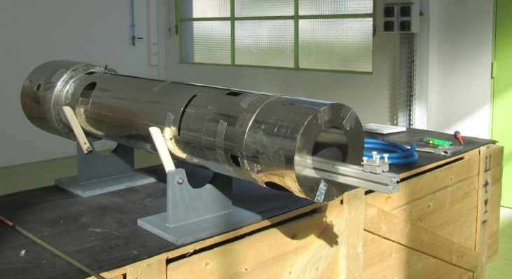
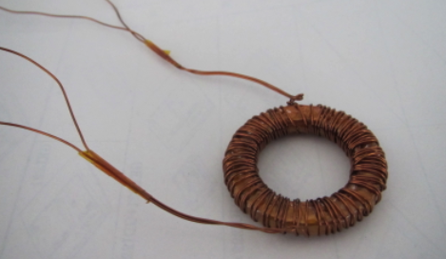
Study on the magnetic shielding for superconducting cavities
A RD 07
Juliette Plouin, Olivier Napoly, Claire Antoine, Antoine Daël (CEA)
Mika Masuzawa, Kiyosumi Tsuchiya (KEK)

Slide 2
Contents
Introduction
Permeability measurement
At room temperature, liquid nitrogen and helium temperatures
Effects of heat treatments
Dependence on cooling rate
Effects of strain
Magnetic shields measurements
Summary
Proposal for 2012

Slide 3
Introduction
Magnetic shielding is a key technology for superconducting RF cavities.
The acceptable level of ambient magnetic field depends on factors such as operating RF frequency and acceleration gradient, but it can be as low as a few mG.
Shielding of the earth magnetic field (~500mG).

Slide 4
High permeability materials at cryogenic temperatures are needed
Some high Ni-content alloys, such as Cryoperm or Cryophy, which are claimed to maintain high permeability at cryogenic temperatures, are used for magnetic shielding of superconducting cavities at many laboratories.
In order to achieve a low ambient magnetic field in cavities at cryogenic temperatures, the following considerations are important:
1) Choosing good shielding material for cryogenic use, for which characterization of the shielding effect is necessary.
2) Minimizing degradation during shield assembly, for which it is necessary to understand the causes of degradation in shielding effects.

Slide 5
Contents
Introduction
Permeability measurement
At room temperature, liquid nitrogen and helium temperatures
Effects of heat treatments
Dependence on cooling rate
Effects of strain
Magnetic shields measurement
Summary

Slide 6
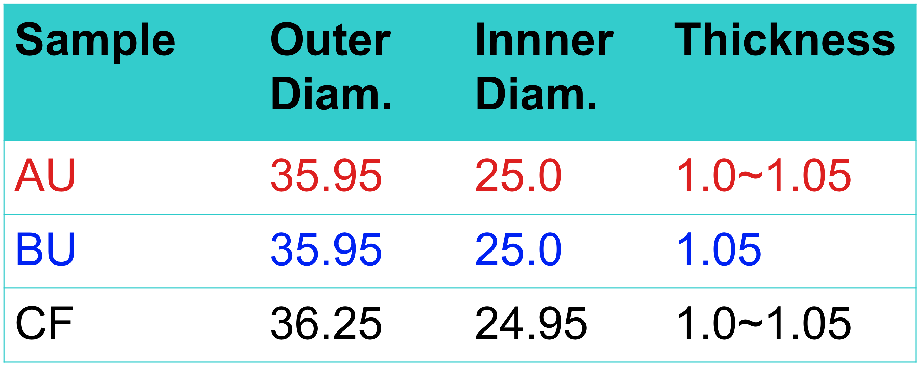
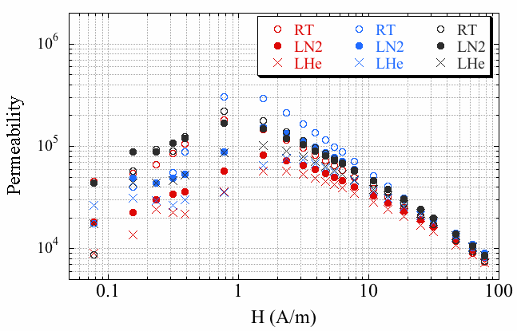
Permeability measurement: the catalog data are the champion data!
Characterization of the shielding effect
We have been measuring various samples of shielding materials. Plotted are the results of some of the shielding materials “AU”, “BU” and “CF” measured at various temperatures.
Permeability of sample rings made of high Ni-content alloys (claimed to maintain a high permeability at cryogenic temperatures) is measured.
CF gives the highest μ_{max}. AU and CF are made of the same high-Ni alloy.
AU & BU are prepared by one manufacturer while CF is by another.

Slide 7
Permeability
The magnetic shielding effects of these materials are being evaluated.
The CEA/Saclay team has set up a system to measure the permeability of samples
Room temperature results from CEA are being compared with KEK results.
Both sets (KEK & Saclay) of results were consistent.
We have continued our investigation of the permeabilities of various materials, by exchanging communication.
Lessons we learned: Do not assume that you always get the catalog performance.

Slide 8
Contents
Introduction
Permeability measurement
At room temperature, liquid nitrogen and helium temperatures
Effects of heat treatments
Dependence on cooling rate
Effects of strain
Magnetic shields measurement
Summary

Slide 9
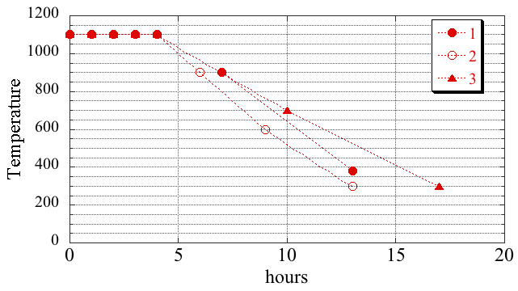
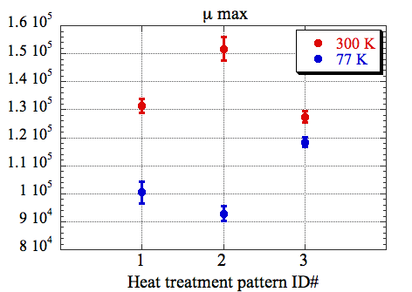
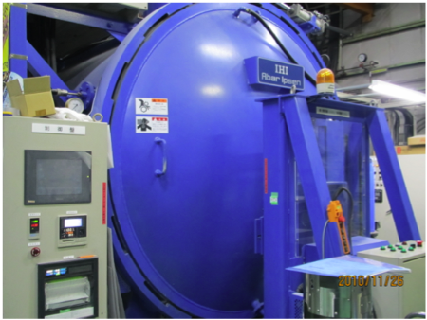
Effects of heat-treatment, using “CF”
Characterization of the shielding effect
Heat treatment pattern 3(▲) resulted in the highest permeability at liquid nitrogen temperature, ~20% higher than the other patterns.
Oven used for the heat-treatment pattern test

Slide 10
Contents
Introduction
Permeability measurement
At room temperature, liquid nitrogen and helium temperatures
Effects of heat treatments
Dependence on cooling rate
Effects of strain
Magnetic shields measurement
Summary

Slide 11
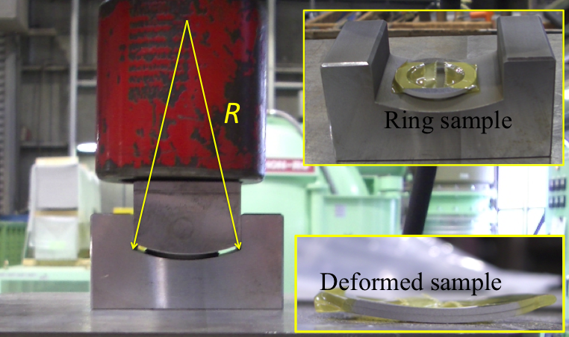
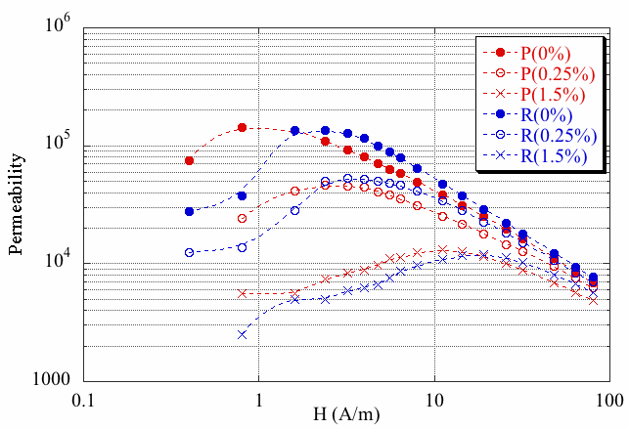
Effects of mechanical strain
Causes of degradation
Permeability of two types of materials P and R measured at the room temperature.
The degree of strain is evaluated by parameter ε, defined as ε=e/2R, where e and R are the thickness of the sample and the radius of the curvature of the template blocks, respectively.
Significant decrease in permeability due to deformation

Slide 12
Contents
Introduction
Permeability measurement
At room temperature, liquid nitrogen and helium temperatures
Effects of heat treatments
Dependence on cooling rate
Effects of strain
Magnetic shields measurement
Summary

Slide 13
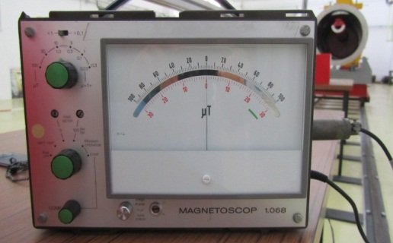
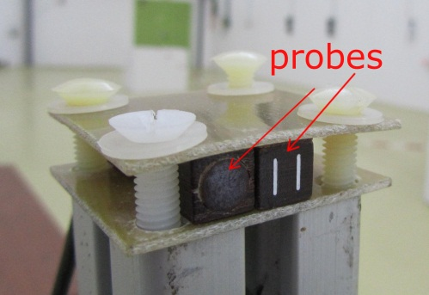
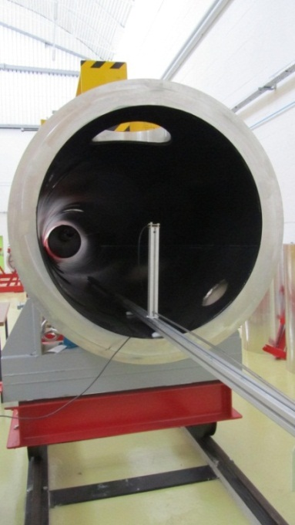
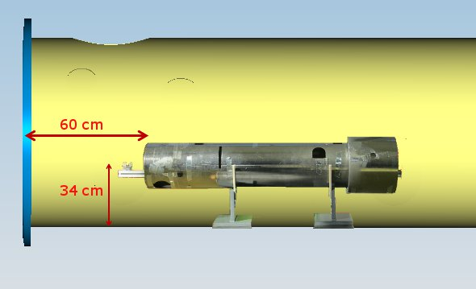
Magnetic shield measurements @ Saclay
B field measurement with a Gaussmeter
Measurements performed at room temperature
In free air
Inside a XFEL vacuum vessel (w/o shield)
Inside two different shields (w/o vessel)
Cryoperm
Cryophy
Inside a shield placed inside the vessel

Slide 14
Magnetic field meas.@Saclay : comparison Cryophy/Cryoperm
Picture is at scale
Both materials give nearly the same results :
⇨same shielding efficiency, Bext/Bint ~25, at room temperature

Slide 15
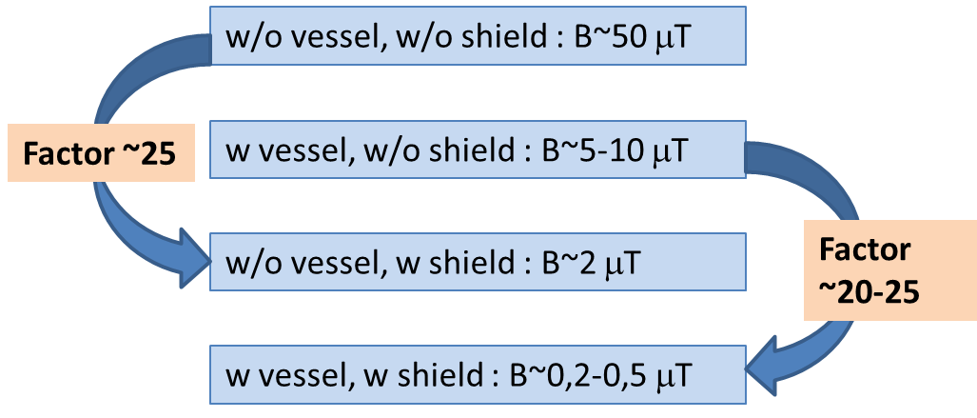
Magnetic field meas.@Saclay : results summary
Shielding efficiency (Bext/Bint)
B is reduced to ~ 2μT with shield alone
B is reduced to less than 0,5 μT with shield and module
Total shielding efficiency (module+magnetic shield) is more than 100

Slide 16
Summary
Permeability measurements of various Ni-content alloys materials
Permeability depends on material and manufacturer
Permeability decreases at cryogenic temperature
Effects of the heat-treatment and mechanical strain
Cooling rate is important.
Significant decrease in permeability due to deformation is observed.
Choosing proper shielding material is necessary though not sufficient.
It is important to understand the conditions needed to reproduce the “good” permeabilities, especially in the case of a large-scale production.
Development of the reliable shielding technology for large scale superconducting cavity systems is needed.

Slide 17
Proposal for 2012
In order to develop a reliable shielding technology for large scale SC cavity systems, we propose to continue the following items:
Development of a procedure to evaluate the permeability of various shielding materials.
Permeability measurements of various samples at various temperatures
→Contribution to a shielding material database
Investigation of possible causes for the performance degradation at cryogenic temperature.
And develop:
A method to evaluate and avoid any unwanted mechanical stress added after the annealing (transportation, assembly...)
A quality control method, suitable for use in mass production.

