Slide 1
A_RD_01 Applications of a high finesse Fabry Perot Cavity for the ILC
Tohru Takahashi
Hiroshima University
for
French Labs. : LAL (Orsay) in Collaboration with CELIA (Laser lab., Bordeaux) and LMA (mirror coatings Lab., Lyon)
Japanese Labs. : KEK, ATF group, Hiroshima University
Introduction
Status of the cavity R&D
at ATF
at LAL/Orsay
28 May 2012
TYL workshop

Slide 2
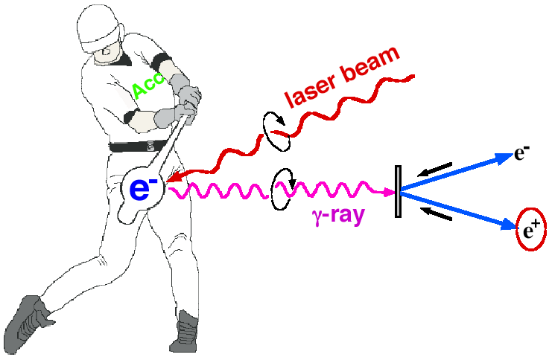
Introduction
Polarized e+ by laser Compton Scheme
Omori
Ee~1GeV for 10MeV gammas
easy to control polarization
Toward the positron sources
-> increase intensity of gamma rays

Slide 3
Miyoshi PosiPol2010
L_{cav}
λ
dL∝λ/enhancement ~0.01nm
for enhancement ~1000

Slide 4
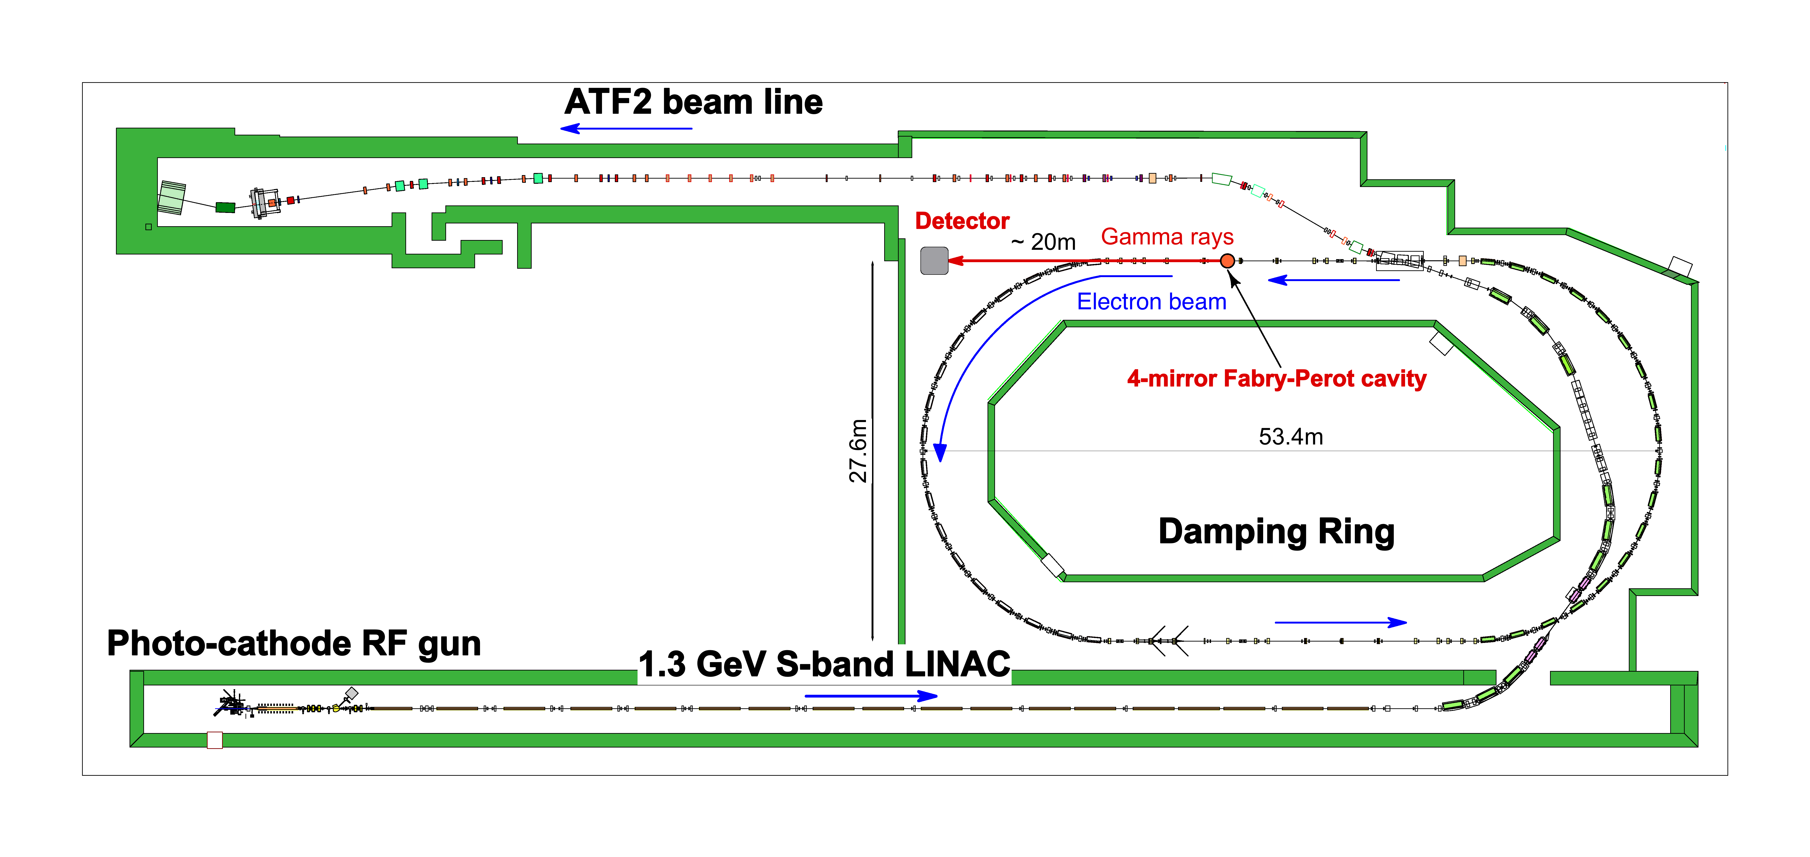
Experiments at the KEK ATF
γs
Cavity
1.3GeV
up to 10 bunches/train

Slide 5
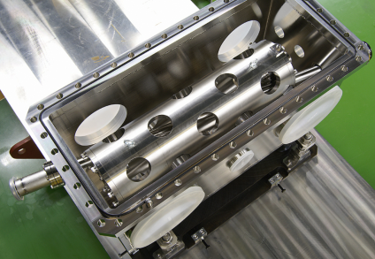
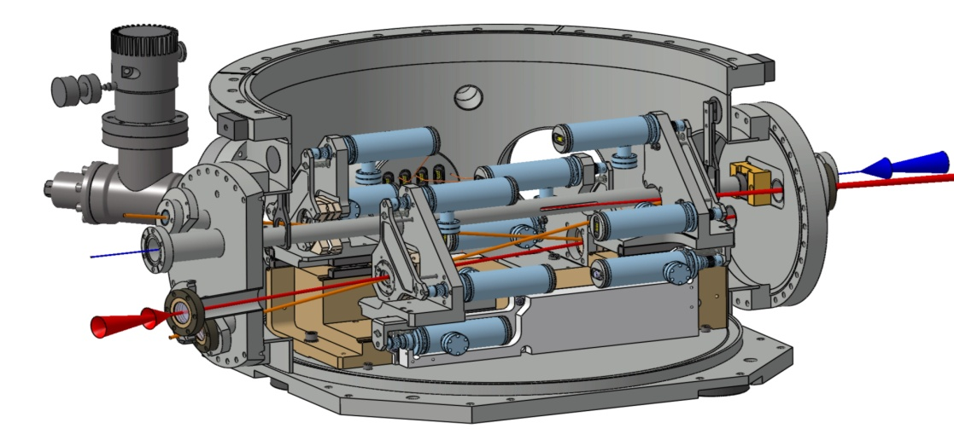
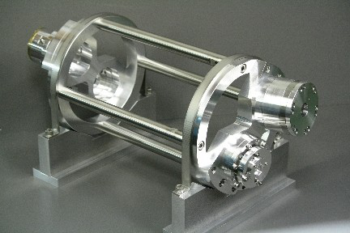
Brief History
2007 2 Mirror cavities installed
2.5kW γ rays generated
2010 French 4 Mirror cavity installed
γ rays confirmed
2011 earthquake
No major damage to our equipment.
beam back in June 2011
2011 KEK-Hiroshima 4 mirror cavity installed
γ rays confirmed
Reported FJPPL2010 Annecy

Slide 6
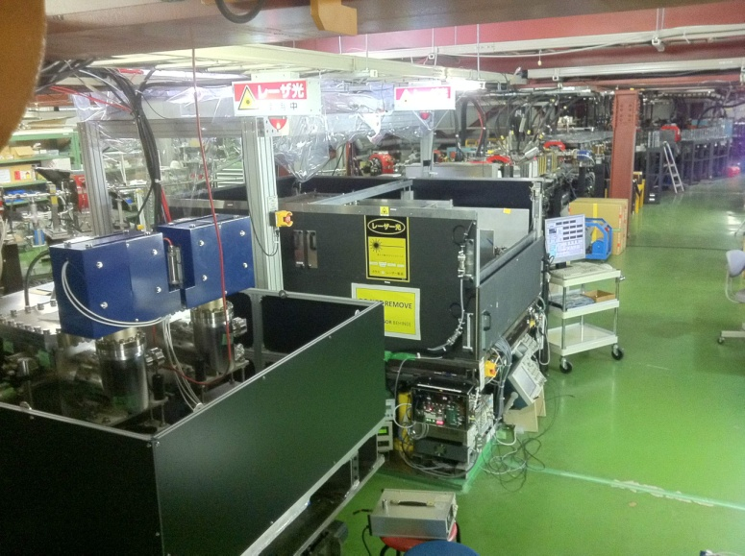
Two 4 mirror cavities are at the ATF
KEK-Hiroshima
installed 2011
LAL-Orsay
installed summer 2010

Slide 7
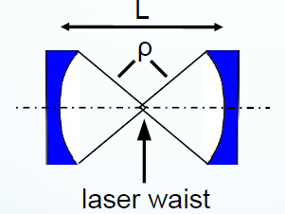
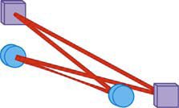
We should go to 3D 4 mirror ring cavity to get small sport size
α
2D 4M has astigmatism
2 mirror cavity is not stable
for small waist size
3D (or twisted)
4M ring cavity

Slide 8
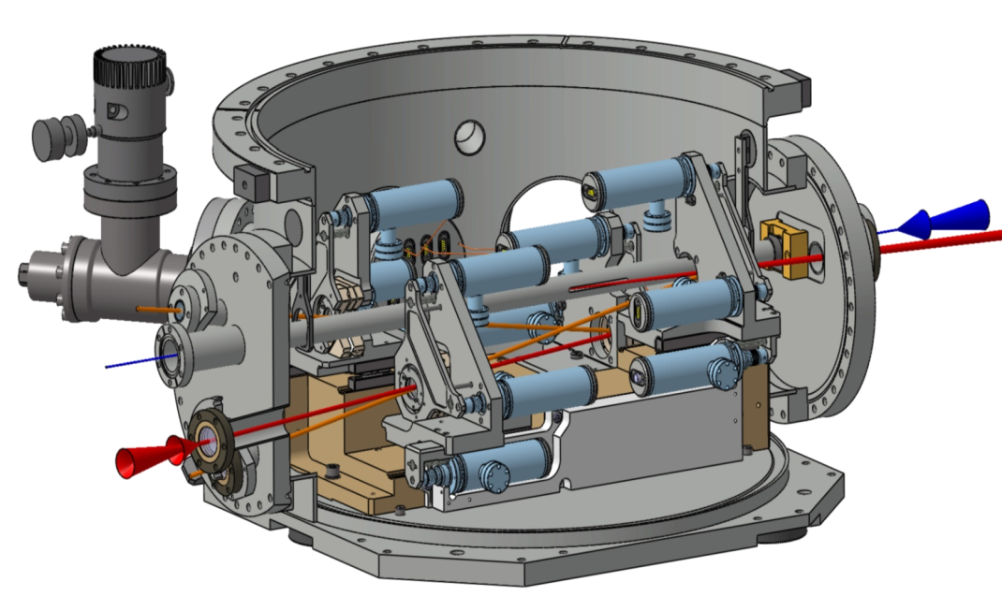
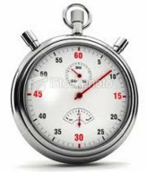
LAL cavity
IP
4-mirror
cavity chamber
Electrons
Finesse = 3,000
∅ 1m
2 plan mirrors
2 spherical mirrors
Laser
~1000 enhancement
a few 10s of kW so far
FIBRE AMPLIFIER
F=3,000
LASER
CAVITY
250mW
PZT
PUMP
PZT
Loop 1
Loop 2
LASER CLK
100W
locked to
locked to
178.5 MHz
PDH
LASER Feedback (PDH)
PDH
technique
PLL + Φ
ATF CLK
CAVITY Feedback (PLL + Φ)
178.5 MHz
Laser
4M Cavity
ATF beam
DIGITAL SYSTEM @100MHz
178.5MHz
178.5MHz
357/2 MHz
Overall Diagram
Locking Loops

Slide 9
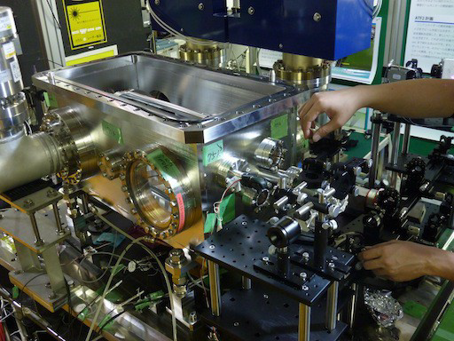
KEK Hiroshima cavity
optical res. cavity
PID
reso. mon
simple
moderate enhancement
new control scheme
phase mon.
PID
e- timing
laser
timing cont.
resonance cont.

Slide 10
Cavity length feedback with 3D feature (KEK-Hiroshima)
3D4M cavity resonates only with
circularly polarized lasers
differential signal
for feedback
+
=
power enhancement 1900
2kW(latest record)
accumulated in the cavity
w/ timing jitter 4ps

Slide 11
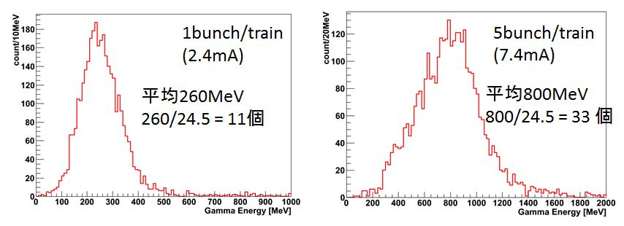
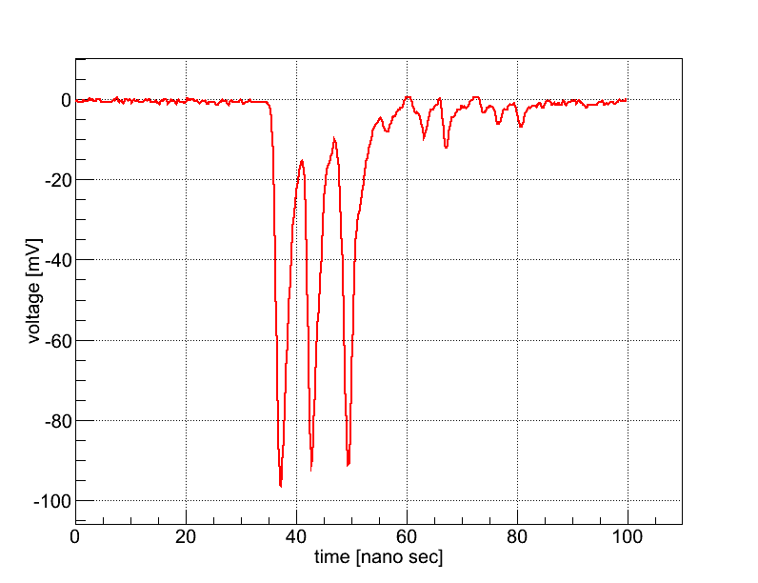
γ ray data KEK-Hiroshima
1900 enhancement
1.6kW in the cavity
laser
e
laser
e
mean
wave form
3 bunches/train
γ yields
0
20
40
60
80
Gamma ray Energy(MeV)
time (ns)

Slide 12
Status and future plan of LAL cavity
ATF SUMMER SHUTDOWN
APRIL
MAY
JUNE
JULY
AUG
SEPT
OCT
NOV
DEC
We use a 4M cavity (prototype) in Orsay
with F=30000 Silica mirrors
We install
the new setup
in ATF
+ we change the mirrors
1st run 10/15
We test the new setup Laser+Fibre Amp. in Orsay
Mightylaser
Setup
in Standby mode
We use the DAQ taken from the DR
Compton γ “ready”
Silica Mirror Finesse 30000
Aim : obtain a full setup, with feedback / Laser / Fibre Amplifier / Mirror Finesse 30,000
High power with
new Fibre Amplifier
New laser
CELIA : New Fibre Amplifier and pump diode
MENLO :
New Laser
FIBRE AMPLIFIER
F=30,000
Silica Mirror Finesse 30,000
over 10W injection
10,000 enhancement
LASER
CAVITY
20mW
PZT
PUMP
PZT
LASER CLK
PDH
178.5 MHz
LASER Feedback (PDH)
ATF CLK
more than 100kW expected
CAVITY Feedback (PLL + Φ)
178.5 MHz
DIGITAL SYSTEM @100MHz

Slide 13
Status and plan of KEK-Hiroshima cavity
2.1KW stored as of 25 May 2012
30 γs / bunch -> 150 γs /train at 5 bunches/train
complete multi-bunch data by June
Plan
Detector: to be replaced w/ a Leas Glass counter
used in TOPAZ barrel cal. at TRISTAN!
digital feedback (developed at Hiroshima)
more power enhancement
16,000 enhancement ? (finesse 48,000)

Slide 14
Summary
Optical Cavity at the ATF is in progress for Polarized positron source for the ILC
Good collaboration between France – Japan team
information / technology exchange
R&D of 4 mirror ring cavities are in progress
Sophisticated mechanism aiming very high laser power enhancement ,,, French team
Relatively simple but new cavity control practical experience w/ the ATF ,,, Japanese team
More to come
more laser power, more γ rays
intensity getting close to usable photon sources

Slide 15
supplementals

Slide 16
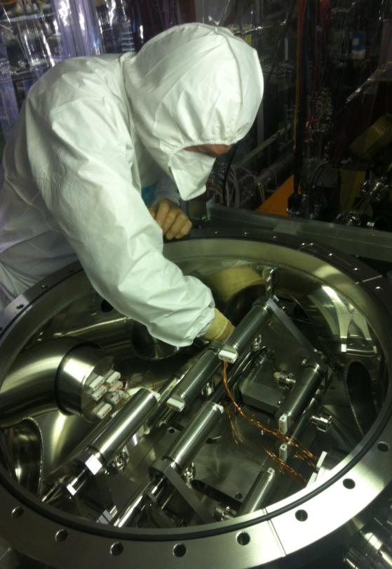
2. Brief history (including a little bit on recovery from the earthquake)
3. Activities since last TYL workshop (last year)
07
July /August : setup installation in ATF Damping Ring
08
Oct. 25th : 1st production of Compton γ
Mirrors Finesse 3000
Single bunch /
Single Train
Pcav = 1700W
CsI detector
2
0
1
0
09
Nov. 1st : Laser Failure, sent back to Europe for repair
10
Dec. 8th : Compton γ
11
Dec. 20th : Laser sent back to Europe for improvements
12
01
Feb. 05 to 12 : Fibre Amplifier Upgrade
02
Feb. 6th : Fibre amplifier High power Test failure
03
Mar. 11th : Earthquake – ATF stopped
04
Jun. 2^{d} : Beam restored in LINAC-DR-ATF2
Jun. 23^{d} : MightyLaser restarted in Direct Injection mode (No fibre Amp.)
No damage found on the setup
2
0
1
1
05
06
July. 20th : Laser Failure, sent back to Europe for repair
07
Oct. 10th : MightyLaser setup restarted
08
Oct. 20th : Laser locked with Frequency Shifter – Best stability on main resonance
09
Oct. 27th : Laser Modelocking Failure. Decision : buy a new laser.
10
Dec. 17th -26th : Mirrors cleaned (Finesse 3000).
Coupling issue : 60% on Air Pressure, less than 10% under Vacuum
11
Jan. 28th : Measurements - Coupling is a function of vacuum (oscillations).
No explanation.
12
2012.04.01 – Mirror Finesse 30000 installation (V. Soskov)
01
2
0
1
2
02
Mar. 23^{d} : Mirrors Finesse 30000 installed. Sapphire type. Unsuccessful.
03
Apr. 11th : Decision to put the experiment in Standby mode until Sept 2012.
04

Slide 17
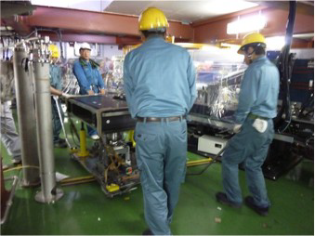
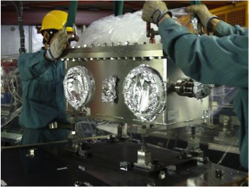
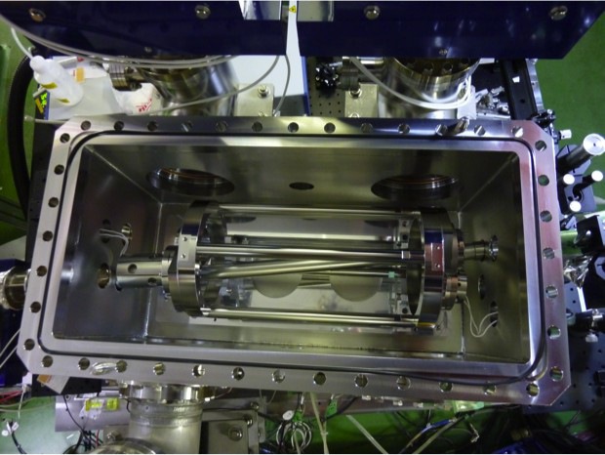
Installation of KEK Hiroshima cavity

Slide 18
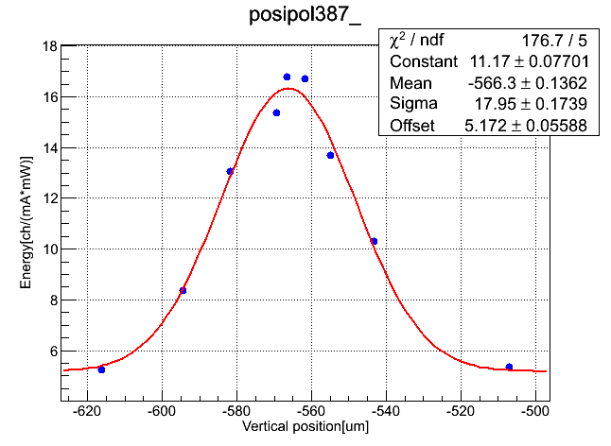
Laser spot size 15μm achieved with KEK-Hiroshima cavity
vertical deirection
σe=10μm
electrons
σL=15μm
γ ray yield [A.U]
σ=18μm
it was 30μm w/ 2 M cavity
vertical position[μm]

Slide 19
γ ray data KEK-Hiroshima
wave form
at 3 bunches/train
1900 enhancement
1.6kW in the cavity
γ yields
time (ns)

