Slide 1
Asia Europe Pacific School of High Energy Physics
October 14-27, 2012
@ Luigans Spa & Resort, Fukuoka, Japan
presented by K. Tokushuku (KEK)

Slide 2
Outline of the First Asia Europe Pacific School
of High Energy Physics
[Purpose]
The purpose of the school is to provide young physicists an opportunity to learn the recent advances in elementary particle physics from world leading researchers. The school also aims to encourage communications among Asian, European and Pacific young researchers.
A long discussion between CERN, KEK and various Asian and European countries including France and Korea. - The experience with France-Asia school was an important input.
The first IAC meeting in May 2011 -> The time and location of the first school is decided.
[Date] October 15-26, 2012 (Check-in: October 14, Check-out: October 27)
[Venue] The LUIGANS Spa & Resort in Fukuoka, Japan
[Students] About 100 students (senior PhD students and post-doctoral researchers)
from Asia, Europe, and Pacific regions
[Schedule] Application deadline: April 23, 2012
Student selection: May 10-11, 2012
School: October 15-26, 2012
Check-in: October 14, Check-out: October 27
today

Slide 3
The committees
International Advisory Committee (IAC)
Etienne Augé (IN2P3)
Mikhail Danilov (ITEP)
Rohini Godobole (Bangalore)
Shih-Chang Lee (Academia Sinica)
Martin Seviour (Melboune)
DongChul Son (KNU)
Fumihiko Takasaki (KEK, Chair)
Rüdiger Voss (CERN)
Yifang Wang (IHEP)

Slide 4
The committees
International Organizing Committee (IOC)
Mark Boland (Australian Synchrotron)
Nick Ellis (CERN, Chair)
Changzheng Yuan (IHEP)
Shi-Lin Zhu (Beijing)
Lydia Roos (IN2P3/LPNHE Paris)
Didier Vilanova (CEA/Irfu)
Subhasis Chattopadhyay (VECC)
Sreerup Raychaudhury (TIFR)
Kazunori Hanagaki (Osaka)
Pyungwon Ko (KIAS)
Simon Eidelman (BINP)
Yee Hsiung (National Taiwan Univ)

Slide 5
The committees
Local Organizing Committee (LOC)
Takeo Higuchi (KEK)
Hiroyuki Iwasaki (KEK)
Kiyotomo Kawagoe (Kyushu Univ, Chair)
Takasumi Maruyama (KEK)
Mitsuaki Nozaki (KEK)
Susumu Oda (Kyushu Univ)
Ken’ichi Okumura (Kyushu Univ)
Akira Sugiyama (Saga Univ)
Motoi Tachibana (Saga Univ)
Junji Tojo (Kyushu Univ)
Katsuo Tokushuku (KEK)
Takami Yoshioka (Kyushu Univ)

Slide 6
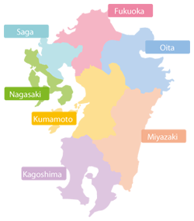
Venue: The LUIGANS Spa & Resort http://www.luigans.com/
Beijing
Seoul
Shanghai
Tokyo
FUKUOKA
Hongkong
Taipei
LUIGANS
Saga
Hanoi
Oita
Bangkok
Manila
Ho Chi Minh
Nagasaki
Singapore
Kumamoto
Miyazaki
Kagoshima

Slide 7
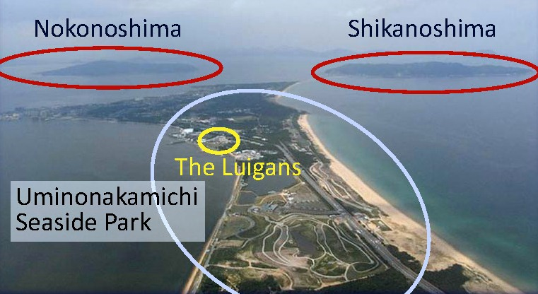
Venue: The LUIGANS Spa & Resort http://www.luigans.com/
FUKUOKA
Saga
Oita
Nagasaki
Kumamoto
Miyazaki
Kagoshima

Slide 8
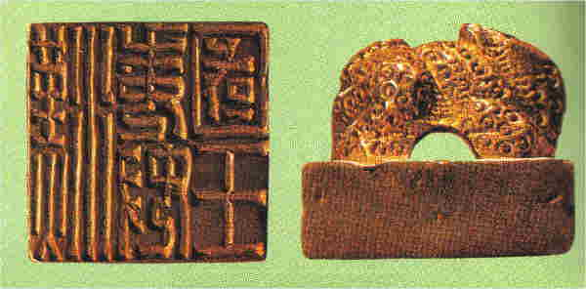
Venue: The LUIGANS Spa & Resort http://www.luigans.com/
FUKUOKA
Saga
Oita
Nagasaki
Kumamoto
Miyazaki
Kagoshima
A Gold Seal of ‘A Japanese king crowned by the Han’; a gift from China, Han dynasty (57 A.D.).
Discovered in the 18th century in Shikanoshima island.

Slide 9
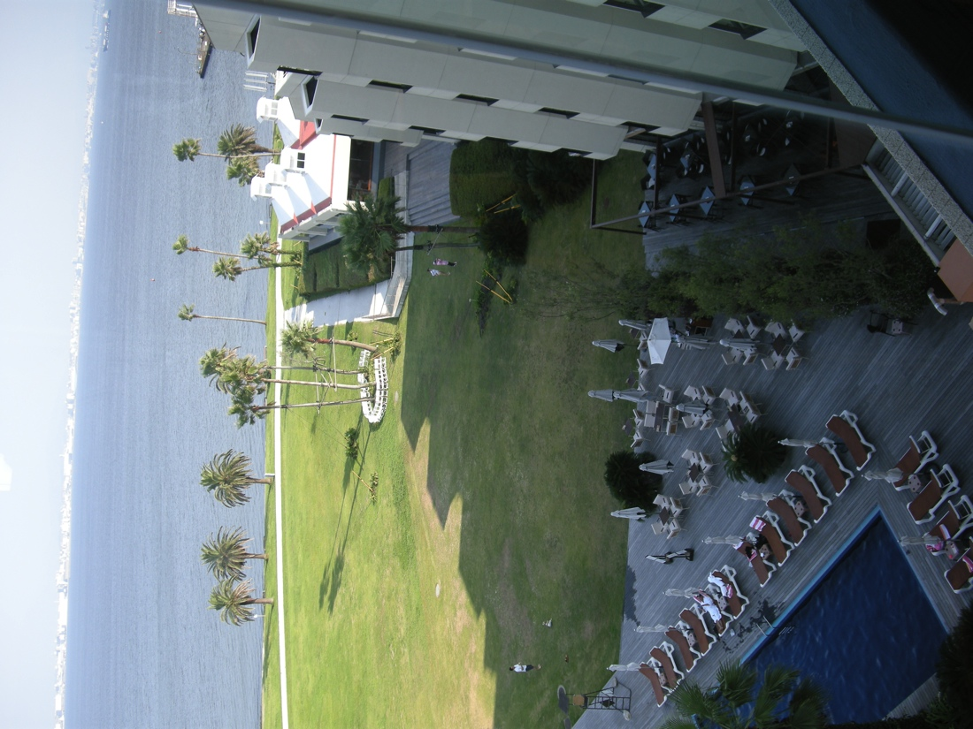
Accommodation: The LUIGANS Spa & Resort
http://www.luigans.com/
Three students share a room.
Every room has a beautiful ocean view.

Slide 10
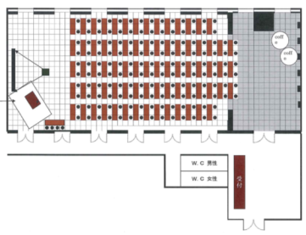
Lecture Room: The LUIGANS Spa & Resort
http://www.luigans.com/
A big lecture room with poster session capability
There are several small meeting rooms nearby.

Slide 11
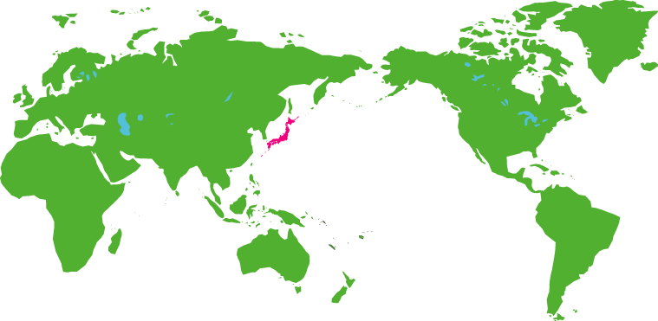
Lecturers & Discussion leaders
[Lecturers]
Field theory, Electroweak Theory and Standard Model: Luis Alvarez-Gaume (CERN)
Instrumentation: Werner Riegler (CERN)
Practical statistics for particle physicists: José Ocariz (IN2P3, Paris-Diderot Univ. )
Quantum chromodynamics (QCD): Hsiang-Nan Li (Academia Sinica)
Flavour physics and CP violation: Emi Kou (LAL Orsay )
Beyond the Standard Model: Mihoko Nojiri (KEK)
Heavy-ion physics: Dinesh K. Srivastava (VECC)
Charm physics: Hai-Bo Li (IHEP)
Neutrino physics: Zhi-Zhong Xing (IHEP)
Cosmology, astro-particle physics and dark matter: Hitoshi Murayama (Univ. Tokyo, LBNL)
LHC results highlights: Shoji Asai (Univ. Tokyo)
Particle physics in Europe: Rolf Heuer (CERN)
Particle physics in Asia: Atsuto Suzuki (KEK)
Marc Besançon(CEA/Irfu)
John Ellis (King’s College London/CERN)
Kin-ya Oda (Osaka Uni.)
Pavel Pakhlov (ITEP Moscow)
Myeonghun Park (CERN)
Raymond Volkas (Univ. Melbourne)
Someone (TBA)
Lecturers
Discussion Leaders
[Discussion Leaders]
1
3
1
2
2
2
1
4
1
1
2
1
1

Slide 12
Scientific Programme
 | Sunday, October 14 |  | Monday, October 15 |  | Tuesday, October 1 |  | Wednesday, October 17 |  | Thursday, October 18 |  | Friday, October 19 |  | Saturday, October 20
AM |  |  | 08:00 | Breakfast | 08:00 | Breakfast | 08:00 | Breakfast | 08:00 | Breakfast | 8:00 | Breakfast | 08:00 | Breakfast
 |  |  | 09:00 | Field theory and EW SM 1 - Luis Alvarez-Gaume (CERN) | 09:00 | Field theory and EW SM 2 - Luis Alvarez-Gaume (CERN) | 09:00 | Field theory and EW SM 3 - Luis Alvarez-Gaume (CERN) | 09:00 | Field theory and EW SM 4 - Luis Alvarez-Gaume (CERN) | 09:00 | Flavour physics and CP violation 1 - Emi Kou (LAL, Orsay) | 09:00 | EXCURSION
 |  |  | 10:30 | Coffee break | 10:30 | Coffee break | 10:30 | Coffee break | 10:30 | Coffee break | 10:30 | Coffee break
 |  |  | 11:00 | Instrumentation 1 - Werner Riegler (CERN) | 11:00 | Instrumentation 2 - Werner Riegler (CERN) | 11:00 | Instrumentation 3 - Werner Riegler (CERN) | 11:00 | QCD 1 - Hsiang-Nan Li (Academia Sinica Taipei) | 11:00 | QCD 2 - Hsiang-Nan Li (Academia Sinica Taipei)
PM | 12:00 | ARRIVAL | 12:30 | Lunch | 12:30 | Lunch | 12:30 | Lunch | 12:30 | Lunch | 12:30 | Lunch
 |  |  | 13:30 | Free time | 13:30 | Free time | 13:30 | EXCURSION | 13:30 | Free time | 13:30 | Free time
 |  |  | 15:30 | Coffee break | 15:30 | Coffee break |  |  | 15:30 | Coffee break | 15:30 | Coffee break
 |  |  | 16:00 | Practical statistics for particle physicists 1 - José Ocariz (IN2P3/LPNHE Paris and University Paris-Diderot) | 16:00 | Practical statistics for particle physicists 2 - José Ocariz (IN2P3/LPNHE Paris and University Paris-Diderot) |  |  | 16:00 | Practical statistics for particle physicists 3 - José Ocariz (IN2P3/LPNHE Paris and University Paris-Diderot) | 16:00 | Flavour physics and CP violation 2 - Emi Kou (LAL, Orsay)
 |  |  | 17:30 | Discussion Session (until 19:00) | 17:30 | Discussion Session (until 19:00) |  |  | 17:30 | Discussion Session (until 19:00) | v | Discussion Session (until 19:00)
 | 19:00 | Dinner | 19:00 | Dinner | 19:00 | Dinner | 19:00 | Dinner | 19:00 | Dinner | 19:00 | Dinner | 19:00 | Dinner
 |  |  |  | Welcome Reception |  |  |  |  | 20:00 | Poster Session (until 23:59)
 | Sunday, October 21 |  | Monday, October 22 |  | Tuesday, October 23 |  | Wednesday, October 24 |  | Thursday, October 25 |  | Friday, October 26 |  | Saturday, October 27
AM | 07:30 | Breakfast
 | 08:30 | Transfer to Kyushu Univ. | 08:00 | Breakfast | 08:00 | Breakfast | 8:00 | Breakfast | 08:00 | Breakfast | 08:00 | Breakfast | 08:00 | Breakfast and Depature
 | 09:00 | Beyond the Standard Model 1 - Mihoko Nojiri (KEK) | 09:00 | Beyond the Standard Model 2 - Mihoko Nojiri (KEK) | 09:00 | Beyond the Standard Model 3 - Mihoko Nojiri (KEK) | 09:00 | Cosmology, astro-particle physics and dark matter 1 - Hitoshi Murayama (IPMU Tokyo & LBL Berkeley) | 09:00 | Cosmology, astro-particle physics and dark matter 2 - Hitoshi Murayama (IPMU Tokyo & LBL Berkeley) | 09:00 | Cosmology, astro-particle physics and dark matter 3 - Hitoshi Murayama (IPMU Tokyo & LBL Berkeley)
 | 10:30 | Coffee break | 10:30 | Coffee break | 10:30 | Coffee break | 10:30 | Coffee break | 10:30 | Coffee break | 10:30 | Coffee break
 | 11:00 | QCD 3 - Hsiang-Nan Li (Academia Sinica, Taipei) | 11:00 | QCD 4 - Hsiang-Nan Li (Academia Sinica, Taipei) | 11:00 | Neutrino physics 1 – Zhi-Zhong Xing (IHEP, Beijing) | 11:00 | Neutrino physics 2 – Zhi-Zhong Xing (IHEP, Beijing) | 11:00 | Neutrino physics 3 – Zhi-Zhong Xing (IHEP, Beijing) | 11:00 | LHC results highlights 2 - Shoji Asai (University of Tokyo)
PM | 12:30 | Lunch | 12:30 | Lunch | 12:30 | Lunch | 12:30 | Lunch | 12:30 | Lunch | 12:30 | Lunch
 | 13:30 | Free time | 13:30 | Free time | 13:30 | Free time | 13:30 | FREE AFTERNOON | 13:30 | Free time | 13:30 | Free time
 | 15:30 | Coffee break | 15:00 | Heavy-ion physics 1 - Dinesh K Srivastava (VECC, Kolkata) | 15:00 | Heavy-ion physics 2 - Dinesh K Srivastava (VECC, Kolkata) |  |  | 15:30 | Coffee break | 15:00 | Particle physics in Europe - Rolf Heuer (CERN)
 | 16:00 | Flavour physics and CP violation 3 - Emi Kou (LAL, Orsay) |  |  |  |  |  |  | 16:00 | LHC results highlights 1 - Shoji Asai (University of Tokyo)
 |  |  | 16:00 | Coffee break | 16:00 | Coffee break |  |  |  |  | 16:00 | Coffee break
 | 17:30 | Discussion Session at Kyushu University) (until 19:00) | 16:30 | Charm physics 1 - Hai-Bo Li (IHEP, Beijing) | 16:30 | Charm physics 2 - Hai-Bo Li (IHEP, Beijing) |  |  |  |  | 16:30 | Particle physics in Asia - Atsuto Suzuki (KEK)
 | 19:00 | Transfer to the Luigans | 17:30 | Discussion Session (until 19:00) | 17:30 | Discussion Session (until 19:00) |  |  | 17:30 | Discussion Session (until 19:00) | 17:30 | Discussion Session (until 19:00)
 | 19:30 | Dinner | 19:00 | Dinner | 19:00 | Dinner | 19:00 | Dinner | 19:00 | Dinner | 19:00 | Dinner
 |  |  |  |  |  |  |  |  | 20:00 | Students Project Presentations |  | Farewell Party
Open Lecture
Joint Session
(DG, KEK & DG, CERN)
@Kyushu Univ.

Slide 13
Students
More than 180 applications
In the IOC meeting held in May 10-11. 110 students have been selected.
The school fee is 100,000 yen (~1kEuro). Not so cheap but there are enough supports from each country, KEK and CERN.

Slide 14
Candidates to participate in the 1st School
Country/region of their home institutes
Students from 27 countries and regions
Australia
UK
China
India
Germany
France
Vietnam
Total: 110
Japan
Korea

Slide 15
Summary
The first Asia-Europe-Pacific School of High Energy Physics (AEPHEP) will be held in Fukuoka, Japan on 14-27 October.
Lecturers and Discussion Leaders have been identified.
More than 180 applications were received.
110 candidates have been selected. They are from 27 countries and regions in Asia, Europe, Oceania, (and Africa and South America).
A large Financial support from KEK, CERN and various countries.
The school will be held in every other year. The second school will be in 2014.

