Slide 1
KEK : Novel Accelerator
Collaboration
  IZEST (CEA) : Prof. Tajima’s talk
  Labo-scale stable laser plasma acceerator
KEK Activity
  Ultra high intense electron beam
  and intense laser
  for the novel accelerator experiment
  in the KEK electron linear accelerator
2012.05.29 TYL Workshop
M. Yoshida, M. Nozaki, K. Koyama,
High energy research organization (KEK)

Slide 2
Considerable novel accelerator
Laser driven accelerator
Laser direct field acceleration
Laser plasma wakefield(LWFA)
Beam driven accelerator
Dielectric accelerator(DWA)
Plasma wakefield (PWFA)
Drive beam
Acceleration beam
Acceleration
Deacceleration
Electron beam

Slide 3
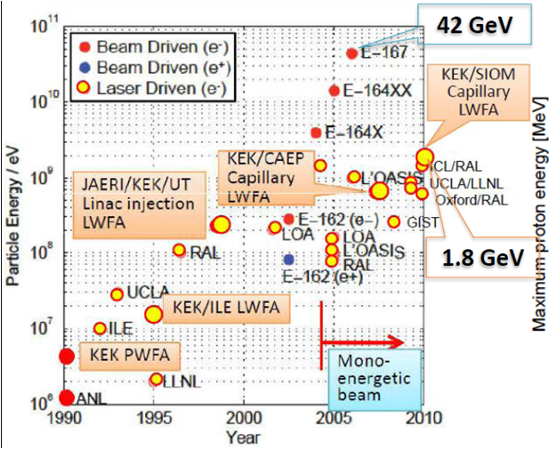
Novel Accelerator Facility in the world

Slide 4
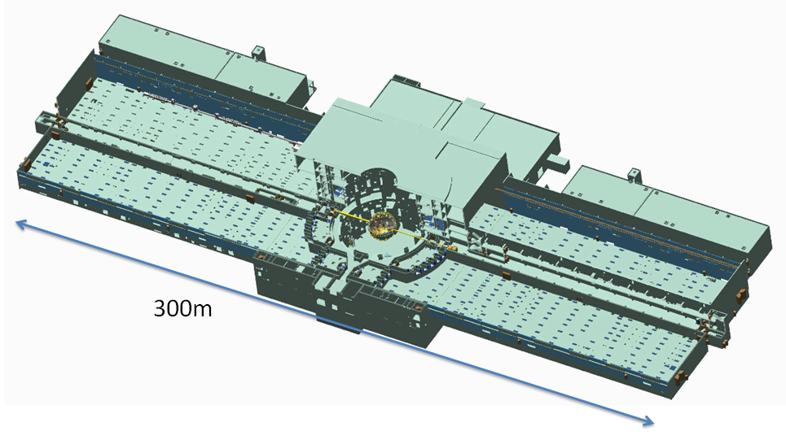
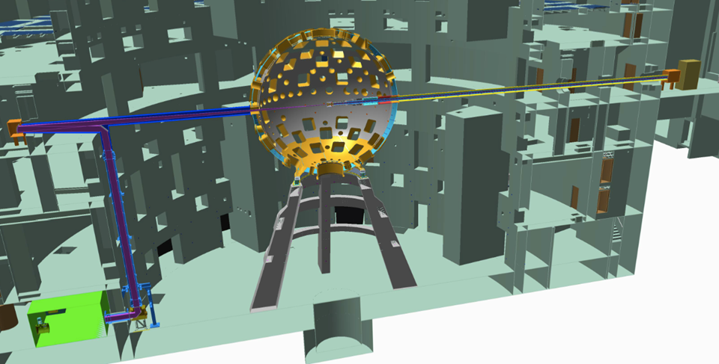
IZEST
PETAL : one hand of the LMU with pulse compression
2 kJ / 500fs = 4 PW
→
Low plasma density
= Large phase space
KEK-IZEST MoU @ 2012.03

Slide 5
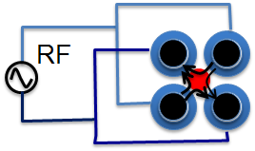
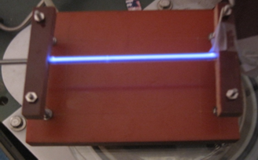
Considerable contribution from Japan for IZEST
Design work
Stable Injector for the one-shot experiment
  Labo-scale stable injector (Osaka-univ)
  Ionization-induced injection
Long plasma channel:
  Quadrupole microwave plasma (Nagoya-univ)
→ 1 m prototype will be tested.

Slide 6
Labo-scale laser plasma accelerator
Target :
  Electron microscopy
  Photon source (FEL / )
Recent progress in the word
  Stable & mono energetic beam can be genarated
  100 MeV – 2 GeV
Commertial laser system ~ a few 100 TW
  Amplitude / Thales

Slide 7
KEK Activity:
Ultra high intense electron beam and intense laser for the novel accelerator experiment in the KEK electron linear accelerator

Slide 8
High intense electron beam
Injection for the SuperKEKB (5nC)
Ultra high field experiment
  Beam driven accelerator (DWA, PWFA)
  Injector for laser plasma accelerator (After burner)
Photon generation
Low emittance ( < 10 mm mrad )
High charge (> 10 nC)
Short bunch length (fs) Bunch compression
→ Bunch shape control / precise syncronization
Electron Gun
(RF-Gun)

Slide 9
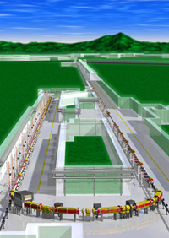
Facility concept of High Intense Beam-Laser Complex at KEK
Install photocathode RF-Gun
ps modulated
laser
Experimental
Area
Pulse compression
σ_{z}=1 ps, q > 5nC, εx,y < 20 mm・mrad
X-band
Pulse compression
Total length ~400m => 7 GeV
High luminosity
Collider ring
～a few 100 fs
e- 7 GeV, 5nC
σx,y = 35μｍ (β～1m)
/ 100fs = 350 TW

Slide 10
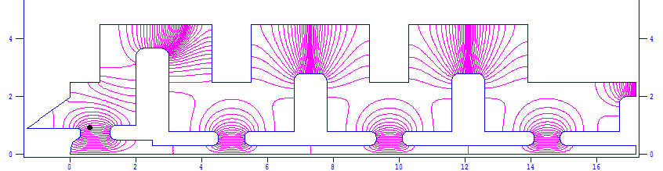
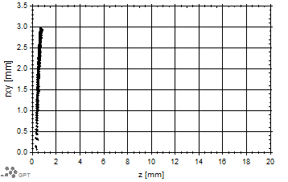
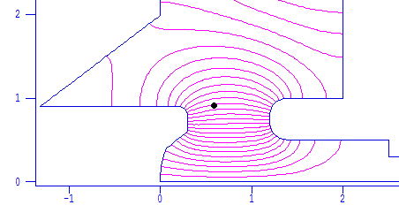
DAW (Disk and Washer) type RF-Gun
Electric field focus
Large coupling
Low electric field
Strong focussing field
Curved surface cathode for low emittance.
Cathode
Notes:
さて，この5nCの高電荷で最も問題になるのは，その発散力であります．
通常のGunではビーム発生直後，低エネルギーのうちに発散力を受けてしまい，gunの中で広がったビームが創りだされてしまいます．
それを抑えるために特に第一空洞で強い集束電場を持たせてあります．更にこのRF電場でエミッタンスが悪くならないようにカソードに曲率をもたせる事も行いました．

Slide 11
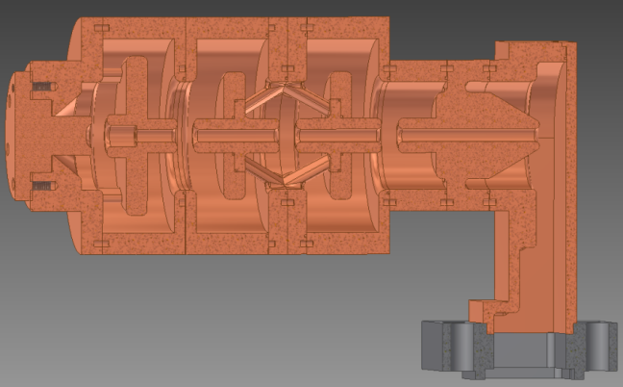
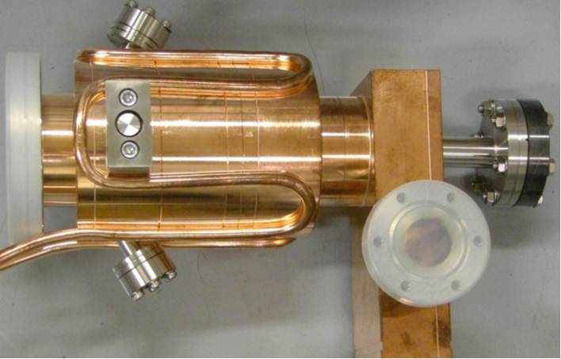
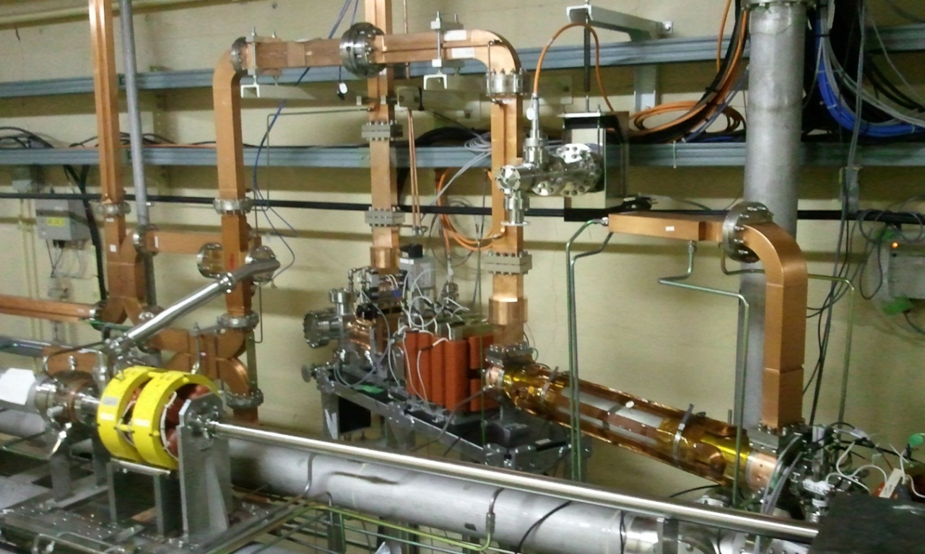
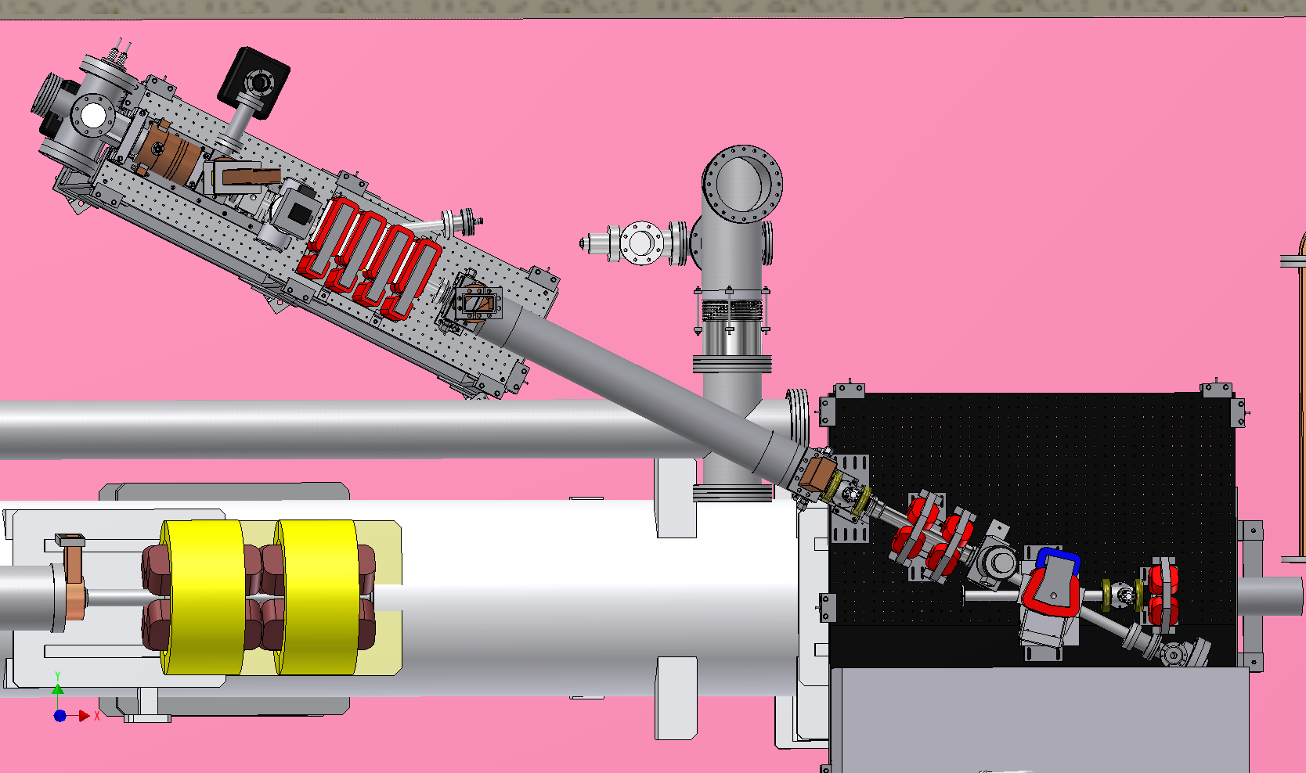
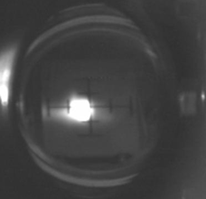
RF gun installation
Injection beam line on the angle
Linac beam line

Slide 12
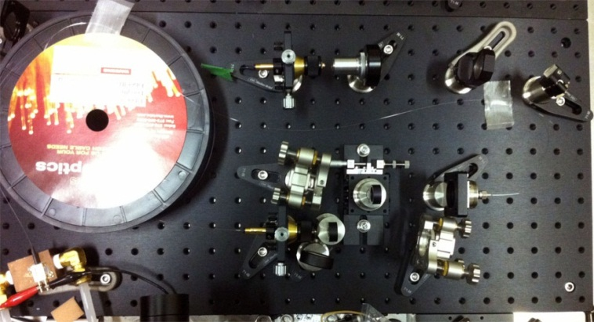
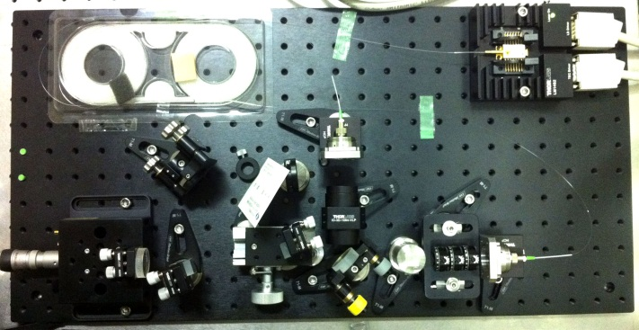
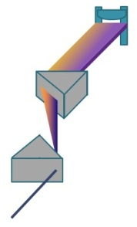
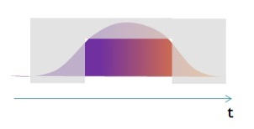
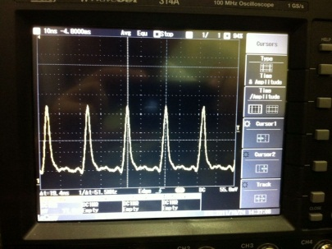
Yb-fiber & Yb solid state laser development
Yb Fiber Main-Amplifier
70W
LD
Pump
λ/4
λ/2
Yb Fiber Pre-Amplifier
2.5μJ
Solid-state Amplifier
Yb:KGW
100Hz
LD
200W
10W
Pump Laser
3mJ
Frequency doubling
LBO
517nm
BBO
259nm
~30ps
0.5mJ
Yb Fiber Oscillator
1035nm
LD
Spectral Range Adjustment
WDM
Prism Pair
Oscillator & pre-amplifier are already working.

Slide 13
8 GeV LINAC Third Switch Yard
KEKB
(continuous inj.)
8 GeV LINAC
New RF Gun
AR
(2 inj./day)
Damping ring
(under construction)
PF (top up)
Third Switch Yard

Slide 14
Ti-Sapphire 20 TW Laser
40 TW laser
7 GeV, 350TW beam

Slide 15
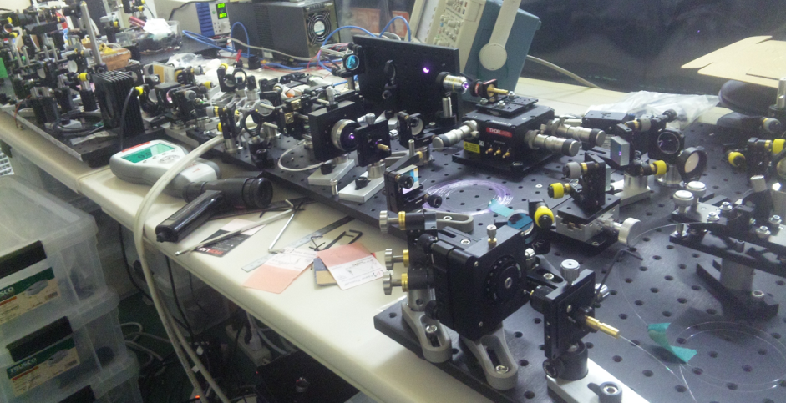
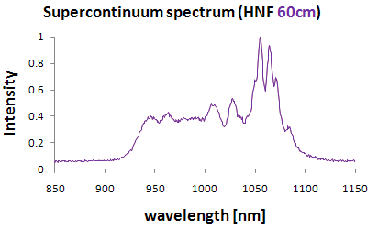
Laser system
Precise synchronization :
  Yb-doped passive synchronization fiber laser
  Supercontinuum frequency broadning
OPA + Ti-Sapphire amplification
Collaboration with Univ-Tokyo

Slide 16
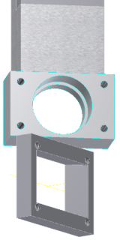
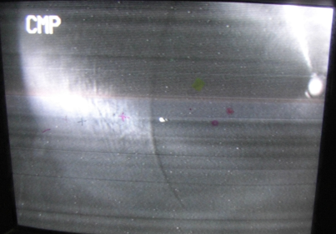
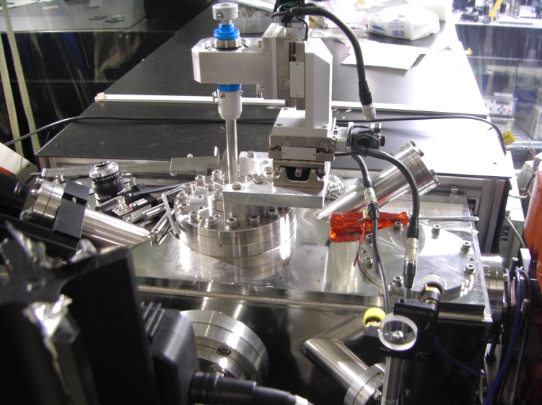
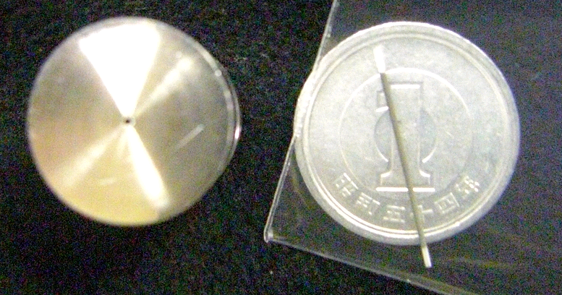
DWA test at 40 MeV LINAC &
Achromatic ARC bunch compressor at AIST
Achromatic ARC
150 fs, 50um bunch size => 3 GV/m is expected.
0.2mm diameter ceramic pipe
=> Planed to test in 7 GeV beam
Notes:
16

Slide 17
Summary
Collaboration in future FJPPL
  IZEST
  Labo-scale laser plasma accelerator
KEK Activity :
  High intense electron beam:
    Strong electric focus RF-Gun
    Energy spread compensation & bunch compression
  Ultra high field experiment
    We would like to focus the reserch of Transformer Ratio and so-called After Burner.
    Beam-Laser complex accelerator facility in KEK is under design.
    KEK 8 GeV LINAC has unique ability for novel accelerator test facility except for SLAC in the world.
Future collaboration for beam-laser complex

