Slide 1
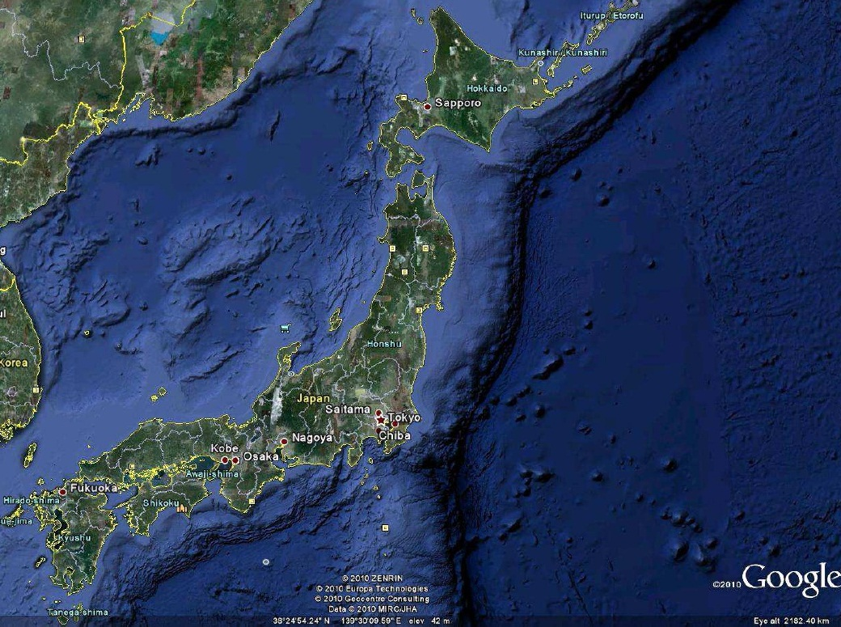
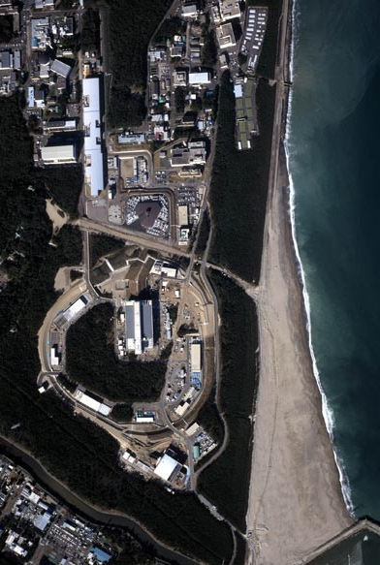
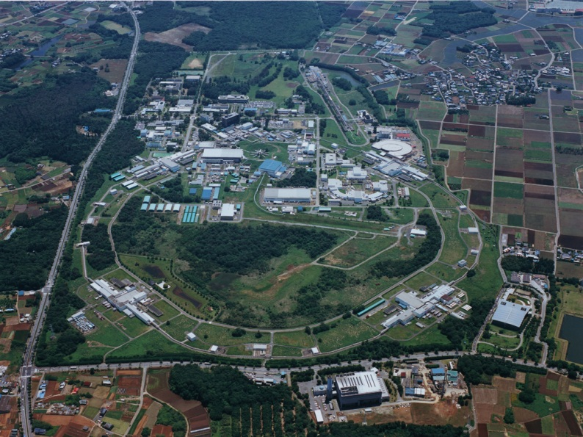
KEK Activities
:
2011 ~
Atsuto Suzuki
Joint workshop of the France-Japan and
France-Korea Particle Physics Laboratory
Clermont-Ferrand, France,
May 28-31, 2012
Tokai
Tsukuba

Slide 2
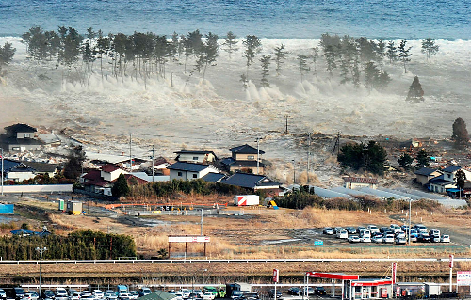
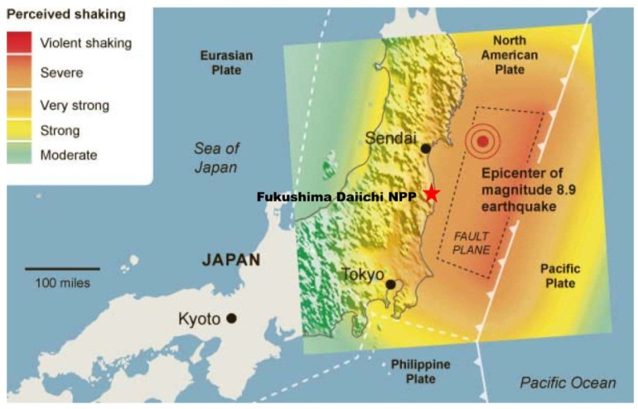
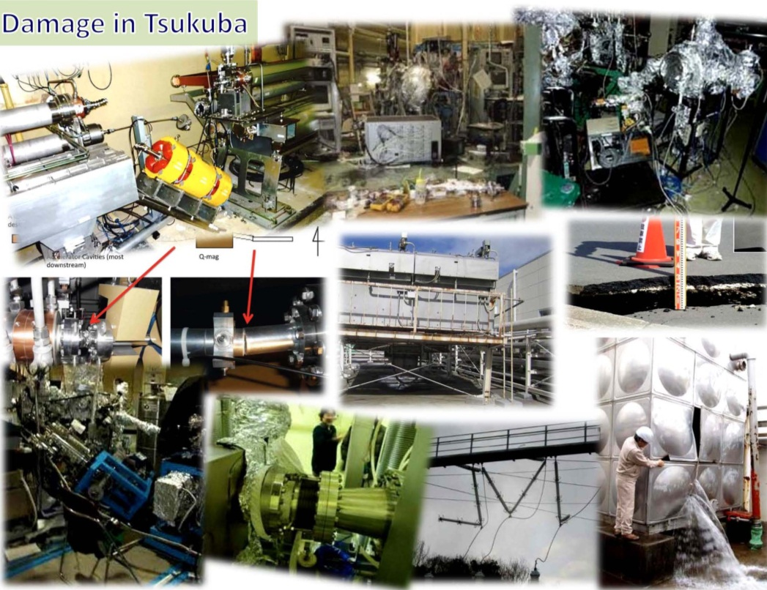
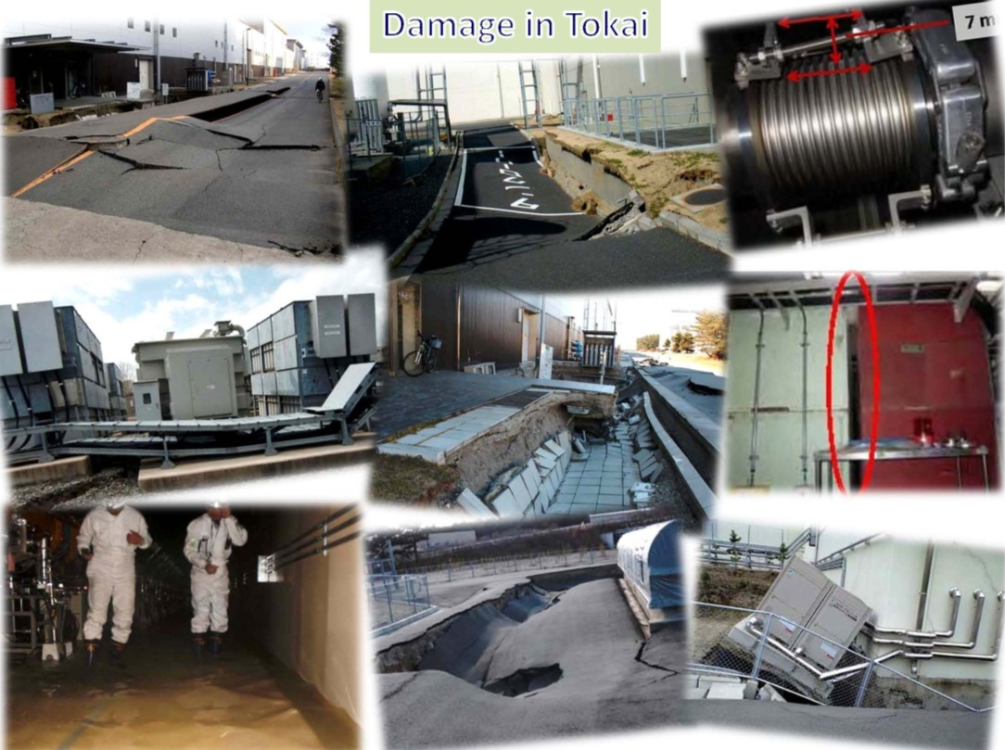
1. Earthquake :
March 11, 2011

Slide 3
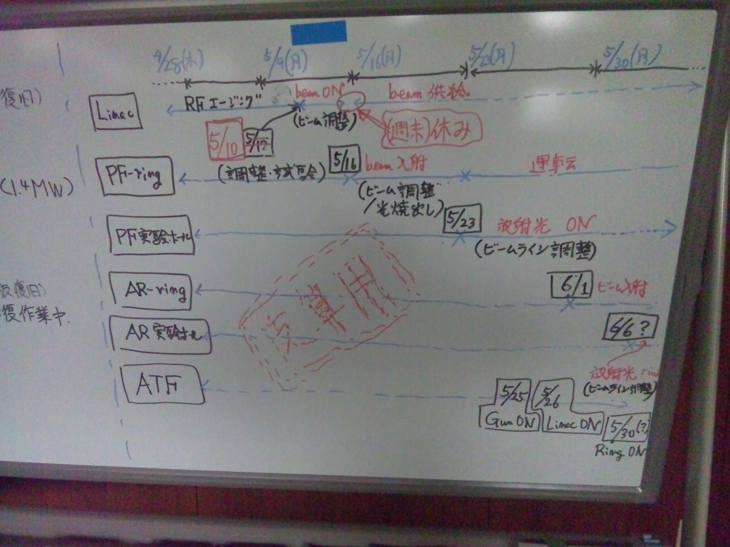
Counting one’s chickens
before they are hatched

Slide 4
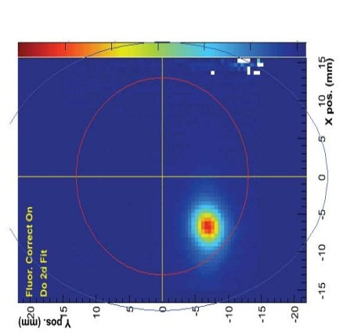
5/16
5/23
6/6
SuperKEKB
12/9
2011/12/24
12/21
12/24

Slide 5
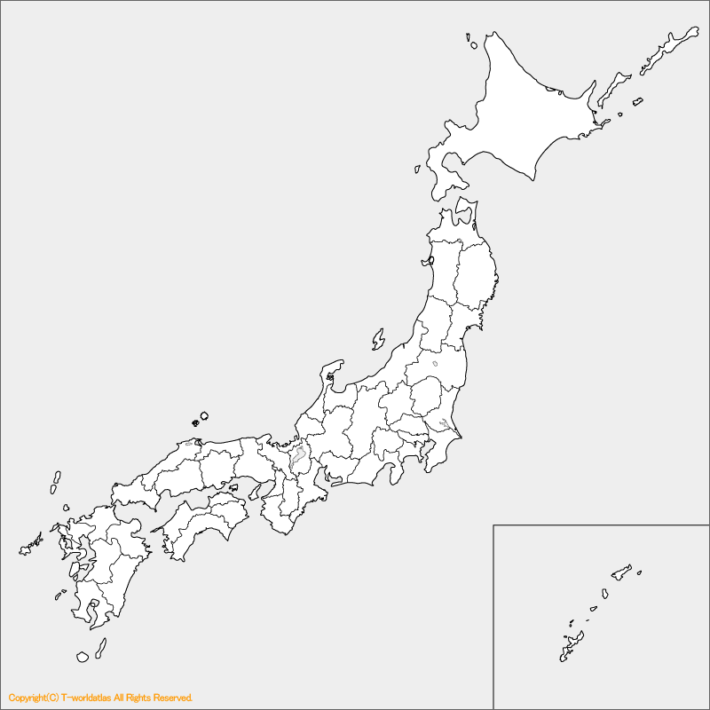
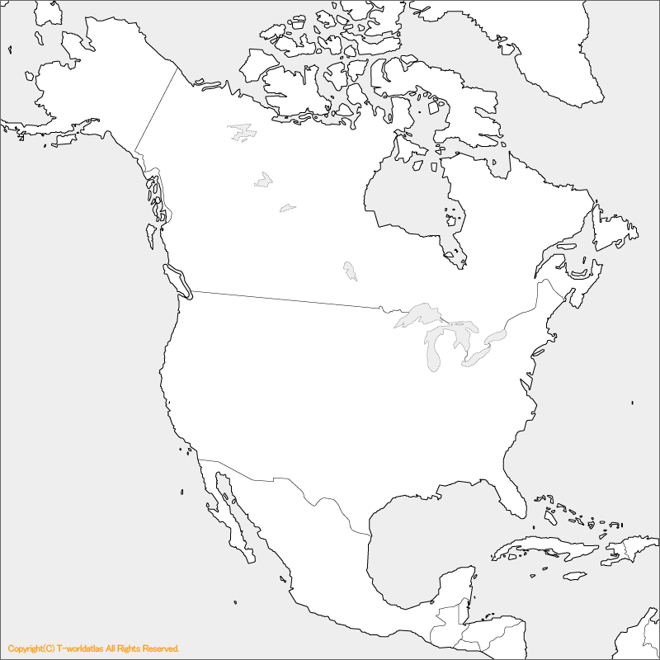
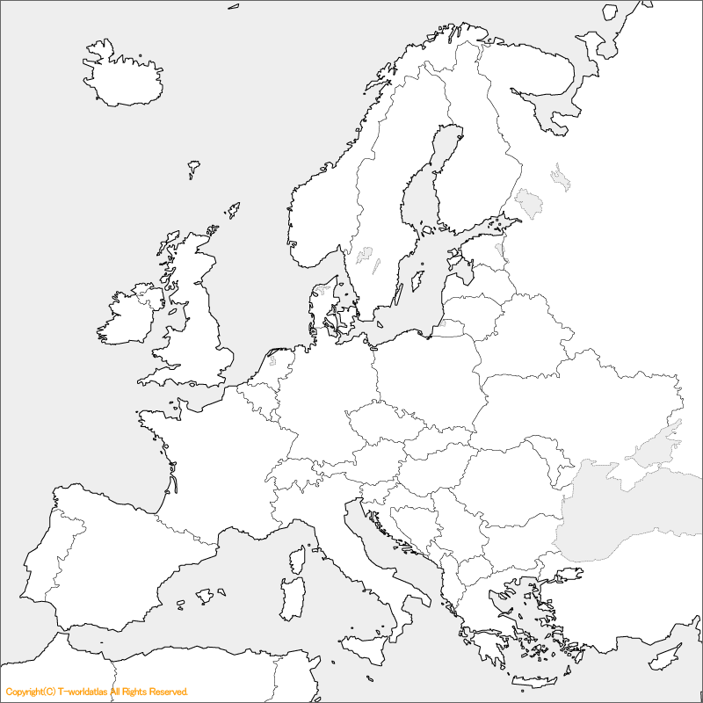
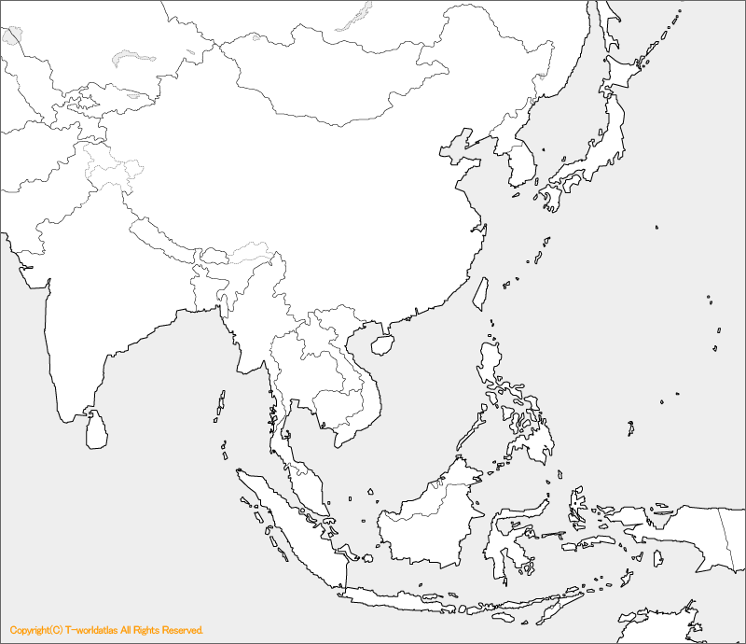
Oversea Researchers （4/1~6/15):
133 (person), 1214 (person・day)
Europe
Russia：8
Beraruce:1
Universities
Ireland：1
KEK
Canada：12
Sweden：1
Poland：4
Americas
J-PARC
with JAEA
UK：11
Kazak stan：1
USA：31
Germany：2
Hungary：1
Belgium：1
Bulgaria：1
France：11
Swiss：2
Georgia: 1
Slovenia：2
Italy：4
Asia
Korea：11
Spain：3
Greek：1
China：12
India：２
Taiwan：２
Malaysia：１
Sri Lanka：１
Australia：１

Slide 6
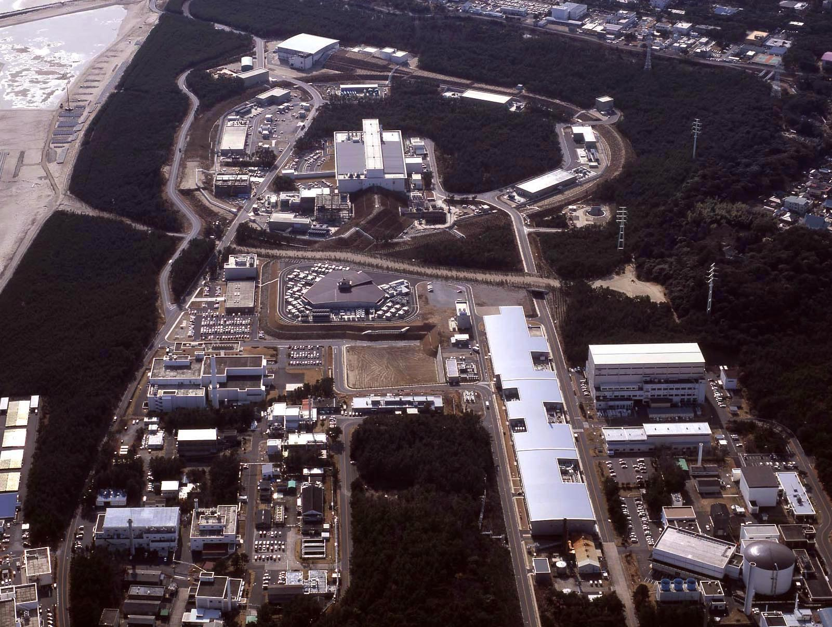
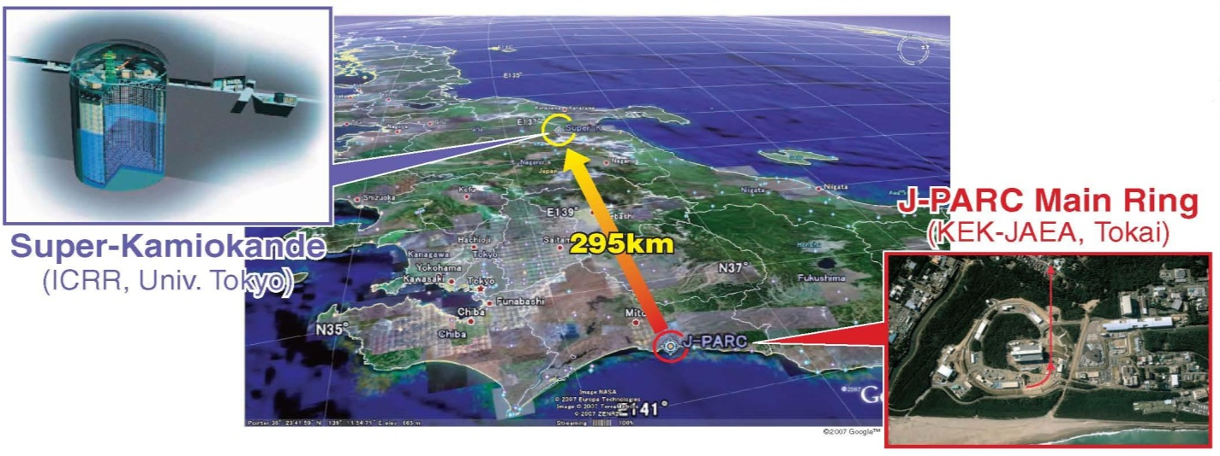
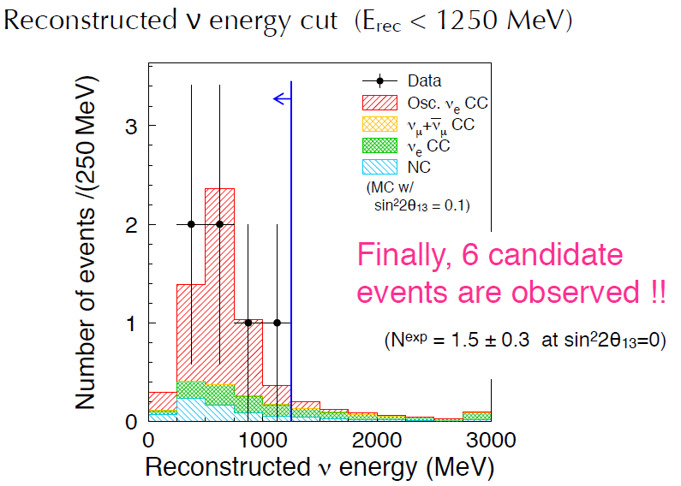
2. J-PARC
T2K (Tokai to Kamioka) ν Experiment
June 2011
2.5 σ

Slide 7
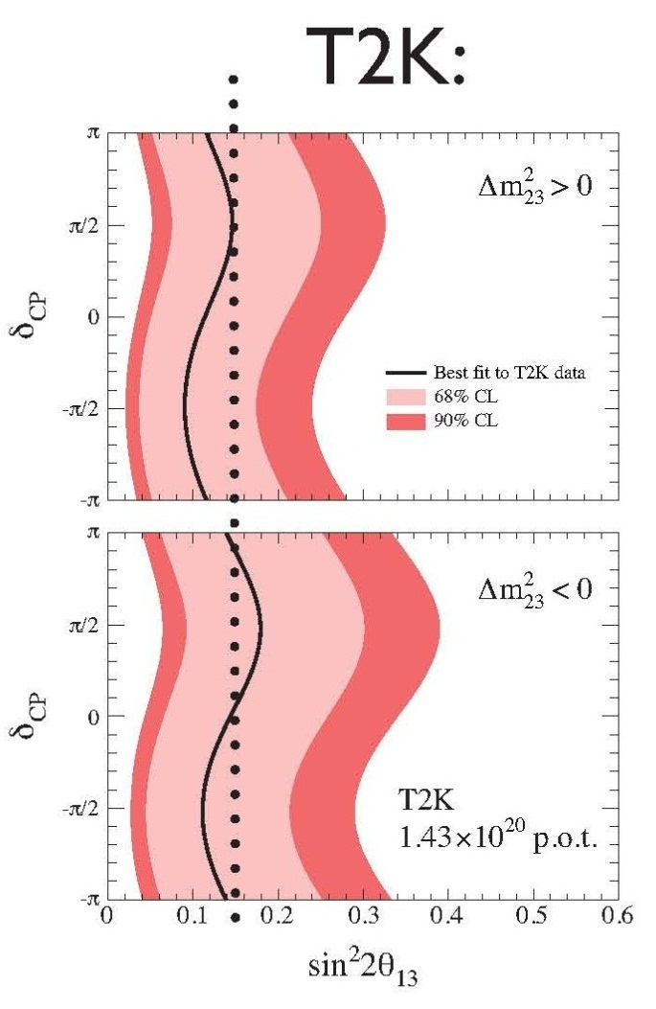
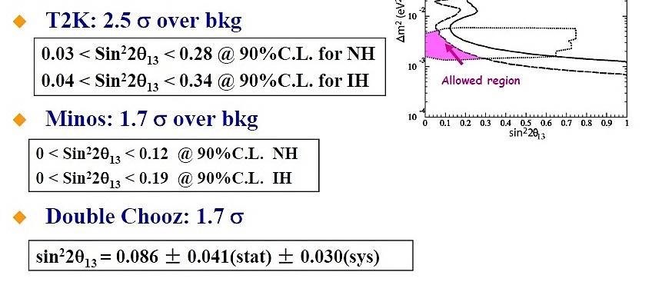
World θ₁₃ Race
Daya Bay
RENO
Sin²2θ₁₃ = 0.103$±0.013(stat.)±0.011(syst.)$
6.3 σ significance

Slide 8
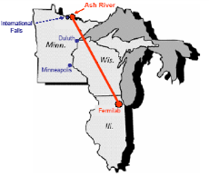
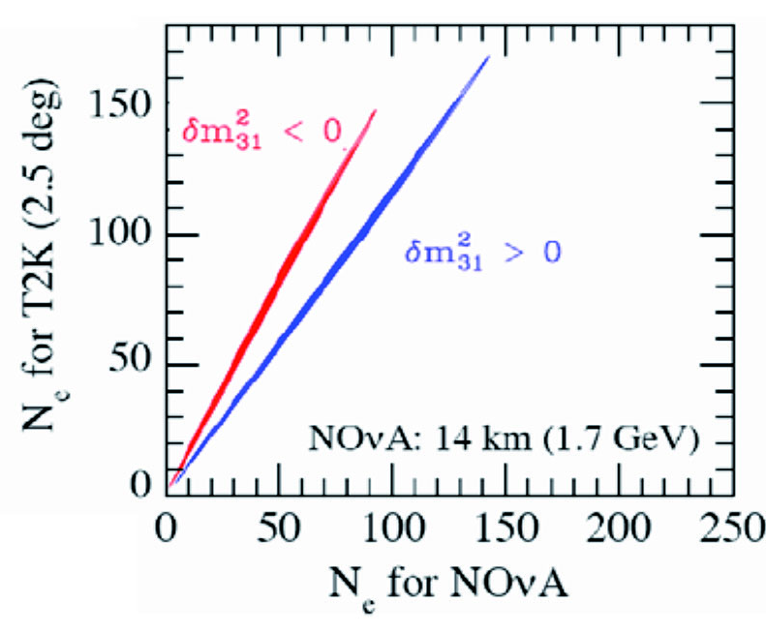
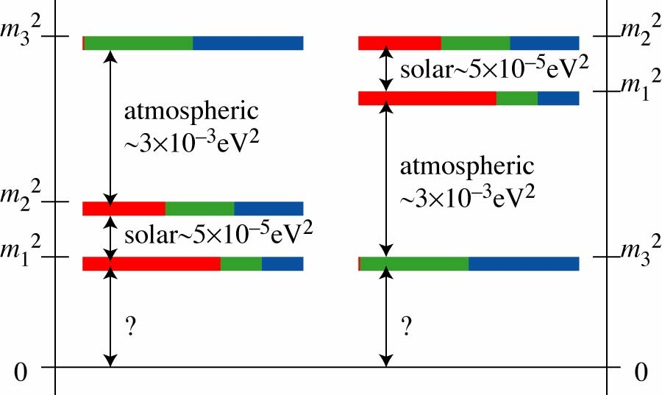
What is the mass hierarchy ?
Δm²₂₁ : 8.2 ± 0.6 (10⁻⁵ eV²)
m₂ > m₁
810 km
T2K + NOνA
ν_{e} ν_{μ} ν_{τ}
normal inverted hierarchy
O. Mena et al., hep-ph/0609011v1

Slide 9
3. SuperKEKB Groundbreaking Ceremony
50 (ab)⁻¹
18/Nov/2011

Slide 10
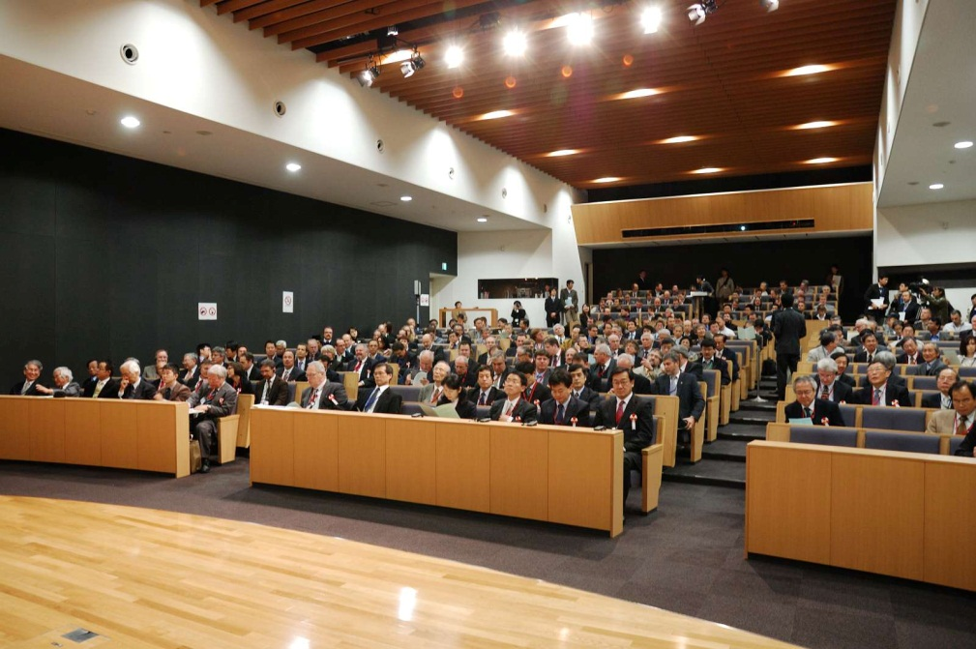
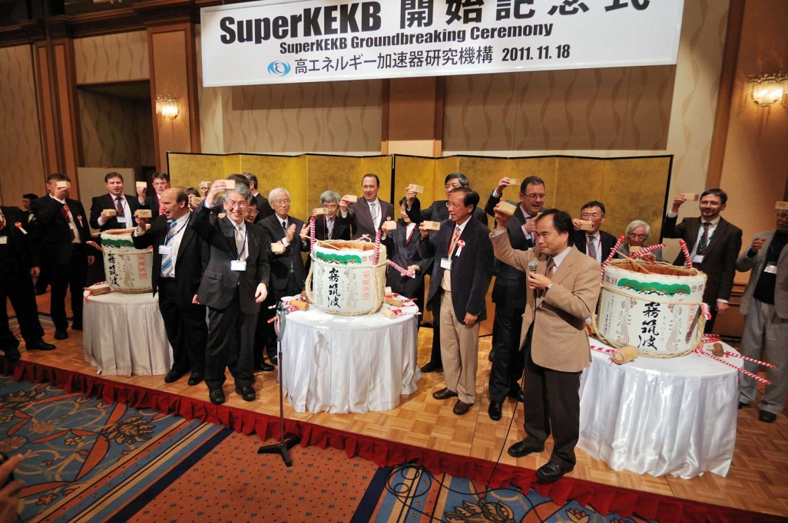
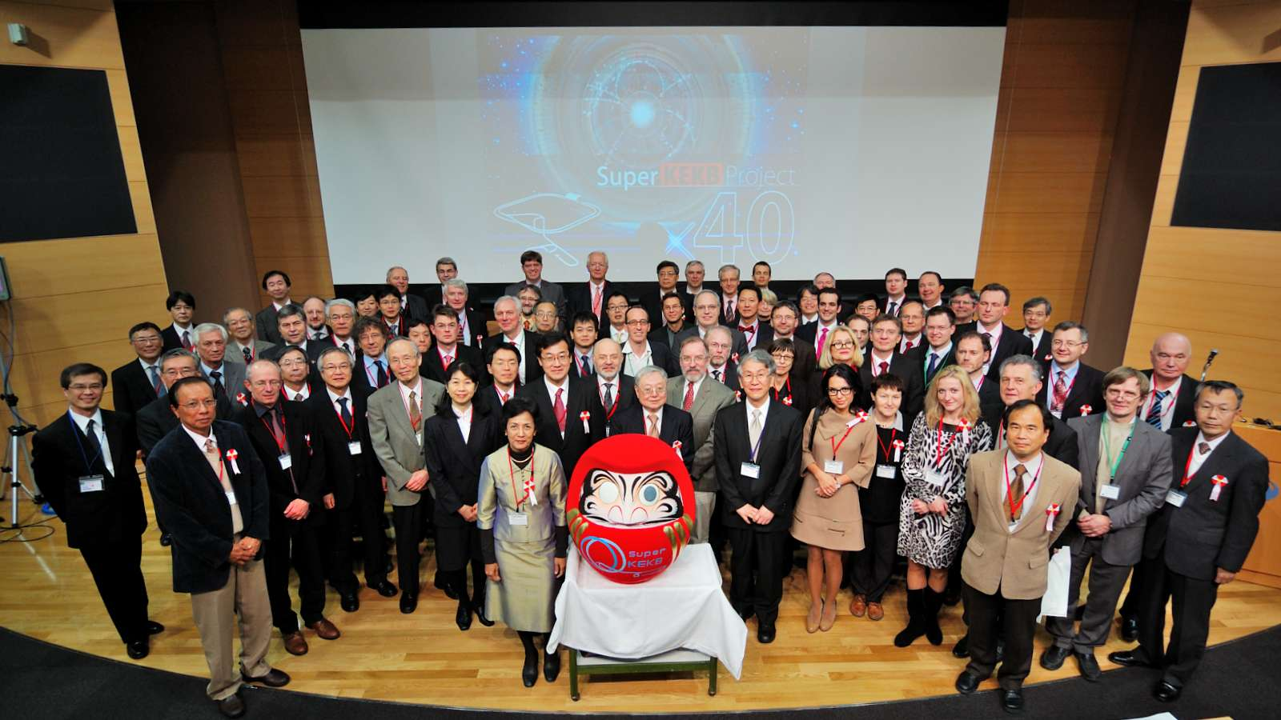

Slide 11
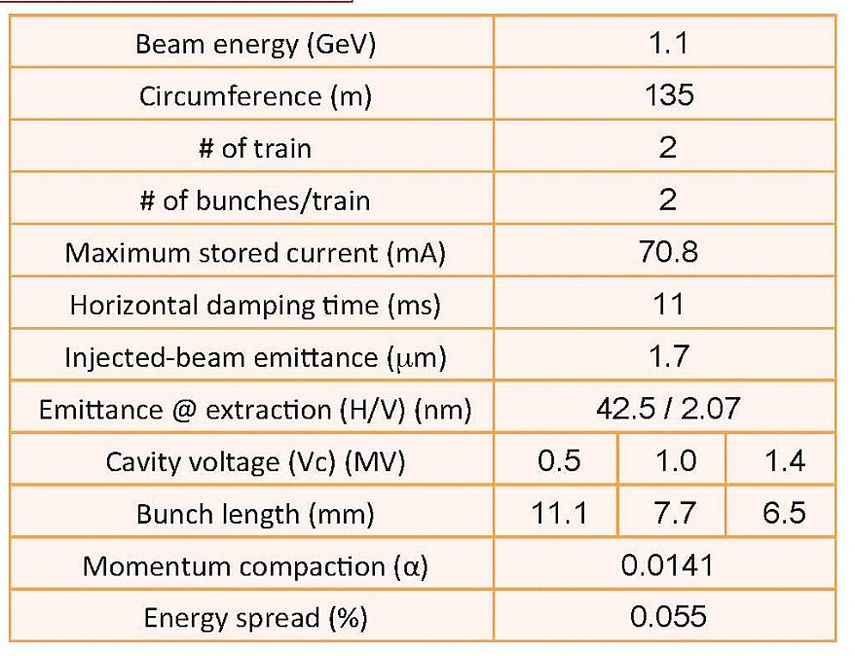
Positron Damping Ring
In December, 2011
C = 135.5 m
M. Kikuchi
Linac Upgrade for SuperKEKB (Higo)

Slide 12
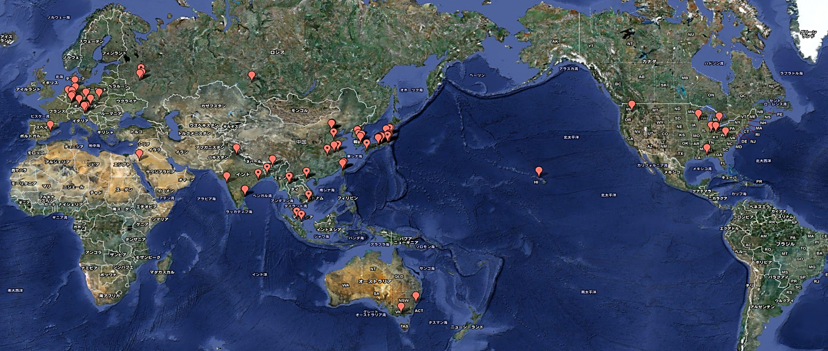
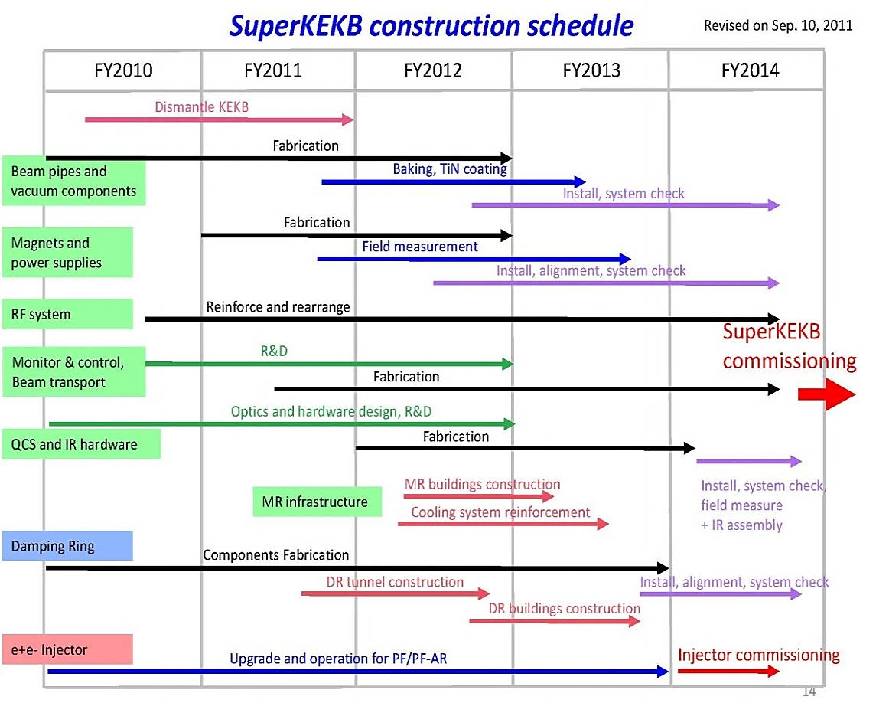
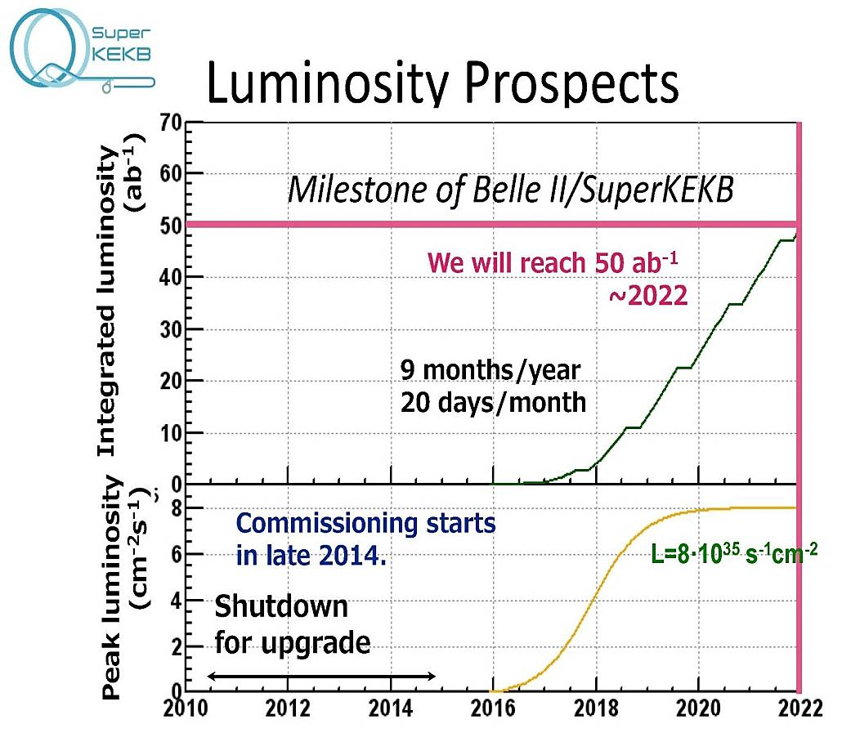
SuperKEKB : International Collaboration
~ 400 collaborators from 15 countries

Slide 13
4. Future PF Light Source : Energy Recovery Linac

Slide 14
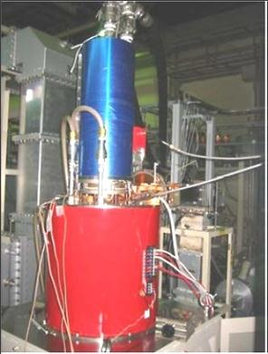
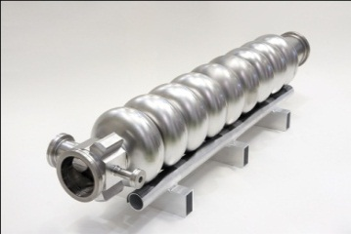
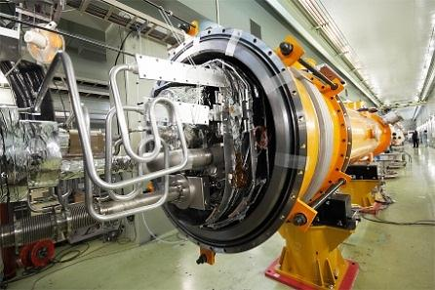
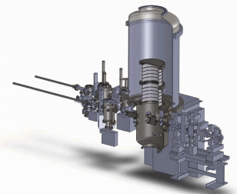
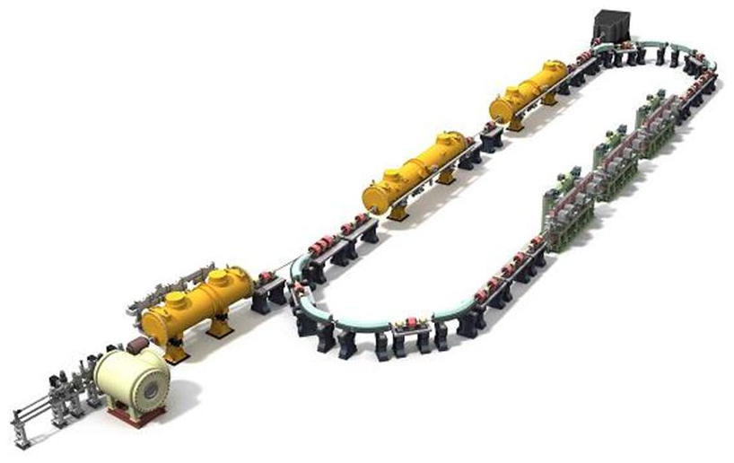
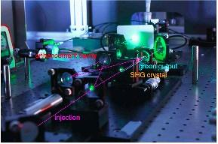
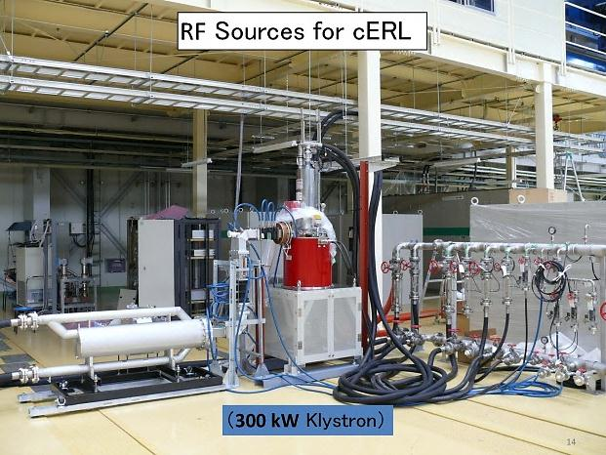
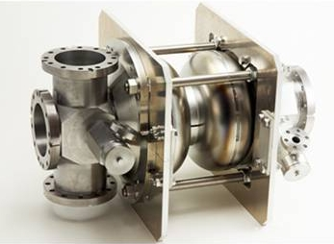
Technical Developments => c-ERL（35MeV→250MeV)
DC gun
RF source
Main SC cavity
the first beam is
expected in FY2012
Technical issues have been almost cleared.
Drive laser
Injector SC cavity
14

Slide 15
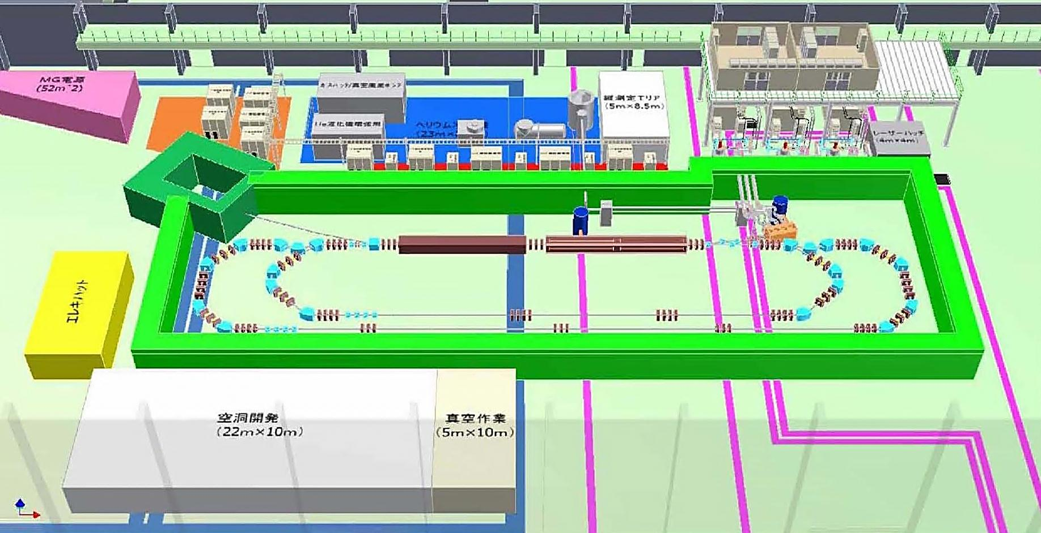
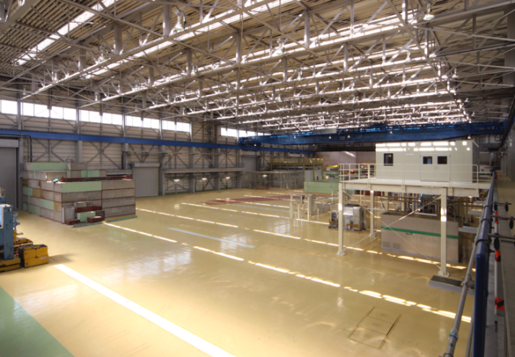
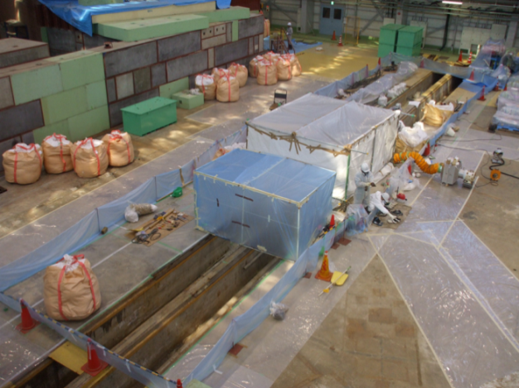
Compact ERL at the end of FY2012 (March of 2013) ERL Test Facility
25 MeV
250 MeV

Slide 16
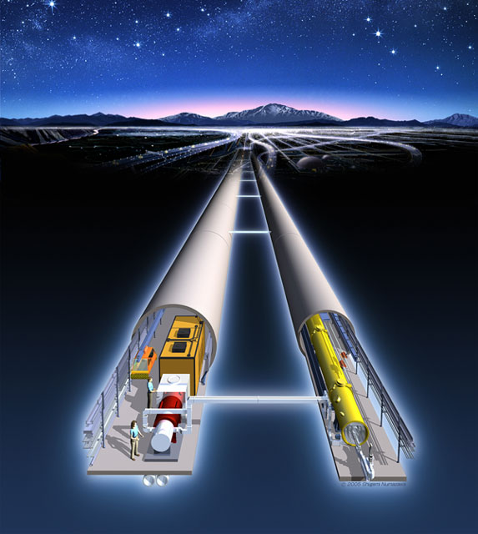
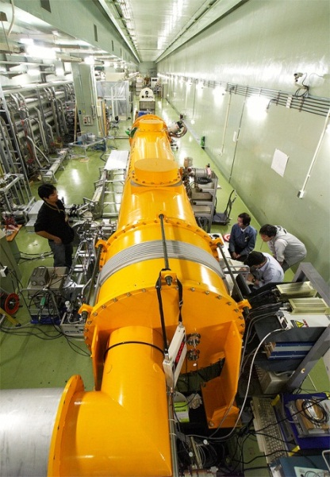
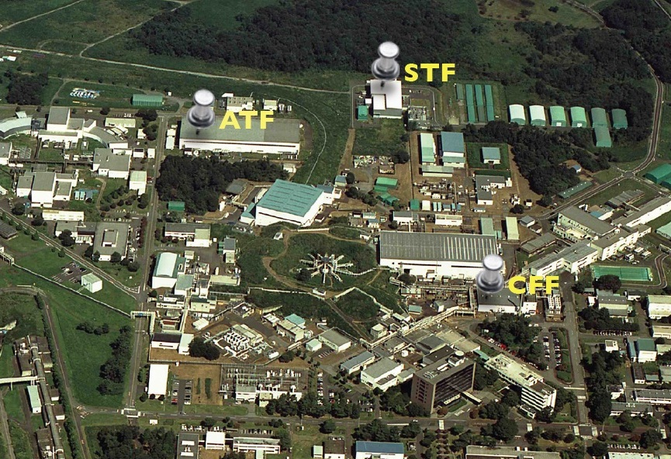
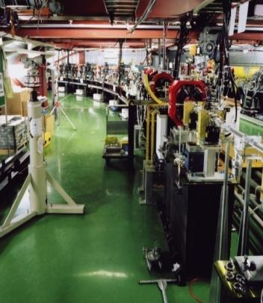
5. ILC R&D
Cryomodule
Fabrication
Facility

Slide 17
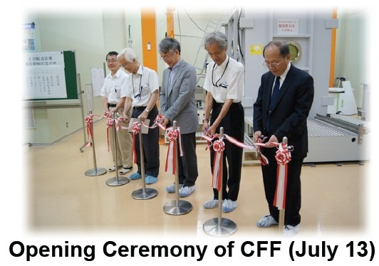
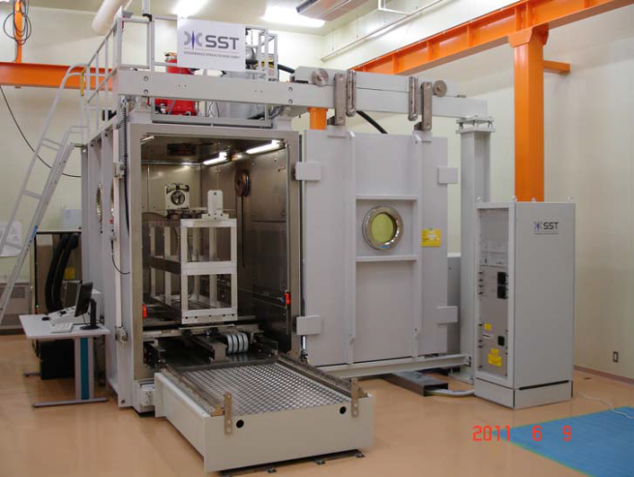
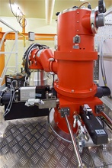
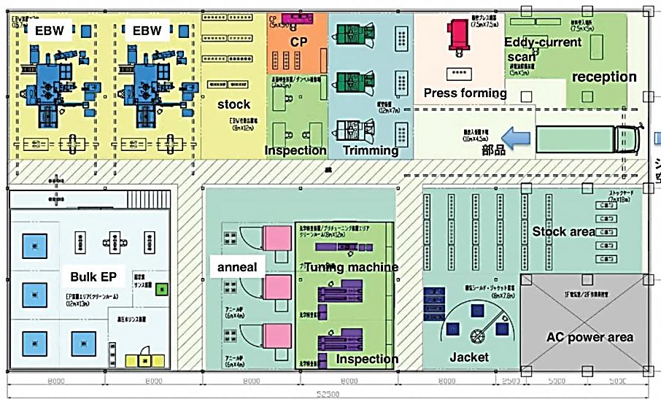
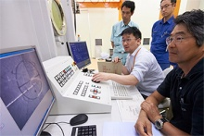
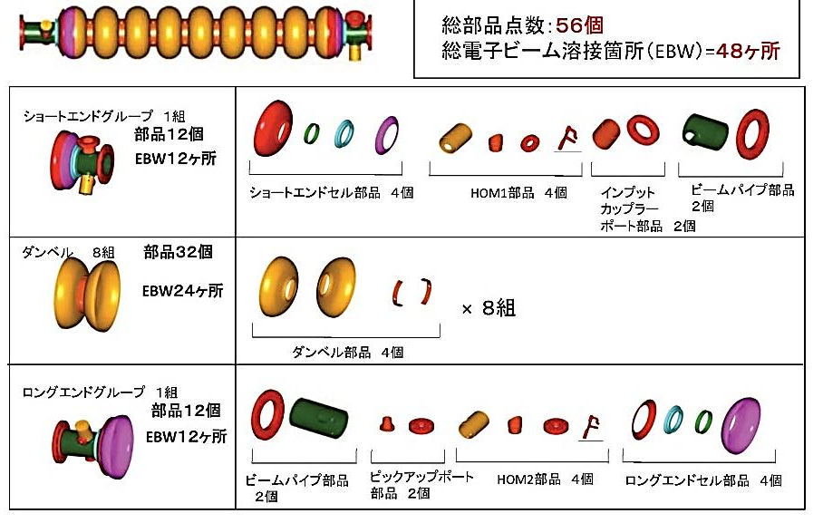
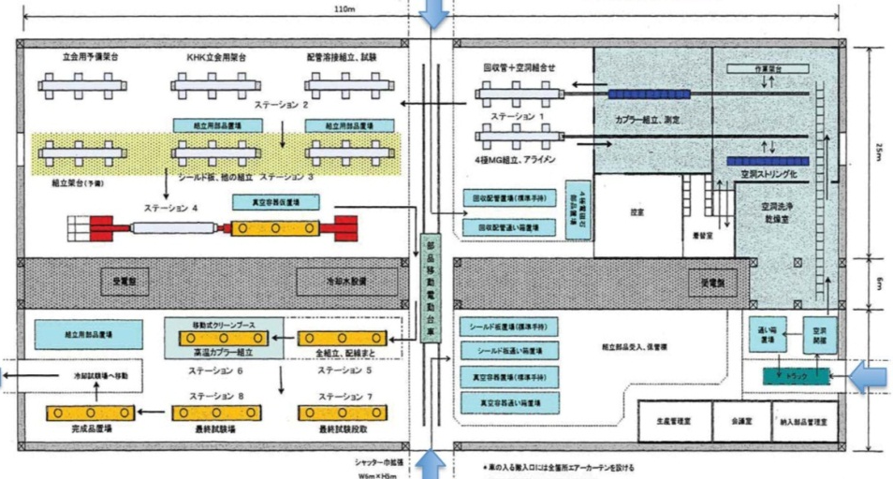
Cryomodule Fabrication Facility
SC Cavity Production Line
Cryomodule Fabrication Line

Slide 18
STF Quantum-Beam experiment
KEK-STF
Quantum-Beam Accelerator
High-flux X-ray by Inverse-Comton scattering
10mA electron beam （40MeV, １ｍｓ, ５Ｈｚ）
4-mirror laser resonator cavity
head-on collision with beam
photocathode RF gun
Capture cryomodule ( 2 SC cavities )
collision point
(Laser, electron beam)
Target: 1.3 x 10¹⁰ photons/sec 1%bandwidth
2012. Feb : cool-down started,
April : beam acceleration

Slide 19
STF QB accelerator commissioning (April 2012)
1ms Beam extraction from RF-gun (Mar.22,2012)
Accelerator tuning (April 13,2012)
Accelerated Beam profile
Beam orbit
Accelerated Beam bunch
172ns Beam acceleration by superconducting cavities (April 13, 2012)

Slide 20
6. LHC Power Upgrade

Slide 21
LHC Luminosity Upgrade
IRQ Development Required for Luminosity Upgrade
Nb₃Al has better performance than Nb₃Sn at the high stress condition
Luminosity Increase of
LHC using Crab Cavities

Slide 22
LHC Injector Upgrade
J-PARC 27 cm FT3L Core
KEK 83 cm FT3L Core
August, 2011
PSB : 33 cm FT3L Core
Cavity
PS : Damper Cavity
(Longitudinal Coupled Bunch Instability)
PSB+PS : Low Level RF
(Reducing Induced Wake-Field)
J-PARC

Slide 23
7. TRIUMF – KEK
T2K Collaboration
~500 members, 62 Institutes,
12 countries
Japan(91), Canada(66), US(58), France(38), UK(37), Switzerland(31),
Poland(22), Korea(13), Russia(12),
Spain(11), Italy(9), Germany(2),
…………..

Slide 24
nEDM -Collaboration

Slide 25
ERL -Collaboration
March 2012
Muon Material Science Collaboration
February 2012
March 2012

Slide 26
Improve Precision
by 5 (0.1 ppm)
Improve Precision
by 100

Slide 27
Muonium production
(300 K ~ 25 meV → 2.3 keV/c)
Surface μ
Ultra Cold μ
μ Linac (300 MeV/c)

Slide 28
8.
Inauguration Ceremony (LCGT) : January 20, 2012

Slide 30
TAMA
I-LCGT
Virgo
Sensitivity [1/√Hz]
Adv. LCGT
Adv. LIGO

Slide 31
9. Big Tornado
Tsukuba Hojou
Big damaged area
May 5, 2012
KEK

Slide 33
10. Summary
To
World
port
&

