Slide 1
R&D for muon g-2 and EDM measurements at J-PARC (new proposal)
TYL-FKPPL WS at Université Blaise Pascal
May 29, 2012
Frédéric Kapusta (LPNHE), Wilfrid da Silva (LPNHE)
Naohito Saito (KEK), Kazuki Ueno (RIKEN), Tsutomu Mibe (KEK)
Paris trivia (from wikipedia)
Population in Paris 2,211,297
Regional population 10,354,675
0.5ppm
0.1ppm
photo taken from PMCU tower in Paris

Slide 2
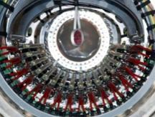
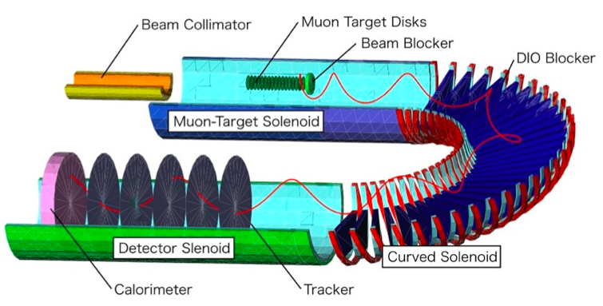
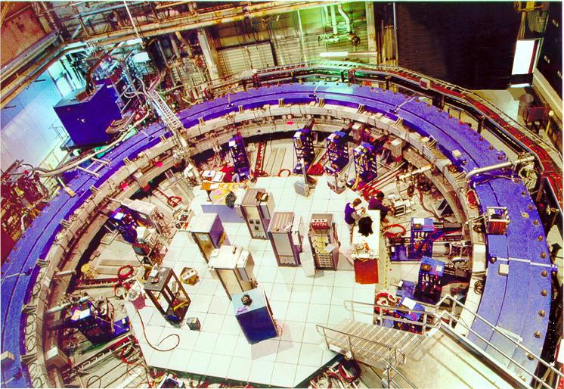
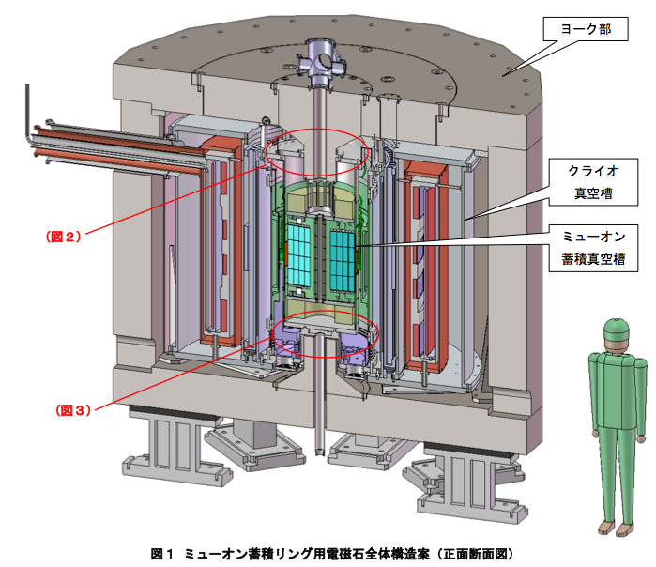
Searching for beyond SM with muons
Muon LFV/g-2/EDM aka “muon trio”
Sensitive probes for BSM (e.g. SUSY, Ext-D, …)
Clues to fundamental questions : Dark Matter, Baryon Asymmetry…
Past - Present
Future
MEG (PSI)
μ→eγ
Renewing upperlimit
Br < 2.4 10E-12
Discovery in horizon
COMET(J-PARC), mu2e (FNAL)
LFV
Next stage
g-2/EDM (J-PARC,FNAL)
g-2
E821 (BNL)
g-2
EDM
a_{μ}^{exp} = 11 659 208.9 (6.3) x 10⁻¹⁰ (0.5ppm)
a_{μ}SM = 11 659 182.8 (4.9) x 10⁻¹⁰
a_{μ}^{exp} -a_{μ}SM = +3.3 σ
Hagiwara / Davier et al.
EDM
d_{μ} < 2.7 10E-19 e cm (90%CL)

Slide 3
muon g-2/EDM measurements
In uniform magnetic field, muon spin rotates ahead of momentum due to g-2 = 0
a_{μ} (= (g-2)/2 ) is deduced from this residual rotation (precession).
In general, spin also rotates due to B_{eff} = β×E and EDM.
general form of spin precession vector:
BNL E821 approach
γ=30 (P=3 GeV/c)
J-PARC approach
E = 0
Continuation planned at FNAL with 0.1ppm precision
Proposed at J-PARC with 0.1ppm precision

Slide 4
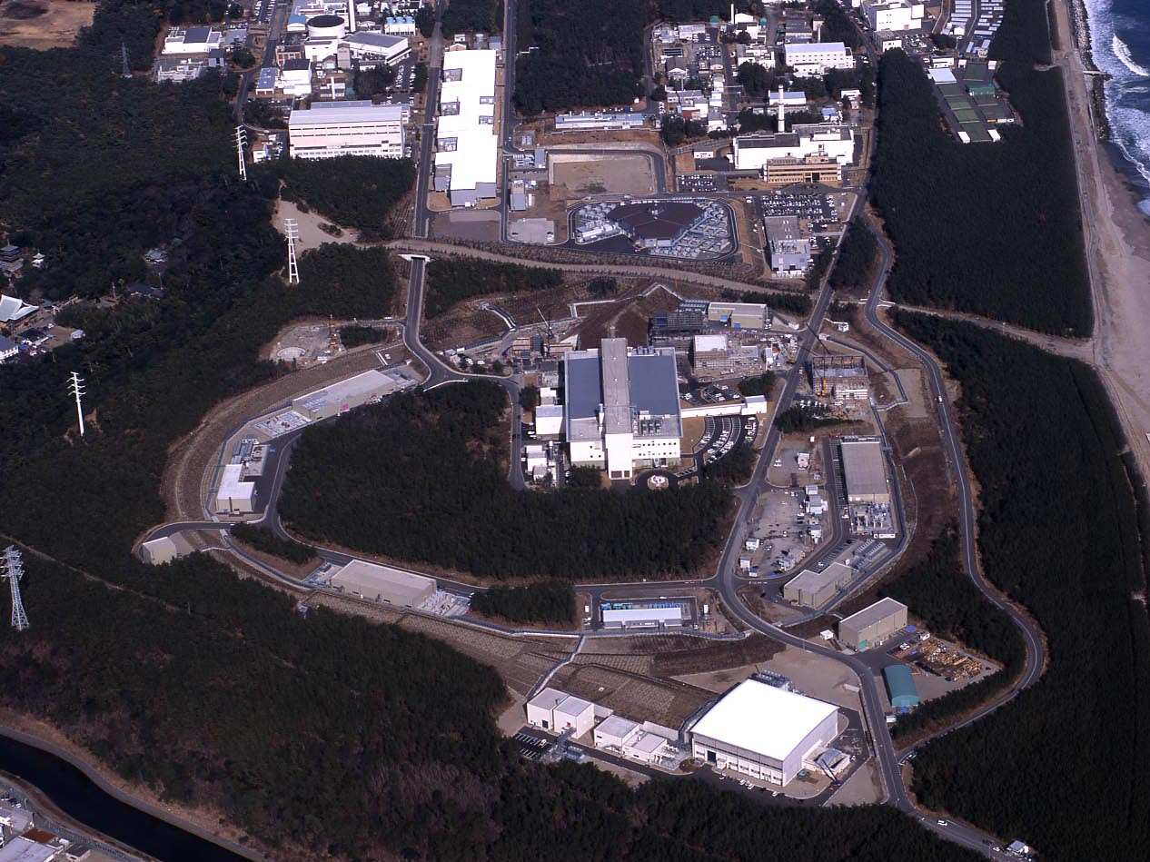
J-PARC Facility
(KEK/JAEA)
LINAC
3 GeV
Synchrotron
Neutrino Beam
To Kamioka
Material and Life Science
Facility
Main Ring
(30 GeV)
Hadron Hall
Bird’s eye photo in Feb. 2008

Slide 5
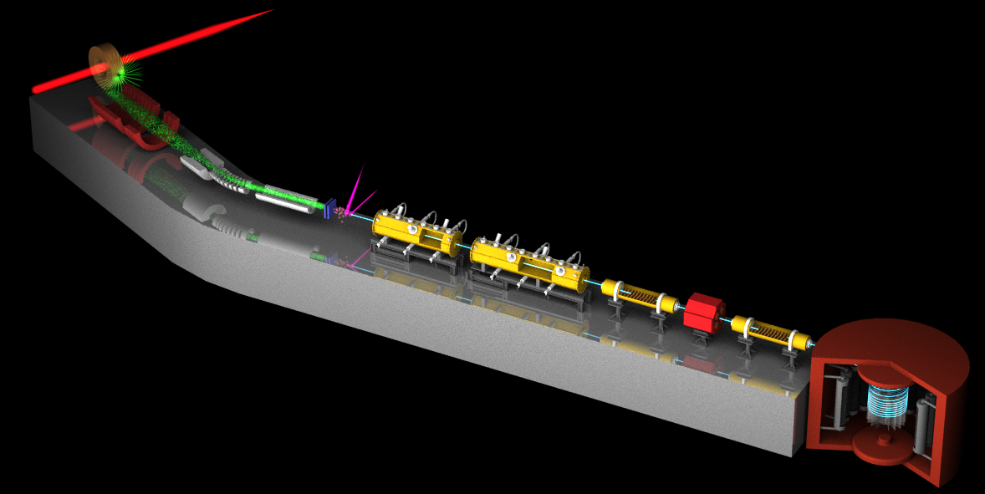
Surface muon
Ultra Cold μ+ Source
Muon
storage
Muon LINAC (300 MeV/c)
New Muon g-2/EDM Experiment at
J-PARC with Ultra-Cold Muon Beam

Slide 6
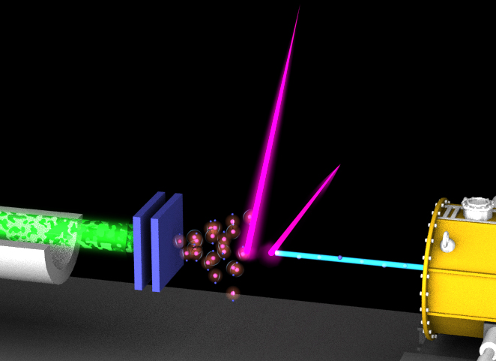
3 GeV proton beam
( 333 uA)
Graphite target
(20 mm)
Surface muon beam
(28 MeV/c, 4x10⁸/s)
Muonium Production
(300 K ~ 25 meV⇒2.3 keV/c)
Surface muon
Ultra Cold μ+ Source
Muon
storage
Resonant Laser Ionization of Muonium (~10⁶ μ⁺/s)
Muon LINAC (300 MeV/c)
New Muon g-2/EDM Experiment at
J-PARC with Ultra-Cold Muon Beam

Slide 7
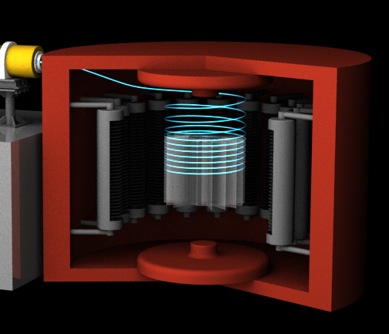
3 GeV proton beam
( 333 uA)
Graphite target
(20 mm)
Silicon Tracker
Surface muon beam
(28 MeV/c, 4x10⁸/s)
66 cm diameter
Muonium Production
(300 K ~ 25 meV⇒2.3 keV/c)
Surface muon
Super Precision Magnetic Field
(3T, ~1ppm local precision)
Ultra Cold μ+ Source
Muon
storage
Resonant Laser Ionization of Muonium (~10⁶ μ⁺/s)
Muon LINAC (300 MeV/c)
New Muon g-2/EDM Experiment at
J-PARC with Ultra-Cold Muon Beam

Slide 8
The muon storage magnet
Magnet iron yoke
Cryogenics
Super-conducting coils
μ storage orbit
2900 mm
e+ tracker

Slide 9
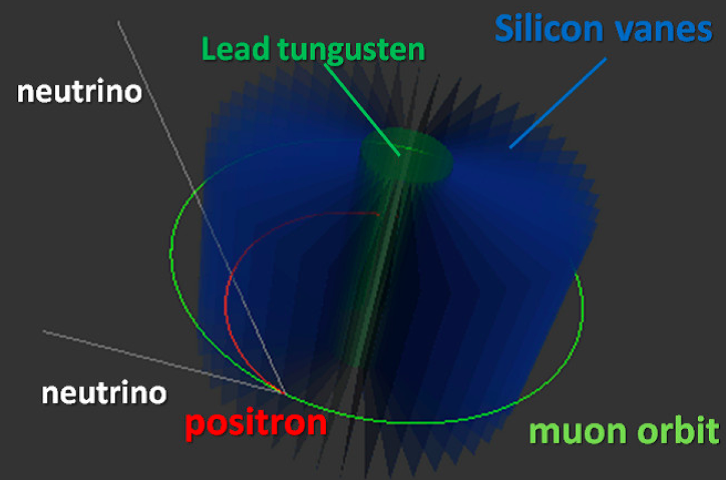
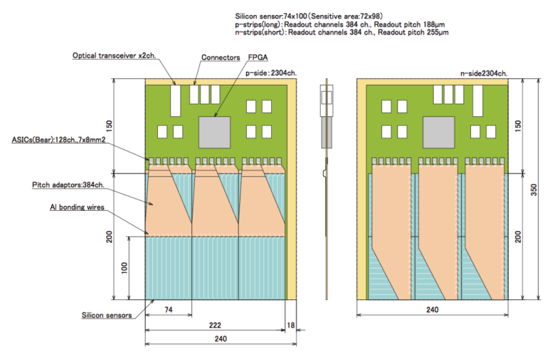
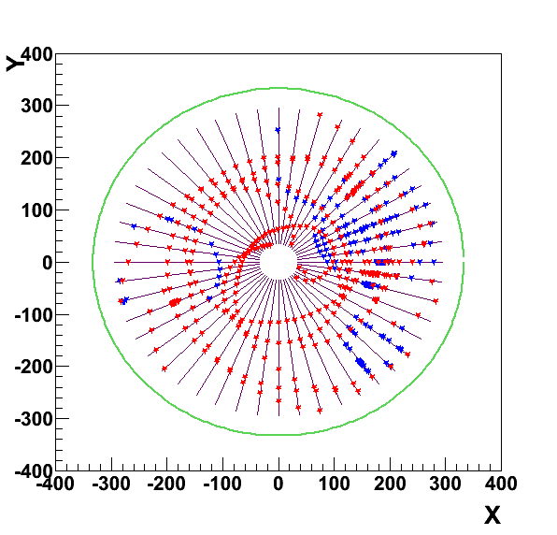
Positron tracker
Positron tracker consists of silicon-strip vanes.
Silicon-strip vane
・ signal e+ (p>200MeV/c)
・ BG e+ (p<200MeV/c)
In the first 5 ns after muon injection,
15 signal e+ tracks with p>200 MeV
30 BG e+ tracks with p<200 MeV
Hit rate 1-2 MHz/200μm
Rate reduced by 1/160 after 30 μs (5 x lifetime)
GEANT4
mm

Slide 10
Expected time spectrum of μ→e⁺νν decay
Muon spin precesses with time.
→ number of high energy e⁺ changes with time by the frequency :
p>200 MeV/c
0.1ppm uncertainty
ω
e⁺ decay time (sec)

Slide 11
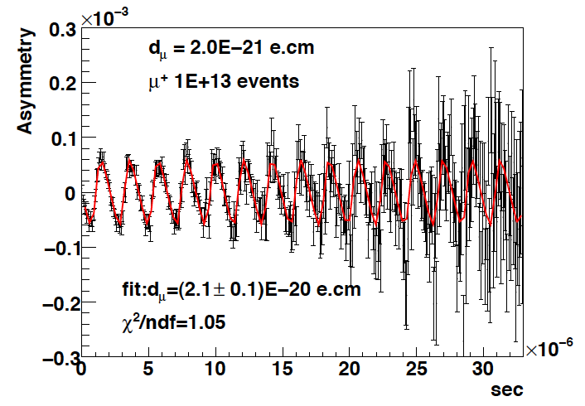
Expected time spectrum of μ→e⁺νν decay
EDM tilts the precession axis.
This yields an up-down decay asymmetry in number of e+
(oscillates with the same frequency ω)
p>200 MeV/c
d_{μ}=2E-20 e・cm
Up-down asymmetry
ω
∝EDM
e+ decay time (sec)

Slide 12
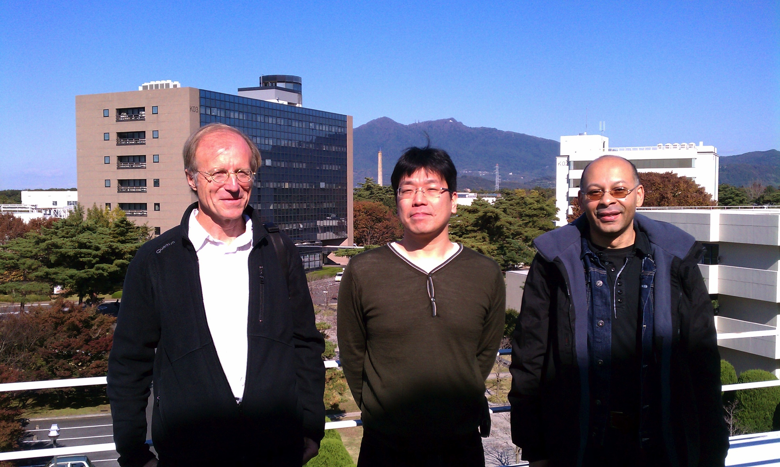
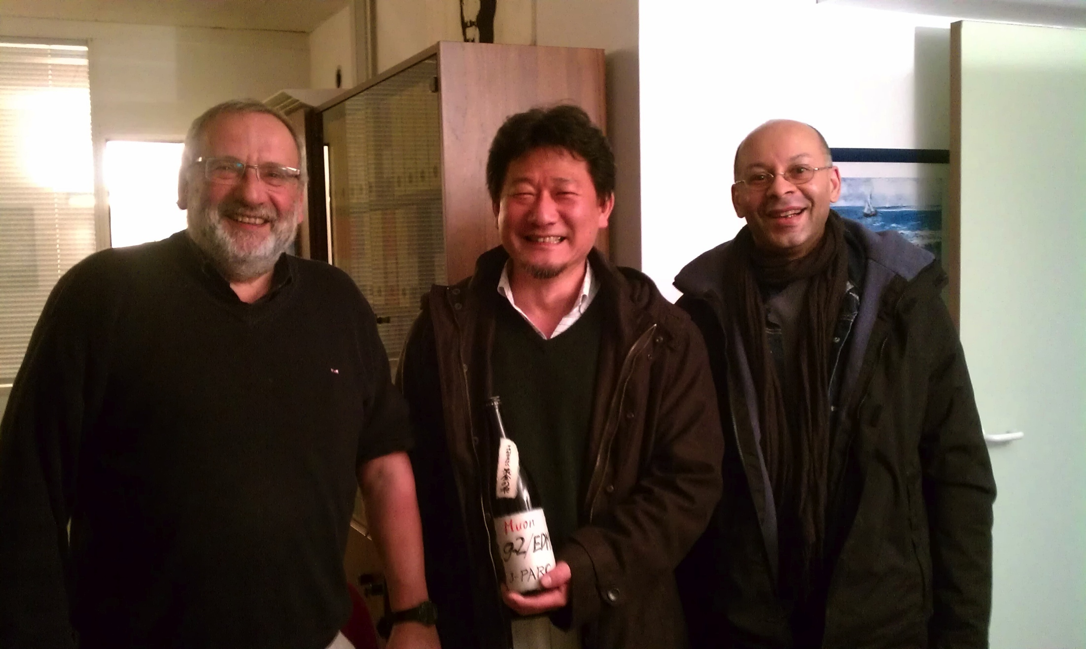
French-Japan collaboration on the positron tracker development
KEK
Osamu Sasaki
Manobu Tanaka
Masahiro Ikeno
Tomohisa Uchida
Takashi Kohriki
Naohito Saito
Tsutomu Mibe
RIKEN
Kazuki Ueno
Univ. of Tokyo
Takuya Kakurai
Rikkyo Univ.
Jiro Murata
Haruna Murakami
LPHNE Paris
Frédéric Kapusta
Wilfrid da Silva
Jean-François Genat
Jaques David
CC-IN2P3 Lyon
Yonny Cardenas
French-Japan collaboration on detector development
was initiated with SAKURA program (MAEE-JSPS) (2011-2012).

Slide 13
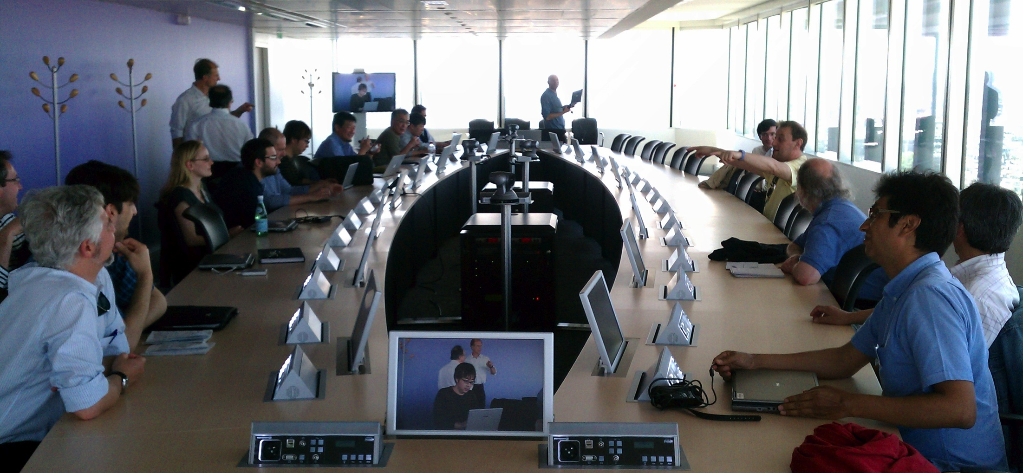
2nd Workshop on muon g-2 and EDM in LHC era
Frédéric Kapusta
(LPNHE)
Hosted by LPNHE
Held in May 25 (last Friday) in LPNHE, Paris
30+ participants from France, Germany, Spain and Japan
Round-table discussion on theoretical & experimental issues

Slide 14
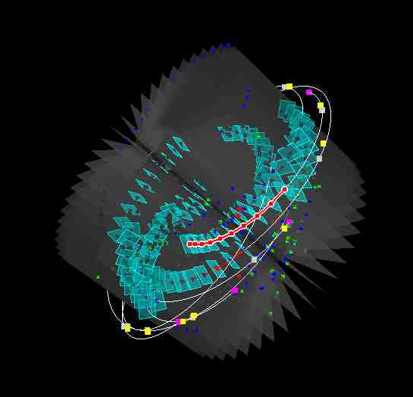
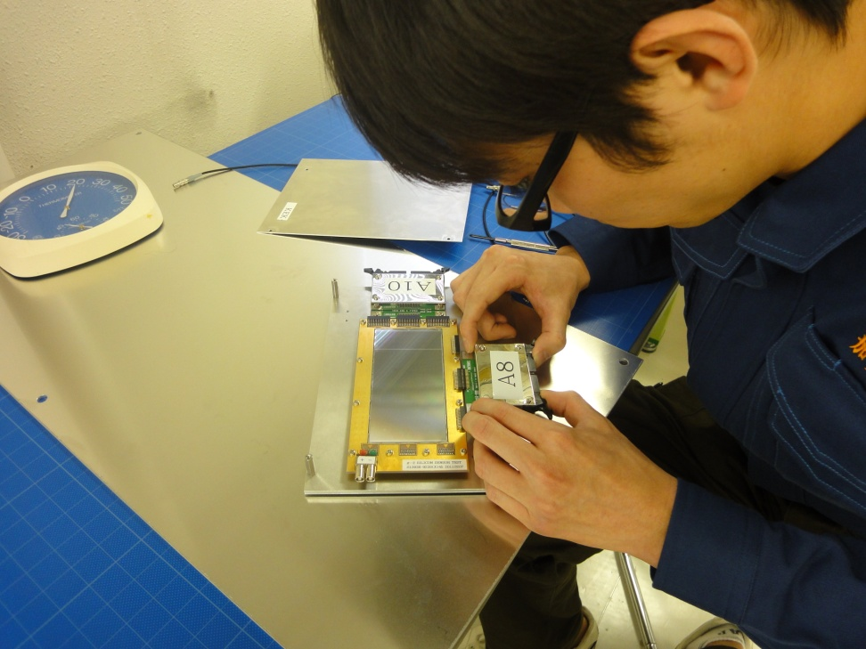
Proposed research program in FJPPL
The base of research program has been developed under SAKURA program (MAEE-JSPS).
We propose to strengthen the collaboration in following areas :
Software framework
Reconstruction software
Simulation software and Computing resource with CC-IN2P3
Detector characterization including beam tests of silicon-strip vanes at DESY/J-PARC
Simulated positron track
and reconstruction

Slide 15
Software framework
Development of software framework become critical as sub-R&D tasks are in advanced stage.
Mokka is a tools developed by French laboratory (Labortoire Leprince-Ringuet (LLR)).
Mokka as example for building the g-2/EDM detector.
Development in FJPPL
Architecture
Technology selection and implementation
Establish link between simulation and hardware design
Plot from Wilfrid da Silva

Slide 16
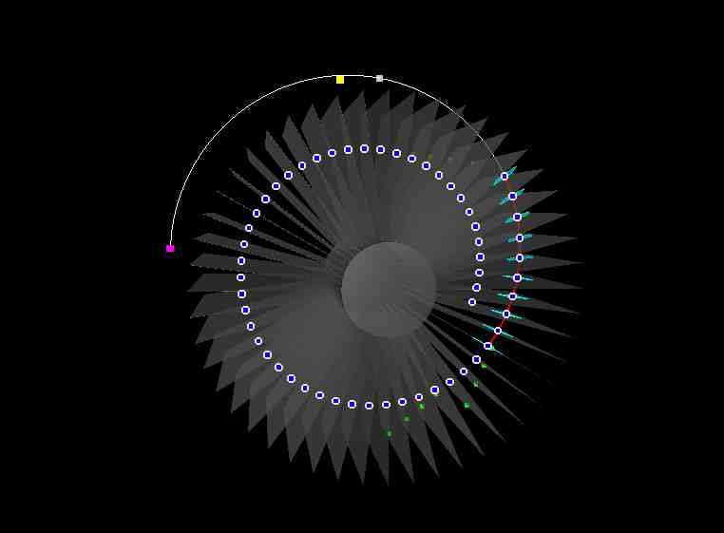
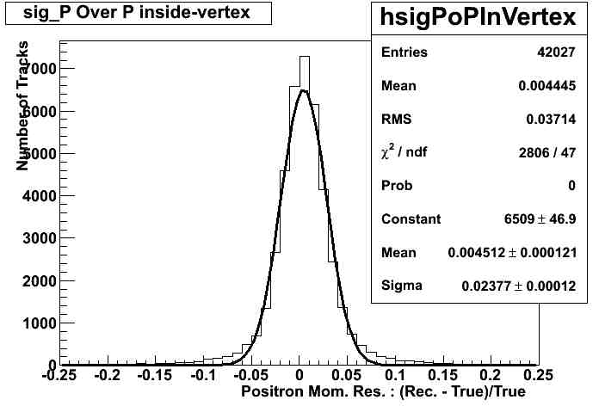
Track reconstruction software
Track of e+ will be reconstructed from tracker hits.
Visualization
Event displays (RIKEN/LPNHE)
Track finding (RIKEN/KEK)
Hough transformations
Steering
Track fitting (LPNHE)
Tools built on GENFIT (made in French)
Performance of track reconstruction has demonstrated for a single track.
Future development in FJPPL
Multi-tracks reconstruction
Vertex reconstruction
Plots from Wilfrid da Silva

Slide 17
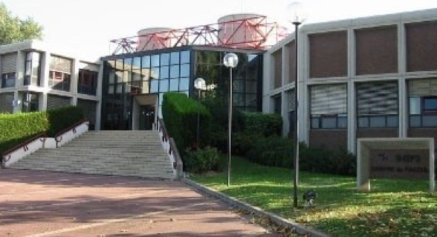
Simulation and computing resource
The experiment measures of 10E+13 muon decays.
Thus, 10E+14 decays in MC simulation.
Significant computing resource required
10E+14 decay/ 1year / 100 cpu = 10E+5/sec
G4 code development (RIKEN/KEK)
Preliminary simulation performed at CC-IN2P3 (Wilfrid da Silva, Yonny Canderas)
Development in FJPPL
Benchmark tests
Code optimizations

Slide 18
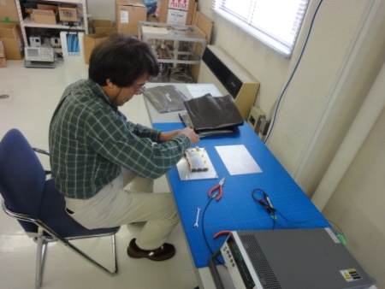
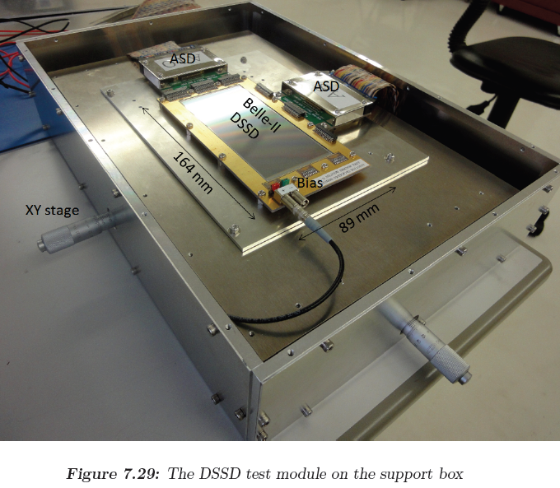
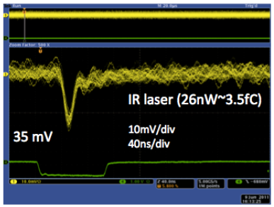
Detector characterization
Test detector module (KEK)
Studies on rate effects
Impact to precision B-field
Frontend ASICs under development (KEK)
Infrastructure for sensor characterization (LPNHE)
Expertise on silicon detector developments (LPNHE)
Development in FJPPL
Characterization of Silicon sensor and frontend electronics
Beam tests at DESY & J-PARC
18

Slide 19
Summary
In FJPPL, we propose to collaborate in following areas of detector R&D for muon g-2/EDM:
Software framework
Reconstruction software
Simulation software and Computing resource with CC-IN2P3
Detector characterization including beam tests of silicon-strip vanes at DESY/J-PARC
Other areas, such as detector hardware and muon beam studies, are also being considered for future collaboration.
Exploring possible collaboration with Korean scientists is top list in agenda too.

Slide 20
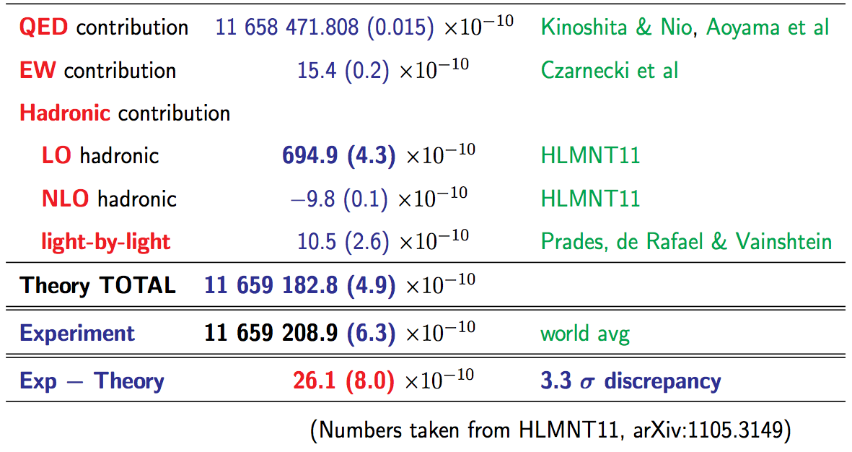
Muon g-2 in standard model
D. Nomura (PhiPsi11)

Slide 21
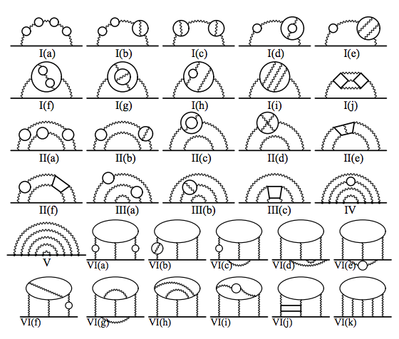
Breaking news!

Slide 22
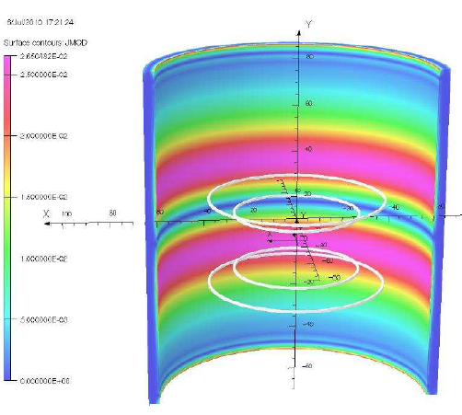
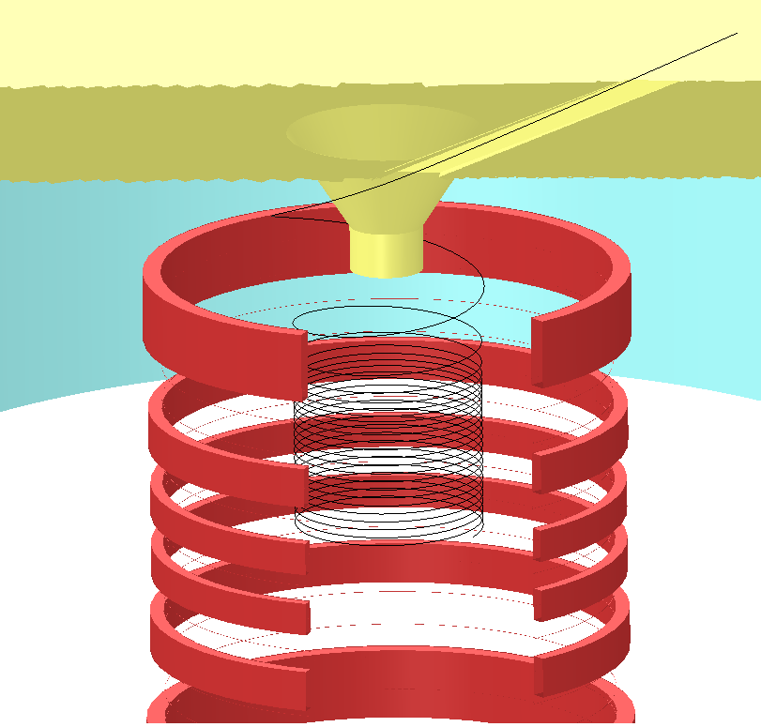
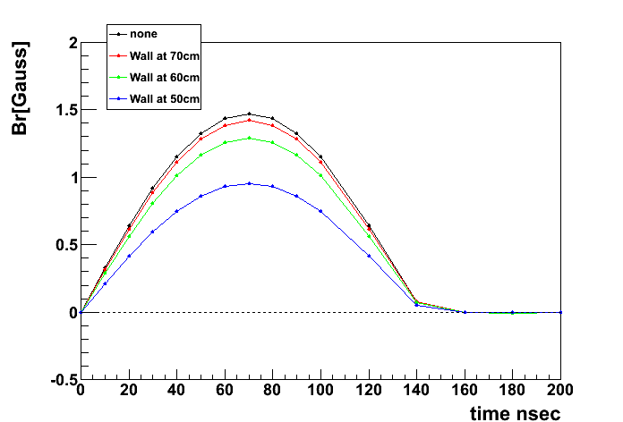
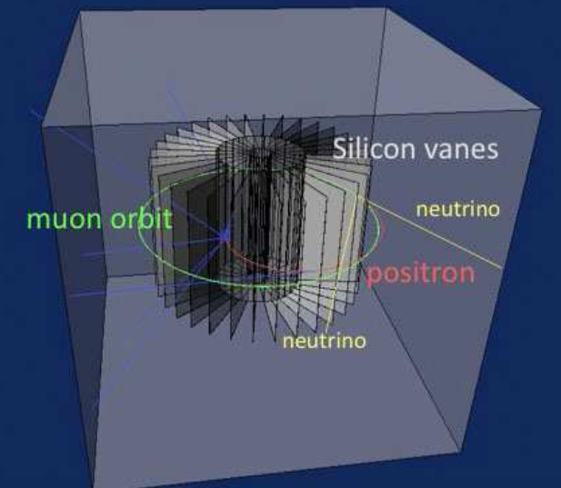
Injection, storage, and positron detection
Muon storage magnet
Muon beam is injected here
Anti-Helmholtz-type kicker
(Pulse kick to stop spiral)
Spiral injection
Magnet coil (3T)
ν
kicker
detector
e⁺
Positron tracker
ν
mm

Slide 23
Requirements and core R&D tasks
Detector should be efficient for
Positron track with p = 200 - 300 MeV/c in 3T solenoidal B-field
with a radial vertex resolution of σ=1 mm (if very-weak focusing is applied).
Immune to early-to-late effect
The decay positron rate changes by two orders of magnitude.
1.6 MHz/strip → 10kHz/strip for 200 um pich Silicon strip.
The positron detector must be stable over the measurements.
Zero E-field (<<10⁻² V/cm) at muon storage area
Not spoil the precision B-field ( <10ppm) at muon storage area
Efficient readout in compatible with the J-PARC beam pulse structure
GEANT4 simulation, toy MC
Track finding studies
feedback
DSSD sensor evaluation
Software design framework
(Simulation, offline reconstruction, DAQ)
Computing environment
(simulation, GRID, finite element analysis)
Mechanical design
(thermal, vacuum, EM shield)
E-field calculation model
B-field measurements by NMR
Front-end electronics

Slide 24
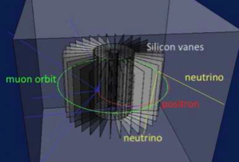
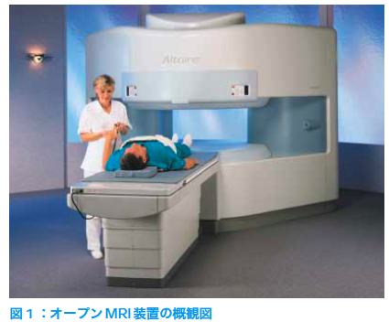
Our approach
Compact storage ring
Suited for precision control of B-field
Example : MRI magnet , 1ppm local uniformity
Completely different systematics than the BNL E821 or FNAL
BNL E821 / FNAL g-2
J-PARC g-2
70 cm
14m
P= 3.1 GeV/c , B=1.45 T
P= 0.3 GeV/c , B=3.0 T
Hitachi co.

Slide 25
Design parameters
Item | Specifications
Fiducial volume | 240mm (radial) x 400 mm (axial)
Number of vane | 48 (still subject for optimization)
Sensor technology | Double- or single-sided Silicon strip sensor
Strip | axial-strip : 188μm pitch, 72mm long , 384 ch radial-strip: 255μm pitch, 98mm long, 384 ch
Sensor dimension | 74 mm x 98 mm x 0.32mm
Number of sensor | 576 ( 12 sensors per vane)
Number of channel | 442,368 ch
Time measurement | Period : 33μs, Sampling time : 5ns

Slide 26
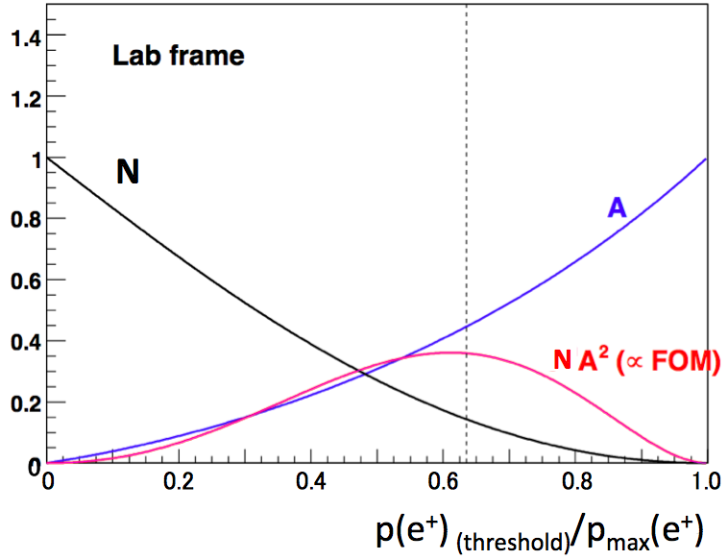
μ→e⁺νν decay kinematics
μ⁺
−
ν_{R}
e⁺_{R}
ν_{L}
Laboratory frame
W⁺_{L}
→ →
N(p>p_{(threshold)}) = N (1 + A s・p /(|s||p|)
Positron emission in muon rest frame
μ⁺
200 MeV/c
spin
−
e⁺
νν
V-A favored
V-A suppressed
p spin
e⁺
−
νν
The e+ angular distribution is subject to the V-A structure of weak interaction.
High energy positron tends to be emitted into the direction of muon spin.
The optimum e⁺ momentum threshold is around 200 MeV/c.

Slide 27
The Silicon vane
T. Kohriki
Detector modules will be placed in vacuum environment (P<0.1Pa)

Slide 28
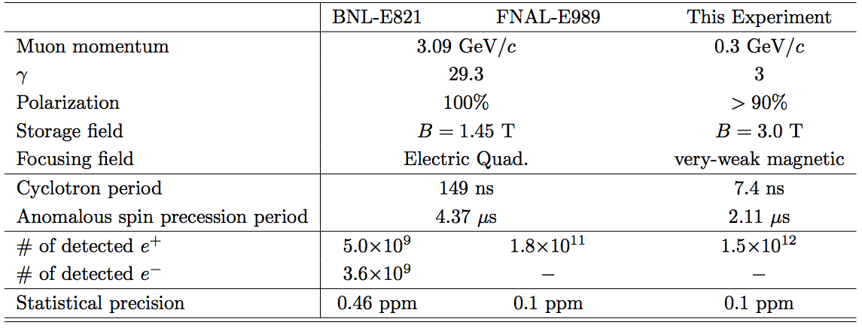
BNL, FNAL, and J-PARC

Slide 29
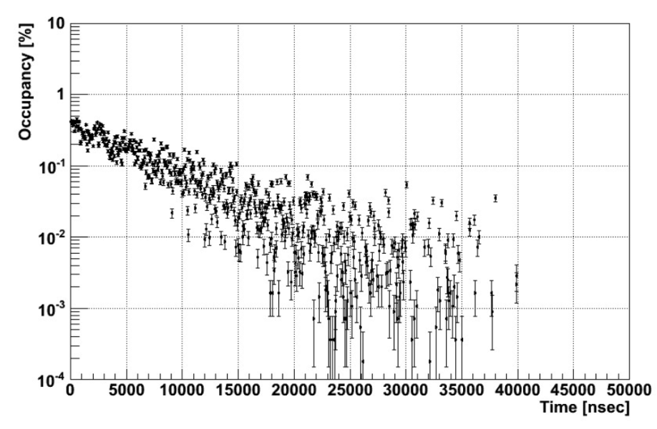
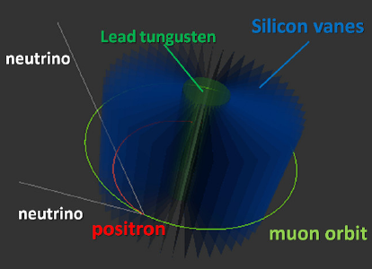
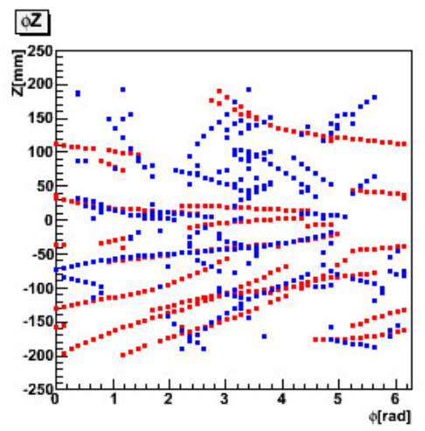
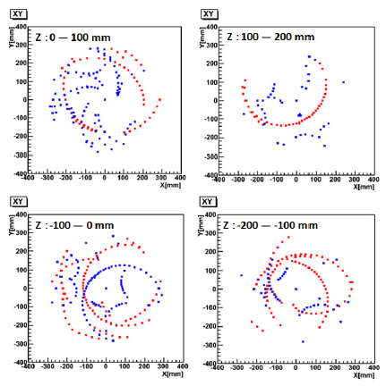
Raw occupancy and hit distributions
K. Ueno
A GEANT4 simulation has been carried out to evaluate positrons hits as well as background hits.
BG consists of EM processes: such as bremsstrahlung, annihilation, pair creation etc...
Occupancy is less than 0.5% per 5ns time stamp (5 hits/strip/spill).
Positron tracks at the beginning:
15 signal e+ tracks with p>200 MeV at first 5ns
30 BG e+ tracks with p<200 MeV at first 5ns
Strong hit correlations in φZ plane and XY plane.
G4 simulation
1 spill (40000 muon decays)
G4 simulation
first 5ns time stamp
z
x
y
φ
・ signal e+ (p>200MeV/c)
・ BG e+ (p<200MeV/c)

Slide 30
Raw occupancy and hit rate
Occupancy is less than 0.5% per 5ns time stamp (5 hits/strip/spill).
Positron tracks at the beginning:
15 signal e+ tracks with p>200 MeV in first 5ns
30 BG e+ tracks with p<200 MeV in first 5ns
G4 simulation
1 spill (40000 muon decays)

Slide 31
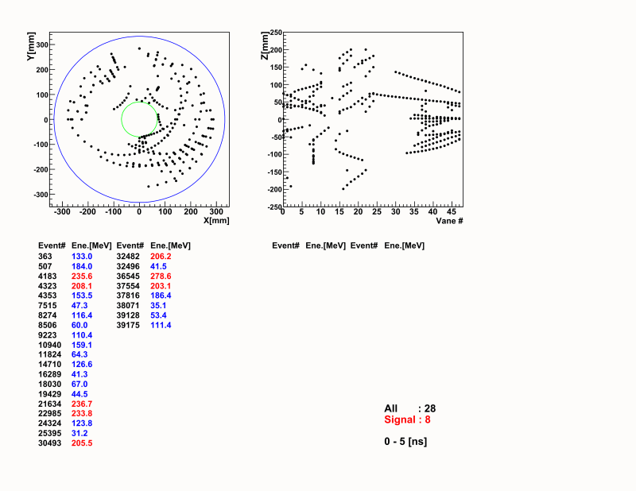
Time evolution of track hits
By Kazuki Ueno

Slide 32
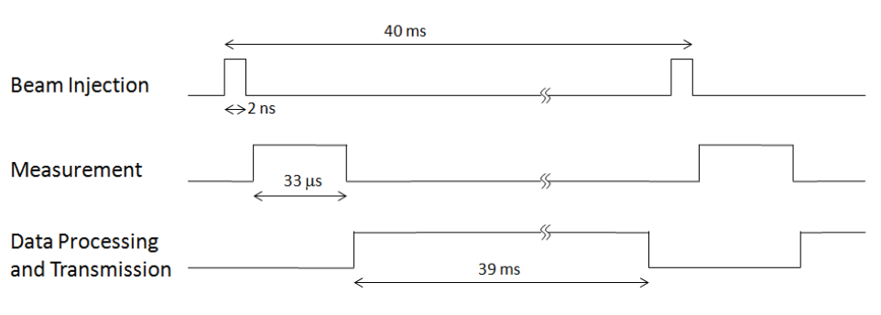
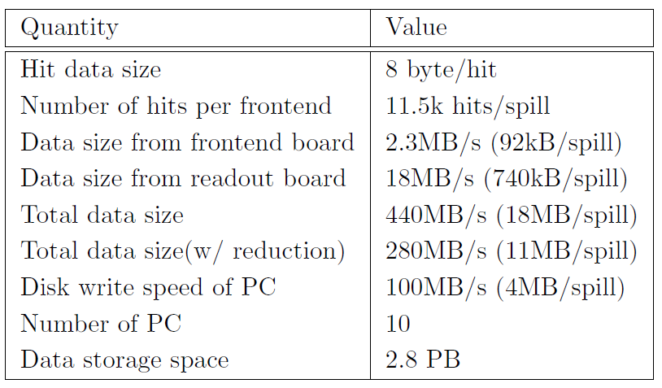
Readout electronics and DAQ
O. Sasaki
M. Tanaka
T. Uchida
J.F. Genat
Readout electronics and DAQ are designed to match the time structure of the J-PARC beam.
Signals in Silicon sensors are amplified and digitized at Front end, then transmitted to the backend readout boards.

Slide 33
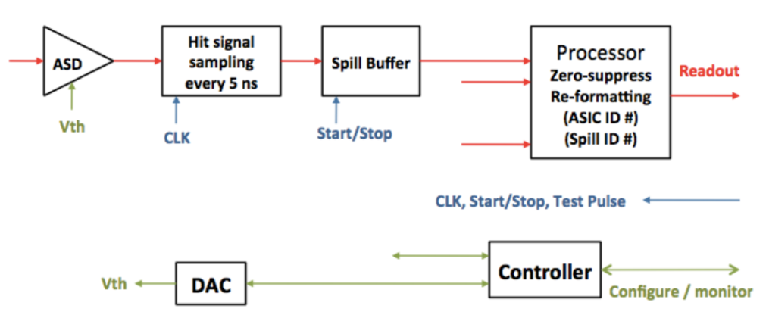
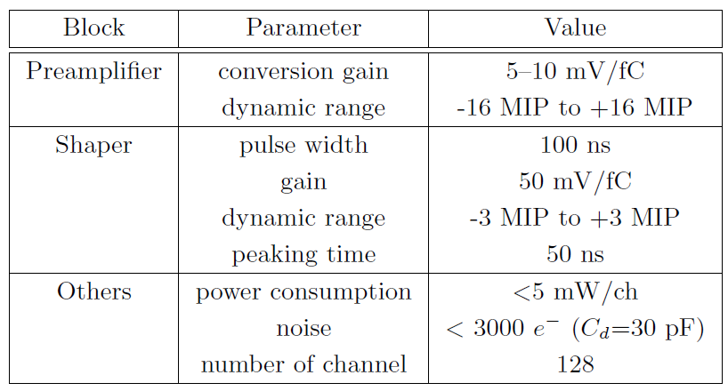
Front-end ASIC
M. Tanaka,T. Uchida
M. Ikeno,O. Sasaki
Analog and digital part of the ASIC has been designed in JFY2011.
Simulated pulse shape in ASD
Preamplifier output
Shaper output
Comparator output

Slide 34
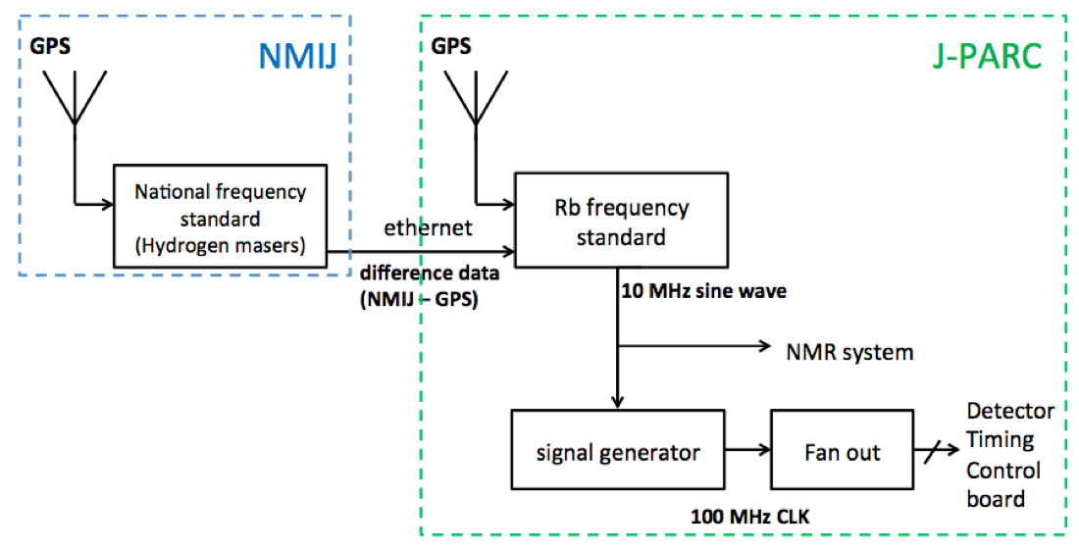
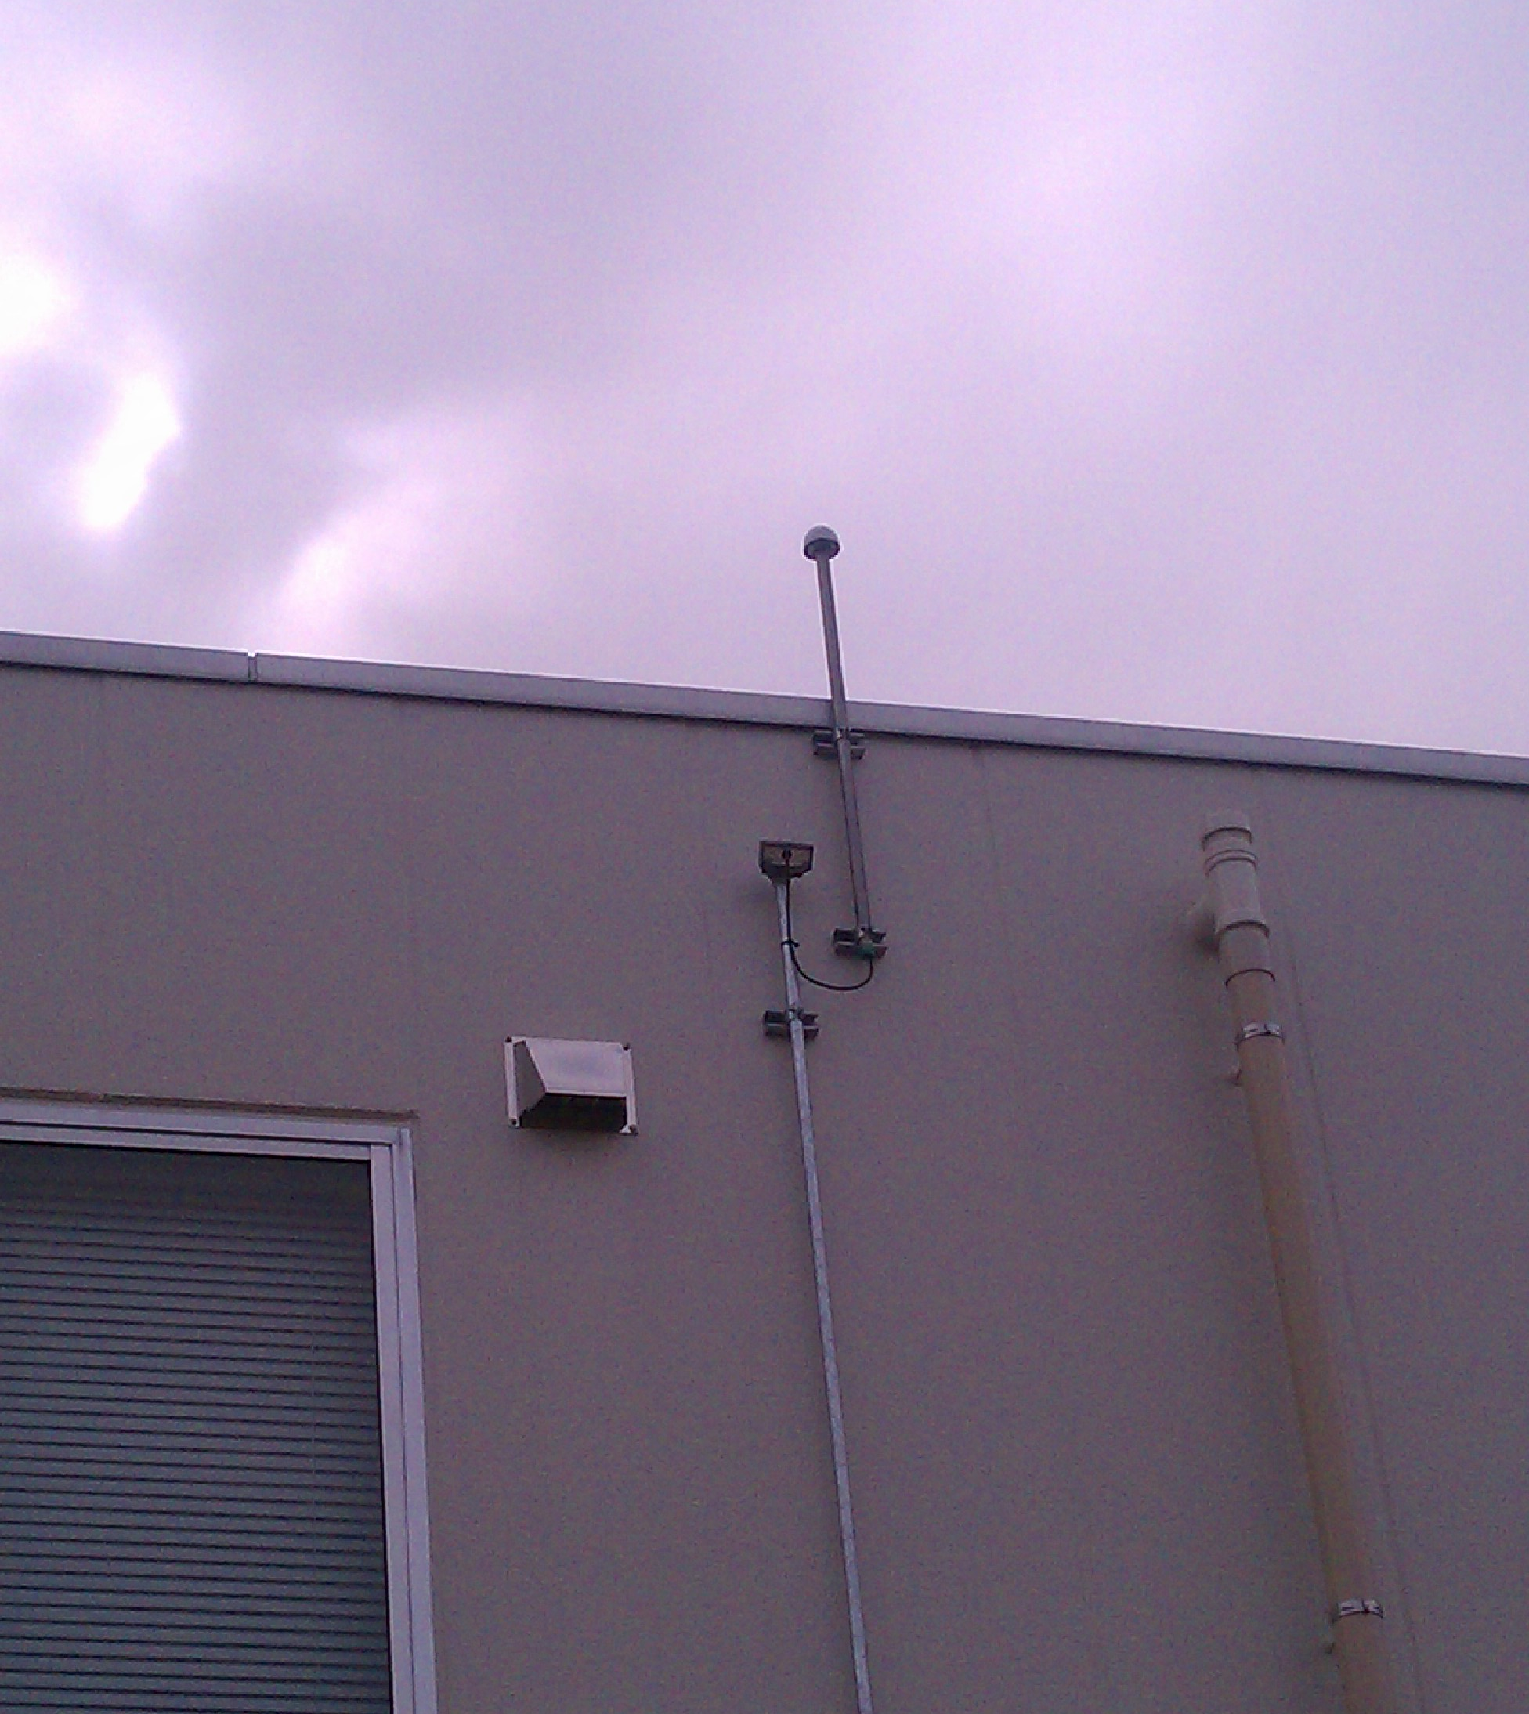
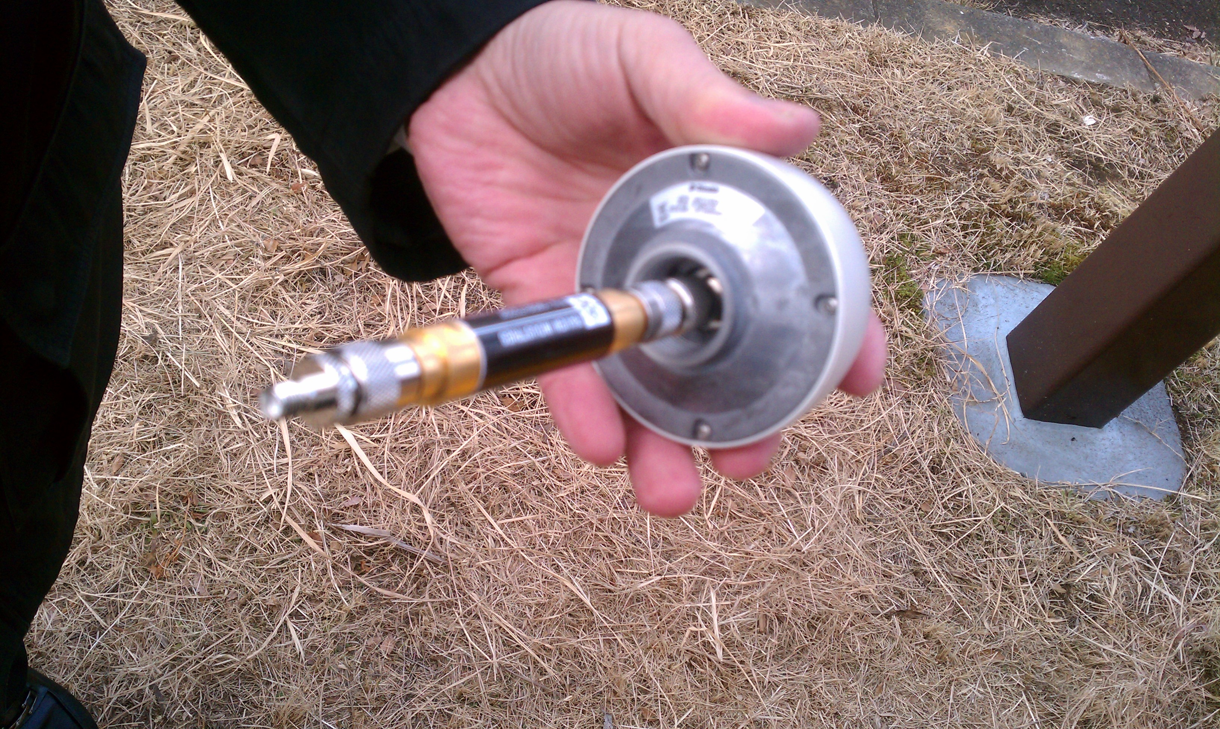
High precision clock
The system clock utilizes the high precision Rb frequency standard with remote calibration from the national frequency standard NMIJ as well as GPS to realize frequency stability of Δf/f <5 x 10⁻⁹/s.
GPS antenna at KEK

Slide 35
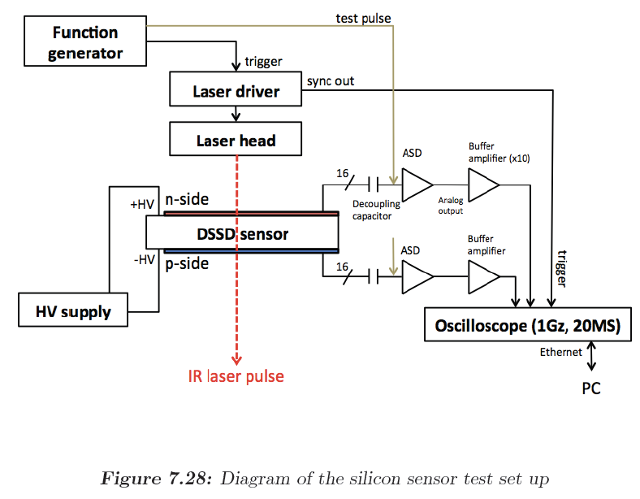
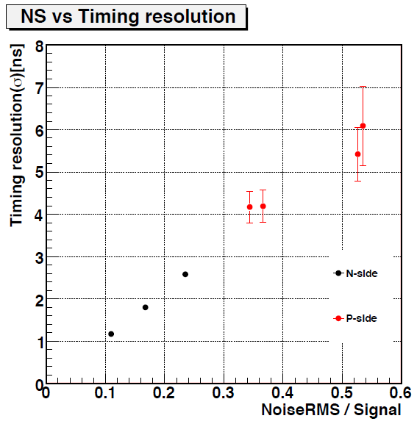
R&Ds for early-to-late effects
T. Kakurai, T. Mibe,
O. Sasaki, T. Kohriki
A silicon-sensor test system with IR laser was built.
The IR laser could be pulsed at repetition rate as high as 80MHz with an asynchronous external trigger.
Systematic studies on early-to-late effects are in progress.
f_{max}=80MHz

Slide 36
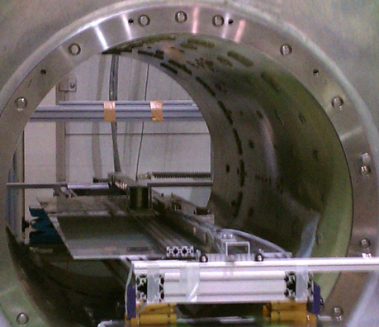
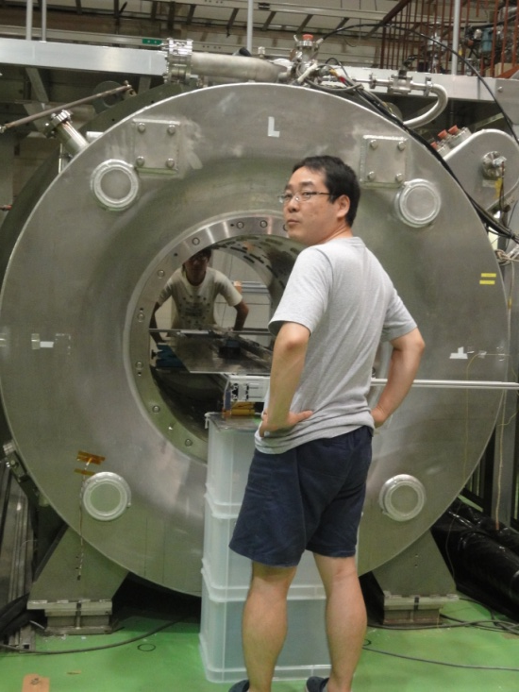
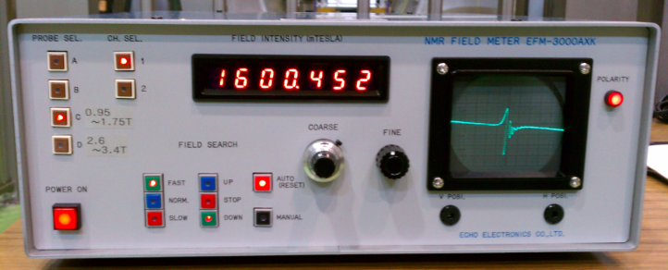
Effect of detector components in the precision B-field
K. Sasaki, T. Kakurai
T. Mibe, O. Sasaki
1.6T super-conducting
solenoid
Test material
NMR probe
NMR controller
B-field in the vicinity of material and detector components were measured by NMR probe.

Slide 37
Effect of magnetic field due to currents in electronics
A data transfer board with a FPGA and an optical transceiver (prepared for Belle-II exp.) was operated under 1.6 T solenoid.
Voltage : 3.3 V
Current : 1 A
Dummy data transmission
B-field change of 12-25 ppm (2 ppm) was observed at 7.5 mm (150 mm) away from the parts. These changes are due to magnetic susceptibility of materials since no change of B-field beyond the sensitivity was observed when the power is on.
B(blank) = 1600.446 mT
B(off) = 1600.407 mT
B(on, idle) = 1600.407 mT
B(on, data TX) = 1600.407 mT
NMR
Probing point
Optical
Transceiver
(3.1Gbps)
7.5mm
B(blank) = 1600.446 mT
B(off) = 1600.468 mT
B(on, idle) = 1600.468 mT
B(on, data TX) = 1600.468 mT
FPGA
Thanks to
Bellle-II group
Nakao-san and Higuchi-san
Belle-II data transfer board

Slide 38
Capacitor
Surface mount capacitors were evaluated (1-100pcs).
No strong dependence on capacitance.
More effect in larger-dimension capacitors.
Lines are from OPERA-3D

Slide 39
Resistor
(1 piece)
実線は磁化率をパラメータにしてOPERA計算結果をデータにフィットしたもの
Surface mount capacitors were evaluated (100pcs).
No strong dependence on resistance, grade.
More effect in larger-dimension registers.

Slide 40
FPGA/PROM/Optical module
磁場変動の２次元マップ
ΔB/B [ppm]
r [mm]

Slide 41
Projected schedule
Now
CDR submitted
Stage-1 approved
TDR submmision
Stage-2 request?

