Slide 1
Registration
ACGRID-III (Hanoi)
1 November 2011

Slide 2
Authentication and Authorization
Common Proxy Service
All authentication is done through common service
Relies on JAAS implementation in Jetty web service container
Flexible mechanism that takes advantage of existing software
Authentication Mechanisms
Username/password (password file or LDAP)
Grid certificates and VOMS proxies (DN file or LDAP)
Shibboleth, SLCS, etc. are currently being worked on
Authorization
Done by individual cloud services and rights may differ between them
Policies based on groups and roles will be available soon

Slide 3
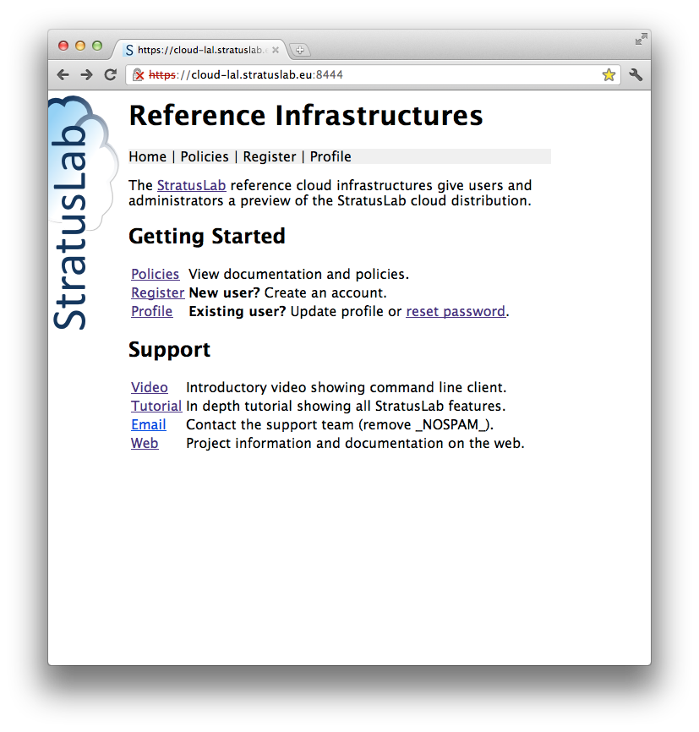
Home
Registering & Account Mgt.
Understanding StratusLab
https://cloud-lal.stratuslab.eu:8444/

Slide 4
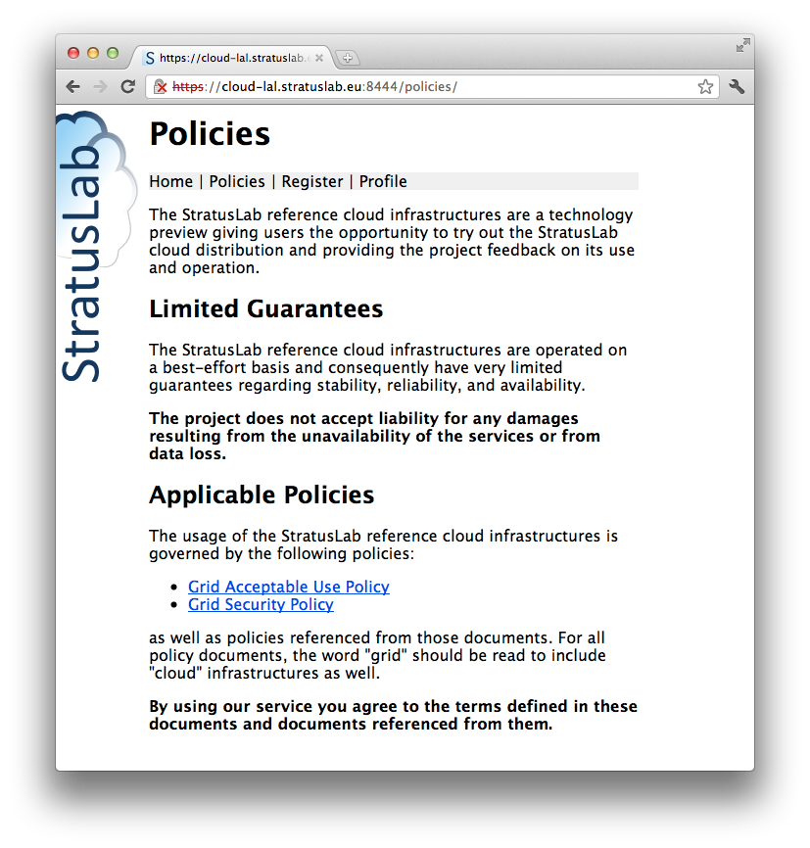
Policies
Disclaimer
Reuse Grid Policies, but…

Slide 5
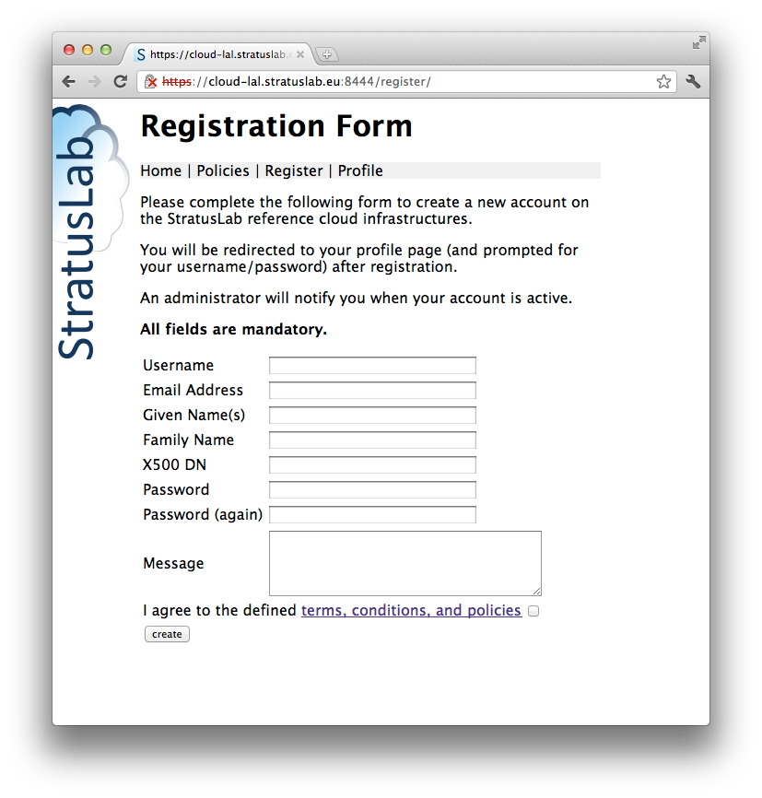
Register
DN not required
Provide information

Slide 6
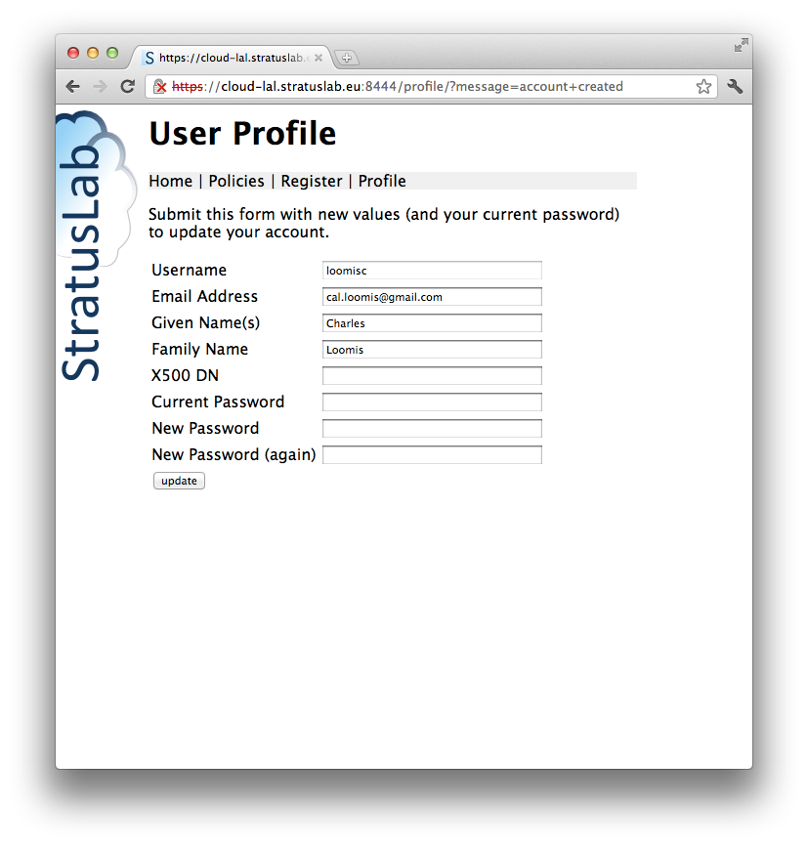
Profile
You can use both a username/password and grid DN to access cloud, but they are considered different users!!
Use password to access and change account information.

Slide 7
Questions and Discussion

