Slide 1
Introduction to Cloud Technology
ACGRID-III (Hanoi)
1 November 2011

Slide 2
Biography: Charles Loomis (Cal)
Ph.D. in High-Energy Physics (<2001)
E735 (Duke), Fermilab Tevatron
CDF (Rutgers), Fermilab Tevatron
ALEPH (CERN), CERN LEP
ATLAS (UCSC), CERN LHC
Grid and Cloud Technologies (2001—)
European DataGrid: Deployment and integration of grid middleware
EGEE, EGEE-II, EGEE-III: Coordinator of user support and liaisons
Quattor: Developer of the pan configuration language compiler
StratusLab: Project coordinator
SixSq Sàrl (2007—)
An SME with 3 partners based in Geneva
Consulting and tools for automated testing of software systems

Slide 3
Biography: Marc-Elian Bégin (Meb)
Degree in Mechanical Aerospace Engineering (<2004)
Real-time simulation and test bed development with Canadian and European Space Agencies
Grid and Cloud Technologies (2004—)
EGEE: Technical coordination, CERN
ETICS (Build and Test System for Grid middleware): Deputy-Project Coordinator
StratusLab: Leader of Integration and Test activity
SixSq Sàrl (2007—)
An SME with 3 partners based in Geneva
Consulting and tools for automated testing of software systems

Slide 4
Biography: Mohammed Airaj
Ph.D. in Applied Mathematics (<2005)
MatraDataVision (EADS)
OpenCascade S.A.
PULDV (Paris), UPPA (PAU)
Grid and Cloud Technologies (2006—)
Integrated Tokamak modelling (ITM):
Infrastructure and Integration Software Project (CEA Cadarache)
Euforia Project (CEA Cadarache)
EGEE-III: Grid Applications Porting Support (CEA Saclay)
StratusLab: User and administrator support and application porting

Slide 5
Your Backgrounds
Researchers and Engineers (End-users)
Use existing academic and/or commercial software on cloud
What scientific domains?
Developers
Modify existing software to use cloud resources
Create new software for the cloud
What types of software?
Administrators
Provide cloud resources to researchers, engineers, and/or developers
What types of users? Local, multi-institute, …?

Slide 6
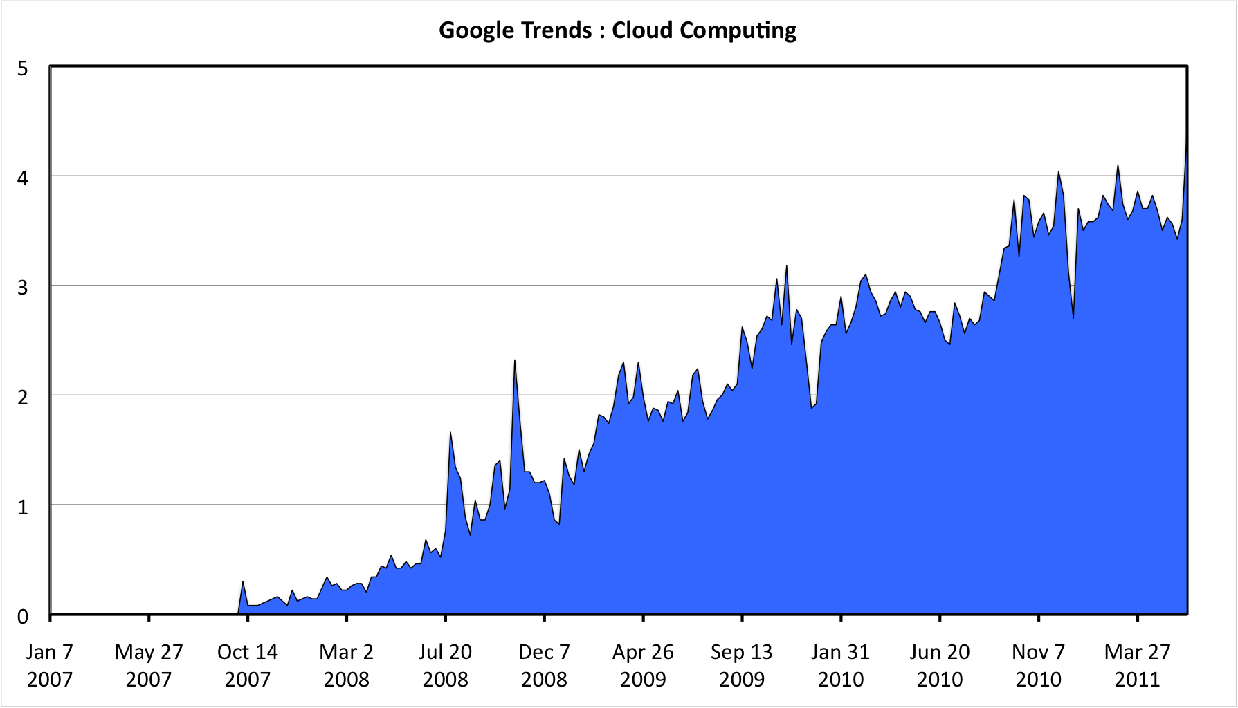
Cloud Marketing
“Cloud” is currently very trendy, used everywhere
Many definitions that are often incompatible
Very often used to market pre-existing (non-cloud) software
But, interesting and useful concepts and tools coming from “cloud”
Cloud Computing

Slide 7
“The” Cloud
Many previous cloud-like initiatives:
Commodity Computing (Sun, 2005)
Utility Computing (IBM, HP, Microsoft, …)
Amazon EC2 (2006), EBS (2008)
Cloud is the convergence of several concepts:
Mature virtualization technology with little performance degradation
Appearance of simplified APIs (REST, XMLRPC, …)
Significant excess of commercial computing capacity (Amazon, Google, …)

Slide 8
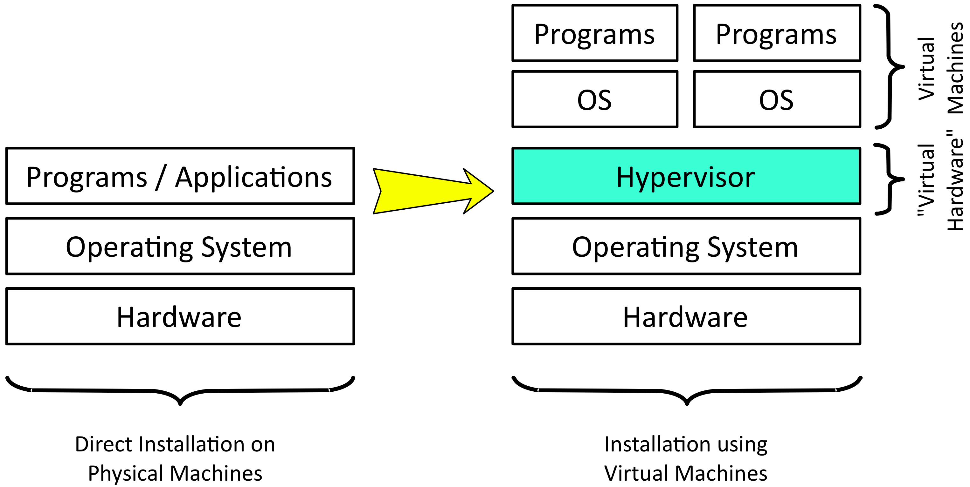
Virtualization

Slide 9
What is a Cloud?
Cloud Taxonomy
Vendor Lock-In
Software as a Service (SaaS)
Flexibility
Platform as a Service (PaaS)
Infrastructure as a Service (IaaS)
Best definitions come from NIST (USA):
http://csrc.nist.gov/publications/PubsDrafts.html#SP-800-145

Slide 10
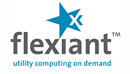
Infrastructure as a Service (IaaS)
Architecture
Access to remote virtual machines
Advantages
Customized environment
Simple and rapid access
Access as “root”
Pay-as-you-go model
Disadvantages
Non-standardized interfaces (vendor lock-in)
Virtual machine creation is difficult and time-consuming
Software as a Service (SaaS)
Platform as a Service (PaaS)
Infrastructure as a Service (IaaS)

Slide 11
Platform as a Service (PaaS)
Architecture
Platform and infrastructure for creating web applications
Advantages
Load balancing, automatic failover, etc.
Programmers can forget about the low-level “plumbing”
Disadvantages
Restricted number of languages
Applications are not portable between different providers
Software as a Service (SaaS)
Platform as a Service (PaaS)
Infrastructure as a Service (IaaS)

Slide 12
Software as a Service (SaaS)
Architecture
Essentially web-hosting
Advantages
Very simple use: web interface with no software installation
Very accessible: laptop, smartphone, …
Disadvantages
Questions about data: access, ownership, reliability, etc.
Integration of different services is often difficult
Software as a Service (SaaS)
Platform as a Service (PaaS)
Infrastructure as a Service (IaaS)

Slide 13
What is a Cloud?
Cloud Taxonomy
Vendor Lock-In
Software as a Service (SaaS)
Flexibility
Platform as a Service (PaaS)
Infrastructure as a Service (IaaS)
Best definitions come from NIST (USA):
http://csrc.nist.gov/publications/PubsDrafts.html#SP-800-145

Slide 14
Deployment Models
Private
Single administrative domain
Community
Different administrative domains but with common interests/procedures
Public
People outside of institute’s administrative domain, general public

Slide 15
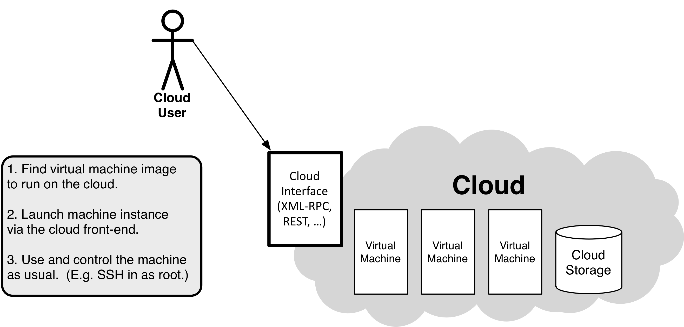
Using an IaaS Cloud

Slide 16
Why use an IaaS cloud?
Customized Environment
Deployment of software with a large number or difficult dependencies
Use an environment that has already been validated
Development and Testing of Software
Easy access to many different operating systems
Change computing environment without impacting other developers
Test software systems that consist of several machines
Service Deployment
Deploy services without the intervention of the local site administrator
Create platforms (PaaS) pour scientific communities
Dynamic access to very significant computing resources

Slide 17
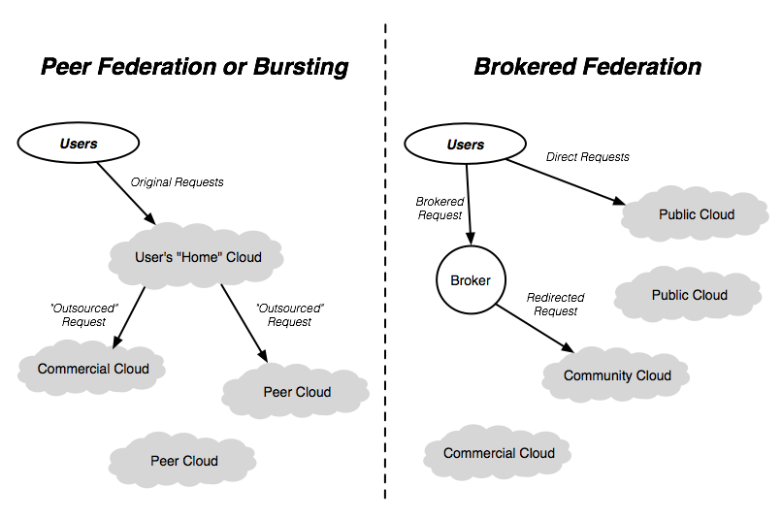
Hybrid Clouds and “Sky” Computing

Slide 18
Questions and Discussion

