Slide 1

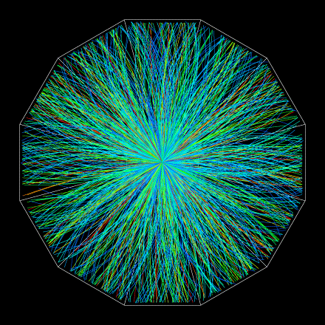
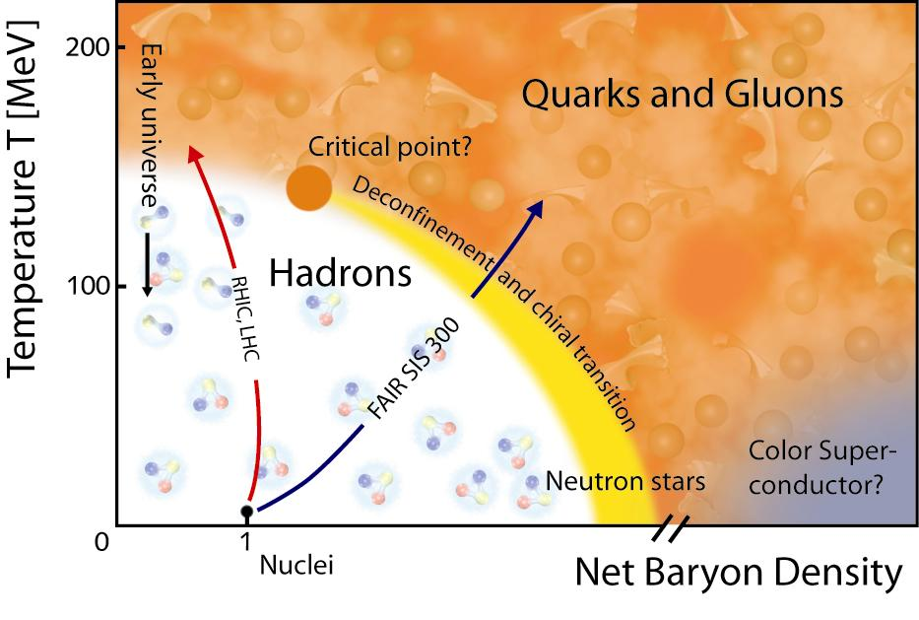

Soft Physics at RHIC
Hadron Collider Physics Symposium 2011
Michal Šumbera
Nuclear Physics Institute AS CR, Řež/Prague
(for the STAR and PHENIX Collaborations)

Slide 2
Remarkable discoveries at RHIC
  Perfect liquid BRAHMS, PHENIX, PHOBOS, STAR, Nuclear Physics A757 (2005)1-283
  Number of constituent quark scaling PHENIX, PRL 91(2003)072301; STAR, PR C70(2005) 014904
  Jet quenching PHENIX, PRL 88(2002)022301; STAR, PRL 90(2003) 082302
  Heavy-quark suppression PHENIX, PRL 98(2007)172301, STAR, PRL 98(2007)192301
  Production of exotic systems
    Discovery on anti-strange nucleus STAR, Science 328 (2010) 58
    Observation of anti-⁴He nucleus STAR, Nature 473 (2011) 353
  Indications of gluon saturation at small x STAR, PRL 90(2003) 082302; BRAHMS, PRL 91(2003) 072305; PHENIX ibid 072303

Slide 3
Remarkable discoveries at RHIC
  Perfect liquid BRAHMS, PHENIX, PHOBOS, STAR, Nuclear Physics A757 (2005)1-283
  Number of constituent quark scaling PHENIX, PRL 91(2003)072301; STAR, PR C70(2005) 014904
  Jet quenching PHENIX, PRL 88(2002)022301; STAR, PRL 90(2003) 082302
  Heavy-quark suppression PHENIX, PRL 98(2007)172301, STAR, PRL 98(2007)192301
  Production of exotic systems
    Discovery on anti-strange nucleus STAR, Science 328 (2010) 58
    Observation of anti-⁴He nucleus STAR, Nature 473 (2011) 353
  Indications of gluon saturation at small x STAR, PRL 90(2003) 082302; BRAHMS, PRL 91(2003) 072305; PHENIX ibid 072303

Slide 4
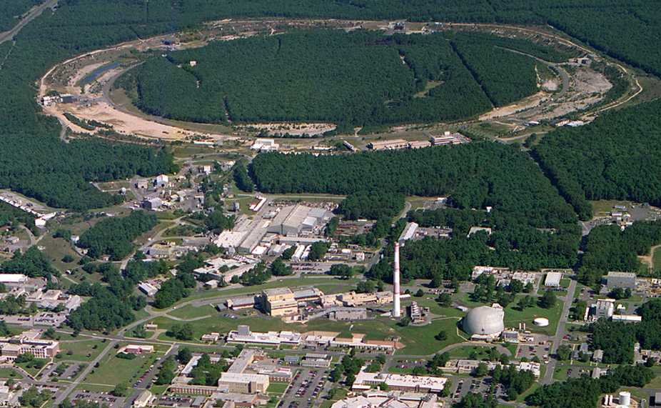
Relativistic Heavy Ion Collider (RHIC)
Brookhaven National Laboratory (BNL), Upton, NY
Year | System | √s_{NN} [GeV]
2000 | Au+Au | 130
2001 | Au+Au | 200
2002 | p+p | 200
2003 | d+Au | 200
2004 | Au+Au p+p | 62.4 200
2005 | Cu+Cu | 200, 62.4, 22
2006 | p+p | 62.4, 200, 500
2007 | Au+Au | 200
2008 | d+Au p+p Au+Au | 200 200 9.2
2009 | p+p | 200, 500
2010 | Au+Au | 200, 62.4, 39, 11.5, 7.7
2011 | Au+Au p+p | 200,19.6,27 500
PHOBOS
BRAHMS
RHIC
PHENIX
STAR
AGS
TANDEMS
World’s (second) largest operational heavy-ion collider
World’s largest polarized proton collider
Animation M. Lisa

Slide 5
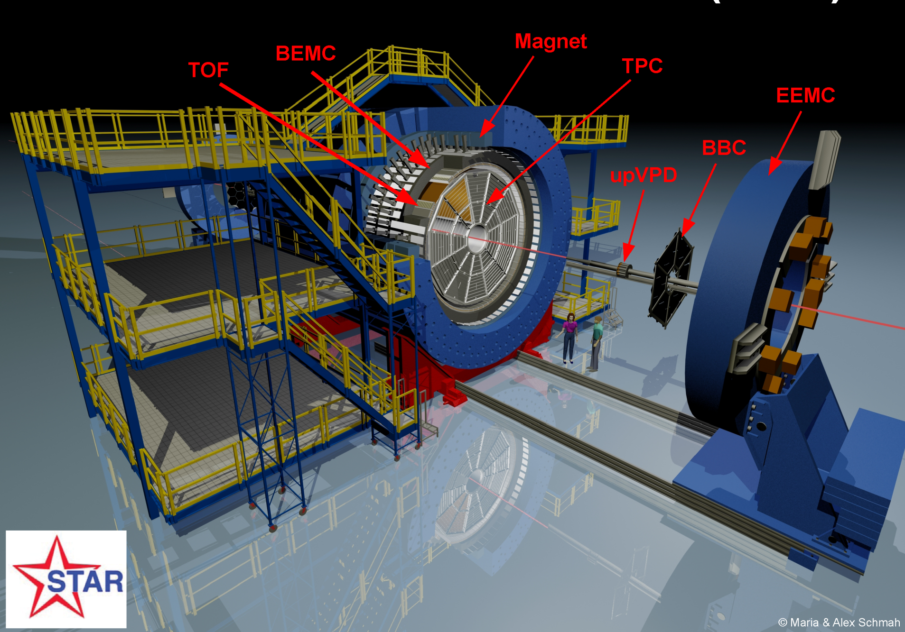
TPC:
Detects Particles in the |η|<1 range
π, K, p through dE/dx and TOF
K⁰_{s}, Λ, Ξ, Ω, φ through invariant mass

Slide 6
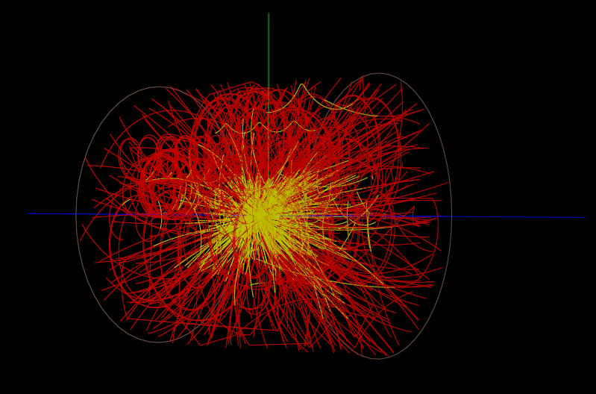
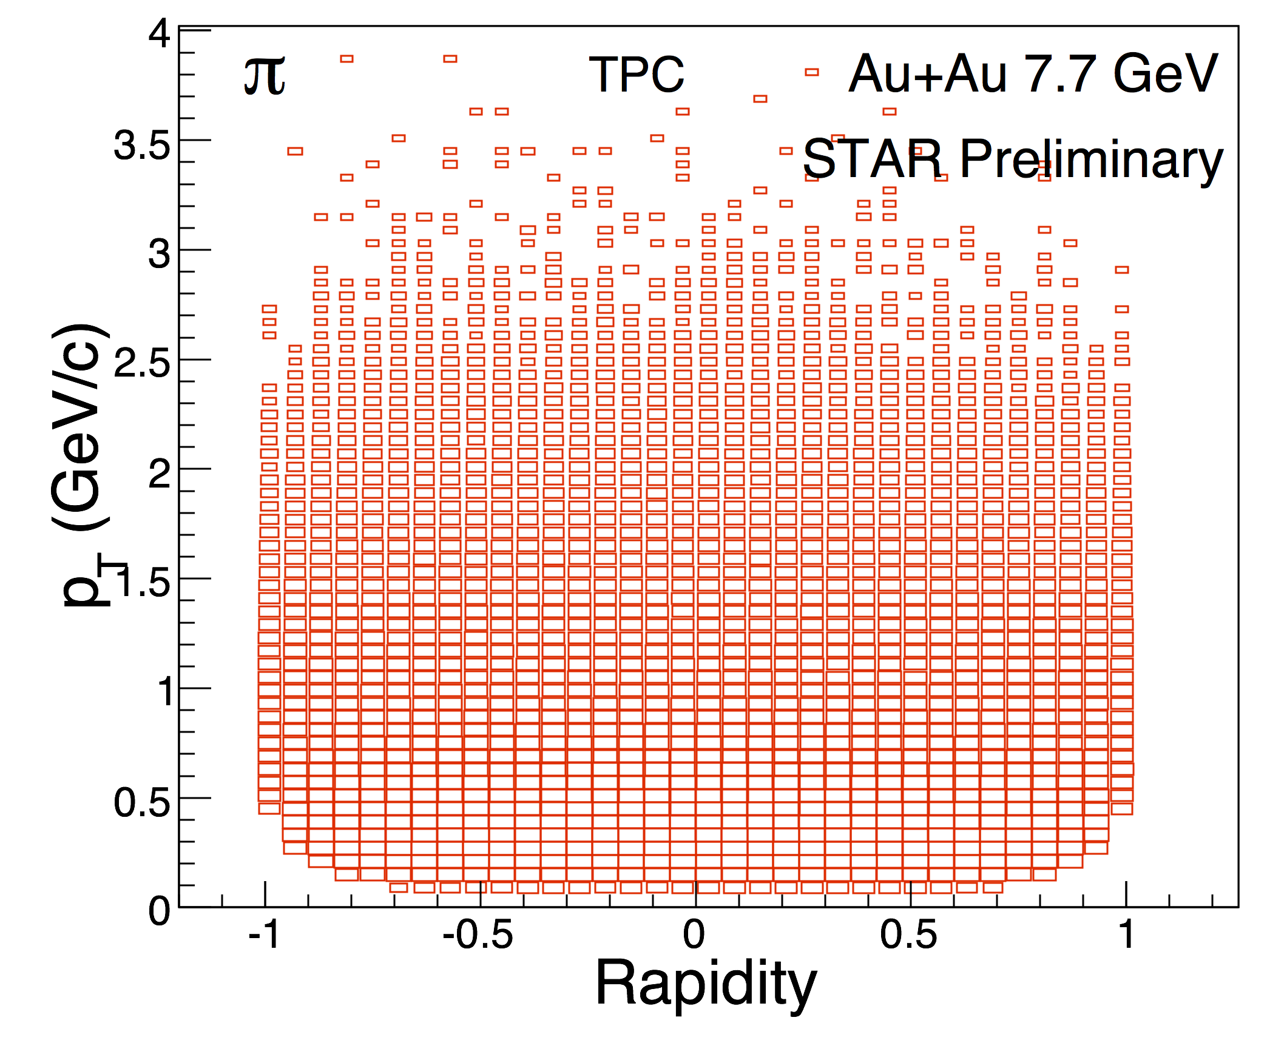
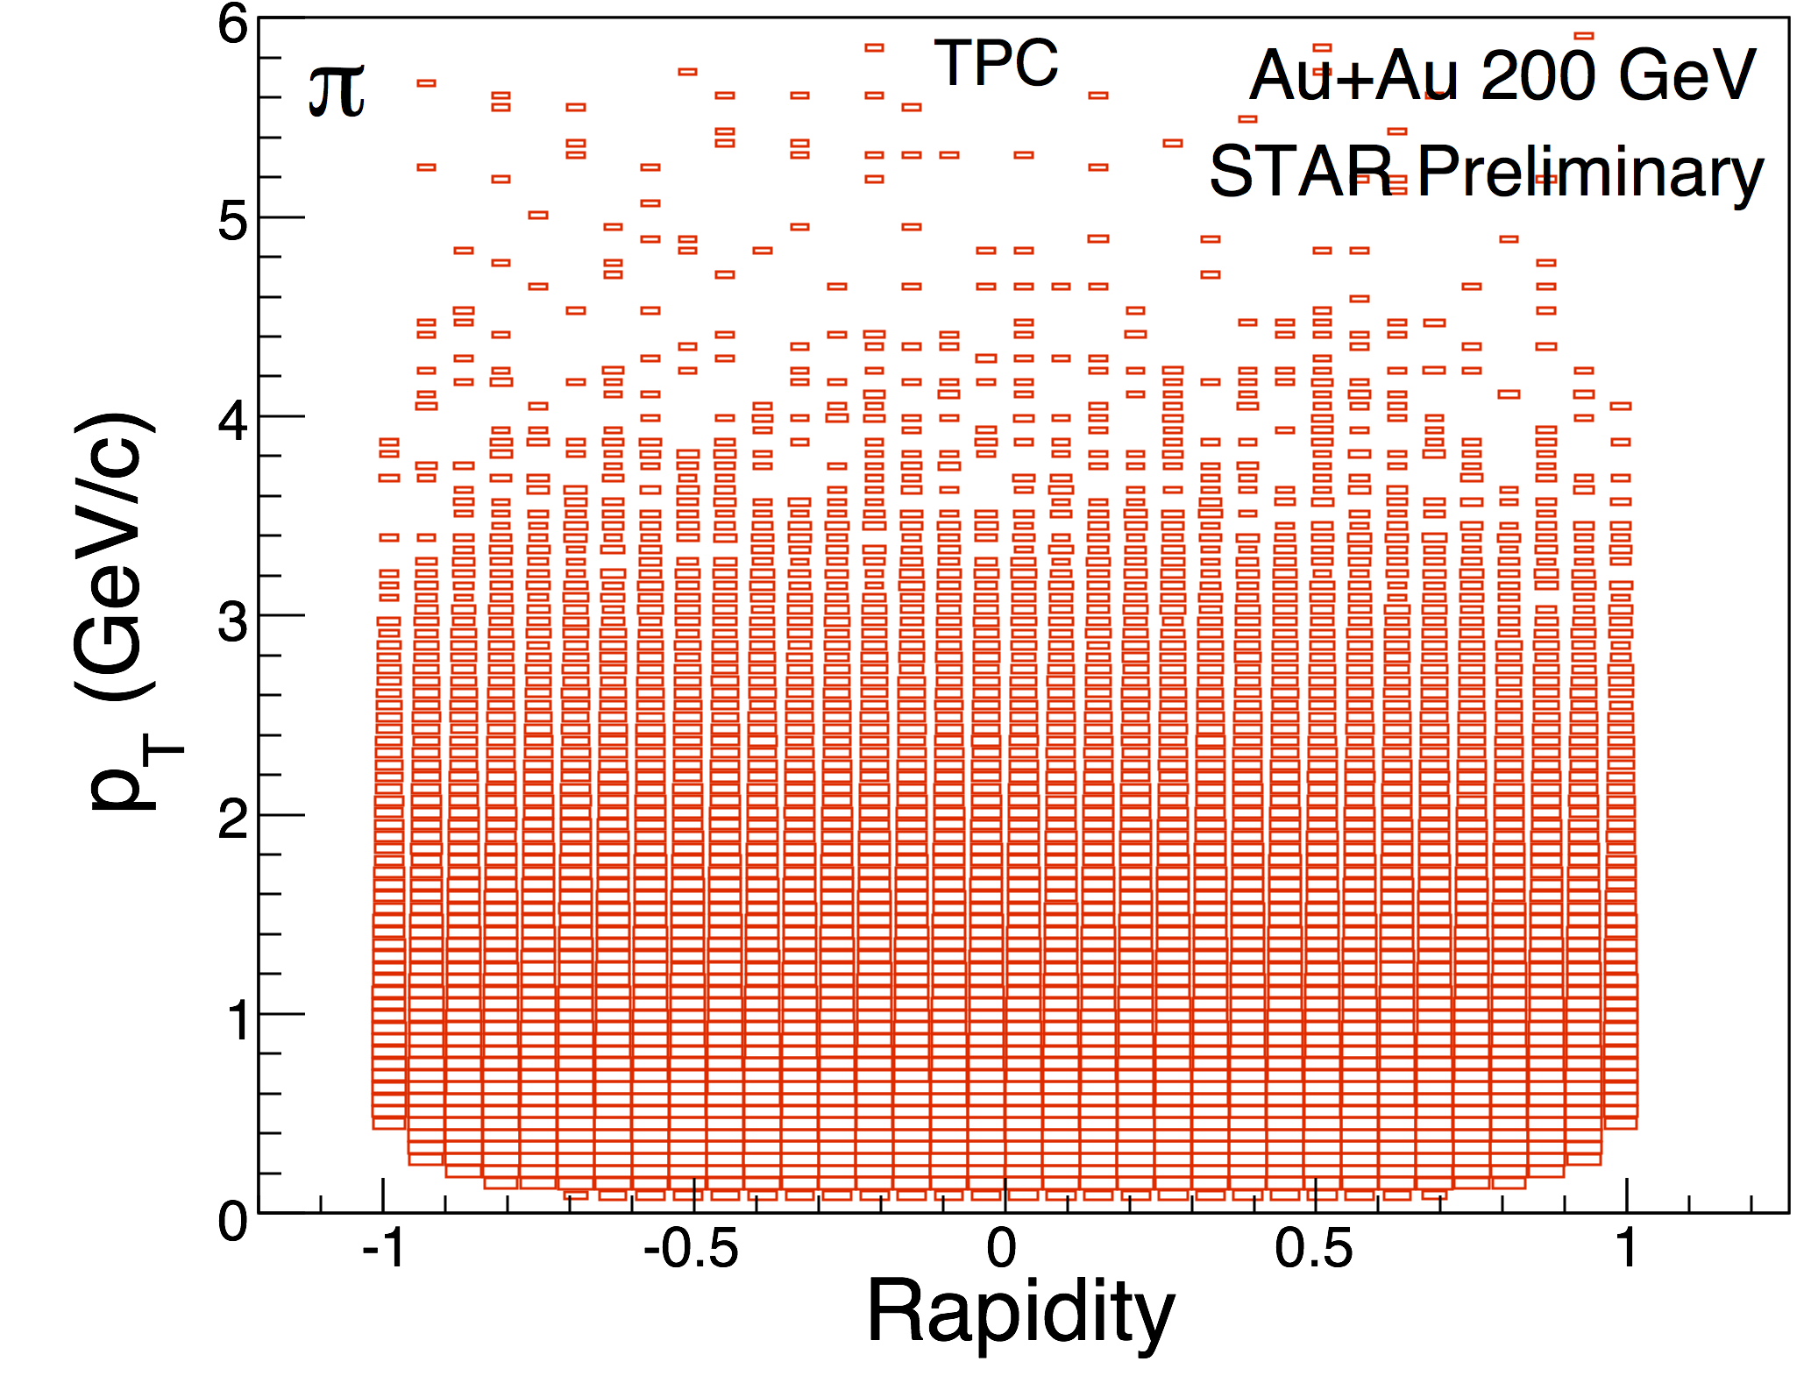
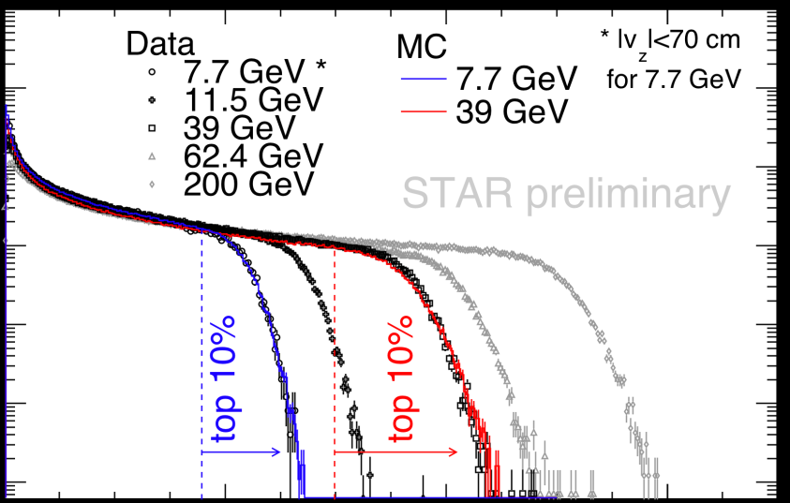
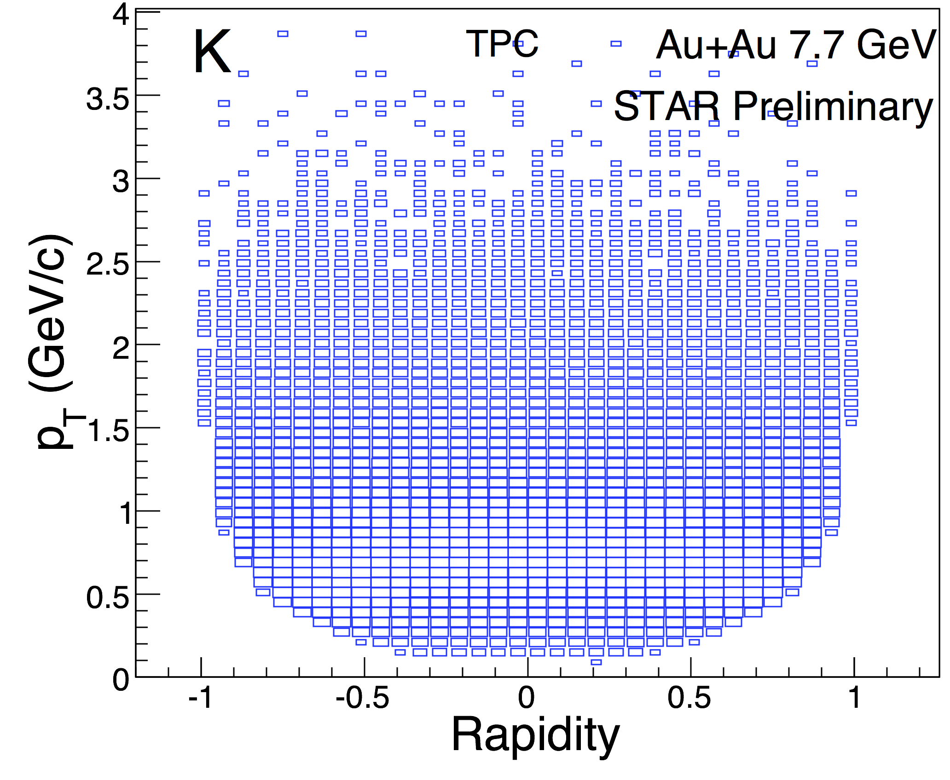
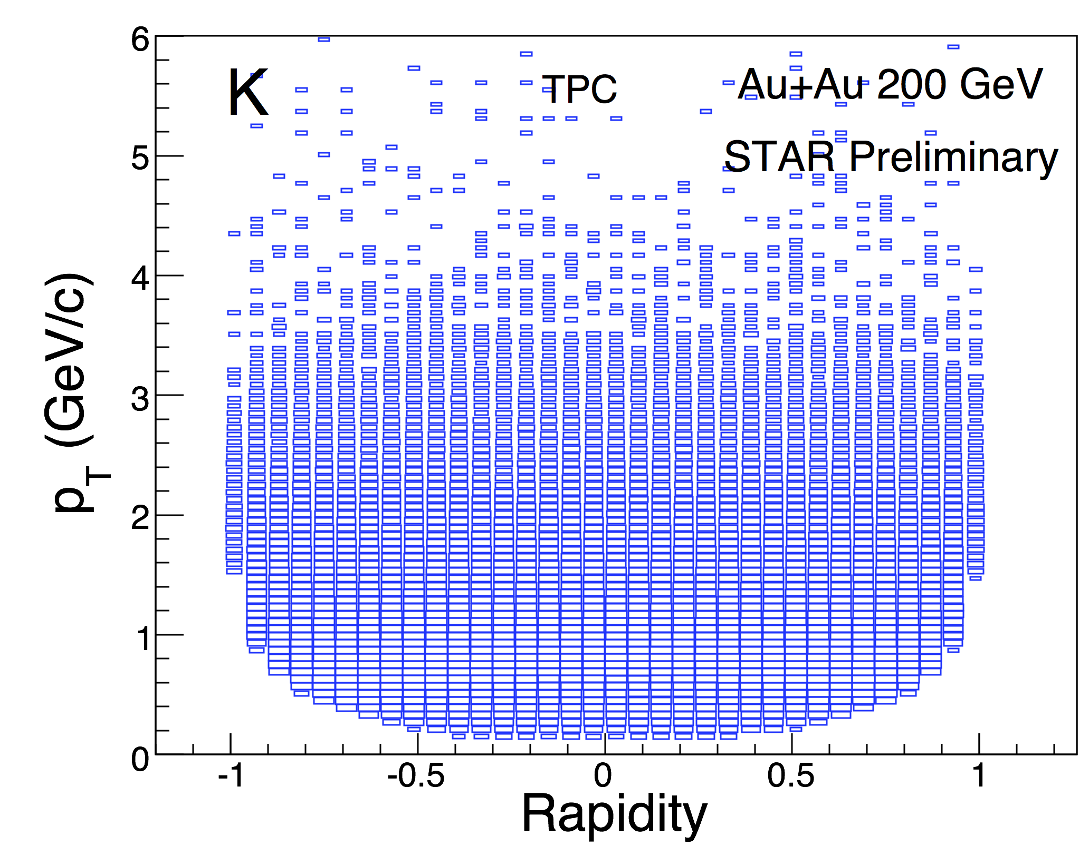
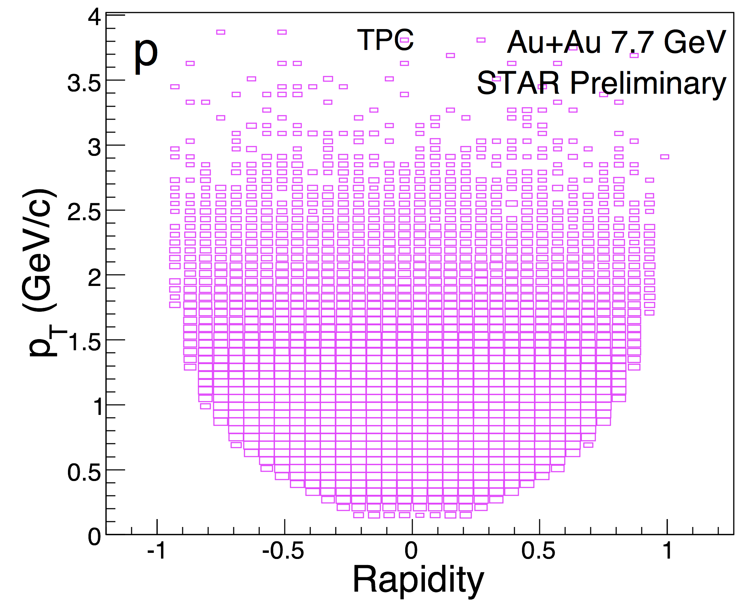
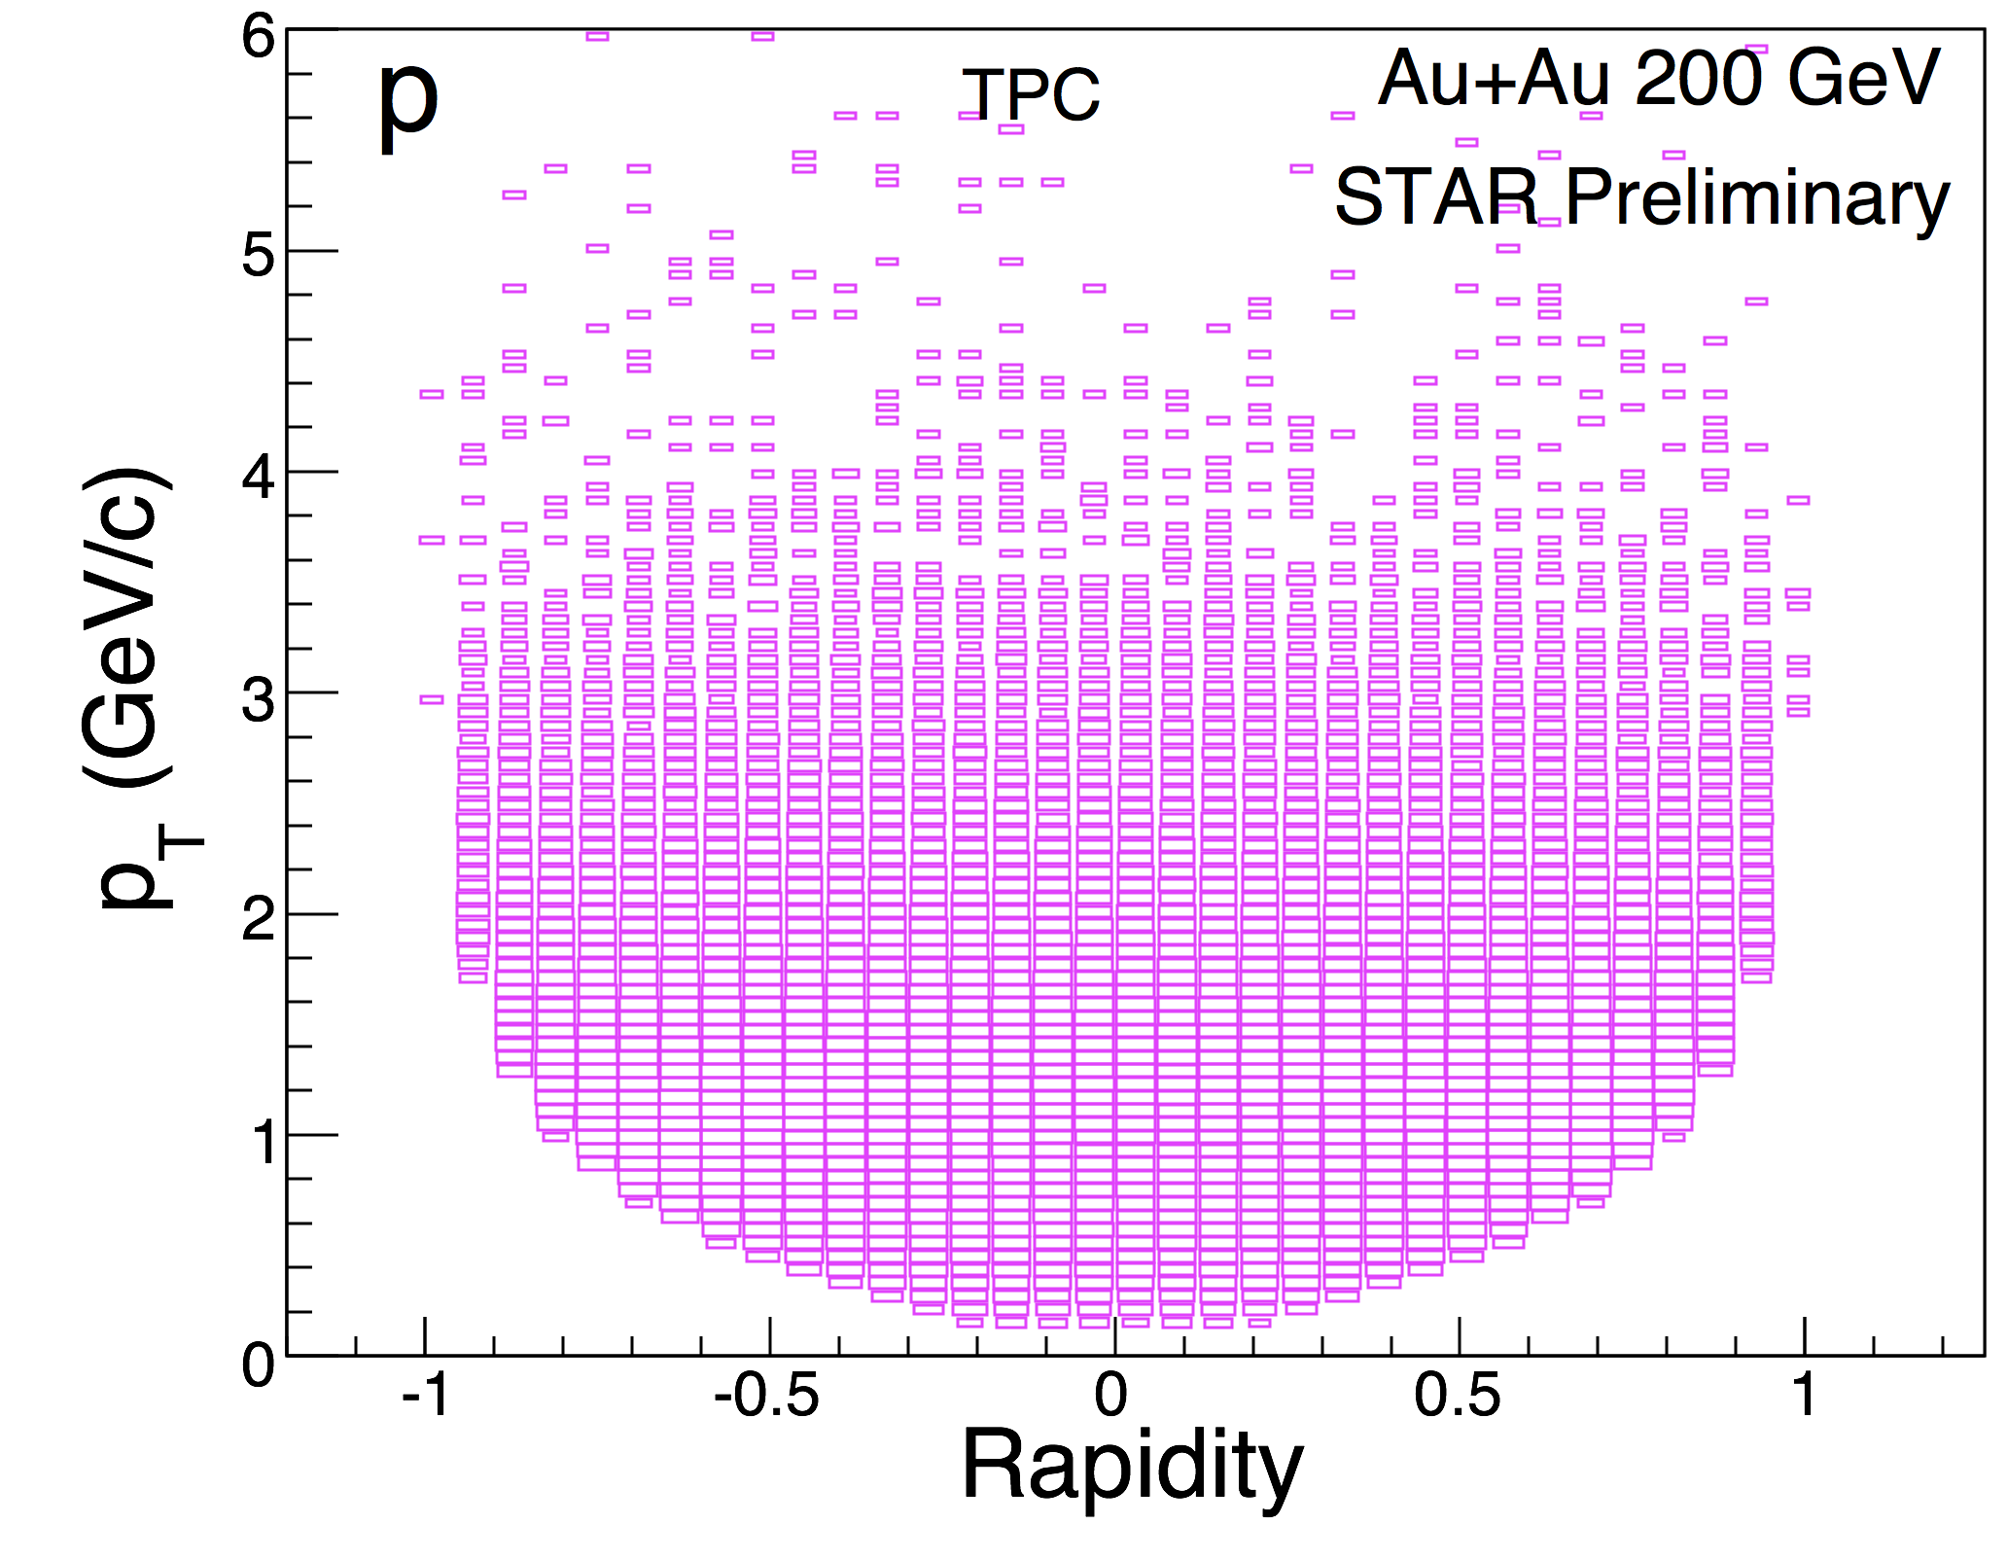
Central Au+Au at 7.7 GeV in STAR TPC
Au+Au @ 7.7 GeV
Au+Au @ 200 GeV
Detector performance generally improves at
lower energies.
Geometric acceptance remains the same,
track density gets lower.
Triggering required effort,
but was a solvable problem.

Slide 7
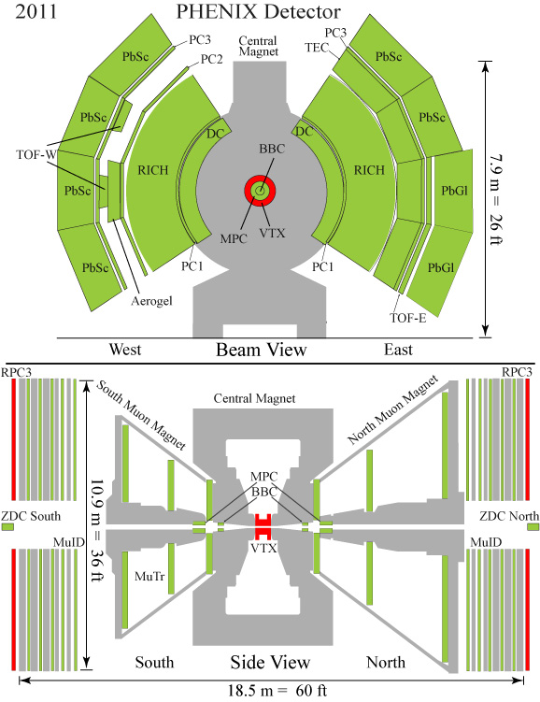

Central arms:
Hadrons, photons, electrons
J/ψ→ e⁺e⁻; ψ’ → e⁺e⁻;
χ_{c} → e⁺e⁻ϒ;
|η|<0.35
p_{e} > 0.2 GeV/c
Δφ=π(2 arms x π/2)
Forward rapidity arms:
Muons
J/ψ→ μ⁺μ⁻ ; ϒ → μ⁺μ⁻
1.2<|η|<2.2
p_{μ} > 1 GeV/c
Δφ = 2π

Slide 8
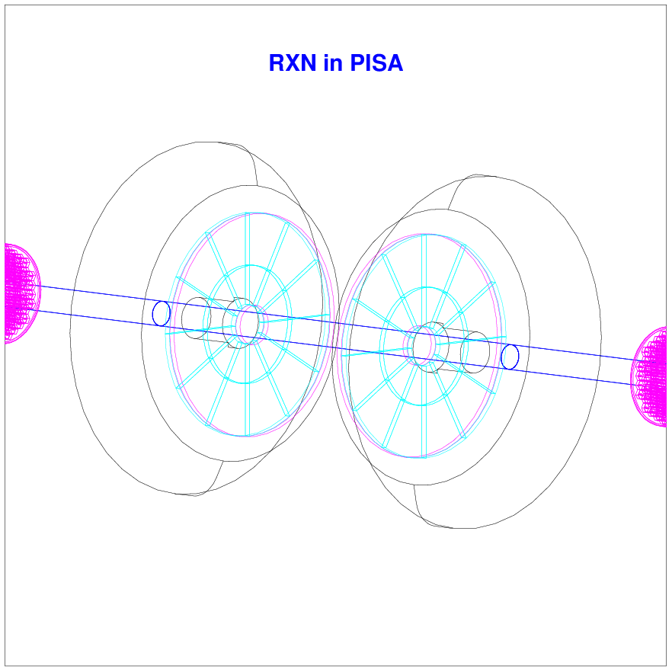
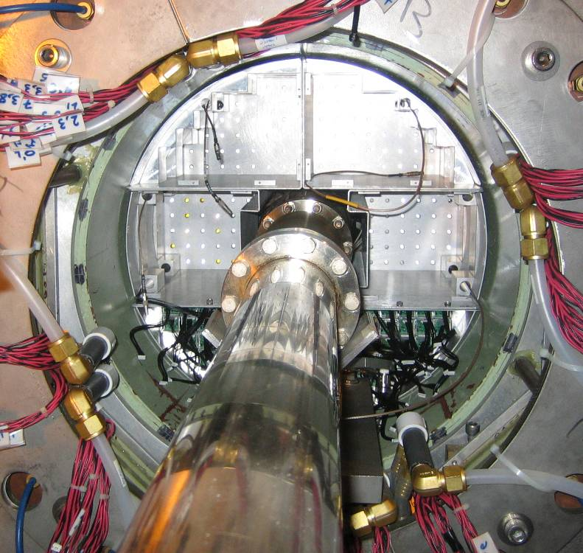
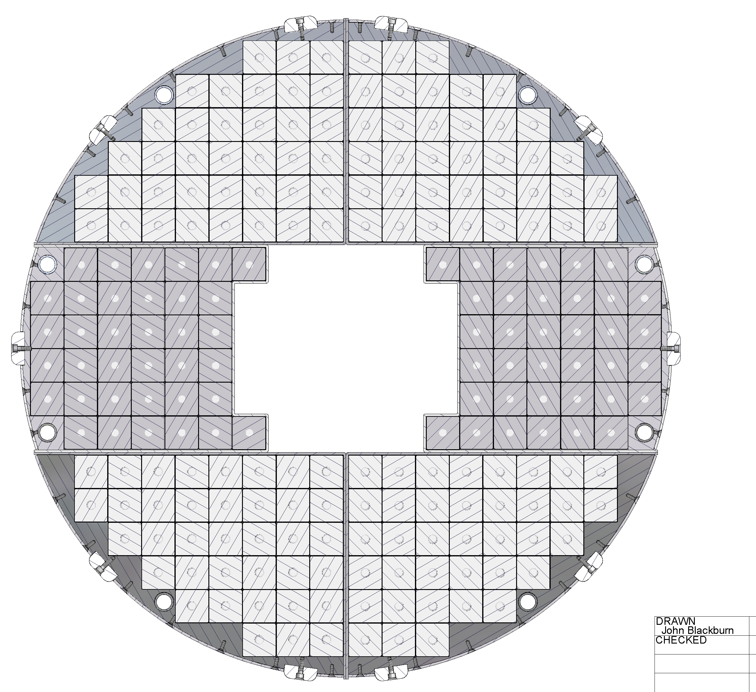
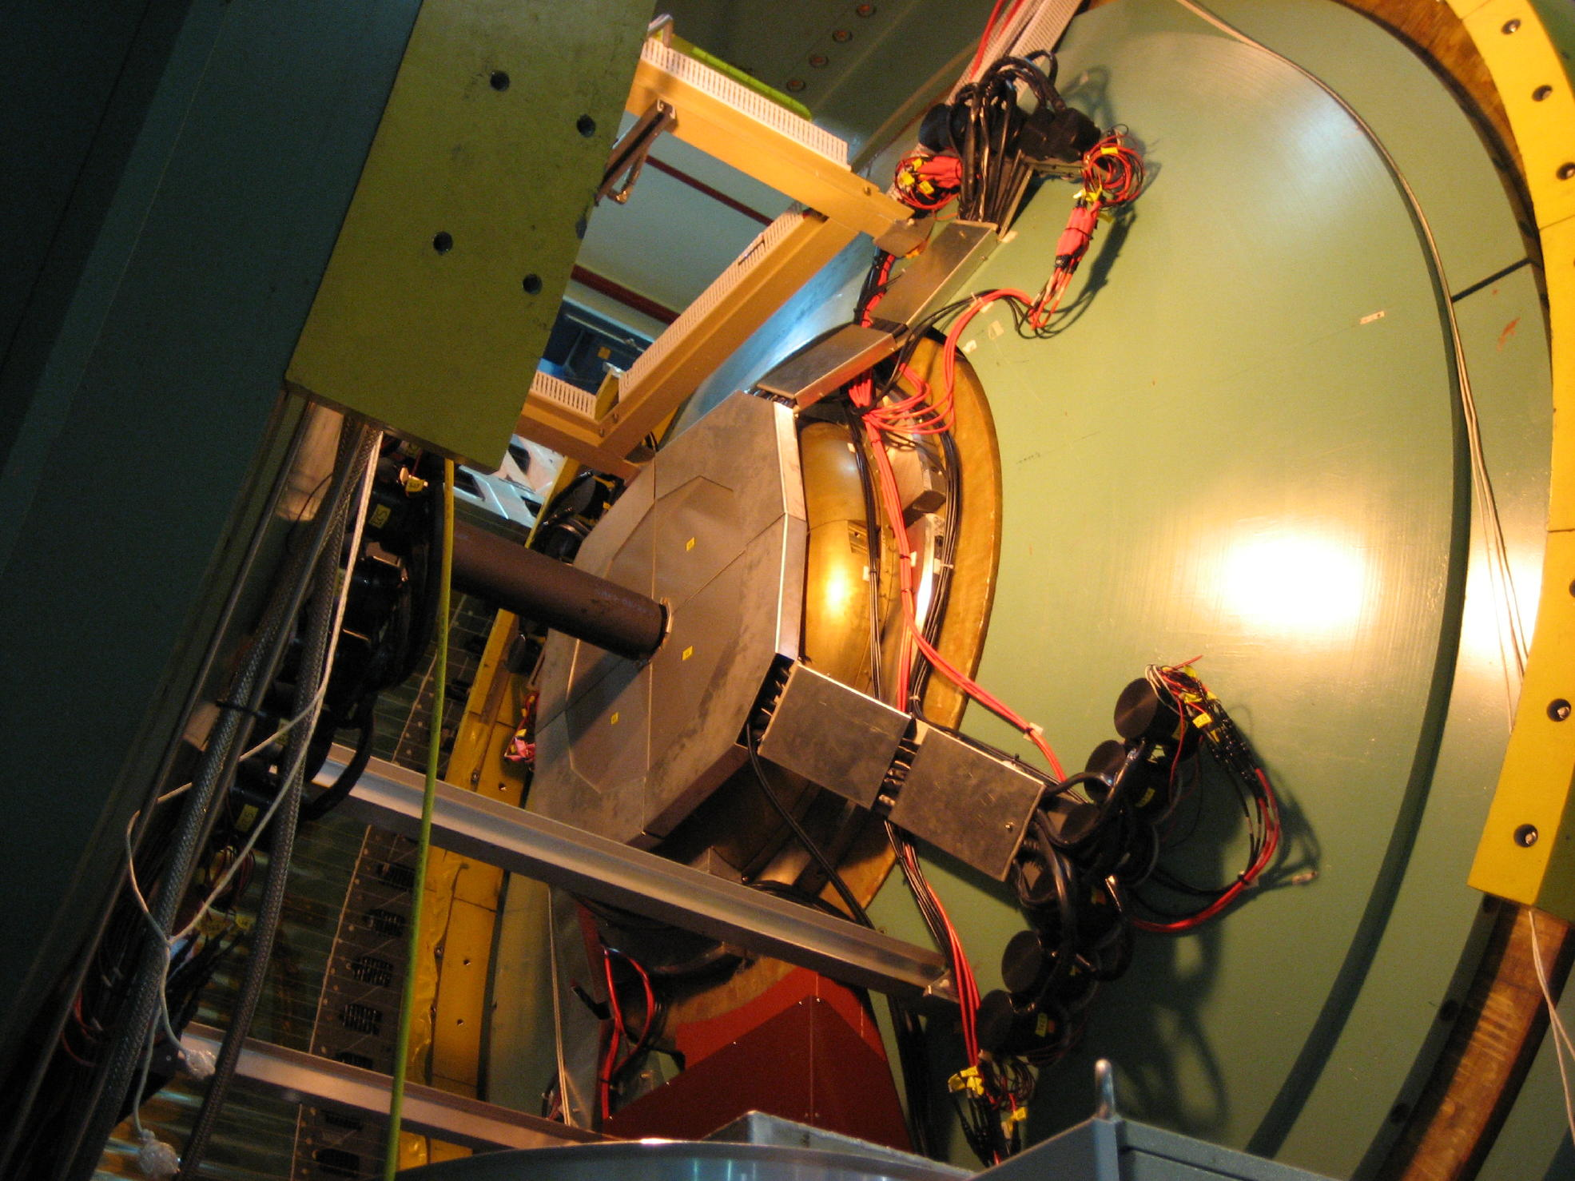
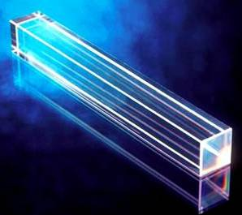
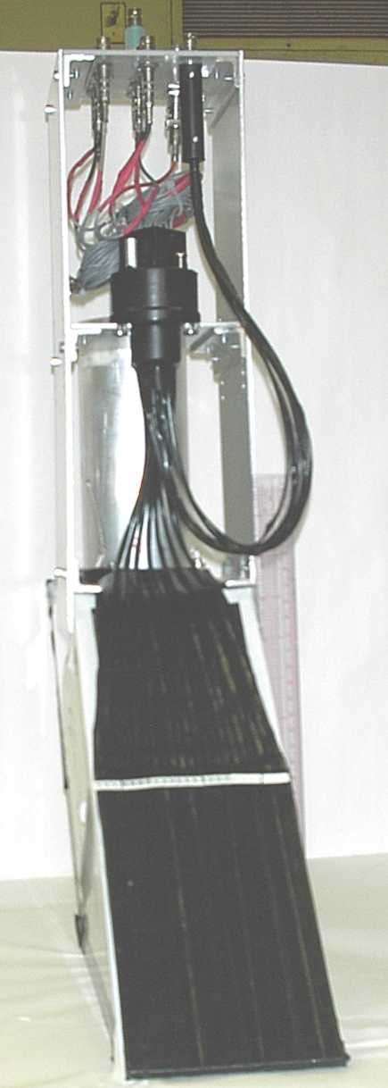
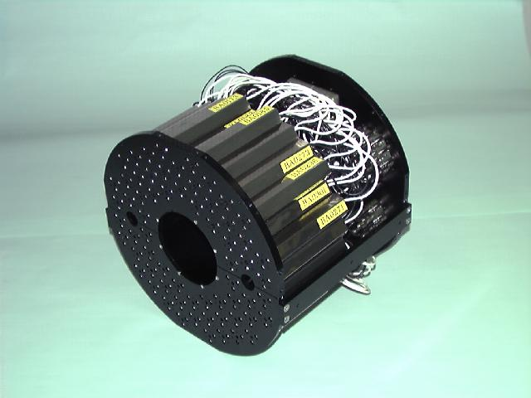

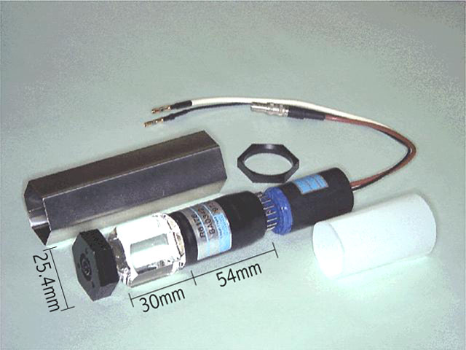
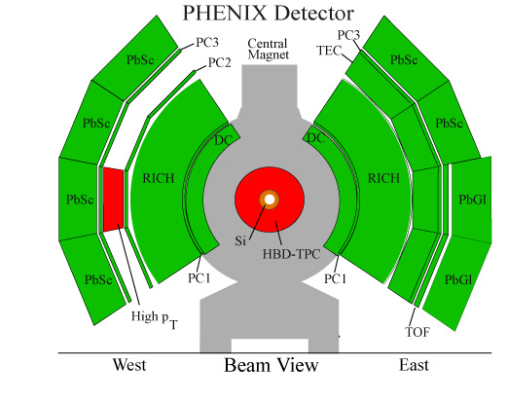
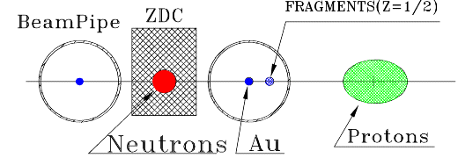
RXN
MPC
(reaction plane detector)
2cm Pb converter
in front
(muon piston
EM-calorimeter)
PbW0₄
dN/dη
Wide range of η coverage with several R.P. detectors for systematic studies
BBC
(beam-beam quartz-
Cherenkov detector)
-5
0
5
η
(zero degree n calorimeter
ZDC/SMD /shower max detector)
CNT
(PHENIX central tracking arm)
Notes:
8

Slide 9
The RHIC Beam Energy Scan Program
Lattice Gauge Theory (LGT) prediction on the transition temperature T_{C} is robust.
LGT calculation, universality, and models hinted the existence of the critical point (CP) on the QCD phase diagram at finite μ_{B}.
Experimental evidence for either the CP or 1st order transition is important for understanding the QCD phase diagram.
In 2009 the RHIC PAC approved a proposal to run a series of six energies to search for the critical point and the onset of deconfinement.
These energies were run during the 2010 and 2011 running periods.
A landmark of the QCD phase diagram

Slide 10
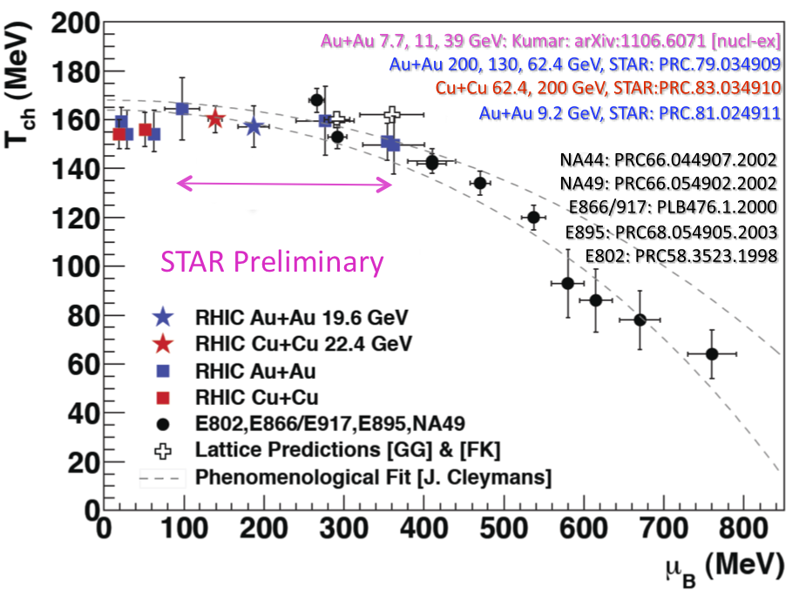
Where are We on the Phase Diagram

Slide 11
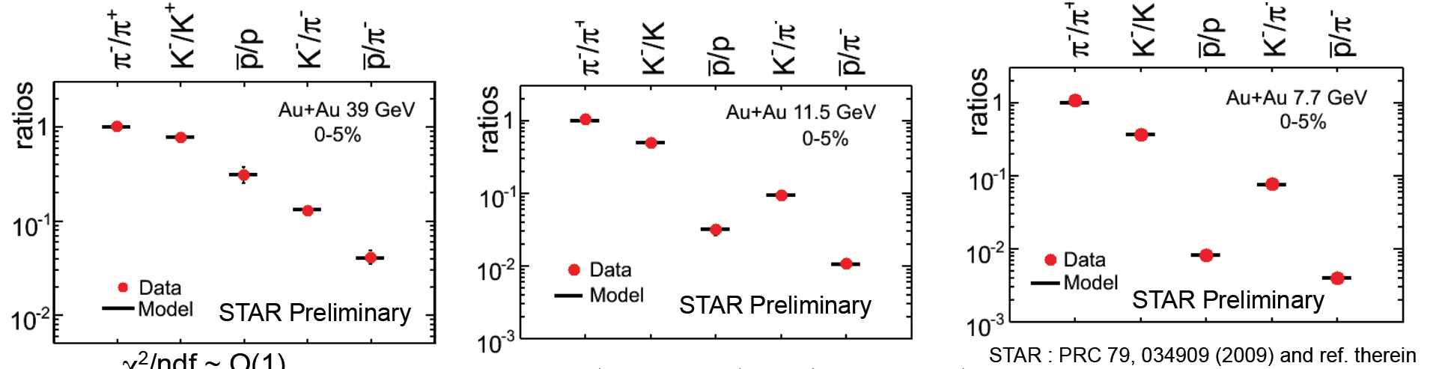
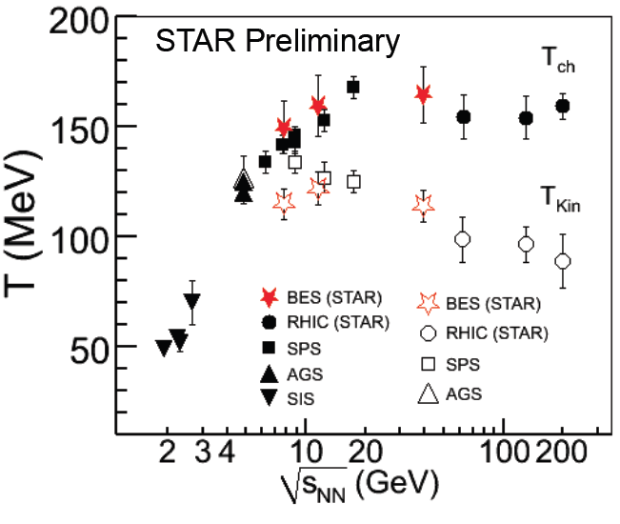
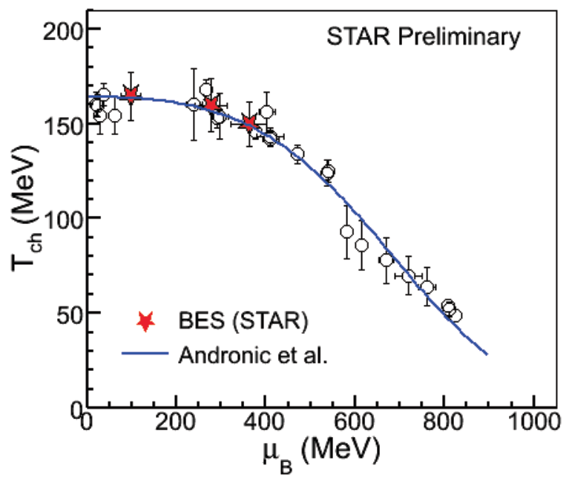
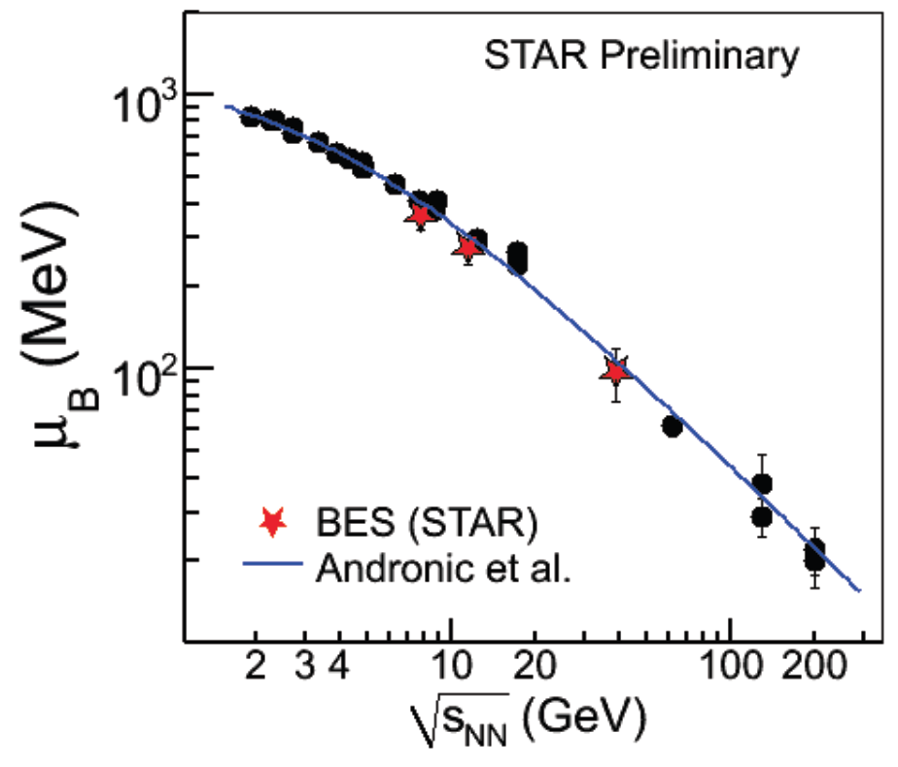
Where are We on the Phase Diagram: BES Result
Using the particle ratios from the π, K, and p and a thermal model, we can determine our location on the phase diagram

Slide 12
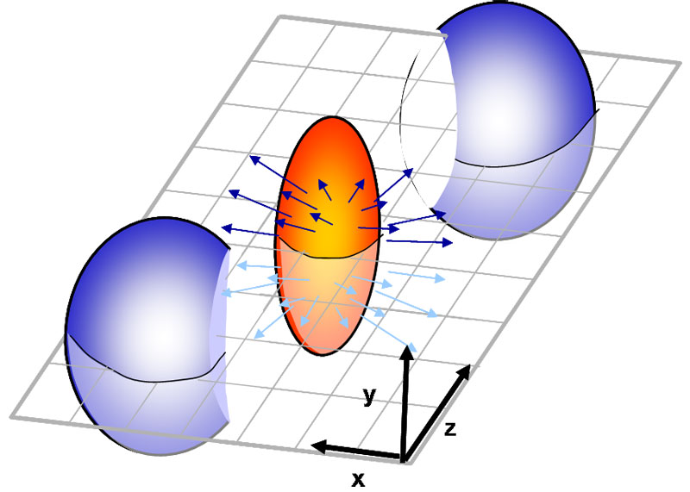
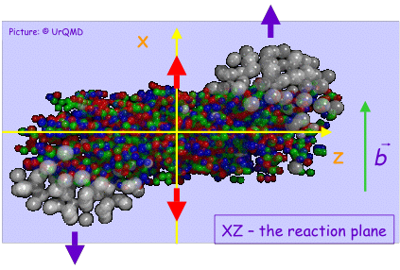
Directed Flow
Directed flow is quantified by the first harmonic:
Directed flow is due to the sideward motion of the particles within the reaction plane.
Generated already during the nuclear passage time (2R/γ ≈ 3 – 0.1 fm/c @7.7 – 200 GeV)
It probes the onset of bulk collective dynamics during thermalization
<p_{x}> or directed flow
rapidity
v₁(y) is sensitive to baryon transport, space - momentum correlations and QGP formation
(preequilibrium)

Slide 13
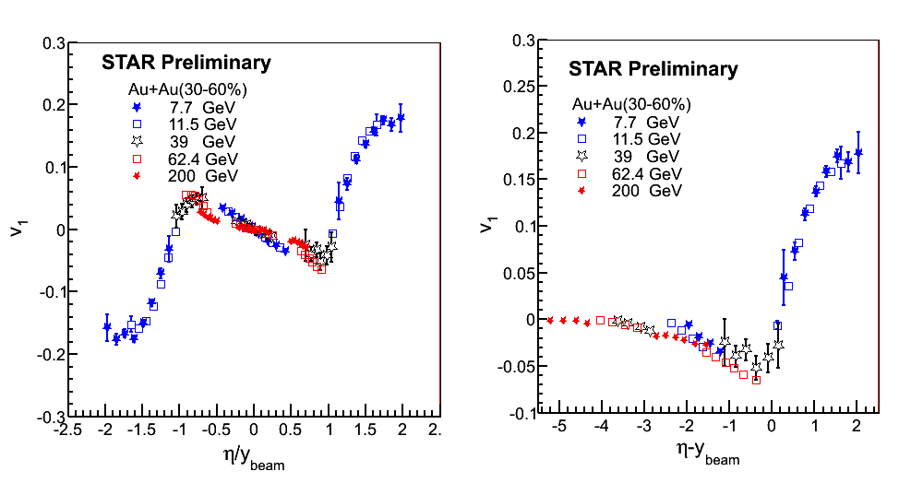
Charged Hadrons v₁: Beam Energy Dependence
Data at 62.4&200GeV from STAR, PRL 101 252301 (2008)
Scaling behavior in v₁ vs. η/y_{beam} and v₁ vs. η’=η-y_{beam}

Slide 14
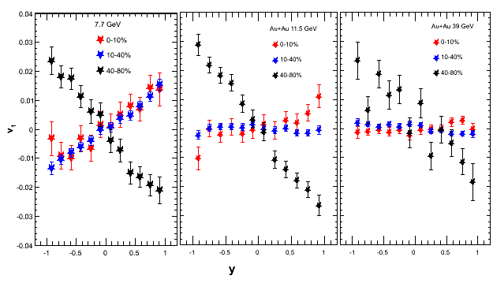
Directed Flow of Protons: BES Results
<p_{x}> or directed flow
STAR Preliminary
rapidity
Proton v₁ slope is positive in mid-central collision at 7.7 GeV. At 11.5 GeV, it is almost flat and at 39 GeV and at higher RHIC energies, the proton slope is negative (but small) for mid-central collisions.
The change in proton slope may be due to the contribution from the transported protons coming to midrapidity at the lower beam energies

Slide 15

Elliptic Flow and Collectivity
Initial spatial anisotropy
Pressure gradient (EOS)
y
φ
x
INPUT
Spatial Anisotropy
2v₂
Interaction among
produced particles
dN/dφ
dN/dφ
OUTPUT
0
φ
2π
0
φ
2π
Momentum Anisotropy
λ=(σρ)⁻¹
Free
streaming
v₂=0
Adapted from B. Mohanty

Slide 16
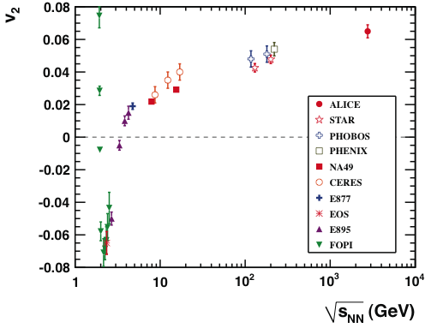
Energy Dependence of Elliptic Flow
ALICE: PRL105 (2010) 252302

Slide 17
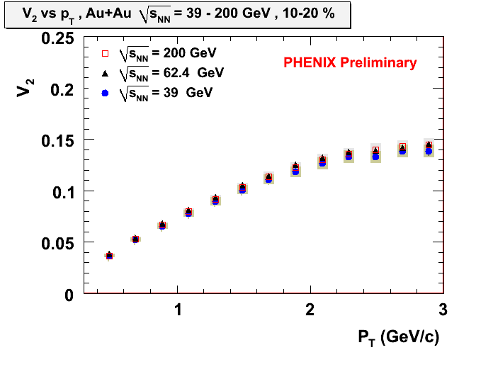
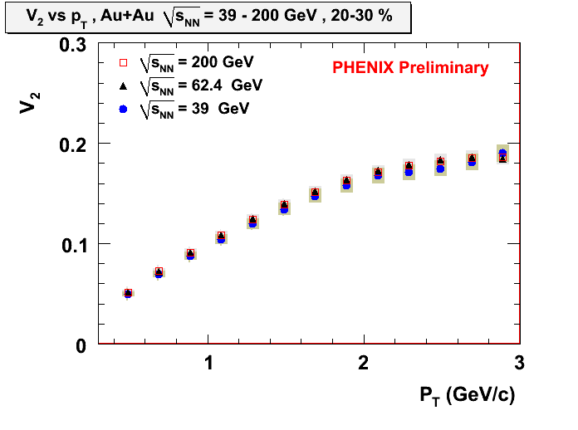
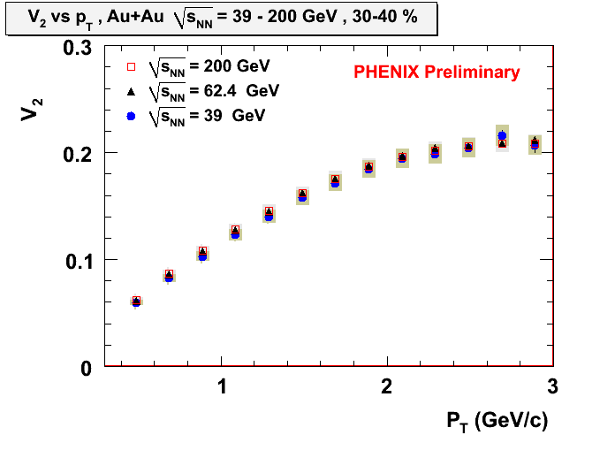
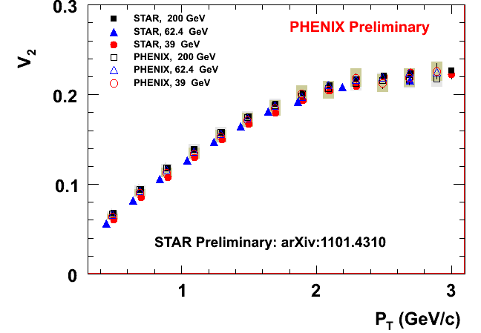
v₂(p_{T}): Au+Au at 39/62.4/200 GeV
Charged Hadrons
10-20%
Charged Hadrons
20-30%
Charged Hadrons
30-40%
Charged Hadrons
STAR arXiv1101.430
Excellent agreement
between experiments
for √s_{NN}=39-200 GeV
Similar hydro-properties from 39 to 200 GeV

Slide 18
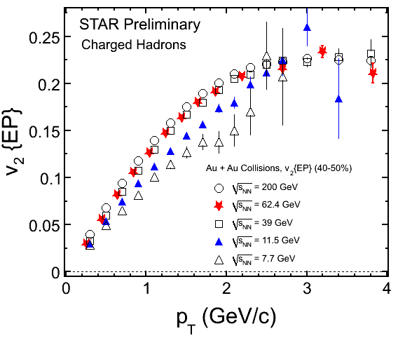
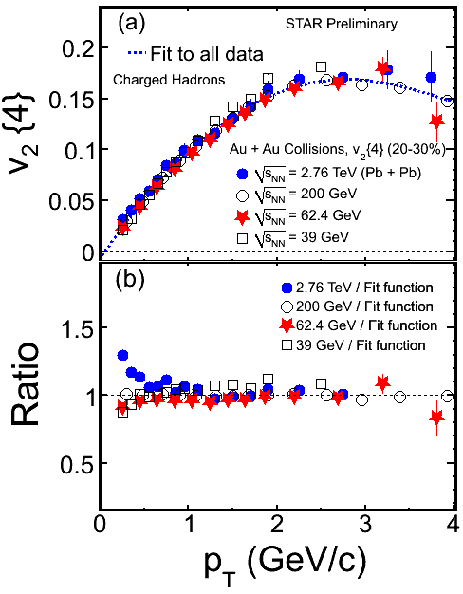
v₂(p_{T}) at RHIC and LHC
STAR: PRC 77 (2008) 054901; PRC 75 (2007) 054906 ALICE: PRL105 (2010) 252302
STAR: Nucl.Phys. A862-863 (2011) 125
v₂ (7.7 GeV) < v₂ (11.5 GeV) < v₂ (39 GeV)
v₂ (39 GeV) ≈ v₂ (62.4 GeV) ≈ v₂ (200 GeV) ≈ v₂ (2.76 TeV)

Slide 19
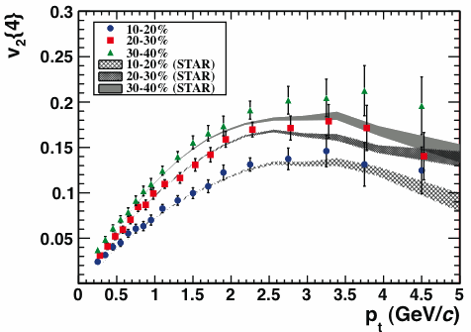
Comparable v₂(p_{T}) from 39GeV to 2.76TeV
ALICE Experiment, PRL105,252302 (2010)
Energy dependence of v₂ is driven by the change in <p_{T}>
The same flow properties from √s_{NN}=39 GeV to 2.76 TeV

Slide 20
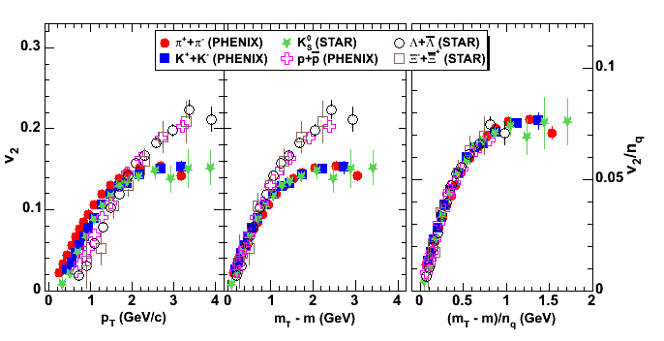
Flow: What are the Relevant d.o.f.
baryons
quarks
mesons
particle mass
dependence
plotted vs.
trans. kinetic energy
both axes scaled by number
of constituent quarks
recombination of constituent quarks
quarks acquire v₂ before hadronization
n_{q} = 2 for mesons
n_{q} = 3 for baryons
STAR: PRL 95, 122301 (2005)
PHENIX: PRL 98, 162301 (2007)

Slide 21
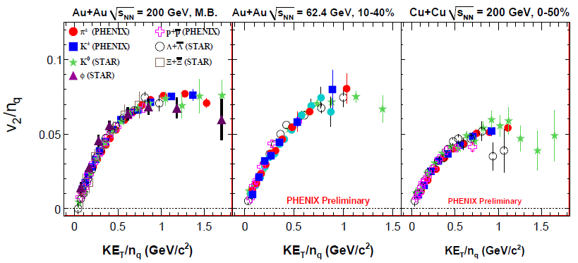
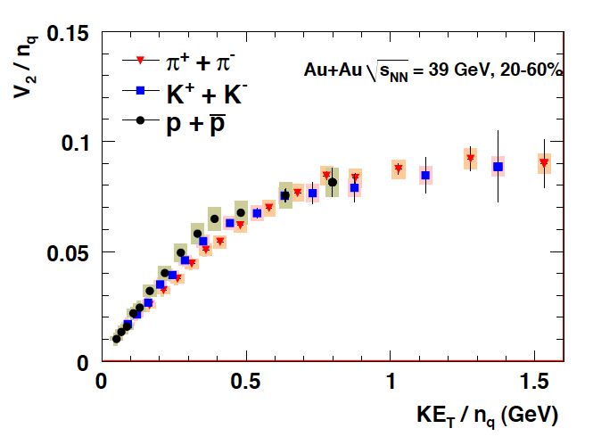
Fluid of Constituent Quarks
PHENIX Preliminary
≡ (m_{T}-m) /n_{q}
From 39 GeV to 200 GeV the same d.o.f. are relevant for the flow
BES goal: find the energy where the effect starts to turn off

Slide 22
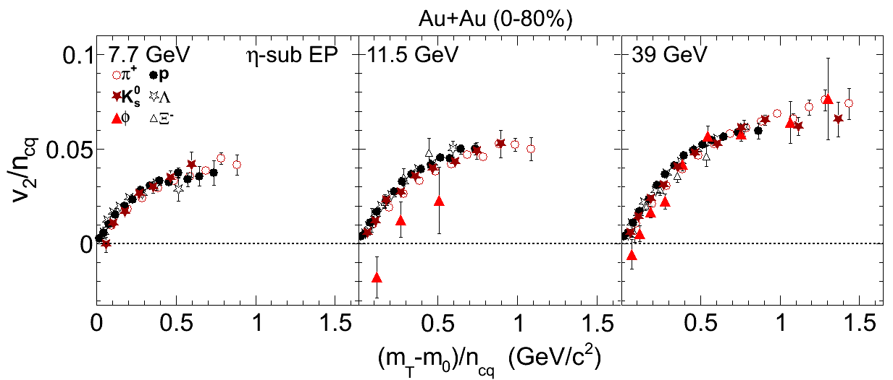
BES Result: n_{cq}-scaling of ϕ meson?
STAR Preliminary
Universal trend for most of particles – n_{cq} scaling not broken at low energies
ϕ meson v₂ deviates from other particles in Au+Au@11.5 GeV:
Mean deviation from pion distribution: 0.02±0.008 (→ 2.6 σ)
Low hadronic cross section of ϕ → less partonic flow seen ?
Reduction of v₂ for ϕ meson and absence of n_{cq} scaling ➔ during the evolution the system remains in the hadronic phase
[B. Mohanty and N. Xu: J. Phys. G 36, 064022(2009)]

Slide 23
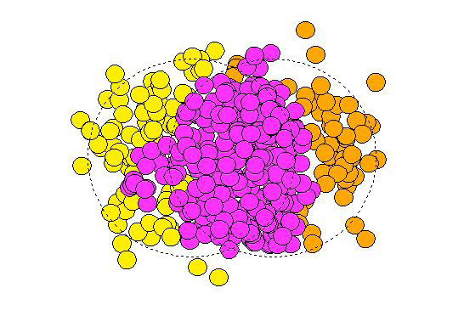
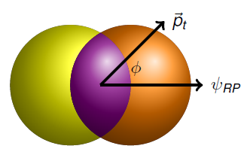
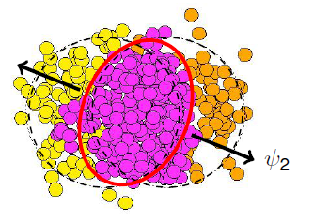
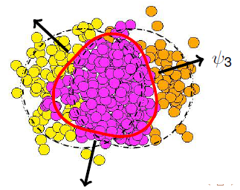
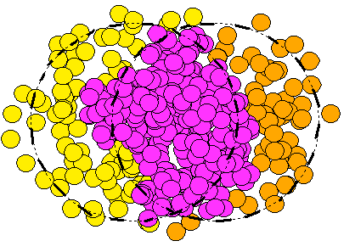
Beyond the v₂: Higher Order Harmonics
For smooth profile odd
harmonics cancel out
For “lumpy” profile
odd harmonics persist
The initial collision
geometry is “lumpy”
No particular symmetry
v_{n+1} ≠ 0 (event-by-event)
_{v2}
_{v3}
_{v4}

Slide 24
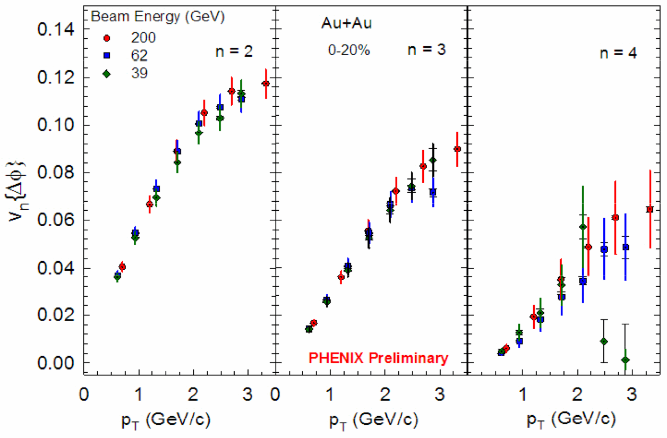
Beam Energy Dependence of v_{2’} v₃ and v₄
charged particle v_{n} : |η|<0.35 ; reaction plane Φ_{n} : |η|=1.0~2.8
charged particle v₃
charged particle v₄
charged particle v₂
v₂, v₃, v₄ are independent of √s_{NN} for 39, 62.4, 200 GeV

Slide 25


Centrality and p_{T}-dependences of v_{n}
Au+Au
Weak centrality dependence of v₃
Consistent with initial fluctuation
charged particle v_{n} : |η|<0.35
reaction plane Φ_{n} : |η|=1.0~2.8

Slide 26
Summary
Results from Beam Energy Scan program provide important constraint on QCD phase diagram. Search for the critical point is ongoing.
Same flow properties of strongly interacting (de-confined) matter are observed over a wide range of incident energies (√s_{NN}=39 GeV - 2.76 TeV).
Higher order harmonics reveal connection between the anisotropic flow and the fluctuations of the energy density in the initial state.

Slide 27
Backup slides

Slide 28
Required Statistics
Collision Energies (GeV) | 5 | 7.7 | 11.5 | 19.6 | 27 | 39 | 62.4
Observables | Millions of Events Needed
v₂ (up to ~1.5 GeV/c) | 0.3 | 0.2 | 0.1 | 0.1 | 0.1 | 0.1
v₁ | 0.5 | 0.5 | 0.5 | 0.5 | 0.5 | 0.5
Azimuthally sensitive HBT | 4 | 4 | 3.5 | 3.5 | 3 | 3
PID fluctuations (K/π) | 1 | 1 | 1 | 1 | 1 | 1
net-proton kurtosis | 5 | 5 | 5 | 5 | 5 | 5
n_{q} scaling π/K/p/Λ (m_{T}-m₀)/n<2GeV | 8.5 | 6 | 5 | 5 | 4.5 | 4.5
φ/Ω up to p_{T}/n_{q}=2 GeV/c |  | 56 | 25 | 18 | 13 | 12
R_{CP} up to p_{T} ~4.5 GeV/c (at 17.3) 5.5 (at 27) & 6 GeV/c (at 39) |  |  |  | 15 | 33 | 24
Total Number of Events Taken | 0 | 5 | 11 | 17 | 130 | 170 | 170
Deconfinement Critical Point
Signatures Signatures

Slide 29

Maximum Net Baryon Density
ρ_{max}≈ ¾ρ₀
The maximum baryon density at freeze-out expected for √s_{NN}≈6-8 GeV

Slide 30
Directed Flow
Directed flow is quantified by the first harmonic:
Directed flow is due to the sideward motion of the particles within the reaction plane.
Generated already during the nuclear passage time (2R/γ≈.1 fm/c@200GeV)
It probes the onset of bulk collective dynamics during thermalization
<p_{x}> or directed flow
rapidity
(preequilibrium)
v₁(y) is sensitive to baryon transport, space - momentum correlations and QGP formation

Slide 31

BES v₂: Particles vs. Anti-particles
STAR AuAu@62.4: Phys.Rev.C75, 054906 (2007)
For Beam energy ≥ 39 GeV:
Baryon and anti-baryon v₂
are consistent within 10%
Almost no difference for meson v₂
Beam energy = 7.7, 11.5 GeV:
Significant difference of baryon
and anti-baryon v₂
→ Increasing with decrease of beam energy
v₂(K⁺)>v₂(K⁻) at 7.7 GeV
v₂(π⁻) >v₂(π⁺) at 7.7, 11.5 GeV
Possible explanation:
Baryon transport to mid-rapidity
Absorption in hadronic environment
The difference between particles and anti-particles is observed
Notes:
31

Slide 32

Reaction plane resolution of n^{th} order plane
200GeV Au+Au
PHENIX Preliminary
n=2 RXN
n=3 RXN
n=4 RXN
n=2 MPC
RXN |η| = 1.0 ~ 2.8
MPC |η| = 3.1~ 3.7
n=3 MPC
σ_{n} = <cos n(Φ_{n(meas.)} - Φ_{n(true)})>
positive correlation in Φ₃ between opposite η up to
+/− 3 ~ 4
better resolution
centrality (%)
No sign flipping in Φ₃ observed
--> Initial geometrical fluctuation
Notes:
32

Slide 33

n_{q}-scaling of v₃
20 -50%
PHENIX preliminary
v₃
Like v₂, constituent quark scaling is seen with v₃.
Evidence of partonic flow.

Slide 34




The Horn and Other Yields
The STAR BES data are consistent with the NA49 results
NA49, PRC78,034918.
NA57, PLB595,68; JPG32, 427
STAR, PRL86,89,92,98;PRC83

Slide 35


y
v₃ and initial fluctuation
Reaction Plane (x-z)
x
x
arXiv:1003.0194
z
y
y
black-disk --> sign-flipping v₃
initial fluctuation --> no-sign-flipping v₃
x
Notes:
35

Slide 36

Indication of strong non-flipping and weak sign-flipping v₃
A: RXN(η>0)
B: BBC(η<0)
C: MPC(η>0)
D: MPC(η<0)
E: BBC (η>0)
F: ZDC (+/{-})

