Slide 1
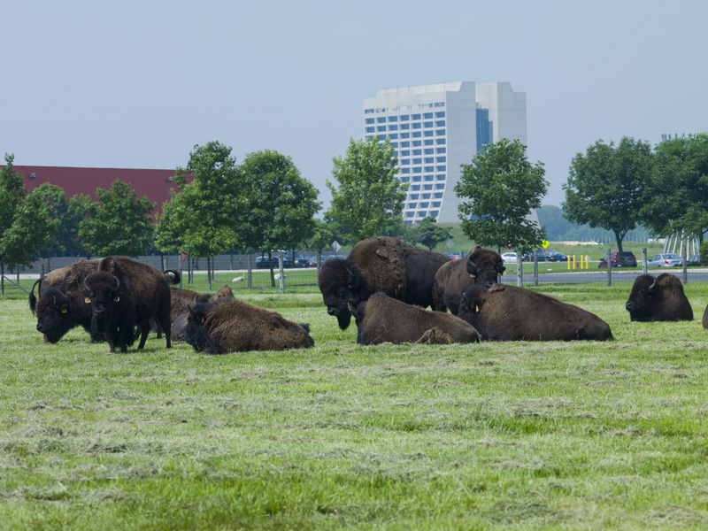
Searches for High Mass Resonances and Exotics at the Tevatron
Ulrich Heintz (Brown University)
for the CDF and D0 Collaborations
HCP Symposium, Paris, November 18, 2011

Slide 2
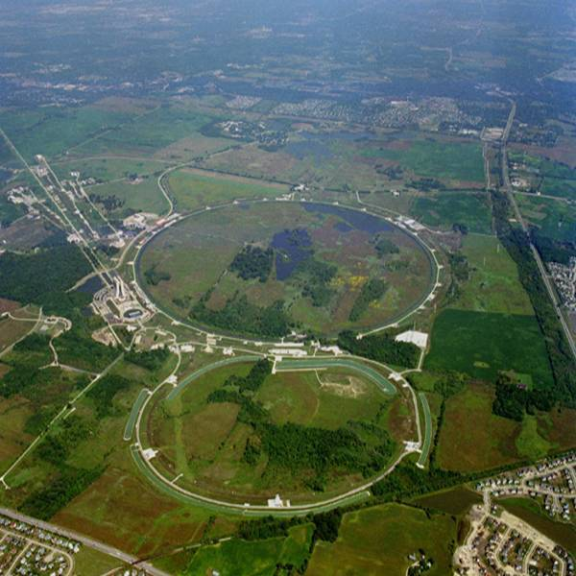
Tevatron

Slide 3
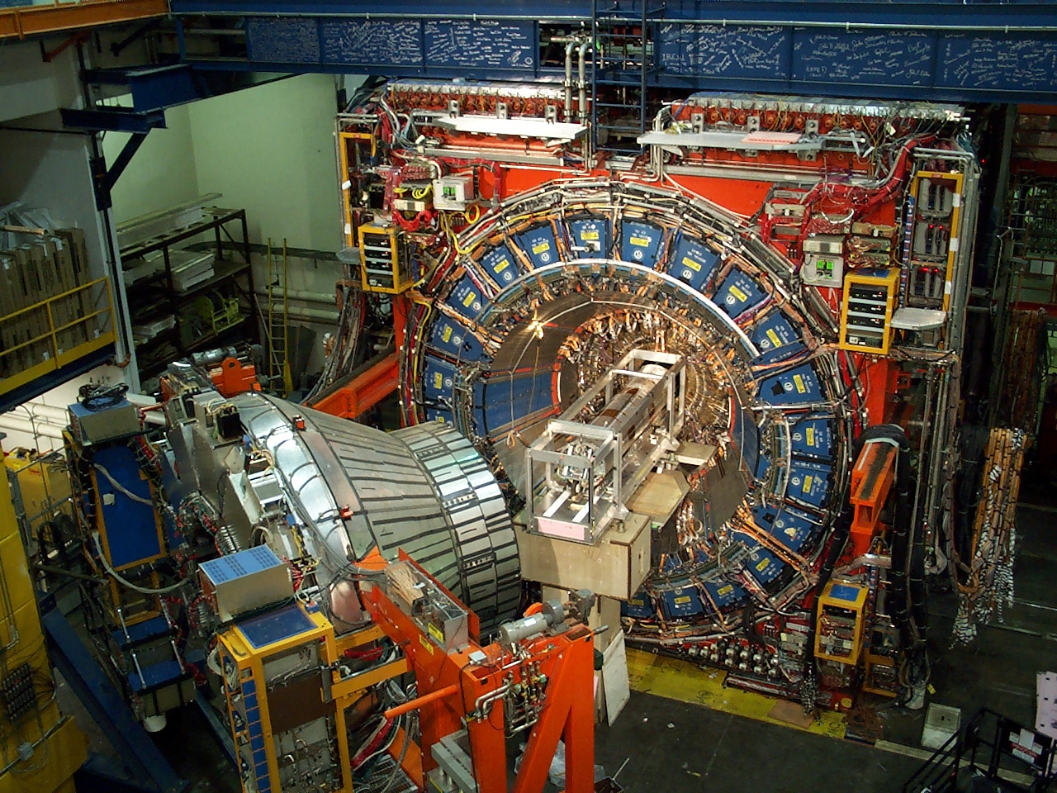
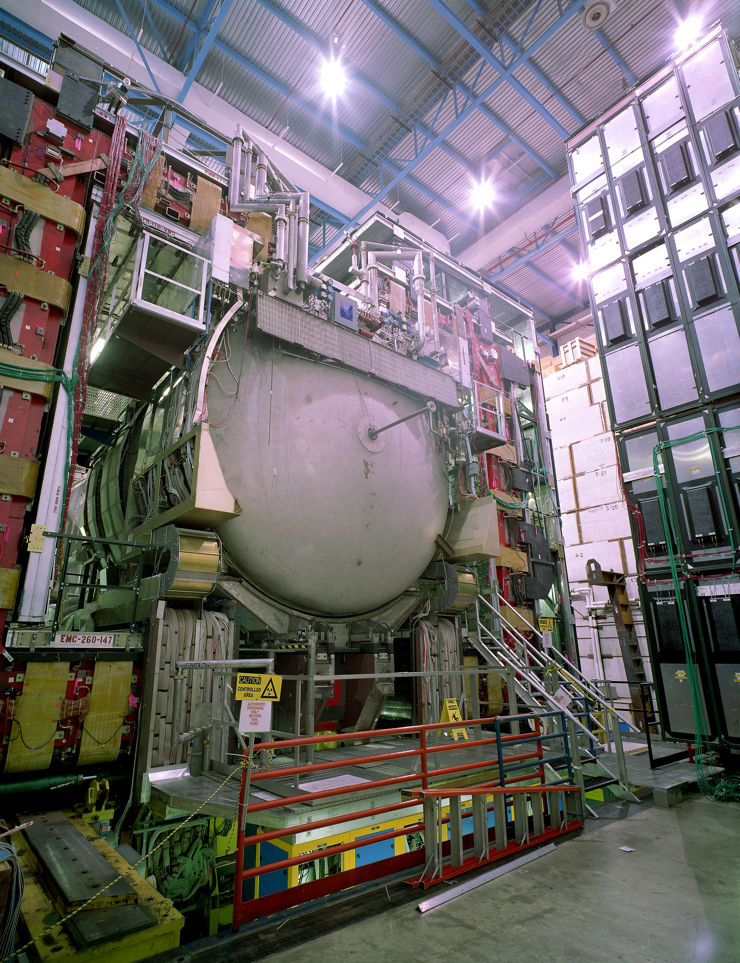
Tevatron

Slide 4
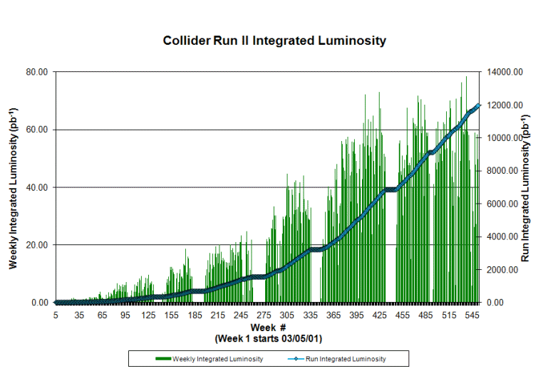
Tevatron

Slide 5
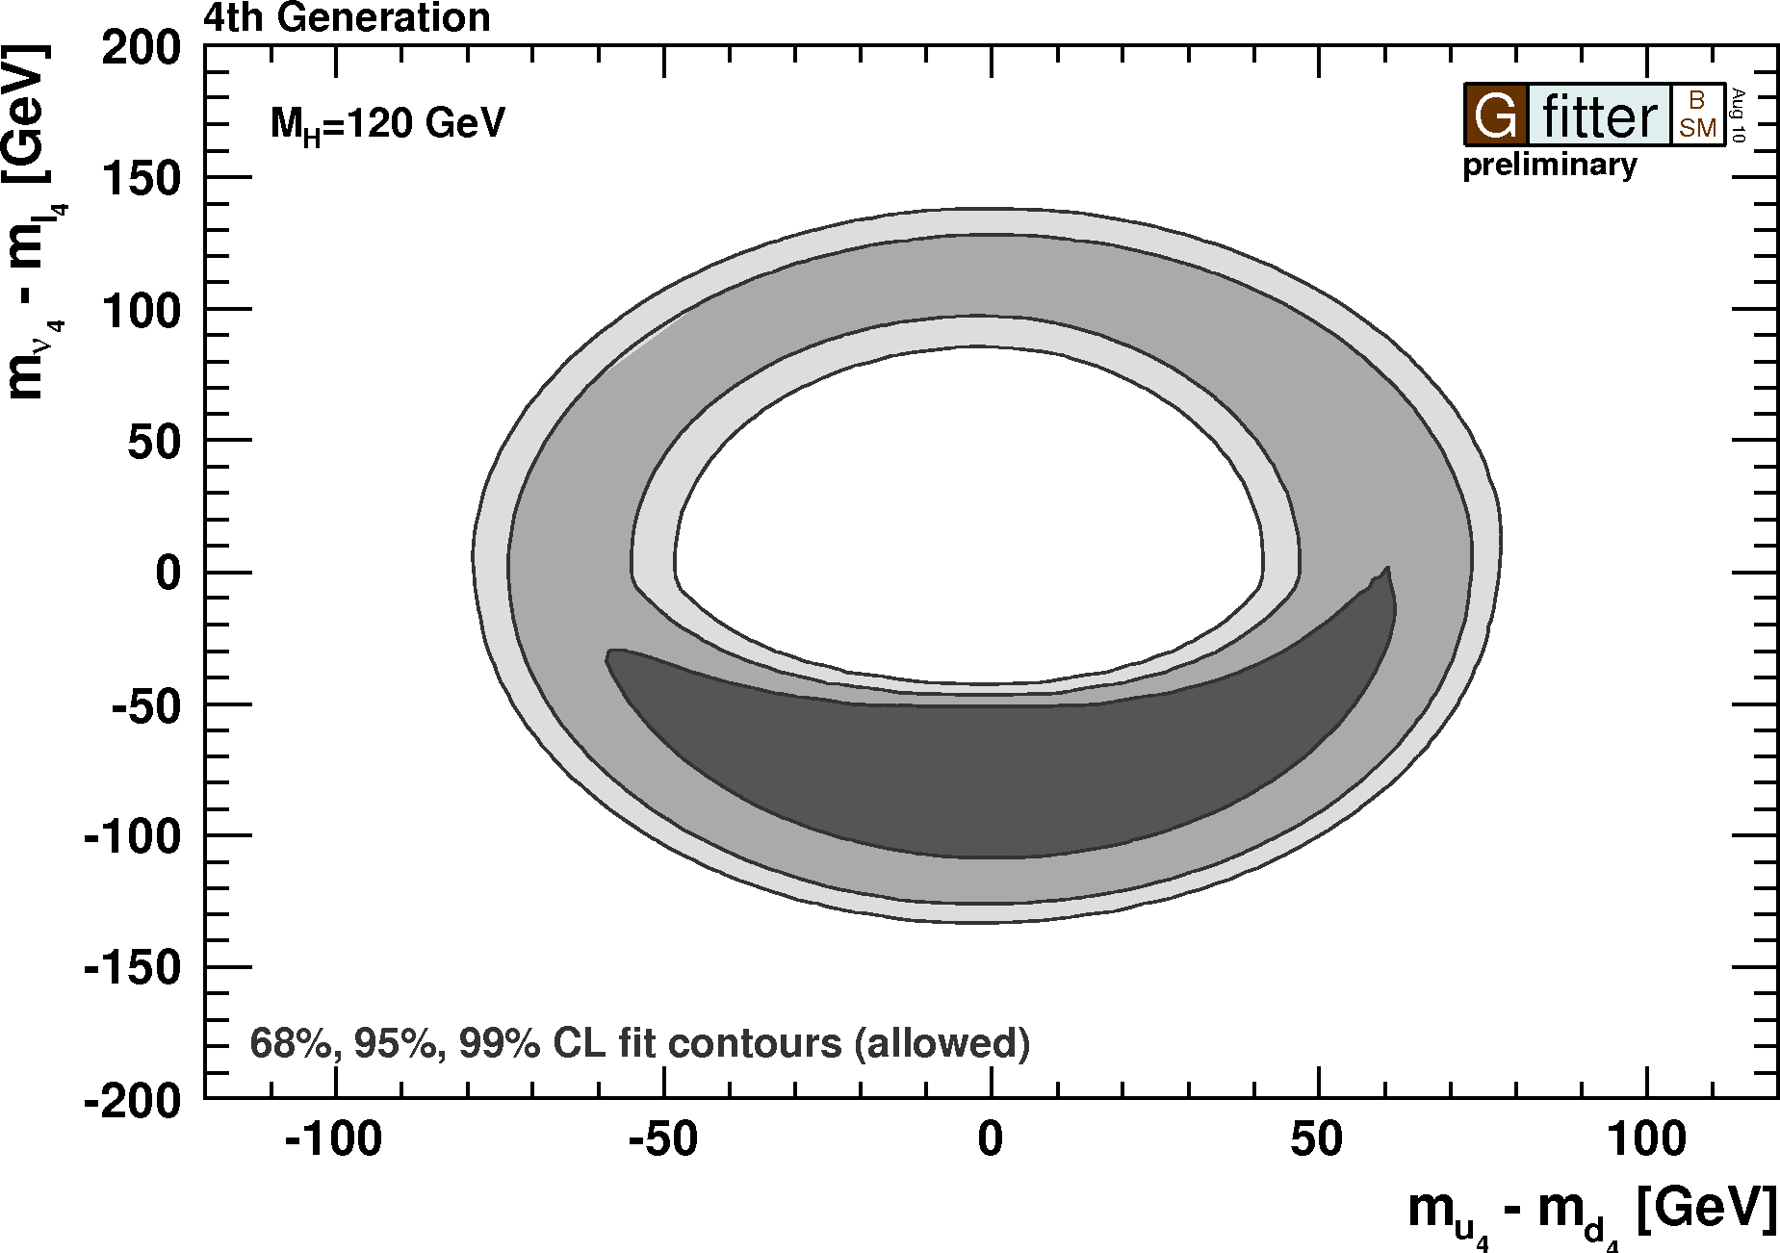
4th fermion generation
straightforward extension of sm
add 2 fermions each to quark and lepton sectors
left-handed weak doublet, two right-handed singlets
new masses and mixing parameters
electroweak measurements constrain parameters
m_{ν’} > ½M_{Z}
|m_{t’} – m_{b’}|<M_{W}
decay modes:
t’ → bW
b’ → tW → bWW
4th generation must decays to 3rd generation
arxiv:1107.0975v1

Slide 6
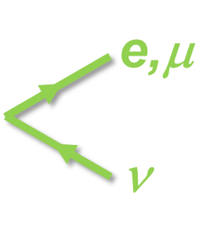
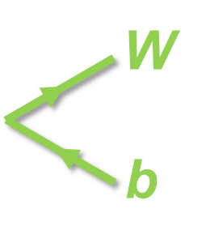
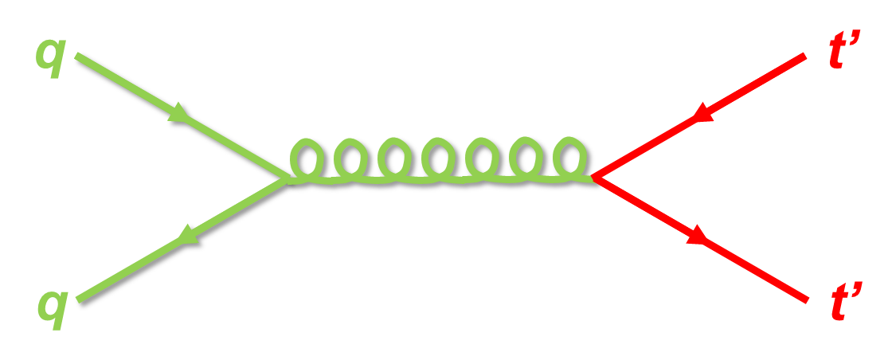
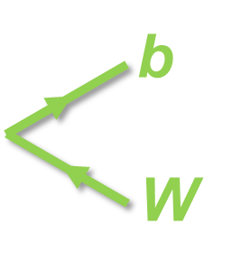
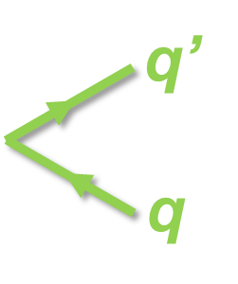
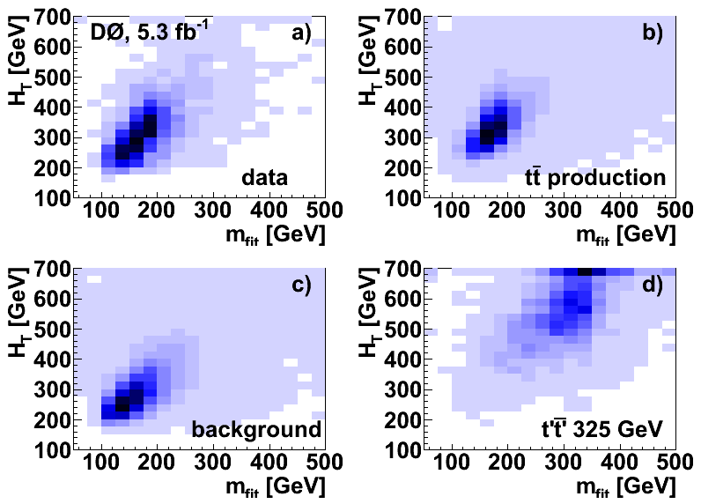
4th fermion generation – t’ quark
signature
require
electron/muon
missing p_{T}
≥4 jets
(≥1 b-tagged jet)
2C kinematic fit
m_{qq}=m_{lν}=M_{W}
m_{bqq}=m_{blν}
→m_{fit}
H_{T} = Σ|p_{T}|

Slide 7
4th fermion generation – t’ quark
no b-tag

Slide 8
4th fermion generation – t’ quark
D0
CDF
m_{t’} > 285 GeV @ 95% CL
m_{t’} > 340 GeV @ 95% CL
with b-tag:
m_{t’} > 358 GeV @ 95% CL
PRL 107, 082001 (2011)
arxiv:1107.3875

Slide 9
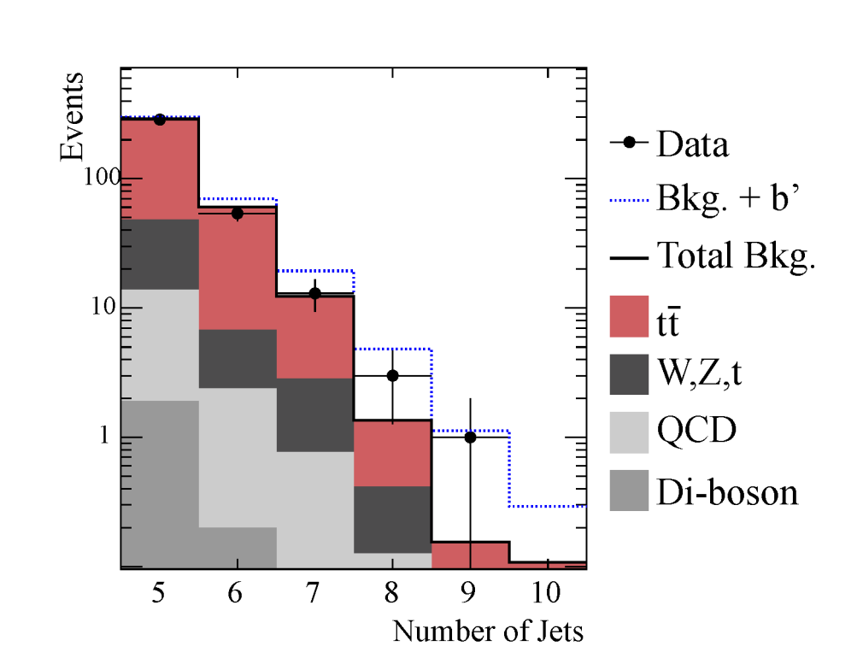
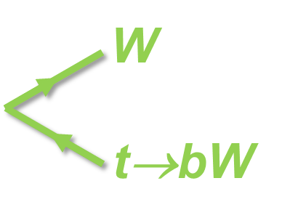
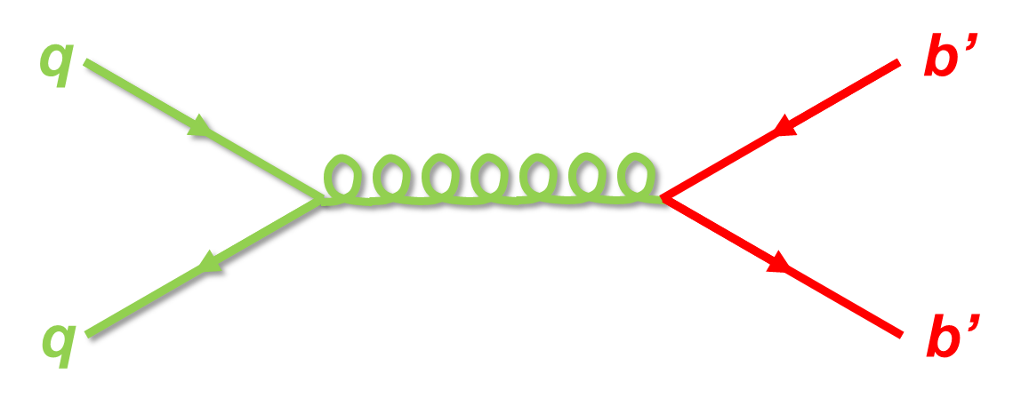
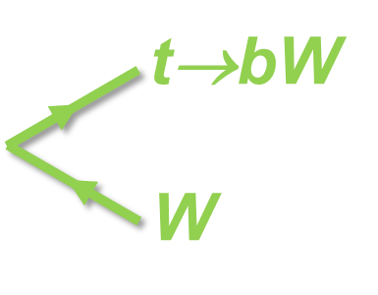
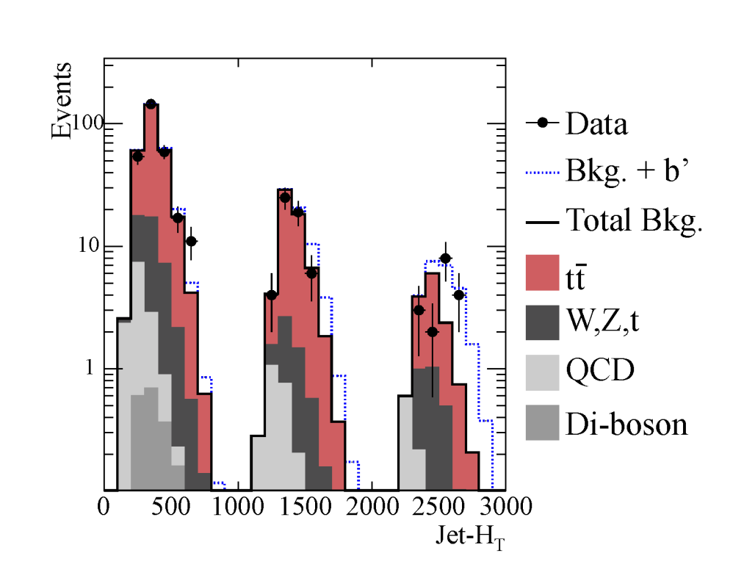
4th fermion generation – b’ quark
signature
require
e/μ p_{T} >20 GeV
missing p_{T} >20 GeV
≥5 jets p_{T} >15 GeV
≥1 b-tagged jet
H_{T} = Σ|p_{T}|
m_{b’} = 350 GeV
N_{jet} = 5
N_{jet} = 6
N_{jet} ≥ 7

Slide 10
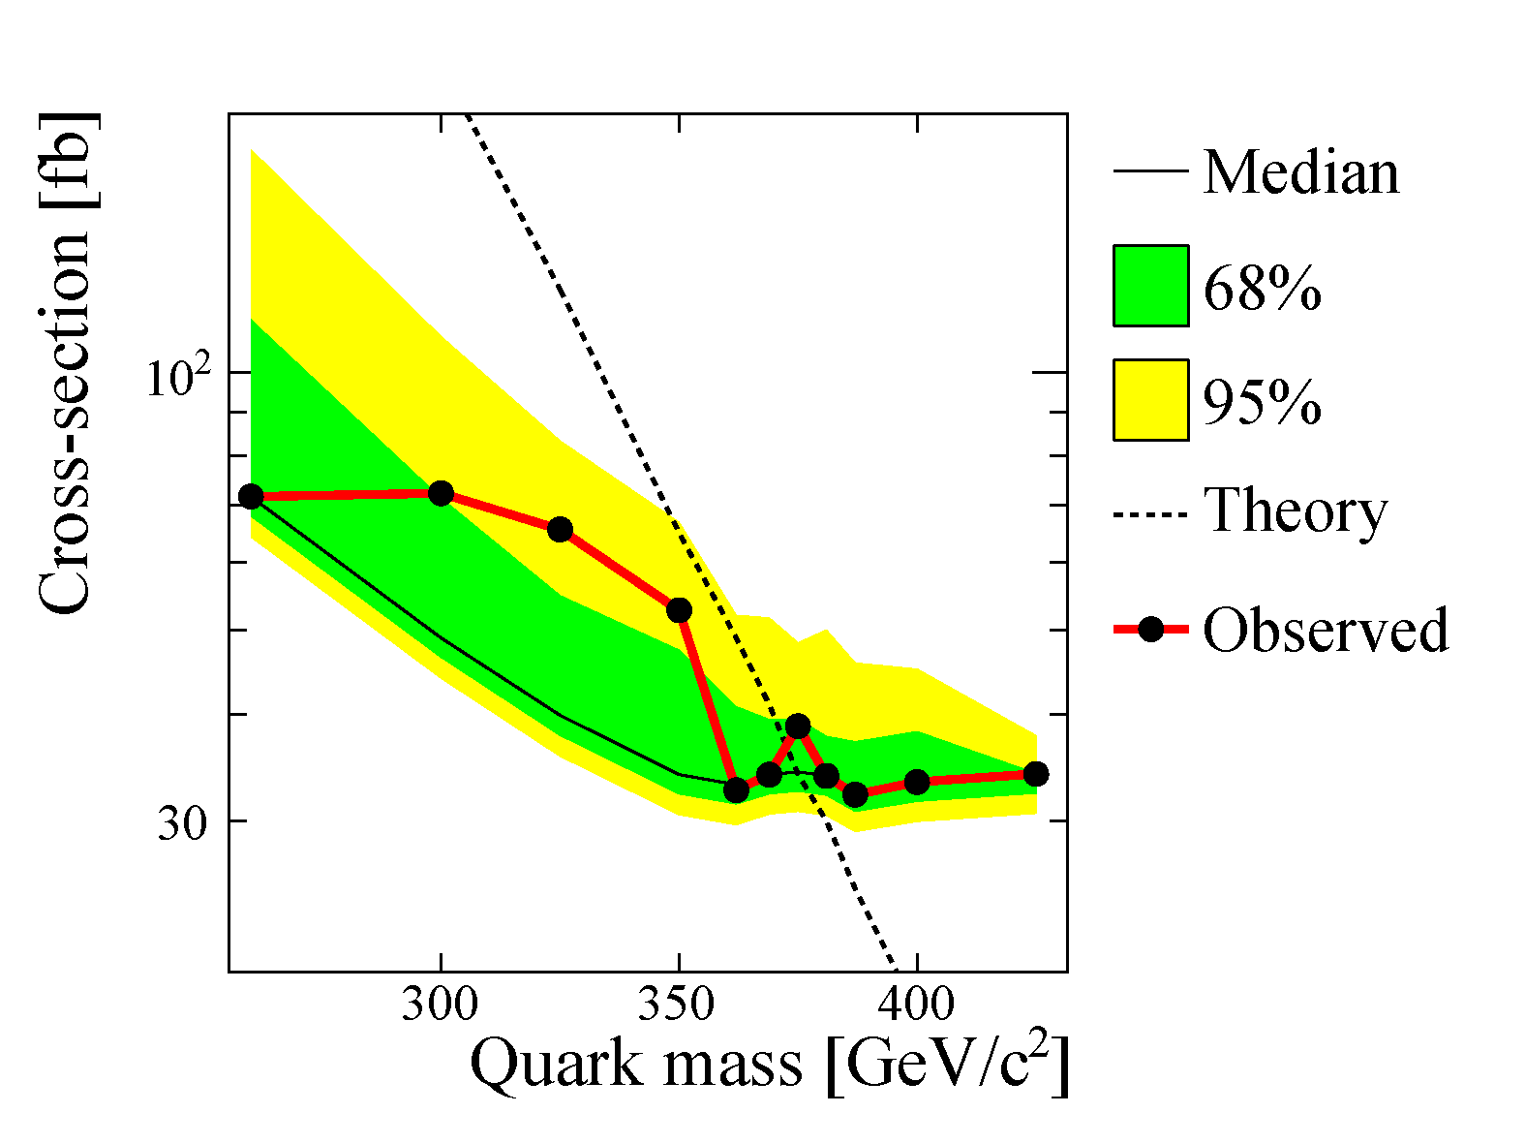
4th fermion generation – b’ quark
m_{b’} > 372 GeV @ 95% CL
PRL 106, 141803 (2011)

Slide 11
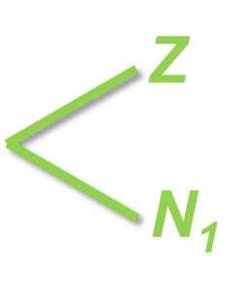
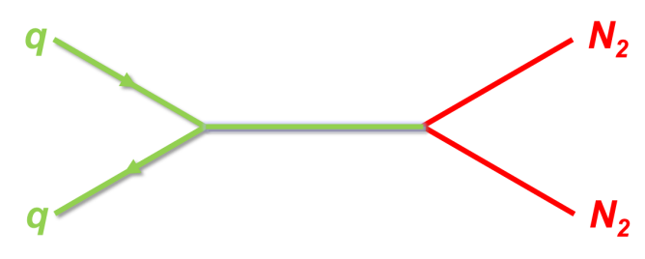
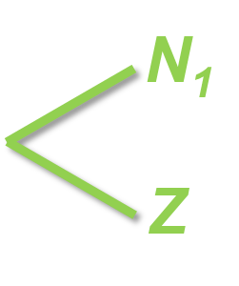
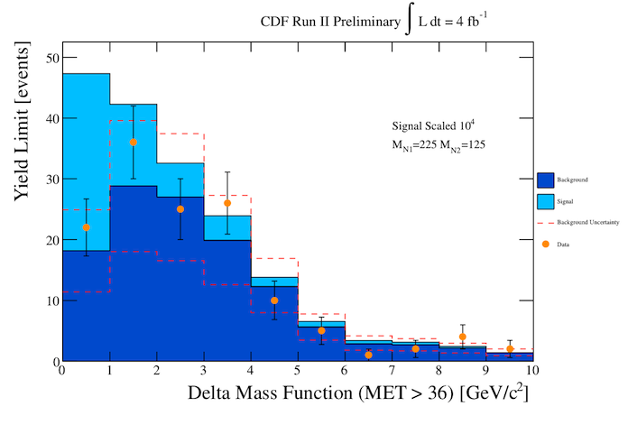
4th fermion generation – heavy ν
superposition of Dirac and Majorana particles
two mass eigenstates:
N1 (lightest 4th generation particle – stable)
N2 (decays to N1+Z)
require
two leptons
p_{T} >20 GeV, same flavor, opposite sign, m_{ll}≈M_{Z}
two jets
p_{T} >15 GeV, untagged
missing p_{T} >40 GeV
L. Carpenter arxiv:1107.0975v1
signal scaled by 10⁴
M_{N2}=225 GeV
M_{N1}=125 GeV

Slide 12
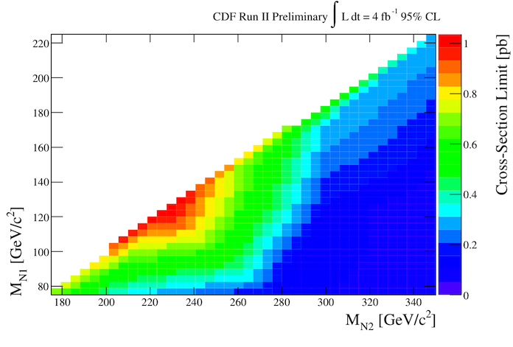
4th fermion generation – heavy ν
M_{N2} | M_{N1} | theory | expected | observed
175 | 75 | 0.51 fb | 511 fb | 702 fb
200 | 75 | 0.21 fb | 292 fb | 369 fb
225 | 125 | 0.16 fb | 684 fb | 1088 fb
225 | 75 | 0.08 fb | 156 fb | 273 fb
275 | 75 | 0.02 fb | 94 fb | 132 fb
300 | 125 | 0.01 fb | 99 fb | 138 fb
300 | 175 | 0.02 fb | 171 fb | 315 fb
350 | 125 | 0.003 fb | 75 fb | 48 fb
350 | 225 | 0.006 fb | 190 fb | 297 fb
350 | 75 | 0.001 fb | 71 fb | 55 fb
CDF note 10539

Slide 13
tt resonance
predicted by many models
GUTs with larger symmetry groups
Kaluza-Klein excitations of gluon or Z boson
axigluons
new strong dynamics
benchmark model
leptophobic topcolor Z’
width Γ = 0.012 × M_{Z’}
B(Z’→tt)=100%
R. M. Harris, C. T. Hill, and S. J. Parke, arxiv:hep-ph/9911288

Slide 14
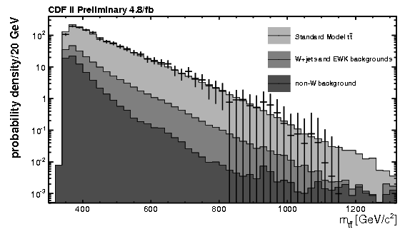
tt resonance
require
1 e/μ with p_{T} >20 GeV
≥4 jets with p_{T} >20 GeV
≥1 b-tagged jet
missing p_{T} >20 GeV
plot probability density for m_{tt}
source | 4 jets | ≥5 jets
sm (except tt) | 197±40 | 51±13
tt | 667±62 | 225±21
total | 864±74 | 276±25
data | 996 | 370

Slide 15
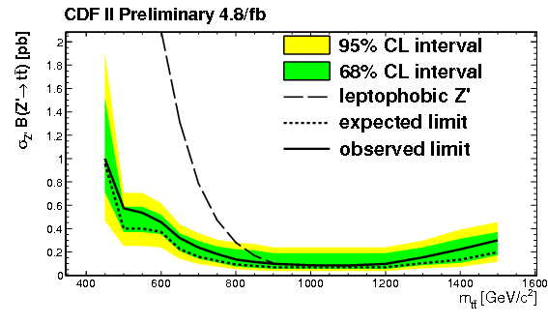
tt resonance
m_{Z’} > 900 GeV @ 95% CL
PRD 84, 072004 (2011) arxiv:1107.5063

Slide 16
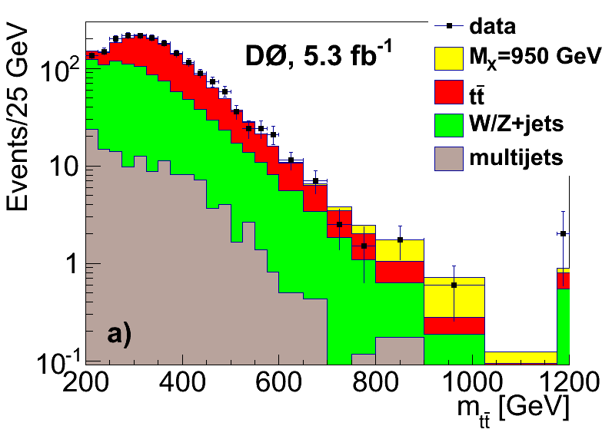
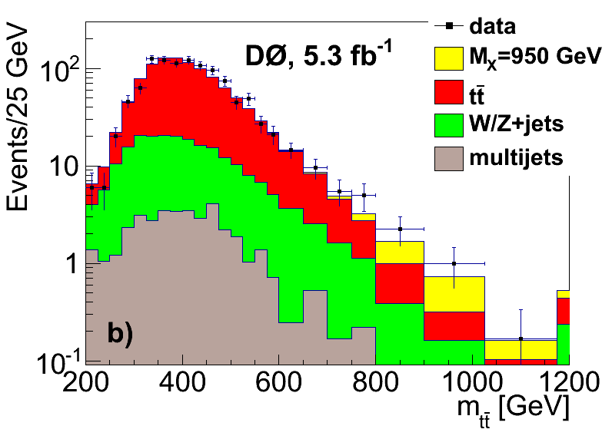
tt resonance
require
1 electron/muon p_{T}>20 GeV
missing p_{T}>20/30 GeV
≥3 jets p_{T}>20 GeV
leading jet p_{T}>40 GeV
≥1 b-tagged jet
plot
invariant mass of ttbar decay products
constrain m(e/μ,ν)=M_{W}
3 jets ≥4 jets

Slide 17
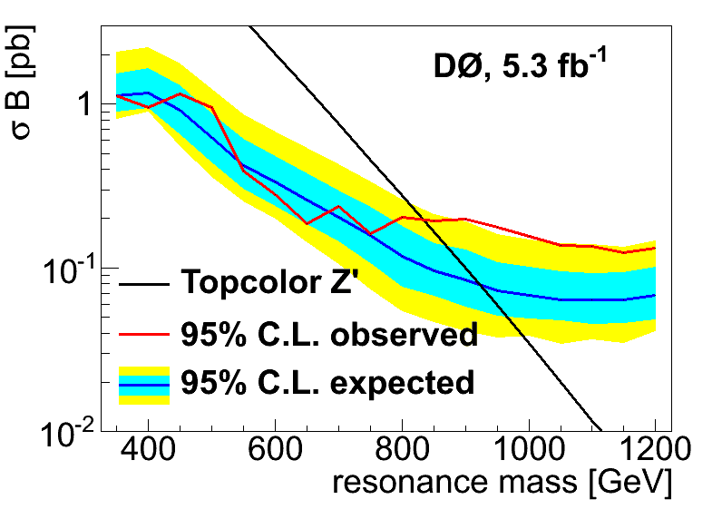
tt resonance
m_{Z’} > 835 GeV @ 95% CL
arXiv:1111.1271 [hep-ex]

Slide 18
universal extra dimensions
theories with 4+n space-time dimensions
all sm fields can propagate
compactified at scale 1/R
Kaluza Klein excitations for all sm particles
M_{n}² = M_{sm}² + n²/R²
number of KK modes is conserved
no vertices with odd number of KK modes
assume n=1
compactification scale 1/R ≈ ewk scale is possible
pair production of g₁, Q₁ – decay to lightest KK particle γ₁
Appelquist, Cheng, Dobrescu, PRD 64, 035002 (2011)

Slide 19
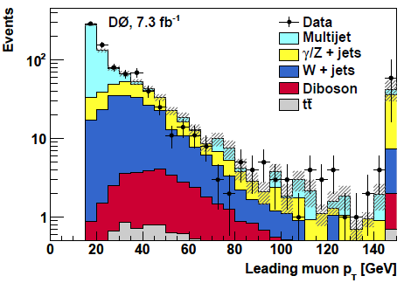
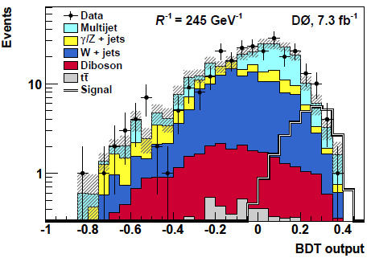
universal extra dimensions
signature
same sign μs from decay
1% of decays
require
μ±μ±
isolated, Δφ>2.9
μ₁: 15<p_{T}<200 GeV
μ₂: p_{T}>10 GeV
20<m_{μμ}<250 GeV
missing p_{T}>25 GeV
QCD background from data
other sm background from MC
boosted decision tree discriminant
preliminary
preliminary

Slide 20
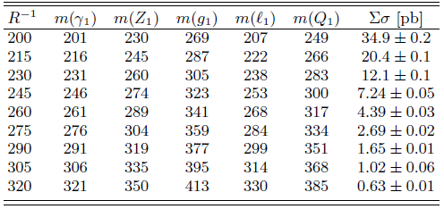
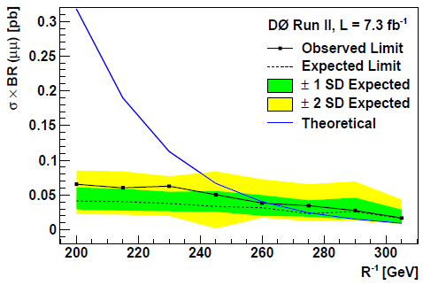
universal extra dimensions
compare with model predictions for a range of compactification scales
1/R > 260 GeV @ 95% CL
lightest KK quark
m(Q₁) > 317 GeV
preliminary

Slide 21
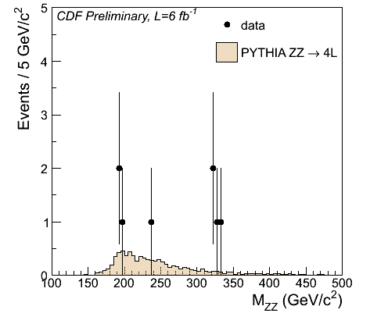
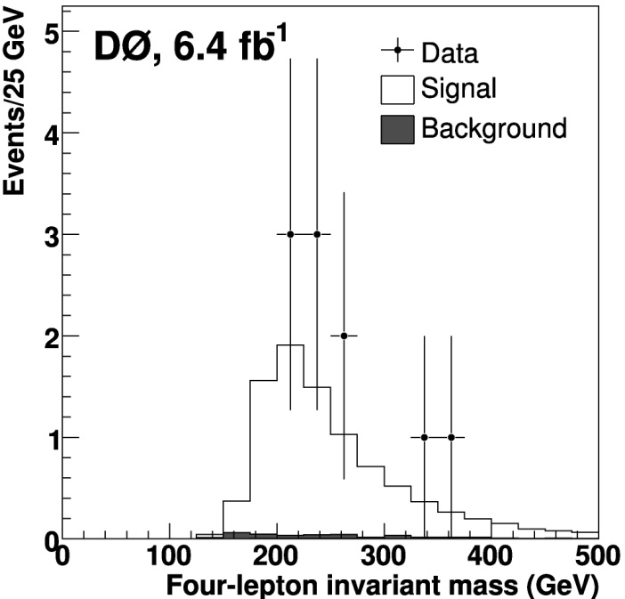
ZZ resonance
KK excitations of RS-graviton
ZZ → l+l−l+l−
B(ZZ→ llll) = 0.5%
4 leptons (≥2 with p_{T}>20 GeV)
76<m_{ll}<106 GeV
no sm background
8 events (2x eeee, 3x eeμμ, 3x μμμμ)
sm prediction: (1.4±0.1) pb
4 events (eeee, 2* eeμμ, μμμμ)
<m> = 327 GeV
Δm = 7 GeV (≈detector resolution)
p-value = (1 – 2)x10⁻⁴
PRD 84, 011103(R) (2011)

Slide 22
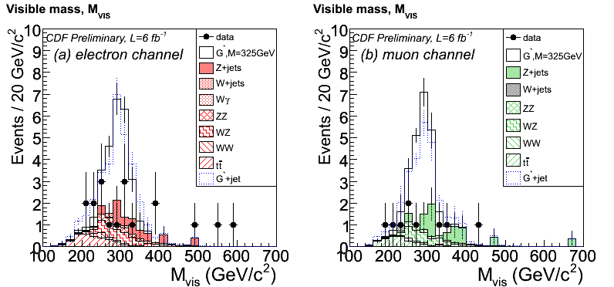
ZZ resonance
RS Graviton with M=325 GeV
normalized to yield 4llll events
ZZ → l+l−νν
2 leptons p_{T}>20 GeV
missing p_{T}>100 GeV
B(ZZ→ llνν) = 3%
observe 27 events
expect 26 events
ZZ → l+l−jj
2 leptons p_{T}>20 GeV
≥2 jets p_{T}>25 GeV
70<m_{jj}<100 GeV
B(ZZ→ llqq) = 10%
dominated by Z+jets
kinematic fit for M_{lljj}

Slide 23
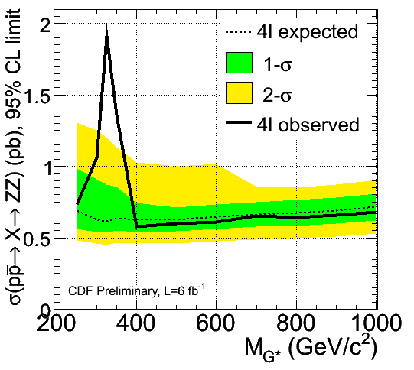
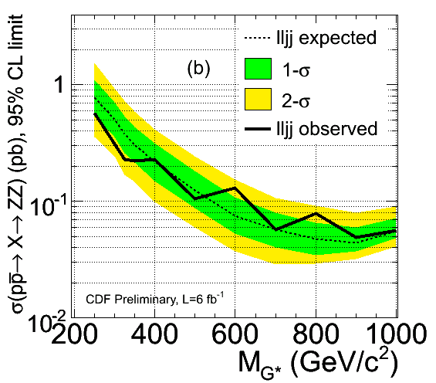
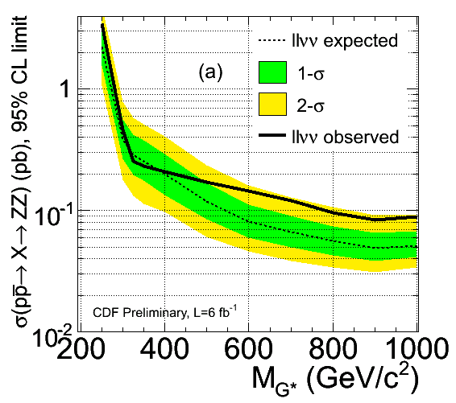
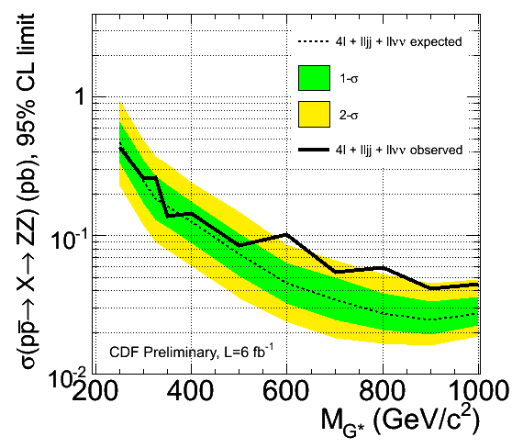
ZZ resonance
CDF note 10603
ZZ → llll
ZZ → lljj
ZZ → llνν
combined

Slide 24
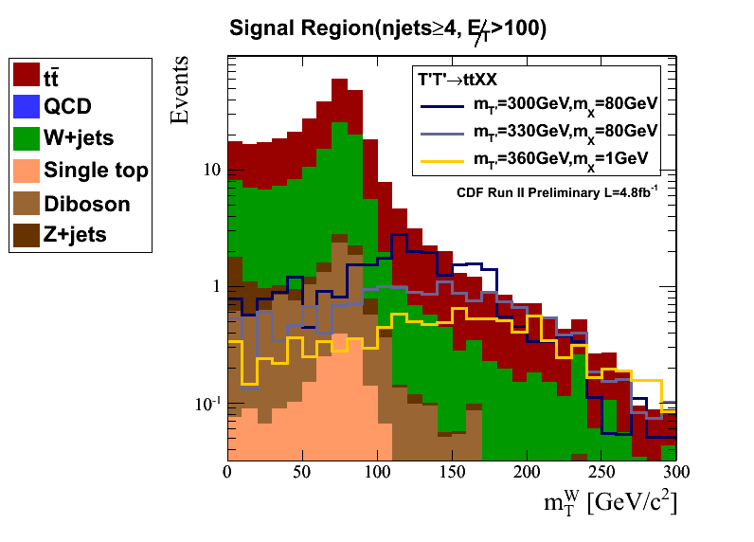
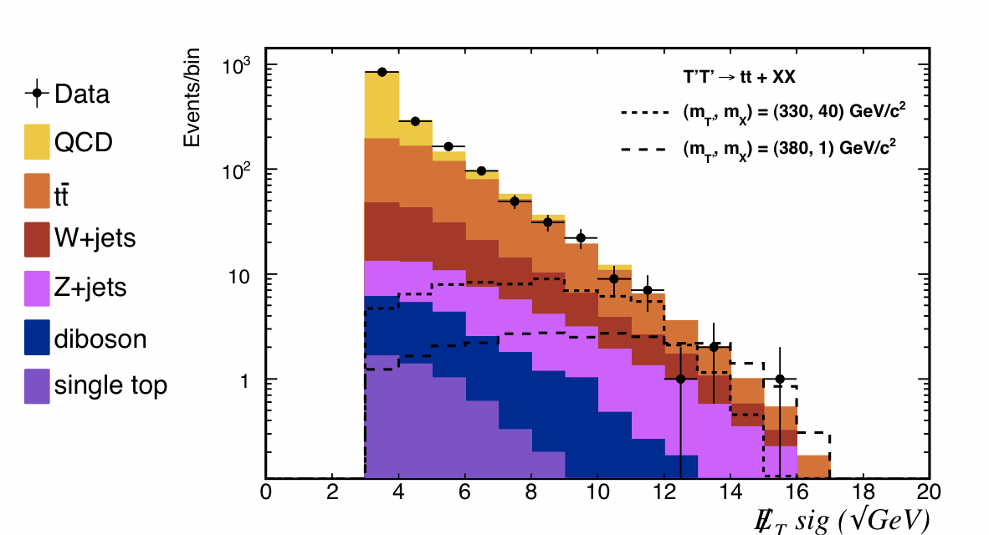
dark matter
stable → carries a conserved new charge
“connector” particle
couples new charge and sm charge
top quark partner $T’t+X$
look for $T^{′}\overline{T′}→t\overline{t}+X\overline{X}$
lepton+jets channel
1 e/μ $pT>20 GeV$
≥4 jets $pT>15 GeV$
missing $pT>100 – 160 GeV$
all hadronic channel
missing $pT>50 GeV$
5≤njets≤10 $pT>15 – 30 GeV$
$HT>220 GeV$
arxiv:1002.3366
CDF 4.8/fb
PRL106,191801 (2011) arxiv:1103.2482
CDF 5.7/fb
PRL107, 191803 (2011) arxiv:1107.3574

Slide 25
dark matter

Slide 26
Conclusions
Tevatron delivered 12/fb
CDF and D0 continue to search for deviations from sm predictions
4th generation
resonances
extra dimensions
dark matter
some deviations but no smoking gun for physics beyond the standard model
CDF results: http://www-cdf.fnal.gov/physics/physics.html
D0 results: http://www-d0.fnal.gov/Run2Physics/WWW/results.htm

