Slide 1
Vectors + Multijet Theory with BlackHat and Sherpa
David A. Kosower Institut de Physique Théorique, CEA–Saclay
on behalf of the BlackHat Collaboration
Carola Berger, Z. Bern, Giovanni Diana, L. Dixon, Fernando Febres Cordero, Darren Forde, Tanju Gleisberg, Stefan Höche, Harald Ita, DAK, Daniel Maître, Kemal Ozeren with contributions by Kurt Barry (ATLAS)
HCP 2011 November 15, 2011

Slide 2
Next-to-Leading Order in QCD
Precision QCD requires at least NLO
QCD at LO is not quantitative: large dependence on unphysical renormalization and factorization scales
NLO: reduced dependence, first quantitative prediction
Want this not just for basic processes, but for every signal and background one
Even more important with many jets

Slide 3
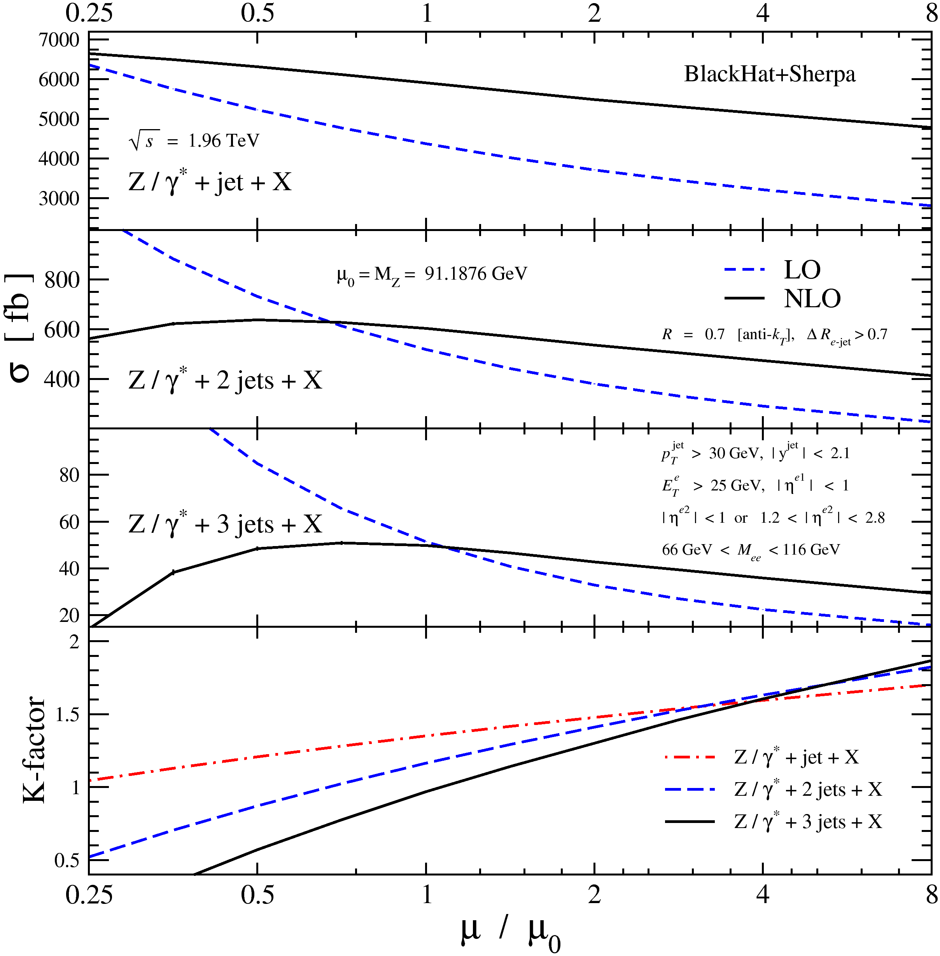
Why NLO?
Reduction of scale dependence
NLO importance grows with increasing number of jets
Expect predictions reliable to 10–15%

Slide 4
Ingredients for NLO Calculations
Tree-level matrix elements for LO and real-emission terms known since ’80s ✓
…but we’ve improved efficiency since then
Singular (soft & collinear) behavior of tree-level amplitudes, integrals, initial-state collinear behavior known since ’90s ✓
NLO parton distributions known since ’90s ✓
General framework for numerical programs known since ’90s ✓ Catani, Seymour (1996); Giele, Glover, DAK (1993); Frixione, Kunszt, Signer (1995)
Automating real—virtual cancellation for general processes Gleisberg, Krauss; Seymour, Tevlin; Hasegawa, Moch, Uwer; Frederix, Gehrmann, Greiner (2008); Frederix, Frixione, Maltoni, Stelzer (2009)
On-shell Methods: one-loop amplitudes
W+2 jets (MCFM) → W+3 jets → W+4 jets → →
Bern, Dixon, DAK, Weinzierl (1997–8); BlackHat; BlackHat Campbell, Glover, Miller (1997) Rocket
NLO Revolution
Bottleneck: one-loop amplitudes

Slide 5
Lots of revolutionaries roaming the world
BlackHat
CutTools+HELAC-NLO: Ossola, Papadopoulos, Pittau, Actis, Bevilacqua, Czakon, Draggiotis, Garzelli, van Hameren, Mastrolia, Worek & their clients
Rocket: Ellis, Giele, Kunszt, Lazopoulos, Melnikov, Zanderighi
Samurai: Mastrolia, Ossola, Reiter, & Tramontano
NGluon: Badger, Biedermann, & Uwer
MadLoop: Hirschi, Frederix, Frixione, Garzelli, Maltoni, & Pittau
Giele, Kunszt, Stavenga, Winter
Ongoing analytic work
Almeida, Britto, Feng & Mirabella

Slide 6
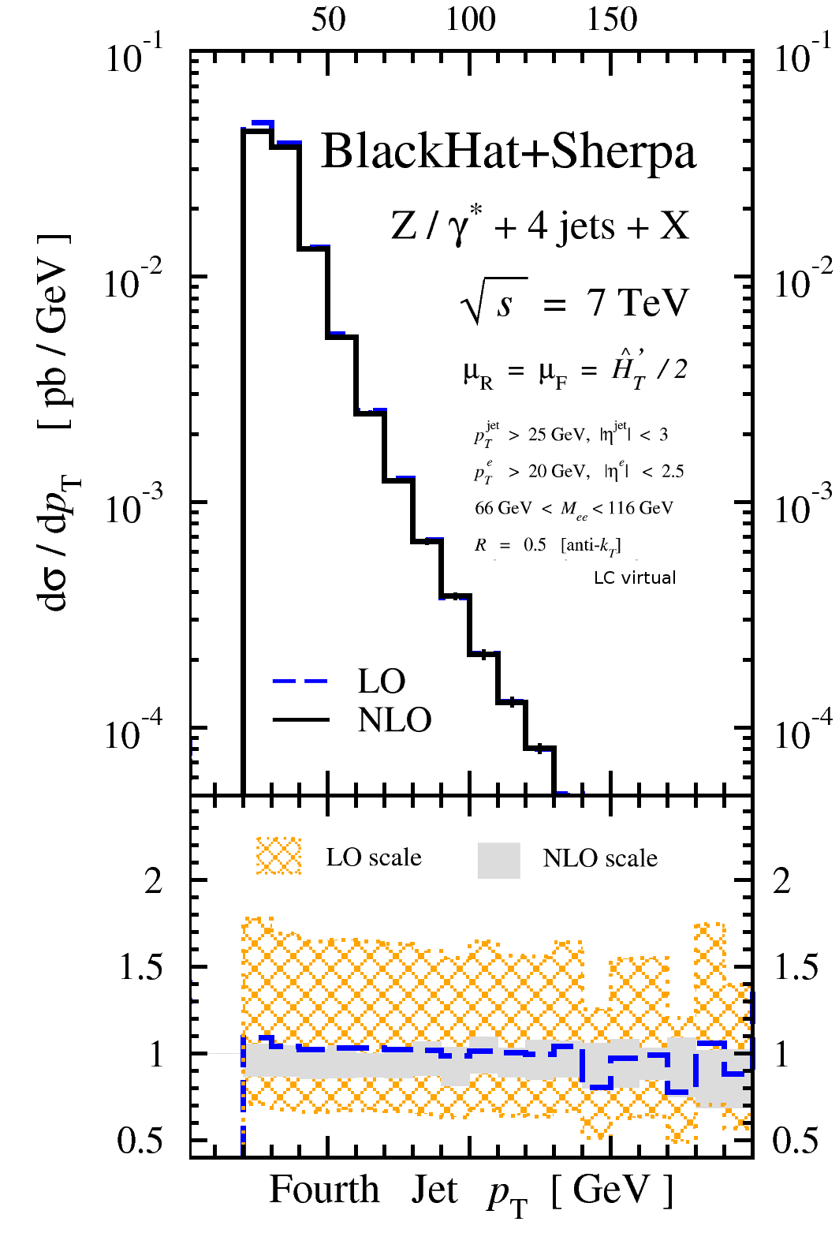
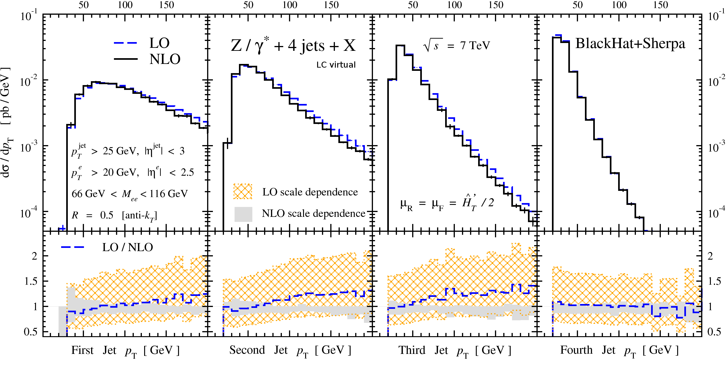
Z+4 Jets
arXiv:1108.2229 [H. Ita, Z. Bern, L. J. Dixon, F. Febres Cordero, DAK, D. Maître]
Dramatic improvement in scale stability
Numerical reliability
Fourth jet p_{T} has little LO→NLO change in shape
…but for leading three jet p_{T}s, shape changes; each successive jet falls faster

Slide 7
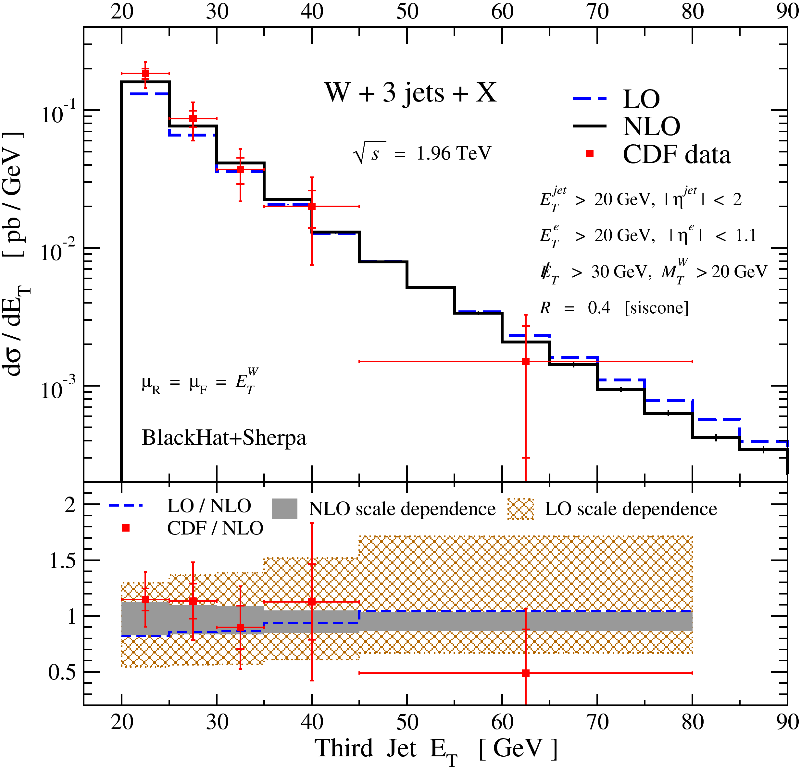
Comparison to Data
At the Tevatron…
Third jet in W+3 jets [0907.1984]
Reduced scale dependence at NLO
Good agreement with CDF data [0711.4044]
Shape change small compared to LO scale variation
SISCone (Salam & Soyez) vs JETCLU

Slide 8
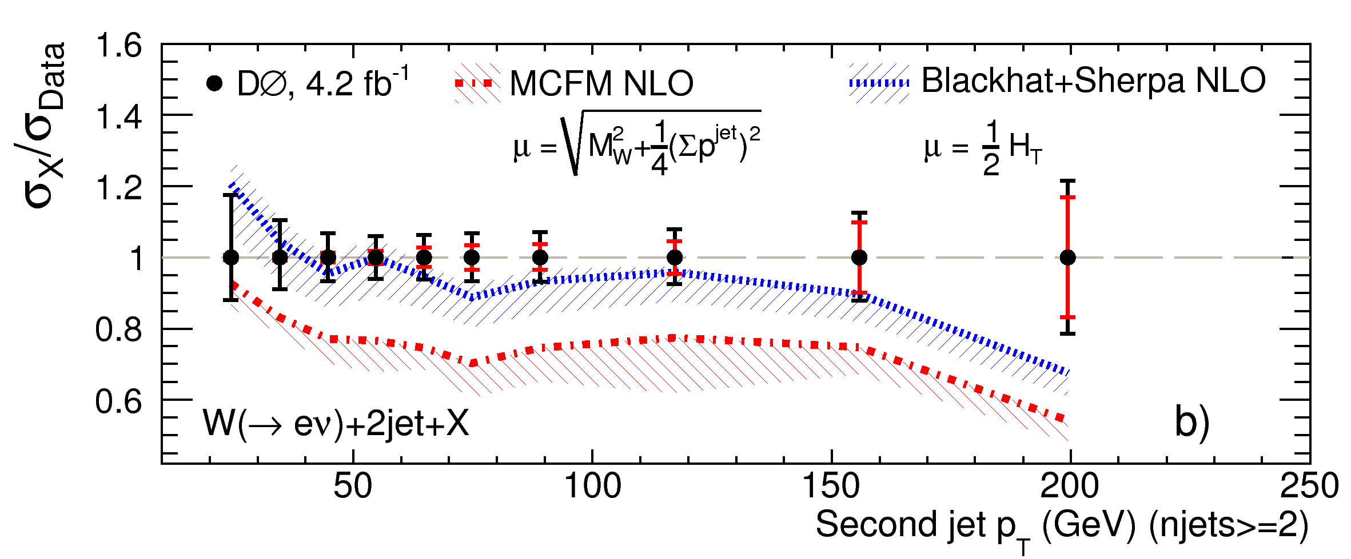
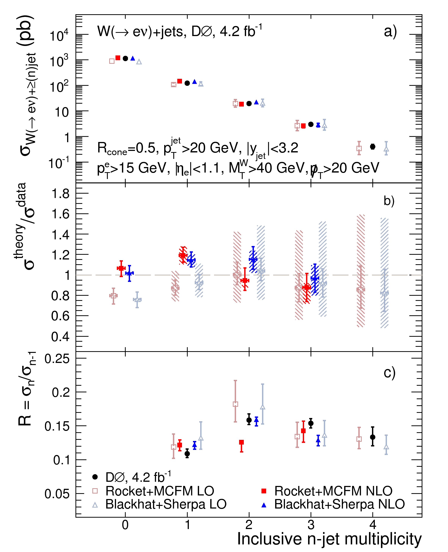
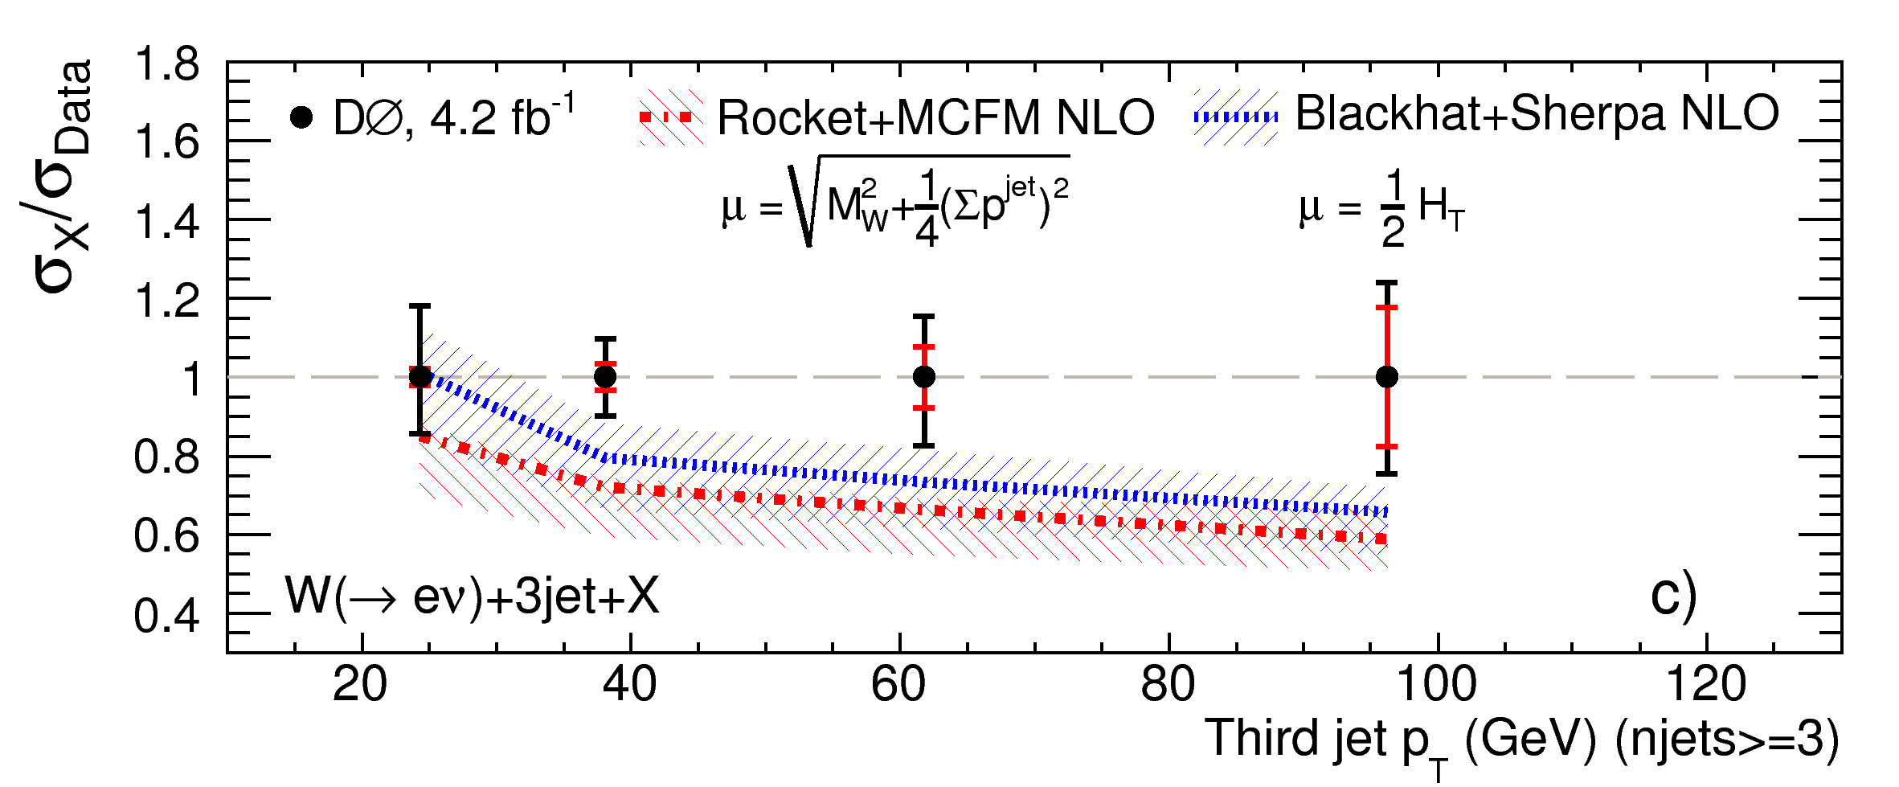
Comparison to Data
At the Tevatron…
Scale dependence bands narrow at NLO with respect to LO
Good agreement with D0 data [1106.1457] for total inclusive n-jet cross sections
D0 midpoint vs SISCone for BlackHat+Sherpa and Rocket+MCFM
Reasonable agreement for p_{T} distributions… some scale issues?

Slide 9
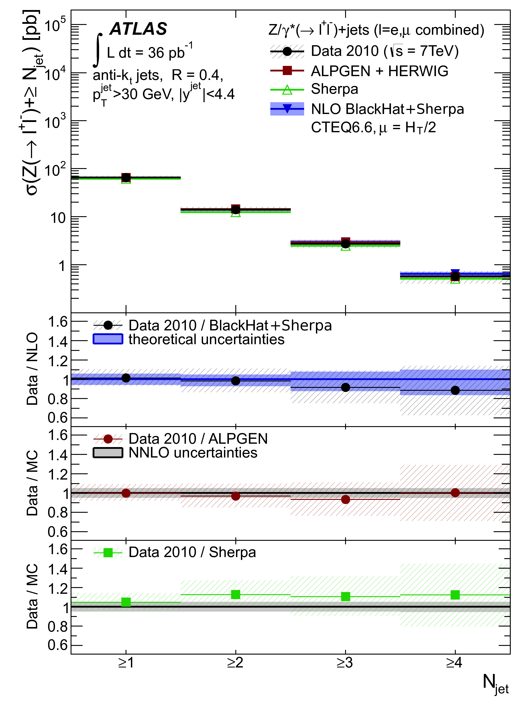
Comparison to Data
Hot off the presses from ATLAS [arXiv:1111.2690]
Cross sections for Z/γ*+≥1,2,3,4 jets, anti-k_{T}, R = 0.4
Small scale variation, good agreement with data
Much more to come!

Slide 10
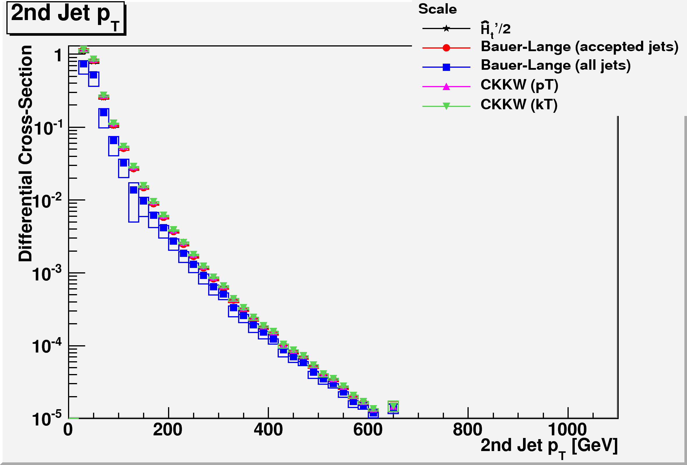
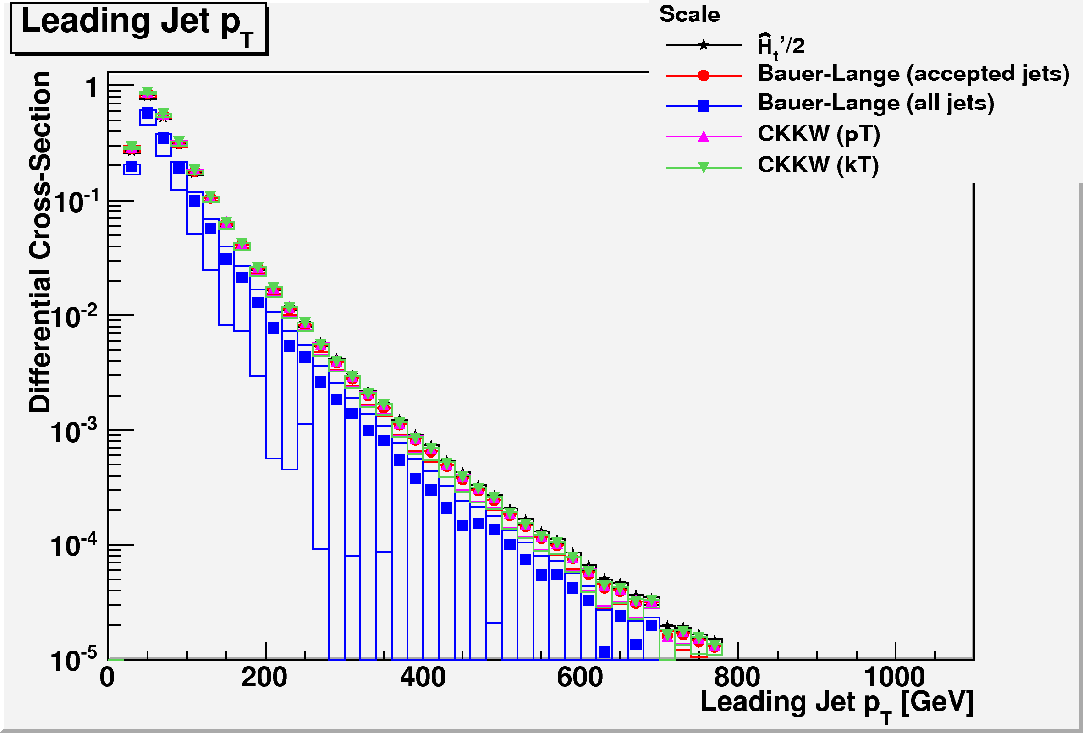
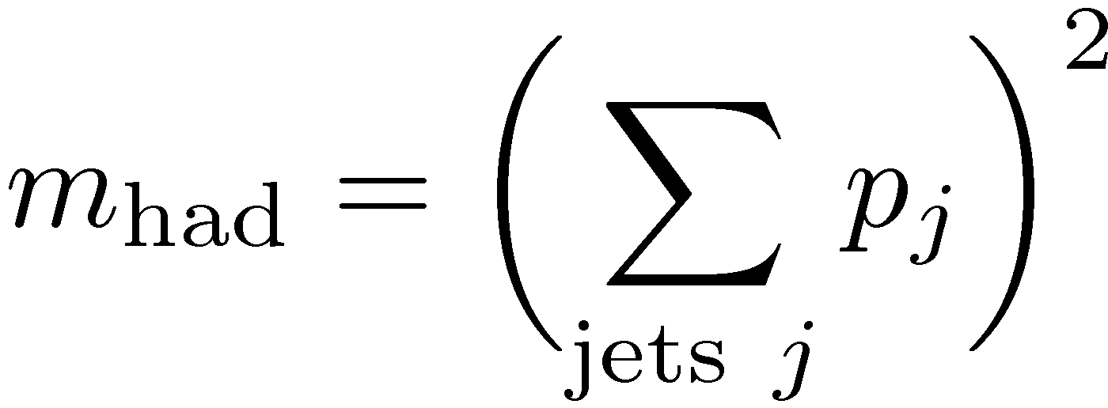
Choosing Scales
E_{T}^{W}: Acceptable at Tevatron, not at LHC
CKKW p_{T}: cluster back to two jets, use
Bauer-Lange (BL): accepted jets or all jets
CKKW k_{T}: like CKKW p_{T}, but cluster back to zero jets, use two largest clustering scales instead of p_{T}s
Thanks to Kurt Barry

Slide 11
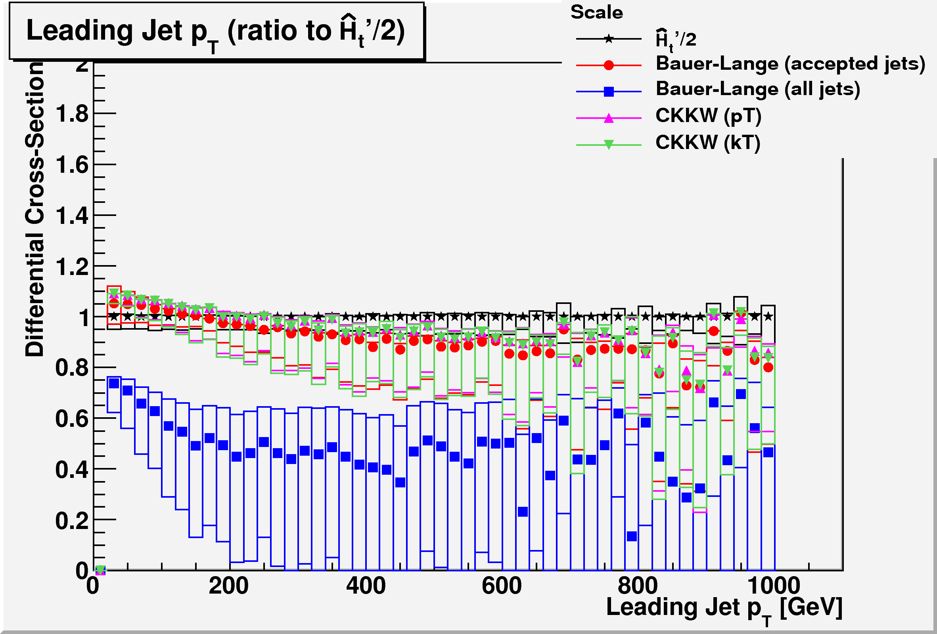
Exploring Scale Variation
Leading jet p_{T}: BL with all jets gives very low result. Scale too high because low-p_{T} third jet gives large contribution to mass; and preferentially suppresses real-emission contribution
Some trends in other scales, but all within 10–15% of Ĥ_{T}’/2

Slide 12
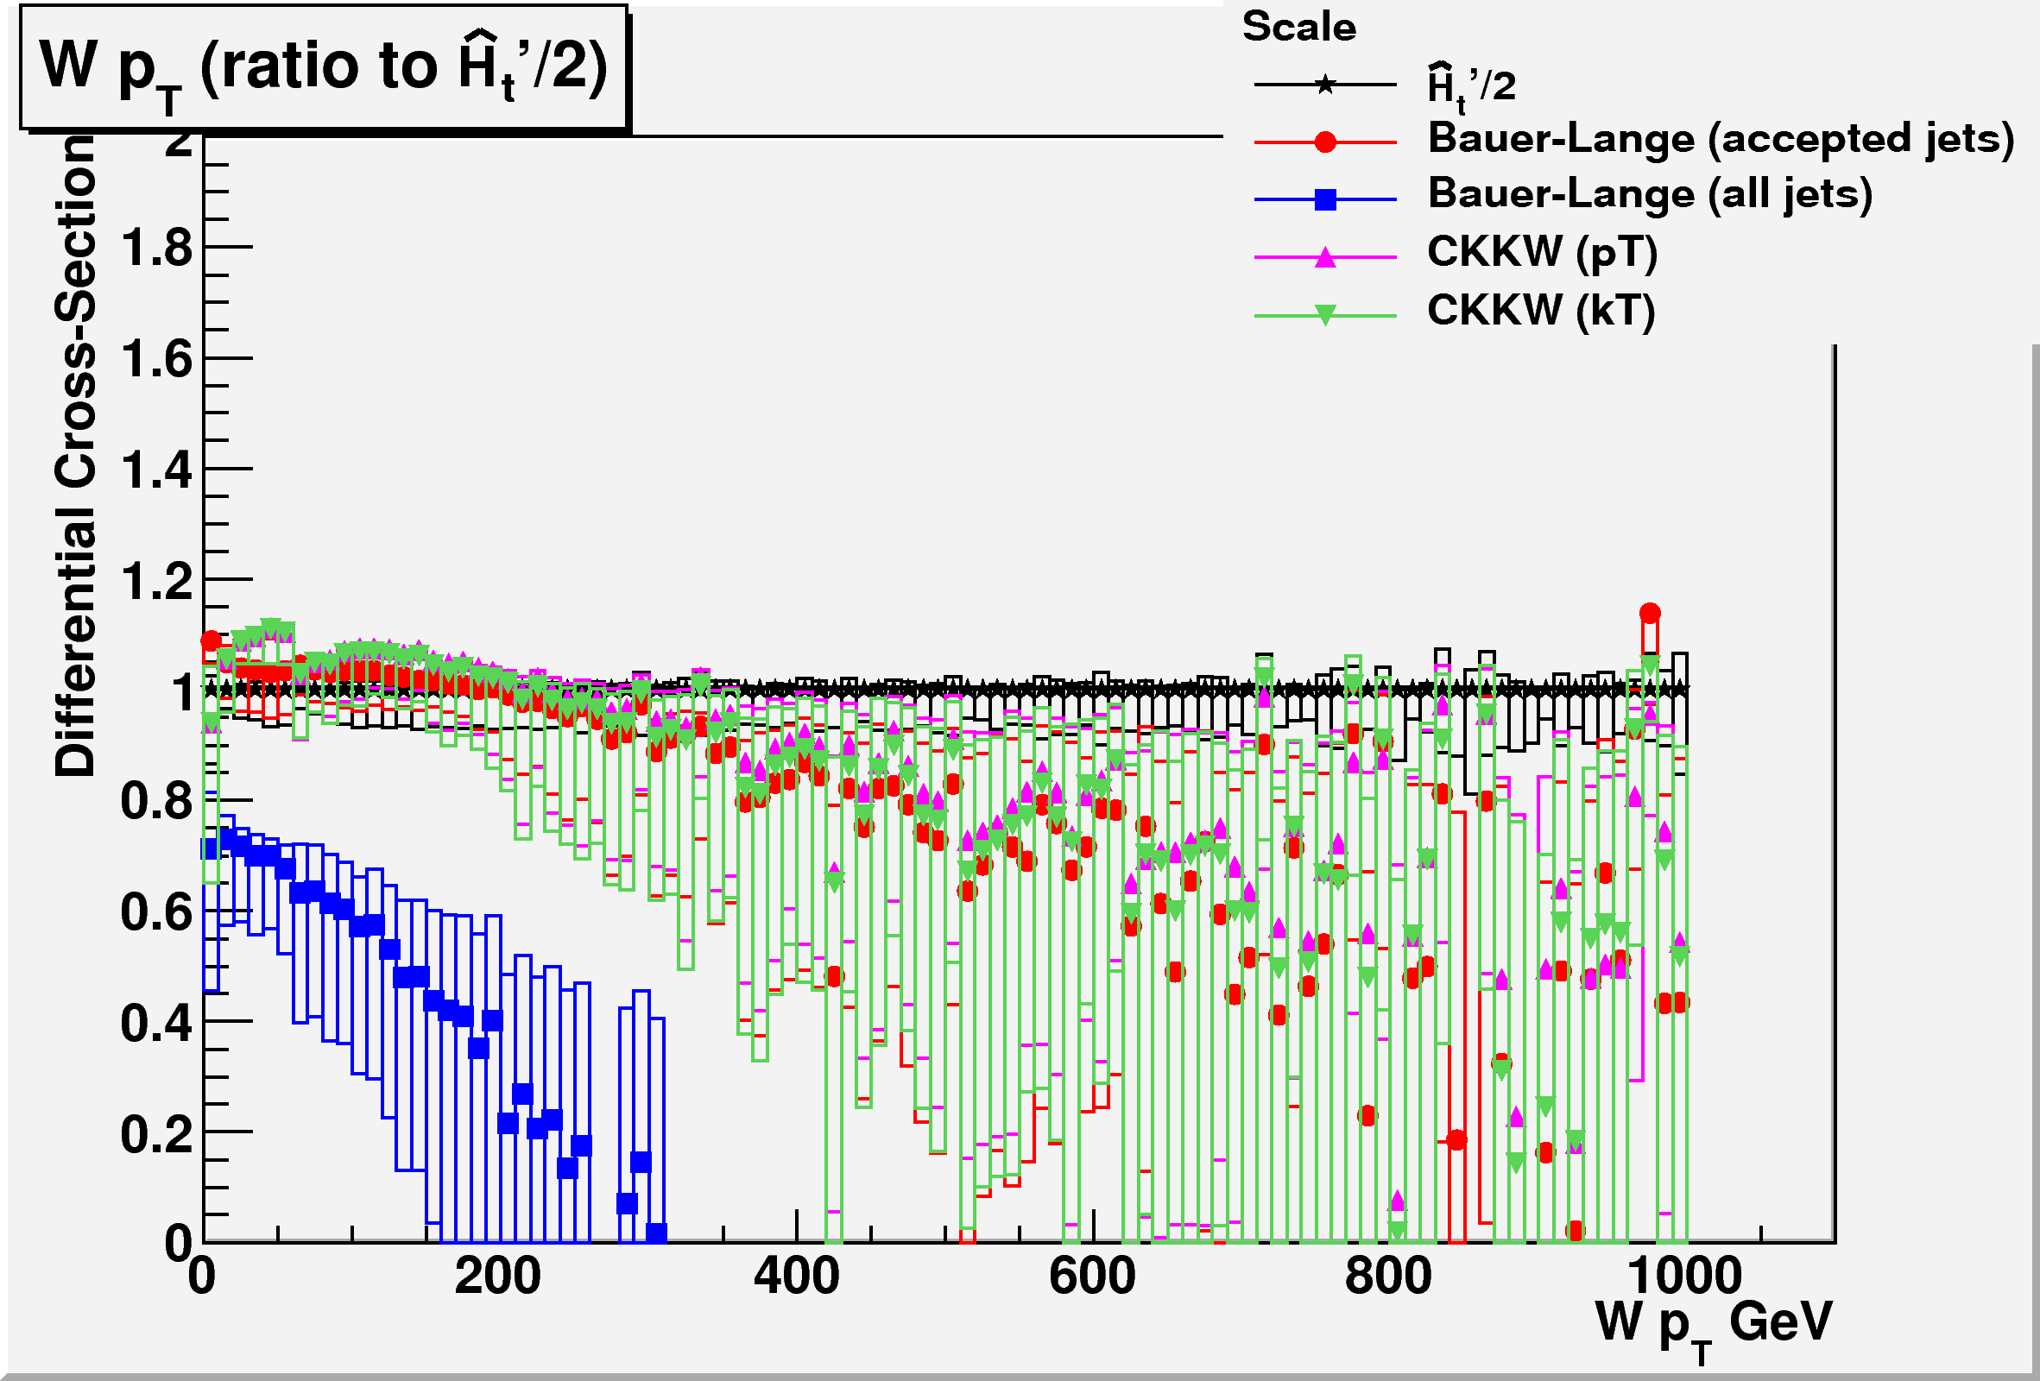
Exploring Scale Variation
W p_{T}: BL–all jet very low, goes negative at ~300 GeV!
No intrinsic problem with NLO, just a bad scale choice
Remaining choices: different behavior for different observables, but within 10–15% of Ĥ_{T}’/2

Slide 13
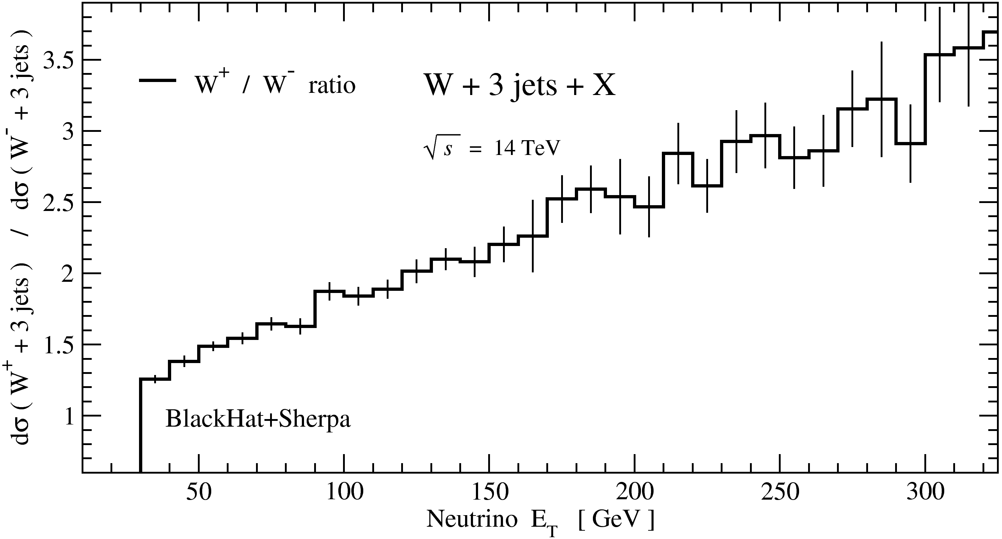
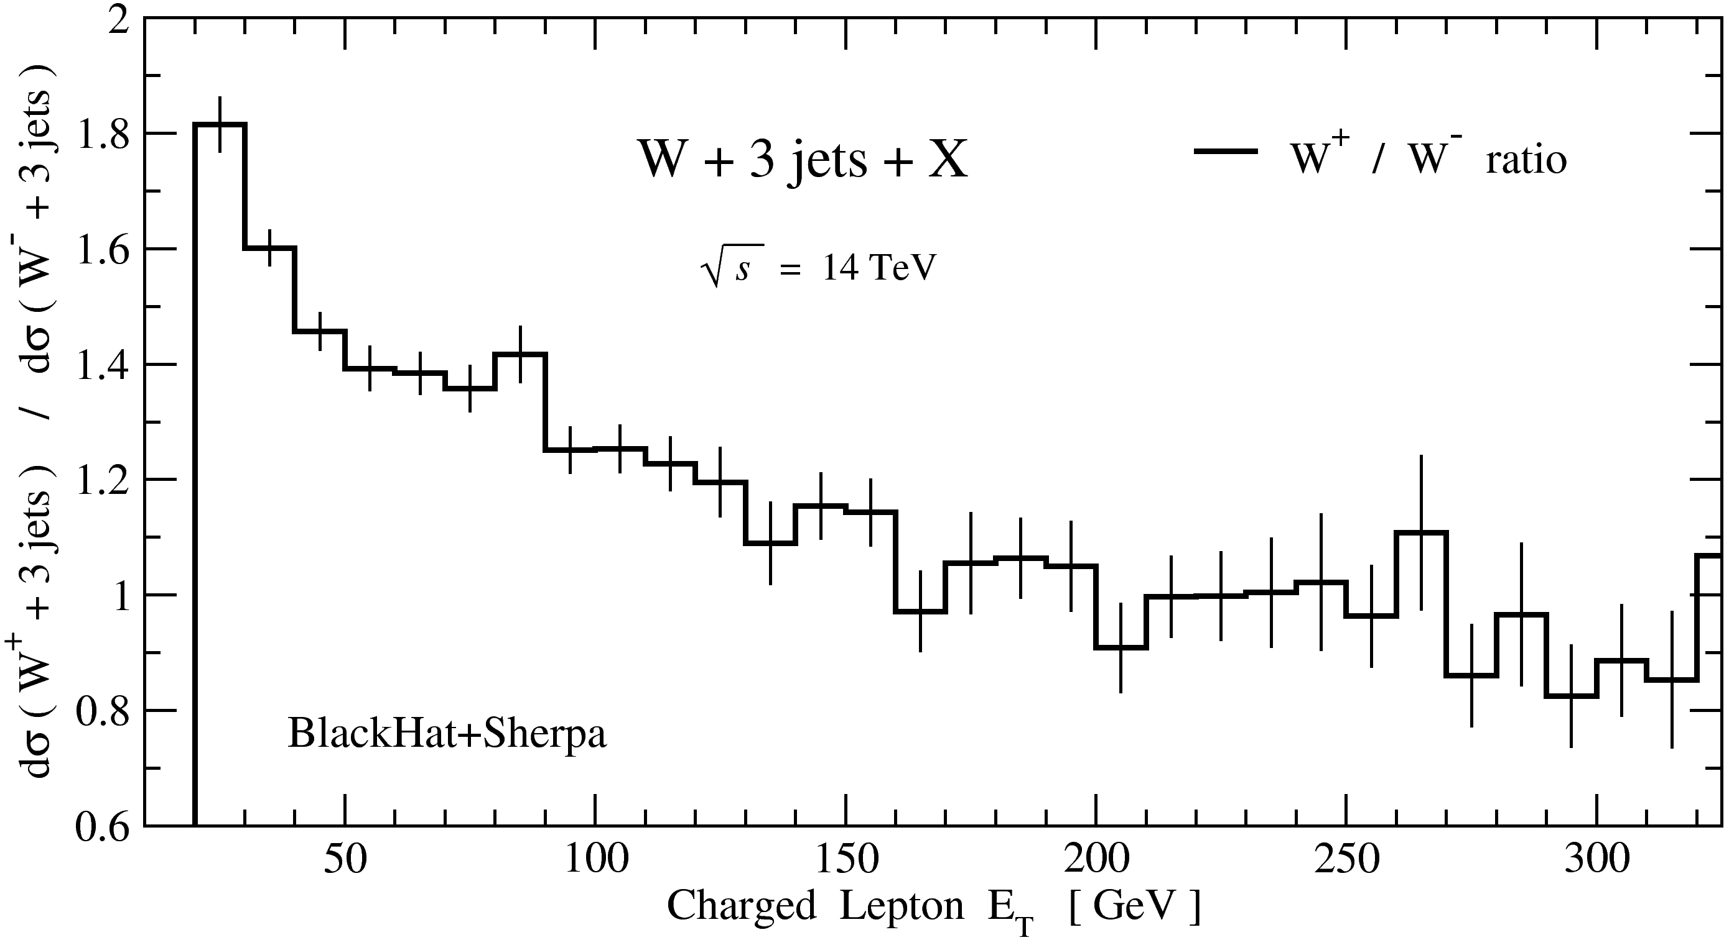
W+3 jets at the LHC: W⁺/W⁻ Ratio
qg dominant initial state at the LHC ⇒ E_{T}-dependent rate difference because of u(x)/d(x) distribution difference
But that’s not the whole story

Slide 14
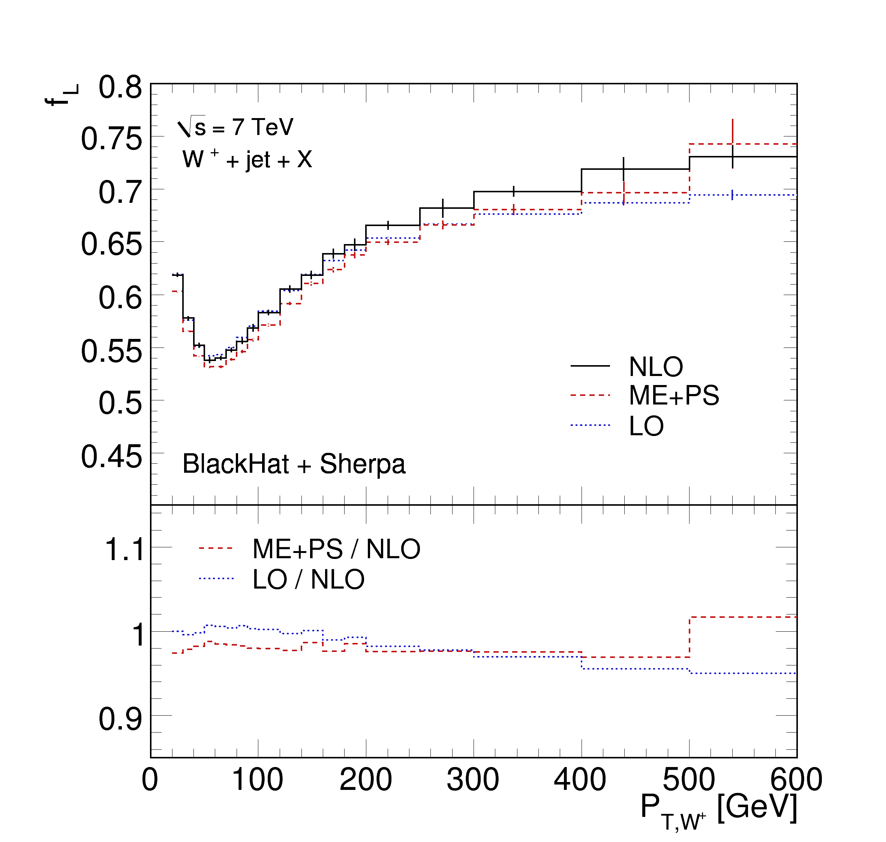
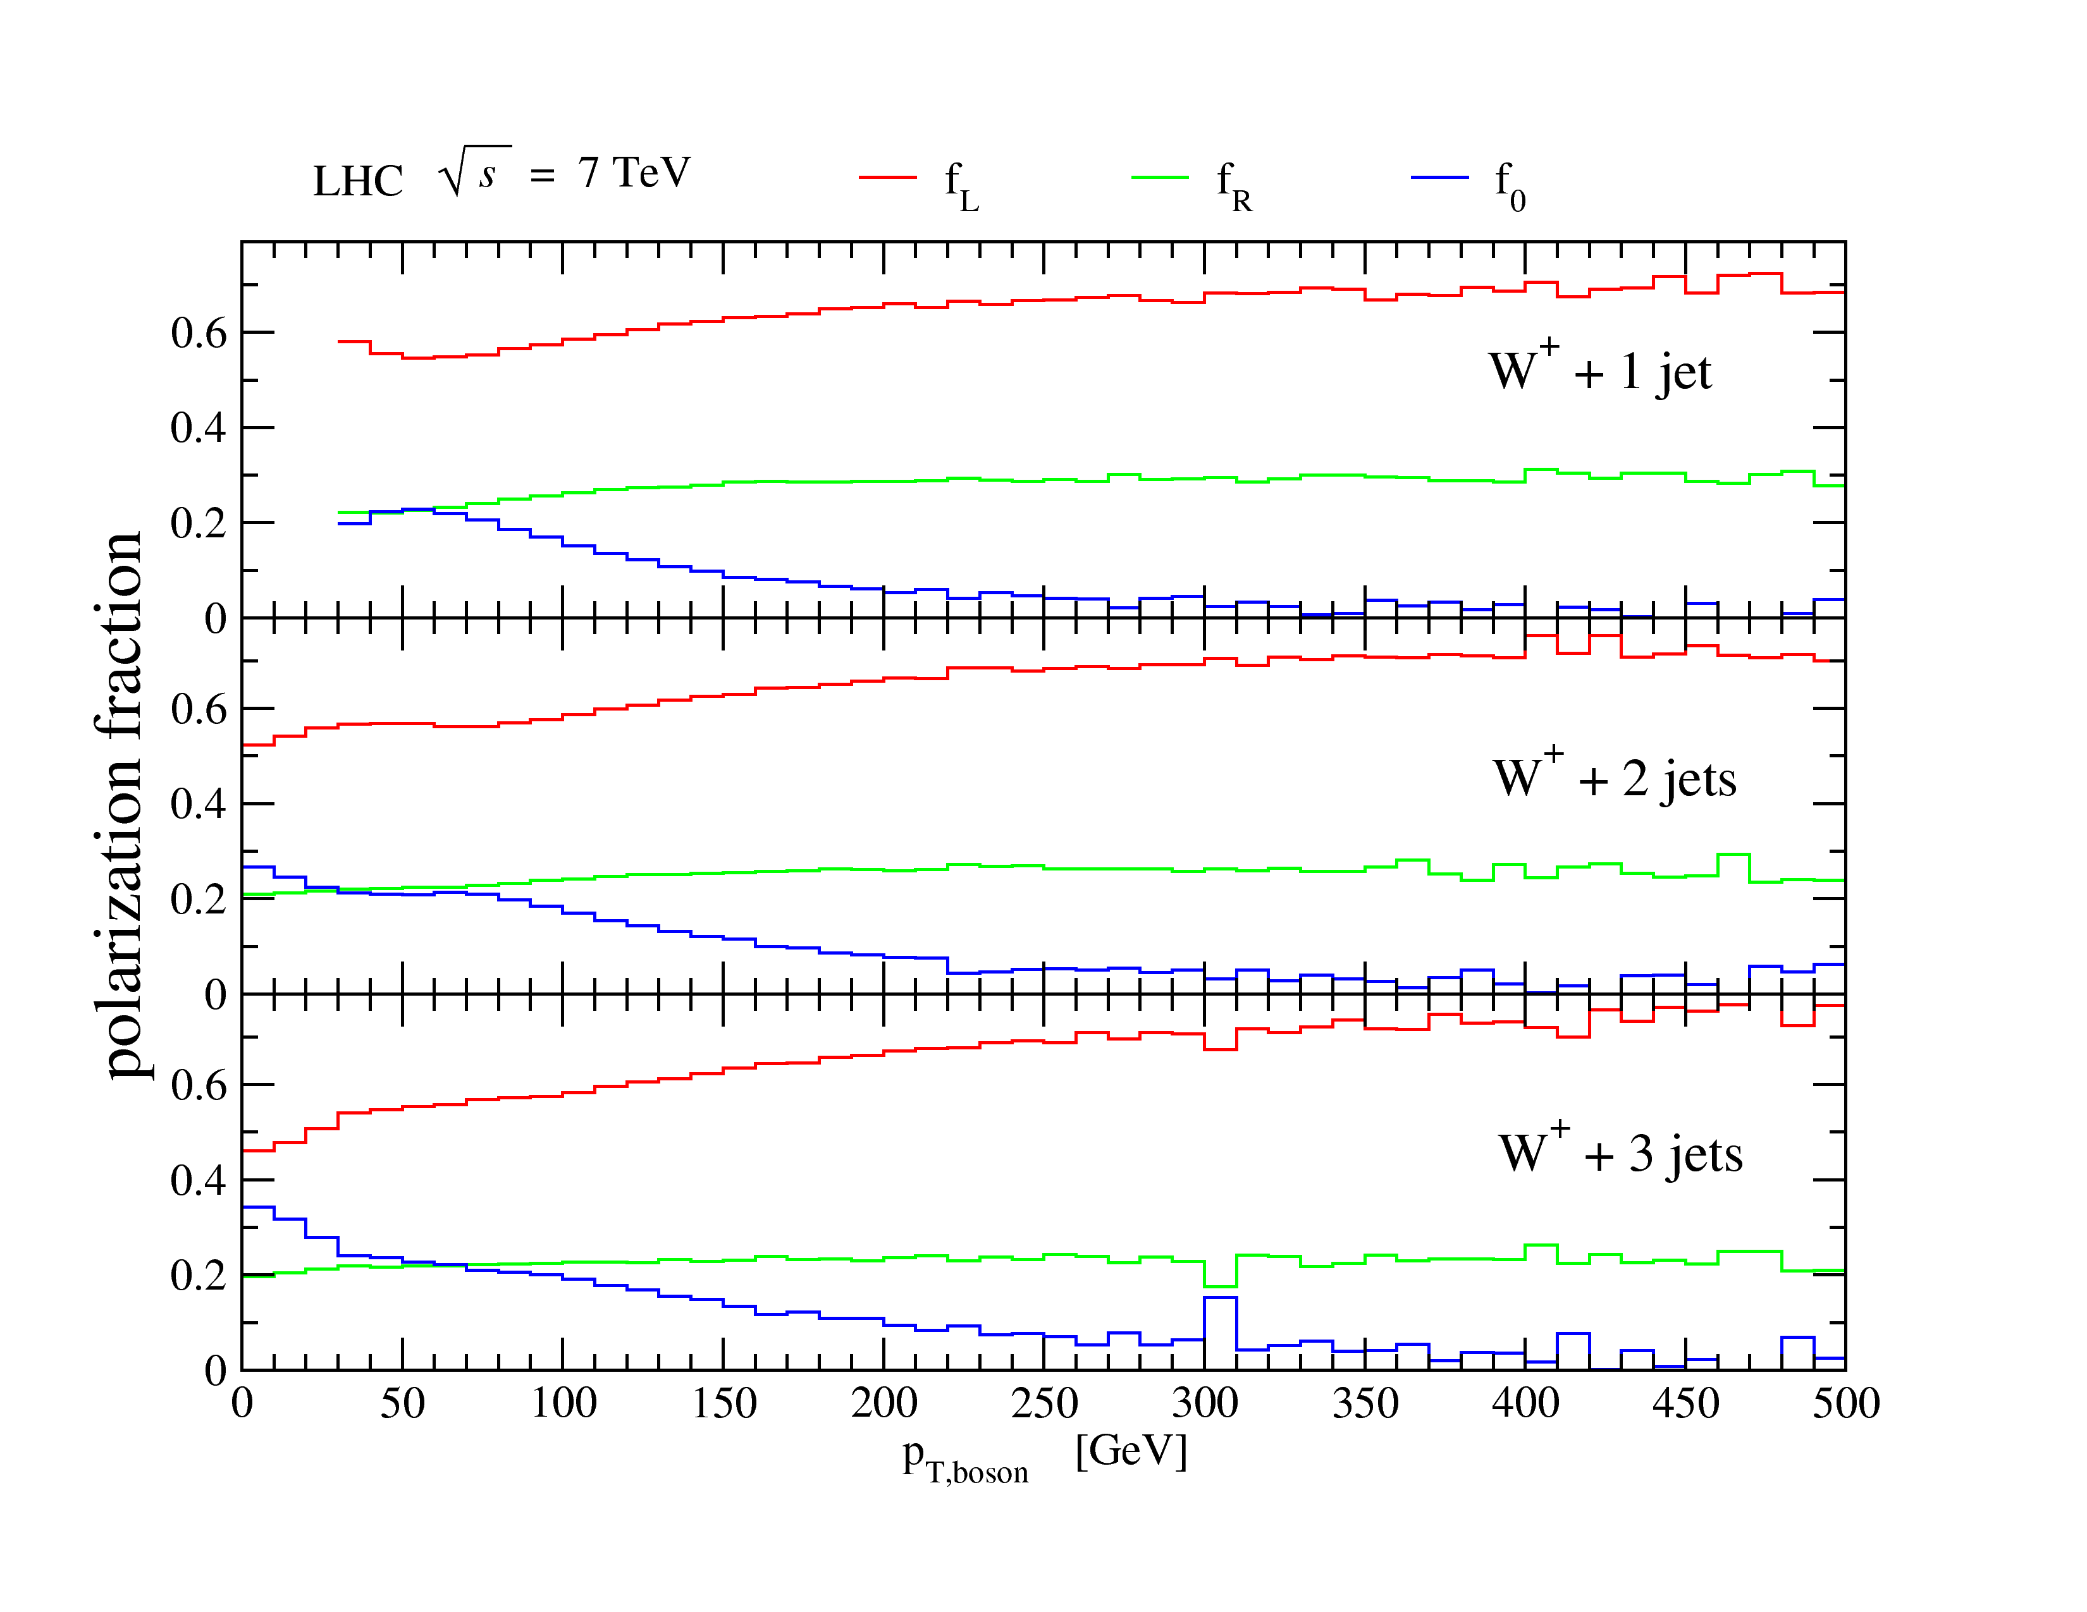
W Polarization
Polarization of low-p_{T}, longitudinal, Ws is textbook material (Ellis, Stirling & Webber) ⇒ dilution in charged-lepton rapidity distribution asymmetry at Tevatron
This is different! Ws are also polarized at high p_{T} ⇒ E_{T} dependence of e⁺/e⁻ ratio and missing E_{T} in W⁺/W⁻ at LHC [0907.1984,1103.5445]
Present at LO
Present for fewer jets too: universality
Very insensitive to NLO corrections
Insensitive to cuts at large p_{T}^{W}
Useful for distinguishing “prompt” Ws from daughter Ws in top decay!
First measurement by CMS

Slide 15
Z/γ & Backgrounds to SUSY
Motivated by CMS’s data-driven estimation of from prompt photon+jets production
Theory needed to translate
Theory needed to estimate uncertainties in translation
⇒ Stirling’s talk
Control region & search regions in terms of |−∑E_{T}| & H_{T}^{jets}; force vector p_{T} to large values
Control: H_{T}^{jets} > 300 GeV, |−∑E_{T}| > 150 GeV
Search: H_{T}^{jets} > 300, |−∑E_{T}| > 250 GeV; H_{T}^{jets} > 500, |−∑E_{T}| > 150 GeV

Slide 16
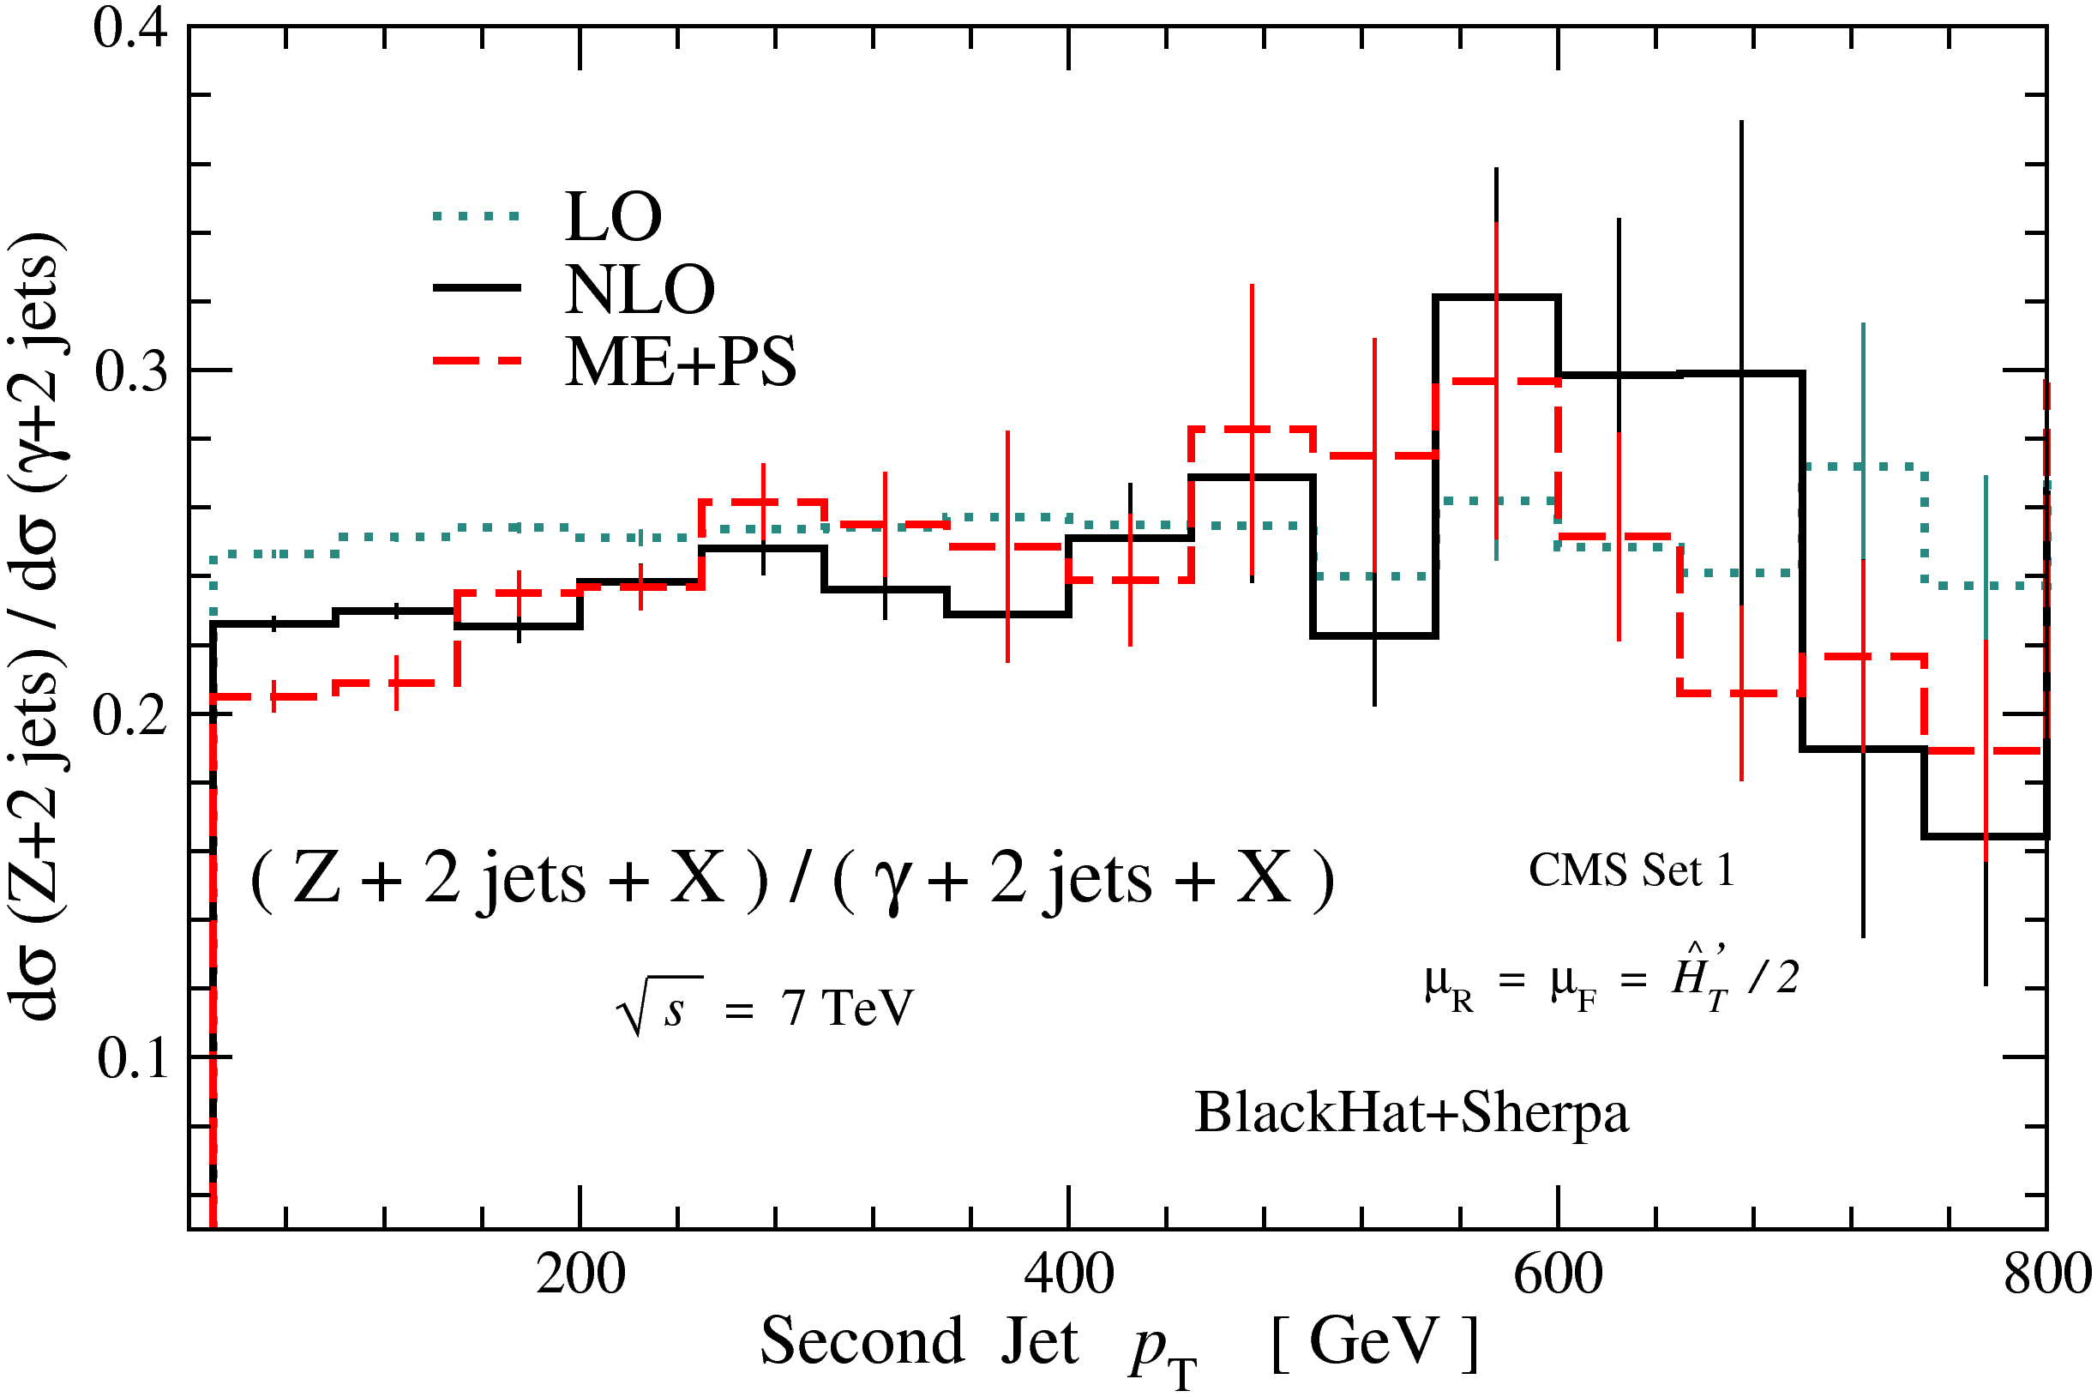
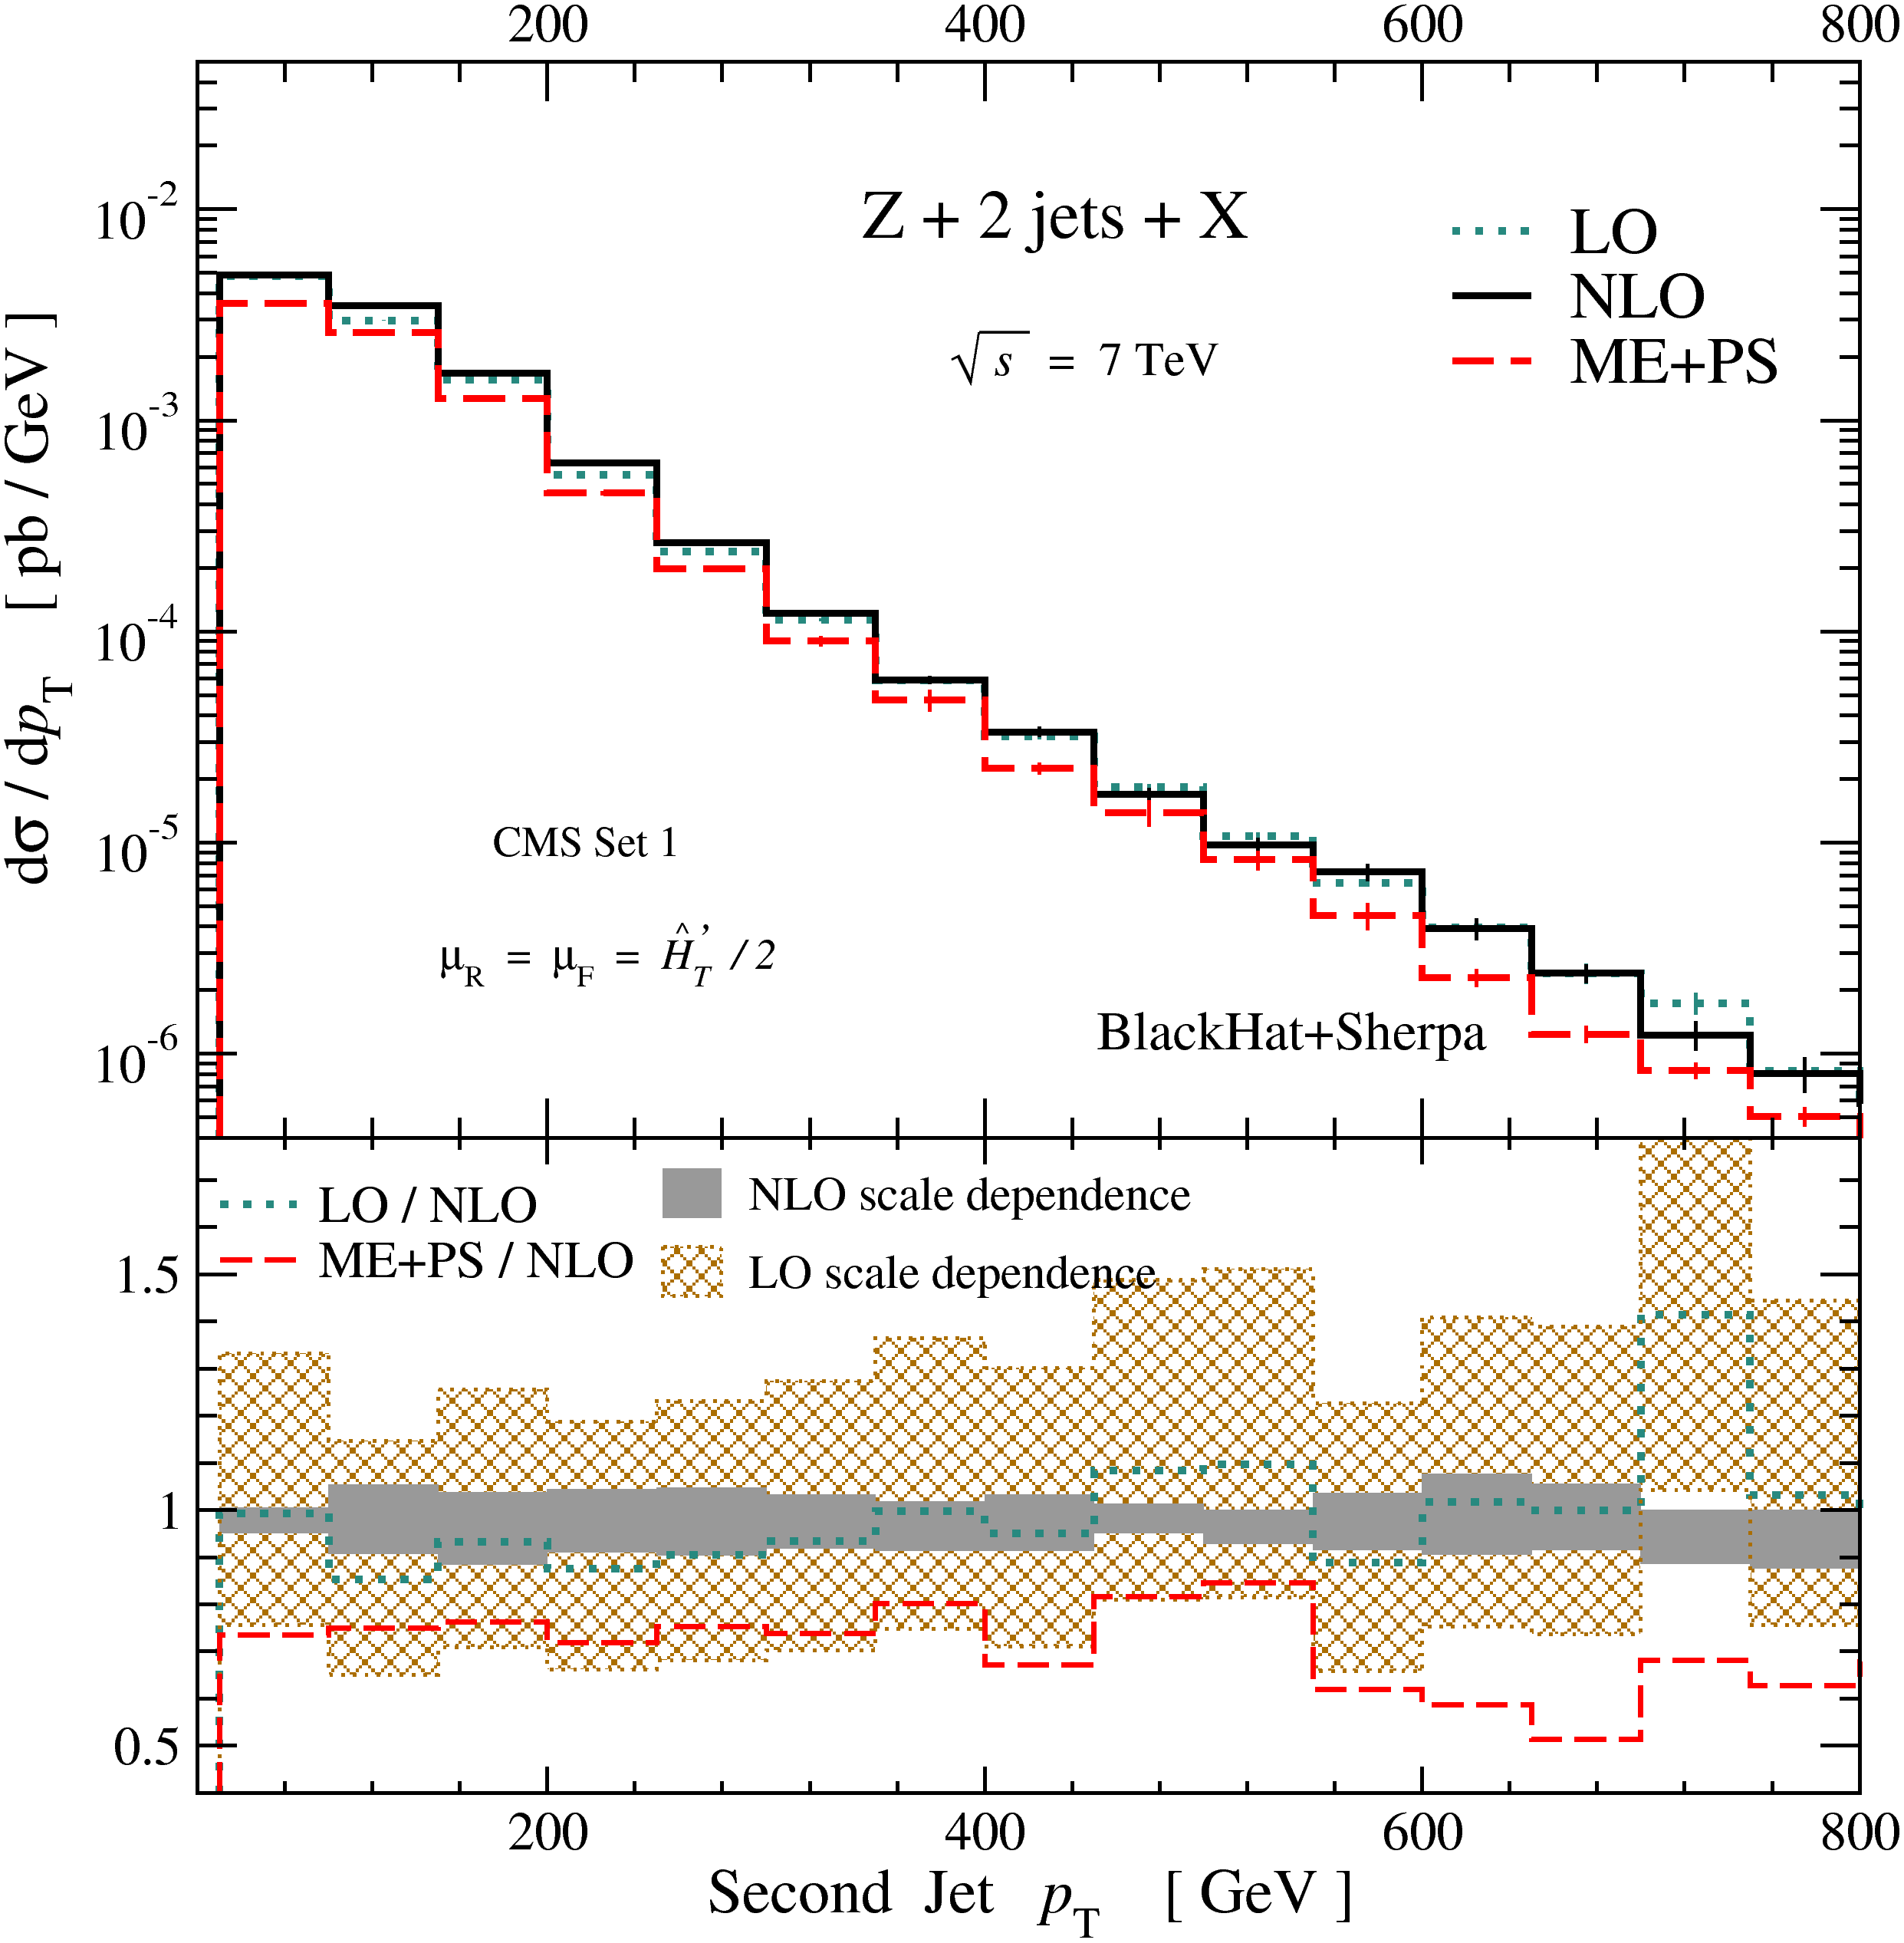
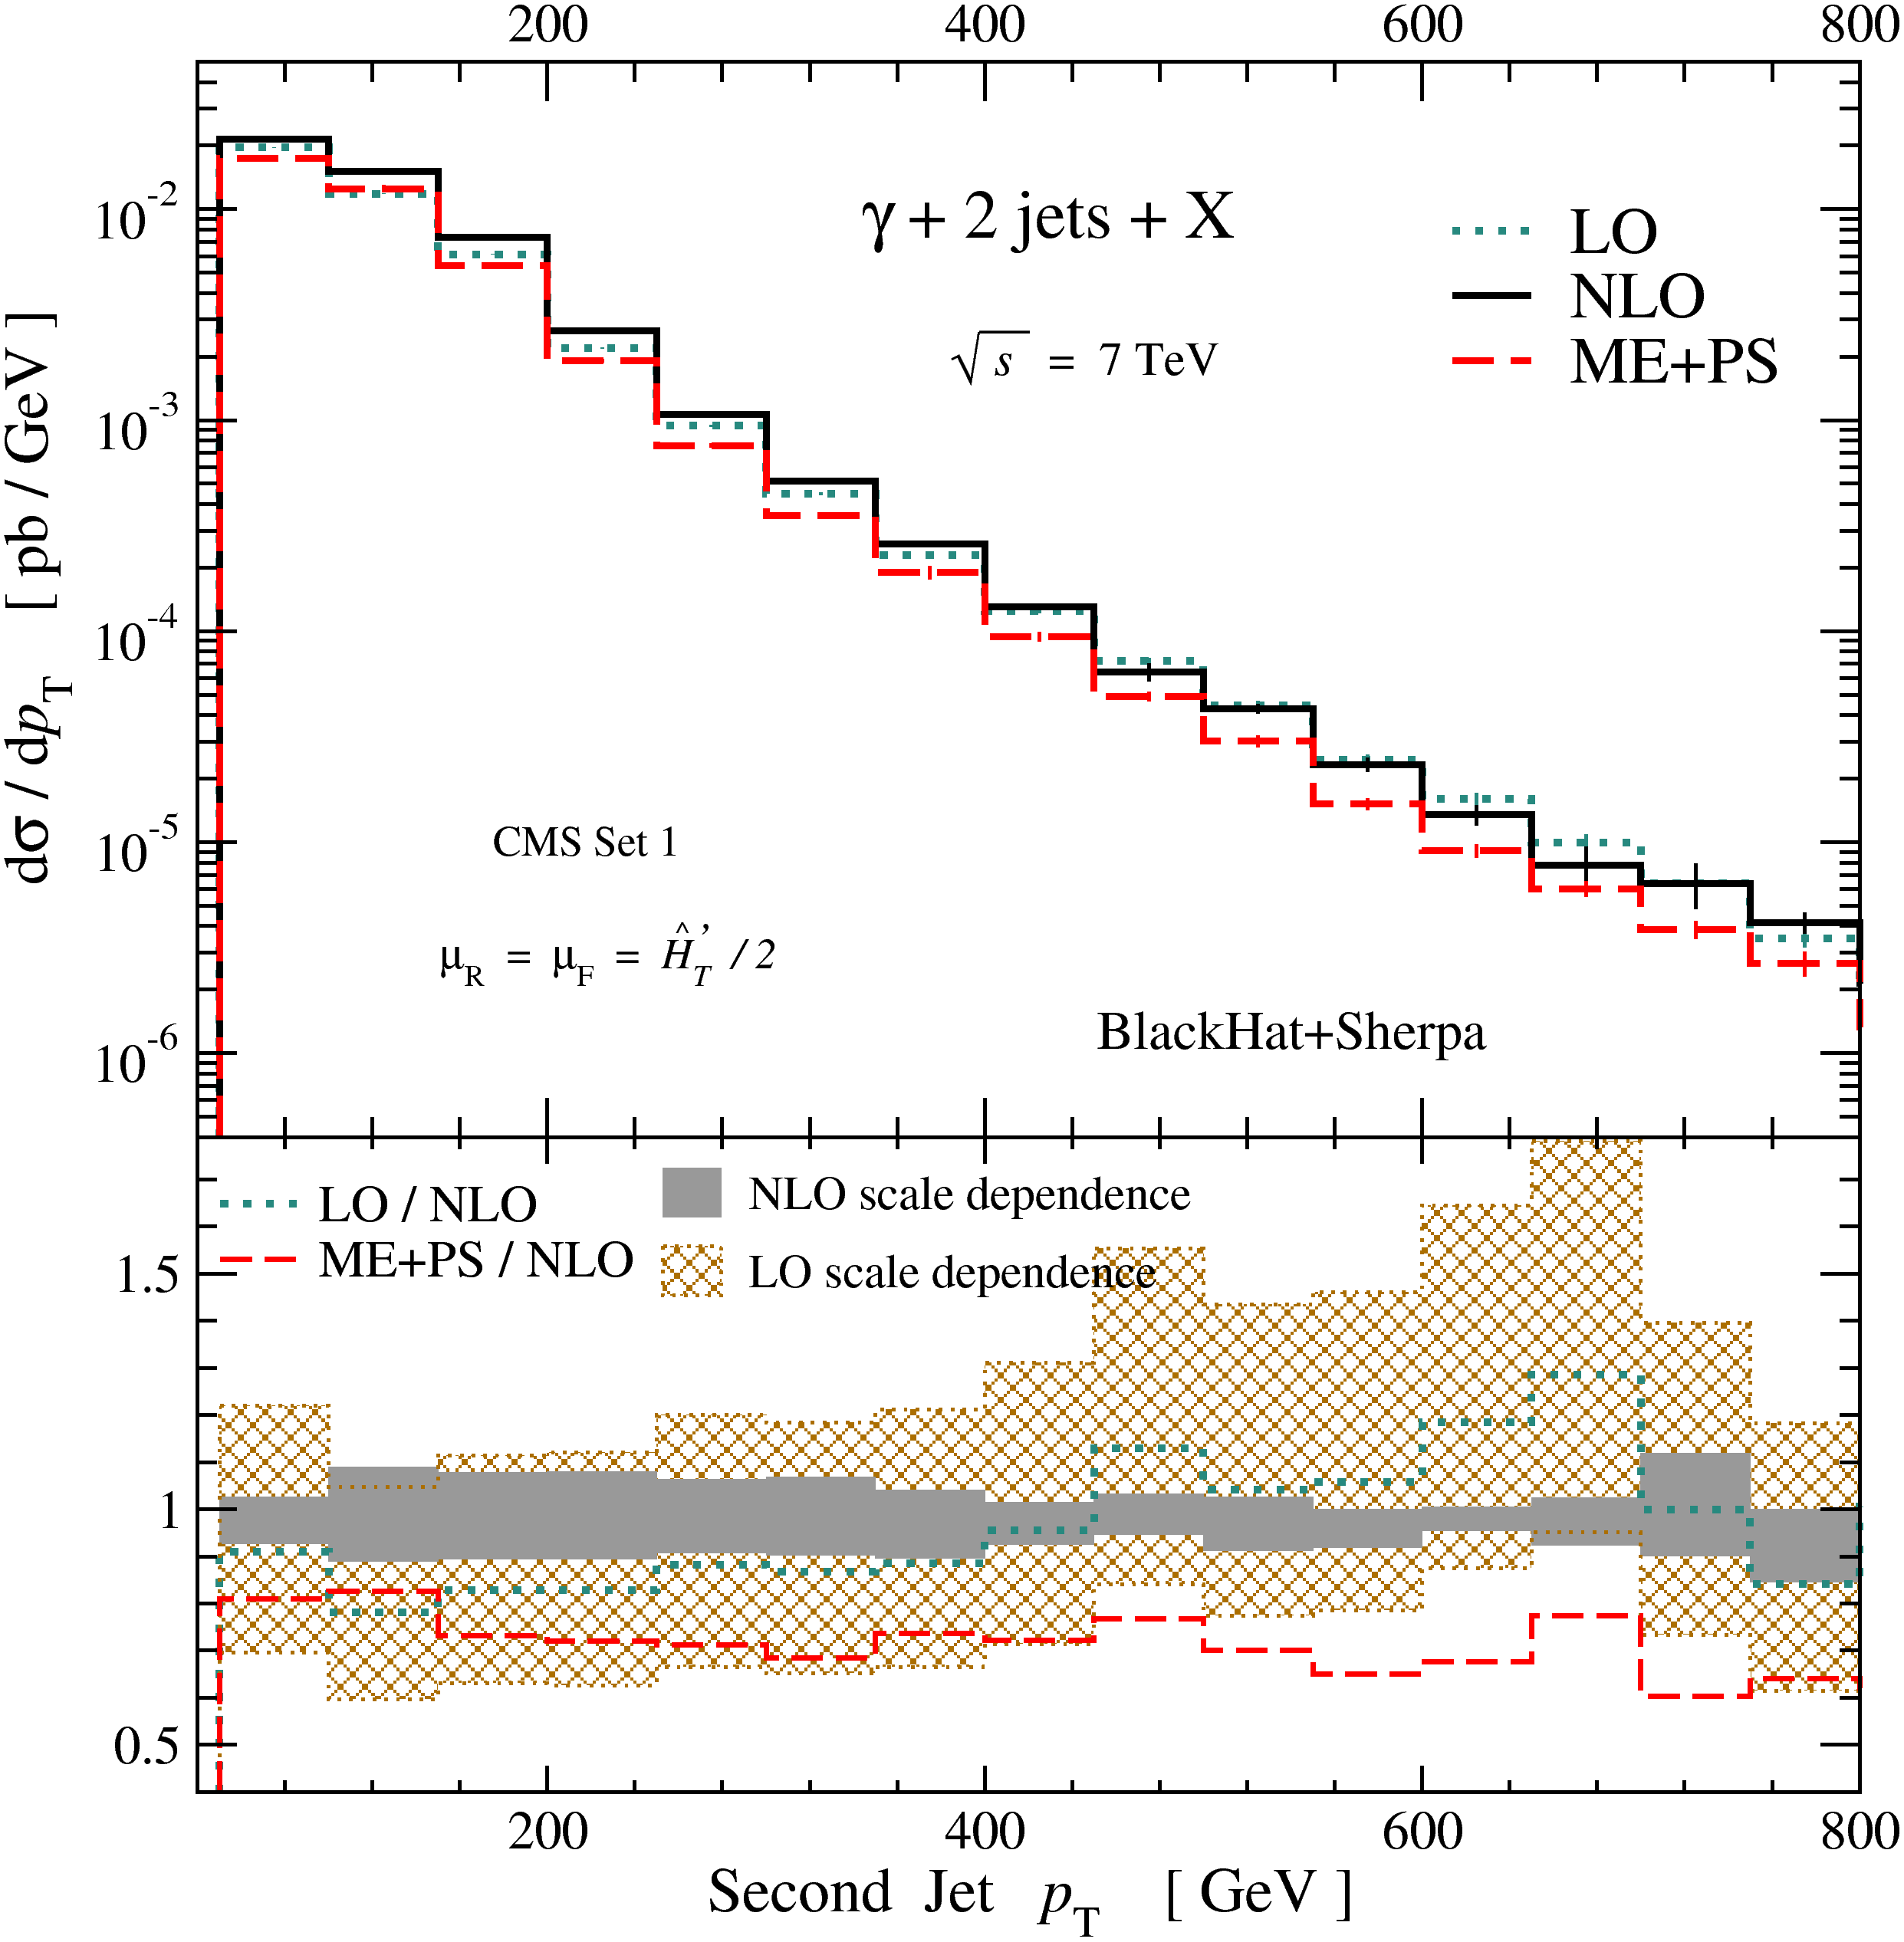
Initial study of Z+2 jets/γ+2 jets [1106.1423]
Frixione isolation for photon: very close to standard cone at large p_{T} (< 1%)
NLO corrections largely disappear in Z/γ ratio; estimate uncertainties by comparing NLO with matrix-element-matched parton shower (ME+PS)
Expected translation uncertainties < 10%
Study of Z+3 jets/γ+3 jets in progress

Slide 17
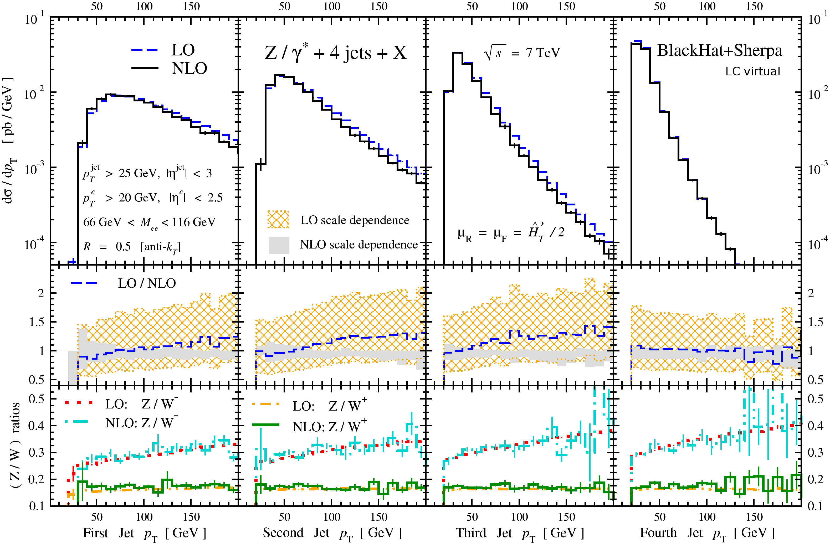
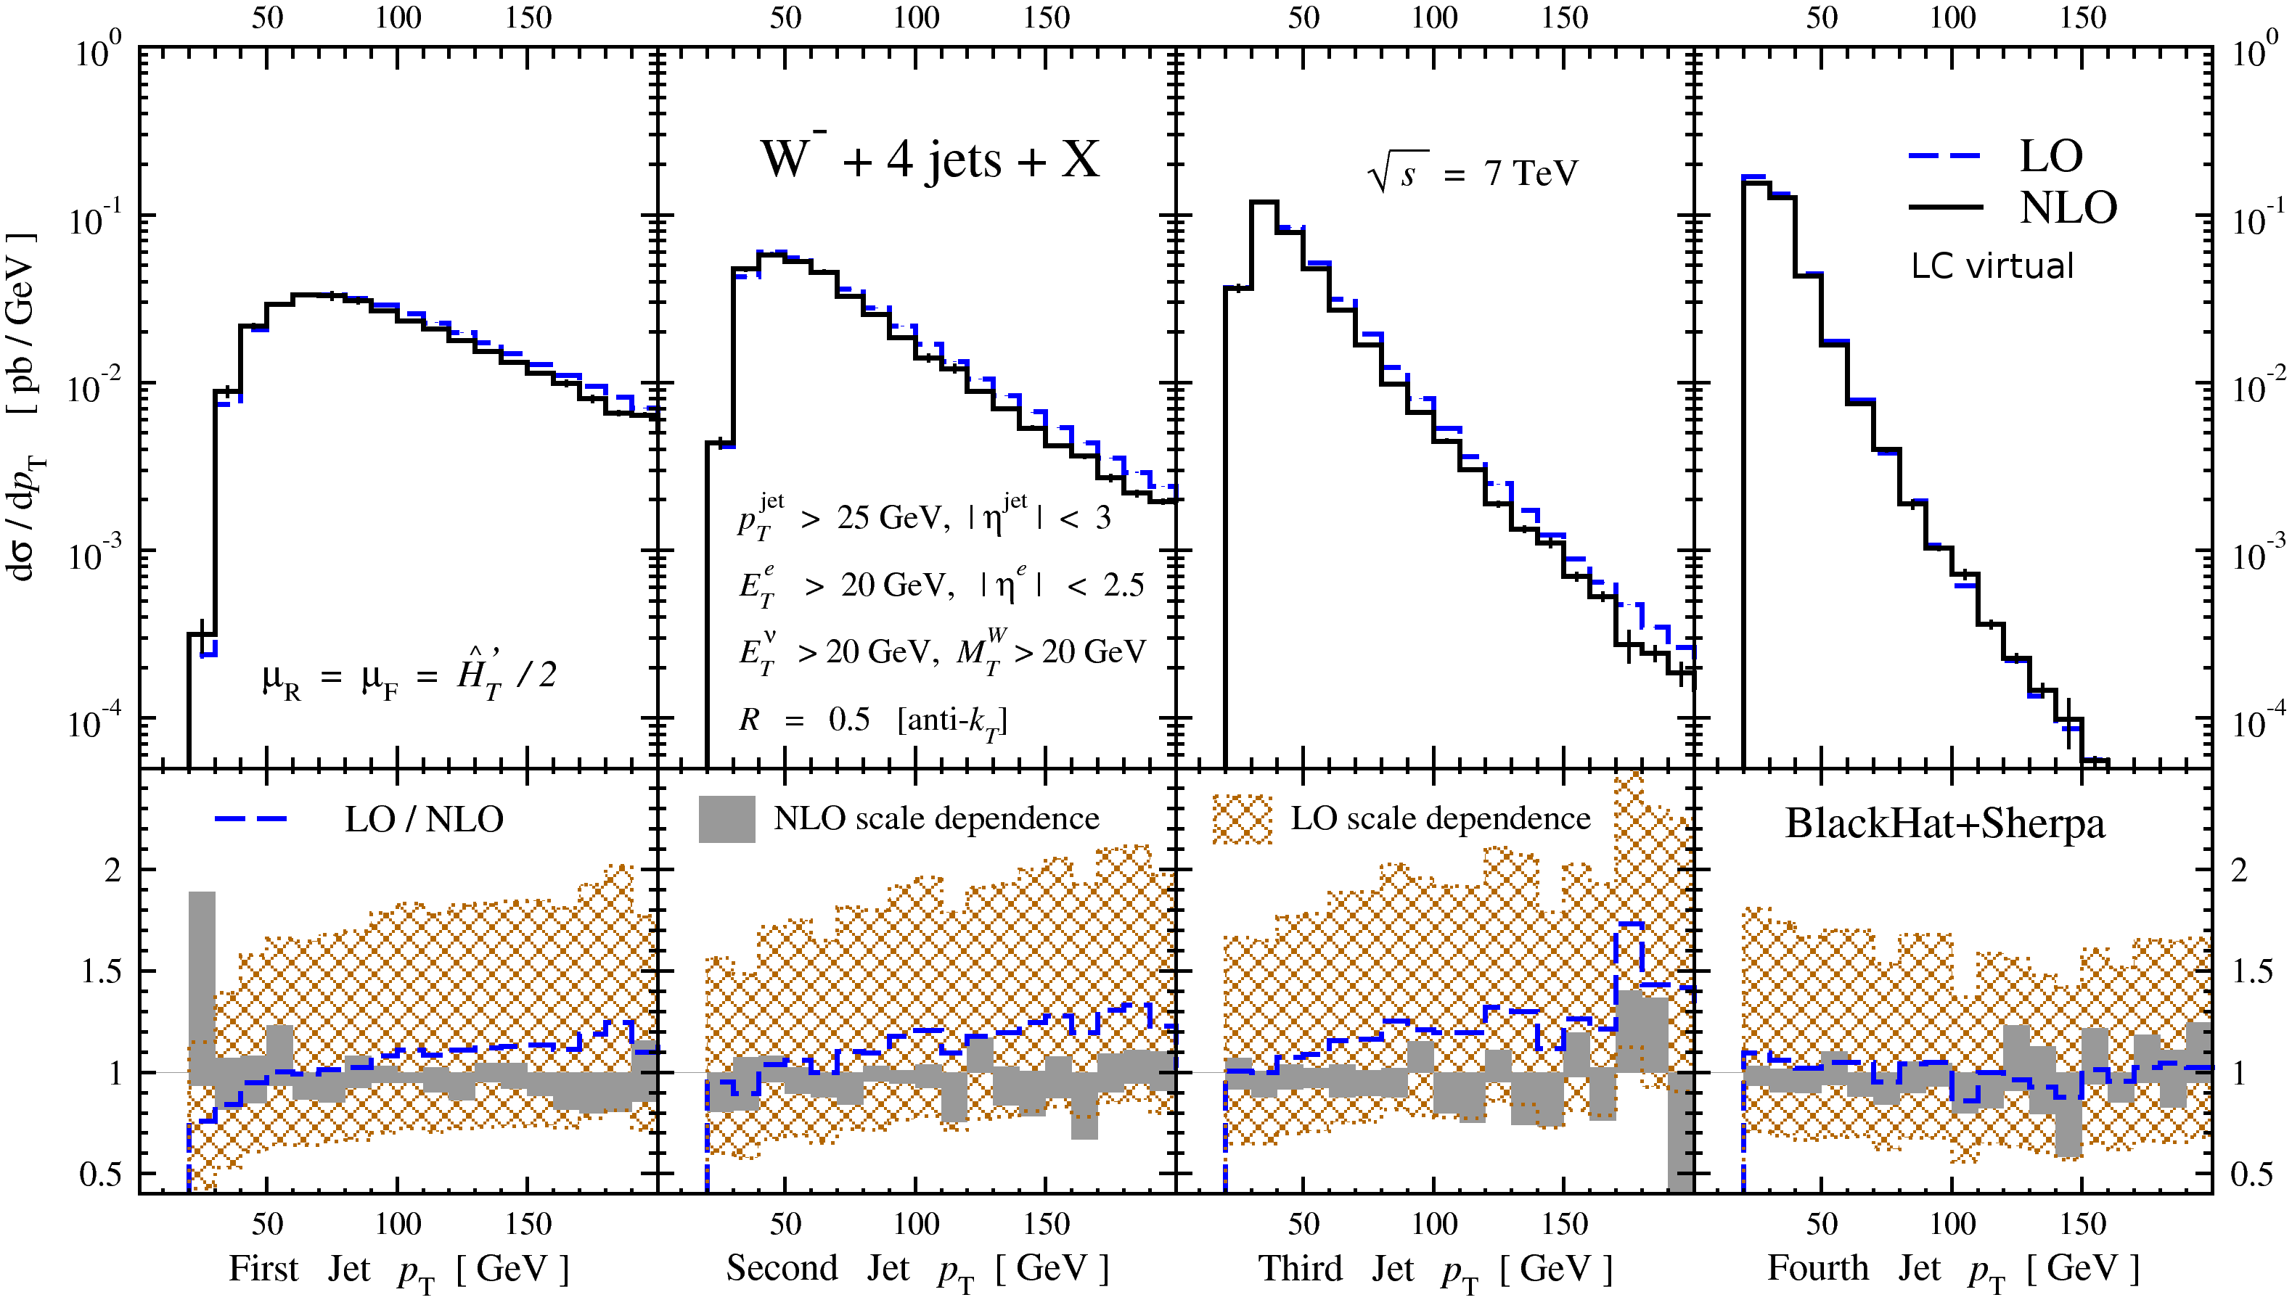
W+4 & Z/W Ratios
Z+4 jet NLO results resemble earlier W+4 results: reduced scale dependence, no change in softest jet shape
Resembles so much that ratios are very insensitive to NLO corrections

Slide 18
Summary
On-shell methods are maturing into the method of choice for QCD calculations for colliders
Phenomenological applications under way
Motivated by experimenters
Motivating experimenters
Standard Model measurements
Backgrounds to new-physics searches
New frontier: W, Z + 4 jets
Broad variety of kinematical configurations probed
Multi-scale issues for theorists

