Slide 1
Rencontres de Moriond EW 2012
EXPERIMENTAL SUMMARY HIGHLIGHTS
OF AN EXTRAORDINARY
MORIOND EW 2012
1. Pushing the New Physics in the corners
2. The New Physics there is:
An elementary scalar boson candidate?
Massive neutrinos properties
3. What do we do next?

Slide 2
Pushing new physics in the corners
Precision measurements
W mass and top mass
Flavor physics
μ→ e γ
B, D decays and asymmetries
Direct searches
Tevatron, LHC
Dark Matter search experiments
Benchmark: Supersymmetry where quantum numbers and thus couplings are ~more or less defined and limits often expressed in particle masses.
Complete fits of pMSSM can be attempted.
(It has become a common currency)
B physics →More generic expressions of new effects for B physics

Slide 3
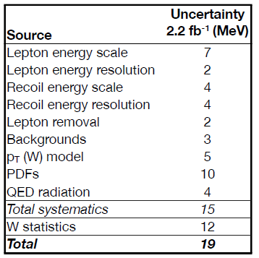
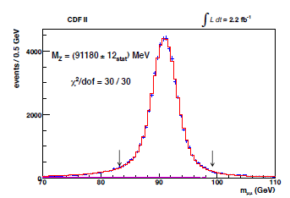
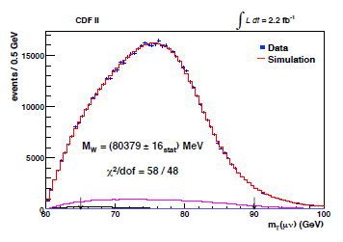
W mass
New ‘best’ result from CDF
Calibrations on J/ψ and Υ
measure m_{Z} to 12 MeV!
Then fit mW to mT spectrum
Largest systematics is from QCD
initial/final radiation etc… 10 MeV
(comp. QED 4 MeV !)

Slide 4
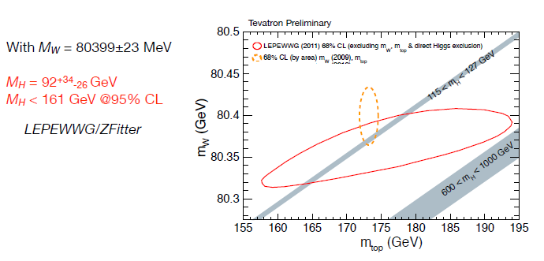
before

Slide 5
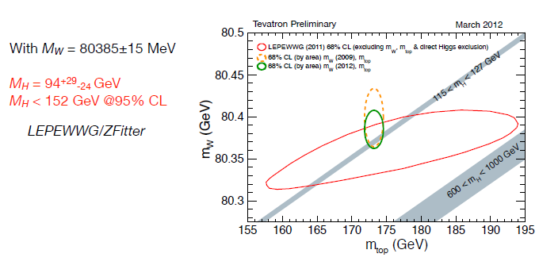
Now m_{w} is the most contraining variable in the indirect limit to m_{H}
When m_{H} is known it will be time to review implications of influential BSM physics on all EW precision measurements
-- 4th generation
-- SUSY
-- Higgs triplets
-- etc. etc.

Slide 6
LHC is already in the game for m_{top!}
Headache error is color recombination – top quark is not a
singlet and has « strings attached » ! (what does ‘mass’ mean?)
LHC vs tevatron …
Different process → different error? Or even different mass?

Slide 7
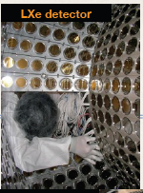
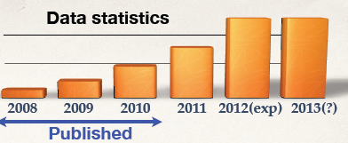
MEG expt @ PSI
3 10⁷ μ/s
Liq Xe calorimeter
DE/E =4% at 50 MeV
New upper limit: B (μ→eγ) < 2.4×10⁻¹² (90%C.L.)
Upgrade?
Will continue run and upgrade detector towards 10⁻¹⁴ sensitivity
Also: mu2e at FNAL, COMET at KEK, mu3e LOI at PSI…

Slide 8
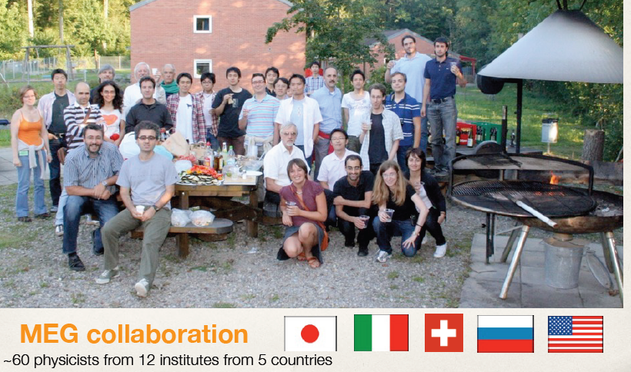
Such a small group of nice people
is killing so many theories…

Slide 9
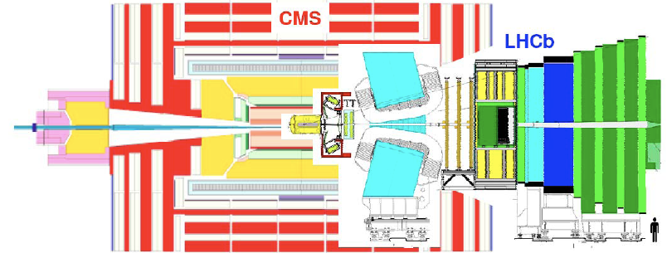
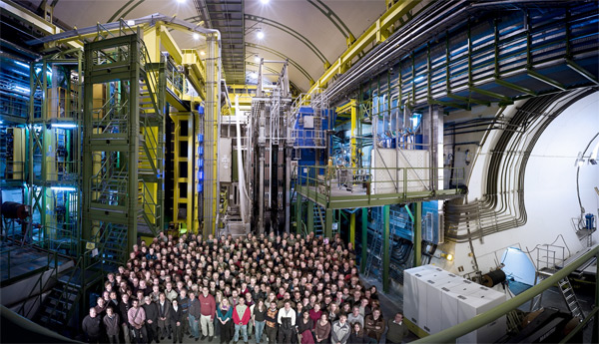
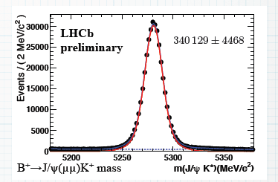
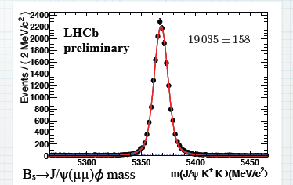
B and D physics : BaBar, Belle, CDF & D0, LHCb, CMS & ATLAS
LHCb = a fixed target experiment design
Huge rates 2<η<5, second vtx locator (velo)
The collaboration fits in the hall
B→ μ μ candidate

Slide 10
Selected Highlight
B E F O R E

Slide 11
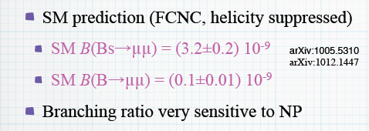
LHCb
SOON these decays will be measured !
This decay being GIM suppressed is very sensitive to
(EW coupled) particles contributing to loops …

Slide 12
Direct CPV in D⁰ → π⁺π–, K⁺K⁻:
CPV in mixing (indirect) can be related to direct CPV via the relation:
<t>/τ = 1 at B factories,
~2.5 at CDF (displaced trigger)
Considering ππ or KK final states we
can build the difference:
Independent of the final state
A_{CP}(K⁺K⁻) – A_{CP}(π+π-) = Δa_{CP} (direct) + Δ<t>/τ a_{CP} ^{ind}
HCP 2011: LHCb, 620 pb⁻¹ : first evidence (3.5 σ) of CPV in charm:
Moriond 2012: CDF, 9.6 fb⁻¹, confirms this result
(- 0.62 ± 0.21 ± 0.10) %
Combination of LHCb and CDF results in a 3.8 σ deviations from zero.

Slide 13
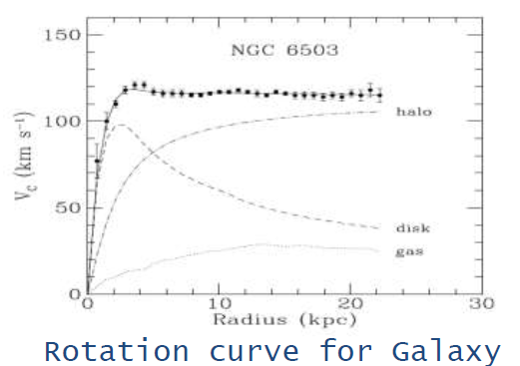
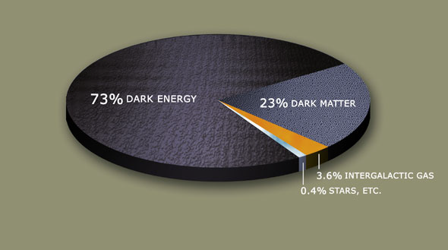
Direct searches
Tevatron, LHC, Dark Matter experiments
Many searches for new particles (SUSY and exotics) leading to the same remarkable result, i.e. the Standard Model always agrees with the data.
The models are losing both in energy range and in degrees of freedom
(or rather they have to invoke new d.o.f.s to survive the attack of data).
I concentrate on the Dark Matter search because we know that there is
Dark Matter – we just dont know what it is.

Slide 14
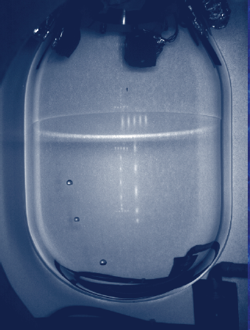
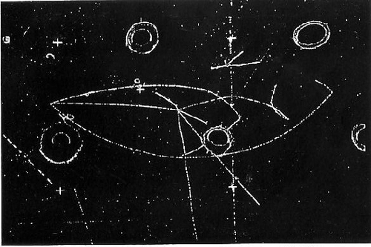
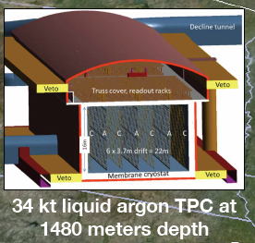
Heavy Liquid Bubble Chamber – Le retour
Gargamelle NC discovery
COUPP
ICARUS

Slide 15
Kim, KIMS DM

Slide 16
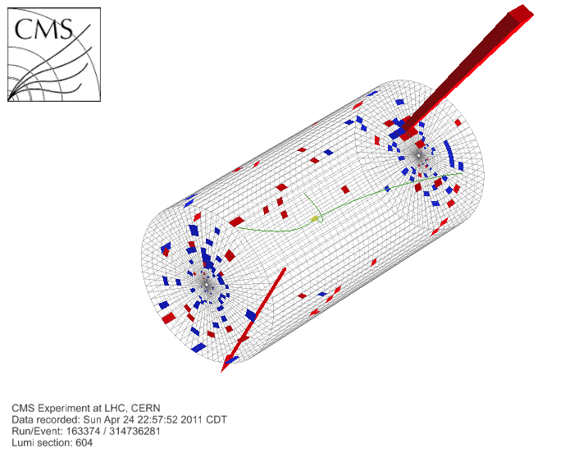
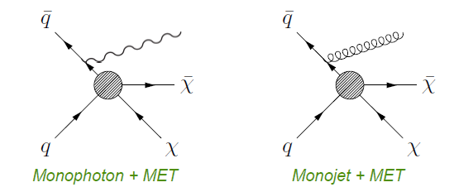
Direct Dark Matter search
Collider Dark Matter search
Isolated high Pt photon or jet + missing Transverse Energy (MET)

Slide 17
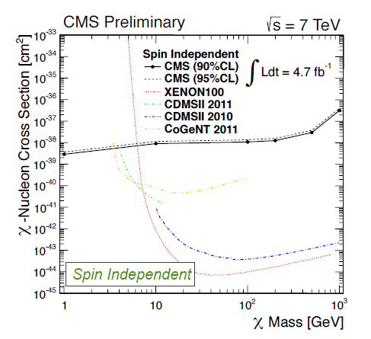
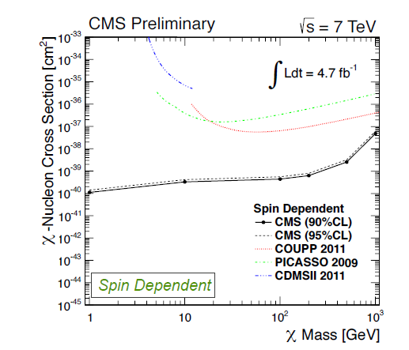
Steven Worm

Slide 18
THE BOSON
François Englert

Slide 19
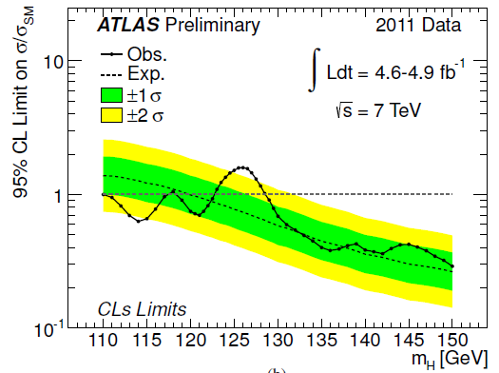
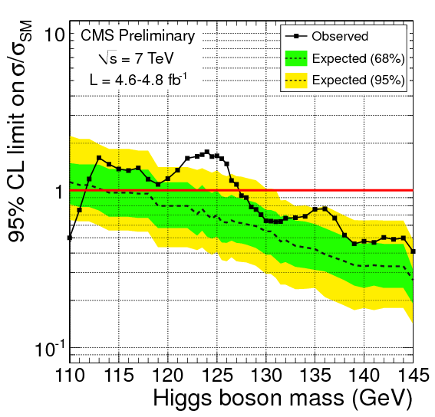
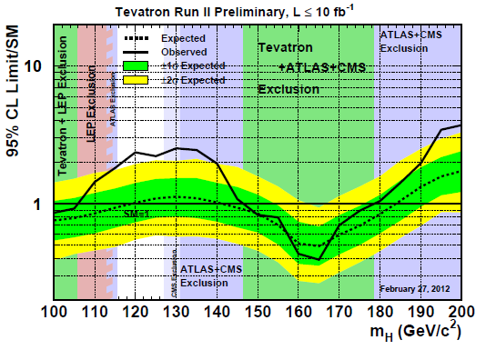
Both ATLAS and CMS exclude a SM scalar boson
up to ~550 GeV
except in range (117-128 GeV): excess 2.5-2.9 σ
at 125-126 GeV/c² (consistent)
ATLAS : γγ and ZZ
CMS : γγ
CDF+ D0 mostly‾bb&WW
Too soon to claim even evidence, but…
‘Who would bet against Higgs boson @125 GeV?’
My guess: Look Elsewhere + Look There
→ CL probably >~ local significance of 2d experiment
More data in 2012→ 5σ and more channels!

Slide 20
We should wait until the « 125 GeV effect » is either killed or established.
A particle decaying in two photons is not spin 1 and more probably spin 0
Is it elementary? Does it have all properties of the SM scalar of EBH et al?
It will be exciting to investigate this NEW object!
Just as for EWRCs, its discovery would eliminate a great number of hypotheses.

Slide 21
How shall we study X(125)?
At LHC
It is there, and will do it.
The question: with which precision? O(10%) or worse (assume 600fb⁻¹)
Effect of pile-up?. Etc. etc.
do we need another machine to study more properties or more precisely?
Performance on couplings self couplings and invisible width?
At a linear collider ?
For 125 GeV Higgs, peak cross-section at ~250 GeV = m_{H}+m_{Z}+30 GeV
But.. 250 GV of acceleration and luminosity at that energy still
requires a large amount of power and superb alignment. Cost?
At a small e+ e- machine? LEP3 in LHC tunnel (see next slides)
Much easier and cheaper than LC but not expandable.
At a muon collider ?
Feasibility study ongoing. Not an easy machine!
Ionization cooling (MICE experiment)
Virtue: s-channel production μ⁺ μ⁻ →H , exquisite energy calibration
and very small energy spread if needed.

Slide 22
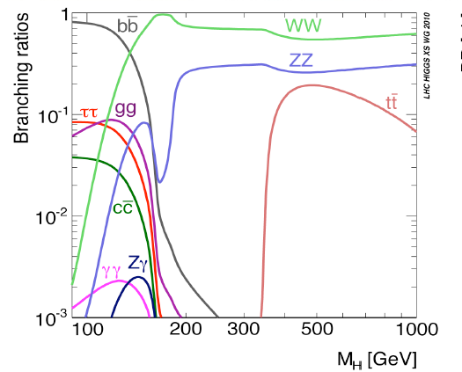
125 GeV is really a good place to be:
‾bb , WW, gg, ττ, ZZ, ‾cc are all above a few % and γγ is ~maximal

Slide 23
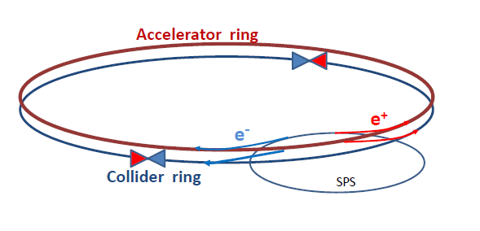
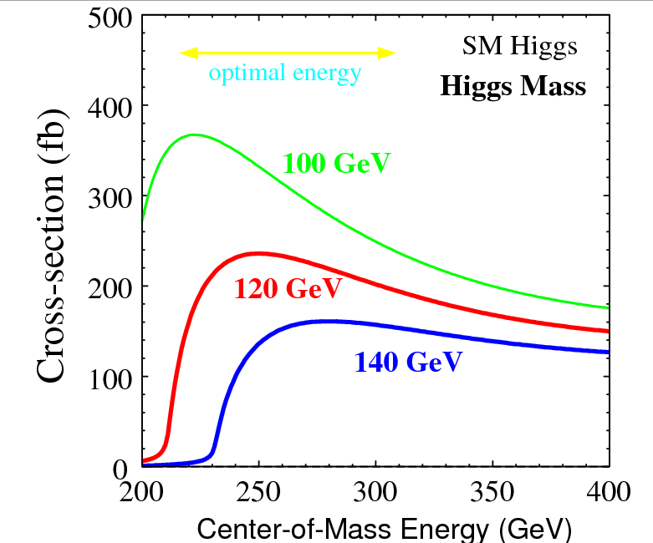
LEP3 Scheme arXiv:1112.2518
LEP operated at 104.5 GeV/beam with
L = 10³² /cm²/s, (peak luminosity)
τ_{b} = 6h beam life-time
P_{SR}= 20 MW Synchrotron Radiation power
Modify parameters (reduce beam sizes by more focusing)
to increase instantaneous luminosity without increasing intensity too much
L = 1.5 10³⁴ /cm2/s, (peak luminosity)
τ_{b} = 12 min beam life-time
P_{SR}= 50 MW Synchrotron Radiation power
Inject continuously using ancellary accelerator.
➔ L = 1.5 10³⁴ /cm2/s 2 10⁴ ZH events per year

Slide 24
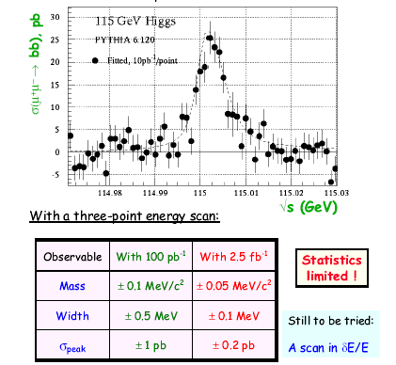
Murray
Muon collider
Janot

Slide 25
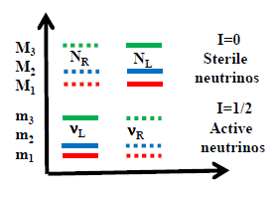
Neutrinos : the New Physics there is… and a lot of it!
SM | Dirac mass term only | Majorana mass term only | Dirac AND Majorana Mass terms
ν_{L} ‾ν_{R} I= ½ ½ | ν_{L} ν_{R} ‾ν_{R} ‾ν_{L} ½ 0 ½ 0 | ν_{L} ν_{R} ½ ½ | N_{R} N_{L} 0 0 ν_{L} ν_{R} ½ ½
X 3 Families | X 3 Families | X 3 Families | X 3 Families
6 massless states | 3 masses 12 states 3 active neutrinos 3 active antinu’s 6 sterile neutrinos… 3 mixing angles 1 CP violating phase | 3 masses 6 active states No steriles 3 mixing angles 3 CP violating phases 0vββ | 6 masses 12 states 6 active states 6 sterile neutrinos… More mixing angles and CPV phases 0vββ ➔ Leptogenesis and Dark matter
Mass hierarchies are all unknown except m₁ < m₂
Preferred scenario has both Dirac and Majorana terms …
… a bonanza of extreme experimental challenges

Slide 26
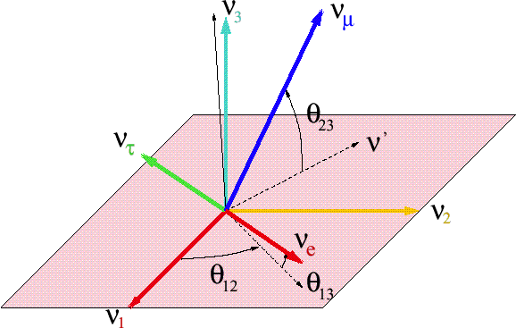
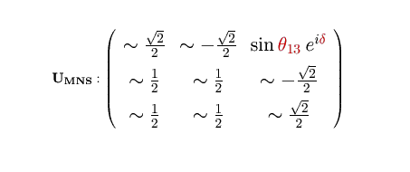
The neutrino mixing matrix: 3 angles and a phase δ
ν₃
Δm²₂₃= 2.4 10⁻³eV²
ν₂
ν₁
Δm²₁₂= 7.5 10⁻⁵ eV²
OR?
ν₂
ν₁
Δm²₁₂= 7.5 10⁻⁵ eV²
ν₃
Δm²₂₃= 2.4 10⁻³eV²
One year ago:
θ₂₃ (atmospheric) ~ 45⁰ , θ₁₂ (solar) ~ 32⁰ , θ₁₃ (Chooz) < 13
Unknown or poorly known
θ₁₃ , phase δ , sign of Δm₁₃
2

Slide 27
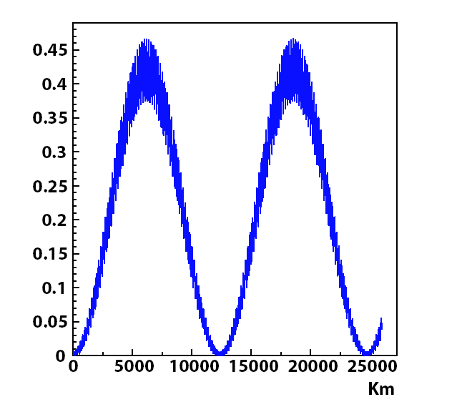
Oscillation maximum 1.27 Δm² L / E =π/2
Atmospheric Δm ²= 2.4 10⁻³ eV ² L = 500 km @ 1 GeV
Solar Δm² = 7.6 10⁻⁵ eV² L = 16000km @ 1 GeV
Consequences of 3-family oscillations:
I There will be ν_{μ} ↔ ν_{e} and ν_{τ} ↔ ν_{e} oscillation at L _{atm}
_{(acc)} P (ν_{μ} ↔ ν_{e} )_{max} =~ ½ sin ²2 θ₁₃ +… (small)
_{(reactor)} P (ν_{e} ↔ ν_{e} )_{max} =~ 1 - sin ²2 θ₁₃ +…(small)
II There will be CP or T violation
CP: P (ν_{μ} ↔ ν_{e}) ≠ P (ν_{μ} ↔ ν_{e})
T : P (ν_{μ} ↔ ν_{e}) ≠ P (ν_{e} ↔ ν_{μ})
1st maximum ≠ second maximum
we do not know if the neutrino ν₁
(which contains more ν_{e)}
is the lightest one (natural?) or not.
Oscillations of 250 MeV neutrinos;
P (ν_{μ} ↔ ν_{e})

Slide 28
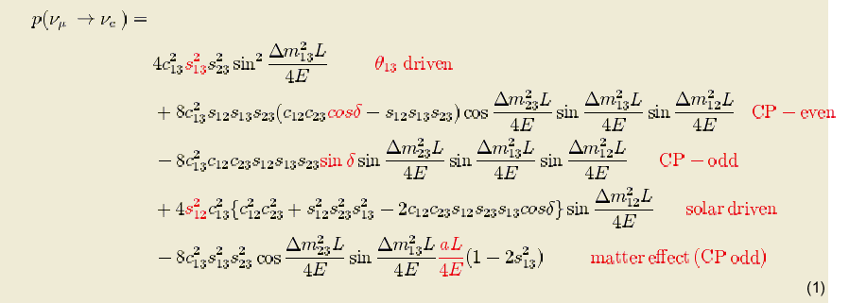
P(ν_{e}→ν_{μ}) = ¦A¦²+¦S¦² + 2 A S sin δ
P(ν_{e}→ν_{μ}) = ¦A¦²+¦S¦² - 2 A S sin δ
P(ν_{e}→ν_{μ}) - P(ν_{e}→ν_{μ})
sinδ sin (Δm²₁₂ L/4E) sin θ₁₂ sinθ₁₃
= A_{CP} α
P(ν_{e}→ν_{μ}) + P(ν_{e}→ν_{μ})
sin² 2θ₁₃ + solar term…
… need large values of sin θ₁₂, Δm²₁₂ (LMA-- we have it!) but *not* large sin²θ₁₃
… need APPEARANCE … P(ν_{e}→ν_{e}) is time reversal symmetric (reactors or sun are out)
… can be large (100%) for suppressed channel (one small angle vs two large)
at wavelength at which ‘solar’ = ‘atmospheric’ and for ν_{e}→ν_{μ} , ν_{τ}
… asymmetry is opposite for ν_{e}→ν_{μ} and ν_{e}→ν_{τ}

Slide 29
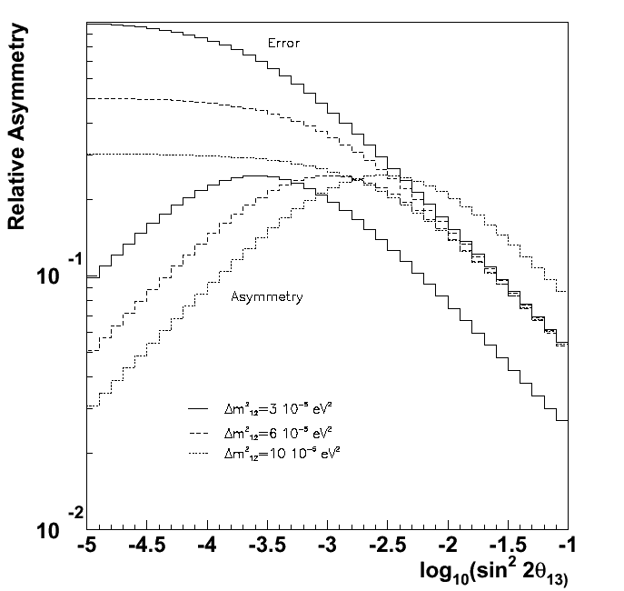
T asymmetry for sin δ = 1
NOTES:
Asymmetry can be very large.
Stat. sensitivity
in absence of bkg
is ~independent of θ₁₃
down to max. asym. point
Asymmetry changes sign
from one max. to the next.
Sensitivity at low values
of θ₁₃ is better for short
baselines, sensitivity at
large values of θ₁₃ is
better for longer baselines
(2d max or 3d max.)
sign of asymmetry changes
with max. number.
100%
Max.
Asymmetry
error
Stat. error
with no background
0.1⁰
0.3⁰
1⁰
3⁰
9⁰

Slide 30
Otani, Results from T2K
selection cuts fixed already in early 2010
Far detector prediction (295 km) determined from flux (+ NA61 prod data)
+ normalisation using Near Detector (280m)
-- earthquake on 11 March 2011 « forced » publication!

Slide 31
Otani, Results from T2K
T2K has restarted , one year after dramatic stop on 11 March 2011

Slide 32
Also results from MINOS and Dchooz:
DChooz
Tsunayuki, Double Chooz

Slide 33
It is a tradition of Moriond that experiments around the planet
work very hard to produce results for the meeting….

Slide 34
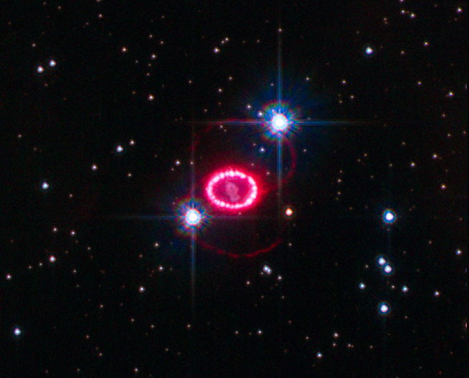
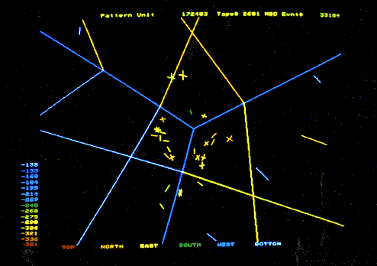
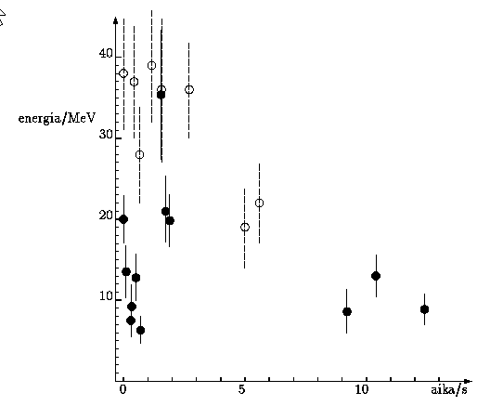
SN1987A 23 Feb 1987 23 February 7:35 UT
SN1987A
Kamioka
IMB
Baksan
24 neutrino interactions observed at 7:35
within 13s!
Between 9:20(not seen) and 10:48 (seen)
the light from the Super Nova reached earth.
168 000 light years away ➔
(v-c)/c < 2 10⁻⁹
OPERA claim: 2.5 10⁻⁵

Slide 35
Longhin, Opera results
Seen 1 event, expect 1.65 bkg 0.16
On full exposure (end 2012) expect 7.5

Slide 36
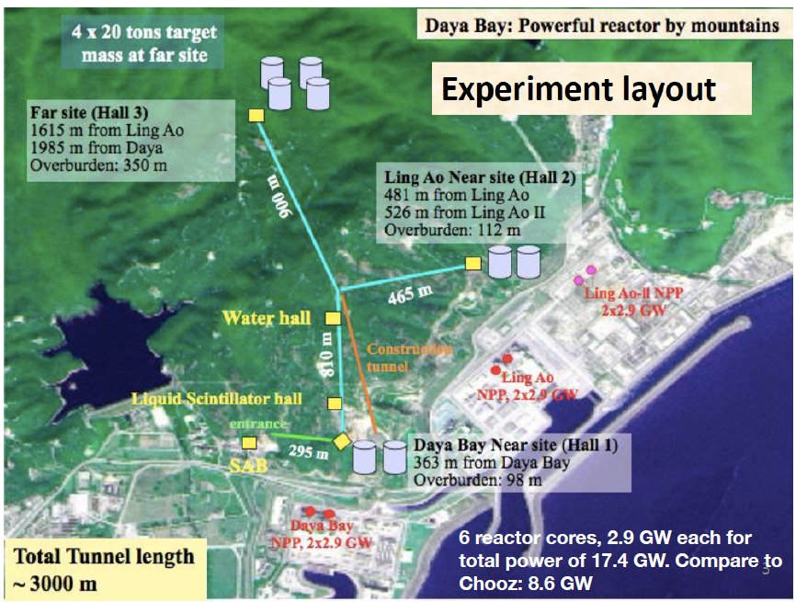

Slide 37
NB I doubt that the release date was decided because of Moriond…
If it was triggered by the 5σ effect, I would predict that
value will go down somewhat…

Slide 38
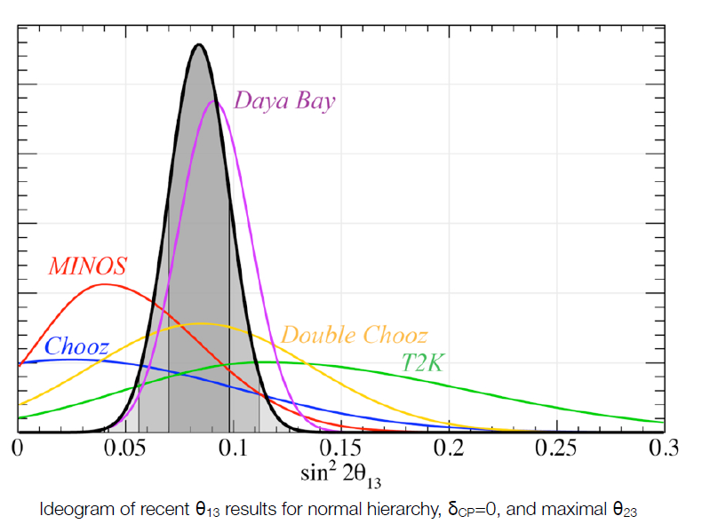
sin²2θ₁₃ ∼ 0.084 ± 0.014 ±
Consequences :
Mass hierarchy becomes easier
CP violation: more events, less asymmetry →
no gain statistically , more sensitive to systematics.
Reactor have no δ_{CP} or mass hierarchy dependence:
Long baseline appearance experiments depend on both.

Slide 39
Neutrinos the next steps
In fact there are several directions to study the neutrino paradigm
Neutrino oscillations: determine mass hirarchy and search CP violation.
Measure precisely the mixing parameters
2. Search for neutrino less double beta decay
Present level 0.5 eV. Next level 200 meV. Need more than one isotope!
3. Search for sterile neutrinos (a..k.a. right handed neutrinos)
– if there is a Dirac mass term they should exist!
4. Determine the mass of neutrinos by direct measurement.

Slide 41
Search for neutrinoless double beta decay
Azusa Gando, KamLAND Zen 2 beta decay

Slide 42
Searching for sterile neutrinos
-- approach 1: LSND result taken as possible sign of sterile neutrino.
Design experiment that rules out (or sees) a ‾ν_{μ}→‾ν_{e} or ν_{e} →ν_{μ} transition
in a compatible place in the (Δm² , θ) plane.
LSND and MiniBooNE had no near detector. This is
-- approach 2: search for mixing of active neutrinos with massive steriles
This can manifest itself by apparent (and energy dependent)
violations of unitarity
Ex: at the Z pole

Slide 43
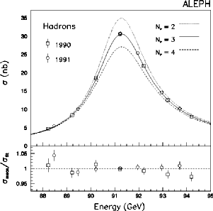
1989 The Number of light neutrinos
ALEPH+DELPHI+L3+OPAL in 2001 N_{ν} = 2.984 ±0.008
Error dominated by systematics on luminosity.

Slide 44
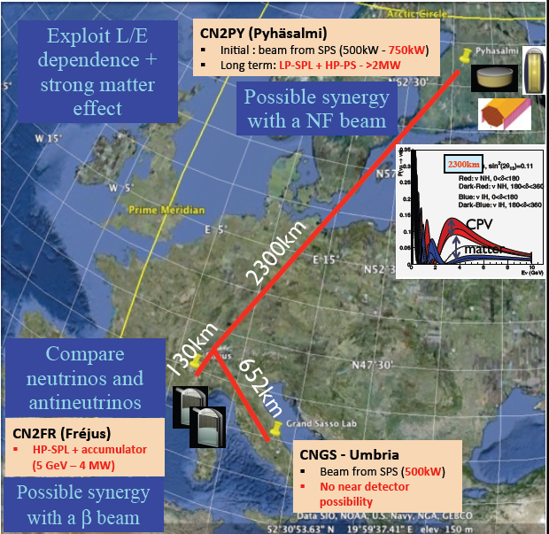
Getting our feet on (under) the ground:
LAGUNA –LBNO
new FP7 design study
2011-2014
A. Rubbia
2 main options
Short distance: 130km
Memphys at Frejus
SPL+beta beam
CP and T violation
CN2PY
Long distance: 2300km
Pyhasalmi
Fine grain detector
e.g. 20kton fid. Larg
+ Magnetized detector
Long distance allows
rapid sensitivity to
sign(Δm²₁₃)
1st step easier: SPS C2PY
➔ consortium 1st priority
Nextsteps HP 50 GeV PS …
…or neutrino factory
Medium term plans include long term plans!

Slide 45
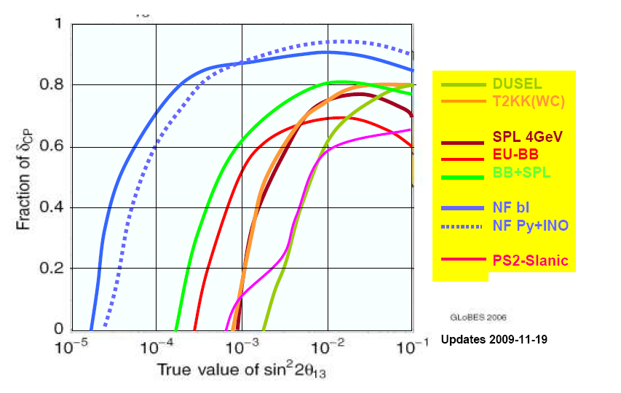
Figure 2 A representative compilation of sensitivities of some future long baseline projects. Here the fraction of d_{CP} where CP violation can be observed at 3 standard deviations is plotted as a function of q₁₃.
T2KK: T2K 1.66 MW beam to 270 kton fid volume Water Cherenkov detectors in Japan (295km) and in Korea (1050 km);
DUSEL: a WBB from Fermilab to a 300 kton WC in Dusel (1300km);
SPL 4 GeV, EU-BB and BB+SPL: CERN to Fréjus (130km) project;
NF bl is the Neutrino Factory baseline (4000km and 7000km baselines) and
NF Py+INO represents the concrete baseline from CERN to Pyhasalmi mine in Finland (2285 km) and to INO in India (7152 km);
PS2-Slanic is a preliminary superbeam study at 1500km based on an upgrade of PS2 to 1.66MW and a 100kton Liquid Argon TPC
CERN – SPC panel report , SPC meeting, 16.03.2010

Slide 46
Conclusions and outlook
This has been an extraordinary Moriond EW session!
Results results results! And many shown first at Moriond…
The near future is exciting!
-- confirm existence of 125 GeV effect
-- study its properties
-- study/understand what should be the next step
LHC only? Linear collider? Ring collider (e+e- or mu+ mu-?)
(much too soon to make decision)
Continue looking for effect of new particles in rare phenomena and
precise measurements (dont forget sterile neutrinos!)
including 0vββ which would put neutrinos definitely beyond the SM.
Make decision on next neutrino facilities now that θ₁₃ is known to ±20%.
Incremental path … but not dead end!

Slide 47
Moriond is good because the physics is good
Looking forward to MORIOND EW 2013!

