Slide 1
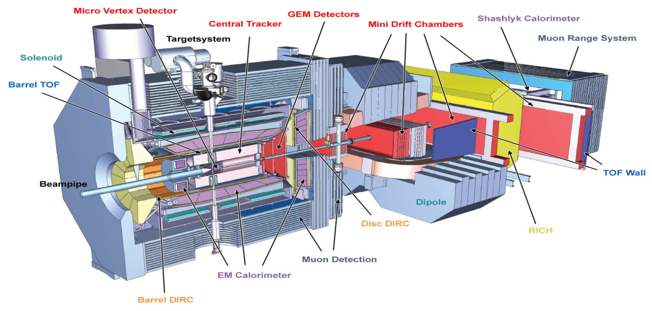
RADIATIVE CORRECTIONS TO
IN PANDAROOT
Radiative correction : emission of photon (soft hard and virtual) in initial and final state .
PandaRoot : Generators and transport models.
Effect of the PHOTOS package of PANDAROOT : Simulation with radiative correction.
Monte Carlo Simulations of
in PANDAROOT: Study of energy and angular distribution of electrons and positrons .

Slide 2
Radiative correctionS
Virtual and soft photon emission (Born approximation) :
Hard photon emission :

Slide 3
RADIATIVE CORRECTIONs IN PandarooT
PandaRoot
Framework of simulation and analysis for the PANDA experiment.
Extension of FairRoot framework developped at GSI.
Based on Root and Virtual Monte-Carlo (transport model : Geant3, Geant 4 and Fluka) .
Event generators of PandaRoot
EvtGen generator: handle complex decay channels.
DPM (Dual Parton Model) generator : generation and studies of background events.
UrQMD (Ultra-relativistic Quantum Molecular Dynamic Model) : used to study collision.

Slide 4
Radiative corrections in pandaroot
PHOTOS
The radiative correction are implemented in Pandaratoot with the package PHOTOS :
Emisson of photons as initial and final state radiation (soft and virtual photons) .
Simulation with\without Photos , analysis and comparison of the obtained spectra for energy and angular distribution of the emitted particles.
generation of 10 000 events.
Using the Macro : run_sim-tpccombi.C
EvtGen generator : EvtElectronPositron.hh. (M. GUMBERIDZE)
Geant3 transport model.

Slide 5
Radiative corrections in pandaroot
Decay file (.DEC):
noPhotos
Decay pbarpSystem 1.0 e+ e- ElectronPositron 1;
Enddecay End
Proton form factor : R=1 (GE=GM).
2 values of antiproton momentum : p=1.7 and 10 GeV/c.
analysis of Monte-Carlo in 4π = no detector acceptance.

Slide 6
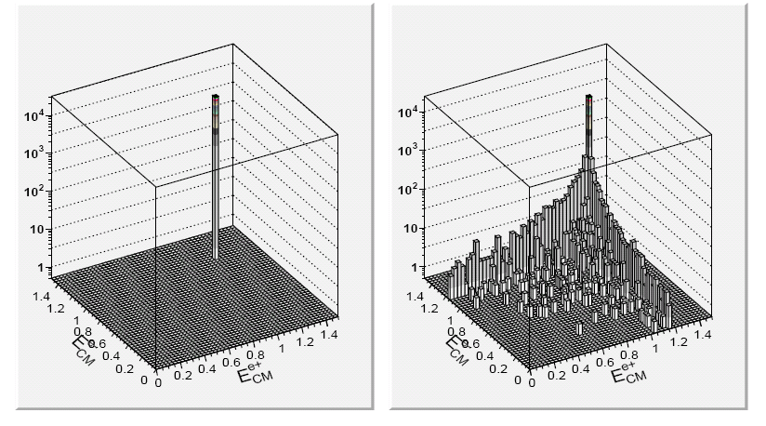
Radiative corrections in pandaroot
noPhotos
Photos

Slide 7
Radiative corrections in pandaroot
Electron-positron energy in the laboratory frame at 1.7 GeV:

Slide 8
Angular distribution of the electron
Angular distribution of the electron at 1.7 GeV :
Photos
noPhotos
Small difference -> necessary to decrease the widh of the bin.

Slide 9
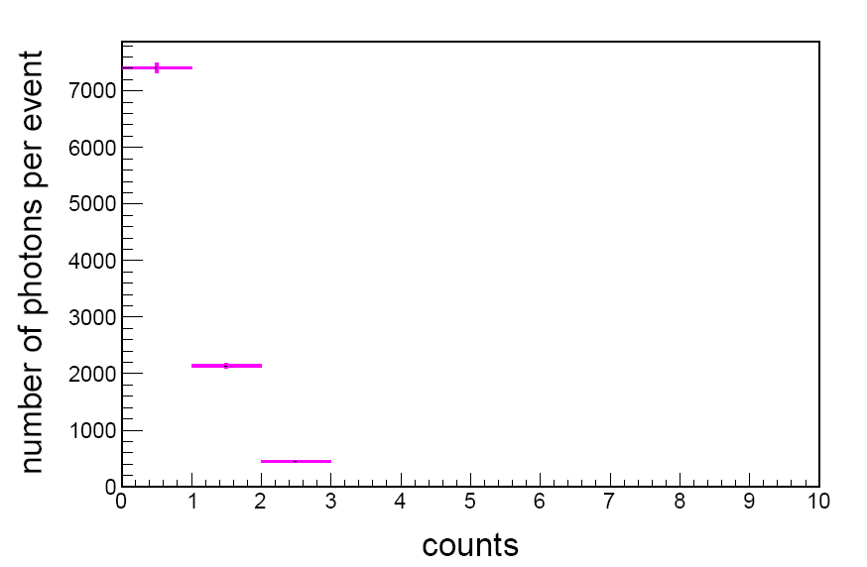
Probability of photon emmision
Probability of photon emmision in PHOTOS
no γ : 75 %
1 γ : 21 %
2 γ : 4 %

Slide 10
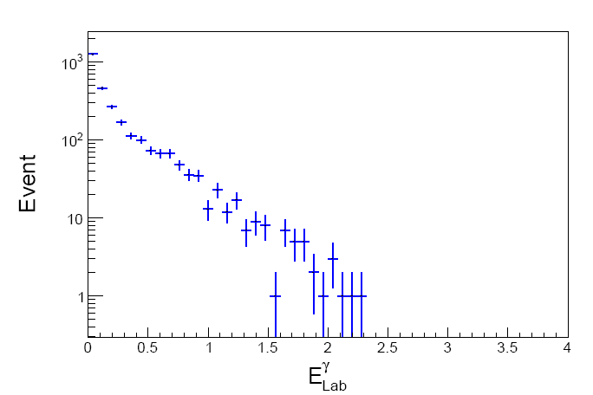
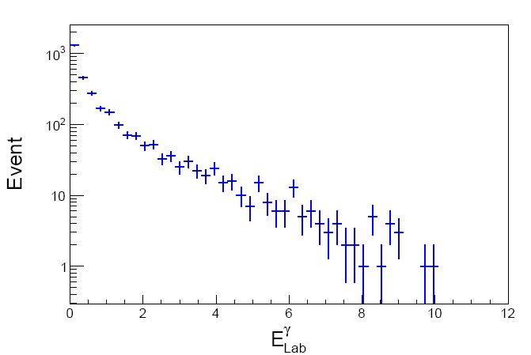
Radiative corrections in pandaroot
Energy of emitted photons in the laboratory frame
P =10 GeV/c
P = 1.7 GeV/c
Mostly soft photon emission

Slide 11
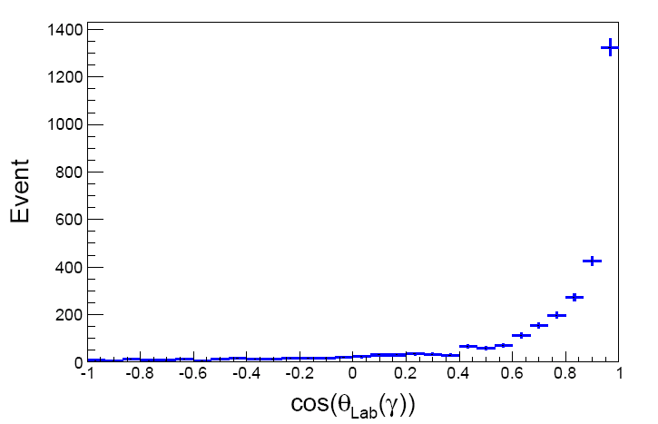
Radiative corrections in pandaroot
Angular distribution of emitted photons in the laboratory frame
Forward emission of photons

Slide 12
Summary
Simulation for the channel .
started
First tests of the Photos have been done
This work can be extended to :
Tracking and reconstruction of the generated particles inside the detectors.
Radiative corrections for the other reactions like the muon productions.
Generator for the hard photon emission :
Thank you

Slide 13
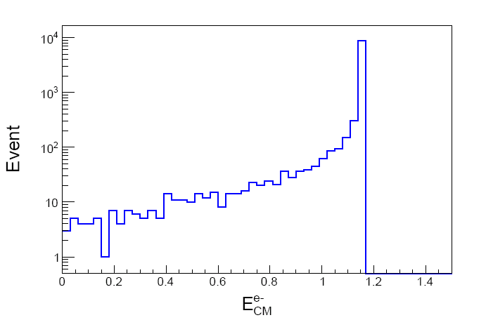
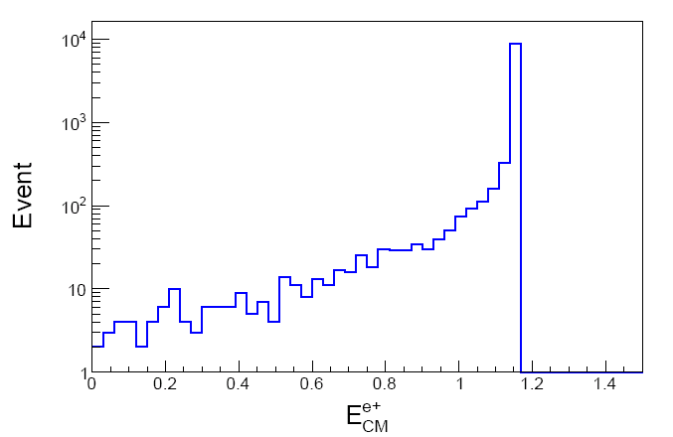
Radiative corrections in pandaroot
Positron and electron energy distribution in the centre of masse at 1.7 GeV.

