Slide 1

Radiative corrections to p+p →e⁺+e⁻
Egle Tomasi-Gustafsson
IRFU, SPhN-Saclay, and
IN2P3- IPN Orsay, France
In collaboration with
E.A. Kuraev, A. Ahmadov,V. Bytev
(JINR-BLTP, Dubna)

Slide 2
QED Radiative Corrections
Modify the absolute value of the experimental observables and their dependence from the relevant
kinematical variables

Slide 3
PLAN
Introduction
Importance of radiative corrections:
- some examples in the scattering region
- simulations for pbar + p -> e⁺ + e⁻
(best precision obtained at electron-positron colliders)
Radiative pbar p annihilation into a radiative pair
  Some calculated spectra
  Application in PandaRoot : PHOTOS
Conclusions

Slide 4
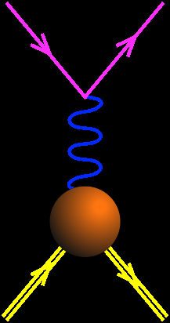
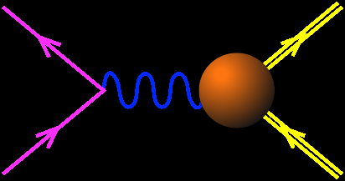
Analyticity
Space-like
See talk J. Boucher
Asymptotics
- QCD
- analyticity
e⁻
e⁻
Time-like
q²<0
GE(0)=1
e⁺
p
GM(0)=μ_{p}
q²>0
p+p ↔ e⁺+e⁻ +π
Unphysical region
p
p
e⁻
p
_
FFs are real
FFs are complex
_
q²=4m_{p}²
p+p ↔ e⁺+e⁻
q²
e+p → e+p
GE=GM
M.P. Rekalo

Slide 5
Radiative Corrections (ep)
Andivahis et al., PRD50, 5491 (1994)
Q²=1.75 GeV²
May change
the slope of σ_{R}
(and even the sign !!!)
Q²=5 GeV²
Q²=3.75 GeV²
RC to the cross section:
− large (may reach 40%)
ε and Q² dependent
− calculated at first order
E. T.-G., G. Gakh, PRC 72, 015209 (2005)

Slide 6
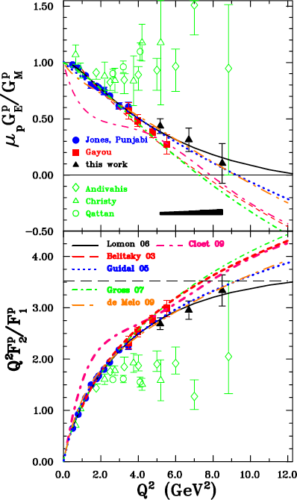
Polarization experiments - Jlab
  GEp collaboration
  "standard" dipole function for the nucleon magnetic FFs GMp and GMn
  2) linear deviation from the dipole function for the electric proton FF Gep
  3) QCD scaling not reached
  3) Zero crossing of Gep?
  4) contradiction between polarized and unpolarized measurements
A.I. Akhiezer and M.P. Rekalo, 1967
A.J.R. Puckett et al, PRL (2010)

Slide 7
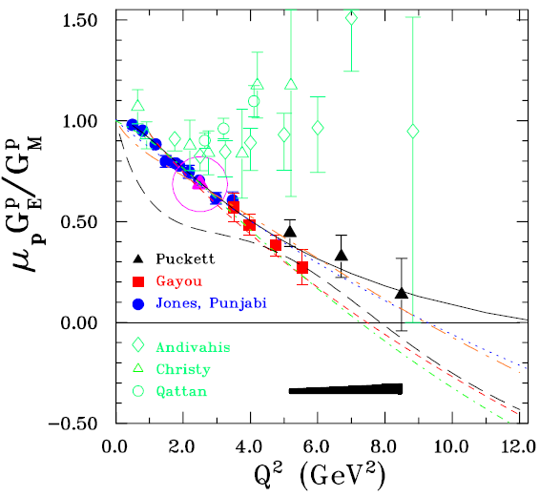
Gep III results (2010)
Lomon
Belitsky
Guidal
Gross
De Melo
Cloet ---

Slide 8
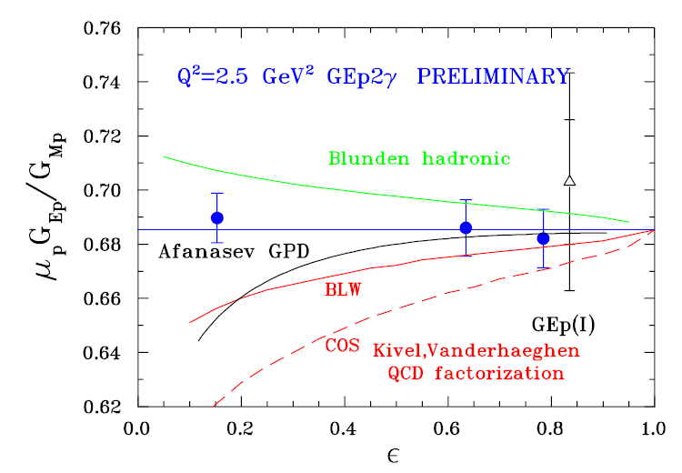
Gep III results (2010)
Bystritskiy SF
No radiative corrections
applied to the data
No evidence of two photon effects

Slide 9
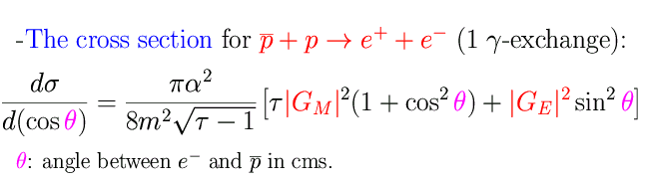


Unpolarized cross section
Two Photon Exchange:
Induces four new terms
Odd function of θ:
Does not contribute at θ =90°
M.P. Rekalo and E. T.-G., EPJA 22, 331 (2004)
G.I. Gakh and E. T.-G., NPA761, 120 (2005)

Slide 10

Symmetry relations
Properties of the TPE amplitudes with respect to the transformation: cos θ = - cos θ i.e., θ → π - θ
(equivalent to non-linearity in Rosenbluth fit)
Based on these properties one can remove or single out TPE contribution
E. T.-G., G. Gakh, NPA (2007)

Slide 11

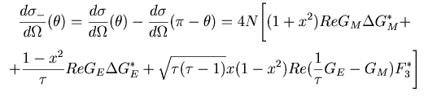

Symmetry relations
Differential cross section at complementary angles:
The SUM cancels the 2γ contribution:
The DIFFERENCE enhances the 2γ contribution:

Slide 12
Simulations
q²=5.4,8.2,13.8 GeV²
Main effect:
odd cosθ−distribution
Approximations:
  Neglect contributions to GE,GM
  Consider only real part

Slide 13




Fitting the angular distributions...
The form of the differential cross section:
is equivalent to:
Cross section at 90⁰
Angular asymmetry
E. T-G. and M. P. Rekalo, Phys. Lett. B 504, 291 (2001)

Slide 14

Fitting the angular distributions...
1 γ exchange:
Linear Fit in cos²θ
2 γ exchange
Quadratic Fit in x=cosθ
E. T-G. and M. P. Rekalo, Phys. Lett. B 504, 291 (2001)

Slide 15
Fitting the angular distributions...
q²=5.4 GeV²
2γ 0

Slide 16
Fitting the angular distributions...
q²=5.4 GeV²
2γ 0.02

Slide 17
Fitting the angular distributions...
q²=5.4 GeV²
2γ 0.05

Slide 18
Fitting the angular distributions…
q²=5.4 GeV²
2γ 0.20

Slide 19
1γ
2γ
0.02
0.05
0.20
q²=5.4 GeV²
q²= 8.2 GeV²
q²=13.8 GeV²

Slide 20

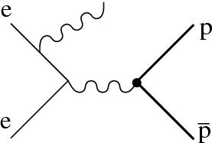
Radiative Return (ISR)
e⁺ +e⁻ → p + p + γ
B. Aubert ( BABAR Collaboration) Phys Rev. D73, 012005 (2006)

Slide 21

Angular distribution
1.877÷1.950
1.950÷2.025
2.025÷2.100
2.100÷2.200
2.200÷2.400
Events/0.2 vs. cos θ
2.400÷3.000
    2γ−exchange?

Slide 22
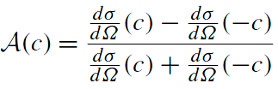
Angular Asymmetry
Mpp=1.877-1.9
A=0.01±0.02
Mpp=2.4-3
E. T.-G., E.A. Kuraev, S. Bakmaev, S. Pacetti, Phys. Lett. B (2008)

Slide 23



Structure Function method
e⁺ +e⁻ → p + p + γ
ΔE=0.05

Slide 24


Virtual and soft photon emission
Hard photon emission
LLA- Structure Functions Kuraev,Fadin (1985)

Slide 25
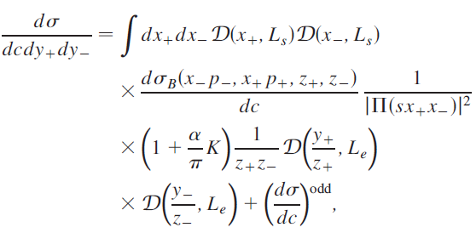
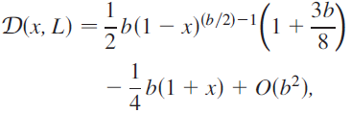

Differential cross section (SF)
Energy fractions of the leptons
K-factor
Partition function
Odd term
The structure function of the lepton

Slide 26
K-factor (hard)
cos θ
of the order of one
from the even part of the cross section

Slide 27

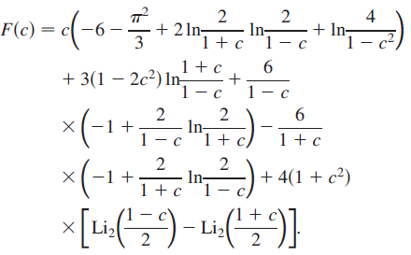
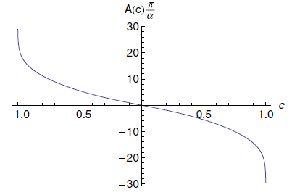

Charge Asymmetry

Slide 28
Radiative correction factor
Ν_{corr}=Ν_{raw}(1+δ)
s=10 GeV²
δ
cos θ
Integrated in all phase space for γ
Proton structureless

Slide 29
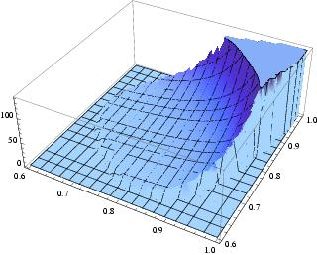
Dalitz-plot p+p →e⁺+e⁻ (+ γ)
s=10 GeV²
x₊=E_{e+}
x₋=E_{e-}

Slide 30
Conclusions/PLAN
QED radiative corrections modify the absolute value of the experimental observables and their dependence from the relevant kinematical variables
Compare electron spectra from Montecarlo with/without RC PHOTOS
Compare PHOTOS/ Calculation in all phase space
3) High order effects : with/without
4) compare: event distribution
charge asymmetry
….Implement new formulas in pandaroot?

Slide 31

Thank you for attention

Slide 32
Questions
My questions for you:
Has anybody looked to the effect of PHOTOS on
specific spectra?
Has PHOTOS been implemented for specific reactions?
PHOTOS is based on SF method: has anybody checked the effects of higher order versus first order contributions on specific spectra?

Slide 33

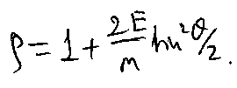
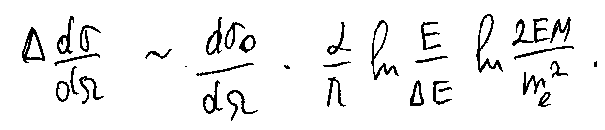
Scattered electron energy
final state emission
Initial state emission
Quasi-elastic scattering
3%
Not so small!
Shift to LOWER Q²
Y₀
All orders of PT needed →
beyond Mo & Tsai approximation!

Slide 34
Short history (I)
Schwinger: corrections to cross section for electron scattering in external field
σ=σ₀(1+δ) (1)
Yennie, Frauchi, Suura: cross section of any pure process (without real photon emission) is zero.
Kessler, Ericsson, Baier, Fadin, Khoze, Y. Tsai : quasi real electron method. Emission of hard photon is described in terms of a convolution of a radiative function with Born cross section.
  → (1) Not adequate

Slide 35


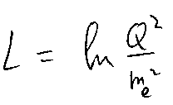
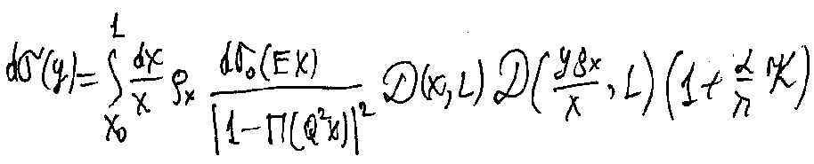

The Structure Function Method
  E. A. K. and V.S. FADIN, Sov. J. of Nucl. Phys. 41, 466 (1985)
Distinguish:
-leading contributions of higher order
-non leading ones
The SF method is based on:
  Renormalization group evolution equation
  Drell-Yan parton picture of the cross section in QCD
Electron SF: probability to ‘find’ electron in the
initial electron, with energy fraction x and virtuality up to Q²

Slide 36
LSF: ‰ precision
  E. A. K. and V.S. FADIN, Sov. J. of Nucl. Phys. 41, 466 (1985)
LLA (Leading Logarithm Approximation)
Precision of LLA
Including K-factor
Even when corrections in first order PT are δ~100%, the accuracy of higher order RC (LSF) is α/π δ≤1% !

Slide 37


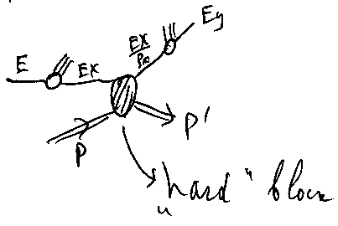
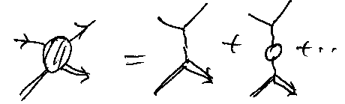
The LSF cross section (for ep )
If the electron is detected in a calorimeter:→ the cross section is integrated over the scattered electron energy fraction:
The K-factor includes all non leading contributions:

Slide 38
QED Radiative Corrections and DVCS
Q²=2.3 GeV²
RC
Differential cross section
xBj=0.36
Born
electrons
positrons
V.V. Bytev, E.A. Kuraev, E.T.G., Phys.Rev.C77:055205,2008.

Slide 39
QED Radiative Corrections and DVCS
Helicity asymmetry
Q²=2.3 GeV²
xBj=0.36
Charge asymmetry
RC
Born
V.V. Bytev, E.A. Kuraev, E.T.G., Phys.Rev.C77:055205,2008.

Slide 40
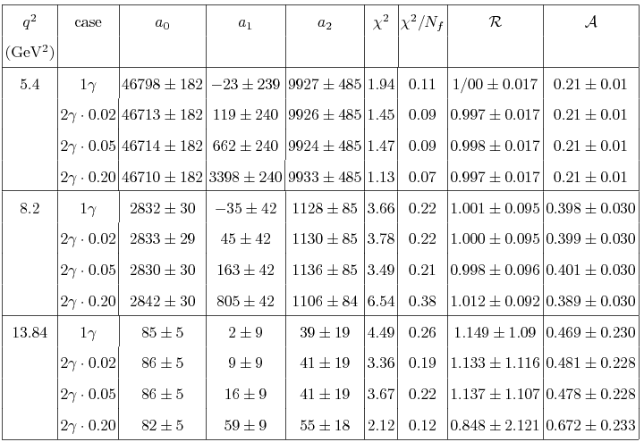
N=a₀+a₂cosθ sinθ +a₁ cos²θ, a₂~2γ

