Slide 1
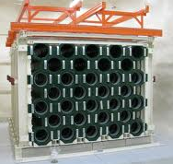
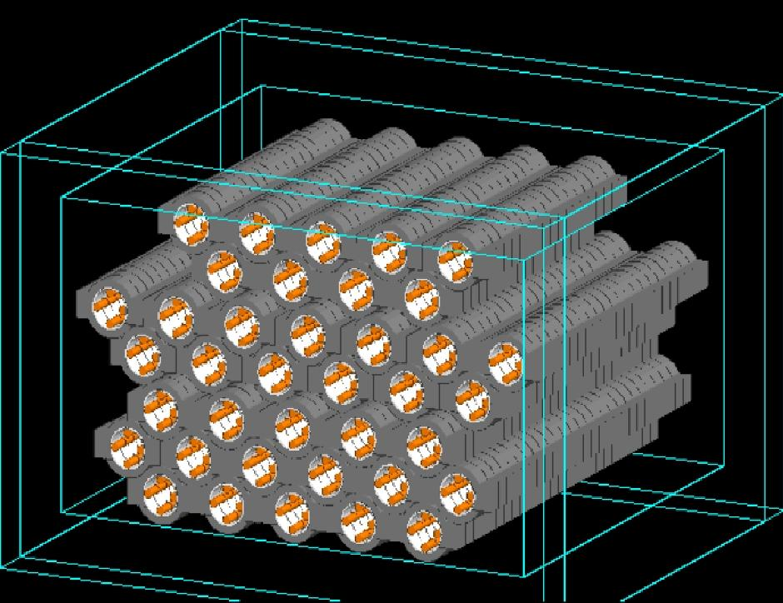
SUPERNOVA NEUTRINO SIGNAL AT HELIUM AND LEAD OBSERVATORY: Learning about the primary neutrino fluxes and neutrino properties
D. Väänänen, C. Volpe, JCAP 1110 (2011) 019
Daavid Väänänen
LAPP, Annecy-le-Vieux 28-29/11/2011

Slide 2
Iron Core-collapse Supernovae
Neutrino production
Core-collapse
Shock wave,
Proto-neutron star
formation
Massive stars M > 8 M_{sol}
Onion structure
H
He
C, O , Si
Fe
PNS
Notes:
(delayed explosion mechanism standard paradigm
Neutrinos are produced..
Trapped, released at neutrinospheres…
(skip!?)

Slide 3
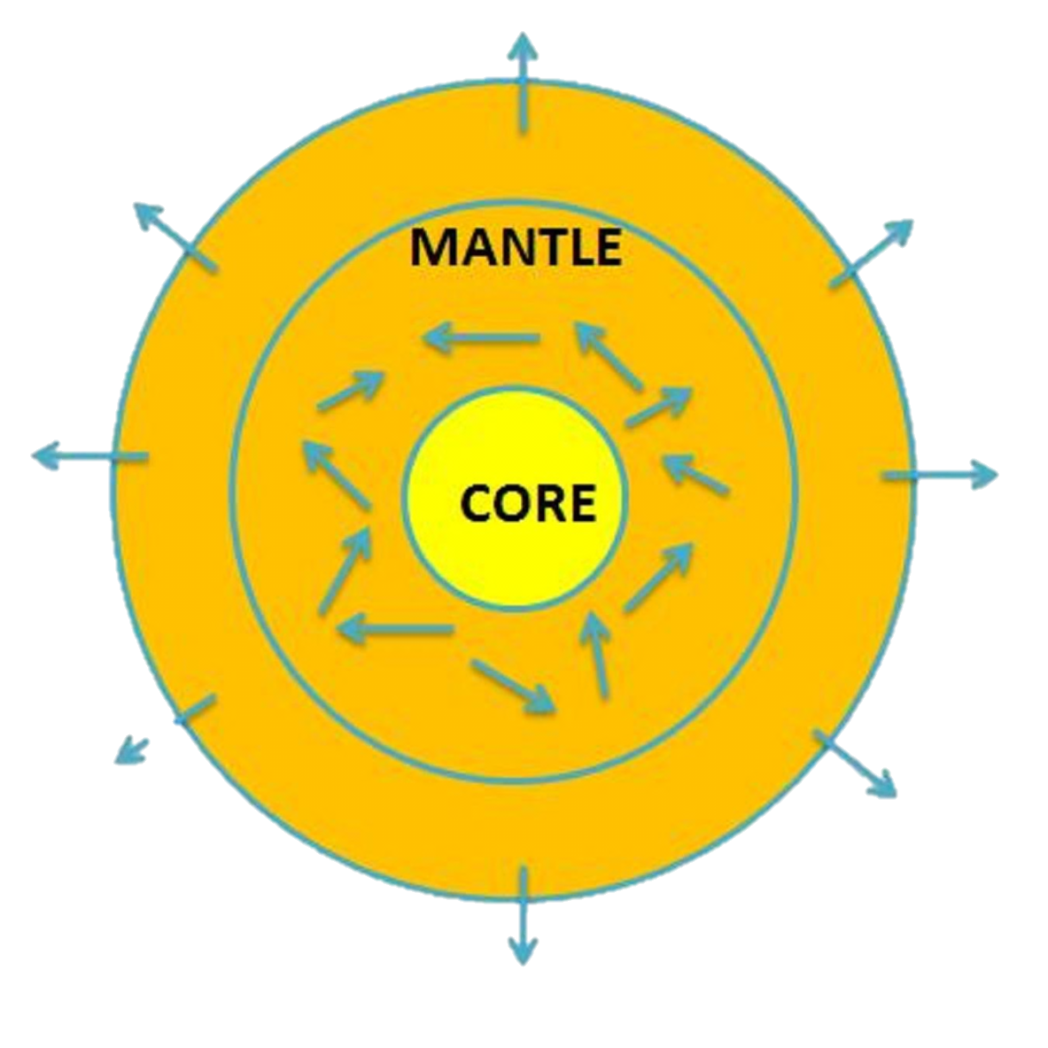
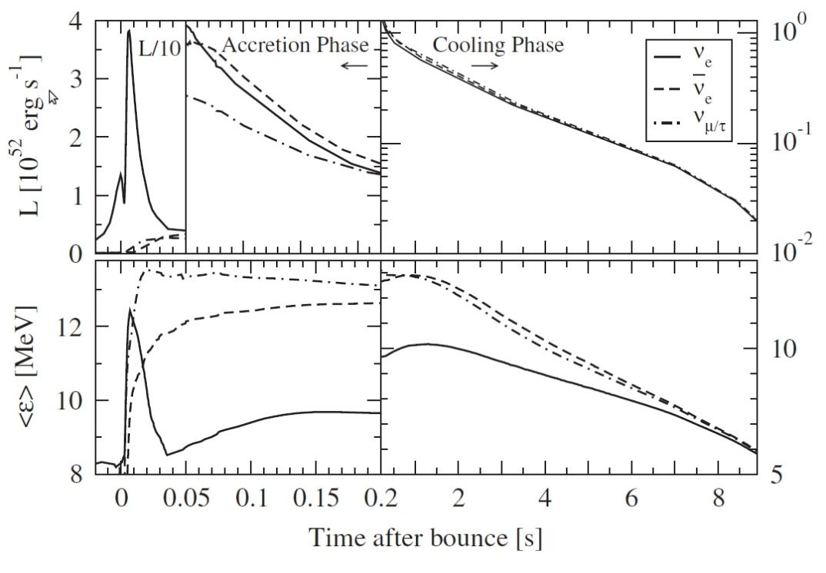
Primary Neutrino Fluxes
Neutrino production
Neutrinos first trapped due to high matter densities
Released at neutrinospheres (primary neutrino fluxes)
PNS
ν_{e} burst
Hüdepohl et al.
PRL 104, 251101 (2010)
Important information on neutrino transport in SN core
Notes:
(delayed explosion mechanism standard paradigm)
Neutrinos are produced..
Trapped, released at neutrinospheres…
(skip!?)

Slide 4
Motivation
Helium And Lead Observatory (HALO)
-- a dedicated supernova (SN) neutrino detector --
under construction at
Most of the existing and proposed detectors mainly sensitive to electron antineutrinos
Pb detector mainly sensitive to electron neutrinos
(with large ν_{e} – Pb cross section!)
Notes:
Why interesting:
Under construction
Complementary detection channel with large cross section!: to get most out of the next SN explosion, especially if we wanna say anything (even hypotheticly) about the flavor evolution, we want to see them all! (especially important for indicating the mass hierarchy; to see whether MSW resonances occur in neutrino or antineutrino channels)
This tells why interesting and why now!
While I will concentrate on HALO, many of the general conclusions apply to any lead (heavy neutron rich nucleus) detector, in fact…

Slide 5
Previous work on Pb detectors
Lead based neutrino detectors proposed: e.g.
OMNIS [D.B Cline et al., PRD 50, 720 (1994)]
LAND [C.K. Hargove et al., Astropart. Phys. 5, 183 (1996)]
Pb(ClO₄)₂ based detector [S.R. Elliot PRC 62, 065802 (2000)]
Predictions:
Fuller, Haxton, McLaughlin, PRD 59, 085005 (1999)
Kolbe, Langanke, PRC 63, 025802 (2001)
Engel, McLaughlin, Volpe, PRD 67, 013005 (2003)
Pb detector sensitive to the high energy component of the hot ν spectrum
Difference in event numbers with and without mixing can be beyond uncertainties
Notes:
There has been several proposals for a lead based detector
And I will not go into details of them, but halo differs from these considerations, I shall talk more about the details later…

Slide 6
Motivation
However,
Current design of HALO differs from earlier considerations
Recent SN simulations indicate lower neutrino energies
Neutrino-neutrino interactions were not included
New predictions for HALO necessary!
Notes:
Fuller et al: CC 2n signal interesting
Kolbe et al: yes, but also NC 2n signal should be accounted for, and CC channel showed as a function of outgoing lepton energy (which is not measured in HALO)
Engel et al: study of lead perchlorate: ability of electron detection (which is not measured in HALO) and the electron signal’s sensitivity to spectral shape
Due to large ν_{e} – Pb cross sections, if ν_{x} (high E)-> ν_{e} flavor oscillations occur, event numbers beyond cross section uncertainties, factor of 40 for 2n events [fuller et al.]
Inclusion of other neutrino interactions in SN core imply different neutrino fluxes at the neutrino sphere

Slide 7
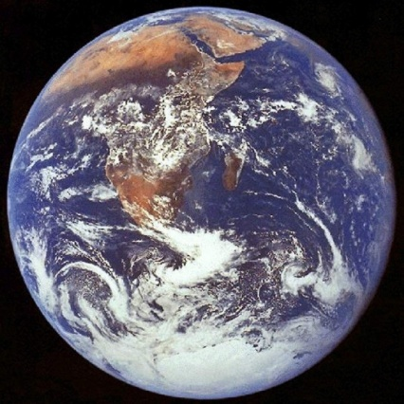
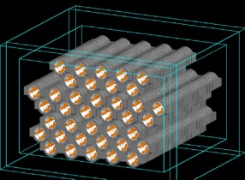
THE EVOLUTION OF THE TALK
PNS
core
A. Open Questions:
1) Unknown neutrino properties
2) Neutrino fluxes at neutrinosphere
NEUTRINO
SPHERE
ν_{e}
ν
ν
ν_{e}
Neutrino Flavor Evolution in SNe
1) MSW effect
2) νν –interaction effects
e⁻
e⁻
ν_{e}
C. The Formalism and Assumptions
D. Neutrino Signal at HALO
Can we extract information on the open questions?

Slide 8
A. Open Questions B. Neutrino Flavor Evolution C. The Formalism D. Neutrino Signal at HALO
1) Unknown neutrino properties:
θ₁₃ < 0.2 (PDG), non-zero?
Neutrino mass hierarchy:
We do not consider:
CP-violation (δ_{CP} = 0)
sterile degrees of freedom
superluminal neutrinos
[Balantekin,Yilmaz, J.Phys. G35, 075007 (2008)]
[T2K Collaboration, PRL 107, 041801 (2011)]
[Fogli et al., arXiv: 1106.6028 (2011)]
Normal (NMH) or Inverted (IMH) ?
ν₃
ν₂
ν₁
ν₂
ν₁
ν₃
Notes:
About nu properties (combine with the next flux slide: two columns!!?)
-Relevant for my discussion is that theta13 is known to be small but only an upper bound exists
-and mass hierarchy is not known
-additionally (not relevant for my discussion) we do not know the nature of neutrinos (D or M or sth else)
-CP violation in leptonic sector?
-sterile neutrinos?

Slide 9
A. Open Questions B. Neutrino Flavor Evolution C. The Formalism D. Neutrino Signal at HALO
2) Neutrino fluxes at the neutrinospheres
-- the primary neutrino fluxes --
Luminosities, average energies and energy spectrum?
Bounds from SN simulations:
(e.g. [Keil, Raffelt, Janka, Astrop.J. 590, 971], [Ficher et al. 0908.1871])
Notes:
About nu properties (combine with the next flux slide: two columns!!?)
-Relevant for my discussion is that theta13 is known to be small but only an upper bound exists
-and mass hierarchy is not known
-additionally (not relevant for my discussion) we do not know the nature of neutrinos (D or M or sth else)
-CP violation in leptonic sector?
-sterile neutrinos?

Slide 10
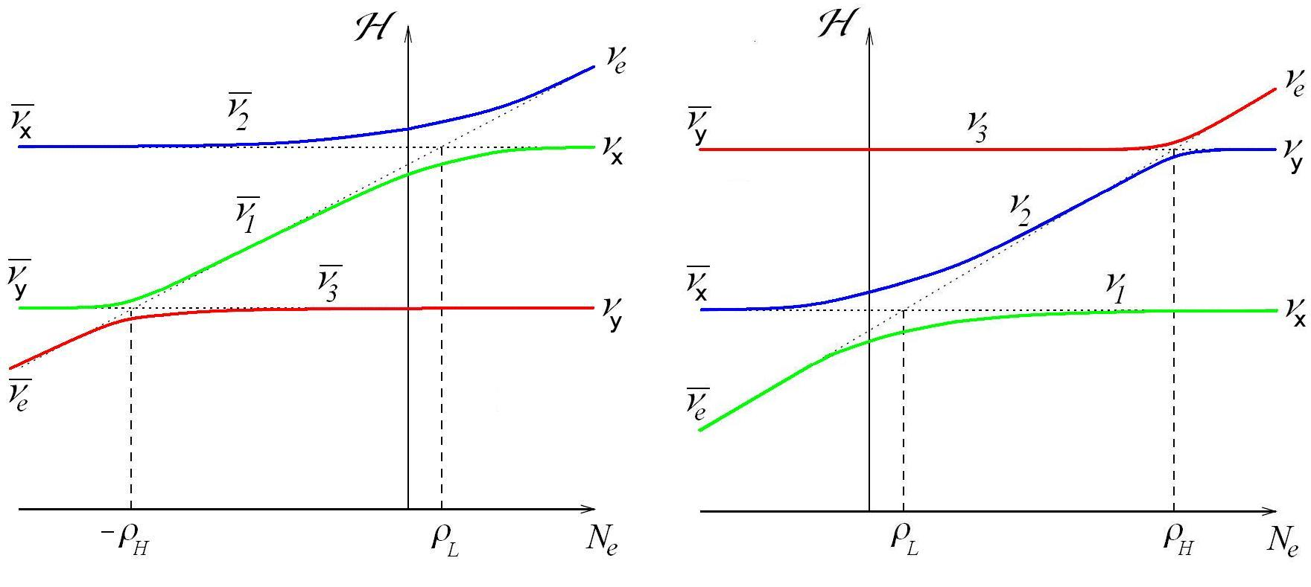
MSW EFFECT
A. Open Questions B. Neutrino Flavor Evolution C. The Formalism D. Neutrino Signal at HALO
1) MSW- Effect
Resonance flavor conversion
Low resonance:
always adiabatic, always for ν’s
High resonance:
(non-)adiabatic for θ ₁₃ > 0.03 (< 0.003)
IMH
NMH
L
H
H
L
A. Dighe, A. Smirnov,
PRD 62, 033007 (2000)

Slide 11
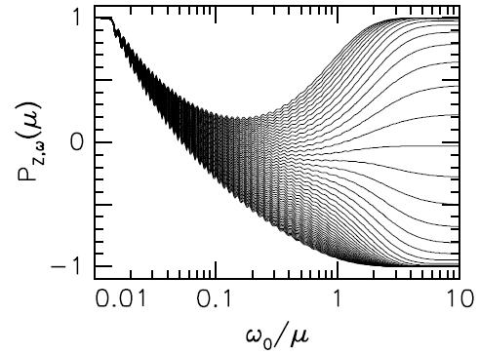
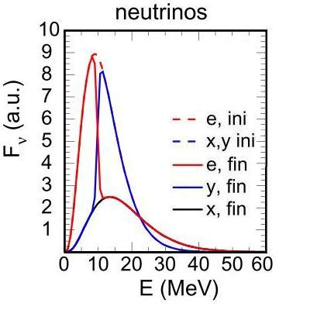
A. Open Questions B. Neutrino Flavor Evolution C. The Formalism D. Neutrino Signal at HALO
2) νν - Interactions
Collective effects:
ν_{e}
ν_{x}
ω₂
ω₁
ΙΜΗ
.
.
.
Raffelt, Smirnov,
PRD 76 (2007) 081301
ω_{N}
ΙΜΗ
A. Mirizzi, R. Tomàs,
PRD 84 (2011) 033013

Slide 12
A. Open Questions B. Neutrino Flavor Evolution C. Neutrino Signal at HALO
C. The Formalism and Assumptions
PNS
We consider iron core-collapse SNe
Factorized dynamics:
4) Propagation to Earth
3) MSW effects
2)
Effects due to
νν−interactions
1)
Primary fluxes
e⁻
NEUTRINO
SPHERE
ν
ν
e⁻
ν
ν
ν

Slide 13
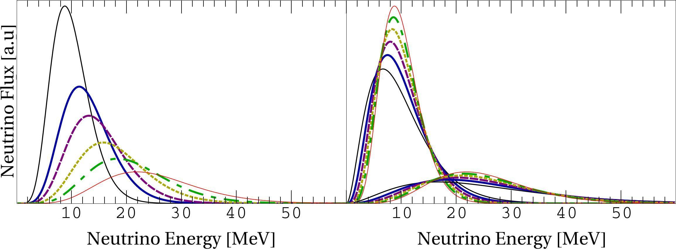
A. Open Questions B. Neutrino Flavor Evolution C. The Formalism D. Neutrino Signal at HALO
1) Neutrino fluxes at the neutrinosphere
We assume:
Power Law
energy distribution
Equal luminosities or and
Important information on neutrino transport in SN core
Notes:
+ show the flux figures again!
L values!? Pinching values???

Slide 14
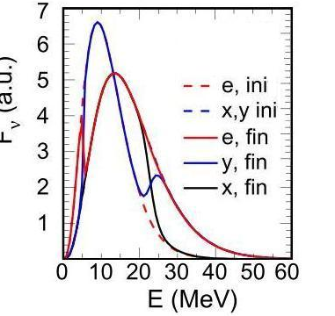
A. Open Questions B. Neutrino Flavor Evolution C. The Formalism D. Neutrino Signal at HALO
2) Fluxes after the νν -interactions
IMH
A. Mirizzi, R. Tomàs,
PRD 84 (2011) 033013
We assume:
0, 1 or 2 splits in energy
Splits sharp in energy
Large dependence on luminosity and mass hierarchy
Notes:
Very sensitive to both mixing and primary flux parameters!
The fate of the neutrino fluxes depends on energy!
High energy split visible?

Slide 15
A. Open Questions B. Neutrino Flavor Evolution C. The Formalism D. Neutrino Signal at HALO
3) Fluxes after the MSW region
IMH
NMH
L
H
A. Dighe, A. Smirnov,
PRD 62, 033007 (2000)
H
L
L
NMH
We assume:
Low resonance always adiabatic
High resonance: adiabatic(θ ₁₃ = 0.1) or non-adiabatic(0.001)
Neutrinos exit the star as pure mass eigenstates
Notes:
PL always present for the whole neutrino spectrum (at least for relevant energies)

Slide 16
A. Open Questions B. Neutrino Flavor Evolution C. The Formalism D. Neutrino Signal at HALO
4) Final neutrino fluxes
Final (flavor) fluxes incoherent sums of massive fluxes
E.g. :
Notes:
Any coherence between mass eigenstates is lost:
No flavor oscillations after the fluxes exit the star
Here F1, F2 or F2 is either F0nue, F0nux or F0nuy!
Ue3 sin^2! Theta13 !!!
(F₁, F₂, F₃ are the initial fluxes F⁰(ν_{e}), F⁰(ν_{x}) or F⁰ (ν_{y}))

Slide 17
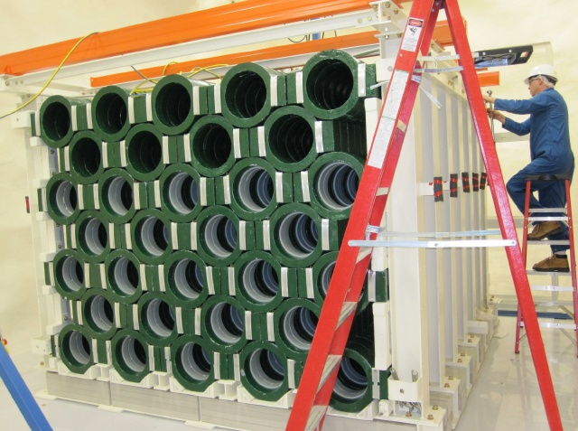
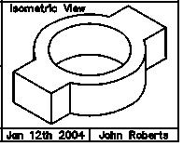
A. Open Questions B. Neutrino Flavor Evolution C. The Formalism D. Neutrino Signal at HALO
D. Helium And Lead Observatory (HALO)
A dedicated SN neutrino detector under construction
79t of Pb (HALO-2: 1kt)
Inside ³He gas detectors for neutron detection
www.snolab.ca/halo/index.html (March 2010)
Detection efficiency: ∼ 50% (electrons not detected)
Good time resolution: ∼ 30 ms
Notes:
About 865 blocks about 90 kg each = about 79 t
N emission E-thresholds: 1n: 6.89 MeV, 2n: 14.98 MeV, 3n: 22.02 MeV

Slide 18
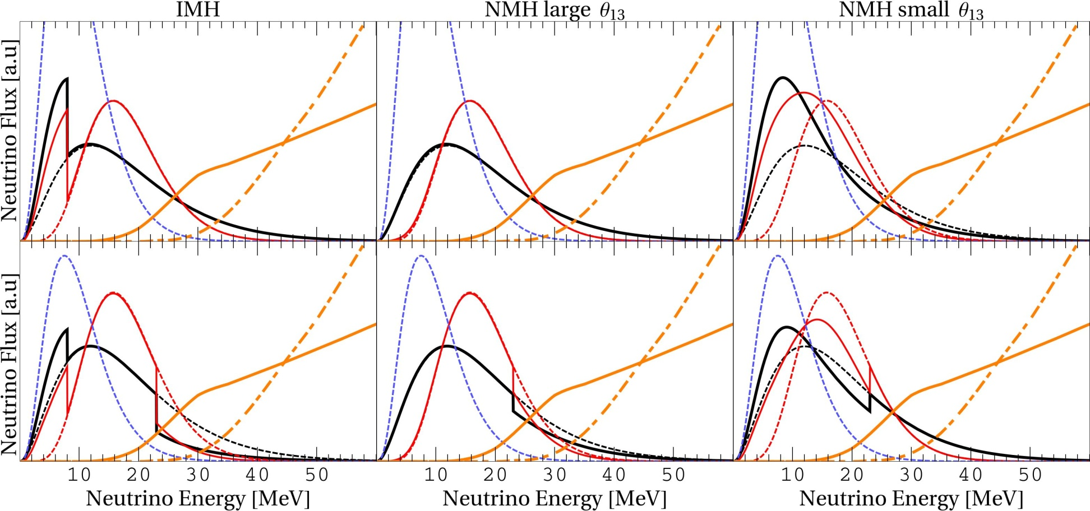
A. Open Questions B. Neutrino Flavor Evolution C. The Formalism D. Neutrino Signal at HALO
ν_{e} flux at Earth
Dependence on α_{νx} and neutron emission cross sections:
α_{νx} – 2
– 7
Equal
L :
L_{νx} =
2 L_{νe} :
2 n
Remark: LARGE UNCERTAINTIES RELATED TO CROSS SECTIONS!
RELY ON THEORETICAL PREDICTIONS:
e.g. [Kolbe, Langanke, PRC 63, 025802 (2001)],
[Engel, McLaughlin, Volpe, PRD67, 013005 (2003)]
1 n
ν_{e}-Pb cross sections [a.u.]
Sensitive to the tail of the energy spectrum
Can we learn about primary ν-fluxes and ν-properties?
Notes:
to show the importance of the tail and effect of variation of pinching
Not only all the boxes are different but also the fluxes within each box can be different when modifying primary flux parameters…to which lead detector is sensitive to!
Nu-Pb CS’s large and also Pb has very low n capture

Slide 19
A. Open Questions B. Neutrino Flavor Evolution C. The Formalism D. Neutrino Signal at HALO
THE RESULTS
Total numbers of 1n- (N_{1n}) and 2n-events (N_{2n}) during the whole explosion
Sensitivity to unknown parameters
Ratio of 1n- and 2n-events (N_{1n} / N_{2n})
We consider:
1 kt of Pb (HALO - 2)
Galactic supernova at 10 kpc
100% detection efficiency
NC + CC events
Notes:
Total numbers of events during the whole explosion
1n- and 2n-event rates (due to good time resolution)
Ratio of 1n- and 2n-events (since 1n- and 2n events can be well distinguished)
Summary

Slide 20
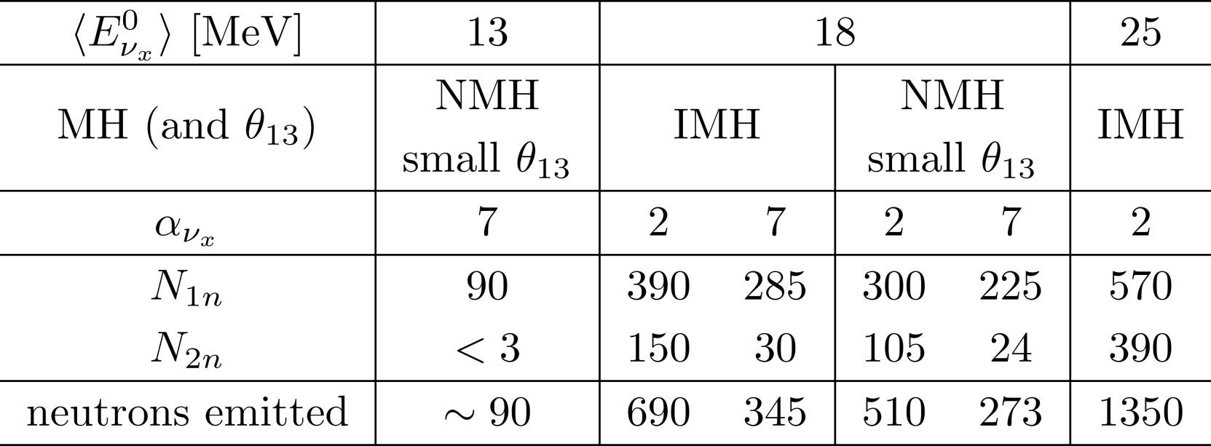
A. Open Questions B. Neutrino Flavor Evolution C. The Formalism D. Neutrino Signal at HALO
1) Total numbers of events
Assuming equal luminosities during the whole explosion with total time-integrated luminosity
For HALO – I, multiply by 0.076
higher average energies appreciated (or SN closer!)
Notes:
N_{1n} always significant
: e.g. 390 -> 30
Sensitive to pinching independently of underlying physical scenario!

Slide 21
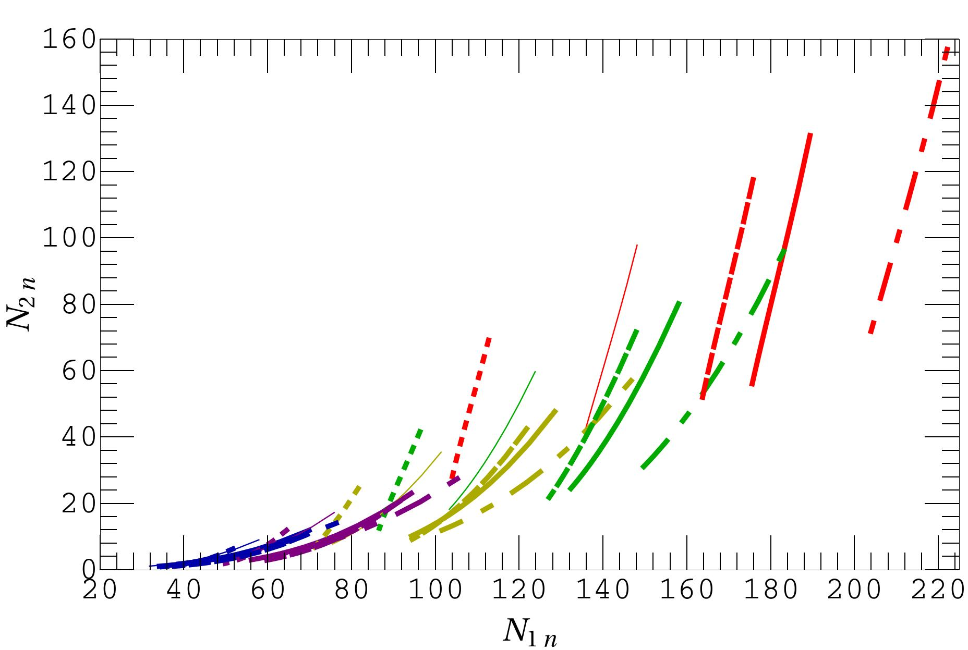
A. Open Questions B. Neutrino Flavor Evolution C. The Formalism D. Neutrino Signal at HALO
4) Sensitivity to unknown parameters
For (COOLING PHASE)
At the top of each curve: α_{νx} = 2, at bottom α_{νx} = 7
Combination of 1n- and 2n-events provides
Constraints on α_{νx} and
Possibility to indicate other unknowns depending on how much the primary neutrino fluxes differ
Notes:
Fig without example measurement: add it afterwards (the same and the other to 25 MeV)
What comes to Uncertainties related to predictions and to measurement

Slide 22
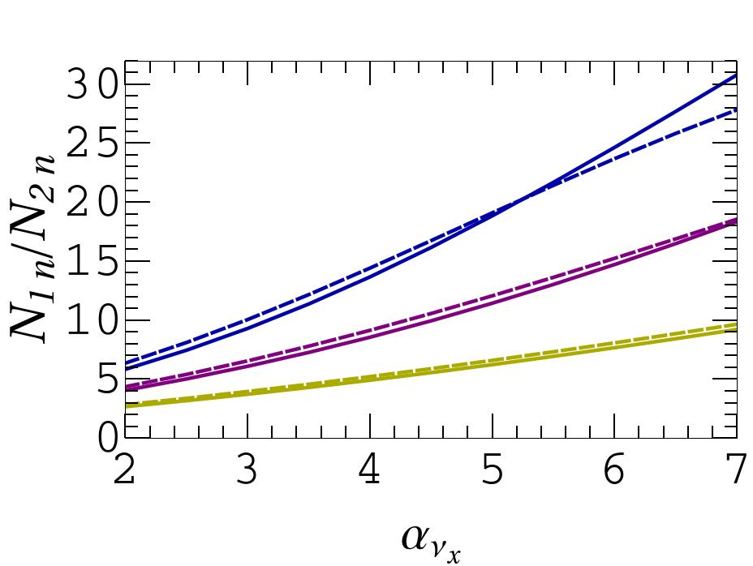
A. Open Questions B. Neutrino Flavor Evolution C. The Formalism D. Neutrino Signal at HALO
3) Ratio of 1n- and 2n- events
Independent of common flux parameters
Equal L
Solid: IMH
Dashed: NMH small θ₁₃
Dash-dotted: NMH large θ₁₃
$$α_{ν_{x}}$$
Allows to identify the degenerate combinations of α_{νx} and
Sensitivity to pinching has small dependence on unknown neutrino properties and flux parameters
Notes:
Sensitive to pinching independently of underlying physical scenario!

Slide 23
Conclusions (1)
We have provided:
Compact analytical way to calculate neutrino flavor evolution in SNe and final neutrino fluxes at Earth
We have shown that SN neutrino signal at HALO provides:
Possibility to identify degenerate solutions of primary non-electron-type neutrino average energy and pinching values
Better constraints and possible indication on luminosity and mass hierarchy and θ₁₃ in conjunction with other detectors
Future prospects:
Better understanding of νν – interaction effects
Include other possible effects (Earth matter, shock wave, turbulence)
[D. Väänänen, C. Volpe, JCAP 1110 (2011) 019]
Notes:
Compact analytical way to calculate flavor evolution and final neutrino fluxes
HALO sensitive to primary neutrino fluxes
Information about the neutrino production environment
Also, in principle, possible to distinguish between different physical scenarios:
Information about neutrino properties, provided that
One can rely on predictions (theoretical uncertainties small)
Measure the signal with sufficient precision
We are in the “lucky case” (primary fluxes differ sufficiently)

Slide 24
Conclusions (2)
Our study emphasizes the importance of having:
More information on the high-energy component of the primary neutrino spectra from SN simulations
Measurement of neutrino – lead cross sections!
spallation sources (e.g SNS at Los Alamos, ESS at Lund) or
Low energy beta beams [C. Volpe, J. Phys. G 30, L1-L6 (2004)]
A worldwide network of supernova neutrino detectors with complementary detection channels and energy thresholds
[D. Väänänen, C. Volpe, JCAP 1110 (2011) 019]
Notes:
HALO sensitive to primary neutrino fluxes
Information about the neutrino production environment
Also, in principle, possible to distinguish between different physical scenarios:
Information about neutrino properties, provided that
One can rely on predictions (theoretical uncertainties small)
Measure the signal with sufficient precision
We are in the “lucky case” (primary fluxes differ sufficiently)

Slide 25
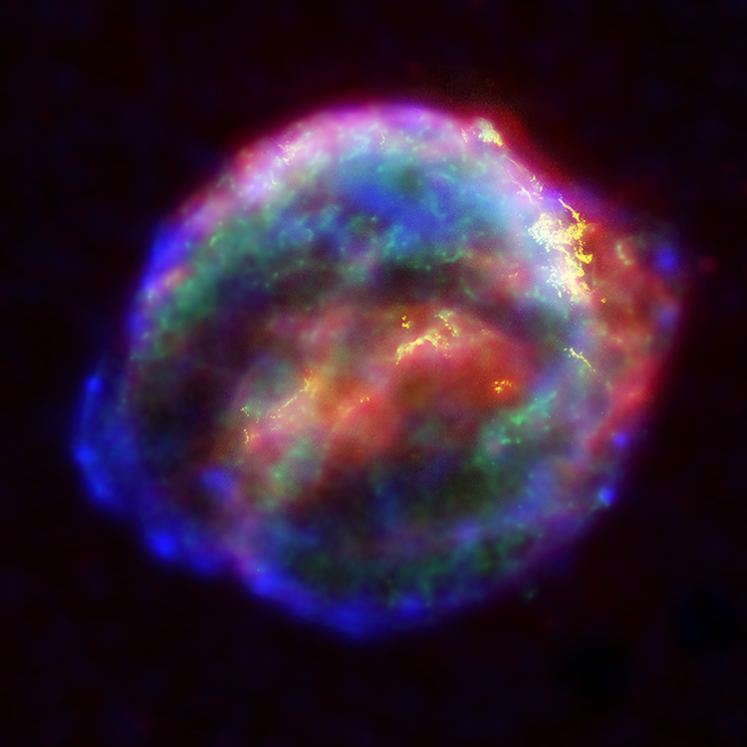
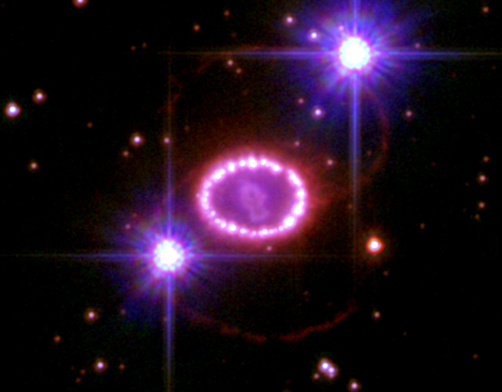
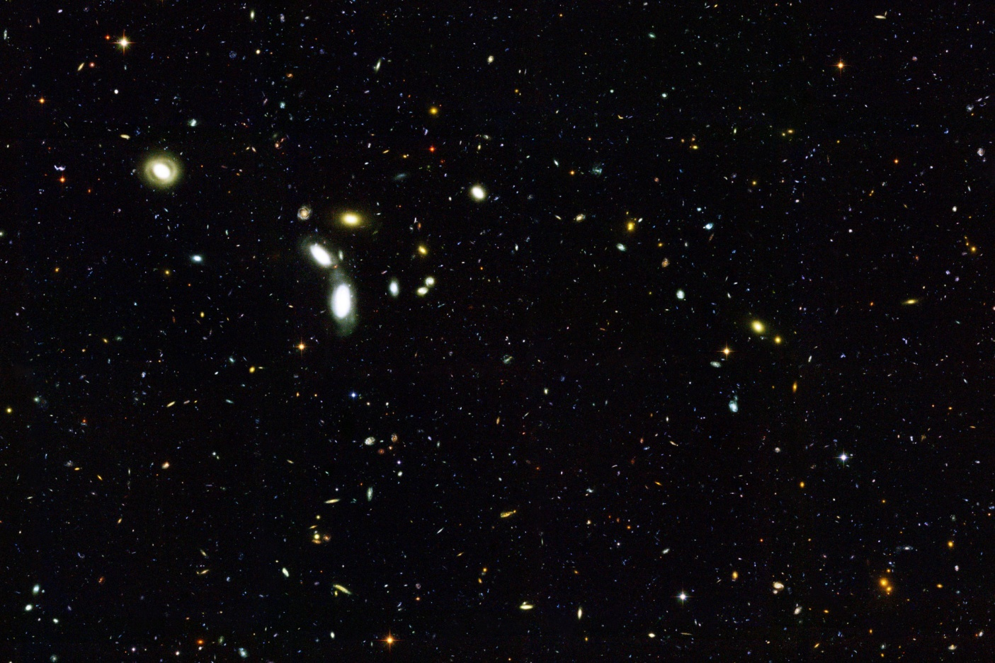
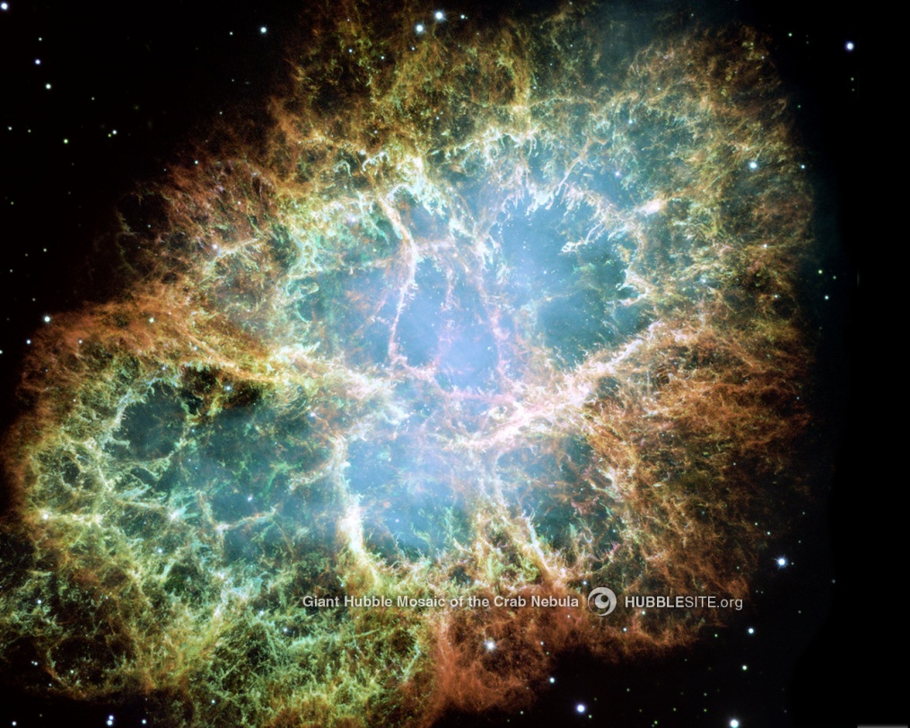
MERCI!

Slide 26
BACK-UPS

Slide 27
Luminosities and average energies
[Keil, Raffelt, Janka, Astrophys. J. 590, 971 (2003) ]
-> aveE_e = 9.4 MeV,
aveE_ae = 13 MeV
aveE_x = 15.8 MeV,
Le = Lae = 4.1x10^51 erg s^-1,
Lx = 7.9x10^51 erg s^-1

Slide 28
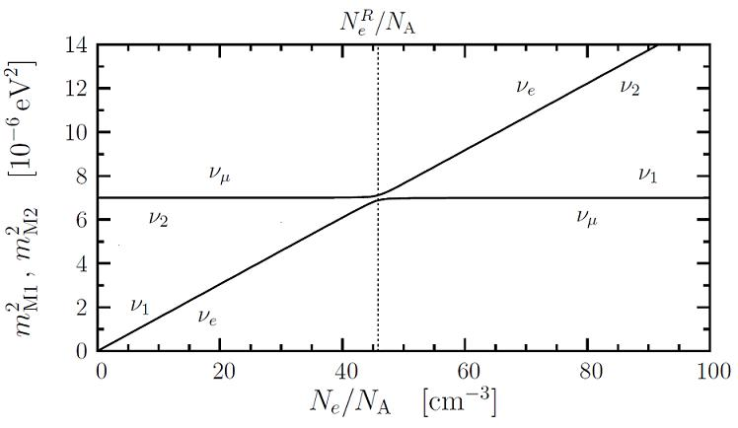
MSW effect
L. Wolfenstein, PRD 17, 2369 (1978), S. Mikheev & A. Smirnov, Sov. J. Nucl. Phys., 42, 913 (1985)
C. Giunti & C. Kim (2007),
“Fundamentals of neutrino
physics and astrophysics”
- Resonant flavor conversion possible even with small θ_{vac}
- Solution to the solar neutrino problem!
Notes:
Exhibits a Resonance which minimizes the effective mass square difference

Slide 29
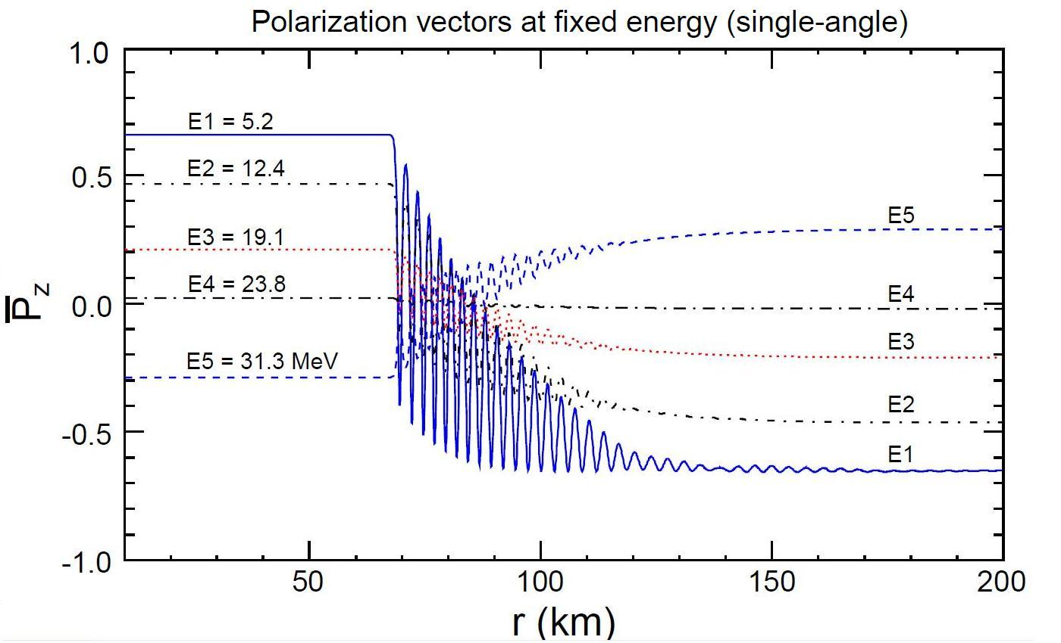
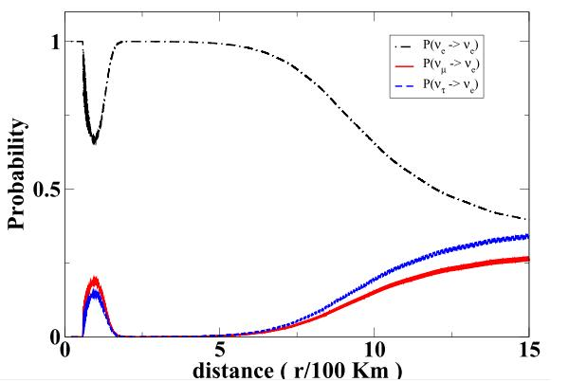
Collective flavor conversion effects
“gyroscopic flavor pendulum”:
ν_{e}
ν_{x}
G. Fogli et al JCAP
12:010 (2007)
Gava et al., PRD 78, 083007 (2008)
Synchronized oscillations
Bipolar oscillations
Spectral split
Notes:
Show first only figs, then the rest!
Pendulum in flavor space
(Dt(D cdot B) = 0: “Flavor lepton number” conservation -> split should occur) add somewhere (next or previous slide or after)?

Slide 30
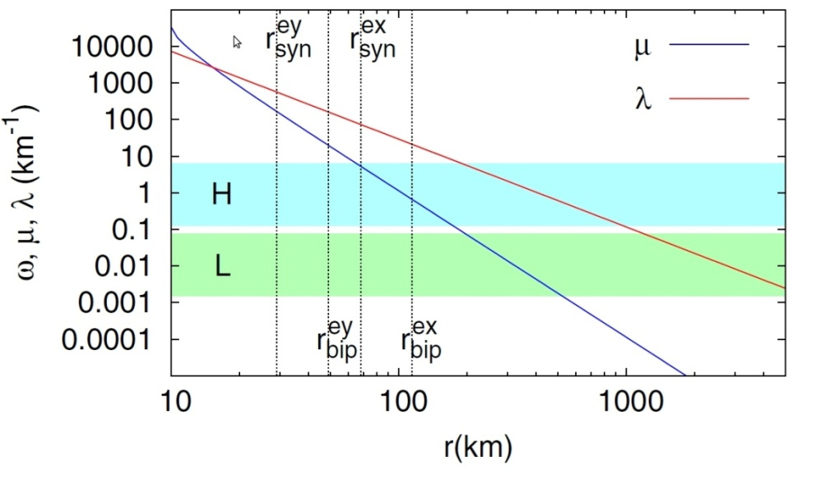
Flavor evolution
Polarization vector formalism (2f):
EOM:
Dasgupta et al., PRD
77, 113002(2008)
Collective effects!
Notes:
n = (n_e + n_x)/(N + antiN), n_e/x = occupation number of nu per unit volume at energy E (N+antiN)xTr(rho)
N = N_e + N_x, N_e/x = int dE n_e/x
Mu much larger than lambda & omega -> each omega mode P follows D: synchronized osc with \sim <omega>
But there is more to it…lets have a more closer look:..
Gyroscopic flavor pendulum:
Massless rod with length |P|,
point like bob at the end with mass M = 1/mu, which spins with sigma = const (in our case large),
Under external force field (for classical gyroscopic pendulum gravity, in our case the B (vacuum) field)
If initially stable that is aligned with the external field (classical pendulum points down) -> no evolution,
If initially unstable that is anti-aligned with the ext. field (classical pendulum points up) -> no evolution
BUT if there is an angle between the direction of the pendulum and the ext. field, ext. field tries to align the pendulum,
However if spin initially large it maintains the pendulum in upright position (only (small) precession around the field)
BUT if mu decreases (correspond to that mass of the bob increases) the external field starts to dominate and system evolves wobbling motion (nutation since spin still tries to bring it up and field tries to bring it down) of the pendulum
Somewhat like a spinning top on the table initially points up anti-aligned with the gravitational field but starts wobbling, in this case, due to slowing down of the spin due to friction between the top and the table
Notice that actually we have vectors for neutrinos and antineutrinos which evolve in opposite directions due to sign difference in the vacuum term…

Slide 31
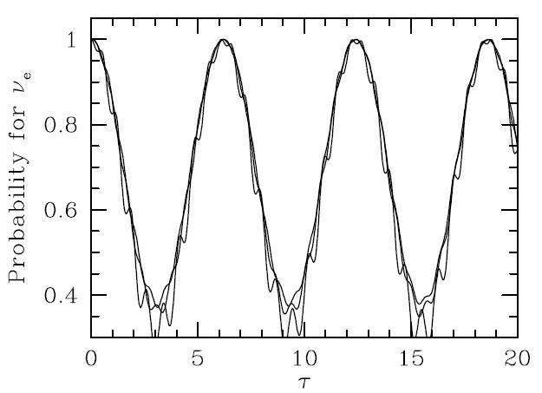
Synchronized oscillations
Pastor, Raffelt, Semikoz,
Phys.Rev. D65 (2002) 053011

Slide 32
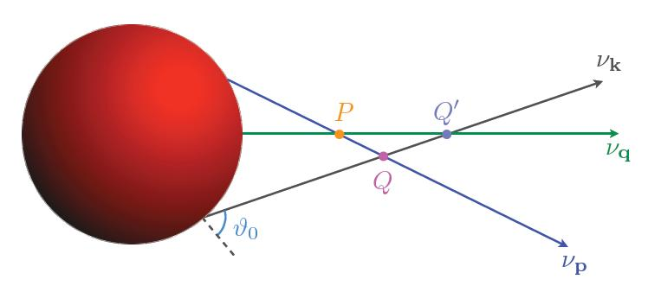

Slide 33
A. Open Questions B. Neutrino evolution C. Neutrino Signal at HALO
Remark: large uncertainties on cross sections
Cross sections rely on theoretical predictions
Ratio of flux
averaged cross-
sections:
To measure:
spallation sources (e.g SNS at Los Alamos, ESS at Lund) or
Low energy beta-beams [C. Volpe, J. Phys. G 30, L1-L6 (2004)]
(1)
(2)
[Engel, McLaughlin,
Volpe, PRD 67, 013005 (2003)]
[N.Paar, private
communication (as in PRC 77, 024608 (2008))]
In order to extract as much information as possible from SN ν fluxes, the ν– Pb cross sections should be measured!
Notes:
Fig. cross section + flux averaged
Sensitive to neutrino properties (MH, theta13) and primary flux parameters (L, Eave, pinching)
(depends also on the detection setup; cross sections…)

Slide 34
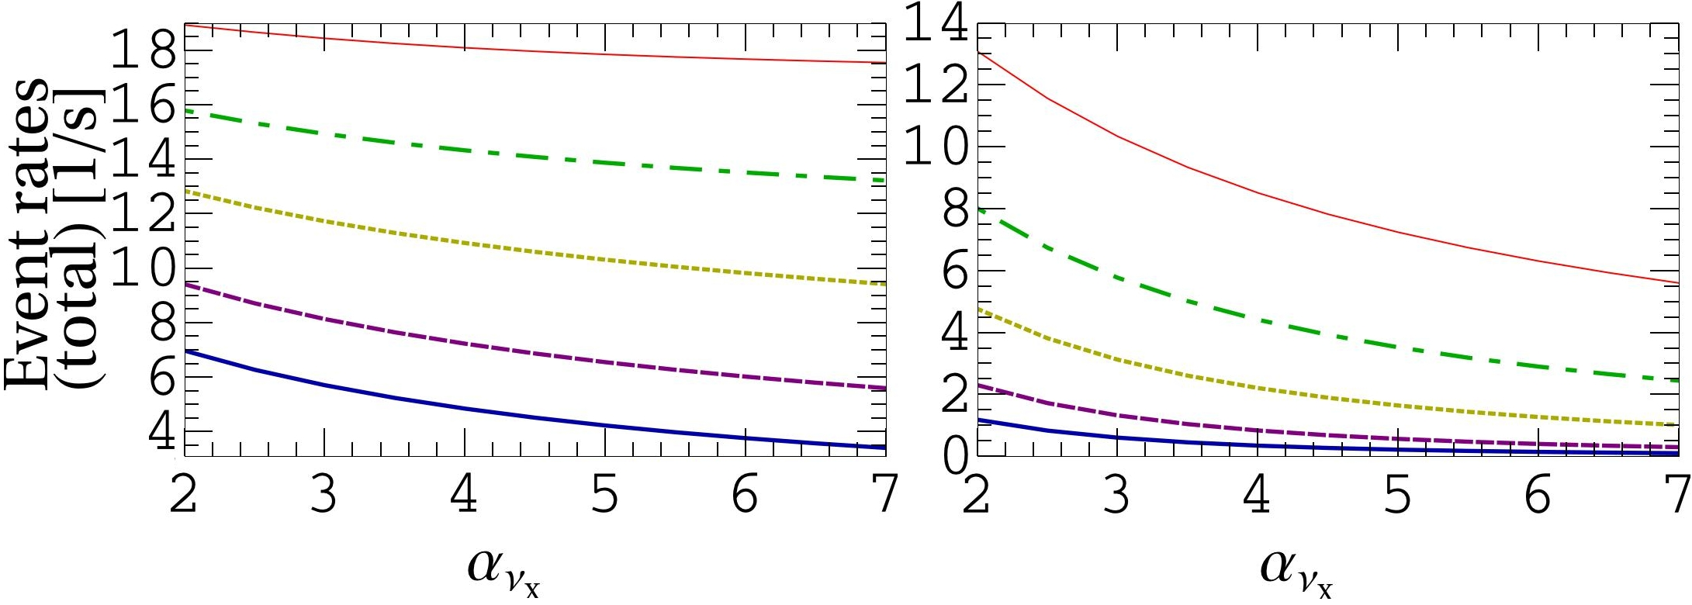
A. Open Questions B. Neutrino evolution C. Neutrino Signal at HALO
2) 1n- and 2n-emission event rates
Assuming IMH and equal luminosities:
1n 2n
Complementary: 1n events more sensitive to pinching for lower average energies while opposite true for 2n events
Notes:
Notice that the total luminosity is very low corresponding to later cooling phase of the explosion
(other scenarios can be obtained simply by scaling)
Due to the good time resolution it is interesting to consider the time dependent signal…these are snapshots in time and can indeed these parameters can be different at different times (e.g. earlier times Eav can be higher than later..)

Slide 35
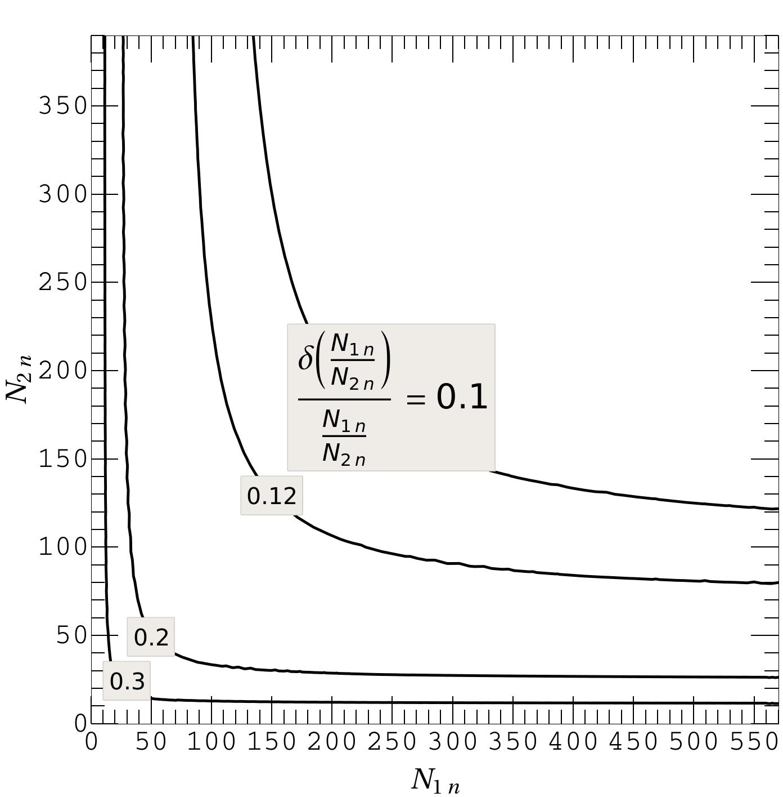
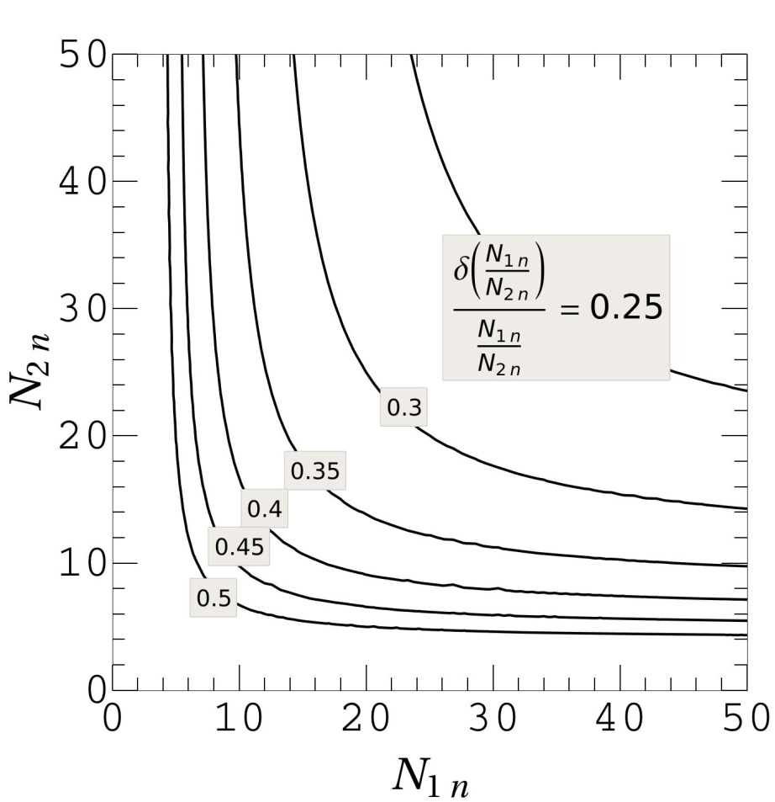
A. Open Questions B. Neutrino evolution C. Neutrino Signal at HALO
3) About statistics related to the ratio
Relative statistical error depending on the event numbers: N_{1n} and N_{2n}:
R = 2.60 + 0.25
(1 kt, 10 kpc, 100%)
R = 5.2 + 1.6
(79 t, 5 kpc 50% per n)
NB. Betelgeuse is at 0.2 kpc -> multiply by a factor of 2500 w.r.t. 10 kpc!
R = 2.6 + 0.9
(79 t, 10 kpc 100%)
R = 5.2 + 3.3
(79 t, 10 kpc 50% per n)
R = 5.2 + 0.9 1 kt, 10 kpc (50% per n)
R = 5.2 + 0.5
(1 kt, 5 kpc 50% per n)
79 t, 10 kpc 100%
62
780
Total numbers of events for IMH with equal luminosities
(50% detection efficiency per neutron)
(100% detection efficiency)
Notes:
Notice that about flat distribution around 5-20 kpc! Add reference!

Slide 36
Paar, Vretenar, Marketin, Ring, PRC 77, 024608 (2008):

Slide 37
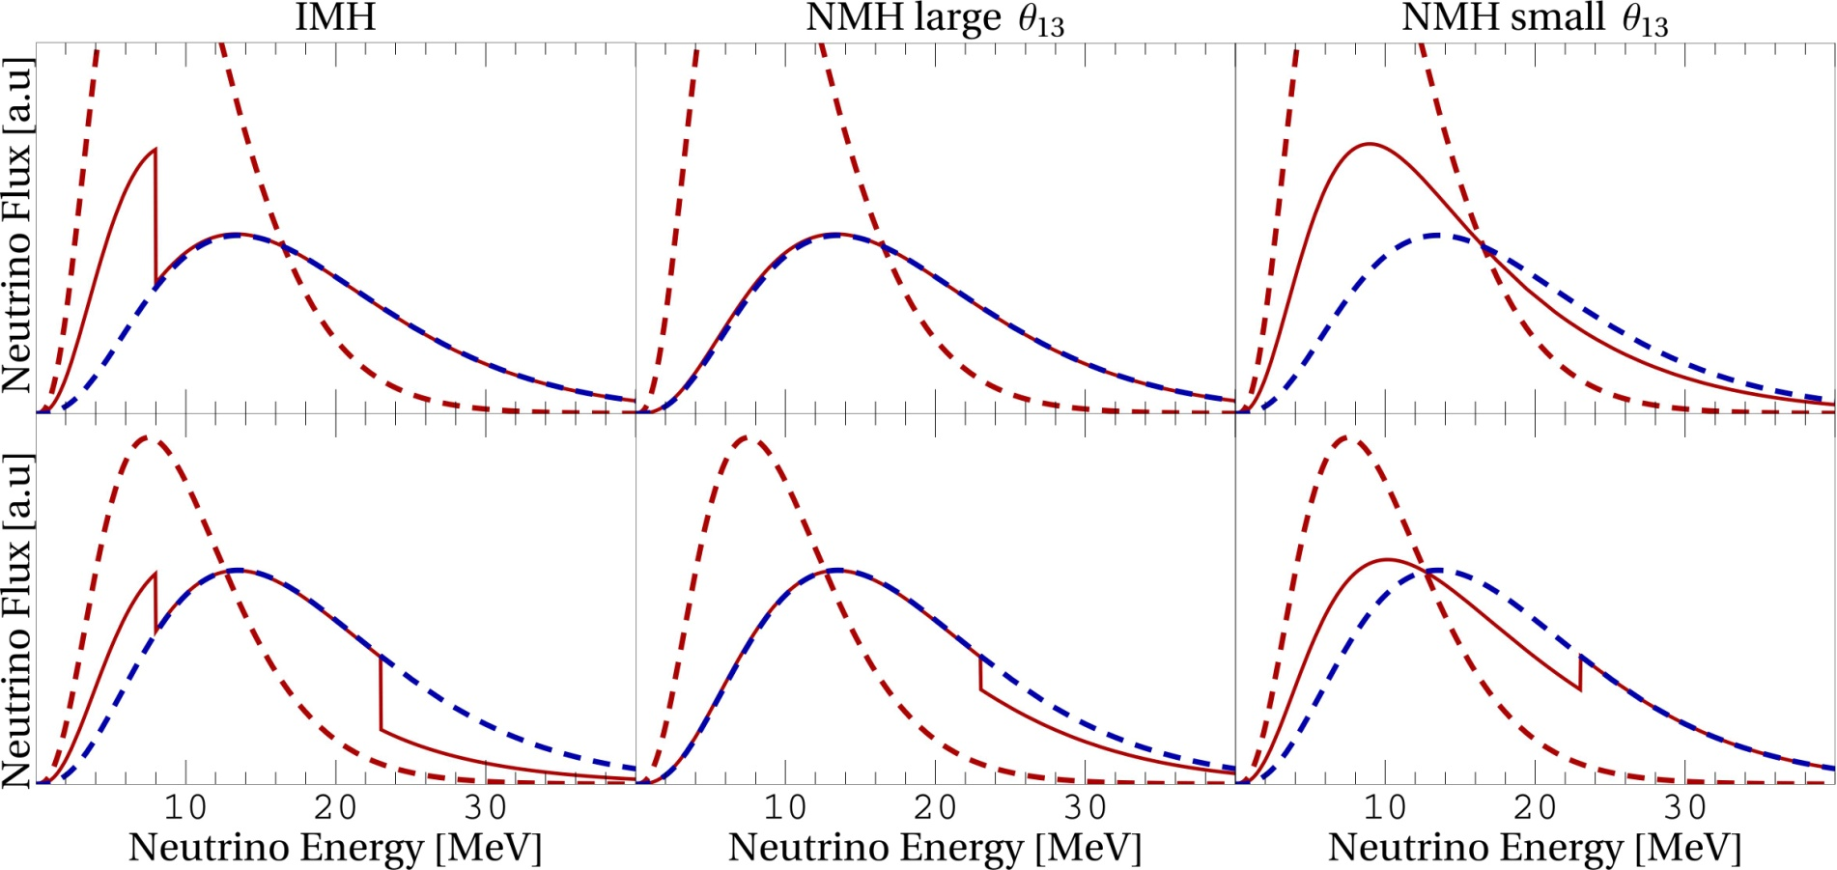
A. Open Questions B. Neutrino evolution C. Neutrino Signal at HALO
4) Final ν_{e} flux at Earth
Equal L :
L_{νx} =
2 L_{νe} :
Can we distinguish among scenarios?
Notes:
Nue fluxes all are similar but also they all differ
Can we say in which of these boxes we are living in?

Slide 38
A. Open Questions B. Neutrino Flavor Evolution C. The Formalism D. Neutrino Signal at HALO
2) Fluxes after the νν -interactions
IMH
We assume:
0, 1 or 2 splits in energy
A. Mirizzi, R. Tomàs,
PRD 84 (2011) 033013
Large dependence on luminosity and mass hierarchy
Notes:
Very sensitive to both mixing and primary flux parameters!
The fate of the neutrino fluxes depends on energy!
High energy split visible?

Slide 39
A. Open Questions B. Neutrino Flavor Evolution C. The Formalism D. Neutrino Signal at HALO
3) Fluxes after the MSW region
IMH
L
NMH
H
m
m
H
m
L
m
A. Dighe, A. Smirnov,
PRD 62, 033007 (2000)
m
m
Neutrinos exit the star as pure mass eigenstates
Notes:
PL always present for the whole neutrino spectrum (at least for relevant energies)

Slide 40
B. Neutrino Flavor Evolution in Supernovae
Influenced by the background densities:
ν(p)
ν(q)
MSW EFFECTS
COLLECTIVE EFFECTS
ν(q)
ν(p)

