Slide 1



Leptonic CP Violation Search with
Beta and Monochromatic Beams
Catalina Espinoza
IPN Orsay
Annecy-le-Vieux

Slide 2
Outline
Leptonic CP Violation
Current status: the third mixing angle
Beta Beams
  CPV Discovery Potential
CP Violation without antineutrinos: Energy Dependence
Monochromatic Beams
A combined BB and EC experiment for the same ion
  CPV Discovery Potential
Conclusions

Slide 3
The Pontecorvo MNS Matrix:
CPV phase δ becomes ‘measurable’
for θ₁₃  0
After diagonalization of the neutrino mass matrix,
For Flavour oscillations:
3 mixings angles (θ12, θ13 and θ23)
and 1 CP phase δ and the mass square . differences Δm²₃₁ and Δm²₂₁
Even if they
are Majorana
Atmospheric
KEK, MINOS,
OPERA
Appearance ν_{μ}→ν_{e}!
Reactors
Matter effects
Solar
KAMLAND
Borexino

Slide 4
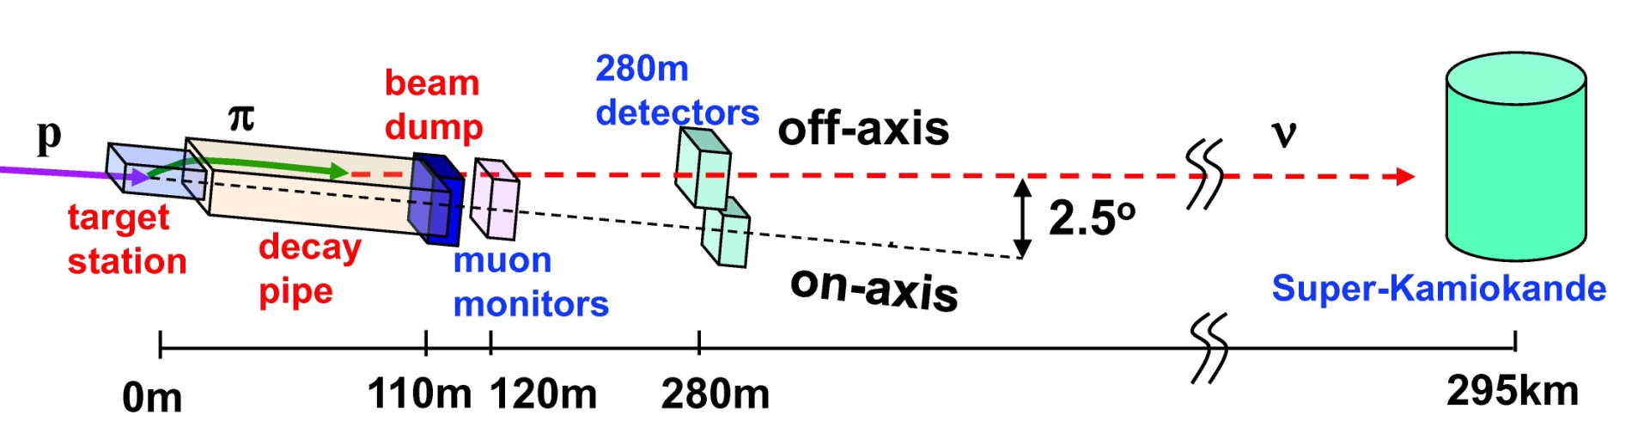

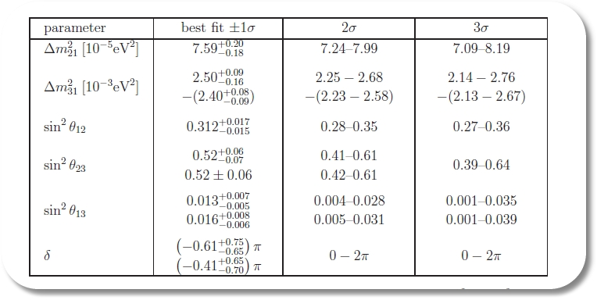
Current status: the third mixing angle
First indication of
θ₁₃  0 !
K. Abe et al. [T2K Collaboration], Phys. Rev. Lett. 107, 041801 (2011).
T2K + MINOS
P. Adamson et al. [MINOS Collaboration], arXiv:1108.0015.
H. D. Kerret, Double Chooz, LowNu11 (2011) Seoul.
Global fit:
T. Schwetz, M. Tortola and J. W. F. Valle, arXiv:1108.1376 [hep-ph]

Slide 5
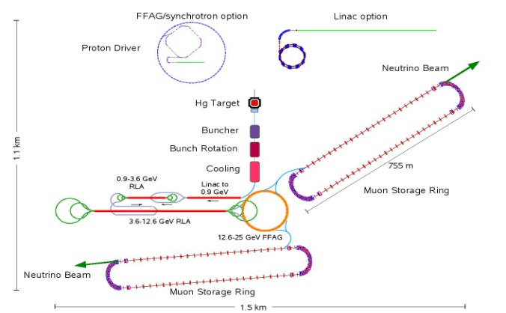
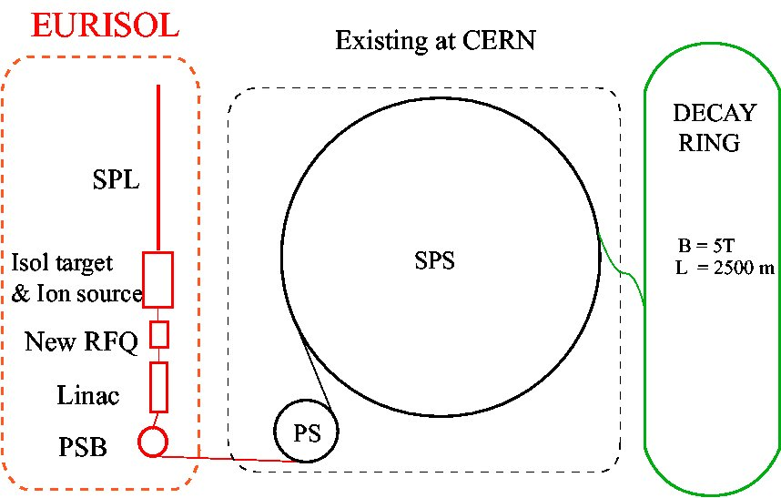
Third Generation Experiments:
CP Violation
European Strategy Plan demands for ~ 2012 a CDR with the alternatives:
SuperBeam: no pure Flavour, uncertain continuous Spectrum, High fluxes.
Neutrino Factory: pure Flavour iff detector with charge discrimination, known continuous Spectrum.
Beta Beam: pure Flavour, known continuous Spectrum.
EC Beam: pure Flavour, known single Monochromatic Beam.
Daedalus: Decay-at-rest experiment offering a new strategy for CPV search.
The size of θ13 will decide best future strategy to follow!

Slide 6
How to measure CP Violation ?
Observation of CP Violation in neutrino oscillations requires appearance experiments
CP Violation can be measured either by
Asymmetry between Neutrinos and Antineutrinos
P( ν_{µ} → ν_{e} ) vs P( ν_{µ} → ν_{e} )
Energy Dependence (CP phase
as a phase shift) in the Neutrino
channel.
or both …

Slide 7
Beta Beams

Slide 8
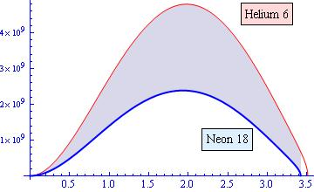
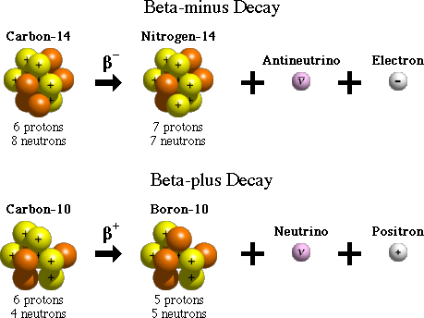

Neutrinos from β⁺/β⁻
β⁺ decay:
boost
β⁻ decay:
Forward direction
Neutrino Flux:
3 body decay
From the well-known β-decay neutrino spectrum,
we can get a pure beam by accelerating β-unstable ions.
P. Zucchelli, Phys.Lett.B532:166-172, 2002

Slide 9
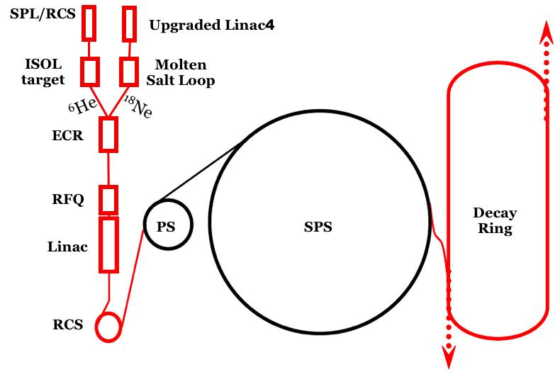
The Beta Beam Proposal:
Ions are produced and injected into the main accelerators
High energy radioactive ions are stored in DR
PS and SPS already
existing at CERN
Straight sections of DR
point to neutrino detectors
Design and performance: EURISOL (ended 2008), EUROnu (lasts until 2012)

Slide 10
Novel features of a β-Beam
Collimated ν-beams are produced from accelerated parent ions
The produced ν-flux is flavor pure
Two thirds of the methodology and facilities required are already existent at CERN
The intensity of the beam and its energy spectrum are well known theoretically
What is left is the collective ring and detector

Slide 11
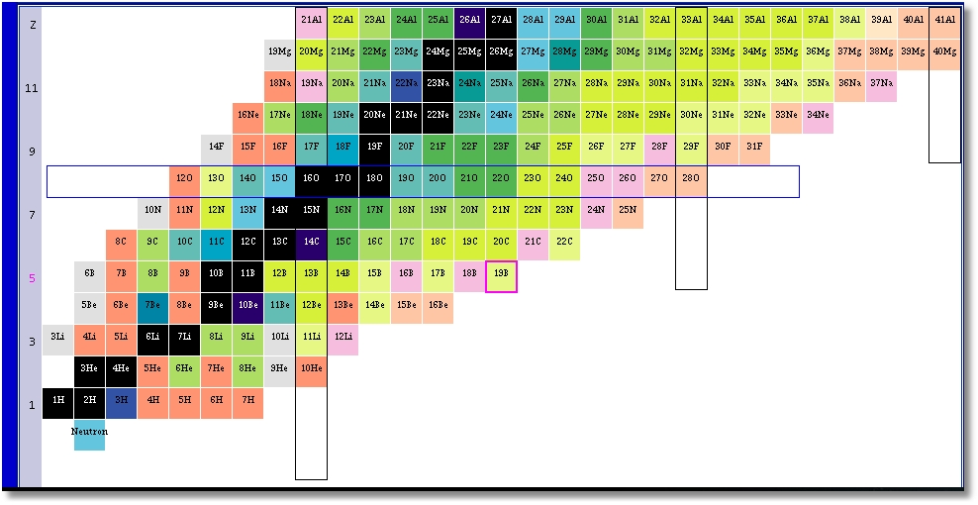
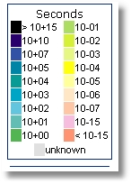
Isotope Characteristics:
The ideal beta beam isotopes should be sufficiently long-lived ions not to decay during the acceleration process and sufficiently short-lived to decay in the decay ring before it is lost due to the other process.
Low Q
decay
τ1/2[s]
6He
β+
1.67
Q[MeV]
18Ne
β-
0.81
3.51
3.0
Chart of Nuclides
High Q
decay
τ1/2[s]
8Li
β+
0.77
Q[MeV]
8B
β-
0.83
12.96
13.92

Slide 12


Several Proposals:
High-Q β-Beams
Higher ν-energy, better x-sections but longer baseline
Isotope production well known
Short baseline – higher flux
Low energy β-Beams
ν-nucleus x-sections
Sterile-active oscillations?
EURISOL (ended 2008)
EUROnu WP 4 (lasts until 2012)
Monochromatic Beams
Low-Q β-Beams

Slide 13
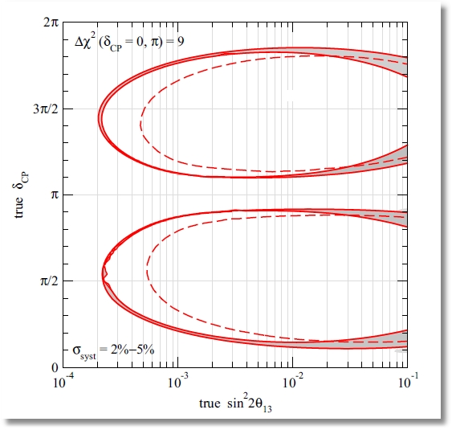
CPV Discovery Potential of BBs
10 years, useful decays ~10¹⁹
440 kton, γ = 100, L = 130 km
5ν + 5ν yrs Beta Beam
6He + 18Ne
5ν + 5ν yrs BB (# ions halved)
T2K 2.5σ sin²2θ > 0.03 (NH)
J.E. Campagne, M. Maltoni, M. Mezzetto, T. Schwetz JHEP 0704:003,2007

Slide 14
CP Violation without antineutrinos: Energy Dependence and
Monochromatic beams

Slide 15
A General Theorem
CP violation:
CPT invariance + CP violation = T non-invariance
No Absorptive part → Hermitian Hamiltonian →
CP odd = T odd =
is an odd function of time = L !
In vacuum neutrino oscillations for relativistic neutrinos
→ L/E dependence, so
CP-even (odd) terms in the appearance probability
→ Even (odd) functions of energy. Then ENERGY DEPENDENCE disentangles the CP-even and CP-odd terms

Slide 16
Interest of energy dependence in suppressed neutrino oscillations
CP violation accessible in suppressed appearance experiments.
Appearance probability:
|Ue3| gives the strength of P(ν_{e}→ν_{μ})
δ acts as a phase shift
δ gives the interference pattern: CP odd term is odd in E/L
This suggests the idea of using either a monochromatic neutrino beam to separate δ and |Ue3| by energy dependence with different boosts, or a combination of channels with different neutrino energies in the same boost
Notes:
→→

Slide 17
δ acts as a phase shift
Appearance probability amplitude as a function
of E / L for different CP phases

Slide 18
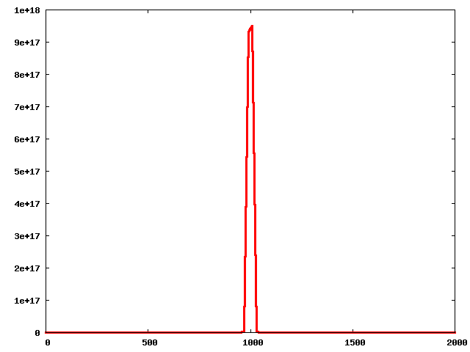
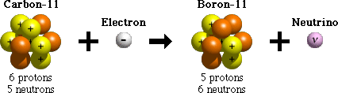
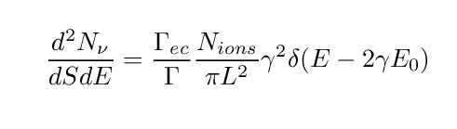
Neutrinos from Electron Capture
Electron capture:
boost
Forward direction
Z protons
N neutrons
Z-1 protons
N+1 neutrons
2 body decay !
In the CM , a single discrete energy
If a single final nuclear level is populated
Neutrino flux:
E_{ν}
From the single energy EC neutrino spectrum, we can get a pure and monochromatic beam by accelerating ec-unstable ions and choosing forward ν’s
→ One can concentrate all the intensity at the most appropriate energy for extracting the neutrino parameters
J. Bernabeu, et. al. JHEP 0512 (2005) 014

Slide 19
Implementation of EC Beams
A Facility with an EC channel would require a different approach to acceleration and storage of the ion beam compared to the standard
beta-beam, as the atomic electrons of the ions cannot be fully stripped
Partly charged ions have a short vacuum life-time against collisions.
The interesting isotopes have to have
half-life < vacuum half-life ~ few min.
For the rest, setup similar to that of a beta-beam:

Slide 20
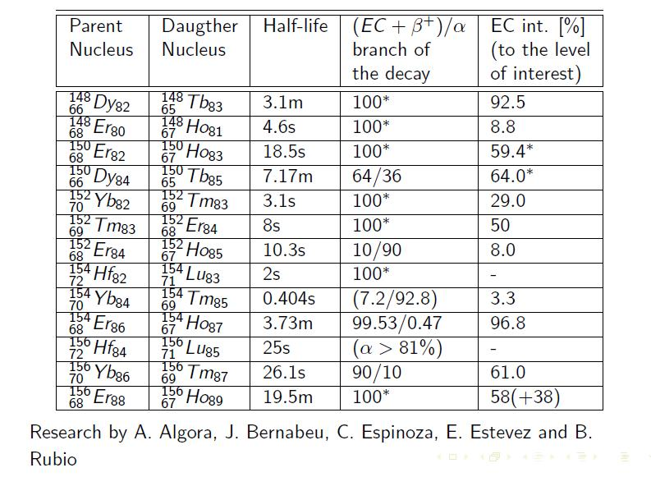
Isotopes with favourable decaying properties:
In proton rich nuclei (to restore the same orbital angular momentum
for protons and neutrons) → Superallowed Gamow-Teller transition
The “breakthrough” came thanks to the discovery of isotopes with small half-lives of one min or less, which decay in neutrino channels near 100% to a SINGLE Gamow-Teller resonance.
PhD Thesis E. Nacher, Valencia 05
Nuclear

Slide 21
Set-up for EC Beam
Combine two different energies for the same ion and baseline
10¹⁸ decaying ions/year
Appearance &
Disappearance
440 kton water ckov detector
Set up I (low energy, Frejus):
5 years γ = 90 (close to minimum energy to avoid background)
5 years γ = 195 (maximum achievable at present SPS)
Versus 10 years for one γ → the virtues of two energies
L = 130 km (CERN-Frejus)
Set up II (high energy, Canfranc):
5 years γ = 195 (maximum achievable at present SPS)
5 years γ = 440 (maximum achievable at upgraded SPS)
L = 650 km (CERN - Canfranc)

Slide 22
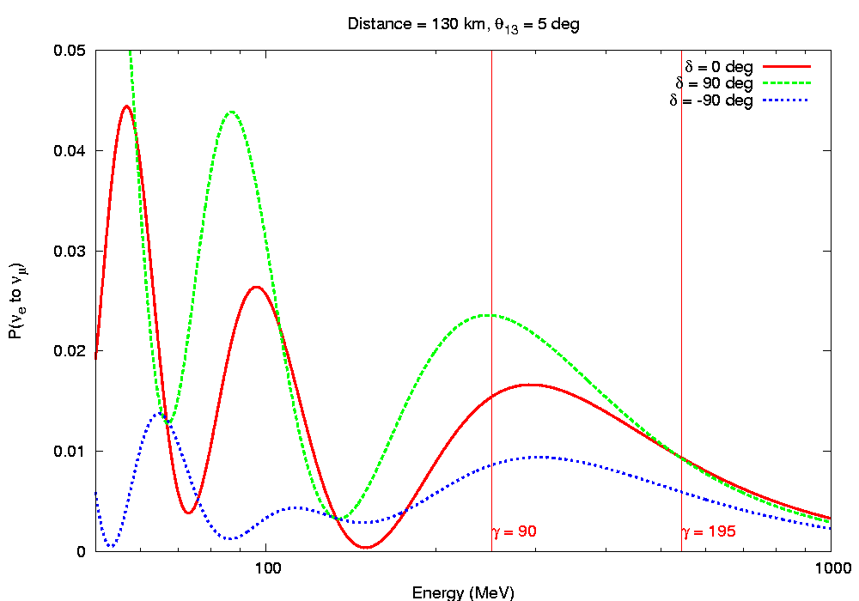
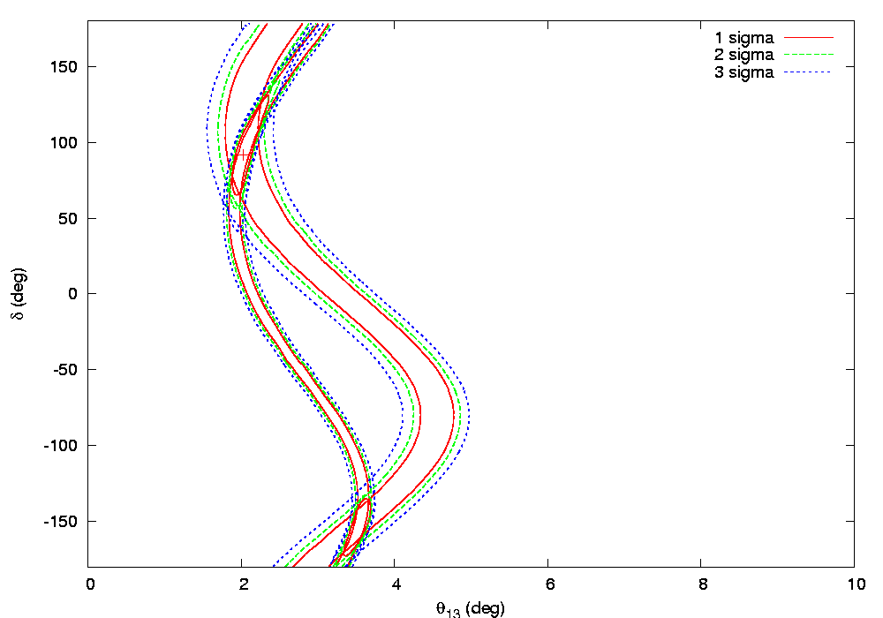
The virtues of combining two energies
Non-overlapping regions cancel
CERN-Frejus γ = 90
L=130 km
CERN-Frejus γ = 195

Slide 23
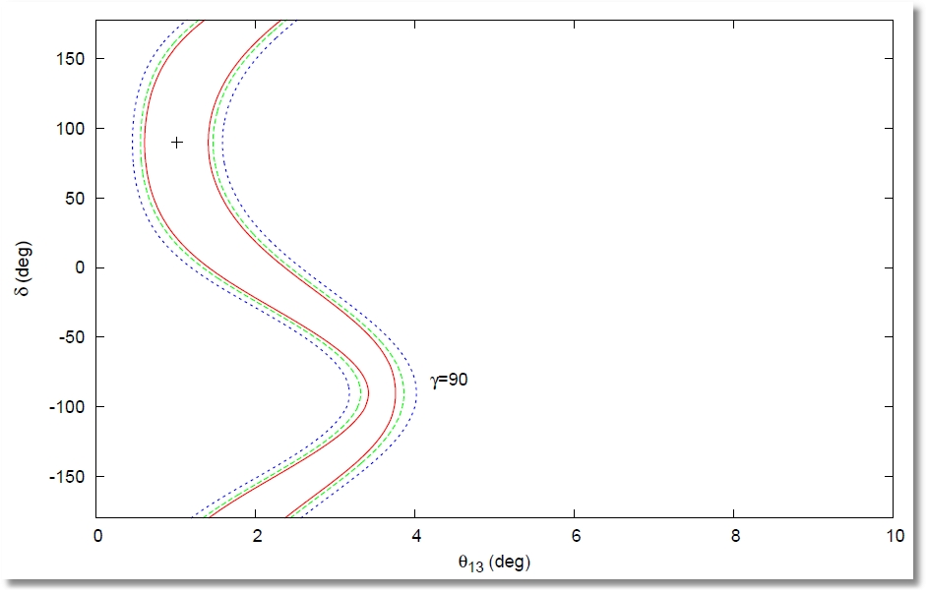
The virtues of two energies
CERN-Frejus γ = 90

Slide 24
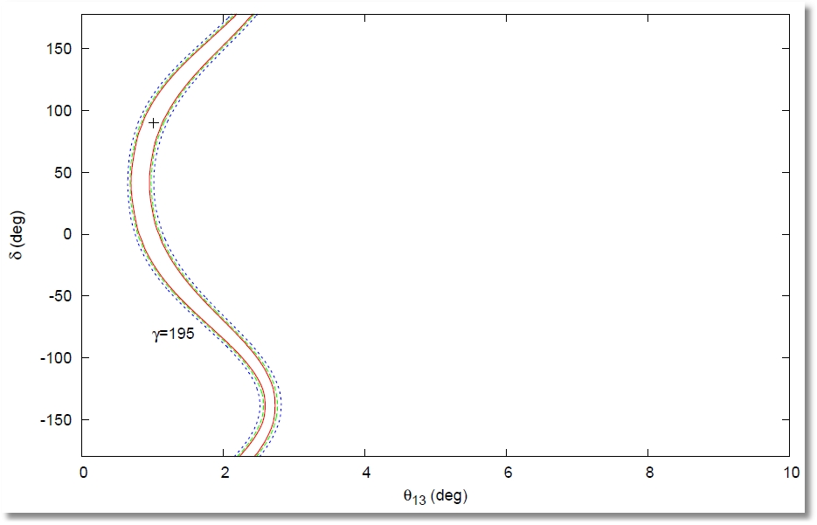
The virtues of two energies
CERN-Frejus γ = 195

Slide 25
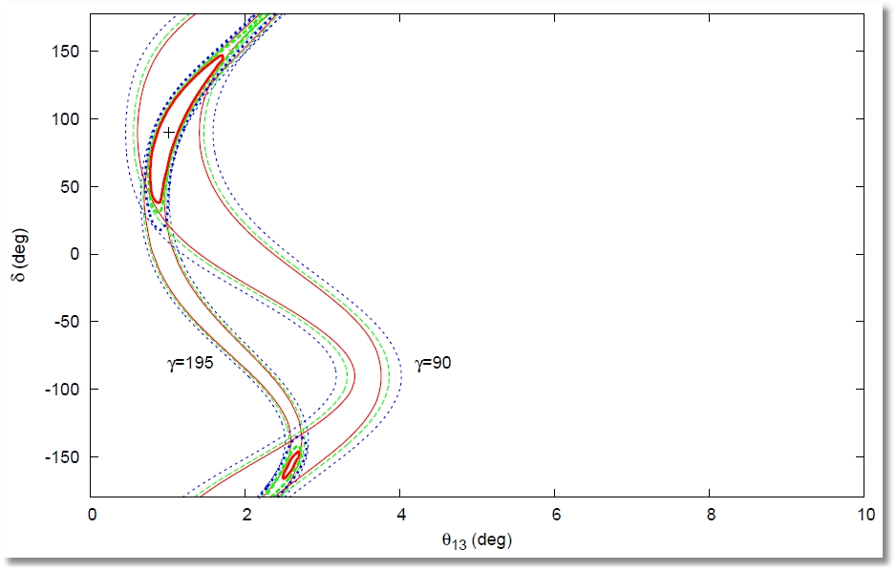
The virtues of two energies
Non-overlapping regions cancel

Slide 26
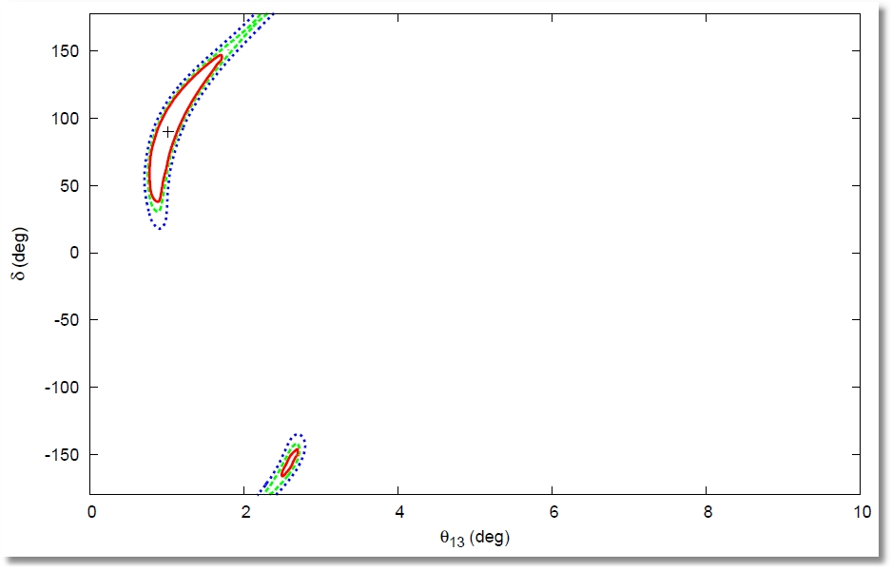
The virtues of two energies
Overall plot

Slide 27
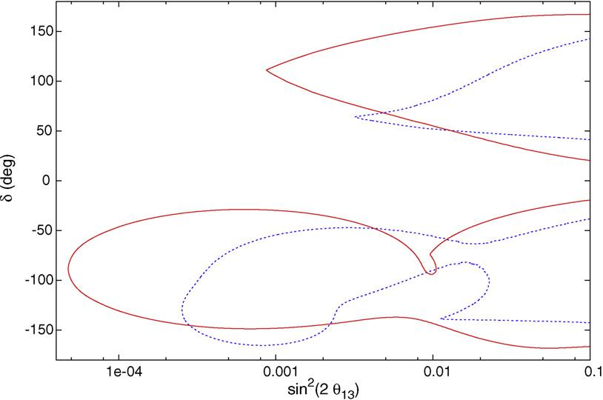
CPV Discovery Potential of EC Beams
CERN-Frejus γ = 90 + γ = 195
Maximum achievable at present SPS
CERN-Canfranc γ = 195 + γ = 440
Maximum achievable at upgraded SPS
T2K 2.5σ sin²2θ > 0.03 (NH)
J. Bernabeu, et. al. Phys.Lett.B664:285-290,2008.

Slide 28
A combined BB and EC experiment for the same ion

Slide 29
A combined Beta Beam and EC neutrino experiment ( )
Isotopes with favourable decaying properties:
J. Bernabeu, et. al. JHEP 0906:040,2009.

Slide 30
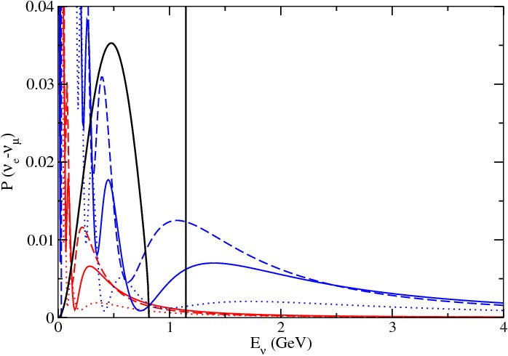
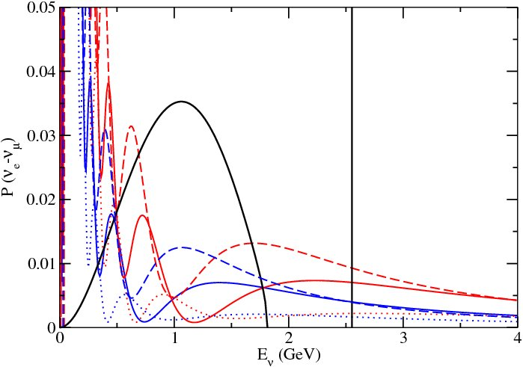
A combined beta-beam and EC neutrino experiment ( )
Suppressed appearance probabilities for the CERN-Frejus (130 Km, red line) and CERN- Gran Sasso o Canfranc (650 Km, blue line) baselines. The unoscillated neutrino flux is shown for γ=166
Suppressed appearance probabilities for the CERN-Gran Sasso o Canfranc (650 Km, blue line) and CERN-Boulby (1050 Km, red line) baselines. The unoscillated neutrino flux is shown for γ=369

Slide 31
Experimental Setups for the combined experiment
Appearance Experiment : Electron Neutrino Flux × Oscillation Probability to muon neutrinos × CC Cross Section for muon production.
Setups:
Boost γ=166 with current SPS
I: CERN-Frejus (130 Km)
II: CERN-Gran Sasso or Canfranc (650 Km)
Boost γ=369 with an upgraded SPS
III: and III-WC: CERN-Gran Sasso or Canfranc (650 Km)
IV: and IV-WC: CERN-Boulby (1050 Km)
Detectors:
LAr or TASD, 50 kton → Neutrino spectral information from CC muon events
Water Cerenkov, 0.5 Mton → Neutrino energy from QE events only + inelastic events
in a single bin, with 70% efficience
Number of decaying ions per year: 2 x 10¹⁸ → 10 years
The separation between the energy of the EC spike and the end point energy of the beta-spectrum is possible: if E_{ν}(QE) > 2γE_{o}(β),
since E_{ν}(true) > E_{ν}(QE), the event must be attributed to the EC flux and hence, it is not necessary to reconstruct the true energy

Slide 32
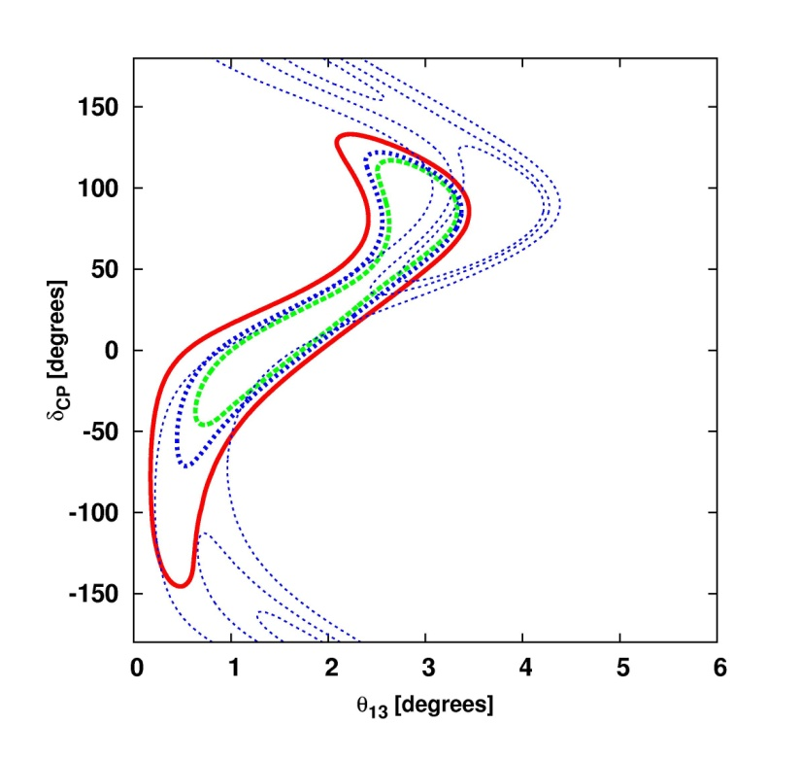
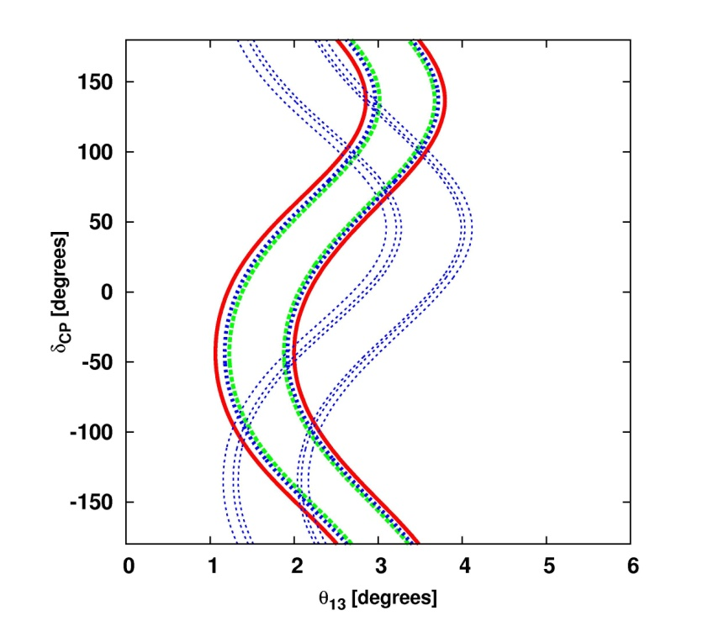
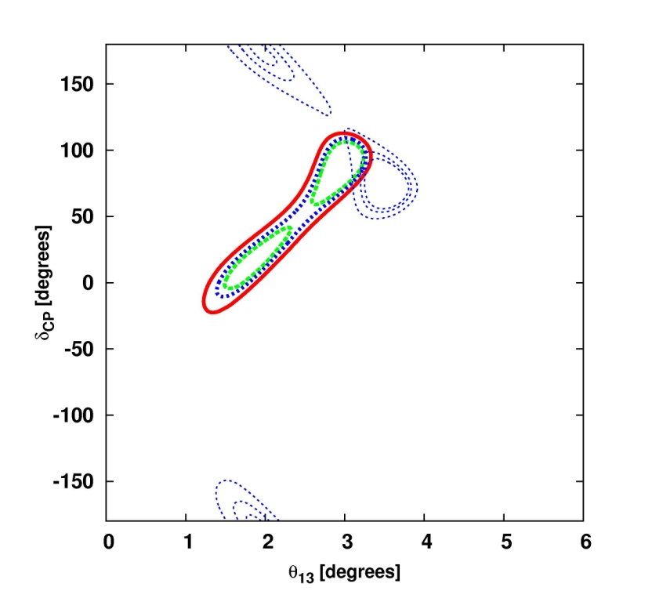
The virtues of combining energies from BB and EC
Sensitivity to θ₁₃ and δ (Setup III: Gran Sasso or Canfranc )
BB
EC
BB+EC
The power of the combination of the two channels is in the difference in phase and in amplitude between the two fake sinusoidal solutions, selecting a narrow allowed region in the parameter space

Slide 33
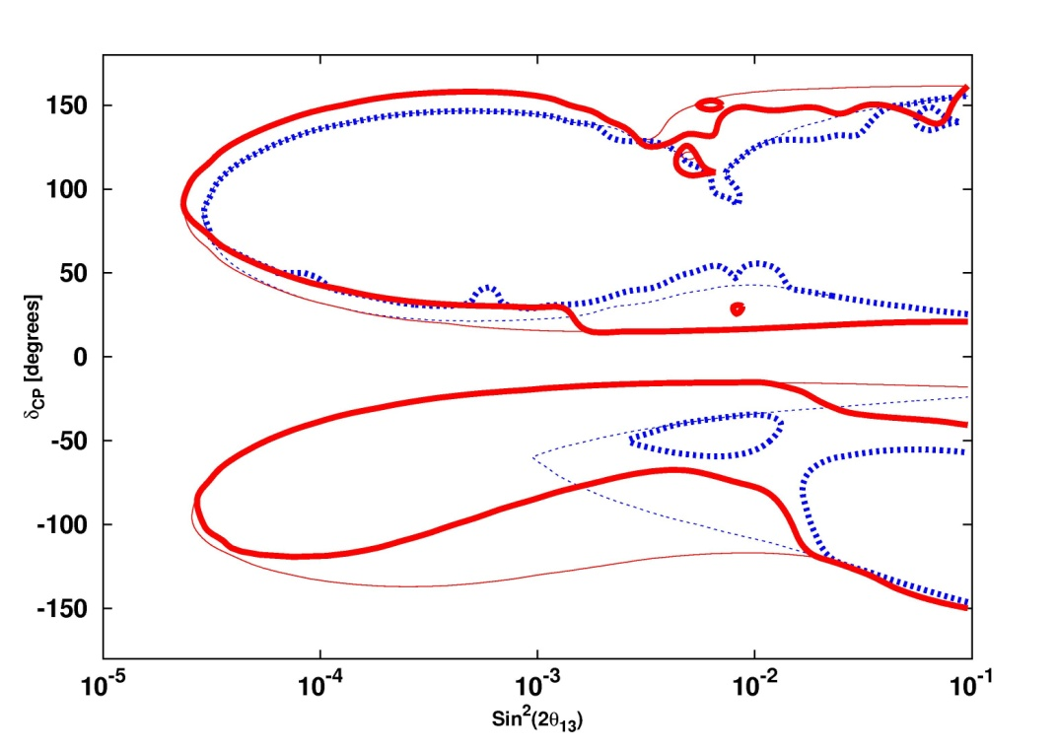
CP Discovery Potential for WC
Gran Sasso or Canfranc
The large detector improves the sensitivity to CP violation of the experiment.

Slide 34
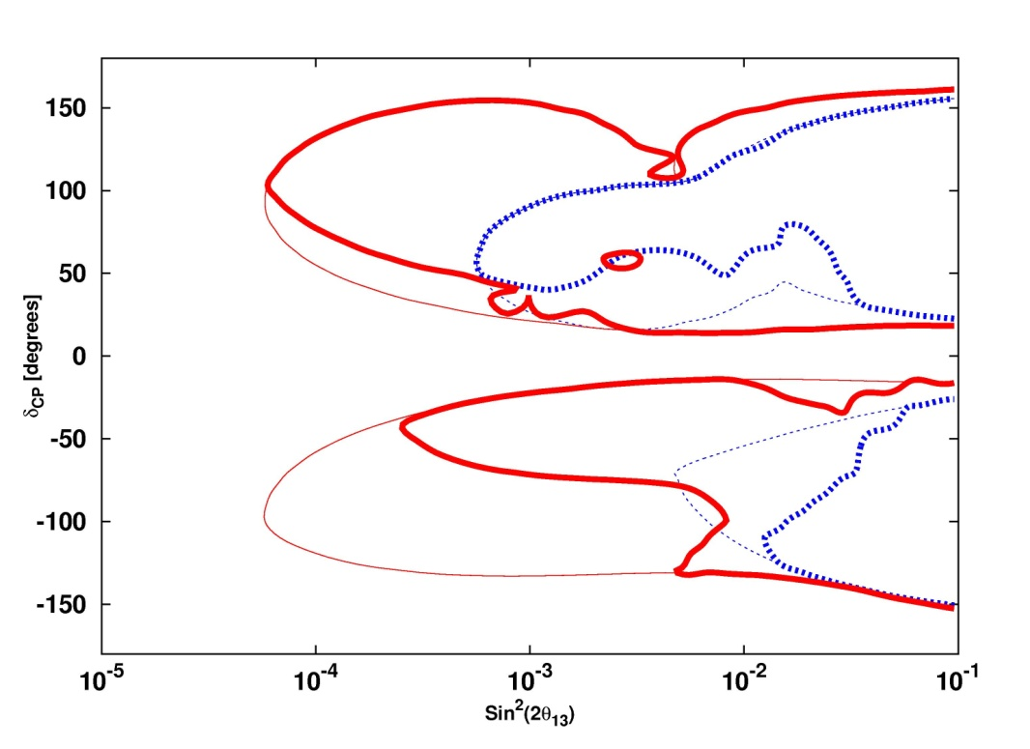
CP Discovery Potential for WC
Boulby
The CERN to Boulby baseline has stronger degenerate effects, but it also provides a better ability to resolve them…

Slide 35
Conclusions and Prospects
T2K and MINOS results are expected to be confirmed in the near future by current ongoing experiments (Double Chooz, Daya Bay …) which renders important to quantitatively study the discovery potential for leptonic CP violation of future facilities.
We have briefly described the CPV discovery potential of Beta Beams. For the T2K+MINOS 2.5 σ interval CP violation can be establish for ~70% of all values of δ.

Slide 36
Conclusions and Prospects
An era of exciting novel neutrino experiments is yet to come with the possible important discovery of a non-conservation of the CP symmetry in the leptonic sector.
We have shown the CPV discovery potential for Monochromatic Beams and their combination with standard β-Beams.
The combination β Beam + Monochromatic in general but in particular inside the T2K+MINOS σ interval shows less negative impact of the degeneracy associated to the mass hierarchy, relative to the performance of a standard Beta Beam with the same characteristics.

Slide 37
Thank you very much for
your attention…

