Slide 1
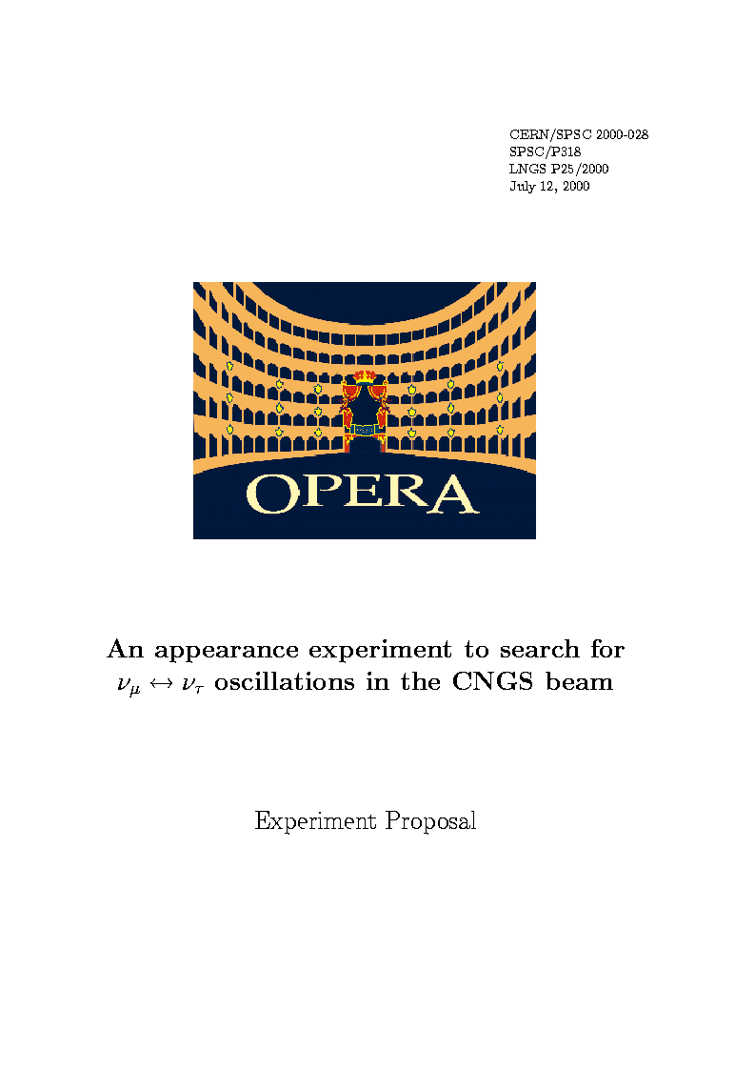
Status and oscillation results of the OPERA experiment
Florian Brunet
LAPP - Annecy
GDR neutrino 29/11/2011

Slide 2
Outline
Goal & principle of the OPERA experiment
Description of the OPERA detector
Status of OPERA
Oscillation results

Slide 3
Outline
Goal & principle of the OPERA experiment
Description of OPERA detector
Status of OPERA
Oscillation results

Slide 4
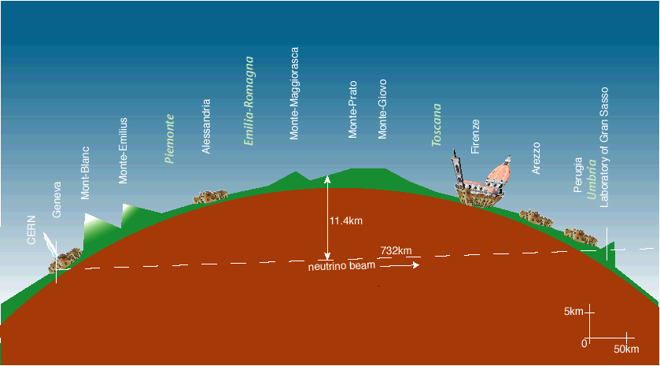
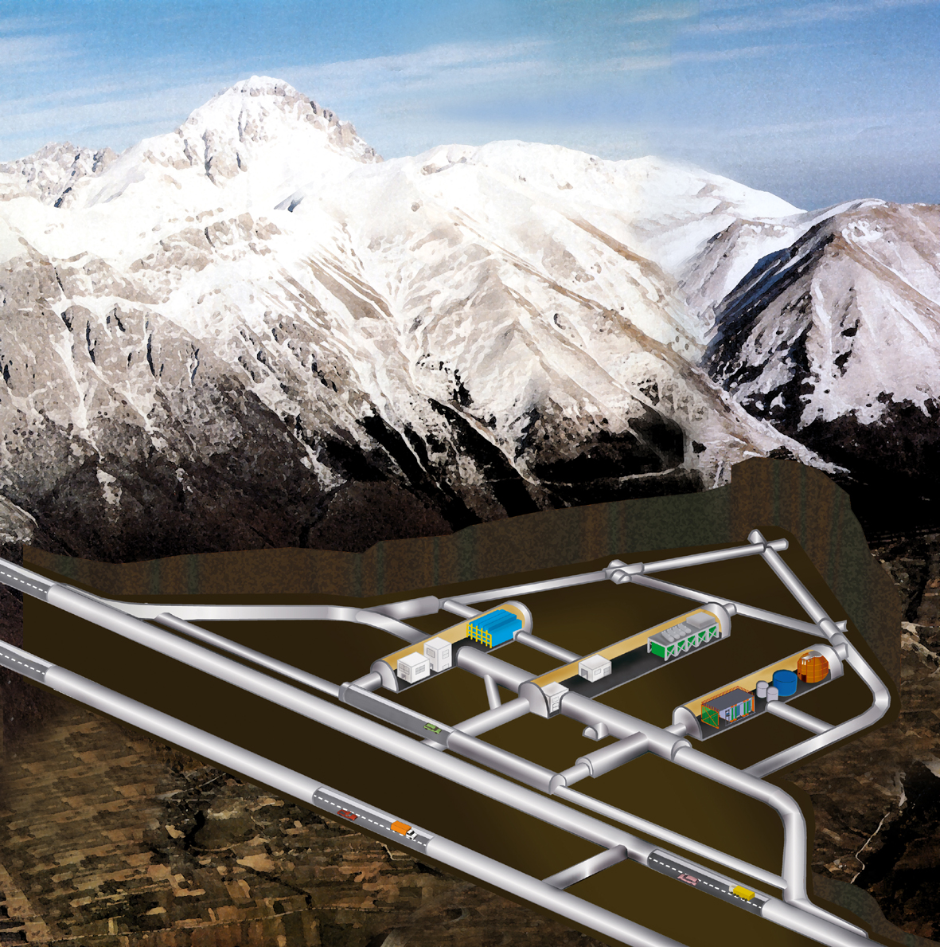
OPERA: first direct detection of neutrino oscillations in appearance mode
Super- Kamiokande → oscillations with atmospheric neutrinos
confirmed with solar neutrinos
➔ the direct observation of the oscillation appearance with accelerator beams is still missing
The PMNS 3-flavor oscillation formalism predicts:
OPERA requires :
long baseline, 2) high neutrino energy, 3) high beam intensity
4) detect short lived τ’s
P(ν_{μ}→ν_{τ}) ~ sin²2θ₂₃cos⁴θ₁₃sin²(Δm²₂₃L/4E)
LNGS under 1400m of rock
CNGS
L = 730 km
OPERA

Slide 5

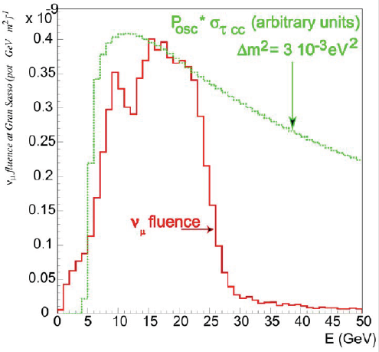
CNGS ντ appearance potential
The beam is optimized for ν_{τ} appearance in the atmospheric oscillation region. The present best fit is now:
Δm₂₃² = (2.43±0.13)×10⁻³ eV²
Although the maximum of oscillation probability at 730 km is at about 1.5 GeV, the ν_{τ} CC cross section and the production threshold of 3.5 GeV should be taken into account
<Eν_{μ}> | 17 Gev
(ν_{e} +‾ν_{e})/ ν_{μ} | 0.87%
‾ν _{μ} / ν_{μ} | 4 %
ντ prompt | negligible
Total p.o.t | 22.5x 10¹⁹
ν_{μ} CC + NC | ~23600
ν_{e} +‾ν_{e} CC | ~160
ντ | ~115

Slide 6


Detection principle
τ⁻
e⁻, μ⁻, h⁻
τ → e (17.9%)
τ → μ (17.4%)
τ → h (49.2%)
ν_{τ}
τ⁻
3h⁻
ν_{τ}
τ → 3h (15.2%)
The detection of the τ lepton requires an identification of a “kink” or “trident” topology
The detector must fulfil the following requests:
1. Large mass due to small CC cross section (lead target)
2. Micrometric and milliradian resolution to observe the kink (photographic emulsions)
3. Trigger & Select neutrino interactions (electronic detectors)
4. Identify muons and their charge to reduce charm background (precision tracker and spectrometer)
➔ OPERA: hybrid detector (emulsions + electronic detectors)

Slide 7
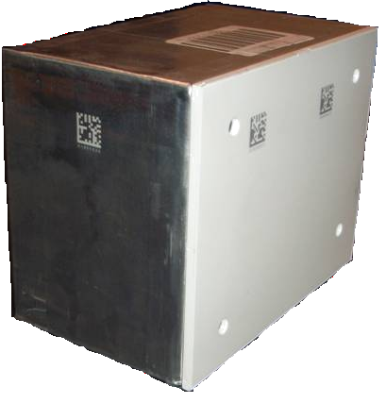
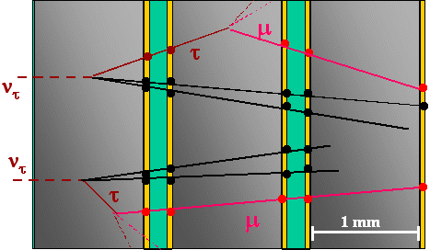
τ identification
The target about 150 000 ECC's (Emulsion Cloud Chamber), so called “bricks” (weight = 8.3 kg)
One brick is made by a sandwich of:
56 (1mm) Pb sheets
57 (300μm) emulsion layers
2 (300μm) Changeable Sheets
ν
10.3 cm
7.5 cm = 10 X₀
12.8 cm
Main background sources:
Production and decay of charmed particles
Hadron reinteractions
Large angle muon scattering
Long
decay
Signal
Example of Background
ν_{μ} CC+ charm production
μ, e, hadron
ν_{τ} CC
τ
ν_{μ}
Short
decay
charm
muon misidentified
μ

Slide 8
Outline
Goal & principle of the OPERA experiment
Description of OPERA detector
Status of OPERA
Oscillation results

Slide 9

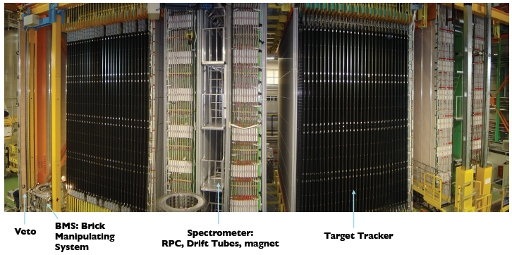
THE IMPLEMENTATION OF THE PRINCIPLE
22 RPC planes + 6 Drift Tubes planes
Magnetic field (1.5 T)
27 brick walls alternated with
scintillator planes
mip : detection efficiency of ~ 99%.
Extract 25-50 bricks per day

Slide 10
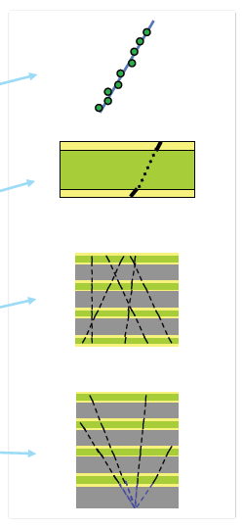
OPERA : A HYBRID DETECTOR (ELECTRONIC + EMULSIONS)
Hybrid target structure.
Trigger on event “on time” with CNGS and selection of the brick using electronic detectors information
Brick extracted by BMS
Electronic tracks validated with CS
Brick is sent to one of 12 scanning labs in Europe and Japan.
(CS)
microtracks
basetracks
tracks
vertices
Scanning : determine the topology of the event to possibly find a kink

Slide 11
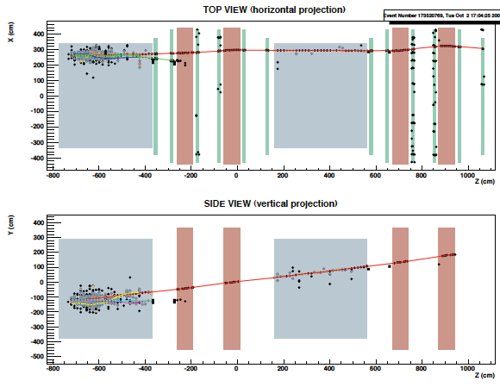
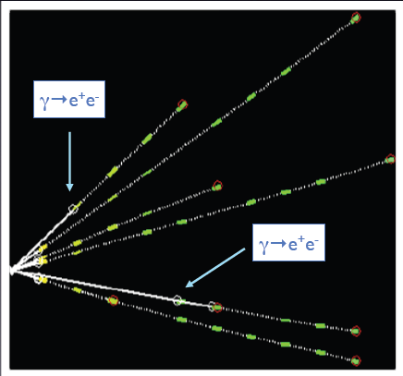
OPERA data : an example of ν_{μ} CC interaction
Reconstruction in electronic detectors
Reconstruction in emulsions

Slide 12
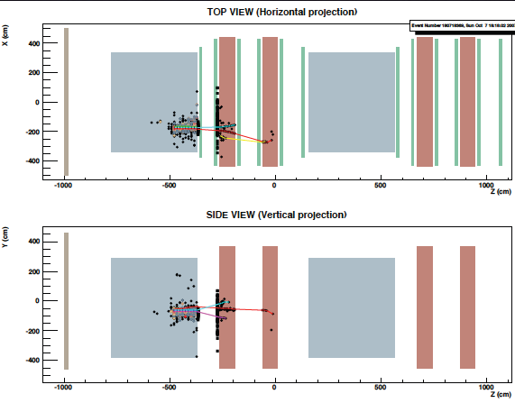
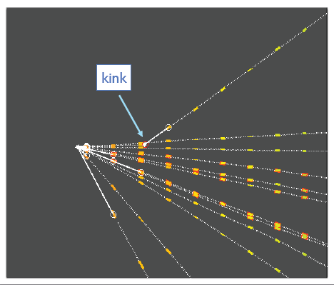
OPERA data : an example of ν_{μ} CC interaction : charm event
Reconstruction in electronic detectors
Reconstruction in emulsions

Slide 13
Outline
Goal & principle of the OPERA experiment
Description of OPERA detector
Status of OPERA
Oscillation results

Slide 14
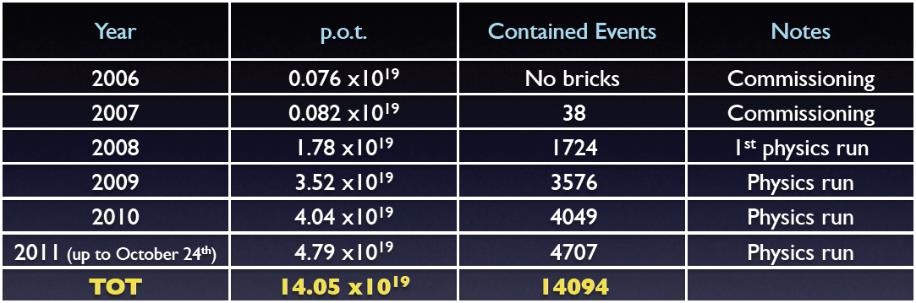

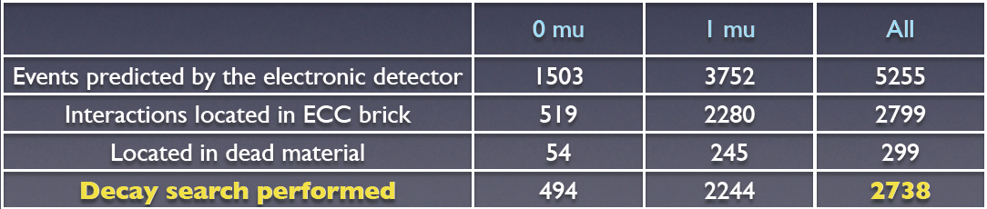
Data taking
We collected a large sample of events and high intensity run is expected in 2012.
The analysis of 2008 and 2009 data is complete (arXiv:1107.2594).

Slide 15
Outline
Goal & principle of the OPERA experiment
Description of OPERA detector
Status of OPERA
Oscillation results

Slide 16
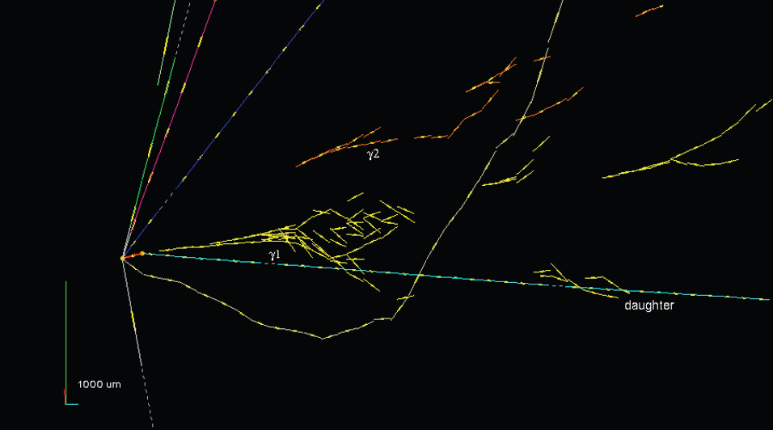
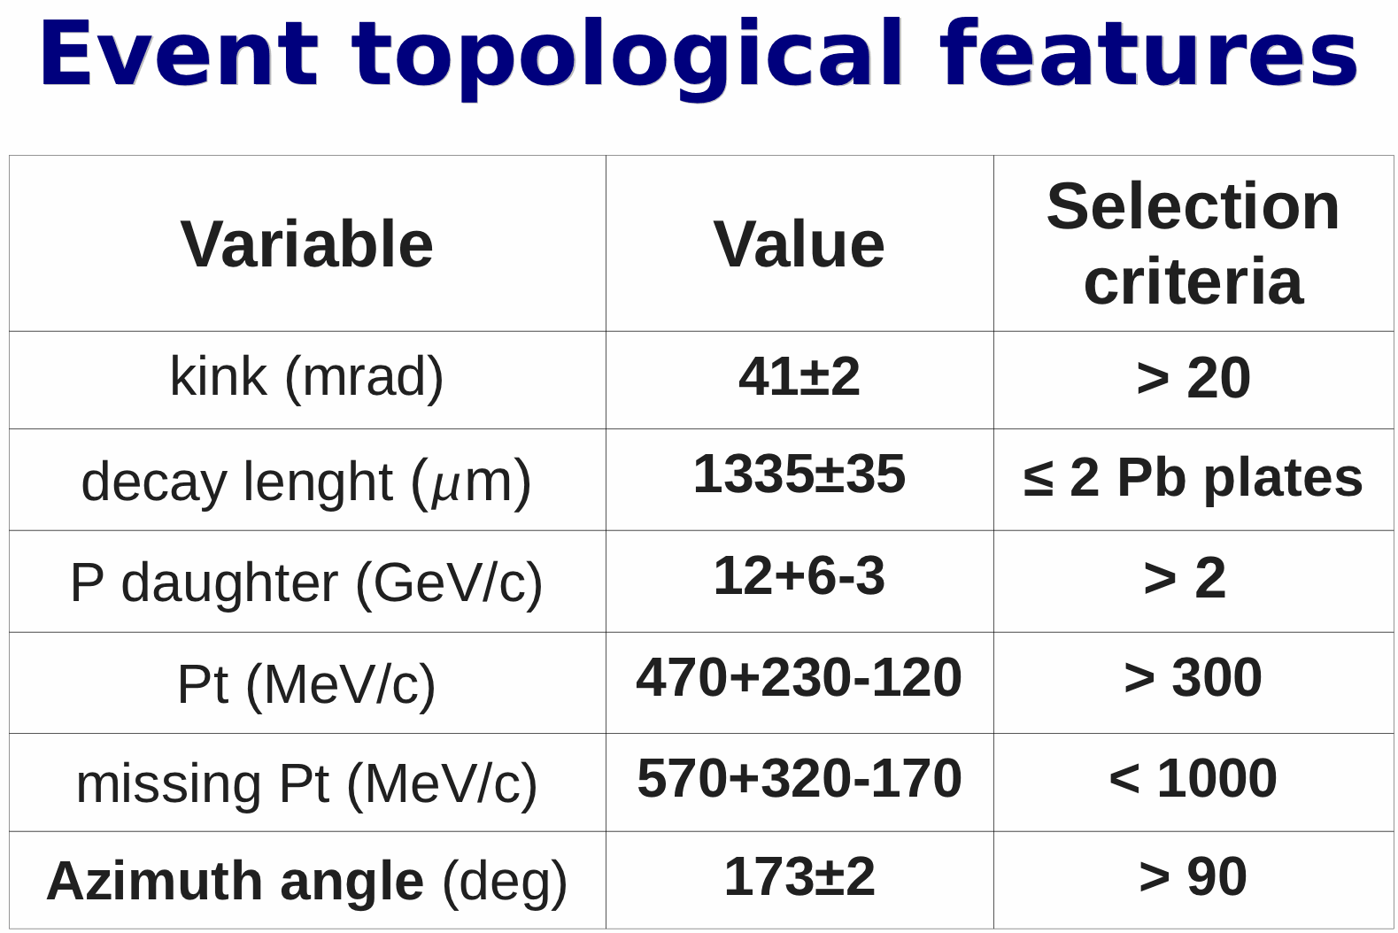
ν_{τ} Oscillation signal
• In the 2008-2009 data we found a ν_{τ} candidate (Phys. Lett. B 691 (2010) 138 ).
Background estimation improvements
Reduction by the systematical tracks follow down for the candidate events to improve
the muon identification
Evaluation of the hadronic reinteraction using MC simulations. (MC validated by
analysing pion test beam data & 14m of hadron tracks in OPERA data)

Slide 17
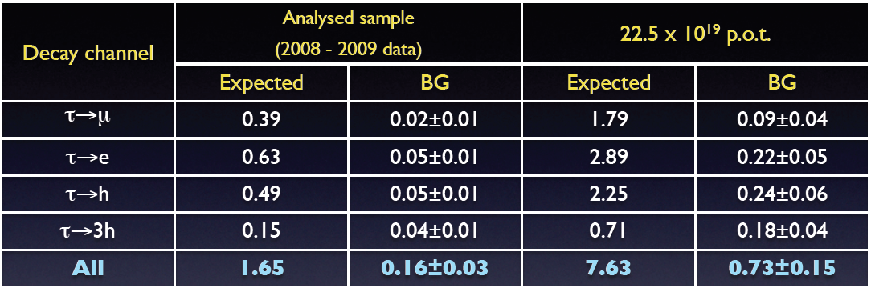
Significance of this result
• In the analyzed sample one ν_{τ} observed in the τ → h channel compatible with the expectation
of 1.65 signal events.
The statistical significance of the observation (i.e. the probability of not being a
fluctuation of the background) is 95%.

Slide 18
Another oscillation study : ν_{μ}→ν_{e} channel
Physics motivation
Signal ν_{μ} ↔ ν_{e} : ν_{e}^{CC} interaction → e + hadronic shower
Background : processes which contain electrons
  ν_{e} beam: ν_{e}^{CC} interaction → e + hadronic shower
  ν_{τ}^{CC} interaction → τ + hadronic shower & τ→eνν
  ν_{μ} beam : ν_{μ}^{NC} interaction → ν + hadronic shower with π⁰ & π⁰ →γγ
  ν_{μ} beam : ν_{μ}^{CC} interaction → μ missed → ν_{μ}^{NC} interaction
We have developed a dedicated strategy for ν_{e} search to increase
the detection efficiency by using information in the emulsion as
well as in the CS
We have detected 14 ν_{e} CC interactions in the 2008-2009
analyzed sample.

Slide 19
ν_{e} study : electromagnetic shower reconstruction
An energy estimation of electromagnetic showers is available by
using OPERA bricks as a calorimeter and that needs the following
studies :
  systematic errors estimation
  calibration with OPERA bricks exposed to an electron beam at
  CERN (4GeV & 2 GeV, 100mrd angle)
  due to relative small size of bricks, an extended shower
  reconstruction with one adjacent or downstream brick to
  achieve a better estimation of the energy
  efficiency estimation
Notes:
Mention that is my personal work

Slide 20
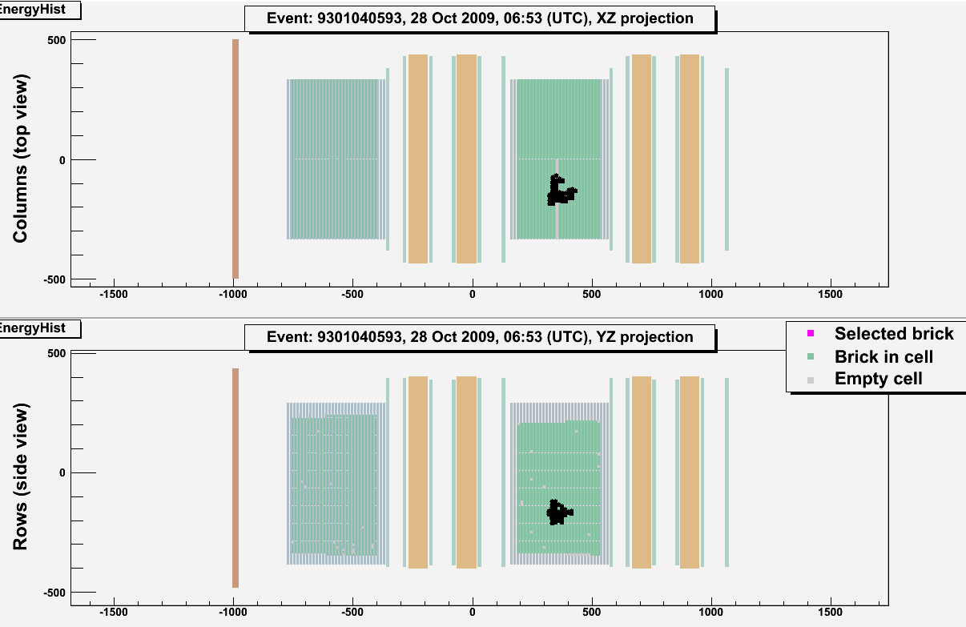
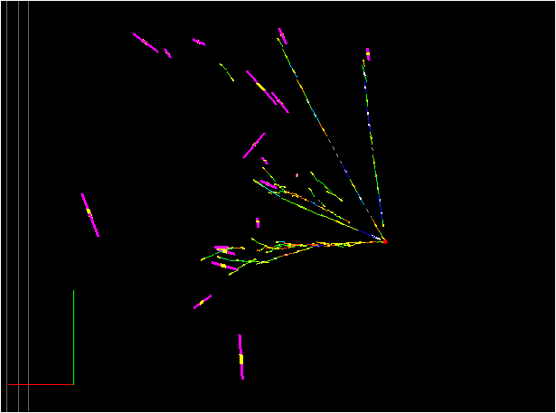
OPERA data : an example of ν_{e} CC interaction
Reconstruction in electronic detectors
Reconstruction in emulsions
Electron energy = 7.4 ± 1.5 GeV

Slide 21
Summary
• The OPERA detector has been taking physics data successfully since 2008.
• The electronic detector response is well understood and the agreement between
data and simulation is quite good.
• 2008 and 2009 data analysis is finished and one ν_{τ} candidate has been observed
and 14 ν_{e} CC interactions.
• We have already collected data to increase the statistics by a factor of 2.7: the
vertex location is being performed on the 2010 data and on the 2011 data.
• The τ search goes on and we hope to have more candidates soon.
• In parallel a specific search for ν_{e} candidates is on-going, since OPERA could
contribute to the numu-nue oscillation study.
• In addition OPERA has measured the neutrino velocity (see talk by G. Brunetti &
arXiv:1109.4897 )

