Slide 1

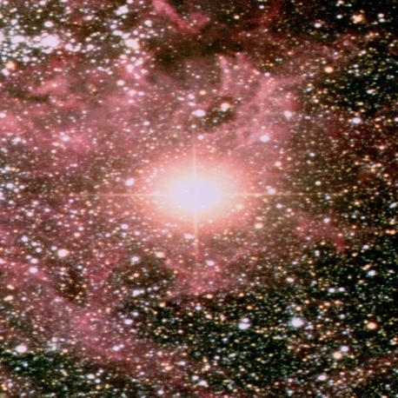
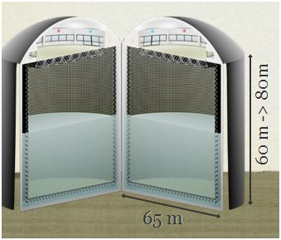


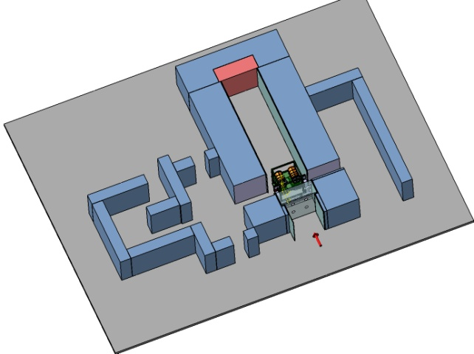
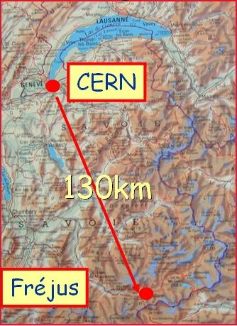
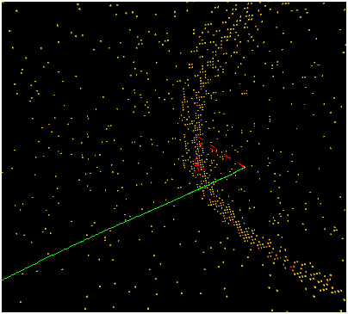
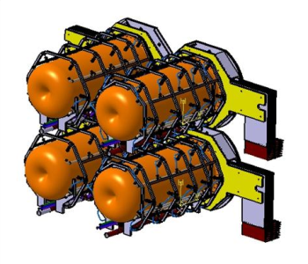
SPL Super Beam and MEMPHYS detector simulations
Nikolas Vassilopoulos, IPHC/CNRS, Strasbourg

Slide 2
Talk layout
Super Beam
Target Studies
Horn shape & SuperBeam Geometrical Optimization
Horn Thermo-mechanical Studies
Energy Deposition, Irradiation and Safety Studies
MEMPHYS
Light collection
Reconstruction of the interaction vertex coordinates and particle direction
Ring counting
Particle identification
Lepton momentum reconstruction, from the total charge on the PMTs.
Neutrino energy reconstruction

Slide 3
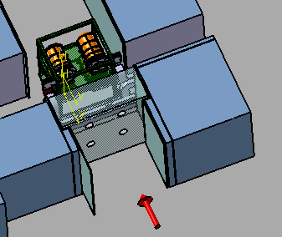
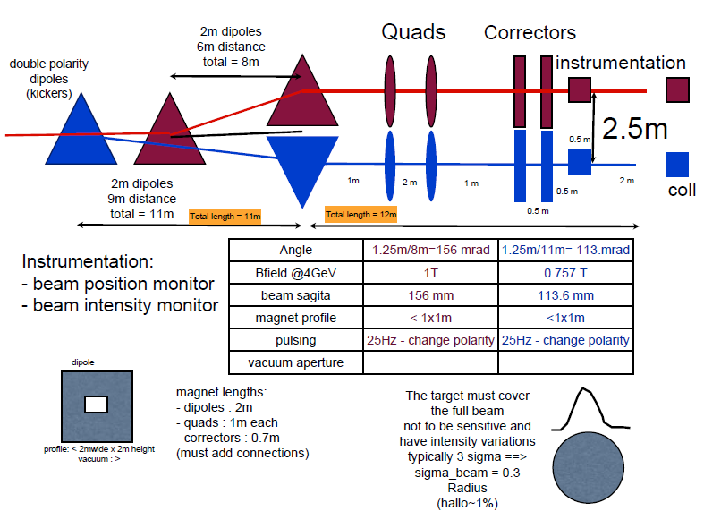

Proton Beam and Target/Horn Station
E_{b} = 4.5 GeV
Beam Power = 4MW -> 4x1-1.3MW
Repetition Rate = 50Hz -> 12.5Hz
Protons per pulse = 1.1 x 10¹⁴
Pulse duration = 0.72 μs
4-horn/target system in order to accommodate the 4MW
power @ 1-1.3MW, repetition rate @ 12.5Hz for each target
Ilias Efthymiopoulos/CERN

Slide 4
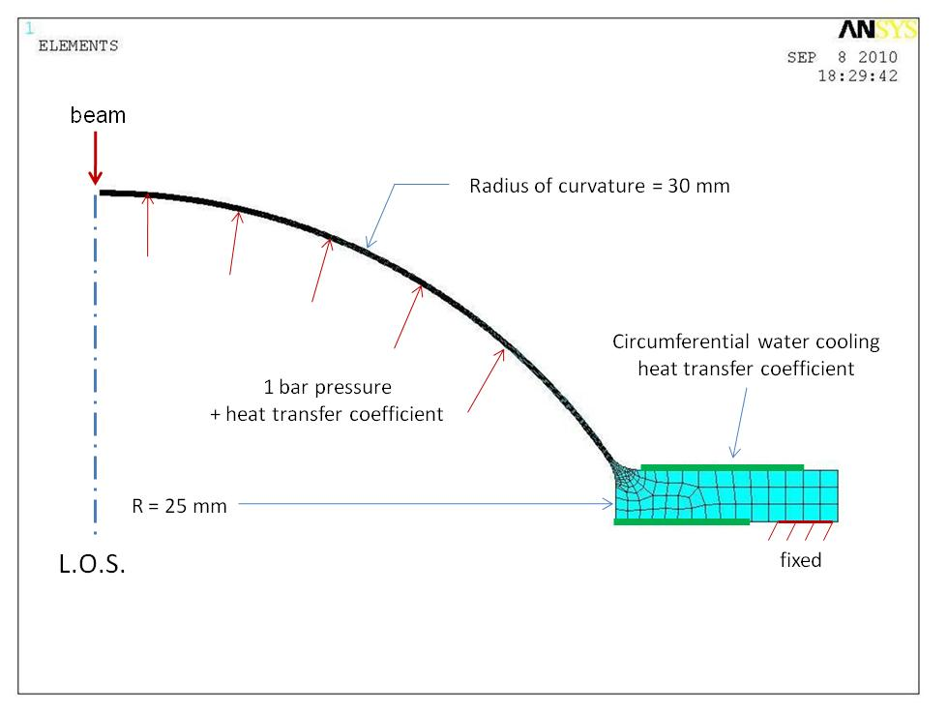
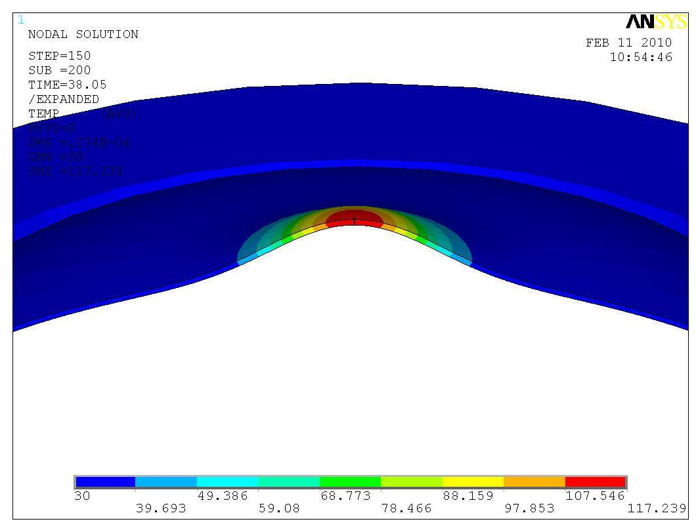
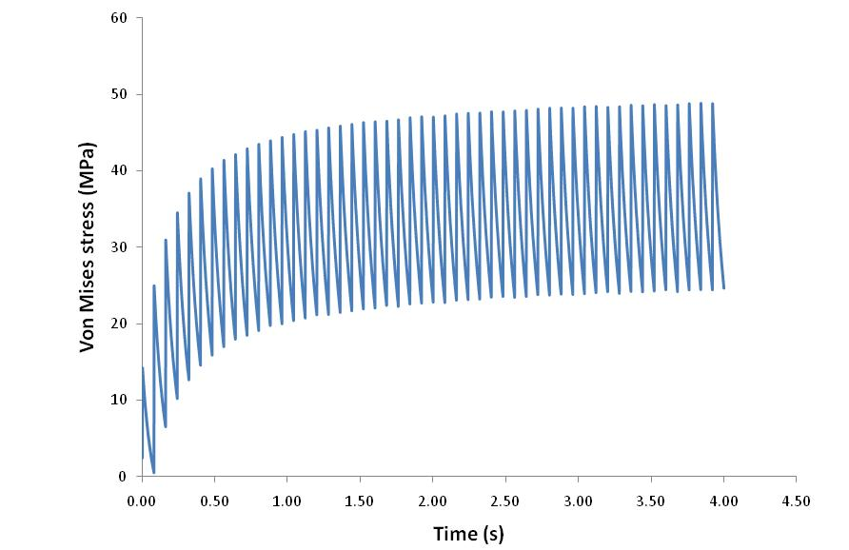
beam window
0.25 mm thick beryllium window
Circumferentially water cooled (assumes 2000 W/m²K)
Max temp ~ 180 °C Max stress ~ 50 MPa
(109ºC and 39 MPa using He cooling)
feasible
Matt Rooney/RAL

Slide 5
Important Issues for the engineering of the target
Heat Removal
  Beam ≈ 60 – 120kW depending on Target Material/configuration
Thermal/mechanical stresses
  long lived “quasi-static” stresses that generated by temperature variations within the target
  inertial dynamic stress waves that are generated by the pulsed nature of the beam
Cooling
  water
  helium
  peripheral vs transversal cooling
Neutron Production – heat load/damage of horn
Safety
Radiation resistance, Reliability, Pion yield
Chris Densham et al. @ RAL

Slide 6
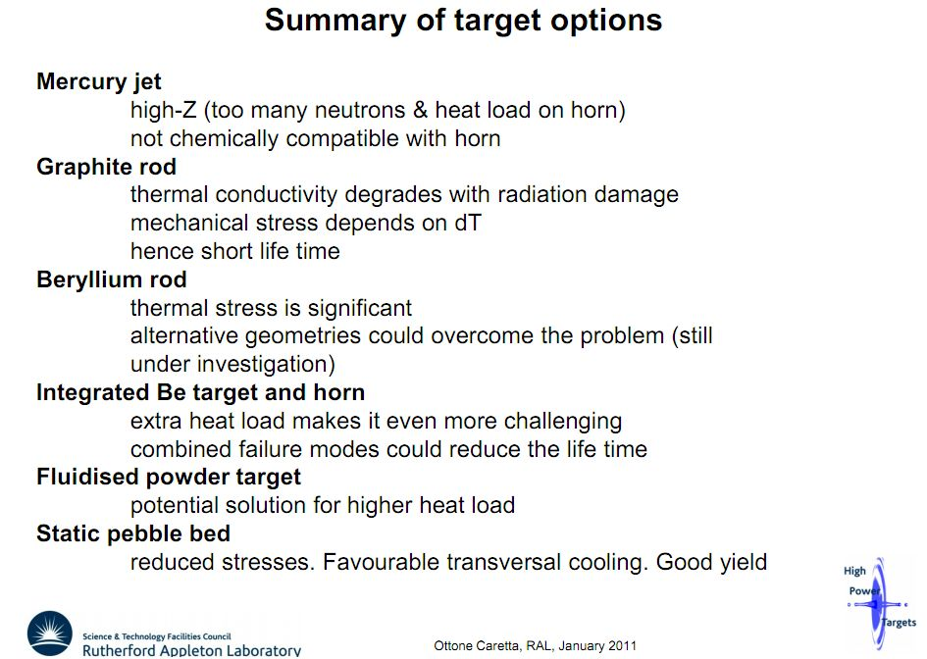
from Liquid Targets to Static Packed one
EUROnu-WP2-note-11-01
favourable baseline for WP2

Slide 7
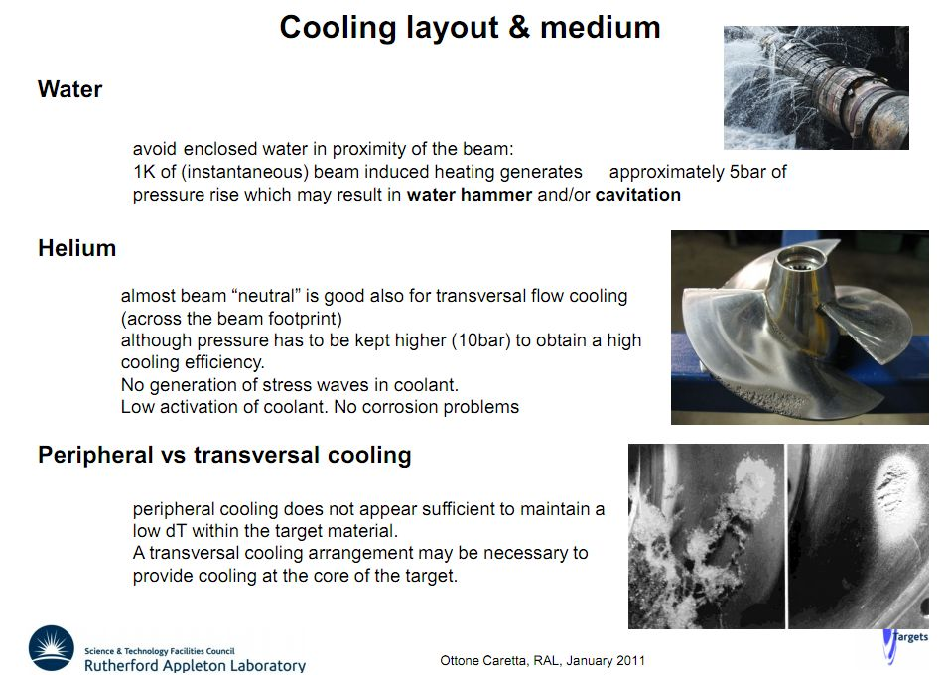
favourable methods

Slide 8
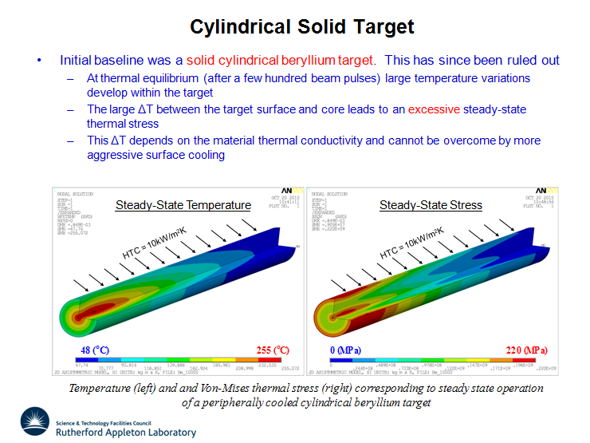
with peripheral cooling
ruled out
Ottone Caretta/RAL

Slide 9
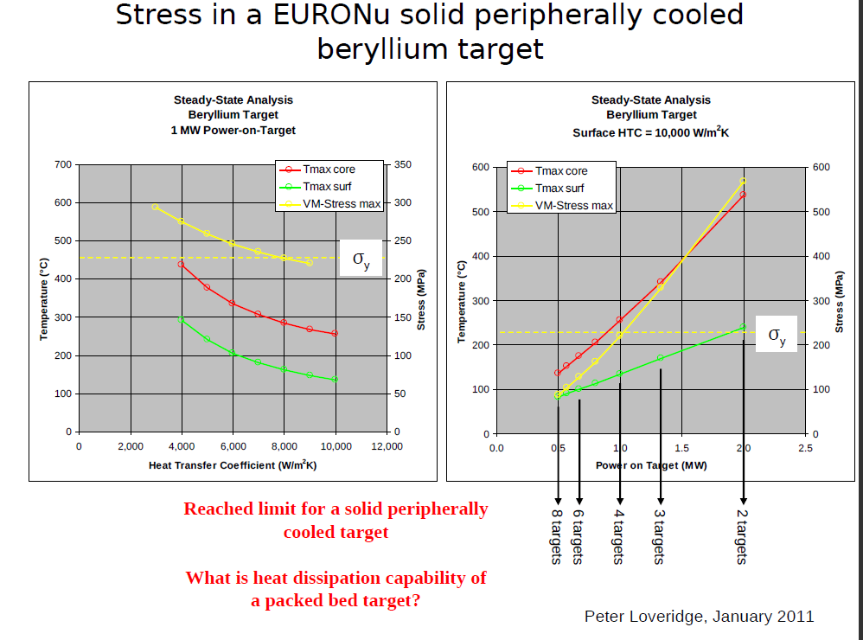

Slide 10
Packed bed Target
Why packed bed target with transversal cooling is the baseline option ?
  Large surface area for heat transfer
  Coolant able to access areas with highest energy deposition
  Minimal stresses
  Potential heat removal rates at the hundreds of kW level
  Pressurised cooling gas required at high power levels
  Bulk density lower than solid density
  From a thermal and engineering point of view seems a reasonable concept where stress levels in a traditional solid target design look concerningly high

Slide 11
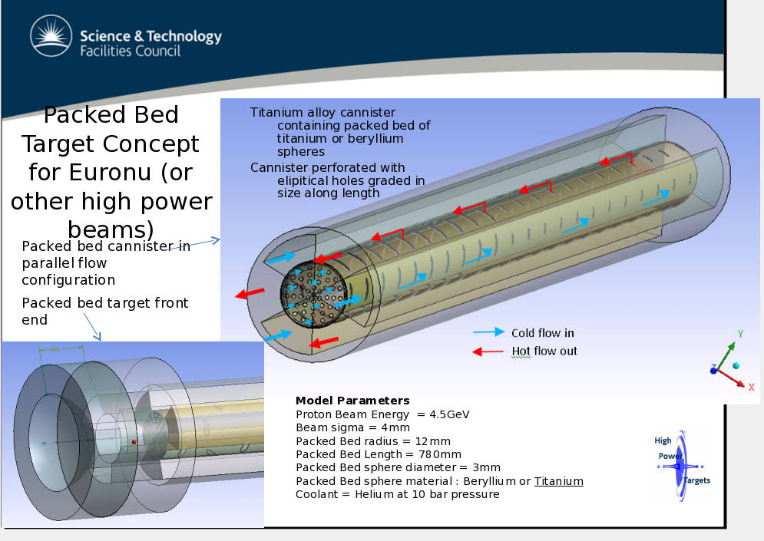
Tristan Davenne/RAL

Slide 12
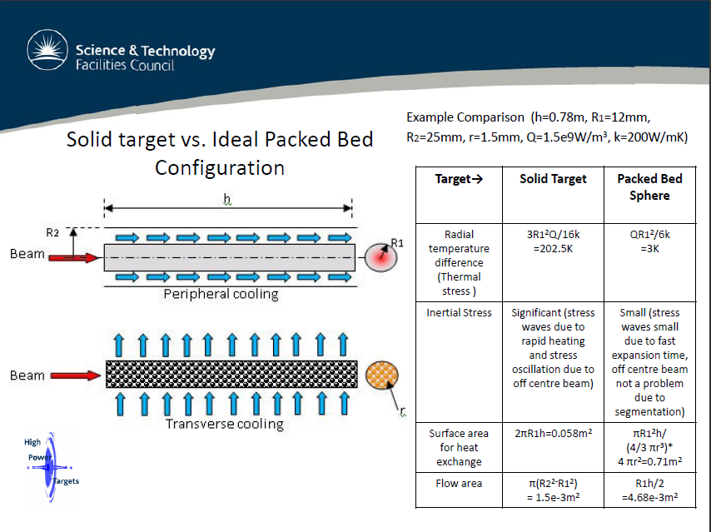
Tristan Davenne/RAL

Slide 13
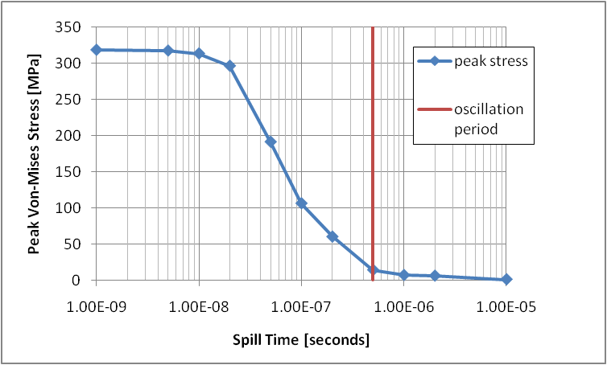
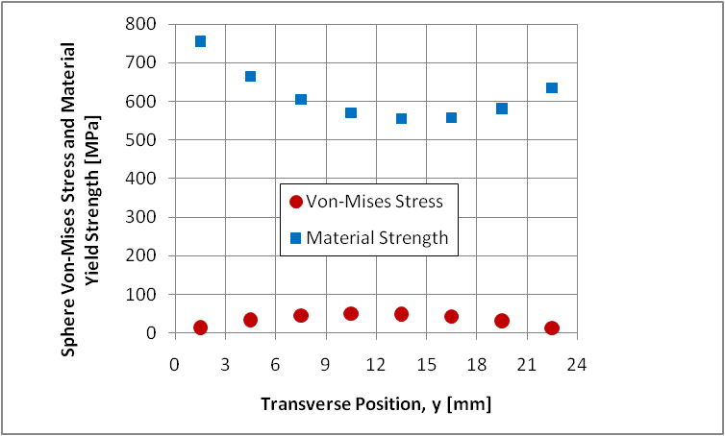
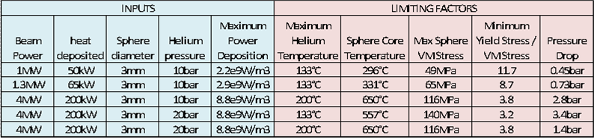
Stresses for the Packed bed target
EUROnu example, 24mm diameter cannister packed with 3mm Ti6Al4V spheres
Quasi thermal and Inertial dynamic components
ideally spill time > oscillation period
Tristan Davenne/RAL

Slide 14
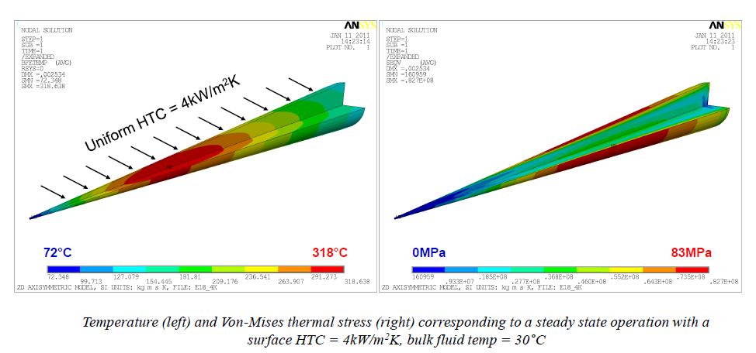
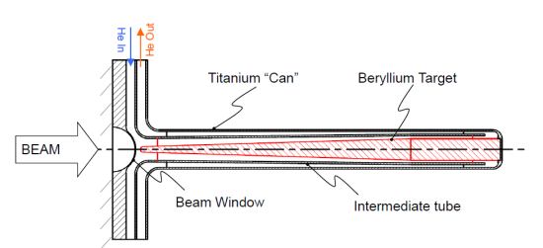
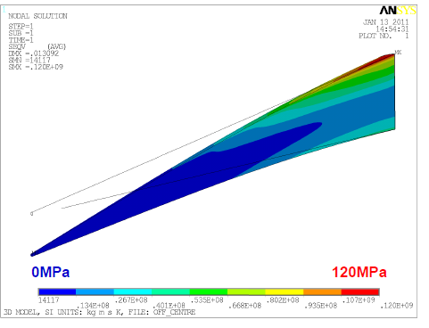
Alternative solution: pencil “closed” Be Solid target
Mike Fitton, Peter Loveridge/RAL
Pencil like Geometry merits further investigation
  Steady-state thermal stress within acceptable range
  Shorter conduction path to coolant
  Pressurized helium cooling appears feasible
  Off centre beam effects could be problematic?
  Needs further thermo-mechanical studies

Slide 15

Horn Studies
details in WP2 notes @ http://www.euronu.org/
evolution of the horn shape after many studies:
triangle shape (van der Meer) with target inside the horn : in general best configuration for low energy beam
triangle with target integrated to the inner conductor : very good physics results but high energy deposition and stresses on the conductors
forward-closed shape with target integrated to the inner conductor : best physics results, best rejection of wrong sign mesons but high energy deposition and stresses
forward-closed shape with no-integrated target: best compromise between physics and reliability
4-horn/target system to accommodate the MW power scale

Slide 16
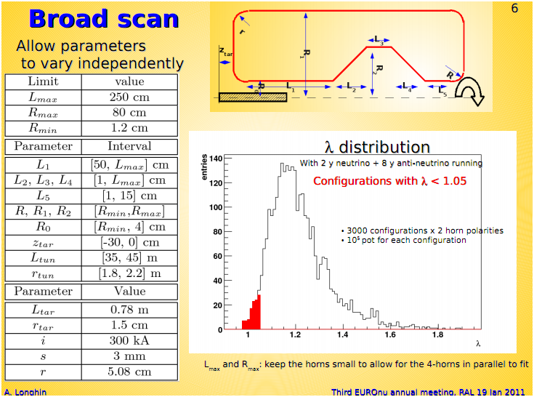
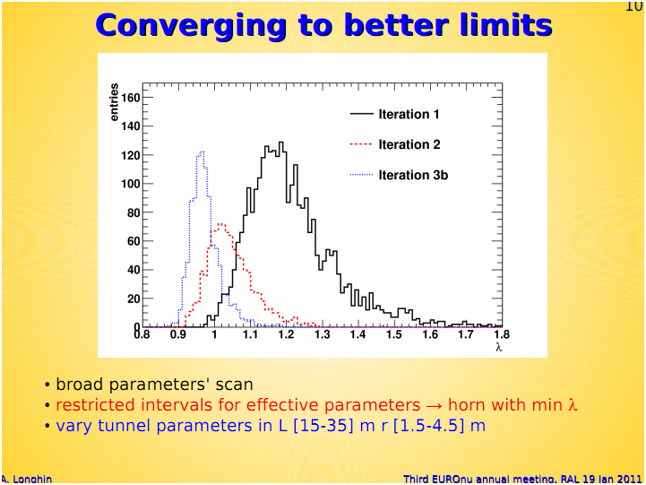
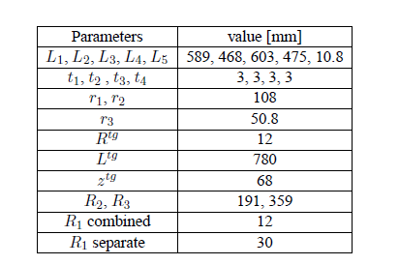
Horn Shape and SuperBeam geometrical Optimization
minimize λ, the δ_{cp}-averaged 99%CL sensitivity limit on sin²2θ₁₃
broad scan, then fix & restrict parameters then re-iterate for best horn parameters & SuperBeam geometry
A. Longhin, C. Bobeth

Slide 17
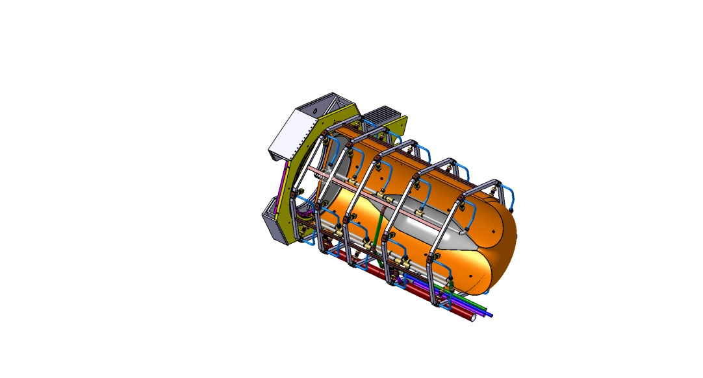
Horn Stress Studies
horn structure
  Al 6061 T6 alloy; good trade off between mechanical strength, resistance to corrosion and electrical conductivity and cost
  horn thickness has to be as small as possible for the best physics performance and to limit energy deposition from secondary particles but thick enough to sustain dynamic stress from the pulsed currents.
horn stress and deformation
  magnetic pressure and thermal dilatation
  COMSOL, ANSYS software
cooling
  water

Slide 18
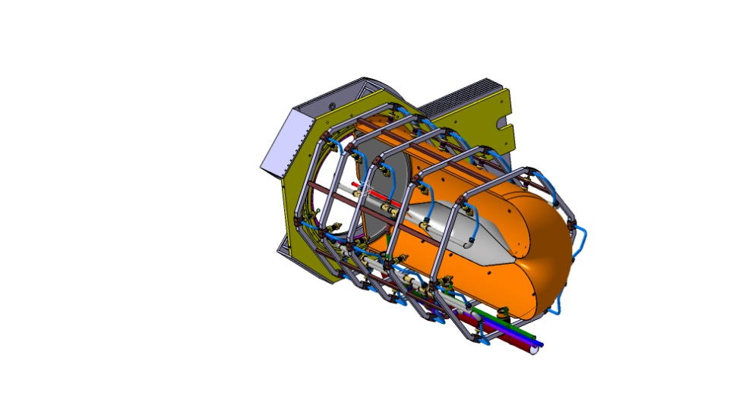
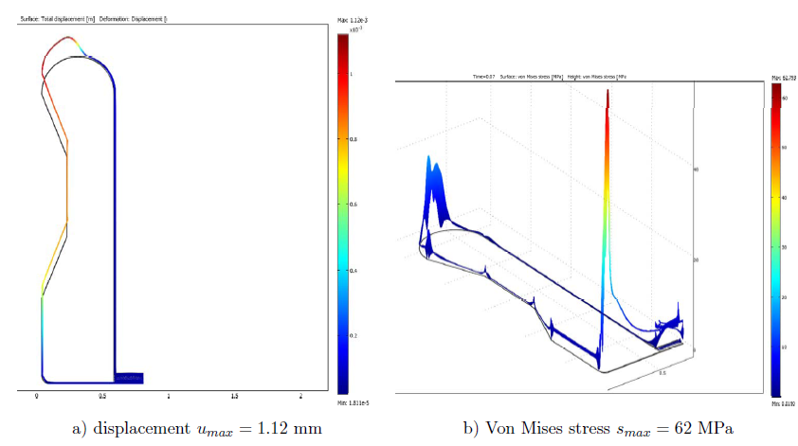
Stress Analysis for the SPL SuperBeam Horn I
B. Lepers/IPHC, P. Cupial , L. Lacny/Cracow Univ. of Tech.
Thermo-mechanical stresses:
  secondary particles energy deposition and joule losses
  T=60ms, τ₀=100μs -> I_{rms}=10.1kA, f=5kHz (worst scenario, 1horn failed)
  T_{Al} =60⁰C, {h_{corner} , h_{inner}, h_{horn/out} }= {6.5, 3.8, 0.1} kW/(m²K)
  S_{max} = 62MPa
B. Lepers/IPHC

Slide 19
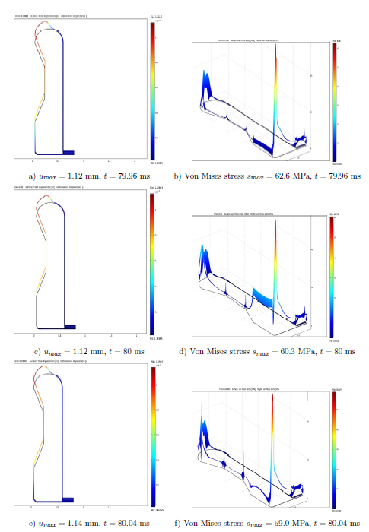
Stress Analysis II
B. Lepers/IPHC
Combined analysis of Thermo-mechanical and magnetic pressure induced stresses:
  significant stress or the inner conductor especially, for the upstream corner and downstream plate inner part
  high stress at inner conductor welded junctions
  thermal dilatation contributes to longitudinal stress; displacement is low due to the magnetic pulse
  maximum displacement at downstream plate
horn lifetime estimation: results have to be compared with fatigue strength data
more water-jet cooling might be applied
if uniform temperature field -> less stress
displacement and stress time evolution ,
peak magnetic field each T=80ms (4-horns)

Slide 20
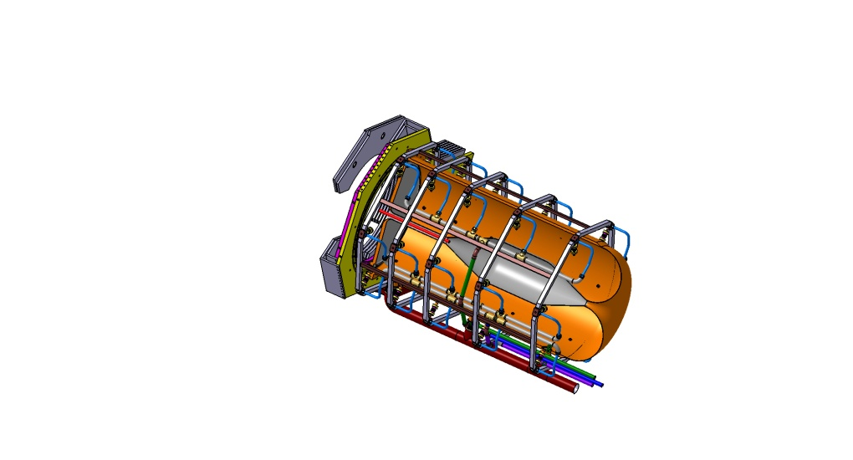
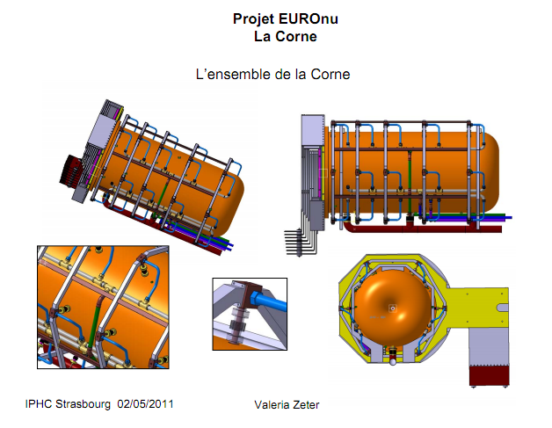
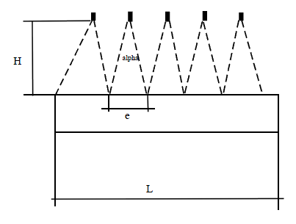
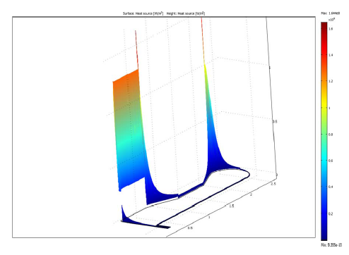
Cooling Studies
B. Lepers, V. Zeter/IPHC
power distribution on Al conductor
planar and/or elliptical water jets
flow rate between 60-120l/min
h cooling coefficient 1-7 kW/(m²K)
EUROnu-Note-10-06
design for 60⁰C uniform horn temperature:
  {h_{corner} , h_{inner} , h_{outer/horn} }= {6.5, 3.8, 1} kW/(m²K)/longitudinal repartition of the jets follows the energy density deposition
  30 jets/horn, 5 systems of 6-jets longitudinally distributed every 60⁰

Slide 21
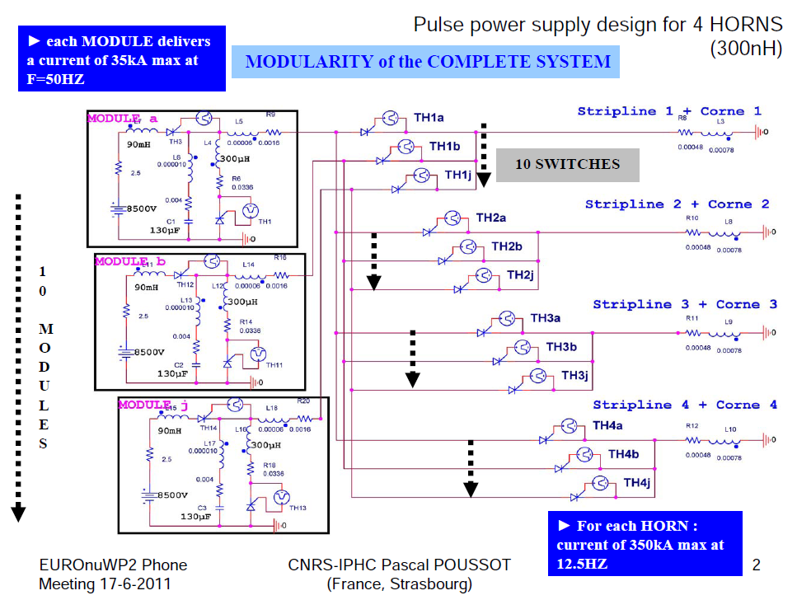
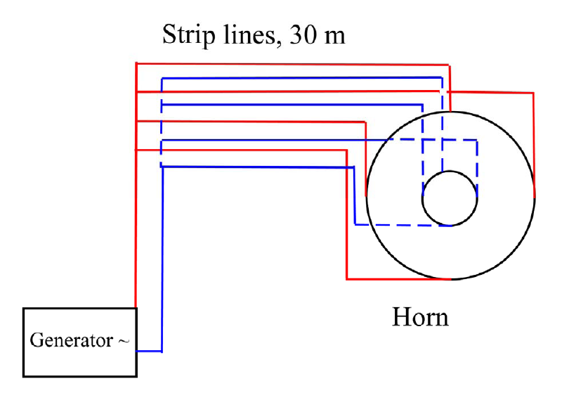
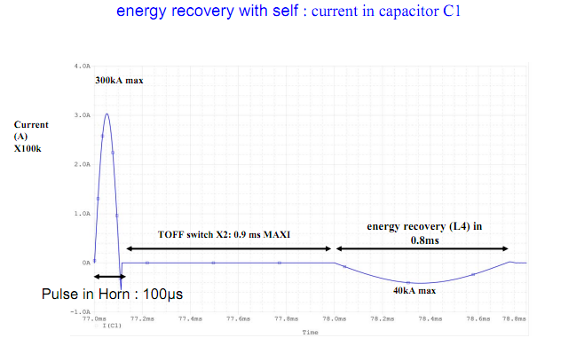
Power Supply Studies
P. Poussot, J. Wurtz/IPHC
horn focusing plateau
Energy recovery with diode and resistor: less constraints on the capacitor, but less energy recuperation
Energy recovery with an inductance L, switch and capacitor, good energy recuperation 60%
under study to find the best solution in terms of feasibility and cost
energy recovery

Slide 22
Super Beam layout
beam dump
shielding
Design includes:
Proton Driver line
Experimental Hall
  MW Target Station
  Decay Tunnel
  Beam Dump
Maintenance Room
Service Gallery
  Power supply
  Cooling system
  Air-Ventilation system
Waste Area
spare area
target/horn station
decay tunnel (25 m)
hot cell
beam
horn power supply and electronics gallery

Slide 23
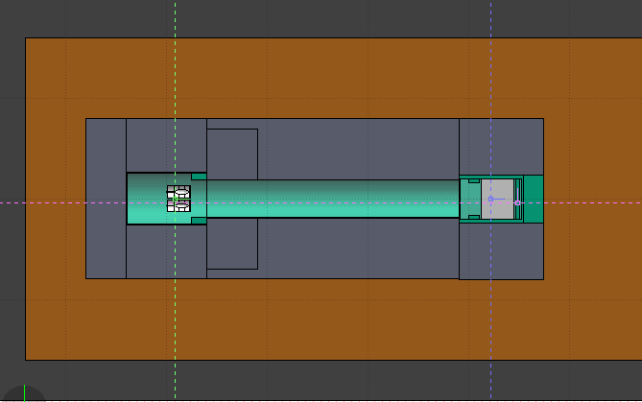
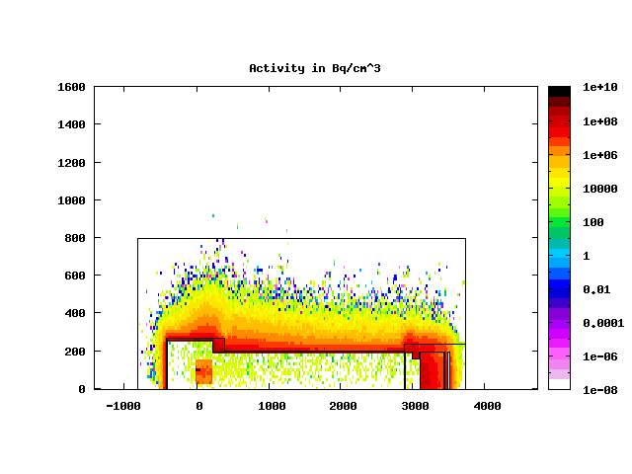
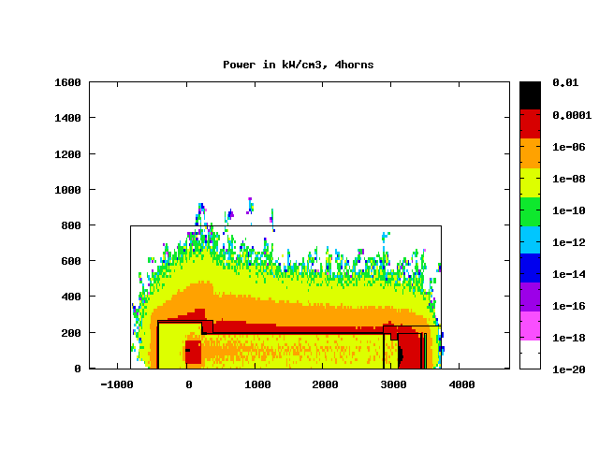
Energy deposition and
Activation Studies
FLUKA MC + FLAIR
rock: molasse @ CERN
concrete
ACTIVITY density in Bq/cm³
Fe shields, vessels
graphite
beam dump
He vessels:
T&H : L=8m, t_{Fe} =10cm , t_{concrete}=5.7m
DT : L =25m, t_{Fe} =1.6cm , t_{concrete}=5.6m
BD : L =8m, t_{Fe} =10-40cm , t_{concrete}=5.7m
molasse
concrete
POWER density in kW/cm³
molasse
concrete
P_{tot} =3.4MW
energy is confined from concrete thickness
minimum activation of molasse rock
minimum/none effective dose to humans in other galleries
detailed tables of the radionuclides
water contamination from tritium is well kept under safety levels
Eric Baussan,
N. Vassilopoulos/IPHC

Slide 24
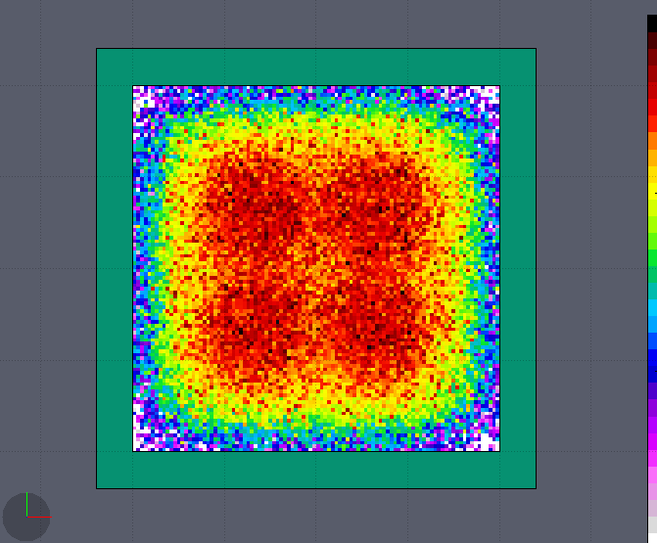
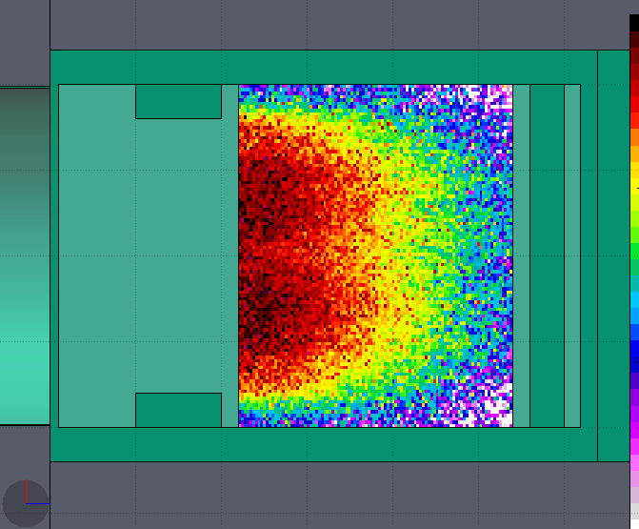
Energy Deposition in Beam Dump vessel
Eric Baussan,
N. Vassilopoulos/IPHC
concrete:
t = 5.6m
L = 8.4m
He vessel + iron plates, water cooled
    t_{Fe} = 10-40cm
    L_{Fe}= 4m
upstream shield (iron plates), water cooled
t_{Fe} = 40cm
L_{Fe} = 1m
Graphite beam dump:
L = 3.2m, W = 4m, H = 4m
P = 530kW
downstream iron shield (iron plates), water cooled:
L_{Fe} = 40cm, W_{Fe} = 4m, H_{Fe} = 4m
P_{Fe} = 10.3kW
outer iron shields (iron plates), water cooled
L _{Fe}= 2m, W_{Fe} = 4.8m, H_{Fe} = 4.8m
P_{Fe} = 1.1kW
530kW

Slide 25
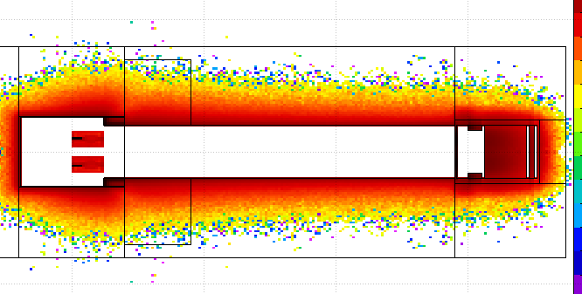
Activation in molasse
(full 4horn simulation, medium stats: 10⁶ protons, 20% error)
molasse @ CERN
concrete
study set up:
packed Ti target, 65%d_{Ti}
4MW beam, 4horns, 200days of irradiation
minimum activation leads to minimum water contamination
concrete thickness determines the activation of the molasse
results:
of all the radionuclide's created ²² Na and tritium could represent a hazard by contaminating the ground water.
Activity distribution
CERN annual activity constraints in molasse (for achieving 0.3mSv for the public through water) |  | SuperBeam, (preliminary)
²² Na | 4.2 x 10¹¹ Bq | - (to be investigated)
tritium | 3.1 x 10¹⁵ Bq | 6x10⁸ Bq
Eric Baussan,
N. Vassilopoulos/IPHC

Slide 26
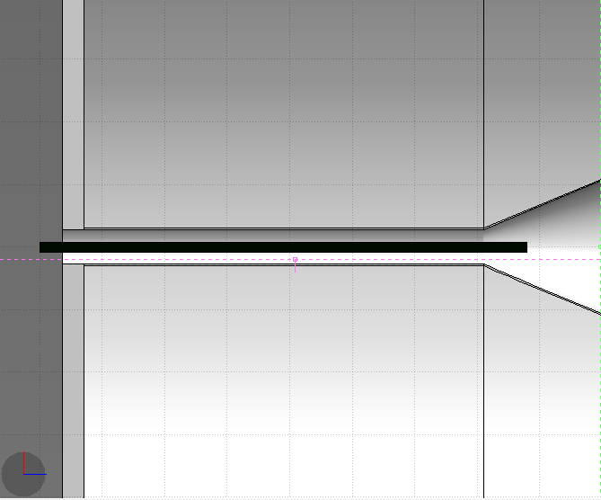
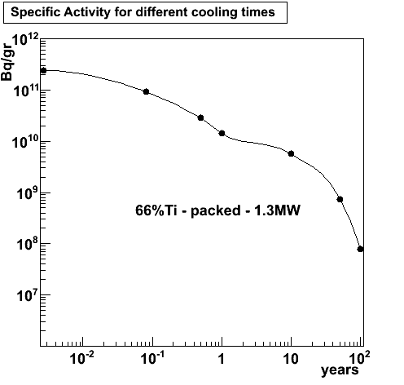
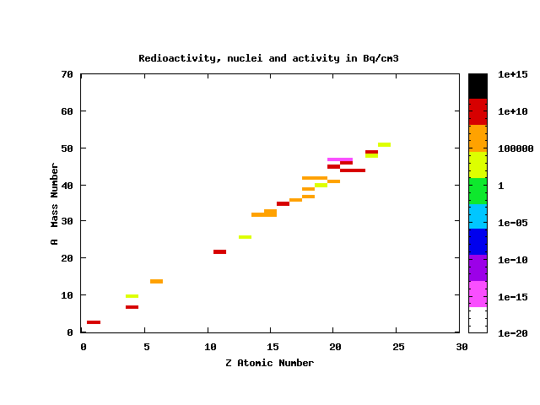
Target Activity at Storage Area
study set up:
packed Ti target, 65%d_{Ti}
1.3MW beam, 200days of irradiation
no other activation at storage area
Eric Baussan,
N. Vassilopoulos/IPHC

Slide 27
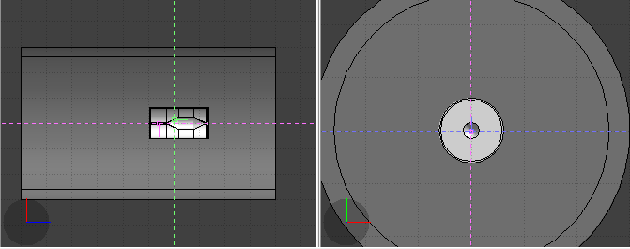

Dose Rates for target/horn at Storage/Service Area, I
radiation limits as in CNGS notes:
rates (e.g.):
at 60cm distance from the outer conductor (calculation of the rates using 20cmx20cmx20cm mesh binning through out the layout -> choose a slice of x-axis with 20cm thickness and 60cm away )
 | Limits per 12-months period (mSv)
 | Public | Workers
France | < 1 | < 20
Switzerland | < 1 | < 20
CERN | < 0.3 | < 20, if .gt. 2mSv/month report to Swiss authorities
Eric Baussan,
N. Vassilopoulos/IPHC
z
x

Slide 28
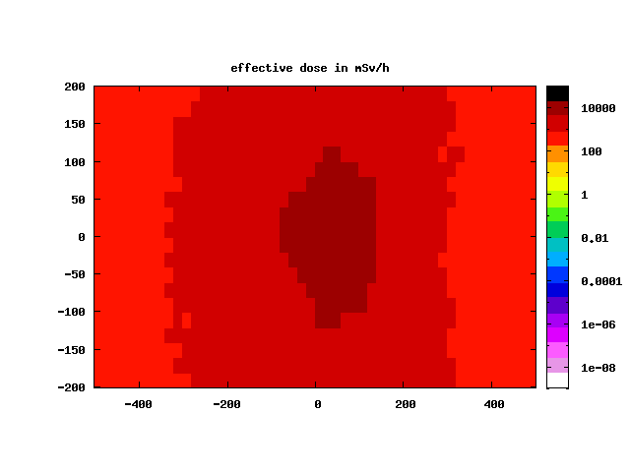
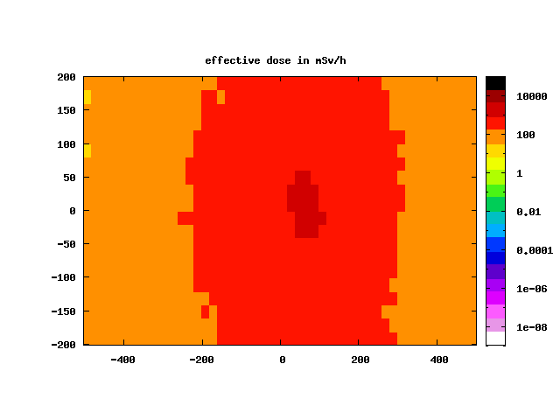
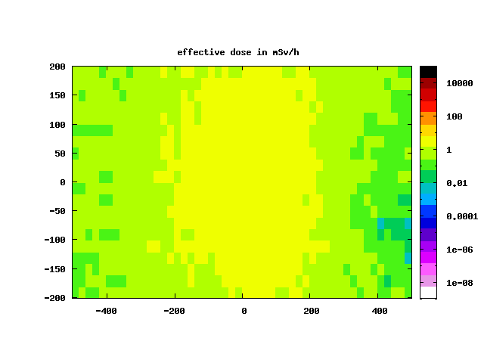

Dose Rates target/horn at Storage Area, II
1month
1year
> 1 Sv/h
> 50 mSv/h
palette in mSv/h
50years
100years
> 0.01 mSv/h
high effective dose rates for the target/horn system makes them inaccessible -> remote handling mandatory
Eric Baussan,
N. Vassilopoulos/IPHC

Slide 29



MEMPHYS: Underground Laboratory and Detector
underground water Cherenkov at Laboratoire Souterrain de Modane Fréjus at 4800 m.w.e.
total fiducial volume: up to 572 kton: 3 x 65mX80m modules, could be designed as 2 x 65mX105m
  size, shape limited by light attenuation length (λ~80m) and pressure on PMTs
  readout : ~220000 8″ PMTs, 30% cover
PMT R&D + detailed study on excavation existing + prototype Cherenkov detector MEMPHYNO
one possible design at LSM
(by Lombardi SA Inagenieurs – Conseils)
The MEMPHYS project, NIM A639, 287-289

Slide 30




MEMPHYS: Full Simulation
Event Generator:
  GENIE for ν beam new
MEMPHYS Full Simulation (M. Fechner, J.E. Campagne/LAL, N. Vassilopoulos/IPHC) :
  Interface with the OpenScientist v16r0 framework (G. Barrand/LAL) using distribution kits as Geant4 & CLHEP & AIDA-IO implementation to Rio (also HDF5, XML)
  3 modes of running in the same framework:
    Interactive Viewing, Batch processing, AIDA_ROOT analysis
  primary + secondary + Optical Photon info, modular detector geometry, ntuples’ storage, etc...
MEMPHYS Event Reconstruction, Analyses (M. Marafini, A. Tonazzo/APC, N. Vassilopoulos/IPHC:
  interactive ROOT- cint
  Solo C++ for complex/high stats using ROOT + AIDA libraries

Slide 31



Light collection
attenuation length in water as a function of the wavelength in MEMPHYS simulation
27% more FV without light reduction
single e- events from 1 to 25 MeV (FC): PMTs and PE infos
65mX60m
* 65mX80m
65mX60m
* 65mX80m
*
*
*
*
*
*
*
*
Number of PMTs with at least one photoelectron as a function of electron energy

Slide 32


Reconstruction of the interaction vertex coordinates, primary vertex fit
pick up a 400 MeV electron (FC), assume point like track length
primary vertex fit based only on each PMT’s timing info: t_{i PMT} = t_{i} + TOF_{i} => t_{i} = t_{i PMT} – TOF_{i} , where TOF_{i} = (n / c) x D, D = distance between each PMT and grid’s coordinates
maximize estimator E a la SK to find the true vertex of electron :
e- vertex
random point
fit estimator

Slide 33



Single rings (FC): e-, μ+ 200MeV to 1000MeV best ring direction estimator
find the best direction maximizing :
PEs angular distribution seen at best vertex and with respect to true direction.
Different shapes
θ_{peak}= 42⁰
θ_{mean}= 44⁰
θ_{edge}
θ_{peak}= 42⁰
θ_{mean}= 38⁰
θ_{edge}
e-
μ+
spread e’ s rings
sharper μ’ s rings
  Q(θ_{edge})
  Q(θ_{edge})

Slide 34

Ring counting
map each hit -> Hough transformation -> peak counting -> ring counting -> π⁰ rejection
CC and π⁰ events in MEMPHYS
Single ring (top) and double ring (bottom) events: projection in spherical coordinates centred
on the reconstructed vertex and direction (left) and their Hough transformations (right) in MEMPHYS

Slide 35


Single rings: e-, μ+ 200MeV to 1000MeV, particle identification
use PEs (PMT) angular distribution from best reconstructed vertex and best direction as fast pid variable
full detector simulation
PEs angular distribution seen at best vertex and with respect to best direction.
Different shapes
θ_{peak}= 42⁰
θ_{mean}= 44⁰
θ_{peak}= 40⁰
θ_{mean}= 37⁰
number of PEs as a function of the PMT distance to the best vertex and with respect to best direction
e-
μ+
dPE(θ) / d (θ)
dPE(θ) / d (θ)
spread e’ s rings
sharper μ’ s rings

Slide 36


Single rings: e-, μ+ up to 1 GeV/c, momentum reconstruction
R_{tot} , to correlate momentum with measured charged from PMTs
full detector simulation
e-
μ+
comparable to SK

Slide 37


Single rings: e-, μ+ up to 1 GeV/c, momentum reconstruction , direction
make the difference between true and reconstructed direction: resolution in degrees at 68% of events
full detector simulation
e-
μ+
comparable to SK

Slide 38


MEMPHYS: neutrino energy reconstruction
the algorithms described above can now be applied to extract the “Migration Matrices” from true to reconstructed neutrino energy.
neutrinos generated with GENIE and processed with the full Geant-4 simulation and event reconstruction of MEMPHYS
ν_{μ}
ν_{μ}
ν_{μ}
gaussian peak due to QE’s smearing of Fermi motion and experimental resolution
tail due to no-QE events, increasing with ν ‘s energy

Slide 39
Summary
Super Beam
Horn with separated target baseline as result of dynamic and static stress analyses
4-horn system to reduce the 4MW power effects
Packed-bed Target is preferable in multi-Watt beam environment due to minimum stresses and high heat rate removal due to transverse cooling among others
Stress analysis support the feasibility of the target/horn design. Furthermore the power supply design looks feasible as well.
Minimum activation in molasse rock for current secondary beam layout. High dose rates in Storage Gallery -> remote handling for repairs mandatory
MEMPHYS
vertex reconstruction, ring direction
excellent single-ring identification as e or μ
single-ring/lepton momentum and direction resolution
detector optimisation: no light reduction when moving from 65mx60m to 65mx80m detector (+27% FV): similar results are expected in event reconstruction
“Migration Matrices” from true to reconstructed neutrino energy, detector energy resolution
Thanks

Slide 40



Slide 41

considerations:

Slide 42


Horn shape and SuperBeam geometrical Optimization I
studies by A. Longhin,
EUROnu-WP2-10-04
parameterise the horn and the other beam elements
as decay tunnel dimensions, etc...
parameters allowed to vary independently
minimize the δ_{cp}-averaged 99%CL sensitivity limit on sin²2θ₁₃

Slide 43
Horn Shape and SuperBeam geometrical Optimization II
fix & restrict parameters then re-iterate for best horn parameters & SuperBeam geometry

Slide 44

Physics Performance for different Targets I
Graphite Solid target, 2λ_{I}
Hg, 2λ_{I}
Integrated target, 2λ_{I}
excellent performance of packed bed Ti, d= 74%d_{Ti}
CERN to Frejus/MEMPHYS neutrino beam
any density reduction of packed could be recuperated increasing the horn current by 50, 100 kA

Slide 45



EUROnu scenario for 4-horn system

Slide 46


Energy Deposition from secondary particles on Horn,
1.3MW, Ti packed bed target
FLUKA MC+FLAIR
target Ti=65%d_{Ti} , R_{Ti}=1.5cm
36kW, t=30mm
8.6kW, t=35mm
1.7kW
2.4kW
1.3kW
2.5kW
9.5kW
radial profile of power density kW/cm³
P_{tg} = 105kW
P_{h} = 62kW

Slide 47

for Experimental Hall (Target/Horns, DT, Beam Dump), Safety Gallery, Maintenance Room, Waste Area

Slide 48


Single rings: particle direction, outer ring edge
keep the 400 MeV e-
calculate roughly the direction: t
θ_{edge}
  θ_{edge} > θ_{peak}
  d²PE(θ) / d² (θ) = 0
θ_{peak =} 42⁰
θ_{edge}
θ_{edge} > θ_{peak}
d²PE(θ) / d² (θ) = 0

