Slide 1


Search for neutrino-less double beta decay with EXO-200 and barium ion tagging R&D for EXO-full
^{GDR Neutrino 2011}
LAPP, Annecy-le-Vieux, November 29, 2011
^{Razvan Gornea}
Albert Einstein Center for Fundamental Physics
^{LHEP, University of Bern}

Slide 2
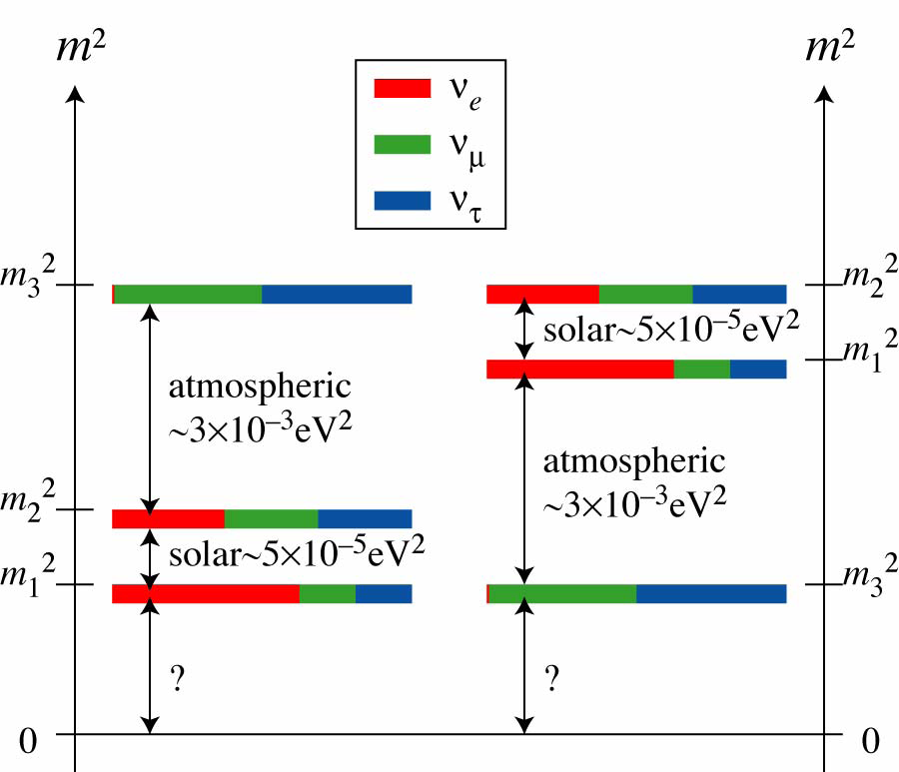
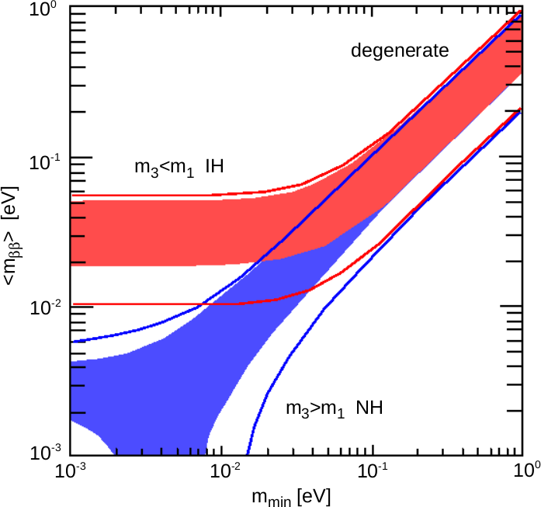
Neutrinos & Neutrino-less Double Beta Decay
Majorana or Dirac neutrino
Lepton number violating process (empirical)
Mass hierarchy
Absolute neutrino mass

Slide 3
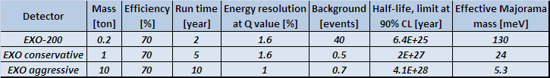
EXO Project & EXO-200 Phase
EXO searches for neutrino-less double beta decay using ¹³⁶Xe
  Ton scale implementation either as liquid or gas phase TPC
  Relatively large Q value (2457.8 keV) and straight forward enrichment technique
  ¹³⁶Ba daughter tagging either in-situ or in external RF cage
EXO-200 is the first phase using 200 kg of 80% enriched Xe
  Major R&D effort precursory to the ton-scale experiment
  Exploration of the quasi-degenerate region with ¹³⁶Xe
  Measurement of the allowed double beta decay rate in Xe-136
  No Ba ion tagging but massive progress for radioactive background reduction and energy resolution improvement (scalable to future detectors)
T_{1/2} > 1.2 × 10²⁴ @ 90% C.L. Bernabei et al. 2002

Slide 4
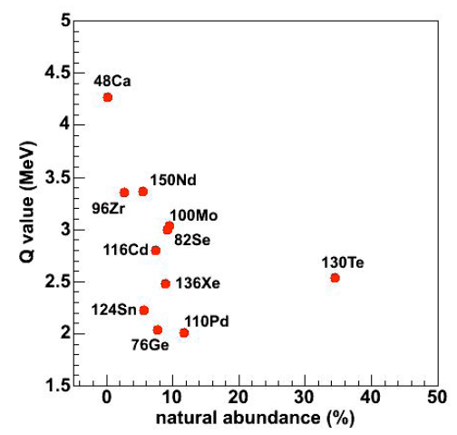
Isotope Selection & Enrichment Program
Noble gas @ STP (enrichment)
Gas & liquid TPC possible
Continuous purification
Transfer to different detector
No long lived radioactive isotopes
Barium ion can be tagged
200 kg of 80% enriched xenon
Mass-separating centrifuges (Russia)
Other isotopes can be returned to provider

Slide 5
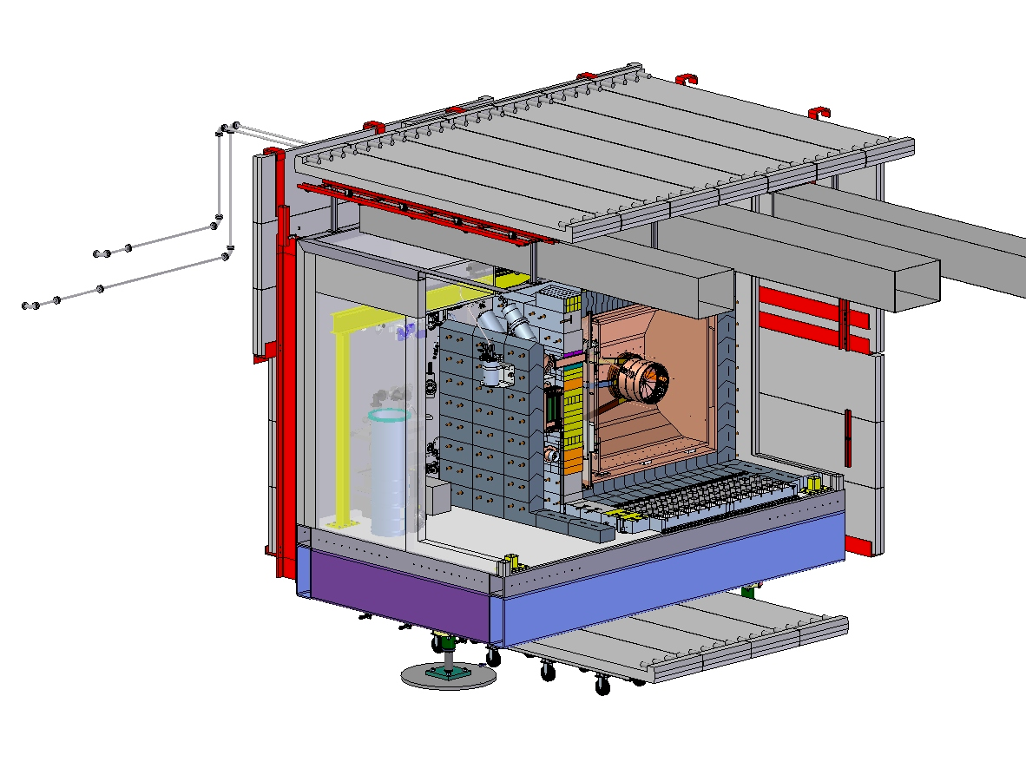
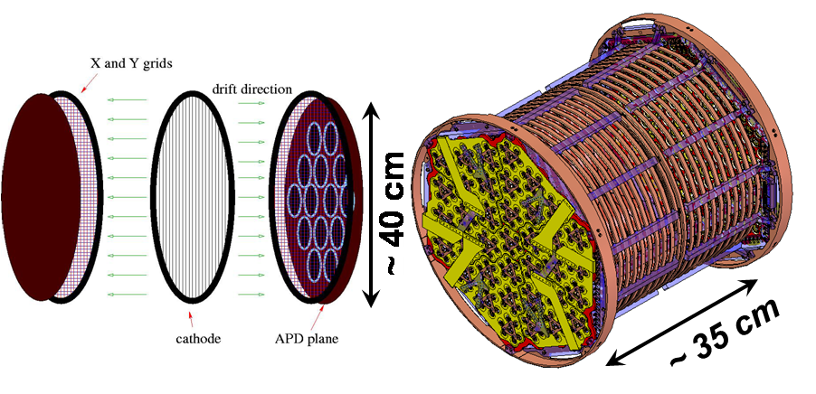
EXO-200 Detector
Liquid xenon TPC with two cylindrical drift volumes
  Charge collection using 114 by 114 wire planes (at 120º pitch)
  Scintillation light readout using 37 groups of 7 bare LAAPD (Large Area Avalanche Photodiodes) at both end caps
High purity copper cryostat with external refrigeration-based cooling
Ultra-low radioactivity materials
Mass minimized around the TPC
Fiducial volume closely enveloped

Slide 6
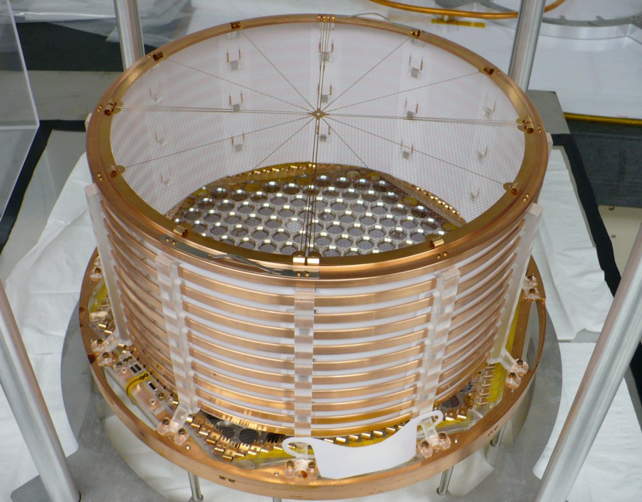
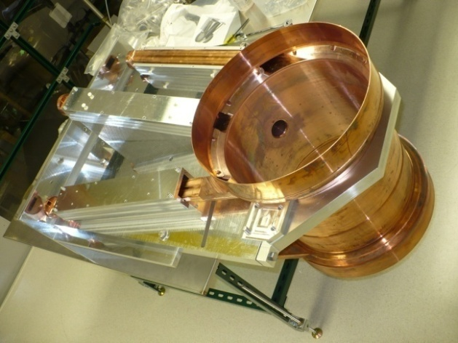
Chamber and Signal Readout
Ultra low residual radioactivity copper!
Shielded surface transport and storage
Only 1.3 mm thickness to reduce mass
PLC-based real-time pressure control
e-beam welded components
TIG welding for the final assembly
Photo-etched phosphor-bronze cathode
Induction & charge collection wire grids
259 LAAPD of 1.6 cm active diameter
QE > 1 @ 174 nm
Gain 100× to 150× @ ~ 1400V
Teflon-based UV light reflectors

Slide 7
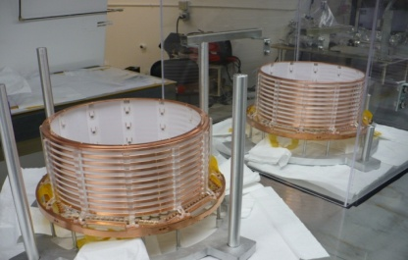
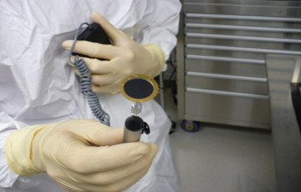
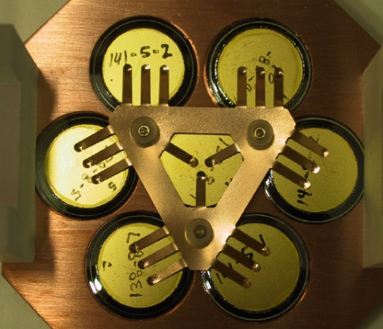
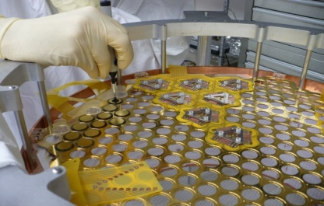
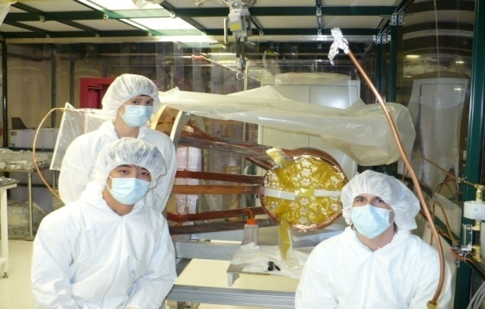
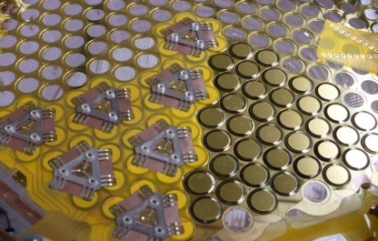
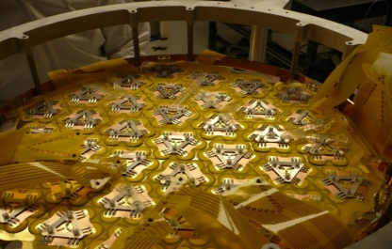
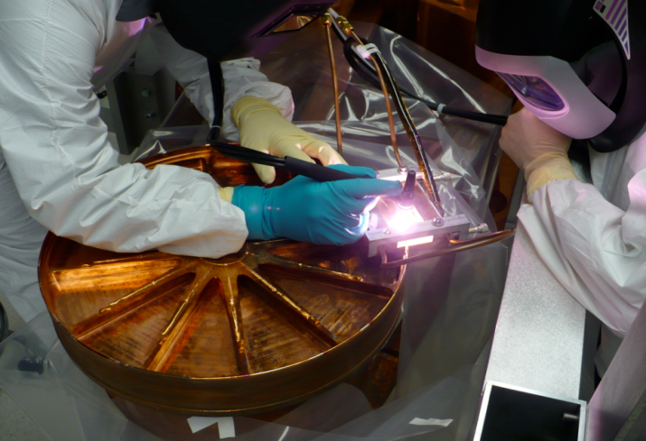
TPC Assembly

Slide 8
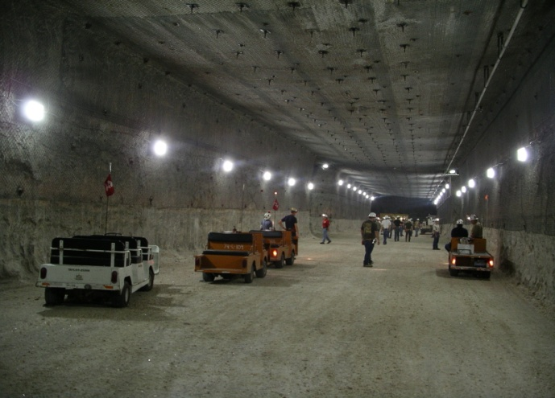
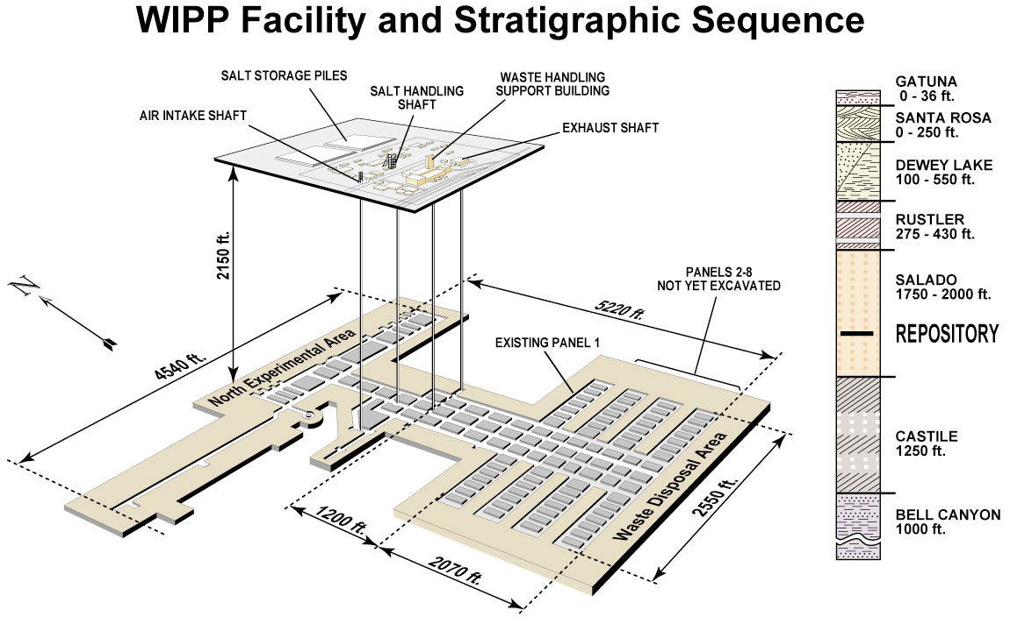
Experiment Location
Waste Isolation Pilot Plant (WIPP), Carlsbad (53 km), New Mexico
  650 m flat overburden (salt bed, 20 Bq/m³)
  ~ 1600 m.w.e. (muon flux reduction by ~ 10×)
Large experimental area available!

Slide 9
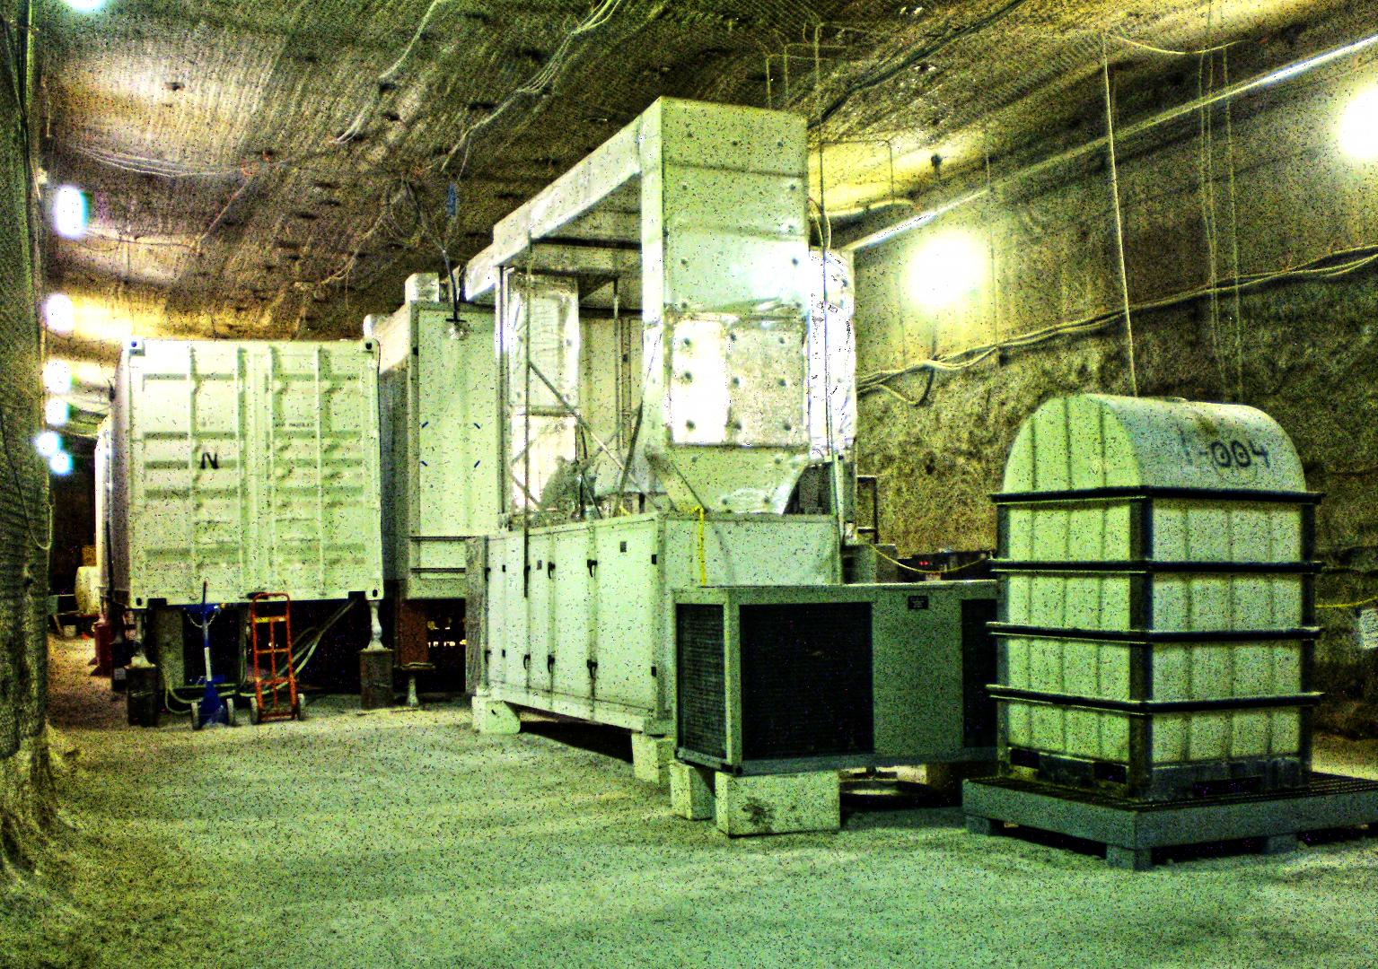
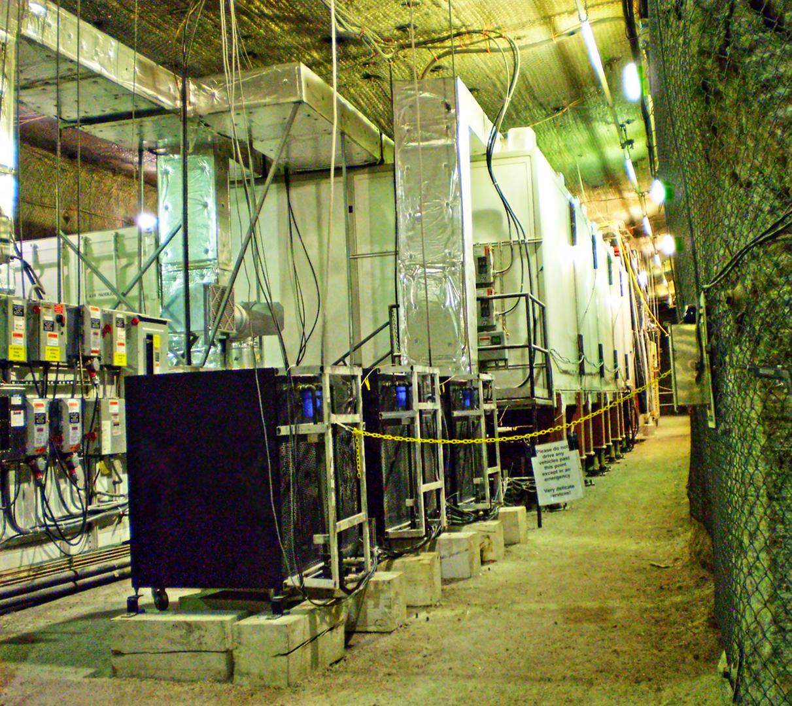
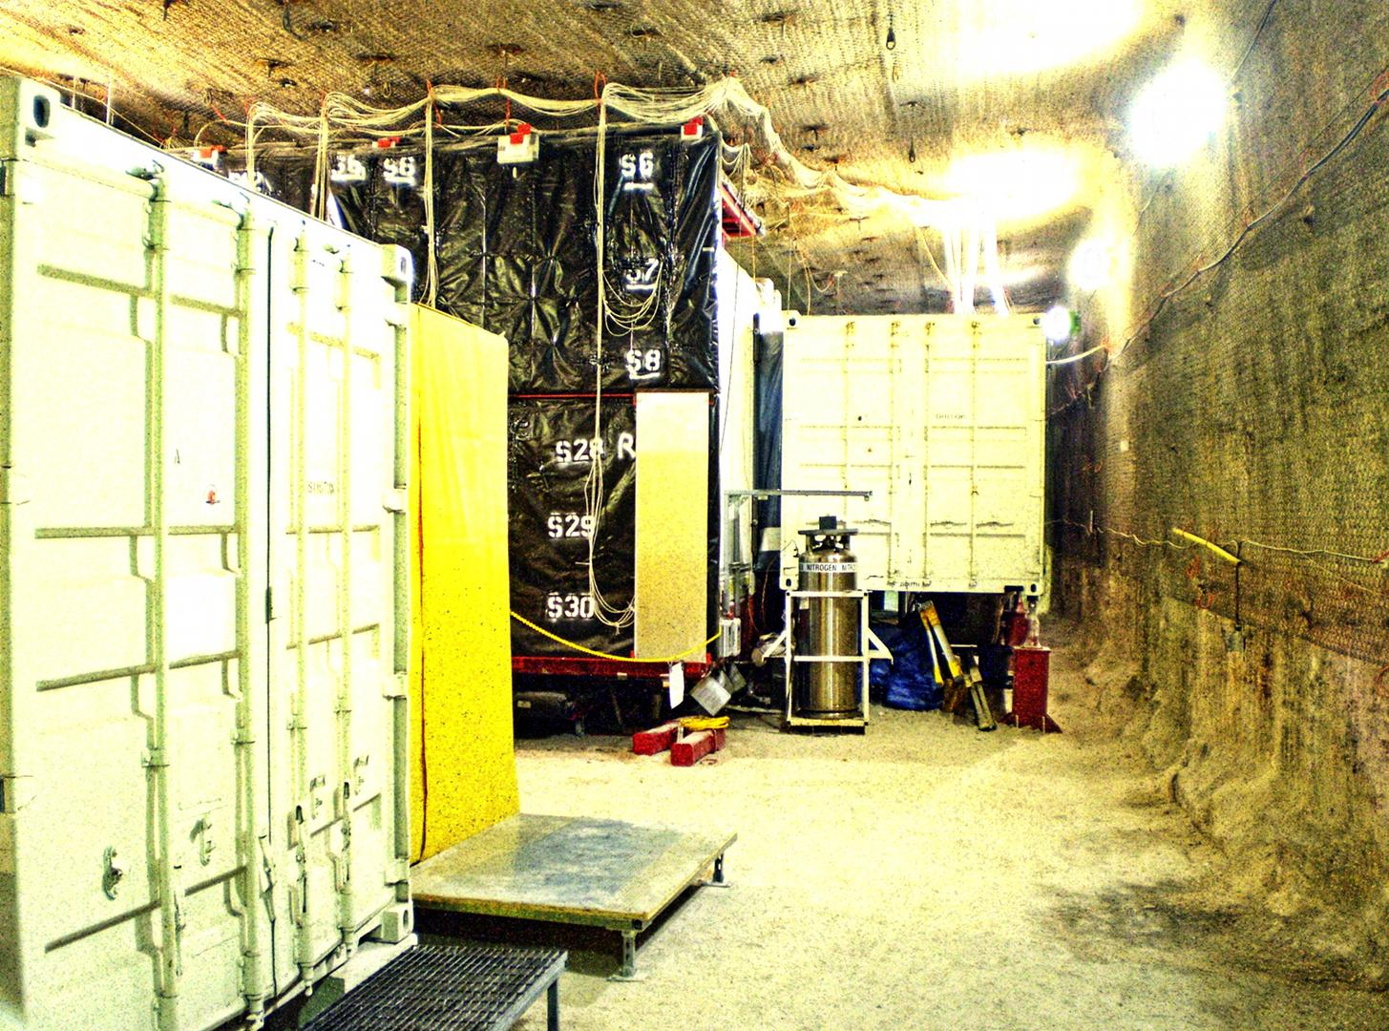
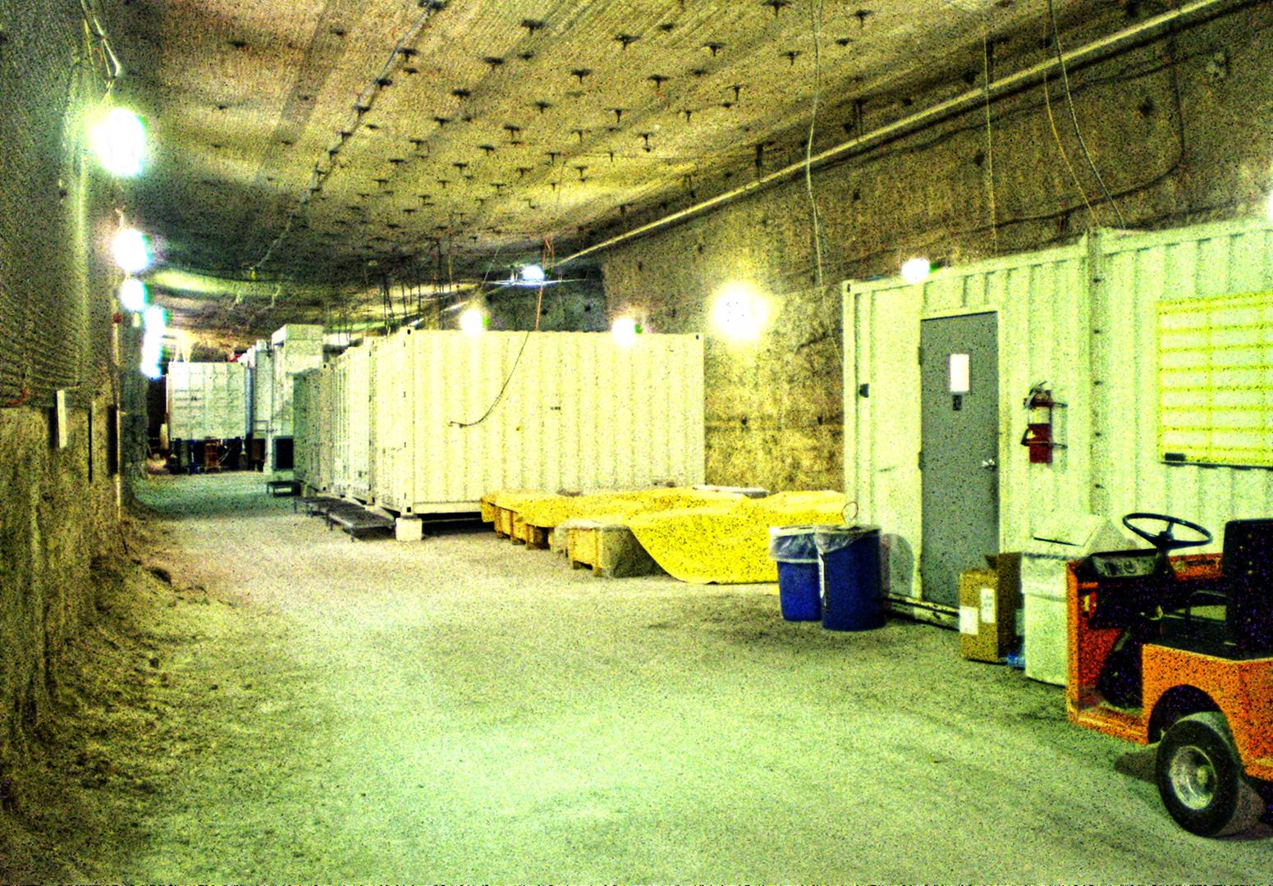
Experiment Installation

Slide 10
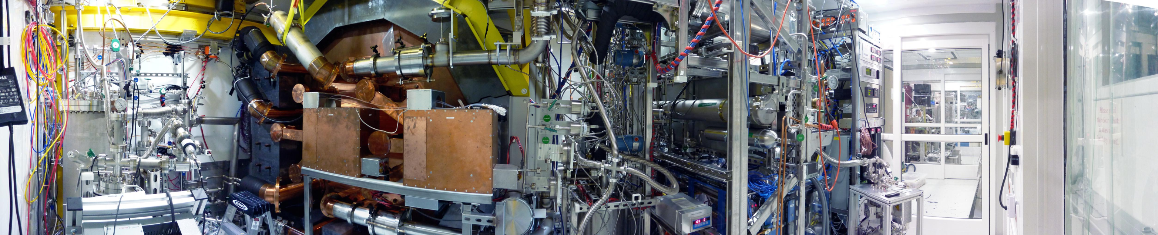
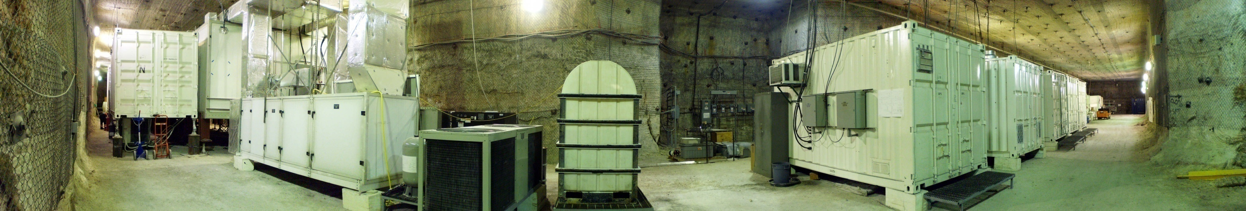
Experiment Installation

Slide 11
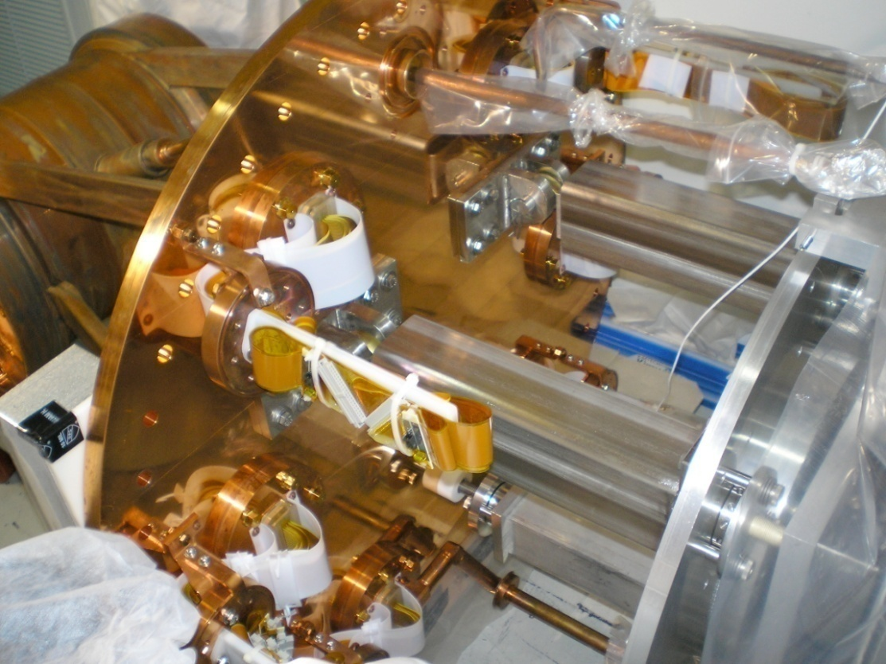
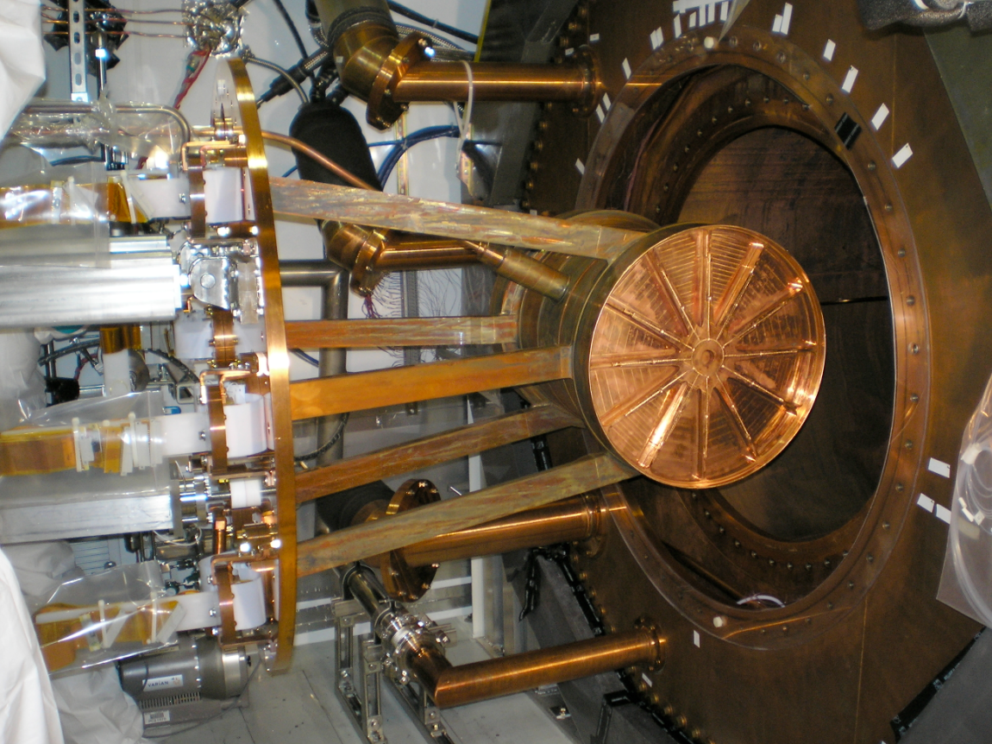
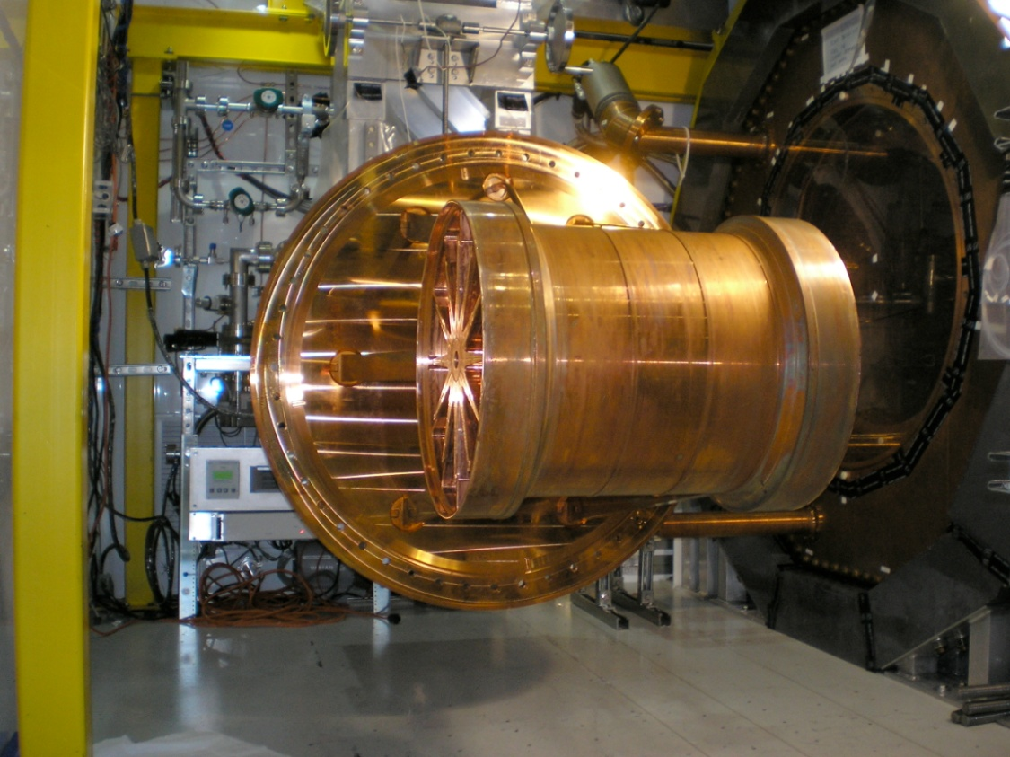
Experiment Installation
Chamber installation

Slide 12
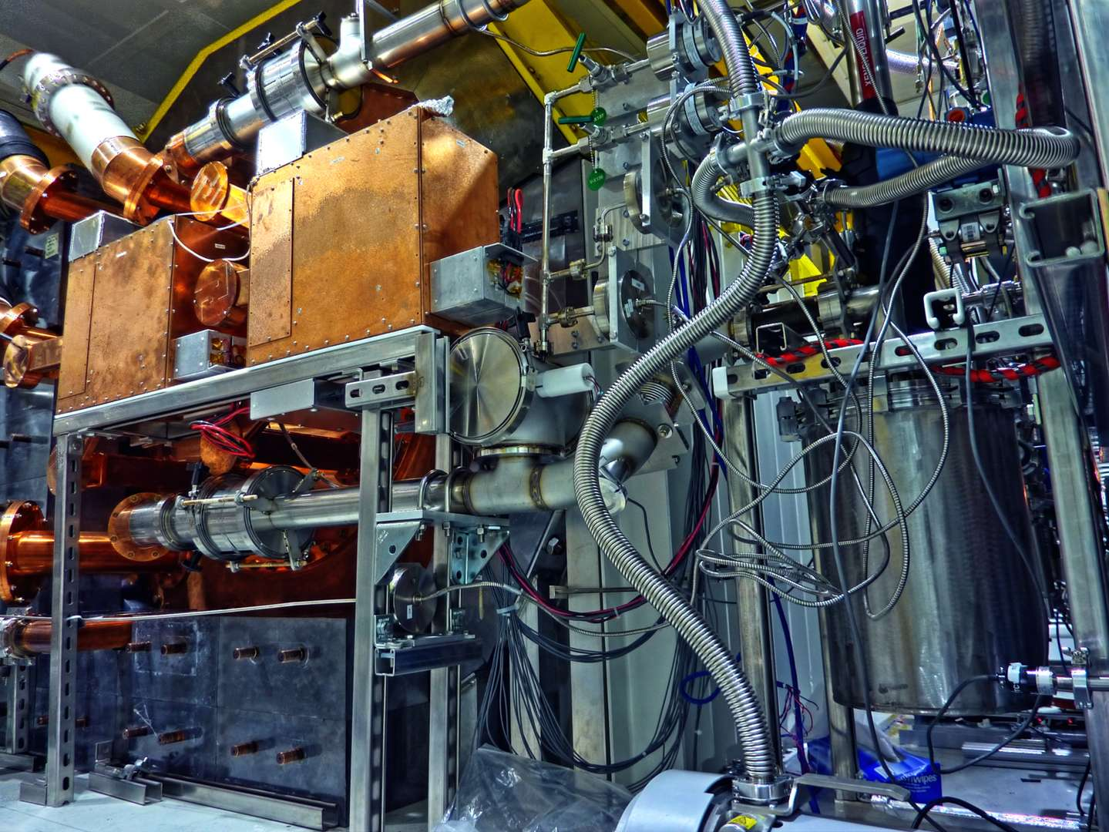
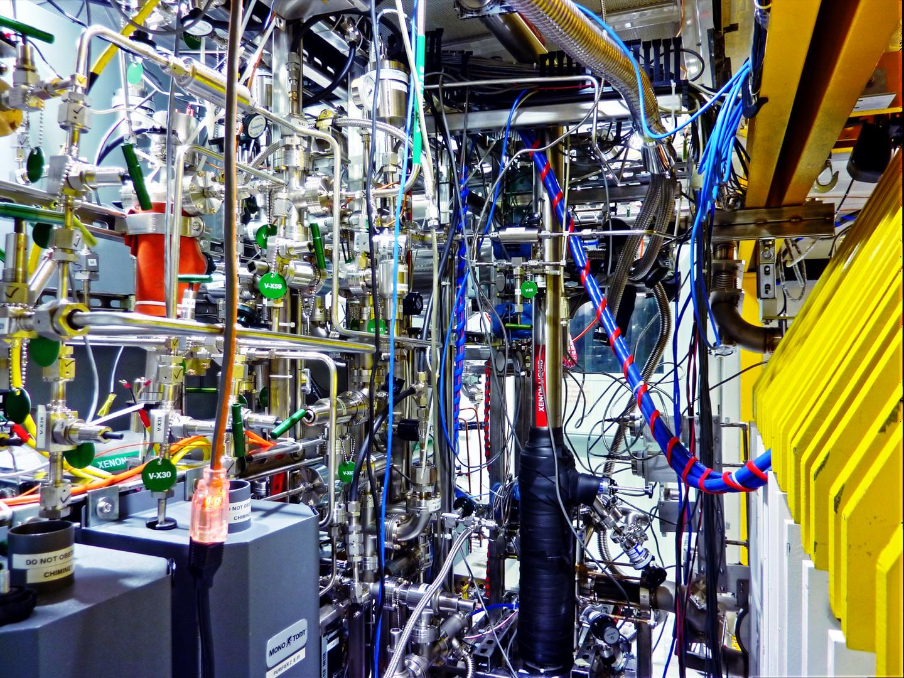
Experiment Installation
Cryostat door view
(transfer lines and electronics installed)
Part of the xenon handling system

Slide 13
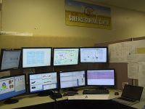
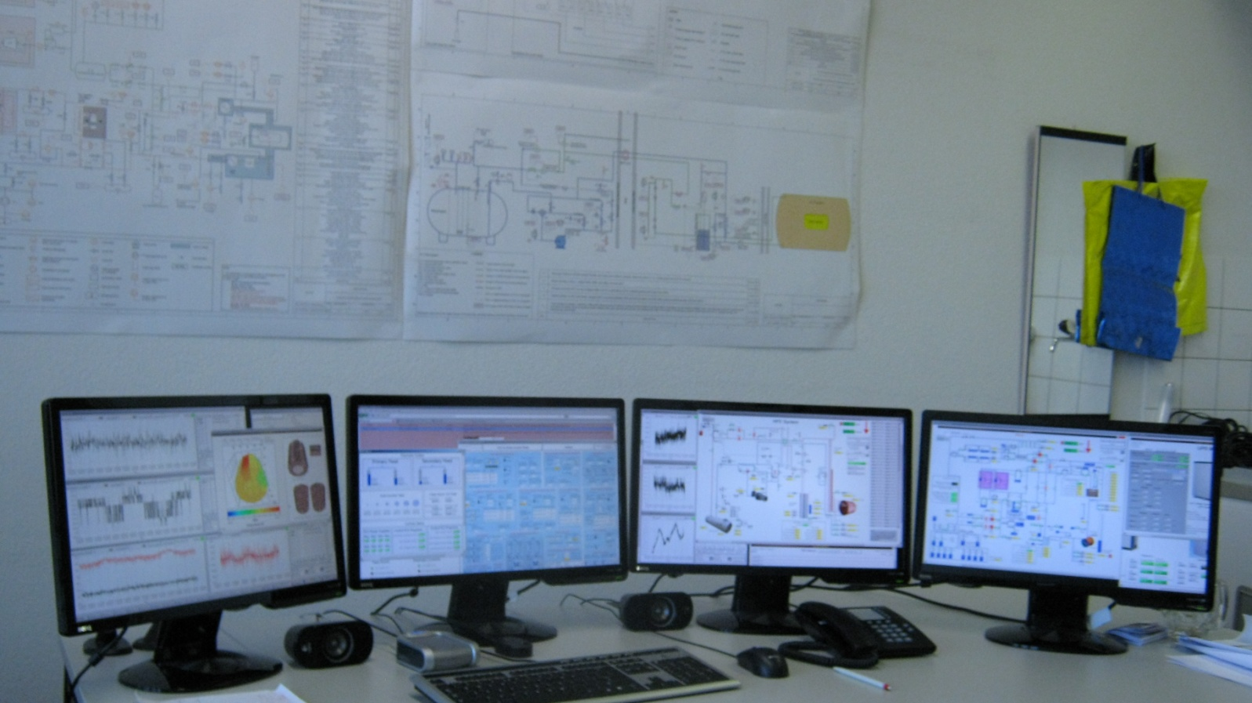
Remote Control Stations
SLAC Control Center
(day and evening shifts)
Bern Control Center
(WIPP night shifts)
588 readout channels
144 control channels
+/- 15 torr pressure regulation
3 cooling units of 1.5 kW @ 170 K
Redundant feed & bleed system (2 compressors)
30h UPS system (7.5 kW power)
PLC based fully autonomous Slow Control System

Slide 14
Expected Performance
Very low radioactive background
  Careful selection of materials, optimized custom design
  Manufacturing, handling and installation done in cleanrooms
Good energy resolution
Data taking started December 2010!
Case
Mass
(ton)
Eff.
(%)
Run Time
(year)
σ_{E}/E
@ 2.5 MeV
(%)
Radioactive
Background
(events)
T_{1/2}
(year) 90% CL
Majorana mass
(meV)
QRPA¹ NSM²
EXO-200
0.2
70
2
1.6
40
6.4*10²⁵
133
186
1) Rodin et. al., Nucl. Phys. A 793 (2007) 213
2) Caurier et. al., arXiv:0709.2137v1
Expected signal for ⁷⁶Ge ββ0ν claim …
QRPA: 46 events (over 40 background → 5.0 σ)
NSM : 170 events (over 40 background → 11.7 σ)

Slide 15
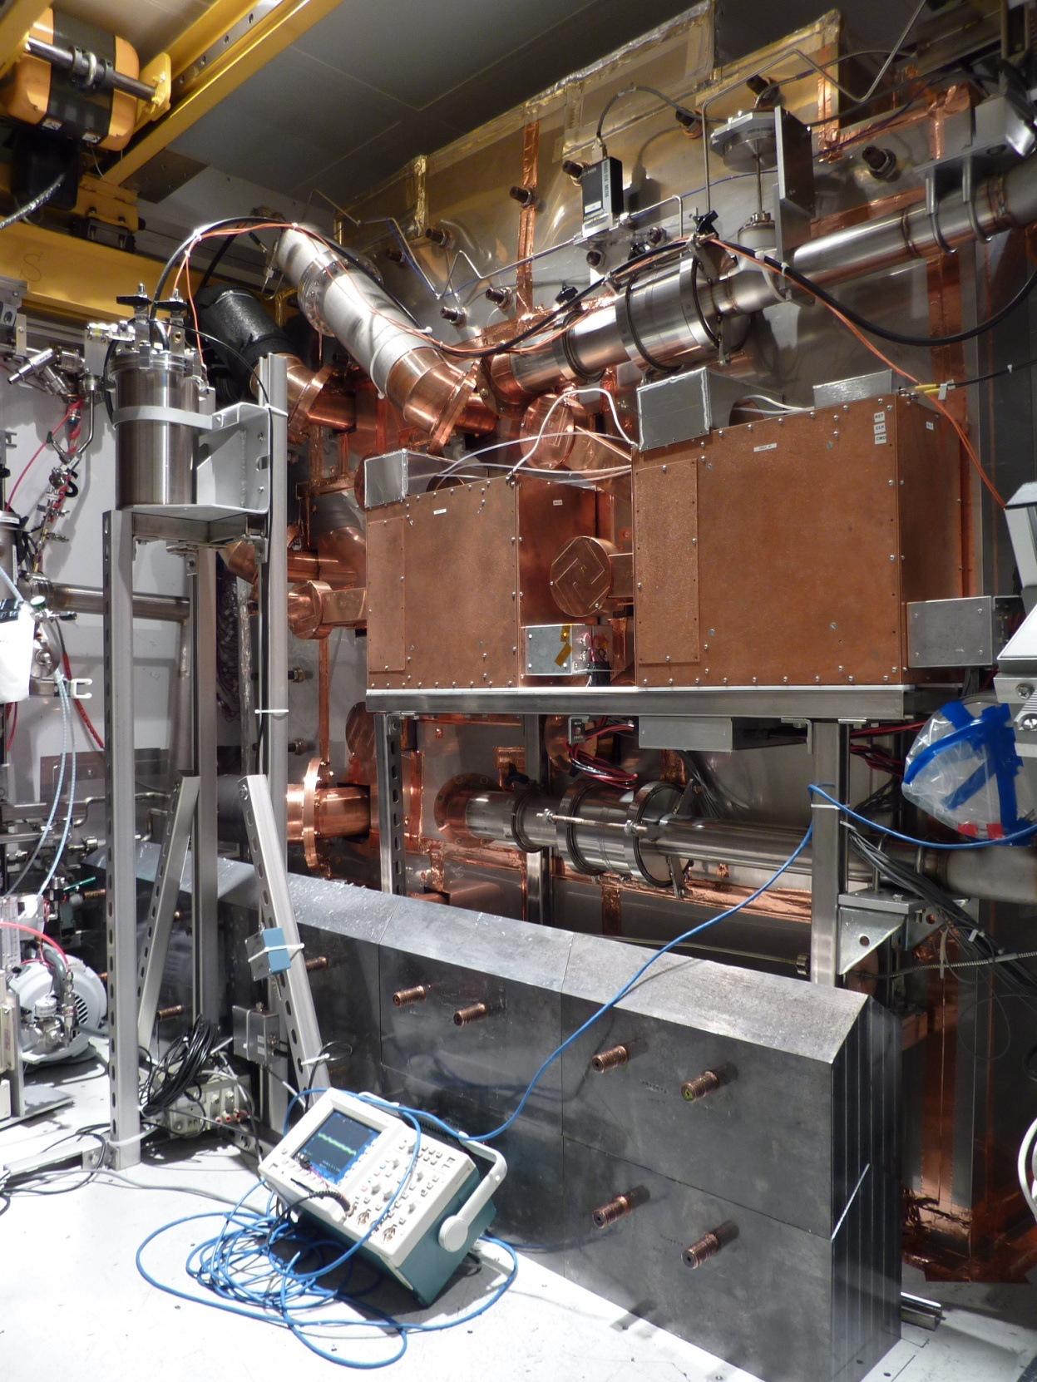
First Physics Campaign with Enriched Xenon
No radon cold trap installed
No radon-tight enclosure
Front lead wall incomplete
Detector filled with enriched xenon by spring 2011 (80% Xe-136)
Daily calibration runs
  Charge injection
  Co-60
  Th-228
  Cs-137
  Light pulses
Optimization of energy resolution
Measurement of T_{1/2} for 2νββ

Slide 16
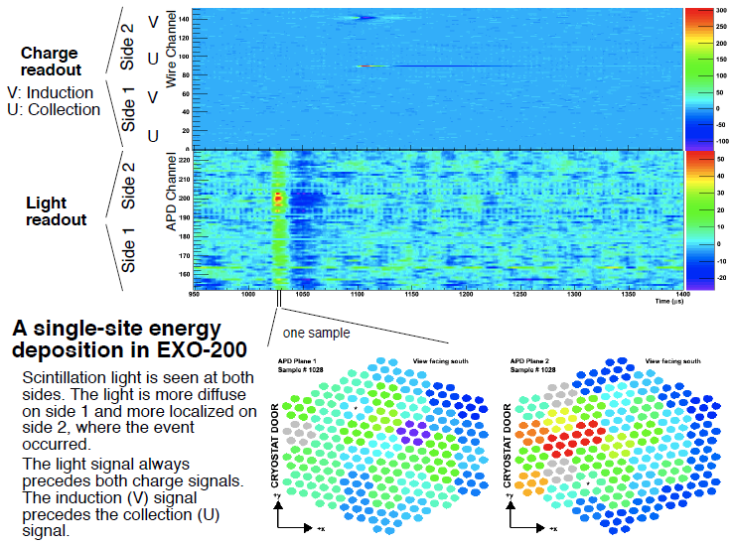
Event Example (single-site)

Slide 17
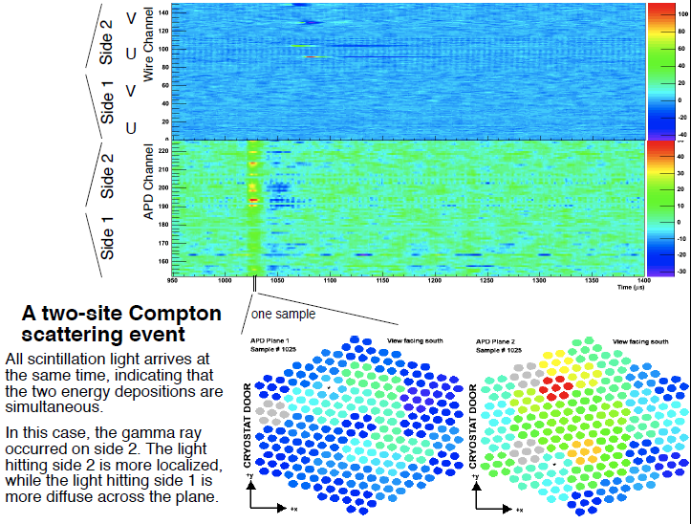
Event Example (multiple-site)

Slide 18
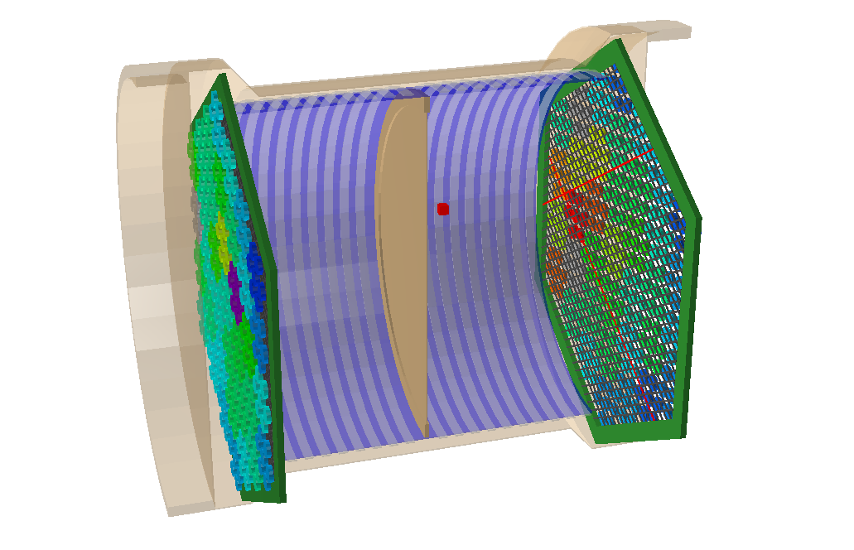
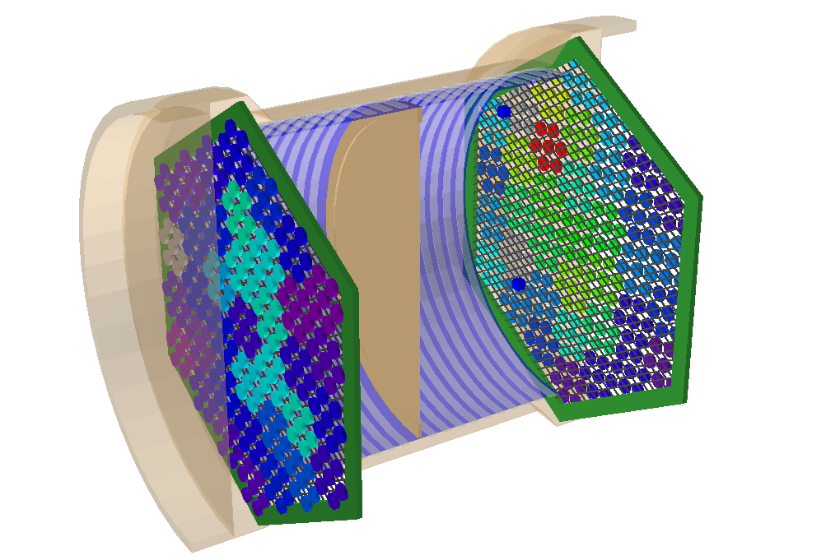
3D Reconstructed

Slide 19
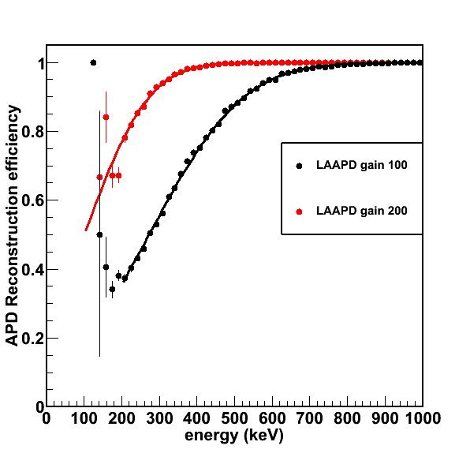
Scintillation Light Detection, Reconstruction Efficiency & Particle Identification (alpha/electron)
Full 3D reconstruction depends on efficient detection of the scintillation light (t₀)
Particle identification is based on the detection of both channels (light + charge)

Slide 20
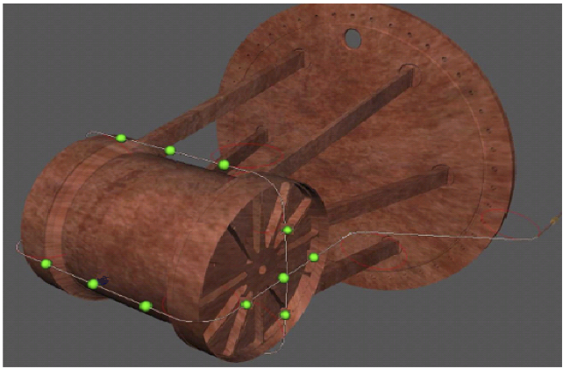
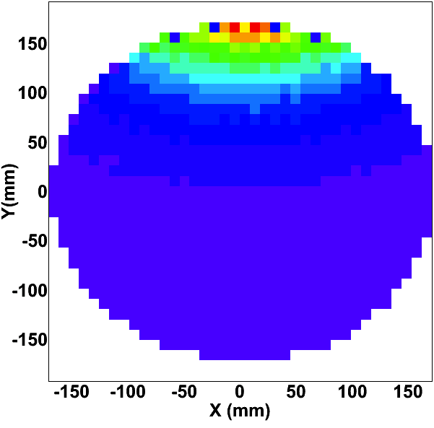
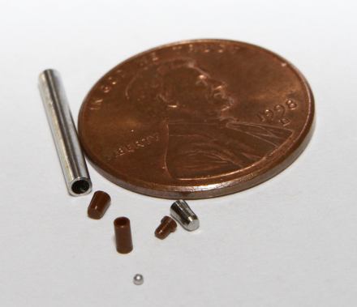
EXO-200 Source Calibration System
¹³⁷Cs, ⁶⁰Co, ²²⁸Th
z
y
x
Cryogenic source calibration handling system
Ultra-low activity copper tube & Teflon pearls

Slide 21
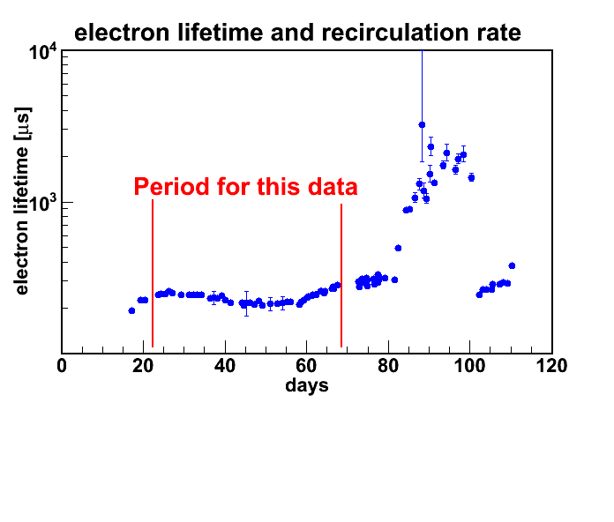
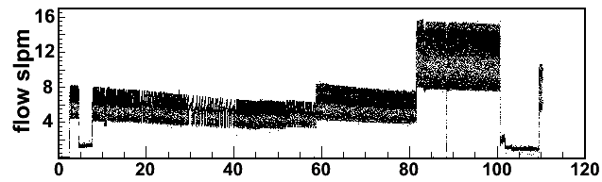
Liquid Xenon Purity
T_{1/2} for 0νββ
Maximum electron drift time ~ 100 μs (@ 0.19 cm/μs)

Slide 22
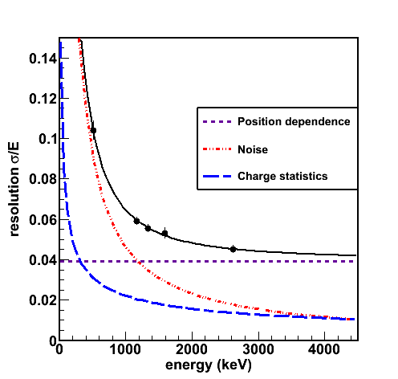
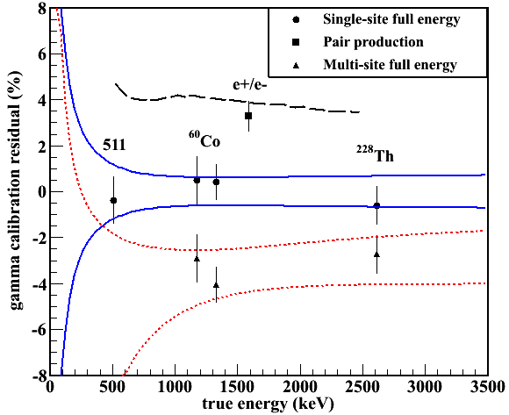
Energy Calibration (charge only!)

Slide 23
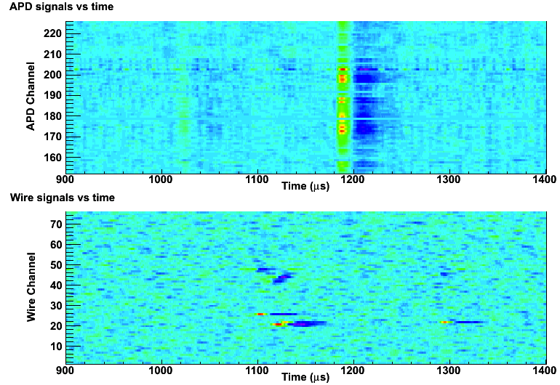
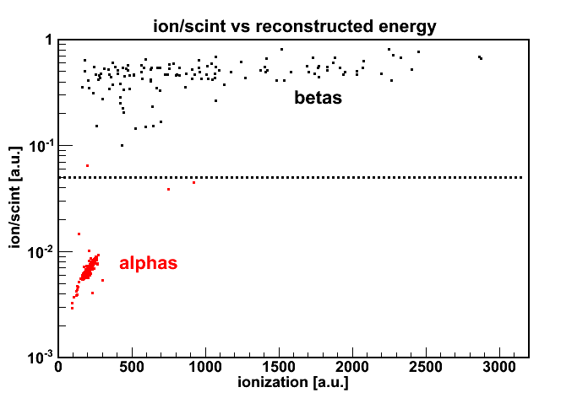
Advanced Event Selection Example
β-decay
α-decay
²¹⁴Bi – ²¹⁴Po correlations
Bi-Po delayed coincidence analysis gives consistent results with those from direct alpha spectroscopy: A_{Rn} = 4.5 μBq/kg
Radon activity compatible with expected value before radon trap installation & commissioning

Slide 24
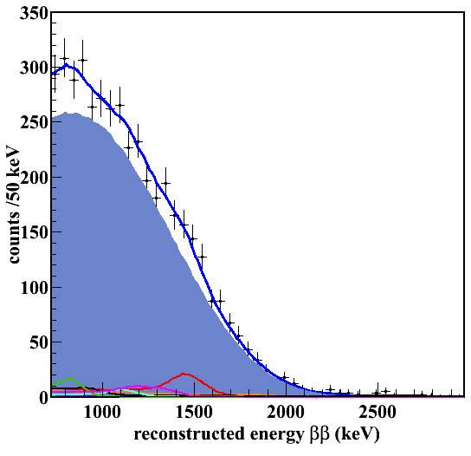
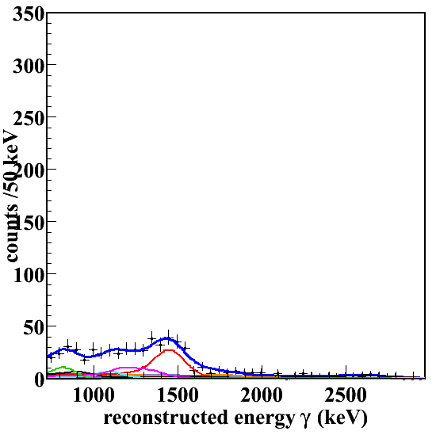
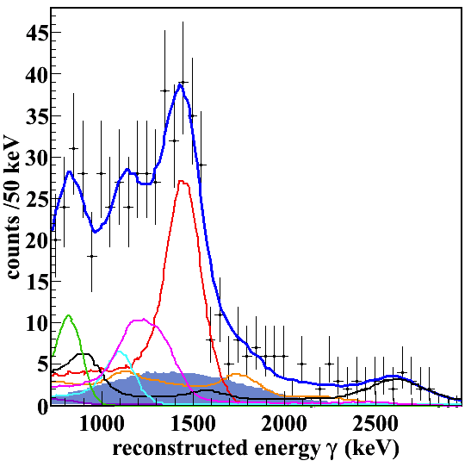
Allowed Double Beta Signal
Single-site
Multiple-site
31 live-days of data
63 kg active mass
T_{1/2} = 2.11 ± 0.04 (stat) ± 0.21 (sys) x 10²¹ years

Slide 25
What can be done for future ton-scale detector(s) with background requirement of the order of 1 #/ton/year?
EXO: final state tagging (potentially zero background)!

Slide 26
Barium Ion Tagging Concept
Ba⁺ grabber pin
Cavity ionizer
APDs
Grid plane
Mass filter
Quadrupole linear ion trap
e-
e-
e-
e-
e-
e-
CCD

Slide 27
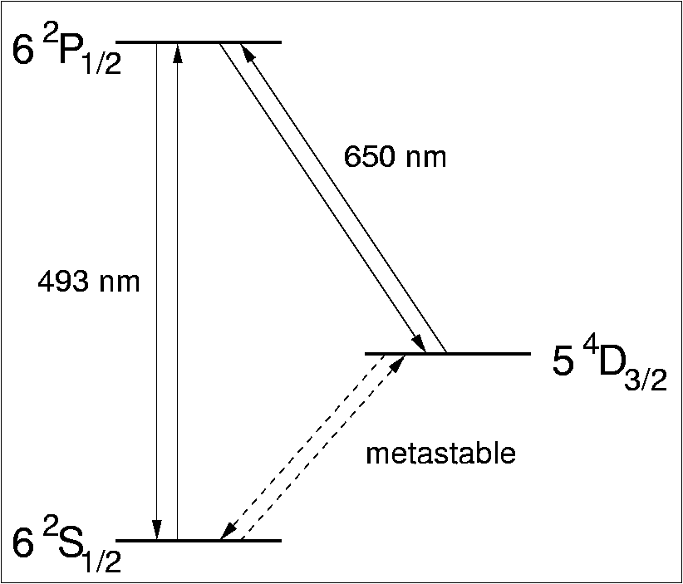

Ba⁺ Tagging using Resonant Light Scattering
Ba⁺⁺ → Ba⁺ conversion expected
  Ionization potentials:
    Xe⁺ = 12.13 eV vs. Ba⁺ = 5.21 eV
    Xe⁺⁺ = 21.21 eV vs. Ba⁺⁺ = 10.00 eV
  Solid Xe band gap (Phys. Rev. B10 4464 1974)
    E_{G} = 9.22 +/- 0.01 eV
  “Liquid Xe ionization potential” close to E_{G} (J. Phys. C: Solid State Phys. Vol. 7 1974)
    9.28 to 9.49 eV range
  Use of additives for gas based detectors
M.Green et al., Phys Rev A76 (2007) 023404
B.Flatt et al., NIM A578 (2007) 409

Slide 28
Final State Tagging
Complete rejection of the background due to residual radioactivity
Ba⁺ tagging
  Locate the ion inside the TPC
    Precise event positioning
    Ion drift properties in liquid and gas xenon
  Extract the ion to a low pressure analysis chamber
    Characterize the efficiency of the extraction process
  Detect and identify the ion in a RF trap using resonant light scattering
Ion extraction and transport
  Using a mechanical probe carrying an electrostatic tip
    Ion encapsulation in solid Xe using a cryogenic probe
    Ion adsorption on a surface with high ablation resistance (pyrolytic graphite, silicon), potentially inducing neutralization
    Ion adsorption on a metal surface with a work function higher than the ionization potential
  Using RF-guiding techniques (RF carpets) to drift the ion to a low pressure chamber
    High pressure gas-based TPC
In-situ ion tagging
  Analysis probe carrying optical fiber(s) for excitation and signal readout

Slide 29


Resonant Ionization Spectroscopy
Use of atomic resonances to selectively obtain a high yield for Ba ionization
Lasers tuned to specific Ba atomic transitions push the atom to a highly excited state from which it decay to a lower energy ionized state
Reached efficiency ~ 10⁻²
New setup targeting “single ion detection” in preparation

Slide 30


In-situ Tagging using Ba Fluorescence
Cryogenic probe carrying an optical fiber for both excitation and light collection
Current detection limit ~ 10⁵ atoms
Exploring avenues for single atom and / or ion detection:
Increasing laser intensity by 10²
Increasing fluorescence light collection by 10⁴

Slide 31






Hot Probe
Grab the Ba ion onto a metal surface with work function higher that the ionization potential
High temperature
Right geometry
Sensitive to barium impurities
Ba on Ta 1800 V (T > 1050 ºC)
Only 30% efficiency from simulations

Slide 32

Conclusion
EXO-200 installed and commissioned! Data taking started in December 2010!
Measured the 2νββ half live in Xe-136!
Reached ultra-low background of 4 #/keV/ton/year @ Q = 2.458 MeV
Various techniques are explored for barium tagging in preparation of EXO-full

Slide 33


EXO Collaboration

Slide 34
Extra Slides

Slide 35


Alpha spectroscopy and radon decay
T_{1/2} = 3.8 days
A ~ 1 #/h

Slide 36




“Double Escape Peak” from Th-228 Source Data
Measured 3-cluster angular distribution

Slide 37

Signal vs. Background

Slide 38

Matrix Elements for the Allowed Double Beta

Slide 39
Radio-Purity Survey
Large effort to determine the residual radioactive contamination of the materials employed for the construction of EXO-200 detector
  Mass spectrometry (MS)
  Neutron activation analysis (NAA)
    Very sensitive but expensive, potential background from main elements
  Alpha counting (evaluation of the ²¹⁰Pb concentration in the shield lead)
  Glow discharge MS (GD-MS), inductively coupled plasma MS (ICP-MS)
    ICP-MS has better sensitivity when pre-concentration procedures are employed but the samples have to be soluble in acids (preferably HNO₃)
  Direct gamma counting
    Large mass samples and long duration exposures are necessary
Published database of over 300 characterized materials
  Nucl. Instr. Meth. A 591, 3, 490 (2008)
Detailed Monte Carlo simulation of expected background

Slide 40
Energy Resolution
Strong anti-correlation between ionization
and scintillation signals in liquid xenon!
E.Conti et al., Phys. Rev. B 68 054201 (2003)

Slide 41







Probe Insertion R&D
Test cryostat for probe insertion in liquid Xe TPC
COMSOL based simulations of the electric field configuration

Slide 42


Ba Ion Source for Tagging R&D
Ba⁺ source for tests in vacuum, liquid and gas Xe
Electroplated Gadolinium on a PIPS alpha detector and covered with a layer of BaF₂
Ba⁺ produced by the recoil of the Samarium and trigger given by the alpha signal
¹⁴⁸Gd → ¹⁴⁴Sm + α
H⁺
Na⁺
Si⁺
Ba⁺
BaF⁺

