Slide 1
Electroweak interaction
1. Basics and history
2. The Standard Model
3. Tests of the Standard Model

Slide 2

Lecture 3
Tests of the Standard Model
Introduction
The electroweak observables, definitions and measurements
Standard Model calculations beyond tree-level
Tests of the Standard Model

Slide 3
The pre-LEP era
Introduction
SM tree-level relations between g, G_{F} and α lead to:
Comparison with experimental data, 1/2:
⇒
  before the W and Z boson discovery:
  DIS, 1982
  ⇒ predictions:
  first mass measurements (UA1 & UA2, 1983):
X
agreement

Slide 4
The pre-LEP era
Comparison with experimental data, 2/2:
  final mass measurements by the UA experiments (1989/92):
  ⇒ hence the prediction:
  DIS, 1990:
The tree-level predictions of the SM of electroweak interactions are confirmed experimentally, with a precision of a few %
From 1989 onwards: go to higher precision (experience + theory)
LEP, SLC, Tevatron
(1%)

Slide 5
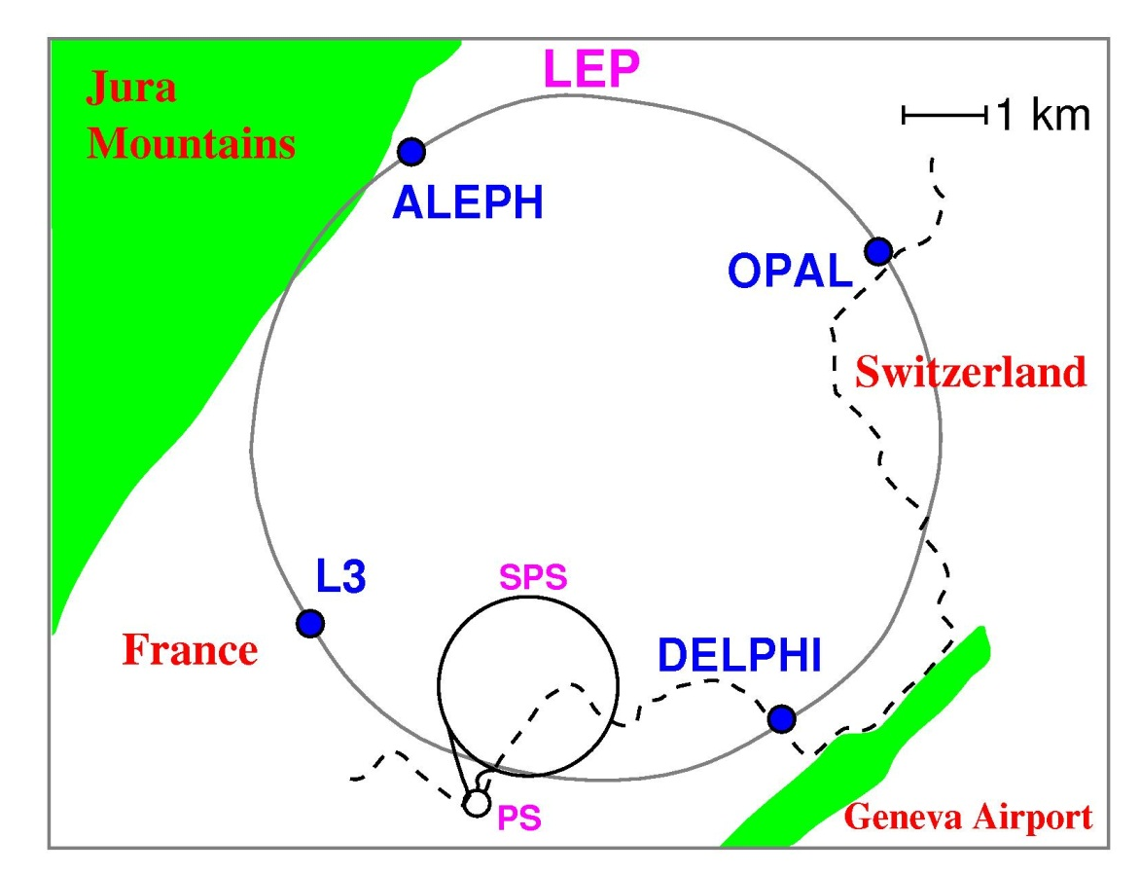
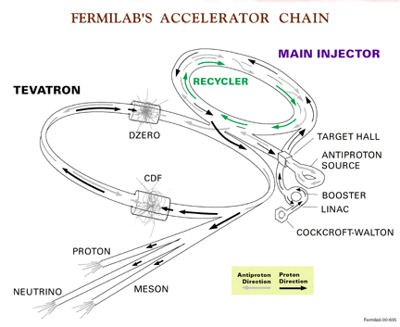
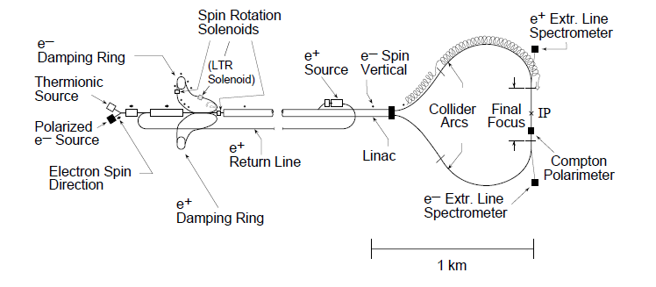
LEP 1989-2000 e⁺e⁻ 91Gev,130-208GeV
Tevatron 1987-2011 pp ~2TeV
Now, EW precision physics carried over at LHC
SLC 1988-1998 e⁺e⁻ 91GeV

Slide 6
The era of precision tests
Most precise mass measurements:
(LEP2, Tevatron)
(LEP1, final)
SM tree-level predictions:
  ⇒ prediction:
  ⇒ strong disagreement with data : higher orders to be included !
X

Slide 7
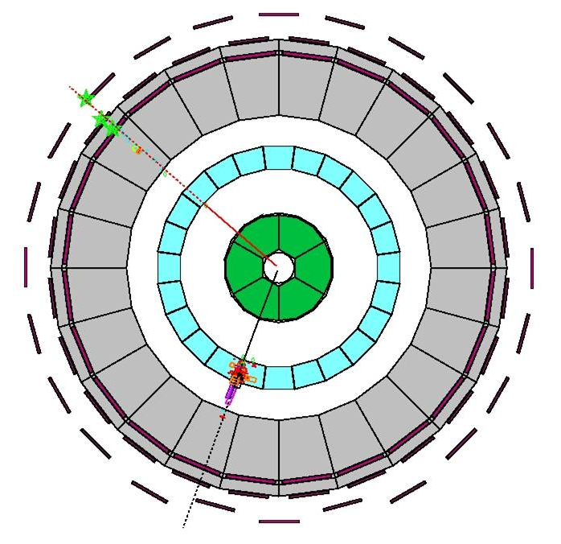
The W mass
Observables
SM tree-level prediction:
W experimental production:
  Tevatron: W events
  LEP2: WW pairs
W mass measurement:
  from reconstructed event
  final-state kinematic properties
  from σ_{WW}(√S) at LEP2
LEP: e⁺e⁻ → W⁺ W⁻ → e⁺νμ⁻ν

Slide 8
W mass measurement: main method is that using distributions of reconstructed W mass estimators
Tevatron: pp→ W → μν
W boson mass (GeV)
CDF
∫ L dt ~ 200 pb⁻¹
LEP EWWG-2011
‘First run II measurement of the W boson mass’,
Phys. Rev. D 77, 112001 (2008).
Notes:
NB: W width measuremenrts are also used

Slide 9
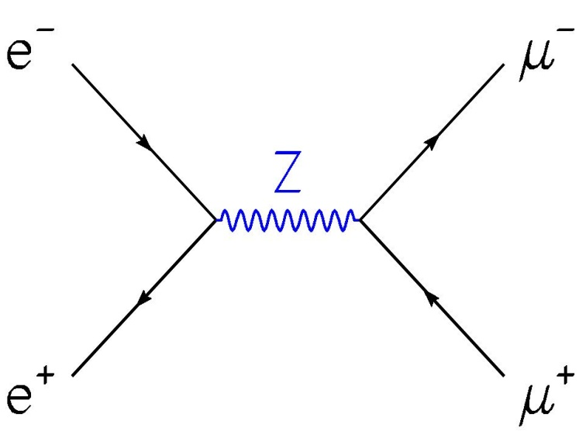
The Z mass and lineshape
Most precisely measured in e⁺e⁻ collisions at √S ~ 91 GeV
SM tree-level prediction for e⁺e⁻ → Z* → two fermions
=
Propagator in unitary gauge
& Breit-Wigner approximation
Note: k² = (M_{Z}*)² = (√s)²
*
μ
ν
=
reference mass
total width
Notes:
Z lineshape = Z mass distribution = connected to the probability to produce a Z boson with a mass close to its reference mass

Slide 10
v
SM tree-level prediction for e⁺e⁻ → Z*→ two fermions
Feynman diagram computation (COM frame, m_{leptons} neglected)
leading to non polarized differential cross-section:
Note: for quark final-states: x C_{q} (colour factor)
μ⁻
θ*
Note: asymmetric term
e⁻
e⁺
μ⁺

Slide 11
v
SM tree-level prediction for e⁺e⁻ → Z*→ two fermions
Total production cross-section:
At the Z pole (i.e. √s=M_{Z}):
hence normalization
factor
energy dependence (from the propagator): Breit-Wigner shape, function of M_{Z},Γ_{Z}

Slide 12
v
SM tree-level prediction for e⁺e⁻ → Z* → two fermions
Z pole cross-section:
Comparison with partial width tree-level computations:
hence
lineshape normalization (from
vertices i.e. couplings) is function
of M_{Z}, Γ_{Z} and Z partial widths
Similar expressions for other final-states

Slide 13
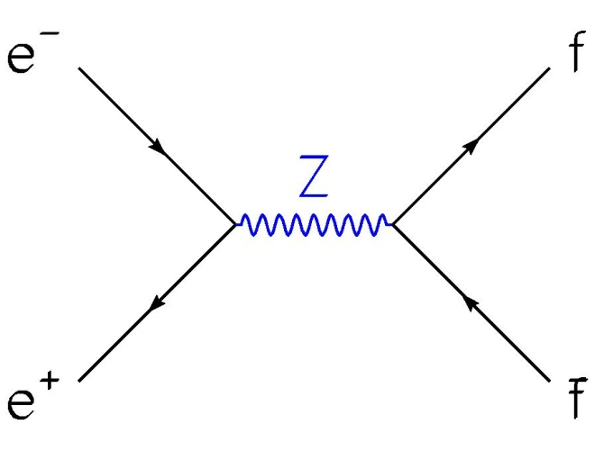
SM tree-level prediction for e⁺e⁻ → Z* → two fermions
Any fermion type:
and
Hadronic final-state (Σ over quarks ≠ top) as a reference:
e+e- collisions : √s = 2 E_{beam} = M_{Z}*
⇒ direct measurement of the Z
lineshape, accurate if E_{beam} precisely
monitored
X
*

Slide 14
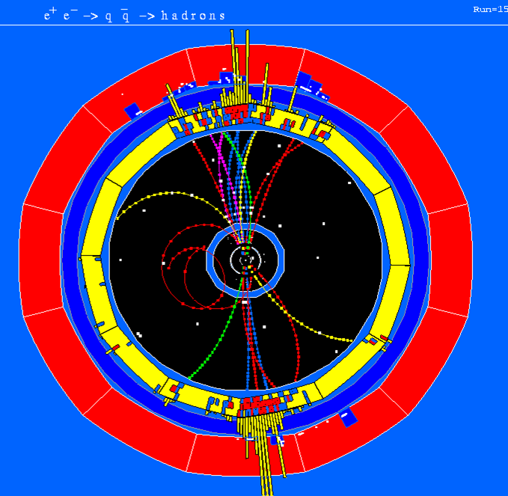
LEP: e⁺e⁻ → Z→ qq→hadrons
Z lineshape measurement
method
Split up two-fermion events according to final-state
In each sample, measure event rate as a function of √s=2E_{beam}
Fit SM prediction for Z lineshape onto data,
i.e. at tree level:
⇒ M_{Z}, Γ_{Z} , σ°_{had} and Γ_{ff}/Γ_{had} , f=e,μ,τ,hadrons,b,c

Slide 15
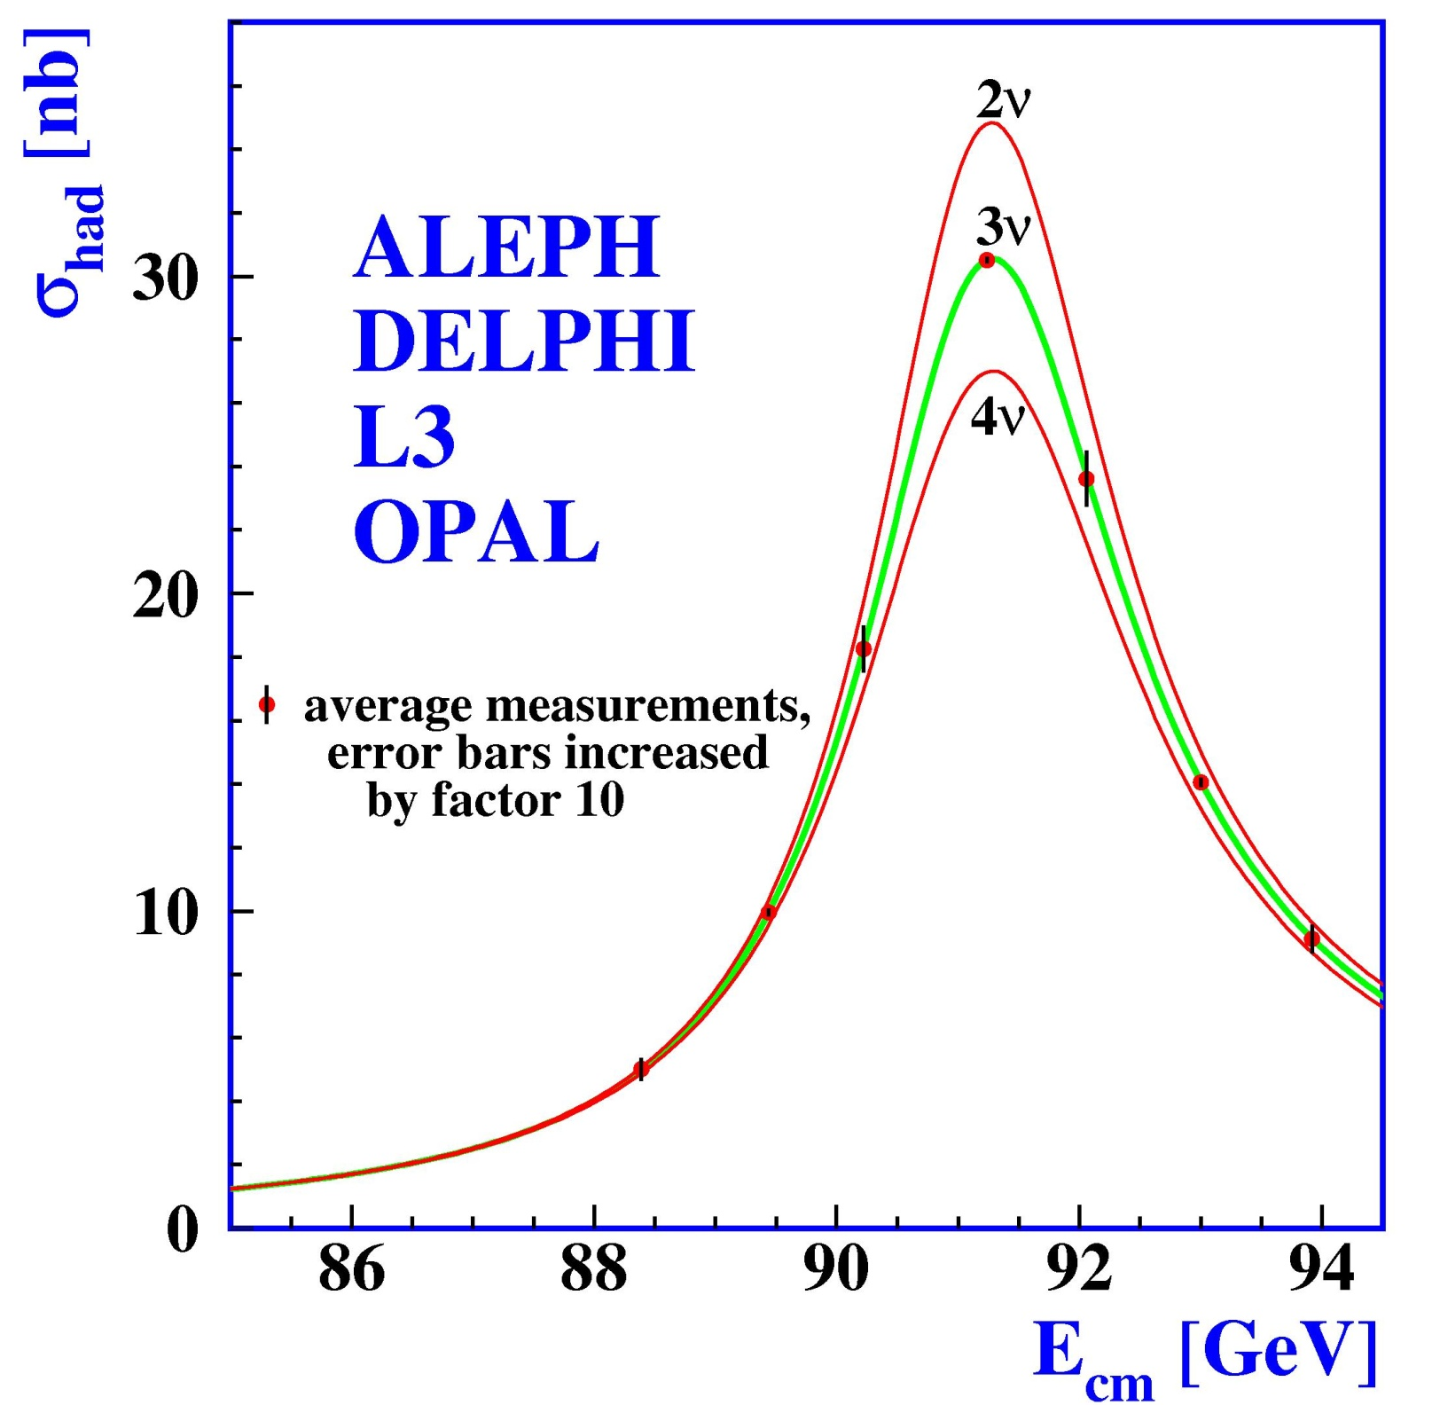
At LEP:
2MeV accuracy on √S
Z lineshape measurement
= "counting experiment"
√S
Physics Report Volume 427
Nos. 5-6 (May 2006) 257.
Final result from LEP

Slide 16
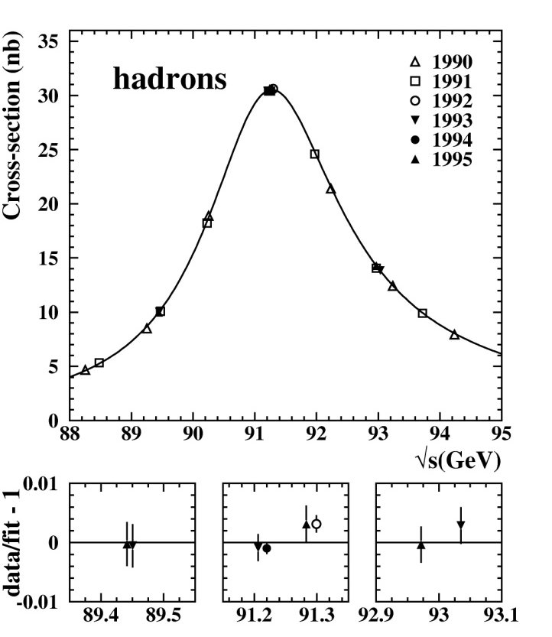
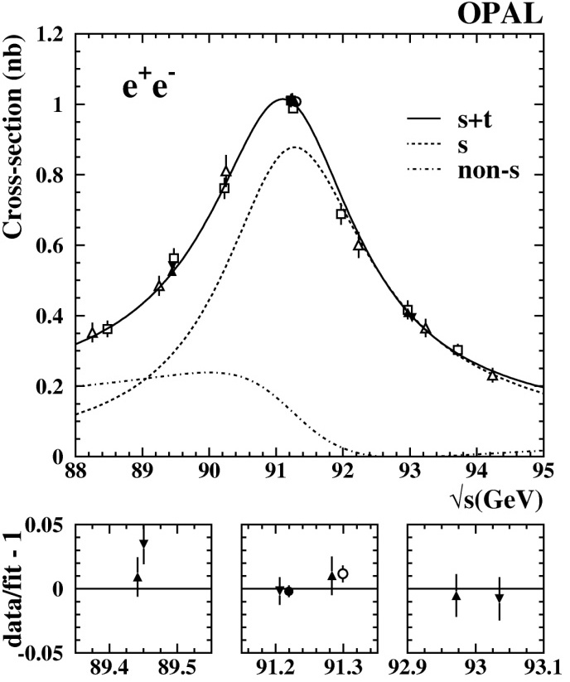
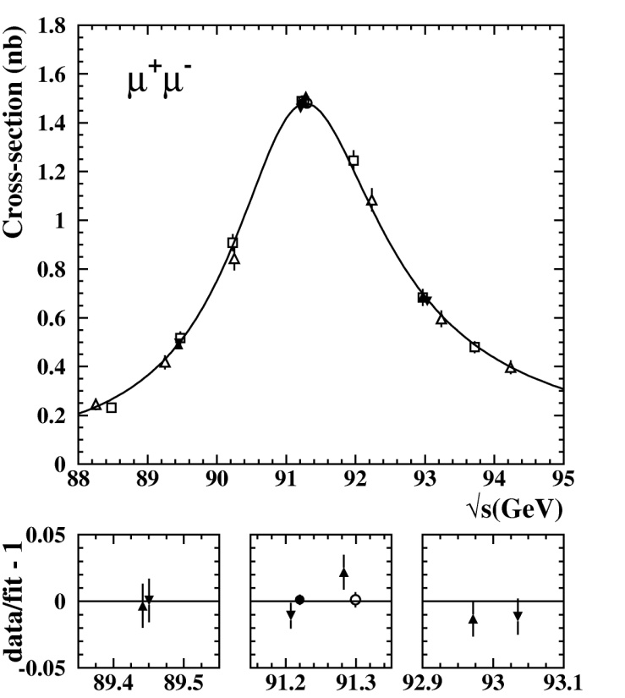
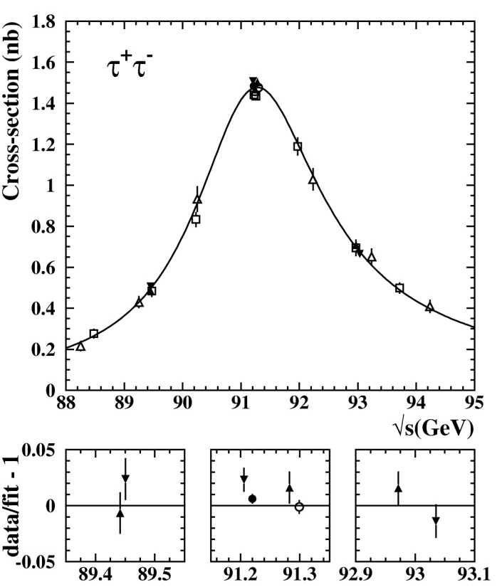
Other examples of
2 fermion
final-states
Overall, lineshape measured for Z into
hadrons,
ee, μμ, ττ ,
bb and cc
final-states
OPAL collaboration,
Eur. Phys. J.
C19 (2001) 587

Slide 17
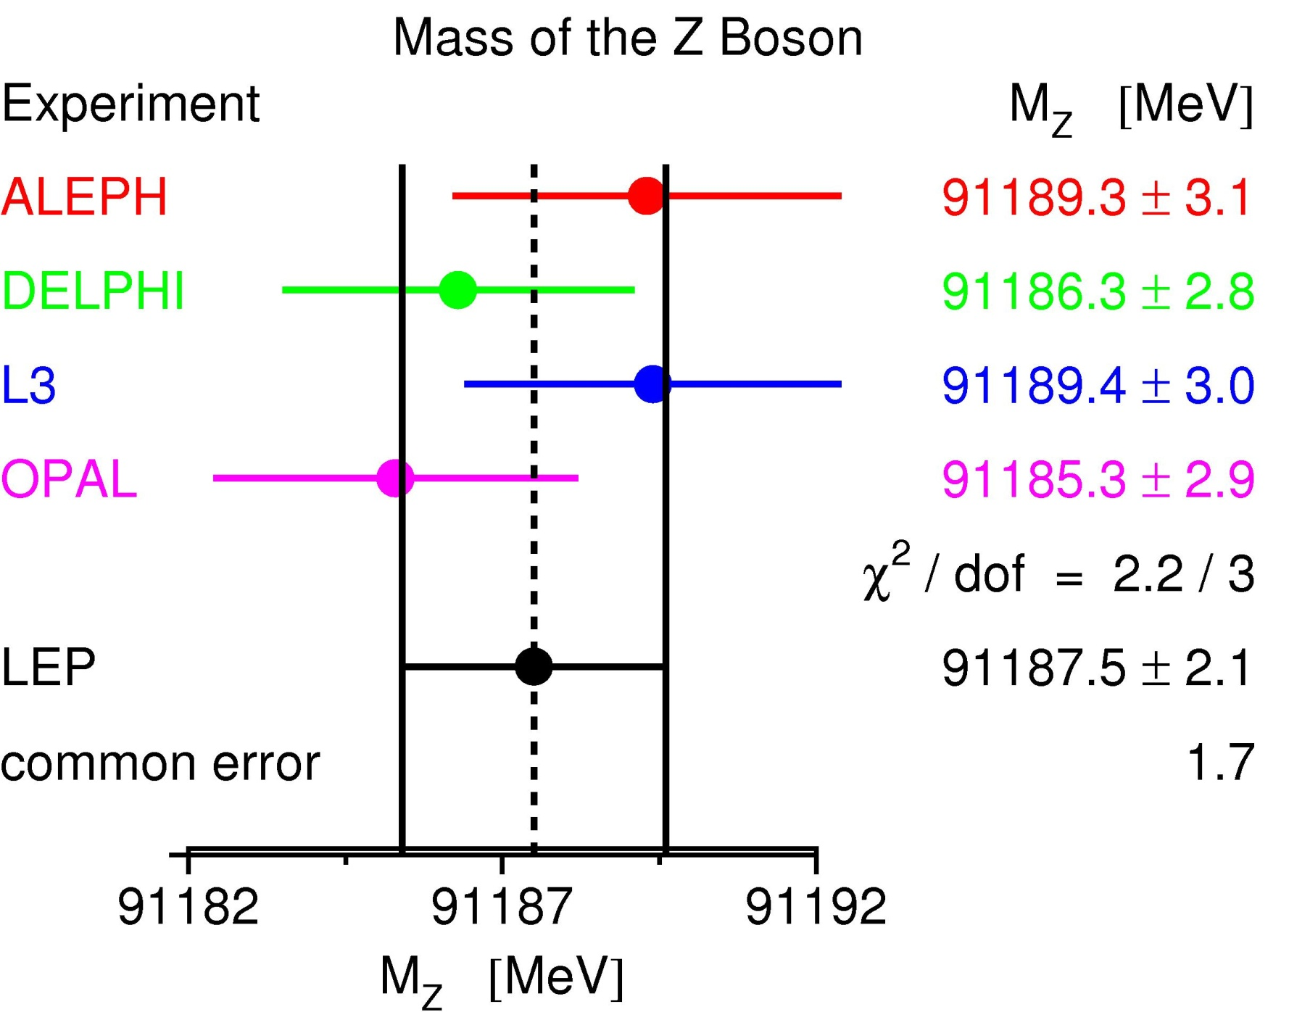
Final M_{Z} measurement at LEP
beam energy uncertainty
Physics Report Volume 427
Nos. 5-6 (May 2006) 257.

Slide 18

v
Back to the number of light ν’s
tree-level SM prediction:
⇒ total width, and hence normalization, depend on N_{ν}
data best agree with N_{ν}=3
Precise measurement of N_{ν} : from the width measurements
5.943±0.016 (0.3%)
0.5022±0.0002 (0.04%)

Slide 19

Asymmetries
Most precisely measured in e⁺e⁻ collisions at √S~91 GeV
Origin: parity violation in neutral weak interaction
=
=
⇒ if g_{a}^{f} ≠ 0, Z couplings to right and left fermions are different
⇒ asymmetries in Z couplings to fermions : not as large as for the W but more interesting (depend on sin²θ_{W})
left-handed fermions
right-handed fermions

Slide 20
v
Asymmetry observables
Forward-backward asymmetry: asymmetry of the Z decay product angular distribution (∀fermion)
Polarisation asymmetry: asymmetry of the rates of the Z decay polarised final-states (can be measured only for τ’s)
more generally
Left-right asymmetry: asymmetry of the cross-sections with incident polarized electron beams
more generally
"asymmetry parameter"

Slide 21
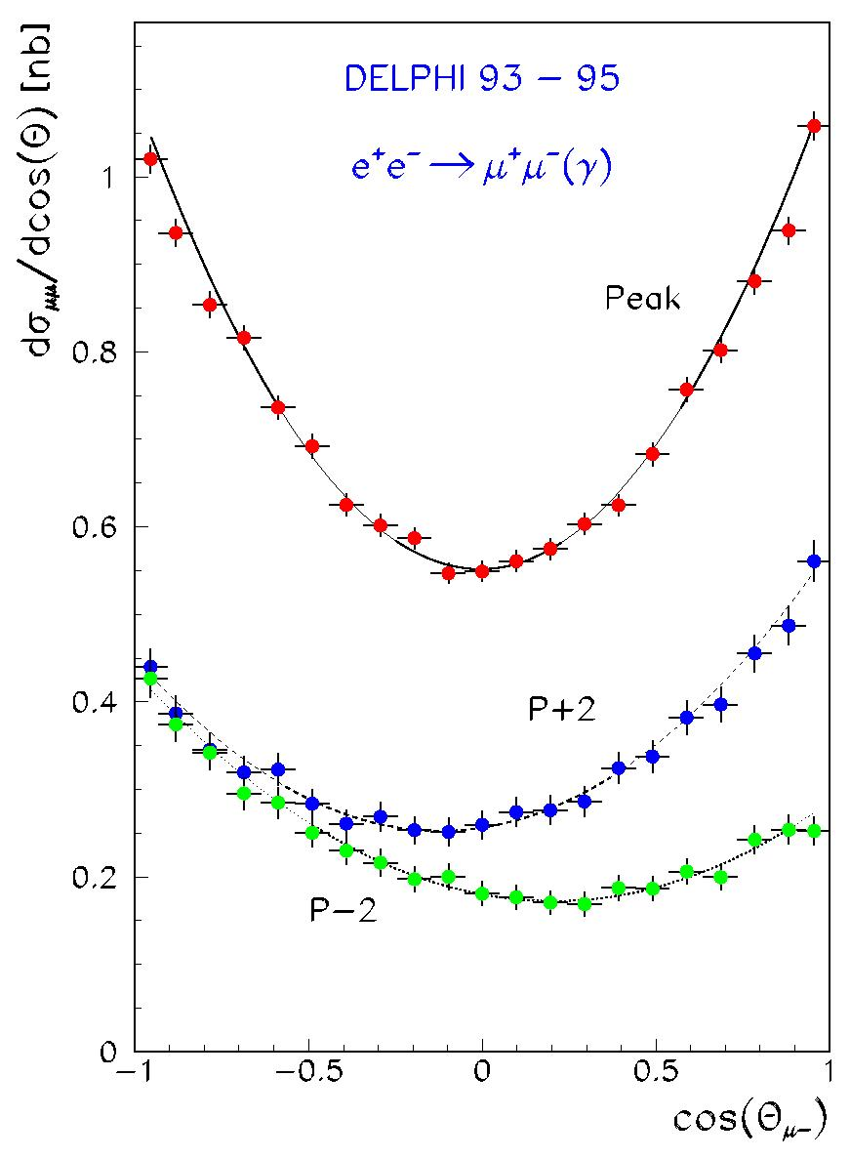
Example: A_{FB} asymmetry
angular distribution at pole (slide 10)
as a function of A_{FB}:
symmetric
asymmetric
tiny effect: A^{0,l}_{FB}~ 0.02
Physics Report Volume 427
Nos. 5-6 (May 2006) 257.

Slide 22
Summary 1: electroweak observables
W mass:
→ M_{W}
Z lineshape:
→ Γ_{Z}, M_{Z}, σ⁰_{had}, R_{l}=Γ^{had}/Γ^{l}, R_{q}=Γ^{q}/Γ^{had} (l=e,μ,τ, q=b,c)
Asymmetries:
→ A_{FB}^{0,f} (f=e,μ,τ,b,c)
→ A_{τ}, A_{e}
→ A_{l}, A_{b}, A_{c}

Slide 23
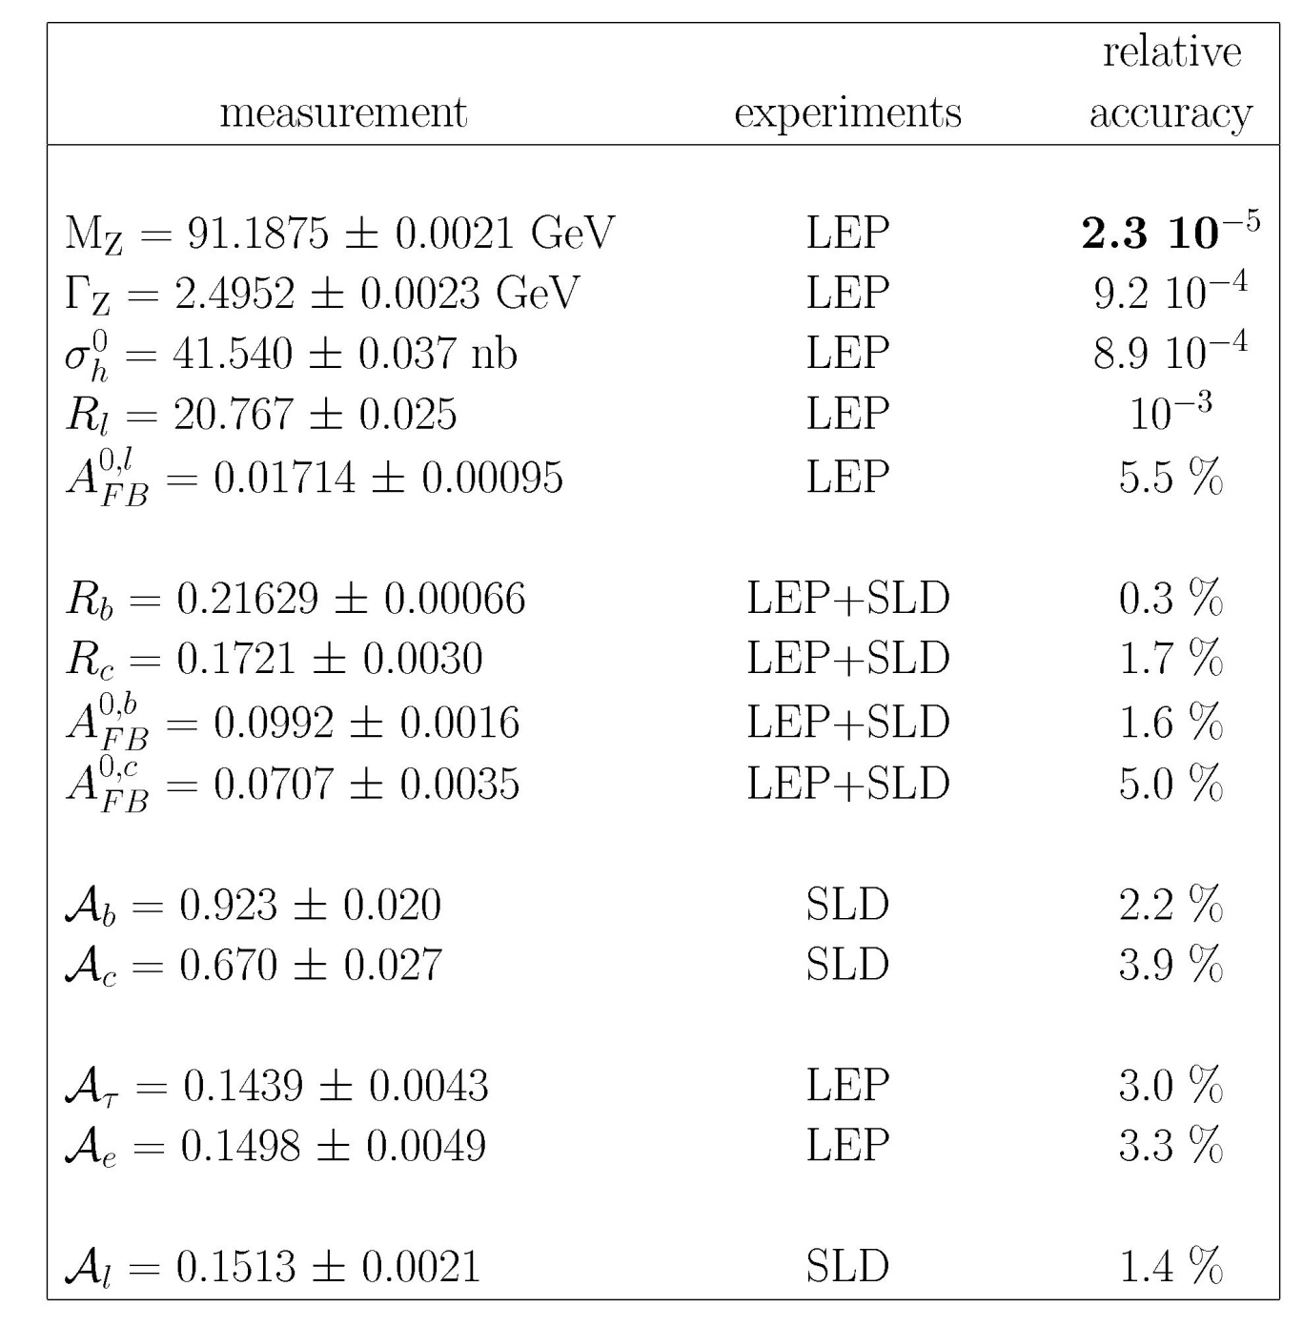
Summary 2: electroweak measurements
Z boson
These results are all final
Physics Report Volume 427
Nos. 5-6 (May 2006) 257.

Slide 24
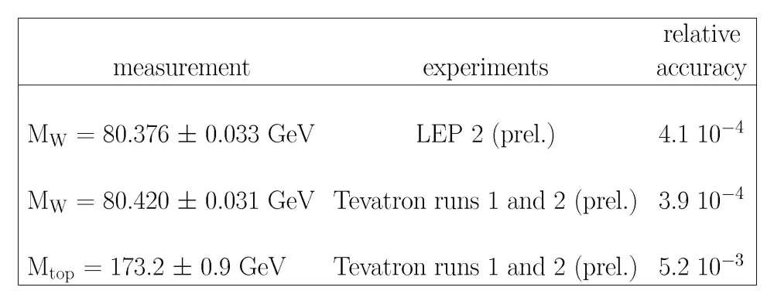
W boson
top
Summer 2011

Slide 25

Summary 3: precision tests of the Standard Model
Precise measurements of :
  the W and the top quark masses
  the Z properties (mass, width, asymmetries)
Resonance curve
c
Angular asymmetries
e⁻
θ_{c}
c
e⁺
σ
(1/σ) dσ/dcos θ_{c}
Γ_{Z}
N_{c}(cosθ_{c}>0) > N_{c}(cosθ_{c}<0)
asymmetry ~6%
m_{Z}
cos θ_{c}
to be compared with precise predictions of the Standard Model

Slide 26
"Radiative corrections"
Beyond tree-level
v
e.g. first order, e⁺e⁻ →μ⁺μ⁻ process
QED corrections
Weak corrections
= adding γ’s to tree-level
main corrections
W,Z
Z,γ
Z,γ
gauge invariant, finite and large corrections
independent of the non-em part of the theory
depend on experimental details (γ below experimental sensitivity)
independent of experimental details
depend on the electroweak theory content
⇒TESTS OF THE SM
CERN Yellow Report 89-08, ‘Z physics at LEP1’

Slide 27
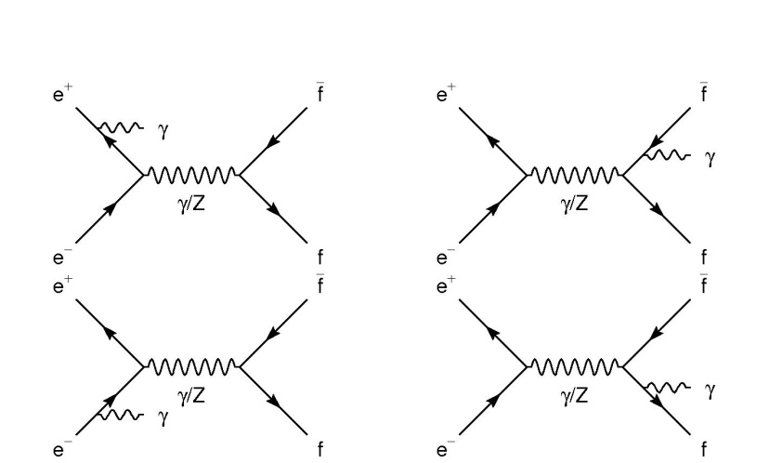
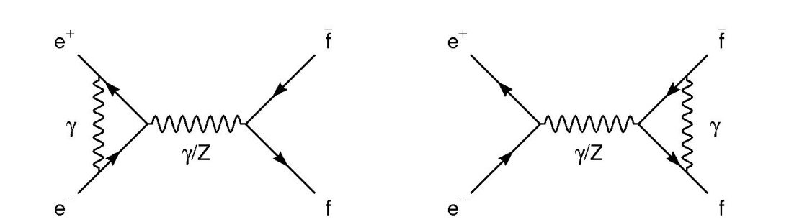
QED corrections
Initial-state radiation, final-state radiation & their interference
Main effect on Z lineshape observables: ISR
cross-section after radiation of a γ with E_{γ}=√s/2(1-z) - see slide 13
G(z): QED radiator, computed to O(α³)
ISR
FSR
ISR
FSR

Slide 28
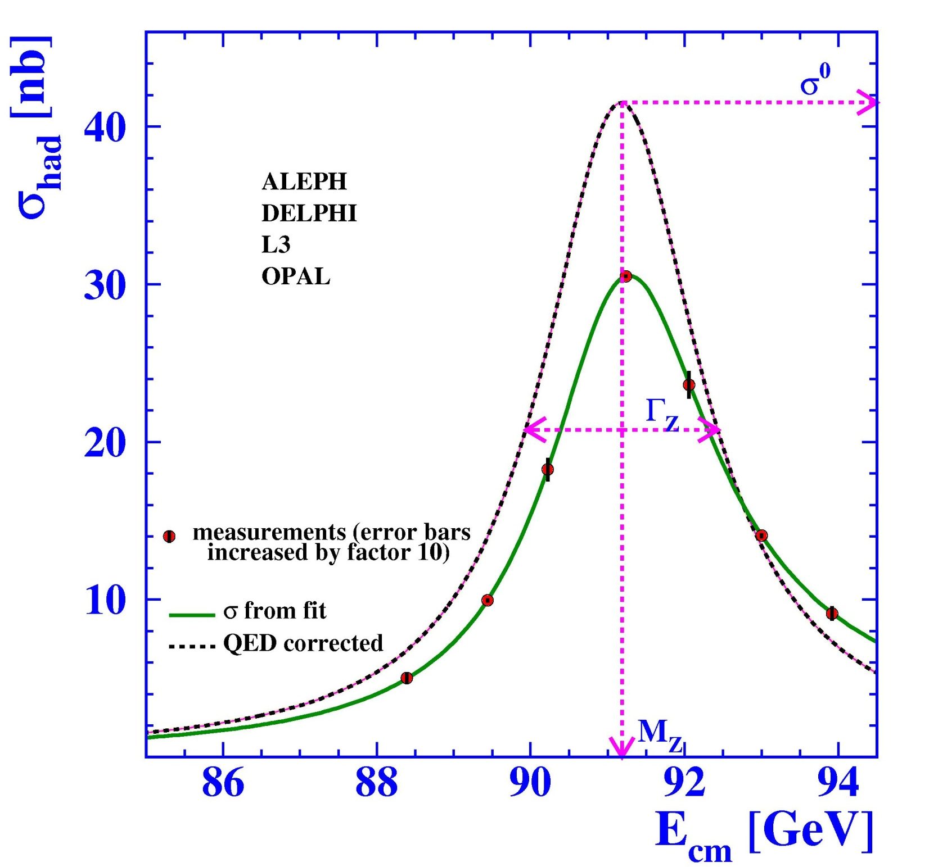
Physics Report Volume 427
Nos. 5-6 (May 2006) 257.
No QED
Reduction of the peak cross-section by 36%
Upward shift of the cross-section peak by +100MeV

Slide 29
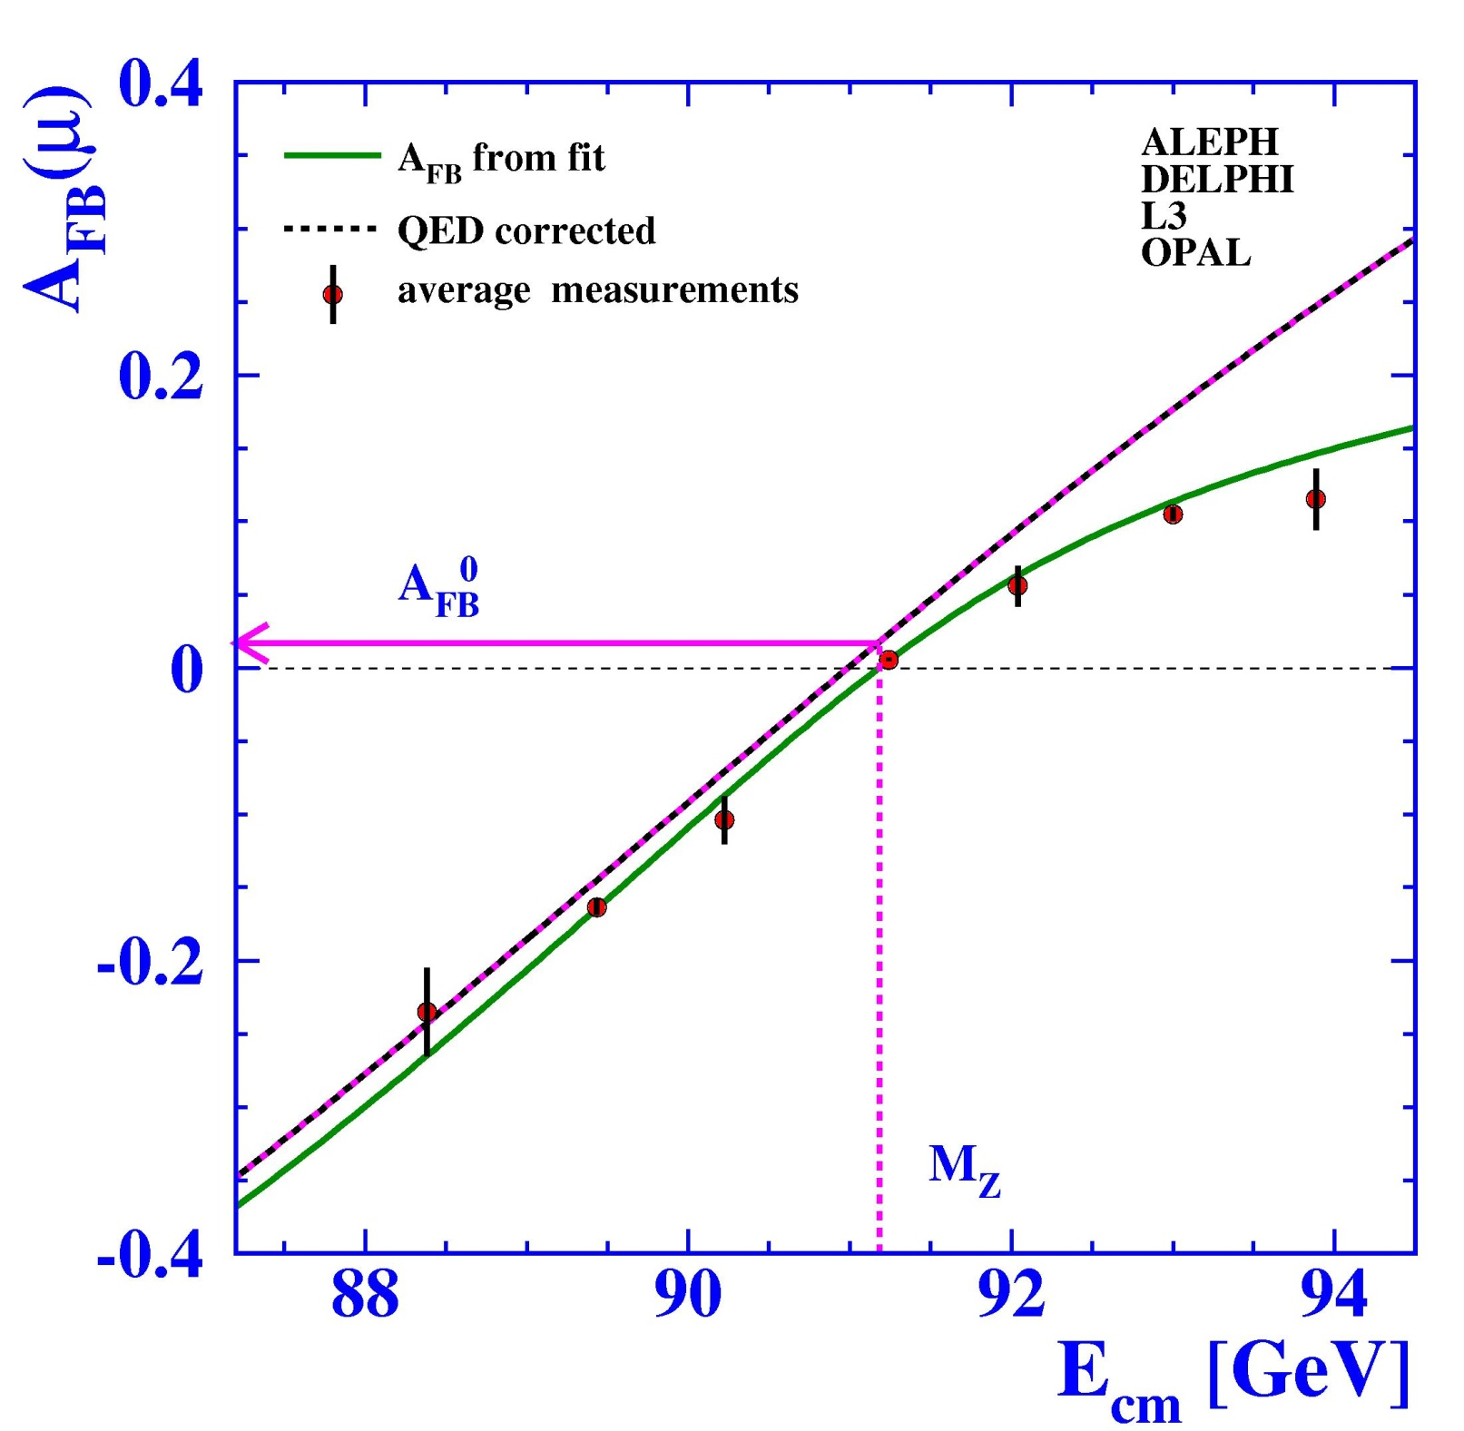
Physics Report Volume 427
Nos. 5-6 (May 2006) 257.
v
No QED
Downward shift of the forward-backward asymmetries,
e.g. at the Z pole, A^{0,l}_{FB} reduced by ~ its tree-level value

Slide 30
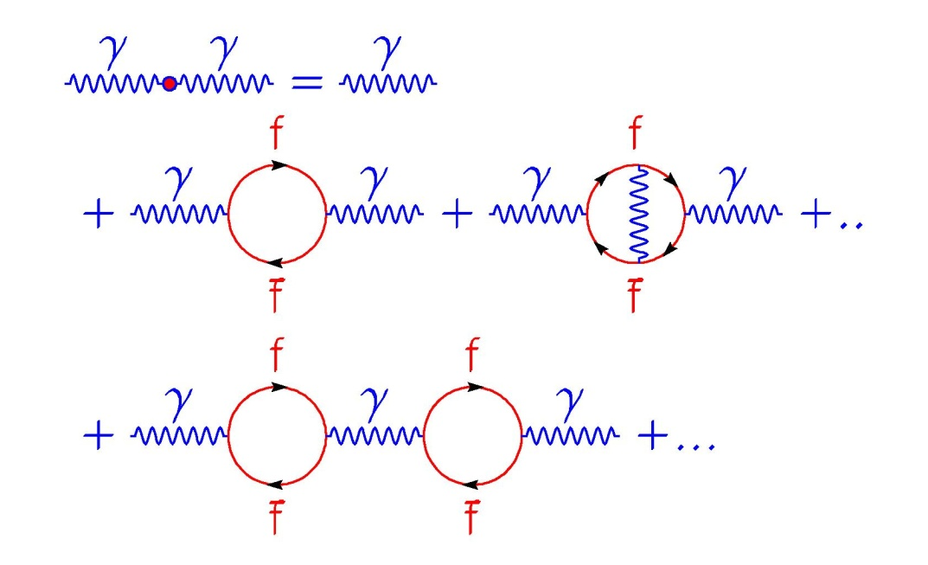
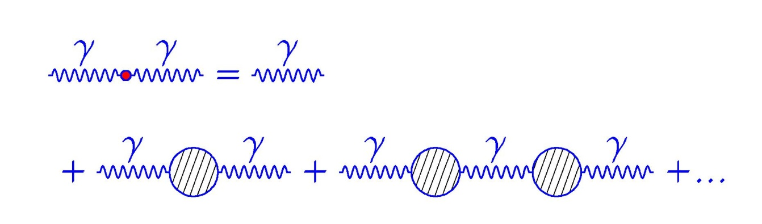
Weak corrections
Example 1 : γ propagator corrections
hence
full
propagator
tree-level
irreducible
diagrams
reducible
diagrams
Taylor expansion,
can be resummed
to all orders
sum of all irreducible diagrams, computed at a given order

Slide 31
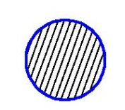
γ propagator corrections
v
In the Feynman gauge, after renormalization (in the on-shell scheme):
  tree-level:
  γ self-energy operator ("vacuum polarization tensor"):
→
  Full, renorm. propagator:
    : sum of the irreducible diagrams. Known to O(α³).
    comes from the resummation of to all orders.
bar = renormalized
γ self-energy function

Slide 32
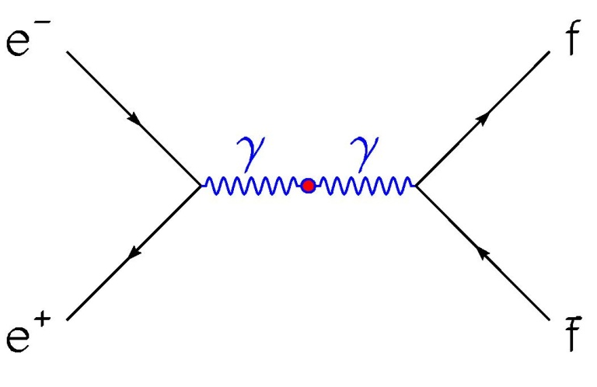
γ propagator corrections
Consequence: "running of α"
Only change w.r.t. tree-level QED amplitudes: change
into
k²~M_{Z}²: Numerically: Δα=0.05901±0.00035
(or α=1/137 → α(M_{Z}²)~1/129)
renormalized electron charge
→
tree-level
propagator
running coupling constant
Notes:
Lepton loops: 3% (order alpha3) with negligible uncertainty; Top: decoupled; Other quarks: from data on R ratio (to have complete corrections from strong interaction) 3%, main contributuion to uncertainty on Delata(alpha): low region in R ratio data (below 5 GeV) which triggered new precise measurements of the R ratio at low energy (BES, CMD-2, KLOE, SND)

Slide 33
Weak corrections
Example 2: W propagator corrections (Feynman gauge)
  tree level:
  full, renormalized propagator:
bare mass, no physical meaning
renormalized
(i.e. physical) W mass
W self-energy function
(on-shell renormalization scheme)
W width: given by imaginary
part of self-energy function, thus tree-level prediction for Γ_{W} is modified by radiative corrections

Slide 34
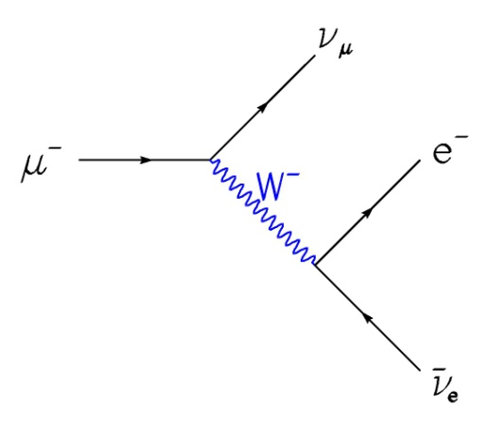
W propagator corrections
Consequence: modification of the relation between g and G_{F}
w.r.t. tree-level:
→
One-loop result:
with
and
X
α
→
β
new wrt tree-level
Fermi model
Notes:
Note: the renormalized SU(2) gauge-coupling g_bar remains equal to e/sintheta_W after renormalization in the on-shell scheme

Slide 35
Back to (simple) test of the W mass prediction
Most precise W mass measurement:
(LEP2, Tevatron)
SM higher order prediction:
  Freitas et al. (2000): Δr~0.037 at (partial) two-loop order (M_{H}=115GeV)
  ⇒ prediction:
  ⇒ once higher orders are included, SM prediction agrees with data !

Slide 36
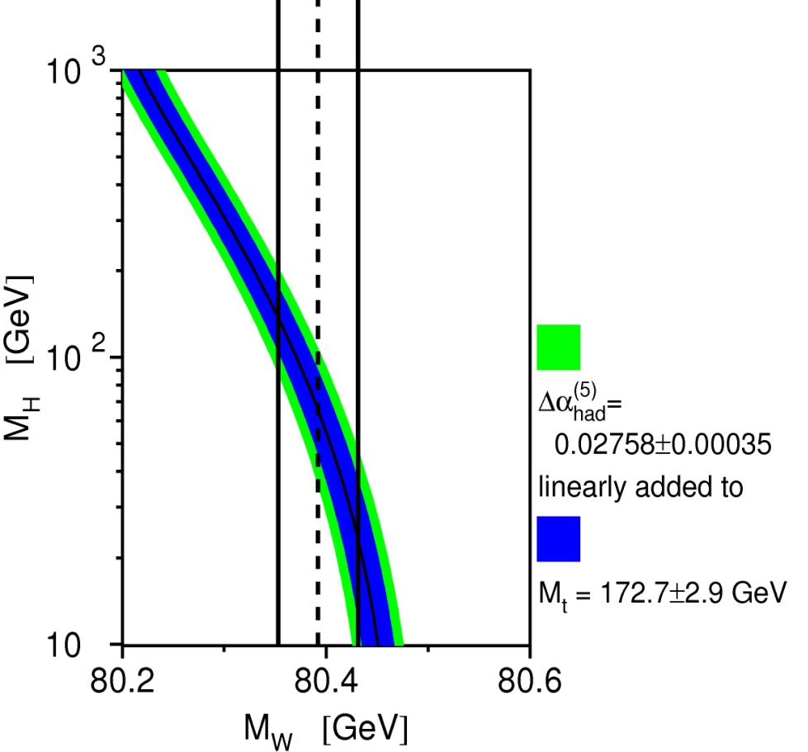
v
Beyond tree-level prediction for M_{W}
Δr(M_{H}), M_{W} & m_{top} fixed
M_{W}(M_{H}), m_{top} fixed
M_{W}=80.419GeV, m_{top}=174.3GeV
LEP EWWG-2005
A.Freitas, W.Hollik, W.Walter, G.Weiglein,
hep-ph/0007091 & Phys.Lett. B495 (2000) 338

Slide 37
Summary 3: weak corrections
Weak corrections are small (a few %) but depend on crucial SM parameters (m_{top}, m_{H}), thus allowing precise tests of the SM
In the on-shell renormalization scheme, tree-level expressions are (moderately) changed as follows:
  W mass:
  with:
  and
  Δr known to complete two-loop order and partial three-loop order

Slide 38
Summary 3: weak corrections
v
Similarily, close to the Z pole (k²~M_{Z}²), tree-level expressions are (moderately) changed as follows :
  Z lineshape:
  Asymmetries:
  with:
  These corrections are known to complete one-loop order and partial
  two- and three-loop orders.

Slide 39
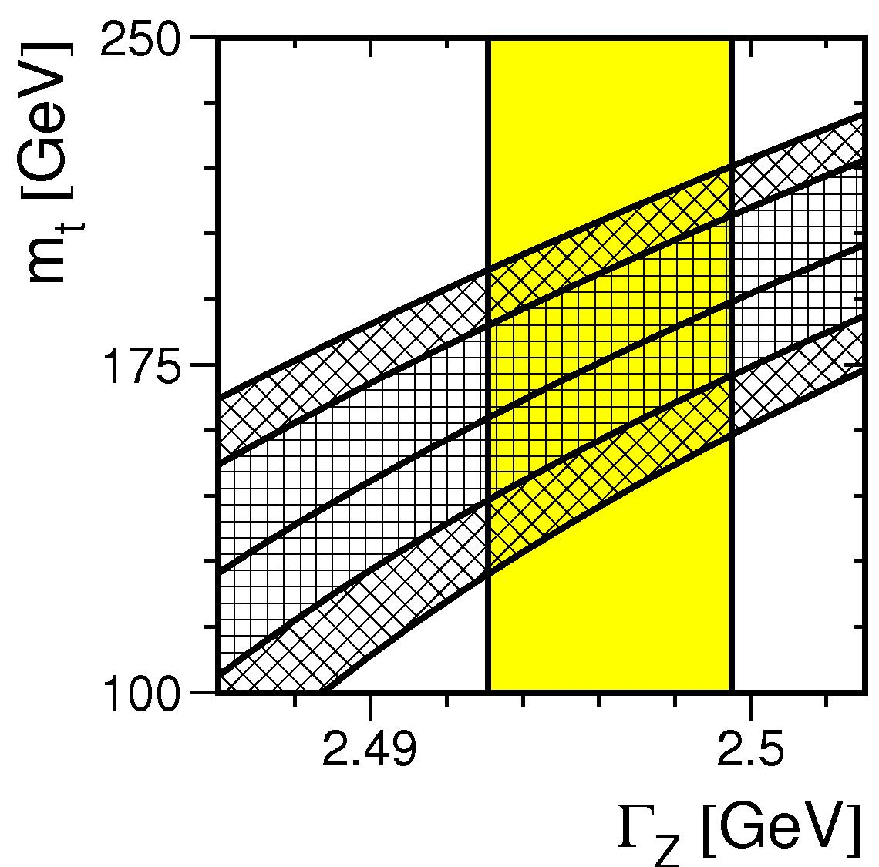
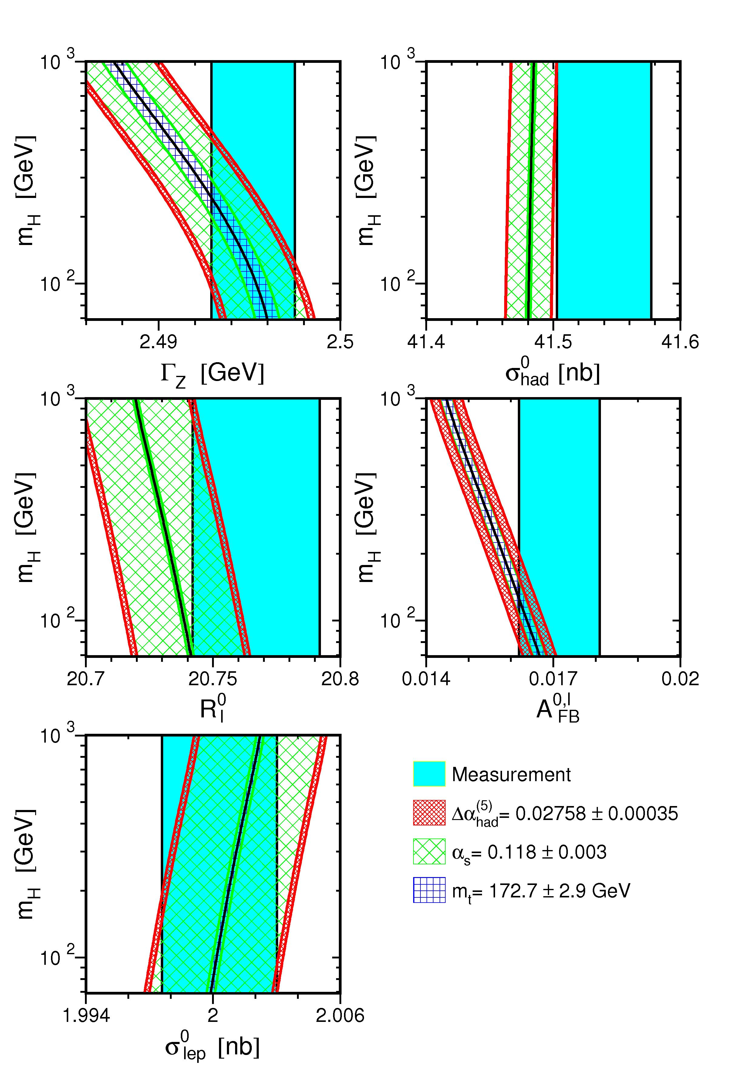
Beyond tree-level prediction for Γ_{Z}
Γ_{Z} = f_{MS}(m_{top})
Γ_{Z} = f_{MS}(M_{H})
60GeV < M_{H}< 1000 GeV
α_{s}=0.123±0.006
LEP EWWG-1995
LEP EWWG-2005

Slide 40
Tests of the SM
Tests of the SM
For a set of ~20 observables:
SM theory → predictions beyond tree-level, f(m_{top}, M_{H})
data → precise (~1% or << 1%) measurements
Step 1: test SM internal consistency with subsets of observables
Step 2: if SM-data consistency, constrain values of unknown SM parameters, e.g. M_{H}

Slide 41
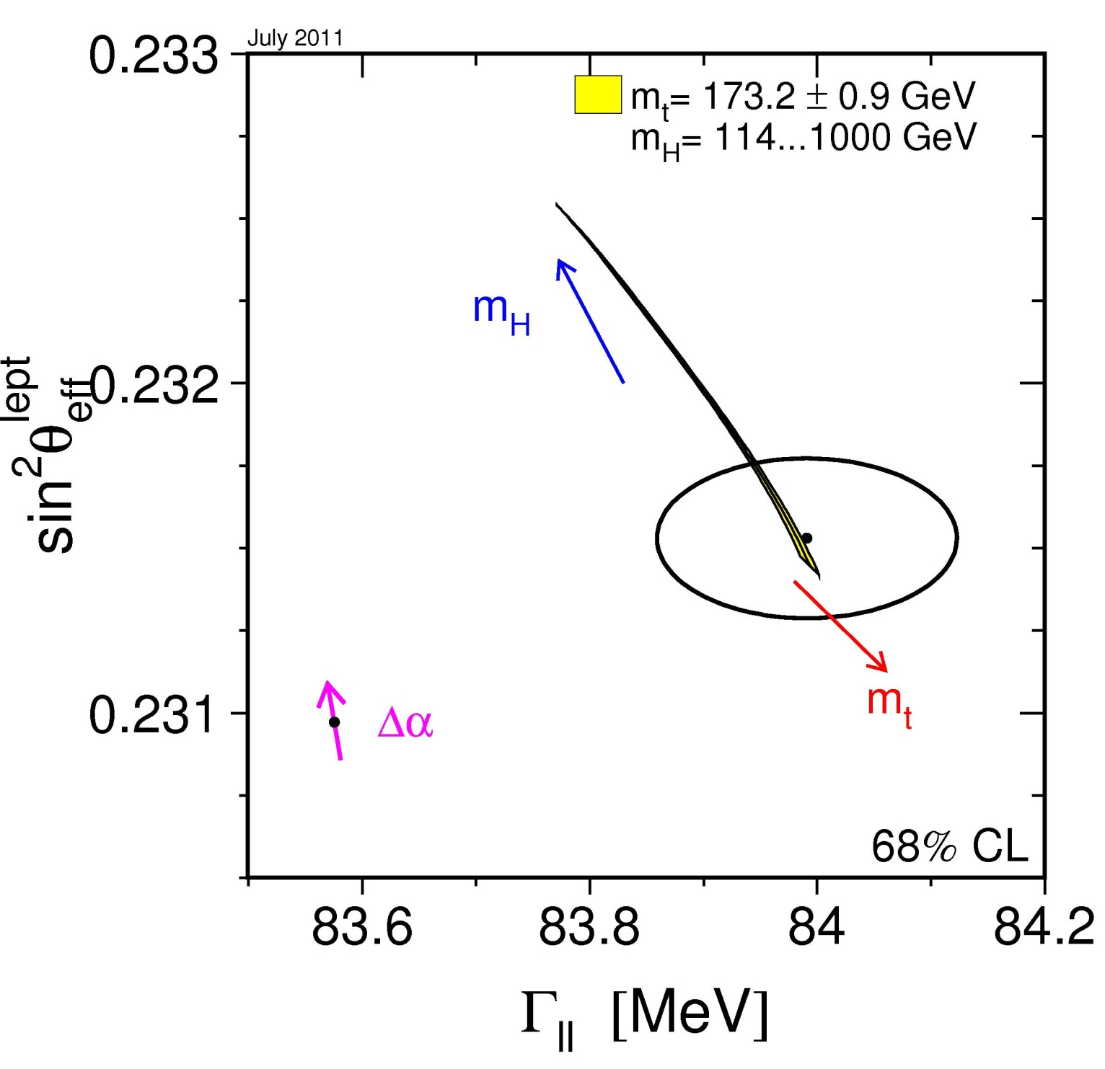
Step 1
Asymmetry measurements, tranlsated into
LEP EWWG -2011
lineshape measurements

Slide 42
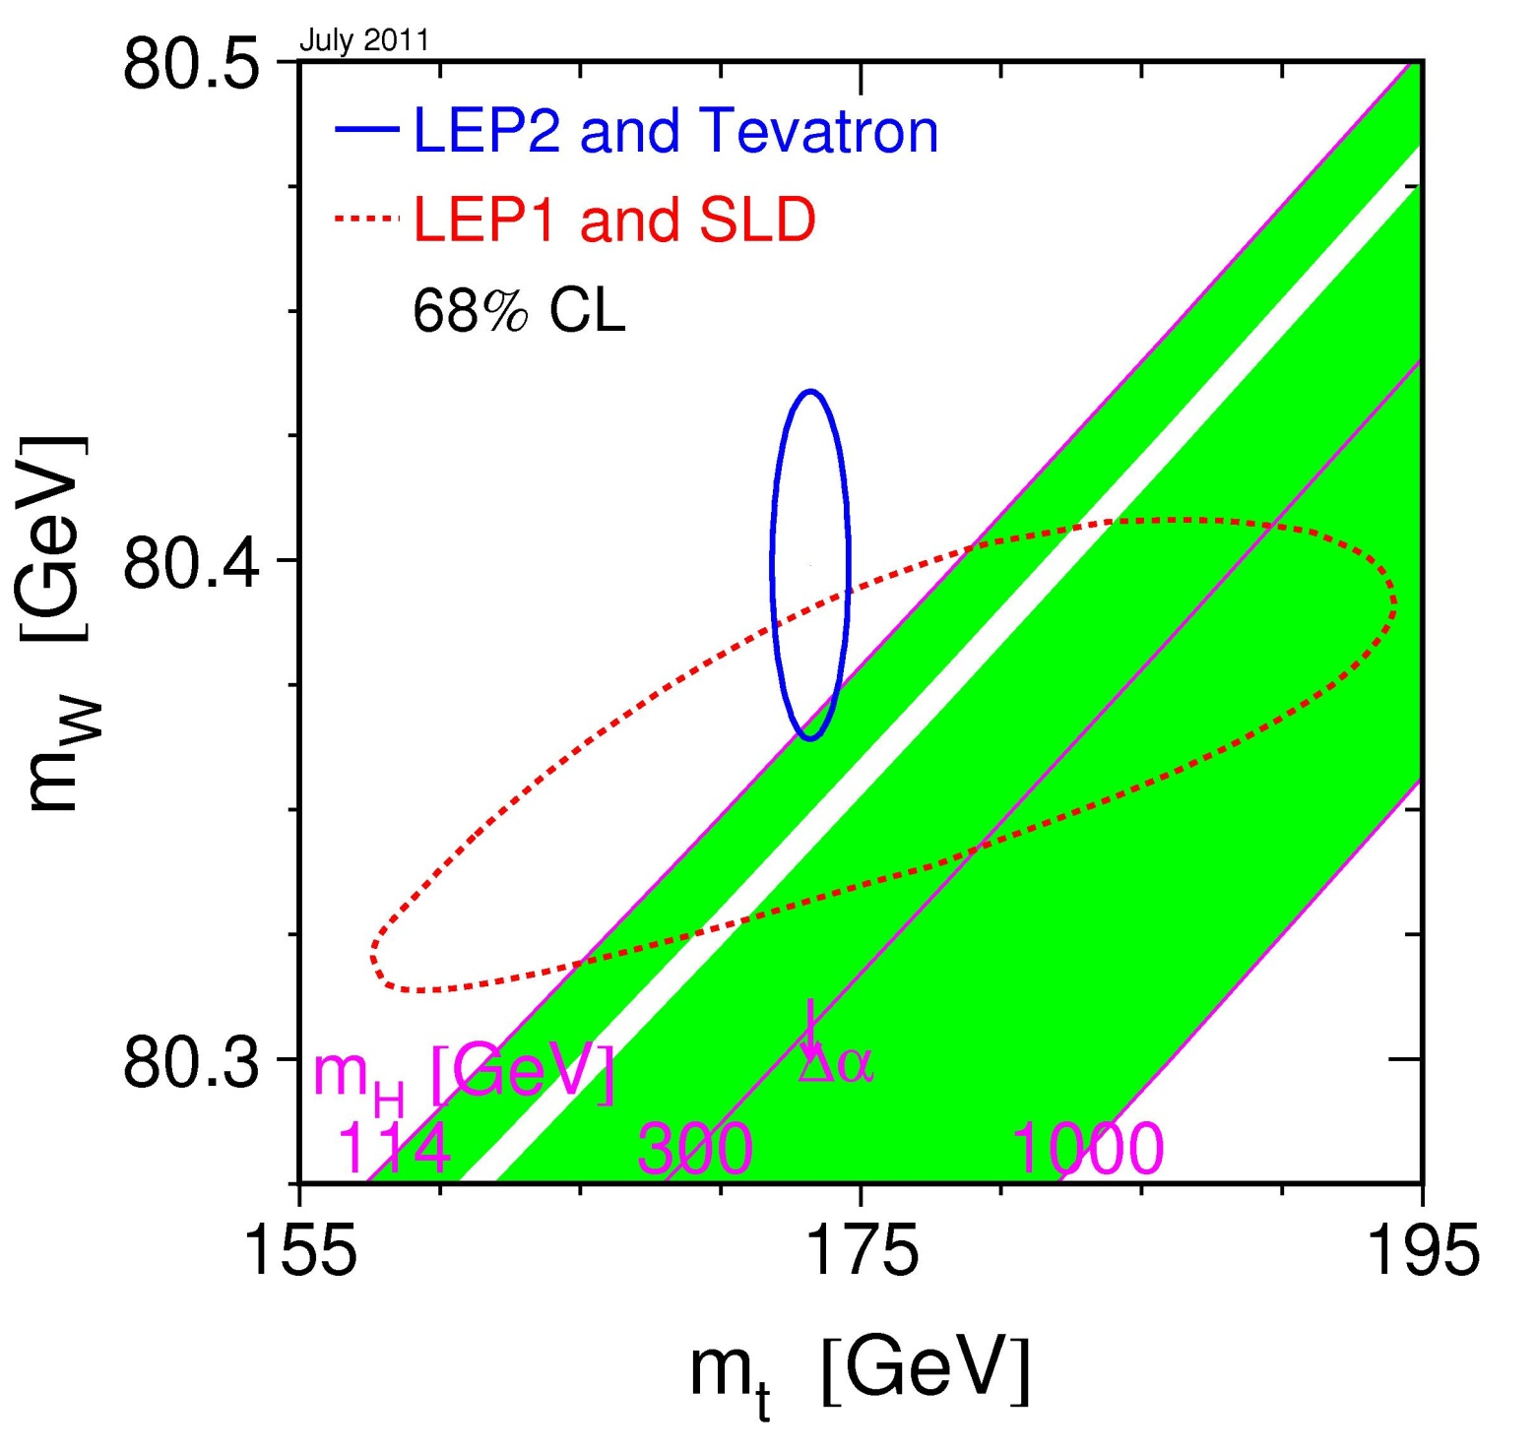
Step 1
LEP2/Tevatron:
direct mass measurements
LEP1/SLD:
all lineshape and asymmetry measurements, translated into indirect constraints on M_{W} and m_{top}
The SM agrees very well with precision
EW data
LEP EWWG –2011

Slide 43
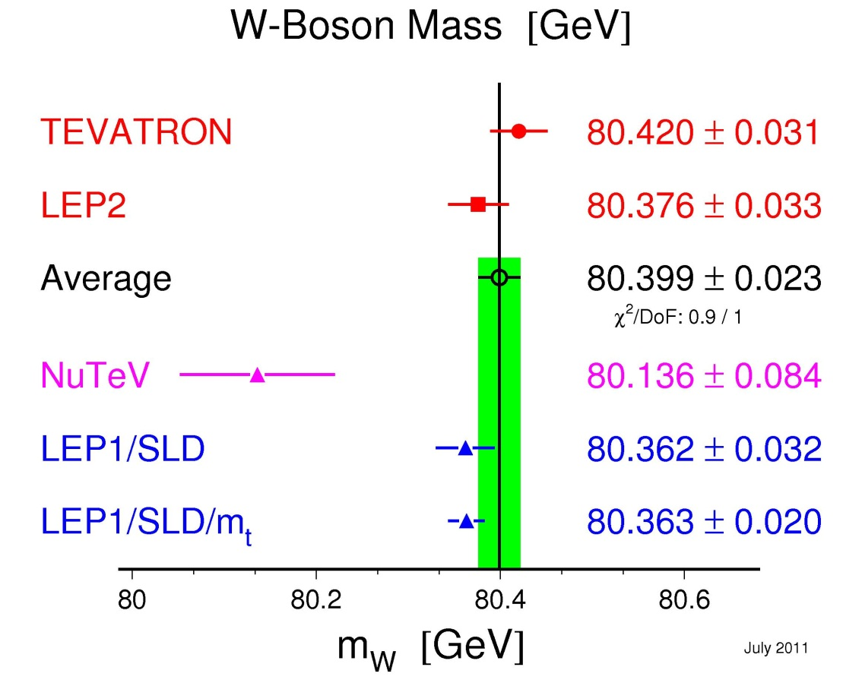
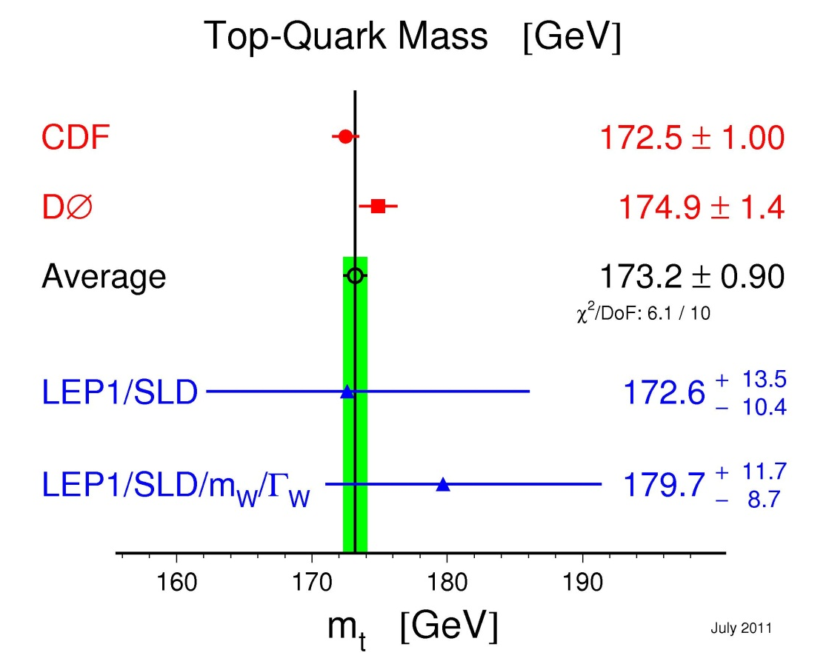
v
Step 1: indirect constraints on M_{W} and m_{top}
(from various SM fits)
Indirect constraints on M_{W} and m_{top} from precision data agree with direct measurements
LEP EWWG –2011

Slide 44
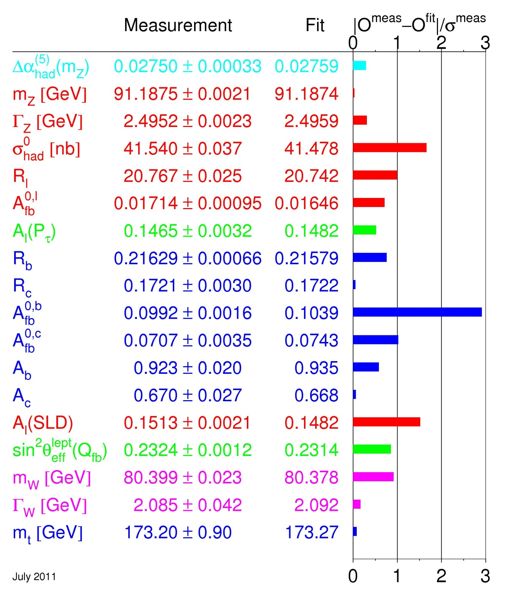
Step 2
SM fit to all precision data to constrain M_{H} value
(χ²/DoF=17.5/13 18%)
LEP EWWG–2011

Slide 45
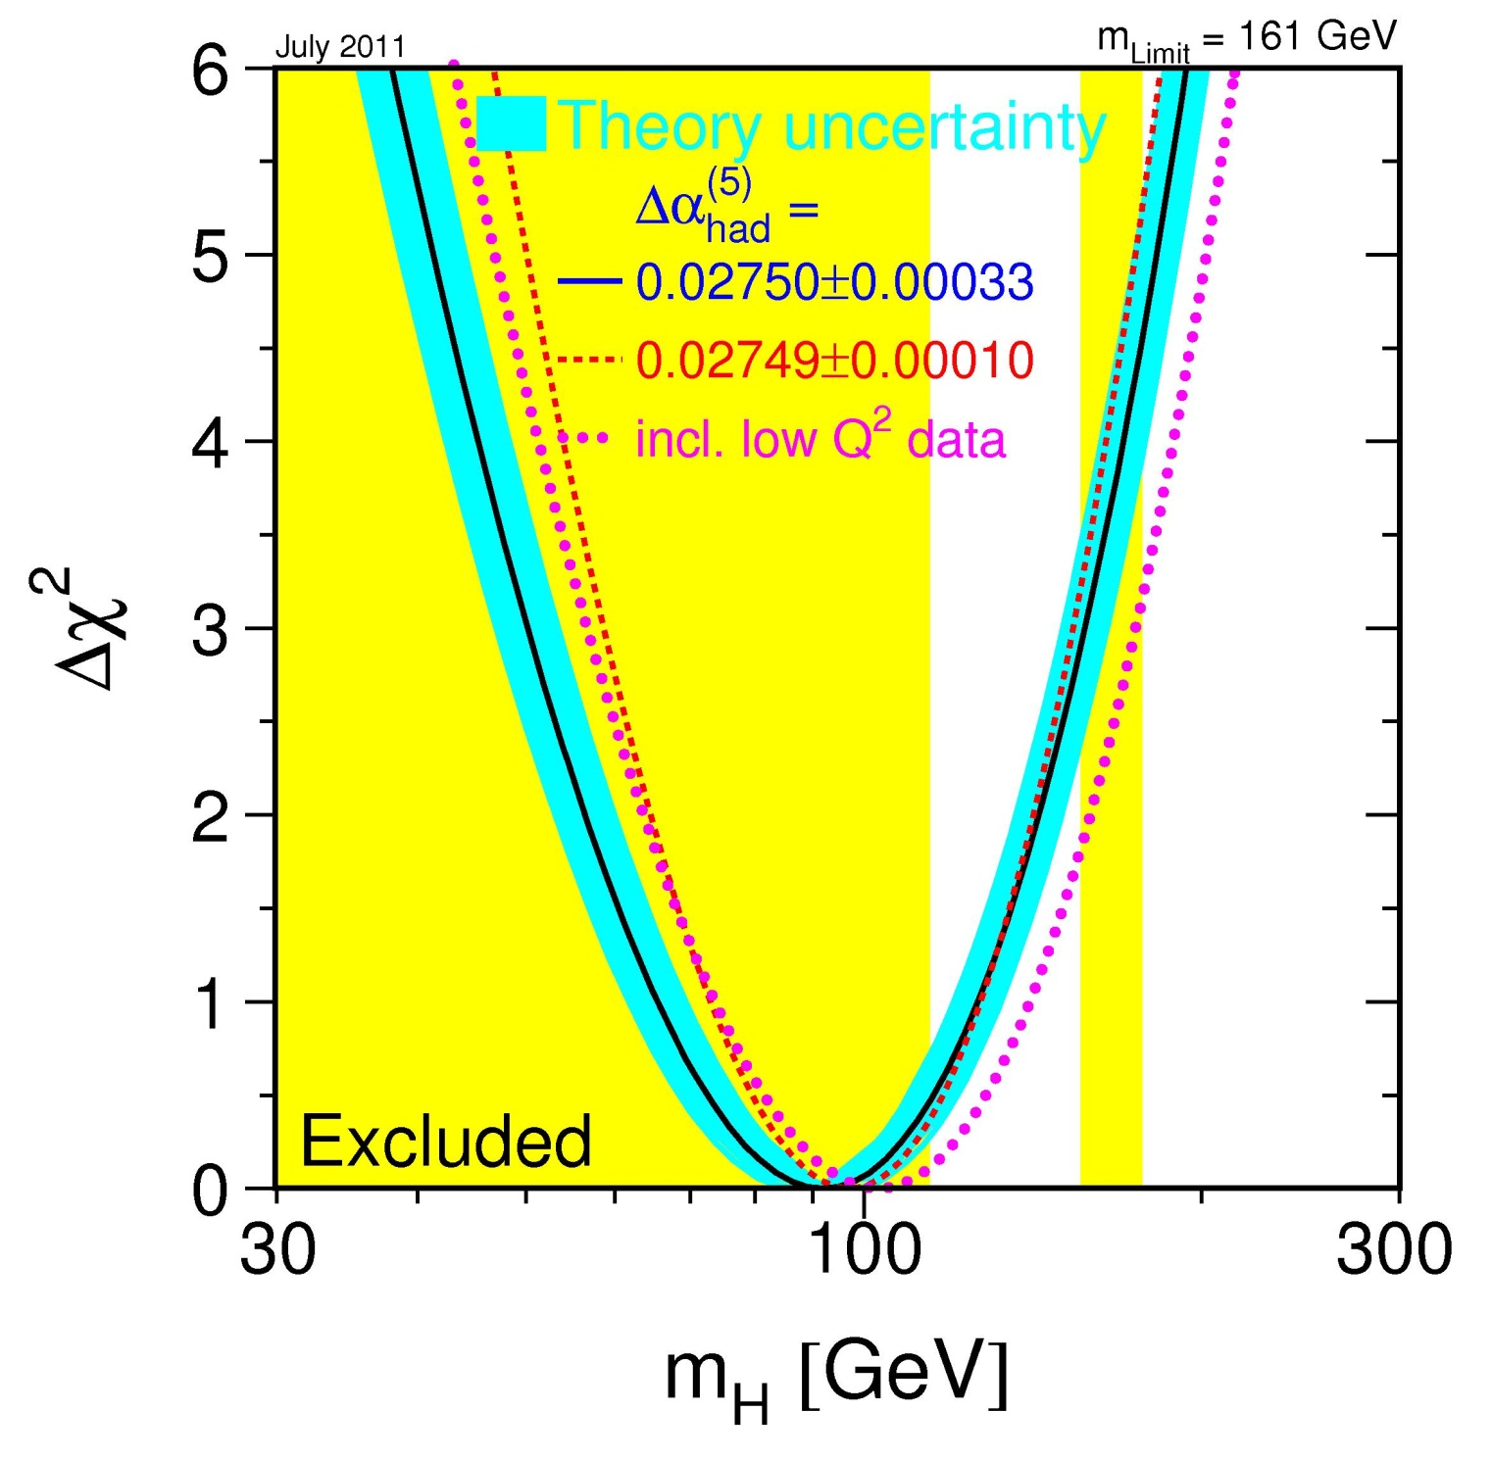
Step 2
Result from
the SM fit to all precision data :
m_{H}<161 GeV (95%CL)
95%CL limits from direct searches:
LEP : m_{H}>114.4 GeV
Tevatron: m_{H}∉[156,177]GeV
Notes:
One-sided 95% CL upper bound : corresponds to Deltachi2=2.7

Slide 46
Fit of Standard Model parameters
v
M_{W} fit
M_{top} fit
M_{H} fit
 | Z pole data | Z pole data + m_{top} | Z pole data + M_{W},Γ_{W} | Z pole data + m_{top},M_{W},Γ_{W}
m_{top}(GeV) | 173 +13 -10 | 173.2 ± 0.9 | 179.7 +11.7 -8.7 | 173.2 ± 0.9
m_{H} (GeV) | 118 +203 -64 | 122 +59 -41 | 158 +260 -88 | 92 +34 -26
α_{s}(M_{Z}²) | 0.1190 ± 0.0027 | 0.1191 ± 0.0027 | 0.1190 ± 0.0028 | 0.1185 ± 0.0026
χ² /dof (P) | 16.0/10 (9.9%) | 16.0/11 (14%) | 17.0/12 (15%) | 17.5/13 (18%)
sin²θ_{eff}^{lept} | 0.23149±0.00016 | 0.23149±0.00016 | 0.23142±0.00014 | 0.23138 ± 0.00013
sin²θ_{W} | 0.22334±0.00062 | 0.22332±0.00039 | 0.22288±0.00036 | 0.22303 ± 0.00028
M_{W} (GeV) | 80.362 ± 0.032 | 80.363 ± 0.020 | 80.387 ± 0.018 | 80.378 ± 0.014
LEP EWWG –2011

Slide 47
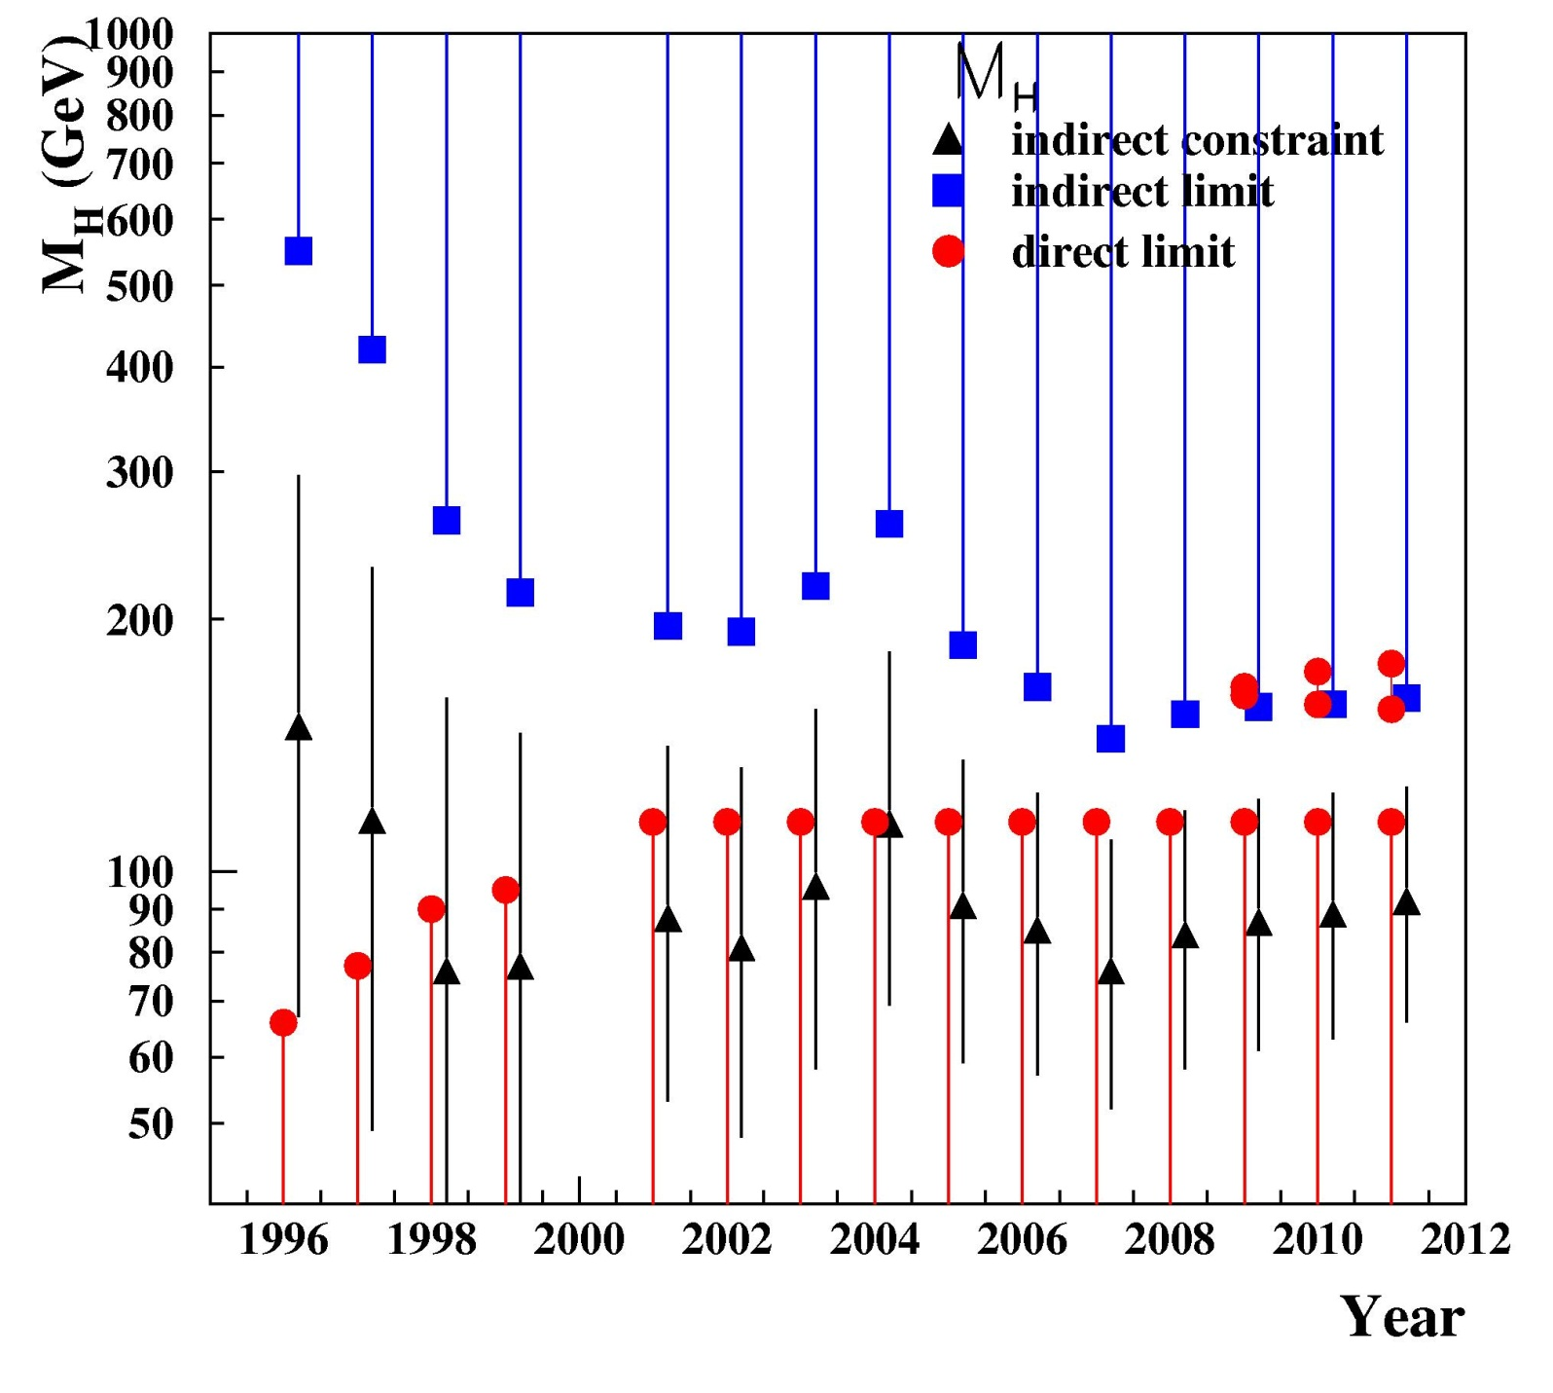
M_{H}
indirect constraint
indirect upper limit
direct upper limit
m_{top} measurement precise enough to constrain M_{H}
new value of Δα⁽⁵⁾_{had}
1st M_{W} measurement at LEP
final LEP limit on M_{H}
new M_{W} and A_{FB} at LEP
new measurements of m_{top} and/or M_{W}
2nd order EW corrections
new m_{top}
2-loop EW corrections

Slide 48
Conclusions
The gauge sector of the Electroweak Standard Model has been tested at quantum loop level and found in excellent agreement with data (for a low-mass Higgs boson).
Next step: identify the mechanism of spontaneous breaking of the electroweak symmetry (either Higgs mechanism or other).
We expect the SSB sector of the theory to behave like
a low-mass Higgs boson to comply with EW precision data.

Slide 49
BACK-UP SLIDES

Slide 50
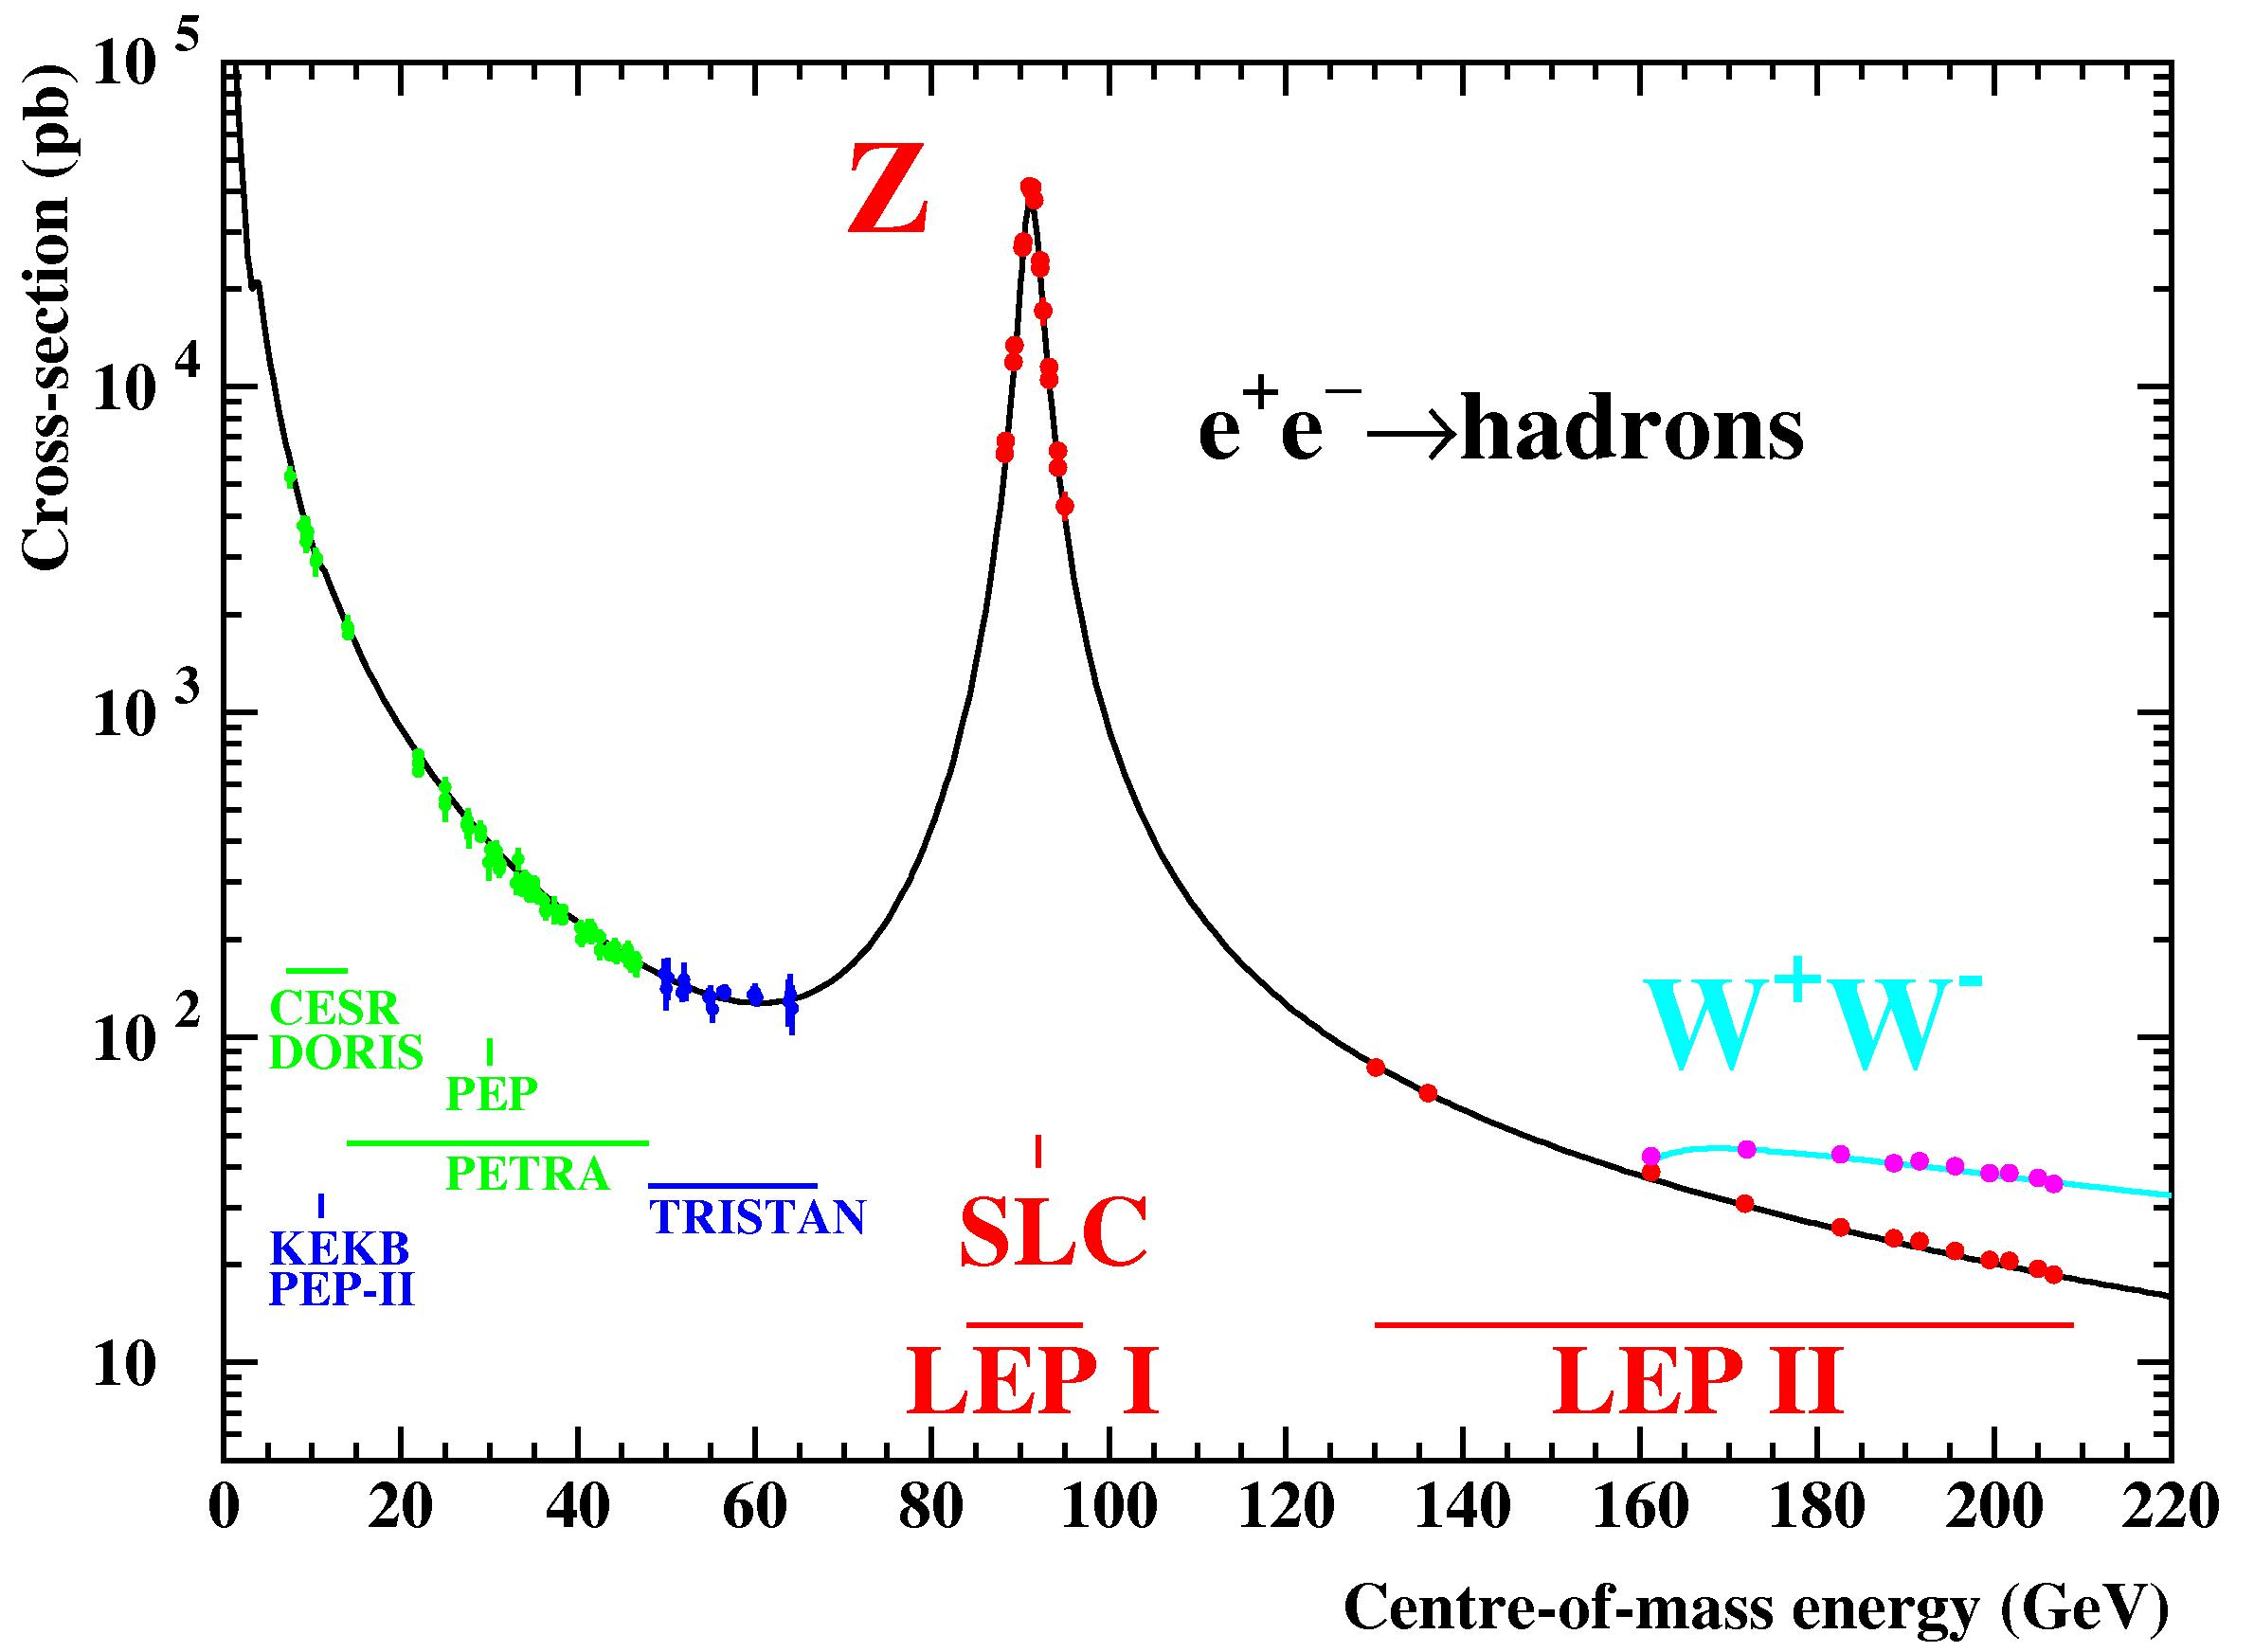
v
Physics Report Volume 427
Nos. 5-6 (May 2006) 257.
Notes:
Gamma/Z exchange: close to the Z pole, gamma exchange contribution is very small (a few per mille of the total cross-section in the mumu final state) but it is included in the predictions (together with gamma-Z interference term)

Slide 51
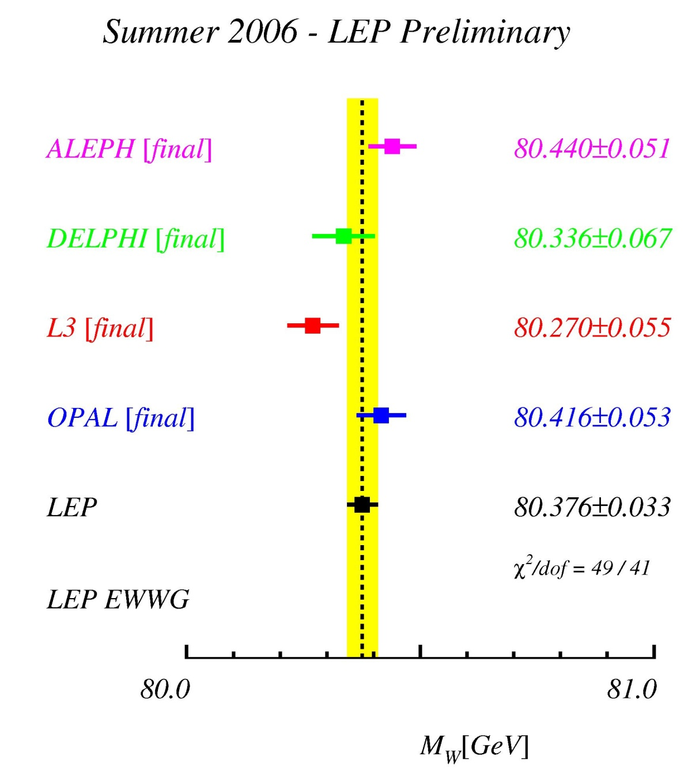
M_{W} at LEP

Slide 52
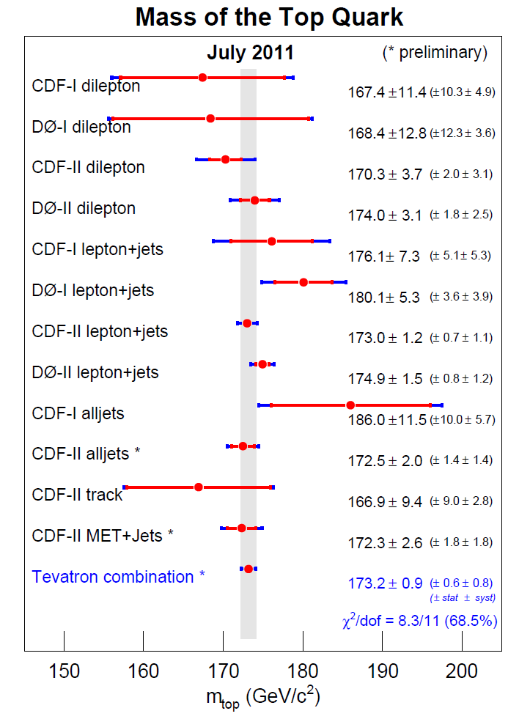

Slide 53
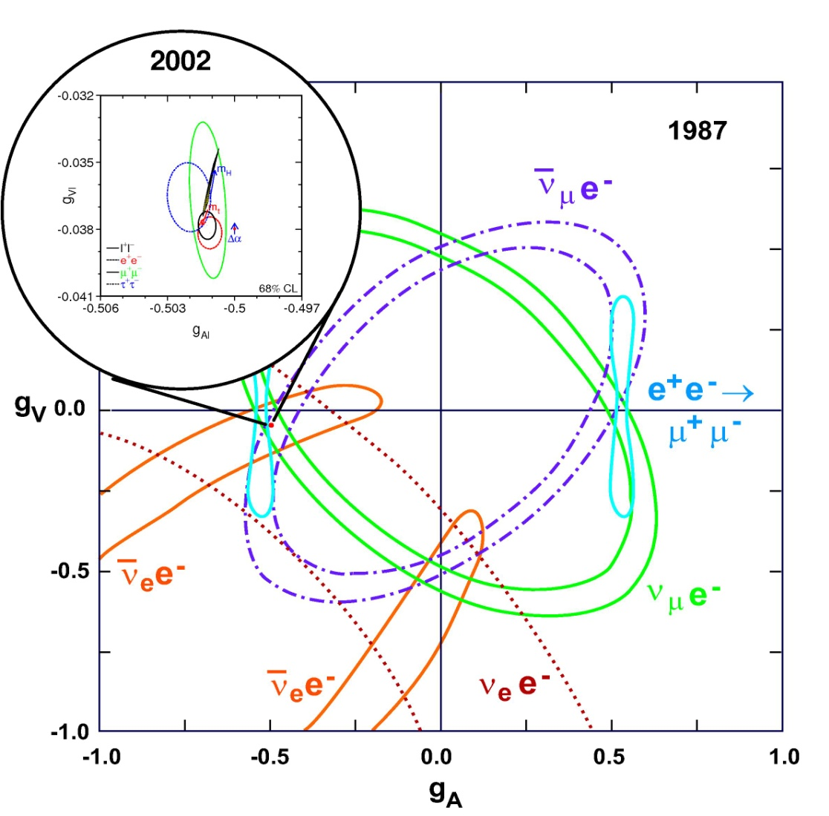
Physics Report Volume 427
Nos. 5-6 (May 2006) 257.

