Slide 1
Electroweak interaction
1. Basics and history
2. The Standard Model
3. Tests of the Standard Model

Slide 2

Lecture 2
The SU(2)xU(1) Standard Model
Elementary constituants and the SM gauge group
The electroweak interaction and the Higgs mechanism
Couplings in the electroweak SM
Fermion masses
First experimental facts in favour of the electroweak SM

Slide 3
Gauge symmetry group, G
Constituants
IVB theory with (V-A) charged current:
with e.g.
QED:
  with
3 currents (J_{lept}, J†_{lept}, J_{em}) ⇒ 3 charges, generators of G :
  which verify:
  with ⇒ T±,Q do not form a closed algebra, G ≠ SU(2)
Notes:
Three currents (thus three gauge bosons) mean three charges and thus a group with at least three generators. SU(2): simplest group with three generators.

Slide 4
Gauge symmetry group, G
First choice: add another neutral gauge boson coupled to T₃
⇒ G = SU(2) x U(1) : weak neutral currents predicted
Second choice: add a new fermion to modify currents and close the algebra
    ⇒ G = SU(2) : no weak neutral current
  model of Georgi and Glashow (1972). Ruled out by the discovery
  of weak neutral-currents (1973).
Note: in both cases, unitarity is preserved (new diagrams).
Notes:
Unitarity : process nu nu_bar gives W+W- (t-channel e- exchange) with both Ws being longitudinally polarized : matrix element violates unitarity at high energy
* SU(2)xU(1): adds an s-channel diagram nu nu_bar gives Z gives WW which cancels the above matrix element
* SU(2): adds a u-channel diagram nu nu_bar gives WW via the exchange of a new fermion in the u-channel, cancellation also occurs

Slide 5
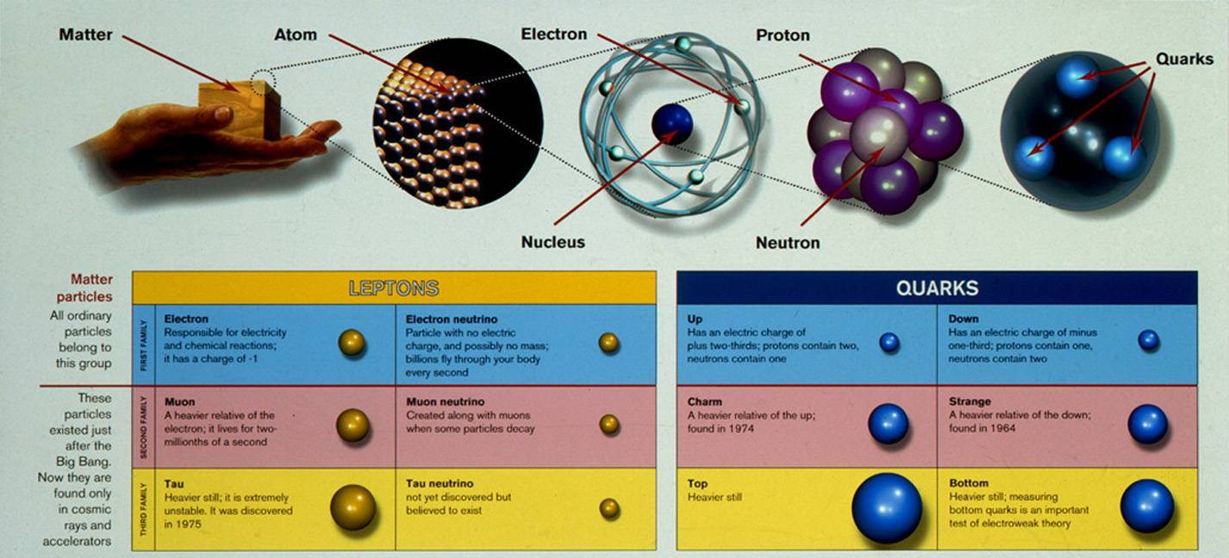
The 12 elementary constituants
6 leptons
6 quarks
e⁻
ν_{e}
u
d
μ⁻
ν_{μ}
c
s
τ⁻
ν_{τ}
t or top
b
All constituants observed experimentally: from e⁻ (1897) to top quark (1995) and ν_{τ}(2000). So far, no internal structure detected.

Slide 6
Fermions
Fermion ″left-handed″ and ″right-handed″ components:
  chirality operator: γ₅ chirality projector: ½(1±γ₅)
  ψ_{L} : negative chirality or left-handed component
  ψ_{R} : positive chirality or right-handed component
  ultra-relativistic limit (E>>m): chirality ∼ helicity
SU(2) quantum number assignment (one lepton family):
SU(2)_{L} doublet (T=½)
  ⇒
  SU(2)_{L} singlet e_{R} (T=0)
  Note: no right component for a massless neutrino
weak isospin
Notes:
SU(2) generators: T1, T2, T3 ; from T1 and T2 we define T+- = (T1 +- i T2)

Slide 7
Fermions
U(1) quantum number assignment (one-lepton family):
⇒ U(1) generator: Y ≡ 2 (Q – T₃) weak hypercharge
Leptons:
Quarks:

Slide 8
Summary 1: fermions
Fermions are described as SU(2)_{L} doublets and U(1)_{Y} singlets, with the following quantum numbers:
T,T₃: weak isospin Y: weak hypercharge
Note: in these lectures, massless neutrinos (no impact on measurements described hereafter) : hence, no singlet neutrinos
Notes:
Under SU(2)xU(1) gauge transformations, fermion left-handed components transform as doublets and fermion right-handed components transform as singlets

Slide 9
The electroweak interaction
Higgs mechanism
SU(2)_{L}xU(1)_{Y} gauge invariant Lagrangian:
covariant derivative
g, g’: SU(2)_{L} & U(1)_{Y} gauge couplings
gauge-field tensors
( )
Intermediate vector bosons: quanta of the SU(2)_{L} gauge fields: W^{i}_{μ}, i=1,2,3 and U(1)_{Y} gauge field: B_{μ}
Note: no mass term (fermions and bosons) in order to preserve gauge invariance
Notes:
Here : psi denotes a general fermion field, no particular representation (doublet, singlet) is assumed. Similarily, Ti and Y are here operators with no representation assumed.
Reminder: when acting on right-handed components, the Ti terms in the covariant derivative are zero (c.f. eignenvalues of right-handed components)

Slide 10
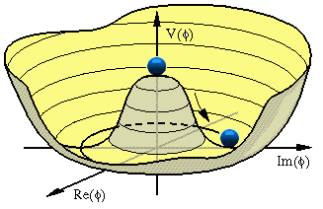
Higgs mechanism
SU(2)_{L} complex doublet of scalar fields
Lagrangian additional term:
μ²,λ>0: infinite number of degenerate vacuum states
"Higgs field vacuum
expectation value"
Choose one vacuum state ⇔ spontaneous symmetry breaking
X

Slide 11
X
Selected vacuum:
    Not invariant under SU(2)_{L}xU(1)_{Y} transformations
    Invariant under U(1)_{Q} =U(1)_{em} transformations
thus
Particles: oscillations around selected vacuum
Note: this is equivalent to choosing the unitarity gauge

Slide 12
Mass spectrum: arises from
  boson masses:
  (D^{μ}Φ)⁺(D_{μ}Φ) contains two mass terms :
  where
X
Notes:
Sintheta_W: Weinberg mixing angle : reflects the relative coupling strength of the SU(2) and U(1) gauge group factors

Slide 13
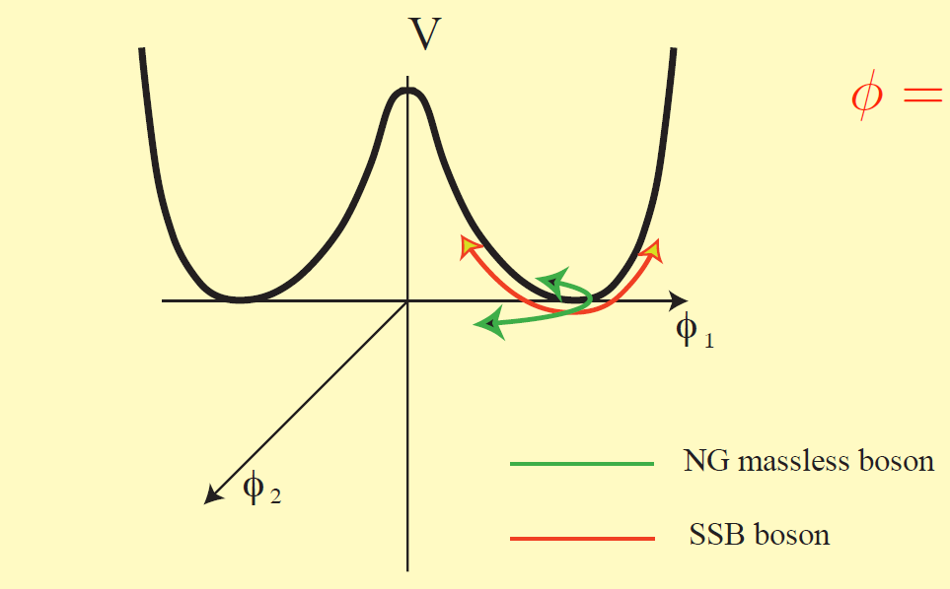
Mass spectrum: arises from
  scalar mass:
  V(Φ⁺Φ) contains one mass term for the η(x) field :
X
η(x) : massive Higgs boson
ζ(x): massless Goldstone bosons

Slide 14
Summary 2: the electroweak interaction
The electroweak interaction is described by an SU(2)_{L}xU(1)_{Y} gauge theory which is spontaneously broken into U(1)_{em}
After SSB:
  3 massive gauge bosons
  1 massless gauge boson
  1 massive Higgs boson

Slide 15
Charged current
Couplings
Fermion-gauge boson interactions: from
e.g. for one lepton doublet:
leads to:
→ (V-A) current
At low-energy :
→ (V-A) theory with
Consequence:
W-leptons
X
from μ lifetime measurements
Notes:
GF: relative precision 10^-5

Slide 16
Electromagnetic current
Fermion-gauge boson interactions: from
e.g. for one lepton doublet:
leads to:
QED recovered if e, electron charge magnitude
Note:
doublet
singlet
electron field
from low-energy measurements
Notes:
alpha (at low energy): relative precision 0.7 10^-9

Slide 17
Weak neutral current
Fermion-gauge boson interactions: from
e.g. for one lepton doublet:
leads to:
Vector and axial couplings of the Z boson:
doublet
singlet
different couplings for different particles

Slide 18
Summary 3: couplings
SU(2)_{L}xU(1)_{Y} gauge couplings are related to precisely mesured constants. At tree level:
  g, M_{W} ↔ Fermi constant:
  g, sinθ_{W} (or g’) ↔ fine structure constant:
Z-fermion vector and axial couplings depend on the fermion type:
  T³(f): quantum number corresponding to weak isospin third component for left-handed fermion component

Slide 19
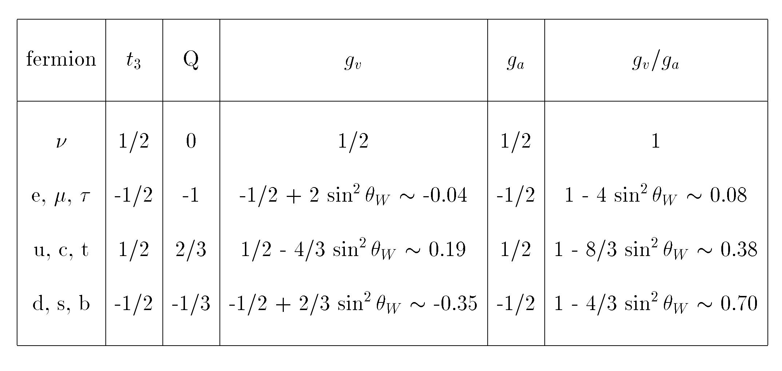
Z vector and axial couplings to fermions
(in the Standard Model at tree-level)
(sinθ_{W}~0.23)

Slide 20
Gauge vs mass eigenstates
Fermion masses
Experimental fact: strangeness-conserving and –changing hadronic weak decays have different strengths
  led to Cabibbo theory (1963):
  in the SM with two families:
⇒ in the quark sector: SU(2) gauge eigenstates are different from mass eigenstates
  (or: weak and strong interactions have different eigenstates)
Notes:
Theta_c: Cabibbo angle (1963) introduced to reproduce differenr rates between hadronic weak decays and leptonic counterparts (hadronic strangeness-changing weak decays << hadronic strangeness-conserving weak decays << leptonic weak decays). Hadronic strangeness-changing weak decay: beta decay of the Lambda particle

Slide 21
Gauge vs mass eigenstates
mass eigenstates
In the SM with three families:
quark mixing can be described as acting only on d,s,b (leads to identical weak currents)
With three families, the mixing matrix may contain one physical phase which would provide explanation for the observed CP violation in the quark sector
weak eigenstates
CKM mixing matrix

Slide 22
Quark mixing and currents
Quark-gauge boson interactions, e.g for one doublet:
Charged weak current:
⇒ charged currents are flavour non-diagonal
Neutral weak current:
⇒ neutral currents are flavour conserving
Electromagnetic current:
with

Slide 23
Fermion masses
Fermion masses: general SU(2)xU(1) scalar-fermion Yukawa interactions added to Lagrangian, e.g. for first family:
Particles: oscillations around selected vacuum
Masses:
  leptons and up-quarks, e.g. e or u:
  down-quarks, e.g. d:
term
term
terms
Notes:
- Yukawa interaction: interaction between a scalar field and a Dirac field (used by Yukawa to set up a theory of the strong interaction between nucleons mediated by pions. After spontaneous symmetry breaking this interaction leads to terms in coupling * vev * psi_bar psi i.e.e mass terms.
- Left and right chiral components of the fermion fields behave differently under gauge transformations: an explicit mass term in the lagrangian would not be gauge invariant and thus is impossible (would lead to violation of unitarity and renormalizability). We need an interaction of the fermion which is chirally non-invariant but gauge invariant. Then when the gauge invariance is spontaneously broken fermion masses emerge as both invariances will have been broken.
- In textbooks: proof based on most general Yukawa interaction terms, derived using matrix formalism, with no refernce to the CKM matrix. Identification of mass terms only, no proof that the CKM matrix leads to vanishing non-diagonal terms.
- Each term psi_bar phi psi_R is U(1)Y and SU(2)L invariant.

Slide 24
Summary 4: fermion masses
Quarks: weak interaction eigenstates and mass eigenstates are different
Consequence: charged weak currents are flavour non-diagonal
Fermion masses: described by gauge-invariant Yukawa scalar-fermion interactions:
⇒ Higgs-ff couplings ∝m_{f}
  Note: in these lectures, massless neutrinos. Neutrino masses would induce mixing in the lepton sector → See lectures of Pr. F. Suekane

Slide 25
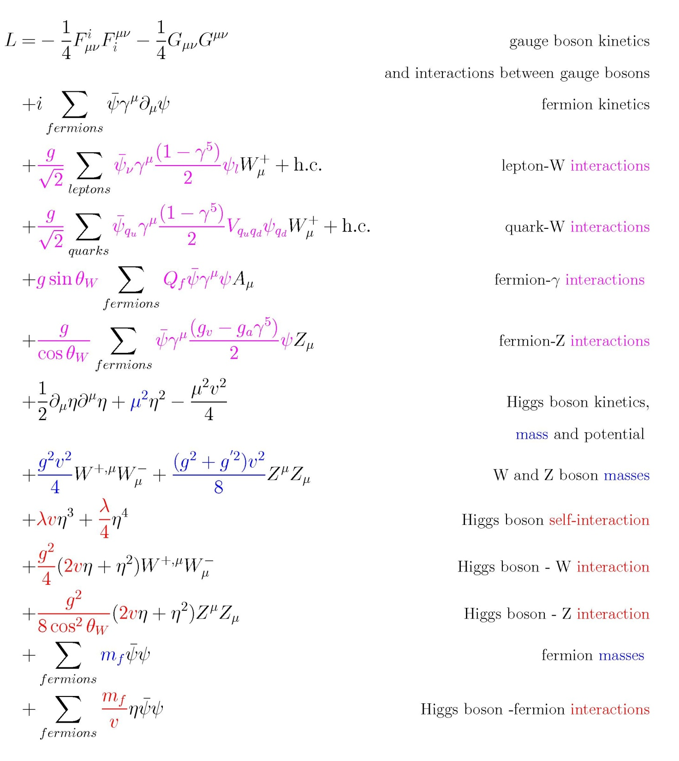
The complete
SM Lagrangian
e
½ M²_{H}
M²_{W}
½ M²_{Z}

Slide 26
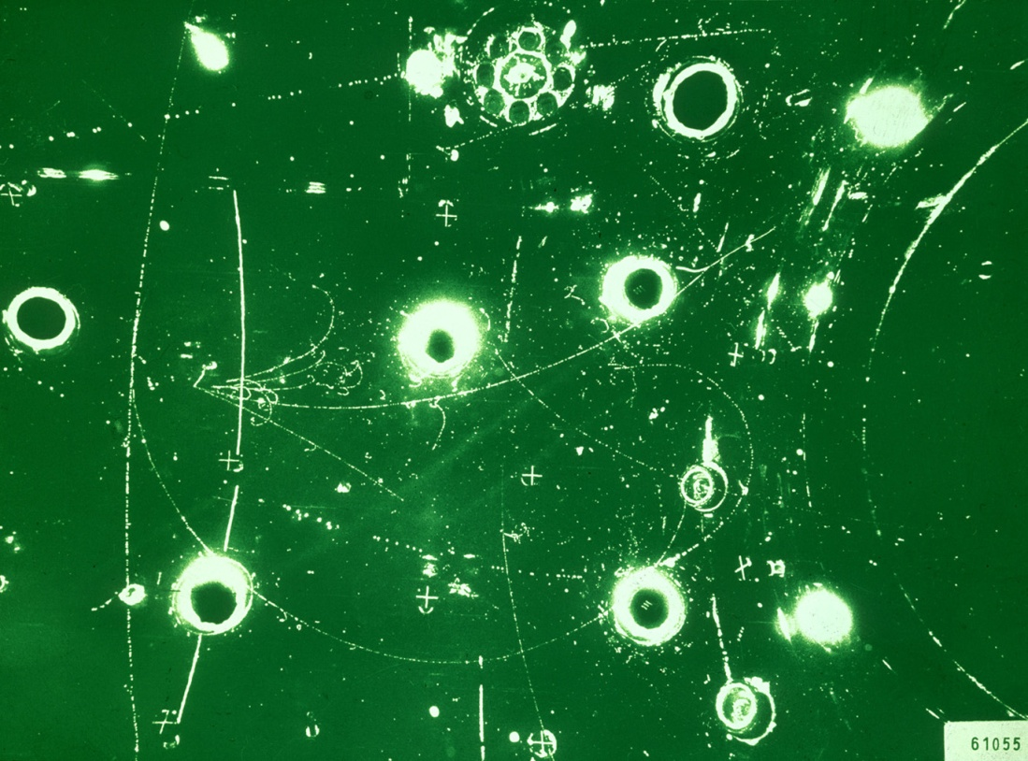
History
First experimental confirmations
1973: neutral current discovery (Gargamelle experiment, CERN)
evidence for neutral current
events ν + N → ν + X in
ν-nucleon deep inelastic
scattering
1973-1982: sin²θ_{W} measurements in deep inelastic neutrino scattering experiments (NC vs CC rates of νN events)
  e.g.
  world average value (PDG, 1982):
Notes:
Neutral current events: an isolated vertex from which only hadrons were produced (contrary to charged current event where a lepton – a muon - was observed in addition). Background from neutron interaction in the chamber (due to an undetected upstream neutrino interaction), discriminated against signal by their longitudinal distribution (exponentially falling in case of background)

Slide 27
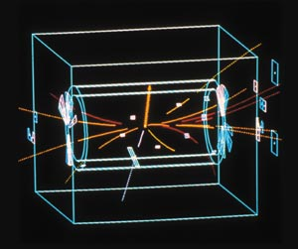
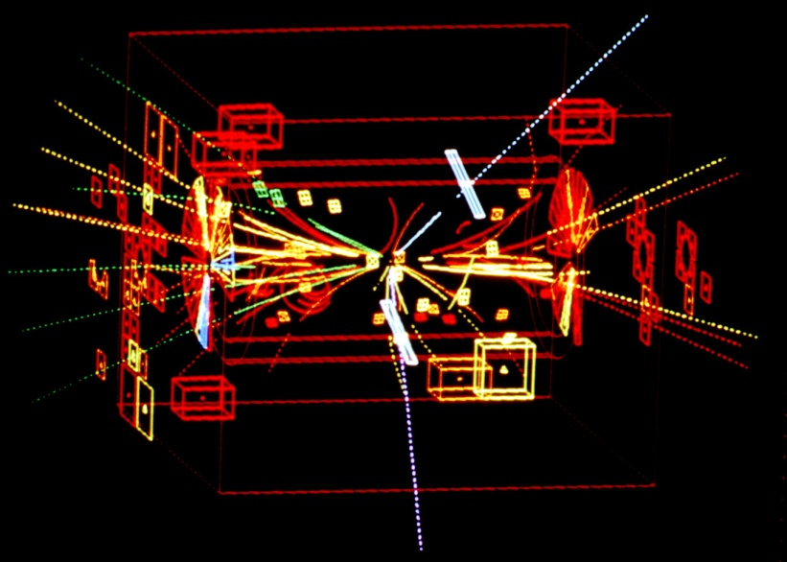
First experimental confirmations
1983: evidence for massive W± and Z bosons (UA1 & UA2 experiments at CERN)
  first mass measurements:
W→eν
Z→ee

Slide 28
1987: with more data:
first measurement of the angular
distribution of W decay electons
in agreement with the V-A structure of the charged currents:
e⁻: θ*~0
e⁺: θ*~π
X
Phys. Lett. B186 (1987)

Slide 29
BACK-UP SLIDES

Slide 30
Gauge transformations in SU(2)_{L}xU(1)_{Y}
with

