Slide 1
Introduction to Accelerators
Mika Masuzawa (KEK)

Slide 2
Contents
Brief history & major inventions
1930~1960
Introduction
DC: Cockcroft-Walton, Van de Graaff
AC: Drift tube, Cyclotron
Betatron
Betatron oscillation, weak focus
A.G. Synchrotron
phase stability, strong focus, synchrotron radiation, (Linear collider)
1960~
Collider
New era of large circular colliders
Energy frontier, Luminosity frontier
Virtual tour of KEKB
Challenges
SuperKEKB as an example
Future accelerators
Final thoughts

Slide 3
Brief history & major inventions 1930~1960
1930~1960
Introduction
DC: Cockcroft-Walton, Van de Graaff,
AC: Drift tube, Cyclotron
Betatron
Betatron oscillation, weak focus
A.G. Synchrotron
phase stability, Strong focus, synchrotron radiation (Linear collider)

Slide 4
Introduction: units
Unit for energy
[eV] electron volt
➔Energy unit charge [e] receives from potential difference of 1 [V].
Why not [J] ?
[J] Joule
➔Energy unit charge [C] receives from potential
difference of 1 [V]
e
V
U=eV
1 kV = 10 ³ eV
1 MeV = 10 ⁶ eV
1 GeV = 10 ⁹ eV
1 TeV = 10 ¹² eV
“Joule” is too large

Slide 5
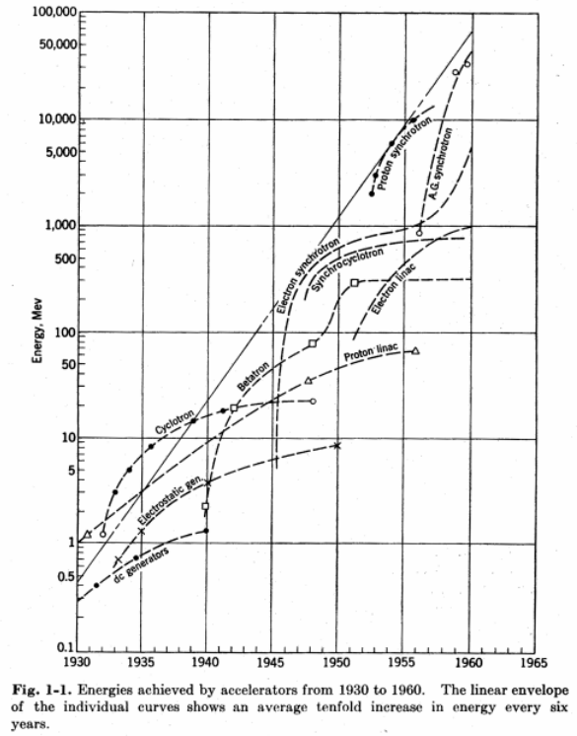
Introduction Livingston's curve : The beam energy of accelerators vs. time.
[MeV]
Proton synchrotron
10000
Electron synchrotron
1000
A.G. Synchrotron
Betatron
Electron linac
100
Proton linac
Cyclotron
10
Electrostatic
An order of magnitude
increase every 6 years!
1
DC generators
1930~1960
From PARTICLE ACCELERATORS by Livingston and John P. Blewett, 1962, p. 6.

Slide 6
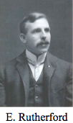
Introduction Dawn: The first nuclear reaction by Rutherford
Fluorescent
material
Nitrogen
gas
He demonstrated in 1919, that alpha particles could knock protons out of nitrogen nuclei and merge with what was left behind.
Radioactive
material
proton
A race to develop high energy accelerators started.
This provoked strong demand for generating high energy beams to study nuclear disintegration phenomena in more detail.

Slide 7
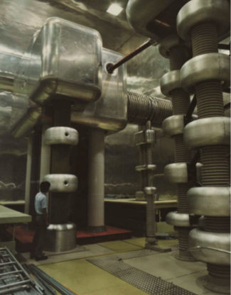
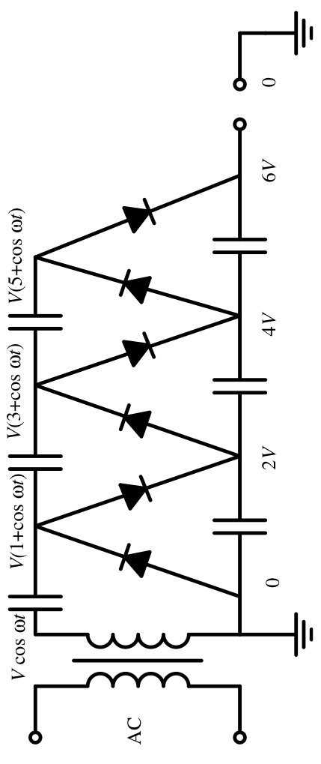
Cockcroft-Walton: First disintegration of atomic nuclei with accelerator
Cavendish Laboratory
1932, Cockcroft and Walton used their machine to accelerate protons, and directed the beam of protons at a sample of lithium. This resulted in changing lithium atoms into two helium atoms. They had disintegrated – “smashed” – the lithium atom by means of artificially accelerated protons.
High voltage is provided by charging capacitors and discharging them in series.
750 keV Cockcroft-Walton
at KEK

Slide 8
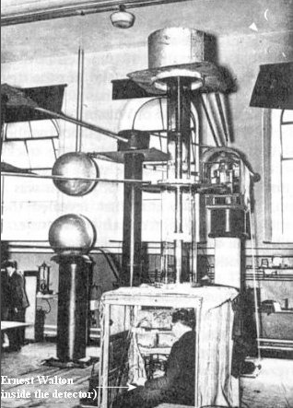
Cockcroft-Walton: First disintegration of atomic nuclei with accelerator
"Transmutation of atomic nuclei by artificially accelerated atomic particles"
On 14 April 1932 Walton set up the tube and bombarded lithium with high energy protons. He then crawled into the little observation cabin set up under the apparatus and immediately saw scintillations of the fluorescent screen. The reaction was giving off alpha-particles.
http://www-outreach.phy.cam.ac.uk/camphy/cockcroftwalton/cockcroftwalton9_1.htm
http://www.daviddarling.info/encyclopedia/C/Cockcroft.html

Slide 9
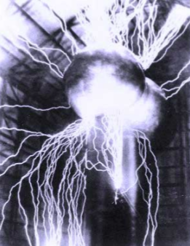
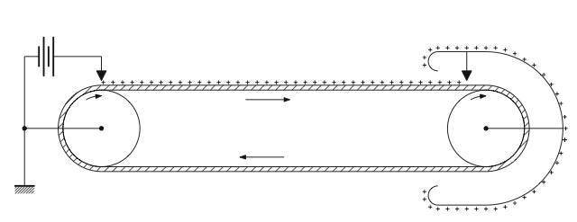
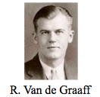
Van de Graaff
Van de Graaff generator (1931)
An electrostatic generator which uses a moving belt to accumulate very high voltages on a hollow metal globe on the top of the stand.
The Van de Graaff generator was developed, starting in 1929, by physicist Robert J. Van de Graaff at Princeton University. ~10MV.

Slide 10
Limits on Electrostatic Accelerators
DC acceleration is limited by high-voltage breakdown.
Ambience | Breakdown voltage
Air 1atm | ~30 kV
SF6 (Sulfur hexa-fluoride) 1atm | ~80 kV
SF6 7atm | ~360 kV
Transformer oil | ~150 kV
UHV | ~220 kV
Typical breakdown voltage for a 1cm gap of parallel metal plates
From K. Takata “Fundamental Concepts of Particle Accelerators”
http://research.kek.jp/people/takata/home.html

Slide 11
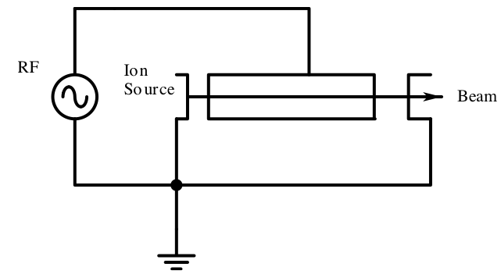
Drift tube: From DC to AC, Radio-Frequency Accelerators
The principle of the acceleration with alternating fields was proposed by G.Ising in 1924.
R. Wideröe accelerated alkali ions (K+, Na+) up to 50 keV (25kV ×2) using the accelerator based on alternating fields (1 MHz) and drift tubes in 1928.
The particles must be synchronized with the rf fields in the accelerating sections.

Slide 12
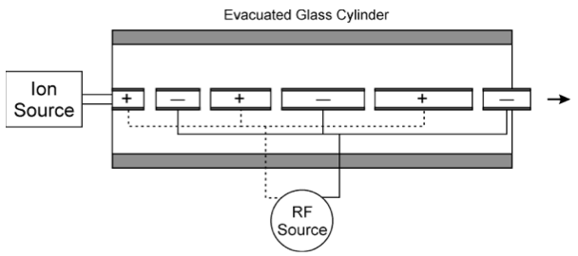
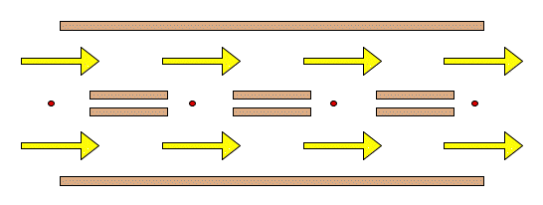
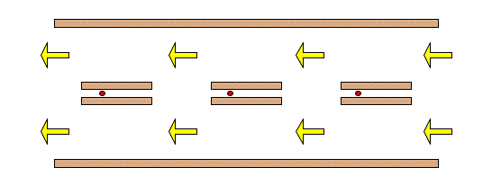
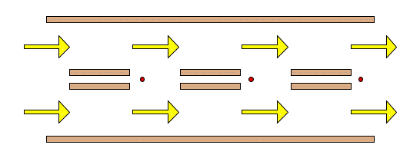
Drift tube: From DC to AC, Radio-Frequency Accelerators
Concept of Wideröe accelerator
Prototype of linear accelerator.
The idea of rf acceleration is also used by circular accelerators.
Need longer tubes and gaps as energy increases.

Slide 13
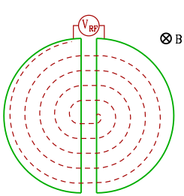
Cyclotron: From DC to AC, Radio-Frequency Accelerators
(2) An oscillating voltage is applied to produce an electric field across the gap between two Ds.
(1) A cyclotron consists of two large dipole magnets (Ds) designed to produce a semi-circular region of uniform magnetic field.
Lorentz Force
F = q v × B
(3) Particles injected into the magnetic field region of a D trace out a semicircular path until they reach the gap.
(4) The electric field in the gap then accelerates the particles as they pass across it.

Slide 14
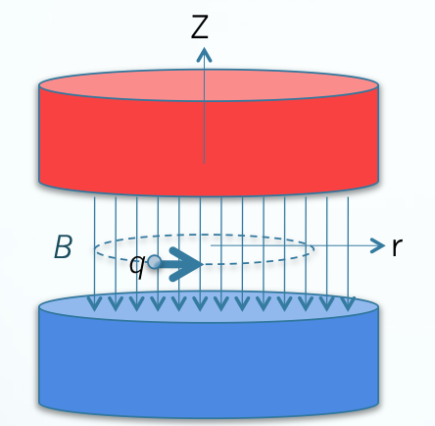
Cyclotron: Frequency and orbit radius how it works.
Suppose a uniform magnetic induction B is applied perpendicular to the velocity v of a particle with mass m, charge q:
The Lorentz Force F = q v × B produces a circular track.
Force, relationship between momentum p and radius ρ:
F = qvB
p= qBρ (since mv²/ρ=qvB )
and for non-relativistic case:
p=mv
We obtain cyclotron frequency and radius as:
f_{rev}=v/2πρ=qB/2πm Frequency is independent of velocity
ρ = mv/qB and radius is proportional to velocity
Centrifugal force
The particles can be excited at a fixed rf frequency and the particles will remain in resonance throughout acceleration.

Slide 15
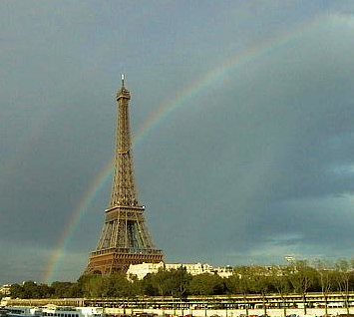
Cyclotron: limits
When particles become relativistic
the mass of the particle increases as
which results in
→ decrease of ω_{rev}
→ asynchronism with RF
Some methods to overcome this limit tried:
Magnetic field distribution
Changing rf frequency with particle energy…
But no drastic improvement beyond
20 MeV with protons.
Breakthrough in 1945
Phase stability principle
Vladimir Veksler (1944) and
Edwin M. McMillan (1945)
⇒Synchrotron
(some slides later)
Recall
f_{rev}=v/2πρ=qB/2πm

Slide 16
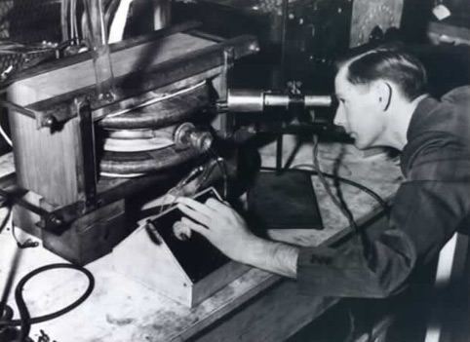
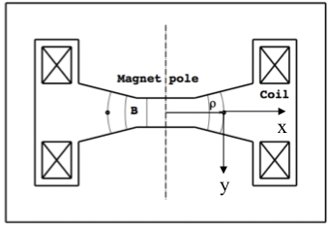
Betatron: non RF, accelerate electrons (beta particles)
The first successful betatron was built by Donald Kerst in 1940, accelerating electrons to 2.2 MeV.
Principle: Electromagnetic induction, not RF.
Maxell’s eq.
Stoke’s theorem
Not dependent on mass.
Good for relativistic particles!
http://physics.illinois.edu/history/Betatron.asp
From (1) and (2) we obtain the condition for constant orbit for betatron.
“2:1 rule” (Wideröe, 1928)
Eq. of motion
For ρ = const.

Slide 17
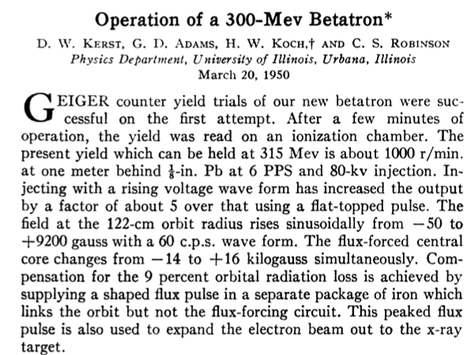
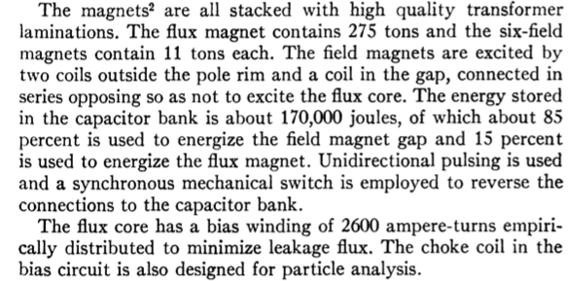
Betatron: limits of accelerating particles by magnetic induction.
Constant orbit, good for relativistic particles but…
We can accelerate particles by increasing the magnetic field, keeping the orbit radius constant. This means, we still need to cover the entire region with a magnetic field (magnets). And this also means that the maximum energy we can obtain is limited by the magnetic field (saturation of the iron core).
limits
Phys. Rev. 78, 297–297 (1950)

Slide 18
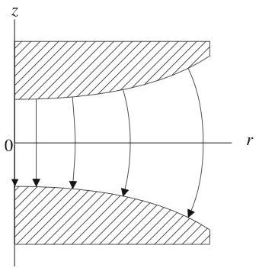
Betatron: Basis of today’s betatron oscillation theory
Key word (1) Orbit stability
Magnetic field, not uniform but still cylindrically symmetric.
Field index
Side view
If the particle passage (orbit) is near the central orbit, r=ρ

Slide 19
Betatron: betatron oscillation
Key word (1) Orbit stability
Z
Use cylindrical coordinate
r
For the passage
near the central
orbit r=r₀
recall
From (1) and (3) and using v=r₀ω, we obtain eq. of motion for x as
and similarly (sort of) for z as
Equation of motion for betatron oscillation
in an axisymmetric field.
Betatron frequency
Betatron tune
Stable oscillation in horizontal plane: 1-n>0
in vertical plane: n>0

Slide 20
Betatron: “weak” focusing
Key word (1) Orbit stability
If 0<n<1, stable oscillation in BOTH horizontal and vertical plane!
But n<1 …. This is why this scheme is called “Weak” focusing.
Motion in Betatron
Tune is less than 1, meaning betatron wave length is larger than the circumference.
If you achieve higher energy, will need large magnets as mentioned in the previous slide.
Stronger focus with more compact scheme is needed.
Betatron
Progress in understanding particle orbits in a magnetic field was made.
Basis of today’s betatron oscillation theory was established.
Discovery of strong focusing
1949 by N. Christofilos
1952 by E.D.Courant, M.S.Livingston and H.Snyder

Slide 21
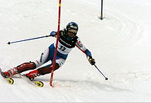
Betatron: concept of emittance
Key word (1) Orbit stability
Betatron amplitude
phase
Horizontal position
Betatron tune
Radius of the design orbit
Instead of t, use s, the distance along the path.
At s=0, y=y₀ and y’=y’₀ and y’=dy/ds
Acceptance
y’
νw/R
Larger ν results in smaller a₁
w
y
Ellipse indicates the phase space condition for stable circulation
emittance

Slide 22
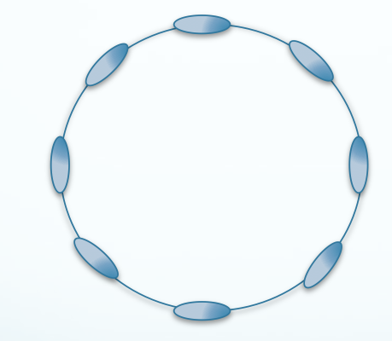
Phase stability: the concept of “bunch” & the Synchrotron
Key word (2) Phase stability
Many particles in a bunch, circulating many turns (tens of thousands, for example.
Particles of different energies have differences in velocity and in orbit length;
➔Particles may be asynchronous with the RF frequency.
➔The RF field, however, may have a restoring force at a certain phase, around which asynchronous particles be captured, that is to say “bunched.”
➔This enables a stable, continuous acceleration of the whole particles in a bunch to high energies.
➔Circular accelerators based on this principle are called “synchrotrons.”

Slide 23
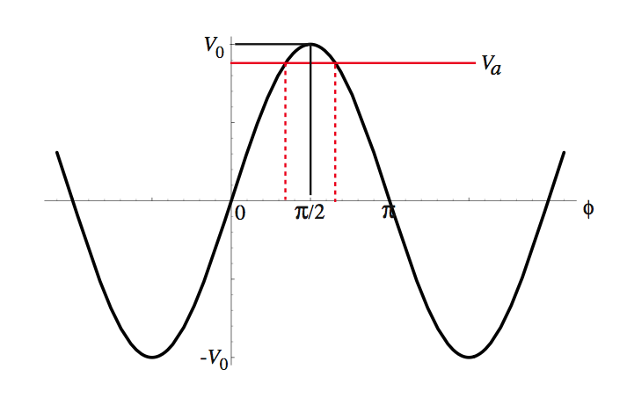
Phase stability: a concept of “bunch”
Key word (2) Phase stability
Va acceleration voltage
Assume RF electric field V = V₀ sin ωt
Which one?
Only one of them can capture particles and make oscillations around the phase.
There are there are two φs which satisfy Va = V₀ sin φ in one RF period

Slide 24
Key word (2) Phase stability
Phase stability: a concept of “bunch”
Case (1) Particles with ΔP >0 travel ΔC > 0
Which phase gives stable oscillations?
Particles arriving at the gap earlier (i.e. particles with ΔP < 0) receive more energy
⇒will travel ΔC > 0
⇒will arrive at the gap later.
Depends on the characteristics of the orbit. (Particle momentum P and orbit C)
ΔC > 0
Oscillations around
Φ_{s} （Synchrotron phase）
Synchrotron oscillations
⇔
ΔC = 0
ΔC < 0
Particles arriving at the gap later (i.e. particles with ΔP > 0) receive less energy
⇒will travel ΔC < 0
⇒will arrive at the gap earlier.
Example of a circular orbit

Slide 25
Phase stability: a concept of “bunch”
Case (2) Particles with ΔP >0 travel ΔC < 0
Quiz: Which phase give stable oscillation?

Slide 26
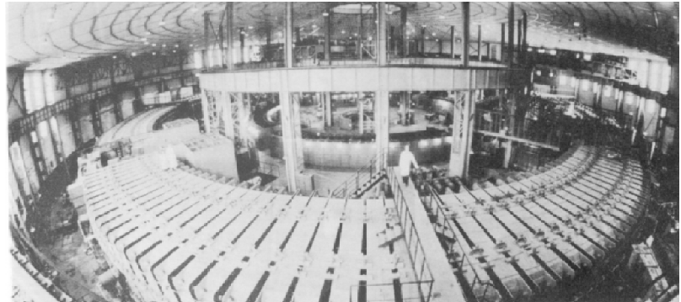
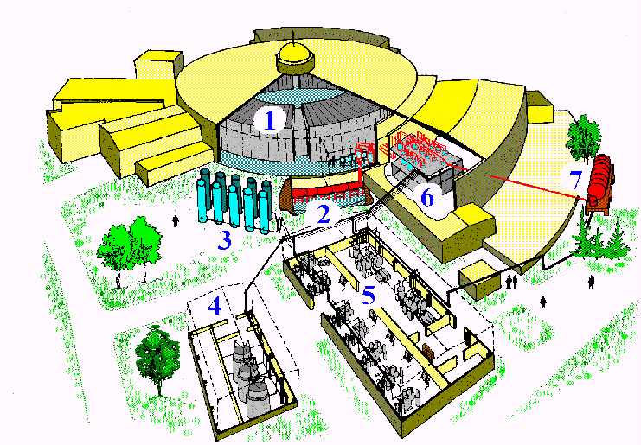
Phase stability: the concept of “bunch” & the Synchrotron
http://lhe.jinr.ru/english/img_01.htm

Slide 27
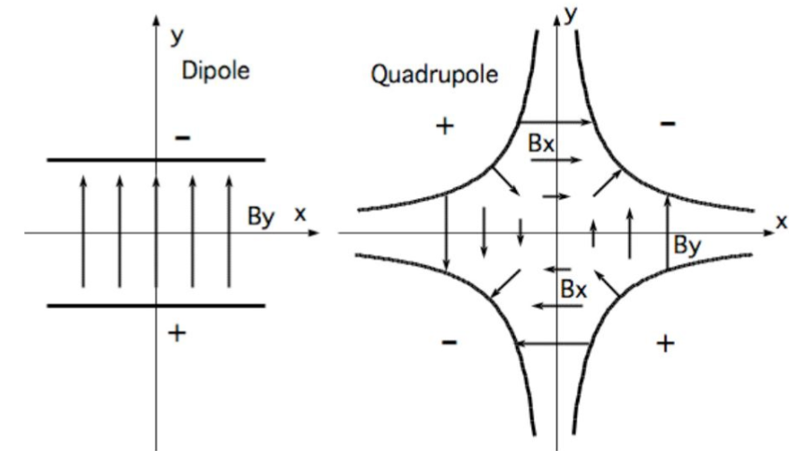
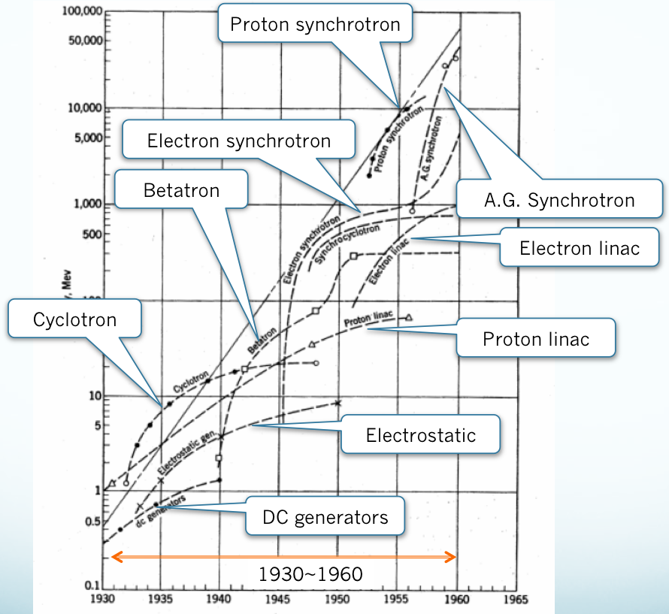
Strong focus: Alternating Gradient synchrotron
Key word (3) Strong focus
For example, compare
B=2[Tesla] and 10kV/mm (10MV/m).
Both are reasonable numbers for today’s accelerators.
Use 2 [T] = 2 [Wb/m²]=2 [V•s/m²]
The magnetic term is 2 [V•s/m²]×3•10⁸[m/s]
=6•10⁸V/m=600MV/m>> 10 MV/m
For very high energy particles, magnetic force is much larger than electric.
Lorentz force
Why do we use
magnetic field to
deflect, focus,,
not electric?
Magnetic fields
To bend (deflect) To focus & defocus

Slide 28
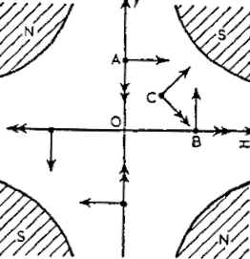
Strong focus: Alternating gradient synchrotron
Key word (3) Strong focus
Positively charged particle
Moving into this paper.
Quiz: What is the force (which one is the correct arrow representing the force) on the particle at points A, B and C?
Focusing in horizontal direction and defocusing in vertical direction -- let’s call it a Focusing or F-type quadrupole magnet.
If the polarity is reversed (N and S are reversed), it becomes defocusing in horizontal and focusing in vertical: a Defocusing or D-type quadrupole magnet.
A big difference from weak focusing case, where focusing is obtained in both directions simultaneously.
By alternating F- and D- , we can obtain a net focusing effect.
Nicholas C. Christofilos (1950), E. D. Courant, M. S. Livingston, and H. S. Snyder (1952)

Slide 29
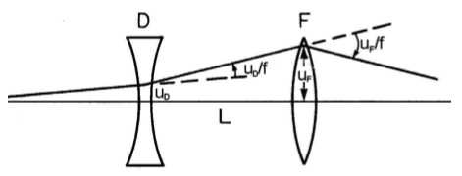
Key word (3) Strong focus
Strong focus: Alternating gradient synchrotron
Analogy with optical thin lens
f1
f2
The deflection (u) is always greater at F than at D.
Obtaining a net focus by combining F- and D-
Magnets is called “strong focus”,
as no constraints on “n.”
Entire orbit does not need to be covered by magnets.
Each magnet can be smaller.
Net focus

Slide 30
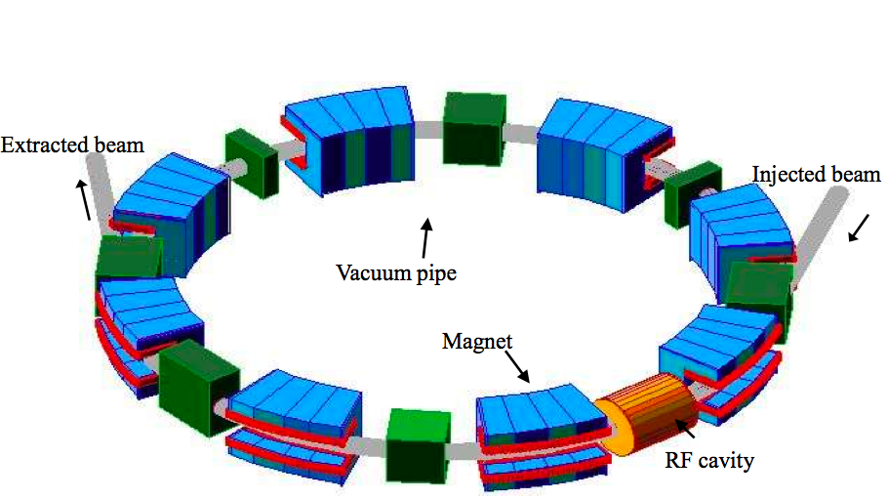
Key word (3) Strong focus
Strong focus: Alternating gradient synchrotron
Let me take a
Side trip here…
Basic components
Magnets
Dipole magnets for bending
Quadrupole magnets for focusing
Vacuum pipes
covers the beam passage
RF cavities
Some photos
Next slides
Strong focus:
Magnet weight proportional to r
The strong-focusing principle revolutionized accelerator design. The principle's practicality was demonstrated in 1954, when Cornell's 1.3-GeV electron accelerator began operation. Then the new technology was applied to larger machines. In 1959, the 25-GeV Proton Synchrotron went into operation at CERN, the European high energy physics laboratory, and in 1960, the 33 -GeV AGS was commissioned. These alternating gradient synchrotrons were constructed using only twice the amount of steel (4,000 tons) needed to construct the weak-focusing, 3.3-GeV Cosmotron.
Weak focus:
Magnet weight proportional to r²
http://www.bnl.gov/bnlweb/history/focusing.asp

Slide 31
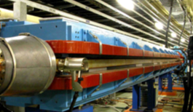
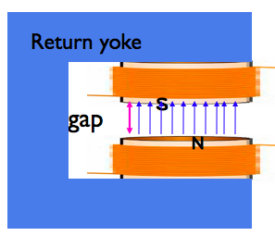
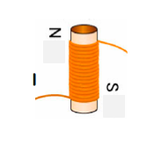
Basic components: Magnets
Dipole magnet
(Bending magnet)
Wind a wire on an iron bar.
Flow current through the wire and the bar will be magnetized. Polarity changes when current direction is changed.
Two poles to generate a uniform magnetic field. Charged particles traveling through the field receive a deflecting (bending) force.
Coils on the pole
+ return yoke
→dipole magnet!

Slide 32
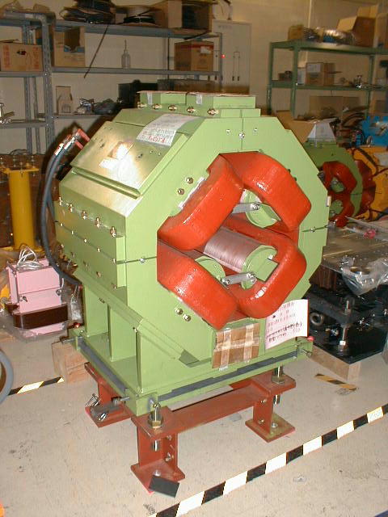
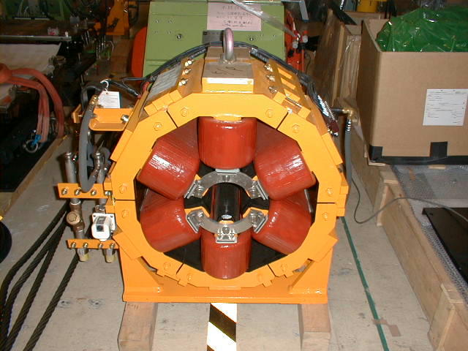
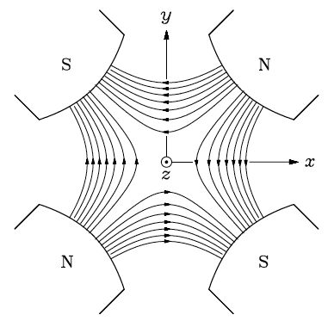
Basic components: Magnets
Quadrupole magnet
Sextupole magnet
Generates a focusing/defocusing field. The charged particles that travel through the quadrupole magnet receive a focusing/defocusing force. The force is proportional to the distance from the magnet center.
(no force if the beam goes though the center)
Sextupole fields have a focal length that is inversely proportional to the distance from the centre of the magnet. Used for correcting the effects of focusing dependence on momentum.

Slide 33
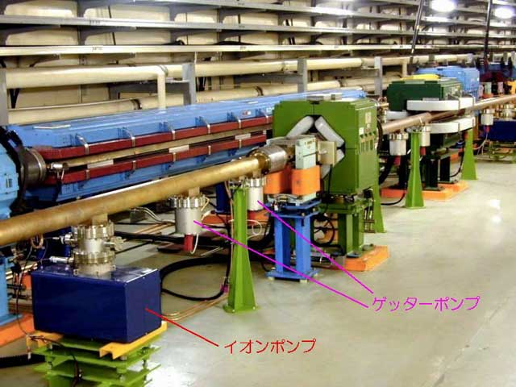
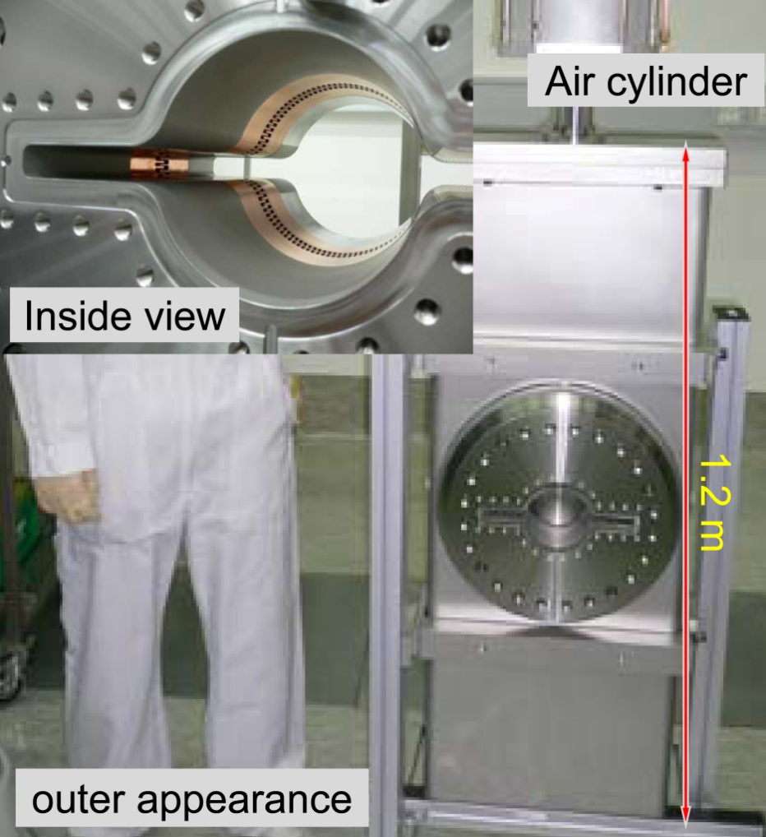
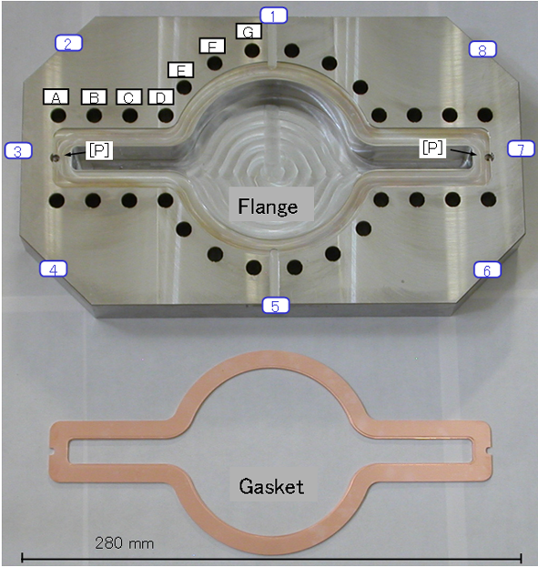
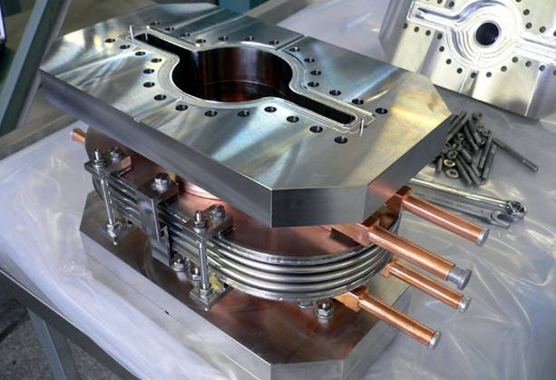
Basic components: Vacuum components
Gate Valve
Vacuum duct
~10⁻⁸ Pa
Cu, Al, ceramics…
Getter pumps
ion pump
Flange & gasket
bellows

Slide 34
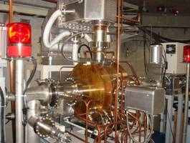
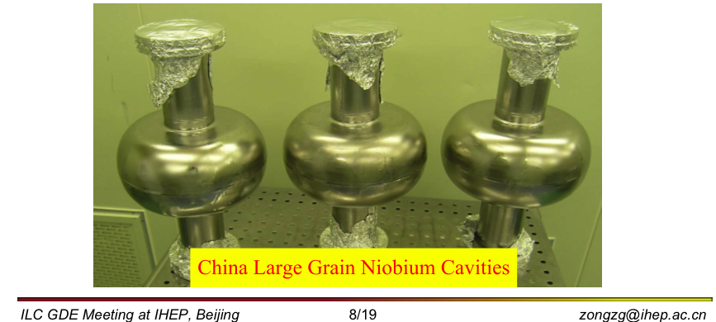
Basic components: RF cavities
R&D Superconducting cavity for ILC
SAGA-Light Source RF cavity
499.8 MHz
500 kV, 90kW
Load
SR loss 31.8 kW
Wiggler 10.2 kW
Wall loss 35.7 kW
Other 7.8 kW
Total 85.5 kW
lam29.lebra.nihon-u.ac.jp/WebPublish/4P31.pdf

Slide 35
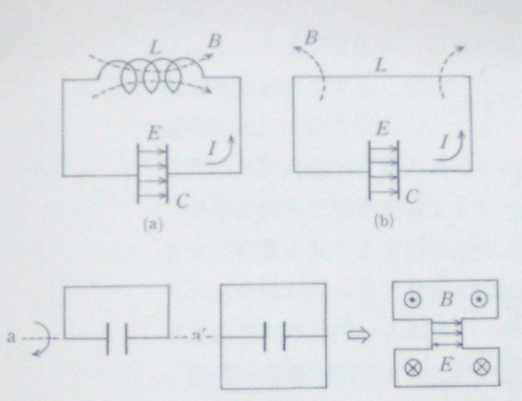
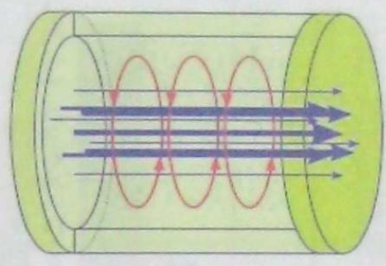
Basic components: RF cavities
Pillbox cavity
TM010 mode

Slide 36
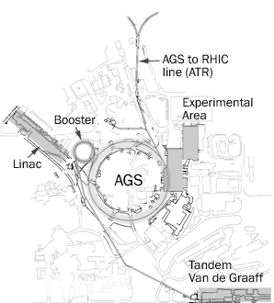
Alternating Gradient Synchrotron (Brookhaven)
Key word (3) Strong focus
28 GeV protons on a beryllium target

Slide 37
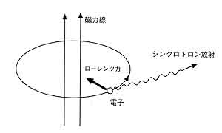
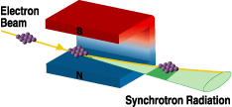
Synchrotron radiation:
Synchrotron radiation (SR) is emitted from a charged particle traveling near the speed of light when its path is bent by a magnetic field. As it was first observed in a synchrotron in 1947,
it was named "synchrotron radiation".
Synchrotron radiation is emitted in a continuous spectrum.
Magnetic field
Synchrotron radiation
Charged particle
http://www.spring8.or.jp/en/news_publications/publications/sp8_brochure/sr.html/publicdocument_view

Slide 38
Synchrotron radiation: lighter particles suffer more.
SR is an electric dipole radiation from a charged particle in acceleration
Radiation power in the rest frame is given by
Larmor’s formula:
Can you derive this?
In the laboratory frame, P becomes
The radiated energy per turn ΔE
for a ring of radius ρ
For relativistic protons and electrons of the same momentum, the energy loss is in the ratio (m_{e}/m_{p})⁴~10¹³. It is 10¹³times smaller for protons than for electrons.
For electrons of energy 10 GeV circulating with ρ=1 km, the SR energy loss is 0.9 MeV/turn. How much is it for 20 GeV electron?
Practical formula

Slide 39
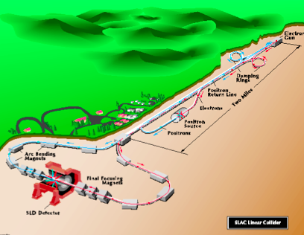
Synchrotron radiation:
SR loss is 10¹³ times smaller for protons than for electrons.
For a high energy electron circular machine, a large ring (radius scaling roughly as the square of the beam energy) is needed.
➔LEP @ CERN, 100GeV, 27 km in circumference.
Low magnetic “guide” fields
➔Still loss needs to be compensated by RF power to keep the beam circulating.
A linear accelerator is the natural
solution to the scaling problems of a circular
collider.
SLC (~50 GeV electron-positron beams,
Ecm~91 GeV, lose some at the arcs).
➔Linear Collider project (following slides)

Slide 40
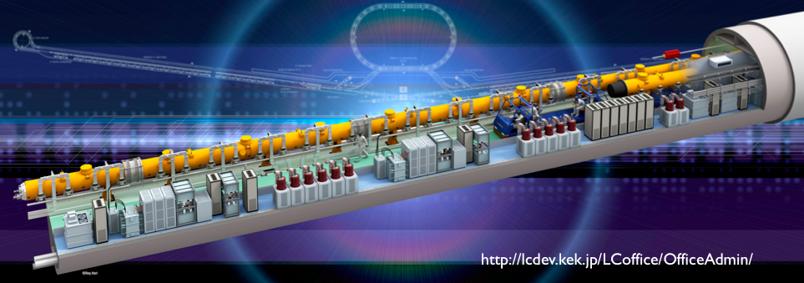
Linear Collider:
http://lcdev.kek.jp/LCoffice/OfficeAdmin/
1st stage 500 GeV

Slide 41
Linear Collider:

Slide 42
Brief history & major inventions 1960~
Collider
New era of large circular colliders
Energy frontier
(side trip: storage ring)
Luminosity frontier

Slide 43
Brief history and inventions before 1960
Cyclotron
Multiple acceleration by RF, orbit changes with energy
Entire orbit covered by magnets
Synchronization becomes difficult as particles become relativistic.
(2)Phase stability principle in1945
Synchronization issue is solved.
Betatron
Acceleration by magnetic induction
Constant orbit
Entire orbit covered by magnets
Early Synchrotron
Acceleration by RF
Huge magnets Synchrophasotron 10 GeV, 39000 ton
(1)Orbit stability
Betatron oscillation
Weak focusing
Circular machine
Synchrotron
Entire orbit not covered by magnets.
Much higher energy
>10 GeV (10000 MeV)
collider
(3)Strong focusing
1952

Slide 44
Collider

Slide 45
Collider: the first collider (e⁻e⁺):AdA (Anello di Accumulazione) and happened to be Bruno Touschek’s aunt’s name.
Collision-based computing, Andrew Adamatzky (2002)
Orbit radius = 65 cm,
250MeV×250 MeV
Operated 1961-1964.
Many feasibility experiments with this working model.
Followed by a full-size collider ADONE
ADONE 1969
C=105 m
E_{cm} < 3 GeV
no J/ψ …
The First Electon-Positron Collider
Carlo Bernardini
Phys. Perspect. 6(2004) 156-183

Slide 46
Collider: Era of large circular colliders, energy frontier machines
Proton × (anti-)proton, e.t.c.
Lecture by K. Yokoya, “Summer Challenge 2008” @ KEK

Slide 47
Collider: Era of large circular colliders
Electron × positron
We are here
Lecture by K. Yokoya, “Summer Challenge 2008” @ KEK

Slide 48
SPS (Super Proton Synchrotron) ➔ SppS(Super Proton Anti-Proton Synchrotron) @CERN
Collider: Era of large circular colliders, energy frontier machines
~7km in circumference
1976 commissioning
1981 SppS
1983 Discovery of W± & Z⁰
Nobel prize for Van der Meer and Rubbia
From a one-beam accelerator into a two-beam collider, SppS. D. Cline, P.McIntyre and C. Rubbia
Collision of a beam of protons with a beam of antiprotons, greatly increasing the available energy in comparison with a single beam colliding against a fixed target.
Rev. Mod. Phys. 57, 689–697 (1985)
Stochastic cooling and the accumulation of antiprotons
Stochastic cooling:
a way of producing and storing dense beams of protons or antiprotons
S. Van der Meer

Slide 49
Collider: Era of large circular colliders, energy frontier machines
Tevatron (Fermilab)
1 Tev proton ×1 TeV anti-proton
6.3km circumference
4.2 T superconducting magnets
1983~2011.9.30
Discovery of top quark in 1995.
http://www.fnal.gov/pub/tevatron/

Slide 50
Collider: Era of large circular colliders, energy frontier machines
LHC (CERN)
Celebrating the first beam in the ATLAS
control room, Sep.2008.
http://public.web.cern.ch/public/en/LHC/LHC-en.html
3.5 x 3.5 = 7 TeV
Aug.2009
http://legacy.kek.jp/newskek/2009/janfeb/LHC_ATLAS.html

Slide 51
Collider: Era of large circular colliders
Next-generation B-factories
Two major goals of accelerators for HEP:
energy and luminosity
Factory machines
Luminosity frontier
High Energy Machine
Energy frontier
Mainly e+e- colliders are shown

Slide 52
Storage ring:
A storage ring is a type of synchrotron.
Conventional synchrotron
Accelerates particles from low to high energy.
RF cavities are used to accelerate particles.
Storage ring
Keeps particles stored at a constant energy for a long time (storage).
RF cavities are only used to replace energy lost through synchrotron radiation and other processes.

Slide 53
Storage ring:
A storage ring
Collider for HEP
B-factories (PEP-II, KEKB)
Tevatron, LHC: energy is ramped up from the injection energy to the target energy at first, but then kept constant for the experiment.
Synchrotron facilities for applied field
Keeps particles stored at a constant energy for a long time (storage).
RF cavities are only used to replace energy lost through synchrotron radiation and other processes.

Slide 54
Collider: Era of large circular colliders, luminosity frontier machines
Luminosity frontier

Slide 55
Collider: Luminosity
Event yield
Luminosity
Fixed target
Beam on solid (usually) target
Collision guaranteed
Collider
Bunch against bunch
Some (most) stream through the other
N_{e+}
N_{e-}
Cross section
The number of particles per unit area per unit time
More particles in a bunch
Frequent collision
Smaller beam
Higher luminosity

Slide 56
Collider: realizing small beam for higher luminosity
Beam size
emittance
For non-dispersive place
Often we write emittance as ε
Some more on emittance for the strong focusing in the next slides.
How can we squeeze down the beam size?

Slide 57
Collider: realizing small beam for higher luminosity
y’
“Weak focus” case
Recall
νw/R
emittance
w
y
“Strong focus” (n >> 1) case;
β-function describes the amplitude of the motion of the particles:
Constant in “weak focus”
Function of s in “strong focus”
α,β and γ are called
Twiss parameters
The area is constant, independent of s
also in strong focusing case.

Slide 58
Collider: realizing small beam for higher luminosity
Particles move in an ellipse in phase space.
Ellipse rotates and change in shape in magnets.
The area of the ellipse is often represented as 2πJ
and this is conserved.
Drift space
(between magnets)
Focusing magnets
Defocusing magnets
From lecture by Y. Ohnishi at OHO 2006
Keys for small collision spot size:
Design a machine with small emittance.
Squeeze the beta-function at the collision point.
I would like to introduce you our project SuperKEKB, as an example of a small beam machine.

Slide 59
Virtual Tour of KEKB: e+e- double ring collider 1999~2010
SuperB
Italy
KEKB &
SuperKEKB
Japan
Global efforts for Next Generation B-factories

Slide 60
Virtual Tour of KEKB: e+e- double ring collider 1999~2010
~50km
North of Tokyo
3 km in circumference
11 m below the ground level

Slide 61
Virtual Tour of KEKB: e+e- double ring collider 1999~2010
Electron (HER)
3.5 GeV positron (LER) ×
8 GeV electron (HER) to produce many
B-mesons at 10.58 GeV.
➔That is why it is called “B-factory”
Energy is fixed by physics goals.
Look for very rare events.
➔This is why we need to have high rate collision (high luminosity)
Double ring, because the beam energy is asymmetric.
3 km circumference, reuse of the previous machine called TRISTAN.
Collide at one Interaction Point (IP).
Belle detector collects data at the IP.
Positron(LER)

Slide 62
Virtual Tour of KEKB: e+e- double ring collider 1999~2010
All starts here, the electron gun

Slide 63
Virtual Tour of KEKB: e+e- double ring collider 1999~2010
Positron production on tungsten target
e-
electron
positron

Slide 64
Virtual Tour of KEKB: e+e- double ring collider 1999~2010
500 m linear accelerating section
(LINAC).
Bicycle is handy.
Electrons and positrons are accelerated to the target energy and transferred to many beam lines.

Slide 65
Virtual Tour of KEKB: e+e- double ring collider 1999~2010
Beam Transport Line
From the LINAC to Main Ring,
From 5 m below G.L. to
11m G.L., going down, down, down.

Slide 66
Virtual Tour of KEKB: e+e- double ring collider 1999~2010
LER e⁺
HER e⁻
From Beam Transport Line to the Main Ring.
Electrons are being injected into the electron ring here.

Slide 67
Virtual Tour of KEKB: e+e- double ring collider 1999~2010

Slide 68
Virtual Tour of KEKB: e+e- double ring collider 1999~2010
SCC (Single-cell Superconducting cavity) for HER
Highest beam current stored (1.45A) in the world.
Electric field in the cavity
Timing
important
TM010 mode

Slide 69
Virtual Tour of KEKB: e+e- double ring collider 1999~2010
To the IP
Positrons (LER)
Electrons (HER)

Slide 70
Virtual Tour of KEKB: e+e- double ring collider 1999~2010

Slide 71
Virtual Tour of KEKB: e+e- double ring collider 1999~2010
Arc section
(Nominal cell section)
Two rings side by side, LER being inner ring in this section.

Slide 72
Virtual Tour of KEKB: e+e- double ring collider 1999~2010
ARES (The Accelerator Resonantly coupled with an Energy Storage) Normal conducting Cavity
Accel. cavity
Coupling cavity
Storage cavity
KEKB
Passive stabilization with huge stored energy.
Eliminates unnecessary modes by a coupling of 3 cavities.
Higher Order Mode (HOM) dampers & absorbers.
No need for longitudinal bunch-by-bunch feedback.
No transverse instabilities arise from the cavities.

Slide 73
Virtual Tour of KEKB: e+e- double ring collider 1999~2010
http://legacy.kek.jp/nobel/photos/photosample/nobel1022.jpg

Slide 74
Virtual Tour of KEKB: e+e- double ring collider 1999~2010
KEKB control room.
We did not usually have this many people there.

Slide 75
Challenges: SuperKEKB as an example
Need for even higher luminosity machine
Q: How many years would we need to accumulate 50 ab⁻¹
(the target given by the physics community)
IF we kept running the present KEKB?
A: With the current peak luminosity of 2x10³⁴ cm⁻²s⁻¹
⇒0.3 ab⁻¹/year (assuming 1.5×10⁷ seconds/year running)
⇒167 years.
Need for much higher luminosity machines:
Next Generation B-factories
Two projects are being pursued: SuperB and SuperKEKB
I will introduce this one today.

Slide 76
Challenges: SuperKEKB as an example
Next Generation
B-factories
This is our mission
50 times higher
Keys to success:
Production and circulation of the very small emittance beams.
Colliding “nano-spot-size” beams and maintaining a good collision condition.
Increase of the beam currents.

Slide 77
Colliding bunches
3.016 km
New IR with S.C.
& P.M. final focusing quads
e- 2.6 A
Nano-Beam
SuperKEKB
e+ 3.6 A
Replace long dipoles with shorter ones (HER).
Add / modify RF systems
for higher currents.
e⁺ damping ring
Redesign the HER arcs to reduce the emittance.
Low emittance positrons to inject
Low emittance gun
Low emittance electrons to inject
New positron target / capture section
~40 times gain in luminosity
TiN coated beam pipe with antechambers

Slide 78
Challenges: SuperKEKB as an example
Hardware challenges
Vacuum components as examples.
Higher beam currents
(a factor of 2 larger than KEKB)
Higher bunch current
Short bunch length
(though the same as KEKB)
Synchrotron radiation power
Higher photon density
Higher heat & gas load
Higher Oder Mode (HOM) heating
Electron cloud instability, heating of components, etc.
Damaged RF finger
Comb-type RF shield
For gate valve
Ante-chamber
Ante-chamber with clearing electrodes

Slide 79
Challenges: Recovery from the earthquake
Magnitude 9.0

Slide 80
Challenges: Recovery from the earthquake

Slide 81
Challenges: Future Accelerators
ERL: Energy Recovery Linac
LC : Linear Collider
μ-μ Collider and/or μ-Factory
Laser-plasma acceleration

Slide 82
Challenges: Future Accelerators
ERL (Energy Recovery Linac)
undulators
Superconducting rf cavities
While an electron storage ring stores the same electrons for hours in an equilibrium state, an ERL stores the energy of the electrons.
Basic idea: Bring the beam through the accelerating structures timed in a way so that the second-pass beam is decelerated, i.e. delivering its energy to the cavity fields.
Required RF power becomes nearly independent of beam current.

Slide 83
Challenges: Future Accelerators
μ-μ Collider and/or μ-Factory
Muon is heavier than electrons
Can accelerate to higher energy with a circular machine than electrons.
How to make a strong muon beam?
Muon life time is only 2.2 μs.
We need to accelerate them quickly.
Use pion decay to generate muons.
But such muons have wide energy spread…
Stochastic cooling is needed.
Neutrino factory?

Slide 84
Challenges: Future Accelerators

Slide 85
Final thoughts
The development of accelerators has required developments in many technical fields, such as rf technologies, vacuum technologies, monitoring technologies, surface treatments, beam stabilization, and magnetic field shaping.
Accelerators for high energy physics continue to push new limits.
Accelerators for other uses have also become a very active field, with different metrics for performance than luminosity and energy:
Synchrotron light sources for biological and materials sciences
Medical applications
Heavy ion machines…
The field of accelerator science is still expanding and diversifying.

Slide 86
Final thoughts
New ideas
Electronics
Safety
Vacuum
RF technology
Theory
Power supply
Radiation
laser
Magnets
Superconductivity
Orbit
Controls
Materials
Cable
Insulation
Intra-beam
intaraction
Monitors
Surface treatment
Machining
Pumps
Device
Beam-beam
Civil Engeering
Survey
Quality contorl
Computers
Instability
Geology
Seismology
People

Slide 87
Thank you
Merci
謝々
고마웠습니다

Slide 88
Spare

Slide 89
Synchrotron radiation:

