Slide 1
AFTER/CHIC experimental connections
Two different physics cases
with a common apparatus concept
AFTER@LHC : experimental constraints
CHIC@SPS : experimental design

Slide 2
AFTER @ LHC – Physics
Idea : use LHC beam on fixed target
7 TeV proton beam (√s ~115 GeV)
p+p, p+A
2.75 TeV Pb beam (√s ~72 GeV)
Pb+A, Pb+p
High boost and luminosity giving access to
QCD at large x
nPDF and nuclear shadowing
QGP
Spin physics
Other ?
See Stan’s talk

Slide 3
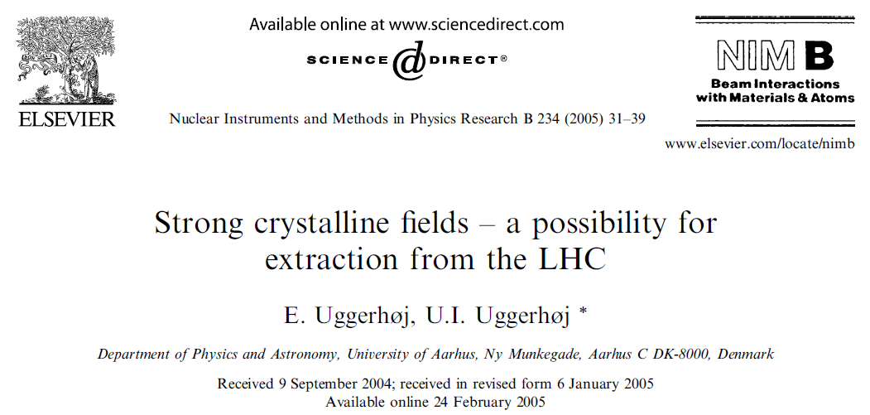
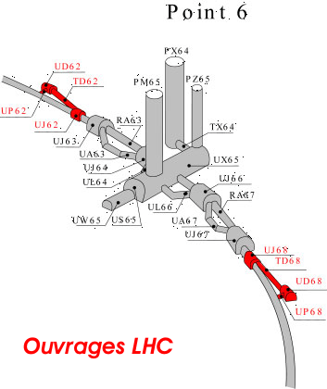
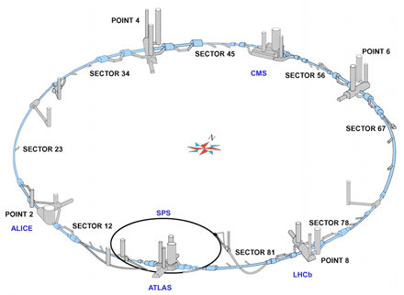
AFTER @ LHC – Beam extraction
Beam extraction @ LHC
…
N_{beam} ~ 5 x 10⁸ p⁺/s
…

Slide 4
AFTER @ LHC – p+A Luminosity
Intensity: expect 5.10⁸ protons.s⁻¹
Beam: 2808 bunches of 1.15x10¹¹ protons = 3.2x10¹⁴ protons
Bunch: Each bunch passes IP at the rate: 3.10⁵km.s⁻¹/27 km ~ 11 kHz
Instantaneous extraction: IP sees 2808 x 11000~3.10⁷ bunches passing every second ➔ extract 5.10⁸/3.10⁷ ~ extract 16 protons in each bunch at each pass
Integrated extraction: Over a 10h run: extract 5.10⁸p x 3600s.h⁻¹ x 10h=1.8 10¹³p.run⁻¹ ➔ extract 1.8 x 10¹³/(3.2 x 10¹⁴)~5.6% of the protons stored in the beam
Instantaneous Luminosity
L = N_{beam} x N_{Target} = N_{beam} x (ρ x e x N_{A})/A
N_{beam}=5 x 10⁸ p⁺/s
e (target thickness) = 1 cm
Integrated luminosity
9 months running/year
➔ 1year ~ 10⁷ s
➔ ∫_{year}L = L_{inst}x10⁷
Targ | ρ (g.cm⁻³) | A | L_{inst} (μb⁻¹.s⁻¹) | ∫_{year}L (pb⁻¹.y⁻¹)
Liq H | 0.068 | 1 | 20 | 200
Liq D | 0.16 | 2 | 24 | 240
Be | 1.85 | 9 | 62 | 620
Cu | 8.96 | 64 | 42 | 420
W | 19.1 | 185 | 31 | 310
Pb | 11.35 | 207 | 16 | 160
1 cm thick target

Slide 5
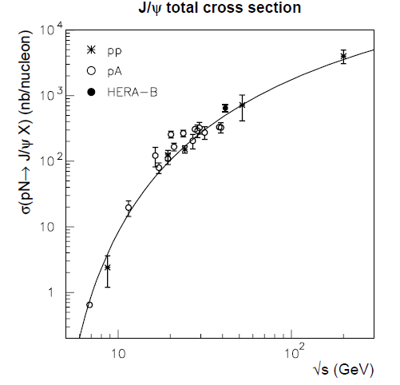
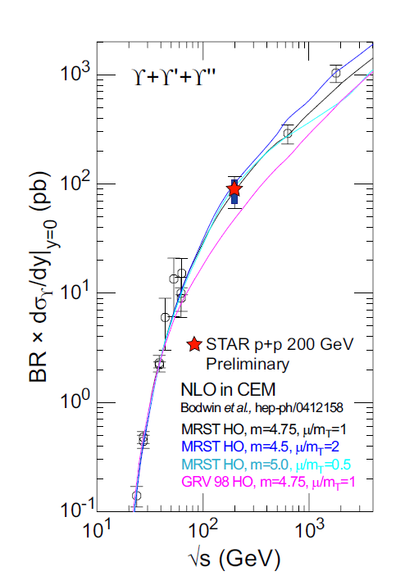
AFTER @ LHC – p+A Luminosity
Typical numbers
J/Ψ @ √s=115 GeV
σ_{Ψ} ~ 1.5 10³ nb
➔ Br_{Ψ→e+e-} dσ_{Ψ}/dy(y=0) ~ 30 nb
ϒ @ √s=115 GeV
Βr_{ϒ◊e+e-} dσ_{ϒ} /dy(y=0)@ 115 GeV ~ 50 pb
Target | ρ (g.cm⁻³) | A | L (μb⁻¹.s⁻¹) | L (pb⁻¹.y⁻¹) | N_{J/Ψ}|_{y=0} (y⁻¹) N_{J/Ψ} = ALσ_{Ψ} | N_{ϒ}|_{y=0} (y⁻¹) N_{ϒ} = ALσ_{ϒ}
Liq H | 0.068 | 1 | 20 | 200 | 6 10⁶ | 1. 10⁵
Liq D | 0.16 | 2 | 24 | 240 | 1.4 10⁷ | 2.4 10⁵
Be | 1.85 | 9 | 62 | 620 | 1.6 10⁸ | 2.8 10⁵
Cu | 8.96 | 64 | 42 | 420 | 8.1 10⁸ | 1.3 10⁶
W | 19.1 | 185 | 31 | 310 | 1.7 10⁹ | 2.9 10⁶
Pb | 11.35 | 207 | 16 | 160 | 1. 10⁹ | 1.7 10⁶
With 1 cm thick target

Slide 6
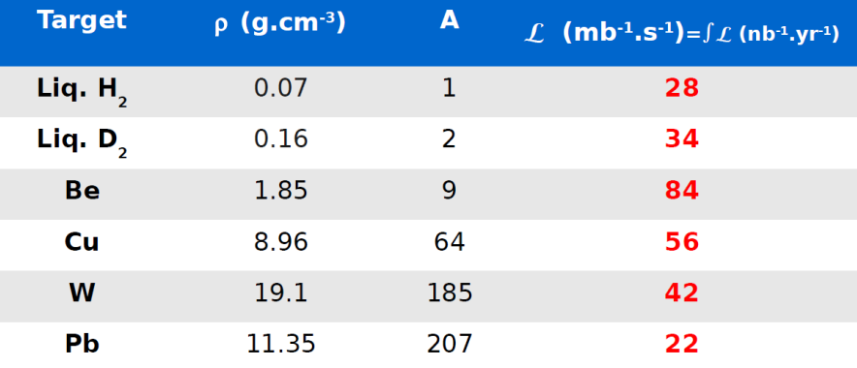
AFTER @ LHC – Pb+Pb Luminosity
Intensity: expect 7.10⁵ Pb.s⁻¹
Integrated luminosity
1 month running/year
➔ 1year ~ 10⁶ s
➔ ∫_{year}L = L_{inst}x10⁶
Typical numbers : PHENIX @ RHIC recorded in 2010
Au+Au @ 200 GeV: 1.3 nb⁻¹
Au+Au @ 62 GeV: 0.11 nb⁻¹

Slide 7
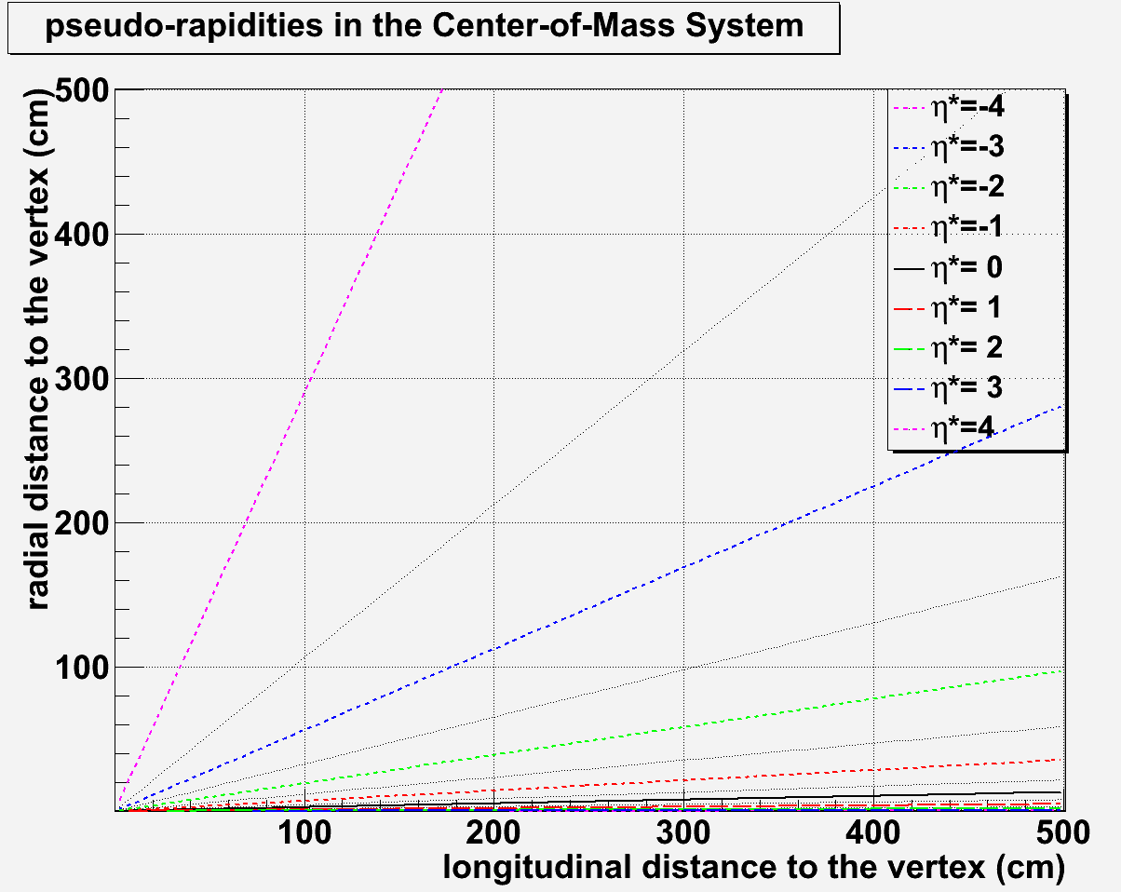
AFTER @ LHC - Pseudorapidity
η* = η – y_{CMS}
forward region: η*>0
backward region: η*<0
Very high boost:
With 7 TeV beam : γ = 61.1
With 2.75 TeV beam: γ = 38.3
Very well placed to access backward physics
Note : taking x₂ = M/√s e^{-y}
x₂(J/Ψ) = 1 ➔ y_{J/Ψ} ~ -3.6
X₂(ϒ) = 1 ➔ y_{ϒ} ~ -2.4
η*=-4.5
7 TeV
y_{CMS}= 4.8
η*=-4.8
η*=-4
η*=0
2.75 TeV
y_{CMS}= 4.3
η*=-4.3
η*=-4
η*=-3.5
η*=0

Slide 8
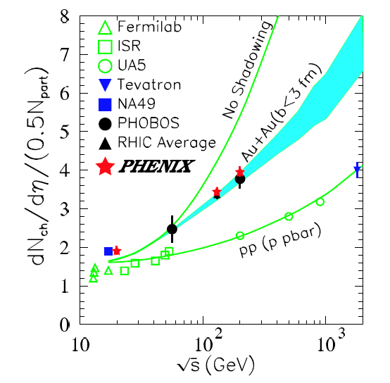
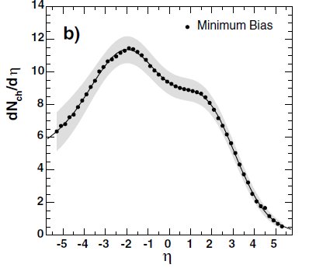
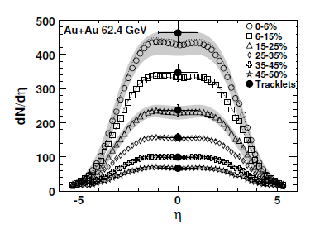
AFTER @ LHC – Multiplicity
Number of charged particles/rapidity unit
(1.5 x ~ charged+neutral)
p+p @ 115 GeV ~ 2
d+Au @ 200 GeV: max~11
Au+Au @ 62.4 GeV: max~450
p+p
PRL 93, 082301 (2004)
PRC 74, 021901(R) (2006)
d+Au

Slide 9
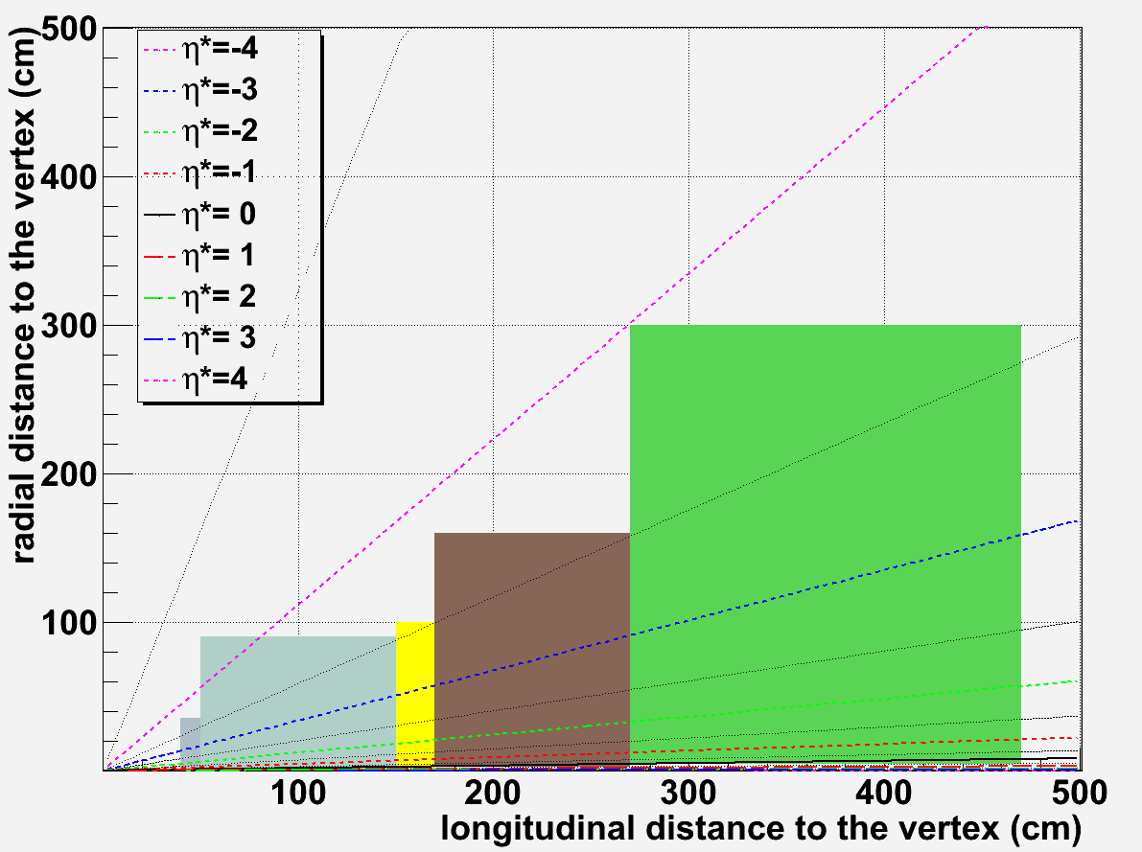
AFTER @ LHC – Detector
~0.1 m
~0.2 m
Typical detector: -3.5 < y_{cms} < 0
Multipurpose detector:
Vertex
Tracking
Calorimetry
Muons
Compact detector
Because of the high boost, the detector must be as compact as possible
Need ultra-granular technologies
~1 m
~1 m
~2 m
MuID
EMcal
Hcal
η*=0

Slide 10
AFTER @ LHC – Detector
Dimension
Detector | Z_{min}/Z_{max} | R_{min}/R_{max}
Vertex | 40/50 cm | 0.5/35 cm
Tracker | 50/150 cm | 0.8/90 cm
EMCal | 150/170 cm | 2/100 cm
Hcal | 170/270 cm | 2.5/160 cm
muons | 270/470 cm | 4/300 cm
HCal
3 m
EMCal
muons
tracker
vertex
5 mm
~4.5 m

Slide 11
AFTER @ LHC – Conclusion
Wide physics case
QCD at large x
nPDF and shadowing
QGP
Spin
Other ?
Up to 7 TeV beam
very high boost
need ultra-granular (new) technologies
Connection with the CHIC experiment @ SPS
Physics : QGP, nPDF and shadowing
The CHIC @SPS experiment also needs ultra-granular technologies
Take advantage of the CHIC expertise to design AFTER

Slide 12
CHIC @ SPS – Physics case
Test charmonium sequential screening in a QGP
Measure χ_{c} in A+A @ 17 GeV
How χ_{c} is suppressed relative to J/Ψ ? Dependence with y, p_{T}, N_{part},… ?
Mandatory to draw the whole picture (SPS .vs. RHIC .vs. LHC)
Goal: measure χ_{c} → J/Ψ γ → μ⁺μ⁻ γ within y_{cms} ∈[-0.5, 0.5]
Challenge: measure χ_{c}’s γ in a high π⁰ multiplicity environment
Measure charmonia production in p+A
what is the depence of charmonia suppression with rapidity @SPS energies?
Crucial to understand effects due to cold nuclear matter
Goal : measure charmonia within y_{cms} ∈[-0.5, 2]
(See Tuesday talk)

Slide 13
CHIC @ SPS – experimental setup
Active target → vertex → spectrometer → calorimeter → absorber → muID
MuID
Muon Filter
(absorber)
target
tracking
tracking
EMCal
Beam
vertex
Dipole field

Slide 14
CHIC @ SPS – Tracking
The NA60 pixel detector
The CHIC pixel detector
~40 cm
L = 0.4 m
~100 cm
L = 1 m

Slide 15
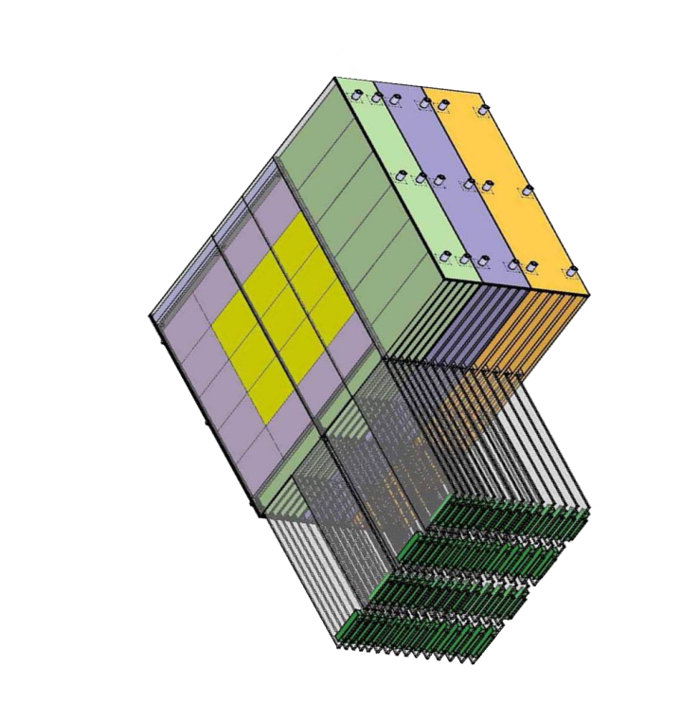
CHIC @ SPS – Calorimetry
Need very high segmentation
Expect up to ~400 photons/rapidity unit
Need to separate two electromagnetic showers
Need to isolate photons from π^{+/-} contamination
W + Si calorimeter à la Calice
30 layers
0.5 x 0.5 cm² pads
24 X₀ in 20 cm
ΔE/E ~ 20% / √E
W+Si : two relevant quantities
Distance between 2 incoming particles: at least one free pad
Moliere Radius
bad
good
Set detector position according to event multiplicity
at CHIC: z_{calo} ~ 2m
Geometrical condition: in principle
Δγ > 2cm

Slide 16
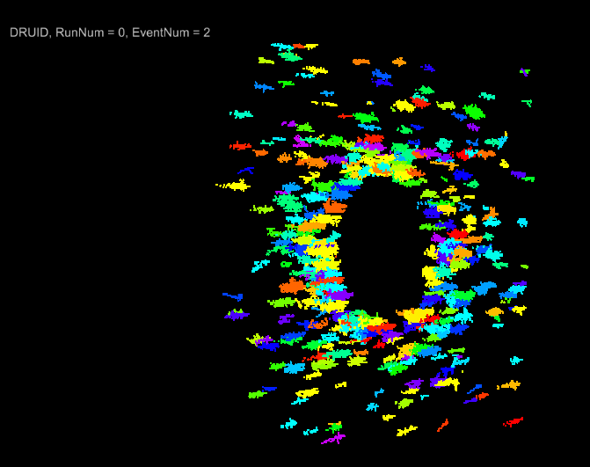
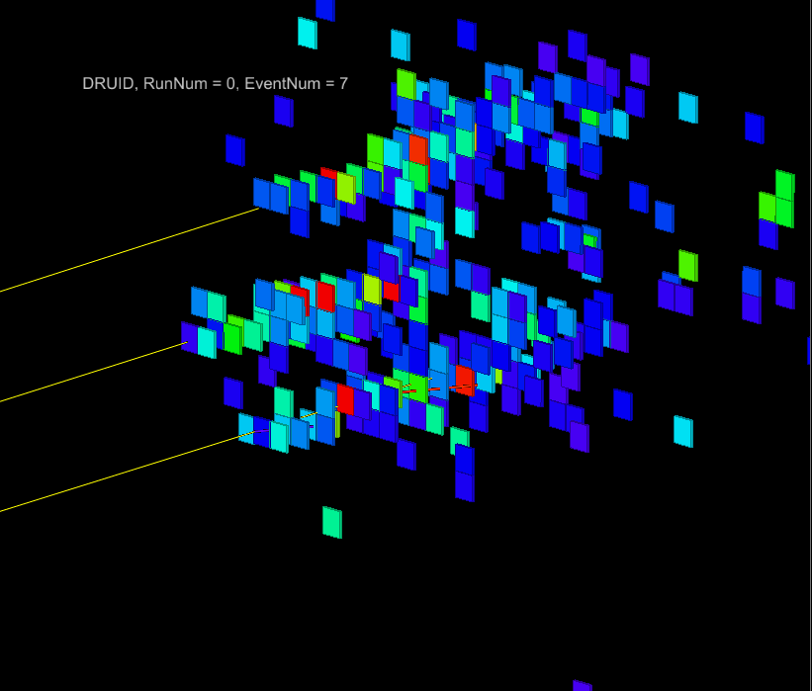
CHIC @ SPS – Calorimetry
Full simulation performed with the Calice Ecal proto
<E>~3 GeV
Pb+Pb
3 photons with E~2 GeV
distance between each photon~ 2 cm
0.5 x 0.5 cm² pads
(full simu made by D. Jeans - Calice collab.)

Slide 17
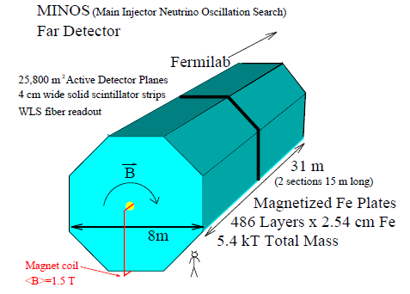
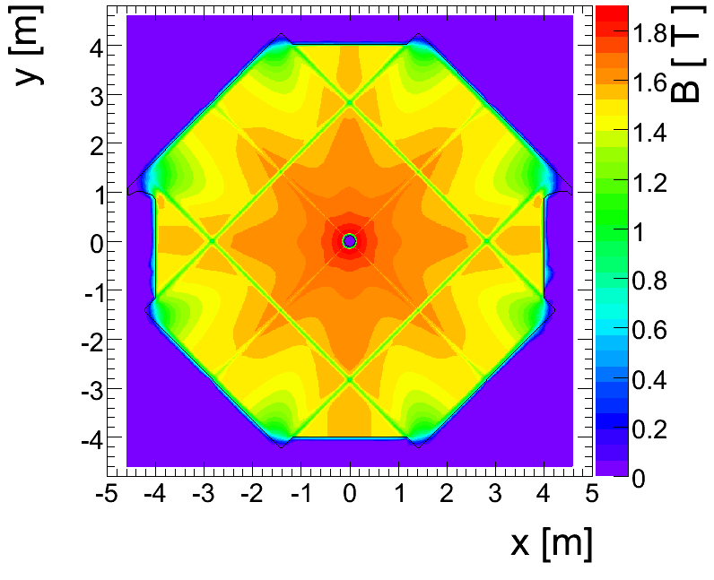
CHIC @ SPS – Absorber
Absorber type
NA50/NA60 : measure muon momentum after the absorber
➔ must minimize multiple scattering
Must use low Z material: best = BeO (but expensive)
NA50 : 0.6 m BeO + 4 m C + 0.6 m Fe = 5.2 m
CHIC : measure muon momentum before the absorber
➔ minimization of multiple scattering not crucial
➔ can use Fe material To absorb π^{+/-}
Need to match muon track position between spectrometer and trigger : Use an instrumented Fe absorber
DHCal
μ
π+
http://newsline.linearcollider.org/archive/2010/20101104.html
Can match muon track momentum between spectrometer and trigger : Use magnetized Fe absorber ?
Minos

Slide 18
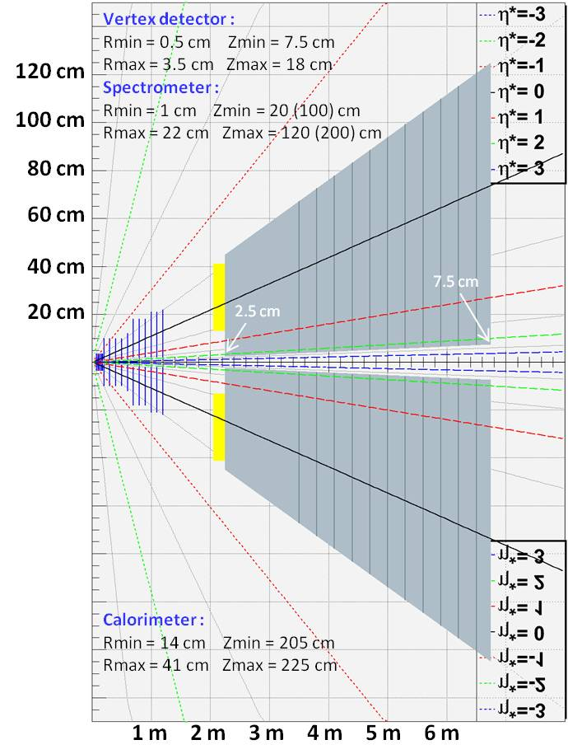
CHIC @ SPS – Overall design
Primary goals :
χ_{c} → J/Ψ + γ → μ⁺ μ⁻ γ at y_{CMS} = 0
J/Ψ→μ⁺ μ⁻ in large y_{CMS} range
Detector features : very compact
Spectrometer
- Measure tracks before absorber ➔ σ_{M}~20 MeV/c²
- Covers y_{CMS} [-0.5, 2] ➔ need high segmentation
➔ Silicon technologies
Calorimeter
- Measuring γ in high π⁰ multiplicity environment
➔ ultra-granular EMCal (Calice)
Absorber/trigger
- Using 4.5 m thick Fe to absorb π/K and low P μ^{+/-}
- Can use smaller absorber if Fe magnetized
- Trigger to be defined (expected rate = 0.3 kHz)
Expected performances
tracking :
Calorimetry :
Dipole field

Slide 19
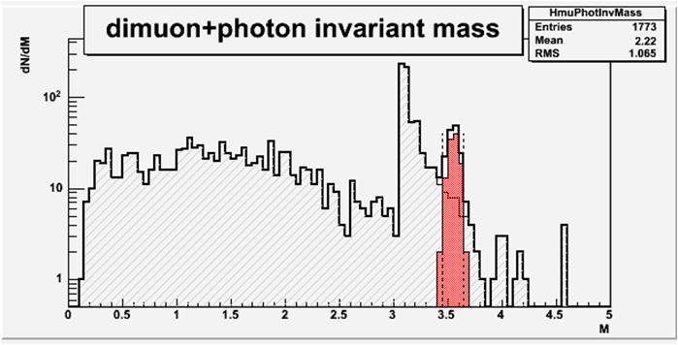
CHIC @ SPS – Performances
χ_{c2} in p+p collisions at √s=17.8 GeV
Sample:
20 kevents with Pythia 6.421
1 χ_{c2}→J/Ψ γ →μ⁺ μ⁻ γ per event
Smearing ΔP_{μ}/P_{μ} = 1%
Smearing ΔE_{γ}/E_{γ} = 20%/√E_{γ}
Selections :
Keep muons w/ -0.5 < y_{cms} < 0.5
Keep muons w/ P_{z} > 7 GeV
Keep muons w/ z_{vertex} < 215 cm
Keep photons w/ -0.5 < y_{cms} < 0.5
Reject photons w/ M_{γγ} ∈[100, 160] MeV/c²
Results : signal/bkg = 2.8
χ_{c2} in Pb+Pb at √s=17.8 GeV
Sample:
10 kevents minbias with Epos 1.6
1 pythia χ_{c2} embedded in each event
Same selections as in p+p
Reject γ if not in the same hemisphere as J/Ψ
Results : signal/bkg = 3.6

Slide 20
AFTER/CHIC - Conclusion
CHIC : (contact : F. Fleuret)
Very strong physics case : measure χ_{c} in Pb+Pb collisions @ SPS energies
not done in the 90’s-00’s because needed technologies not available at that time
Today, ultra-granular technologies are mature
Measuring χ_{c} in Pb+Pb collisions is now doable
Contact: F. Fleuret (fleuret@in2p3.fr) – LLR, Elena Ferreiro – Santiago
AFTER :
Wider physics case (QCD at large x, nPDF, nuclear shadowing, QGP, spin physics)
Up to 7 TeV beam, very high boost, need ultra-granular technologies
Take advantage of the CHIC expertise to design AFTER
Contact: J.-P. Lansberg (lansberg@in2p3.fr) - IPNO, S. Brodsky – SLAC, F. Fleuret – LLR, C. Hadjidakis – IPNO
Timescale and plans :
July 7th 2011 : one-day meeting
October 2011 :
Draft of a Letter Of Intent for CHIC to be submitted to SPS-C by the end of the year.
GDR-QCD meeting.
December 2011 : CHIC/AFTER ANR calls for proposal
simulations for CHIC (experimental)/AFTER (physics)
2012 : AFTER expression of interest

Slide 21
Backup

Slide 22
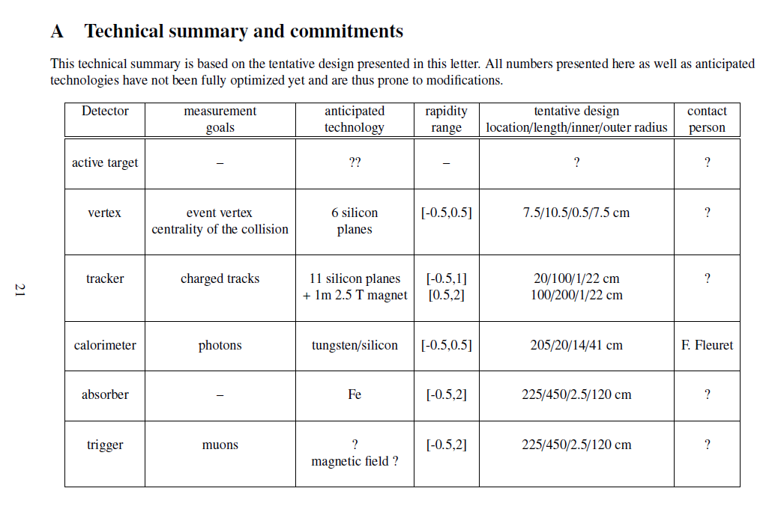
CHIC @ SPS – Conclusion
A key measurement to test charmonium sequential screening in QGP
Not done in the 90’s-00’s because needed technologies not available at that time
Today, ultra-granular technologies are mature
Measuring χ_{c} in Pb+Pb collisions is doable
Inaugurate a new generation of detectors for fixed target experiments

Slide 23
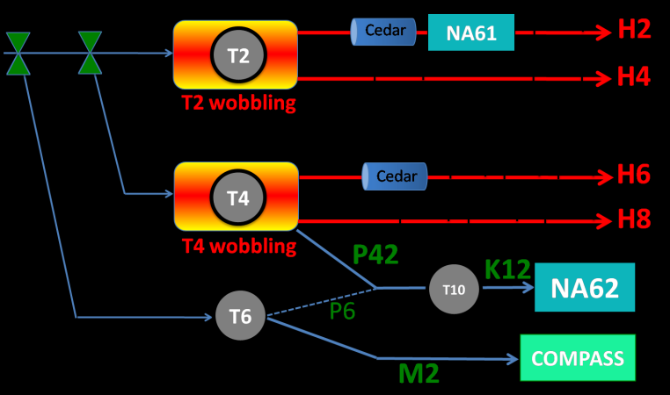
CHIC @ SPS - Expected yields
Need high intensity p and Pb beams (~ 10⁷ Pb/sec)
NA50/NA60 beam line not available (NA62)
H2 beam line occupied by NA61
H4 and H8 available but need shielding for HI
NA50: European Physical Journal C39 (2005) 335
New measurement of J/ψ suppression in Pb+Pb at 158 GeV/nucleon
35 days of data taking in 2000
~1.10⁷Pb/s over 5s bursts every 20s
4 mm thick Pb target (10%λ_{I})
~ 100 000 J/Ψ→μ⁺μ⁻ within y*∈[0,1] (on tape)
Expect fair amount of χ_{c}: N_{J/Ψ} ~ 60% direct + ~30% from χ_{c} + ~10% from Ψ’
With same conditions as 2000 NA50 setup ➔ ~20 000 χ_{c} expected within yCMS
Expect more with larger y* range
Expect more with thicker target (1cm for instance)
North Area Beamlines
|_{y=0}

Slide 24
Fixed target experiments @ SPS
NA38, NA50, NA51: 1st generation
Active Target → absorber → spectrometer → muID
Active target, but no vertex for open charm and not very good mass resolution

Slide 25
Fixed target experiments @ SPS
NA60: 2nd generation
+ NA50
See NA50
Active Target → telescope → absorber → spectrometer → muID
Active target, vertex for open charm and not very good mass resolution

