Slide 1









crystal assisted manipulation of high energy particle beam in UA9
W. Scandale

Slide 2
outlook
Historical perspective
  RD22 at the CERN-SPS as a test bed of beam extraction at LHC
  E853 at the FNAL-Tevatron as a test bed for the SSC
  The CERN-INTAS programmes on crystal technology
  Crystal collimation test at RHIC
  Crystal collimation test at the Tevatron
Collimation in LHC
UA9 as a test bed for crystal assisted collimation at LHC
Radiation hardness of crystals

Slide 3
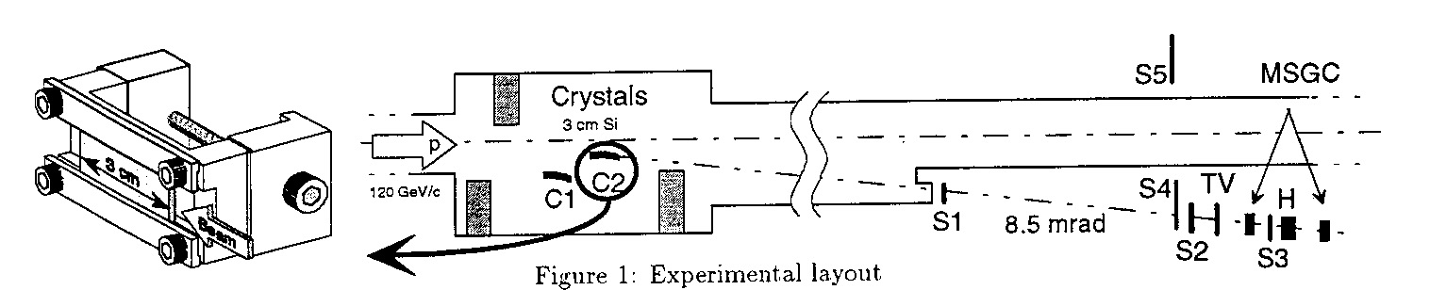
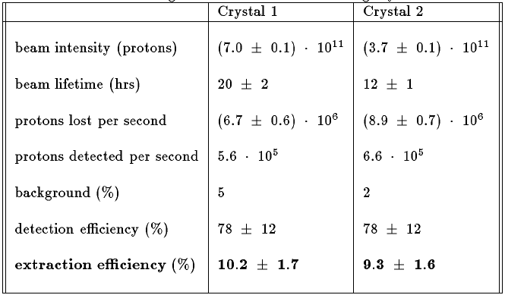
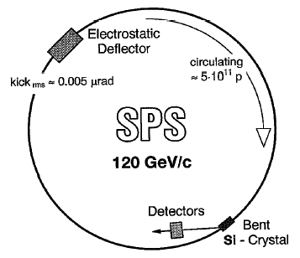
RD 22: extraction of 120 GeV protons (SPS: 1990-95)
The RD22 Collaboration, CERN DRDC 94-11
Large channeling efficiency measured for the first time
Consistent with simulation expectation extended to high energy beams
Experimental proof of multi-turn effect (channeling after multi-traversals)
Definition of a reliable procedure to measure the channeling efficiency

Slide 4
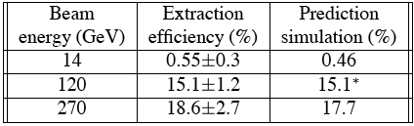
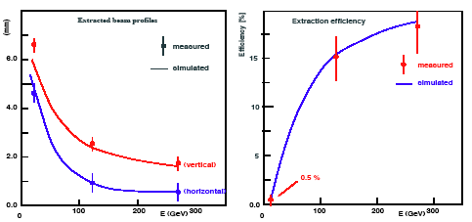
RD 22: varying the proton energy
G. Arduini et al., CERN SL 97-031 and SL 97-055
Dechanneling vs beam energy
Critical angle ψ_{c} ∝ p^{-1/2}
Dechanneling is induced by hits on e⁻ by bending of the atomic planes
e- hit dech. Length --> L_{D} ∝ p
bending dech. Length --> L_{B} = L_{D} (1-F)²
Channeling probability
Crystal length:
l_{s} = straight part
l_{b} = bent part
Scattering angle
Gaussian distribution
<θ> = 0
L_{eff} is the effective scattering length
X₀ = rad. length (= 9.7 cm for Si at 120 GeV)
Multiple scattering and dechanneling determine the dependence of efficiency on energy
For a given beam energy and crystal bending angle there is an optimal crystal length
Extrapolations of crystal efficiency to the LHC beam energy can be considered reliable

Slide 5
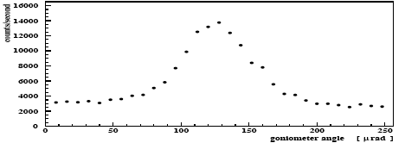
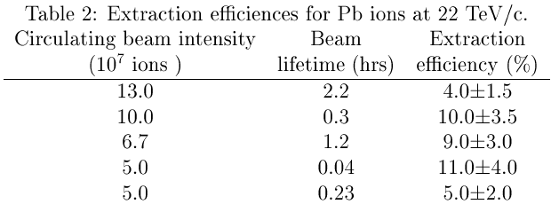
RD 22: ion extraction
G. Arduini et al., CERN SL 97-036 and SL 97-043
High energy ions are efficiently channeled
Angular scan FWHM smaller than with protons
Electromagnetic break-up cross section large
Multi-turn effect less effective than with protons

Slide 6
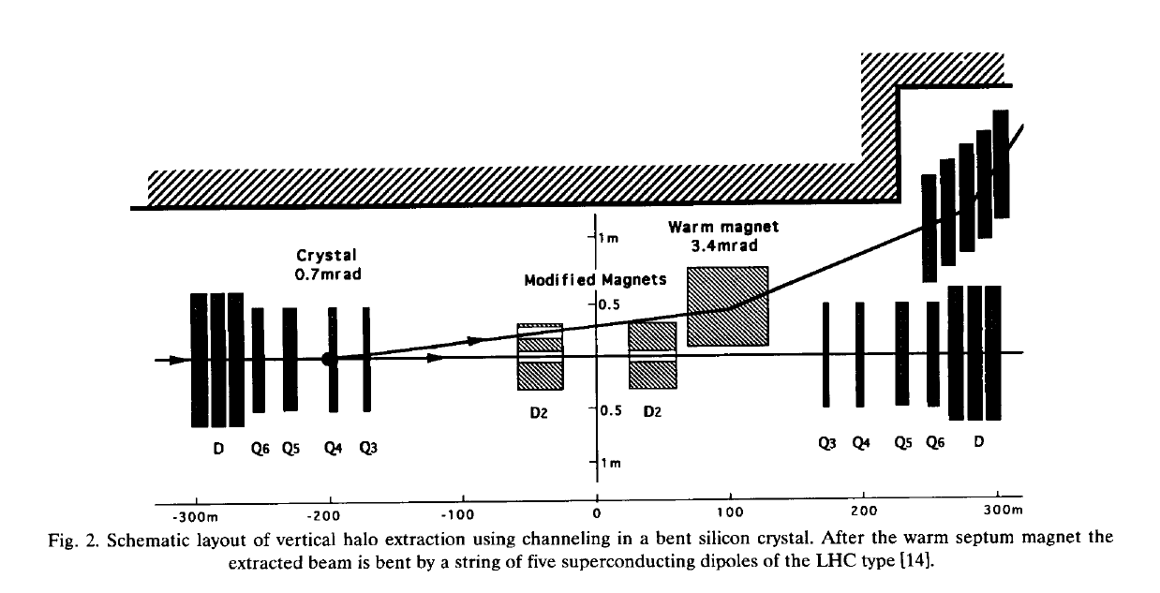
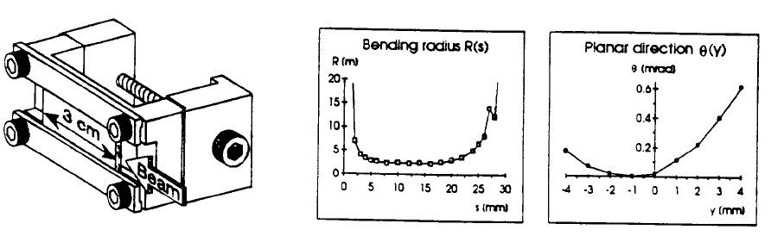
RD22: what for?
Extraction scenario from LHC
Extraction efficiency limited by
the crystal technology

Slide 7
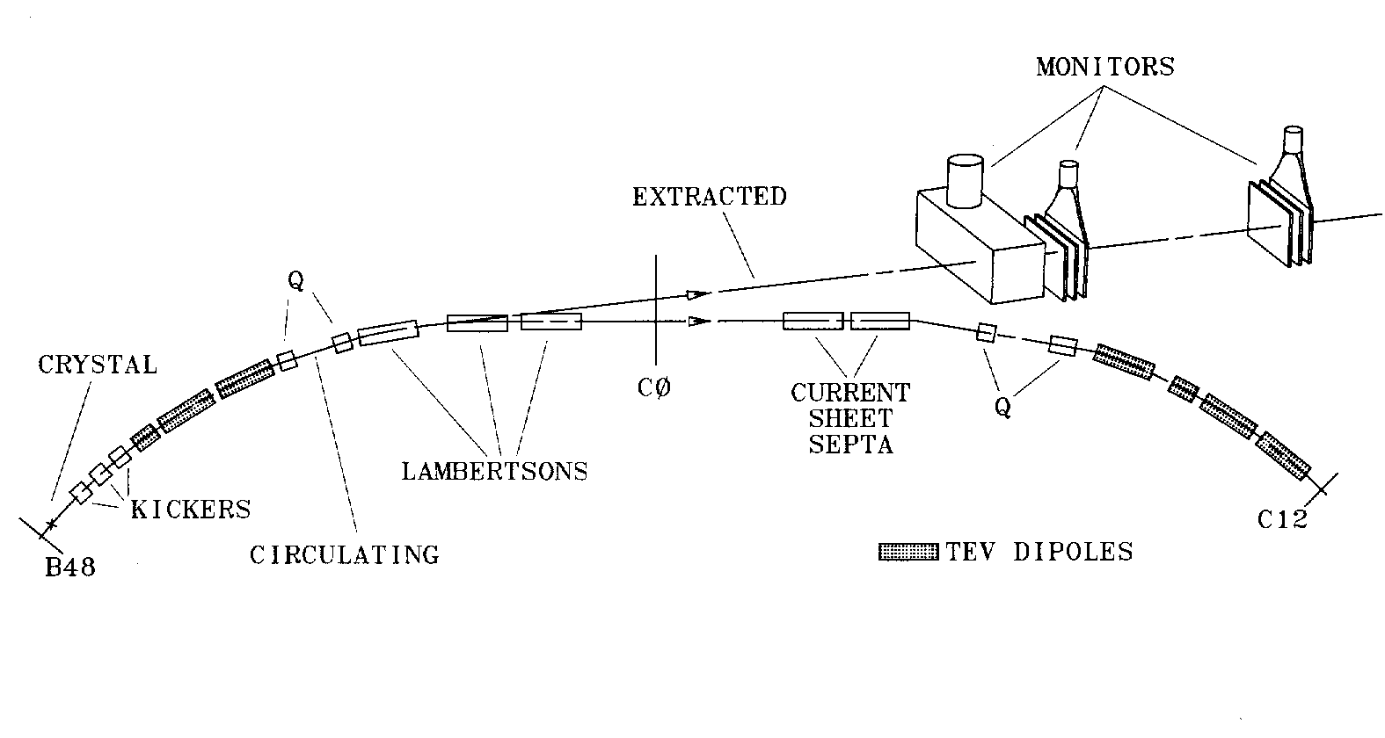
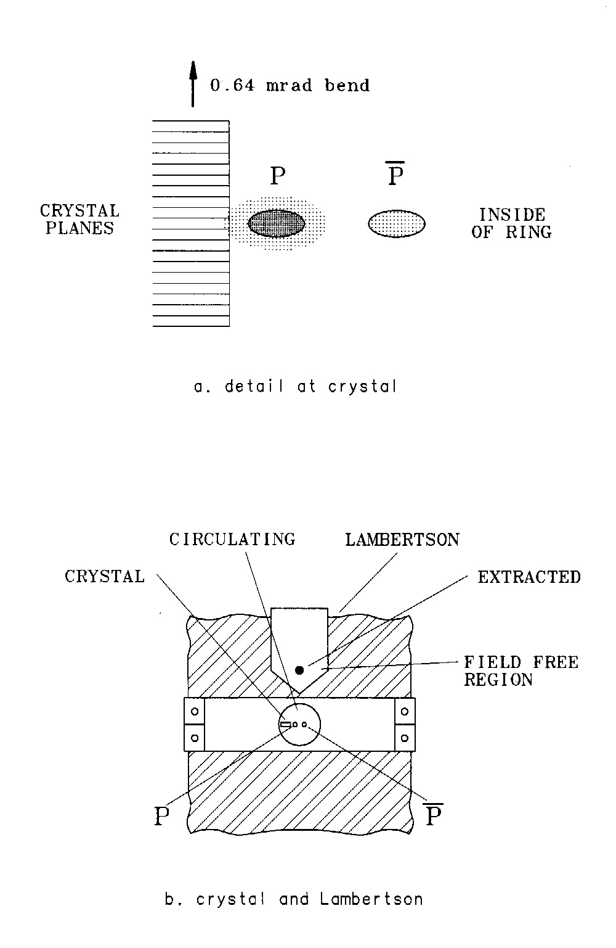
E853: extraction of 900 GeV protons (FNAL: 1993-98)
At crystal
Extracted significant beams from the Tevatron parasitic, kicked and RF stimulated
First ever luminosity-driven extraction
Highest energy channeling ever
Useful collimation studies
Extensive information on time-dependent behavior
Very robust
Lambertson, crystal

Slide 8
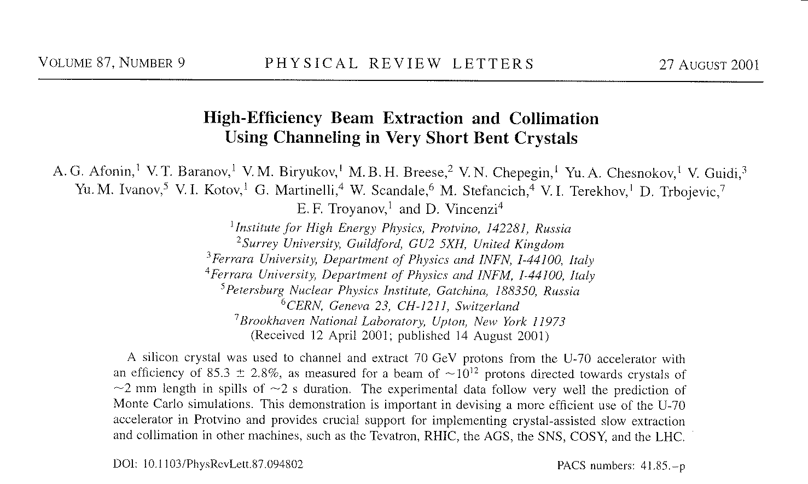
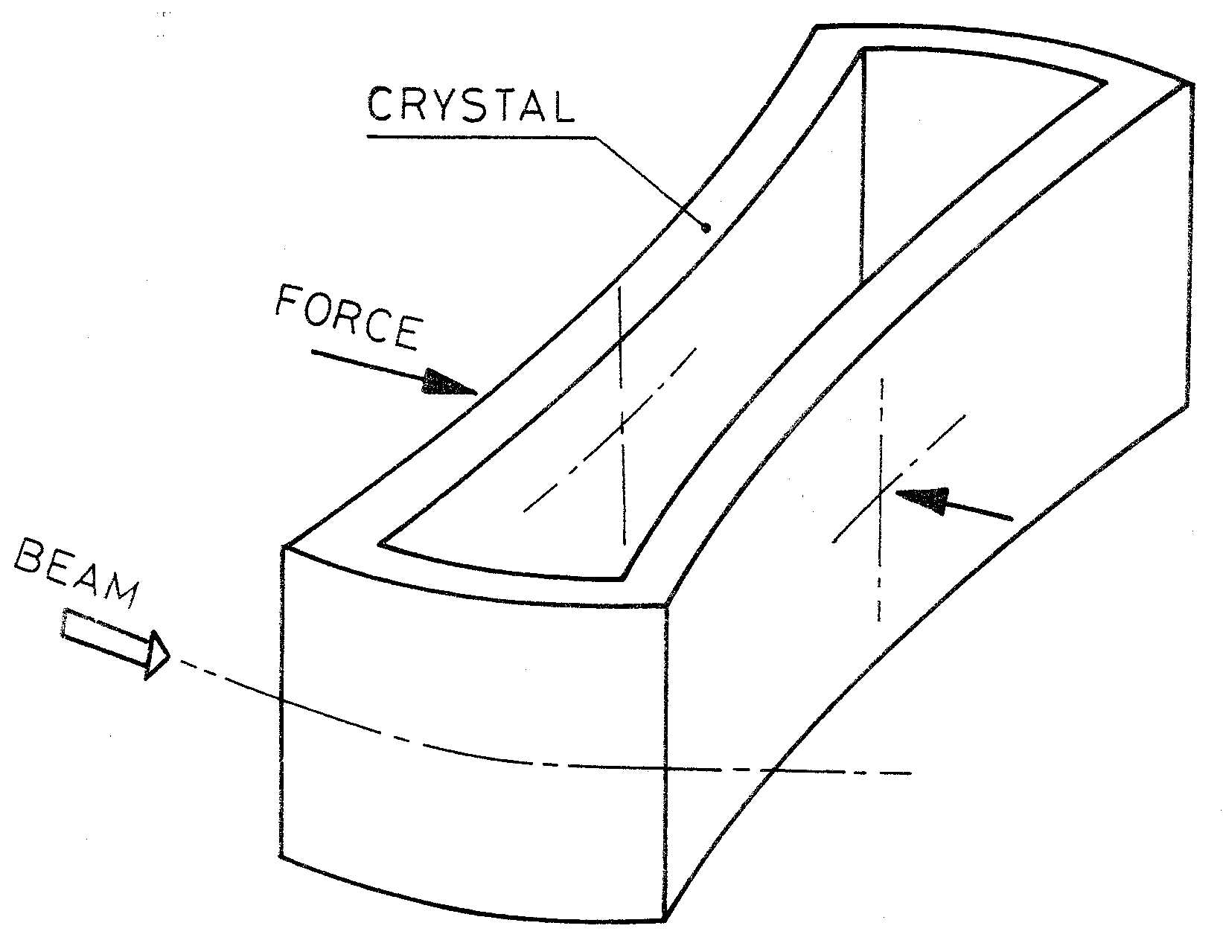
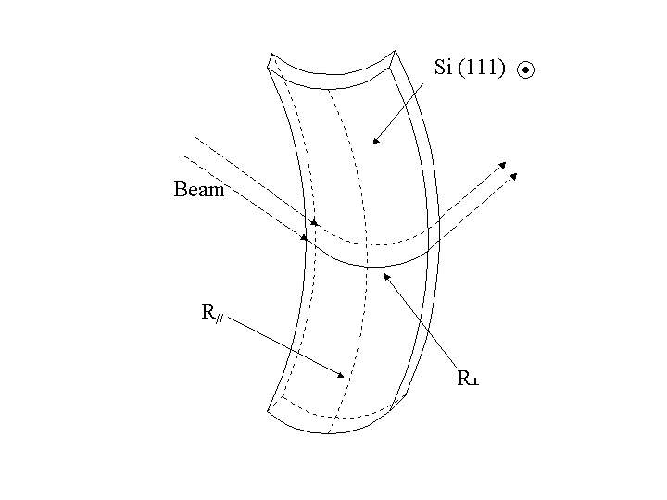
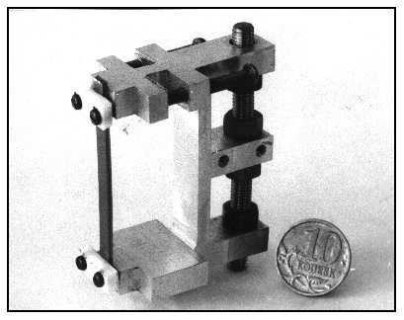
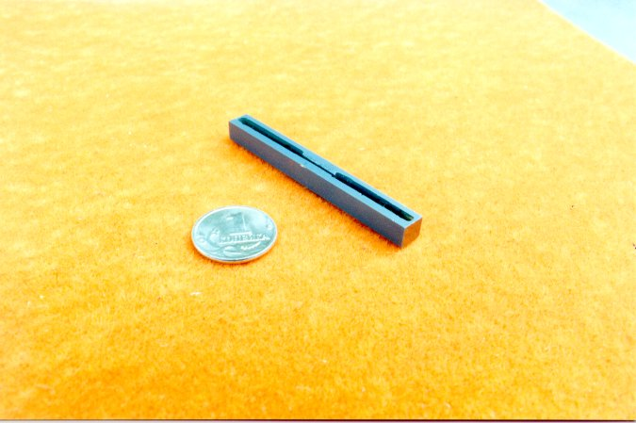
INTAS 00-132: short crystals (2001)
Two examples of bent short crystals
Saddle shaped crystals 0.5×2 ×50 mm³.
The saddle shape is induced by anticlastic forces
O-shaped crystals 3÷5 mm long

Slide 9
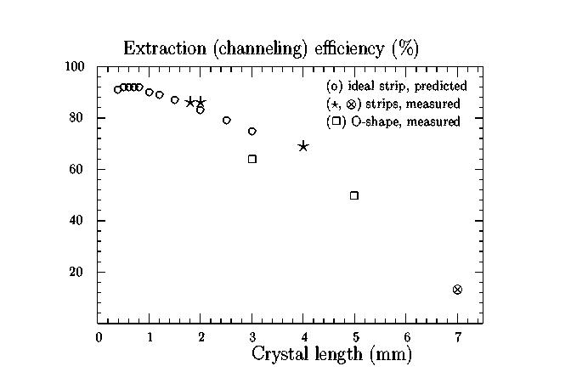
INTAS 00-132: short crystals (2001)
Efficiency predicted in a perfect strip crystal with 0.9 mrad bending (” ○ “)
Efficiency measured using 70 GeV protons in IHEP U-70 (”  □  “)
Crystal bending angle varied from 0.8 to 1.7 mrad
Measured efficiency of about 85 % for 2 mm long crystals (largest ever)

Slide 10
INTAS 03-51-6155: extraction efficiency (2003)
Channeling efficiency computed as a function of the crystal length along the LHC beam: at flattop 7 TeV and at injection 450GeV
The chosen bending angle is 0.2mrad.
Channeling efficiency computed as a function of the crystal bending angle.
Silicon crystal (110) with a 1µm thick rough surface.

Slide 11
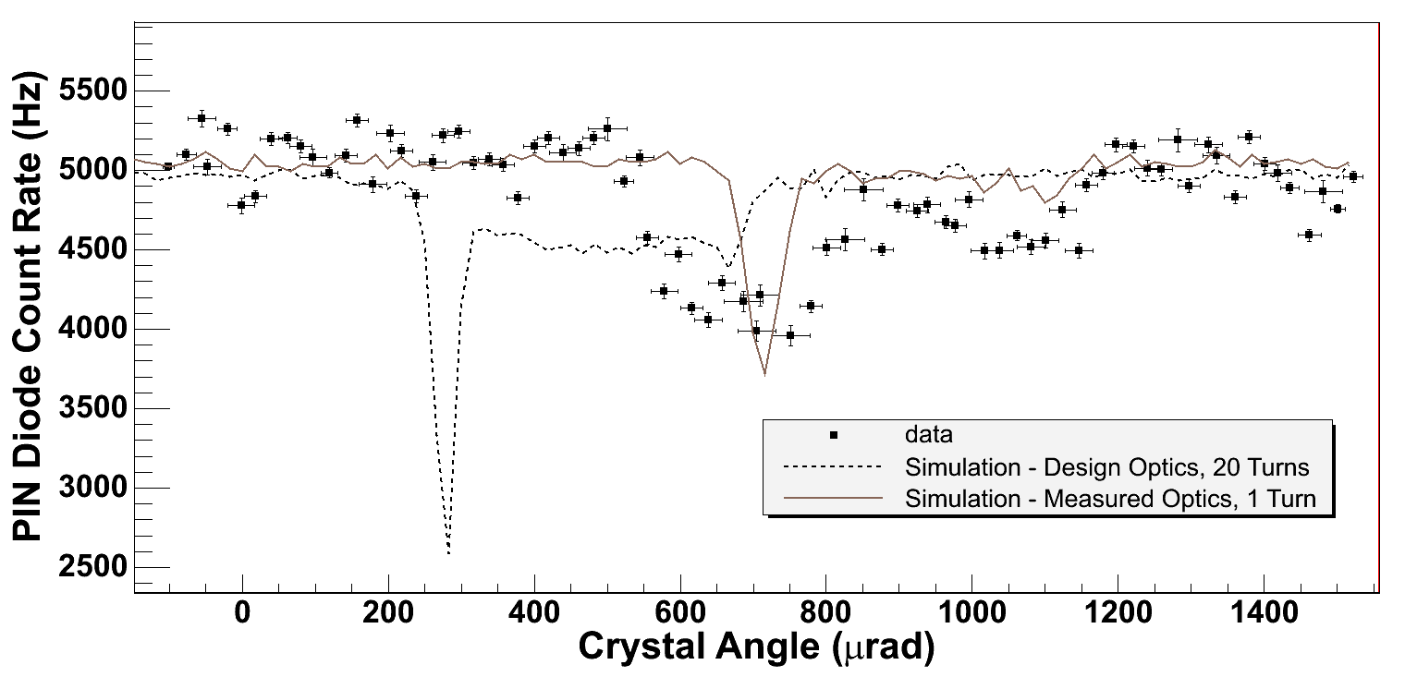
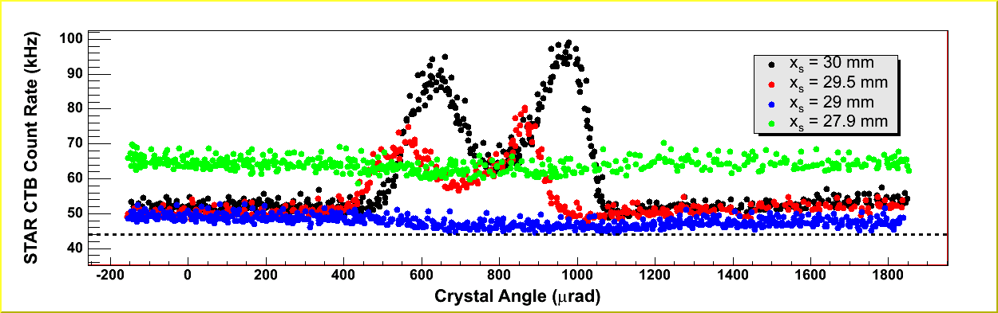
RHIC crystal collimation (2001/05)
Indirect experiment (measure particles disappearance) with Au and p runs
Si crystal 5×1 mm with θ_{B}=465 mrad located in interaction region matching section
Positioning not optimal (large beam divergence and α ≠ 0)
Crystal bends in the same plane where it scrapes ⇒ sensitivity to horiz. halo
No clear interpretation of the results!
Measured ch. efficiency (~25%) doesn’t match theoretical predictions ( 56% with nominal machine optics). Better agreement and consistency when using measured beam divergence ➔ need accurate knowledge of lattice functions.
Multipass physics and halo distribution models too simplistic?
Low channelling efficiency ⇒ collimation not successful & increased backgrounds !!
Not conclusive & abandoned !
R.Fliller III,
A.Drees, 2005
STAR Background during crystal collimation

Slide 12
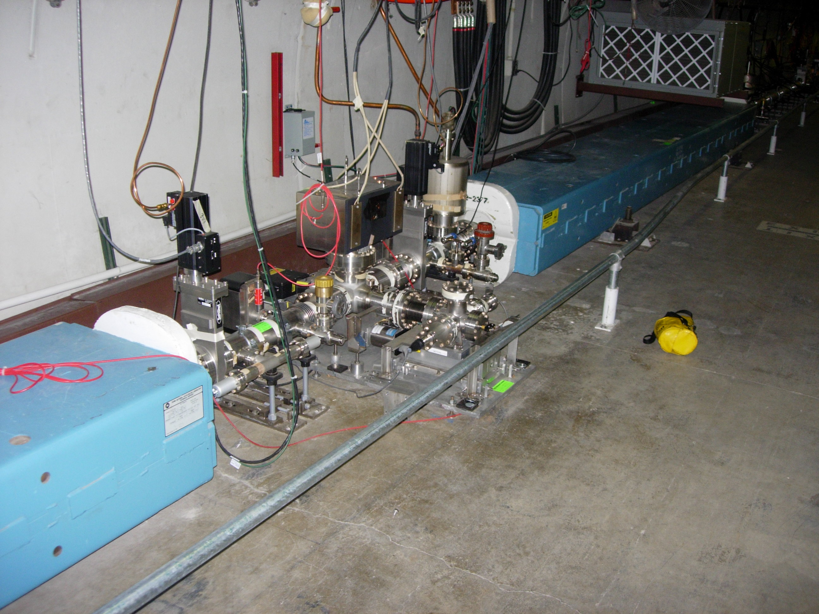
FNAL crystal collimation (2005-2011)
Crystal Collimator in E0 replacing a Tungsten Target (2005)
Tungsten scatterer
Using the crystal, the secondary collimator E03 can remain further (-1 mm or so) from the beam and achieve almost a factor of 2 better result!

Slide 13
Multi stage collimation as in LHC
The halo particles are removed by a cascade of amorphous targets:
Primary and secondary collimators intercept the diffusive primary halo.
Particles are repeatedly deflected by Multiple Coulomb Scattering also producing hadronic showers that is the secondary halo
Particles are finally stopped in the absorber
Masks protect the sensitive devices from tertiary halo
beam core
0
primary halo
6
secondary halo
& showers
6.2
7
secondary halo
& showers
primary collimator
0.6 m CFC
secondary collimator
1m CFC
secondary collimator
1m CFC
10
Normalizes aperture [σ]
tertiary collimator
absorber 1m W
tertiary halo
& showers
>10
Sensitive devices
(ARC, IR QUADS..)
masks
Collimation efficiency in LHC ≅ 99.98% @ 3.5 TeV
  Probably not enough in view of a luminosity upgrade
  Basic limitation of the amorphous collimation system
    p: single diffractive scattering
    ions: fragmentation and EM dissociation

Slide 14
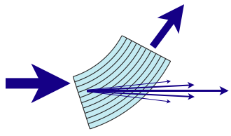
Crystal assisted collimation
Bent crystals work as a “smart deflectors” on primary halo particles
Coherent particle-crystal interactions impart large deflection angle that minimize the escaping particle rate and improve the collimation efficiency
θ_{ch} ≅ α_{bending}
1 m CFC
3 mm si
amorphous
channeling
<θ>_{MCS}≅3.6μrad @ 7 TeV
θ_{optimal @7TeV}≅ 40 μrad
R. W. Assmann, S. Redaelli, W. Scandale, “Optics study for a possible crystal-based collimation system for the LHC”, EPAC 06
beam core
0
primary halo
6
Multiple Coulomb scattered halo (multi-turn halo)
6.2
Dechanneled particles in the crystal volume
7
Deflected halo beam
10
Normalizes aperture [σ]
Silicon bent crystal
secondary halo
& showers
>10
primary collimator
0.6 m CFC
absorber
1m W
Sensitive devices
(ARC, IR QUADS..)
secondary collimator
1m CFC
secondary collimator
1m CFC
masks
Collimators partially retracted
Absorber retracted

Slide 15
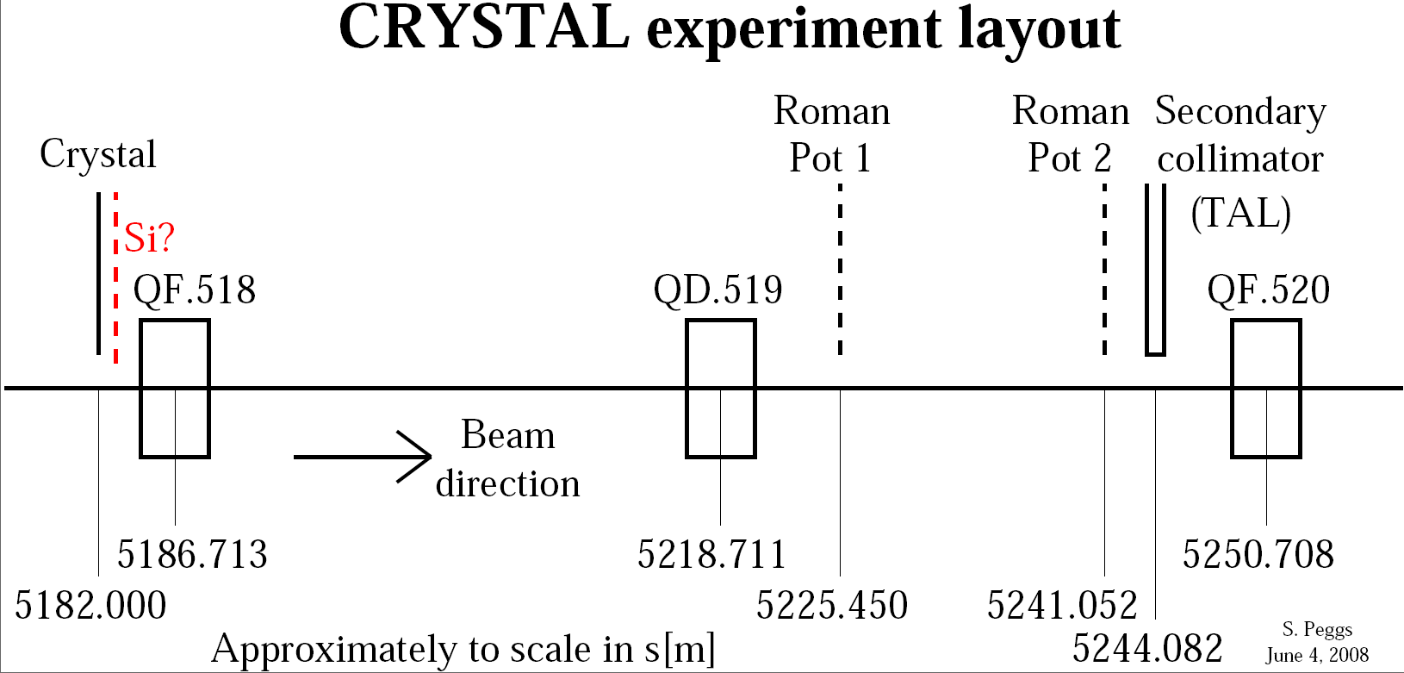
UA9 crystal collimation in the SPS (2008-…)
Goals:
Demonstrate loss localization
Measure channeling and collimation efficiency
Measure the single particle dynamics (later ?)

Slide 16
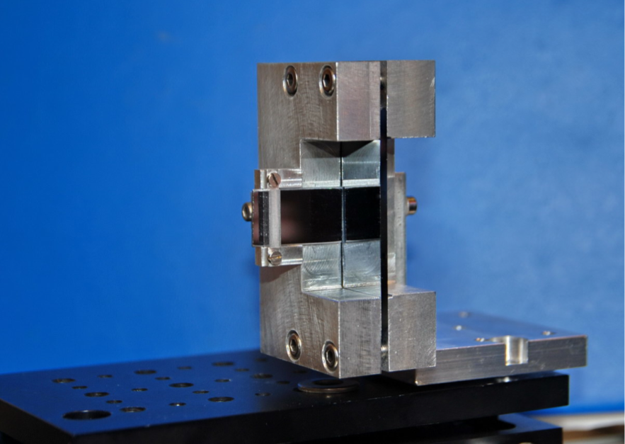
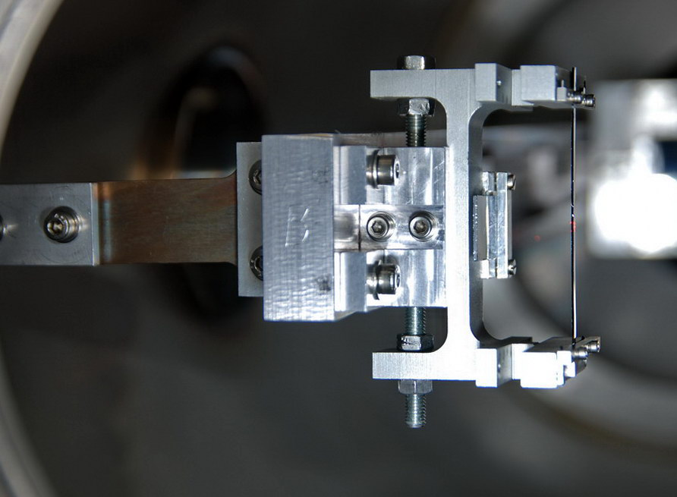
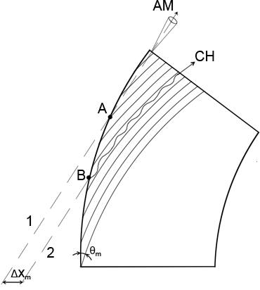
Crystals to assist collimation
Quasimosaic crystal
Bent along (111) planes
Minimal length a few tenths of mm
Non-equidistant planes d1/d2 = 3
Strip crystal
Bent along (110) planes
Minimal length ~ 1 mm
Equidistant planes
Crystals
Dislocation-free silicon crystals plates or strips
for optimal channeling efficiency
  short length (few mm)
  moderate bending radius 45 ÷ 70 m
Mechanical holders with large C-shape frame imparting the main crystal curvature
  Strip crystal: (110) planes are bent by anticlastic forces
  Quasimosaic crystal: (111) planes are bent by 3-D anticlastic forces through the elasticity tensor
Expected crystal defects:
  Miscut: can be ≈100 μrad, but negligible effect if good orientation is applied
  Torsion: can be reduced down to 1 μrad/mm ➔ UA9 data in the SPS North Area
  Imperfection of the crystal surface: amorphous layer size ≤ 1 μm
SPS at 120÷270 GeV) 1÷2 mm length, 150÷170 μrad angle
LHC 3÷5 mm length, 40÷60 μrad angle

Slide 17
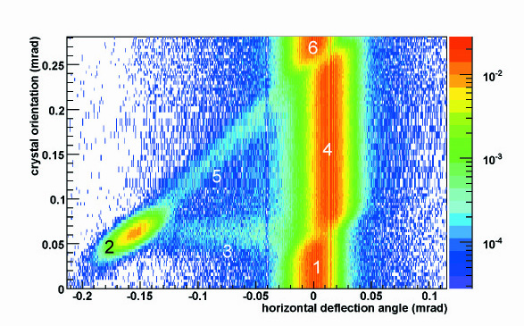
Coherent interactions in bent crystals
6. amorphous
5. Volume Capture
4. Volume Reflection P=95÷97%
2. Channeling
P=50÷85 %
3. dechanneling
1. amorphous
Two coherent effects could be used for crystal collimation:
  Channeling ➔ larger deflection with reduced efficiency
  Volume Reflection (VR) ➔ smaller deflection with larger efficiency
SHORT CRYSTALS in channeling mode are preferred ➔ ×5 less inelastic interaction than in VR or in amorphous orientation (single hit of 400 GeV protons)
W. Scandale et al, PRL 98, 154801 (2007)
W. Scandale et al., Nucl. Inst. and Methods B 268 (2010) 2655-2659.

Slide 18
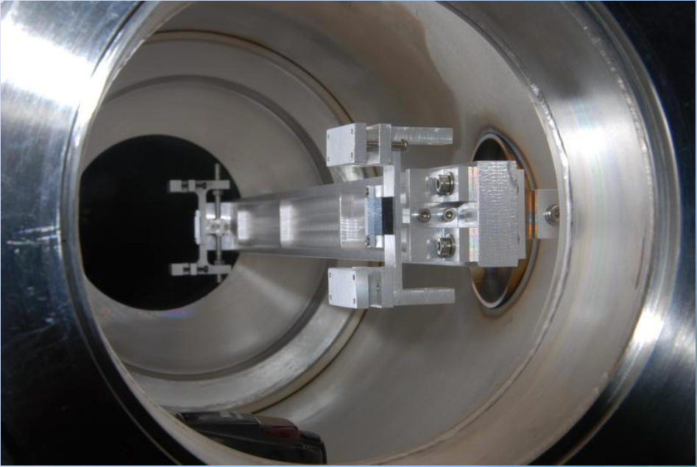
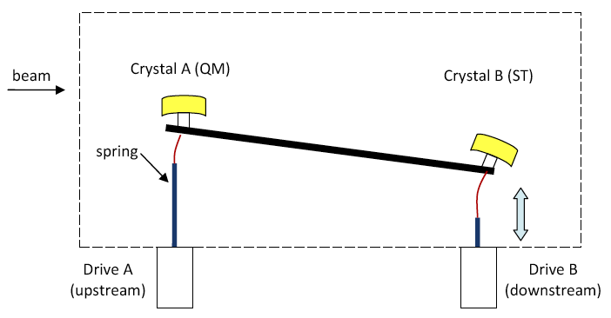
Goniometer
The critical angle governs the acceptance for crystal channeling
120 GeV ➔ θ_{c} = 20 μrad
450 GeV ➔ θ_{c} = 10 μrad
7 TeV ➔ θ_{c} = 2.5 μrad
Required goniometer accuracy
δθ = 10 μrad for E ≤ 450 GeV
δθ = 1÷2 μrad at LHC collision
IHEP goniometer providing δθ = 10 μrad
Upgrade of the goniometer launched in view of application to LHC

Slide 19


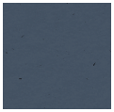
UA9 basic layout in the SPS
W. Scandale, M. Prest, SPSC-P-335 (2008).
W. Scandale et al, “The UA9 experimental layout”, submitted to JINST, Geneva (2011).
~ 67m / Δμ=90°
~45m / Δμ=60°
~ 45m / Δμ=60°
1m Cu, LHC-type collimator
4 different crystals,
independently tested
10 cm Al scraper,
dispersive area
60 cm W absorber
Medipix in a Roman pot
Collimation region
High dispersion area
Observables in the collimation area:
Intensity, profile and angle of the deflected beam
Local rate of inelastic interactions
Channeling efficiency (with multi-turn effect)
Observables in the high-D area:
Off-momentum halo population escaping from collimation (with multi-turn effect)
Off-momentum beam tails

Slide 20

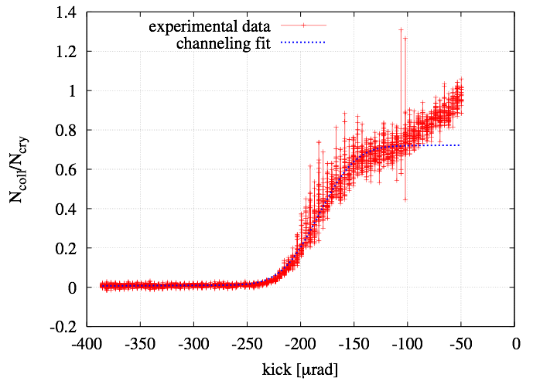
Channeling efficiency by coll. scans
~ 67m / Δμ=90°
~45m / Δμ=60°
~ 45m / Δμ=60°
absorber
collimator
BLMs
Efficiency 70-80%
Multi turn channeling efficiency and channeling parameters are measured using a collimator scan, and analyzing the losses detected by downstream BLMs
Ncoll/Ncry [-]
channeling kick
Equivalent crystal kick[μrad]

Slide 21
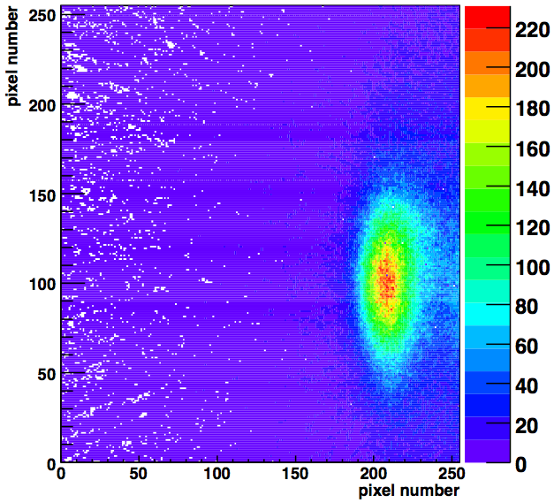
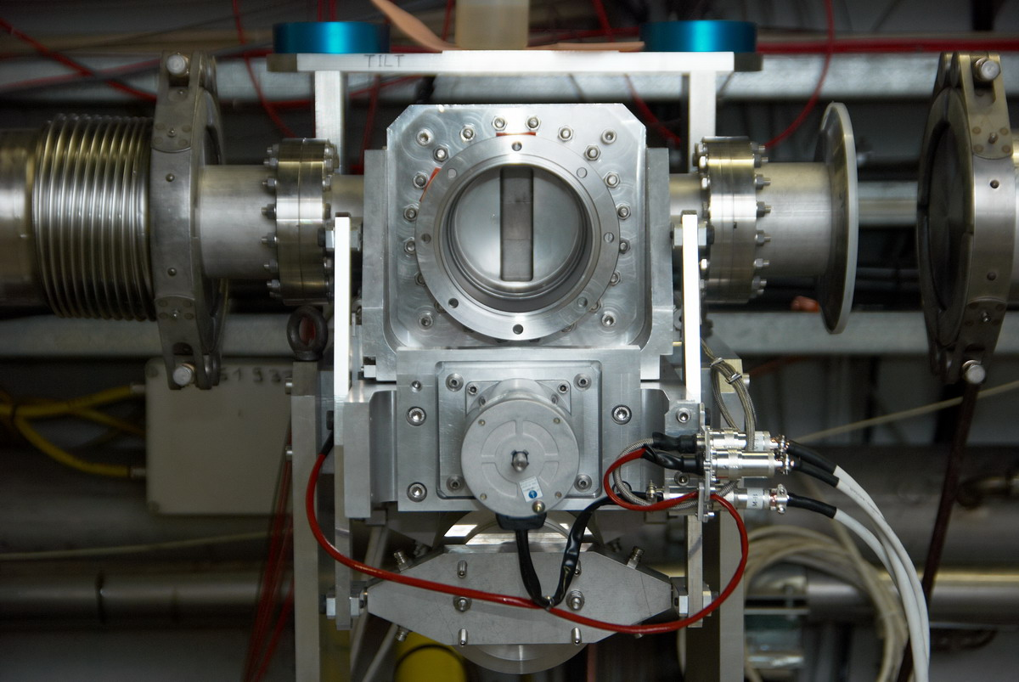
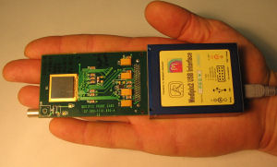
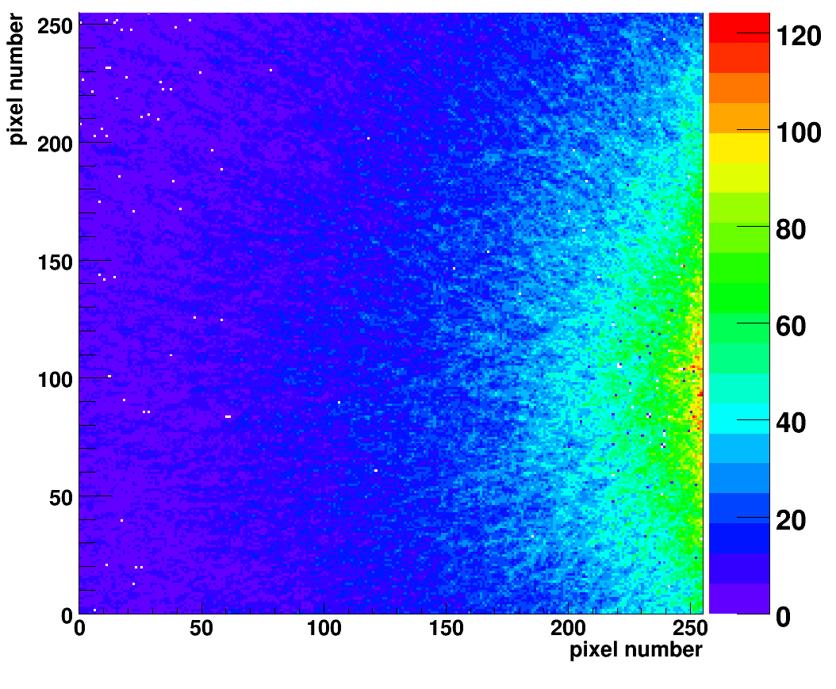
Direct view of channeled beam
~ 67m / Δμ=90°
~45m / Δμ=60°
~ 45m / Δμ=60°
channeling
absorber
Medipix in a Roman pot
amorphous
Medipix pixel detector in a Roman pot:
Intensity, profile and angle of the deflected beam
Efficiency of channeling (with multi-turn effect) (needs information on circulating beam current)

Slide 22
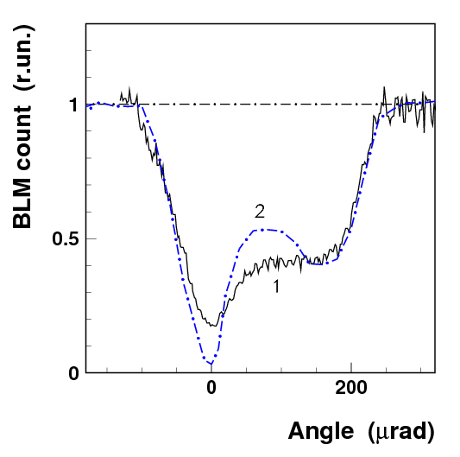
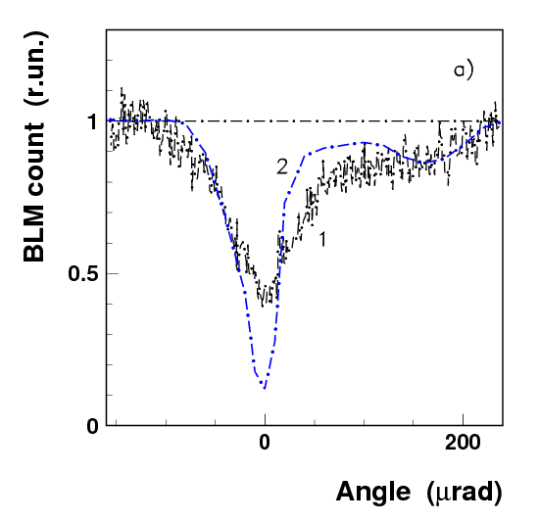
Loss rate reduction at the crystal
~ 67m / Δμ=90°
Loss rate reduction factor
for protons 5÷8
for lead ions ≈ 3
σ_{tot}(lead ions)=σ_{h}+σ_{ed}=5.5 b≅10×σ_{tot}(p)
Nuclear spray
absorber
Loss rate counters
protons
Lead ions
simulation
simulation
data
×5÷8 reduction
×3 reduction
data

Slide 23
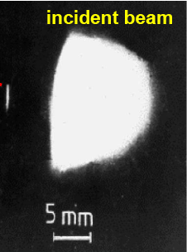
Radiation hardness
Test of power deposit at IHEP U-70 (Biryukov et al, NIMB 234, 23-30)
70 GeV protons hitting a 5 mm long si-crystal for several minutes
Hit rate: 10¹⁴ protons in 50 ms, every 9.6 s
The channeling efficiency was unchanged
After irradiation
Equivalent in LHC to the instant dump of 2 nominal bunches per turn for 500 turns every ~ 10 s.
deflected
Test of radiation damages at NA48 (Biino et al, CERN-SL-96-30-EA)
450 GeV protons hitting a 10x50x0.9 mm³ si-crystal for one year
Hit rate: 5×10¹² protons over 2.4 s every 14.4 s
Total flux: 2.4×10²⁰ p/cm² over an area of 0.8 x 0.3 mm²
The channeling efficiency over the irradiate area was reduced by ~30%
2.4 10²⁰ p/cm²
LHC loss density 0.5×10²⁰ p/cm² per year
3×10¹⁴ stored protons per fill and per ring
(assume 200 fills per year and ⅓ of the current lost in 4 collimators)
0.25×10¹⁴ protons lost per crystal
Area of the irradiated crystal 1mm×10μm

Slide 24
Summary
The SPS tests on crystal assisted collimation at have shown that
The procedure for crystal channeling is robust, fast and well reproducible
  The crystal and the absorber are positioned at the beam peripheral
  The absorber is retracted by 2÷3σ to allow multi-turn extraction of the halo
  The crystal is very precisely oriented in channeling mode using BLM signals
In channeling states the benefits are threefold
  Most of the halo population is promptly deflected towards the absorber
  The rate of the nuclear interaction at the crystal is strongly reduced
  The population of the self-generated off-momentum halo decreases
The crystal technology is fully mature to meet requirements of larger hadron colliders such as the LHC
UA9 is being extended in LHC

