Slide 1
Atlas reprocessing II at CC-IN2P3
E.V-G.R
CC-IN2P3, Villeurbanne, 22 September 2011

Slide 2
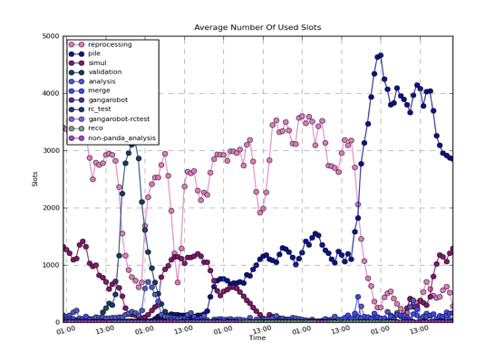
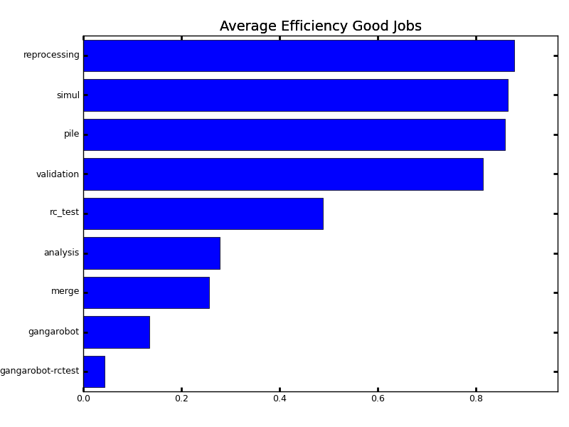
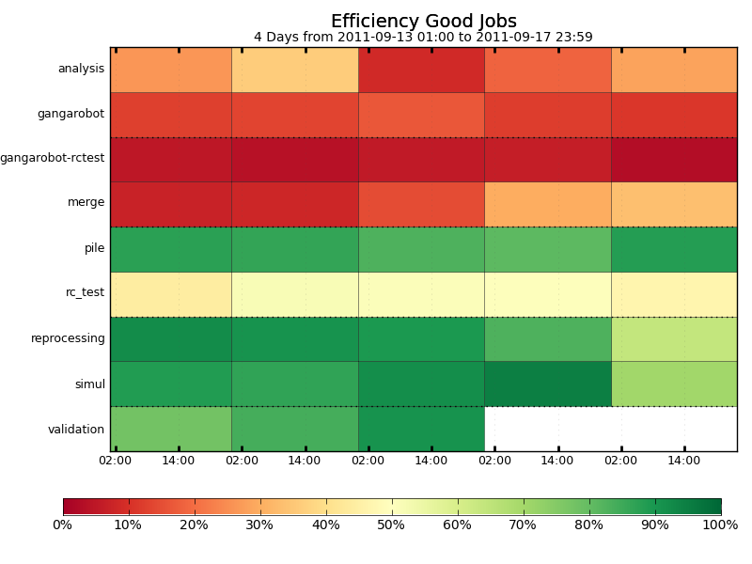
Global ATLAS activity
Global activity on BQS and GE.
Repro on GE only
There were activities overlapping on GE with reprocessing but difficult to know how much
In total success rate = 88% BQS+GE

Slide 3
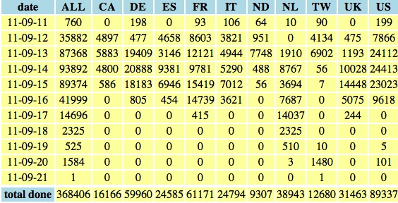
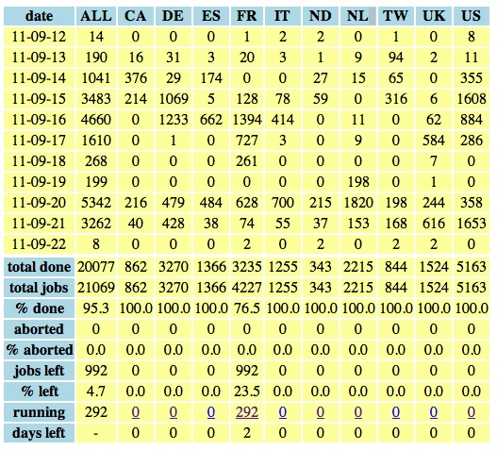
Repro II

Slide 4
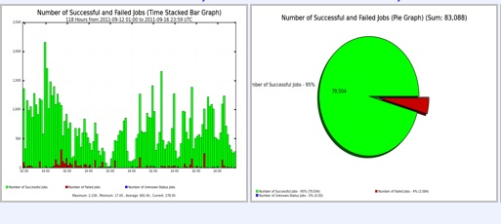
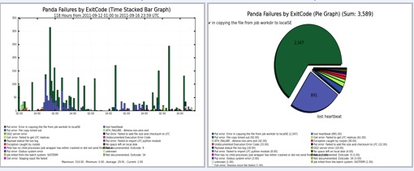
Statistics Reprocessing part II
Success vs total number of jobs:
95%
Select only reprocessing activity
Period from 12/9 to 17/9

Slide 5
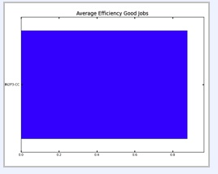
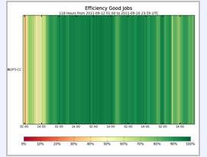
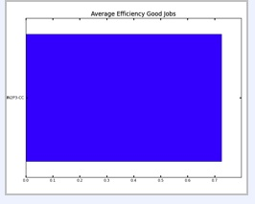
Reprocessing
Repro II: 90%
Repro I: 72%

Slide 6
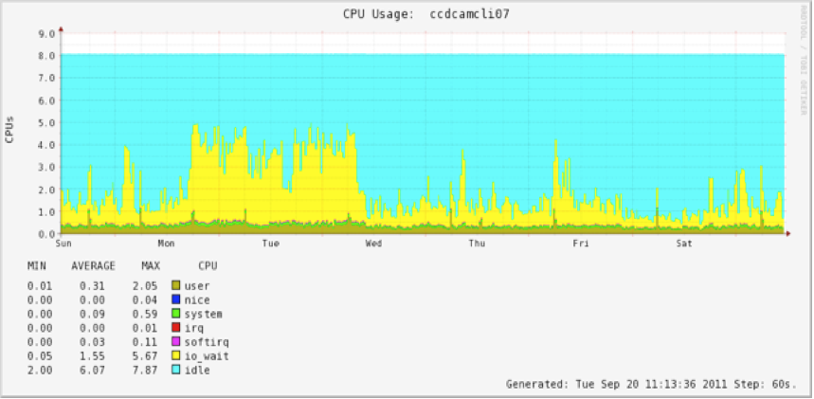
Chronology
12 Sept 13:00 Beginning of the reprocessing
12-13 Sept: srmput failures
High IO wait on Chimera DB causing internal timeout between SRM and Chimera servers. Workaround is to reduce the other activity on Chimera

Slide 7
Chronology (cont’d)
13-14 Sept for about 12 hours: Drop of the number of jobs of ATLAS in GE. Queues are empty. Jobs went back around 13:00
Investigation shows that there are jobs activated on the side of ATLAS ready to be run. But Condor seems to see that the queues are full and it does not send new pilots.
Pb somewhere between the CREAMCE and GE: gridmasters? https://cctools.in2p3.fr/wiki/exploitation:incidents:incidentpertejobsqueue20110914
PB still under investigation
Few other drops of jobs during the rest of the reprocessing
15 Sept 12:00 for about 1 hour Pb with GEmaster.
The shadow master replaces it in a 10min delay. But AFS tokens are lost during the exchange and jobs have to be suppressed.
16 Sept: end of the RAW→ESD repro (bulk in term of jobs).

Slide 8
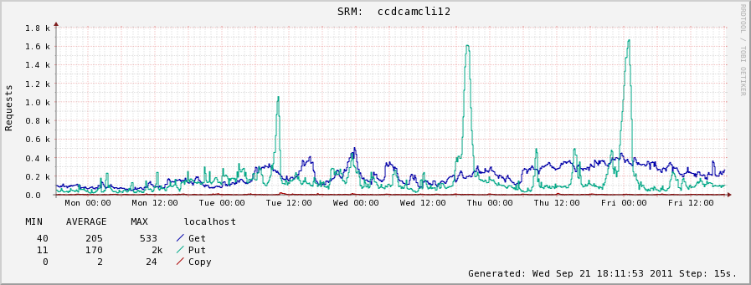
Chronology (end)
During repro: Some other errors due to high number of srmput. Correlation seen with high imports from CERN.

Slide 9
Summary
The reprocessing was successful.
Very good behaviour of CVMFS: has not shown problem.
dCache: No major problem:
Overloads were under control and no crash
Prestaging was done prior to the reprocessing
Actions to follow:
Use more performant hardware for dcache/chimera server.
Actually studied by dcache masters:
During 4 Octb stop:
Dump/restore the DB
add RAM
High performance disks for postgres.
Longer term:
New more customized hardware.

Slide 10
OTHER ITEMS
New channel exchanges:
Specific jabber and elog opened. Used by Atlas people, support, dcache and exploitation/ctrl-room.
Finish to configure all workers BQS with CVMFS
Status monitoring
The compilation of the existing pages is done.
https://cctools.in2p3.fr/wiki/support:monitoring:start
Work has begun to include them in webpages and thus avoid problems of authentication for internal pages.
New FRONTIER service
Frontier/launchpad for Oracle database on a new machine
Ongoing high activity for new config, tests.

