Slide 1
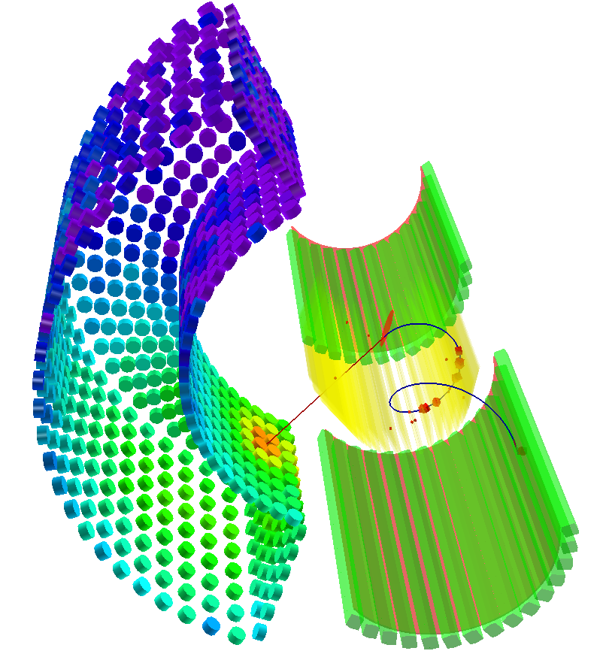
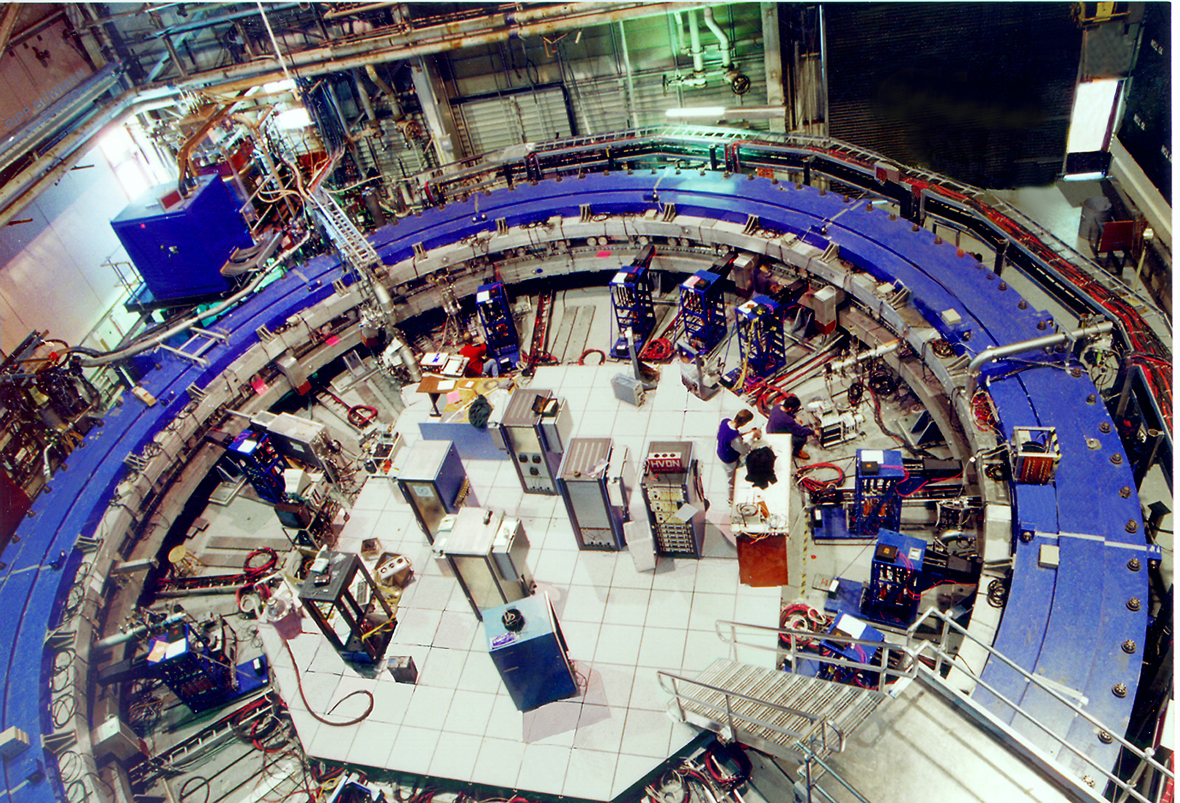
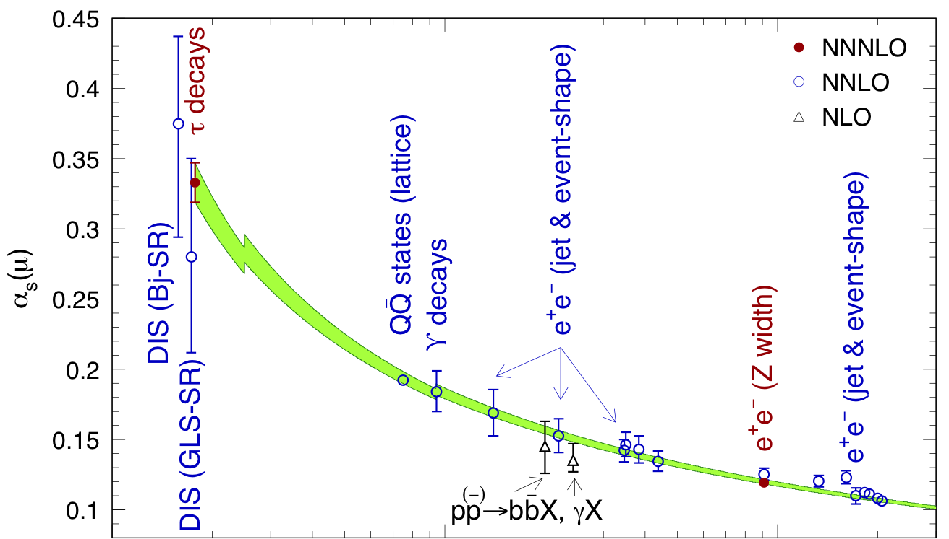
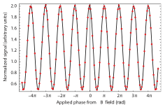
Charged-Lepton Flavour Physics
Andreas Hoecker (CERN)
LAPP – Annecy, 2011
Lepton-Photon Symposium, Aug 22–27, 2011, Mumbai-India

Slide 2
Clean measurements in the charged-lepton flavour sector can probe new physics at scales up to hundreds of TeV and above
Some deviations in flavour sector seen — none large enough to claim discovery — but very interesting to be followed up
For this talk, I have been asked to discuss:
  Charged-lepton flavour violation
  Lepton electric dipole moments and CP violation
  Recent tau physics results
  Muon anomalous magnetic moment
  + Conclusions
E821 at BNL

Slide 3
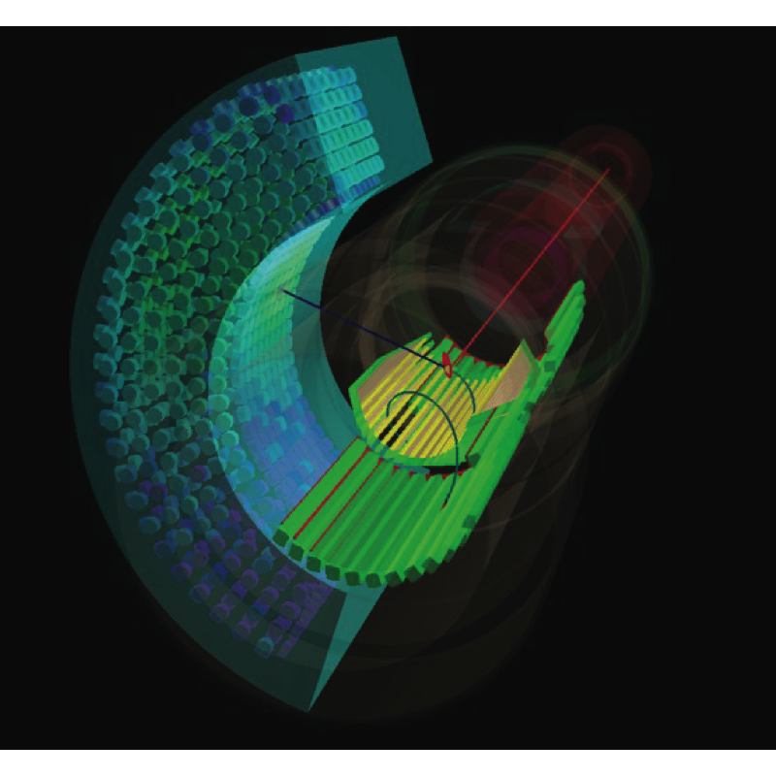
Absence of the decays µ → eγ and τ → µγ established, in the early days, that µ and τ were new elementary leptons, and not electron excitations
In analogy to the GIM mechanism, absence of µ → eγ also required to introduce the muon neutrino to cancel flavour changing neutral currents (Feinberg 1958, prior to ν_{µ} discovery in 1962)
Charged-Lepton Flavour Violation
MEG simulation

Slide 4
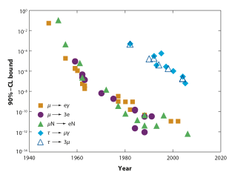
Charged-Lepton Flavour Violation
Only null observation to date
Marciano et al., Annu. Rev. Nucl. Part. Sci.58, 315 (2008)
…
BABAR / Belle
Super-B (50 ab^{–1})
MEGA
…
MEG
SINDRUM-II
Mu2e / COMET
Spectacular perspective !

Slide 5
Mu-to-e Flavour Violation
Minimal SM: m = 0 → strictly zero transitions between lepton flavours
SM extension to m  0 → unobservable tiny LFV rates predicted (GIM)
SM
Generic NP contribution
Chirality flip
where A_{L(R)} are radiative transition dipole amplitudes (dim-5 amplitude)
Flavour Changing Neutral Current
For generic new physics, parametrise:
Also: BR_{NP}(µ → eee) ~ α_{QED} × BR_{NP}(µ → eγ)
Search for charged-LFV probes new physics without SM contamination !
Prior best limit on µ⁺ → e⁺γ by MEGA experiment (LAMPF, 1999): B < 1.210^{–11}
MEGA, PRL 83, 1521 (1999)

Slide 6
Mu-to-e Flavour Violation
Minimal SM: m = 0 → strictly zero transitions between lepton flavours
SM extension to m  0 → unobservable tiny LFV rates predicted (GIM)
SM
Generic NP contribution
Chirality flip
Can vary significantly with chosen new physics amplitudes
where A_{L(R)} are radiative transition dipole amplitudes (dim-5 amplitude)
Flavour Changing Neutral Current
For generic new physics, parametrise:
Also: BR_{NP}(µ → eγ) ~ 170 × BR_{NP}(µ → eee)
Search for charged-LFV probes new physics without SM contamination !
Prior best limit on µ⁺ → e⁺γ by MEGA experiment (LAMPF, 1999): B < 1.210^{–11}
MEGA, PRL 83, 1521 (1999)

Slide 7
Mu-to-e Flavour Violation
Minimal SM: m = 0 → strictly zero transitions between lepton flavours
SM extension to m  0 → unobservable tiny LFV rates predicted (GIM)
probes slepton mixing matrix
SM
SUSY
Chirality flip
Flavour Changing Neutral Current
In seesaw related to ln(M_{νR}/M_{Planck})
Search for charged-LFV probes new physics without SM contamination !
Prior best limit on µ⁺ → e⁺γ by MEGA experiment (LAMPF, 1999): B < 1.210^{–11}
MEGA, PRL 83, 1521 (1999)

Slide 8






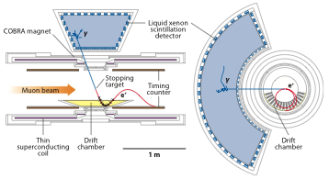
The MEG µ⁺ → e⁺γ Experiment at PSI
PSI πE5 produces 29 MeV surface µ⁺ at 3×10⁷ Hz rate hitting on thin stopping target
Signal reconstruction:
  Stopped μ⁺ beam: monoenergetic
  Back-to-back and in-time e—γ
  Exploit E_{γ}, E_{e}, T_{eγ}, θ_{eγ}, φ_{eγ} in combined fit
Background sources:
  Radiative μ⁺ → e⁺γ νν (RMD)
  Accidental photon coincidence from RMD, bremsstrahlung, or e⁺ annihilation in flight
Sketch of MEG experiment
10% solid angle coverage
55 Collaborators

Slide 9
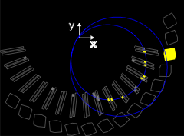
MEG display of µ⁺ → e⁺γ candidate event
Stopping target
γ
e⁺

Slide 10

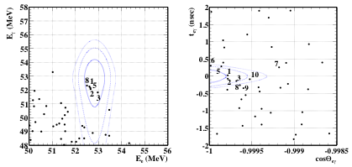
Situation after Preliminary Analysis of 2009 Data
*
* two months stable data taking in 2009
MEG (Sawada), PoS ICHEP2010, 263 (2010)
Selection variables: photon energy (E_{γ}), positron energy (E_{e}), time difference (T_{eγ} ), polar and zenith angles (θ_{eγ,} φ_{eγ} )
Events selected in analysis regions
Contours show 1, 1.64, 2σ regions of signal PDF
Numbers classify events according to highest signal likelihood
Unbinned maximum likelihood fit gave slight signal excess and 90% CL upper limit:

Slide 11
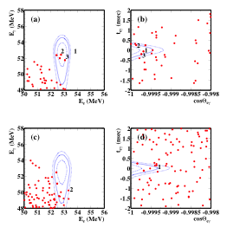
Combined Analysis of 2009 and 2010 Data
Total of 1.8×10¹⁴ μ⁺ decays in the target, 2010 about twice statistics of 2009
MEG arXiv:1107.5547, T. Mori at EPS-HEP-2011
Excess in 2009 data confirmed by reanalysis
(Background-only p-value: 8%)
2009
2009
2010
2010
However, not reproduced in 2010 data

Slide 12
Combined Analysis of 2009 and 2010 Data
MEG arXiv:1107.5547, T. Mori at EPS-HEP-2011
Excess in 2009 data confirmed by reanalysis
(Background-only p-value: 8%)
2009
2009
2010
2010
However, not reproduced in 2010 data
5 times better than previous limit !
90% CL (Feldman-Cousins) upper limit:

Slide 13
Full Analysis of 2009 and 2010 Data
MEG arXiv:1107.5547, T. Mori at EPS-HEP-2011
Excess in 2009 data confirmed by reanalysis
Systematic uncertainties in PDF and normalisation factors are small and will partly decrease with more statistics
MEG continues data taking in 2011+2012 to explore µ⁺→e⁺γ up to the design sensitivity of O(a few 10^{–13})
2009
2009
2010
2010
However, not reproduced in 2010 data
90% CL (Feldman-Cousins) upper limit:

Slide 14
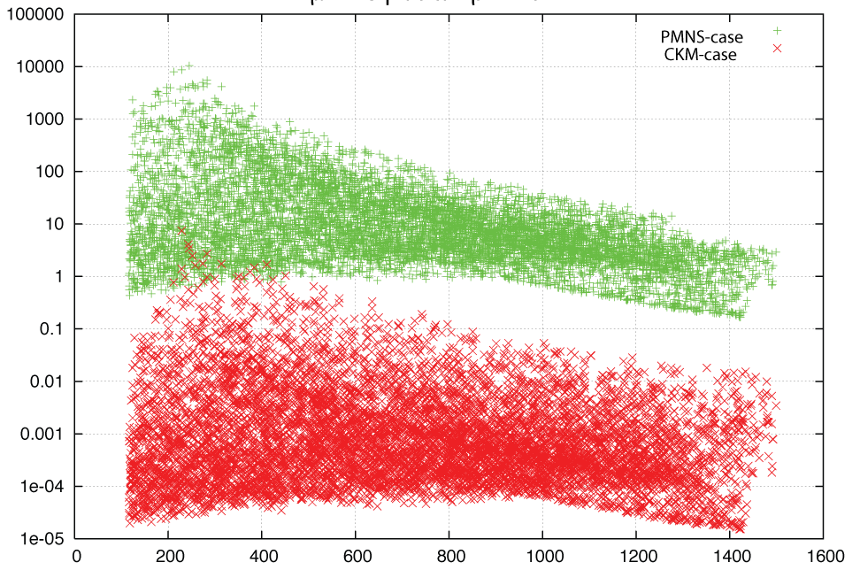
Full Analysis of 2009 and 2010 Data
Calibbi et al., hep-ph/0605139
Interpretation in terms of SUSY-GUT SO(10) MSUGRA models:
CKM case: min. mixing
PMNS case: max. mixing
MSUGRA with tanβ = 40,
m₀ < 5 TeV, −3m₀ < A₀ < 3m₀, µ = ±
BR(µ → eγ) [ 10^{–11} ]
PMNS case
MEG 2009+2010
MEG 2009–2012
CKM case
m_{1/2} [ GeV ]
90% CL (Feldman-Cousins) upper limit:

Slide 15
µ–e Conversion
Neutrinoless muon capture: µ → e conversion via recoil against nucleus: µ–N → e–N
Principle:
Stopped muon captured by atom
There: decay or capture or µ—e conversion
Conversion gives single monoenergetic electron (104.96 MeV for Al, 95.56 MeV for Au)
ex.: SUSY⁽*⁾
~ α_{QED}
Simplicity and distinctive signature (very low background e rate at 105 MeV) allows extremely high rates and thus very sensitive measurement
Observable:
Dependence on A, Z, can be exploited to distinguish NP models after discovery
Best current limit from SINDRUM-II (PSI): R_{µe}(Au) < 7×10^{–13} (90% CL)
SINDRUM-II EPJ C 47, 337 (2006)
⁽*⁾ Also: possible enhanced sensitivity to SUSY Higgs exchange compared to µ → eγ (Kitano et al., hep-ph/0308021) → use to discriminate between models

Slide 16
µ–e Conversion
New physics sensitivity compared to µ → eγ for generic dipole dominance models ~390 times lower for Al target
[ Classes of models involving µ—N exchange may enhance µ—e conversion over µ → eγ ]
BR(µ → eγ) < 10^{–13} requires R_{µe}(Al) < 3×10^{–16}
Forthcoming experiments: Mu2e @ FNAL, COMET @ J-PARC
Goal: sensitivity down to ~2×10^{–17} with data-taking by 2018
[ Requires 5×10¹⁹ muons – approaching #grains of sand on earth… (R. Bernstein, Pittsburgh 2011) ]
A muon converts to en electron while recoiling against a nucleus: µ–N → e–N
Principle:
Stopped muons captured by atoms
There: decay or capture or m—e conversion
Conversion gives single monoenergetic electron (105.1 MeV for Au)
ex.: SUSY
Simplicity and distinctive signature (no accidentals) allows extremely high rates and thus sensitive measurement
Observable:
Se, e.g., Cirigliano et al., arXiv:0904.0957
Best current limit from SINDRUM-II (PSI): R_{µe}(Au) < 7×10^{–13} (90% CL)
SINDRUM-II EPJ C 47, 337 (2006)

Slide 17
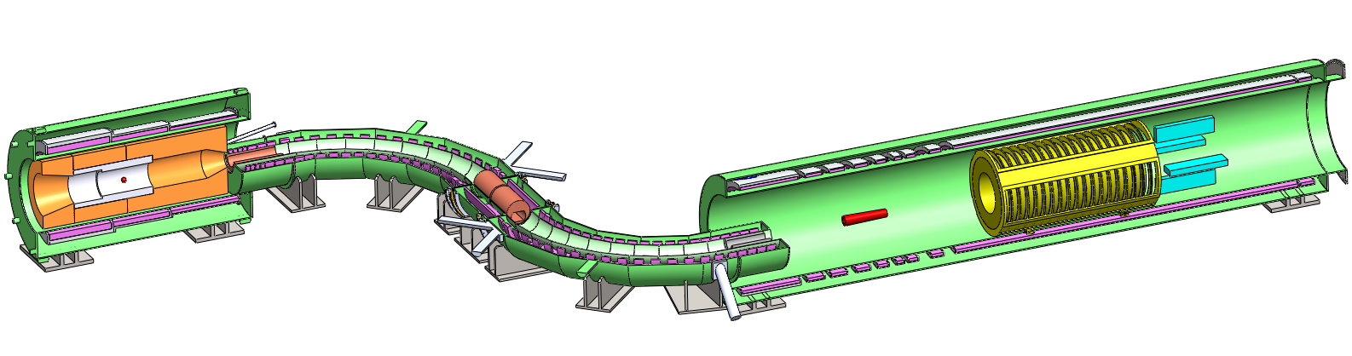
Mu2E (FNAL) Overview
Production: magnetic bottle traps π’s which decay into accepted μ’s
See: http://mu2e.fnal.gov/ and, e.g.,
R. Bernstein, Pittsburgh Seminar, Feb 2011
Tracker
Solenoids
Stopping target
Collimators
EM calorimeter
Production
target
Detector: stopping target, tracking and calorimeter
Transport: S-shape eliminates backgrounds and selects p(µ–)
Pulsed Beam: eliminate prompt backgrounds (e.g., radiative π capture), 0.6 MHz, 10^{–10} pulse extinction after 0.7 µs, use late muonic atom decays (τ ~1 µs) for measurement
Gradient B-fields: guide muons, increase muon acceptance, evacuate loopers
Detection: atoms pass through tracker and stop in calorimeter, e– helix in gradient field
Expected backgrounds: R_{μe} = 10^{–16} → ~4 signal / 0.2 bkg. events (RPC, decay-in-orbit)
Multiple ring structure at FNAL: no interference with NOvA running
Mu2e features

Slide 18
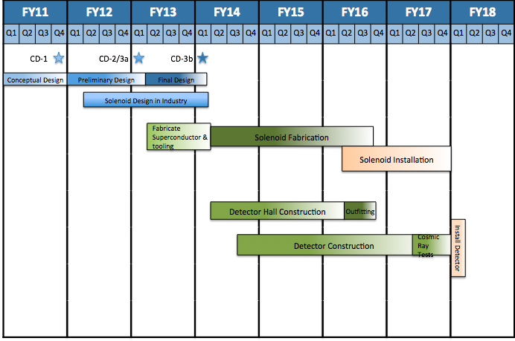
Mu2E (FNAL) Schedule
US$ 200 M total cost at CD-0
(TDR)
Data taking
Project-X proton source upgrade may improve additional 2 orders of magnitude
~130 Collaborators

Slide 19
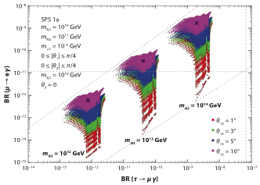
Lepton Flavour Violation in Tau Decays
LFV in tau decays (= neutrinoless tau decays) is searched for in a large variety of modes at the B-factories with sensitivity to different new physics scenarios
CMSSM model point with 3 massive RH N for various
m(N₃) and θ₁₃
Excluded by MEG 2011
Excluded by BABAR 2010
Antusch et al.. JHEP 11, 90 (2006)

Slide 20
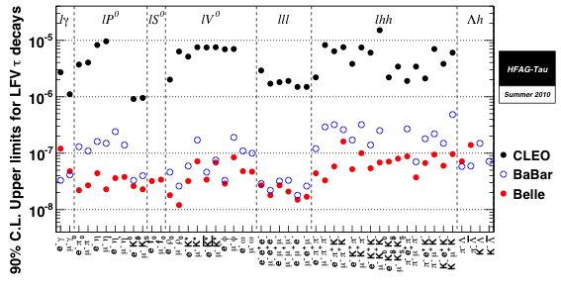
Compilation of Tau LFV Search Limits
Heavy Flavour Averaging Group, Summer 2010
10^{–8} sensitivity reached
Belle’s new limits almost ready, but not quite for LP 2011
BABAR: PRL 104, 021802 (2010) PRL 104, 021802 (2010)

Slide 21
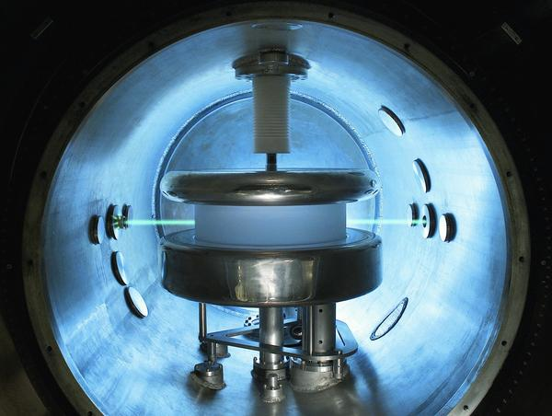
Elementary particles are predicted to be non-spherical, distorted by an electric dipole moment (EDM)
However, as for charged lepton flavour violation, EDMs are predicted to be undetectably tiny in the SM
Thus, any hint for a non-zero EDM would be physics beyond the SM, and indeed many SM extensions predict EDMs that are detectable by current experiments
Electric Dipole Moments
EDM is CP-nonconserving:
For magnetic moment:
For EDM:
© PSI

Slide 22
Electric Dipole Moments
Precession frequency:
EDM is CP-nonconserving:
B
E
d
d ~ 5 × 10^{–28} ecm gives:
Δf ~1 nHz in 10 kV/cm field
For magnetic moment:
+
Basic measurement principle:
Flip E field and measure frequency difference:
–
For EDM:
µ
Effective E field can be polarisation amplified (up to 10⁶) in molecules

Slide 23
Origin of EDMs
Pospelov-Ritz, hep-ph/0504231
Raidal et al., arXiv:0801.1826
K. Kirch talk at PANIC-2011
Michael Romalis
Hierarchy of scales between CP-odd sources and generic classes of observable EDMs
Energy
Fundamental CP-odd source
TeV
QCD
Muon EDM
< 1.9 × 10⁻¹⁹
CP - odd Operator scale
Neutron & proton EDM
nuclear
d_{n} < 2.9 × 10⁻²⁶
EDMs of nuclei and ions (deuteron, etc)
Solid states
EDMs
EDMs of paramagnetic atoms (Tl, Rb, Cs) and molecules (YbF, PbO, HfF⁺)
atomic
EDMs of diamagnetic
atoms (Hg, Xe, Ra, Rn)
Best bound: 10.5 × 10⁻²⁸ (YbF)
Best bound: 2 × 10⁻²⁸ (¹⁹⁹Hg)

Slide 24
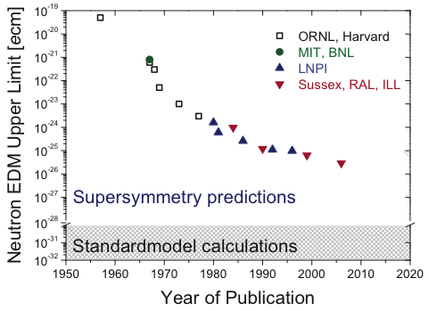
EDM – Experimental Programme
90% CL limits given
Neutron EDM
Best limit: |d_{n}| < 2.9 × 10^{–26} ecm [ Sussex-RAL-ILL Collaboration, PRL 97, 131801 (2006) ]
Beams
UCN
Zsigmond (nEDM Collaboration) at EPS-HEP 2011 — modified by A.H.

Slide 25
EDM – Experimental Programme
90% CL limits given
Neutron EDM
Best limit: |d_{n}| < 2.9 × 10^{–26} ecm [ Sussex-RAL-ILL Collaboration, PRL 97, 131801 (2006) ]
Beams
UCN
Zsigmond (nEDM Collaboration) at EPS-HEP 2011 — modified by A.H.
–
Strong CP problem: |d_{n}| limit translates into |θ| ~ |d_{n}|· 2×10¹⁶ < 5×10^{–10}
Why so small ?
SUSY CP problem: |d_{n}| ~ 10^{–23} ecm · (300 GeV / m_{SUSY})² · sinφ_{SUSY}

Slide 26
EDM – Experimental Programme
90% CL limits given
Neutron EDM
Best limit: |d_{n}| < 2.9 × 10^{–26} ecm [ Sussex-RAL-ILL Collaboration, PRL 97, 131801 (2006) ]
Group | No. of people | Sensitivity [10^{–26} ecm] | Due date
nEDM at PSI n2EDM | ~50 | 0.5 0.05 | 2013 2016
PNPI at ILL | ~10–20 | 1 | 2012
CryoEDM at ILL | ~25 | 0.3 | 2016
nEDM at SNS-ORNL | ~90 | 0.03 | 2020
nEDM at RCNP at TRIUMF | ~35 | 1 0.1 0.01 | 2014 2017 > 2020
First nEDM data this year? [ Zsigmond at EPS-2011 ]
Forthcoming nEDM experiments
by K. Kirch, ETH at PANIC-2011

Slide 27
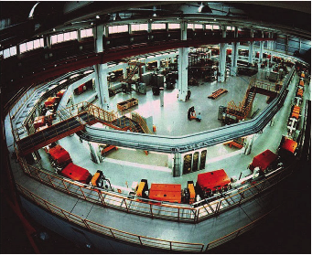
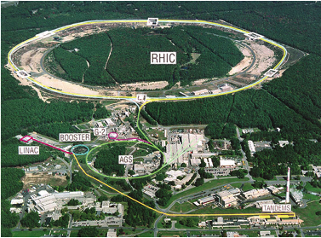
EDM – Experimental Programme
See, e.g., Y. Semertzidis at Patras Workshop, 2011
Proton / Deuterium EDM
Proposals at BNL, USA and Juelich, Germany for storage ring based pEDM measurement with sensitivity: 10^{–29} ecm
Radial E field, aligned spin and momentum vectors at magic momentum (0.7 GeV for protons)
Similar new physics sensitivity as for neutrons, but better precision!
BNL, USA: proton “magic” ring
COSY/IKP, Jülich/Germany deuteron ring: JEDI

Slide 28
EDM – Experimental Programme
90% CL limits given
Electron EDM
Prior best limit obtained using Thallium (Tl) atoms at Berkeley
[ Regan et al., PRL 88, 071805 (2002) ]
10^{–22}
10^{–24}
MSSM φ ~ 1
10^{–26}
Multi Higgs
d_{e} < 16 x 10^{–28} ecm
Left-Right
d_{e} < 10.5 x 10^{–28} ecm
MSSM φ ~ α/π
10^{–28}
Goal of YbF exp. at IC
Predicted values for the electron EDM d_{e} (ecm)
10^{–30}
10^{–32}
New best limit using YbF molecules at Imperiel College, UK
[ Hudson et al., Nature 473, 493 (2011) ]
10^{–34}
10^{–36}
Standard Model
Regan et al., PRL 88, 071805 (2002)
Hudson et al., Nature 473, 493 (2011)
Graph taken from: B. Sauer, IC

Slide 29
EDM – Experimental Programme
Hudson et al., Nature 473, 493 (2011)
Electron EDM – new measurement using paramagnetic YbF molecules
Schiff theorem: nonrelativistic system of electrostatically interacting charged particles (eg, atom) is fully shielded with respect to external E fields
Broken by magnetic, relativistic interactions and extended nucleons
→ Effective EDM: d_{Z} ~ (η² Z ³) × d_{e}
B
E
d_{Z}
Enhanced in heavy atoms / molecules
d_{Tl} ~ 585 × d_{e} (exploited by Berkeley Tl experiment, 2002
d_{YbF} ~ 1.4×10⁶ × d_{e} (for 11 kV/cm field; earlier saturation than Tl)
Also systematic error advantage of YbF molecules over Tl (motional magnetic field)
But: much smaller production rate than Tl
µ
YbF exp. looks for spin interferometer phase shift of F = 0,1 YbF hyperfine levels when E field is reversed

Slide 30

EDM – Experimental Programme
Hudson et al., Nature 473, 493 (2011)
Electron EDM
YbF @ IC, UK
Static E, B fields: ±10 kV/cm, 13 nT
#Counts ~ cos²φ
φ = 0
Cold YbF (25 Hz pulses)
Interferometer curve from magnetic field scan
YbF experiment, 2010 data
+E
–E
δφ = –…
δφ = +4d_{e}ηET/h
Detector count rate
Drawing taken from B. Sauer, IC
–B₀
B₀
Applied magnetic field

Slide 31
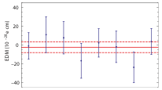
EDM – Experimental Programme
Hudson et al., Nature 473, 493 (2011)
Electron EDM
YbF @ IC, UK
Static E, B fields: ±10 kV/cm, 13 nT
#Counts ~ cos²φ
φ = 0
Cold YbF (590 m/s, 25 Hz pulses)
d_{e} = (–2.4 ± 5.7_{stat} ± 1.5_{syst}) × 10^{–28} ecm
|d_{e}|< 10.5 × 10^{–28} ecm (90% CL)
EDM values for each* manual-reversal state of the experiment
(after removing “blinding” offset)
Statistics dominated
Largest systematic effect from E-field uncertainties
RF detuning phase shift and E reversal Stark shift corrected
YbF experiment, 2010 data
*Swaps of HV, magnet and RF cables

Slide 32
EDM – Experimental Programme
Pioneering measurement with great potential in spite of relatively little improvement over Tl result from 2002
Measurement statistically limited, systematic errors reducible to < 10⁻²⁹ ecm
Factor of 10 sensitivity improvement within a few years, final goal is factor of 100
Several other EDM experiments, based on electron spin precession in atoms, molecules, molecular ions or solids, in progress

Slide 33
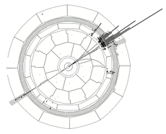
Fantastic combination work done by HFAG group – I will use a lot of their work here !
Tau-Lepton Physics
ALEPH
Z → τ ⁺τ — candidate

Slide 34
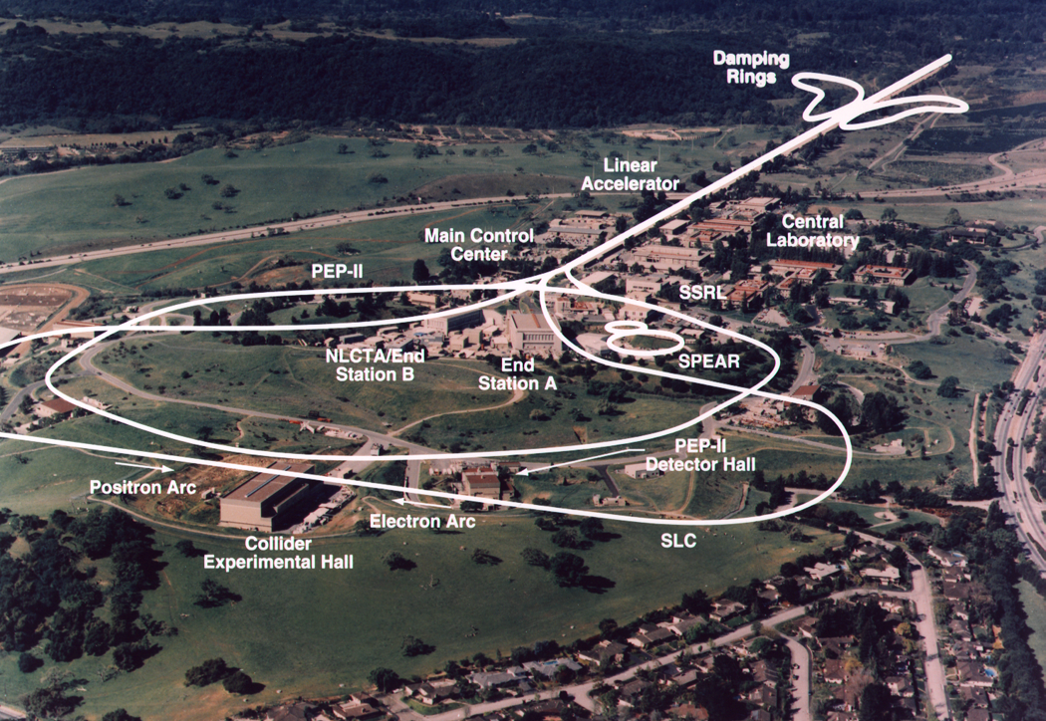
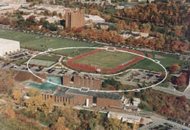
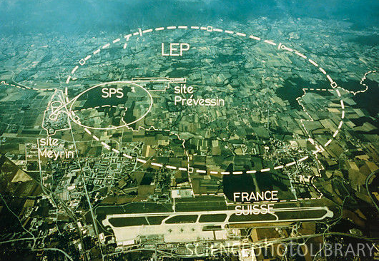
Tau-Lepton Physics
Last year was the 20th anniversary of the Tau Workshops (started in 1990 at Orsay)
During this period there was magnificent progress in tau physics through the LEP, CLEO, B-factories, BES, VEPP-2M, and neutrino experiments
Early meetings concentrated on consolidation of tau as a standard lepton without invisible decays and with universal couplings (precision experiments)
Increased data samples and better methods allowed to study electroweak and QCD physics leading to precision measurements of fundamental SM parameters, such as sin²θ_{W}, α_{S}, |V_{us}|
CESR at Cornell, USA
1979—2008
LEP at CERN
1989—2000
~3.6 M ττ produced for
CLEO-I/II
~165,000 Z→ττ per experiment

Slide 35
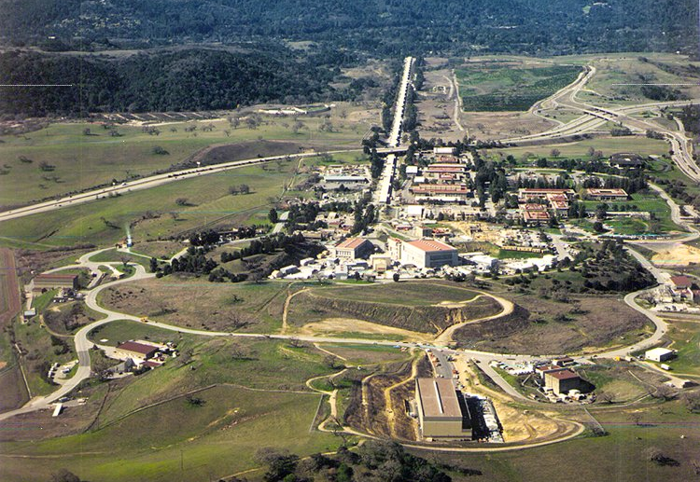
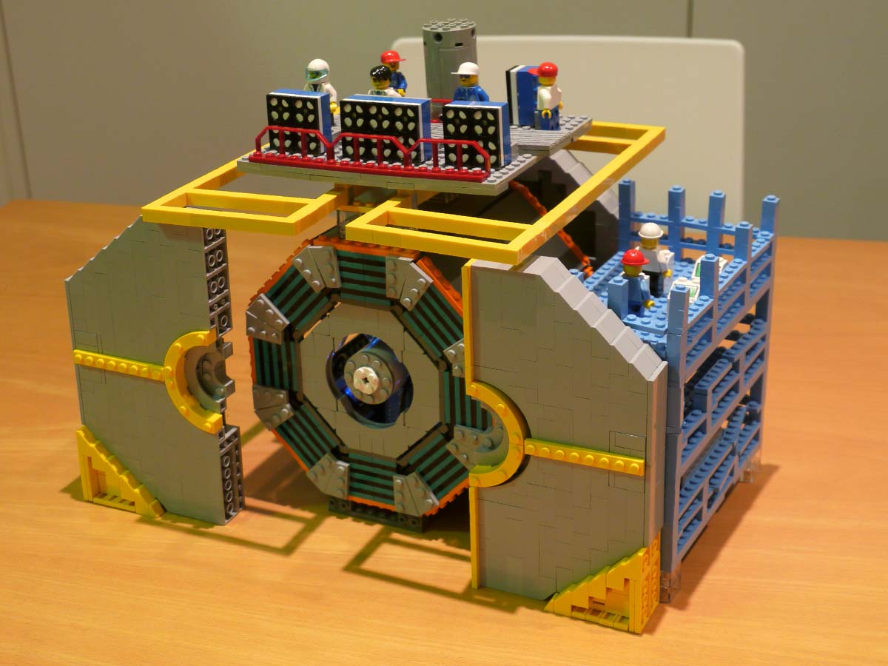
Tau-Lepton Physics
Huge samples of roughly 500 M and 900 M tau pairs collected by BABAR and Belle
Experiments concentrate on rare modes and searches for new physics:
Lepton flavour violation in tau decays
Weak current universality tests (0.14% precision reached!), rare branching fractions
“Second class currents” (isospin violation)
CP violation
Phenomenological work on determination of α_{S} and |V_{us}| (→ V. Lubicz’, T. Gershon’s talks) from tau branching fractions and spectral functions still actively pursued
KEK-B at KEK, Japan
PEP-2 at SLAC, USA
LEGO model of Belle
B/τ Factories at KEK and SLAC

Slide 36
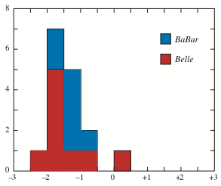
Tau Branching Fractions
Large amount of new branching fraction measurement by BABAR and Belle. Significant improvement in modes with kaons (but also a few inconsistencies)
Hayes in PDG 2010
Number of measurements
Sigma difference
General trend observed between earlier and BABAR/Belle measurements
→ not understood; leads, a.o., to smaller strange hadronic width of tau

Slide 37
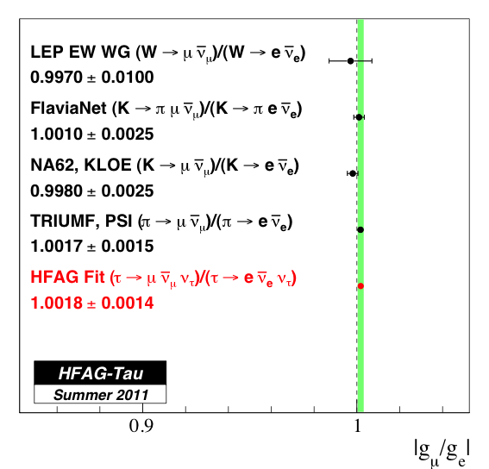
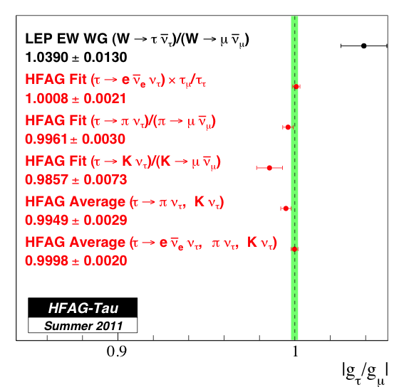
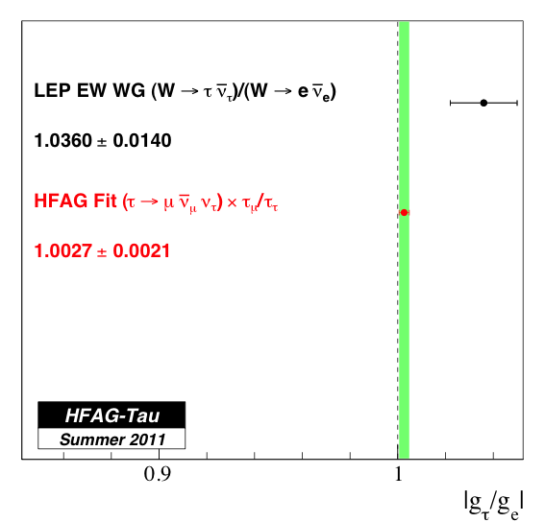
Tau Leptonic Charged Current Couplings
Probe new physics by testing the universality of charged weak couplings using tau branching fractions into leptons and tau lifetime
|g_{μ} /g_{e}|
|g_{τ} /g_{μ}|
|g_{τ} /g_{e}|
Down to 0.14% test of e—μ universality, compared to ~0.28% from Γ_{Z→ee/μμ},
and 0.13% for the effective weak axial coupling g_{A,e/μ}
LEP+SLC, Phys. Rept. 427, 257 (2006)

Slide 38
Searches for “Second Cass Currents” in Tau Decays
“Second class currents” have spin-parity J^{PG} = 0⁺⁻, 0⁻⁺, 1⁺⁺ or 1⁻⁻ and are proportional to u/d quark mass difference-squared
vanish in strict isospin limit
Branching ratios expected to be of order 10⁻⁵
See, e.g., Nussinov-Soffer, arXiv:0806.3922 and references therein
Published BABAR limit with full statistics (470 fb⁻¹)
BABAR, arXiv:1011.3917
Other second class current modes that are studied involve η’π and ωπ final states

Slide 39
CP Violation in Tau Decays
Due to mixing-induced CPV in Kº system (ε_{K}), expect to see decay rate asymmetry
Bigi-Sanda, PLB 625, 47 (2005)
Deviations in A_{Q} should have NP origin as possible in, eg, multi-Higgs models
Kühn-Mirkes, PLB, 398, 407 (1997)
Results consistent with the SM found in D± → K_{S}π± [ BABAR, PRD 83, 071103 (2011) ] and in angular analysis of τ ± → K_{S}π ±ν [ Belle, arXiv:1101.0349 ]
New preliminary analysis of A_{Q} in τ ± → K_{S}π ±(≥ 0πº)ν from BABAR using 476 fb^{–1}
Electron and muon tags used
Correction for different nuclear interaction cross sections of Kº and Kº
Dominant systematic error from selection bias measured from data (stat. error)
Raw asymmetry corrected for K_{S}K±(≥ 0πº)ν and KºKºπ ± feed-through (assuming SM A_{Q})
—
—
BABAR finds A_{Q} = (−0.45 ± 0.24 ± 0.11) %, which deviates ~3σ from SM
BaBar-PUB-11/009

Slide 40
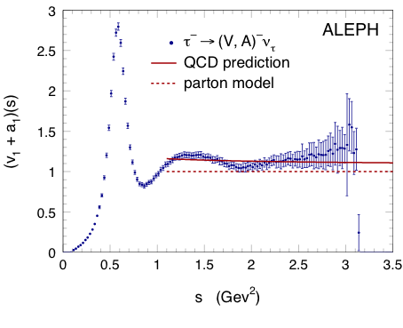
Tau Hadronic Spectral Functions and α_{S}
The measurement of complete vector and axial-vector tau hadronic spectral functions by ALEPH and OPAL triggered enormous activity on QCD studies
Precision determination of α_{S} from comparison of tau hadronic width with essentially pQCD
ALEPH: EPJ C4, 409 (1998): 5th most cited ALEPH paper
HFAG, 2011
Benefits, as EW fit of Z hadronic width, from NNNLO perturbative calculation
Baikov et al., arXiv:0801.1821
ALEPH, hep-ex/0506072
updated: Davier et al., arXiv:0803.0979
Nonperturbative contributions measured from data using “spectral moments” and found very small
Unfortunately, ambiguity in perturbative treatment does currently not allow to fully exploit the available precision
See, e.g.: Davier et al., arXiv:0803.0979; Beneke-Jamin, arXiv:0806.3156; Menke, arXiv:0904.1796, and others

Slide 41
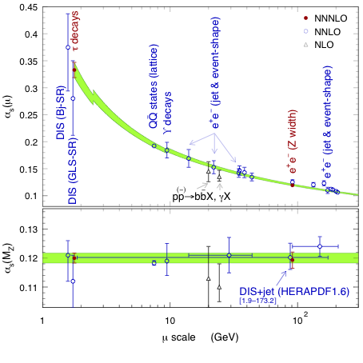
NNNLO Determination of α_{S}
4-loop RGE evolution of α_{s}(μ), 3-loop quark flavour matching
From combined fit of R_{τ} and spectral moments:
α_{s}(M_{Z}) = 0.1200 ± 0.0005_{exp} ± 0.0008_{theo} ± 0.0013_{CIPT/FOPT} ± 0.0005_{evol} (0.0017_{tot})
Central value is arithmetic mean between CIPT and FOPT, with half the difference as syst. error
Excellent agreement with NNNLO result from EW fit
α_{s}(M_{Z}) = 0.1193 ± 0.0028
Modified from: Davier et al., arXiv:0803.0979
0.1183 ± 0.0008
(QQ states / Lattice)
Baak et al., arXiv:1107.0975
Precise test of asymptotic freedom property of QCD
Courtesy: Z. Zhang. Compilation from Bethke, arXiv:0908.1135

Slide 42
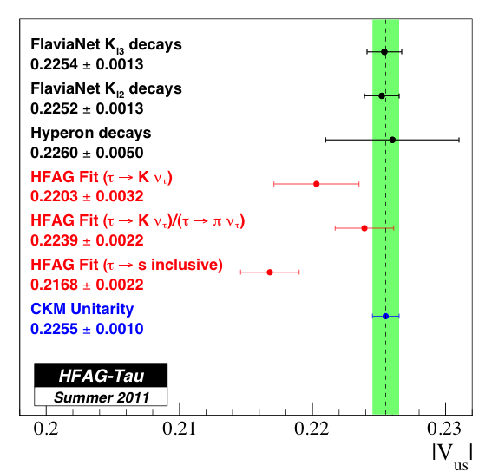
|V_{us}| Determination from Strange Tau Decays
Inclusive analysis uses:
Dependence on |V_{ud}|, and theoretical dependence on α_{S} and m_{s} (problematic behaviour of perturbative series)
May miss yet unmeasured modes, compatibility can be tested with full strange spectral function
Trend of smaller branching ratios from B-factories. Without B-factory data, |V_{us}| would increase to ~0.2213.
Almost competitive accuracy with lepton K decays → unexpected in earlier days !
Dependence on decay constants (Lattice QCD)
= 3.6σ∗
⁽*⁾3.3σ when using unitarity constraint for BK)

Slide 43
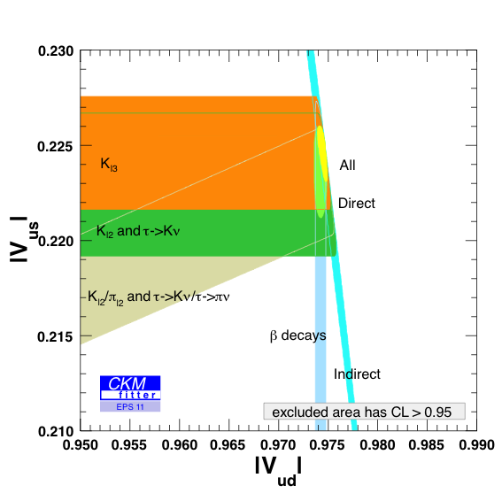
|V_{us}| Determination from Strange Tau Decays
Unitarity constraint
First row of CKM matrix shows good agreement with unitarity
V. Niess at EPS 2011

Slide 44
Anomalous Magnetic Moment
Gyromagnetic factor g = 2 is modified by loop contributions
“Anomalous” magnetic moment:
E821 at BNL

Slide 45
Probing New Physics
The experimental precision for a will be worse than for a_{e}, so why do it ?
In lowest order, where mass effects appear, contributions from heavy virtual particles scale as m²_{e /μ} :
γ
?
Loose about a factor of 800 in experimental precision
μ
a_{μ} should be roughly 50 times more sensitive to NP than a_{e} !
a_{τ} even more sensitive, but insufficient experimental accuracy

Slide 46





Loop contributions:
QED
Hadronic
Weak
SUSY... ?
... or some unknown type of new physics ?
?
“Light-by-light scattering”
… or no effect on a_{µ}, but new physics at the LHC? That would be interesting as well !!

Slide 47
Measuring (g – 2)_{µ}
For polarized muons moving in a uniform B field (perp. to muon spin and orbit plane), and vertically focused in E quadrupole field, the observed difference between spin precession frequency and cyclotron frequency is:
At “magic γ with p_{μ} = 3.09 GeV
and assuming, µEDM = 0 !
The experiment measures directly (g – 2)/2 !
One actually measures: a_{µ} = R/(λ − R), R = ω_{a}/ω_{p}, λ = µ_{µ}/µ_{p}

Slide 48
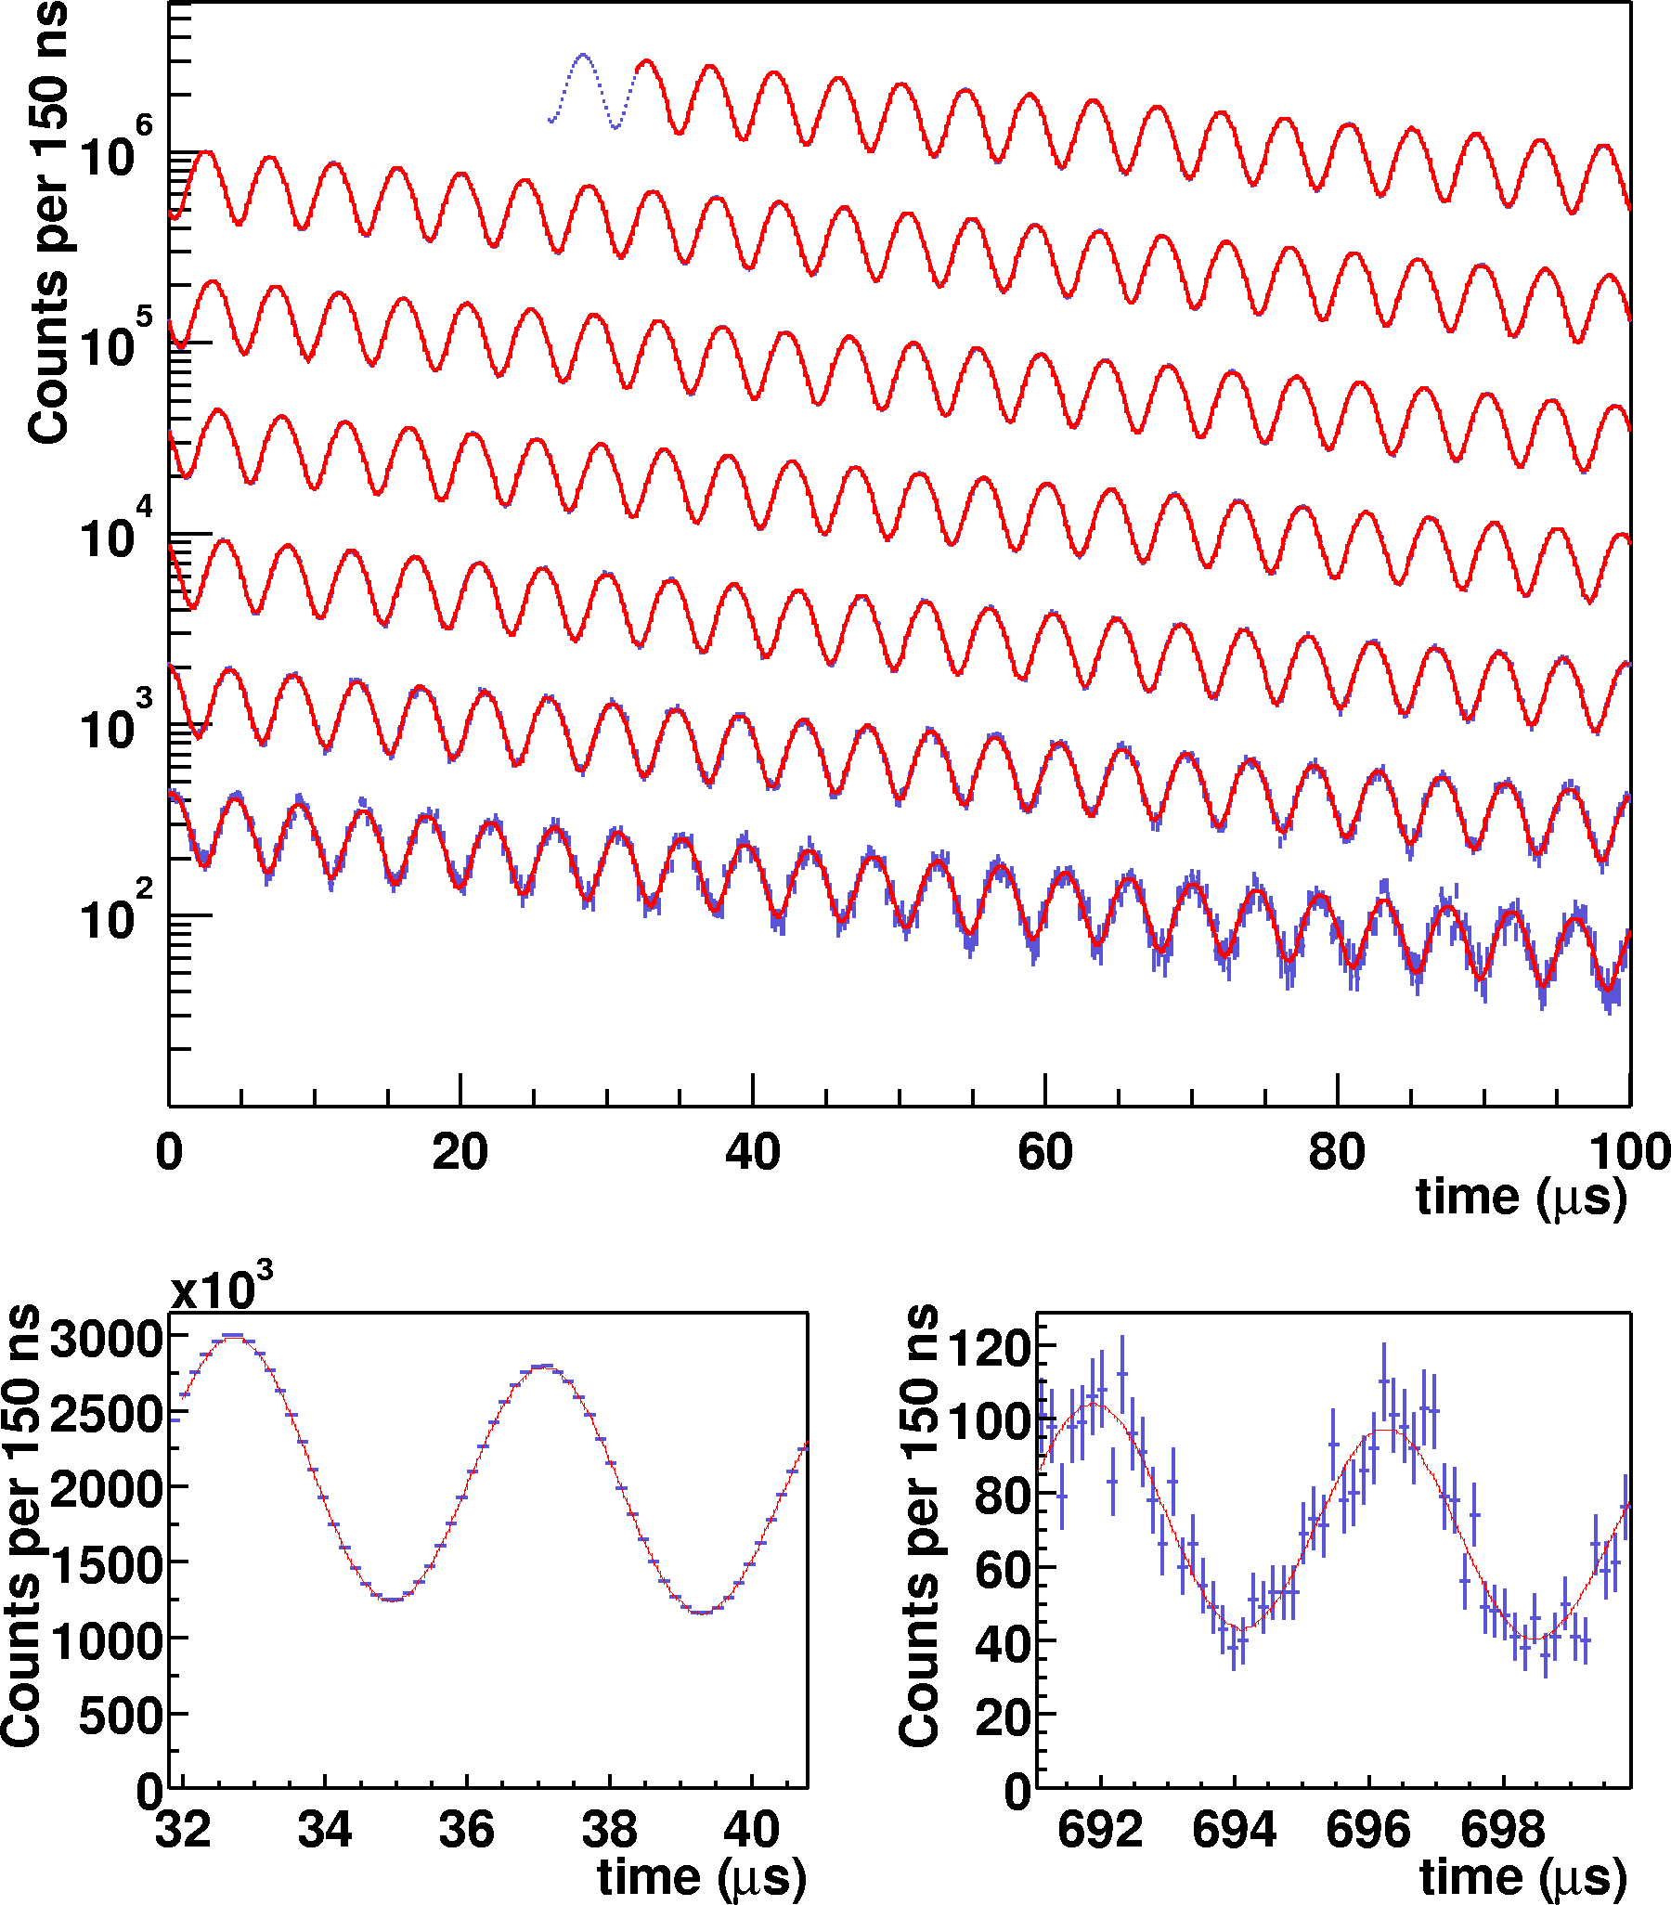
The BNL Muon g – 2 Experiment
Observed positron rate in successive 100μs periods
Difference between spin preces-sion and cyclotron frequency:
obtained from fit to:
B-field from precise NMR probe
Plot taken from: E821 (g –2), hep-ex/0202024

Slide 49
Measuring (g – 2)_{µ}
World average (2006 – final BNL-E821 report):
a_{μ} = 11 659 208.9 (5.4) (3.3) × 10⁻¹⁰
…still statistics dominated !
E821, PRD 73, 072003 (2006)

Slide 50
Confronting Experiment with Theory
The Standard Model prediction of a_{μ} is decomposed in its physical contributions:
of which the hadronic contribution has the largest uncertainty:

Slide 51
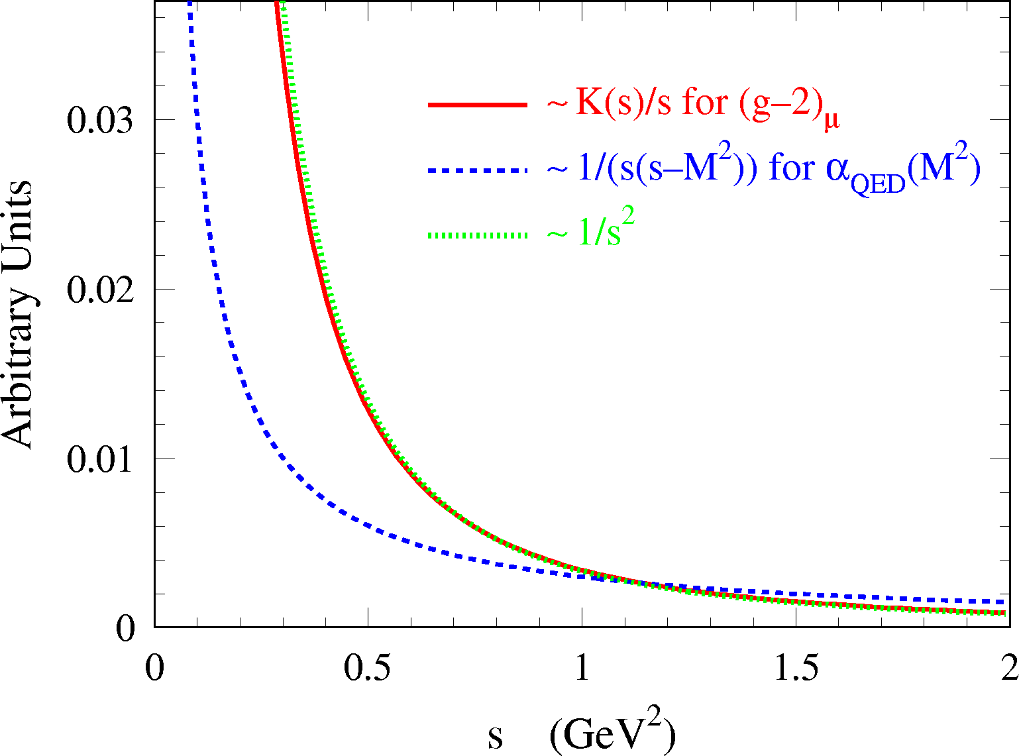
Hadronic Contribution
Cannot be computed from first principles due to low-energy hadronic effects
Fortunately, one can benefit from analyticity and unitarity to obtain real part of photon polarisation function from dispersion relation over total hadronic cross section data
had
γ
Im[ ] ∝ | had |²
had
μ
γ
γ

Slide 52
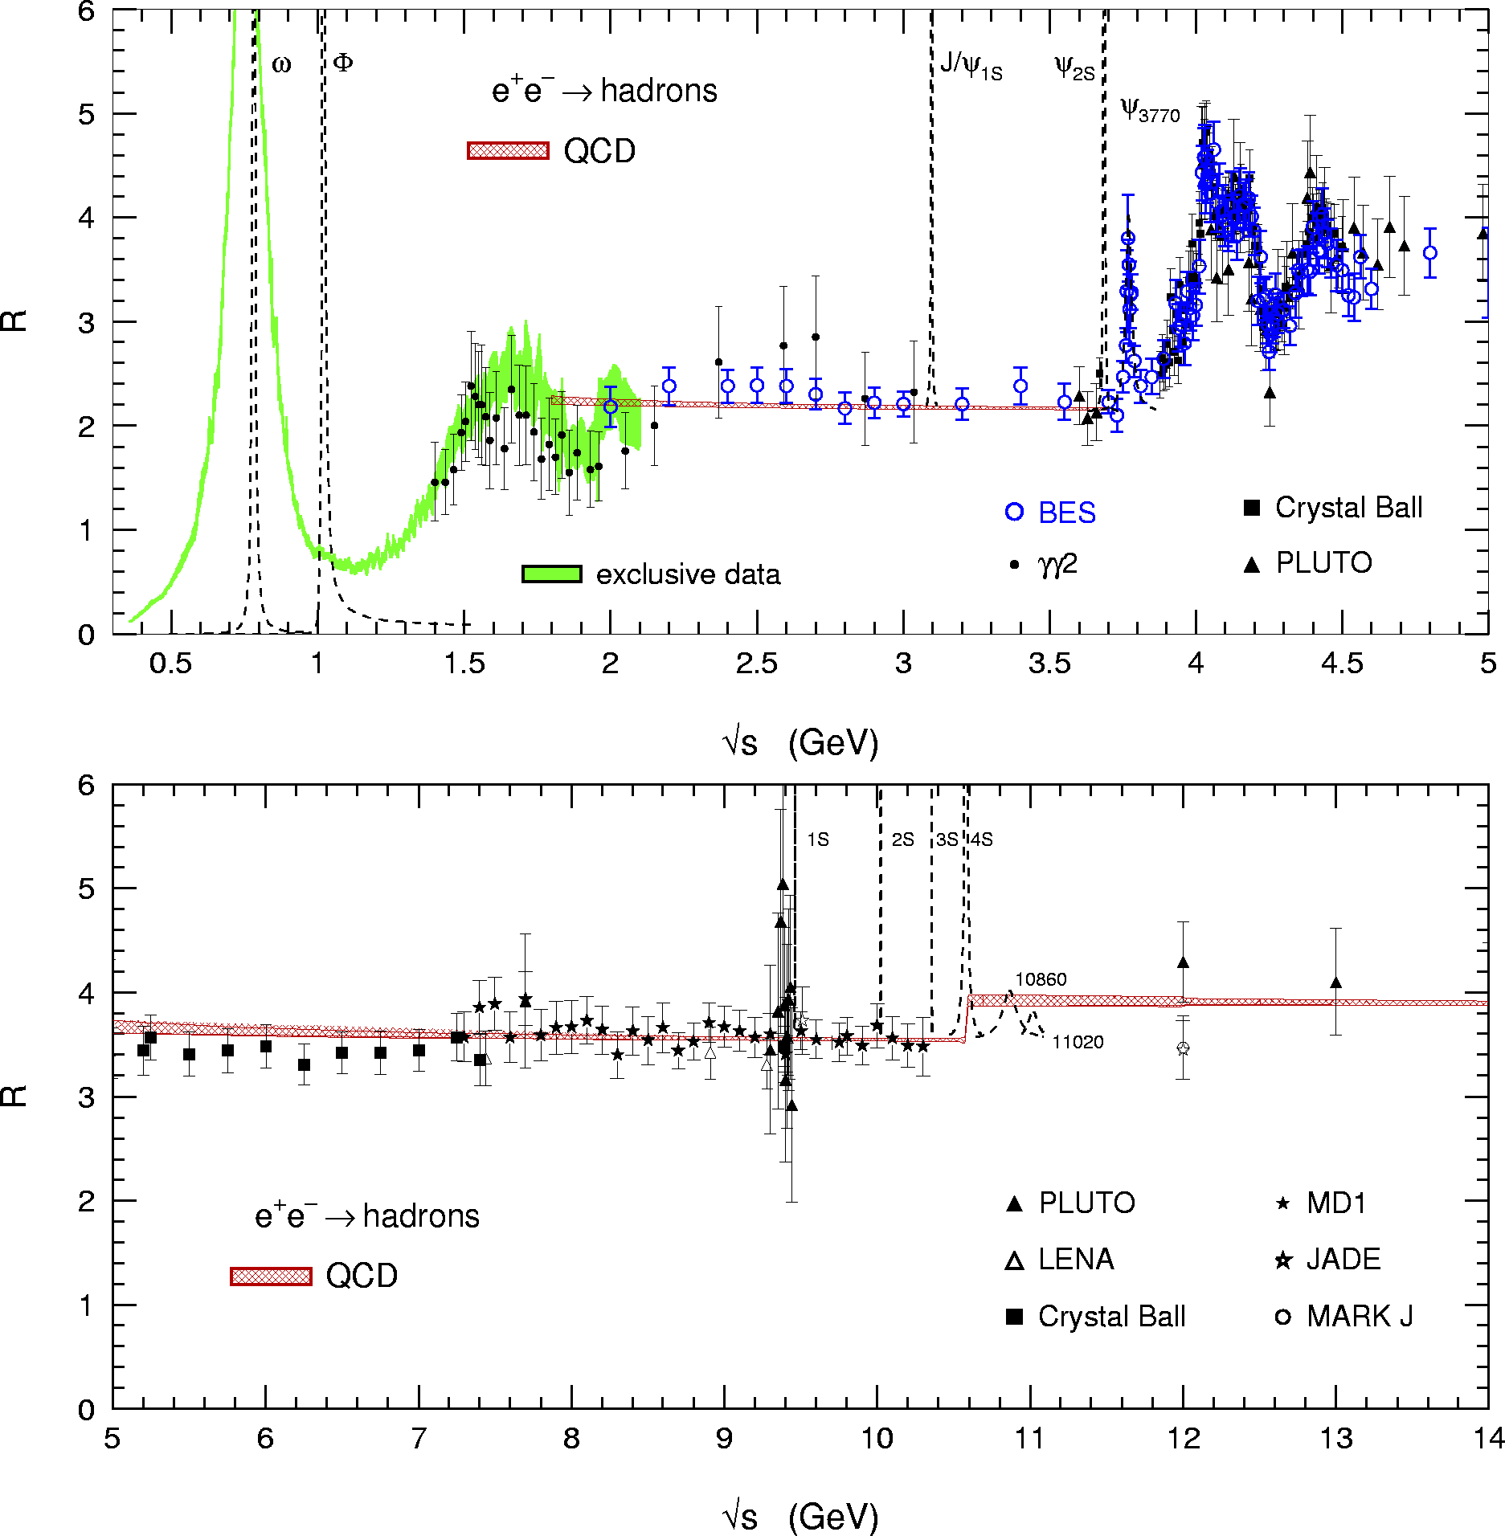
Huge 20-years effort by experimentalists and theorists to reduce error on lowest-order hadronic part
Improved e⁺e– cross section data from Novisibirsk (Russia)
More use of perturbative QCD
Technique of “radiative return” allows to use data from Φ and B factories
Isospin symmetry allows us to also use τ hadronic spectral functions

Slide 53
Plot not fully up to date – for illustration only
use QCD

Slide 54
Plot not fully up to date – for illustration only
use QCD
Due to the strongly decaying integration kernel, 73% of dispersion integral stems from π⁺π– channel, which must be obtained from experiment

Slide 55
Plot not fully up to date – for illustration only
use QCD
At low energy, the inclusive hadronic cross section is obtained by summing up to 26 exclusively measured final states, and by estimating unmeasured modes using isospin symmetry

Slide 56
Plot not fully up to date – for illustration only
Agreement between Data (BES) and pQCD (within correlated systematic errors)
use QCD
Perturbative QCD can be used away from the quark thresholds in the continuum region

Slide 57
Plot not fully up to date – for illustration only
use QCD
Experimental data must be used in the charm anti-charm resonance region

Slide 58
Plot not fully up to date – for illustration only
Perturbative QCD can be used beyond the charm
use QCD
use QCD

Slide 59
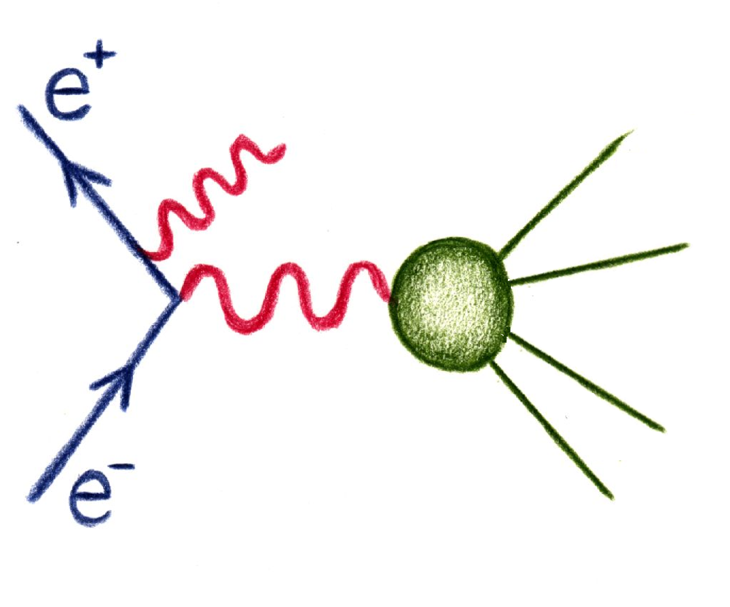
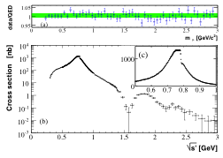
e⁺e– → π⁺π –(γ) Cross Section — BABAR’s tour de force
BABAR, PRL 103, 231801 (2009)
e⁺e– → μ⁺μ –(γ)
m_{µµ} [GeV/c²]
Hard γ radiated in initial state
ρ(770)
Virtual photon γ* with M_{γ*}< s
ρ(1450)
ρ(1700)
new ρ(~2300) ?
Systematic uncertainty: 0.5—1.4%
e⁺e– → π⁺π –(γ)

Slide 60
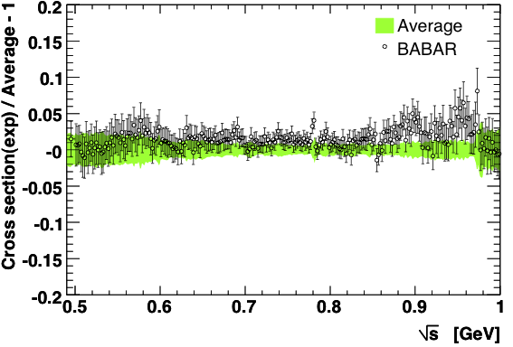
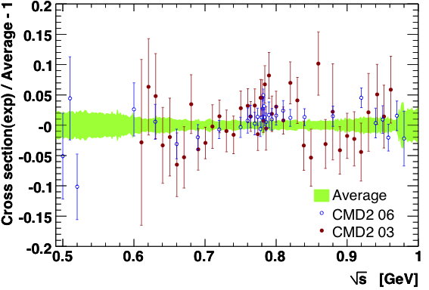
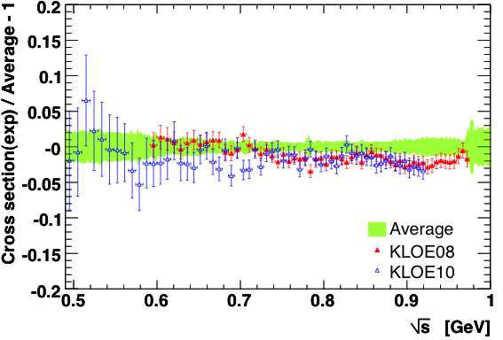
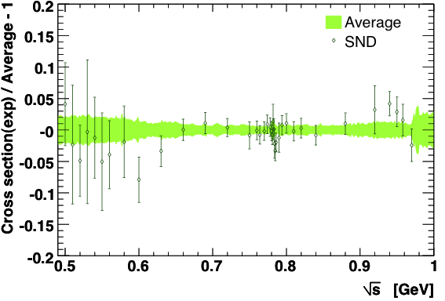
Situation of Two-Pion Channel (e⁺e–)
Davier et al., EPJ C 71, 1515 (2011)
Most data points dominated by systematic uncertainties that are correlated between data points

Slide 61

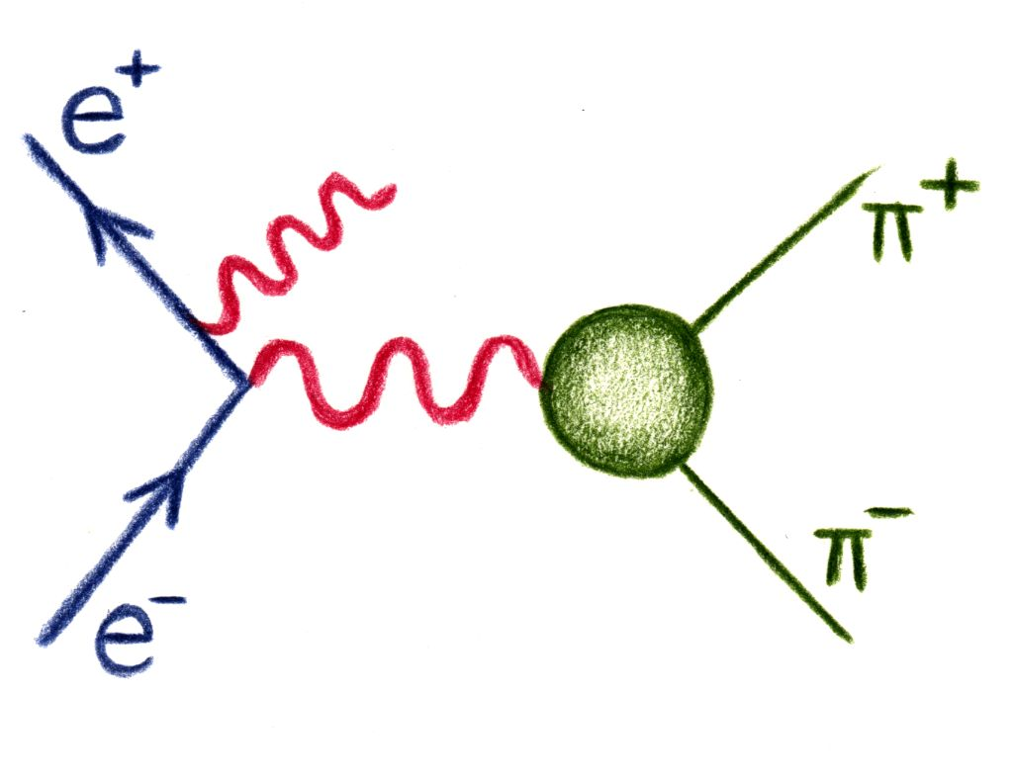
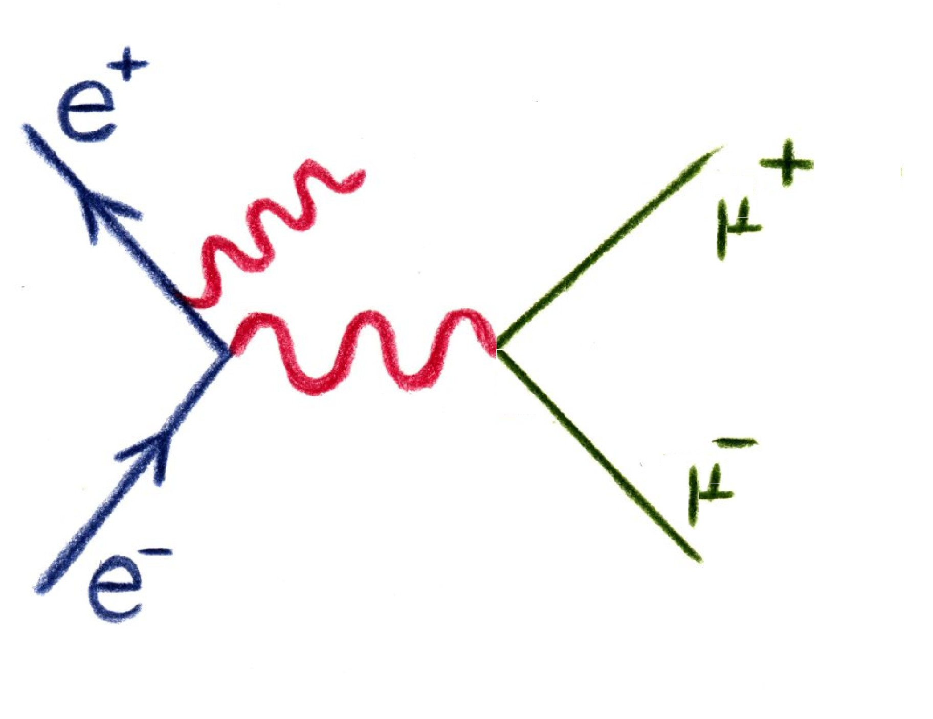
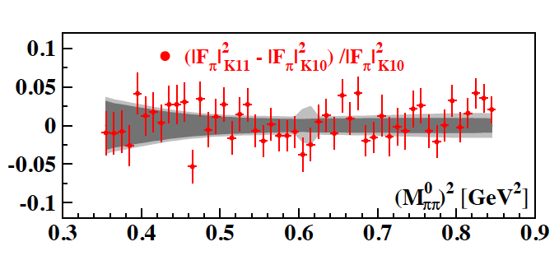

Brand new e⁺e– → π⁺π –(γ) — KLOE’s tour de force
G. Venanzoni (KLOE) at EPS 2011
So far KLOE published small and large-angle photon scattering results based on ππ(γ) data only, ie, requiring explicit insertion of QED radiator function
New result at EPS-2011 using ππ(γ) / μμ(γ) ratio (as BABAR)
Many corrections cancel: radiation, luminosity, vacuum polarisation
However, crucially relies on well understood π / μ separation
Statistics: 2002 data (239 pb^{–1}): 0.87 M μμ(γ) / 3.4 M ππ(γ) events
Overall, excellent 1% systematic error achieved (BABAR: 0.5—1.0%)
Preliminary
Good agreement found! This corroborates the earlier KLOE results and thus the discrepancy with BABAR (and τ data)
Band depicts KLOE 10 errors

Slide 62
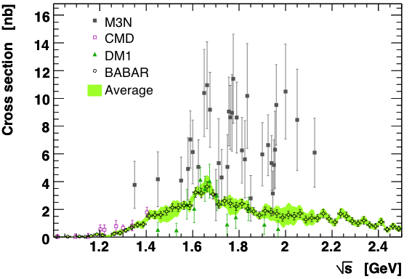
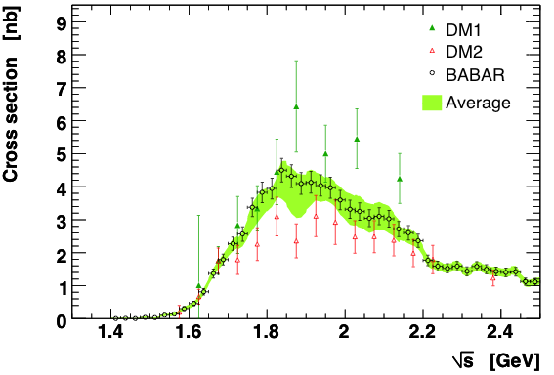
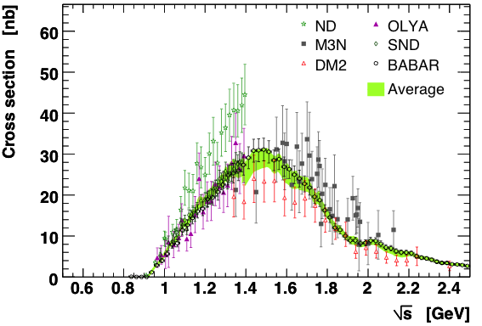
Examples for Rarer and High-Multiplicity Modes
Davier et al., EPJ C 71, 1515 (2011)
BABAR measured (almost) all the exclusive e⁺e– → hadrons modes
Many inconsistencies resolved
Huge impact on hadronic vacuum polarisation calculation

Slide 63
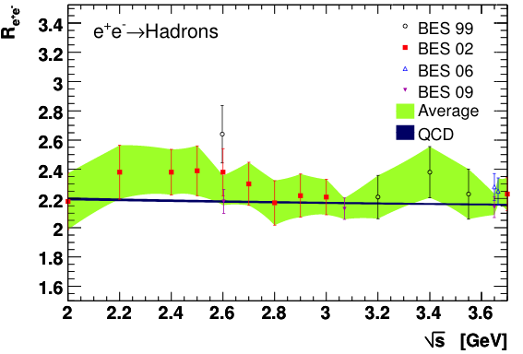
–
Inclusive Cross Section below DD Opening
Agreement between QCD and BES data (within correlated systematic errors), but much better precision from QCD. Important for α_{QED}(M_{Z}).

Slide 64

–
Inclusive Cross Section above DD Opening
ψ (4040)
ψ (3770)
ψ (4160)
ψ (4415)
Integration of data points requires much care:
interpolation, averaging, correlations, biases, …
→ Consistent approach using pseudo-MC simulation

Slide 65
Can use precise tau data to improve a_{µ} prediction
What do the Tau data tell us?

Slide 66
Can use precise tau data to improve a_{µ} prediction
In practice, used for 2π and 4π channels with isospin rotation
Tau spectral functions measured by ALEPH, Belle, CLEO, OPAL
Excellent precision of tau data. Branching ratio (ie, spectral function normalisation) for τ → ππºν known to 0.4%.
Invariant mass spectrum requires unfolding using detector simulation, which is however under good control
Main experimental challenge: abundance and shape modeling of feed-through from other tau final states
Main theoretical challenge: isospin breaking
Radiative corrections, charged vs. neutral mass splitting and electromagnetic decays: (–3.2 ± 0.4)% correction to a_{µ}^{had}

Slide 67

Situation of Two-Pion Channel (τ )

Slide 68

Situation of Two-Pion Channel (e⁺e– vs. τ )
Good agreement between BABAR vs. Belle / CLEO
Conflict between KLOE and Tau data (and BABAR)

Slide 69



Adding all (28) Contributions Together
Hadronic LO term:
Δ(τ — e⁺e–) = 19.5 ± 8.3 (2.4σ)
Hadronic NLO terms:
Davier et al., EPJ C 71, 1515 (2011)
Vacuum polarization (1-loop) + additional photon or VP insertion
Computed akin to LO part via dispersion integral with modified kernel function
Hagiwara et al. 2010 (and others)
Light-by-light scattering
  Dispersion relation approach not possible (4-point function)
  Model-dependent calculations
Prades-deRafael-Vainshtein (and others)
Jansen et al., arXiv:1103.4818
  Lattice results may be in reach (LO HVP (u+d quarks only) computed to 3% accuracy ???)

Slide 70

Results for Muon g – 2
Davier et al., EPJ C 71, 1515 (2011)
Status: summer 2011 (published results shown only)
BNL E821 (2004):
a_{μ}^{exp} = (11 659 208.9 ± 6.3) ×10 ^{–10}
Difference: experiment — SM
a_{μ} ^{exp} – a_{μ} SM | = | (28.7 ± 8.0) × 10 ^{–10}
 3.6 ”standard deviations“ (e⁺e–)
 2.4 ”standard deviations“ (τ)

Slide 71

What could a Δa_{μ} ≈ 30×10^{–10} Deviation Tell Us?
Amount of discrepancy in ballpark of SUSY with mass scale of several 100 GeV
Alternative recent scenario involves “dark photons”
→ Light vector boson from dark matter sector coupling to SM through mixing with photon
Coupling to charged particles with strength ε·e
But strong m_{SUSY} limits from LHC require large tanβ
which, for ε ≈ 0.001—0.002 and m_{dark γ} ≈ 10—100 MeV, can provide a solution for the discrepancy
Searches for the dark photon in that mass range are currently underway at Jefferson Lab, USA, and MAMI in Mainz, Germany
Pospelov, PRD 80, 095002 (2009)
Tucker-Smith and Yavin, PRD 83, 101702 (2011)

Slide 72


A Future for the Muon g — 2
Unfortunately, the situation stays non-conclusive
But: current discrepancy still limited by experimental uncertainty
Fortunately, improvements are in view !
Proposal for new experiment E989 at FNAL with precision target of 1.6 ·10^{–10}
Alternative proposal of similar precision at J-PARC without magic γ and no E field, requiring ultra-slow muons generated from laser-ionised muonium atoms
Final E989 proposall:
http://gm2.fnal.gov/public_docs/proposals/Proposal-APR5-Final.pdf
LOI: KEK_J-PARC-PAC2009-06
See also, e.g., Naohito SAITO (KEK), Seminar at DESY 2011

Slide 73
A Future for the Muon g — 2
Final E989 proposall: http://gm2.fnal.gov/public_docs/proposals/Proposal-APR5-Final.pdf
Proposal for new experiment E989 at Fermilab with precision target of 1.6 ·10^{–10} (factor ~20 increase in statistics)
Fermilab
E989
http://gm2.fnal.gov
Relocate E821 (BNL) storage ring to Fermilab (12 T weight)
Continue “magic-gamma” technique
Interlink several proton rings at Fermilab
  Higher proton rate, less protons per bunch than at BNL
  900 m pion decay line (BNL: 80 m) → less pion “flash” at muon ring injection
  Zero-degree muons → 5—10 times larger muon yield per proton as BNL
  5—10 times as many muons stored per hour as BNL
Improved detectors against signal pileup, new electronics, better shimming to reduce B-field variations, more improvements over BNL
→ Expect ~2.5 (3) times reduced systematic error on B-field (ω_{a})
Can run parasitic to main injector experiments (e.g. NOVA)
Experiment approved Jan 2011

Slide 74



A Future for the Muon g — 2
Final E989 proposall: http://gm2.fnal.gov/public_docs/proposals/Proposal-APR5-Final.pdf
Proposal for new experiment E989 at Fermilab with precision target of 1.6 ·10^{–10} (factor ~20 increase in statistics)
Fermilab
E989
http://gm2.fnal.gov
Helicopter transports coil to barge
Relocate E821 (BNL) storage ring to Fermilab (12 T weight)
Continue “magic-gamma” technique
Interlink several proton rings at Fermilab
  Higher proton rate, less protons per bunch than at BNL
  900 m pion decay line → less pion background at muon ring injection
  zero-degree muons → 5—10 times larger muon yield per proton as BNL
  5—10 times as many muons stored per hour as BNL
Improved detectors against signal pileup, new electronics, better shimming to reduce B-field variations, more improvements over BNL
→ Expect ~2.5 (3) times reduced systematic error on B-field (ω_{a})
Can run parasitic to main injector experiments (e.g. NOVA)
Experiment approved Jan 2011
Projected E989 timeline as of Feb 2011
[L. Roberts at INT workshop, Seattle, 28 Feb 2011]

Slide 75
Summary
We all are passionately following ATLAS and CMS in their direct searches for EW symmetry breaking remnants and new physics at the TeV-scale energy frontier
Probing new physics orders of magnitude beyond that scale and helping to decipher possible TeV-scale new physics requires to work hard on the intensity and precision frontiers
Charged leptons offer an important spectrum of possibilities:
  LFV and EDM measurements have SM-free signals
  Current experiments and mature proposals promise orders of magnitude sensitivity improvements
  The muon g–2 may already show a deviation from the SM
  New physics models usually strongly correlate these sectors
E821 at BNL

Slide 76
Acknowledgment
I am most grateful to Alessandro Baldini, Swagato Banerjee, Robert Bernstein, Michel Davier, Tim Gershon, Herve Hiu Fai Choi, Yoshitaka Kuno, Alberto Lusiani, Bogdan Malaescu, James Miller, Toshinori Mori, Steven Robertson, Karim Trabelsi, Graziano Venanzoni and Zhiqing Zhang for their help with the preparation of this talk.
Extra slides…

Slide 77

Full Analysis of 2009 and 2010 MEG Data
Total of 1.8×10¹⁴ μ⁺ decays in the target, 2010 about twice statistics of 2009
Improved time resolution in 2010, but slightly worse tracking resolution (noise)
Precision improvements over prelim. 2009 analysis: calibration & alignment, gradient B-field (0.2%), more data-driven performance measurements
Blind unbinned maximum likelihood analysis using E_{γ}, E_{e}, T_{eγ}, θ_{eγ}, φ_{eγ} with PDFs mostly derived from data, fitting signal + RMD + accidental bkg. components
γ background
e⁺ background
Must cope with high e+ rate
Signal
Signal
Good γ resolution most critical
MEG arXiv:1107.5547, T. Mori at EPS-HEP-2011

Slide 78

COMET (J-PARC) Overview
COMET, TDR, KEK Report 2009-10 and update (courtesy: Y. Kuno)
Similar design features as Mu2e:
Sensitivity: R_{µe} ~ 3×10^{–17}
Pulsed proton beam
Efficient π collection around proton target
(~850 protons with 8 GeV required to produce 1 muon)
Curved solenoids for muon charge and momentum selection
C-shaped (as opposed to S-shaped) transport for better p_{µ} selection
C-shaped detector section eliminates low-E DIO e and protons

Slide 79

COMET (J-PARC) Overview
COMET, TDR, KEK Report 2009-10 and update (courtesy: Y. Kuno)
Similar design features as Mu2e:
Sensitivity: R_{µe} ~ 3×10^{–17}
Pulsed proton beam
Efficient π collection around proton target
(~850 8 GeV protons required to produce 1 muon)
Curved solenoids for muon charge and momentum selection
C-shaped (as opposed to S-shaped) transport for better p_{µ} selection
C-shaped detector section eliminates low-E DIO e and protons
Schedule:
Stage-1 approval obtained in 2009 (CDR)
TDR expected end of 2011
Superconducting magnet design biggest challenge
Pion capture tested with MuSIC (Osaka)
Request funding in 2014/2015
Data taking in 2018
Upgrade project to PRISM (with muon storage ring) expecting sensitivity of R_{µe} ~ 3×10^{–19}

Slide 80


Lepton Flavour Violation in Tau Decays
LFV in tau decays (= neutrinoless tau decays) is searched for in a large variety of modes at the B-factories with sensitivity to different new physics scenarios
Grey regions excluded by experiment
Hisano et al., arXiv:0904.2080
BABAR 2010
SUSY SU(5) with right-handed neutrinos
BABAR 2010
SUSY SU(5)
MEG 2011
MEG 2011
MEGA 2011
Green points sampled to agree with b→sγ, Δa_{μ} and M_{H} constraints

Slide 81

EDM – Experimental Programme
90% CL limits given
Neutron EDM
Best limit: |d_{n}| < 2.9 × 10^{–26} ecm [ RAL-Sussex-ILL Collaboration, PRL 97, 131801 (2006) ]
Lamoreaux-Golub, J. Phys. G 36, 104002 (2009) [modified by A.H.]

Slide 82
EDM – Experimental Programme
90% CL limits given
Muon g–2 Collaboration, PRD 80, 052008 (2009)
Muon EDM
Best limit: |d_{µ}| < 1.9 × 10^{–19} ecm [ Muon g–2 Collaboration, PRD 80, 052008 (2009) ]
Factor of 5 improvement over CERN experiment [ Bailey et al., Phys. G4, 345 (1978) ]
If new physics scales with lepton mass, |d_{µ}| >> |d_{e}|, but may need sensitivity of 10^{–23} ecm to be competitive with current |d_{e}| limits
Relative spin precession frequency modified by EDM:
EDM creates a vertical component of spin polarisation that oscillates with amplitude proportional to |d_{µ}|
Measurement uses in addition to positron scintillators other detectors sensitive to the vertical decay-electron position. Final result dominated by systematic uncertainties
Limit reveals that |d_{µ}| contribution to a_{µ} must be smaller than 0.5 (+0.51 / −0.33) × 10⁻¹¹
Fermilab E989 / J-PARC g–2/EDM expect to improve sensitivity to O(10^{–21})
J-PARC g–2/EDM experiment can run in magic-γ (p_{µ}(B, E) ~ 125 MeV) and E=0 modes

Slide 83

Predict Tau Branching Ratios from e⁺e– Data (CVC)
IB corrections of +0.69 ± 0.22 applied for π⁺π⁰
Difference: BR[τ ] – BR[e⁺e – (CVC)]:
Mode | Δ(τ – e⁺e –) | “Sigma“
τ – → π – π ⁰ ν_{τ} | + 0.58 ± 0.28 | 2.1
τ – → π – 3π ⁰ ν_{τ} | – 0.03 ± 0.09 | 0.3
τ – → 2π – π ⁺ π ⁰ ν_{τ} | + 0.69 ± 0.22 | 3.2
CVC predictions of π⁺π⁰ much improved with BABAR data and reevaluated IB corrections (4.5σ previously) !
Davier et al, arXiv:0906.5443 (2009)

Slide 84
The Muon g – 2 in the Standard Model
QED contribution
Using  from latest e [Gabrielse et al. PRL 97, 030802, 2006]
Computed up to 4th order
(5th order estimated)
1st order known since 1948
[J. Schwinger, PR73(48)416]
Up to 3rd order
known analytically
4th order known numerically
[T. Kinoshita et al, 1980’s]
5th order estimated recently, T. Kinoshita
& M. Nio, PRD 73, 053007, 2006

Slide 85


The Muon g – 2 in the Standard Model
Electroweak contribution
Computed up to 2nd order
Czarnecki et al.,
PRD 52, 2619 (1995)
PRL 76, 3267 (1996)
2nd order contribution surprisingly large:
( due to large logs: ln[m_{Z} / m_{μ}] )
Note that between a_{μ} and a_{e}, the same sensitivity factor as for new physics applies here
1-loop [computed in 1972]
2-loop

Slide 86

e⁺e– → π⁺π – Cross Section — Compilation
Impressive precision.
Most data points dominated by systematic uncertainties that are mostly correlated between points belonging to same experiment.
Proper treatment of radiative corrections crucial!

Slide 87




There is also the Running of α_{QED} !
Electromagnetic corrections to electroweak precision observables depend on α(M_{Z})

Slide 88
There is also the Running of α_{QED} !
Same principle as for g—2: energy-dependent vacuum polarisation effects screen the bare electromagnetic coupling. Leptonic contributions computed via QED, hadronic contributions obtained from dispersion relation, requiring precise data and QCD

Slide 89
*Due to– 40% correlation between Δα_{had}(M_{Z}) and M_{H} in the global electroweak fit, the change in the central value increases M_{H} and reduces tension between fit and LEP bound.
There is also the Running of α_{QED} !
New evaluation of hadronic contribution:
Δα_{had}⁽⁵⁾(M_{Z}) = 0.02749 ± 0.00010
reduces EM coupling strength, thus increasing Higgs mass estimate from global electroweak fit by +12 GeV, which reduces tension with LEP bound*

Slide 90
*Due to– 40% correlation between Δα_{had}(M_{Z}) and M_{H} in the global electroweak fit, the change in the central value increases M_{H} and reduces tension between fit and LEP bound.
There is also the Running of α_{QED} !

Slide 91

At LHC, τ’s are important probes for new physics

