Slide 1
Possible strategies for next-to-minimal
flavor violation scenarios and rare
radiative B-decays
Vladimir Shevchenko
ITEP &
LAPP, Annecy, 01/02/2008

Slide 2
Flavor structure of the Standard Model is governed
by the CKM matrix
It is impossible to diagonalize simultaneously charged
currents interaction term and the mass term
4 real parameters

Slide 3
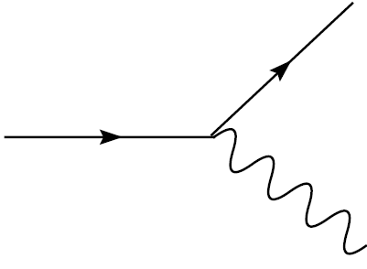
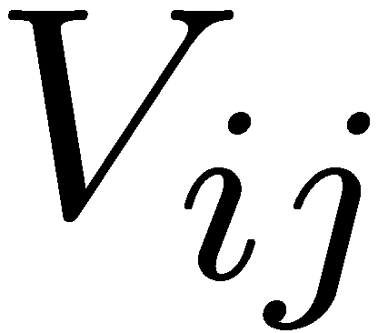
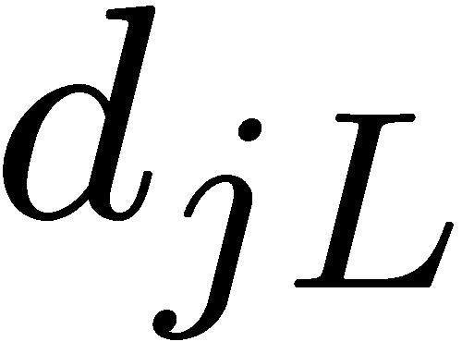
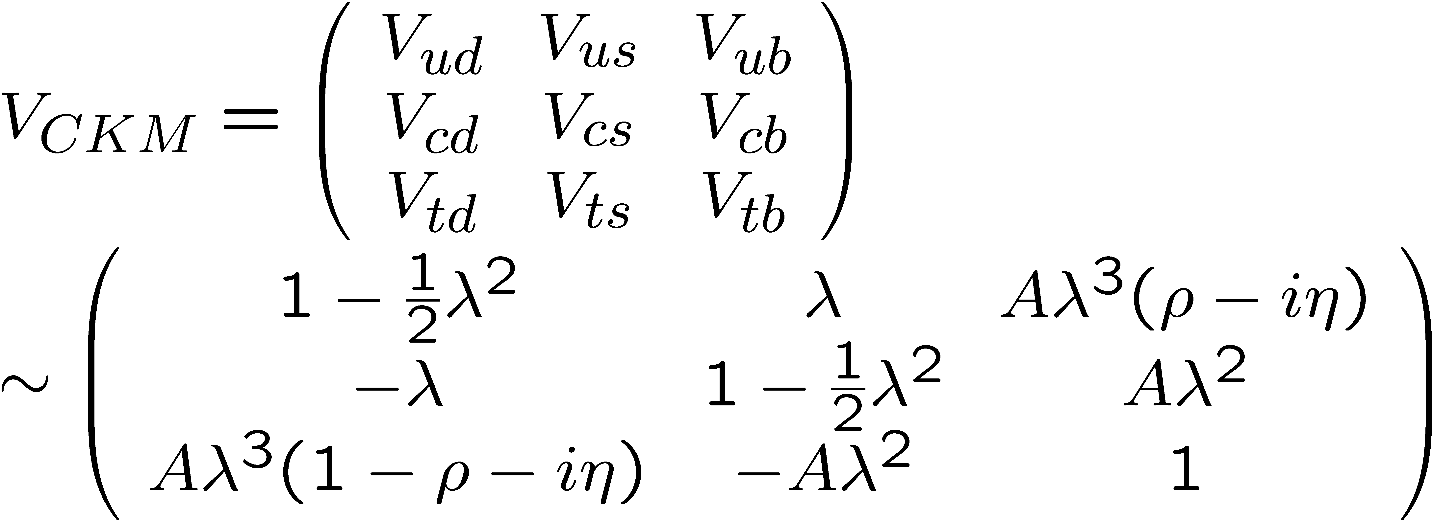
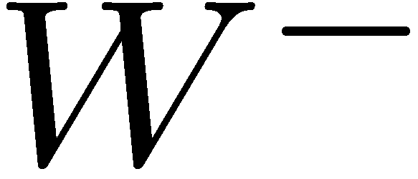
Wolfenstein parameterization manifests the mysterious
CKM matrix elements hierarchy in terms of
Invariants: and

Slide 4
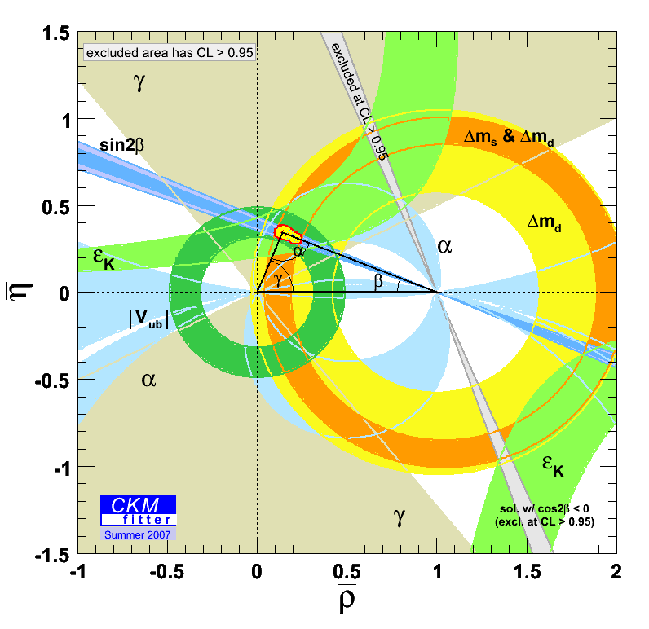
Current view of the Unitarity Triangle
on the complex plane of constraints
is well known and really impressive..

Slide 5
At present an accuracy of determination of the sides is
limited mostly by theory (soft hadron contributions)
An accuracy of angles is limited at present mostly by experiment: δα~ ± 13° ; δβ ~ ± 1.5° ; δγ ~ ± 20°
Is there a way to overcome the necessity to solve npQCD
in order to discover New Physics (NP)?
Different answers for different NP scenarios

Slide 6
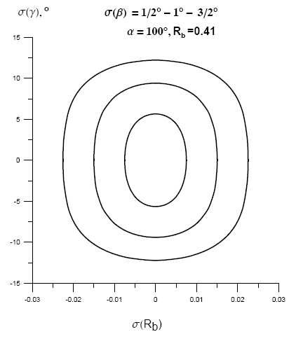
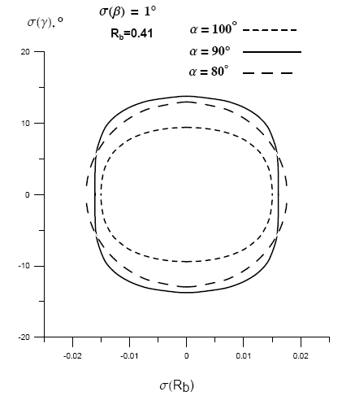
Unfortunately, the geometry of UT is such (α close to 90º)
that 3º uncertainty in the angle β corresponds to about
25º uncertainty in the angle γ

Slide 7
If there exist NP CP-violating phases beyond those of CKM –
one can hope to see their effects in some CP-asymmetries.
On the other hand, if flavor structure of the SM is kept intact,
while NP is encoded in universal real master functions F_{r}
(reducing to the standard Inami-Lim functions in the SM),
we have to deal with the
naïve Minimal Flavor Violation scenario
(E.Gabrielli, G.F.Giudice,’95; A.Buras et al, ‘00)
where there are no new weak phases
and no special flavor alignment
To uncover NP in this form (i.e. the difference between F_{r} and
the SM short distance functions) high precision of the SM
theoretical predictions is absolutely crucial.

Slide 8
There is a good motivation to go beyond naïve MFV however:
flavor puzzle vs EWSB
Naively from kaon oscillations one gets for effective
four-fermion operator
which is much larger than EWSB scale ~ [a few TeV]
If NP d.o.f. couple to the first two generations with the
strength, dictated by CKM, they must be too heavy (?)
Can be relaxed by considering NP effective operators
where is down-Yukawa matrix

Slide 9
Taking down-Yukawa matrices to be diagonal up to a
CKM-like matrix
(A.Buras, ’01; K.Agashe et al, ’05)
one gets
for the NP effects in ΔF=2 processes to be comparable
with the SM contributions.
Here NP d.o.f. interact mostly with t and b quarks and
it is convenient to represent CKM matrix in such a way
that distinguishes the 3rd generation

Slide 10
In flavor physics we touch t-quarks only through loops.
There are a few other good reasons to be interested in loops
(and hence, in electroweak setting, in rare decays):
Loop amplitudes contain loop momentum integrals and
hence can indirectly probe physics at large mass scale
can be much
larger than
2. Loop amplitudes contain sums over all relevant degrees
of freedom (and hence provide indirect information about
still unknown particles).
Q
u, c, t
q
W⁺
W⁻
q
u, c, t
Q
V_{iq}
V*_{iQ}

Slide 11
3. Loop physics is intimately related to overall integrity
and the deepest features of quantum theory (Heisenberg
uncertainty principle, unitarity, causality etc).
Example: optic theorem & all that
Sum over everything!
by means of dispersion
relations (causality)
2
At order e²
Each arrow is nontrivial.
Deep relations between
trees and loops.

Slide 12
The absolute values of and can be
extracted in many different ways: from box-type ΔB=2
processes, penguin mediated ΔB=1 decays and by unitarity
from the tree-level observables.
They all must agree with each other!
Since we concentrate on exclusive modes the main uncertainty comes from npQCD dominated parts and from the value of , which enters the tree-level definition, dictated by unitarity:

Slide 13
General expression for observables sensitive to “side”
variables of CKM (and not to “angles”) can be written as
“hard theory”
“experiment”
“soft theory”
In this way one gets a set of values, determined from the
processes of different topology (i.e. with different short
distance functions) and with different npQCD uncertainties

Slide 14
It can be convenient to define the following ratios:
By construction
But in the SM one must have
Actually there are two U-spin related sets, corresponding to
Br(B→ K* γ) and Br(B → ρ γ); ΔM_{d} and ΔM_{s} etc, but in
NMFV we generally do not expect to gain any new information
from this doubling.

Slide 15
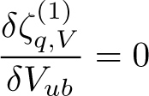
To represent the data graphically it is natural to use
logarithmic ternary coordinate system:
A + B + C = 0
(
3
)
(
2
)
where the summands
are log ζ^{(i)}
SM
(
1
)
A.Golutvin, V.Sh.;
“Complementary strategy of New Physics searches in B-sector”
hep-ph/0609175

Slide 16
The main message for the lattice:
It is very important to compute all relevant hadron inputs
simultaneously, using the same machine, algorithms, dynamical quarks etc in order to achieve a reduction of
(at least some part of) the errors
B→π l ν
exclusive V_{ub}
Formfactors for
B→K* γ
B→μμ f_{B}
ζ^{(i)}
ΔM_{B} f_{B}√B_{B}
Error reduction in this case is principally
different from that of in SU(3) ratios like

Slide 17
A comment on angles determination
Boxes:
- β vs Rb is limited by theory (δRb ~10% ) (d-box)
- χ is not yet measured (s-box)
Penguins:
- σ(δγ(NP)) ~ 30° (d-penguin)
- σ(δβ(NP)) ~8° (a hint !) (s-penguin)
- σ(δχ(NP)) not measured (s-penguin)
δγ(NP) measured in B→ππ and B→ρρ decays may differ depending on penguin contribution to ππ and ρρ final states
δβ(NP) = β(B→φ K_{s}) - β(B→J/ψ K_{s}) δχ(NP) = χ(B_{s}→φφ) -χ(B_{s}→J/ψφ)
In MFV δβ(NP) = 0 ; δχ(NP) =0
What can be said about
[δβ(NP) - δχ(NP)] ?
In NMFV in general δβ(NP), δχ(NP) ≠ 0

Slide 18
Of much interest in NMFV framework are the exclusive modes
which probe NP ΔF =1 chirality flipping operators, such as
The best way to disentangle the effects of such operators seems to be the photon polarization studies in exclusive
B → Yγ decays
(D.Atwood, M.Gronau, A.Soni, ’97)
M.Gronau,Y.Grossman,D.Pirjol,A.Ryd ; PRL 88, 5, 2002
D.Atwood,T.Gershon,M.Hazumi,A.Soni ; hep-ph/0701021
V.Orlovsky, V. Sh.;
“On the photon polarization in radiative B -> phi K gamma decay ”
arXiv:0708.4302 [hep-ph], subm. to PRD
A truly remarkable feature of radiative penguins is a fact that the photon
plays a role of effective vertex Lorentz structure probe, insensitive to
details of hadron dynamics.

Slide 19
The effective SM Hamiltonian for this process has the form:
W–
b
u, c, t
q
m_{b}γ_{L}+m_{q}γ_{R}
In the SM
Thus the photons are dominantly right-handed in the decays
of B-mesons and left-handed in the decays of anti-B mesons
Real life is a little bit more complicated, npQCD corrections
also contribute to “wrong” helicity amplitude (P.Ball et al, ‘06)
But not much.

Slide 20
Current experimental status of radiative decays (in 10⁻⁶ units)
For photon helicity studies the most promising
channels are
Expected LHCb
yield per 2 fb⁻¹
BR(B⁺ → K⁺π⁻π⁺γ) ~ 2.5 × 10⁻⁵ rich pattern of resonances ~60k
BR(B⁺ → K⁺φγ) ~ 3 × 10⁻⁶ highly distinctive final state ~ 7k
BR(B_{s} → φγ) ~ 6 × 10⁻⁶ CP eigenstate hadron ~ 11k

Slide 21
The b-quark from initial B meson decays into a photon
and s-quark. The latter forms the hadron system Y
(together with the spectator), which is characterized by
total angular momentum J and its projection. Strong
dynamics causes consequent decay of Y into a
pseudoscalar meson (where the spectator quark goes)
and a vector or tensor (where the s-quark goes).

Slide 22
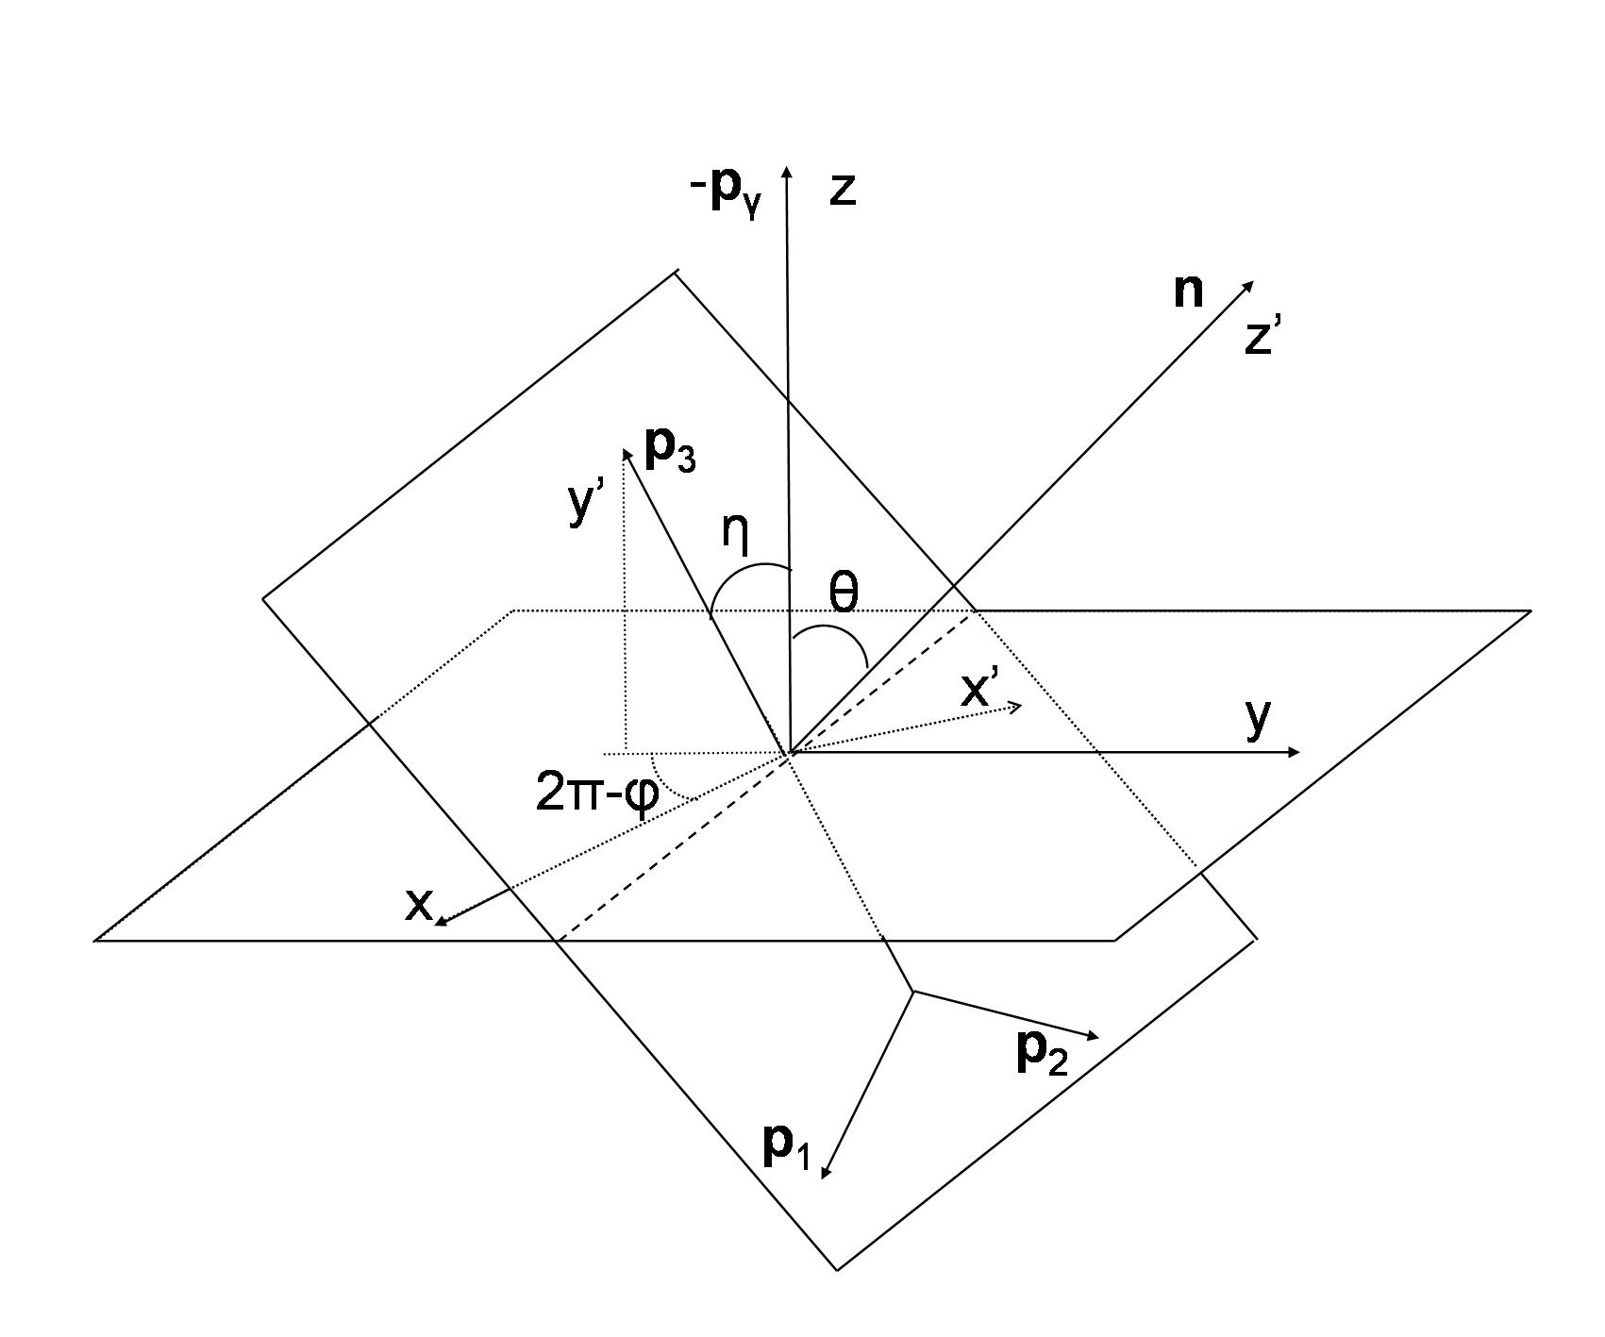
Angle convention:
Partial waves expansion sum over
angular momentum projections of
intermediate state:
If only s-wave contributes, Clebsch-Gordan coefficients are trivial (=1) and there is no sensitivity to the photon helicity λ.

Slide 23
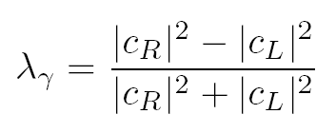
The branching ratio has the form
or, in terms of the photon helicity λ:
Notice that the photons with different helicities do not
interfere and the asymmetry
entirely comes from partial waves interference.

Slide 24
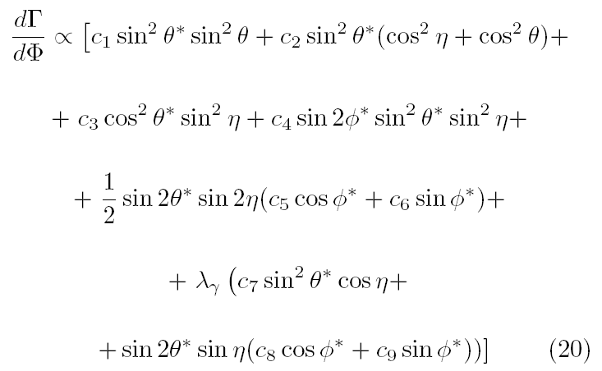
If one keeps only J^{P} = 1⁺ intermediate state contributions, the result simplifies considerably, but asymmetry remains:

Slide 25
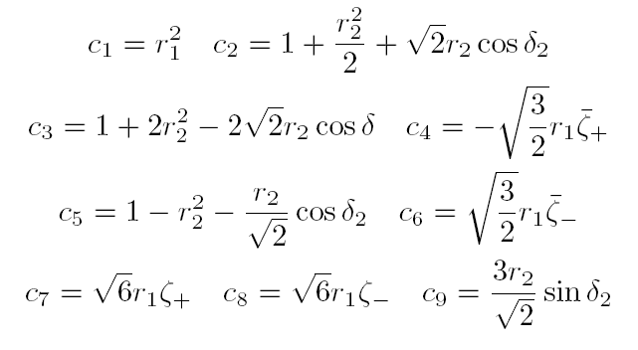
The coefficients
are written in terms of partial amplitudes ratios:

Slide 26
B_{s} → φ γ
The time-dependent decay width with CP-eigenstate and
a photon at the final state is given by
where ΔΓ_{q} = | Γ₁ - Γ₂ | and Δm_{q} = | m₁ - m₂ | for q =s or d
where
if neither nor is small (in SM CKM angle )
– we have a chance to find from the time-dependent rate.
Thus B_{s} mesons provide unique possibility to test whether ψ ≈ 0

Slide 27
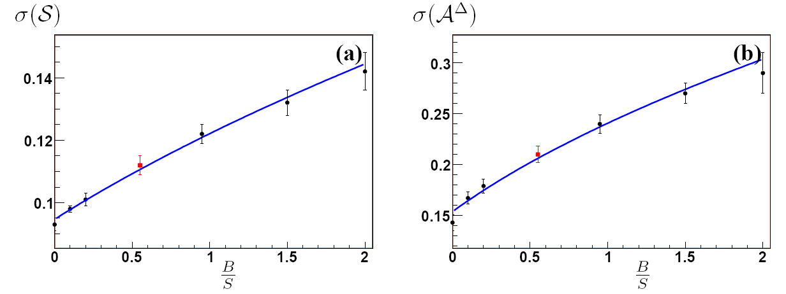
The estimated uncertainties in parameters (a) and (b) as
functions of the background to signal ratio in the 5.2-5.6 GeV/c²
mass window, from
L.Shchutska, Y.Xie, A.Golutvin, V.Egorychev, V.Sh, I.Belyaev;
“Probing the photon polarization in B_{s} → φ γ at LHCb”
LHCb-PHYS-2007-147

Slide 28
Instead of conclusions
There are no new (i.e. beyond CKM) sources of
CP-violation of O(1) in B_{d}, K and D ΔF=2 processes.
Still some hope with B_{s}
If New Physics is (Next to) Minimal Flavor Violating –
there seems to be (almost) no way to discover it without
serious progress in npQCD.
Waiting for LHC to start!

