Slide 1
Summary of electron studies & τ→e MC study
LAPP – Annecy
Florian Brunet
Supervisor : Amina Zghiche
OPERA LAPP Meeting – 13/07/2011

Slide 2
Outline
Electron Working Group studies
MC Efficiency (Umut)
Extended Scanback : e-pair trigger (Matteo)
Electron energy measurement by kinematics (Aki)
τ→e MC study (Flo)
Electron energy estimation within 2 bricks (Flo)

Slide 3


MC OpEmuRec efficiency
MC Study
Umut
NEWNEW !
Type | OpCarac | BF | CS | SB(pl<55) | SB Pl<55 and dz(5plate) | vertex | Vertex Dr<1mm
numuCC | 0.970 |  | 0.705 | 0.665 | 0.651 | 0.479 | 0.456
numuNC | 0.822 |  | 0.396 | 0.372 | 0.330 | 0.263 | 0.232
Taue DIS* | 0.871 |  | 0.541 | 0.488 | 0.429 | 0.332 | 0.229
Taue QE* | 0.744 |  | 0.411 | 0.349 | 0.262 | 0.161
Tau->mu | 0.940 | 0.650 | 0.532 | 0.487 | 0.471 | 0.417 | 0.387
Tau->1p | 0.927 | 0.593 | 0.553 | 0.517 | 0.488 | 0.499 | 0.420
Type | OpCarac | BF | CS | SB(pl<55) | SB Pl<55 and dz(5plate) | vertex | Vertex Dr<1mm
nueCC |  |  | 0.697 | 0.670 | 0.660
nnueQE |  |  | 0.690 | 0.675 | 0.653

Slide 4
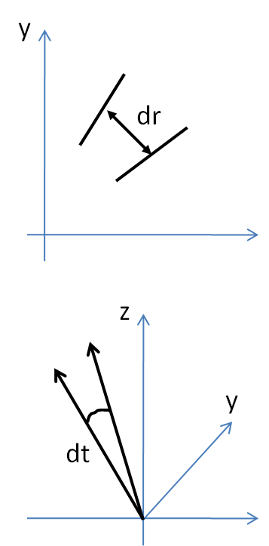
MC Study
E-Pair Trigger in Scanback
Matteo
Goal : recognize an e-pair by visual inspection in the stopping plate
How (Real data): search for two near and similar basetracks
How (MC): search for a basetrack within angular tolerance (dtmax) and spatial tolerance (drmax) from the scanback one
in case of many candidates, there are two simple selection crietria:
choose nearest basetrack -> (the one with smallest dr)
choose most similar basetrack -> (the one with smallest dt)
Different values of dtmax and drmax and different selection criteria has been investigated, evaluating for each configuration “efficiency” and “purity”:
the sample is represented by upstream scanback segments (of 1000 TAUE events) belonging to electron originating from a gamma
the efficiency is defined as the fractions with trigger (i.e. with at least one neighbor and similar basetrack within the tolerances)
the purity is defined as the fractions (of segments with trigger) where a real e-pair has been triggered.
x
x

Slide 5
MC Study
e-Pair Trigger in Scanback : Result
Matteo
A first proposal could be:
drmax = 20 micron
dtmax = 100 mrad
with the position criterium
to get a reasonable values of efficency and purity.
Sample: 1000 TAUE and TAUEQE events
(/sps/opera/operap/production/OpEmuIO/march2011/TYPE/SB)
taking into account Oscillation Probability
preliminary
Type | TAUE | TAUEQE
At least one CS connected in brick conteining neutrino interaction | 63.8% | 49.6%
Neutrino interaction inside standard volume | 49% | 31%
Neutrino interaction not inside standard volume | 14.8% | 18.6%
Events with e-pair trigger | 2.4% | 4.2%
Vertex inside extended volume | 0.7% | 0.4%

Slide 6
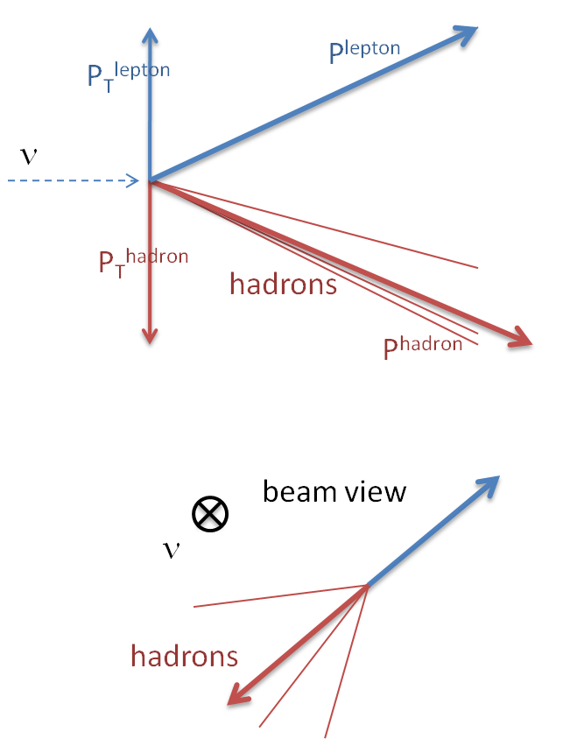
Electron energy measurement by kinematics
MC Study
Aki
Lepton and hadron share transverse momentum.
P_{T}^{lepton} = P_{T}^{hadron}
if we can know well about hadrons, we can compute lepton part.
P^{hadron} , muon and hadron vector → lepton energy.
lepton
(e, μ, τ)
lepton
(e, μ, τ)

Slide 7
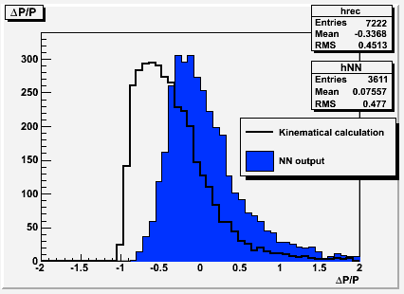
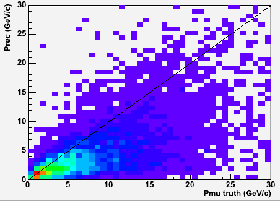
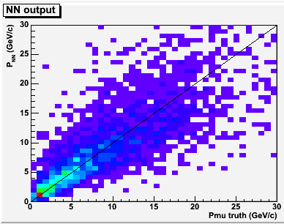
Electron energy measurement by kinematics : results
MC Study
Aki
Realistic case, only charged, P smearing, θ<0.5…
NN output, linear correlation.
ΔP/P distribution
Kinematic only
mean -0.34
~60% resolution (with factor 1.34)
NN
mean 0.08 (by high energy tail)
1σ between [-0.41, 0.49]
~ 35% resolution near center
including tail ~50%
Notes:
Realistic case… Problem.
neutral particles are escaping
low momentum rejection (P>0.5)
angular acceptance (θ<0.5)
momentum smearing (30%)
→ underestimate energy

Slide 8
Strategy for nu-e studies
Strategy
Aki
Goal : publish a paper as soon as possible (with statistics of 2008+2009 +alpha).
A possible schedule is to finalize all study before next collaboration meeting and appear with a draft of paper.
We need to finalize :
1) systematic nu-e search
2) efficiency computation
3) energy measurement
4) physics performance
Data taking of “VTX->CS” analysis has to be done in July, because the scanning labs in Italy will be in vacation in Aug. Aki together with Carlo will send a request to scanning labs as soon as possible (already sent on 7thJuly).
We will study the efficiency computation and summarize a document like the decay search procedure, within July. This will include the short term goal toward a quick paper, and also the long term goal to increase efficiency. Dario showed an idea of possible strategy. Aki will work further for realization.

Slide 9
MC Sample - OpRelease 4.0
MC Study
Florian
Samples of 1000 τ→e DIS & QE produced by Elisabetta /sps/opera/operap/production/OpEmuIO/march2011/TAUE/DATA/taueforemu_tgt1000_OpR4.0_rec_11.root
Processed through OpEmuIO
Processed through OpEmuRec packages : CS, Scanback, Link, Alignment, Track & Shower by using all plates available in the brick
All packages up to OpEmuRec Track are taken from the release $GROUP_DIR/soft/OpRelease4.0_emulsion_march2011/
OpEmuRec Shower is released here : /sps/opera/scratch/flbrunet/analysis/OpRelease_2011-04-04_OKwithShower/4.0/OpEmuRec/
LAST FEDRA RELEASE (1173)
LAST OPEMUREC(v3)/OPRELEASE(4.0)
Notes:
9

Slide 10
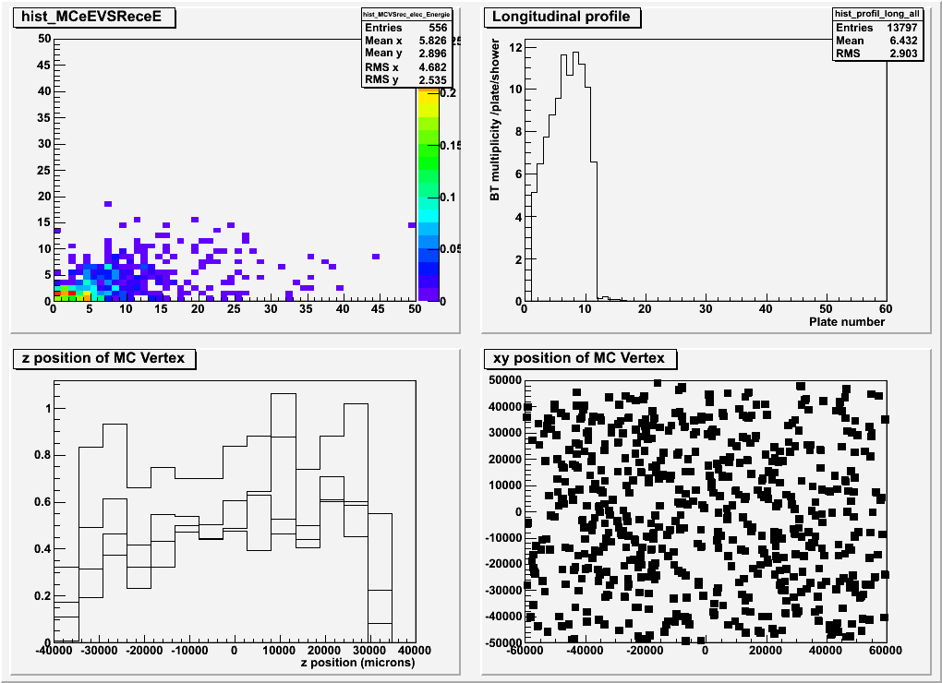
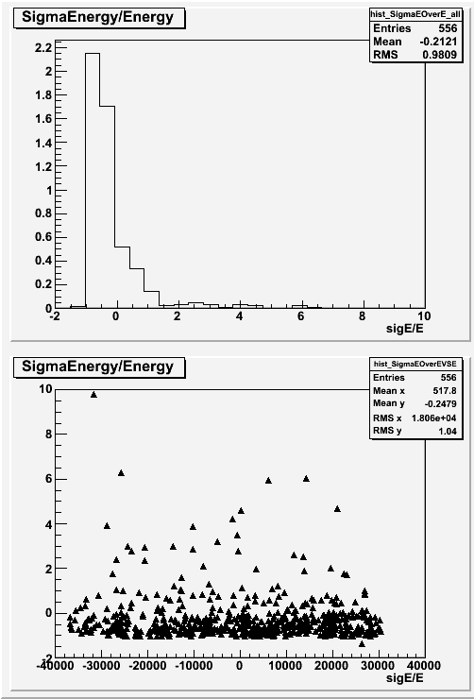
τ→e MC study
MC Study
Florian
REPROCESS ON GOING

Slide 11
Electron energy estimation within 2 bricks
MC Study
Florian
By taking into account MT efficiency
MT 2nd brick / MT 1st brick ratio : 0.950
2ry electron Microtracks
MT 2nd brick / MT 1st brick ratio : 0.402

Slide 12
Outlook
Upgrade Frank Rec : debugging necessary (no stopping condition, loop over plate condition wrong maybe more ?)
➔no face to face meeting but skype meeting on the next week
Upgrade OpEmuRec OK
Study of shower contamination starts
2-Brick analysis starts
Calibration of shower tool : beamtest brick analysis in Bern

Slide 13
Outlook
Upgrade Frank Rec : debugging necessary (no stopping condition, loop over plate condition wrong maybe more ?)
➔no face to face meeting but skype meeting on the next week
Upgrade OpEmuRec OK
Study of shower contamination starts
2-Brick analysis starts
Calibration of shower tool : beamtest brick analysis in Bern

Slide 14
Backup slides

Slide 15
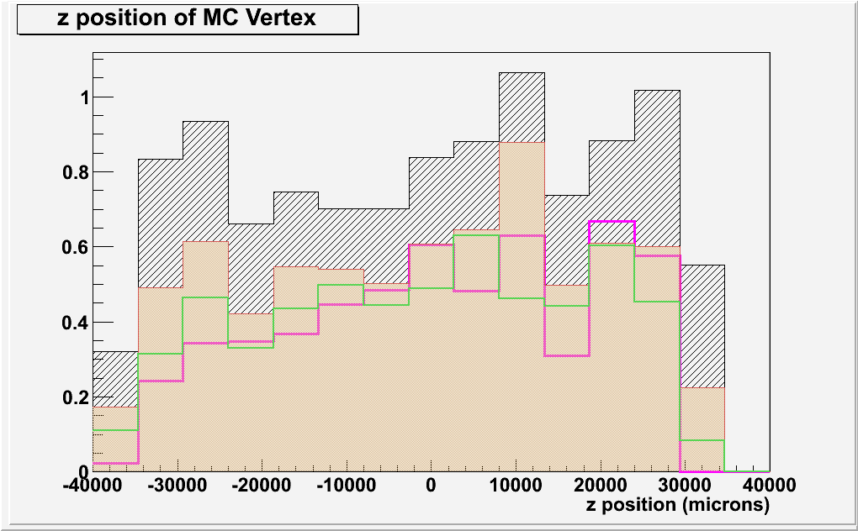
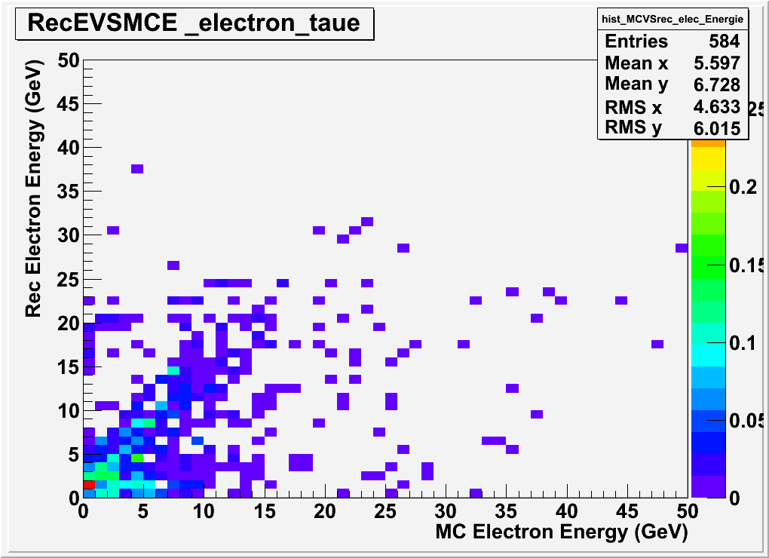
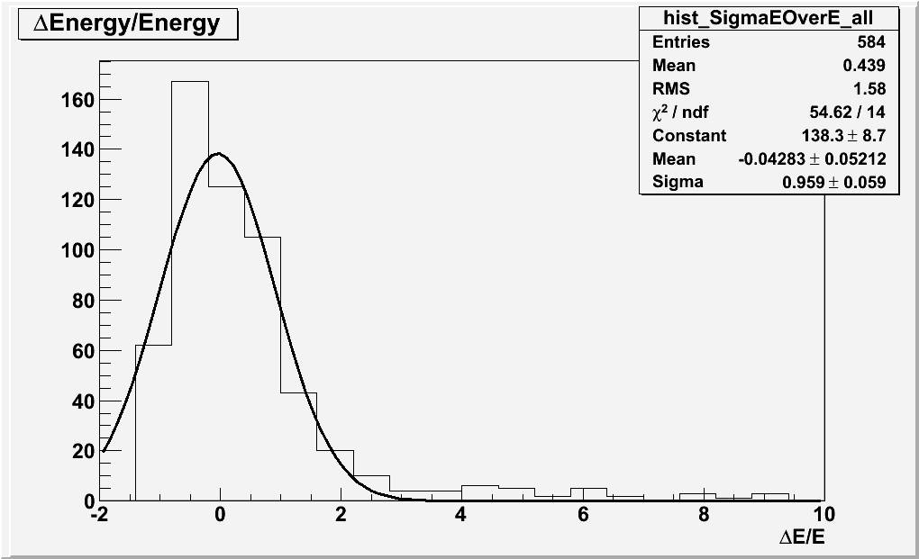
τ→e DIS channel
MC Study
Florian
Z MC truth vertex
Z MC truth vertex BF OK
Z MC truth vertex SB OK
Z 1st BT of shower
But the critical point will be decay search

Slide 16
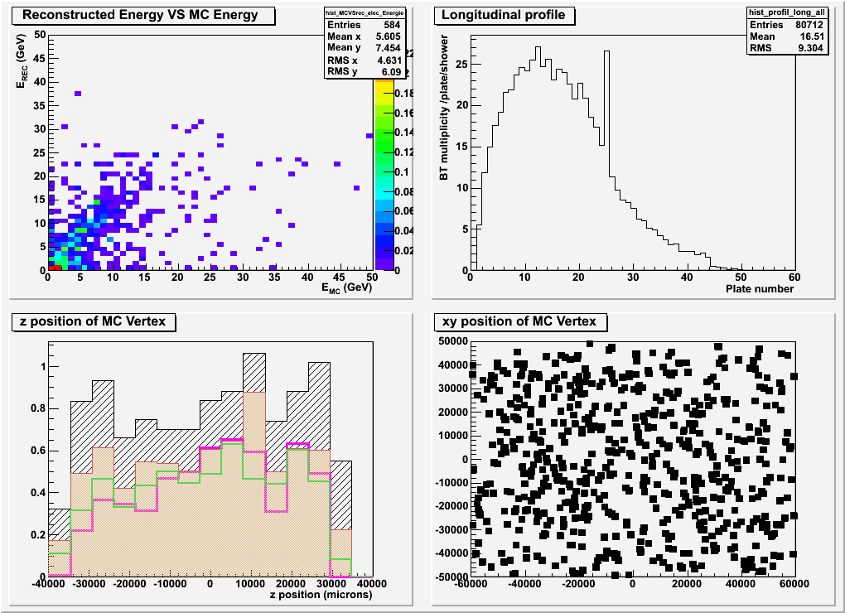
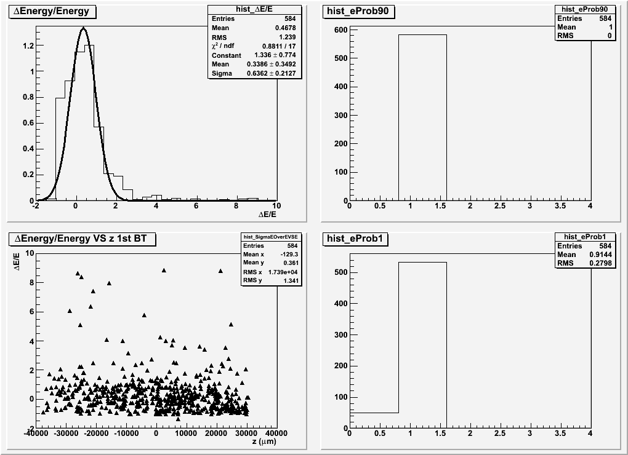
τ→e DIS channel : contamination pion
OLD
NEW

Slide 17
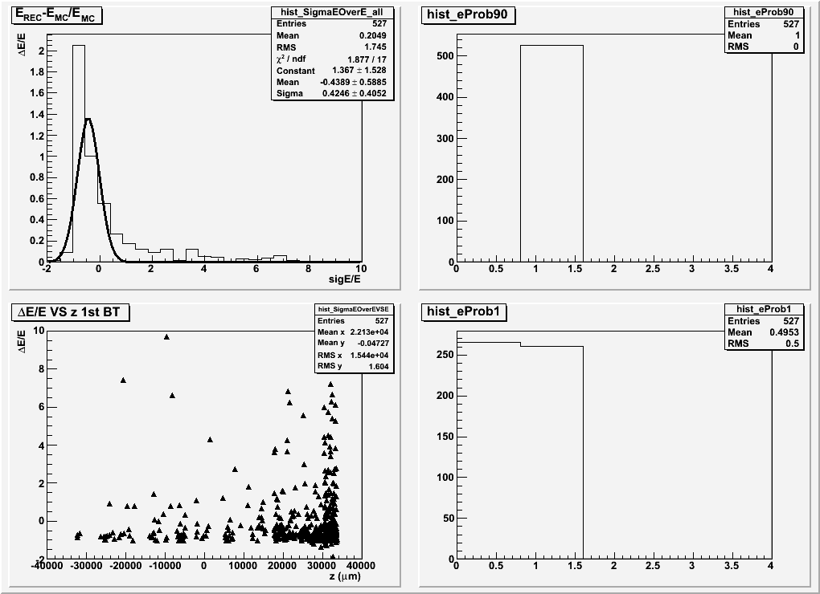
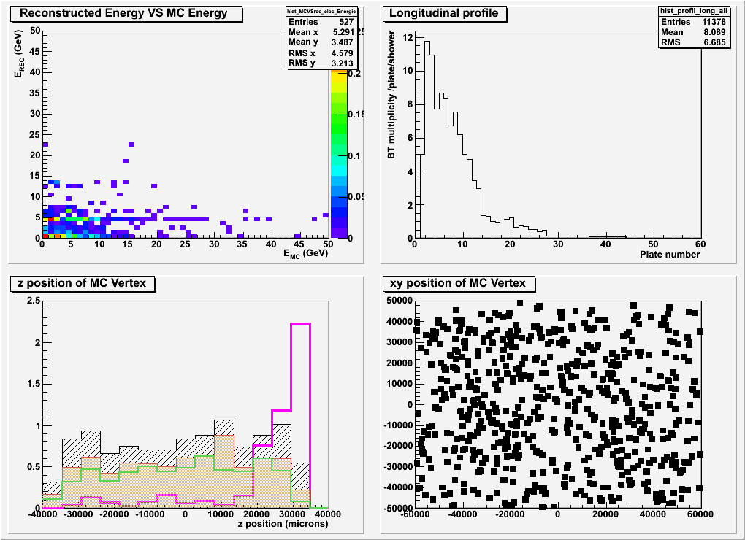
τ→e DIS channel : upgrade Frank Rec

Slide 18
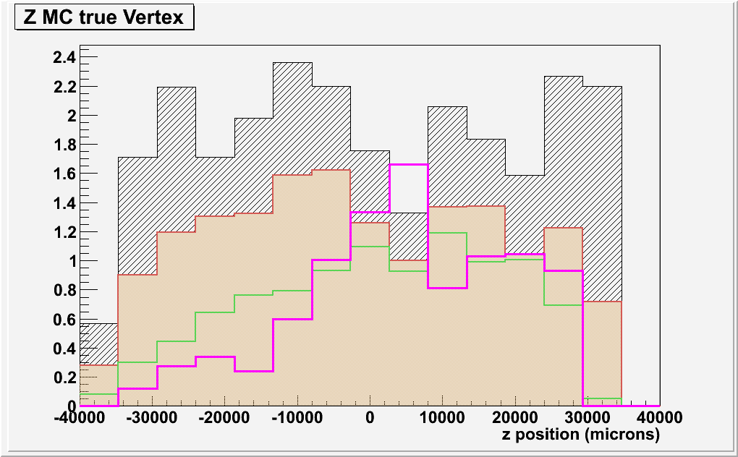
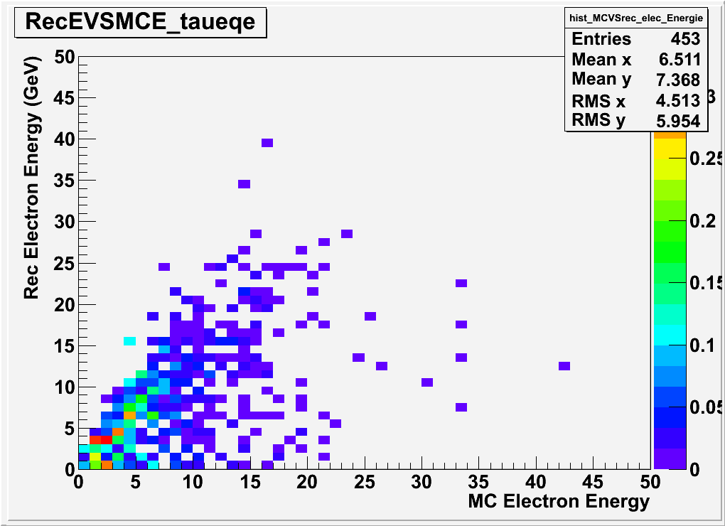
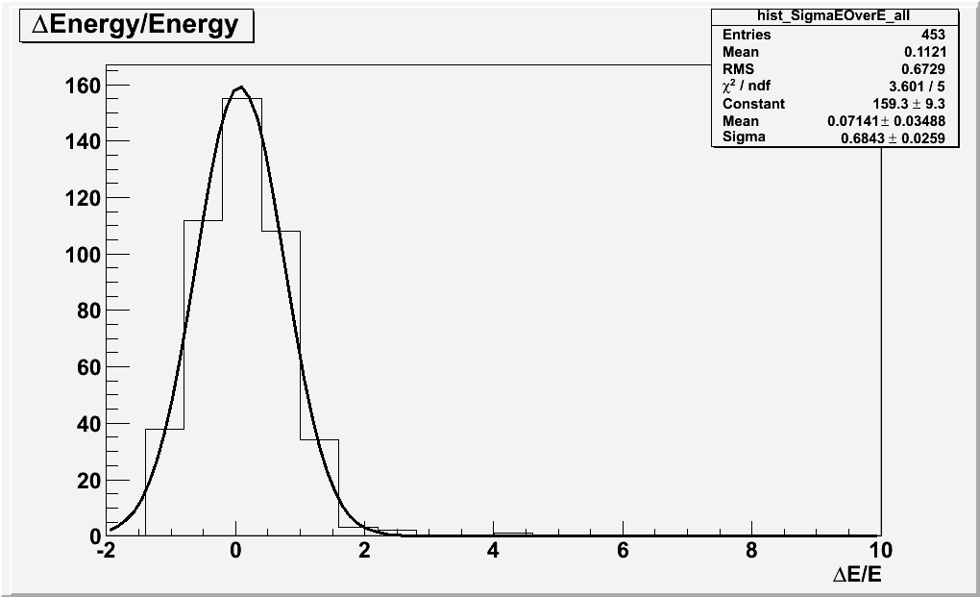
τ→e QE channel
MC Study
Florian
Z MC truth vertex
Z MC truth vertex BF OK
Z MC truth vertex SB OK
Z 1st BT of shower
The critical point is scanback ➔ extended scanback strategy

Slide 19
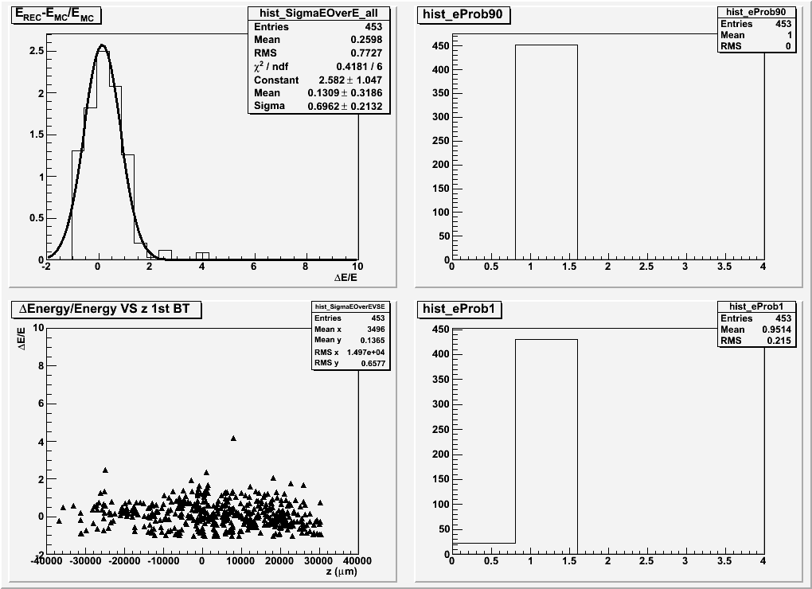
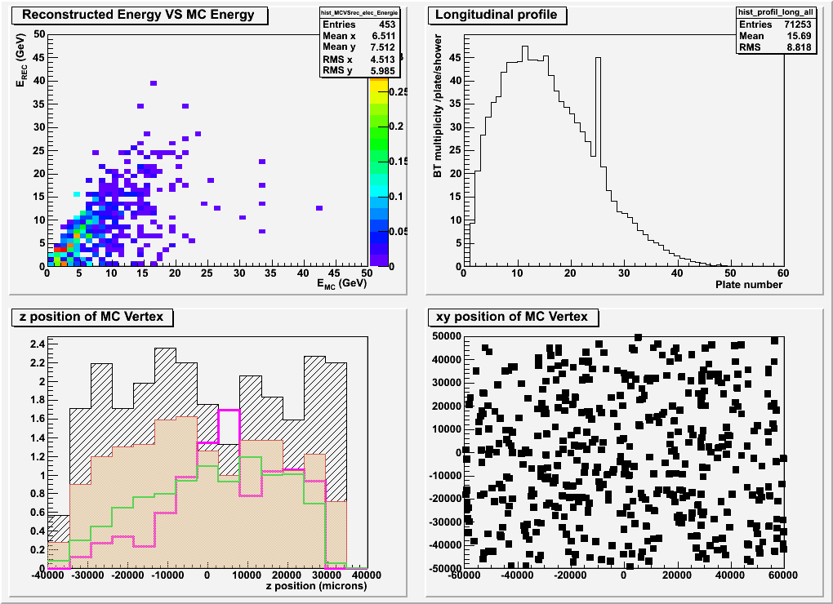
τ→e QE channel : contamination pion
OLD
NEW

Slide 20
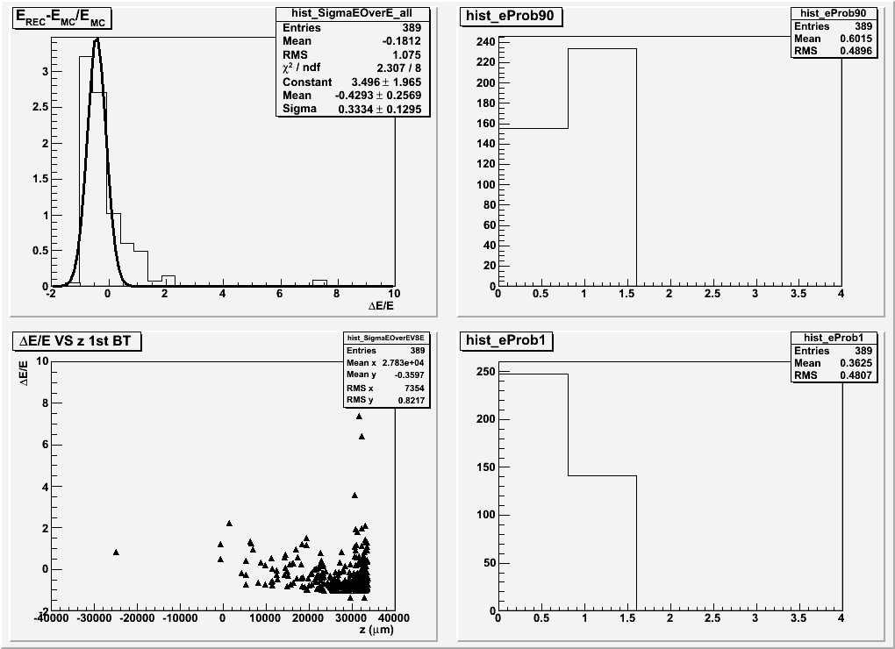
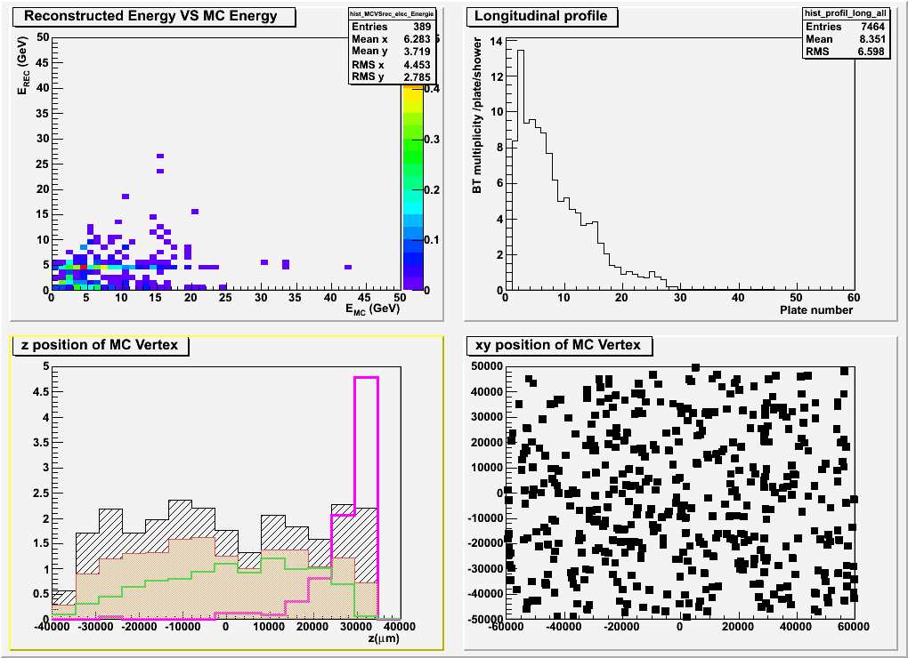
τ→e DIS channel : upgrade Frank Rec

