Slide 1
Outils Operationnels
Généralités et Nouveautés
1

Slide 2
Service Availability Monitoring (SAM)
2

Slide 3
SAM Scope
• SAM grid monitoring (SAM-Gridmon)
central services (Web, API, availability)
• SAM-Nagios
– Monitoring platform supporting multiple configurations:
  NGI-Nagios
  VO-Nagios1
  Site-Nagios
  Operations Tools-Nagios (ops-monitor)
3

Slide 4
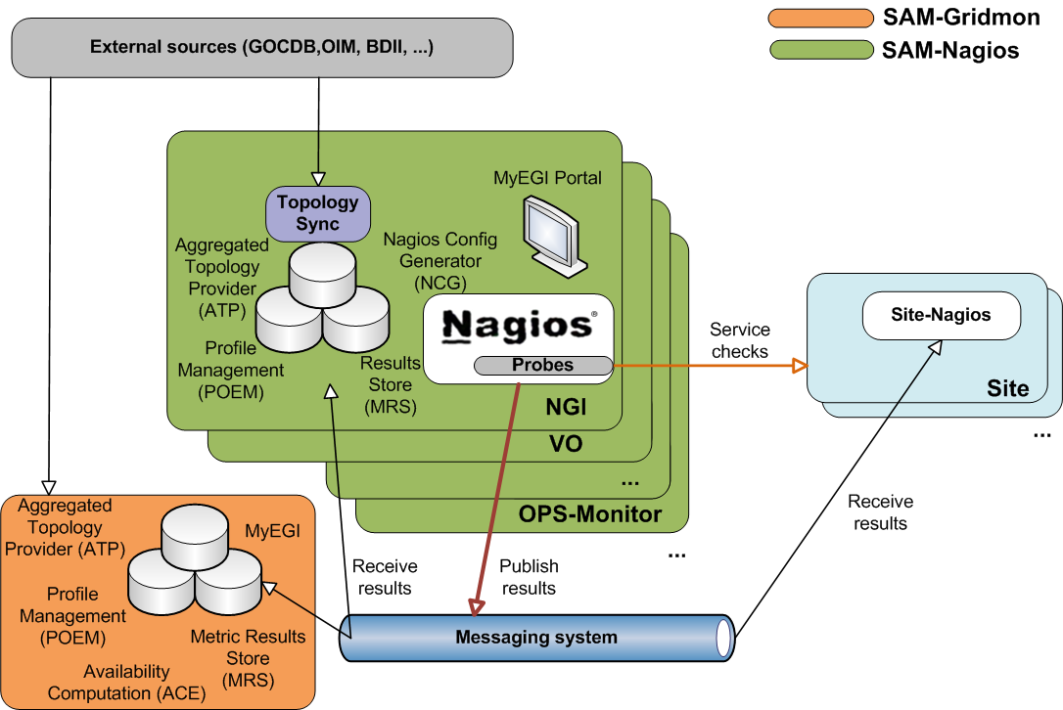
SAM Architecture
4

Slide 5
Aggregated Topology Provider (ATP)
Service aggregating grid topology information and downtimes from different external sources (GOCDB, OIM, CIC, BDII,GSTAT, feeds)
• Recent changes
  regionalization
  VO feeds
  sanity checking
  integration of changes in GSTAT, VO cards
  improvements in logging
5

Slide 6
Profile Management (POEM)
Replaces MDDB (metric description database)
Defines and groups metrics into profiles (e.g. ROC_CRITICAL)
  metrics
  VO
  topological groups (optional) – region, site, ngi
Profiles are used to generate Nagios configuration
Regionalized:
  multiple POEM WEB instances (central, regional)
  synchronization of profiles from any number of sources
  namespace concept (e.g. ch.cern.sam-ROC_CRITICAL)
6

Slide 7
Nagios Configuration Generator (NCG)
Generates Nagios configuration files
Recent Changes
support for failover instance
integration of Globus5 and UNICORE probes
improved integration with Operations Portal
notification improvements
7

Slide 8
Metric Store (MRS)
Stores metric output and computes service statuses
Recent changes
performance tuning
performance measurements
new probe to indicate MRS status [5]
8

Slide 9
Web and API (MyEGI)
SAM Web and application interfaces
https://grid-monitoring.egi.eu/myegi (central instance)
https://ccnagboxli01.in2p3.fr/myegi/ (regional instance)
Visualisation tools (status , availability , gridmap , metrics history) [R5]
Recent changes :
Added Gridmap-style features
  visualization per site status, flavour, VO, profile
  historical and current status views
  topology view by regions and tiers
Service Availability (only on the central instance )
Performance and validation of Web service API
  throttling and limits
Programmatic Interface queries [R6]
https://ccnagboxli01.in2p3.fr/myegi/sam-pi/service_types_and_flavours_per_service?
https://grid-monitoring.egi.eu/myegi/sam-pi/status_of_site_in_profile?profile_name=ALICE_CRITICAL&vo_name=alice&group_type=Site
9

Slide 10
References
Development policy document https://tomtools.cern.ch/confluence/display/SAMDOC/Probes+Development+Policy
New structure of the documentation (user / developer / adminstrator guide)
  https://tomtools.cern.ch/confluence/display/SAMDOC (remplace le twiki)
Service Availability on the central instance
  http://grid-monitoring.cern.ch/myegi
https://tomtools.cern.ch/confluence/display/SAM/Central+Data+Warehouse+Monitoring
Probe status document
  https://tomtools.cern.ch/confluence/display/SAM/Probes
MyEGI documentation
  https://tomtools.cern.ch/confluence/display/SAM/MyEGI/
MyEGI API Documentation
  https://tomtools.cern.ch/confluence/display/SAMDOC/Web+Services+Specification
10

Slide 11
Broker Messaging
Recent changes
EGI usage policy (OMB) : https://wiki.egi.eu/wiki/Message_brokers
Deployment of authentication
Enforcing the ACLs to the topics
Use of queues
11

Slide 12
ACE (Availability Computation Engine)
ACE is released by the SAM team and made available in the central grid-monitoring service (WLCG product used in EGI and OSG)
ACE main task is to compute availability and reliability statistics for grid services and sites:
  Status is the status of service instances, overall service flavours, and sites at a given point in time
  Availability is the fraction of time a service was up during the period the service was known
  Reliability is the fraction of time a service was up during the period the service was scheduled to be up
12

Slide 13
Overview
Metric Results
Status Computation
Calculated per Hour, Day, Week, and Month
Calculated continuously
Availability Computation
Based on Service Instances, Service Flavours, Sites
Based on Service Instances, Service Flavours, Sites
Visualization
Retrieved from Messaging Broker and stored in DB
Monthly Reports
Web Interface
13

Slide 14
Overview
  ACE Profiles are a collection of metrics/services defined for VOs (multiple profiles per VO). Each profile defines its computation algorithm.
Service
s₁
s_{n}
s₁
s_{n}
s₁
s_{n}
Flavour
CREAM-CE
SRMv2
sBDII
Profile 1
Profile 2
t₁
t_{n’’}
t_{1’}
t_{n’}
t_{1’’}
t_{n’’}
Metric
14

Slide 15
Status Computation
  ACE computes status for services, service flavours, and sites based on metric results
ORing
At least one service up → up
ANDing
All services up → up
Metric
Results
Service
Status
Service Flavour
Status
Site
Status
ORing
At least one flavours up → up
ANDing
All flavours up → up
ANDing
All metrics in OK state → up
15

Slide 16
Availability Computation
Based on the concepts of hourly up fraction, scheduled down fraction, and unknown fraction
From the status and downtimes information ACE computes hourly availability and reliability for services, overall service flavours, and sites
From the hourly availability and reliability information ACE computes daily, weekly, monthly availabilities and reliabilities for services, overall service flavours, sites, and federations
16

Slide 17
Visualization
Monthly Reports:
EGI: Management of OPS VO profile and algorithm (OR CEs) AND (OR of SEs) AND sBDII
  Generation of monthly availability and reliability reports for OPS VO
  http://gvdev.cern.ch/GRIDVIEW/downloads/Reports/
  PDFs reporting monthly availability and reliability numbers
  Created once per month and distributed to WLCG/EGI
  Created using iReport, OpenReports, and JasperReports
Web Interface: Operation of the service availability web interface provided by the central grid-monitoring MyEGI portal
  https://grid-monitoring.cern.ch/myegi/sa
  Online tool showing availability and reliability graphs
  Queries can be based on: profiles, groups, sites, dates
17

Slide 18

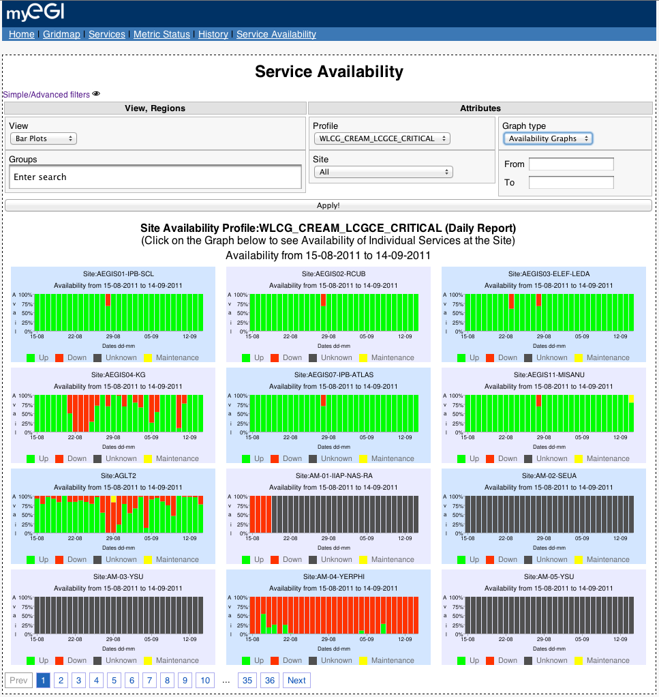

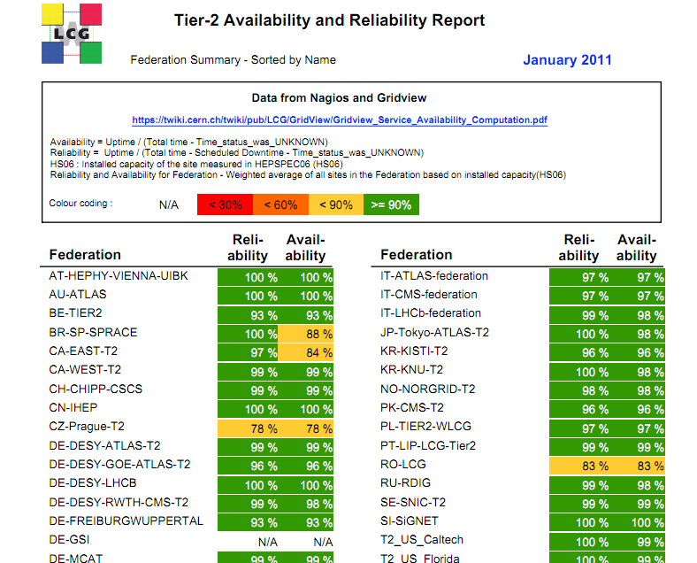
Doc: https://tomtools.cern.ch/confluence/display/SAM/ACE
Monthly Reports
Web Interface
iReport
OpenReports
JasperReports
18

Slide 19
GOC DB
19

Slide 20
GOCDB-4.2 Release (25-11-2011)
This release includes scoping of sites and service endpoints.
A GOCDB instance (whether central or regional) needs to differentiate between EGI and non-EGI data. To do this, new tagging logic had been added so that new data scoping rules can be applied to GOCDB entities, allowing Sites, Services and other data to be identified as either EGI, Local some other scoped data. This is a regionalisation prerequisite. By default, sites and services are defined in the 'EGI' scope.
GOCDB-4.1 Release (01-11-2011)
New View Site page (to support scoping)
New View Service Endpoint page
Added current UTC time to new Downtime page
New Downtime interface much improved, moved to single page + can now select all endpoints under one site
Increased front end responsiveness
Cleaned old roles
Added a URL field to service endpoint objects to support UNICORE services
Add a "my site" link in the main menu
Record Certification Status History
Consolidated Wiki and all documentation.
20

Slide 21
Operations Portal
21

Slide 22
Dashboard - Rappels
Permalinks
https://operations-portal.egi.eu/dashboard?ngi=NGI_FRANCE
https://operations-portal.egi.eu/dashboard?site=IN2P3-CC
Rss (Thunderbird , Outlook)
https://operations-portal.egi.eu/rss/nagiosNotifications/site/AUVERGRID
https://operations-portal.egi.eu/rss/nagiosNotifications/ngi/NGI_FRANCE
https://operations-portal.egi.eu/rss/nagiosNotifications/site_list/71
22

Slide 23
Security Dashboard (1/3)
Goal
Detect and inform sites about security incidents and vulnerabilities.
Propose an adapted display and workflow to open tickets against sites in the Operations Dashboard.
Achieved work
Authentication model : authorization is applied based on GOC DB and EGI SSO in order that security staff access only data in their own scope (EGI / NGI or site )
Summary of the current issues : Nagios and pakiti with historical details + Notepads and attached problems
Possibility to create / update notepads againt the site and attach problems to this notepad .
Possibility to generate dynamically metrics (table or charts)
Possibility to manage / declare events
Remaining work
Extension of the notepad to tickets into RT
23

Slide 24
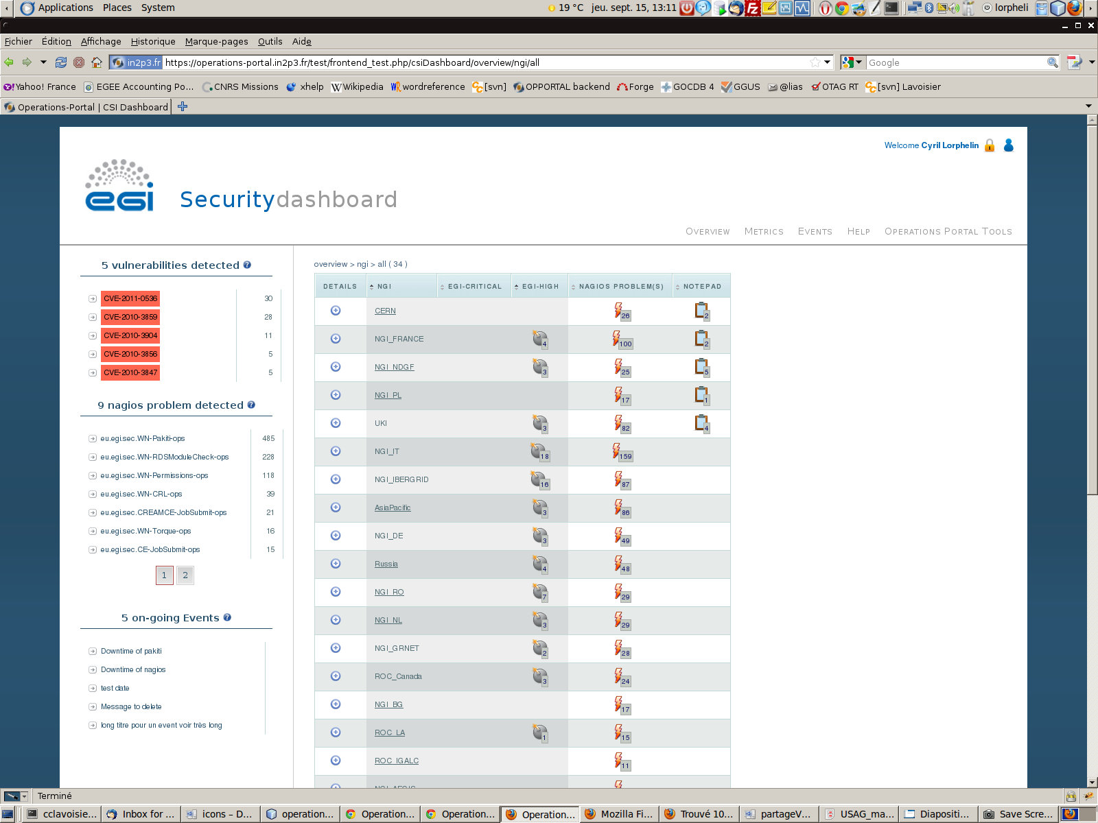
Security Dashboard (2/3)
24

Slide 25
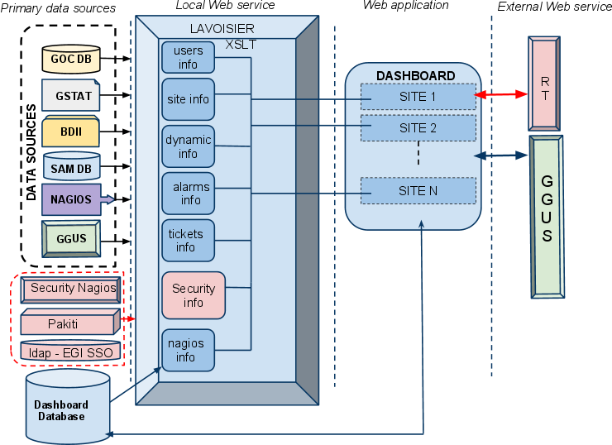
Security Dashboard (3/3)
25

Slide 26
VO oriented Dashboard
Basic functions
• Collecting results from Nagios
• The basic “unit” of the report will be a site, the Dashboard will be able to “construct” a VO view out of the relevant sites.
• Providing a view of a VO/NGI/site
• Proper access control must be applied : VO shifters either declared in the VO ID cards either based on a VOMS role
• Dispatching alerts when needed
• Operations functions – links to GOC DB, EGI RT , GGUS or Gstat
• Reporting functions – generation on demand and automatically on regular basis
• compute VO metrics based on the numbers gathered
• Possibility to declare a list of tests to take into account on a VO basis.
Different additional communication channels :
• notepad to send a note to the site
• handover to communicate between shifters
26

Slide 27
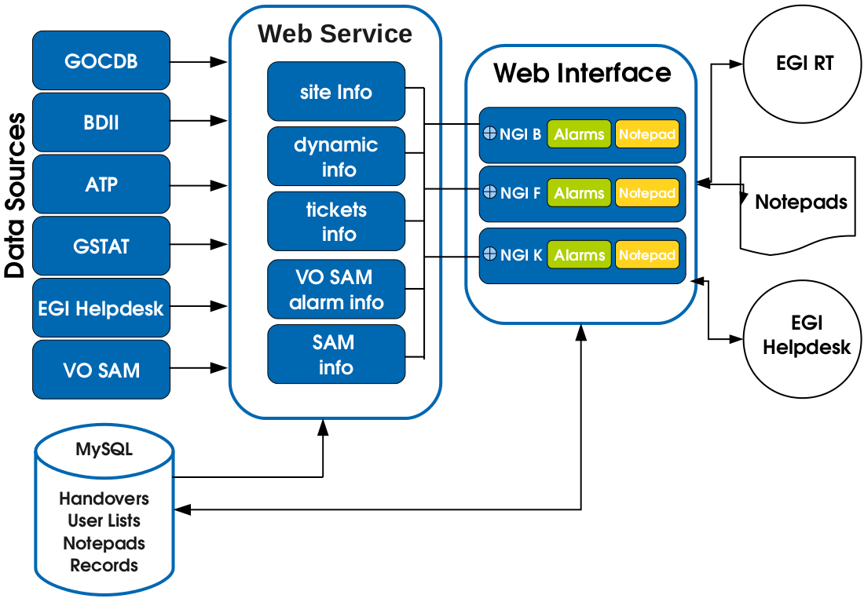
VO oriented Dashboard
Architecture
27

Slide 28
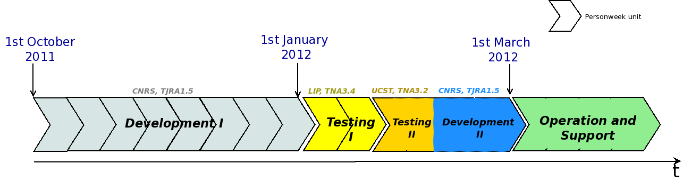
VO oriented Dashboard
Roadmap
Tasks for phase Development I | Estimated required effort (personweek)
Data connection and treatment | 1
Interface developments | 4
Overview part (dashboard) | 2
Metrics part | 1
Handover Part | 1
Authentication and control access | 1
Notepad and tickets creation | 2
TOTAL EFFORT | 8

